Slide 1
The Foucault pendulum in Aggieland
What does it show?? Seeing is believing
T=10 sec how long is it??
https://sibor.physics.tamu.edu/home/courses/physics-222-modern-physics/

Slide 2

THE NOBEL PRIZE IN PHYSICS 2020
Roger Penrose showed that black holes are a direct consequence of the general theory of relativity. Reinhard Genzel and Andrea Ghez discovered that an invisible and extremely heavy object governs the stars’ orbits at the centre of our galaxy, the Milky Way.
Modern Astrophysics describes the
large-scale structure of the universe, and the very nature of space-time at the largest and smallest
scales. This modern physics of the 21st century has been driven by the observations of gravitational waves emitted during the collision of black holes
Penrose tiling.
Stephen Hawking at the Schuessler Ranch

Slide 3
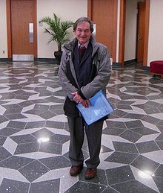
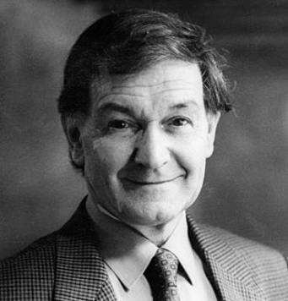
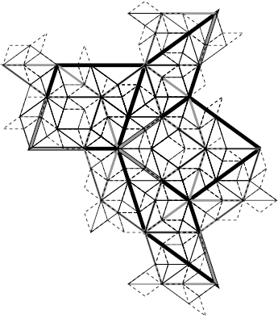
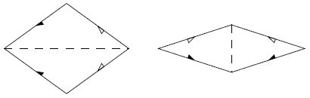
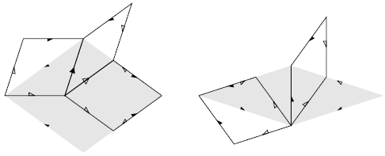
Can one find a set of shapes that can cover the plane non-periodically?
→ Penrose tiling (1974)
need only 2 tiles (rhombus type)
菱形
1
τ
1/τ
2π/5
2π/10
Crucial marks
substitution rule

Slide 4
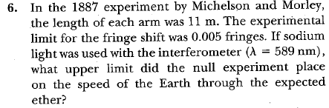
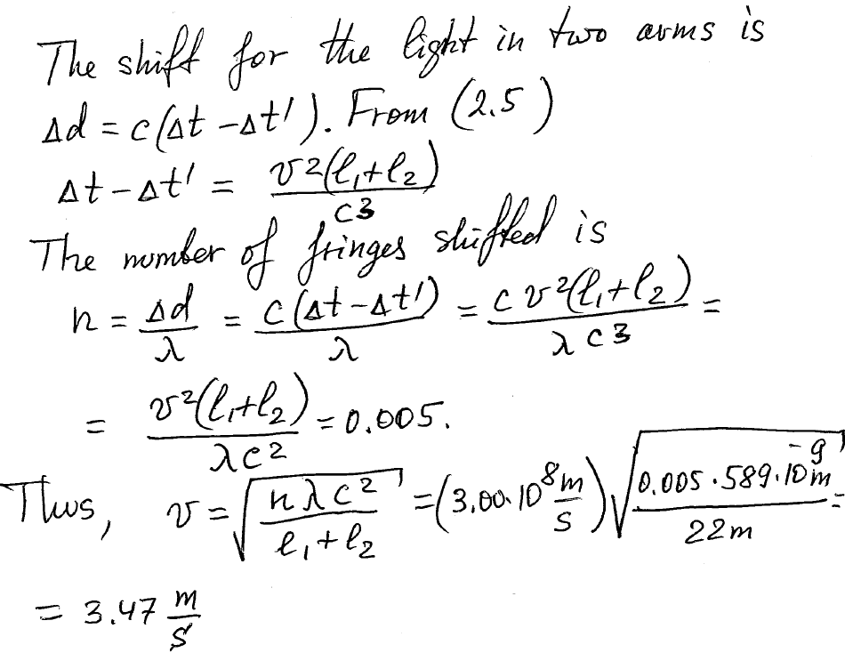
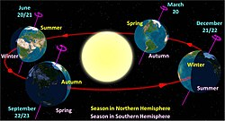
Section 2.1, problem 6
=3.47 km/s
Earth's orbital speed averages 29.78 km/s

Slide 5
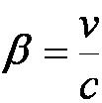


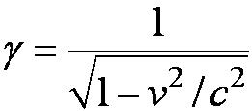


Lorentz Transformation Equations
A more symmetric form:
Notes:
Repositioned these equations for better spacing.

Slide 6
Derivation of Lorentz Transformations
Use the fixed system K and the moving system K’
At t = 0 the origins and axes of both systems are coincident with system K’ moving to the right along the x axis.
A flashbulb goes off at the origins when t = 0.
According to postulate 2, the speed of light will be c in both systems and the wavefronts observed in both systems must be spherical.
K ,K’
Notes:
Title changed to include Lorentz Transformation
Changes “system” in second bullet to “systems”; and, bolded and ital. “coincident”
Moved K and K’ together noting it as K,K’

Slide 7


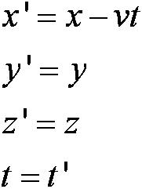
Derivation (con’t)
Spherical wavefronts in K:
Spherical wavefronts in K’:
Note: these are not preserved in the classical transformations with

Slide 8


Derivation (con’t)
Let x’ = (x – vt) so that x = (x’ + vt’)
By Einstein’s first postulate:
The wavefront along the x,x’- axis must satisfy:
x = ct and x’ = ct’
Thus ct’ = (ct – vt) and ct = (ct’ + vt’)
Solving the first one above for t’ and substituting into the second...

Slide 9
Derivation of the Lorentz transformation
The simplest linear transformation
Principle of relativity
Consider expanding light is spherical, then light travels a distance
Substitute t
from the
lower to the
upper equation
Divide each
equation by c
Solve for

Slide 10
Find transformation for the time t’
We had
t=>x/c

Slide 11
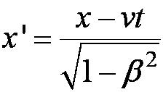
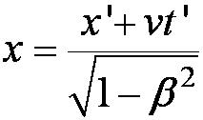


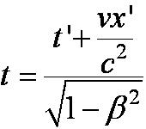
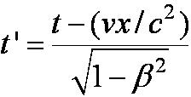
The complete Lorentz Transformations
Including the inverse (i.e v replaced with
–v; and primes interchanged)

Slide 12
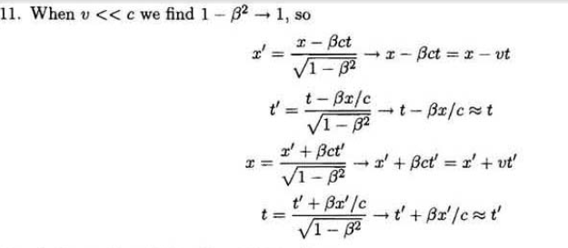
S
2.4. # 11. Show that both Eqs. (2.17) and (2.18) reduce
to the Galilean transformation when v<<c.
Eqs. (2.17)
Eqs. (2.18)

Slide 13
Remarks
If v << c, i.e., β ≈ 0 and ≈ 1, we see these equations reduce to the familiar Galilean transformation.
Space and time are now not separated.
For non-imaginary transformations (which is required to have physical sense), the frame velocity cannot exceed c.

Slide 14
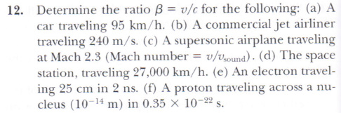

‘
100
(Note: values are somewhat
changed compared to #12)
290

Slide 15
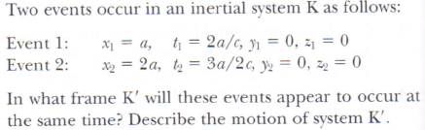
2.4
#13
We require
Plugging values for Events 1 and 2 and solving the equation for v, velocity of K’ relative to K, we find v= - c/2.

Slide 16
2.5: Time Dilation and Length Contraction
Consequences of the Lorentz Transformation:
Time Dilation:
Clocks in K’ run slow with respect to stationary clocks in K.
Length Contraction:
Lengths in K’ are contracted with respect to the same lengths stationary in K.

Slide 17
Time Dilation
To understand time dilation the idea of proper time must be understood:
The term proper time,T₀, is the time difference between two events occurring at the same position in a system as measured by a clock at that position.
Same location (spark “on” then off”)

Slide 18
Time Dilation
Not Proper Time
spark “on” then spark “off”
Beginning and ending of the event occur at different positions

Slide 19
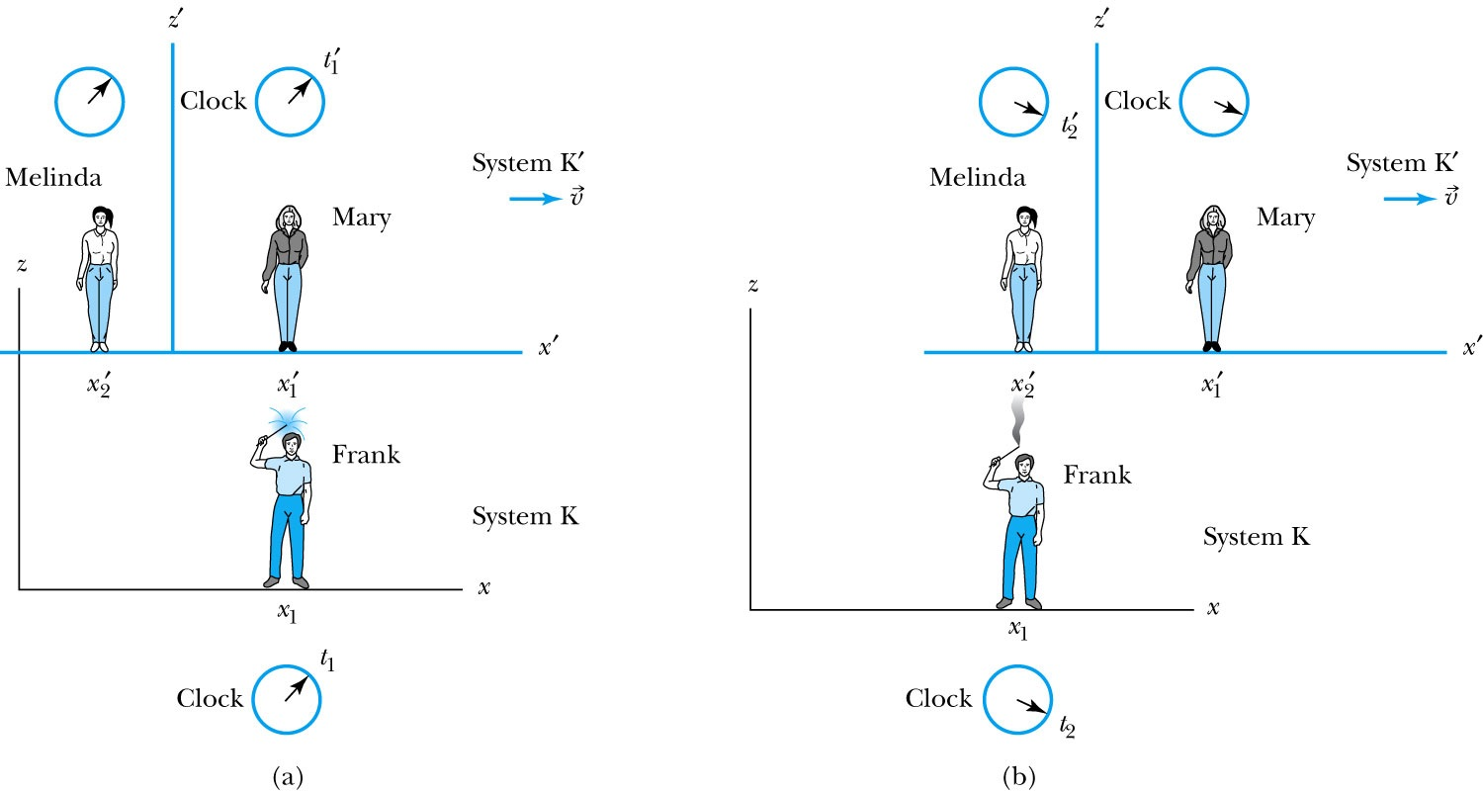
Time Dilation with Mary, Frank, and Melinda
Frank’s clock is at the same position in system K when the sparkler is lit in (a) and when it goes out in (b). Mary, in the moving system K’, is beside the sparkler at (a). Melinda then moves into the position where and when the sparkler extinguishes at (b). Thus, Melinda, at the new position, measures the time in system K’ when the sparkler goes out in (b).

Slide 20
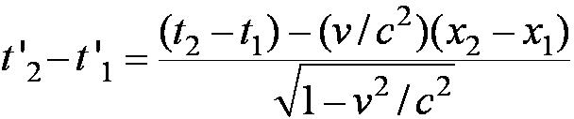
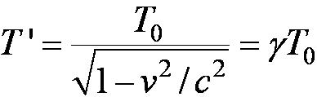
According to Mary and Melinda…
Mary and Melinda measure the two times for the sparkler to be lit and to go out in system K’ as times t’₁ and t’₂ so that by the Lorentz transformation:
  Note here that Frank records x₂– x₁ = 0 in K with a proper time: T₀ = t₂ – t₁ or
with T ’ = t’₂ - t’₁

Slide 21
Time Dilation:
Moving Clocks Run Slow
1) T ’ > T₀ or the time measured between two events in moving system K’ is greater than the time between the same events in the system K, where they are at rest: time dilation.
2) The events do not occur at the same space and time coordinates in the two systems
3) System K requires 1 clock and K’ requires 2 clocks.

Slide 22
Length Contraction
To understand length contraction the idea of proper length must be understood:
Let an observer in each system K and K’ have a meter stick at rest in their own system such that each measures the same length at rest.
The length as measured at rest is called the proper length.
Notes:
Added “their own system”; changed measure to measures

Slide 23
What Frank and Mary measure in their own reference frames
Each observer lays the stick down along his or her respective x axis, putting the left end at x_{ℓ} (or x’_{ℓ}) and the right end at x_{r} (or x’_{r}).
  Thus, in system K, Frank measures his stick to be:
L₀ = x_{r} - x_{ℓ}
  Similarly, in system K’, Mary measures her stick at rest to be:
L’₀ = x’_{r} – x’_{ℓ} =L₀

Slide 24
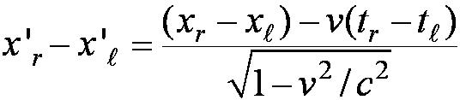
What Frank and Mary measure for a moving stick
Frank in his rest frame measures the length of the stick for Mary’s frame moving with relative velocity.
Thus, according to the Lorentz transformations :
It is assumed that both ends of the stick are measured simultaneously, i.e, t_{r} = t_{ℓ} and =>t_{r} - t_{ℓ} =0
Here Mary’s proper length is L’₀ = x’_{r} – x’_{ℓ}
and Frank’s measured length is L = x_{r} – x_{ℓ}

Slide 25
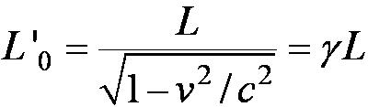
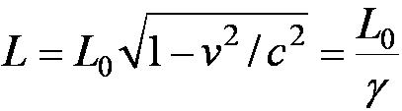
Frank’s measurement
So Frank measures the moving length as L given by
but since both Mary and Frank in their respective frames measure L’₀ = L₀
i.e. the measured length for the moving stick shrinks
and L₀ > L.

Slide 26
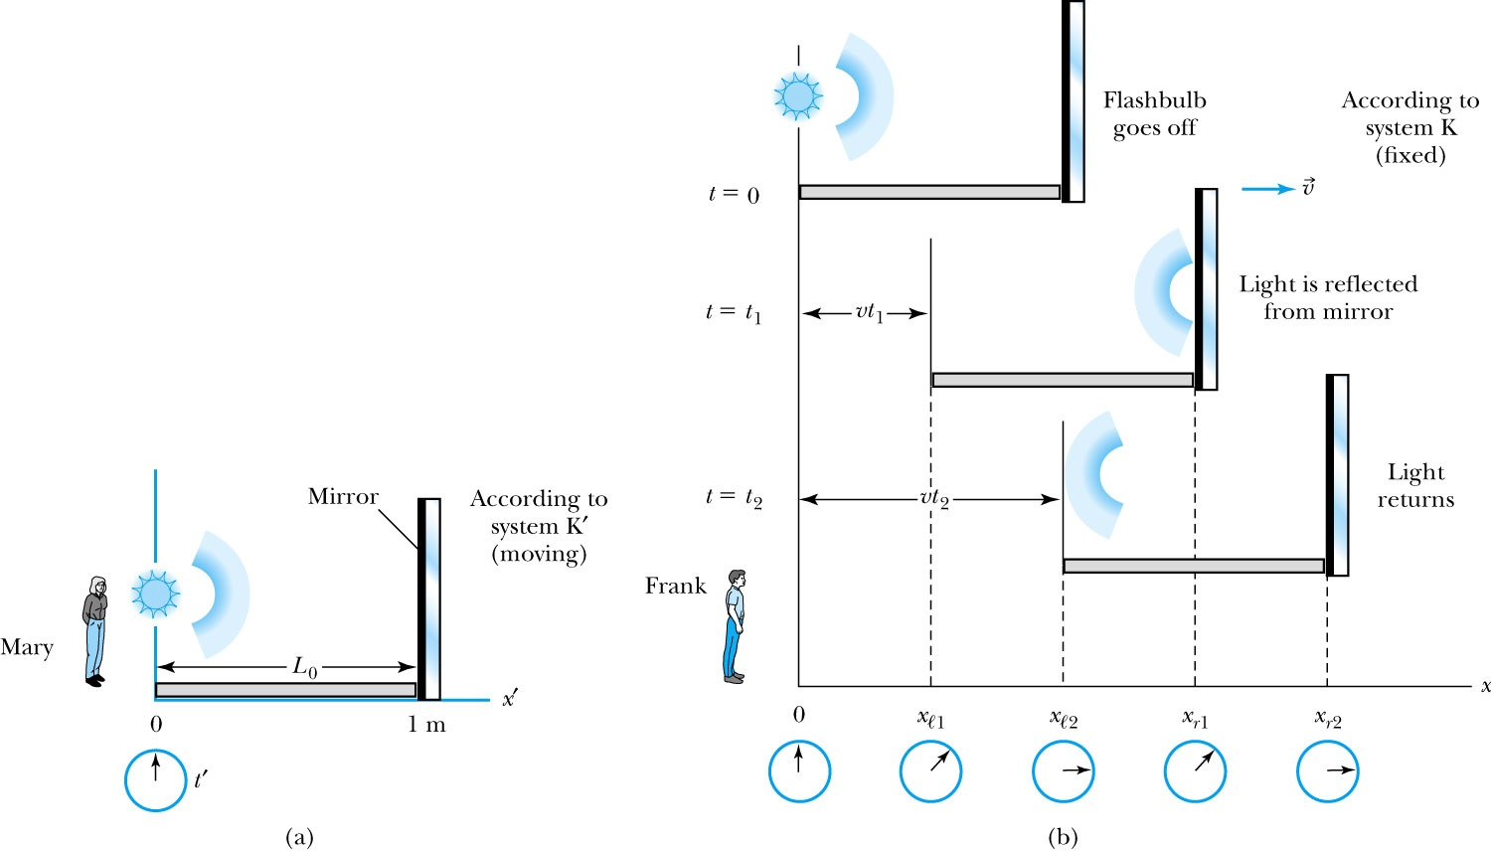
A “Gedanken Experiment” to Clarify Length Contraction
Notes:
Figure 2.11 (a) Mary, in system K´, ﬂashes a light down her x´ axis along a stick at rest in her system of length L₀, which is the proper length. The time interval for the light to travel down the stick and back is 2L₀/c. (b) Frank, in system K, sees the stick moving, and the mirror has moved a distance vt₁ by the time the light is reﬂected. By the time the light returns to the beginning of the stick, the stick has moved a total distance of vt₂. The times can be compared to show that the moving stick has been length contracted by L= L₀ √1– v² ⁄ c².

Slide 27

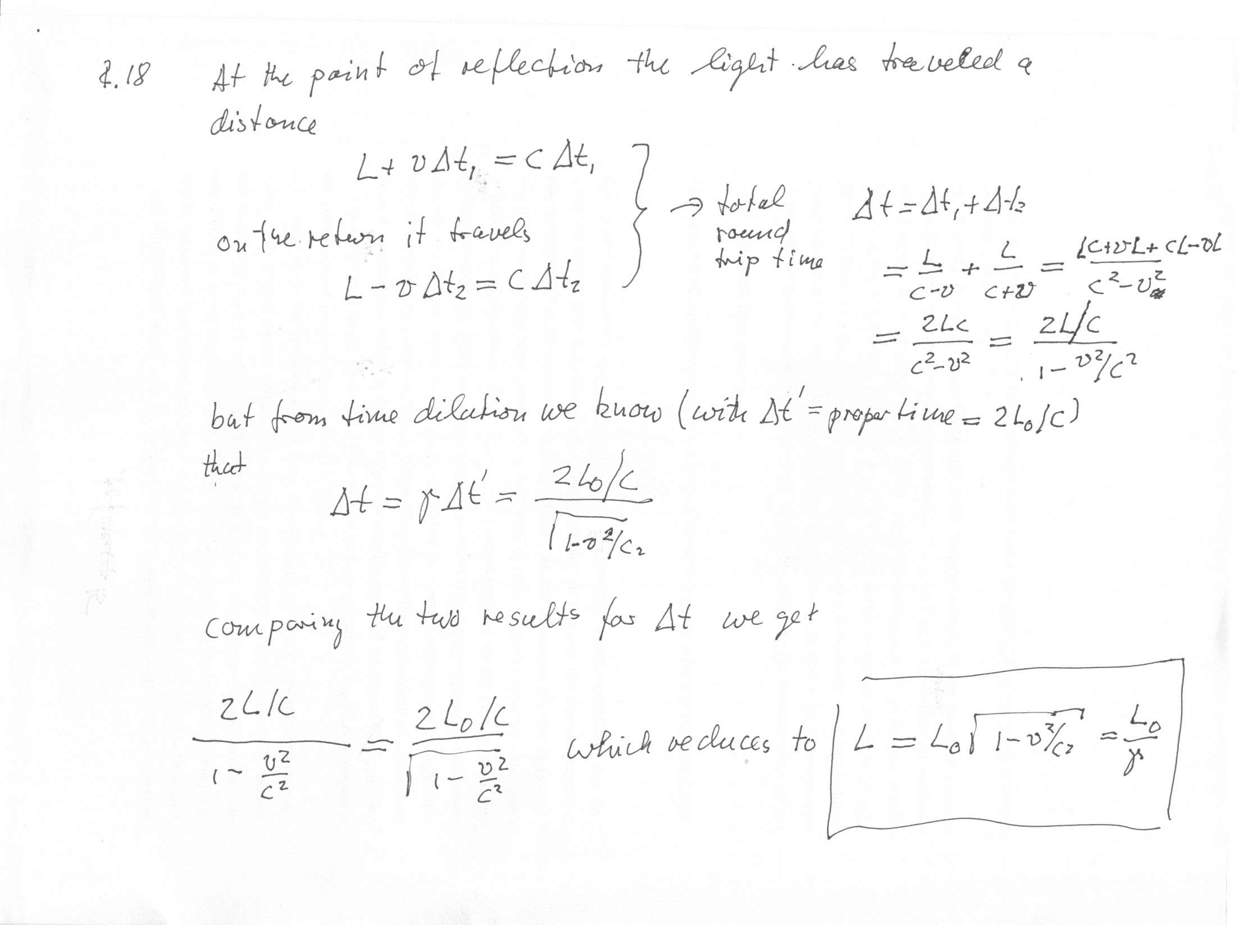
2.5
#18

Slide 28
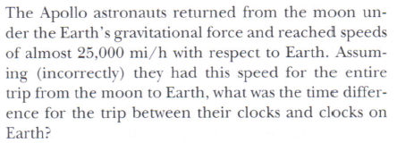
Example
2.5
#22

Slide 29
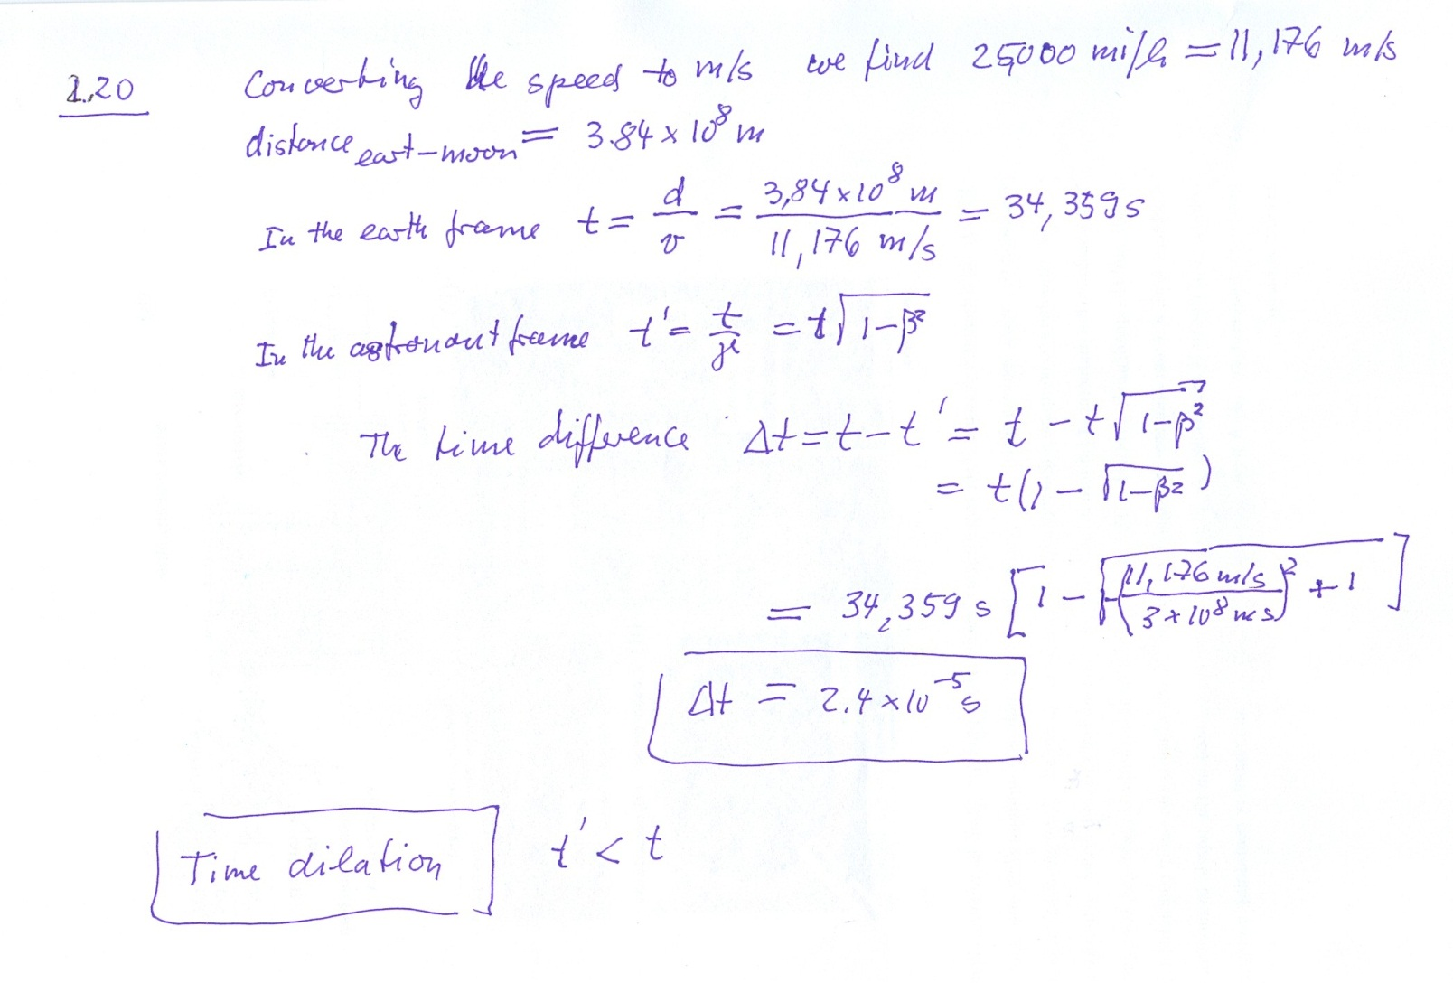
2.5
#22

Slide 30
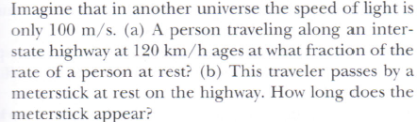
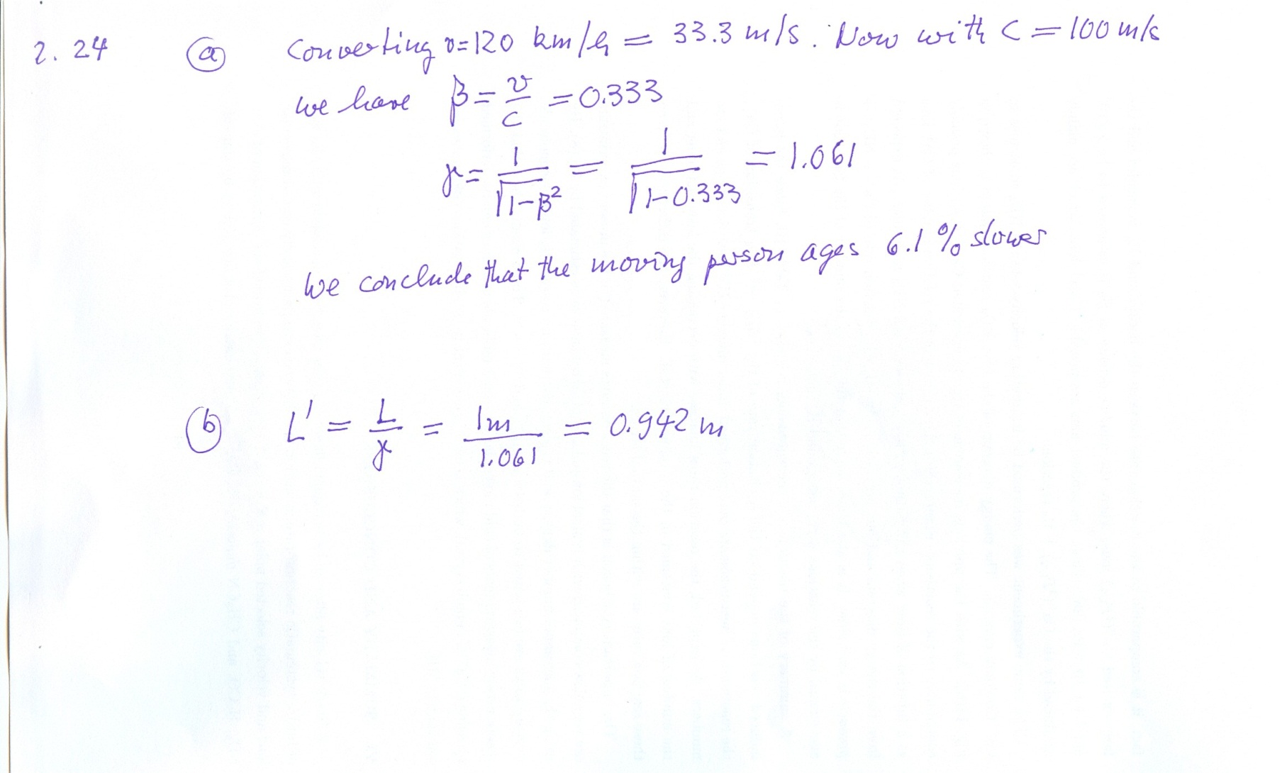
2.5
#28
2

Slide 31
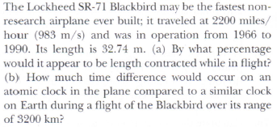
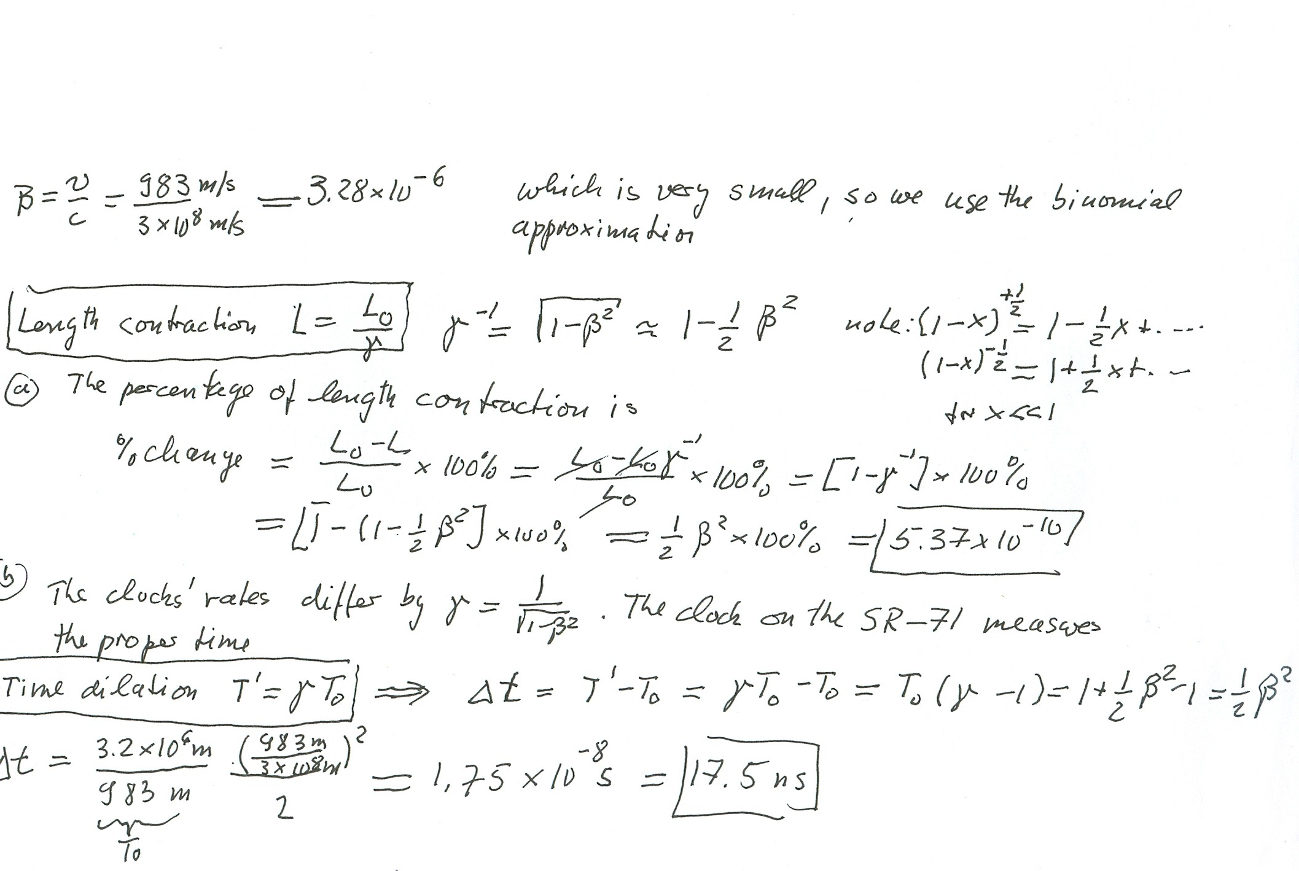
Problem 100,ch.2

Slide 32
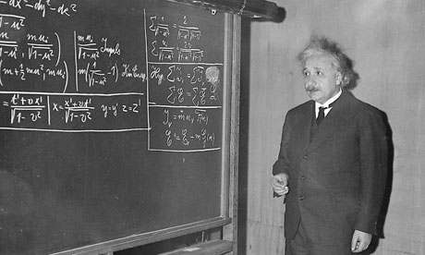
Albert Einstein lecturing on the special theory of relativity. Photograph: AP

Slide 33
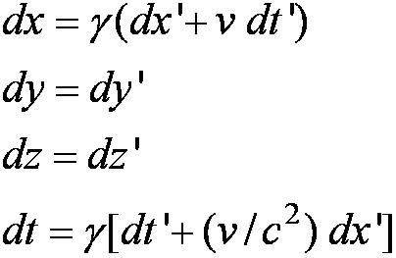
2.6: Addition of Velocities
Taking differentials of the Lorentz transformation, relative velocities may be calculated:

Slide 34
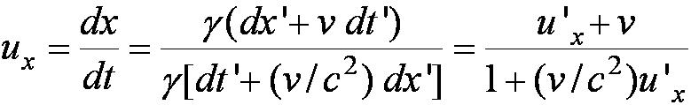
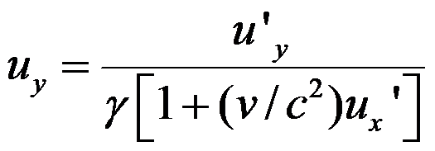
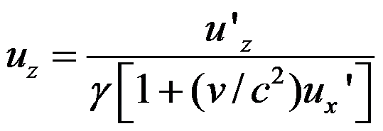
So that…
defining velocities as: u_{x} = dx/dt, u_{y} = dy/dt,
u’_{x} = dx’/dt’, etc. it is easily shown that:
With similar relations for u_{y} and u_{z:}

Slide 35
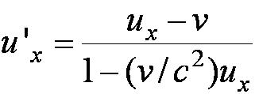
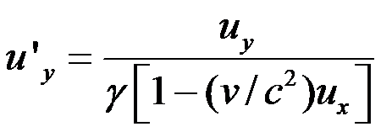
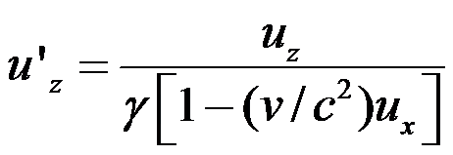
The Lorentz Velocity Transformations
In addition to the previous relations, the Lorentz velocity transformations for u’_{x}, u’_{y} , and u’_{z} can be obtained by switching primed and unprimed and changing v to –v:

Slide 36
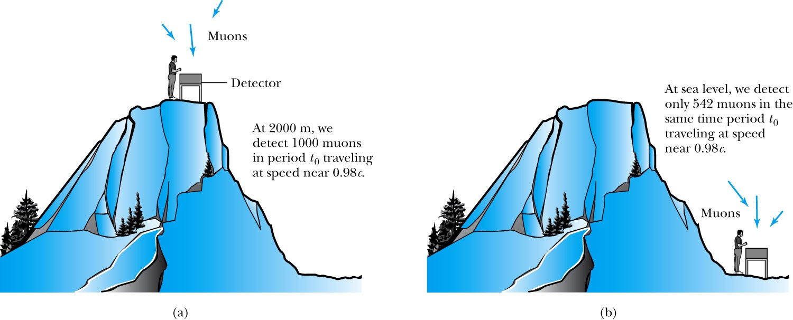
2.7: Experimental Verification
Time Dilation and Muon Decay
Figure 2.18: The number of muons detected with speeds near 0.98c is much different (a) on top of a mountain than (b) at sea level, because of the muon’s decay. The experimental result agrees with our time dilation equation.

Slide 37
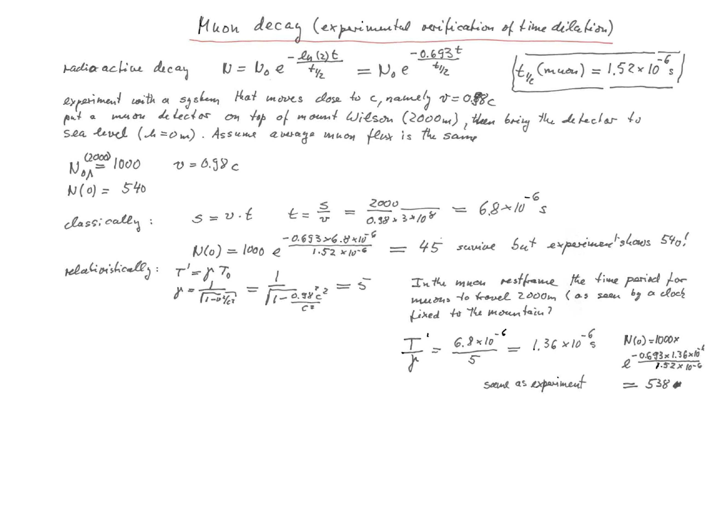
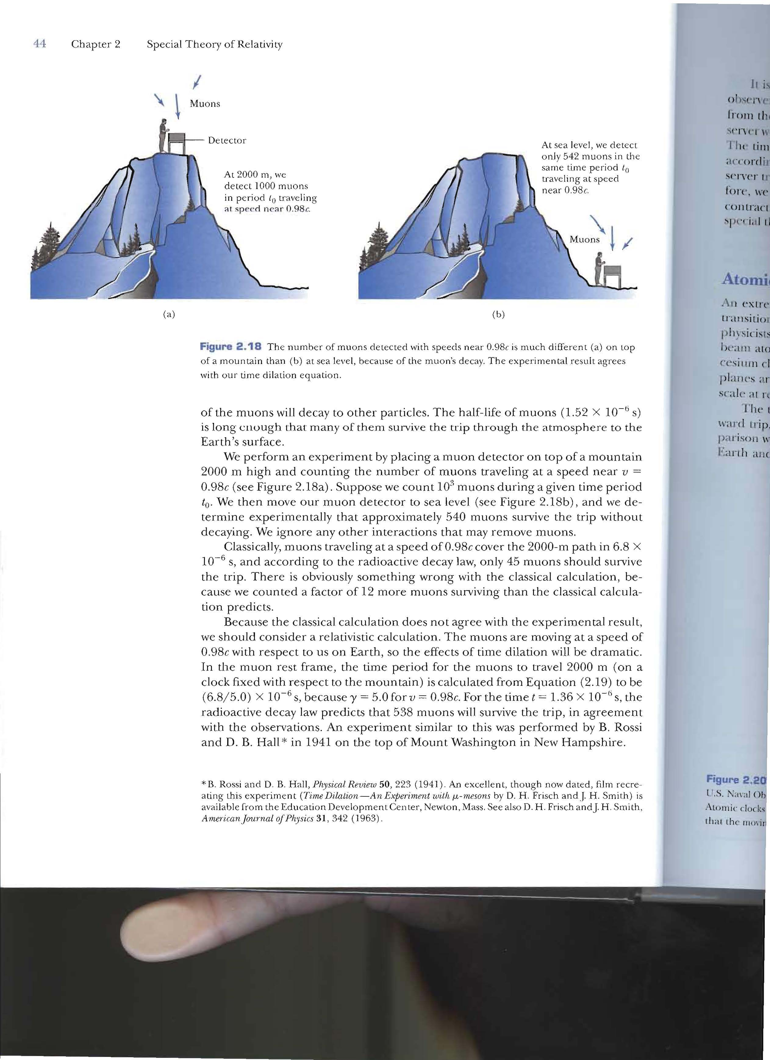

Slide 38
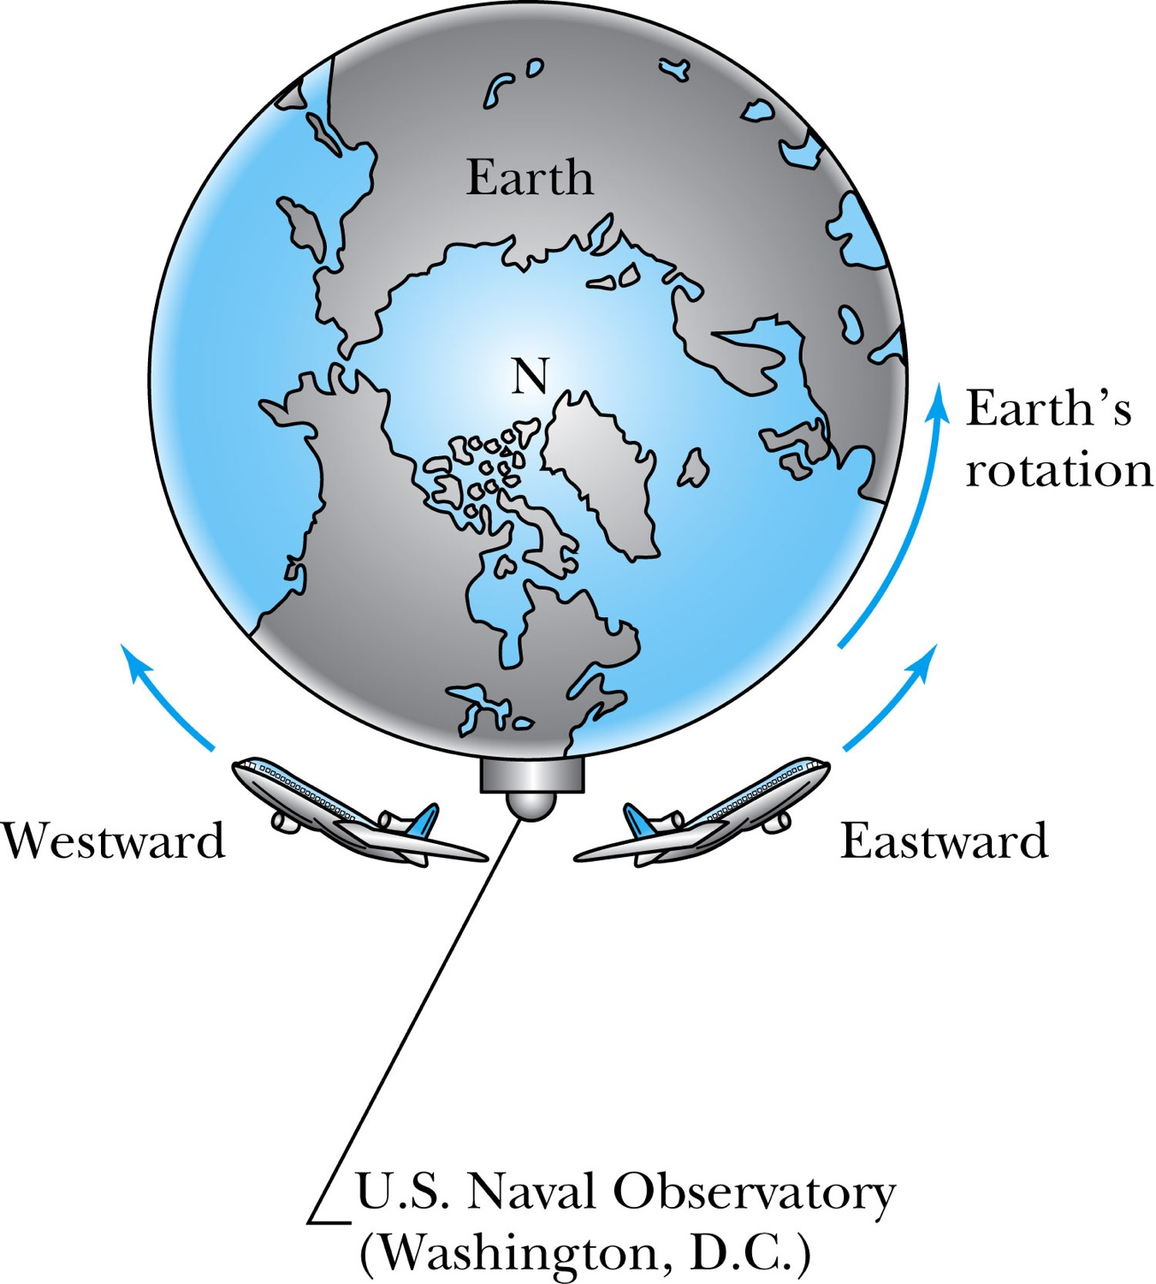
Atomic Clock Measurement
Figure 2.20: Two airplanes took off (at different times) from Washington, D.C., where the U.S. Naval Observatory is located. The airplanes traveled east and west around Earth as it rotated. Atomic clocks on the airplanes were compared with similar clocks kept at the observatory to show that the moving clocks in the airplanes ran differently.

Slide 39
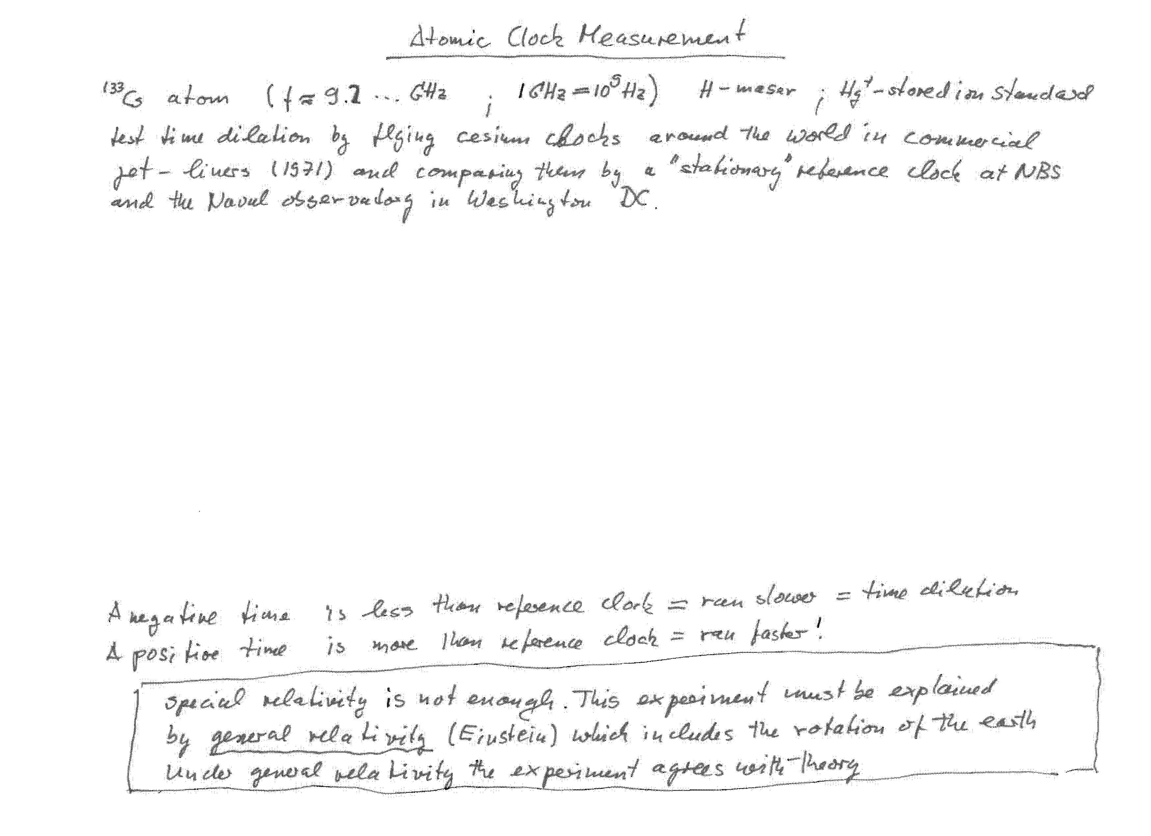
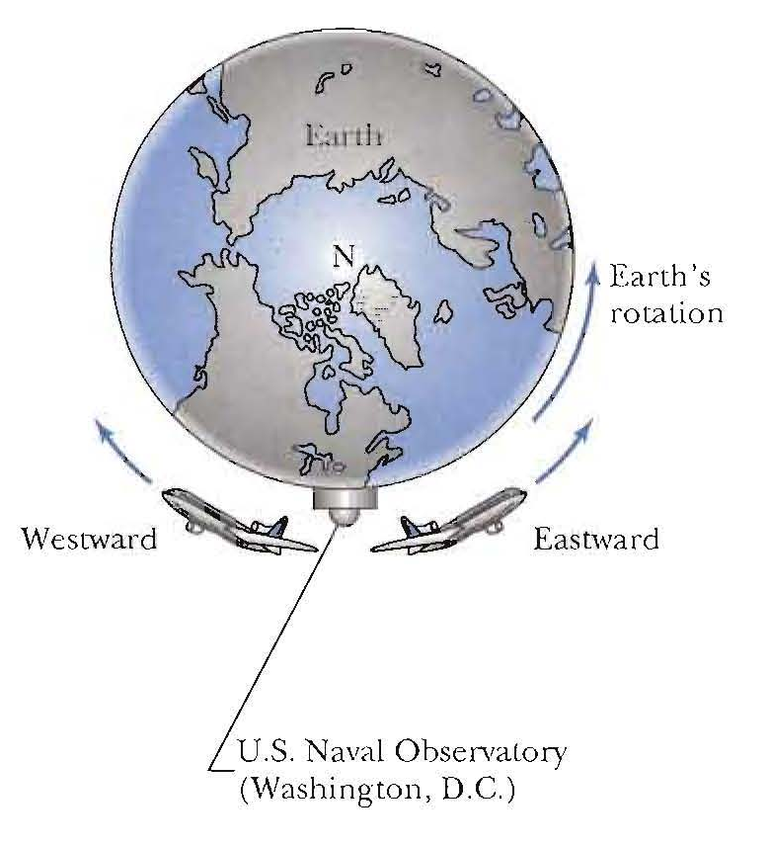
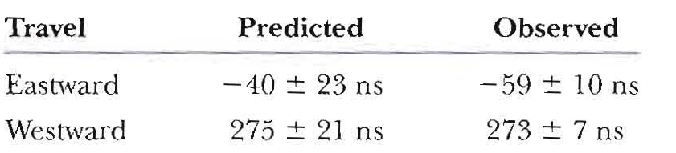
Flight time
(41.2 h)
(48.6 h)
The time is changing in the moving frame, but the calculations must also take into account corrections due to general relativity (Einstein). Analysis shows that the special theory of relativity is verified within the experimental uncertainties.

Slide 40
Respondus lockdown browser
https://www.youtube.com/watch?v=XuX8WoeAycs&feature=youtu.be
https://web.respondus.com/he/monitor/resources/

