Slide 1
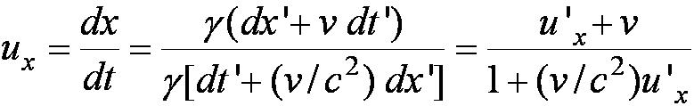
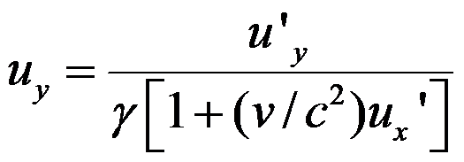
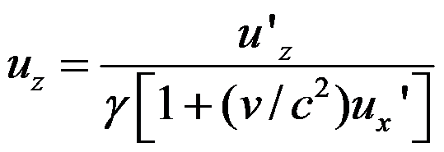
The Lorentz Velocity Transformations
defining velocities as: u_{x} = dx/dt, u_{y} = dy/dt,
u’_{x} = dx’/dt’, etc. it is easily shown that:
With similar relations for u_{y} and u_{z:}

Slide 2
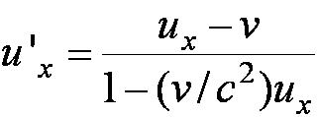
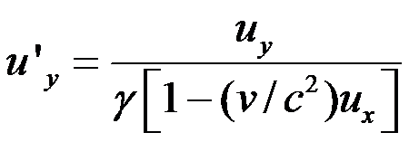
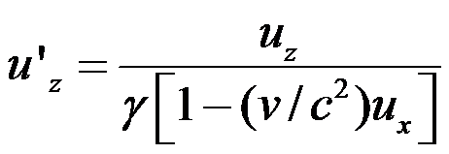
The Lorentz Velocity Transformations
In addition to the previous relations, the Lorentz velocity transformations for u’_{x}, u’_{y} , and u’_{z} can be obtained by switching primed and unprimed and changing v to –v:

Slide 3
The Lorentz Velocity Transformations: an object moves with the speed of light
u’_{x} = c (light or, if neutrinos are massless, they must travel at the speed of light)

Slide 4
Problems: Time dilation,length contraction

Slide 5
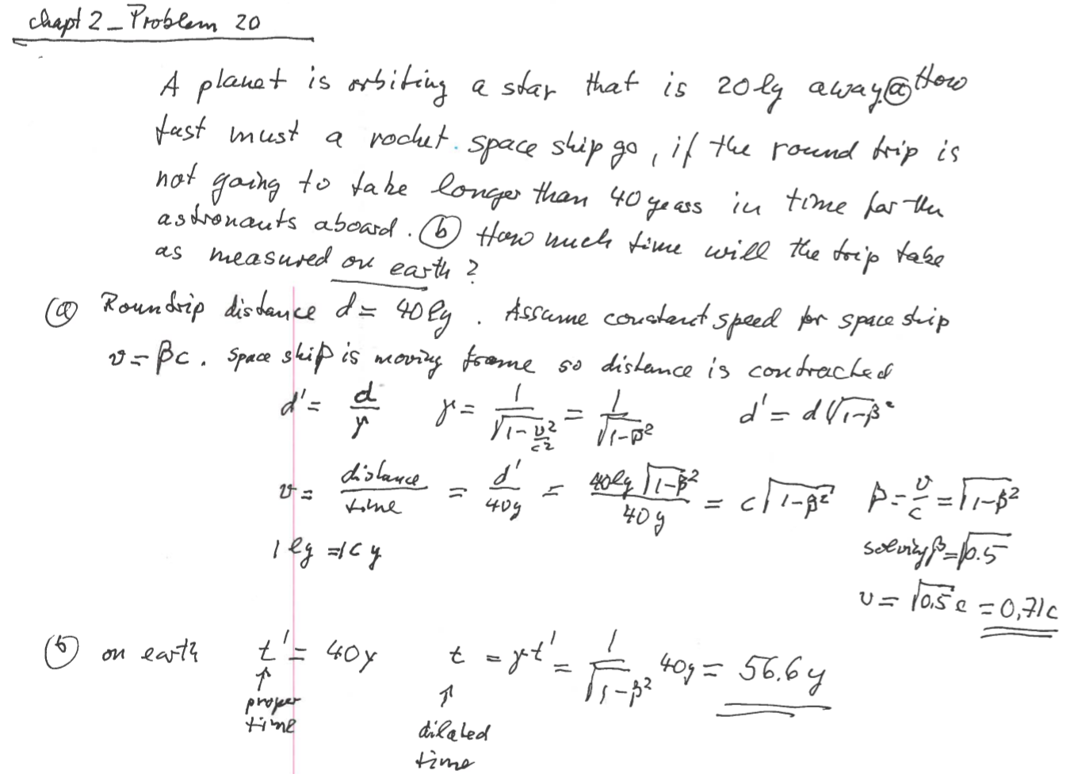

Slide 6
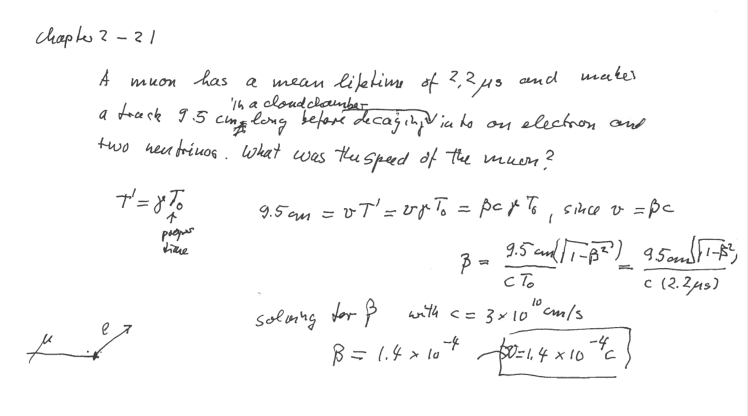

Slide 7
2.9: Spacetime
When describing events in relativity, it is convenient to represent events on a spacetime diagram.
In this diagram one spatial coordinate x, to specify position, is used and instead of time t, ct is used as the other coordinate so that both coordinates will have dimensions of length.
Spacetime diagrams were first used by H. Minkowski in 1908 and are often called Minkowski diagrams. Paths in Minkowski spacetime are called worldlines.

Slide 8
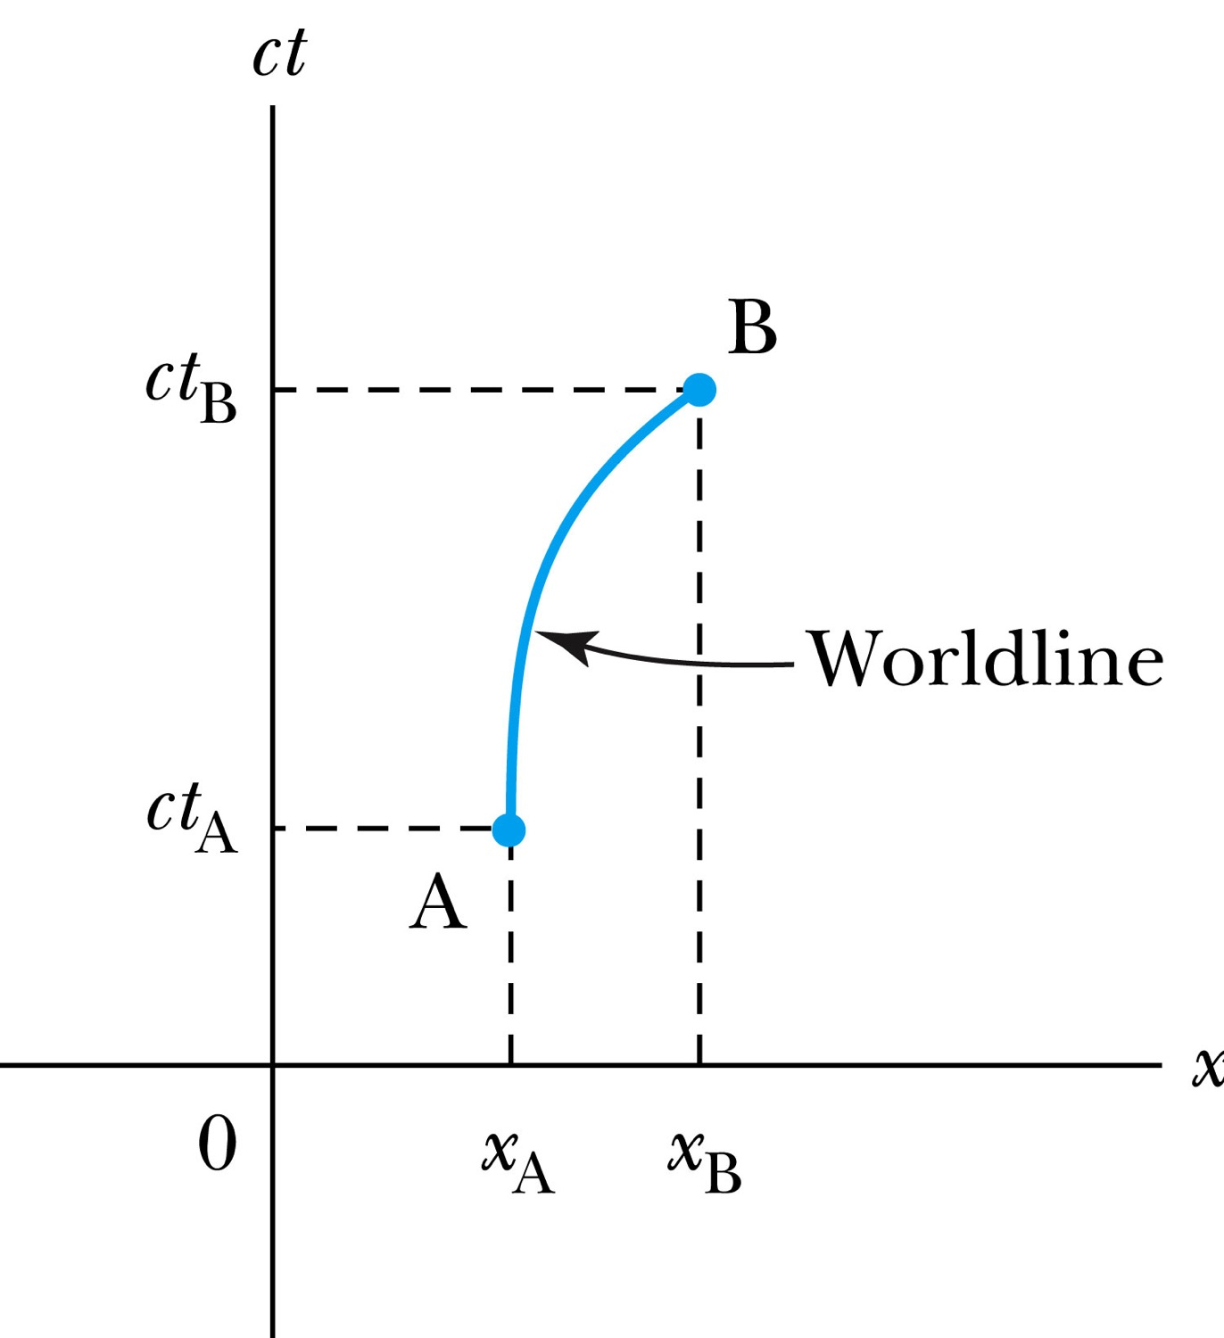
Spacetime Diagram
It takes 4 dimensions to specify an event
Notes:
Add the paragraph for Figure 2.21

Slide 9
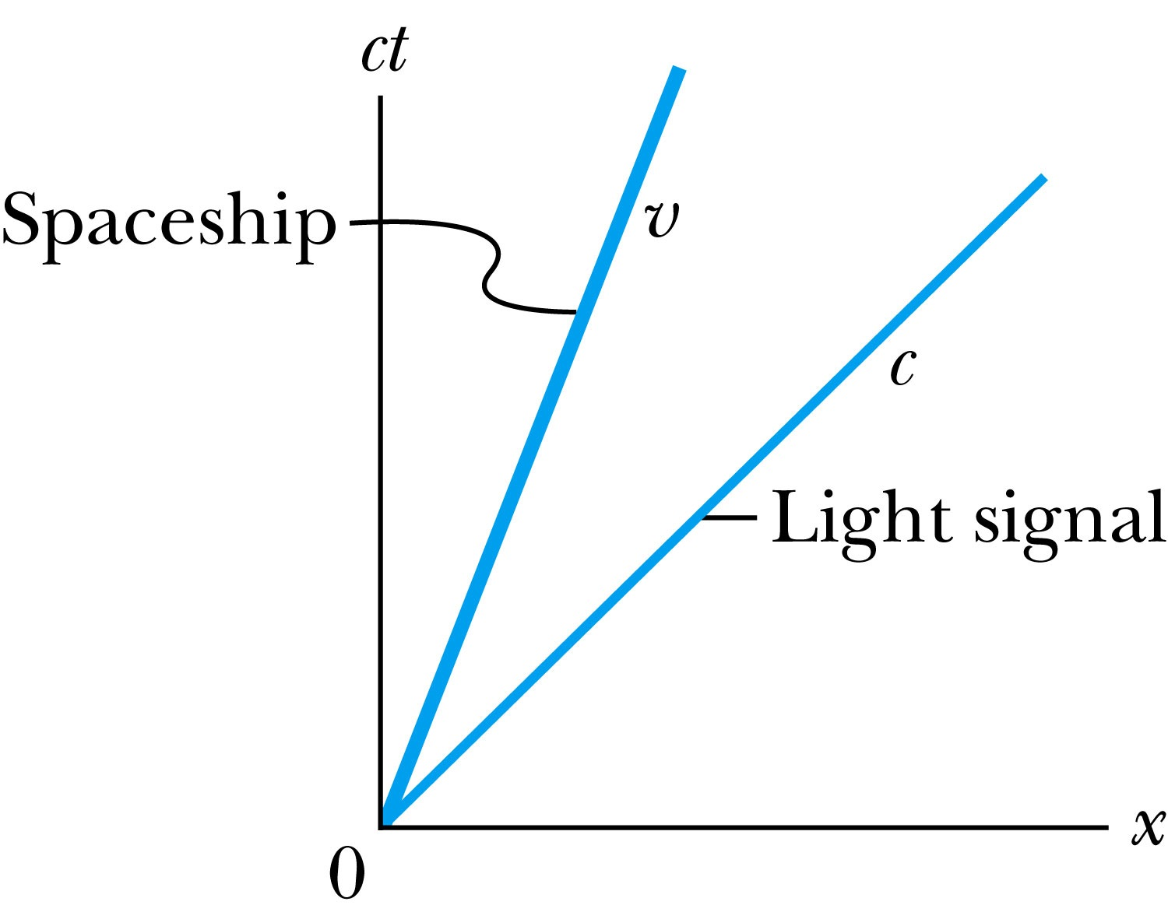
Particular Worldlines
Notes:
Add the paragraph from Fig. 2.22

Slide 10
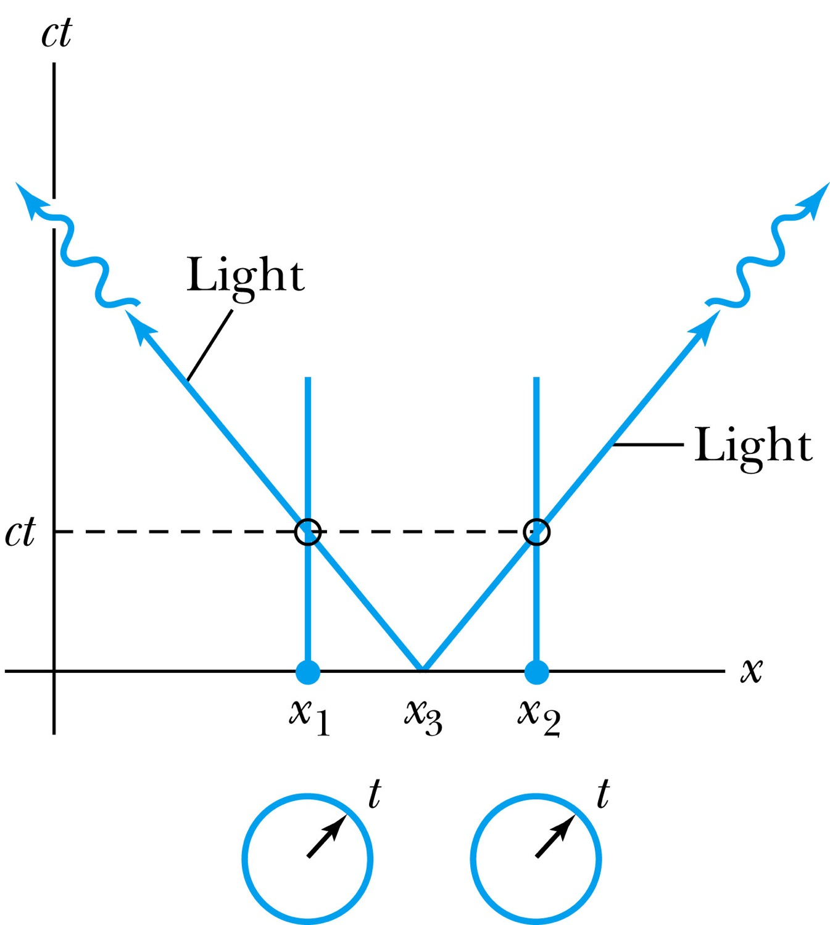
Worldlines and Time
Synchronize clocks by sending a light signal from a position halfway between them
Notes:
Add paragraph from figure 2.23

Slide 11
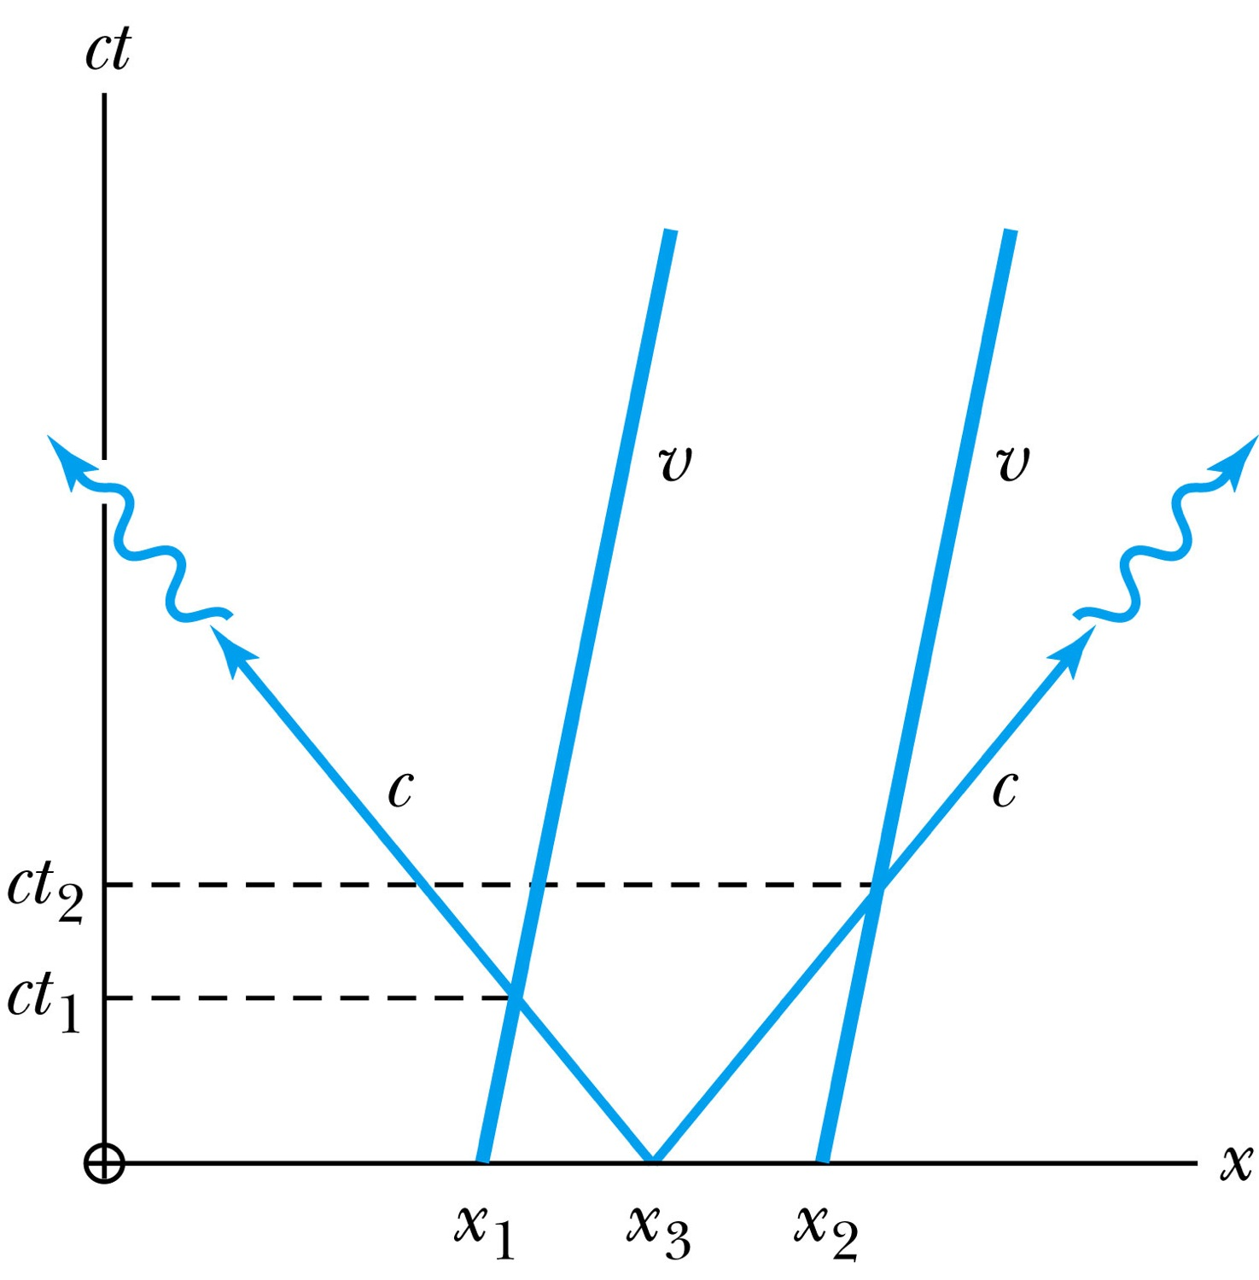
Moving Clocks
If the corresponding x’ position where the light flashes is on K’ ,then the arrival times will not be simultaneous in K
Notes:
Add paragraph from figure 2.24

Slide 12
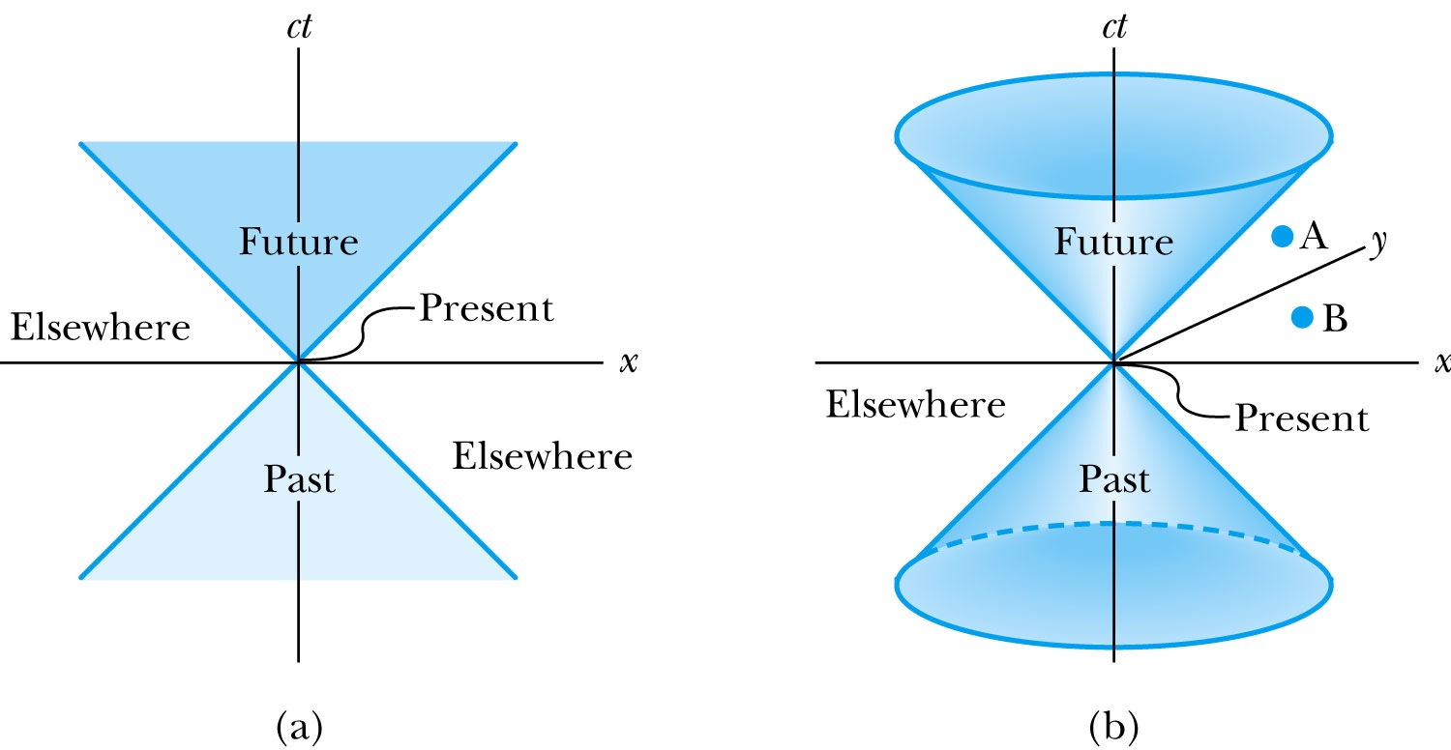
The Light Cone
Notes:
Add paragraph from Figure 2.25

Slide 13
Invariant Quantities: The Spacetime Interval
Since all observers “see” the same speed of
light, then all observers, regardless of their
velocities, must see spherical wave fronts.
s² = x² – c²t² = (x’)² – c² (t’)² = (s’)²

Slide 14
Spacetime Invariants
If we consider two events, we can determine the quantity Δs² between the two events, and we find that it is invariant in any inertial frame. The quantity Δs is known as the spacetime interval between two events.

Slide 15
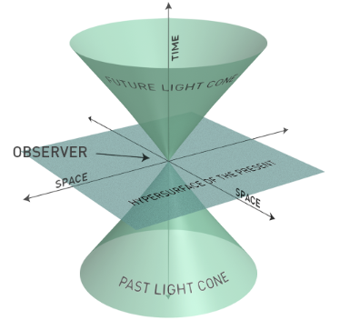
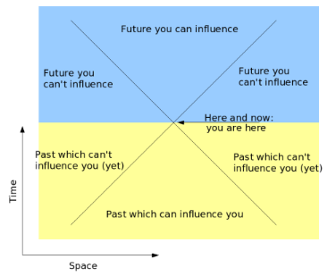
Spacetime diagrams
For two events
lightlines
Spacetime interval
=
lightlike
spacelike
Causality: cause-and-effect relations
Invariant:
timelike
Courtesy: Wikimedia Commons and John Walker

Slide 16
Spacetime Invariants
There are three possibilities for the invariant quantity Δs²:
Δs² = 0: Δx² = c² Δt², and the two events can be connected only by a light signal. The events are said to have a lightlike separation.
Δs² > 0: Δx² > c² Δt², and no signal can travel fast enough to connect the two events. The events are not causally connected and are said to have a spacelike separation.
Δs² < 0: Δx² < c² Δt², and the two events can be causally connected. The interval is said to be timelike.

Slide 17
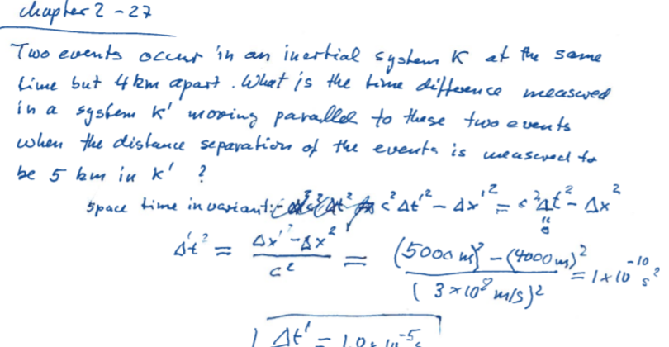

Slide 18
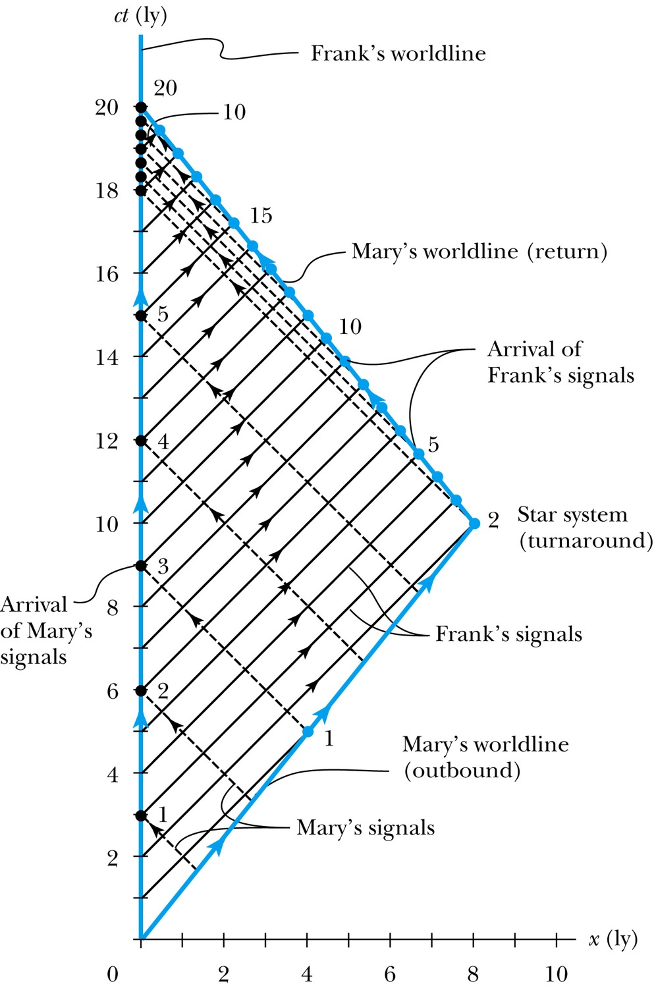
The Twin Paradox in Space-Time
Spaceship’s speed=0.8c
Slope of world lines=c/0.8 c
EXAMPLE 2.7
The twins Frank and Mary sent signals at annual intervals and count the number of signals from each other.
Frank sends 20 signals, Mary sends 12 since her clock runs slower due to time dilation.
Mary is 8years younger as Frank at return
Notes:
Figure 2.26 The spacetime diagram for Mary’s trip to the star system and back. Notice that Frank’s worldline is a vertical line at x = 0, and Mary’s two worldlines have the correct slope given by the magnitude c/v. The black dashed lines represent light signals sent at annual intervals from Mary to Frank. Frank’s annual signals to Mary are solid black. The solid dots denote the time when the light signals arrive.

Slide 19
2.10: The Doppler Effect
The Doppler effect of sound in introductory physics is represented by an increased frequency of sound as a source such as a train (with whistle blowing) approaches a receiver (our eardrum) and a decreased frequency as the source recedes.
Also, the same change in sound frequency occurs when the source is fixed and the receiver is moving. The change in frequency of the sound wave depends on whether the source or receiver is moving.
On first thought it seems that the Doppler effect in sound violates the principle of relativity, until we realize that there is in fact a special frame for sound waves. Sound waves depend on media such as air, water, or a steel plate in order to propagate; however, light does not!

Slide 20
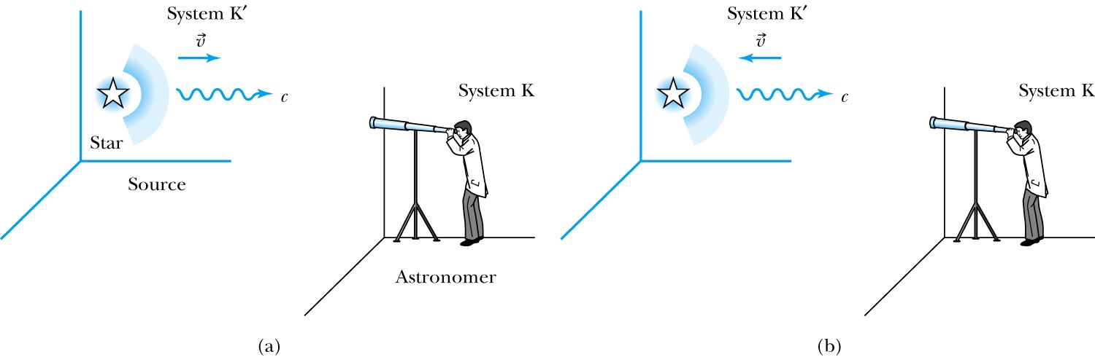
Recall the Doppler Effect
Notes:
Add paragraph from figure 2.27

Slide 21
The Relativistic Doppler Effect
Consider a source of light (for example, a star) and a receiver
(an astronomer) approaching one another with a relative velocity v.
Consider the receiver in system K and the light source in system K’ moving toward the receiver with velocity v.
The source emits n waves during the time interval T.
Because the speed of light is always c and the source is moving with velocity v, the total distance between the front and rear of the wave transmitted during the time interval T is:
Length of wave train = cT − vT

Slide 22
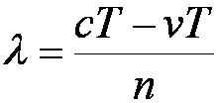
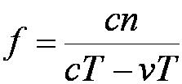
The Relativistic Doppler Effect (con’t)
Because there are n waves, the wavelength is given by
And the resulting frequency is

Slide 23
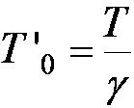
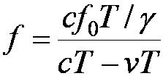
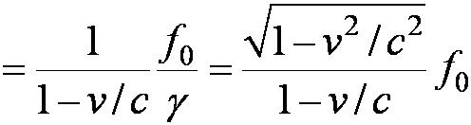
The Relativistic Doppler Effect (con’t)
In this frame: f₀ = n / T ’₀ and
Thus:

Slide 24
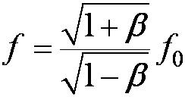
Source and Receiver Approaching
With β = v / c the resulting frequency is given by:
(source and receiver approaching)

Slide 25
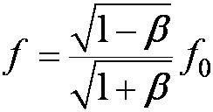
Source and Receiver Receding
In a similar manner, it is found that:
(source and receiver receding)

Slide 26
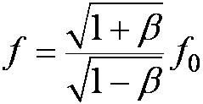
The Relativistic Doppler Effect (con’t)
Equations (2.32) and (2.33) can be combined into one equation if we agree to use a + sign for β (+v/c) when the source and receiver are approaching each other and a – sign for β (– v/c) when they are receding. The final equation becomes
Relativistic Doppler effect (2.34)

Slide 27
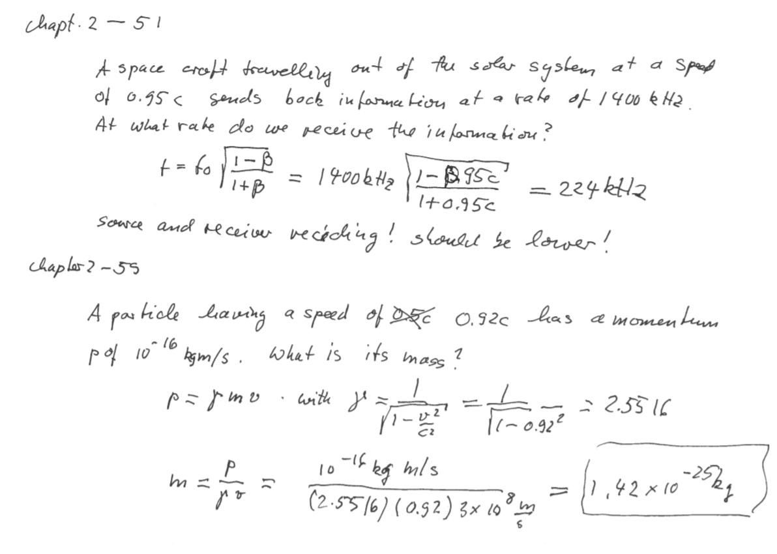
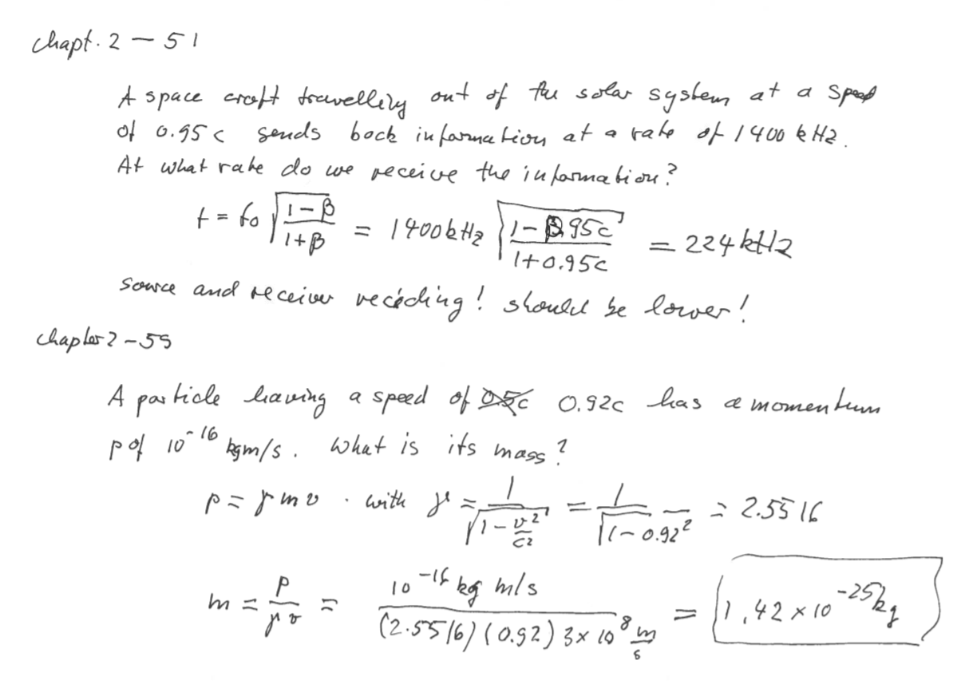

Slide 28
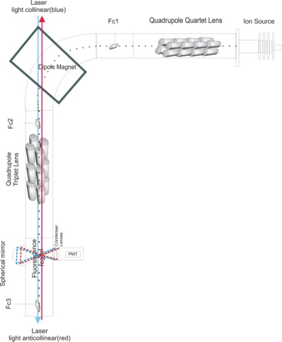
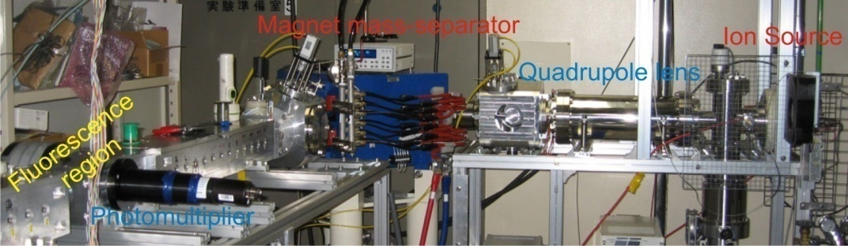
Example: DOPPLER EFFECT IN Fast ion beam precision laser spectroscopy IN collinear and anti-collinear Geometries referenced TO a frequency comb
(Another example with the Doppler effect: laser cooling of atoms)

Slide 29
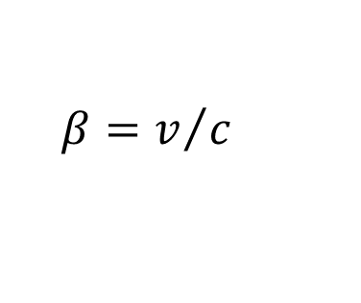
Exclusion of relativistic frequency shifts by combining collinear and anticollinear measurements
Frequency of light perceived by a moving ion
Laser tuned to resonance; the perceived frequency equals the transition frequency
Thus, the resonance frequencies for collinear geometry
and for anticollinear geometry
To obtain the transition frequency we take the product
and this is an exact relativistic formula!

Slide 30
Another example with Doppler effect: laser cooling of atoms

Slide 31
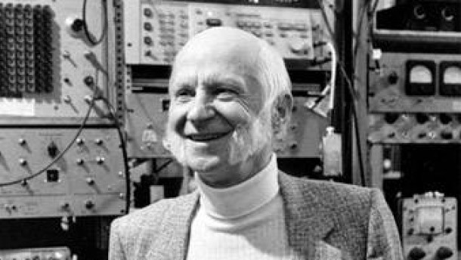

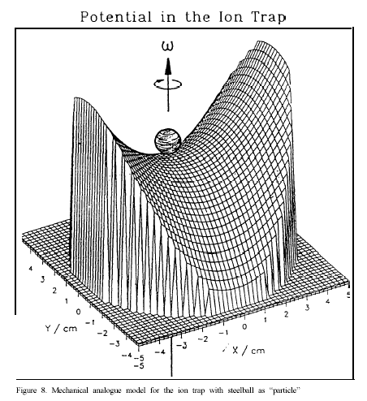
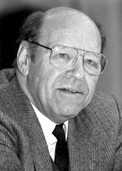
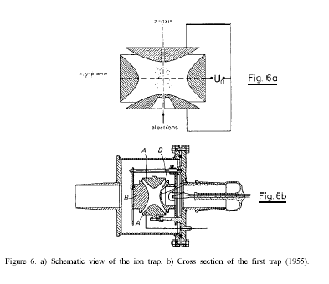
Ion trap basics
My teachers
Nobel price 1989
Ions move in a time-averaged harmonic pseudo potential, created by AC electric fields
Secular motion: Characteristic oscillation in the trap potential
Micro motion:
Oscillation with driving RF frequency

Slide 32
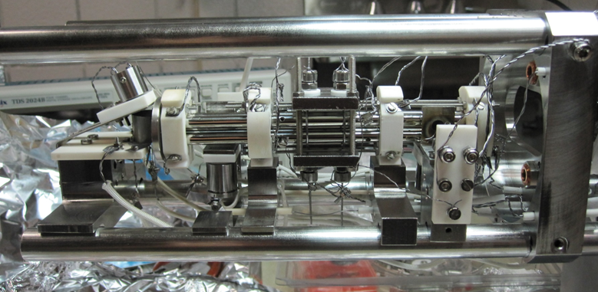
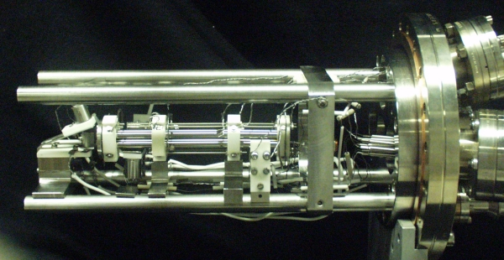

Trapping ions: ion trap picture
Tamu

Slide 33
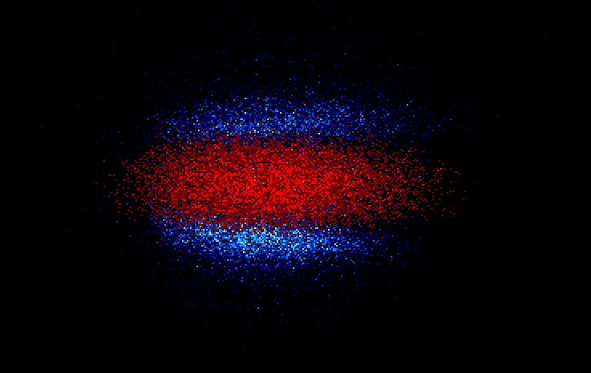
Large ²⁴Mg⁺ - ²⁶Mg⁺ ion crystal (N~10⁴)

Slide 34
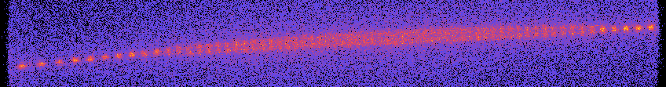

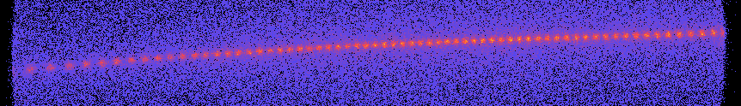
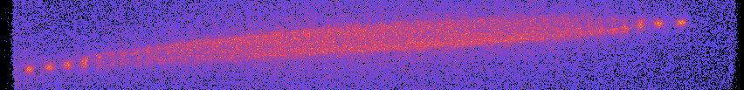


Structure phase transition (N~70)
α~ 0.001
α~ 0.004
α~ 0.02
α~ 0.08
α~ 0.12
α~ 0.20
1mm
α~ 0.24

Slide 35
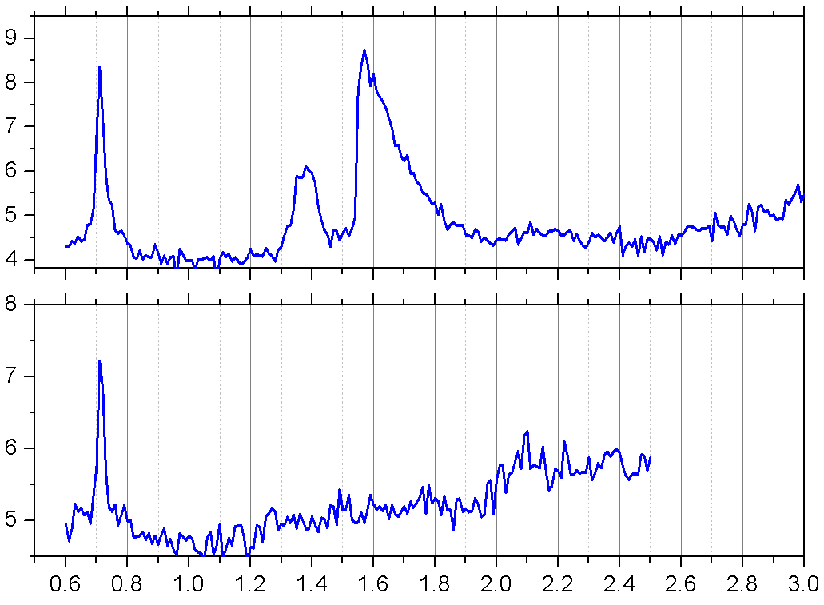
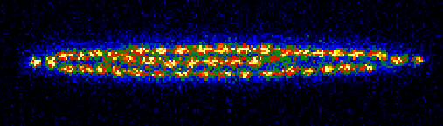
Be⁺-He⁺ mixed crystal: Secular excitation
Be⁺
He⁺
With He⁺
HeH⁺
Fluorescence (a.u.)
Be⁺
Without He⁺
Secular
Frequency (MHz)

Slide 36
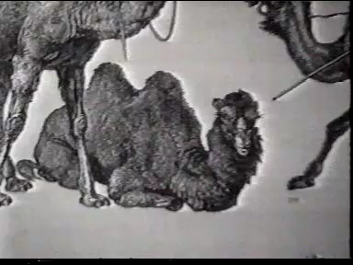
Ion trap video

Slide 37
Problems: velocity addition

Slide 38
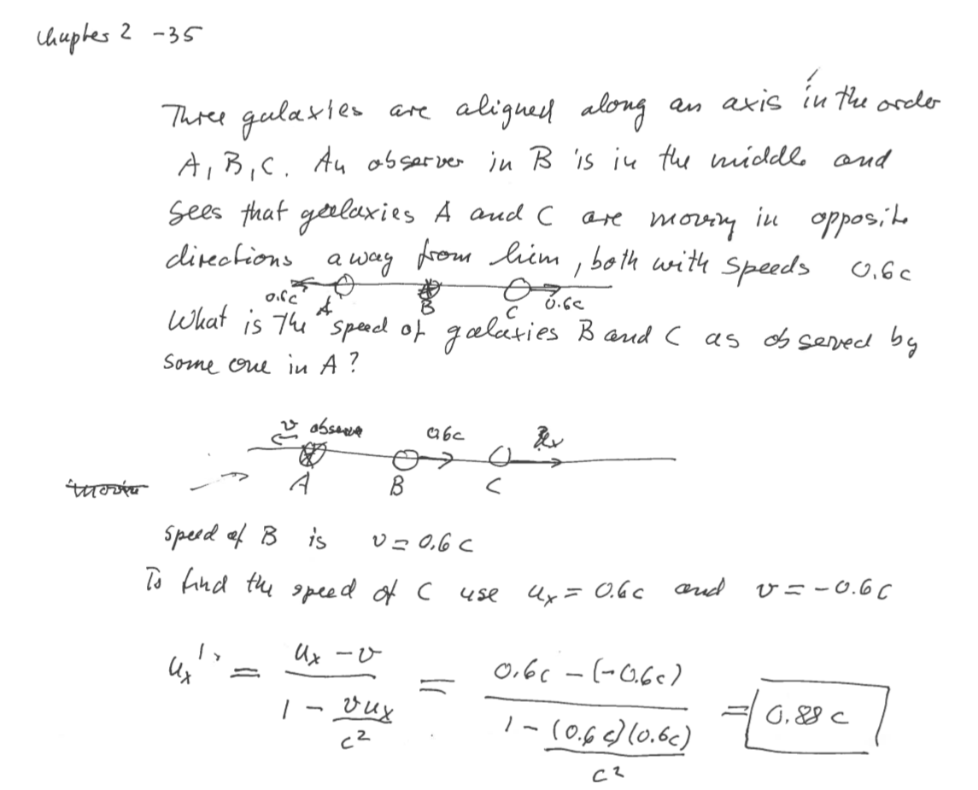

Slide 39
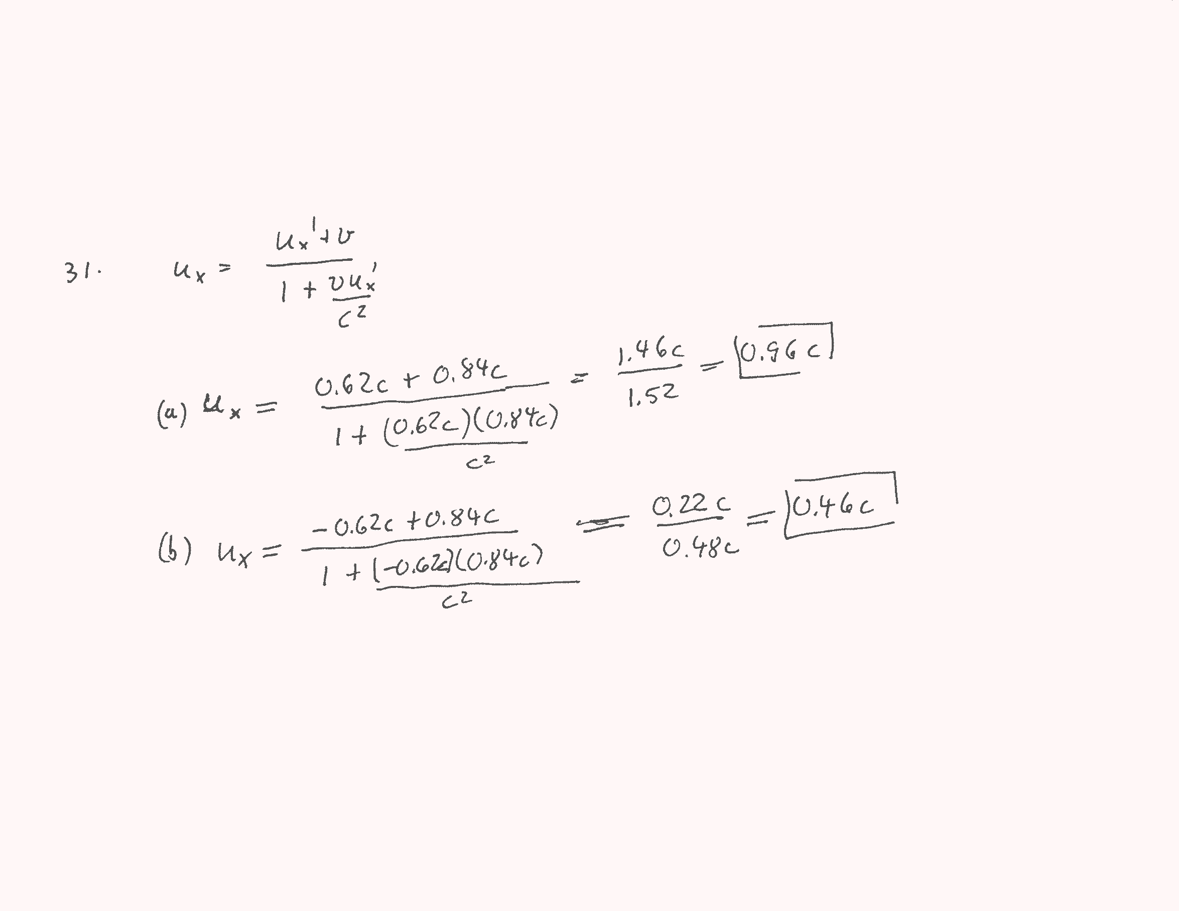


2.6
#31

Slide 40

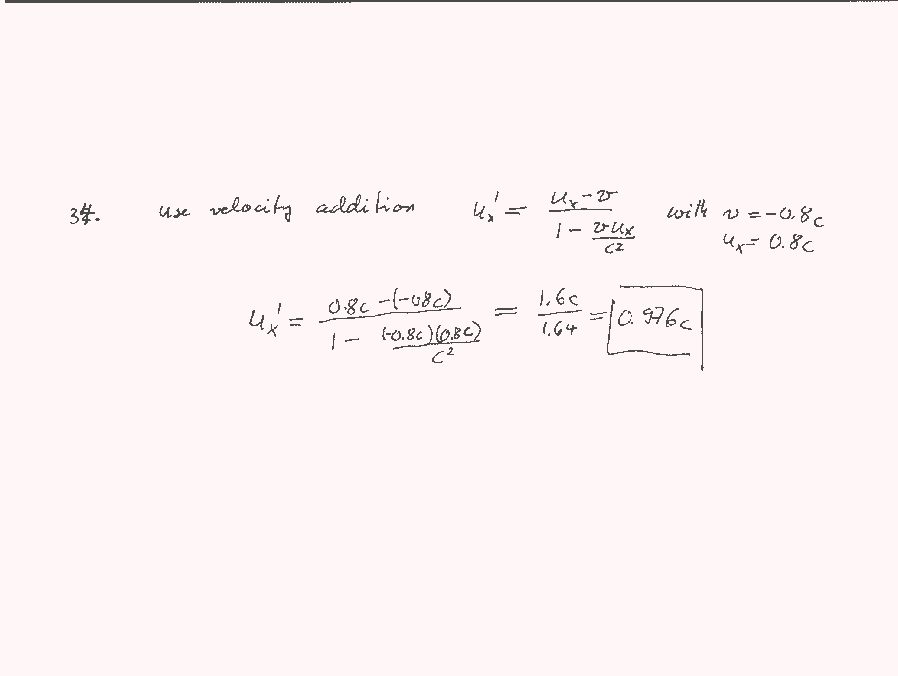
2.6
#32
Solution:

Slide 41
Thank you for your attention!

