Slide 1
L6bCH2 09-15-2021
Total Energy and Rest Energy, Mass-energy Equivalence

Slide 2
Binding Energy
The equivalence of mass and energy becomes apparent when we study the binding energy of systems like atoms and nuclei that are formed from individual particles.
The potential energy associated with the force keeping the system together is called the binding energy E_{B}.

Slide 3
Total Energy and Rest Energy, Mass-energy Equivalence
We rewrite the energy equation in the form
The term mc² is called the rest energy and is denoted by E₀.
This leaves the sum of the kinetic energy and rest energy to be interpreted as the total energy of the particle. The total energy is denoted by E and is given by
(2.63)
(2.64)
(2.65)

Slide 4
Relationship of Energy and Momentum
We square this result, multiply by c², and rearrange the result.
We use the equation for γ to express β² and find
Expressing β through γ
Notes:
Title rewritten

Slide 5
Energy and Momentum
The first term on the right-hand side is just E², and the second term is E₀². The last equation becomes
We rearrange this last equation to find the result we are seeking, a relation between energy and momentum.
or
Equation (2.70) is a useful result to relate the total energy of a particle with its momentum. The quantities (E² – p²c²) and m are invariant quantities. Note that when a particle’s velocity is zero and it has no momentum, Equation (2.70) correctly gives E₀ as the particle’s total energy.
(2.70)
(2.71)
Notes:
Changed title

Slide 6
Useful formulas
from
and

Slide 7
2.13: Computations in Modern Physics
We were taught in introductory physics that the international system of units is preferable when doing calculations in science and engineering (“everyday” scales).
In modern physics a somewhat different set of units is often used, which is more convenient for problems considered in modern physics.
The smallness of quantities often used in modern physics suggests the need for some new units more practical for smaller scales .

Slide 8
Units of Work and Energy
Recall that the work done in accelerating a charge through a potential difference is given by W = qV.
For a proton, with the charge e = 1.602 × 10⁻¹⁹ C being accelerated across a potential difference of 1 V, the work done on the particle is
W = (1.602 × 10⁻¹⁹C)(1 V) = 1.602 × 10⁻¹⁹ J

Slide 9
The Electron Volt (eV)
The work done to accelerate the proton across a potential difference of 1 V could also be written as
W = (1 e)(1 V) = 1 eV
Thus eV, pronounced “electron volt,” is also a unit of energy. It is related to the SI (Système International) unit joule by the 2 previous equations.
1 eV = 1.602 × 10⁻¹⁹ J

Slide 10
Other Units
Rest energy of a particle: Example: E₀ (proton)
Atomic mass unit (amu):
Example: carbon-12
Mass (¹²C atom)
Mass (¹²C atom)

Slide 11
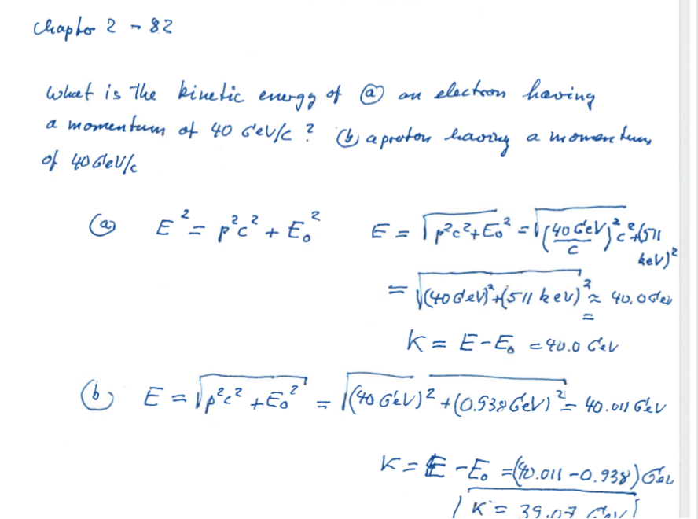

Slide 12
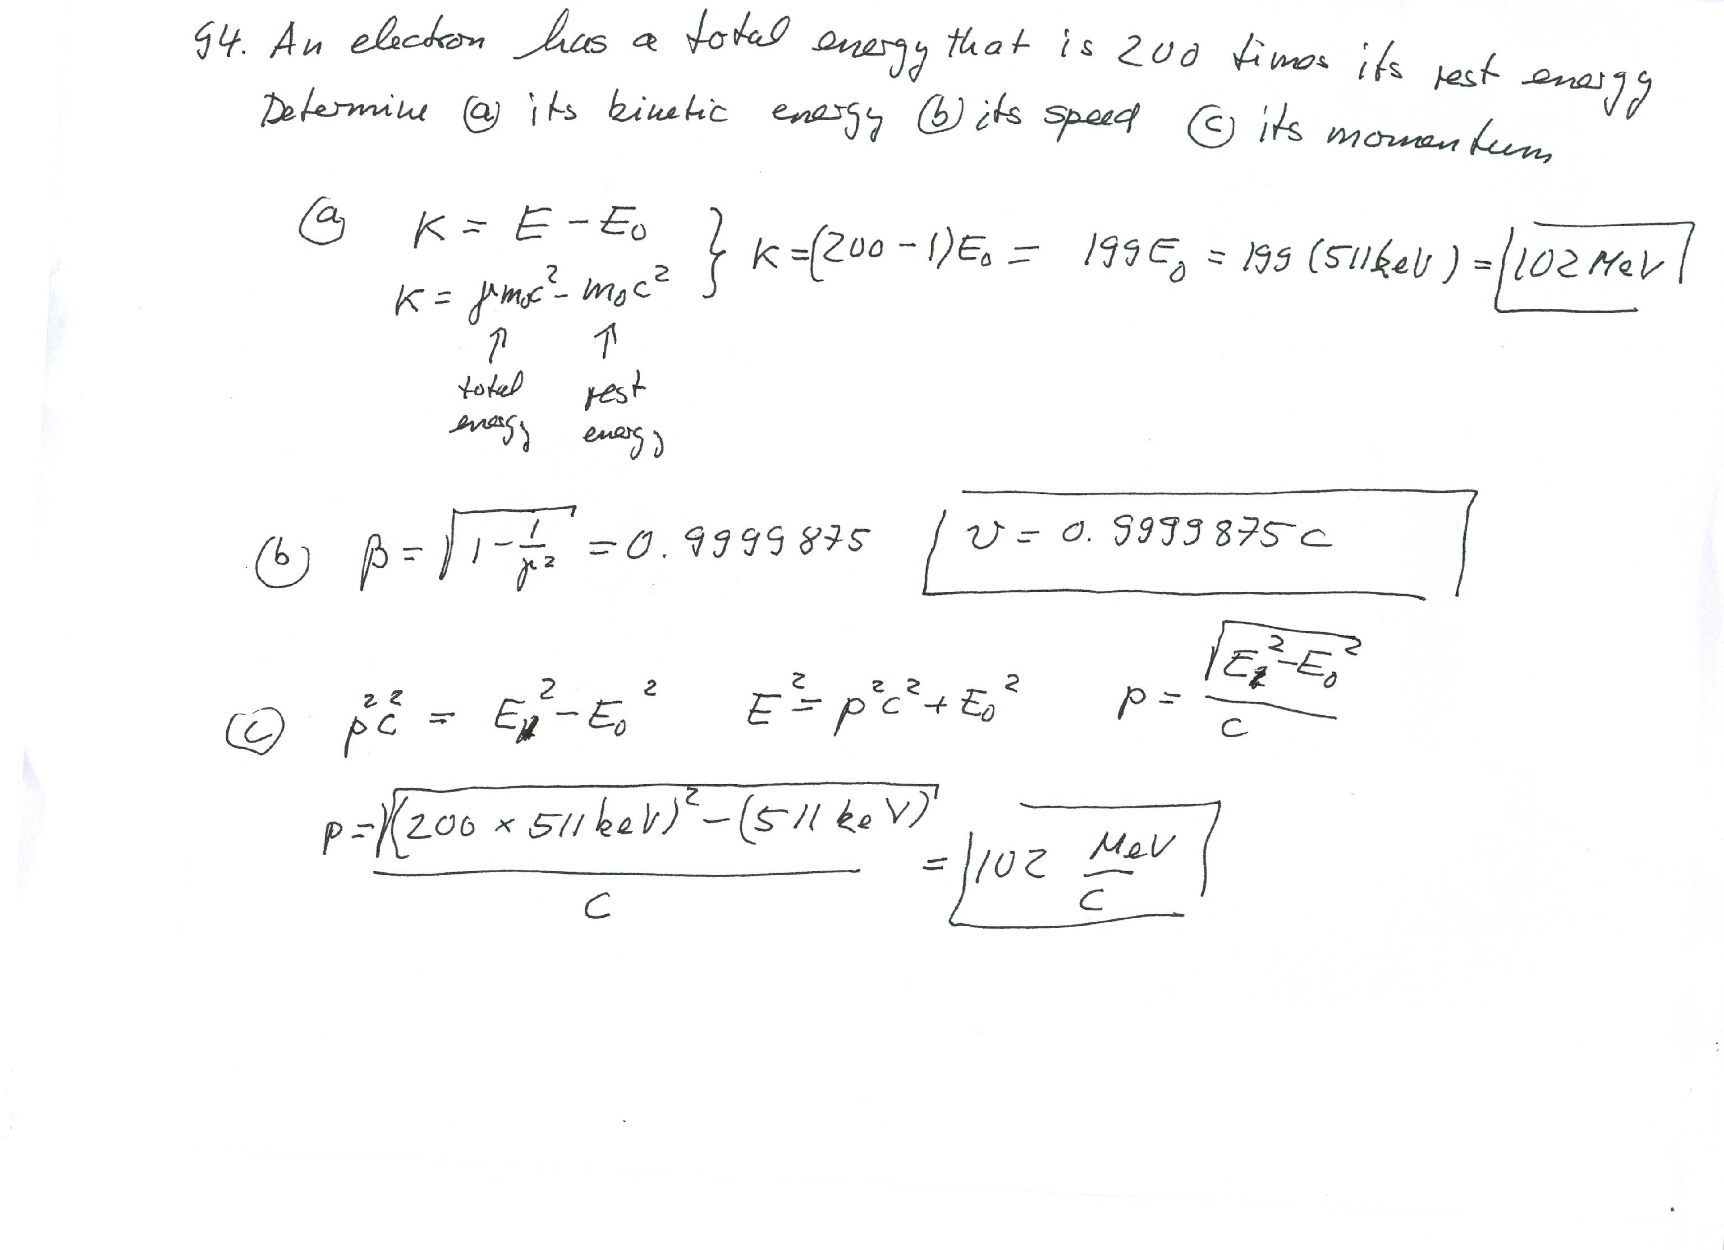

Slide 13
Binding Energy
The binding energy is the difference between the rest energy of the individual particles and the rest energy of the combined bound system.
The binding energy is the work required to pull the particles out of the bound system into separate, free particles at rest
Conservation of energy

Slide 14
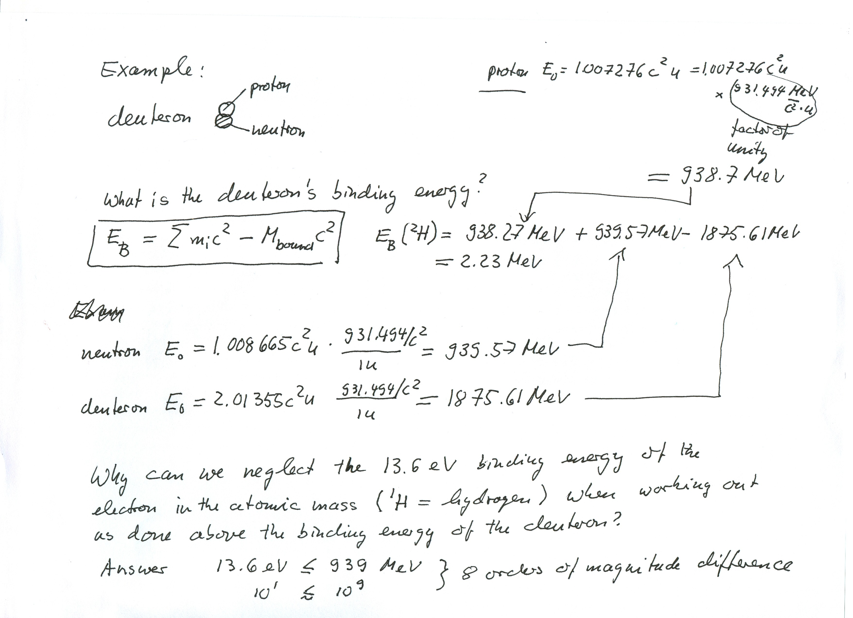

Slide 15
13.6: Fusion
Similar to the energy emitted by stars, if two light nuclei fuse together, they also form a nucleus with a larger binding energy per nucleon and energy is released. This reaction is called nuclear fusion.
The most energy is released if two isotopes of hydrogen fuse together in the reaction.

Slide 16
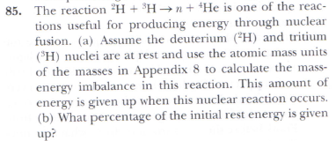
Problem
85,Ch2
Fusion is a clean and efficient energy source

Slide 17
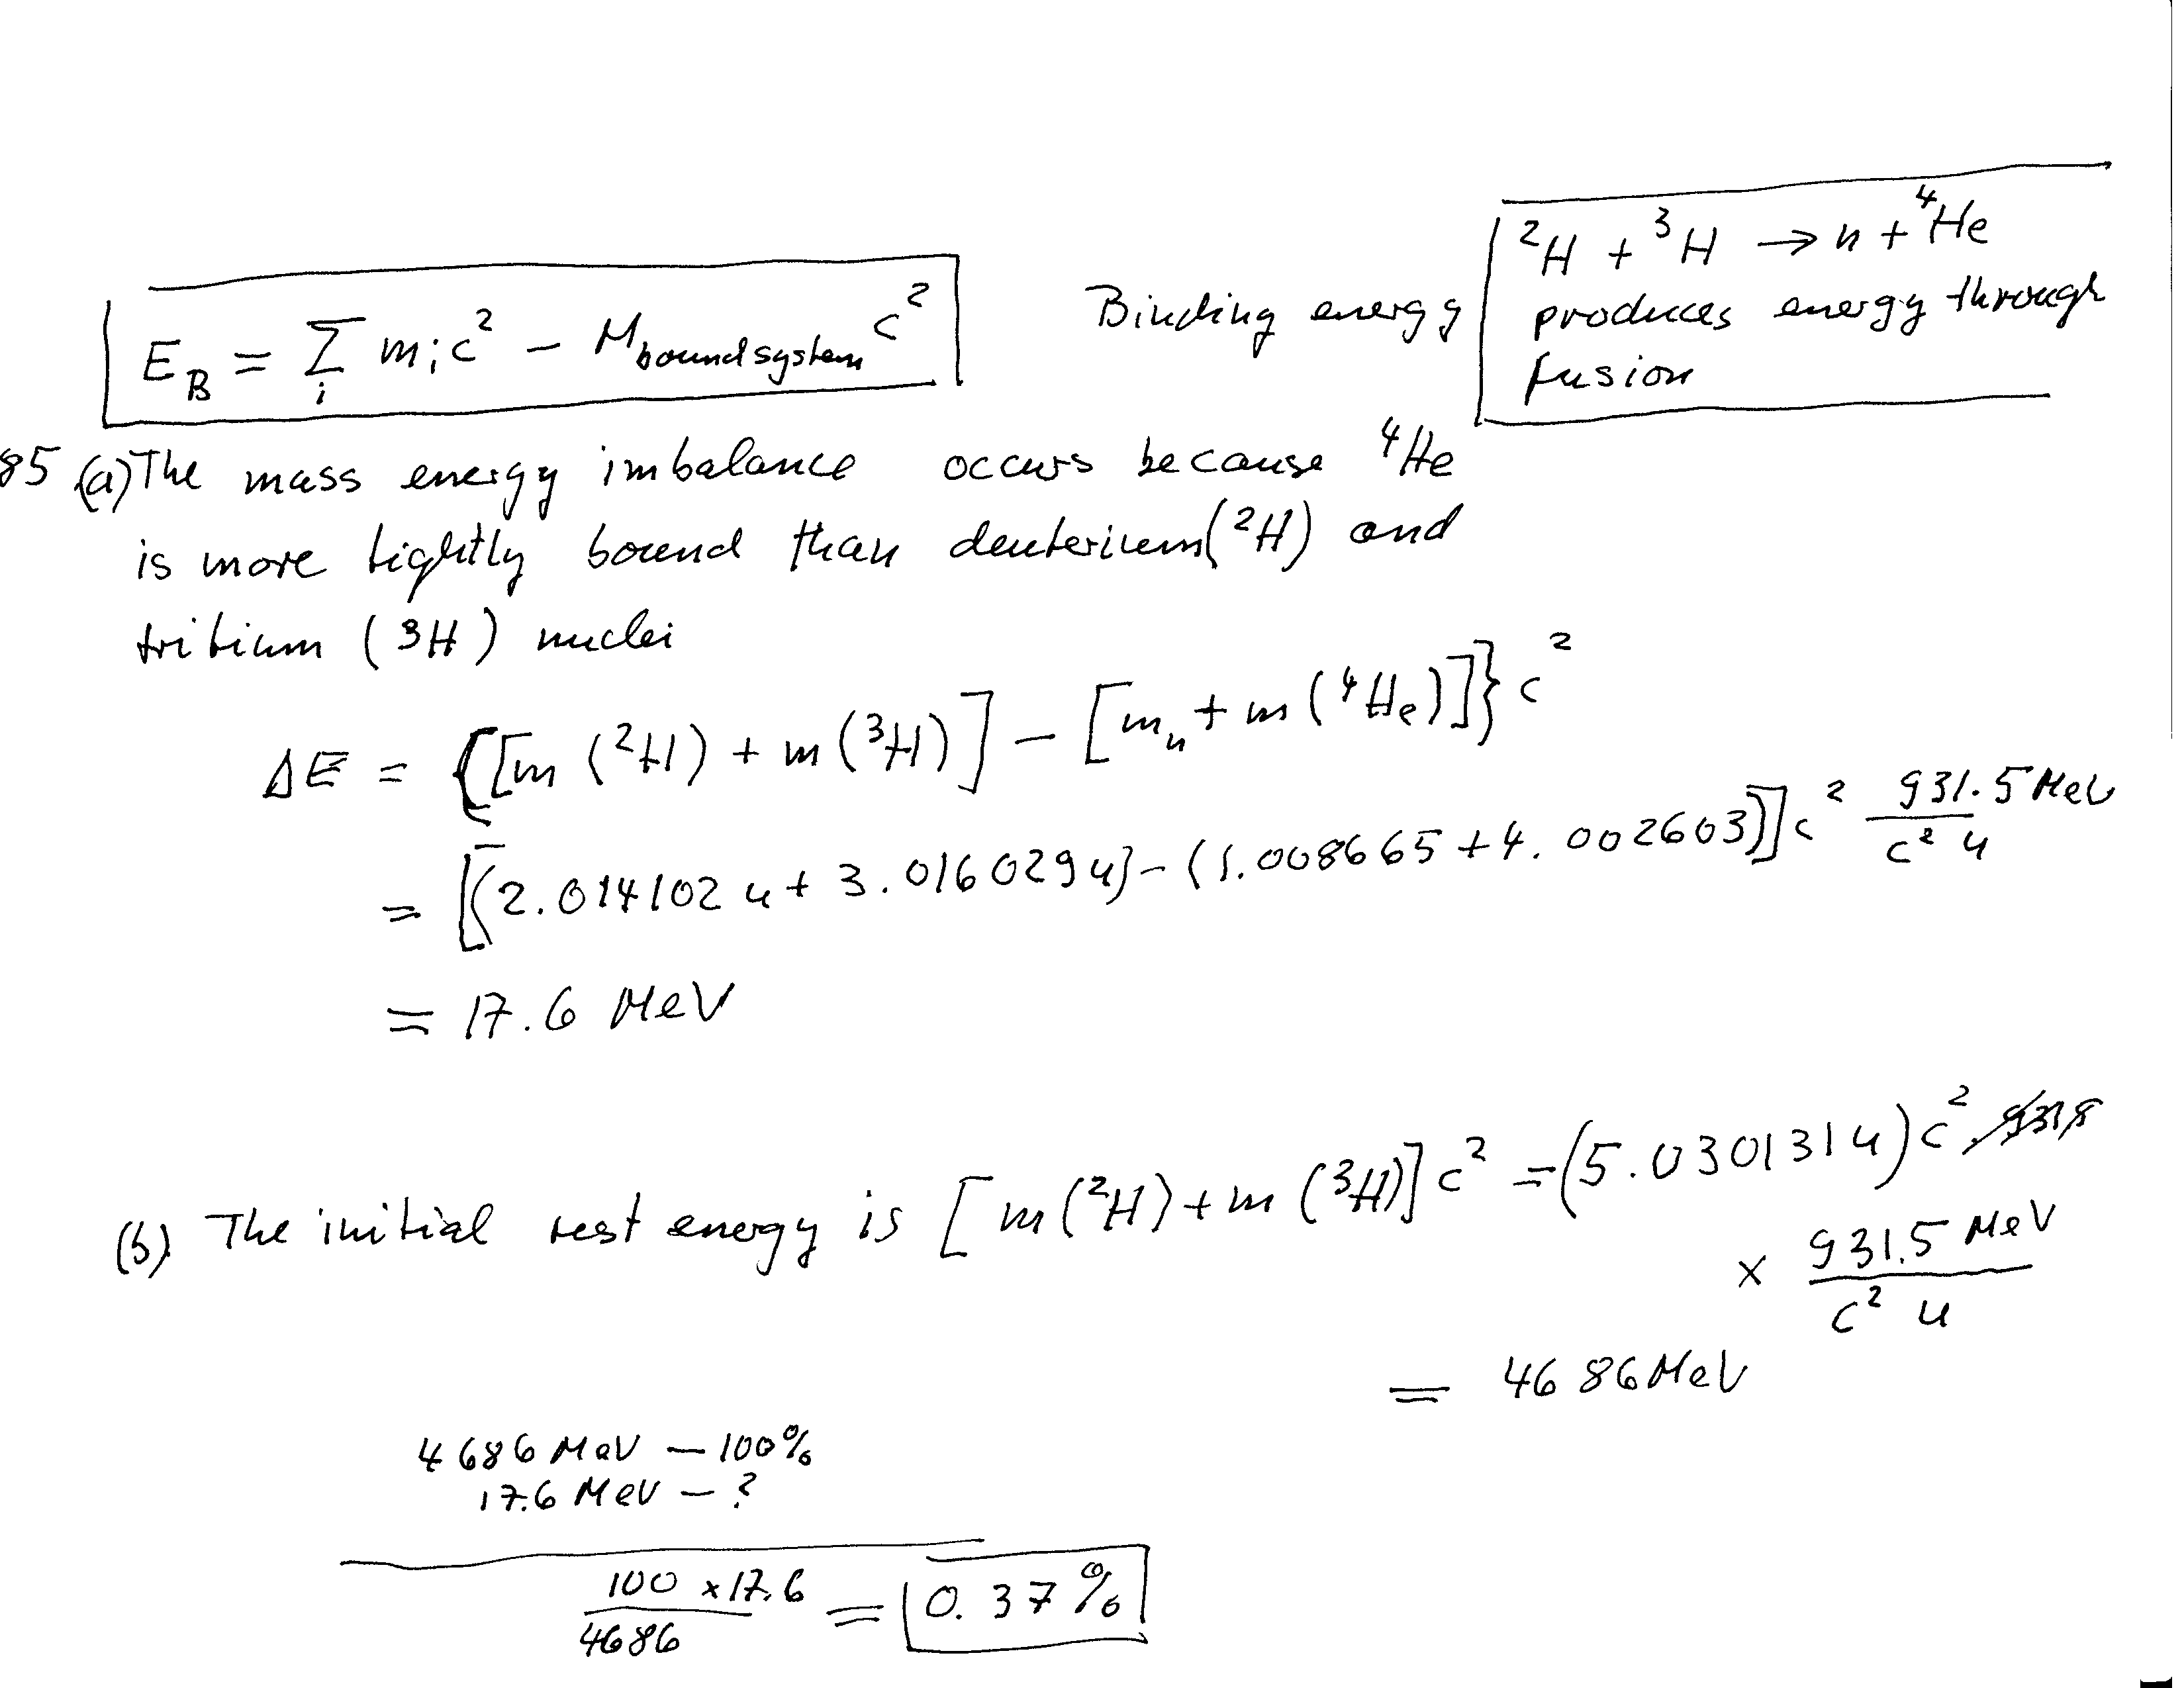
Problem 85,Ch2 (solution)

Slide 18
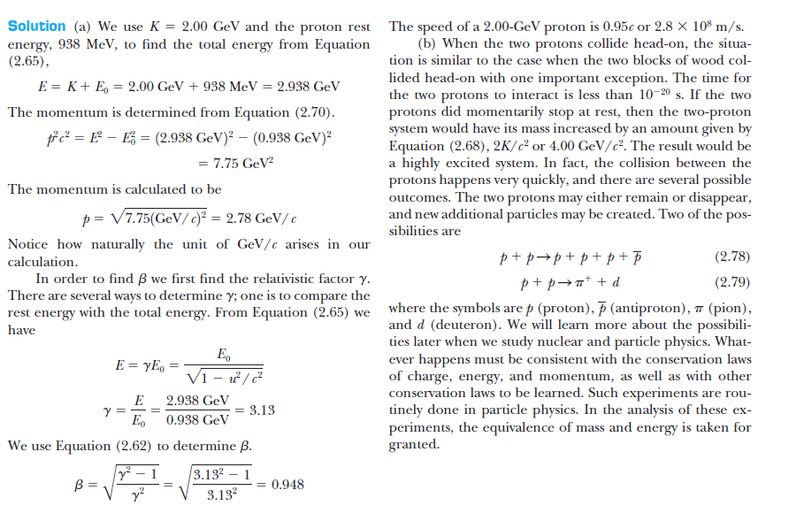
Two high energy protons hit each other headon

Slide 19
The Texas Supercollider That never was Waxahachie
The aborted Superconducting Super Collider (SSC) in Texas would have had a circumference of 87 km. Construction was started in 1991, but abandoned in 1993

Slide 20
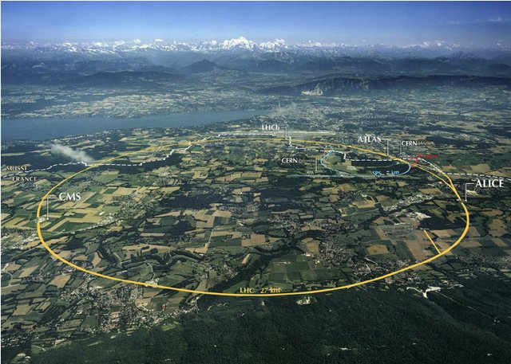
Supercollider at CERN
Aerial photograph representing the Large Hadron Collider, with the border between France and Switzerland indicated by a dashed line. The 27 km LHC tunnel cannot be seen, because it is 45 to 175 meters underground, but it is represented by the large circle

