Slide 1
Maxwell’s equations
Dr. Alexandre Kolomenski

Slide 3
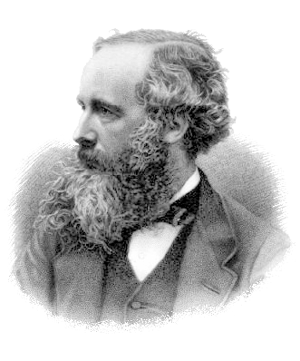
Maxwell
(13 June 1831 – 5 November 1879) was a Scottish physicist.
Famous equations published in 1861

Slide 4
Maxwell’s equations: integral form
Gauss's law
Gauss's law for magnetism:
no magnetic monopole!
Ampère's law (with Maxwell's addition)
Faraday's law of induction (Maxwell–Faraday equation)

Slide 5
Relation of the speed of light and electric and magnetic vacuum constants
ε₀ | permittivity of free space, also called the electric constant | As/Vm or F/m (farad per meter)
μ₀ | permeability of free space, also called the magnetic constant | Vs/Am or H/m (henry per meter)

Slide 6
Differential operators
the divergence operator
div
Other notation used
the curl operator
curl, rot
the partial derivative with respect to time

Slide 7
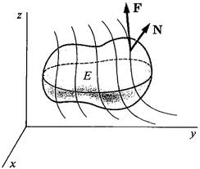
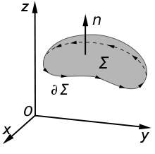
Transition from integral to differential form
Gauss’ theorem for a vector field F(r)
Volume V, surrounded by surface S
Stokes' theorem for a vector field F(r)
Surface Σ, surrounded by contour ∂Σ

Slide 8
Maxwell’s equations: integral form
Gauss's law
Gauss's law for magnetism:
no magnetic monopoles!
Ampère's law (with Maxwell's addition)
Maxwell–Faraday equation (Faraday's law of induction)

Slide 9
Maxwell’s equations (SI units) differential form
ρ density of charges
j density of current

Slide 10
Electric and magnetic fields and units
E | electric field, | volt per meter, V/m
B | the magnetic field or magnetic induction | tesla, T
D | electric displacement field | coulombs per square meter, C/m^2
H | magnetic field | ampere per meter, A/m

Slide 11
Constitutive relations
These equations specify the response of bound charge and current to the applied fields and are called constitutive relations.
P is the polarization field,
M is the magnetization field, then
where ε is the permittivity and μ the permeability of the material.

Slide 12
Wave equation
0
Double vector product rule is used
a x b x c = (a⋅c) b - (a⋅b) c

Slide 13
2 more differential operators
),
or Δ
Laplace operator or Laplacian
d'Alembert operator or d'Alembertian
=

Slide 14
Plane waves
Thus, we seek the solutions of the form:
From Maxwell’s equations one can see that
is parallel to
is parallel to

Slide 15
Energy transfer and Pointing vector
Differential form of Pointing theorem
u is the density of electromagnetic energy of the field
S is directed along the propagation
direction
||
Integral form of Pointing theorem

Slide 16
Energy quantities continued
Observable are real values:

