Slide 1
Optical Resonators

Slide 7
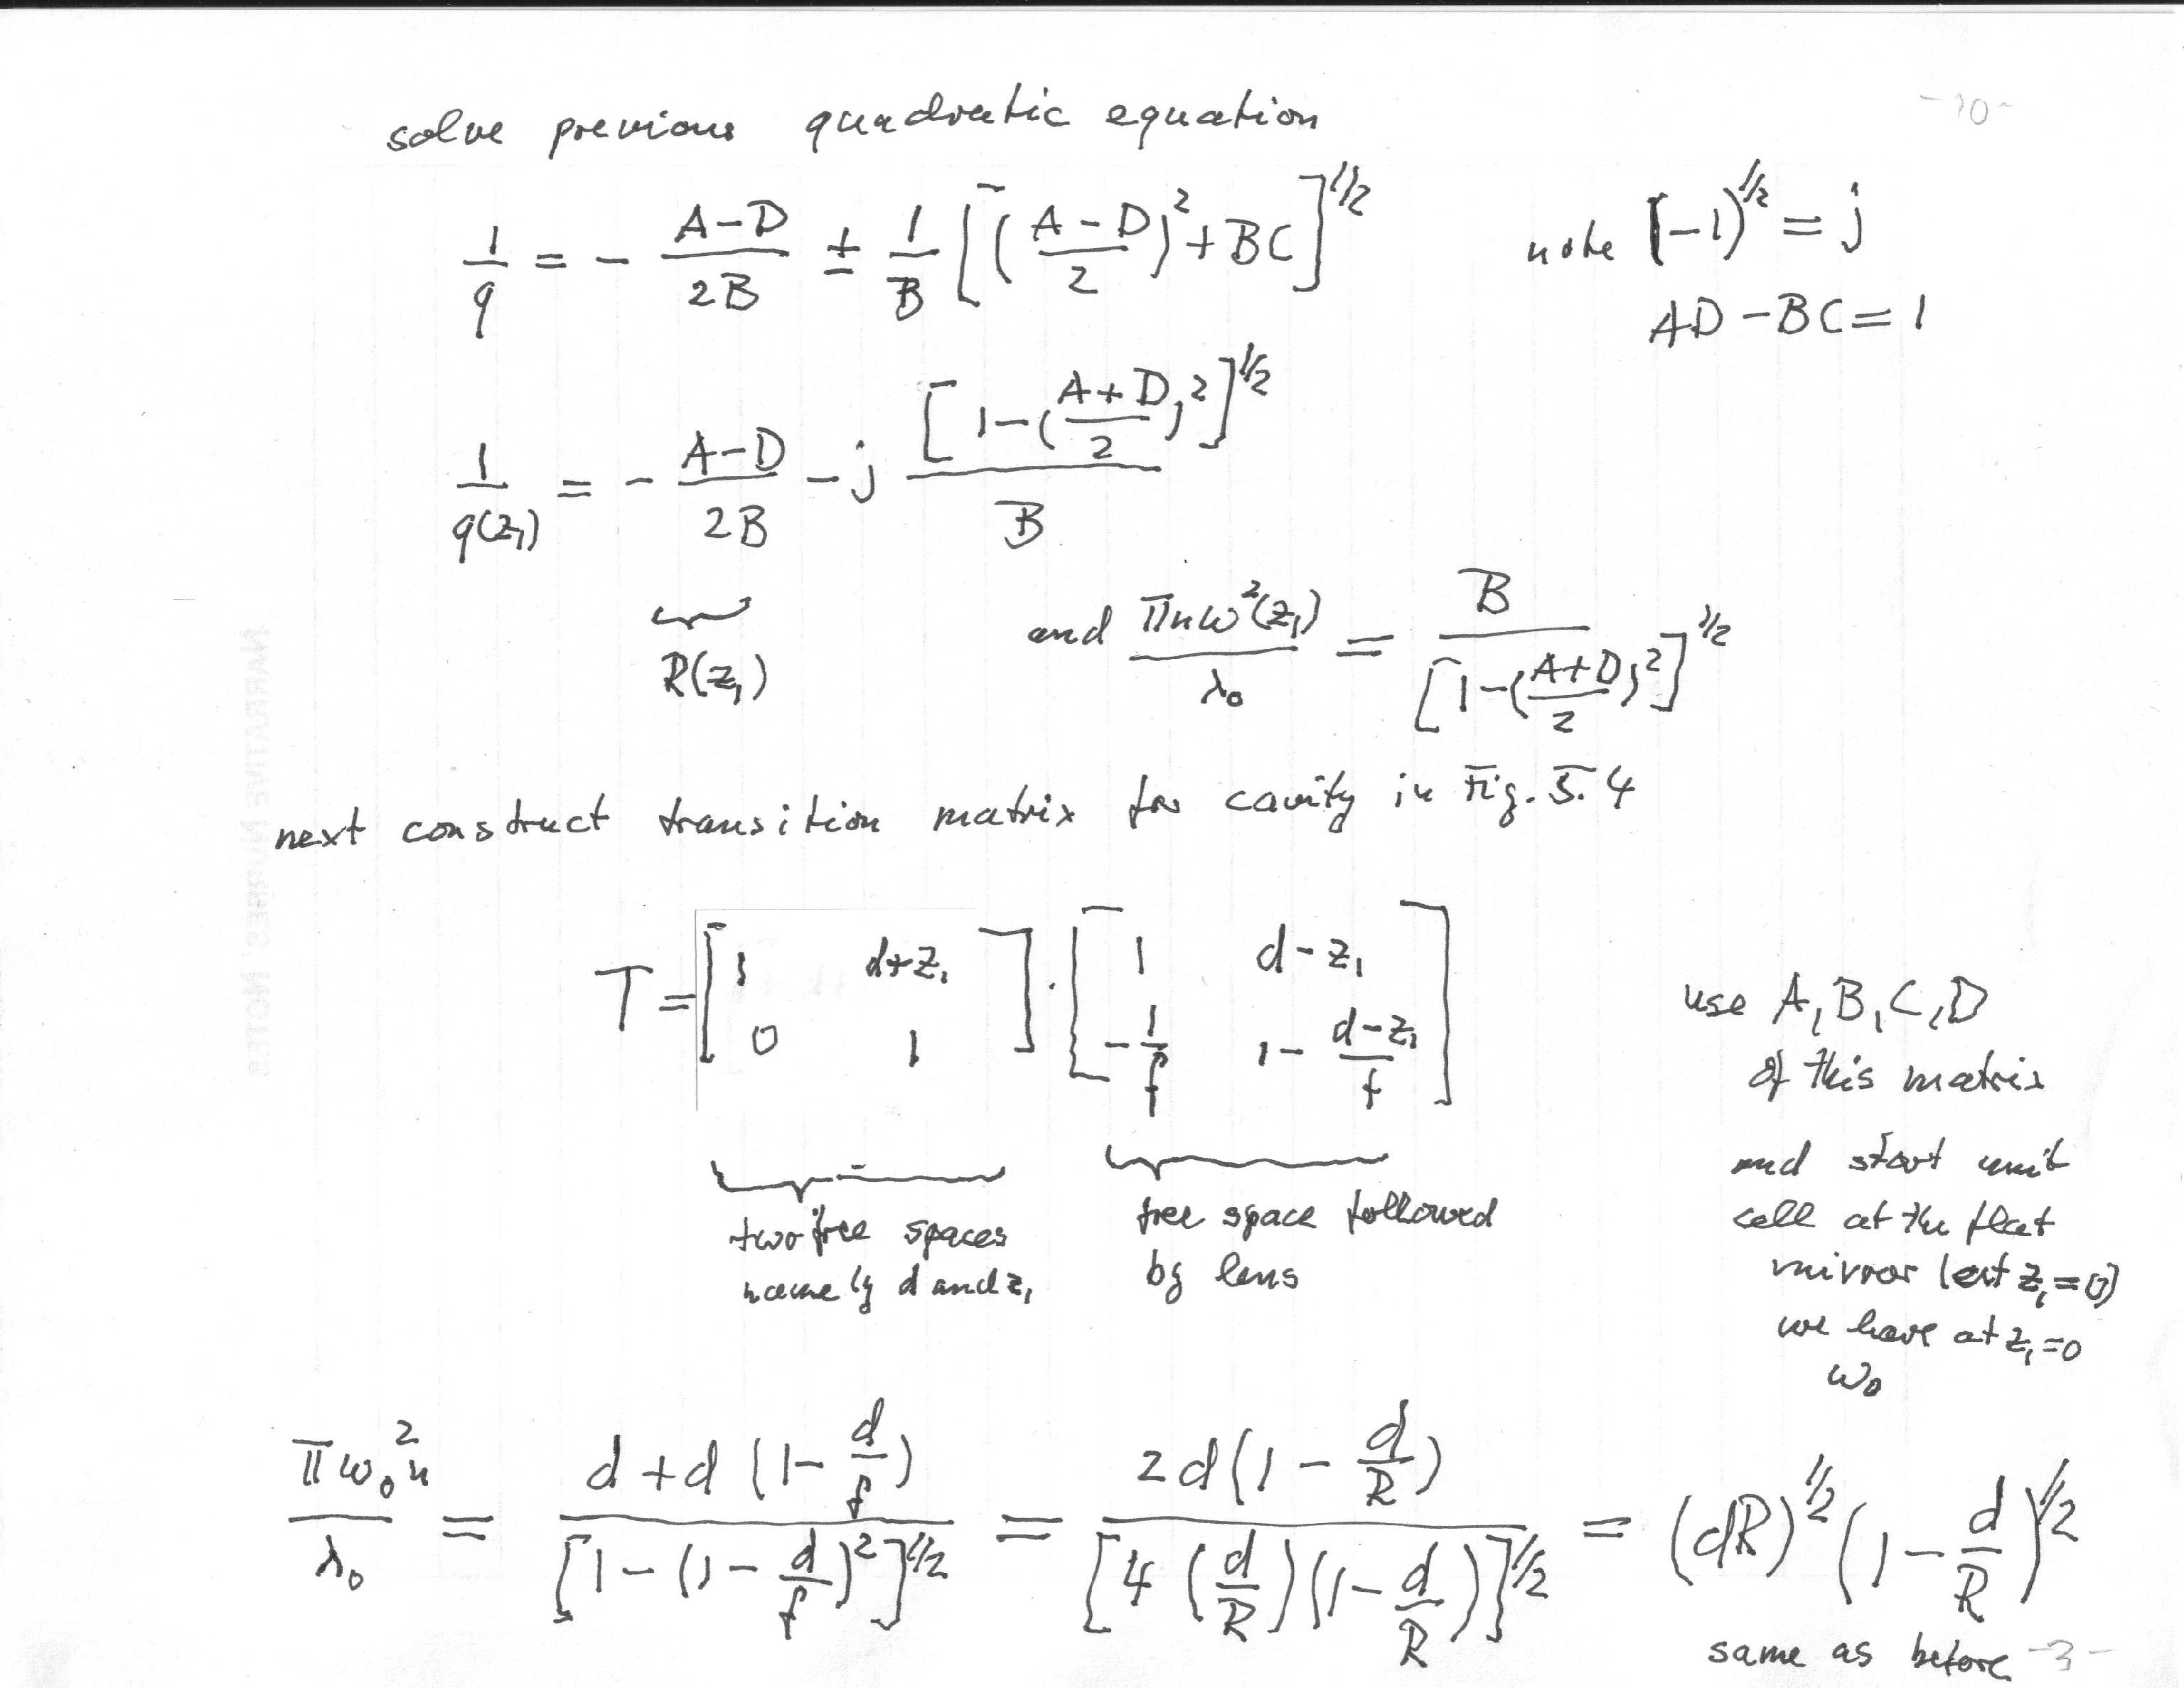

Slide 8
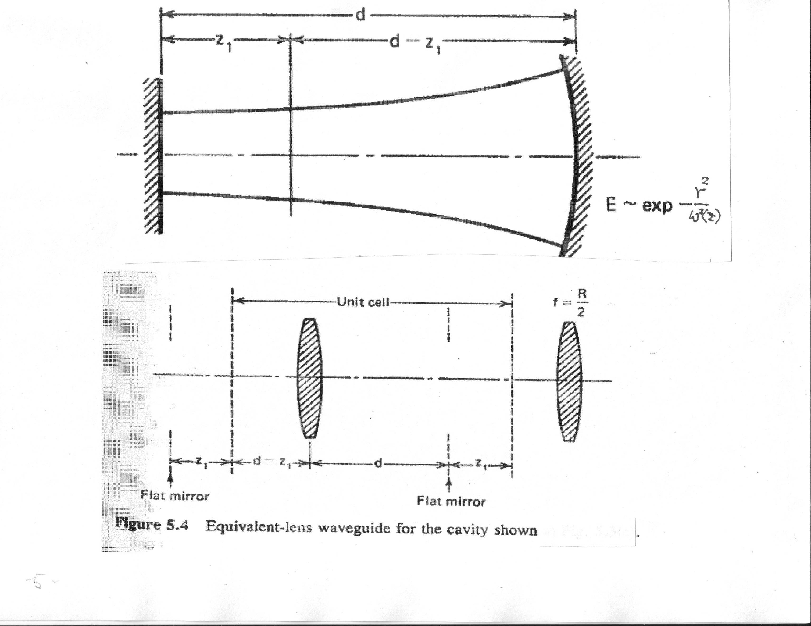

Slide 10
