Slide 1
Fine structure and relativistic effects

Slide 2
Fine structure

Slide 4
Spin-orbit interaction

Slide 7
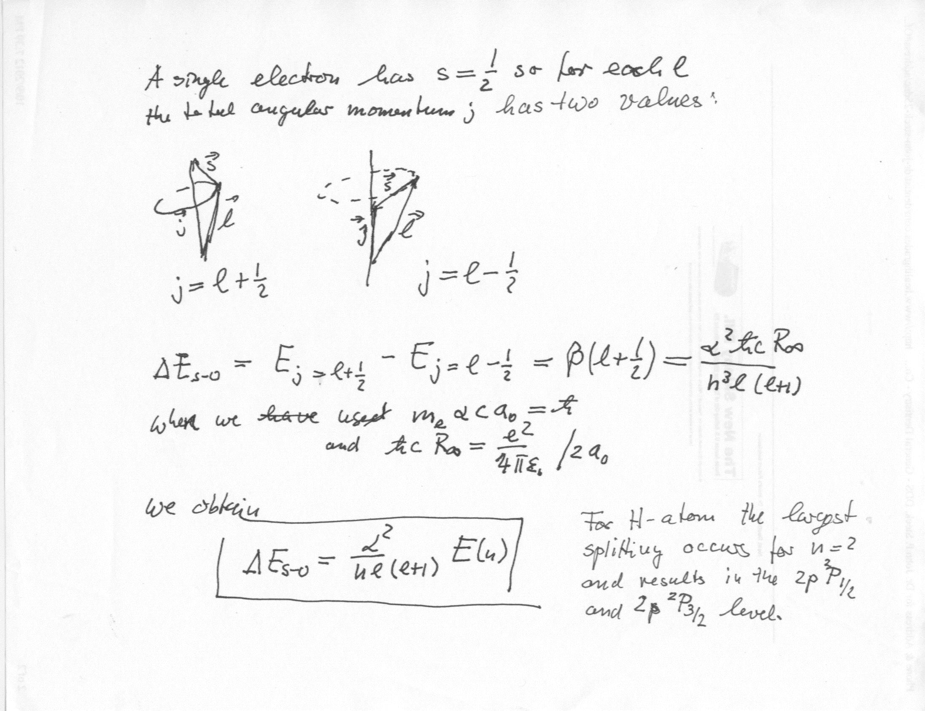

Slide 8
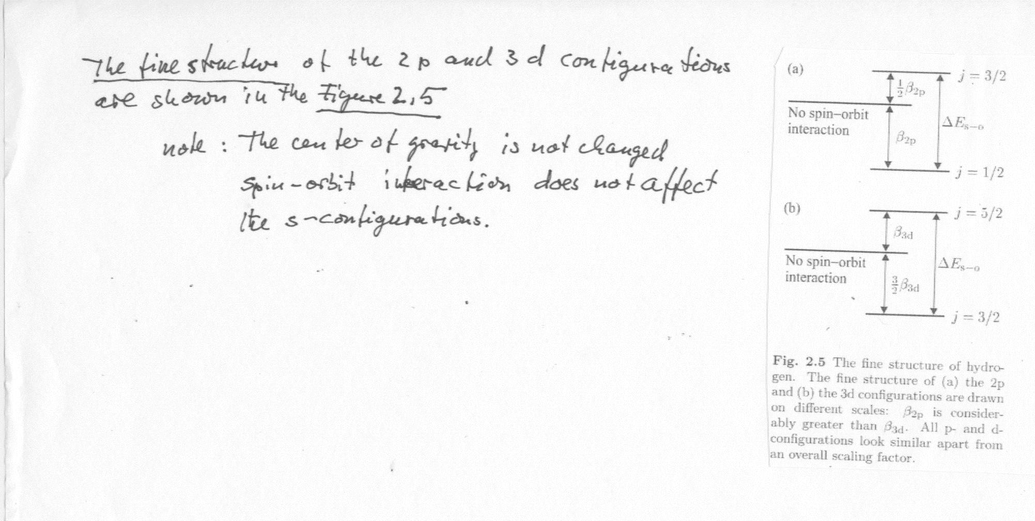

Slide 10
