Slide 1
Atomic Structure and the periodic table

Slide 2
Atomic Structure and the periodic table

Slide 3
Review of Atomic Structure
8.1 Atomic Structure and the Periodic Table
8.2 Total Angular Momentum
8.3 Anomalous Zeeman Effect
For me too, the periodic table was a passion…. As a boy, I stood in
front of the [Science Museum, London] display for hours, thinking how
wonderful it was that each of these metal foils and jars of gas had its
own distinct personality.
Freeman Dyson
What distinguished Mendeleev was not only genius, but a passion for the elements. They became his personal friends; he knew every quirk and detail of their behavior.
- J. Bronowski
From Thornton and Rex Modern Physics

Slide 4
8.1: Atomic Structure and the Periodic Table
What would happen if there are more than one electron?
a nucleus with charge +2e attracting two electrons
the two electrons repelling one another
Can not solve problems exactly with the Schrödinger equation because of the complex potential interactions
Can understand experimental results without computing the wave functions of many-electron atoms by applying the boundary conditions and selection rules

Slide 5
Pauli Exclusion Principle
To understand atomic spectroscopic data for optical frequencies, Wolfgang Pauli proposed an exclusion principle:
No two electrons in an atom may have the same set of quantum numbers (n, ℓ, m_{ℓ}, m_{s}).
It applies to all particles of half-integer spin, which are called fermions, and particles in the nucleus are fermions.
The periodic table can be understood by two rules:
The electrons in an atom tend to occupy the lowest energy levels available to them.
Only one electron can be in a state with a given (complete) set of
quantum numbers (Pauli exclusion principle).

Slide 6
Atomic Structure
Hydrogen: (n, ℓ, m_{ℓ}, m_{s}) = (1, 0, 0, ±½) in ground state
In the absence of a magnetic field, the state m_{s} = ½ is degenerate with the m_{s} = −½ state.
Helium: (1, 0, 0, ½) for the first electron
(1, 0, 0, −½) for the second electron
Electrons have antialigned (m_{s} = +½ and m_{s} = −½) spins as being paired Supports Pauli exclusion principle
The principle quantum number also has letter codes.
n = 1 2 3 4...
Letter = K L M N…
n = shells (eg: K shell, L shell, etc.)
nℓ = subshells (eg: 1s, 2p, 3d)
Electrons for H and He atoms are in the K shell.
H: 1s²
He: 1s¹ or 1s

Slide 7
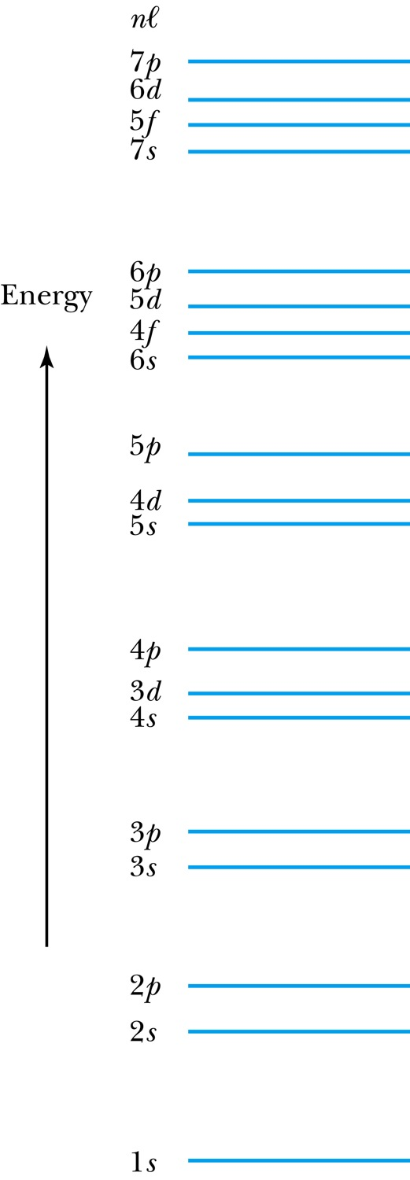
Atomic Structure
How many electrons may be in each subshell?
Recall: ℓ = 0 1 2 3 4 5 …
letter = s p d f g h …
ℓ = 0, (s state) can have two electrons
ℓ = 1, (p state) can have six electrons, and so on
 | Total
For each m_{ℓ}: two values of m_{s} | 2
For each ℓ: (2ℓ + 1) values of m_{ℓ} | 2(2ℓ + 1)
The lower ℓ values have more elliptical orbits than the higher ℓ values.
Electrons with higher ℓ values are more shielded from the nuclear charge
Electrons lie higher in energy than those with lower ℓ values
the shielding is so pronounced that the 4s fills
before 3d even though it has a larger n

Slide 8
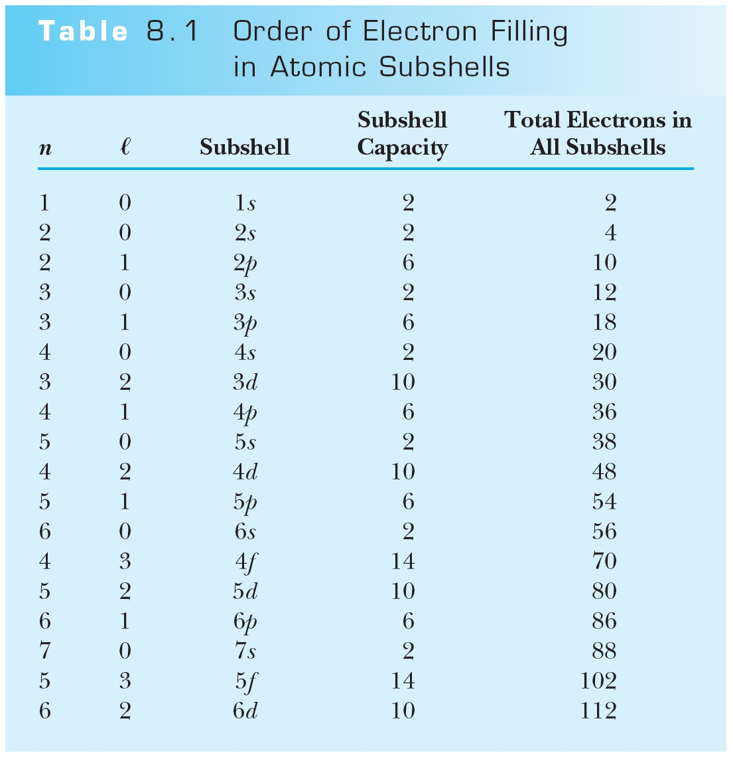
Order of Electron Filling in Atomic Subshells

Slide 9
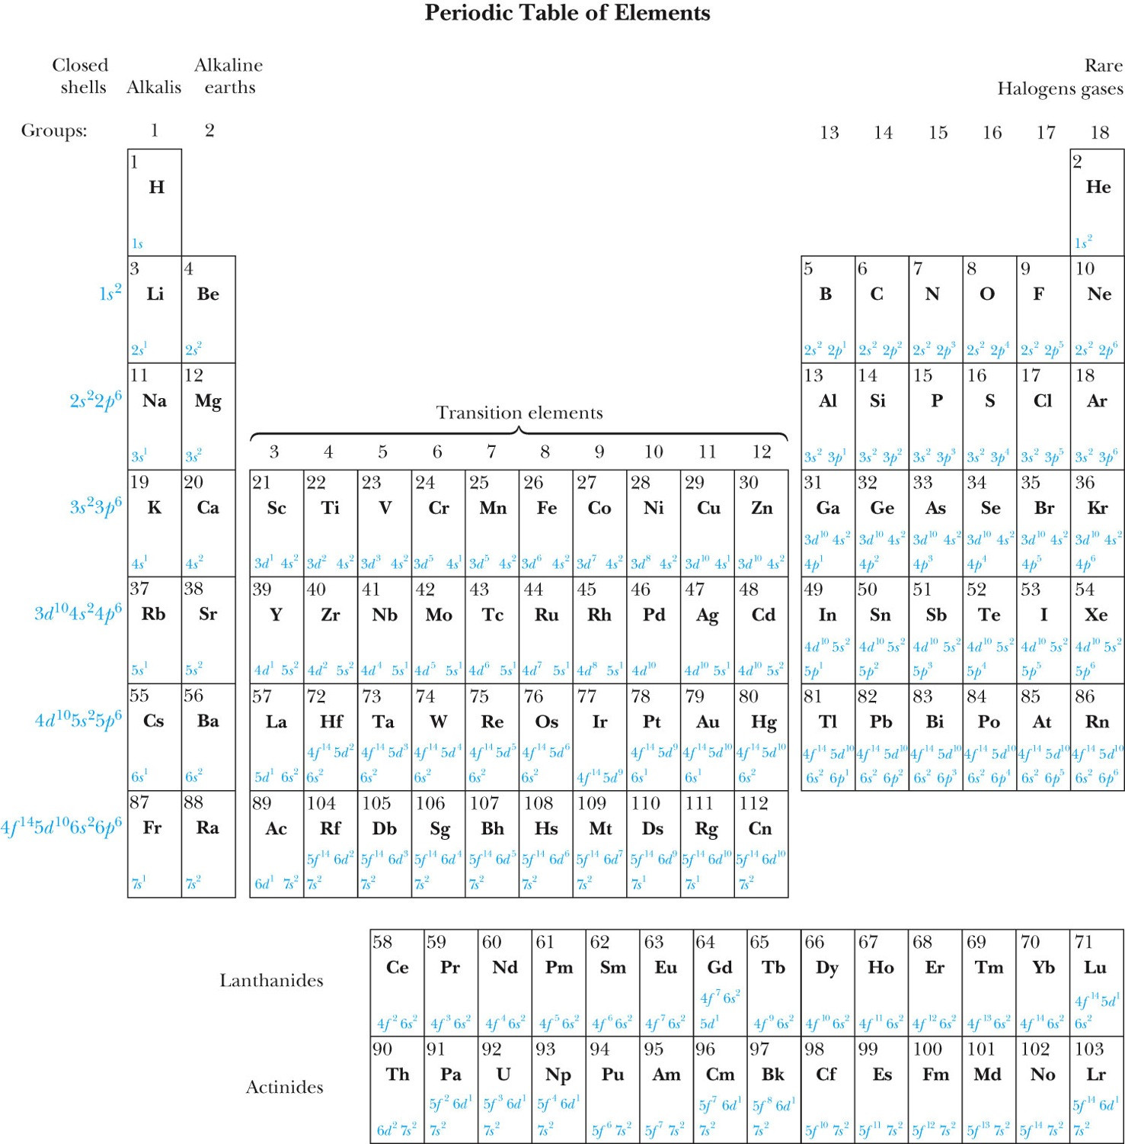
The Periodic Table

Slide 10
Groups and Periods in the Periodic Table
Groups:
Vertical columns
Same number of electrons in an ℓ orbit
Can form similar chemical bonds
Periods:
Horizontal rows
Correspond to filling of the subshells

Slide 11
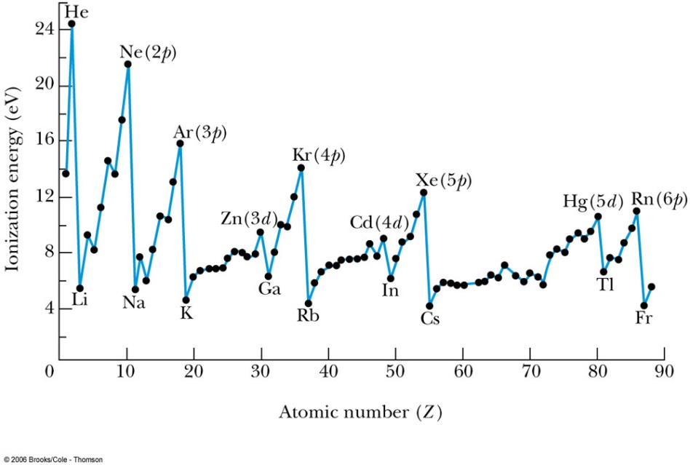
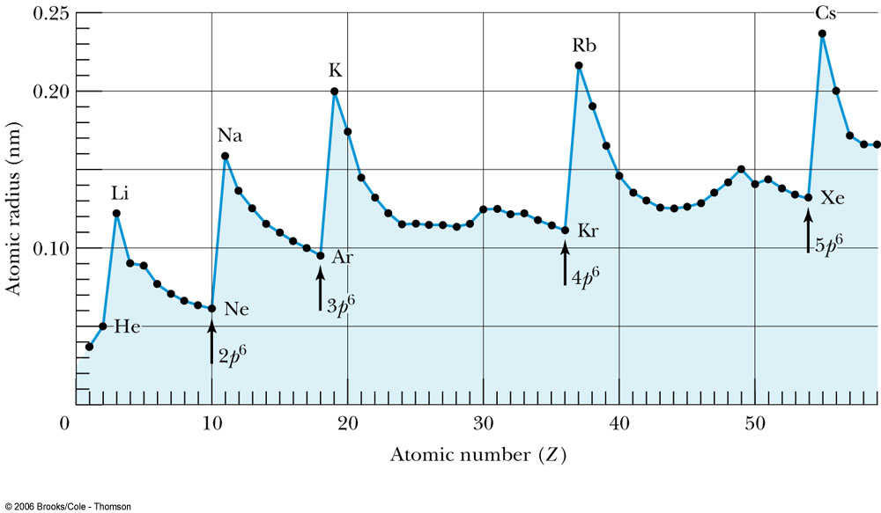
Ionization Energies of Elements and Atomic Radii Some properties of elements are compared by the ionization energies of elements and atomic radii:

Slide 12
The Periodic Table
Inert Gases:
Last group of the periodic table
Closed p subshell except helium
Zero net spin and large ionization energy
Their atoms interact weakly with each other
Alkalis:
Single s electron outside an inner core
Easily form positive ions with a charge +1e
Lowest ionization energies
Electrical conductivity is relatively good
Alkaline Earths:
Two s electrons in outer subshell
Largest atomic radii
High electrical conductivity

Slide 13
The Periodic Table
Halogens:
Need one more electron to fill outermost subshell
Form strong ionic bonds with the alkalis
More stable configurations occur as the p subshell is filled
Transition Metals:
Three rows of elements in which the 3d, 4d, and 5d are being filled
Properties primarily determined by the s electrons, rather than by the d subshell being filled
Have d-shell electrons with unpaired spins
As the d subshell is filled, the magnetic moments, and the tendency for neighboring atoms to align spins are reduced

Slide 14
The Periodic Table
Lanthanides (rare earths):
Have the outside 6s² subshell completed
As occurs in the 3d subshell, the electrons in the 4f subshell have unpaired electrons that align themselves
The large orbital angular momentum contributes to the large ferromagnetic effects
Actinides:
Inner subshells are being filled while the 7s² subshell is complete
Difficult to obtain chemical data because they are all radioactive
Have longer half-lives

Slide 15
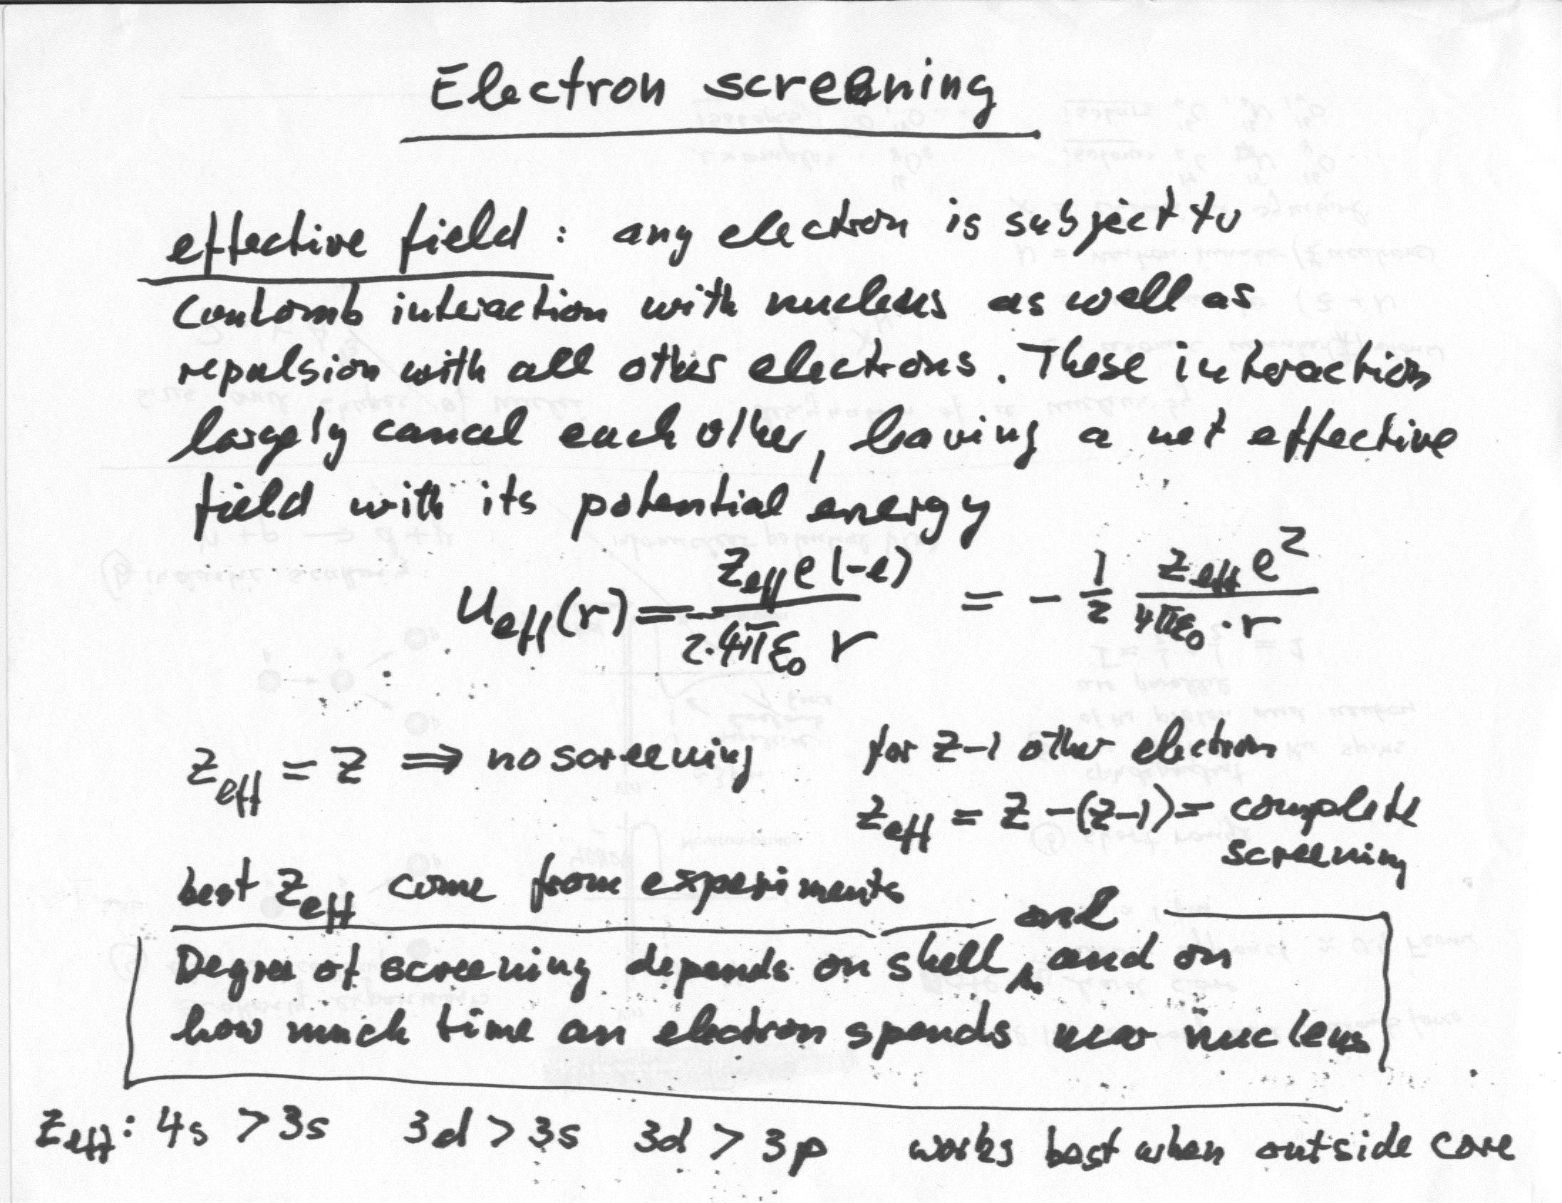
Electron screening

Slide 16
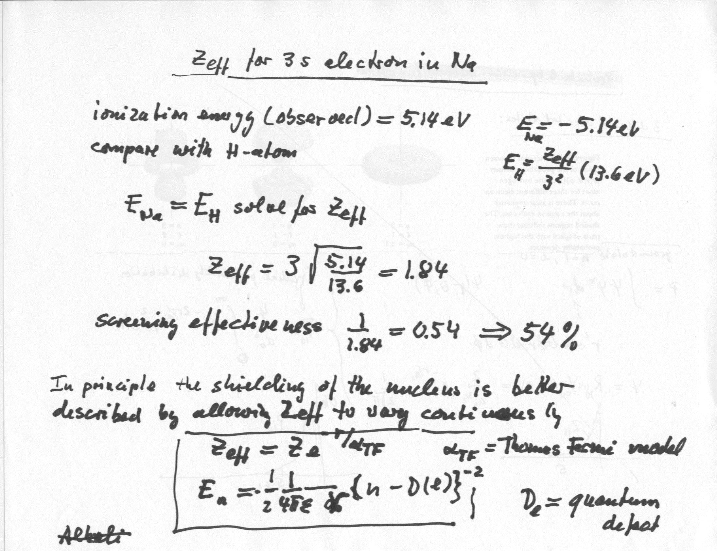
Z(eff) for 3s electron in Na

