Slide 1
Vector coupling of angular momentum

Slide 2
Total Angular Momentum
Orbital angular momentum
Spin angular momentum
Total angular momentum
L, L_{z}, S, S_{z}J and J_{z} are quantized

Slide 3
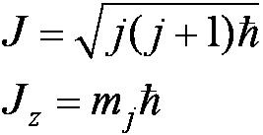
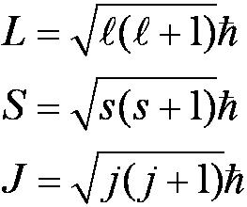
Total Angular Momentum
If j and m_{j} are quantum numbers for the single electron (hydrogen atom)
Quantization of the magnitudes
The total angular momentum quantum number for the single electron can only have the values

Slide 4
The Total Angular Momentum Diagram
Figure 8.5 When forming the total angular momentum from the orbital and spin angular momenta, the addition must be done vectorially, .

Slide 5
Spin-Orbit Coupling
An effect of the spins of the electron and the orbital angular momentum interaction is called spin-orbit coupling.
is the magnetic field due to the proton
where cos α is the angle between
The dipole potential energy
The spin magnetic moment ∝ .
.

Slide 6
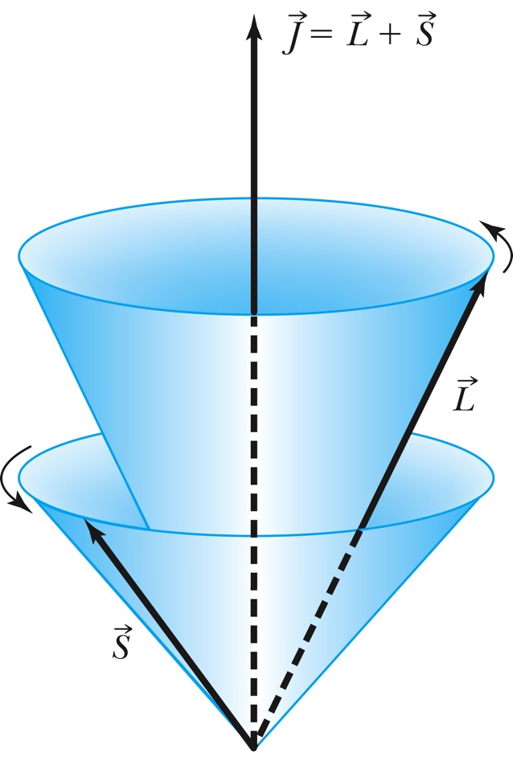
Total Angular Momentum
No external magnetic field:
Only J_{z} can be known because the uncertainty principle forbids J_{x} or J_{y} from being known at the same time as J_{z}

Slide 7
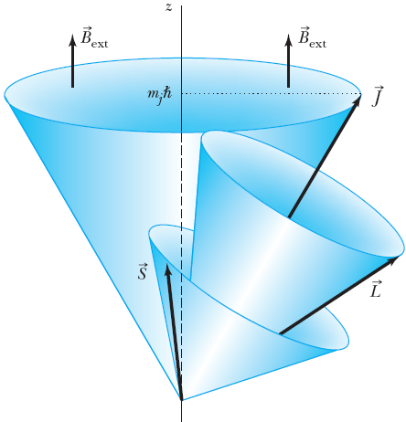
Total Angular Momentum
With an internal magnetic field:
will precess about

Slide 8
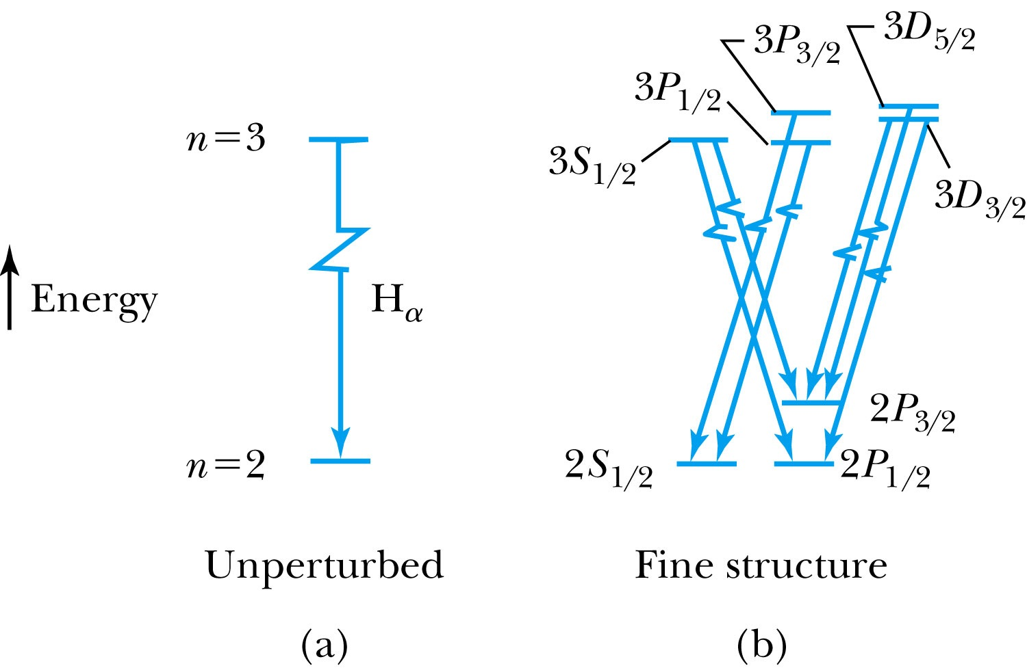
Total Angular Momentum
Now the selection rules for a single-electron atom become
Δn = anything Δℓ = ±1
Δmj = 0, ±1 Δj = 0, ±1
Hydrogen energy-level diagram for n = 2 and n = 3 with the spin-orbit splitting

Slide 9
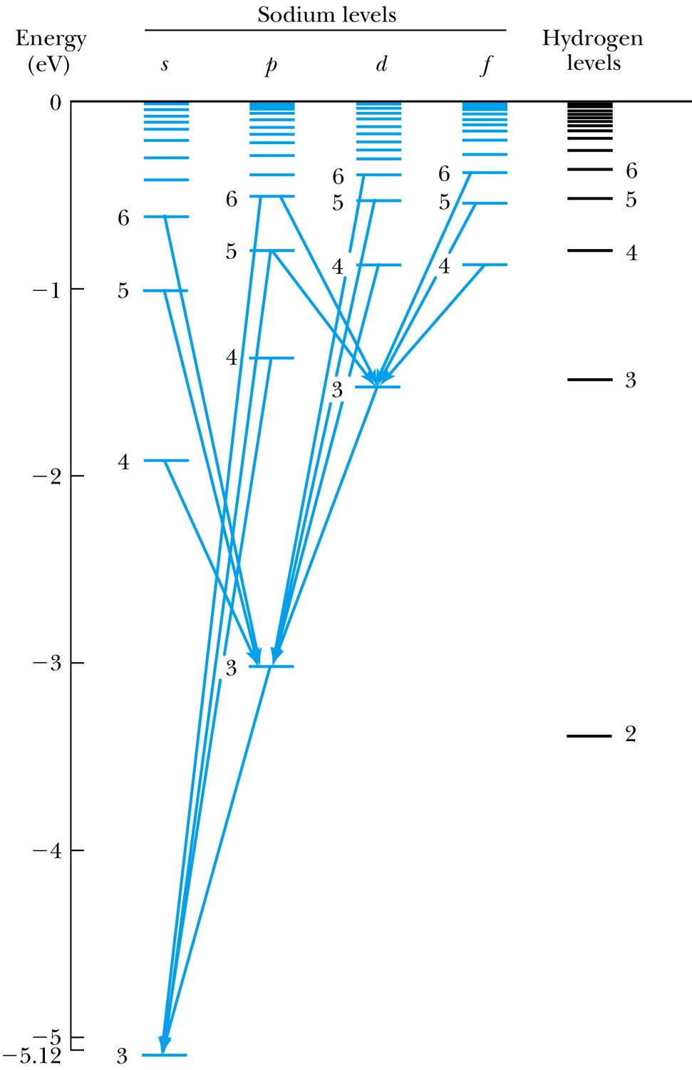
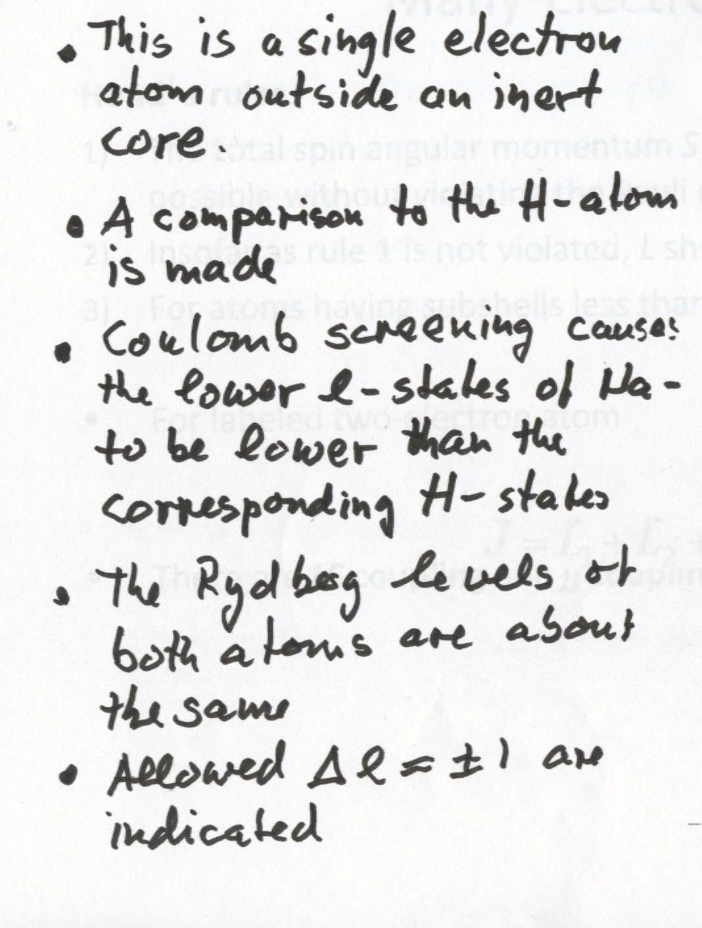
The Energy-Level Diagram of Sodium

Slide 10
Many-Electron Atoms
Hund’s rules:
The total spin angular momentum S should be maximized to the extent possible without violating the Pauli exclusion principle.
Insofar as rule 1 is not violated, L should also be maximized.
For atoms having subshells less than half full, J should be minimized.
For labeled two-electron atom
There are LS coupling and jj coupling to combine four angular momenta J.

Slide 11
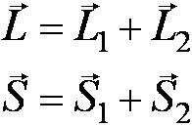
LS Coupling
This is used for most atoms when the magnetic field is weak.
If two electrons are single subshell, S = 0 or 1 depending on whether the spins are antiparallel or parallel.
For given L, there are 2S + 1 values of J
For L > S, J goes from L − S to L + S
For L < S, there are fewer than 2S + 1 possible J values
The value of 2S + 1 is the multiplicity of the state

Slide 12
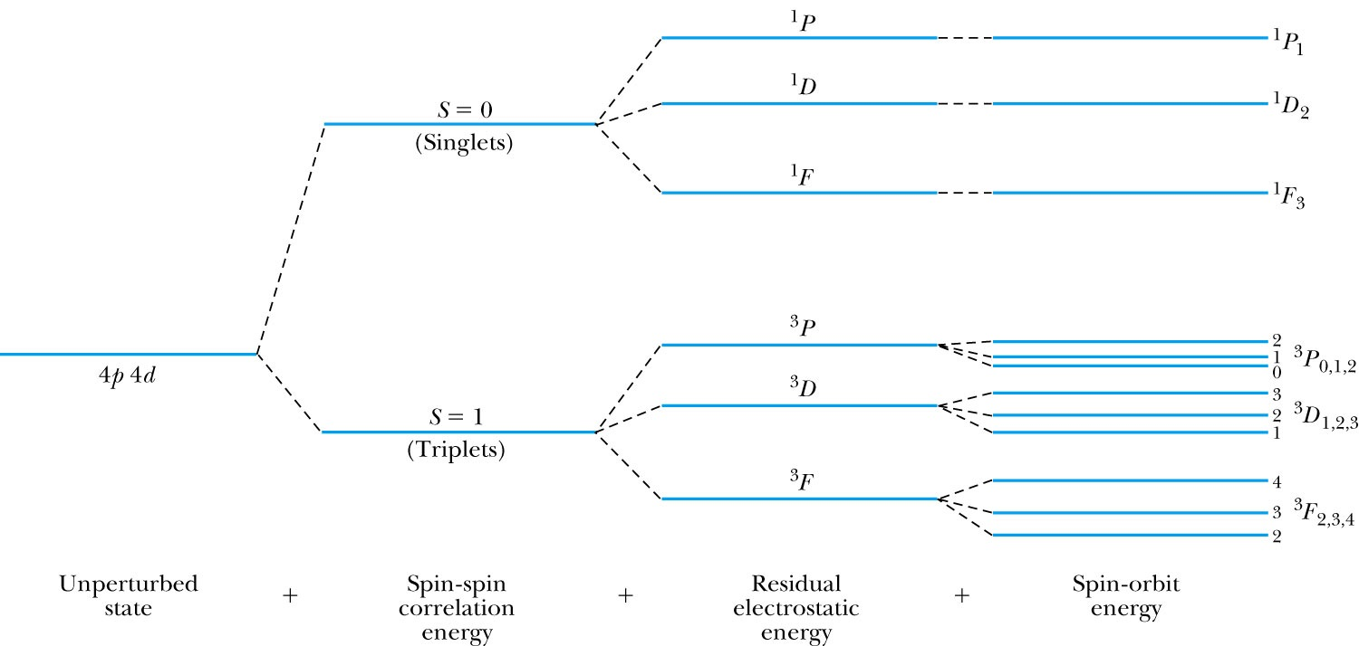
LS Coupling
The notation for a single-electron atom becomes
n^{2S+1} L_{J}
The letters and numbers are called spectroscopic symbols.
There are singlet states (S = 0) and triplet states (S = 1) for two electrons.

Slide 13
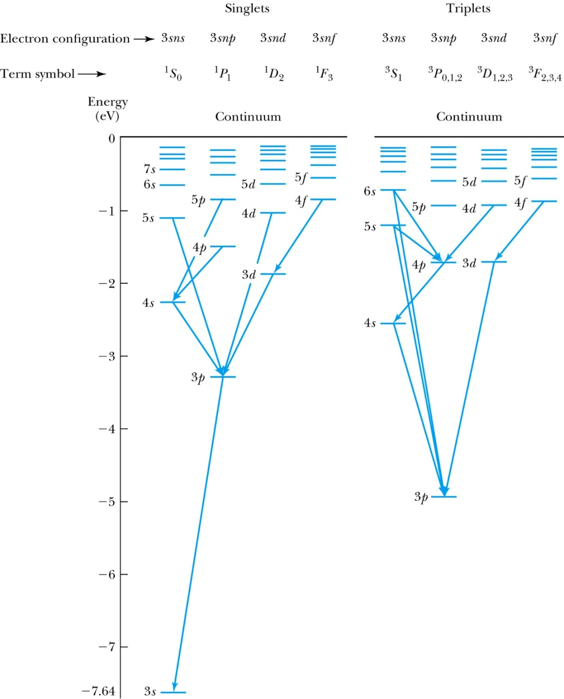
Energy level diagram of Mg LS Coupling
There are separated energy levels according to whether they are S = 0 or 1
Allowed transitions must have ΔS = 0
No allowed (forbidden) transitions are possible between singlet and triplet states with much lower probability
This is a two-electron atom with one electron in the 3s and the other excited into the nl subshell

Slide 14
LS Coupling
The allowed transitions for the LS coupling scheme are
ΔL = ±1 ΔS = 0
ΔJ = 0, ±1 (J = 0 → J = 0 is forbidden)
A magnesium atom excited to the 3s3p triplet state has no lower triplet state to which it can decay.
It is called metastable, because it lives for such a long time on the atomic scale.

Slide 15
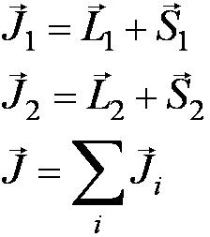
jj Coupling
It is for the heavier elements, where the nuclear charge causes the spin-orbit interactions to be as strong as the force between the individual and .
The coupling order becomes

Slide 16
