Slide 1
Zeeman effect HFS and isotope shift

Slide 2
Anomalous Zeeman Effect
More than three closely spaced optical lines were observed.
The interaction that splits the energy levels in an external magnetic field is caused by interaction.
The magnetic moment depends on
The 2J + 1 degeneracy for a given total angular momentum state J is removed by the effect of the .
If the is small compared to internal magnetic field, then and precess about while precesses slowly about .
<= 0.1T for Zeeman splitting
The normal Zeeman affect occurs for S=0
Orbital contribution
and
Spin magnetic moment

Slide 7
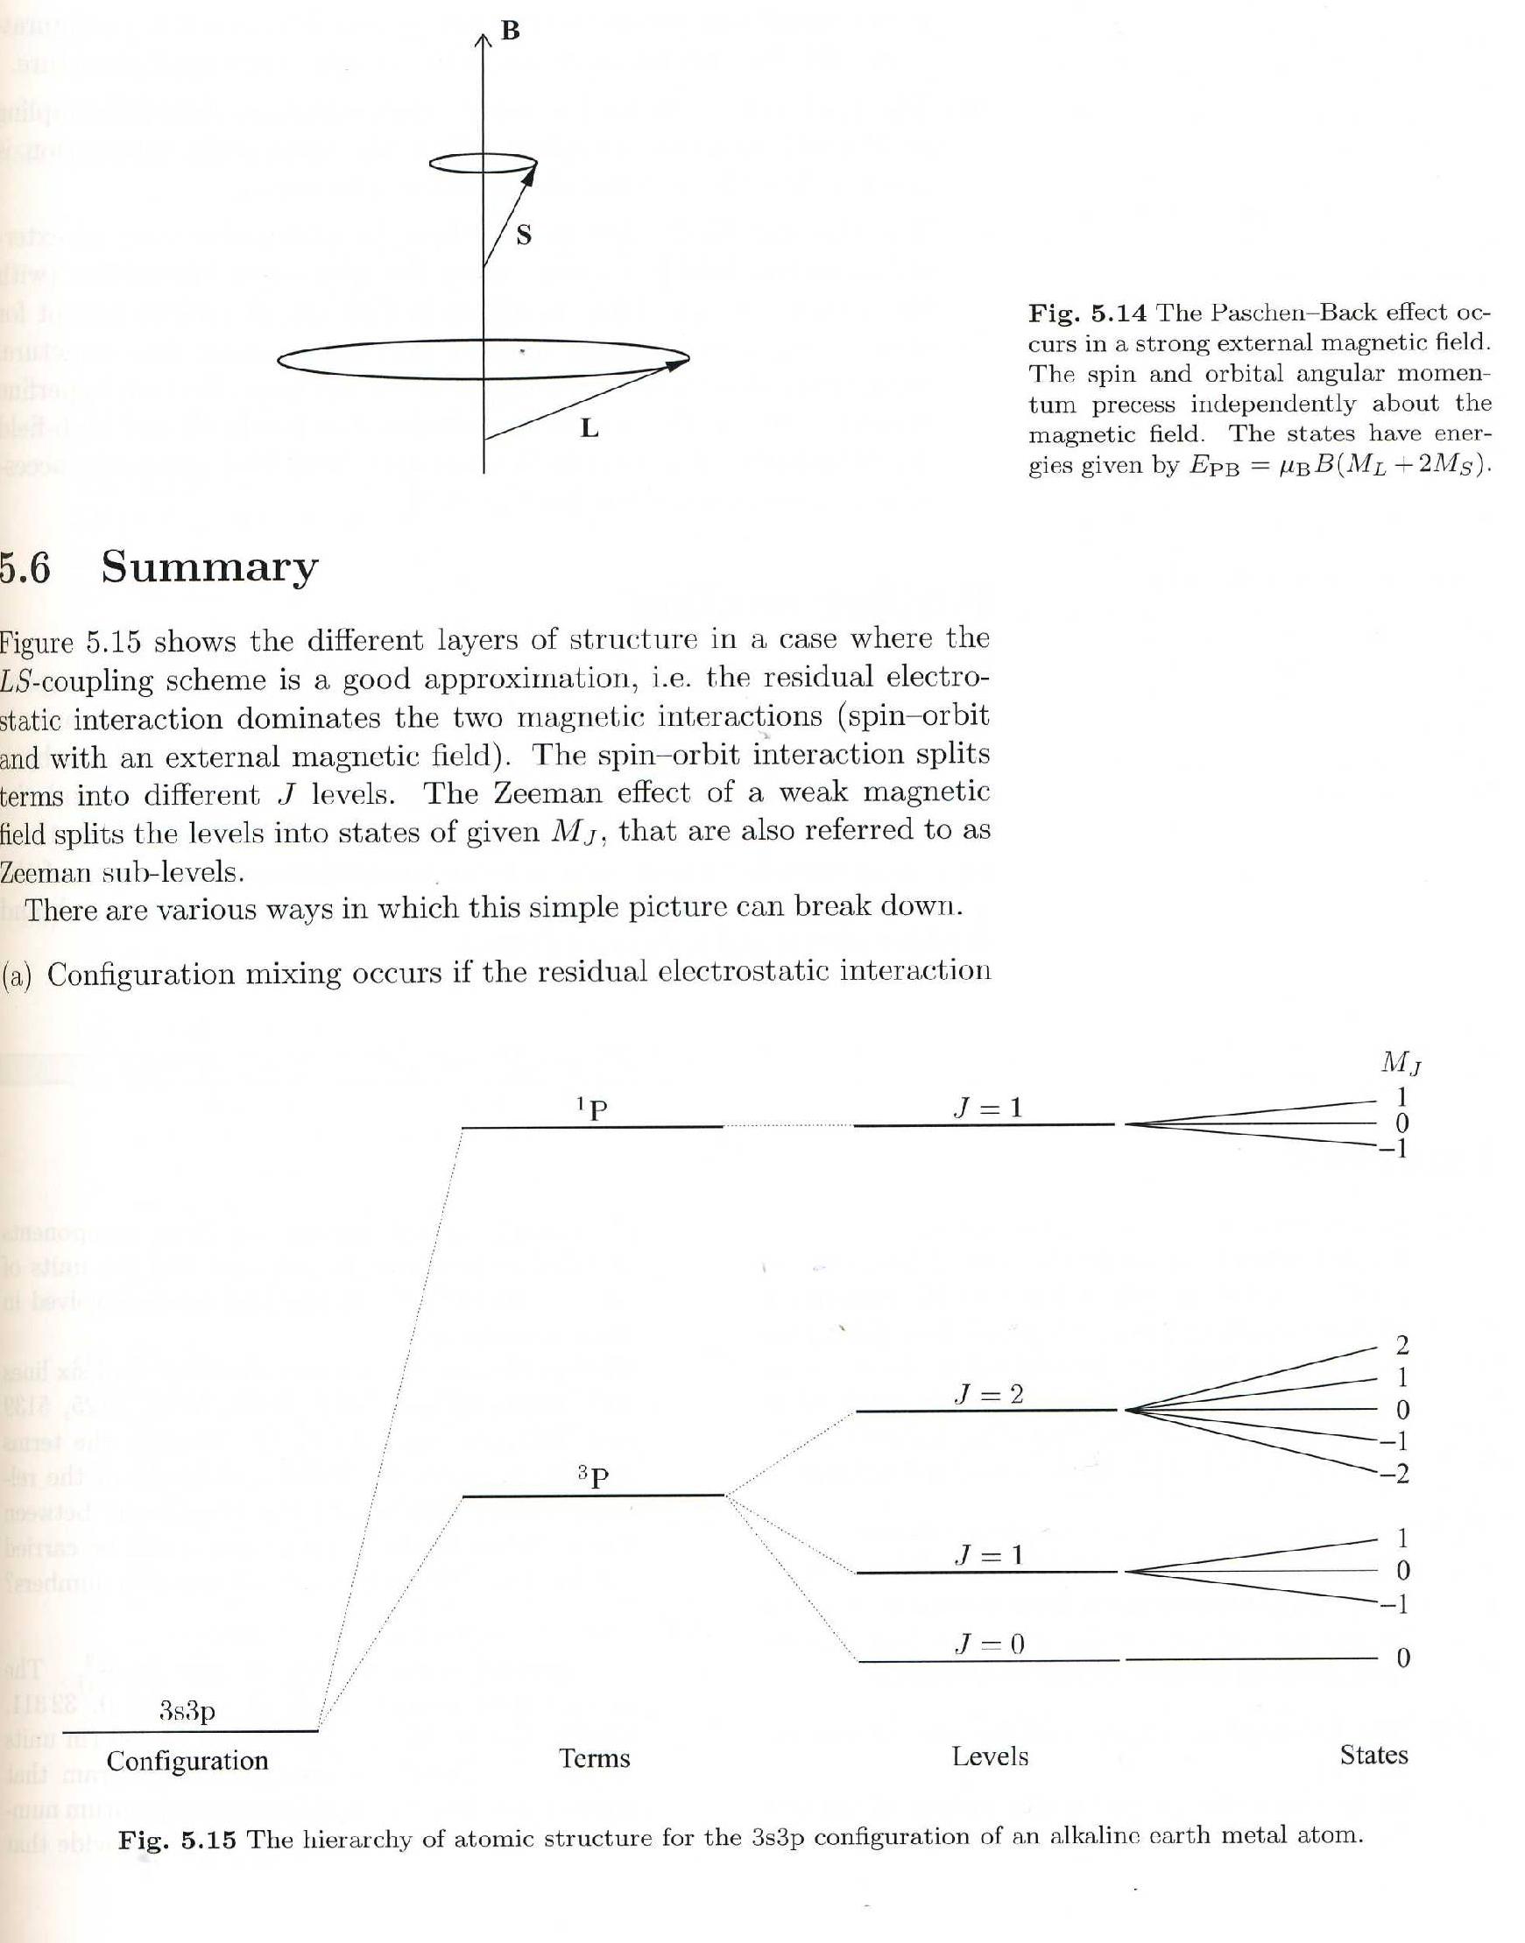

Slide 8
Nuclear shell model

Slide 9
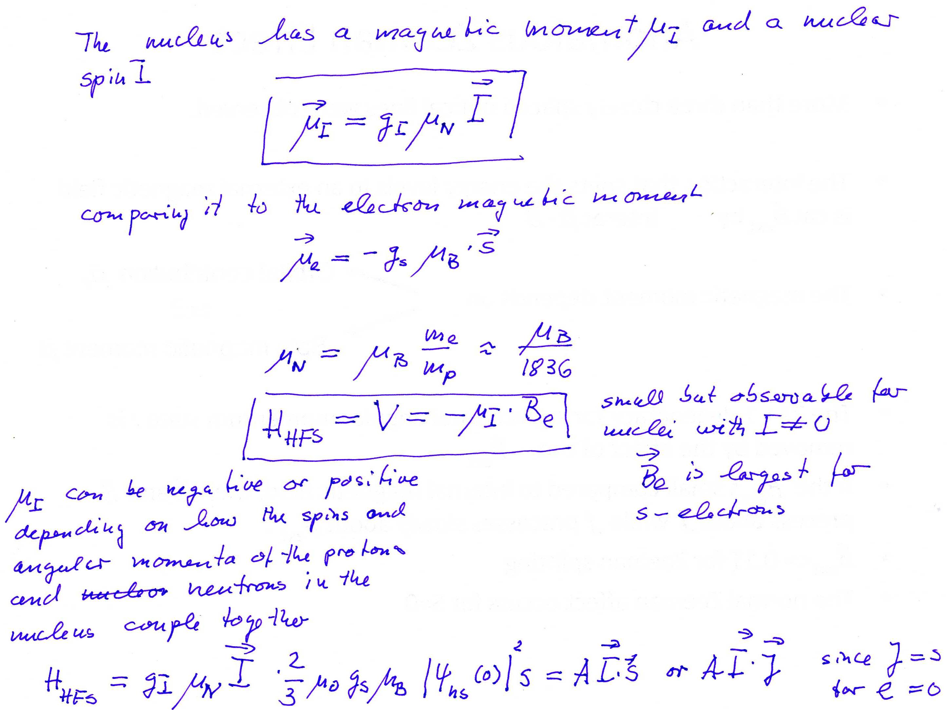
HFS and isotope shift

Slide 11
F
5/2
(5/2)A
3/2
(3/2)A
1/2
HFS levels: for Q=0 full lines B > 0
broken lines B < 0
with

Slide 12
Field isotope shift:
A
r
charge density
of s electrons at
the site of the nucleus
This amounts to a few percent

