Slide 1
Molecular bonding

Slide 2
Molecular Bonding and Spectra
The Coulomb force is the only one to bind atoms.
The combination of attractive and repulsive forces creates a stable molecular structure.
Force is related to potential energy F = −dV / dr, where r is the distance separation.
it is useful to look at molecular binding using potential energy V
Negative slope (dV / dr < 0) with repulsive force
Positive slope (dV / dr > 0) with attractive force

Slide 3
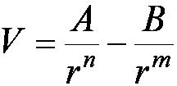
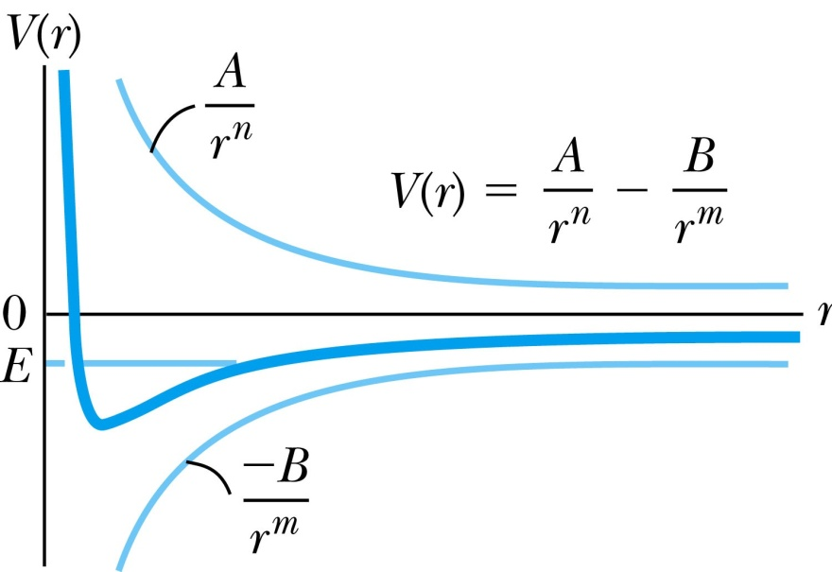
Molecular Bonding and Spectra
An approximation of the potential of one atom in the vicinity of another atom is
where A and B are positive constants.
Because of the complicated shielding effects of the various electron shells, n and m are not equal to 1.
Eq. 10.1 provides a stable equilibrium for total energy E < 0. The shape of the curve depends on the parameters A, B, n, and m. Also n > m.

Slide 4
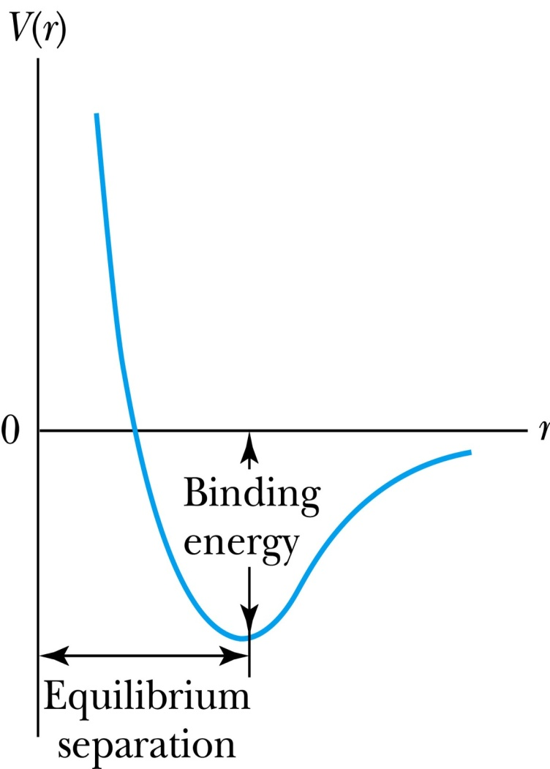
Molecular Bonding and Spectra
Vibrations are excited thermally, so the exact level of E depends on temperature.
Once a pair of atoms is joined, then:
One would have to supply energy to raise the total energy of the system to zero in order to separate the molecule into two neutral atoms.
The corresponding value of r at the minimum value is an equilibrium separation. The amount of energy to separate the two atoms completely is the binding energy which is roughly equal to the depth of the potential well.

Slide 5
Molecular Bonds
Ionic bonds:
The simplest bonding mechanisms.
Ex: Sodium (1s²2s²2p⁶3s¹) readily gives up its 3s electron to become Na⁺, while chlorine (1s²2s²2p⁶3s²3p⁵) readily gains an electron to become Cl⁻. That forms the NaCl molecule.
Covalent bonds:
The atoms are not as easily ionized.
Ex: Diatomic molecules (H₂, N₂, O₂) formed by the combination of two identical atoms tend to be covalent. These are referred to as homopolar molecules.
Larger molecules are formed with covalent bonds.

Slide 6
Molecular Bonds
Van der Waals bond:
Weak bond found mostly in liquids and solids at low temperature
Ex: In graphite, the van der Waals bond holds together adjacent sheets of carbon atoms. As a result, one layer of atoms slides over the next layer with little friction. The graphite in a pencil slides easily over paper.
Hydrogen bond:
Holds many organic molecules together
Metallic bond:
Free valence electrons may be shared by a number of atoms.

Slide 7
Ionic bonding NaCl

Slide 8
Potential energy of and

Slide 9
Covalent Bonding or homopolar bonding
Responsible for formation of stable diatomic molecules

Slide 10
Plots of wave function and of two electrons when they are apart
Spins anti-parallel
Spins parallel

Slide 11
Total potential energy versus r for two hydrogen atoms

Slide 12
Exchange energy and the Pauli exclusion principle

Slide 13
Hybrid covalent bonds
Four covalent bond of molecule: the hybrid (mixed) orbitals are represented by
Or other combinations by subtracting rather than adding the mixture of one 2s and three 2p orbitals to give four hybrids
Each C----H bond consists of an overlapping 1s orbital from hydrogen and an sp3 hybrid orbital from carbon. Theses orbitals have two lobes and only the longer ones are depicted.

Slide 14
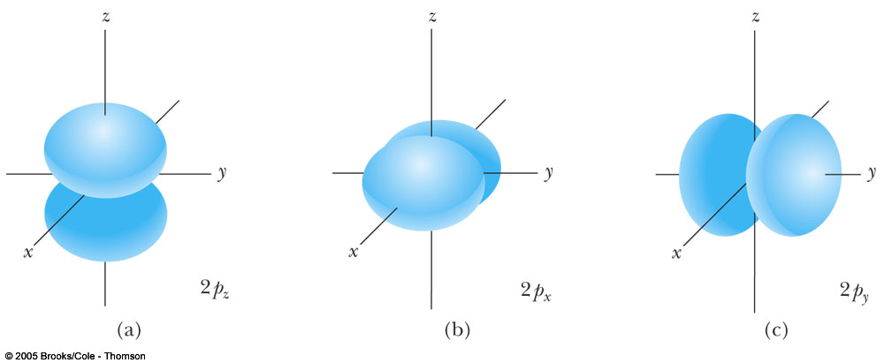
Probability density

Slide 15
Van der Waals bonds
The van der Waals forces for bonding arises when an electrically neutral
molecule has centers of positive and negative charge which do not coincide
Dipole-dipole force
Dipole-induced force
Dispersion force
All types fall off with 1/r^6

Slide 16
Hydrogen bond
The two negative fluorine ions are bound by the positively charged proton between them
Very weak = bond energy 0.1 eV

Slide 17
Hydrogen bond
A hydrogen atom attached to a relatively
electronegative atom is a hydrogen bond donor.
The hydrogen bond (5 to 30 kJ/mole) is stronger than a van der Waals interaction, but weaker than covalent or ionic bonds.
This type of bond occurs in both inorganic molecules such as water and organic molecules like DNA and proteins.

Slide 18
Bonding in complex molecules
(a) And (b): Formation of a sigma bond in from the overlap of the orbitals on adjacent N atoms. (c) Formation of a pi bond by overlap of the orbitals on adjacent N atoms. A similar bond is formed by overlap of the orbitals.

Slide 19
Fermions versus bosons

Slide 20
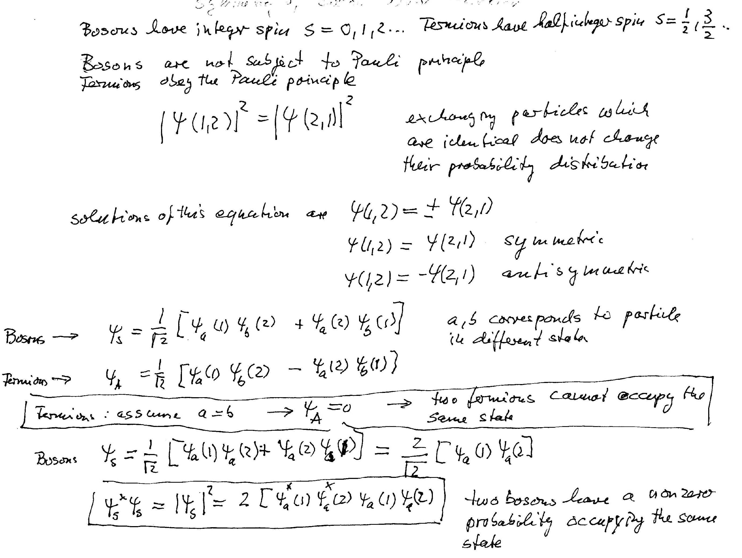
Symmetry of Boson wave function

Slide 21
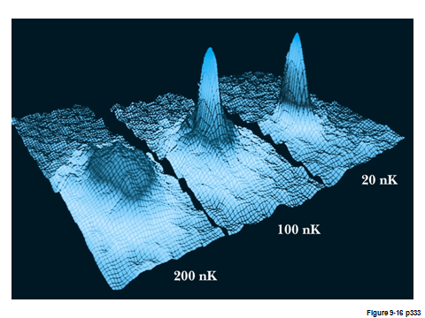
Bose-Einstein condensation in gases
2001 Nobel Prize
Wieman
Cornell
Ketterle
The transitions from a broad velocity distribution to an extremely narrow one signifies Bose-Einstein condensation
Rb, Na atoms
Two horizontal axes represent velocity components in x and y
Vertical axis represents number of atoms having those having velocities
Field of view 200um by 270um

