Slide 1
Rotation and vibration spectra

Slide 2
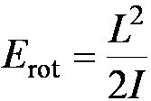
Rotational States
Molecular spectroscopy:
We can learn about molecules by studying how molecules absorb, emit, and scatter electromagnetic radiation.
From the equipartition theorem, the N₂ molecule may be thought of as two N atoms held together with a massless, rigid rod (rigid rotator model).
In a purely rotational system, the kinetic energy is expressed in terms of the angular momentum L and rotational inertia I.

Slide 3
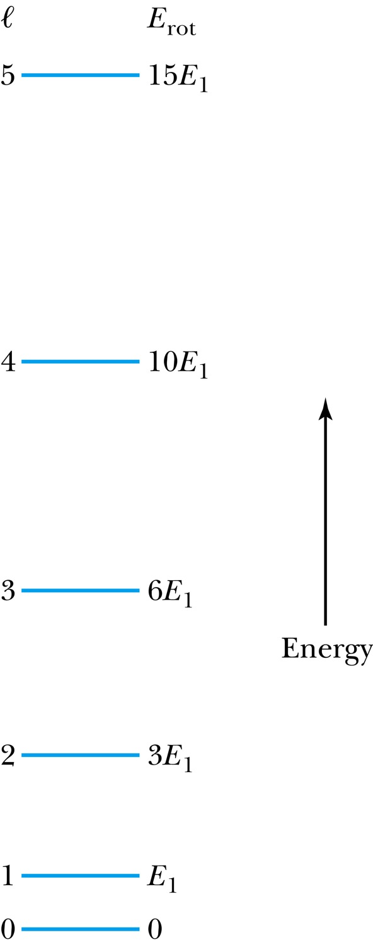
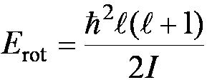
Rotational States
L is quantized.
The energy levels are
E_{rot} varies only as a function of the quantum number l.

Slide 4
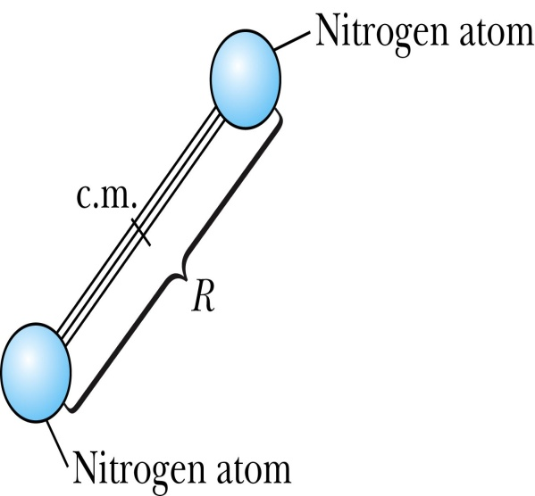
Notes:
Figure 10.4 Schematic of a diatomic molecule (N₂) as a rigid rotator, with an equilibrium separation R between atomic centers.

Slide 5
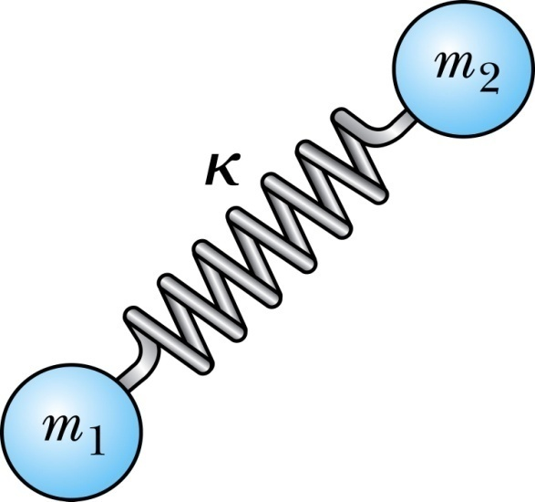
Vibrational States
There is the possibility that a vibrational energy mode will be excited.
No thermal excitation of this mode in a diatomic gas at ordinary temperature.
It is possible to stimulate vibrations in molecules using electromagnetic radiation.
Assume that the two atoms are point masses connected by a massless spring with simple harmonic motion:

Slide 6
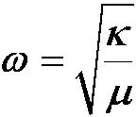
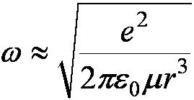
Vibrational States
The energy levels are those of a quantum-mechanical oscillator.
The frequency of a two-particle oscillator is
Where the reduced mass is μ = m₁m₂ / (m₁ + m₂) and the spring constant is κ.
If it is a purely ionic bond, we can compute κ by assuming that the force holding the masses together is Coulomb.
and

Slide 7
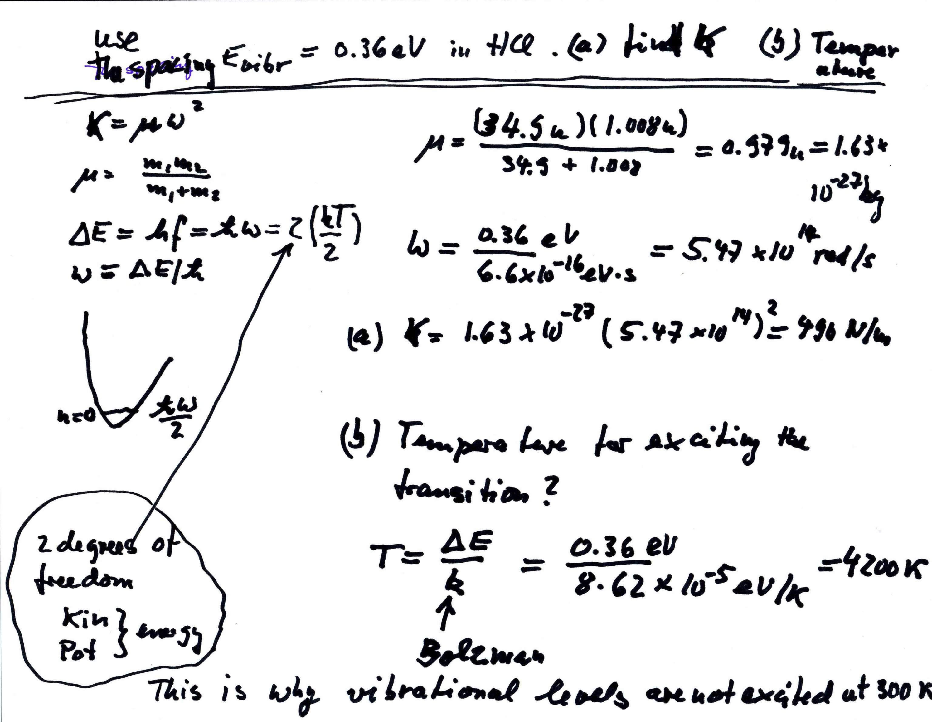

Slide 8
Vibration and Rotation Combined
It is possible to excite the rotational and vibrational modes simultaneously.
Total energy of simple vibration-rotation system:
Vibrational energies are spaced at regular intervals.
emission features due to vibrational transitions appear at regular intervals: ½ħω, 3/2ħω, etc.
Transition from l + 1 to l:
Photon will have an energy

Slide 9
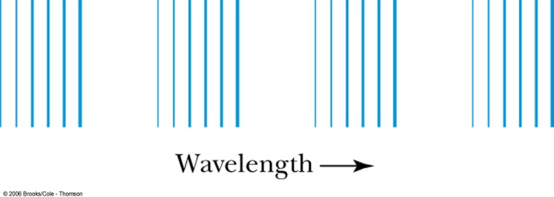
Vibration and Rotation Combined
An emission-spectrum spacing that varies with l
The higher the starting energy level, the greater the photon energy.
Vibrational energies are greater than rotational energies. This energy difference results in the band spectrum.
Typical section of the emission spectrum of a diatomic molecule. Equally spaced groups of lines correspond to the equal spacings between vibrational levels. The structure within each group is due to transitions between rotational levels.

Slide 10
Vibration and Rotation Combined
The positions and intensities of the observed bands are ruled by quantum mechanics. Note two features in particular:
1) The relative intensities of the bands are due to different transition probabilities.
- The probabilities of transitions from an initial state to final state are not necessarily the same.
2) Some transitions are forbidden by the selection rule that requires Δℓ = ±1.
Absorption spectra:
Within Δℓ = ±1 rotational state changes, molecules can absorb photons and make transitions to a higher vibrational state when electromagnetic radiation is incident upon a collection of a particular kind of molecule.

Slide 11
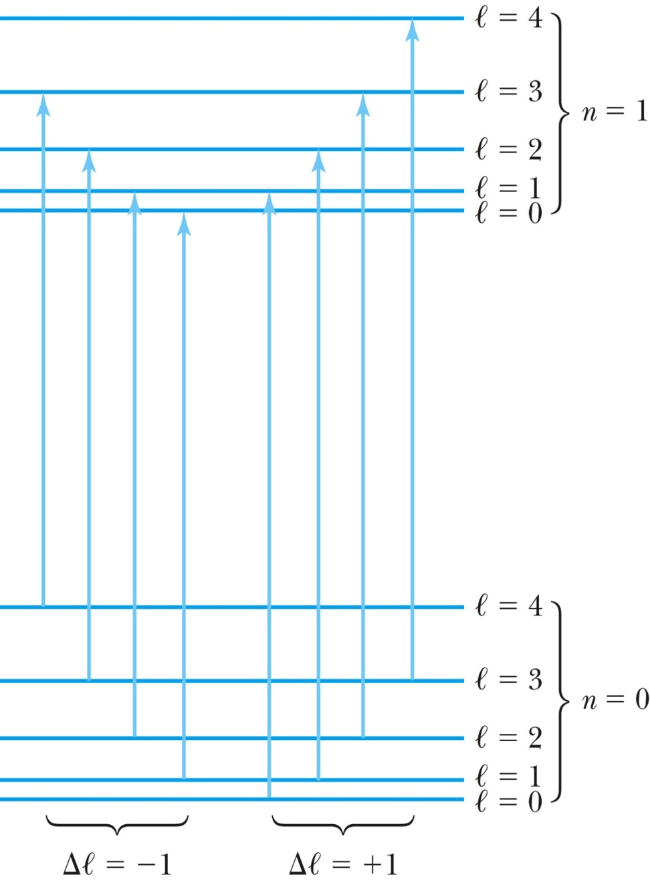
Vibration and Rotation Combined
ΔE increases linearly with l as in Eq. (10.8).
A schematic diagram of the absorptive transitions between adjacent vibrational states ( n = 0 to n = 1) in a diatomic molecule.

Slide 12
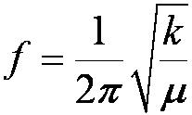
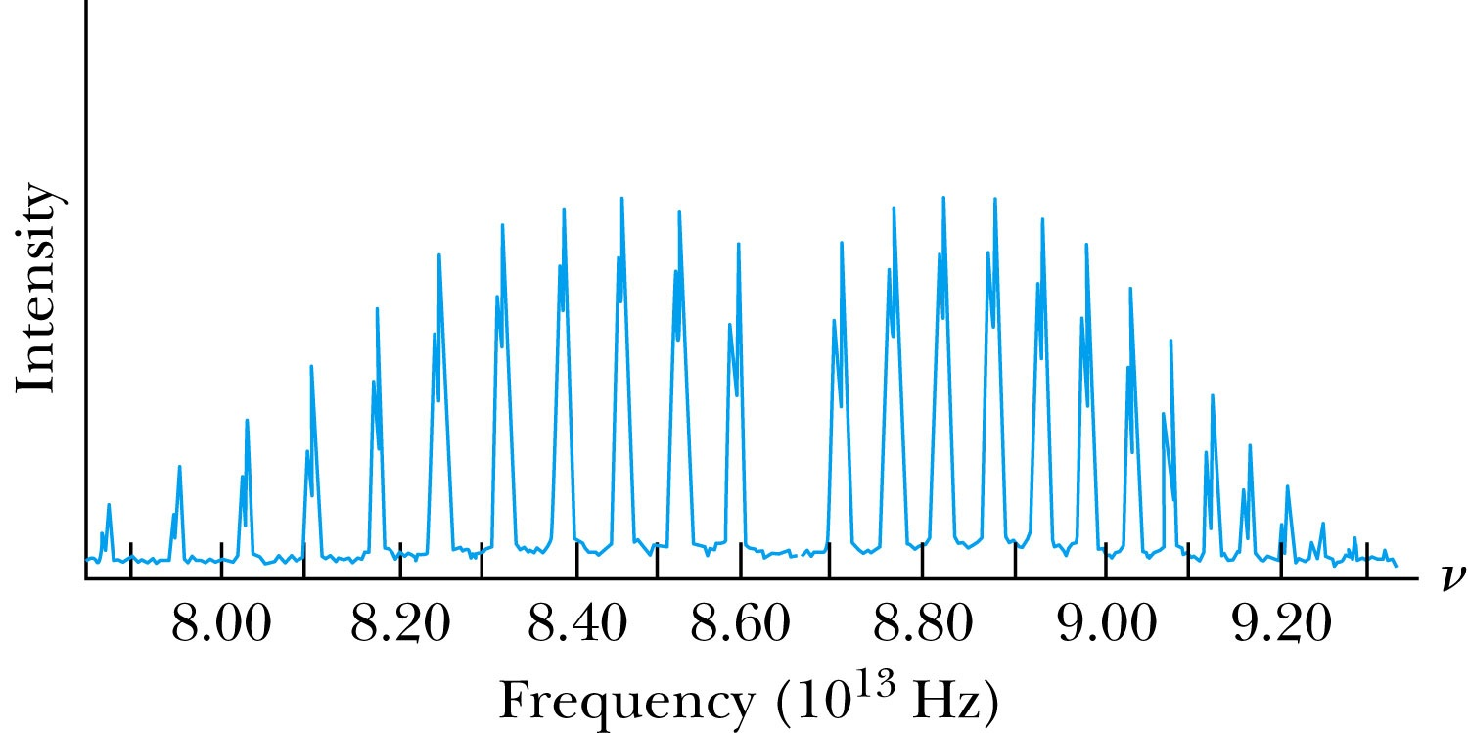
Vibration and Rotation Combined
In the absorption spectrum of HCl, the spacing between the peaks can be used to compute the rotational inertia I. The missing peak in the center corresponds to the forbidden Δℓ = 0 transition.
The central frequency

Slide 13
Dual comb spectroscopy of (Feng 2012)

Slide 14
Vibration and Rotation Combined
Fourier transform infrared (FTIR) spectroscopy:
Data reduction methods for the sole purpose of studying molecular spectra.
A spectrum can be decomposed into an infinite series of sine and cosine functions.
Random and instrumental noise can be reduced in order to produce a “clean” spectrum.
Raman scattering:
If a photon of energy greater than ΔE is absorbed by a molecule, a scattered photon of lower energy may be released.
The angular momentum selection rule becomes Δℓ = ±2.

Slide 15
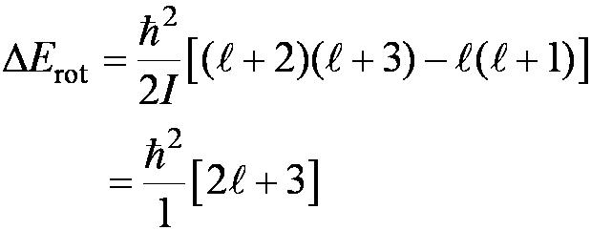
Vibration and Rotation Combined
A transition from l to l + 2
Let hf be the Raman-scattered energy of an incoming photon and hf ’ is the energy of the scattered photon. The frequency of the scattered photon can be found in terms of the relevant rotational variables:
Raman spectroscopy is used to study the vibrational properties of liquids and solids.

Slide 16
Raman Spectroscopies

Slide 17
Raman scattering
Because the photon energy changes the effect is an example of an inelastic collision. Energy is still conserved overall with the photon energy loss or gain compensated by the suitable change in the rotational and/or vibrational state of the molecule

