Slide 1
Welcome to PHYS-222, Modern Physics for Engineers!

Slide 2
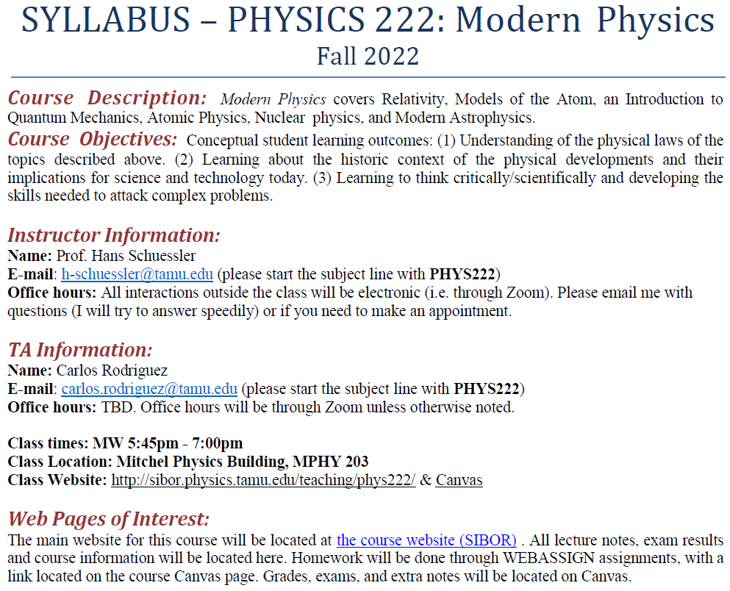
Notes:
2

Slide 3
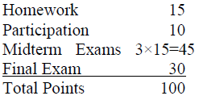
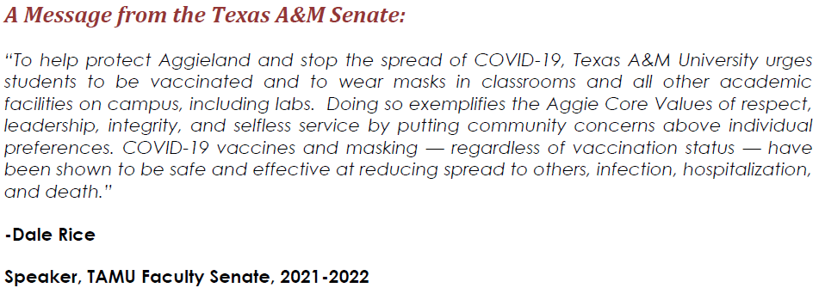
“To contribute in protecting students in attendance I am providing masks at the classroom entrances. In the spirit of Aggieland let us fight together and continue to show that Aggies are stronger than the pandemic and do not make other Aggies sick by not wearing masks.”
- Hans Schuessler, Professor of Physics, Chair of Optical and Biomedical Physics

Slide 4
CHAPTER 1
"The eternal mystery of the world is its comprehensibility.“
"Anyone who has never made a mistake has never tried anything new."
A. Einstein
1.1 Classical Physics of the 1890s
1.2 The Kinetic Theory of Gases
1.3 Waves and Particles
1.4 Conservation Laws and Fundamental Forces
1.5 The Atomic Theory of Matter
1.6 Unresolved Questions of 1895 and New Horizons

Slide 5
1.1: Classical Physics of the 1890s
Mechanics
Electromagnetism
Thermodynamics

Slide 6
MECHANICS
CLASSICAL
PHYSICS
1.1
ELECTRICITY
AND
MAGNETISM
THERMODYNAMICS
CONSERVATION LAWS

Slide 7
Triumph of Classical Physics: The Conservation Laws
Conservation of energy: The total sum of energy (in all its forms) is conserved in all interactions.
Conservation of linear momentum: In the absence of external forces, linear momentum is conserved in all interactions.
Conservation of angular momentum: In the absence of external torque, angular momentum is conserved in all interactions.
Conservation of charge: Electric charge is conserved in all interactions.

Slide 9
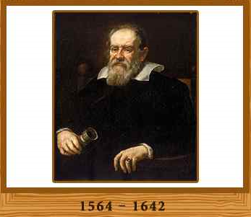
Mechanics
Galileo Galilei (1564-1642)
Great experimentalist
Principle of inertia
Established experimental foundations

Slide 10
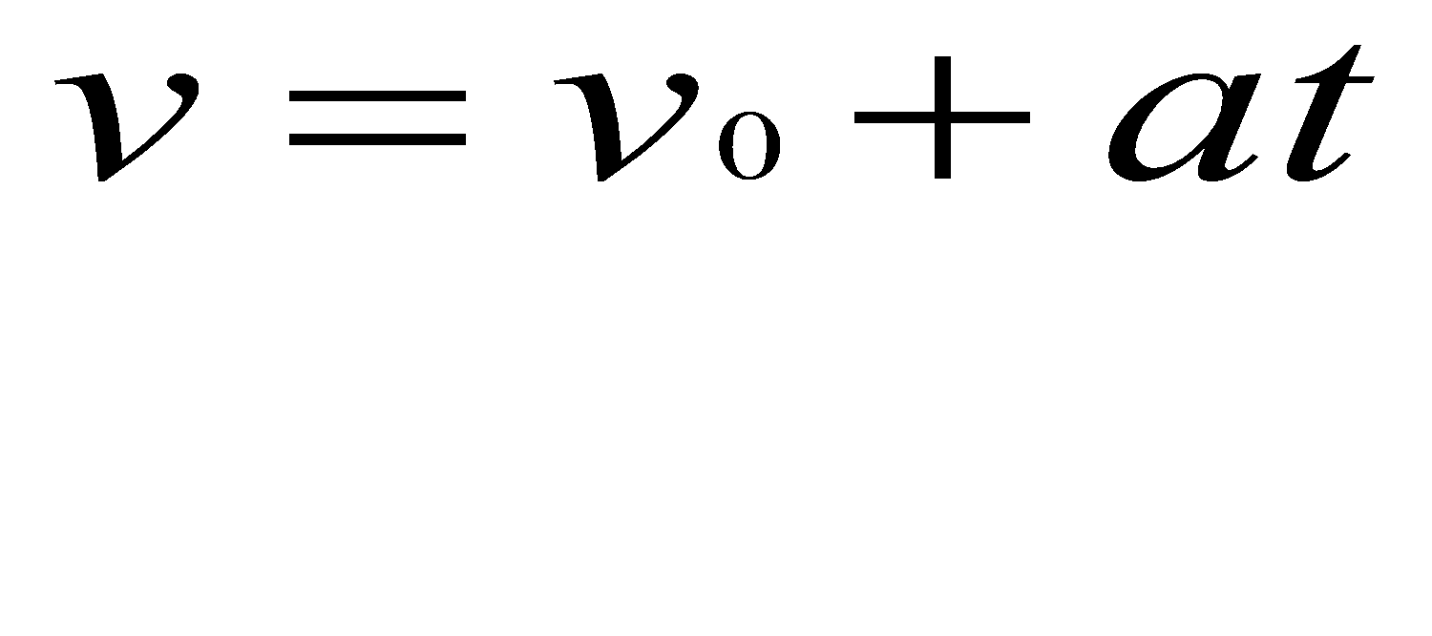
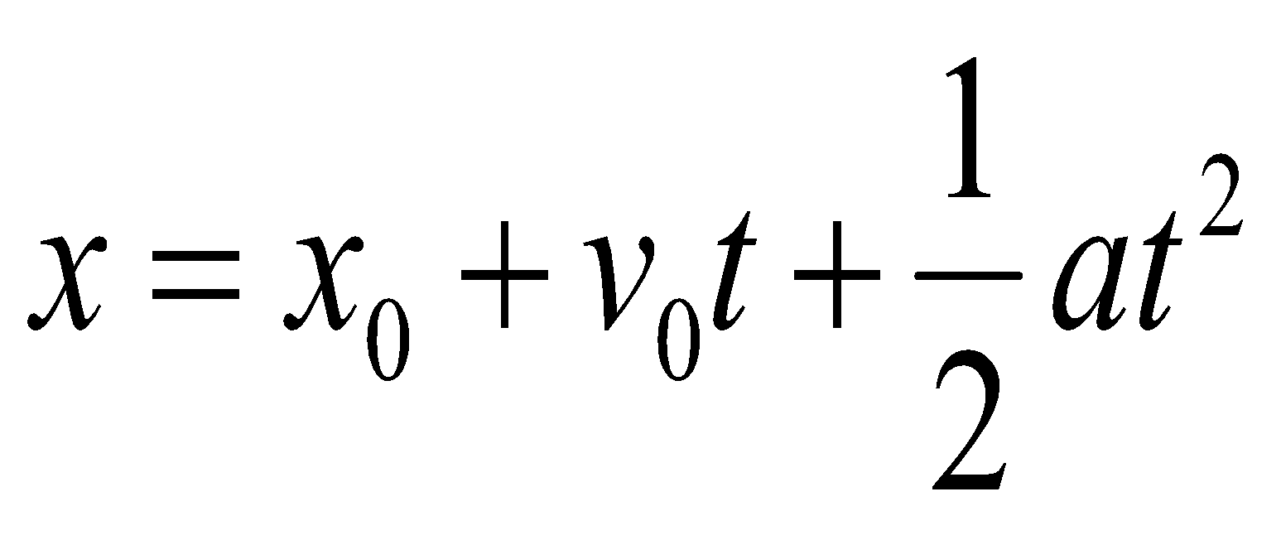
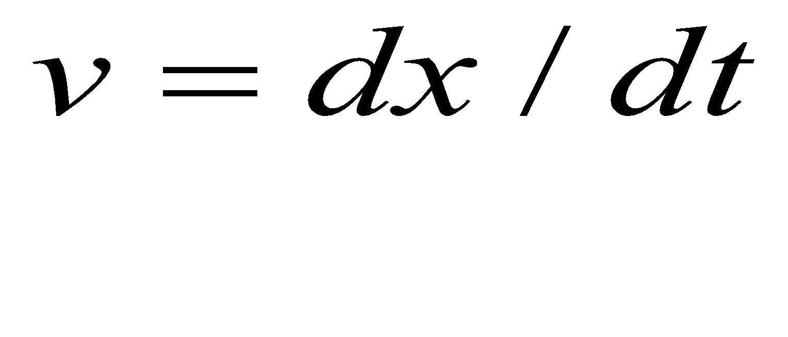
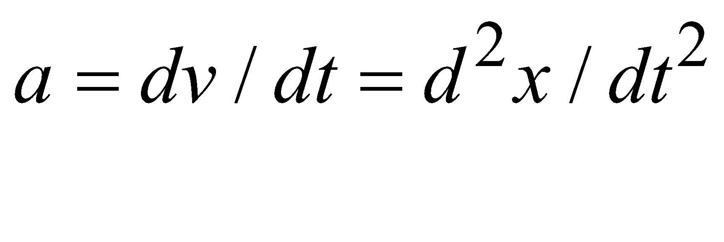
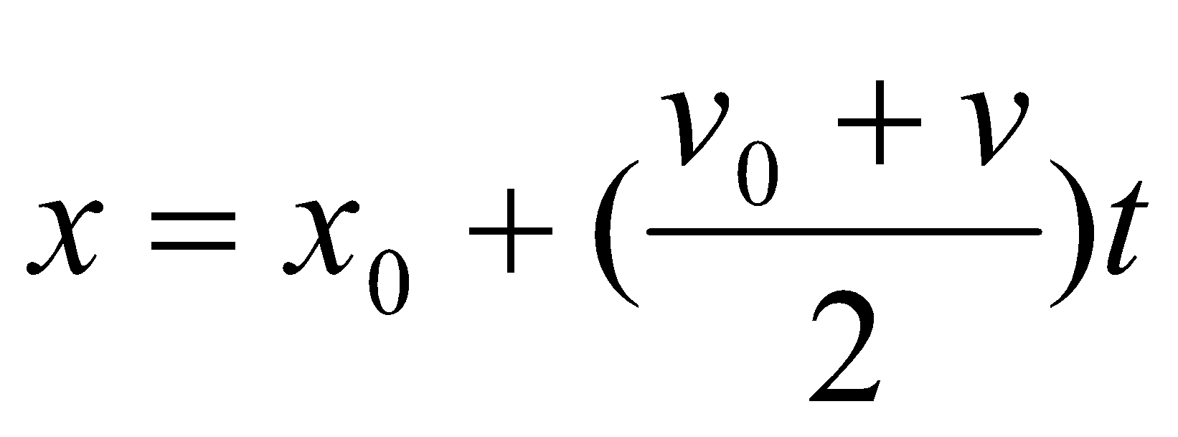
Kinematics equations for constant acceleration
General formulas:

Slide 11
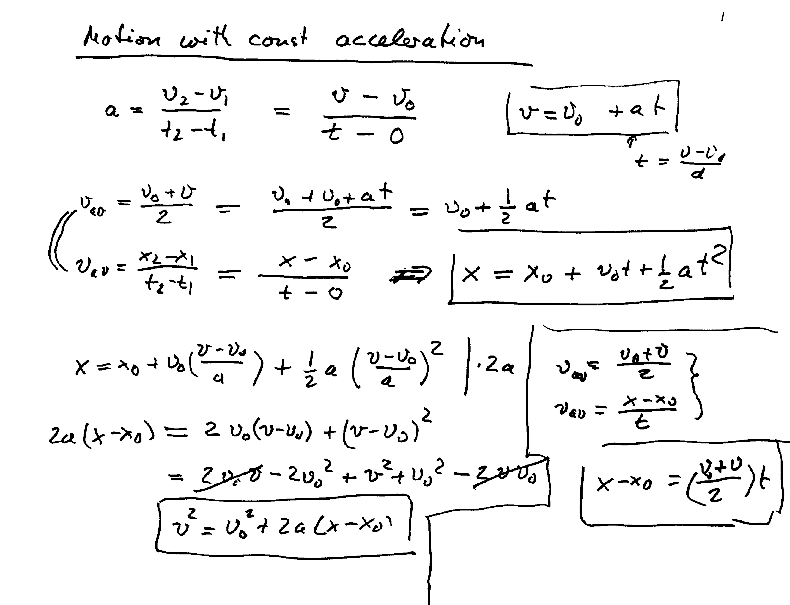

Slide 12
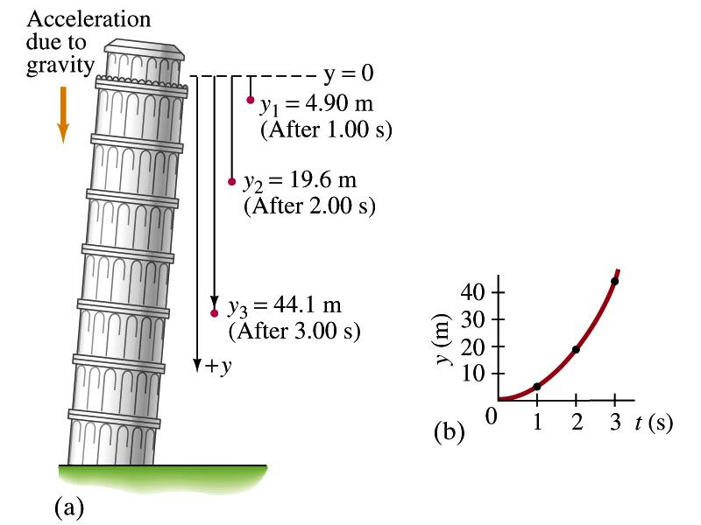
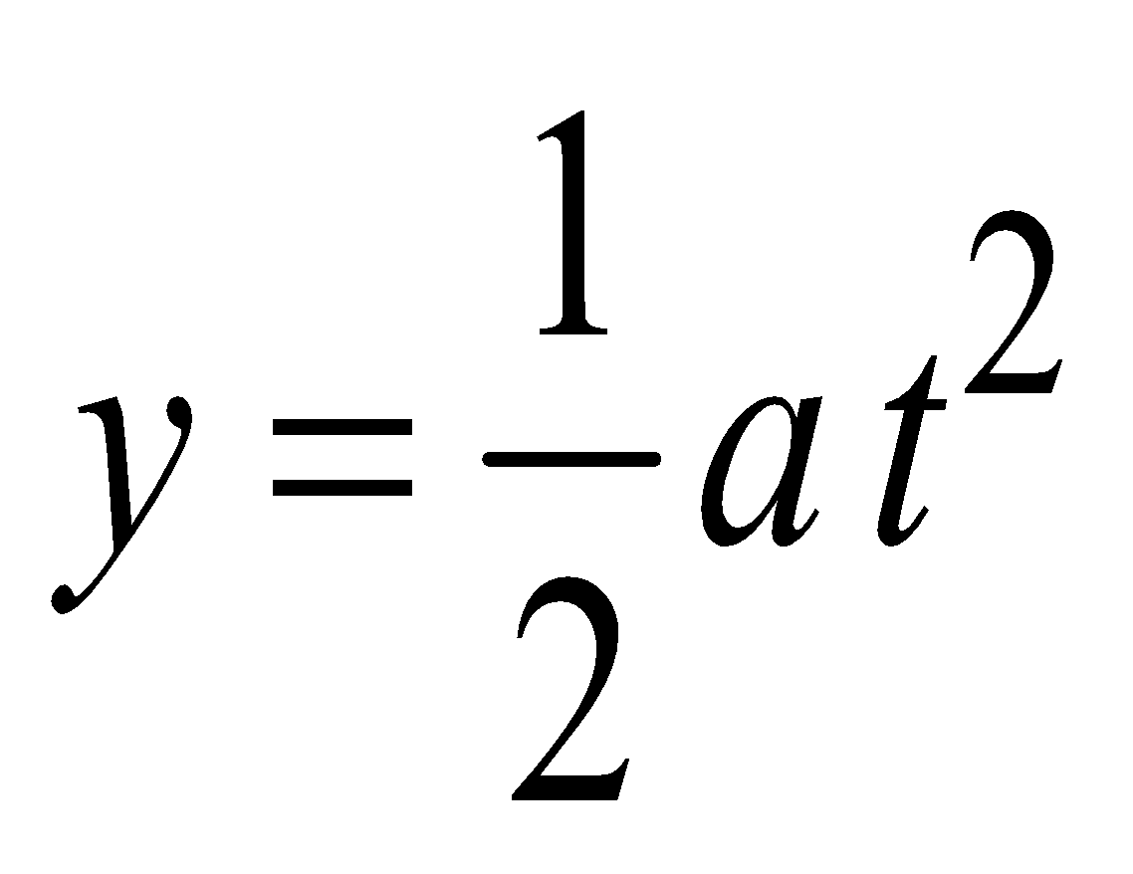
Testing Kinetics for a=9.80m/s²

Slide 13
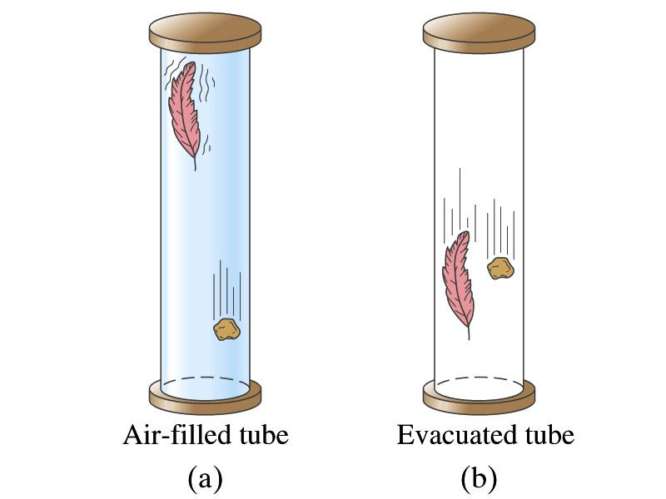
All objects fall with the same constant acceleration!!

Slide 14
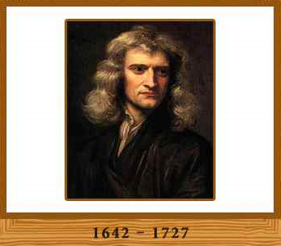
Isaac Newton (1642-1727)
Three laws describing the relationship between
mass and acceleration.
Newton’s first law (law of inertia): An object in motion with a constant velocity will continue in motion unless acted upon by some net external force.
Newton’s second law: Introduces force (F) as responsible for the change in linear momentum (p):
Newton’s third law (law of action and reaction): The force exerted by body 1 on body 2 is equal in magnitude and opposite in direction to the force that body 2 exerts on body 1.

Slide 15
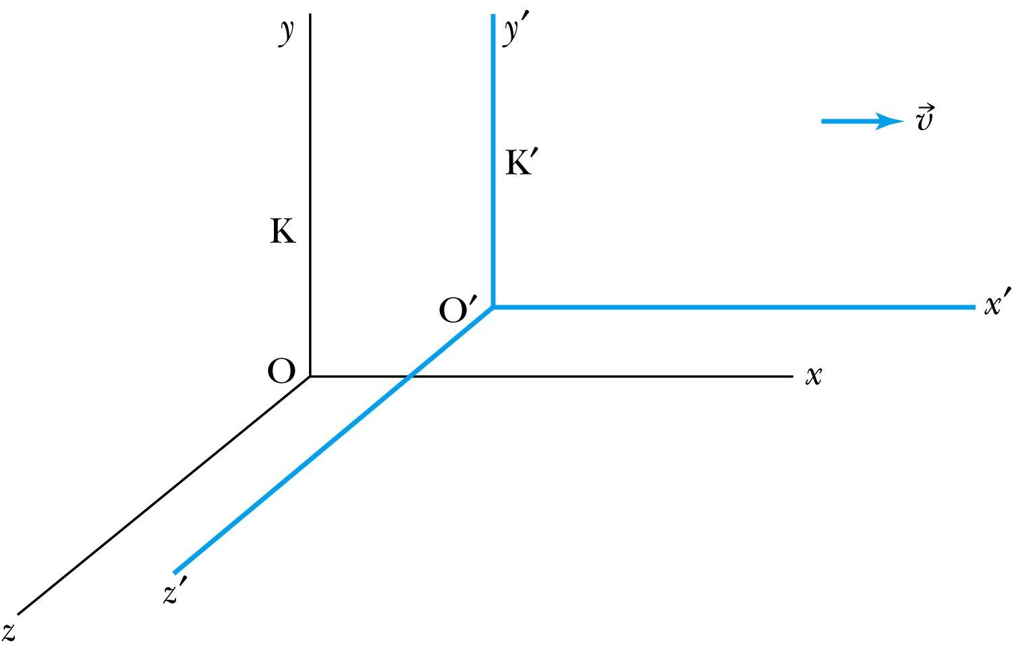
Inertial Frames K and K’
K is at rest and K’ is moving with constant velocity
Axes are parallel
K and K’ are said to be INERTIAL COORDINATE SYSTEMS

Slide 16
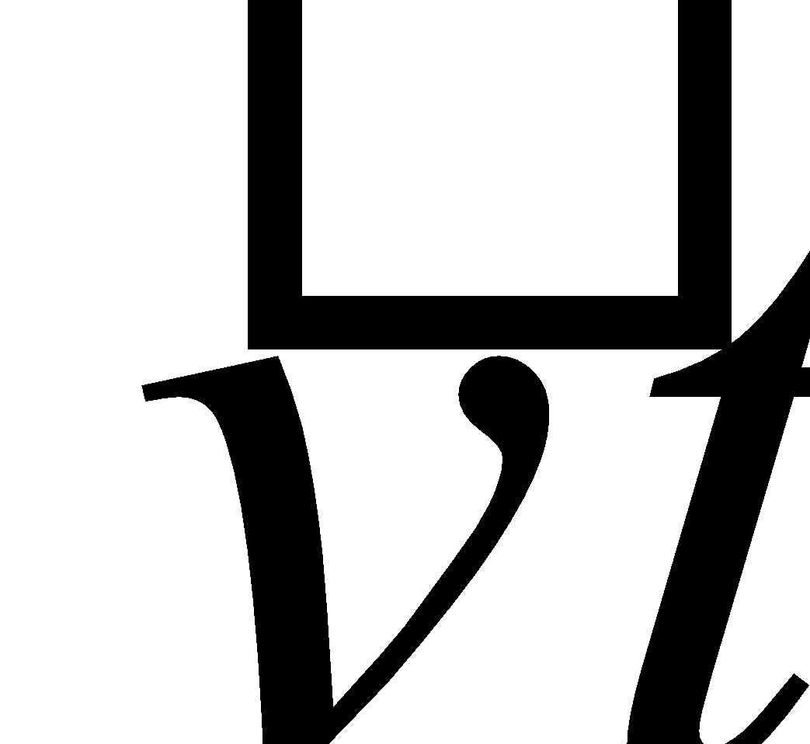
The Galilean Transformation
For a point P
In system K: P = (x, y, z, t)
In system K’: P = (x’, y’, z’, t’)
x
P
K
K’
x’-axis
x-axis

Slide 17
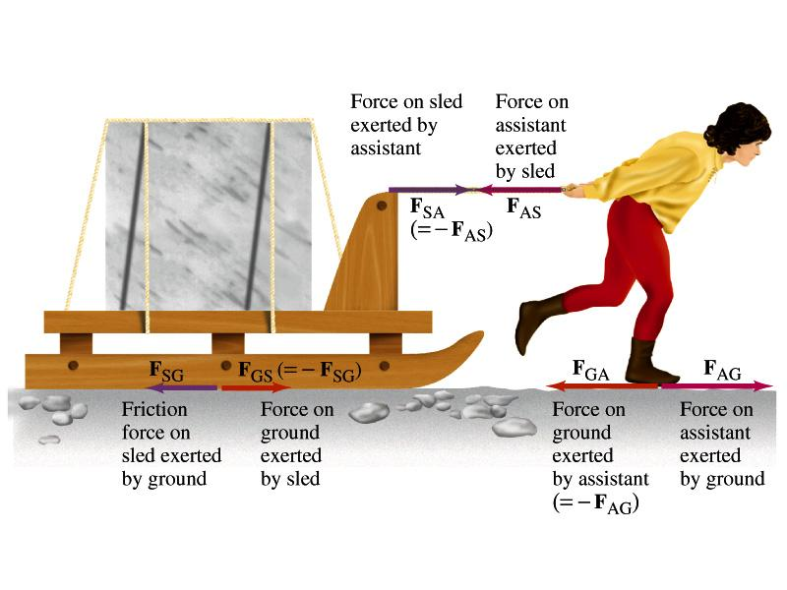
pulling a sled, Michelangelo’s assistant
For forward motion: F_{AG}> F_{AS} F_{SA} > F_{SG}

Slide 18
Gravitation
Newton’s Law of Gravitation

Slide 19
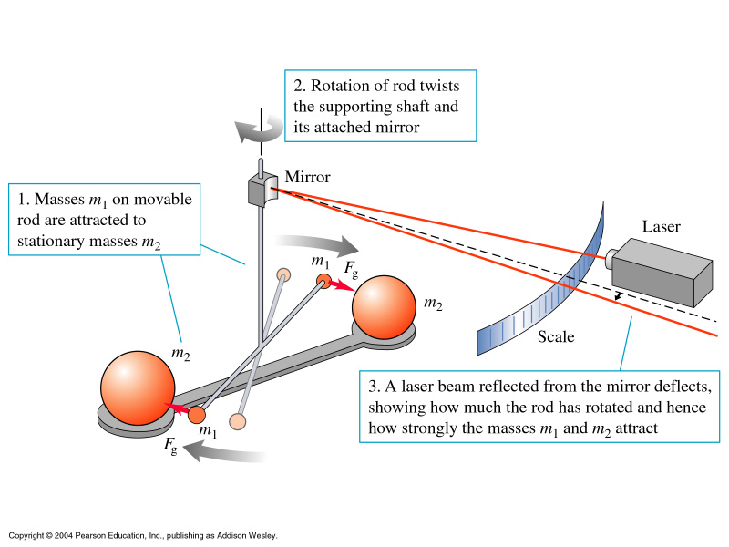
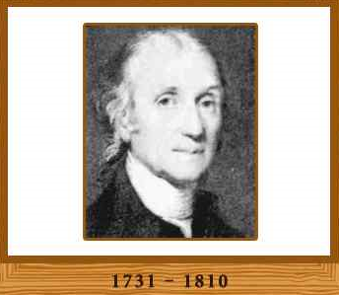
Cavendish balance
Light source
( )
Henry Cavendish(1798) announced that he has weighted the earth.
Notes:
19

Slide 20
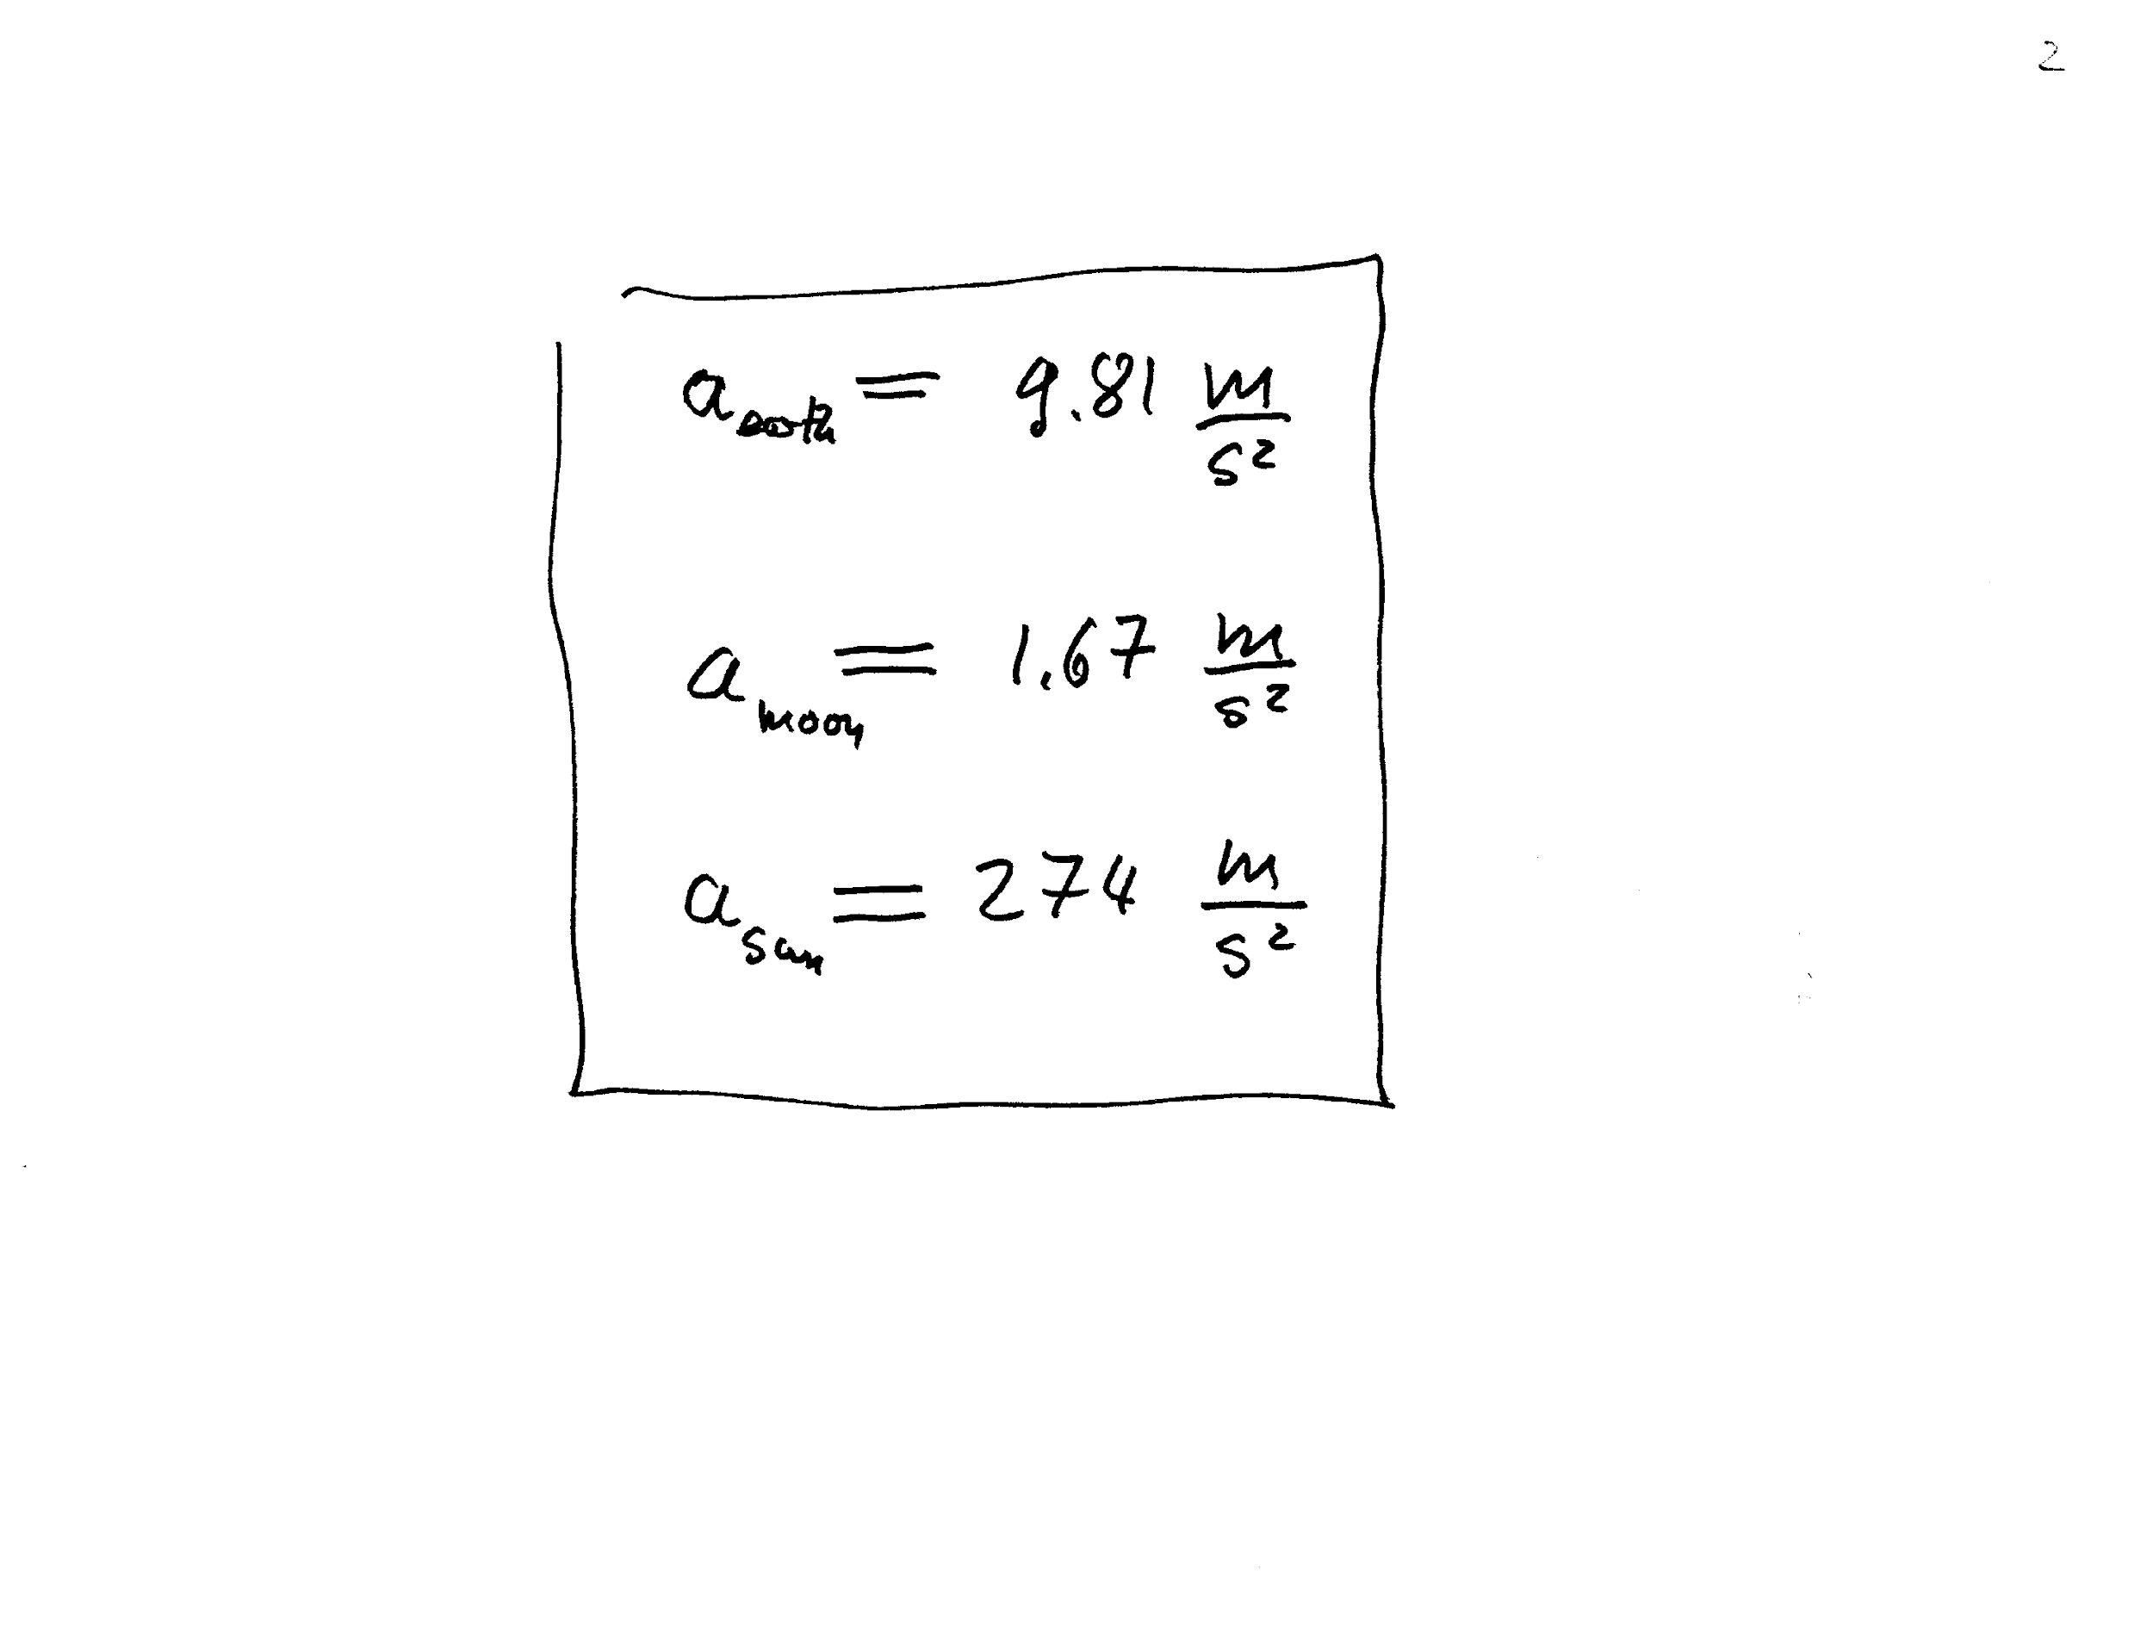
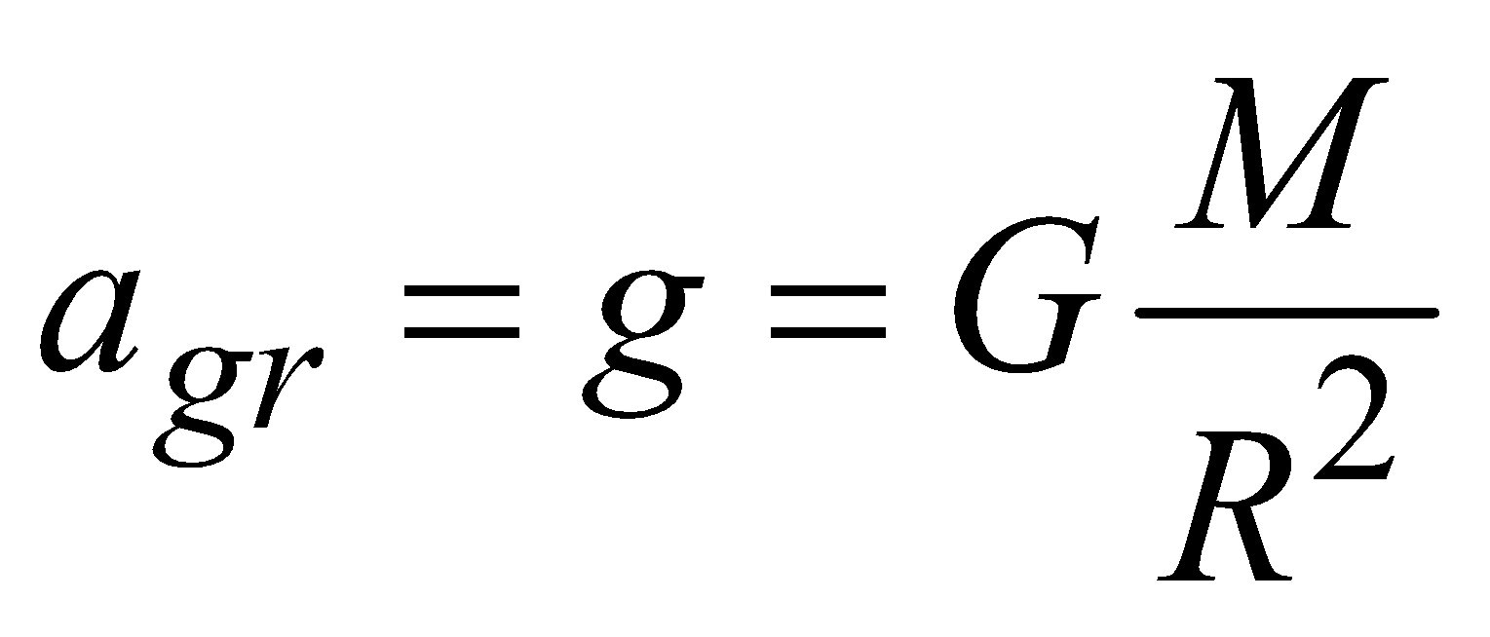

Slide 21
The Foucault pendulum in Aggieland
What does it show?? Seeing is believing
T=10 sec how long is it??

Slide 22
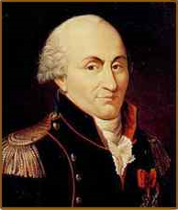
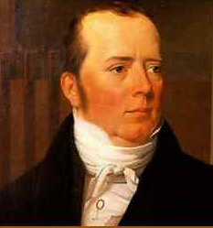
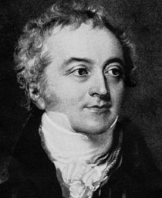
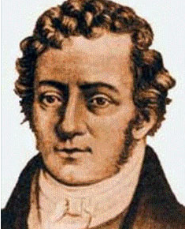
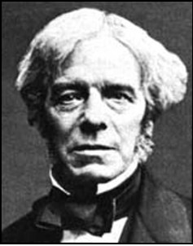
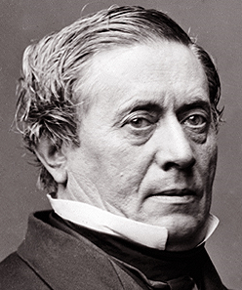
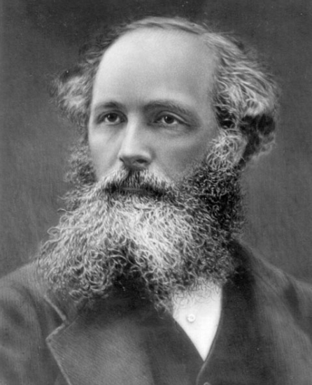
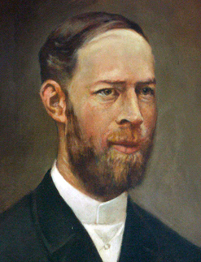
Electromagnetism: 18th-19th centuries
Contributions made by:
Coulomb (1736-1806)
Oersted (1777-1851)
Young (1773-1829)
Ampère (1775-1836)
Faraday (1791-1867)
Henry (1797-1878)
Maxwell (1831-1879)
Hertz (1857-1894)

Slide 23
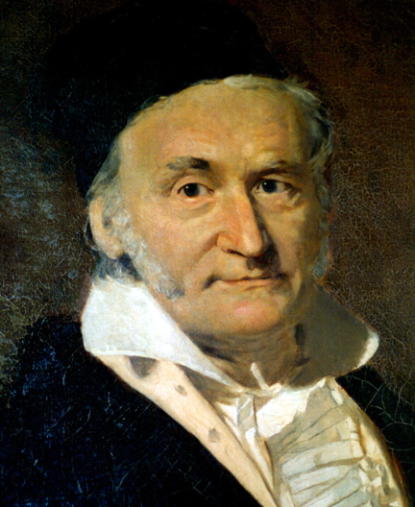
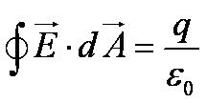
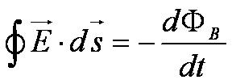
Culminates in Maxwell’s Equations
Gauss’s law (Φ_{E}):
(electric field)
Gauss’s law (Φ_{B}):
(magnetic field)
Faraday’s law:
Ampère’s law:
(Generalized)
Lorentz law:
(force)
Gauss (1777 –1855)

Slide 24
Thermodynamics
Contributions made by:
Benjamin Thompson (1753-1814) (frictional heat)
(Count Rumford)
Sadi Carnot (1796-1832) (heat engine and Carnot cycle)
James Joule (1818-1889) (mechanical equivalent of heat))
Rudolf Clausius (1822-1888) (heat can never pass from a colder to a warmer body without some other change)
William Thompson (1824-1907)
(Lord Kelvin) (proposed absolute temperature scale)

Slide 25
Primary Results
Deals with temperature, heat, work, and the internal energy of systems
Introduces thermal equilibrium
The first law establishes heat as energy and expresses conservation of energy
Introduces the concept of internal energy and considers temperature as a measure of internal energy
Introduces limitations of the energy processes that can or cannot take place

Slide 26
The Laws of Thermodynamics
First law: The change in the internal energy ΔU of a system is equal to the heat Q added to a system plus the work W done on the system
ΔU = Q + W
Second law: It is not possible to convert heat completely into work without some other change taking place.
The “zeroth” law: Two systems in thermal equilibrium with a third system are in thermal equilibrium with each other.
Third law: It is not possible to achieve an absolute zero temperature.

Slide 27
1.2: The Kinetic Theory of Gases
Contributions made by:
Robert Boyle (1627-1691)
Jacques Charles (1746-1823)
Joseph Louis Gay-Lussac (1778-1823)
Culminates in the ideal gas equation for n moles of a “simple” gas:
pV = nRT
(where R is the ideal gas constant, 8.31 J/(mol · K)

Slide 28
Additional Contributions
Amedeo Avogadro (1776-1856) (number of molecules in a mole and their weights)
John Dalton (1766-1844) (atomic theory of elements)
Daniel Bernoulli (1700-1782) (kinetic theory of gases)
Ludwig Boltzmann (1844-1906) (kinetic theory of gases, entropy as log() of probability)
James Clerk Maxwell (1831-1879) (velocity distribution)
J. Willard Gibbs (1939-1903) (thermodynamic and chemical potentials)

Slide 29
Primary Results
Average molecular kinetic energy directly related to absolute temperature
Internal energy U directly related to the average molecular kinetic energy
Internal energy equally distributed among the number of degrees of freedom (f ) of the system containing n moles of substance
(N_{A} = 6.022×10²³ mol⁻¹
Avogadro’s number: number of molecules in 1 mole)

Slide 30
Other Primary Results
2. Maxwell derives a relation for the molecular speed distribution f (v):
3. Boltzmann contributes to determine the root-mean-square of the molecular speed
Thus relating energy to the temperature for an ideal gas

Slide 31
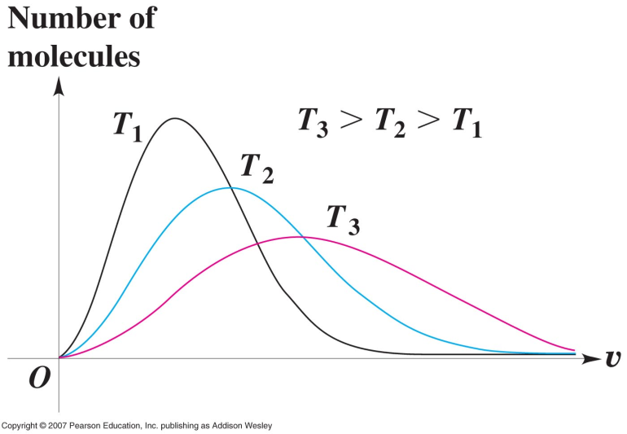
Molecular speeds in an ideal gas
21

Slide 32
1.3: Waves and Particles
Two ways in which energy is transported:
Point mass interaction: transfers of momentum and kinetic energy: particles
Extended regions wherein energy transfers by way of vibrations and rotations are observed: waves

Slide 33
Particles vs. Waves
Two distinct phenomena describing physical interactions
Particles in the form of point masses and waves in the form of perturbation in a mass distribution, i.e., a material medium
The distinctions are observationally quite clear; however, not so for the case of visible light
Thus by the 17th century begins the major disagreement concerning the nature of light

Slide 34
The Nature of Light
Contributions made by:
Isaac Newton (1642-1742)
Christian Huygens (1629 -1695)
Thomas Young (1773 -1829)
Augustin Fresnel (1788 – 1829)

Slide 35
The Nature of Light
Newton suggested the corpuscular (particle) theory
Particles of light travel in straight lines or rays
Explained sharp shadows
Explained reflection and refraction

Slide 36
The Nature of Light
Christian Huygens promoted the wave theory
Light propagates as a wave of concentric circles from the point of origin
Explained reflection and refraction
Did not explain sharp shadows

Slide 37
The Wave Theory Advances…
Contributions by Huygens, Young, Fresnel and Maxwell
Double-slit interference patterns
Refraction of light from a vacuum to a medium
Light is an electromagnetic phenomenon
Establishes that light propagates as a wave

Slide 38
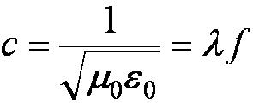
The Electromagnetic Spectrum
Visible light covers only a small range of the total electromagnetic spectrum
All electromagnetic waves travel in a vacuum with a speed c given by:
(where μ₀ and ε₀ are the respective permeability and permittivity of “free” space)

Slide 39
1.4: Conservation Laws and Fundamental Forces
Recall the fundamental conservation laws:
Conservation of energy
Conservation of linear momentum
Conservation of angular momentum
Conservation of electric charge
Later we will establish the conservation of mass as part of the conservation of energy

Slide 40
Modern Results
In addition to the classical conservation laws, two modern results will include:
The conservation of baryons and leptons
The fundamental invariance principles for time reversal, distance, and parity

Slide 41
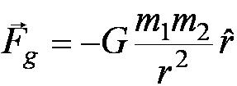
Also in the Modern Context…
The three fundamental forces are introduced
Gravitational:
Electroweak
Weak: Responsible for nuclear beta decay and effective only over distances of ~10⁻¹⁵ m
Electromagnetic: (Coulomb force)
Strong: Responsible for “holding” the nucleus together and effective less than ~10⁻¹⁵ m

Slide 42
Unification
Neutrons and protons are composed of quarks, which have the color force acting between them
Grand Unified Theory (GUT) attempts to unify electroweak and strong forces
String theory is one of these
They have yet to be verified experimentally

Slide 43
Unification of Forces
Maxwell unified the electric and magnetic forces as fundamentally the same force; now referred to as the electromagnetic force
In the 1970’s Glashow, Weinberg, and Salam proposed the equivalence of the electromagnetic and the weak forces (at high energy); now referred to as the electroweak interaction

Slide 44
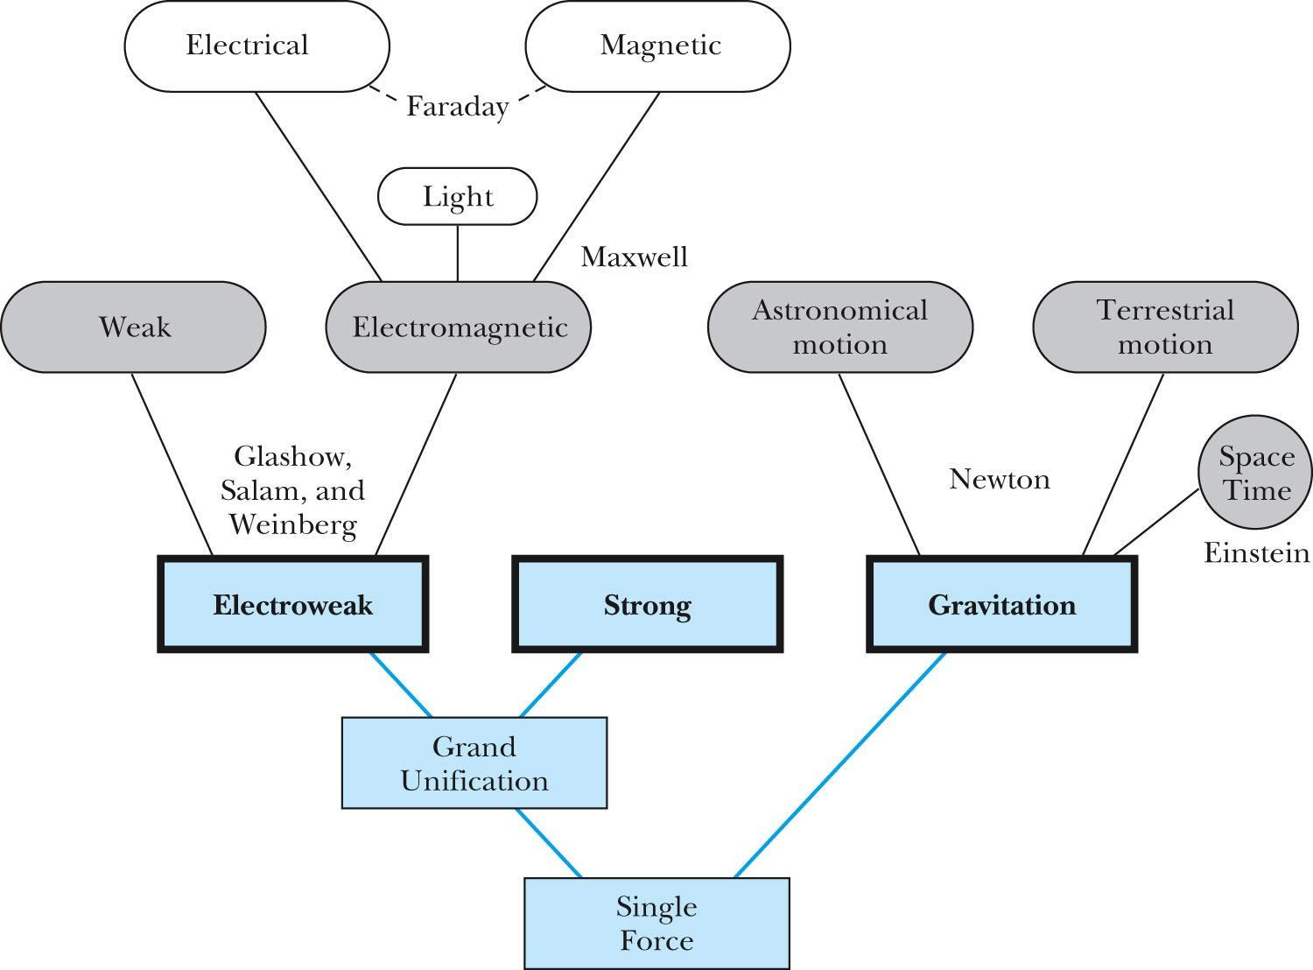
Goal: Unification of All Forces into a Single Force

Slide 45
1.5: The Atomic Theory of Matter
Initiated by Democritus and Leucippus (~450 B.C.)
(first to us the Greek atomos, meaning “indivisible”)
In addition to fundamental contributions by Boyle, Charles, and Gay-Lussac, Proust (1754 – 1826) proposes the law of definite proportions
Dalton advances the atomic theory of matter to explain the law of definite proportions
Avogadro proposes that all gases at the same temperature, pressure, and volume contain the same number of molecules (atoms); viz. 6.02 × 10²³ atoms per mole
Cannizzaro (1826 – 1910) makes the distinction between atoms and molecules advancing the ideas of Avogadro.

Slide 46
Further Advances in Atomic Theory
Maxwell derives the speed distribution of atoms in a gas
Robert Brown (1753 – 1858) observes microscopic “random” motion of suspended grains of pollen in water
Einstein in the 20th century explains this random motion using atomic theory

Slide 47
Opposition to the Theory
Ernst Mach (1838 – 1916) opposes the theory on the basis of logical positivism, i.e., atoms being “unseen” place into question their reality
Wilhelm Ostwald (1853 – 1932) supports this premise but on experimental results of radioactivity, discrete spectral lines, and the formation of molecular structures

Slide 48
Overwhelming Evidence for Existence of Atoms
Max Planck (1858 – 1947) advances the concept to explain blackbody radiation by use of submicroscopic “quanta”
Boltzmann requires existence of atoms for his advances in statistical mechanics
Albert Einstein (1879 – 1955) uses molecules to explain Brownian motion and determines the approximate value of their size and mass
Jean Perrin (1870 – 1942) experimentally verifies Einstein’s predictions

Slide 49
1.6: Unresolved Questions of 1895 and New Horizons
The atomic theory controversy raises fundamental questions
It was not universally accepted
The constitutes (if any) of atoms became a significant question
The structure of matter remained unknown with certainty

Slide 50
Further Complications
Three fundamental problems:
The question of the existence of an electromagnetic medium
The problem of observed differences in the electric and magnetic field between stationary and moving reference systems
The failure of classical physics to explain blackbody radiation

Slide 51
Additional Discoveries Contribute to the Complications
Discovery of x-rays
Discovery of radioactivity
Discovery of the electron
Discovery of the Zeeman effect

Slide 52
The Beginnings of Modern Physics
These new discoveries and the many resulting complications required a revision of the fundamental physical assumptions that culminated in the huge successes of physics
To this end, the introduction of the modern theory of relativity and quantum mechanics becomes the starting point of this most fascinating revision.

Slide 53
Four forces video

