Slide 1
CHAPTER 4 Structure of the Atom
4.1 The Atomic Models of Thomson and Rutherford
4.2 Rutherford Scattering
4.3 The Classic Atomic Model
4.4 The Bohr Model of the Hydrogen Atom
4.5 Successes and Failures of the Bohr Model
4.6 Characteristic X-Ray Spectra and Atomic Number
4.7 Atomic Excitation by Electrons

Slide 2
4.1 The Atomic Models of Thomson and Rutherford
Pieces of evidence that scientists had in 1900 to indicate that the atom was not a fundamental unit:
There seemed to be too many kinds of atoms, each belonging to a distinct chemical element.
Atoms and electromagnetic phenomena were intimately related.
The problem of valence. Certain elements combine with some elements but not with others, a characteristic that hinted at an internal atomic structure.
The discoveries of radioactivity, of x rays, and of the electron

Slide 3
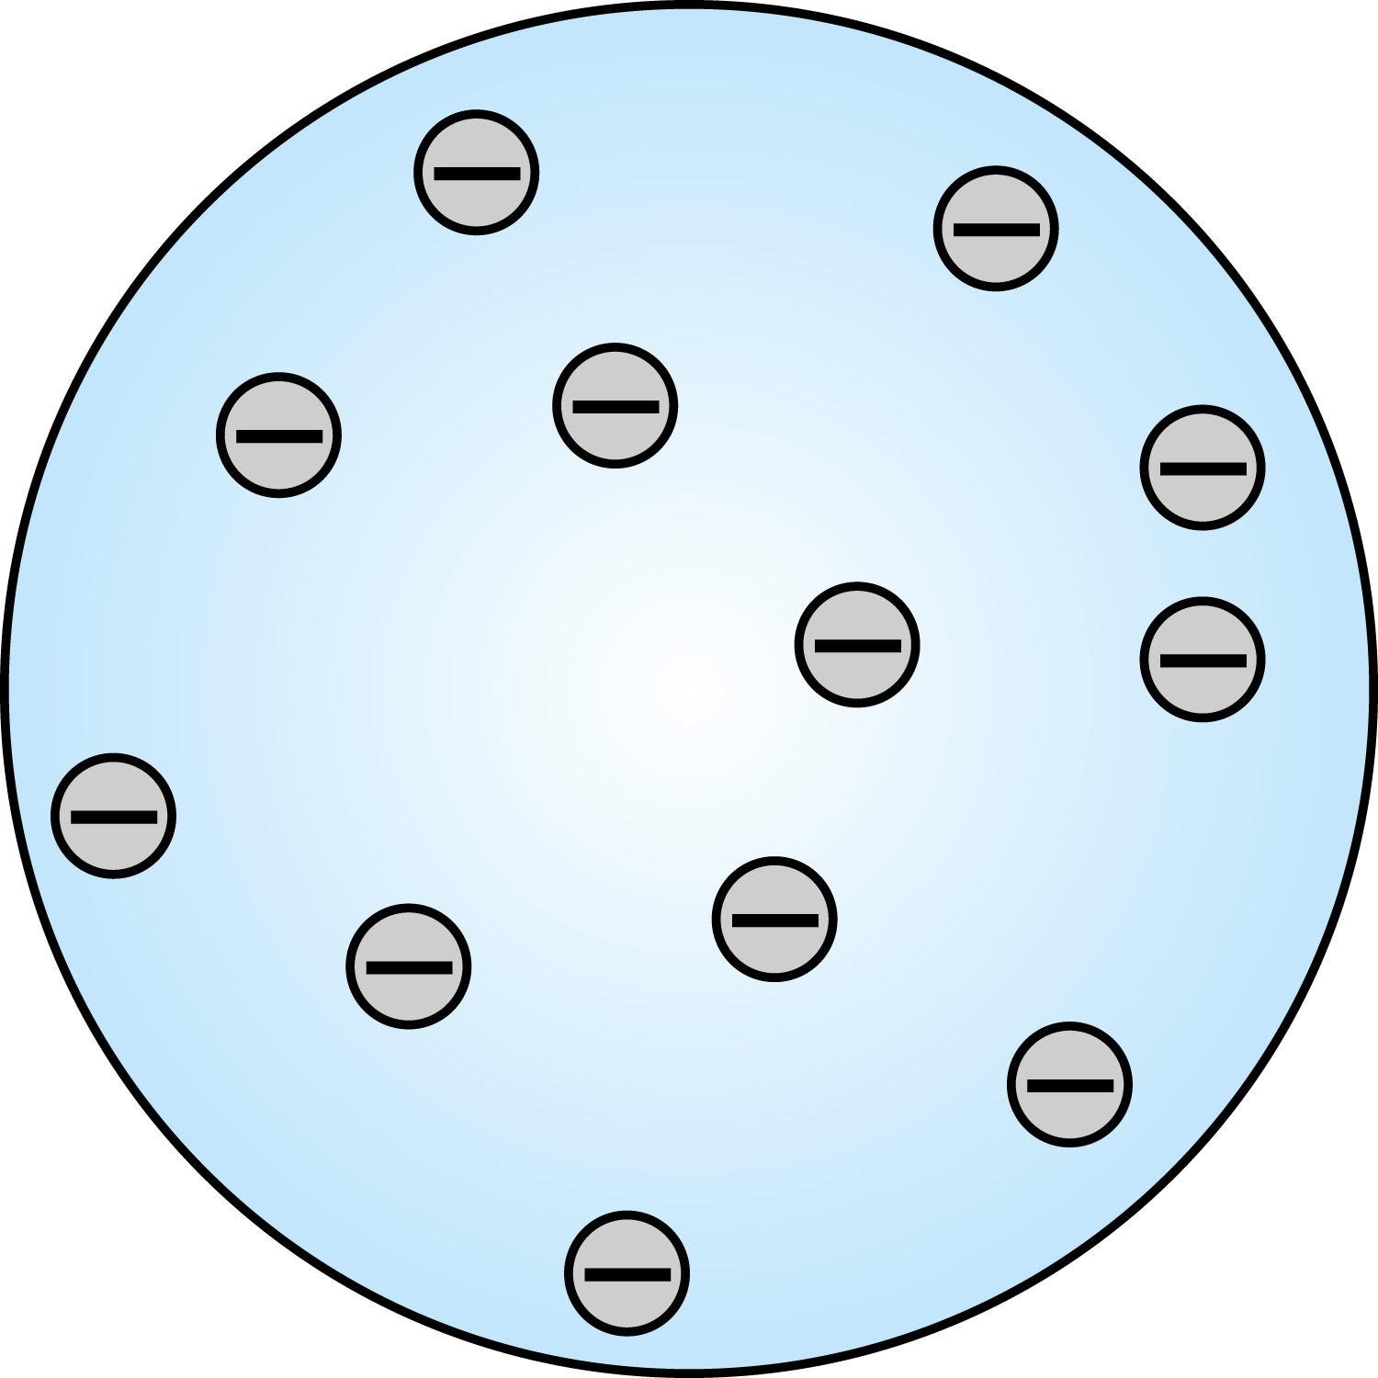
Thomson’s Atomic Model (turned out to be not correct)
Thomson’s “plum-pudding” model of the atom had the positive charges spread uniformly throughout a sphere the size of the atom with, the newly discovered “negative” electrons embedded in the uniform background.
In Thomson’s view, when the atom was heated, the electrons could vibrate about their equilibrium positions, thus producing electromagnetic radiation.
Alpha particles cannot be scattered through large angles in this model

Slide 4
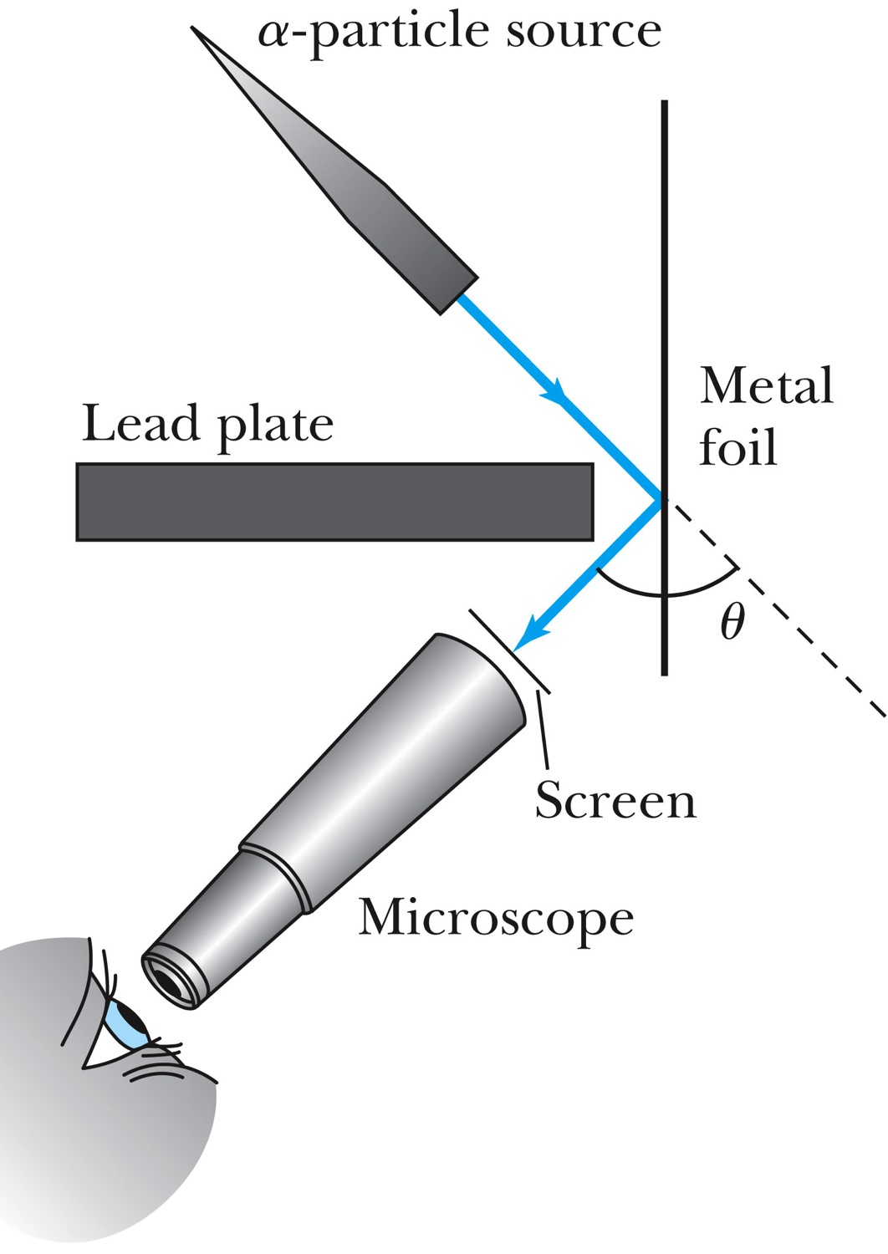
Experiments of Geiger and Marsden
Rutherford, Geiger, and Marsden conceived a new technique for investigating the structure of matter by scattering α particles from atoms.
Geiger showed that many α particles were scattered from thin gold-leaf targets at backward angles greater than 90°.
Schematic diagram of the ping –pong cannon

Slide 5
Rutherford’s Atomic Model (correct)
even if the α particle scattered from all 79 electrons in each atom of gold
The experimental results were not consistent with Thomson’s atomic model.
Rutherford proposed that an atom has a positively charged core (nucleus) surrounded by the negative electrons.

Slide 6
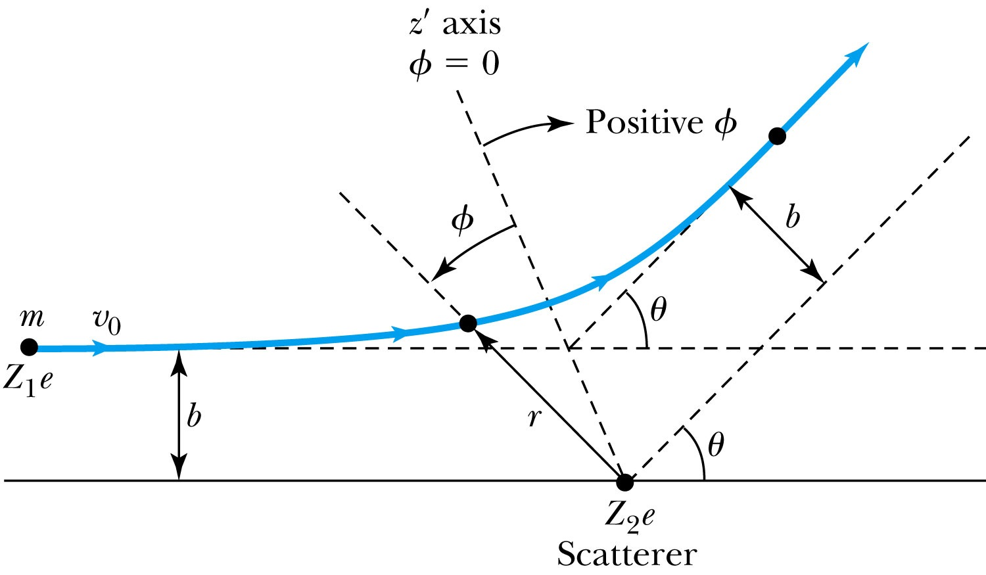
Rutherford Scattering
Scattering experiments help us study matter too small to be observed directly.
There is a relationship between the impact parameter b and the scattering angle θ.
When b is small,
r gets small.
Coulomb force gets large.
θ can be large and the particle can be repelled backward.

Slide 7
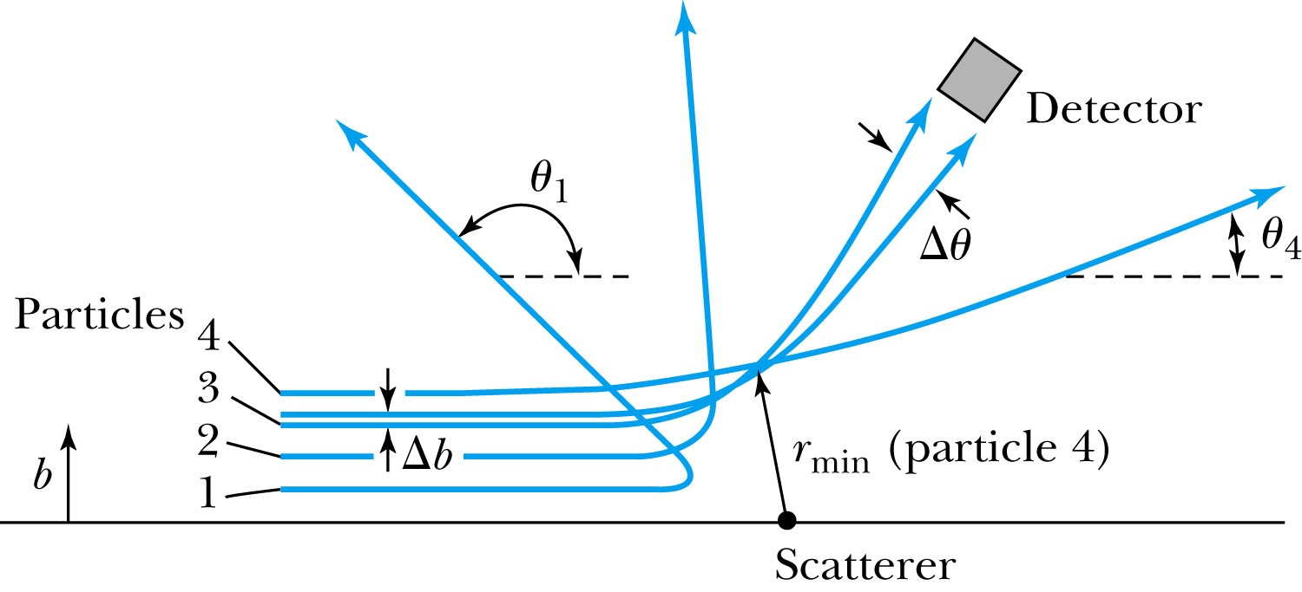
The Relationship Between the Impact Parameter b and the Scattering Angle
Figure 4.7 The relationship between the impact parameter b and scattering angle u. Particles with small impact parameters approach the nucleus most closely (rmin) and scatter to the largest angles. Particles within the range of impact parameters b will be scattered within u.

Slide 8
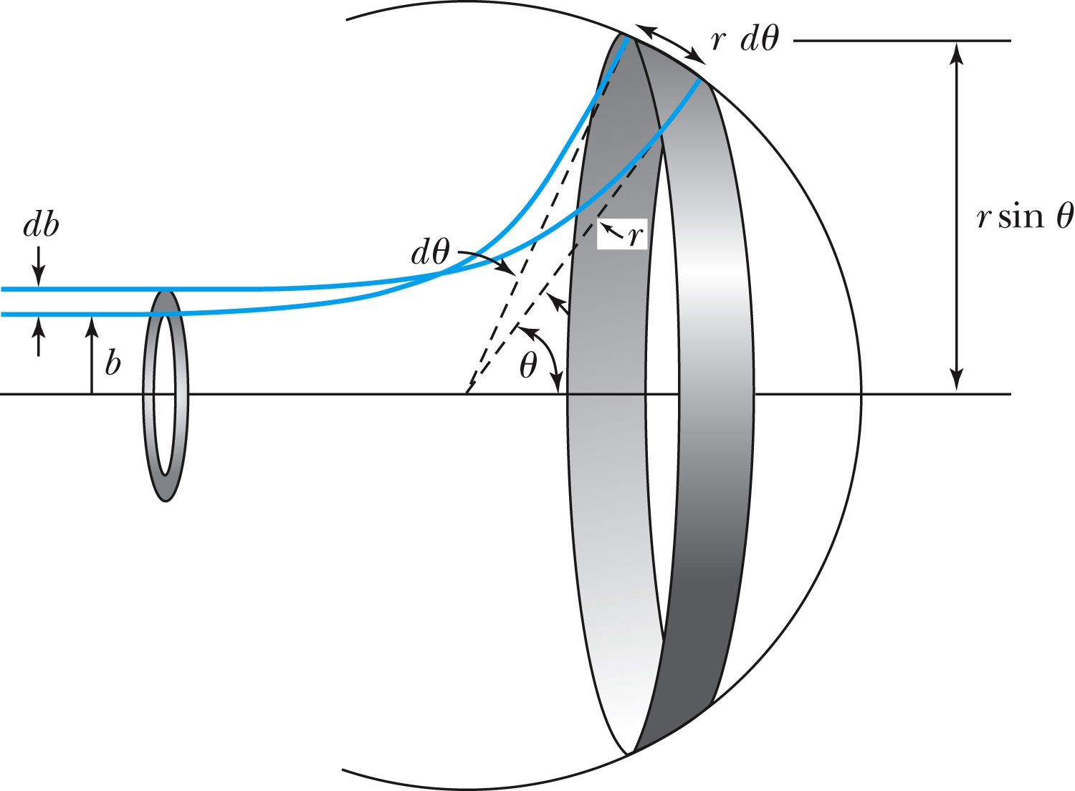
Rutherford Scattering Equation
In actual experiment a detector is positioned from θ to θ + dθ that corresponds to incident particles between b and b + db.
The number of particles scattered per unit area is

Slide 9
The Important Points
The scattering is proportional to the square of the atomic number of both the incident particle (Z₁) and the target scatterer (Z₂).
The number of scattered particles is inversely proportional to the square of the kinetic energy of the incident particle.
For the scattering angle , the scattering is proportional to 4th power of sin( /2).
The Scattering is proportional to the target thickness for thin targets.

Slide 10
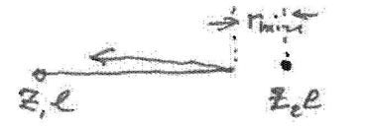
The distance of closest approach is in a head-on collision

Slide 11
Clicker - Questions
7) Indicate the true statement concerning Rutherford’s model of the atom
a) The electrons are in the center forming a negative nucleus with positive charges filling a larger volume.
b) All the positive charges are in the center forming a positive nucleus, which can deflect α-particles through a large angle.
c) α-particles scattering produces small angle scattering from the nucleus.
d) α-particles are attracted by the positive nucleus.

Slide 12
From the inside cover of the Modern Physics textbook

Slide 13
4.3: The Classical Atomic Model
As suggested by the Rutherford Model the atom consisted of a small, massive, positively charged nucleus surrounded by moving electrons. This then suggested consideration of a planetary model of the atom.
Let’s consider atoms as a planetary model.
The force of attraction on the electron by the nucleus and Newton’s 2nd law give
where v is the tangential velocity of the electron.
The total energy is
Radial acceleration
a=v^2 / r

Slide 14
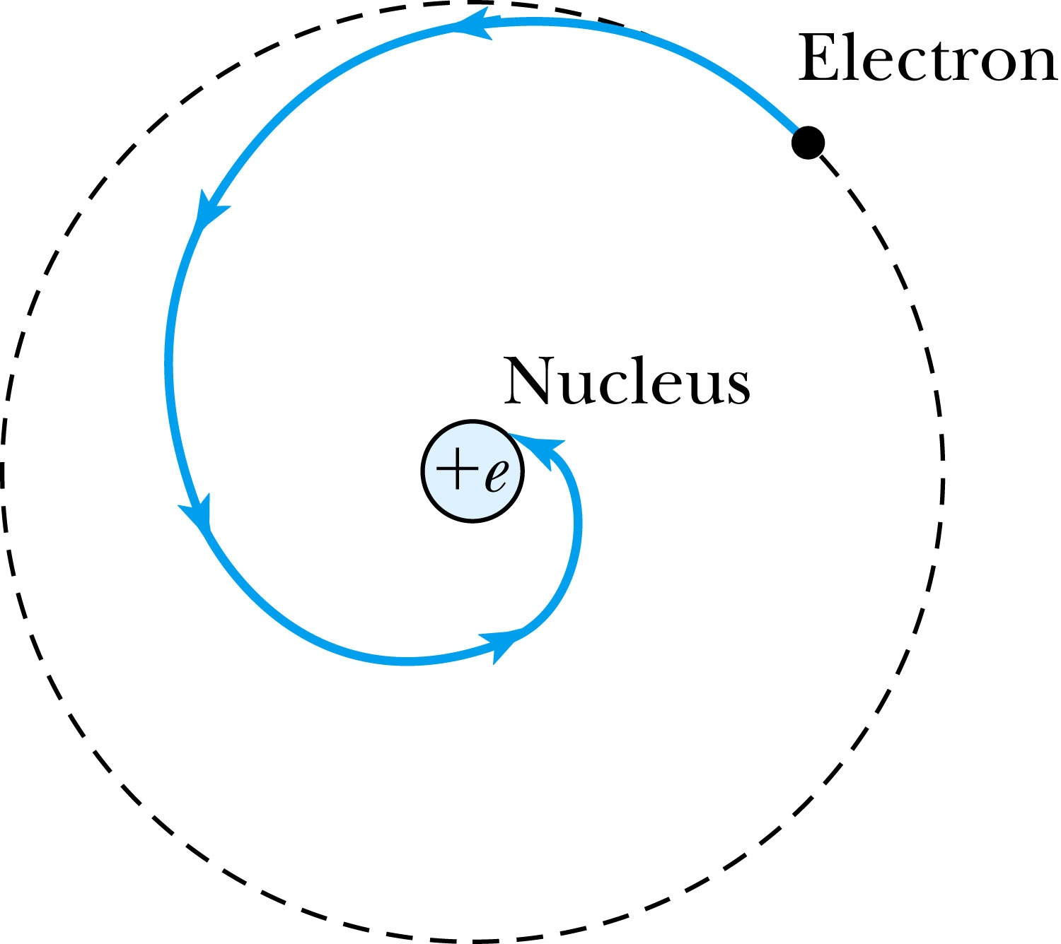
The Planetary Model is Doomed
From classical E&M theory, an accelerated electric charge radiates energy (electromagnetic radiation) which means total energy must decrease. Radius r must decrease!!
Electron crashes into the nucleus!?
Physics had reached a turning point in 1900 with Planck’s hypothesis of the quantum behavior of radiation.

Slide 15
4.4: The Bohr Model of the Hydrogen Atom
Bohr’s dramatic general assumptions:
“Stationary” states or orbits must exist in atoms, i.e., orbiting electrons do not radiate energy in these orbits. These orbits or stationary states are of a fixed definite energy E.
The emission or absorption of electromagnetic radiation can occur only in conjunction with a transition between two stationary states. The frequency, f, of this radiation is proportional to the difference in energy of the two stationary states:
E = E₁ − E₂ = hf
where h is Planck’s Constant
D. Classical laws of physics do not apply to transitions between stationary states.
The mean kinetic energy of the electron-nucleus system is K = nhf_{orb}/2, where f_{orb} is the frequency of rotation. This is equivalent to the angular momentum of a stationary state to be an integral multiple of h/2
L=mvr=nh/2

Slide 16
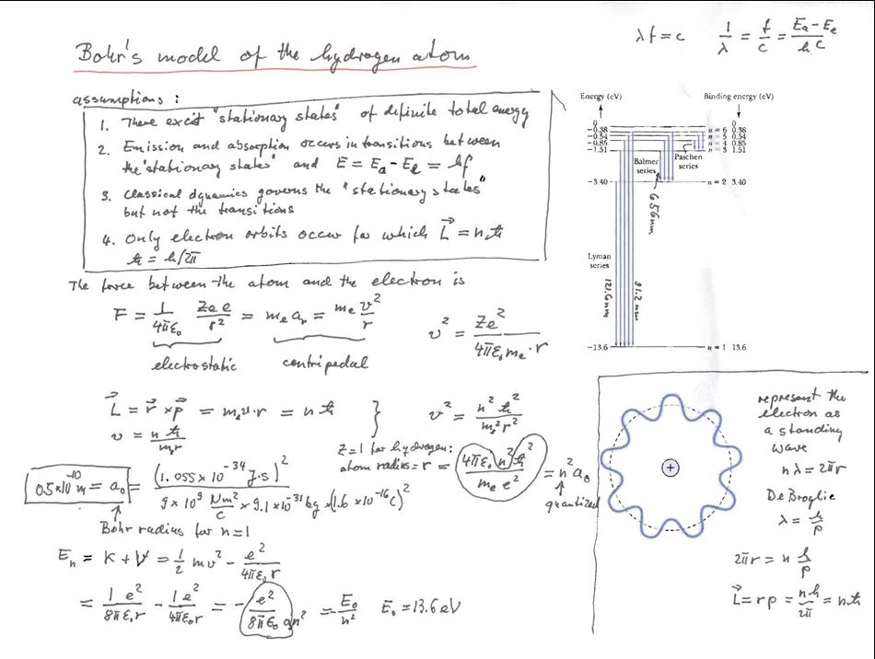
Summary: Bohr’s model of the hydrogen atom

Slide 17
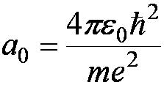
Bohr Radius
The diameter of the hydrogen atom for stationary states is
Where the Bohr radius is given by
The smallest diameter of the hydrogen atom is
n = 1 gives its lowest energy state (called the “ground” state)

Slide 18
Chapter 4 quiz question
In his calculations, Bohr came across a number now called
the "Bohr radius". This number is 5.29 x 10-11 m and is
a.The maximum radius of the hydrogen atom.
b.The minimum radius of the hydrogen atom.
c.The average radius of the hydrogen atom.
d. The minimum radius of atoms of all elements.
e.The maximum radius of atoms of all elements.

Slide 19
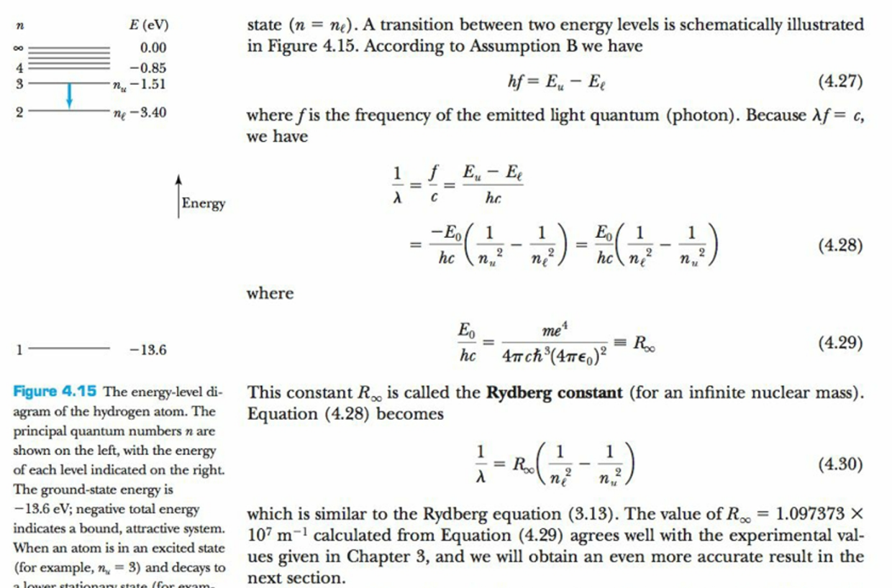
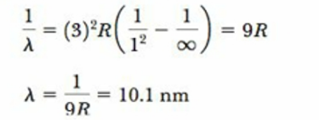
Rydberg equation
Calculate the shortest wavelength of the Li ++ ion

Slide 20
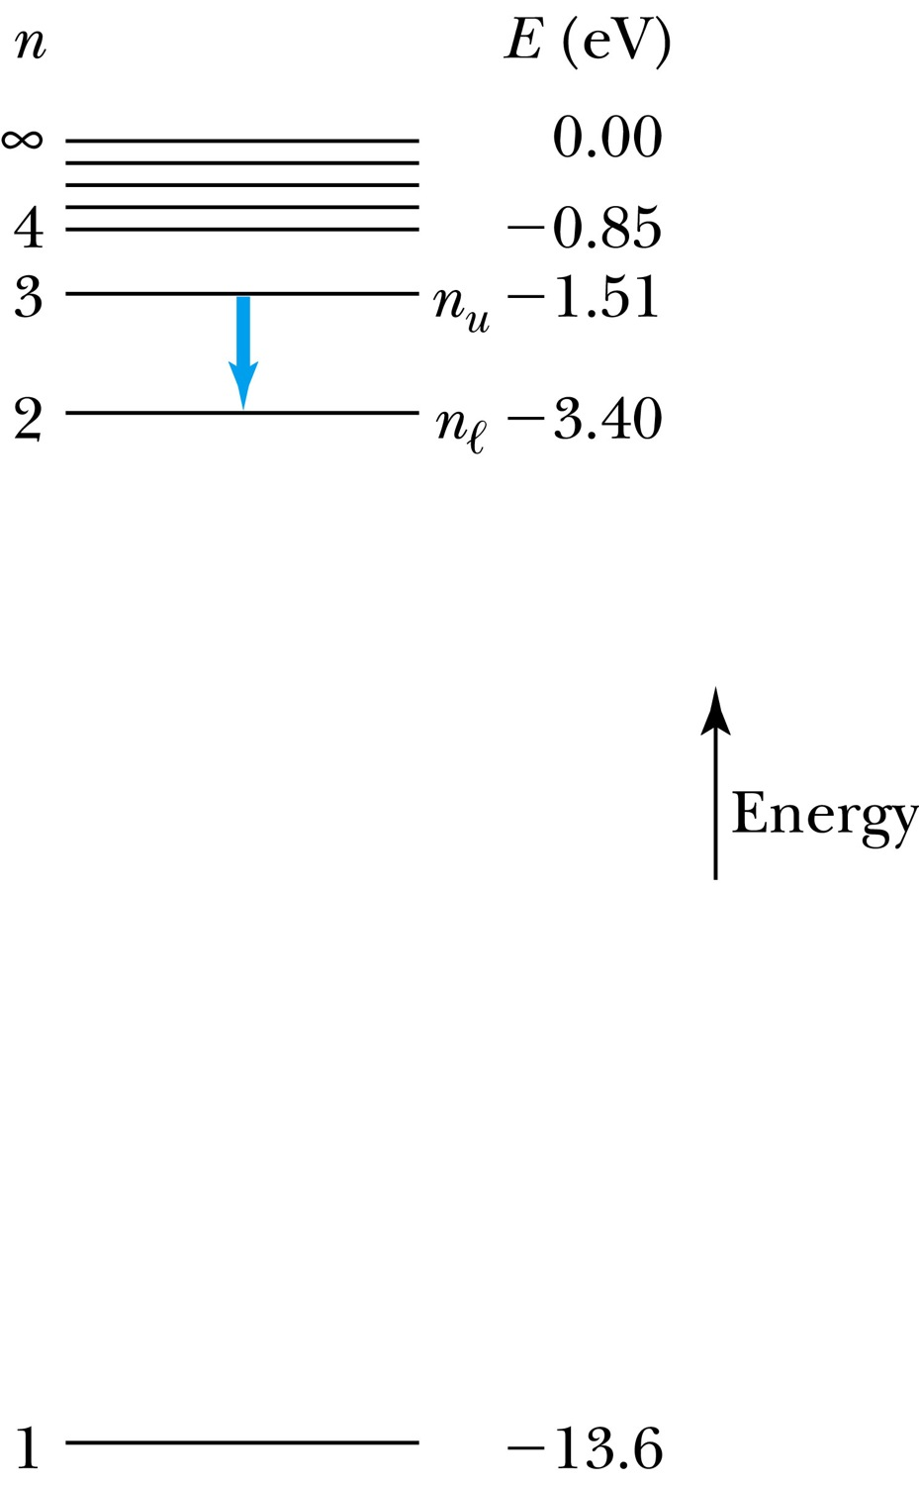
The Hydrogen Atom
The energies of the stationary states
where E₀ = 13.6 eV
Emission of light occurs when the atom is in an excited state and decays to a lower energy state (n_{u} → n_{ℓ}).
where f is the frequency of a photon.
R∞ is the Rydberg constant.

Slide 21
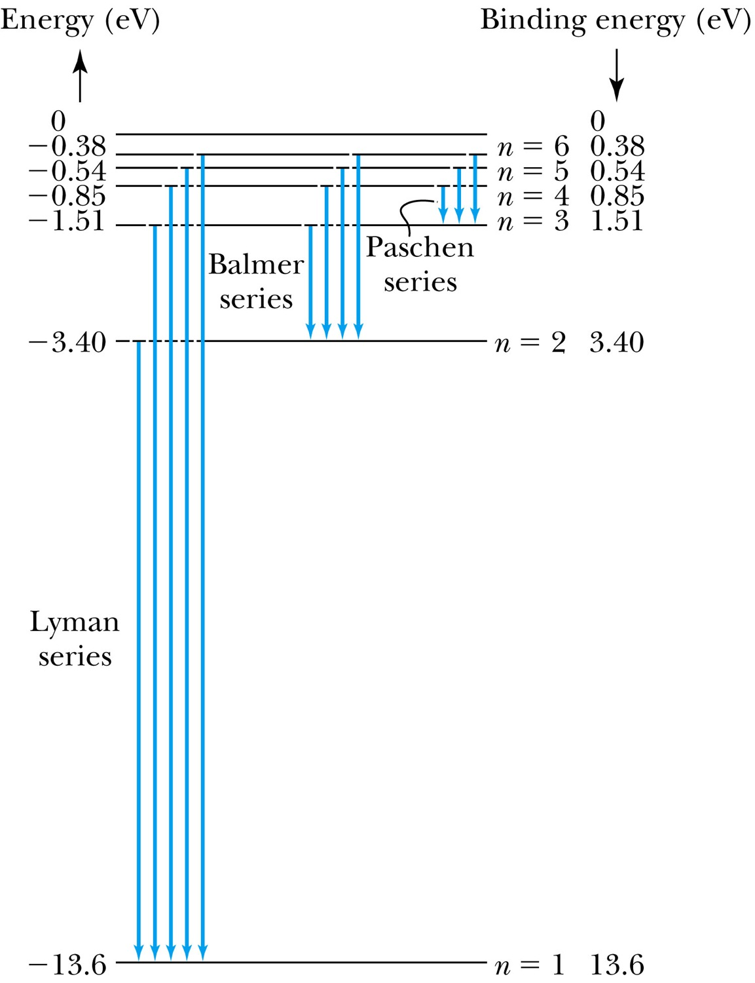
Transitions in the Hydrogen Atom
Lyman series
The atom will remain in the excited state for a short time before emitting a photon and returning to a lower stationary state. All hydrogen atoms exist in n = 1 (invisible).
Balmer series
When sunlight passes through the atmosphere, hydrogen atoms in water vapor absorb the wavelengths (visible).

Slide 22
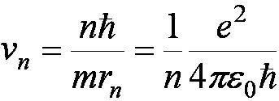
Fine Structure Constant
The electron’s velocity in the Bohr model:
On the ground state,
v₁ = 2.2 × 10⁶ m/s ~ less than 1% of the speed of light
The ratio of v₁ to c is the fine structure constant.

Slide 25
Clicker - Questions
1) Indicate in which atom the electron is most strongly bound?
a) H
b) He⁺
c) Li⁺⁺

Slide 26
Clicker - Questions
4) The diameter of the stationary states of the H-atom is increasing with n
a) Linearly
b) Quadratically
c) With the varying Bohr’s radius
d) Inversely

Slide 27
Clicker - Questions
5) The Bohr radius is 0.5x10⁻¹⁰ m.What is the radius of the stationary state with n=2 ?
a) 2x10⁻¹⁰ m
b) 1x10⁻¹⁰ m
c) 4.5x10⁻¹⁰ m
d) 0.25x10⁻¹⁰ m

Slide 28
The Correspondence Principle
Classical electrodynamics
Bohr’s atomic model
+
Determine the properties
of radiation
Need a principle to relate the new modern results with classical ones.
Bohr’s correspondence
principle
In the limits where classical and quantum theories should agree, the quantum theory must reduce the classical result.

Slide 29
Clicker - Questions
7) Indicate the true statement concerning Rutherford’s model of the atom
a) The electrons are in the center forming a negative nucleus with positive charges filling a larger volume.
b) All the positive charges are in the center forming a positive nucleus, which candeflect α-particles through a large angle.
c) α-particles scattering produces small angle scattering from the nucleus.
d) α-particles are attracted by the positive nucleus.

Slide 30
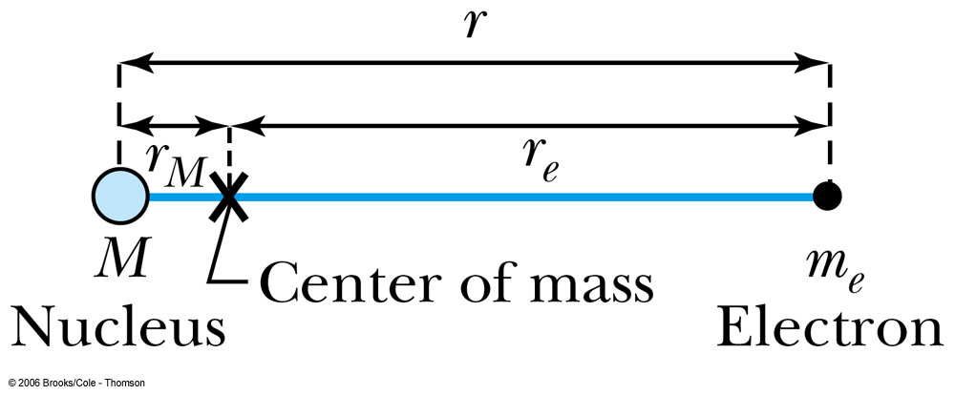
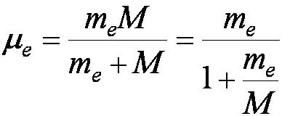
4.5: Successes and Failures of the Bohr Model
The electron and hydrogen nucleus actually revolved about their mutual center of mass.
The electron mass is replaced by its reduced mass.
The Rydberg constant for infinite nuclear mass is replaced by R.

Slide 31
APPENDIX 7 Particle masses

Slide 32
Problem 4.36
Calculate the Rydberg constant for the single- electron (hydrogen-like) ions of helium, potassium, and uranium. Compare each of them with R and determine the percentage difference.
APPENDIX 5 Atomic Mass Table

Slide 34
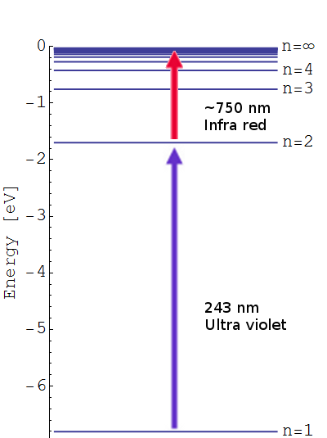
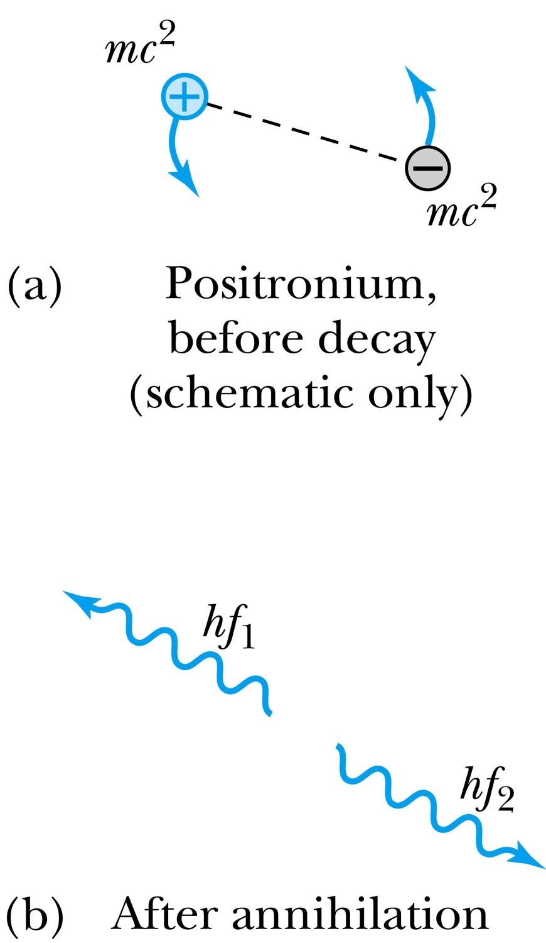
Positronium energy levels
Use reduced mass

Slide 35
Mass of muon = 105.7MeV/c 2 =200 times he mass of the electron

Slide 36
Limitations of the Bohr Model
The Bohr model was a great step of the new quantum theory,
but it had its limitations.
Works only to single-electron atoms
Could not account for the intensities or the fine structure of the spectral lines
Could not explain the binding of atoms into molecules

Slide 37
X-rays revisited
Bremsstrahlung=braking radiation has sharp lines in it

Slide 38
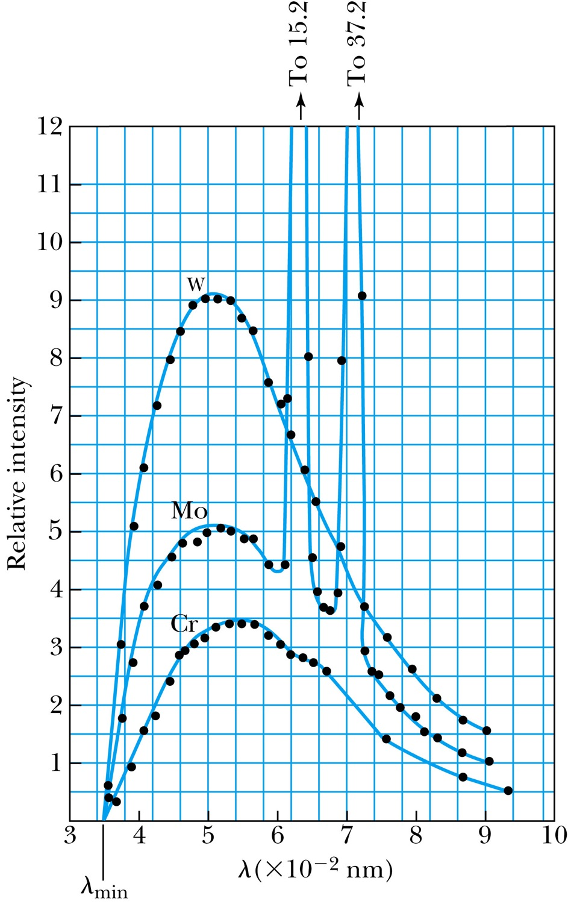
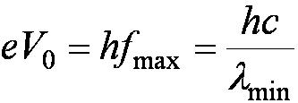
Inverse Photoelectric Effect (slide from Chapter3).
Conservation of energy requires that the electron kinetic energy equal the maximum photon energy where we neglect the work function because it is normally so small compared to the potential energy of the electron. This yields the Duane-Hunt limit which was first found experimentally. The photon wavelength depends only on the accelerating voltage and is the same for all targets.
K(alpha) and K(beta) of Mo

Slide 39
4.6: Characteristic X-Ray Spectra and Atomic Number Many electron atoms
Shells have letter names:
K shell for n = 1
L shell for n = 2
The atom is most stable in its ground state.
When it occurs in a heavy atom, the radiation emitted is an x ray.
It has the energy E (x ray) = E_{u} − E_{ℓ}.
For this to happen an inner shell vacancy has to be produced(for instance by a high energy electron collision) in Roentgen’s discovery of X-rays
An electron from higher shells will fill the inner-shell vacancy at lower energy.

Slide 40
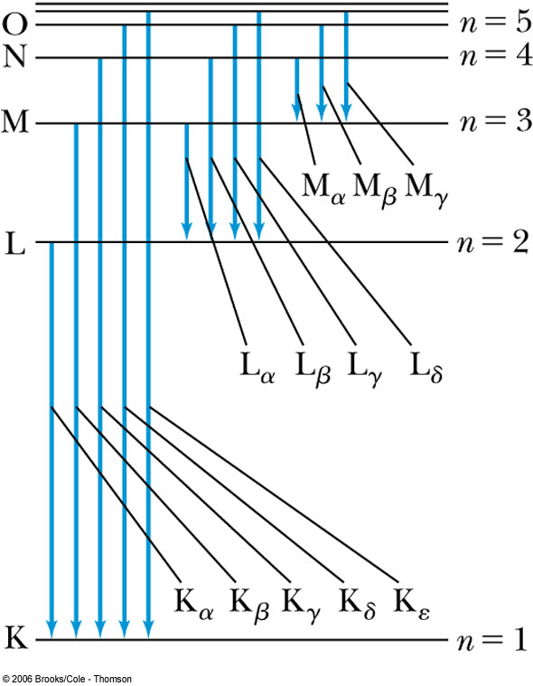
Atomic Number
E (x ray) = E_{u} − E_{ℓ}.
L shell to K shell K_{α} x ray
M shell to K shell K_{β} x ray
Atomic number Z = number of protons in the nucleus
Moseley found a relationship between the frequencies of the characteristic x ray and Z.
This holds for the K_{α} x ray

Slide 41
Chapter4 quiz question
Characteristic x-ray spectra come from
a. bremsstrahlung processes for electrons close to the nucleus.
b.electrons transitioning down from an outer shell replace electrons ejected from an inner shell.
c.random excitations of electrons when atoms are near room temperature.
d.photons scattering off of electrons, thereby losing energy and emitting radiation.

Slide 42
Clicker - Questions
9) The k_{α}-xray comes from transition of an electron;
a) From the L-shell to a vacancy in the k-shell
b) From the M-shell to a vacancy in the k-shell
c) From the M-shell to a vacancy in the L-shell
d) From the U-shell to a vacancy in the k-shell

Slide 43
Moseley’s Empirical Results
The K_{α} x ray is produced from n = 2 to n = 1 transition.
In general, the K series of x ray wavelengths are
Moseley’s research clarified the importance of the electron shells for all the elements, not just for hydrogen.
An electron in the L shell feels the effective charge Z-1 due +Ze of the nucleus and –e from the remaining electron in the K shell electron

Slide 45
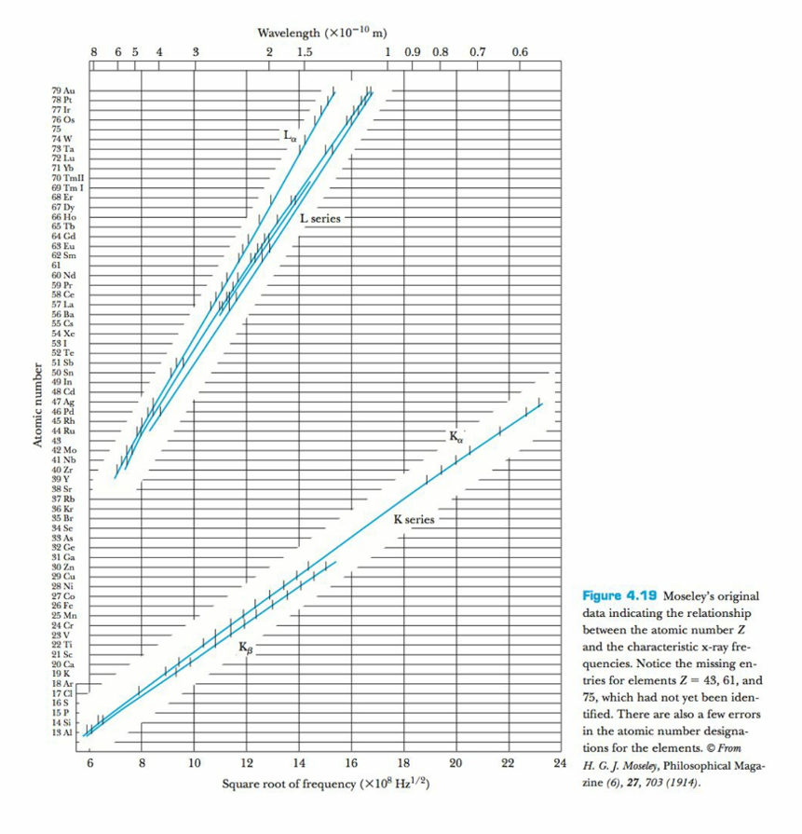
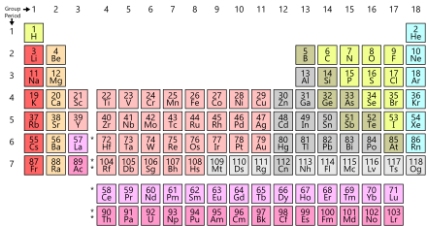
Mosely plot the atomic number Z is responsible for ordering the periodic table
Notice the missing entries for Z=43,61 and 75
Promethium(Z=61) discovered in 1940
Appendix 5 Atomic Mass Table

Slide 46
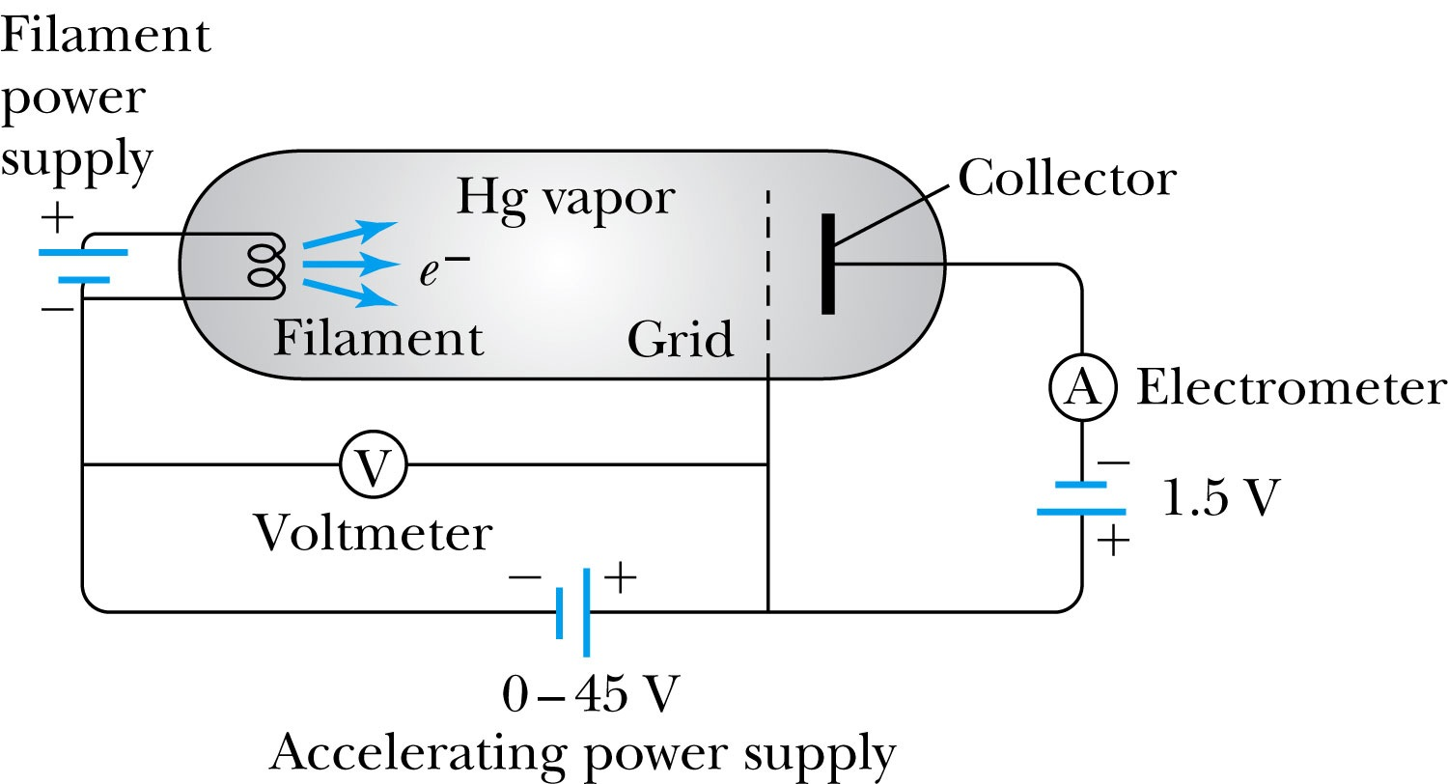
4.7: Atomic Excitation by Electrons
Franck and Hertz studied the phenomenon of ionization.
Accelerating voltage is below 5 V
electrons did not lose energy
Accelerating voltage is above 5 V
sudden drop in the current

Slide 47
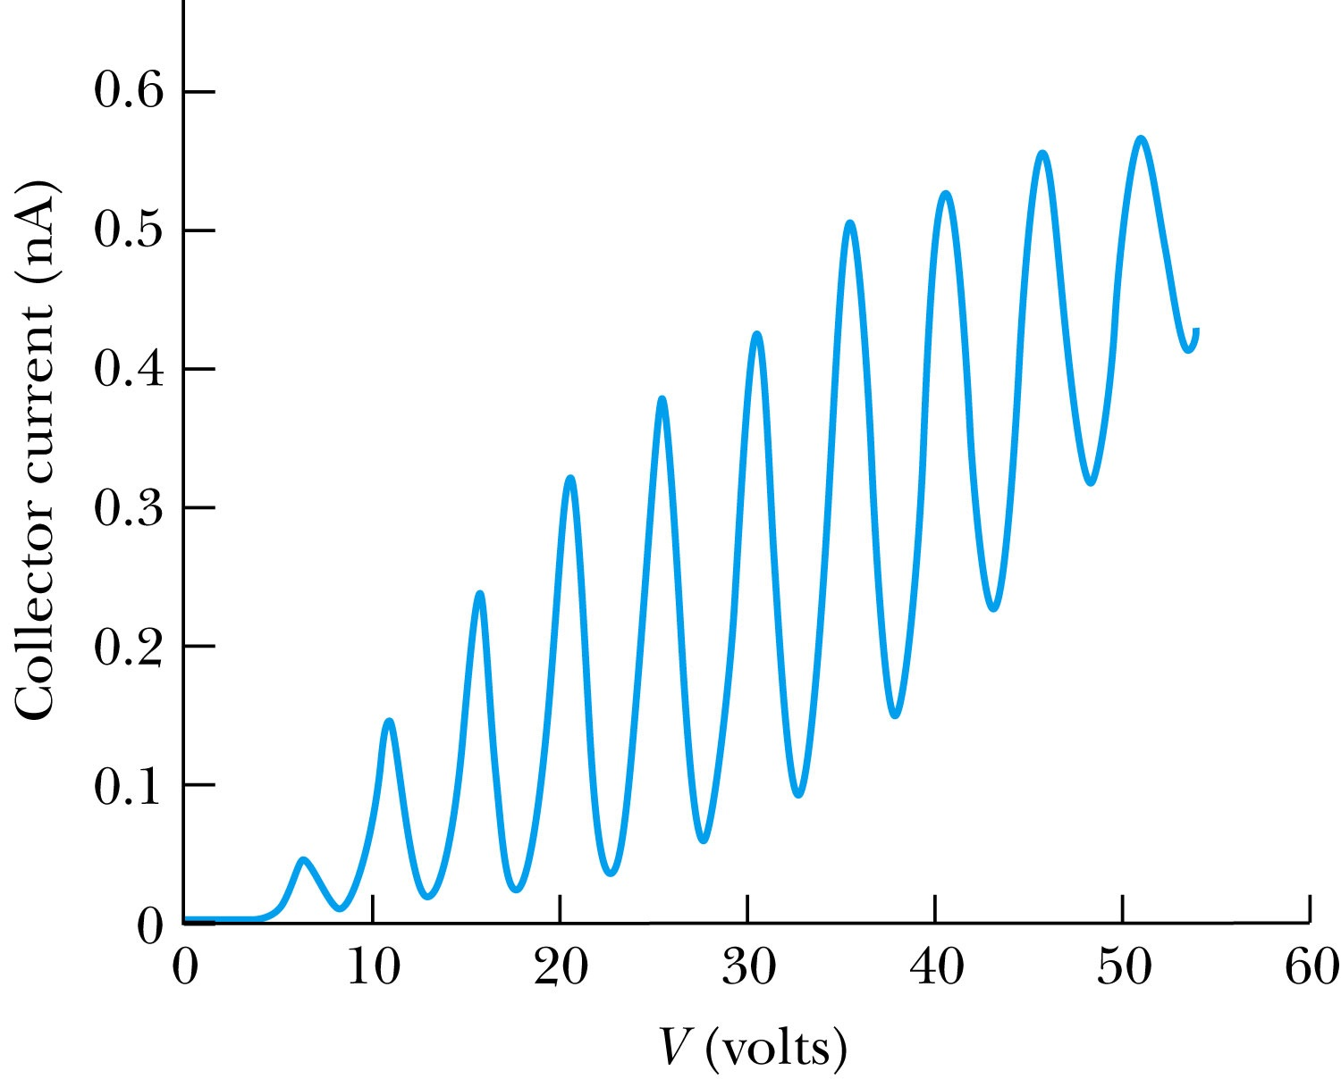
Atomic Excitation by Electrons
Ground state has E₀ to be zero.
First excited state has E₁.
The energy difference E₁ − 0 = E₁ is the excitation energy.
Hg has an excitation energy of 4.88 eV in the first excited state
No energy can be transferred to Hg below 4.88 eV because not enough energy is available to excite an electron to the next energy level
Above 4.88 eV, the current drops because scattered electrons no longer reach the collector until the accelerating voltage reaches 9.8 eV and so on.

Slide 48
Problem 4.46 Why is the small negative potential difference between grid and collector plate necessary??
Without the negative potential an electron with any energy, no matter how small, could drift into the collector plate. As a result the electron could give up its kinetic energy to a Hg atom and still contribute to the plate current. The Franck-Hertz curve would not show the distinguishing periodic drops, but rather would rise monotonically.
.

Slide 49
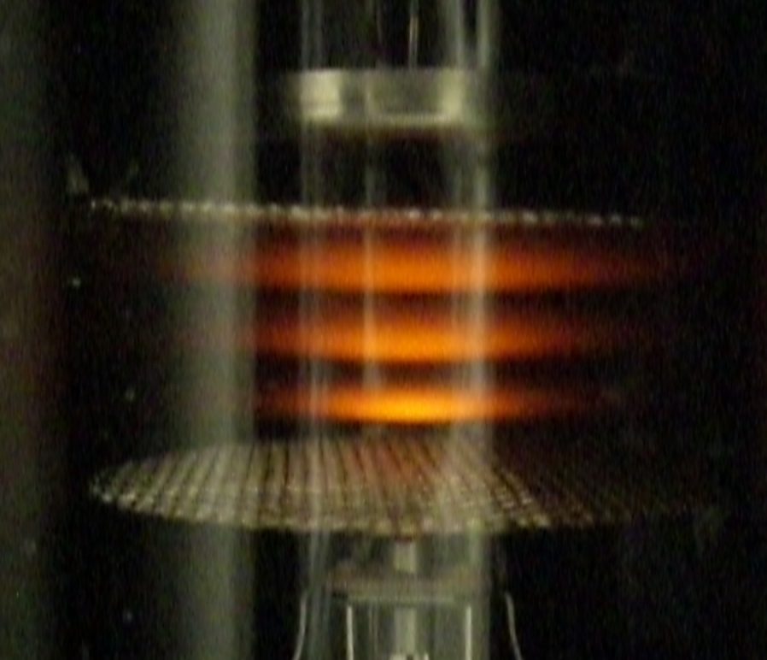
frFFr
Neon

Slide 50
Clicker - Questions
2) In the Franck-Hertz experiment the electron loses energy by
a) Ionization of a Hg atom
b) Excitation of a Hg atom to the first excited state
c) Excitation to the second excited state of a Hg atom
d) By being captured by a Hg atom

Slide 51
Clicker - Questions
3) In the Franck-Hertz experiment the electron collides with a Hg atom in an
a) Elastic Collision
b) Inelastic Collision
c) Grazing Collision
d) Orbiting Collision

Slide 52
Problem 4.47
Determine Planck’s constant from the Frank Hertz experiment in Hg vapor
h = 6.6261x 10 ^{-34 J s}

