Slide 1
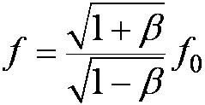
The Relativistic Doppler Effect (con’t)
Equations (2.32) and (2.33) can be combined into one equation if we agree to use a + sign for β (+v/c) when the source and receiver are approaching each other and a – sign for β (– v/c) when they are receding. The final equation becomes
Relativistic Doppler effect (2.34)

Slide 2
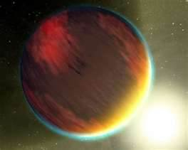
Application of the Doppler shift in Astronomy Detecting Extrasolar Planets
Great effort is made to discover earth-like planets in distant solar systems
Various techniques to detect Exoplanets via:
  the additional redshift caused by the star’s motion around a common center of gravity
  the induced change in position of its star
  the dimming of the star’s brightness during the transition of a planet
  the induced change of a another planet’s orbit
Habitable Earth-like exoplanets?
Notes:
Topic with much publicity: extrasolar planets
1st method: frequency measurement
Our business!
Habitable Earth-like exoplanets?

Slide 3
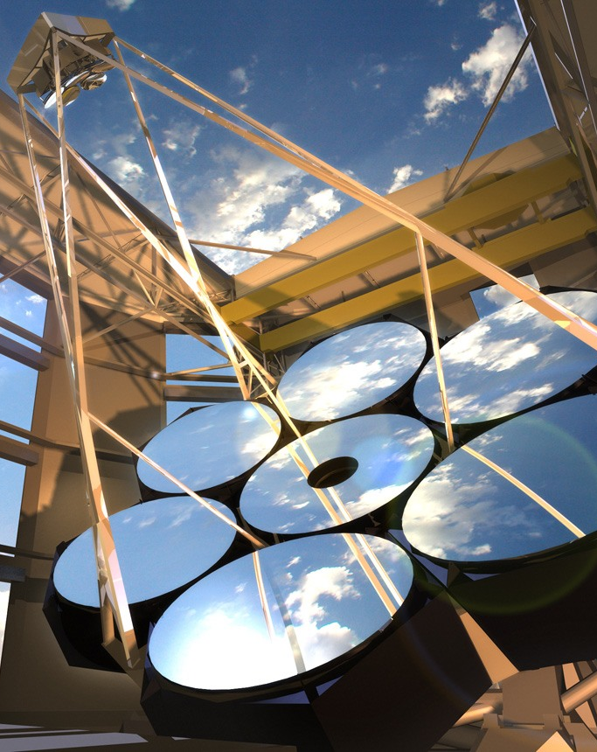
Touching Modern Physics in 2020-25
Giant Magellan Telescope
is a ground-based extremely large telescope under construction. It will consist of seven 8.4 m (27.6 ft) diameter primary segments,^{[1]} that will observe optical and near infrared (320–25000 nm^{[2]}) light, with the resolving power of a 24.5 m (80.4 ft) primary mirror and collecting area equivalent to a 22.0 m (72.2 ft) one,^{[3]} which is about 368 square meters.^{[4]} The telescope is expected to have a resolving power 10 times greater than the Hubble Space Telescope.

Slide 4


StoRy of GoldiLocks & the 3 bears
Once upon a time, there was a little girl named Goldilocks. She went for a walk in the forest. Pretty soon, she came upon a house. She knocked, and when no one answered, she walked right in…
At the table in the kitchen, there were three bowls of porridge.
  “This porridge is too hot!”
  “This porridge is too cold!”
  “This porridge is just right!”
She also tried out each of the three chairs and three beds.
  Too big, Too small, Too hard, Too soft, and Just Right

Slide 5
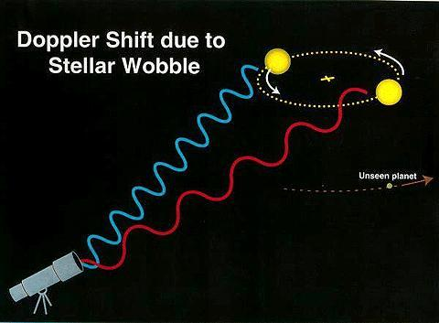
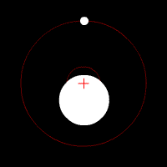
RV search for exo - Planets
Radial Velocity
Variations induced
by exo-planets

Slide 6
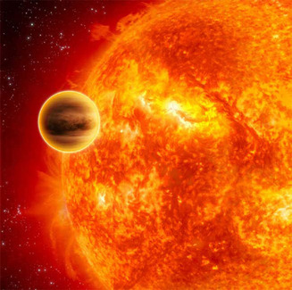
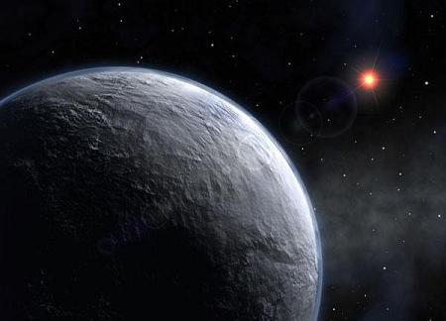
Detecting Extra Solar Planets
As of September 1 2022 there are
5,157 exoplanets discovered
smallest planet detected so far:
5-Earth-mass
corresponding precision: 60 cm/s required
precision for an Earth-mass
object in an Earth-like orbit
around a Sun-like star:
5 cm/s (50 kHz)
long term stability over years
Notes:
617 known

Slide 7
2.11: Relativistic Momentum
Because physicists believe that the conservation of momentum is fundamental, we begin by considering collisions where there do not exist external forces and
dP/dt = F_{ext} = 0

Slide 8
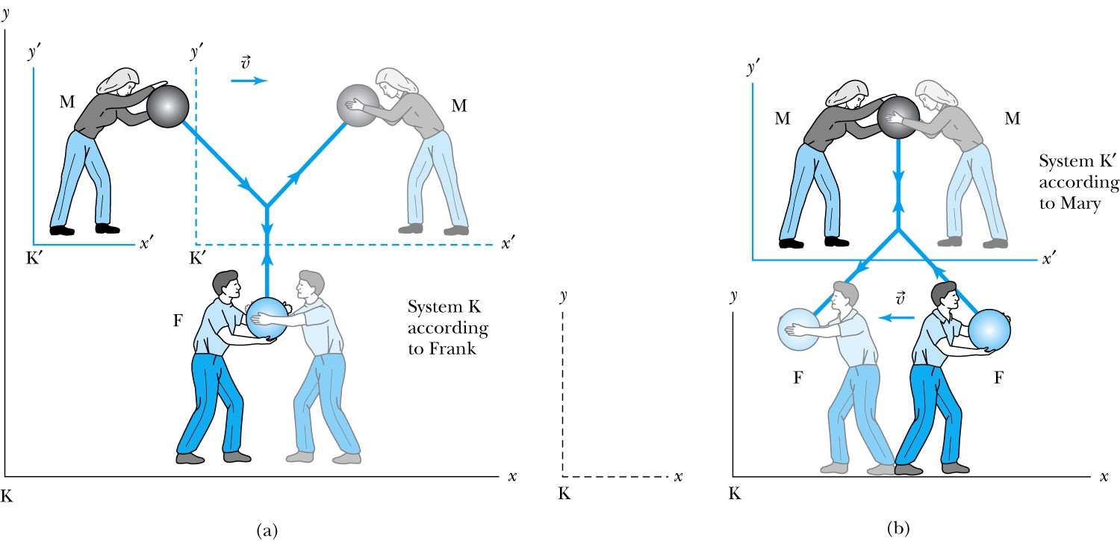
Relativistic Momentum
Frank (fixed or stationary system) is at rest in system K holding a ball of mass m. Mary (moving system) holds a similar ball in system K that is moving in the x direction with velocity v with respect to system K.
Notes:
Add paragraph from figure 2.29

Slide 9
Relativistic Momentum
If we use the definition of momentum, the momentum of the ball thrown by Frank is entirely in the y direction:
p_{Fy} = mu₀
The change of momentum as observed by Frank is
Δp_{F} = Δp_{Fy} = −2mu₀

Slide 10

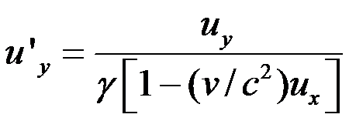

According to Mary (the Moving frame)
Mary measures the initial velocity of her own ball to be u’_{Mx} = 0 and u’_{My} = −u₀.
In order to determine the velocity of Mary’s ball as measured by Frank we use the velocity transformation equations:
(we used velocity summation formula
with u_{x}=0)

Slide 11


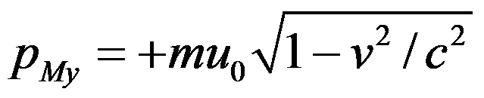

Relativistic Momentum
Before the collision, the momentum of Mary’s ball as measured by Frank (the Fixed frame) becomes
Before
Before
For a perfectly elastic collision, the momentum after the collision is
After
After
The change in momentum of Mary’s ball according to Frank is
(2.42)
(2.43)
(2.44)
Notes:
Spaced a bit more evenly

Slide 12
Relativistic Momentum (con’t)
The conservation of linear momentum requires the total change in momentum of the collision, Δp_{F} + Δp_{M}, to be zero. The addition of Equations (2.40) and (2.44) clearly does not give zero.
Linear momentum is not conserved if we use the conventions for momentum from classical physics even if we use the velocity transformation equations from the special theory of relativity.
There is no problem with the x direction, but there is a problem with the y direction along the direction the ball is thrown in each system.
Δp_{F} = Δp_{Fy} = −2mu₀

Slide 13
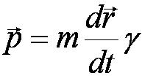

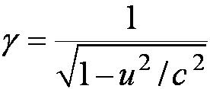
Relativistic Momentum
Rather than abandon the conservation of linear momentum, let us look for a modification of the definition of linear momentum that preserves both it and Newton’s second law.
To do so requires reexamining mass to conclude that:
Relativistic momentum (2.48)

Slide 14
With modified (relativistic) momentum (Example 2.9 )
Now Δp_{F} + Δp_{M} =0
and momentum conserved!

Slide 15
Relativistic Momentum: two points of view
physicists like to refer to the mass in Equation (2.48) as the rest mass m₀ and call the term m = γm₀ the relativistic mass. In this manner the classical form of momentum, p=mu, is retained. The mass is then imagined to increase at high speeds.
physicists prefer to keep the concept of mass as an invariant, intrinsic property of an object. We adopt this latter approach and will use the term mass exclusively to mean rest mass.

Slide 16
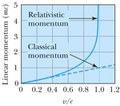
Behavior of relativistic momentum and classical momentum for v/c->1

Slide 17

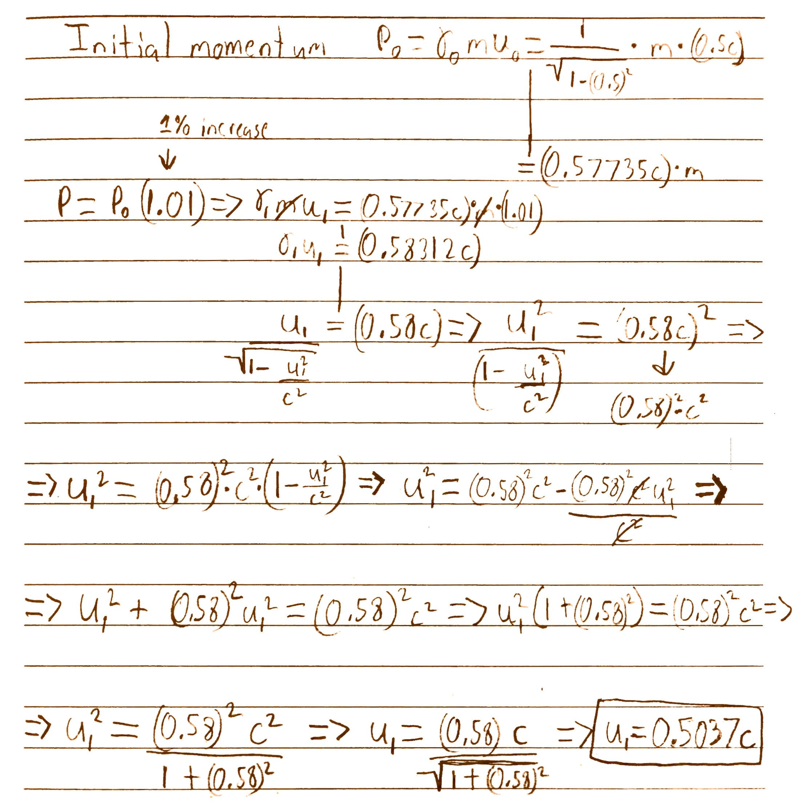
2.11
#60
(a)

Slide 18
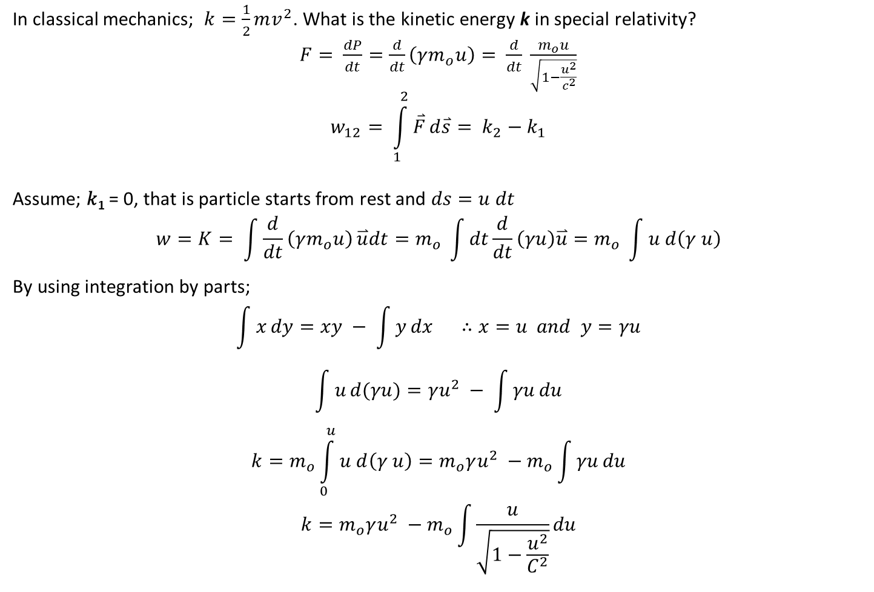
Relativistic Kinetic Energy

Slide 19
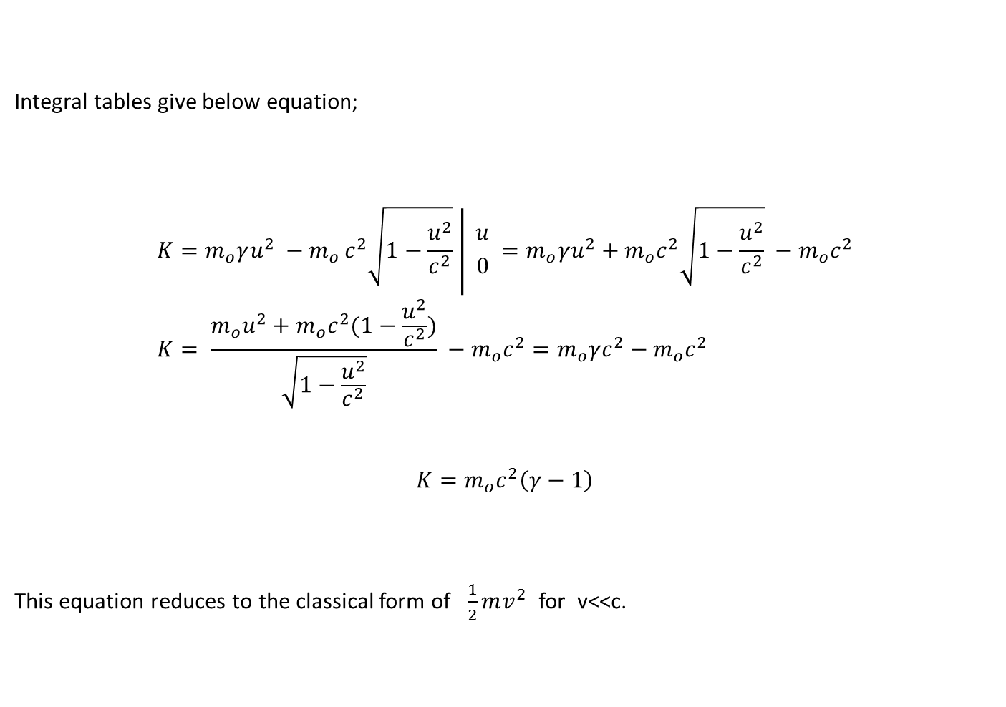

Slide 20
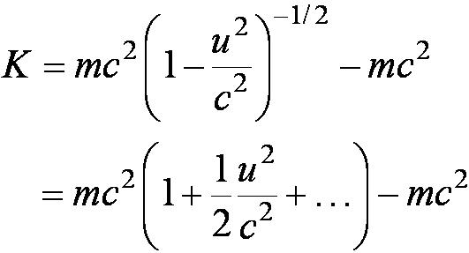
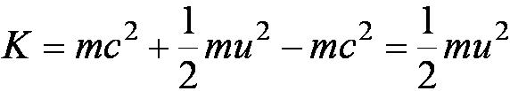
Relativistic Kinetic Energy
Equation (2.58) does not seem to resemble the classical result for kinetic energy, K = ½mu². However, if it is correct, we expect it to reduce to the classical result for low speeds. Let’s see if it does. For speeds u << c, we expand in a binomial series as follows:
where we have neglected all terms of power (u/c)⁴ and greater, because u << c. This gives the following equation for the relativistic kinetic energy at low speeds:
which is the expected classical result.
Notes:
Add con’t title

Slide 21
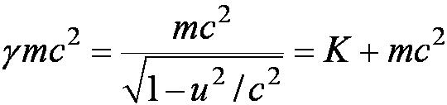

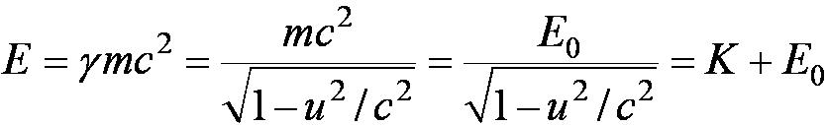
Total Energy and Rest Energy, Mass-energy Equivalence
We rewrite the energy equation in the form
The term mc² is called the rest energy and is denoted by E₀.
This leaves the sum of the kinetic energy and rest energy to be interpreted as the total energy of the particle. The total energy is denoted by E and is given by
(2.63)
(2.64)
(2.65)

Slide 22
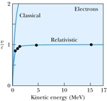
Kinetic Energy-Velocity (Relativistic and Classical )

Slide 23
The Equivalence of Mass and Energy
By virtue of the relation for the rest mass of a particle:
we see that there is an equivalence of mass and energy in the sense that “mass and energy are interchangeable”
Thus the terms mass-energy and energy are sometimes used interchangeably.
Notes:
Add this new slide

Slide 24
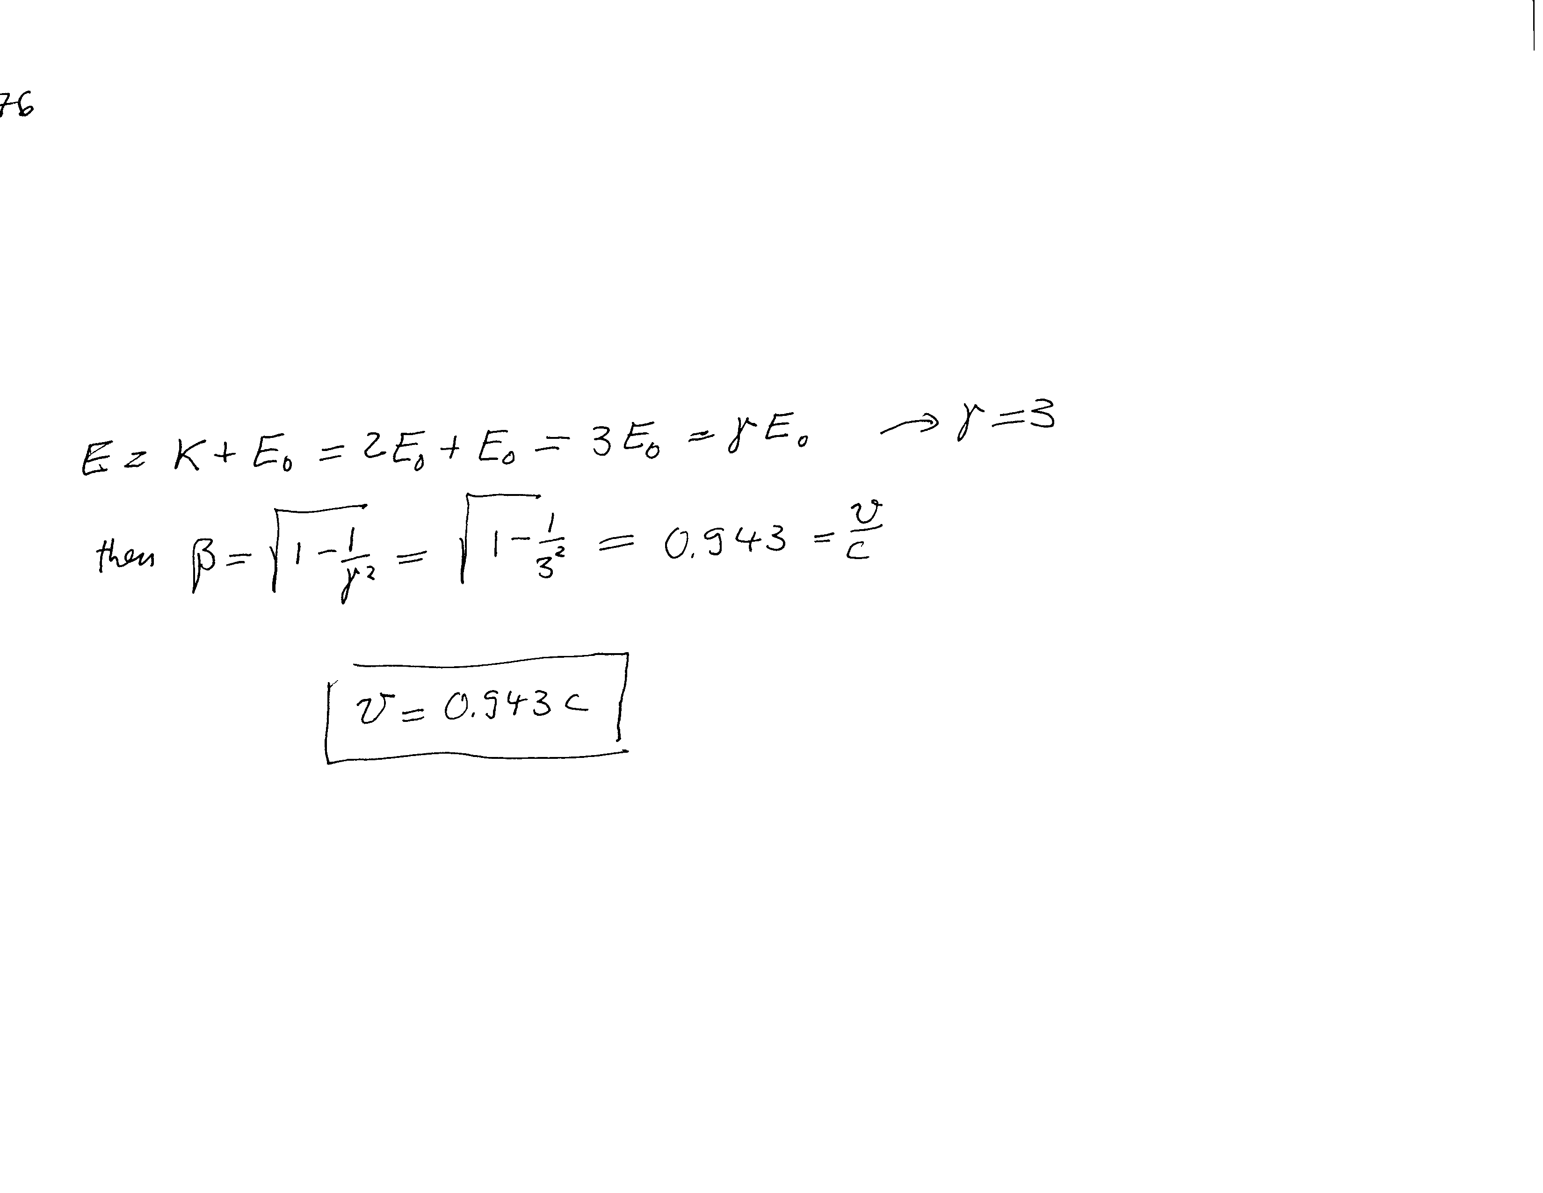

2.12#70

Slide 25

Problem 2.12 #75

Slide 26
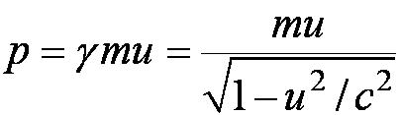

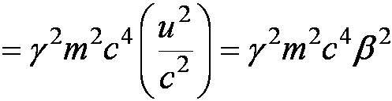
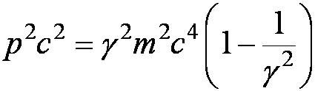

Relationship of Energy and Momentum
We square this result, multiply by c², and rearrange the result.
We use the equation for γ to express β² and find
Expressing β through γ
Notes:
Title rewritten

Slide 27



Energy and Momentum
The first term on the right-hand side is just E², and the second term is E₀². The last equation becomes
We rearrange this last equation to find the result we are seeking, a relation between energy and momentum.
or
Equation (2.70) is a useful result to relate the total energy of a particle with its momentum. The quantities (E² – p²c²) and m are invariant quantities. Note that when a particle’s velocity is zero and it has no momentum, Equation (2.70) correctly gives E₀ as the particle’s total energy.
(2.70)
(2.71)
Notes:
Changed title

Slide 28
Useful formulas
from
and

Slide 29
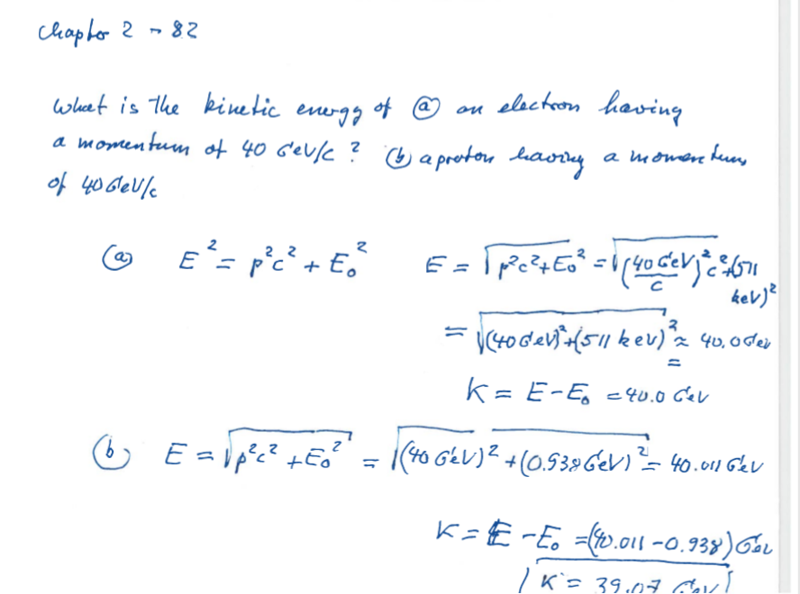

Slide 30
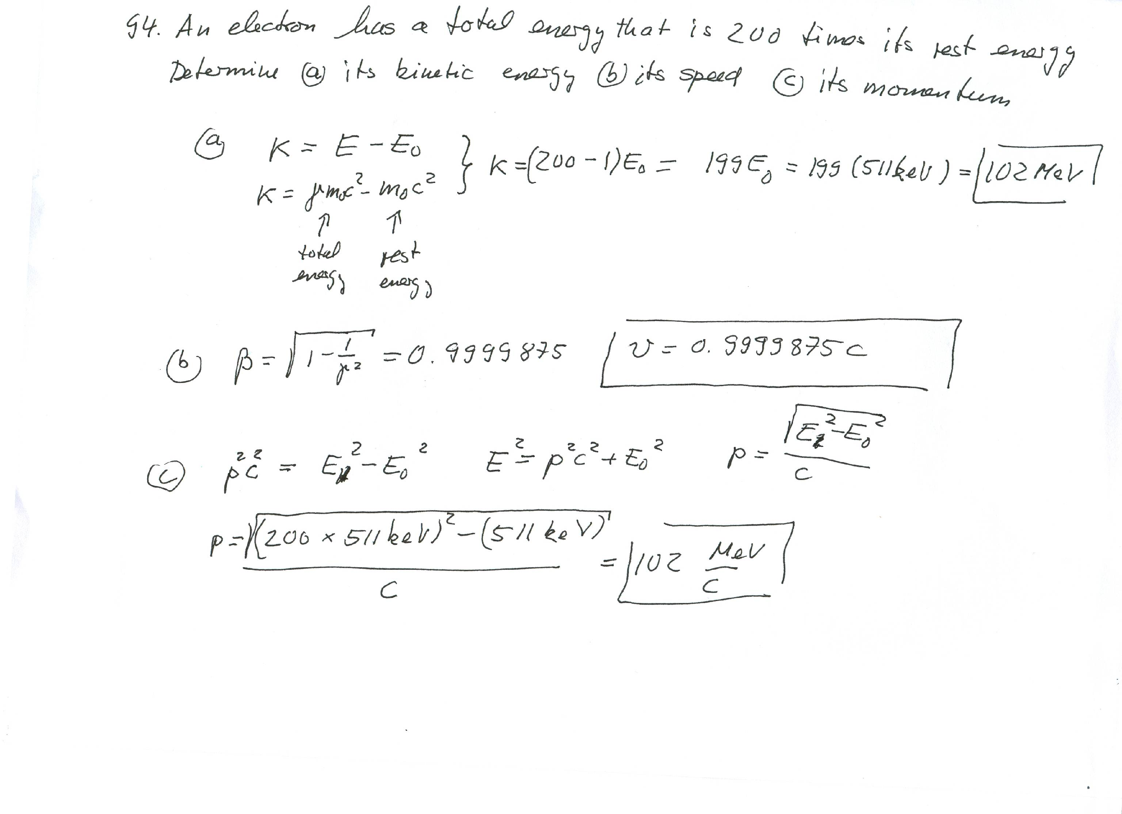

Slide 31
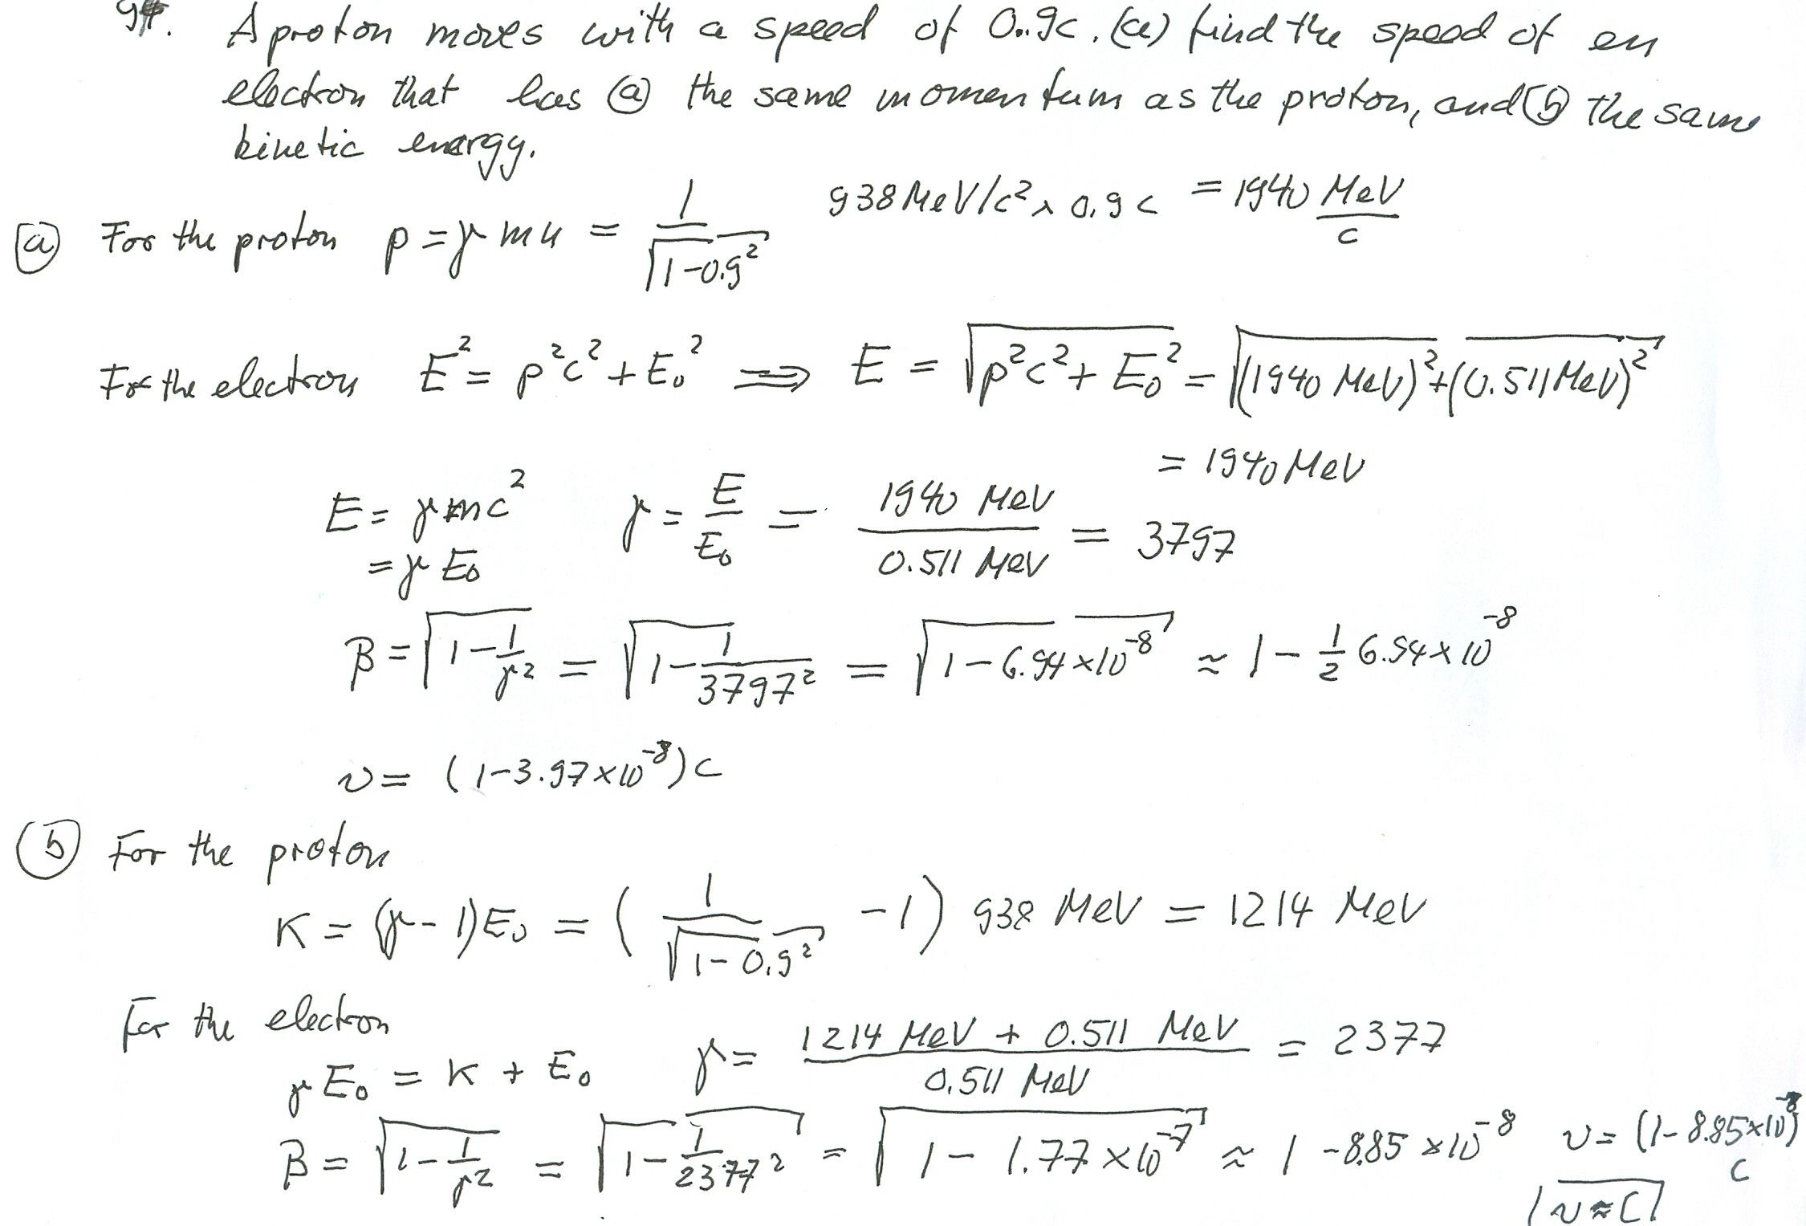
#2.95
×

Slide 32
From chapter2 Quiz
When relating the linear momentum and total energy of an object with speed v = 0.8c, which of the following changes would increase the energy by the greatest amount? Assume that it is possible to change the mass of the object.
increase the momentum of the object to 2p while keeping the mass constant.
increase the mass of the object to 2m while keeping the momentum constant.
imagine the speed of light to change to 82% of its present value (the object is still at initial speed v).
increase the momentum of the object to 2p while keeping the velocity constant.
increase the speed of the object to 0.95c.

Slide 33
Massless particles have a speed equal to the speed of light c
Recall that a photon has “zero” rest mass and that equation 2.70, from the last slide, reduces to: E = pc and we may conclude that:
Thus the velocity, u, of a massless particle must be c since, as 0, and it follows that: u = c.
Notes:
Add this slide

Slide 34
2.13: Computations in Modern Physics
We were taught in introductory physics that the international system of units is preferable when doing calculations in science and engineering (“everyday” scales).
In modern physics a somewhat different set of units is often used, which is more convenient for problems considered in modern physics.
The smallness of quantities often used in modern physics suggests the need for some new units more practical for smaller scales .

Slide 35
Units of Work and Energy
Recall that the work done in accelerating a charge through a potential difference is given by W = qV.
For a proton, with the charge e = 1.602 × 10⁻¹⁹ C being accelerated across a potential difference of 1 V, the work done on the particle is
W = (1.602 × 10⁻¹⁹C)(1 V) = 1.602 × 10⁻¹⁹ J

Slide 36
The Electron Volt (eV)
The work done to accelerate the proton across a potential difference of 1 V could also be written as
W = (1 e)(1 V) = 1 eV
Thus eV, pronounced “electron volt,” is also a unit of energy. It is related to the SI (Système International) unit joule by the 2 previous equations.
1 eV = 1.602 × 10⁻¹⁹ J

Slide 37
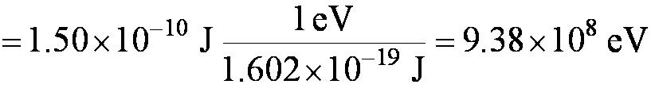
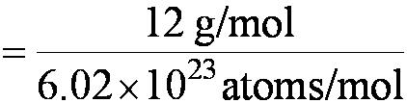


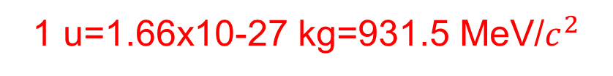
Other Units
Rest energy of a particle:
Example: E₀ (proton)
Atomic mass unit (amu):
Example: carbon-12
Mass (¹²C atom)
Mass (¹²C atom)

Slide 38
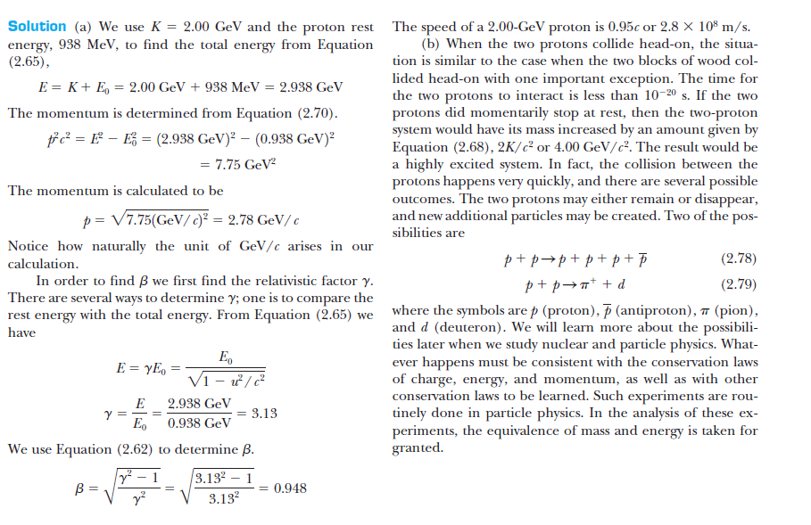
Two high energy protons hit each other headon

Slide 39
Electromagnetism and Relativity
Einstein was convinced that magnetic fields appeared as electric fields observed in another inertial frame. That conclusion is the key to electromagnetism and relativity.
Einstein’s belief that Maxwell’s equations describe electromagnetism in any inertial frame was the key that led Einstein to the Lorentz transformations.
Maxwell’s assertion that all electromagnetic waves travel at the speed of light and Einstein’s postulate that the speed of light is invariant in all inertial frames seem intimately connected.

Slide 40
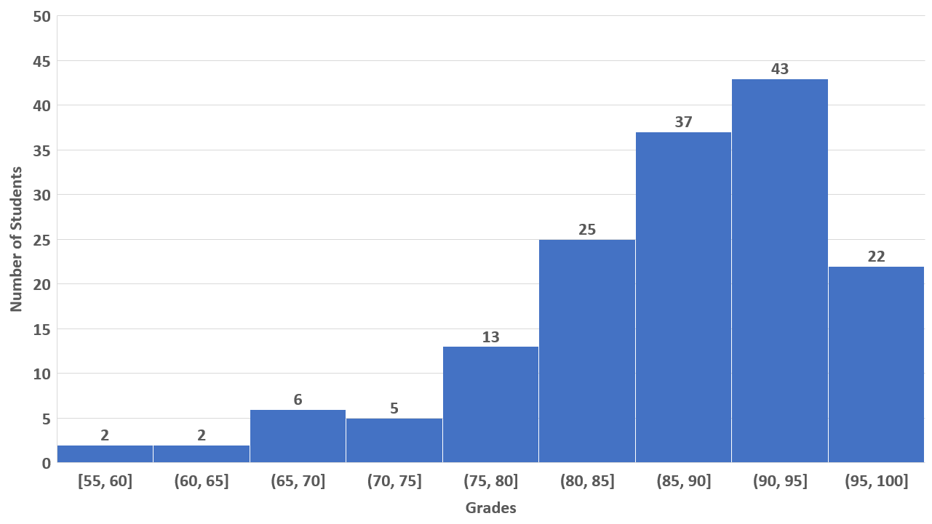
PHYS 222 , Fall 2022
Exam I
N = 155
Avg = 89
A >= 90
B >= 80
C >= 70
D >= 60
F <= 50

Slide 41
Thank you for your attention!

