Slide 1

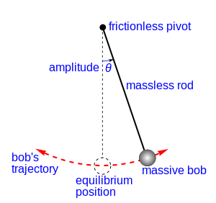
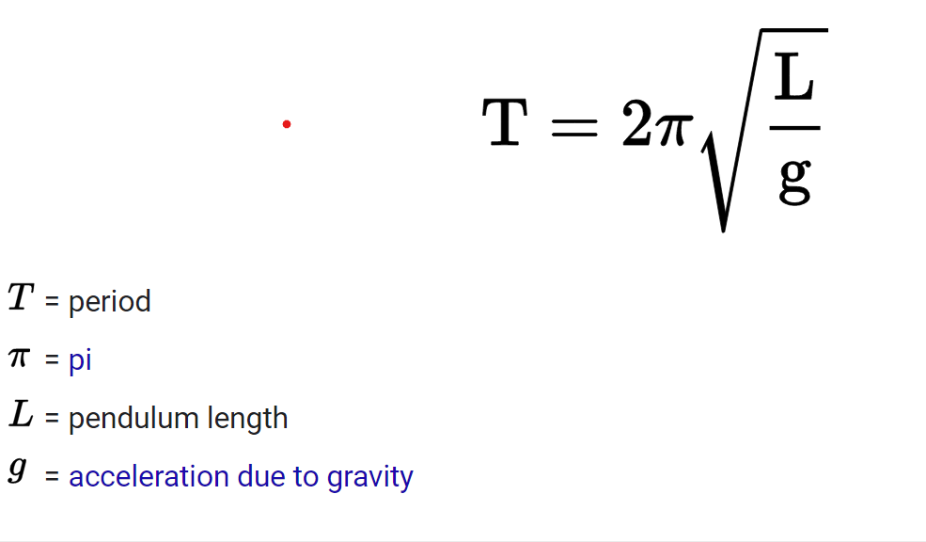
Foucault pendulum

Slide 2
CHAPTER 3
The Experimental Basis of Quantum Physics
3.1 Discovery of the X Ray and the Electron
3.2 Determination of Electron Charge
3.3 Line Spectra
3.4 Quantization
3.5 Blackbody Radiation
3.6 Photoelectric Effect
3.7 X-Ray Production
3.9 Pair Production and Annihilation

Slide 3
3.1: Discovery of the X Ray and the Electron
X rays were discovered by Wilhelm Röntgen in 1895.
  Observed x rays emitted by cathode rays bombarding glass
Electrons were discovered by J. J. Thomson.
  Observed that cathode rays were charged particles

Slide 4
Cathode Ray Experiments
In the 1890s scientists and engineers were familiar with “cathode rays”. These rays were generated from one of the metal plates in an evacuated tube across which a large electric potential had been established.
It was surmised that cathode rays had something to do with atoms.
It was known that cathode rays could penetrate matter and their properties were under intense investigation during the 1890s.

Slide 5
Observation of X Rays
Wilhelm Röntgen studied the effects of cathode rays passing through various materials. He noticed that a phosphorescent screen near the tube glowed during some of these experiments. These rays were unaffected by magnetic fields and penetrated materials more than cathode rays.
He called them x rays and deduced that they were produced by the cathode rays bombarding the glass walls of his vacuum tube.

Slide 6
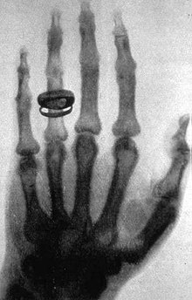
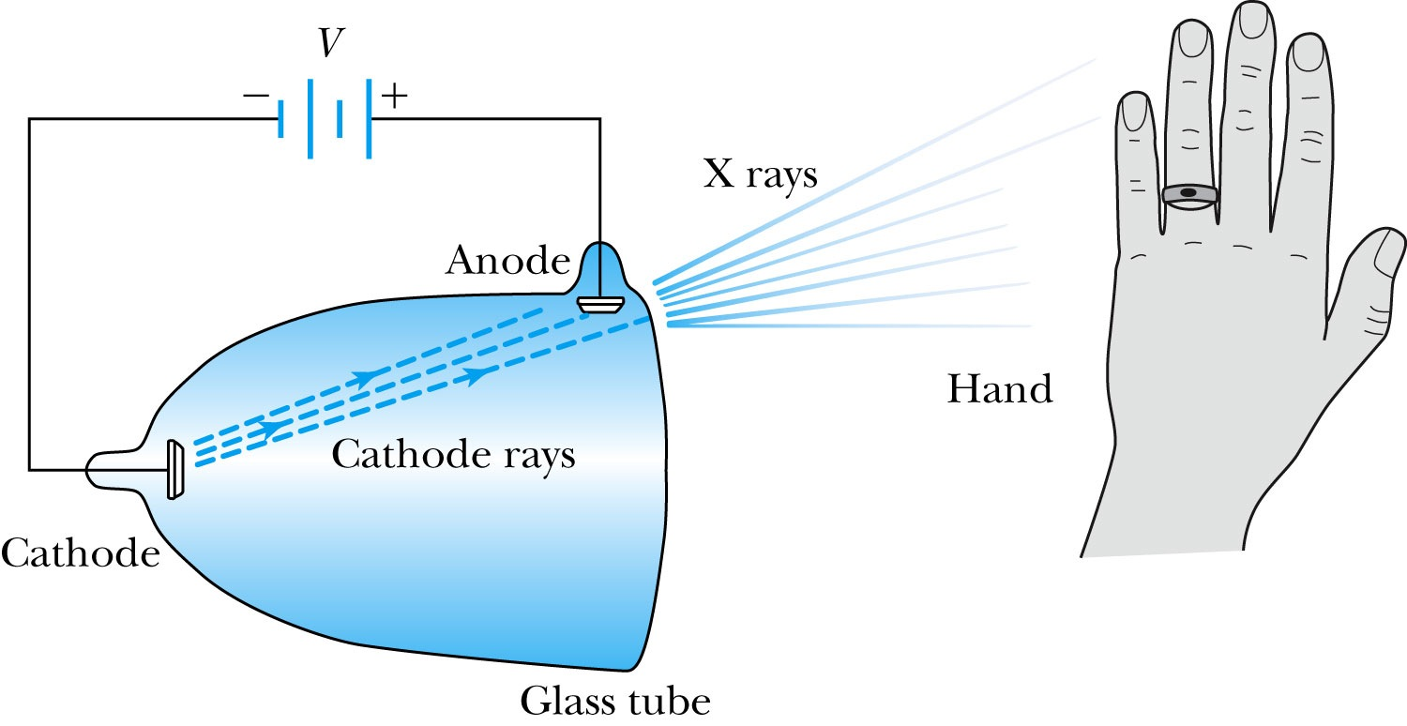
Röntgen’s X Ray Tube
Röntgen constructed an x-ray tube by allowing cathode rays to impact the glass wall of the tube and produced x rays. He used x rays to image the bones of a hand on a phosphorescent screen.

Slide 7
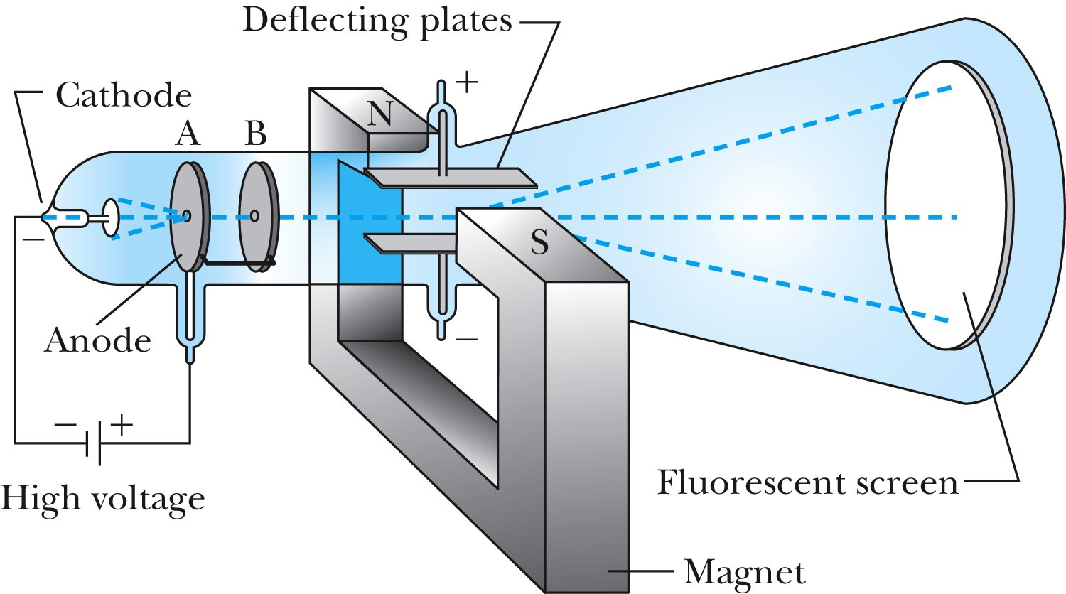
Apparatus of Thomson’s Cathode-Ray Experiment
Thomson used an evacuated cathode-ray tube to show that the cathode rays were negatively charged particles (electrons) by deflecting them in electric and magnetic fields.

Slide 8
12. How did Thomson measure the charge to mass ratio of the electron?
a.He shot helium nuclei into gold foil to measure the nuclei scattering against electrons within.
b.He passed cathode rays through a magnetic field and measured the deflection.
c.He suspended a drop of oil between electrodes to measure the electric field from the electrons.
d. He measured very precisely a known quantity of hydrogen atoms and calculated the reduced mass ratio within each atom.

Slide 9
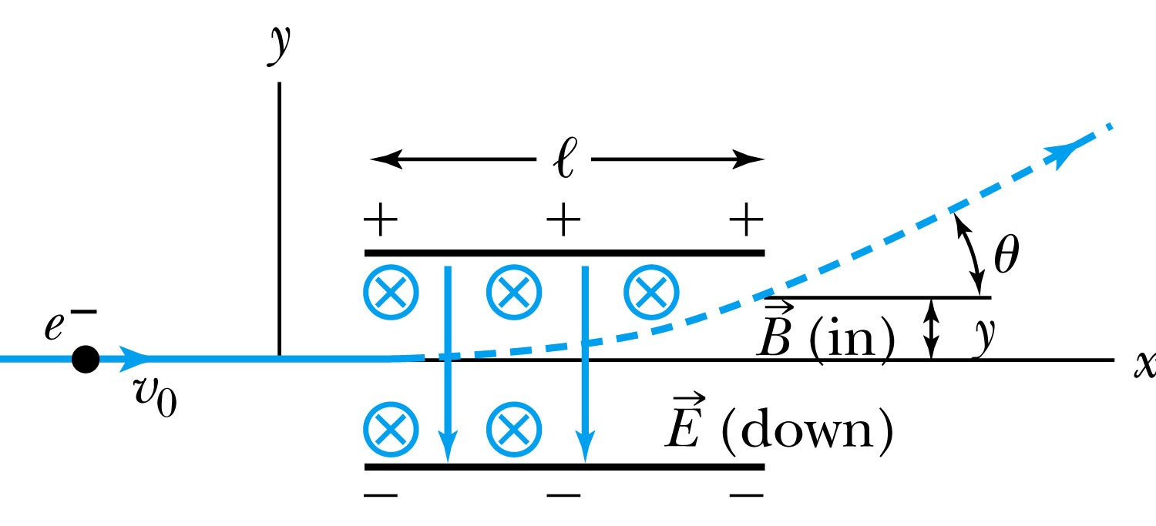
Thomson’s Experiment
Thomson’s method of measuring the ratio of the electron’s charge to mass was to send electrons through a region containing a magnetic field perpendicular to an electric field.

Slide 10
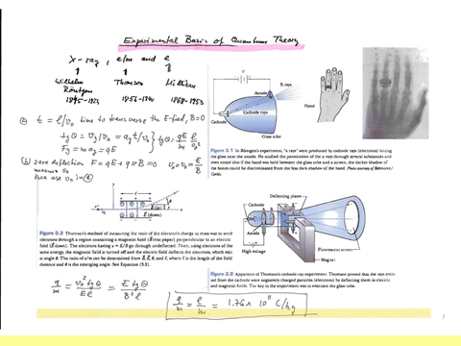

Slide 11

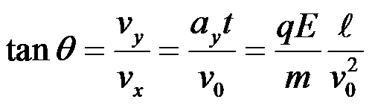

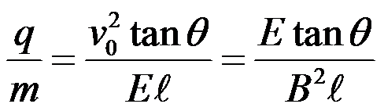
Calculation of e/m
Examble 3.1
An electron moving through the electric field is accelerated by a force:
Electron angle of deflection:
The magnetic field deflects the electron against the electric field force.
The magnetic field is adjusted until the net force is zero.
Charge to mass ratio:
q/m= 1,8x 10 ^11 C/kg

Slide 12
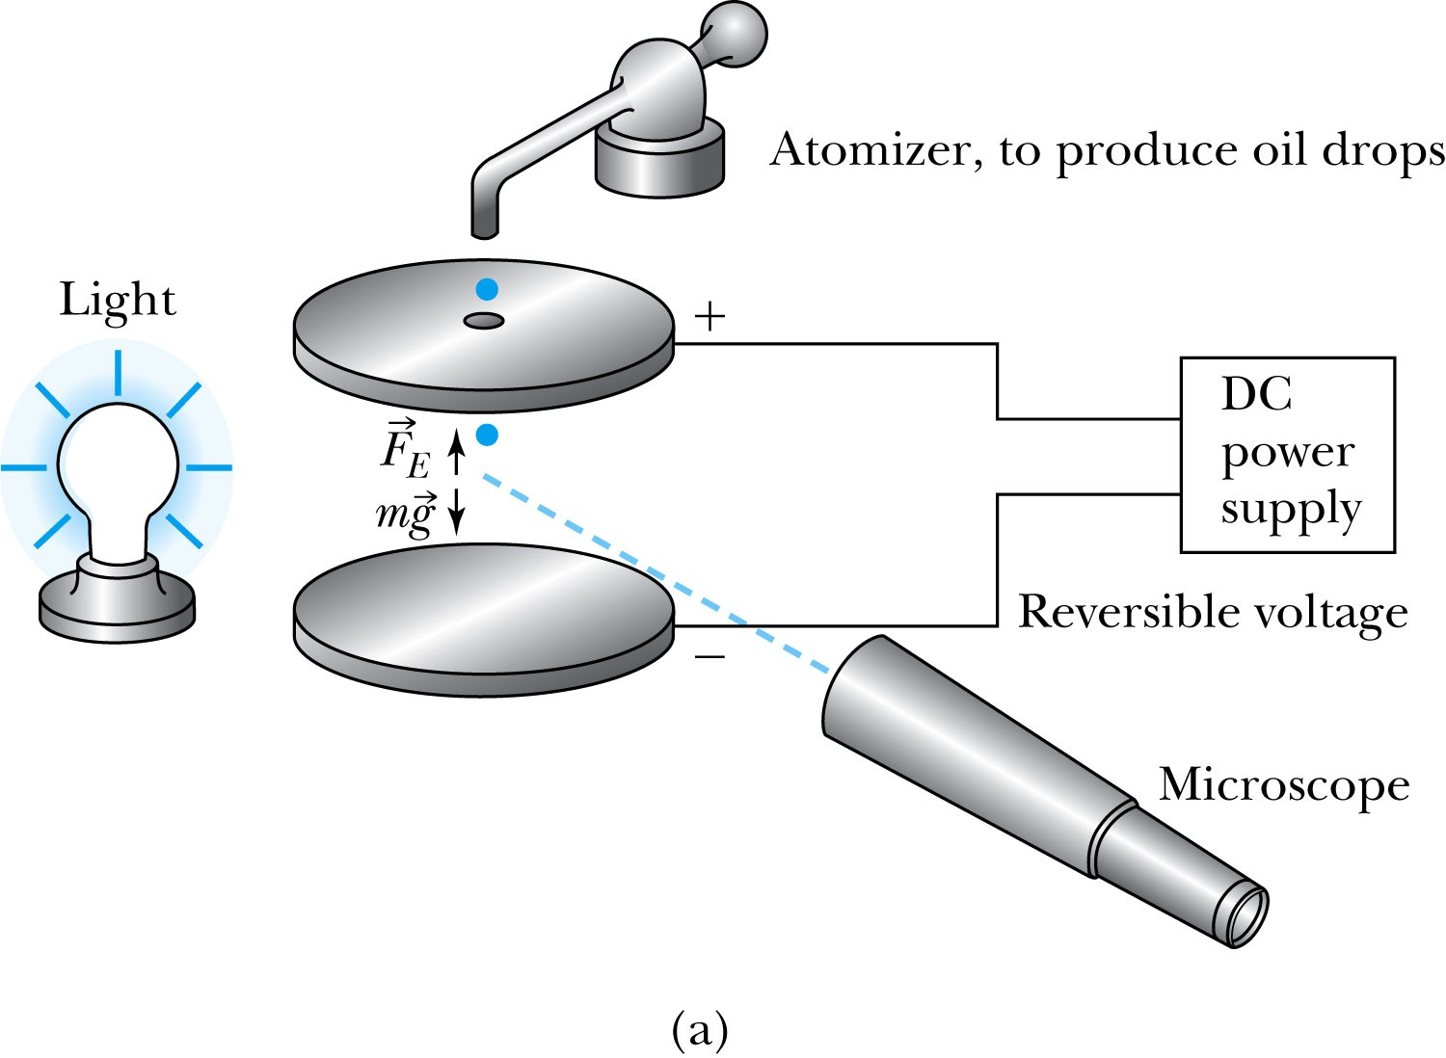
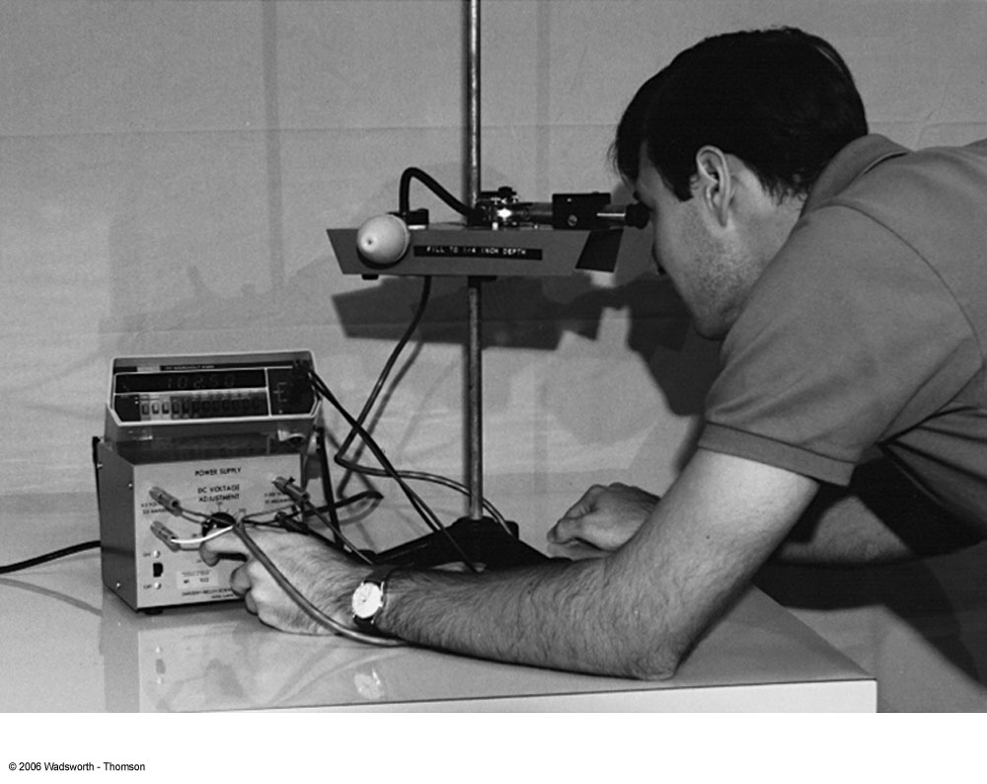
3.2: Determination of Electron Charge
Millikan oil drop experiment

Slide 13
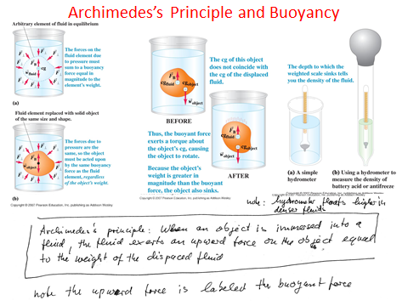

Slide 14


Slide 15
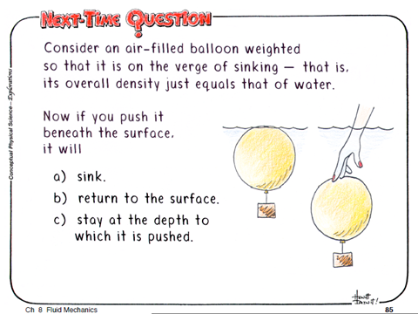

Slide 16
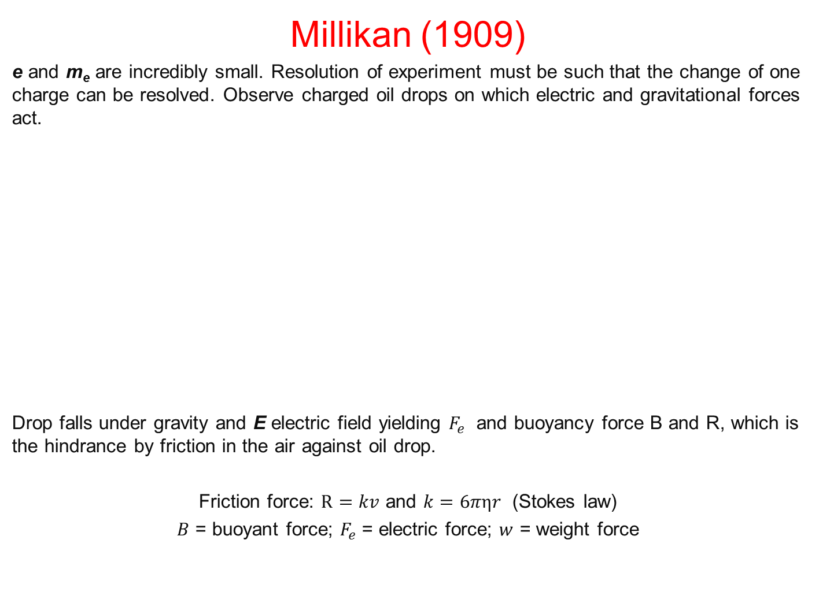
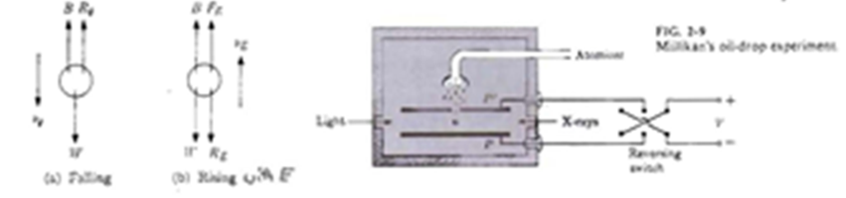

Slide 17
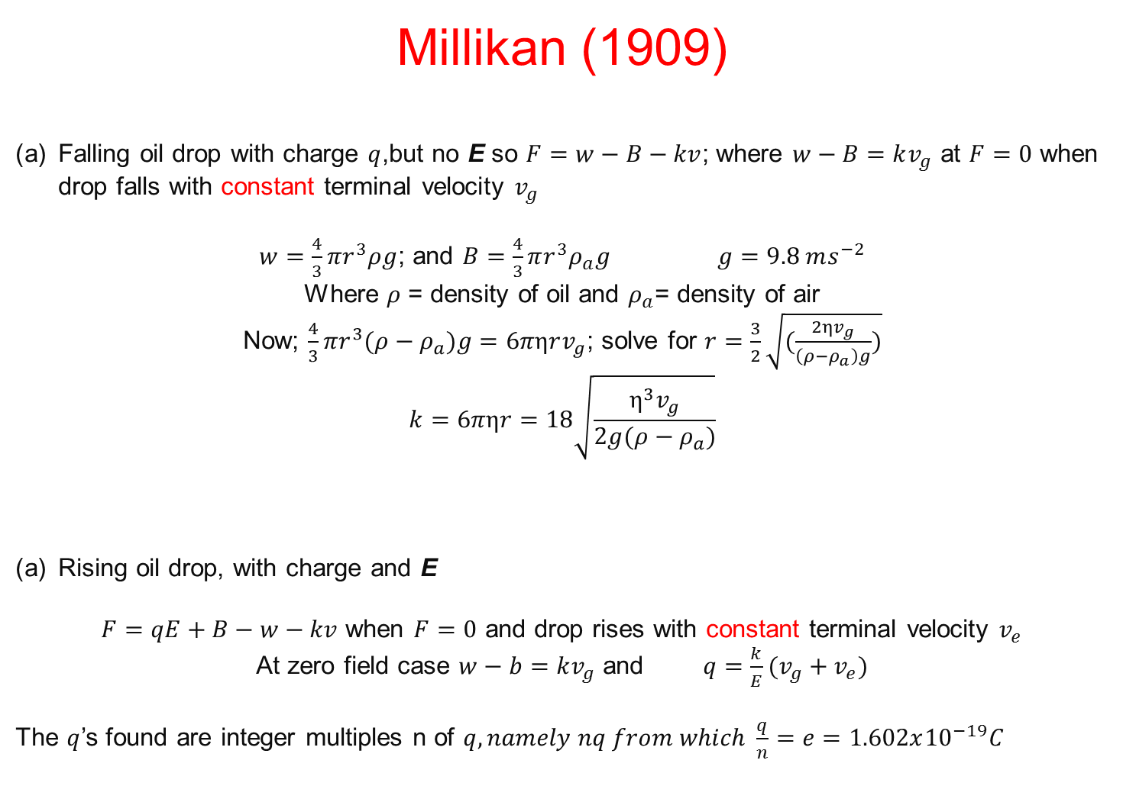
Oil drop is in motion, either falling without E, or rising with E

Slide 18
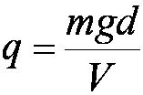


Calculation of the oil drop charge(at rest)
Used an electric field and gravity to suspend a charged oil drop
Magnitude of the charge on the oil drop
Mass is determined from Stokes’s relationship of the terminal velocity to the radius and density
Thousands of experiments showed that there is a basic quantized electron charge
C

Slide 19

3.3: Line Spectra
Chemical elements were observed to produce unique wavelengths of light when burned or excited in an electrical discharge.
Collimated light is passed through a diffraction grating with thousands of ruling lines per centimeter.
  The diffracted light is separated at an angle θ according to its wavelength λ by the equation:
where d is the distance between rulings and n is an integer called the order number

Slide 20
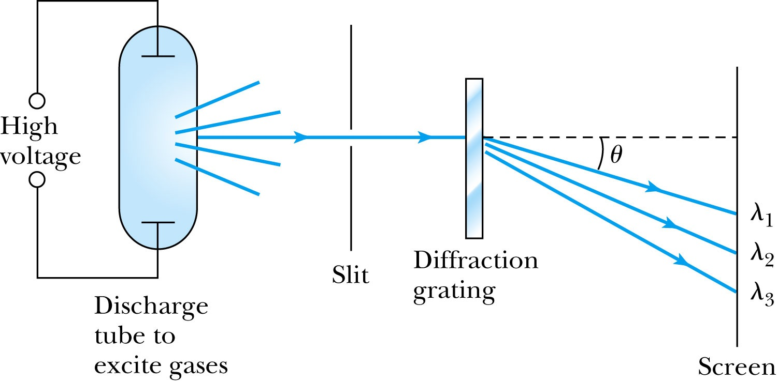
Optical Spectrometer
Diffraction creates a line spectrum pattern of light bands and dark areas on the screen.
Wavelengths of these line spectra allow identiﬁcation of the chemical elements and the composition of materials.
a
l
lo.

Slide 21
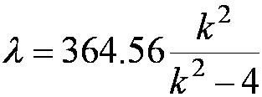
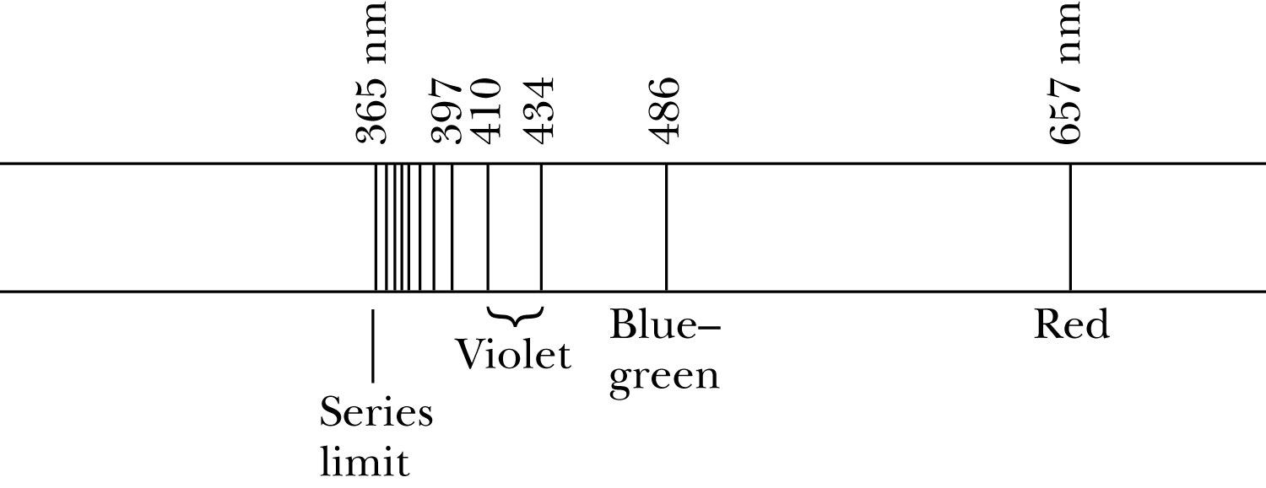
Balmer Series
In 1885, Johann Balmer found an empirical formula for wavelength of the visible hydrogen line spectra in nm:
nm (where k = 3,4,5… and k > 2)

Slide 22
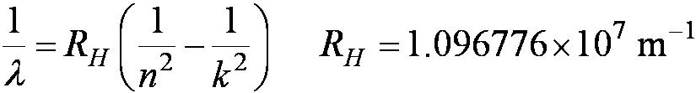
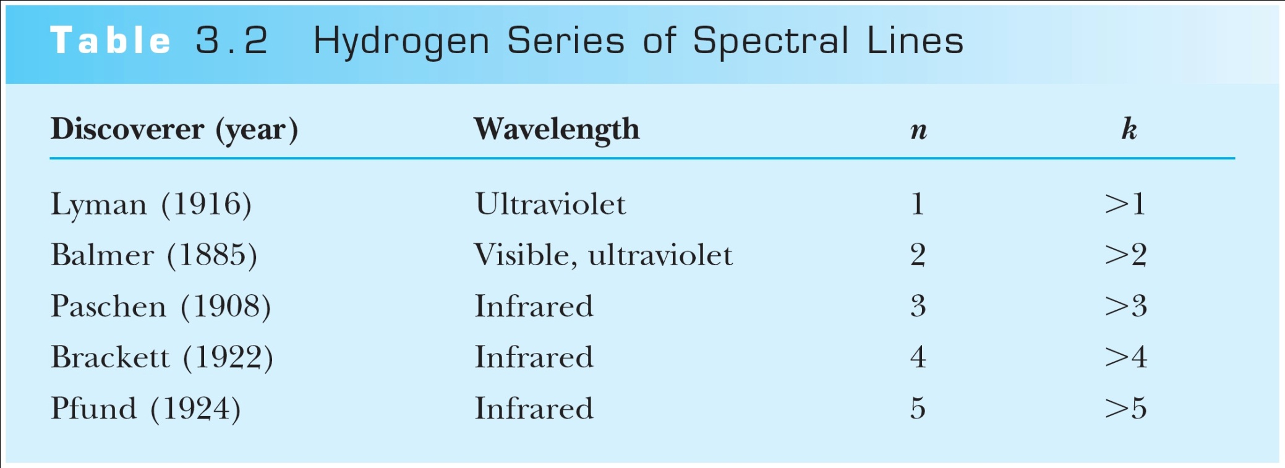
Rydberg Equation
As more scientists discovered emission lines at infrared and ultraviolet wavelengths, the Balmer series equation was extended to the Rydberg equation:
(n =1, 2,3…)

Slide 23
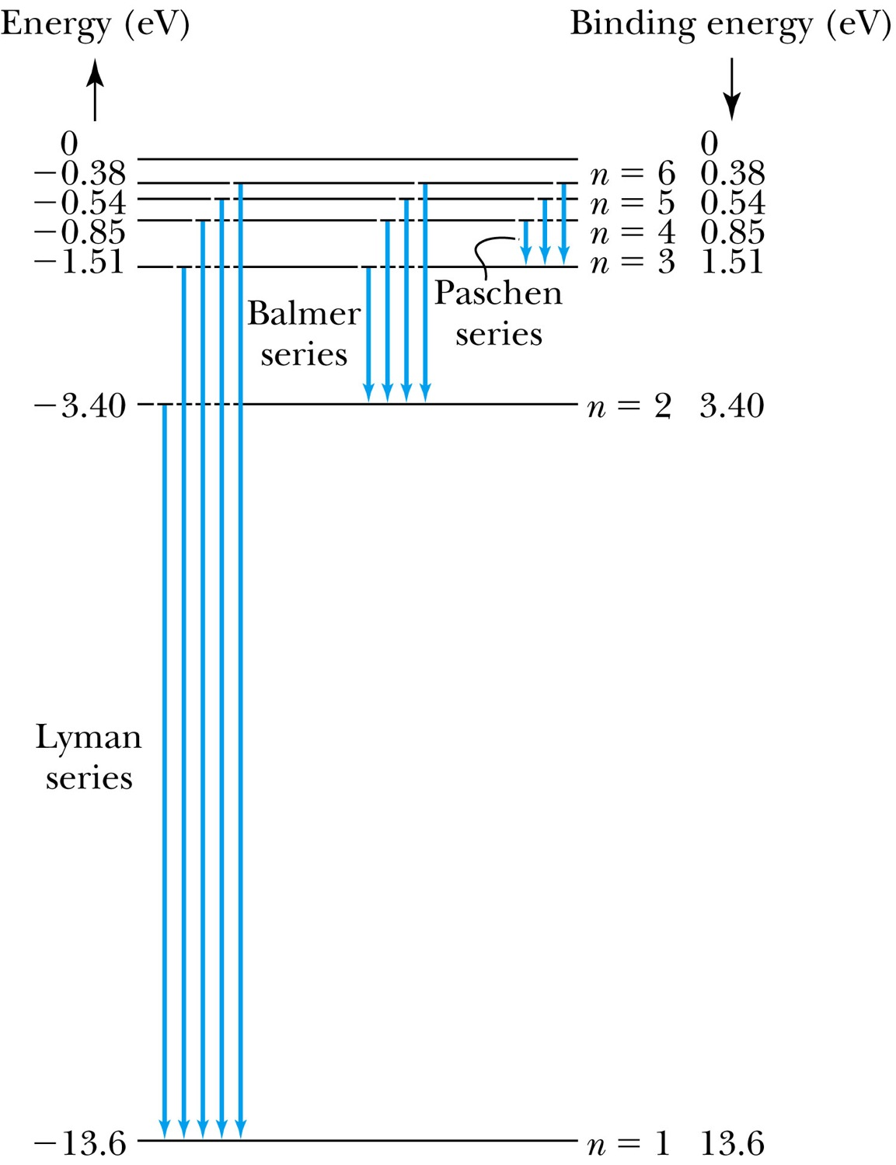
Transitions in the Hydrogen Atom
Lyman series
The atom will remain in the excited state for a short time before emitting a photon and returning to a lower stationary state. All hydrogen atoms exist in n = 1 (invisible).
Balmer series
When sunlight passes through the atmosphere, hydrogen atoms in water vapor absorb the wavelengths (visible).

Slide 24
3.4: Quantization
Current theories predict that charges are quantized in units (quarks) of ±e/3 and ±2e/3, but quarks are not directly observed experimentally. The charges of particles that have been directly observed are quantized in units of ±e.
The measured atomic weights are not continuous—they have only discrete values, which are close to integral multiples of a unit mass.
Molecules consist of integral number of atoms. Modes in a cavity are discrete

Slide 25
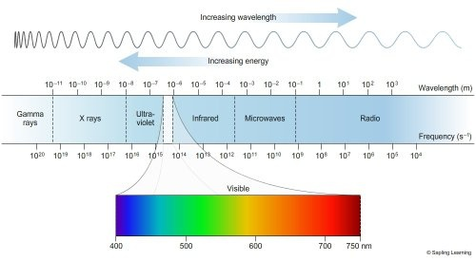
Light=electromagnetic radiation

Slide 26
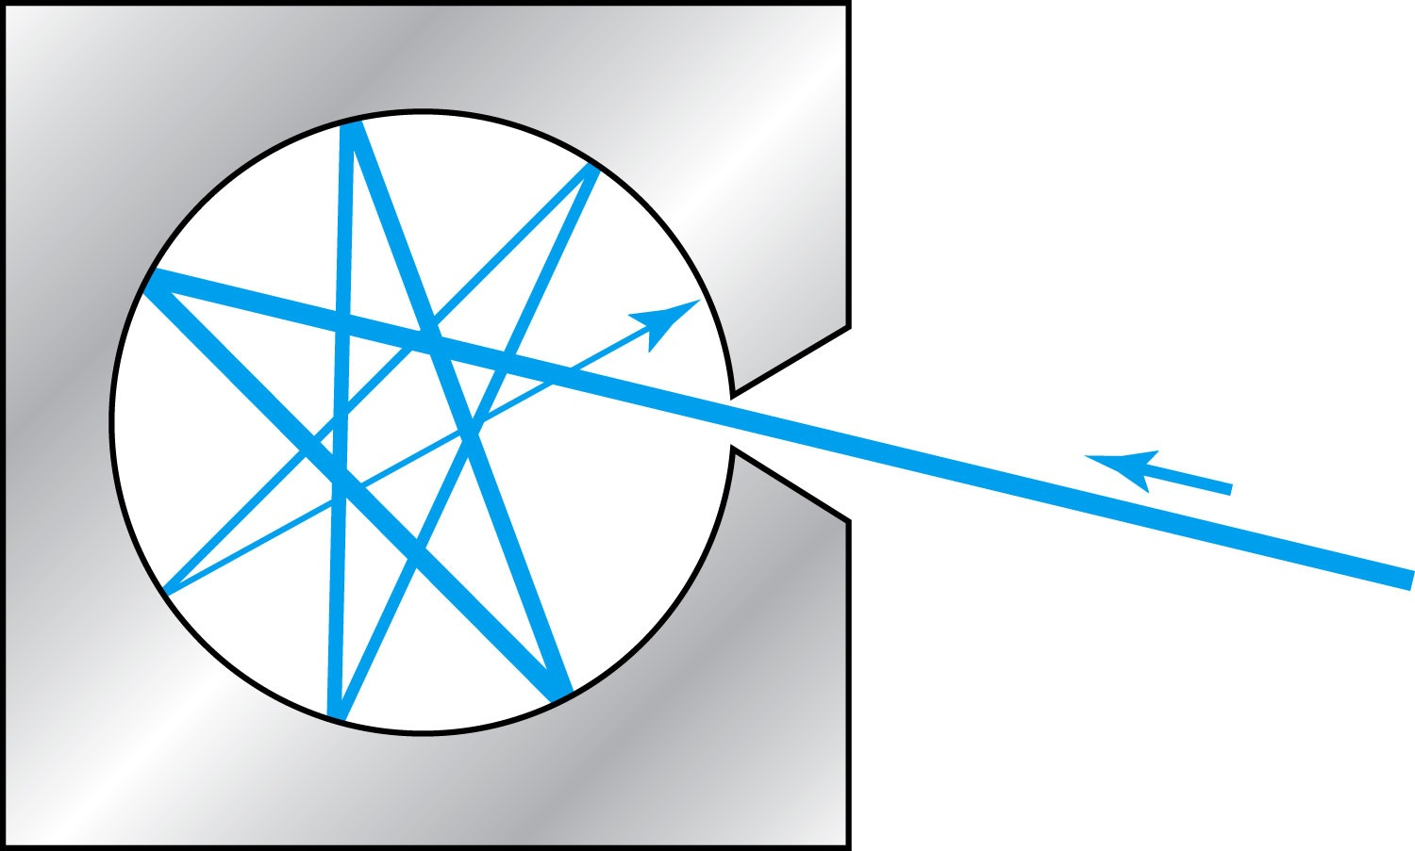
3.5: Blackbody Radiation
When matter is heated, it emits radiation.
A blackbody is a cavity in a material that only emits thermal radiation. Incoming radiation is absorbed in the cavity.
Blackbody radiation is theoretically interesting because the radiation properties of the blackbody are independent of the particular material. Physicists can study the properties of intensity versus wavelength at fixed temperatures.
A key hole is always black and a black body

Slide 27
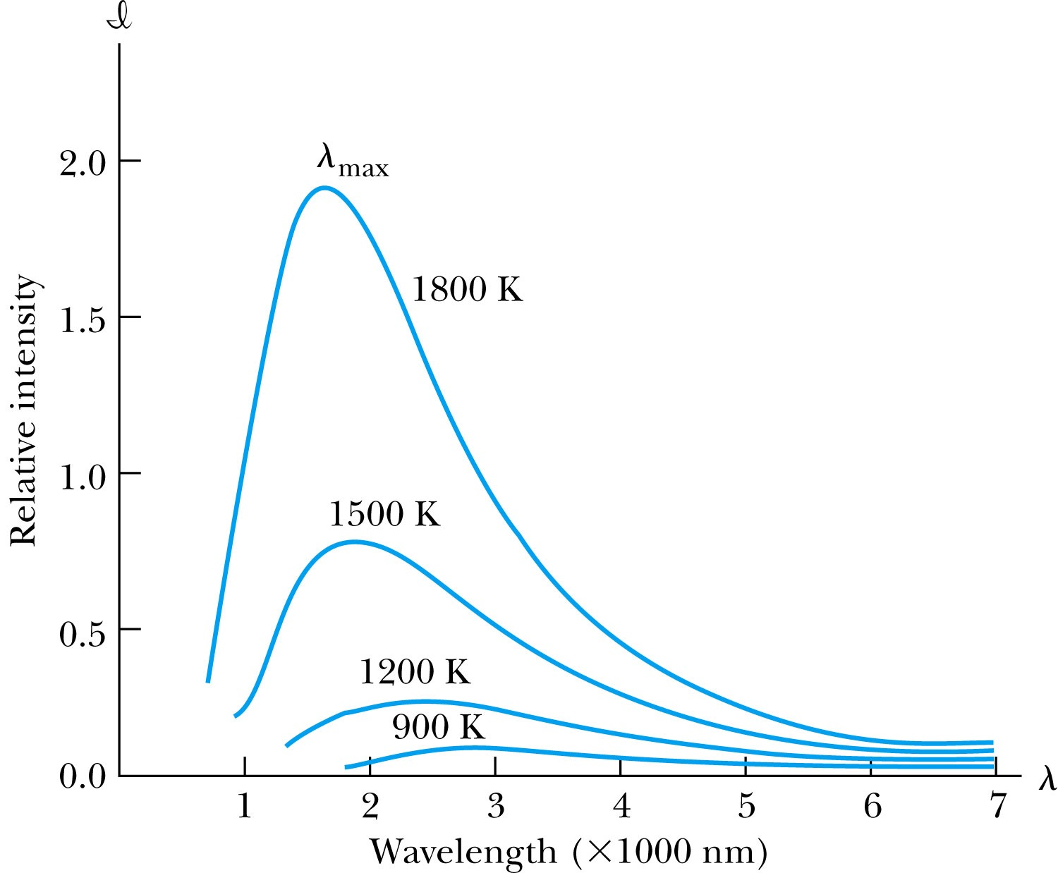

Wien’s Displacement Law
The intensity (λ, T) is the total power radiated per unit area per unit wavelength at a given temperature.
Wien’s displacement law: The maximum of the distribution shifts to smaller wavelengths as the temperature is increased.
(where λ_{max} = wavelength of the peak)
Blacksmith formining a horse shoe

Slide 28
Problem 21. Calculate the maximum wavelength for blackbody radiation(a) liquid helium at 4.2 K (b)room temperature at 293 K,(c)a steel furnace at 2500 K,(d) a blue star at 9000 K

Slide 29

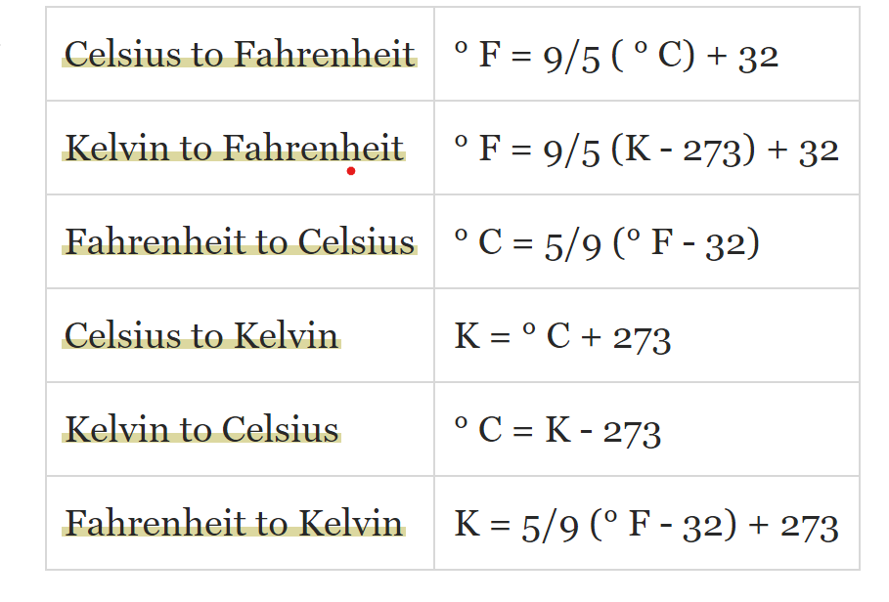
When do you have fever?
for body temperature of 100 F (37.8 C )

Slide 30

Problem 21. Calculate the maximum wavelength for blackbody radiation(a) liquid helium at 4.2 K (b)room temperature at 293 K,(c)a steel furnace at 2500 K,(d) a blue star at 9000 K

Slide 31

Stefan-Boltzmann Law
The total power radiated increases with the temperature:
This is known as the Stefan-Boltzmann law, with the constant σ experimentally measured to be 5.6705 × 10⁻⁸ W / (m² · K⁴).
The emissivity є (є = 1 for an idealized blackbody) is simply the ratio of the emissive power of an object to that of an ideal blackbody and is always less than 1.

Slide 32
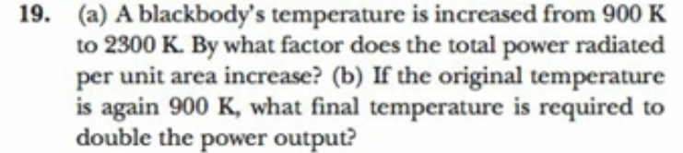
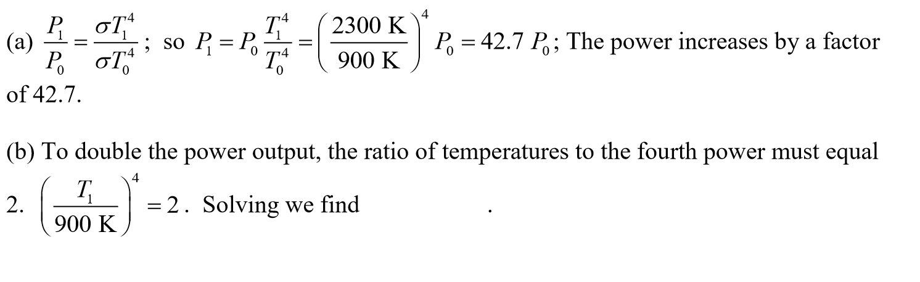
T1=900x2^1/4=1070 K

Slide 33
Problem 20
(a) At what wavelength will the human body radiate the maximum radiation? (b) Estimate the total power radiated by a person of medium build (assume an area given by a cylinder of 175-cm height and 13-cm radius). (c) Using your answer to (b), compare the energy radiated by a person in one day with the en- ergy intake of a 2000-kcal diet
There is more energy radiated away than consumed by eating
273 +37 (body temperature in C) = 310

Slide 34
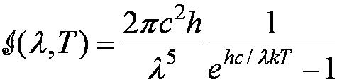

Planck’s Radiation Law
Planck assumed that the radiation in the cavity was emitted (and absorbed) by some sort of “oscillators” that were contained in the walls. He used Boltzman’s statistical methods to arrive at the following formula that fit the blackbody radiation data.
Planck made two modifications to the classical theory:
    The oscillators (of electromagnetic origin) can only have certain discrete energies determined by E_{n} = nhf, where n is an integer, f is the frequencyof the radiation, and h is called Planck’s constant.
    h = 6.6261 × 10⁻³⁴ J·s.
    The oscillators can absorb or emit energy in discrete multiples of the fundamental quantum of energy given by
Planck’s radiation law

Slide 35
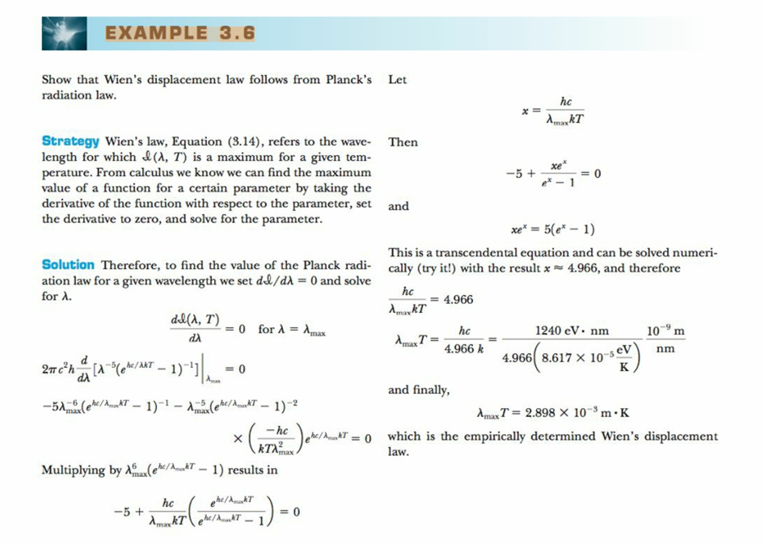

Slide 36
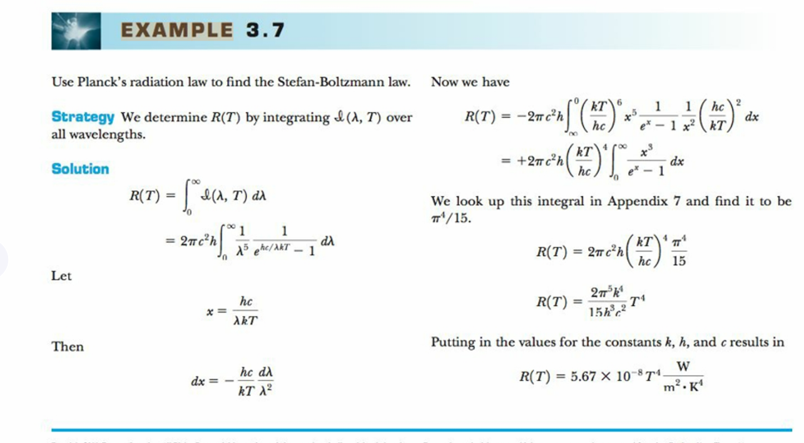

Slide 37
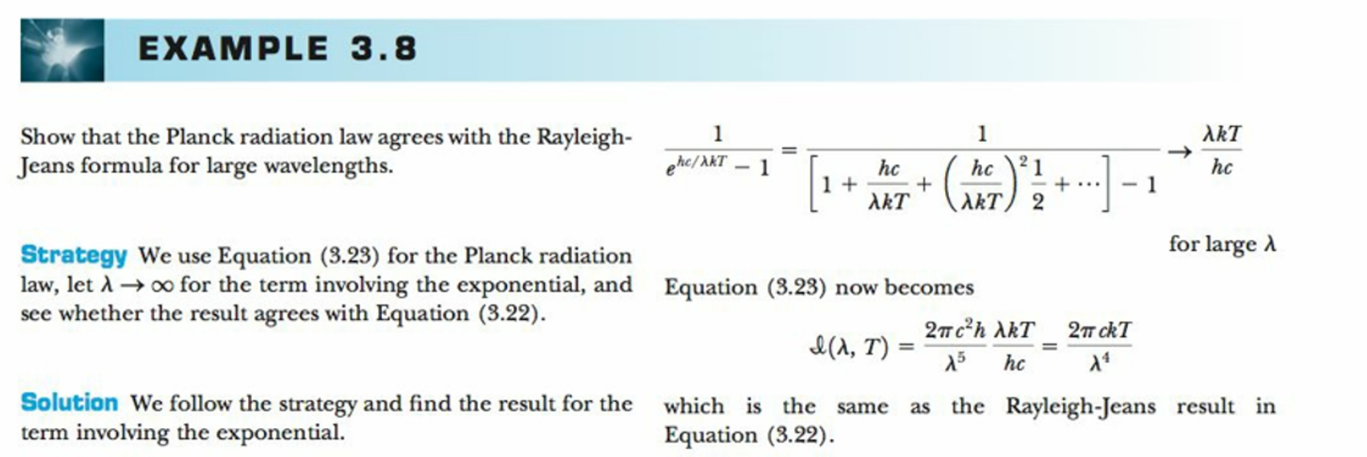

Slide 38
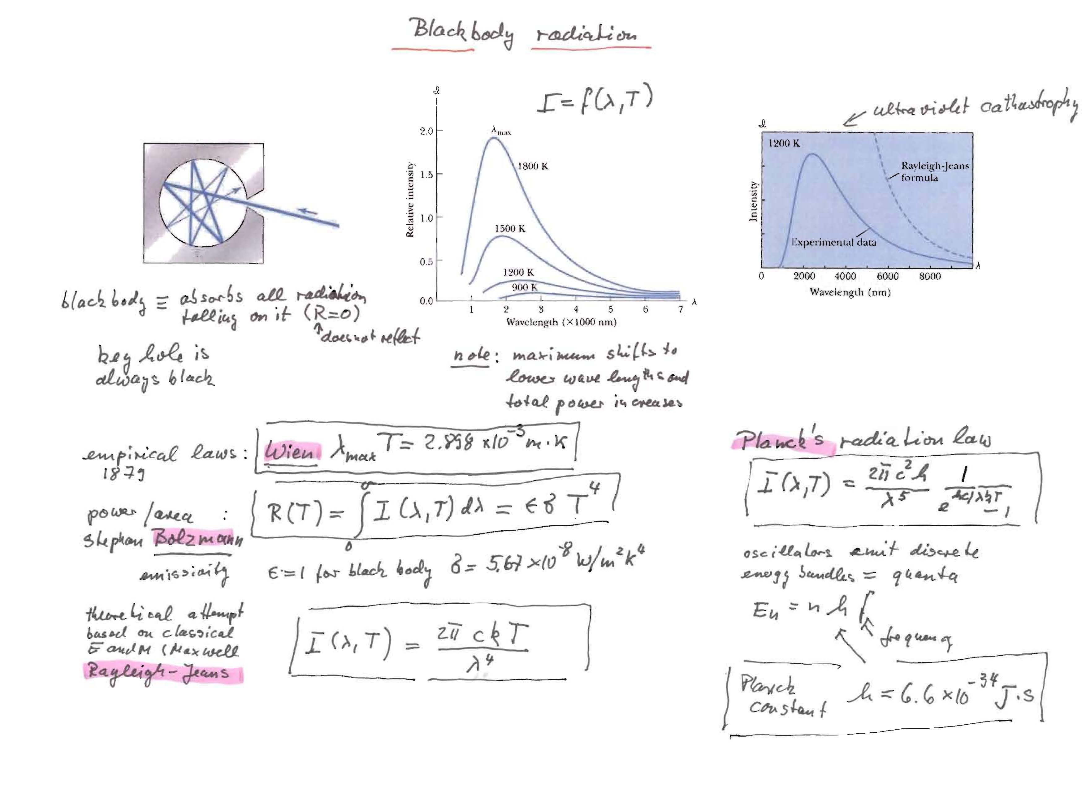
S
Summary of blackbody radiation
Summary: Blackbody radiation

Slide 39
Question form chapter 3 quiz
The Rydberg equation is used to
a. Determine the ratio of the electron charge to its mass
b. Calculate the wavelengths of different spectral lines of hydrogen
c. Measure the mass of the hydrogen atom
d. Calculate the wavelengths of different transitions in energy level of electrons in helium

Slide 40
How did Planck modify the classical theory of blackbody radiation to correctly determine his radiation law? a.He found that the blackbody model was incorrect for purposes of theory b.He accepted the Stefan-Boltzmann law c.He assumed light was absorbed and emitted in quanta d.He realized that the charge of the electron was not quantized e.He proved the necessity of relativistic considerations

Slide 41
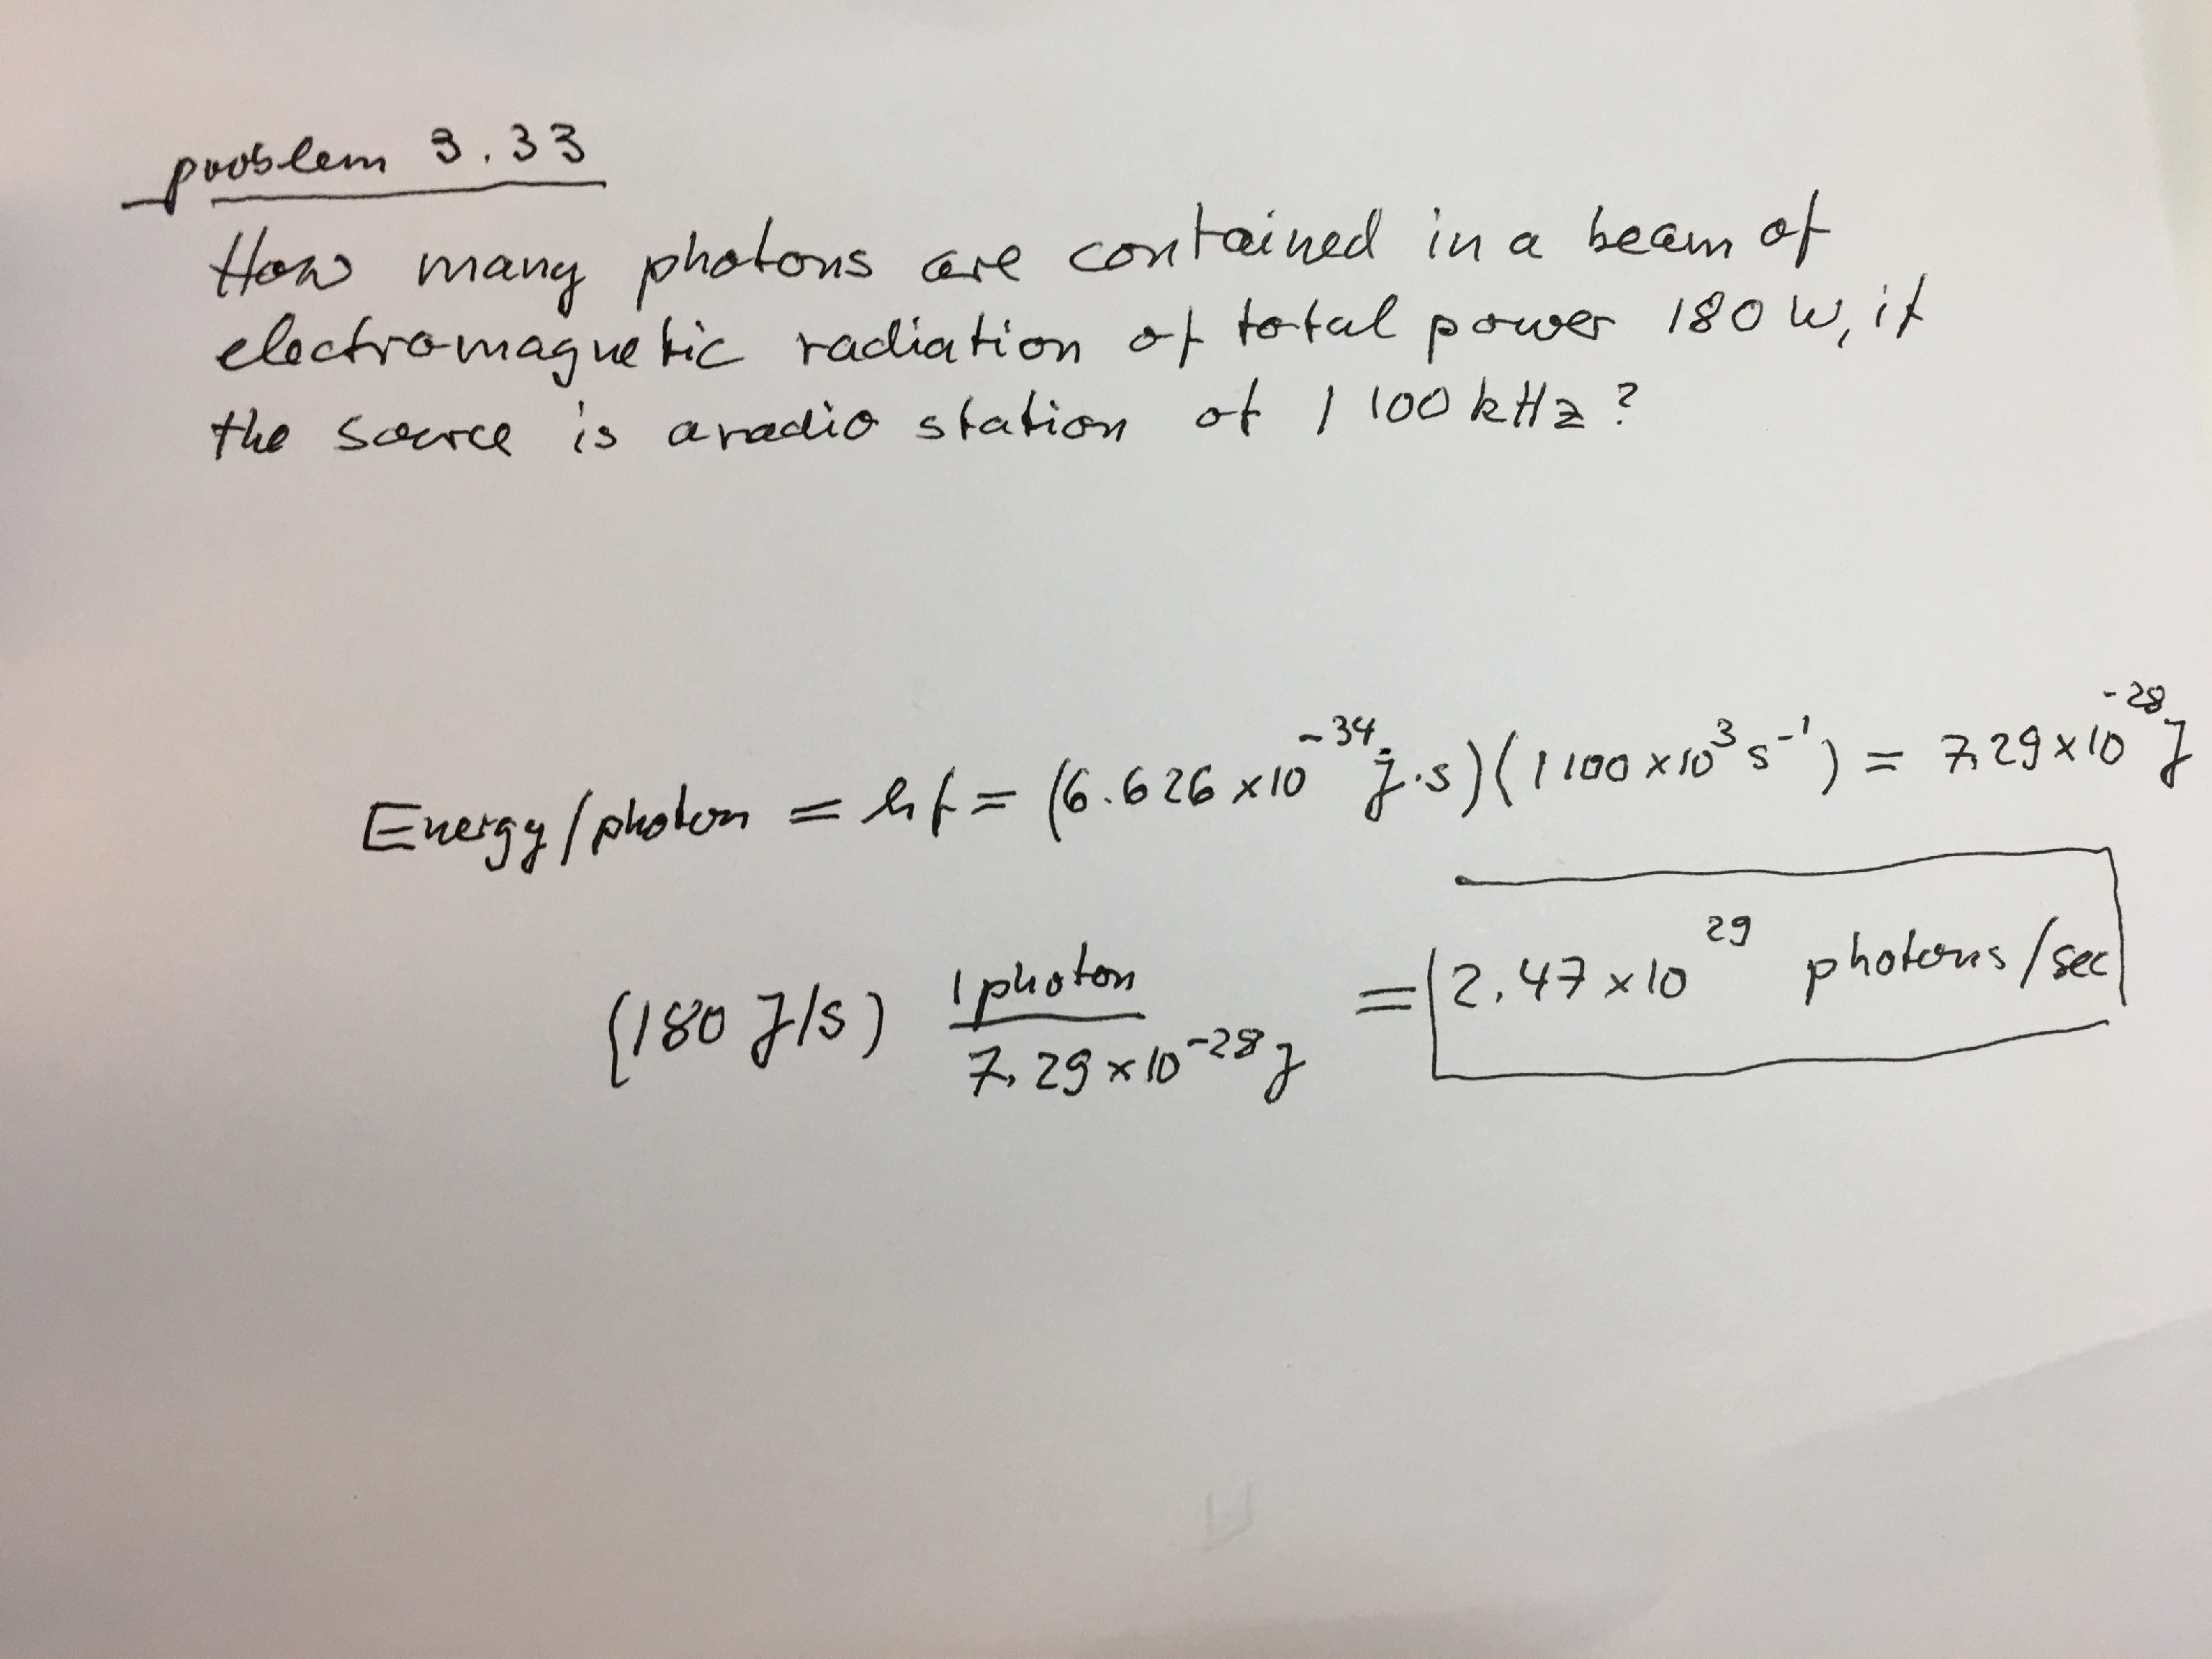

Slide 42
3.6: Photoelectric Effect
Methods of electron emission:
Thermionic emission: Application of heat allows electrons to gain enough energy to escape.
Secondary emission: The electron gains enough energy by transfer from another high-speed particle that strikes the material from outside.
Field emission: A strong external electric field pulls the electron out of the material.
Photoelectric effect: Incident light (electromagnetic radiation) shining on the material transfers energy to the electrons, allowing them to escape.
Electromagnetic radiation interacts with electrons within metals and gives the electrons increased kinetic energy. Light can give electrons enough extra kinetic energy to allow them to escape. We call the ejected electrons photoelectrons.

Slide 43
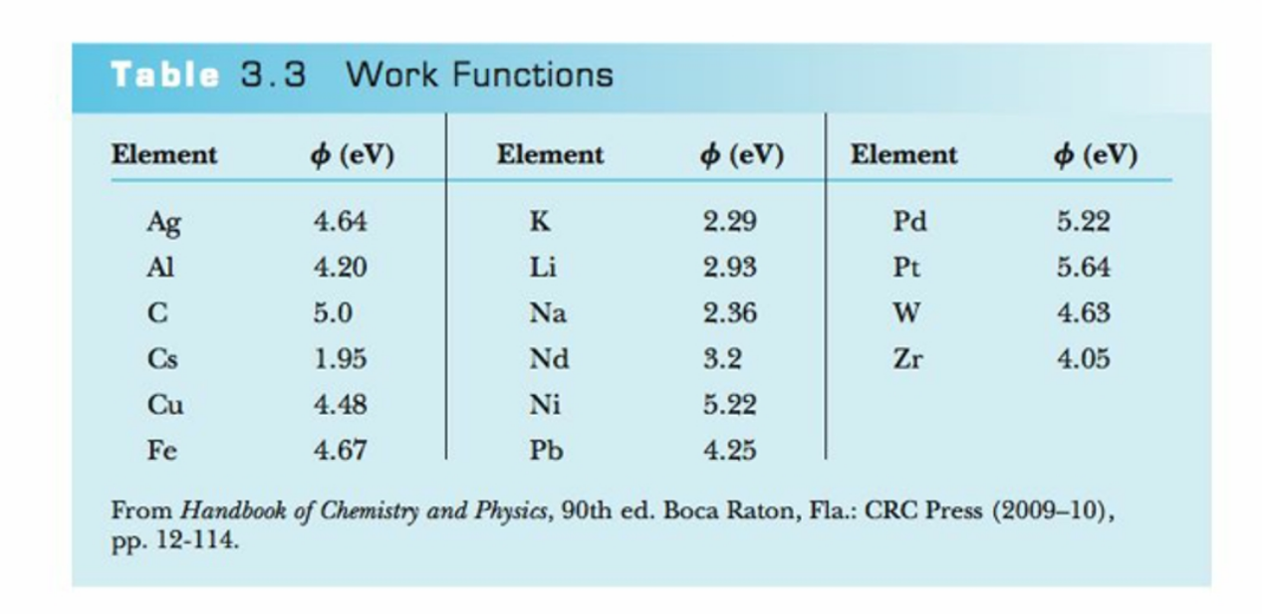
Work function=minimum binding energy of the electron
In metals electrons are weakly bound in the conduction band

Slide 44
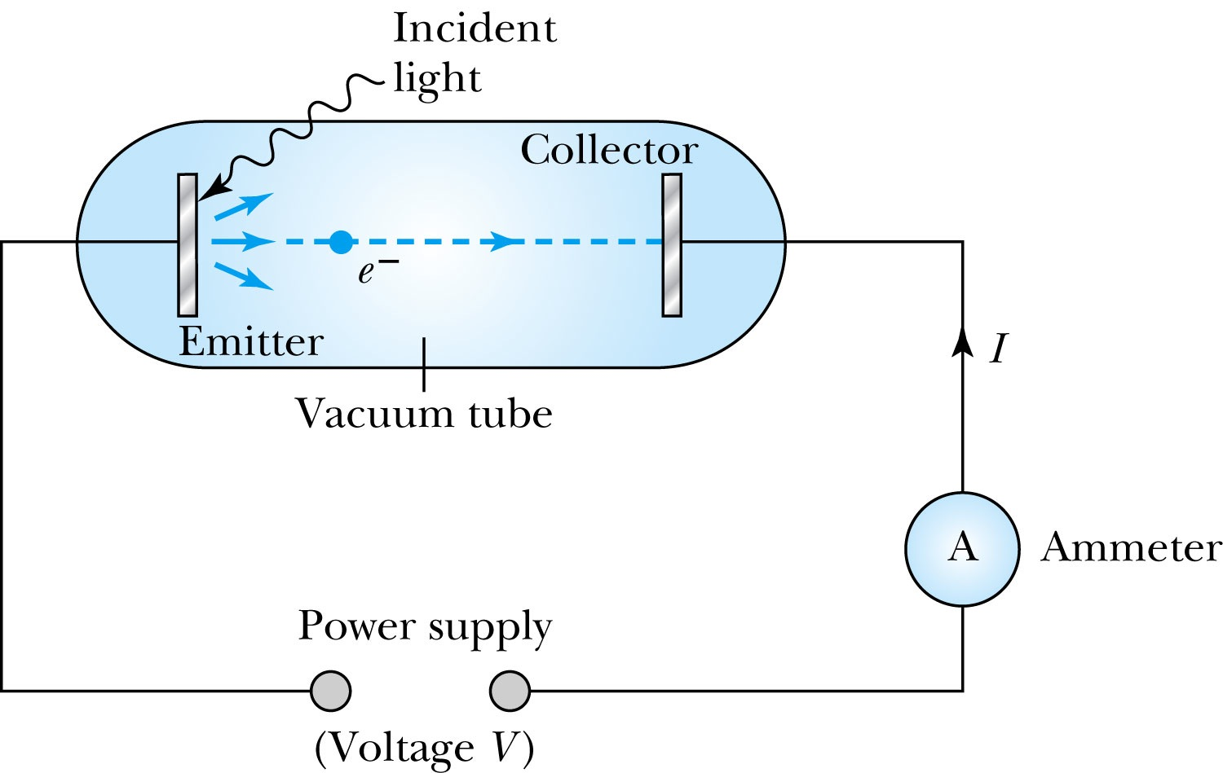
Experimental Setup

Slide 45
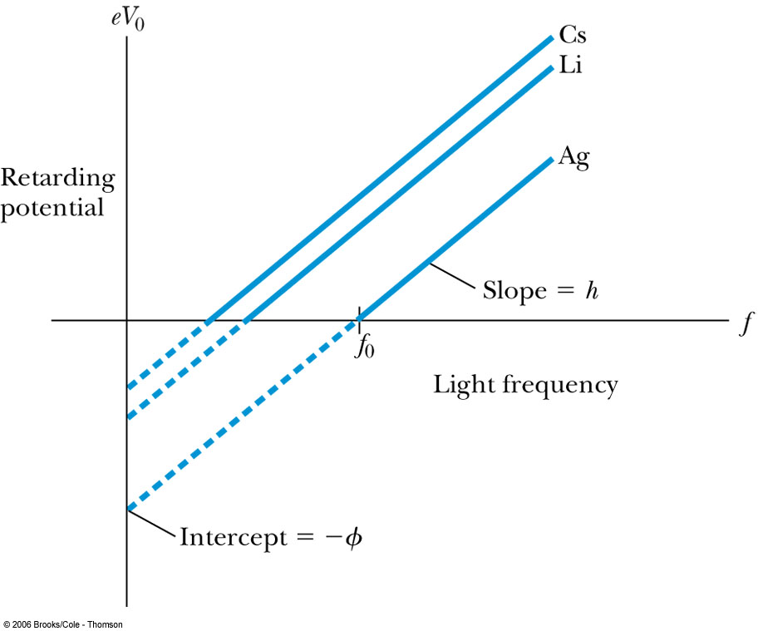
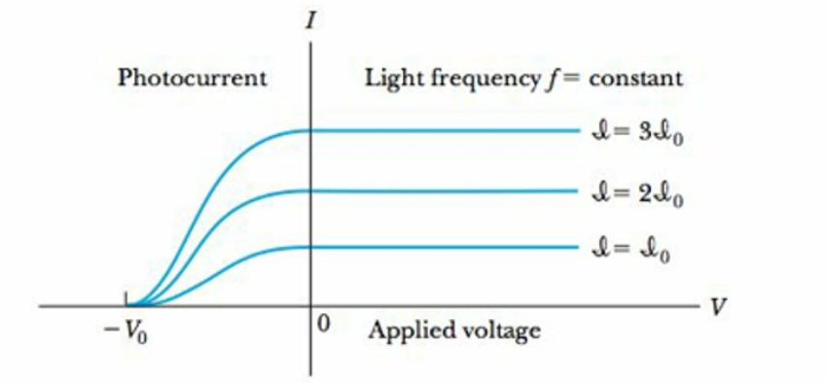
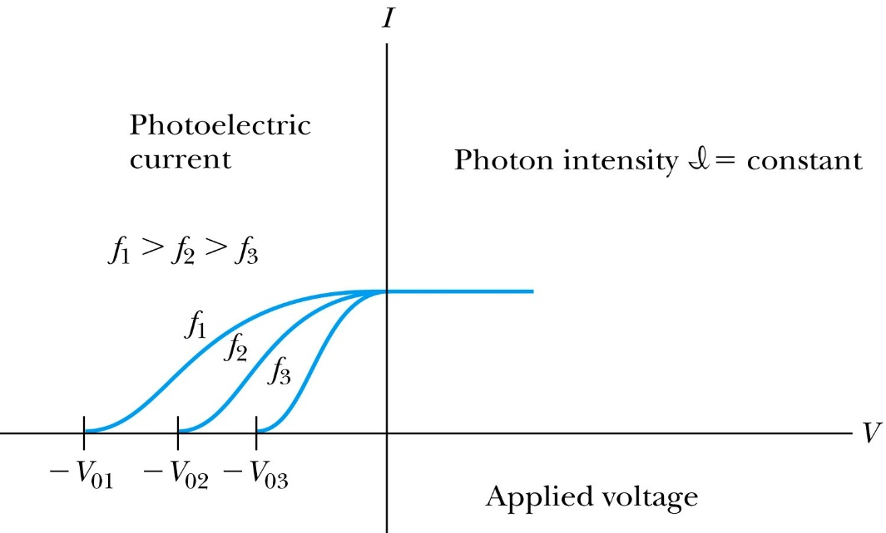
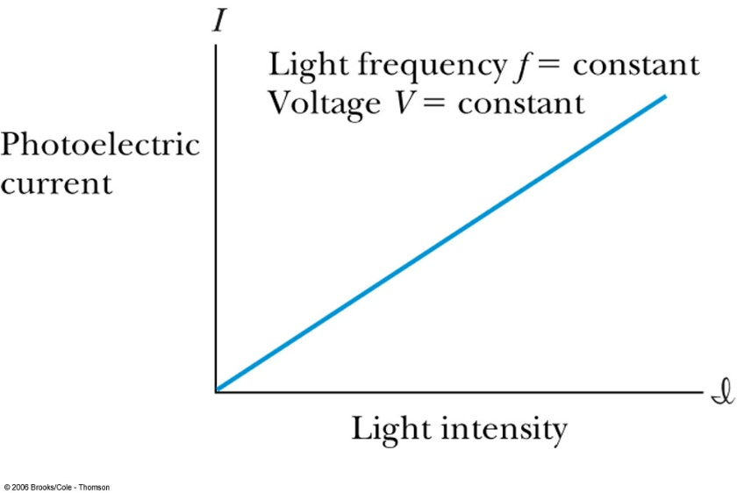
Experimental Results
Stopping potential measures maximum kinetic energy
threshold frequency
Same Kinetic energy
Work function
Frequency dependence of maximum kinetic energy
Photoelectric current starts in nsec

Slide 46
Experimental Results
The kinetic energies of the photoelectrons are independent of the light intensity.
The maximum kinetic energy of the photoelectrons, for a given emitting material, depends only on the frequency of the light.
The smaller the work function φ of the emitter material, the smaller is the threshold frequency of the light that can eject photoelectrons.
When the photoelectrons are produced, however, their number is proportional to the intensity of light.
The photoelectrons are emitted almost instantly following illumination of the photocathode, independent of the intensity of the light.

Slide 47
Classical Interpretation
Is not possible
Classical theory predicts that the total amount of energy in a light wave increases as the light intensity increases.
The maximum kinetic energy of the photoelectrons depends on the value of the light frequency f and not on the intensity.
The existence of a threshold frequency is completely inexplicable in classical theory.
Classical theory would predict that for extremely low light intensities, a long time would elapse before any one electron could obtain sufficient energy to escape. We observe, however, that the photoelectrons are ejected almost immediately.

Slide 48


Einstein’s Theory
Einstein suggested that the electromagnetic radiation field is quantized into particles called photons. Each photon has the energy quantum:
where f is the frequency of the light and h is Planck’s constant.
The photon travels at the speed of light in a vacuum, and its wavelength is given by

Slide 49



Einstein’s Theory
Conservation of energy yields:
where is the work function of the metal
Explicitly the energy is
The retarding potentials measured in the photoelectric effect are the opposing potentials needed to stop the most energetic electrons.

Slide 50
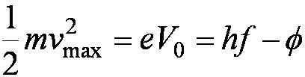
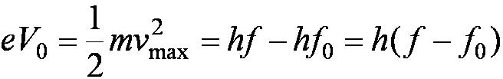
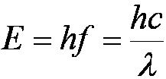
Quantum Interpretation
The kinetic energy of the electron does not depend on the light intensity at all, but only on the light frequency and the work function of the material.
Einstein in 1905 predicted that the stopping potential was linearly proportional to the light frequency, with a slope h, the same constant found by Planck.
From this, Einstein concluded that light is a particle with energy:

Slide 51
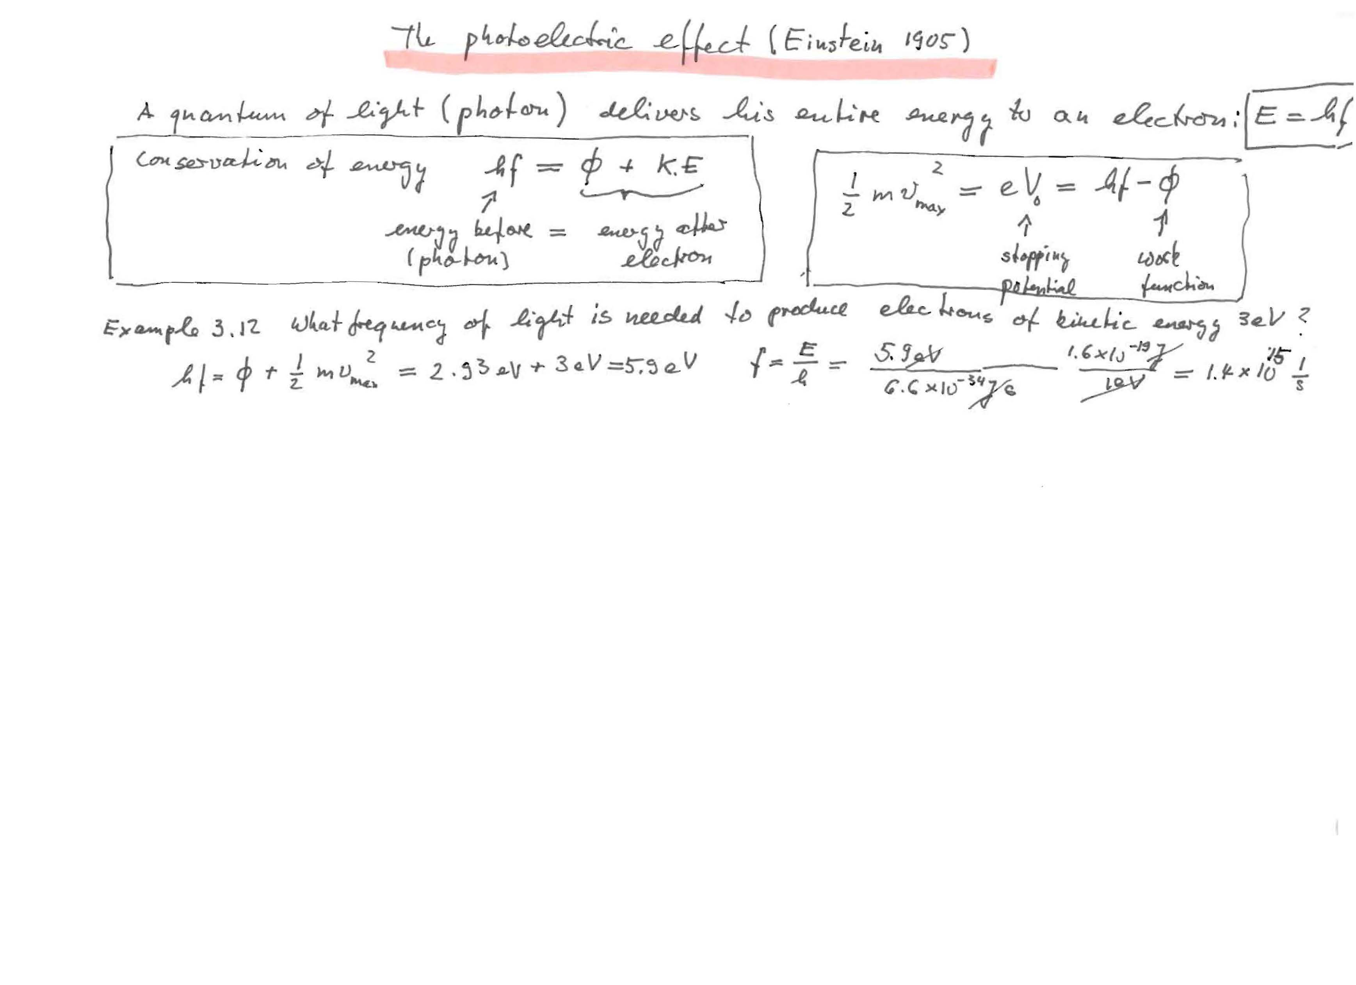
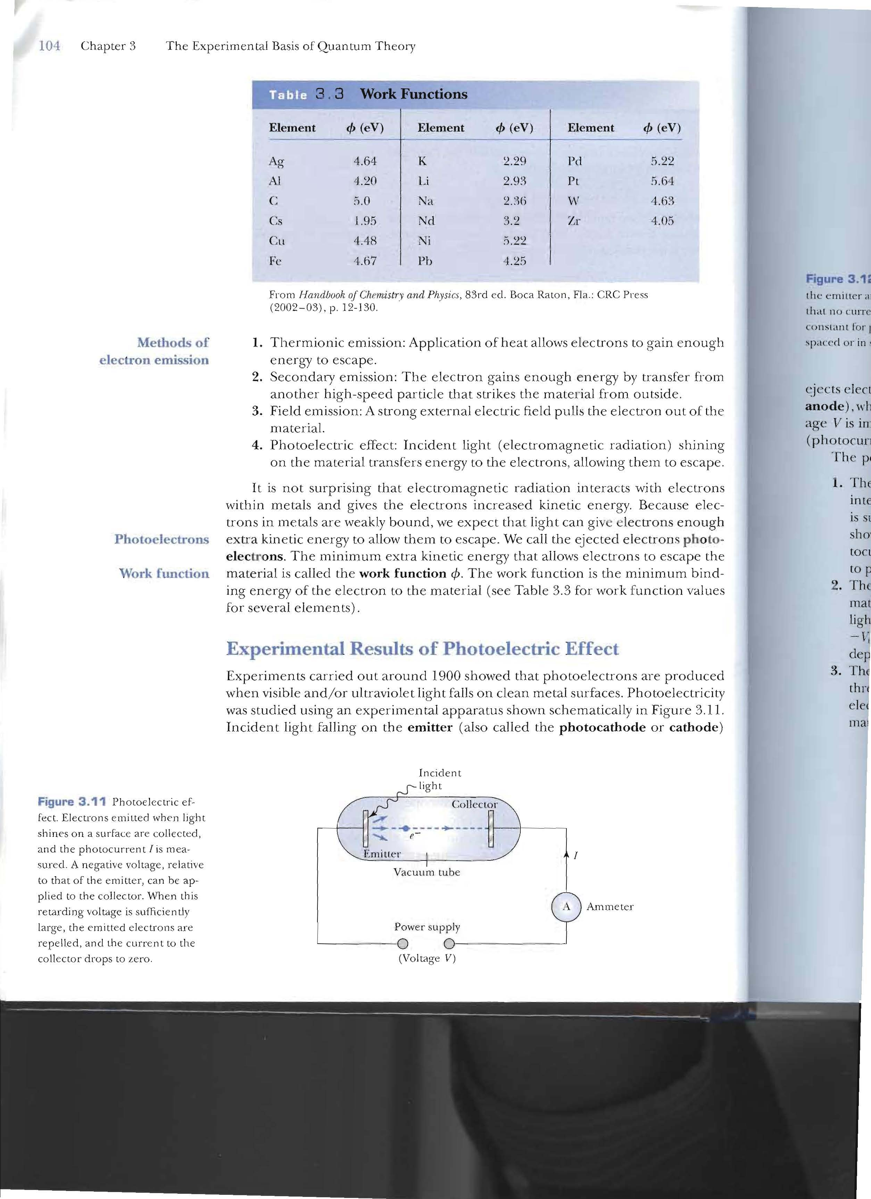
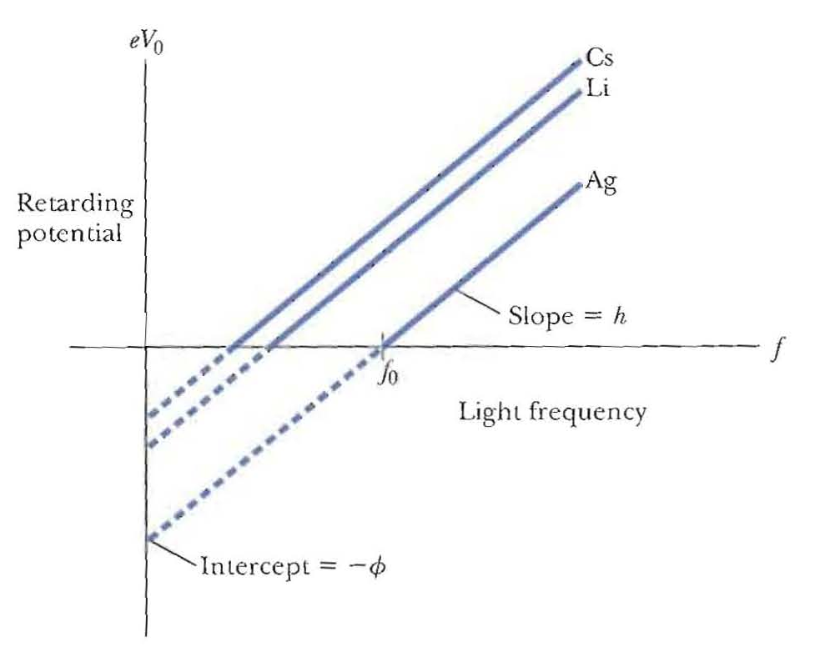
ss
Summary: photoelectric effect
For Li

Slide 52
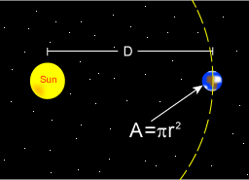
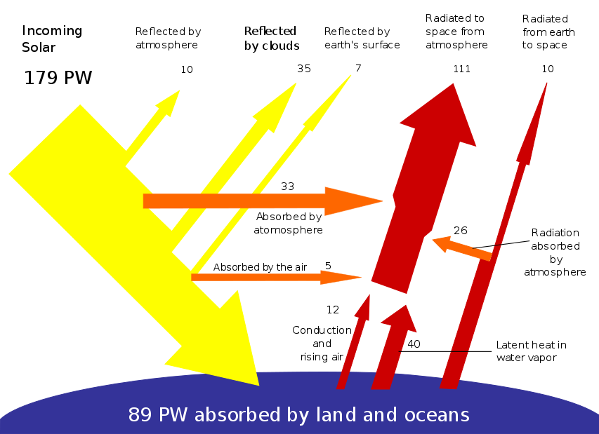



Slide 53
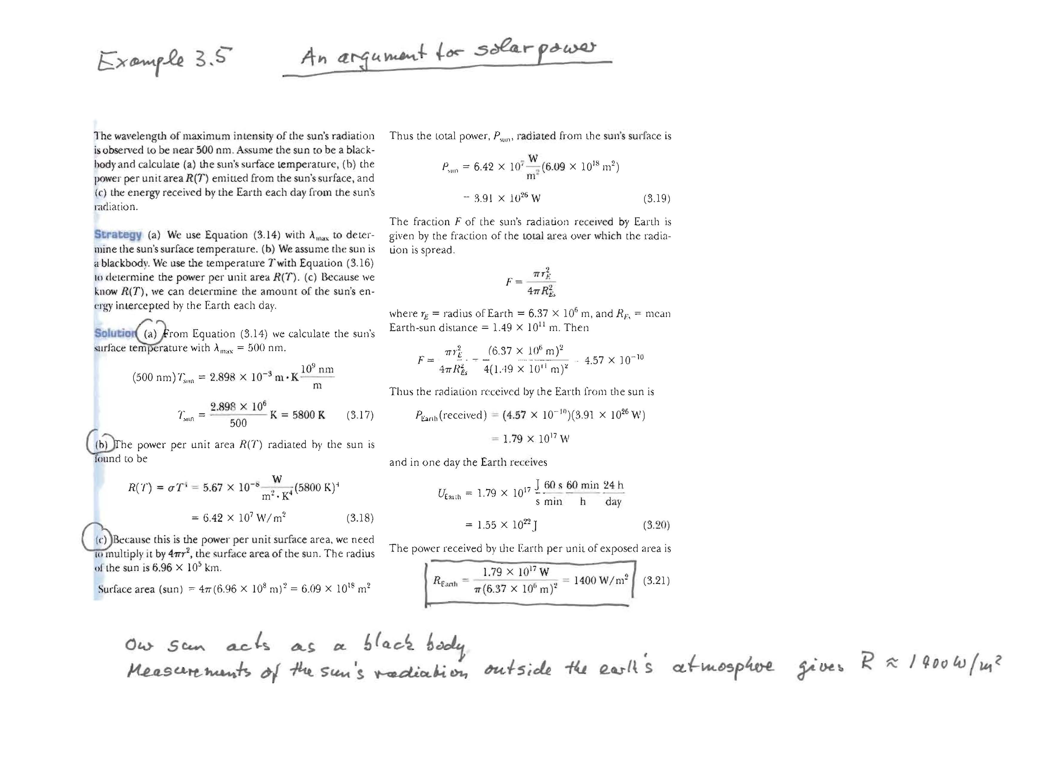


A
An argument for solar power

Slide 54



Slide 55



Slide 56
Problem 34. What is the threshold frequency for the photo electric effect in lithium with a work function of 2.93eV?What is the stopping potential if the wavelength of the incident light is 380 nm

Slide 57
Question from chapter3 quiz
When you increase only the intensity of the light onto the emitter, you measure
a. A decrease in the necessary stopping voltage
b. An increase in the necessary stopping voltage
c. No change in either current or stopping voltage
d. Either a or c. You cannot determine which from the information given.
e. An increased current

Slide 58

Maxwell classical light wave Einstein Photon particle
Rayleigh-jeans
Planck quantization
Einstein quantized photons

Slide 59




3.7: X-Ray Production(inverse photoelectric effect)
An energetic electron passing through matter will radiate photons and lose kinetic energy which is called bremsstrahlung, from the German word for “braking radiation.” Since linear momentum must be conserved, the nucleus absorbs very little energy, and it is ignored. The final energy of the electron is determined from the conservation of energy to be
An electron that loses a large amount of energy will produce an X-ray photon. Current passing through a filament produces copious numbers of electrons by thermionic emission. These electrons are focused by the cathode structure into a beam and are accelerated by potential differences of thousands of volts until they impinge on a metal anode surface, producing x rays by bremsstrahlung as they stop in the anode material.
Unlike the photon an electron can give up part of its energy(as bremsstrahlung) and be the same electron

Slide 60
bremsstrahlung, from the German word for “braking radiation “
What is the bremsstrahlung process?
a.The emission of a photon from an electron being accelerated by a nucleus
b.The emission of an electron from a metal when light is shined on it
c.Thermal excitation of photons in a substance
d.The emission of an electron from an inner electron shell and the resulting photon when an electron drops from an outer shell to take its place
e.Converting power-producing nuclear material to weapons grade

Slide 61



Inverse Photoelectric Effect.
Conservation of energy requires that the electron kinetic energy equal the maximum photon energy where we neglect the work function because it is normally so small compared to the potential energy of the electron. This yields the Duane-Hunt limit which was first found experimentally. The photon wavelength depends only on the accelerating voltage and is the same for all targets.

Slide 62

m

Slide 63
Bremsstrahlung: in X-ray emission

Slide 64



3.8: Compton Effect
When a photon enters matter, it is likely to interact with one of the atomic electrons. The photon is scattered from only one electron, rather than from all the electrons in the material, and the laws of conservation of energy and momentum apply as in any elastic collision between two particles. The momentum of a particle moving at the speed of light is
The electron energy can be written as
This yields the change in wavelength of the scattered photon which is known as the Compton effect:
Compton wavelength = h/mc = 2.426x 10^-3 nm

Slide 65


Figure 3-20 p114
Notes:
Figure 3.20 Compton scattering of a photon by an electron essentially at rest.

Slide 66

Thomson scattering=photon scattering from an tightly bound electron(use atom mass)
Compton scattering=photon scattering from a loosely bound electron(use electron mass)
Figure 3-21 p115
Notes:
Figure 3.21 Compton’s original data showing (a) the primary x-ray beam from Mo unscattered and (b) the scattered spectrum from carbon at 135° showing both the modiﬁed and unmodiﬁed wave

Slide 67



Slide 68

3.9: Pair Production and Annihilation
If a photon can create an electron, it must also create a positive charge to balance charge conservation.
In 1932, C. D. Anderson observed a positively charged electron (e⁺) in cosmic radiation. This particle, called a positron, had been predicted to exist several years earlier by P. A. M. Dirac.
A photon’s energy can be converted entirely into an electron and a positron in a process called pair production.

Slide 69




Pair production
Pair production from gamma ray
Pair annihilation
Conservation of mass energy
Proton – antiproton
Electron – positron
Hydrogen – antihydrogen
Neutron – antineutron
Matter – antimatter
Cloud chamber with tracks left behind by positron and electron

Slide 70




Pair Production in Empty Space
Conservation of energy for pair production in empty space is
Considering momentum conservation yields
This energy exchange has the maximum value
Recall that the total energy for a particle can be written as
However this yields a contradiction:
and hence the conversion of energy in empty space is an impossible situation.

Slide 71


Pair Production in Matter
Since the relations and contradict each other, a photon can not produce an electron and a positron in empty space.
In the presence of matter, the nucleus absorbs some energy and momentum.
The photon energy required for pair production in the presence of matter is

Slide 72





Pair Annihilation
Para-positronium T=0.12 ns Ortho-positronium T=138 ns
A positron passing through matter will likely annihilate with an electron. A positron is drawn to an electron by their mutual electric attraction, and the electron and positron then form an atomlike configuration called positronium.
Pair annihilation in empty space will produce two photons to conserve momentum. Annihilation near a nucleus can result in a single photon.
Conservation of energy:
Conservation of momentum:
The two photons will be almost identical, so that
The two photons from positronium annihilation will move in opposite directions with an energy:

Slide 73


