Slide 1
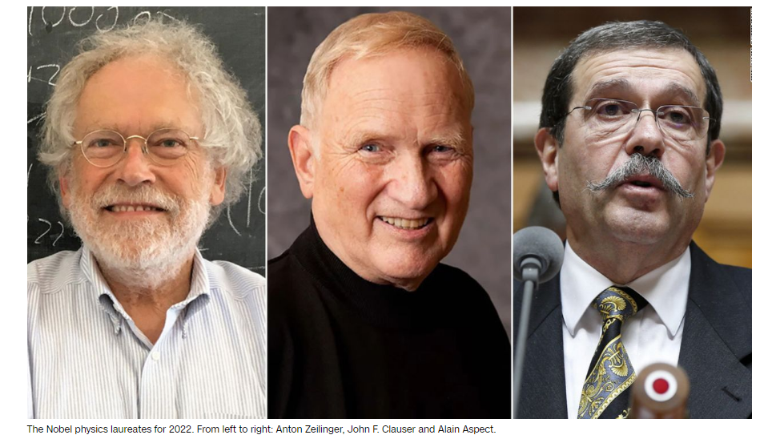
Nobel Prize in Physics 2022

Slide 2
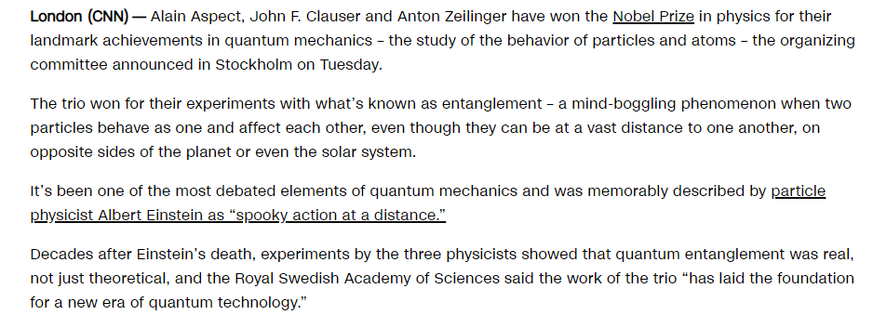
Entanglement

Slide 4
Quantum Science : Quantum Cryptography, Quantum Computing

Slide 5
CHAPTER 5 Wave Properties of Matter and Quantum Mechanics I
5.1 X-Ray Scattering
5.2 De Broglie Waves
5.3 Electron Scattering
5.4 Wave Motion
5.5 Waves or Particles?
5.6 Uncertainty Principle
5.7 Probability, Wave Functions, and the Copenhagen Interpretation
5.8 Particle in a Box

Slide 6
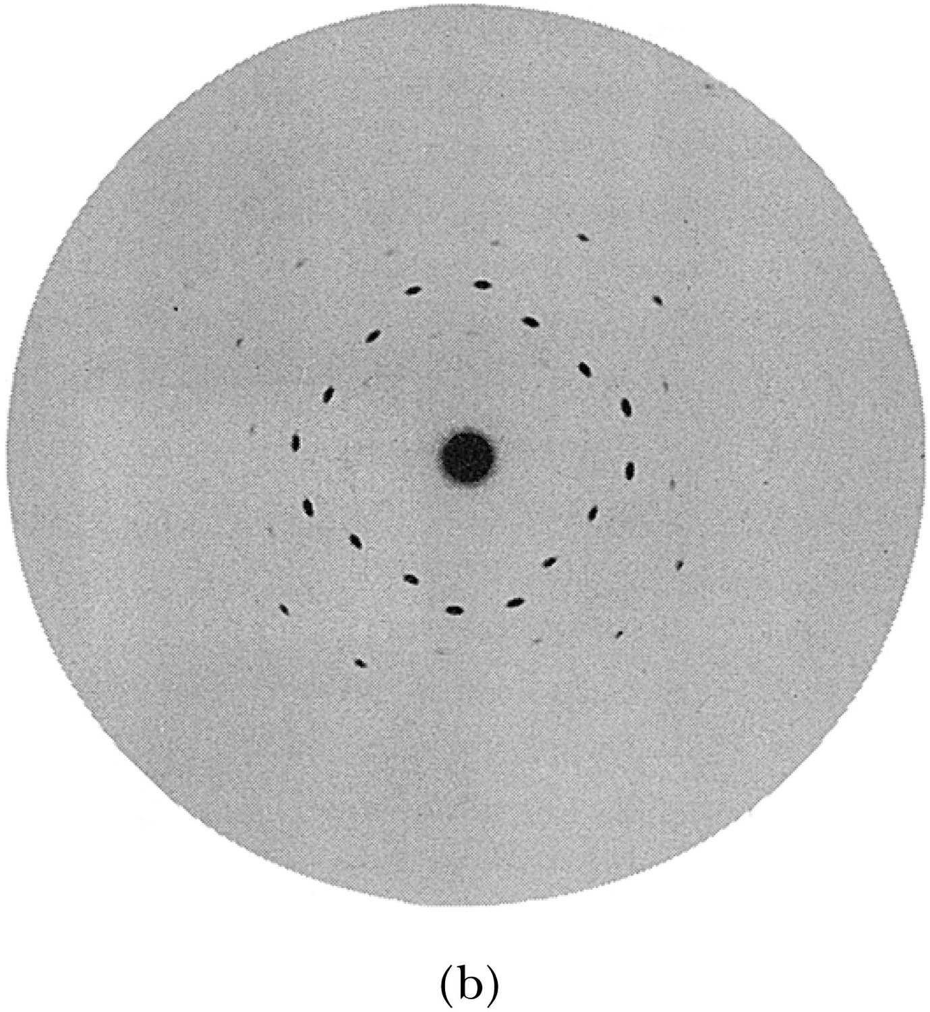
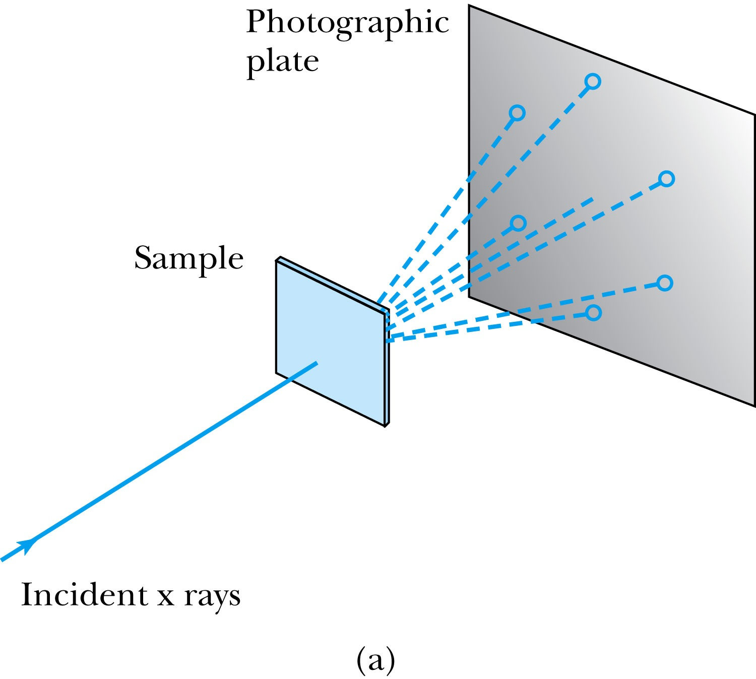
5.1: X-Ray Scattering
Max von Laue suggested that if x rays were a form of electromagnetic radiation, interference effects should be observed.
Crystals act as three-dimensional gratings, scattering the waves and producing observable interference effects.
Lattice spacing d is about o.1 nm

Slide 7
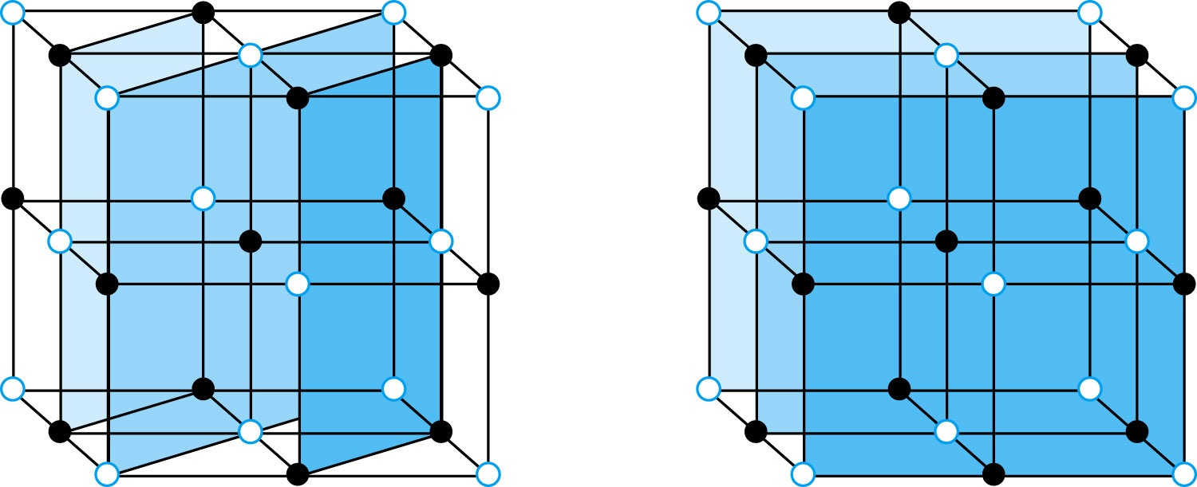
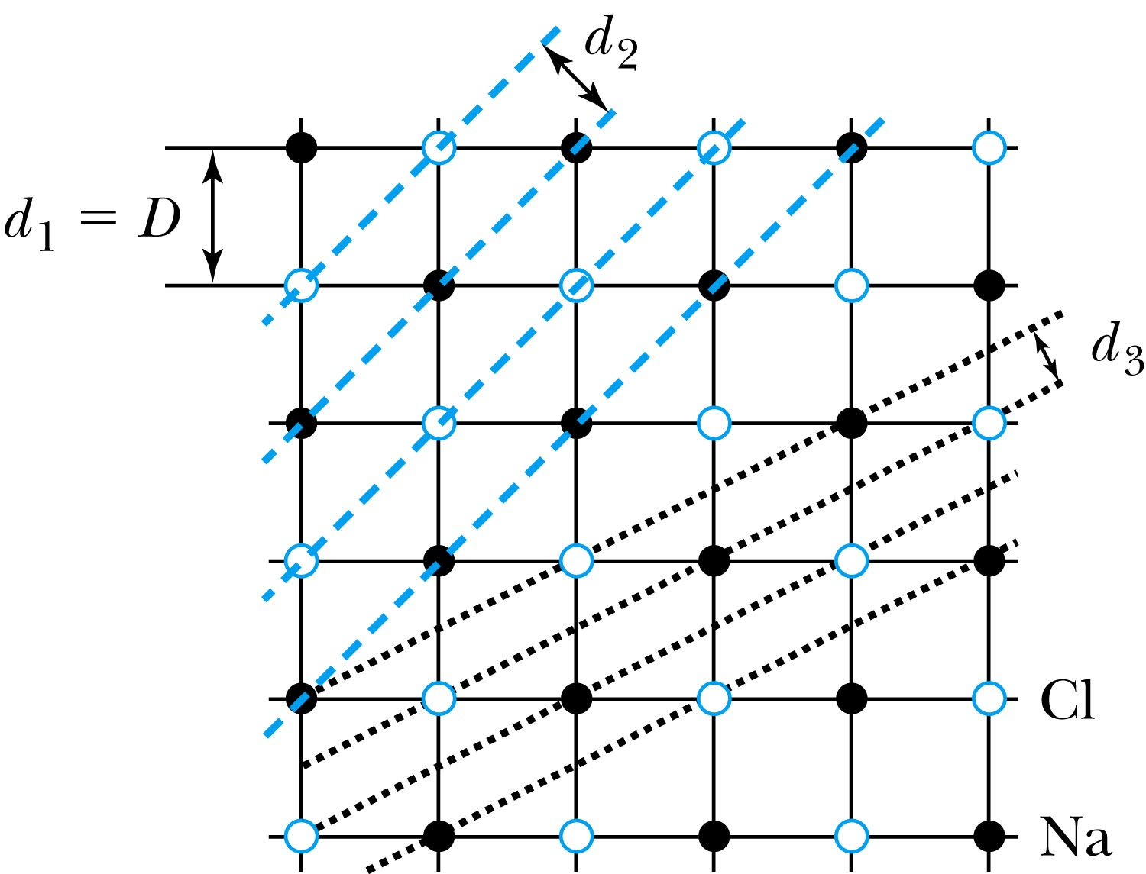
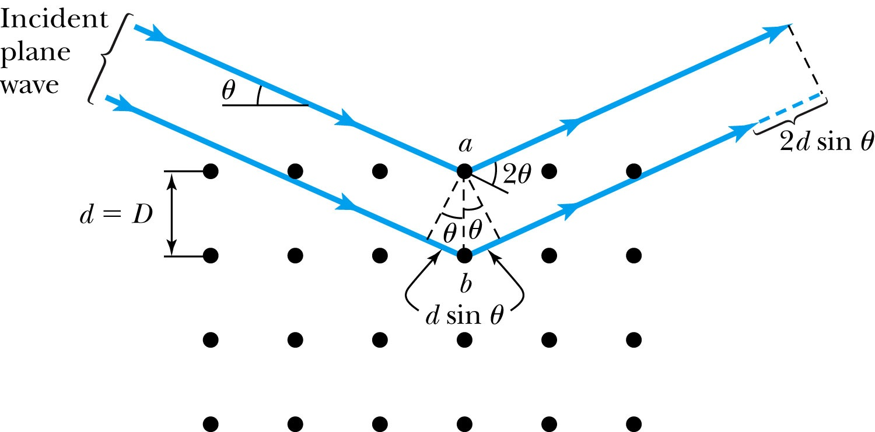
Bragg’s Law
William Lawrence Bragg interpreted the x-ray scattering as the reflection of the incident x-ray beam from a unique set of planes of atoms within the crystal.
There are two conditions for constructive interference of the scattered x rays:
The angle of incidence must equal the angle of reflection of the outgoing wave.
The difference in path lengths must be an integral number of wavelengths.
Bragg’s Law:
nλ = 2d sin θ
(n = integer)
Used for determining wavelength or interplanar spacing

Slide 8
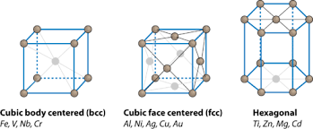

Slide 9
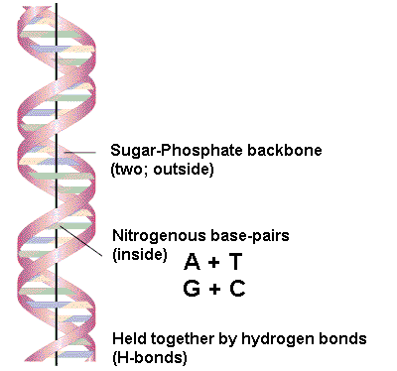
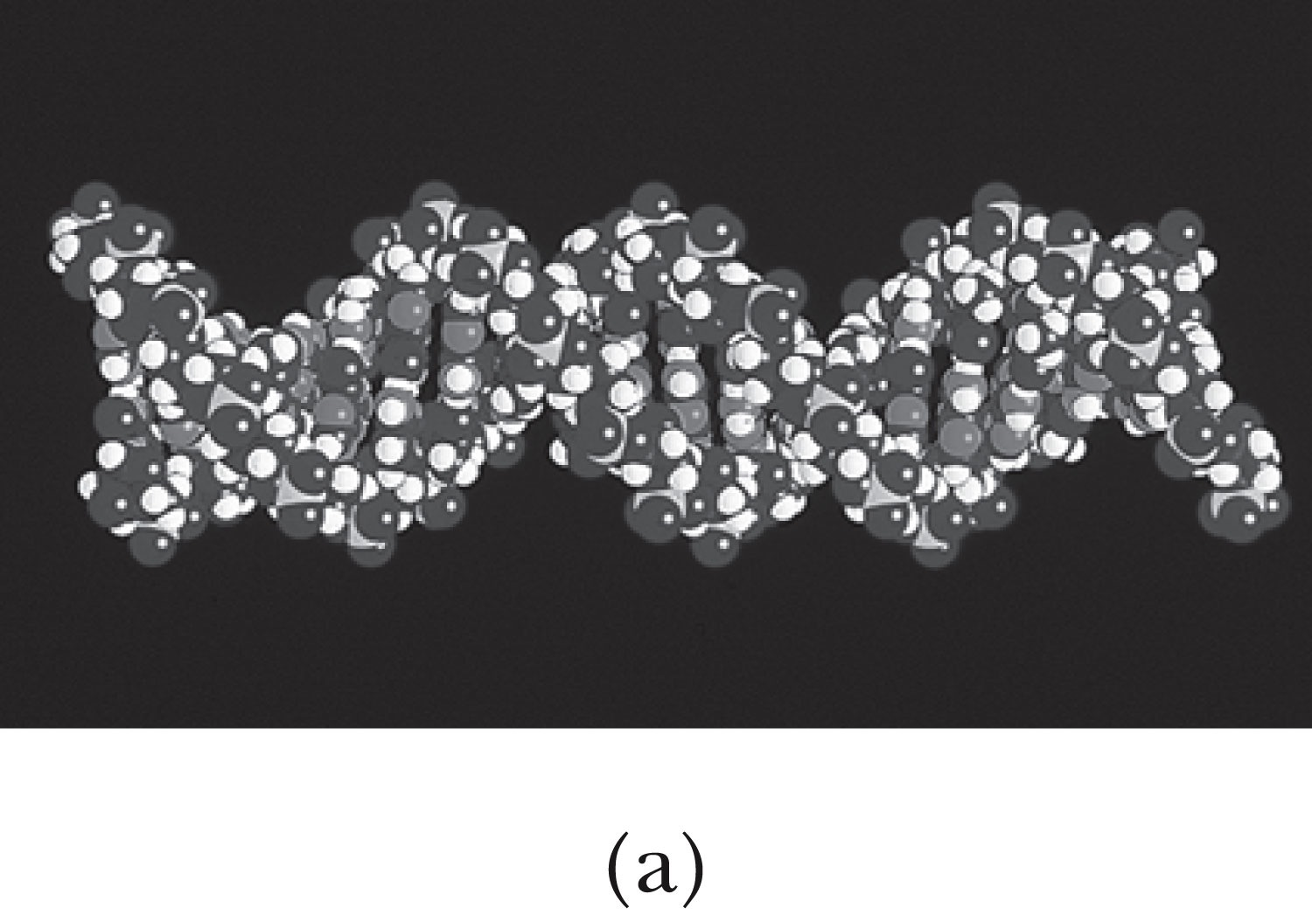
structure of DNA-double-helix by x-ray diffraction (Watson and Crick)
Figure 5-6a p166
Notes:
Figure 5.5 Schematic diagram of Bragg spectrometer. X rays are produced by electron bombardment of metal target. The x rays are collimated by lead, scatter from a crystal, and are detected as a function of the angle 2u.

Slide 10
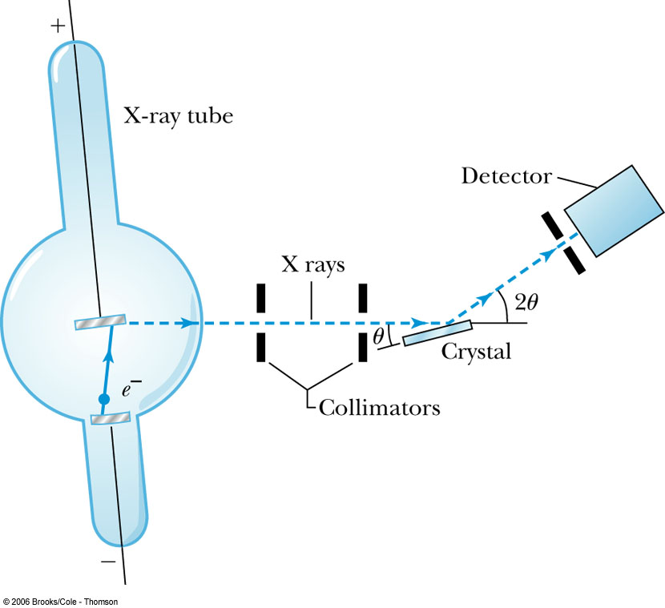
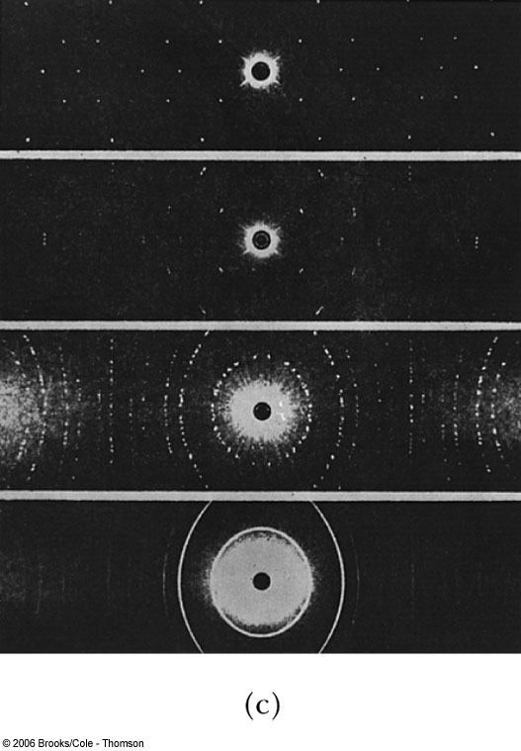
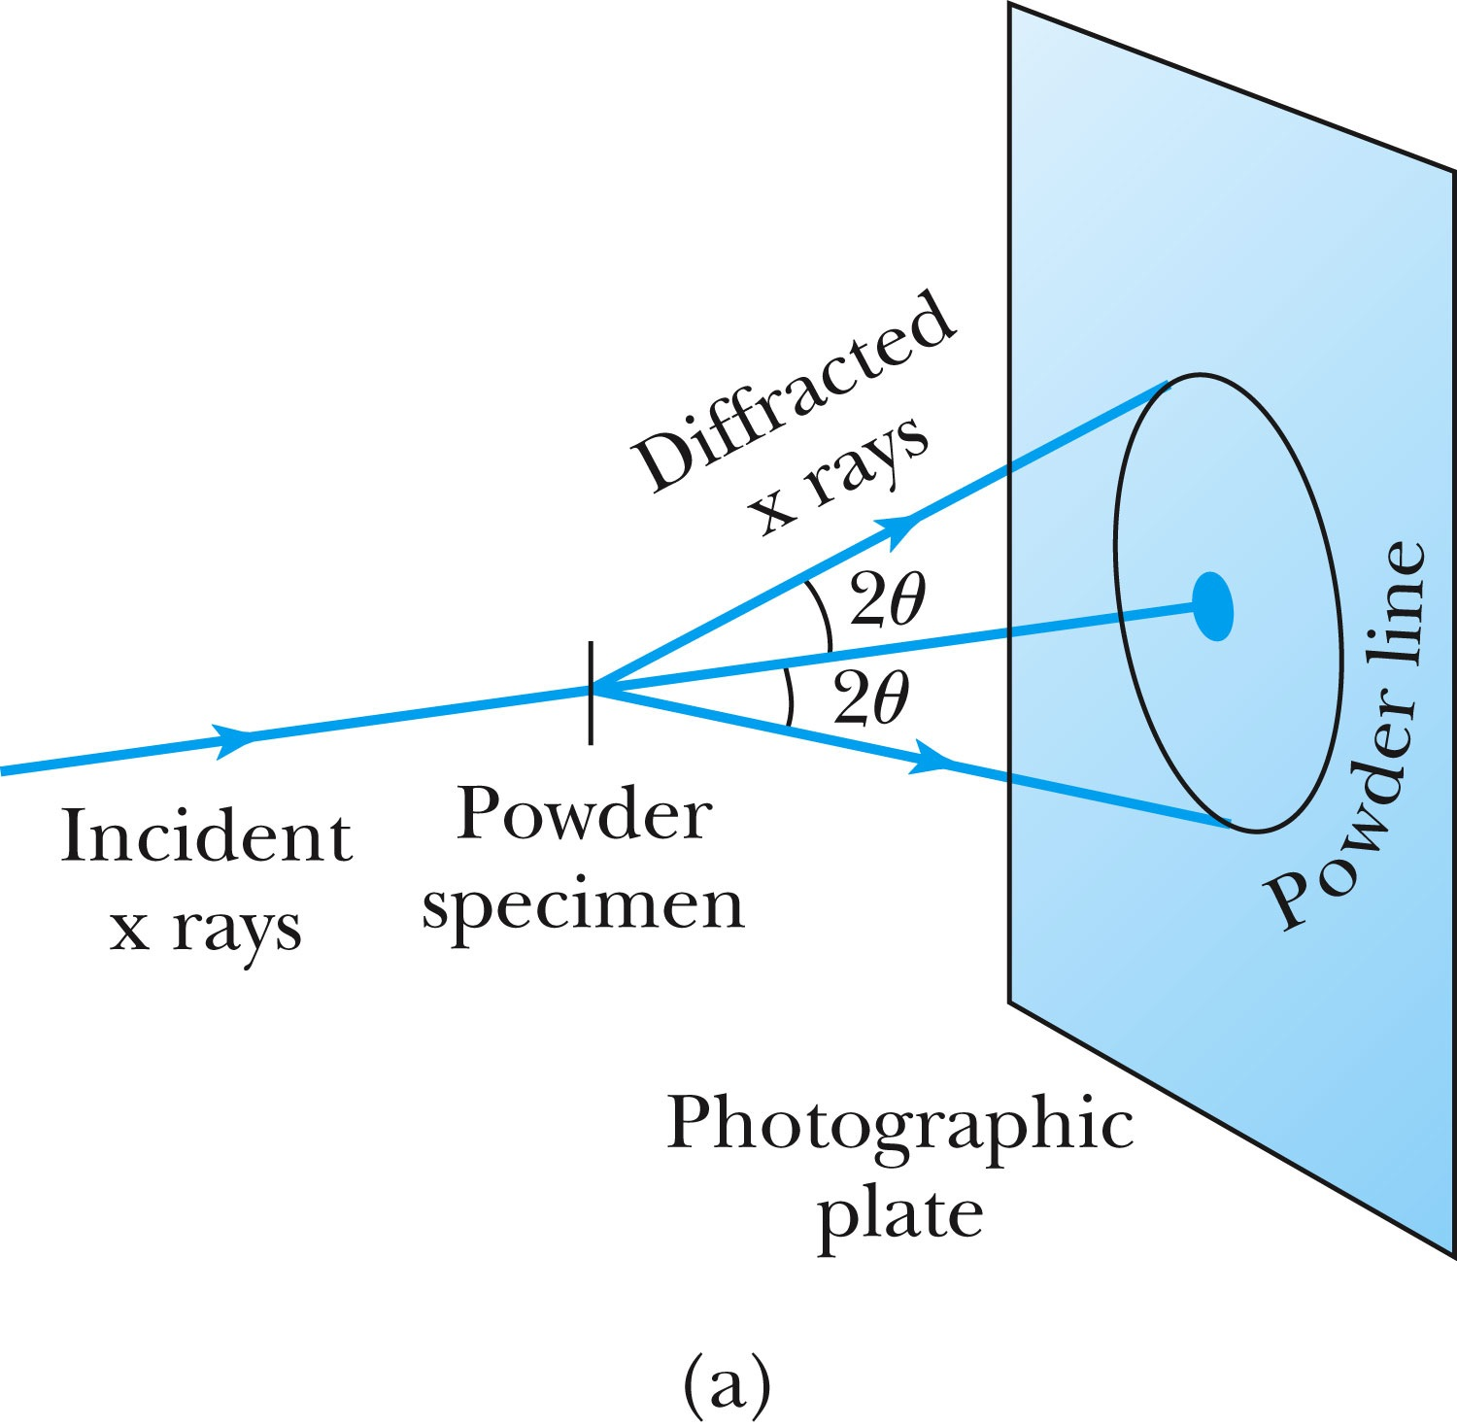
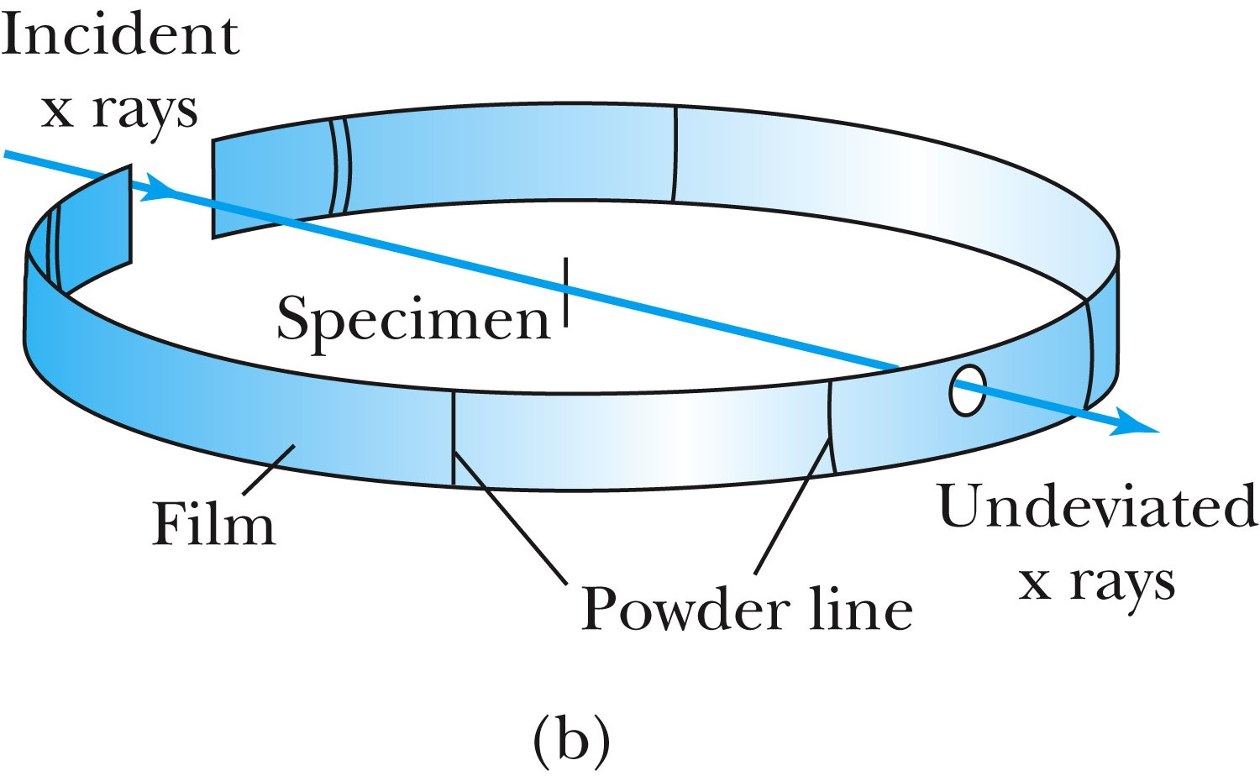
The Bragg Spectrometer
A Bragg spectrometer scatters x rays from several crystals. The intensity of the diffracted beam is determined as a function of scattering angle by rotating the crystal and the detector.
When a beam of x rays passes through the powdered crystal, the dots become a series of rings.

Slide 11
Quiz question
Which of the following is true about Bragg planes?
a. There is only one Bragg plane for any given crystal structure.
b.They are especially useful for detecting transitions between energy levels in the crystals' atoms.
c.They are used to scatter alpha particles in gold and other materials.
d.They are evenly spaced planes within crystal structures of atoms.
e. All of the above.

Slide 12
Clicker - Questions
11) The color of visible light are listed in increasing order of frequency.
a) violet, blue, yellow, green, orange, red
b) red, yellow, orange, violet, blue, green
c) blue, violet, green, yellow, red
d) red, orange, yellow, green, blue, violet

Slide 13
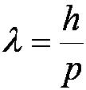
5.2: De Broglie Waves = matter waves
Prince Louis V. de Broglie suggested that mass particles should have wave properties similar to electromagnetic radiation.
Thus the wavelength of a matter wave is called the de Broglie wavelength:
Since for a photon, E = pc and E = hf, the energy can be written as

Slide 15
Clicker - Questions
14) Compute the De Broglie wavelength of
A 2000 kg car traveling at 100m/sec.
A smoke particle of mass 10⁻⁶g moving at 1cm/sec
An electron with kinetic energy of 1eV
A proton with kinetic energy of 1eV
3.3x10⁻⁴¹m, 6.6x10⁻²⁵m, 1.2nm, 0.3nm
3.3x10⁻²⁵m, 6.6x10⁻²⁴m, 1.2nm, 0.3nm
3.3x10⁻³⁹m, 6.6x10⁻²³m, 12Å, 0.028nm
5.5x10⁻²⁵m, 6.6x10⁻²³m, 1.2Å, 500Å
None of the above

Slide 16
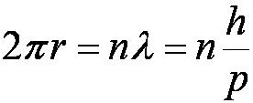
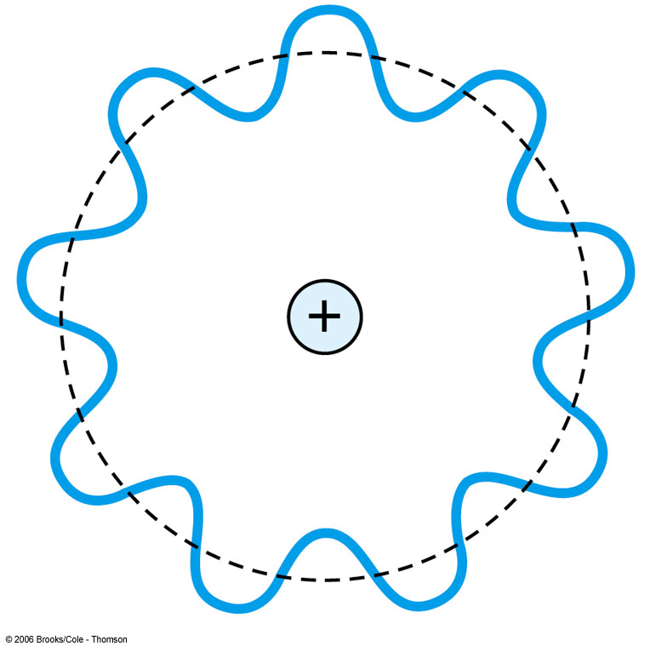
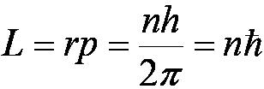
Bohr’s Quantization Condition
One of Bohr’s assumptions concerning his hydrogen atom model was that the angular momentum of the electron-nucleus system in a stationary state is an integral multiple of h/2π.
The electron is a standing wave in an orbit around the proton. This standing wave will have nodes and be an integral number of wavelengths.
The angular momentum becomes:
Apply the deBroglie wavelength of the electron in the Bohr atom as a standing wave

Slide 17
When de Broglie's matter waves are applied to electrons in the Bohr atom, which of the following occurs?
a.The electron is found to have in its orbit an integral number of half-wavelengths.
b.Bohr's quantization assumption for electron orbits is modified to incorporate the wave properties of the electron.
c.de Broglie's results allow an integral number of wavelengths in the electron orbits.
d.The angular momentum of the electron in the atom is constant, with longer wavelengths at larger quantum numbers.

Slide 18
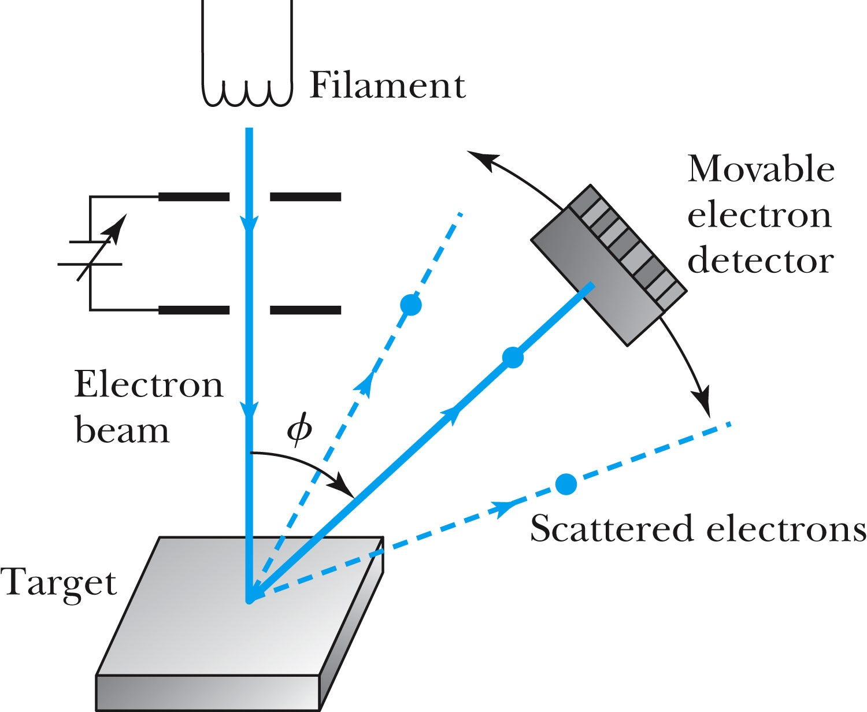
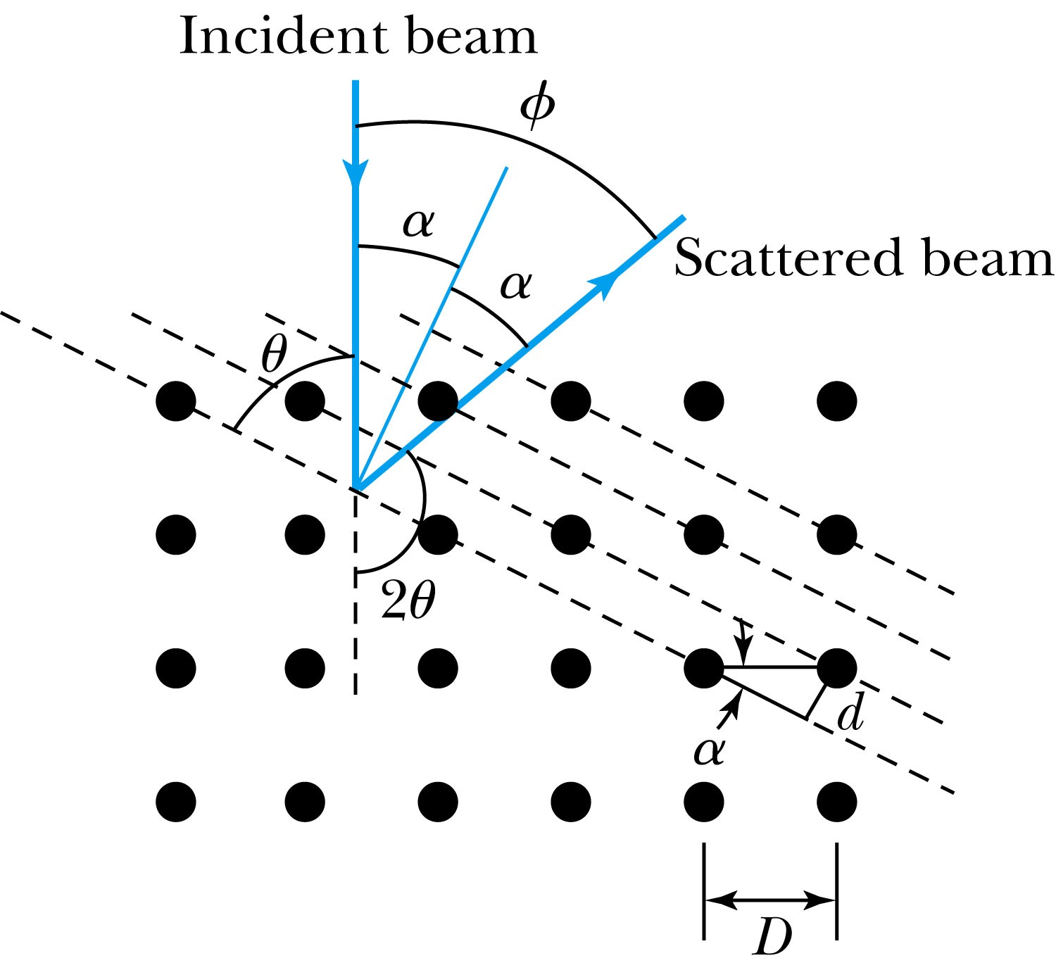
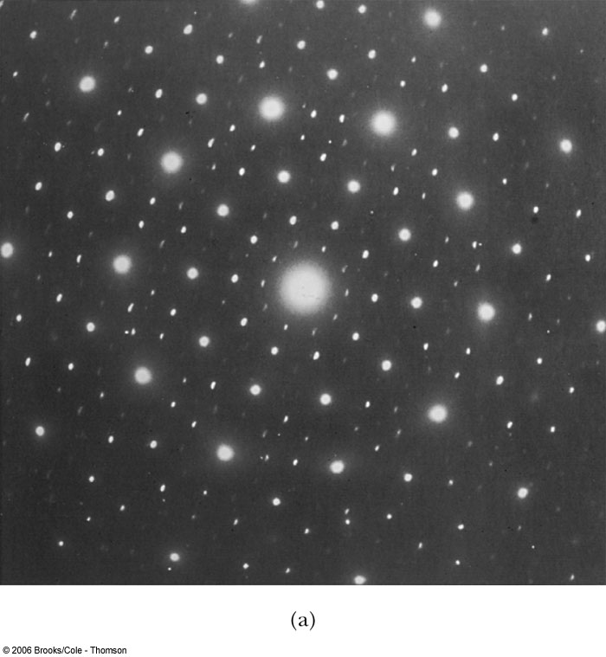
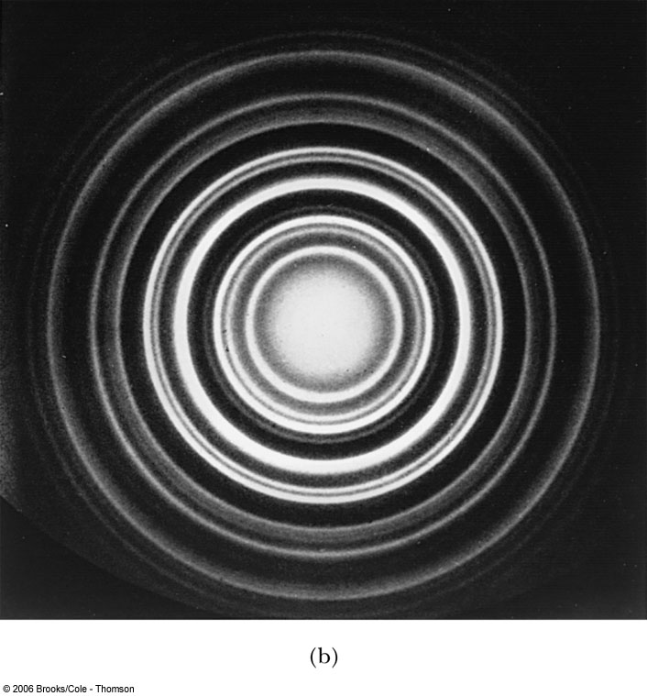
5.3: Electron Scattering
Davisson and Germer experimentally observed that electrons were diffracted much like x rays in nickel crystals.
George P. Thomson (1892–1975), son of J. J. Thomson, reported seeing the effects of electron diffraction in transmission experiments. The first target was celluloid, and soon after that gold, aluminum, and platinum were used. The randomly oriented polycrystalline sample of SnO₂ produces rings as shown in the figure at right.

Slide 19
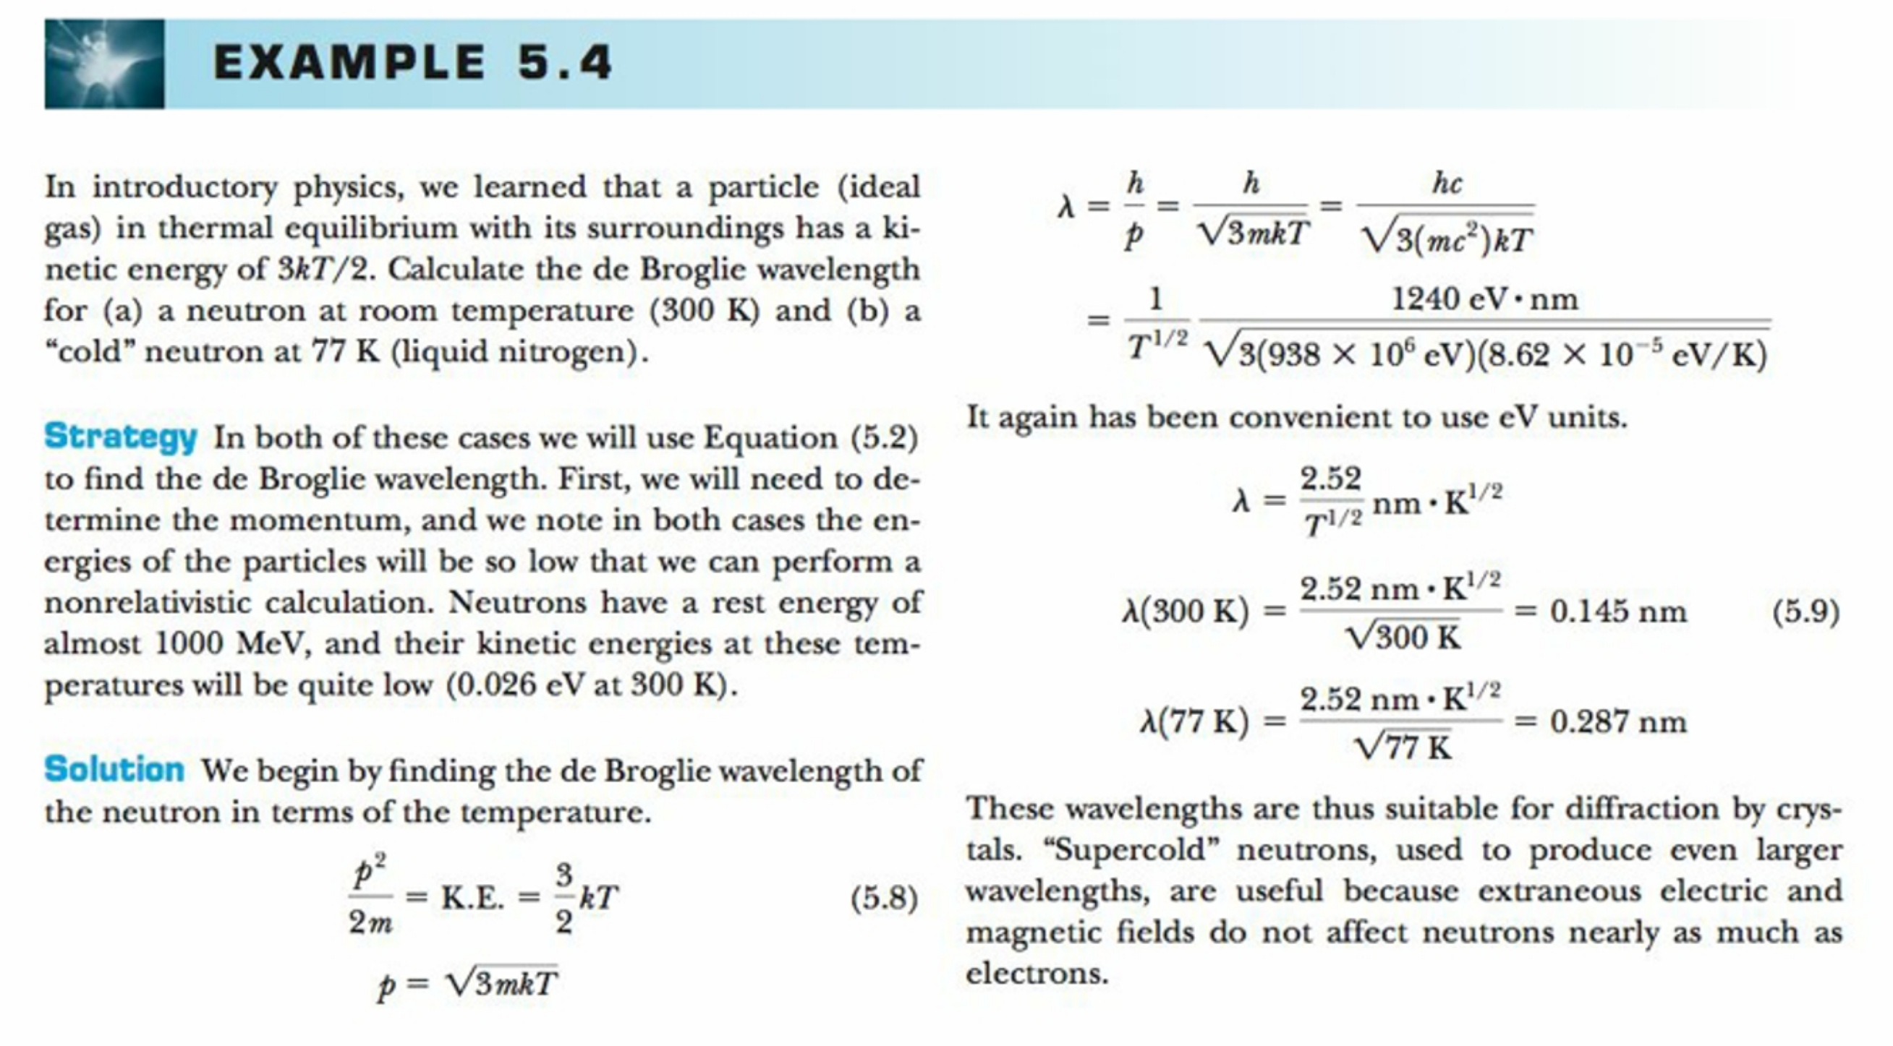
The Spallation Neutron Source at Oakridge

Slide 20
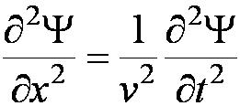
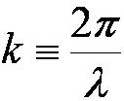
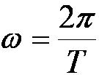
5.4: Wave Motion
De Broglie matter waves suggest a further description. The displacement of a wave is
This is a solution to the wave equation
Define the wave number k and the angular frequency ω as:
The wave function is now: Ψ(x, t) = A sin (kx − ωt)
and

Slide 21
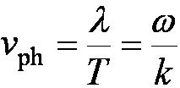
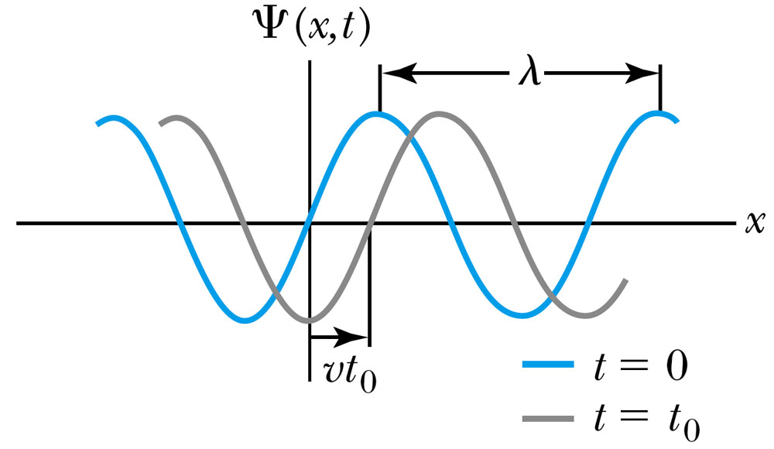
Wave Properties
The phase velocity is the velocity of a point on the wave that has a given phase (for example, the crest) and is given by
A phase constant Φ shifts the wave:
.
Notes:
2

Slide 22
Wave motion

Slide 23
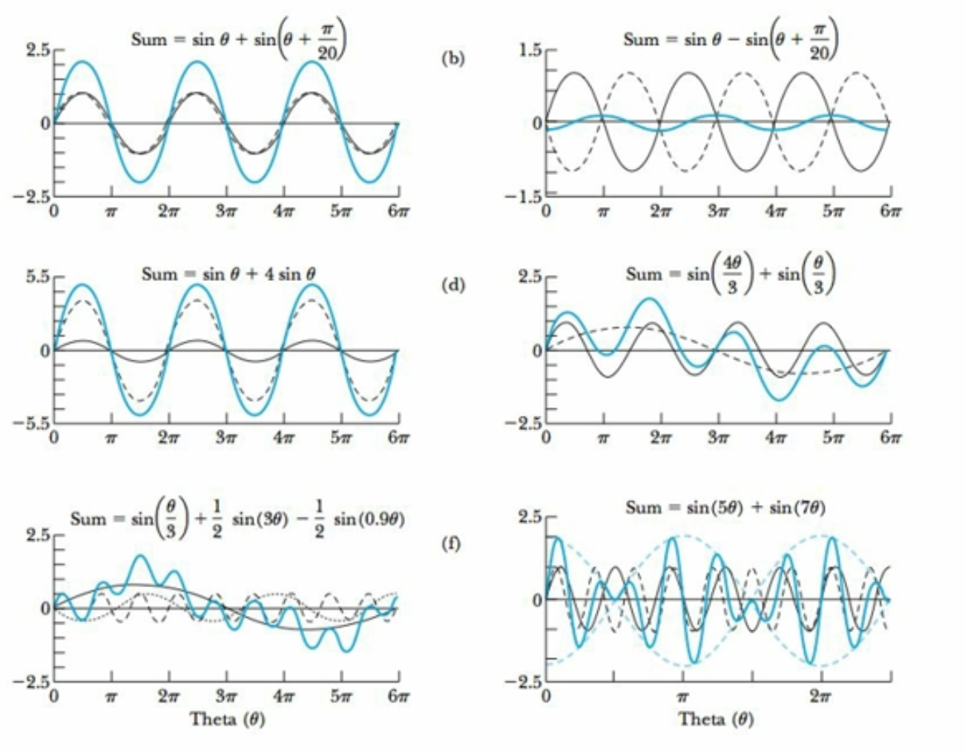
Superposition of waves with different frequencies,phases, and amplitudes

Slide 24
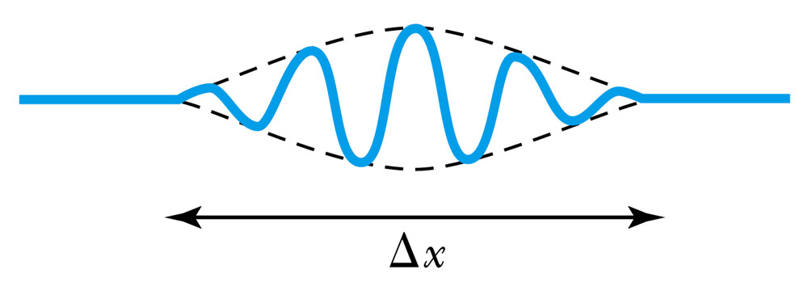
Principle of Superposition
When two or more waves traverse the same region, they act independently of each other.
Combining two waves yields:
The combined wave oscillates within an envelope that denotes the maximum displacement of the combined waves.
When combining many waves with different amplitudes and frequencies, a pulse, or wave packet, is formed which moves at a group velocity:

Slide 25
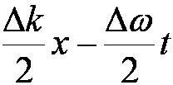
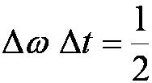
Wave Packet Envelope(from two waves)
The superposition of two waves yields a wave number and angular frequency of the wave packet envelope.
The range of wave numbers and angular frequencies that produce the wave packet have the following relations:
A Gaussian wave packet has similar relations:
The localization of the wave packet over a small region to describe a particle requires a large range of wave numbers. Conversely, a small range of wave numbers cannot produce a wave packet localized within a small distance.

Slide 26
Wave packet : Fourier Series and Integral
The sum of many waves that form a wave packet is called a Fourier series:
Summing an infinite number of waves yields the Fourier integral:

Slide 27
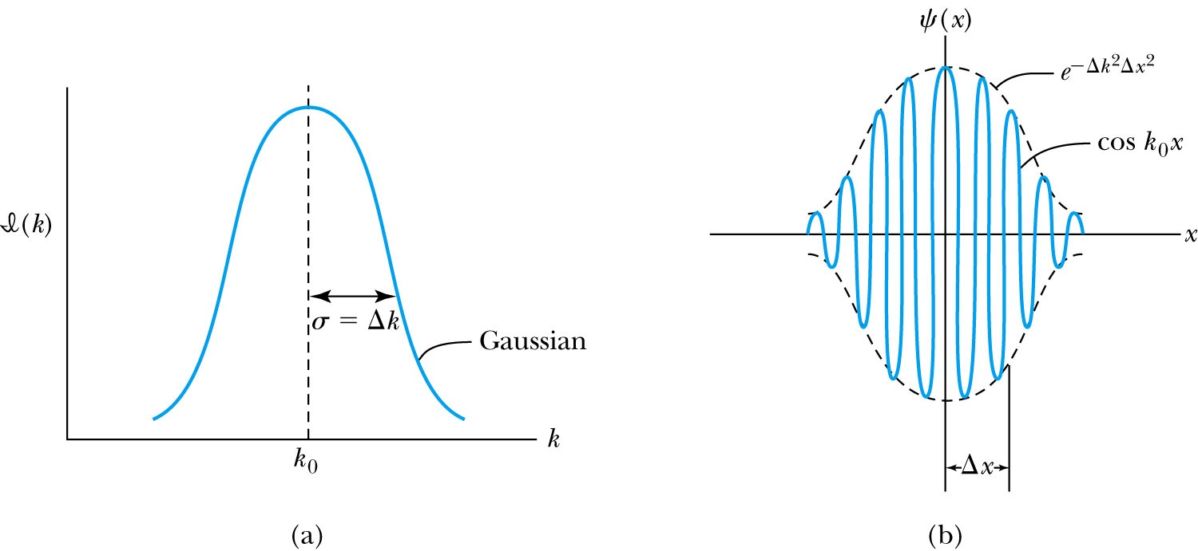
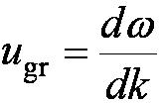
Gaussian Function
A Gaussian wave packet describes the envelope of a pulse wave.
The group velocity is
X=

Slide 28
Group velocity of the wave packet=velocity of the particle described by the wavepacket
mv c^2/ mc^2=v

Slide 29
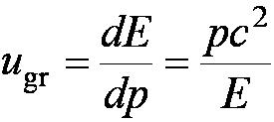
Dispersion causes group and phase velocities to be different
Considering the group velocity of a de Broglie wave packet yields:
The relationship between the phase velocity and the group velocity is
Hence the group velocity may be greater or less than the phase velocity. A medium is called nondispersive when the phase velocity is the same for all frequencies and equal to the group velocity.

Slide 30
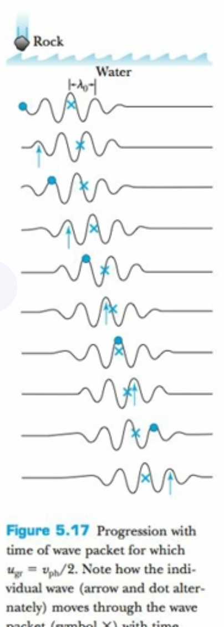
phase and group velocity

Slide 32
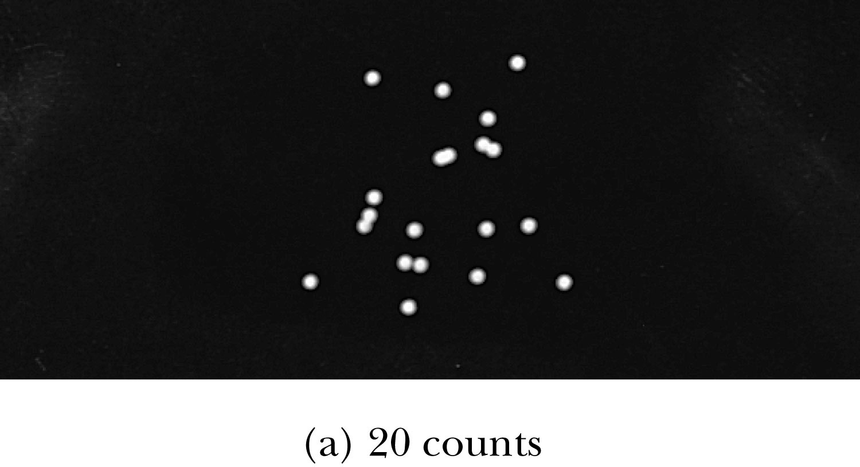
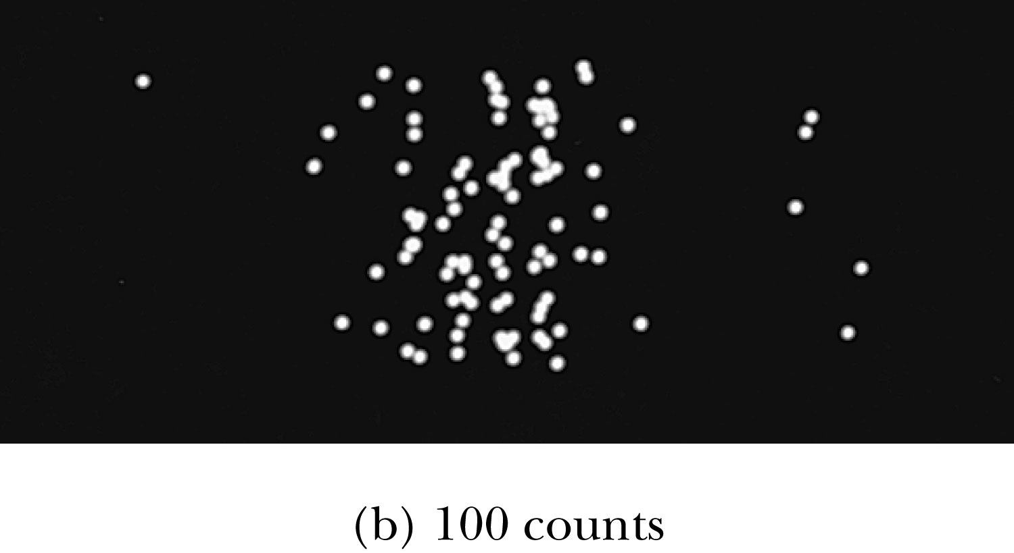
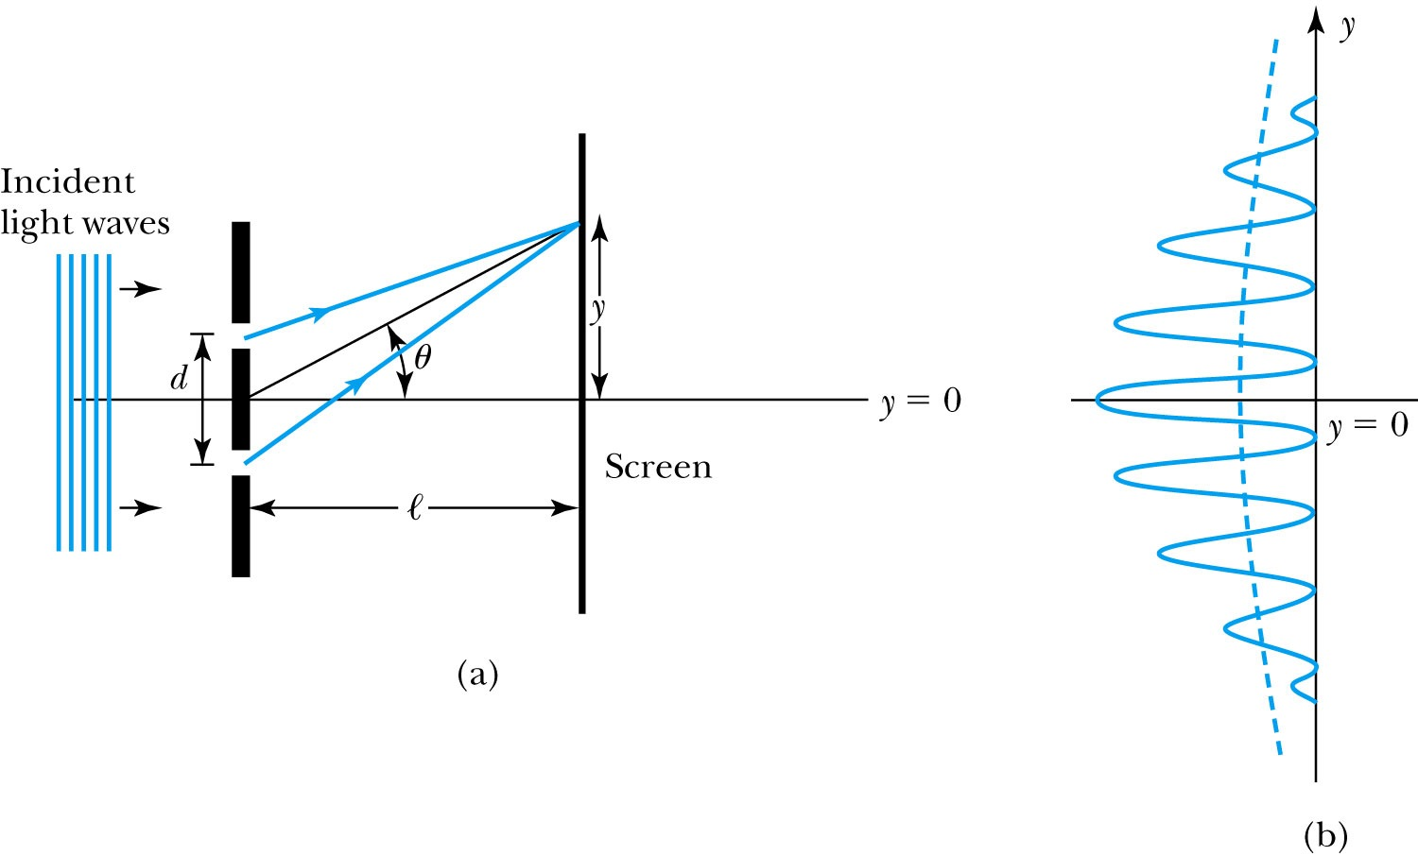
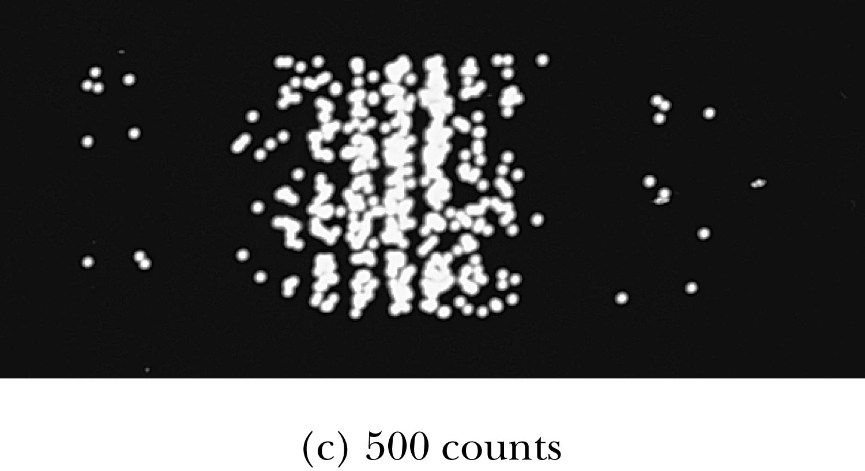
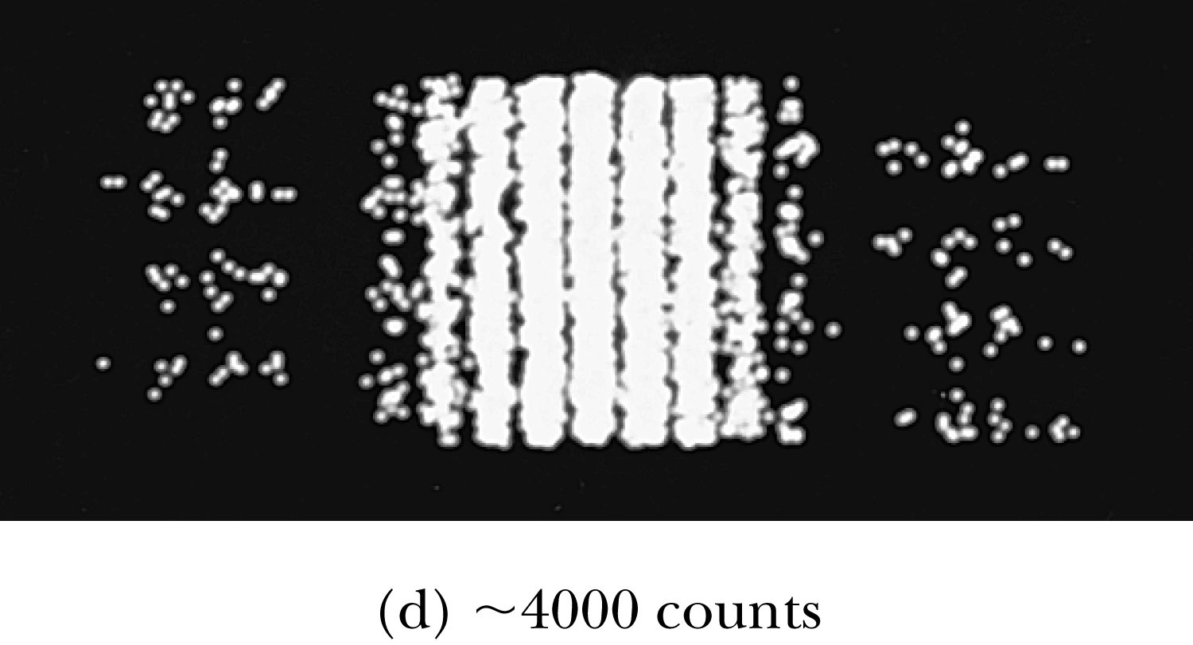
5.5: Waves or Particles?
Young’s double-slit diffraction experiment demonstrates the wave property of light.
However, dimming the light results in single flashes on the screen representative of particles.

Slide 33
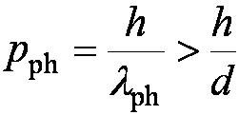
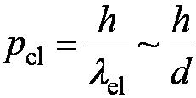
Which slit?
To determine which slit the electron went through: We set up a light shining on the double slit and use a powerful microscope to look at the region. After the electron passes through one of the slits, light bounces off the electron; we observe the reflected light, so we know which slit the electron came through.
Use a subscript “ph” to denote variables for light (photon). Therefore the momentum of the photon is
The momentum of the electrons will be on the order of .
The difficulty is that the momentum of the photons used to determine which slit the electron went through is sufficiently great to strongly modify the momentum of the electron itself, thus changing the direction of the electron! The attempt to identify which slit the electron is passing through will in itself change the interference pattern.

Slide 34
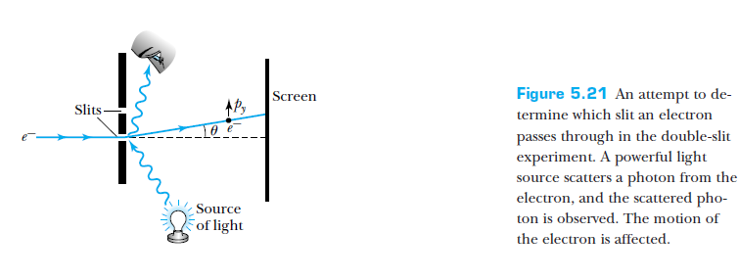
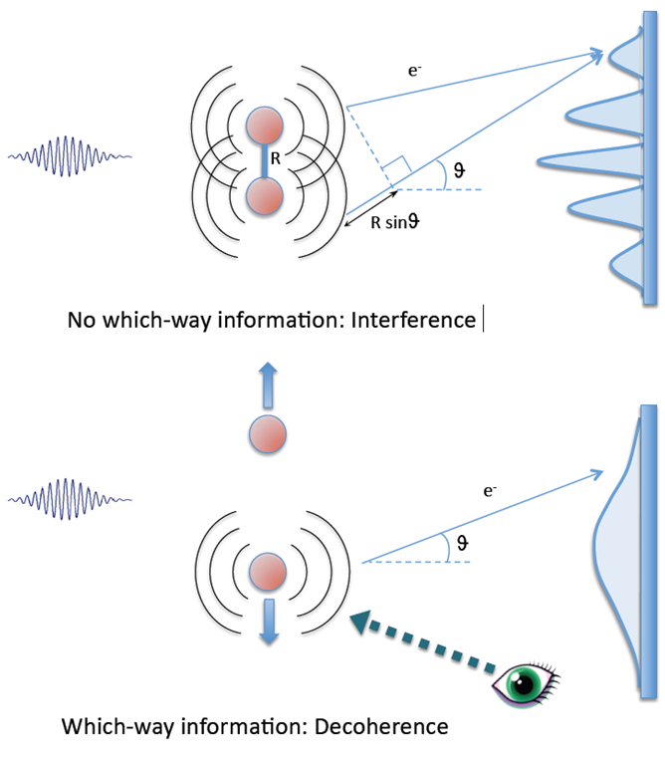
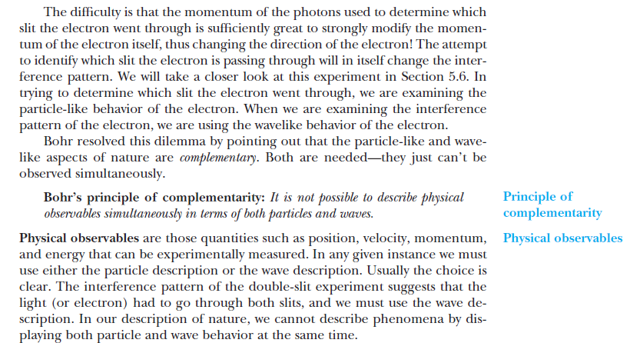

Slide 35
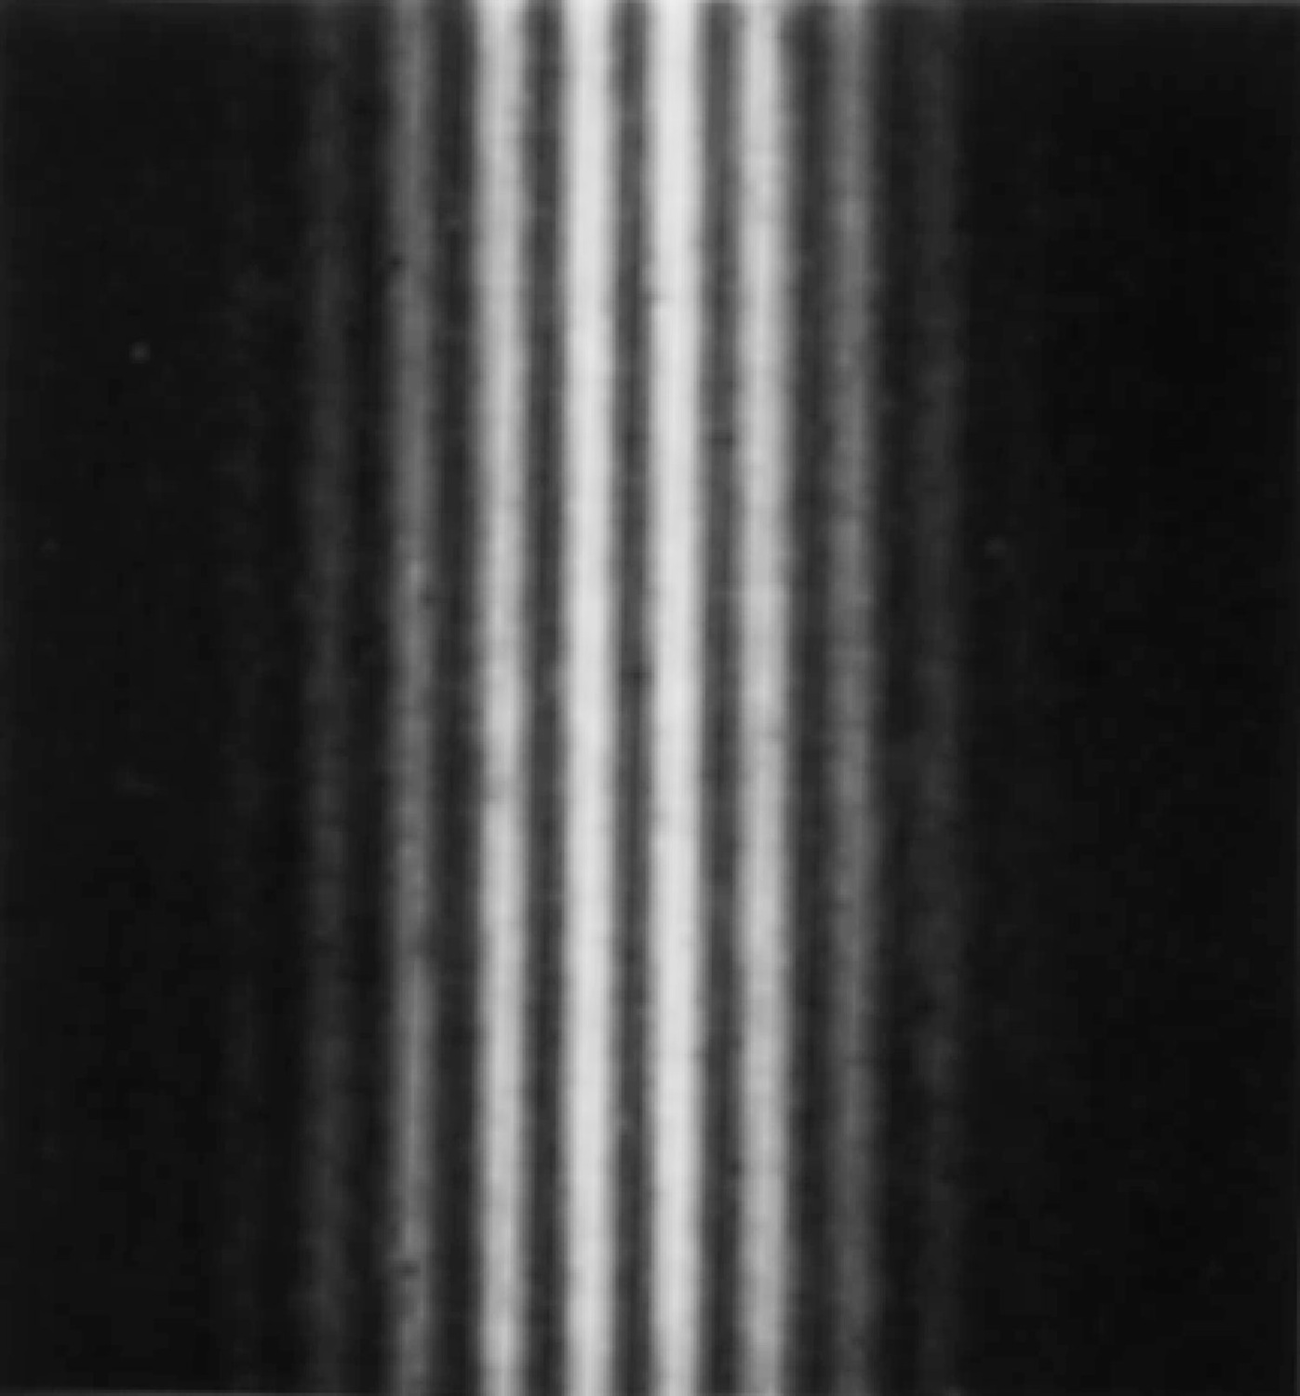
Electron Double-Slit Experiment
C. Jönsson of Tübingen, Germany, succeeded in 1961 in showing double-slit interference effects for electrons by constructing very narrow slits and using relatively large distances between the slits and the observation screen.
This experiment demonstrated that precisely the same behavior occurs for both light (waves) and electrons (particles).

Slide 36
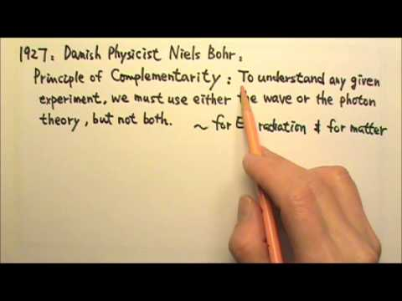
Wave particle duality solution
The solution to the wave particle duality of an event is given by the following principle.
Bohr’s principle of complementarity: It is not possible to describe physical observables simultaneously in terms of both particles and waves.
Physical observables are those quantities such as position, velocity, momentum, and energy that can be experimentally measured. In any given instance we must use either the particle description or the wave description.

Slide 37
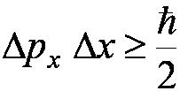
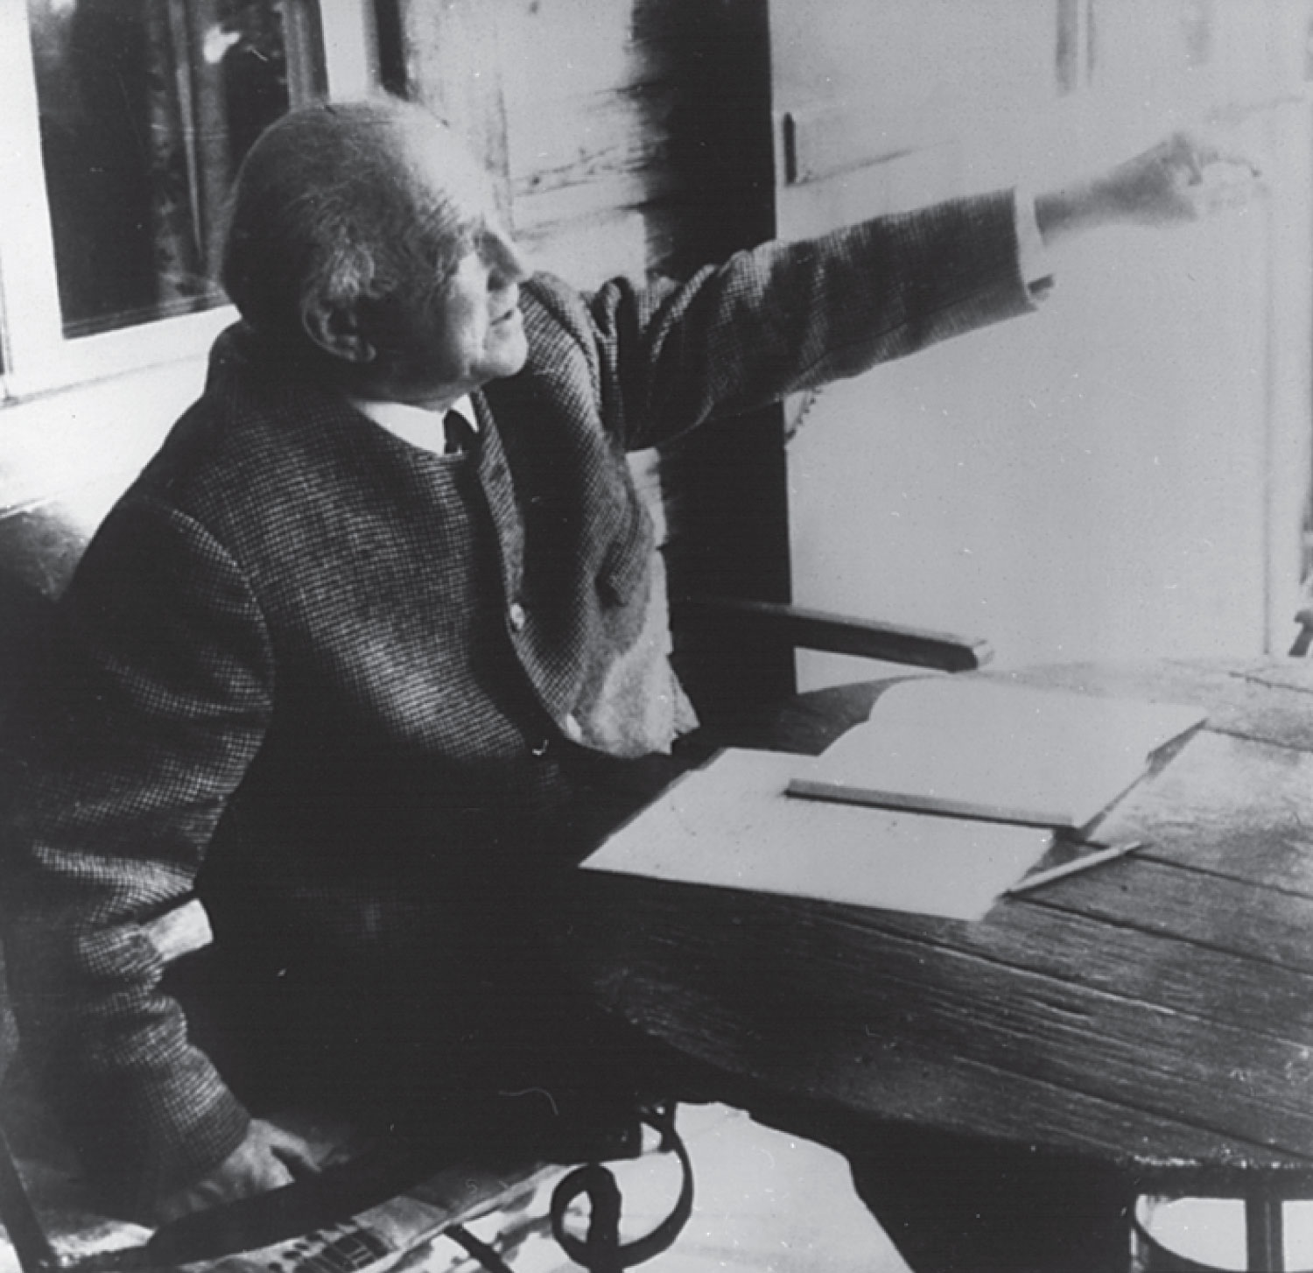
5.6: Uncertainty Principle
It is impossible to measure simultaneously, with no uncertainty, the precise values of k and x for the same particle. The wave number k may be rewritten as
For the case of a Gaussian wave packet we have
Thus for a single particle we have Heisenberg’s uncertainty principle:

Slide 38
Energy Uncertainty
If we are uncertain as to the exact position of a particle, for example an electron somewhere inside an atom, the particle can’t have zero kinetic energy.
The energy uncertainty of a Gaussian wave packet is
combined with the angular frequency relation
Energy-Time Uncertainty Principle: .

Slide 40
Which of the following statements is most correct about the uncertainty principle?
a) It is impossible to know exactly both the position and the momentum of a particle simultaneously.
b) An electron with some momentum can be trapped into an arbitrarily small box.
c) Our instruments will eventually be able to measure more precisely than the principle presently allows.
d) On large length scales, the uncertainty principle dominates our understanding of the physical world.
e) A particle limited in space can occupy any energy.

Slide 41
Not a large uncertainty
This is a large uncertainty

Slide 42
5.7: Probability, Wave Functions, and the Copenhagen Interpretation
The wave function determines the likelihood (or probability) of finding a particle at a particular position in space at a given time.
The total probability of finding the electron is 1. Forcing this condition on the wave function is called normalization.

Slide 43
The Copenhagen Interpretation
Bohr’s interpretation of the wave function consisted of 3 principles:
The uncertainty principle of Heisenberg
The complementarity principle of Bohr
The statistical interpretation of Born, based on probabilities determined by the wave function
Together these three concepts form a logical interpretation of the physical meaning of quantum theory. According to the Copenhagen interpretation, physics depends on the outcomes of measurement.

Slide 44
5.8: Particle in a Box
A particle of mass m is trapped in a one-dimensional box of width l.
The particle is treated as a wave.
The box puts boundary conditions on the wave. The wave function must be zero at the walls of the box and on the outside.
In order for the probability to vanish at the walls, we must have an integral number of half wavelengths in the box.
The energy of the particle is .
The possible wavelengths are quantized which yields the energy:
The possible energies of the particle are quantized.

Slide 45
Probability of the Particle
The probability of observing the particle between x and x + dx in each state is
Note that E₀ = 0 is not a possible energy level.
The concept of energy levels, as first discussed in the Bohr model, has surfaced in a natural way by using waves.

Slide 47
An integer number of half wavelengths must fit into the box. At the wall’s the probability must be zero which means also the wave function must be zero.

Slide 48
5.42 What is the minimum uncertainty in the speed of a bacterium…………….

Slide 49
so
5.36 some physics theories indicate a lifetime of the proton of 10^36 years. What does such a prediction say about the energy of a proton??

Slide 50
Clicker - Questions
13) The energies of the excited states of a particle in a infinite square well are exact and have no energy uncertainty. What does this suggest about the lifetime of a particle in those excited states?
The particle stays in its excited state forever.
The particle decays immediately.
The particle decays with an exponential decay law.
The lifetime depends on whether the particle is an electron or a proton.

Slide 51
Clicker - Questions
15) An electron is trapped in a one-dimensional region of length 1x10⁻¹⁰m. How much energy must be supplied to excite the electron from the ground state to the second excited state?
a) 38 eV
b) 114 eV
c) 304 eV
d) 342 eV

Slide 53
PHYS222-Fall 2022
Exam II
N = 153
Avg: 71.6
A= 80 – 100
B= 65 – 79
C = 55 – 64
D = 45 – 54
F < 44

