Slide 1
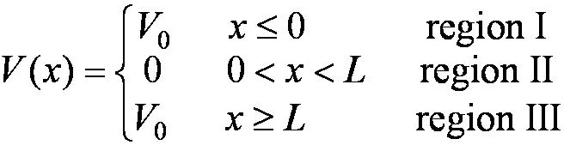
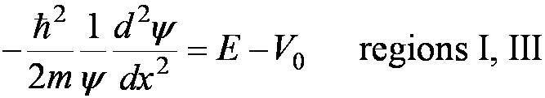

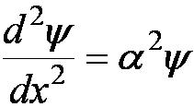
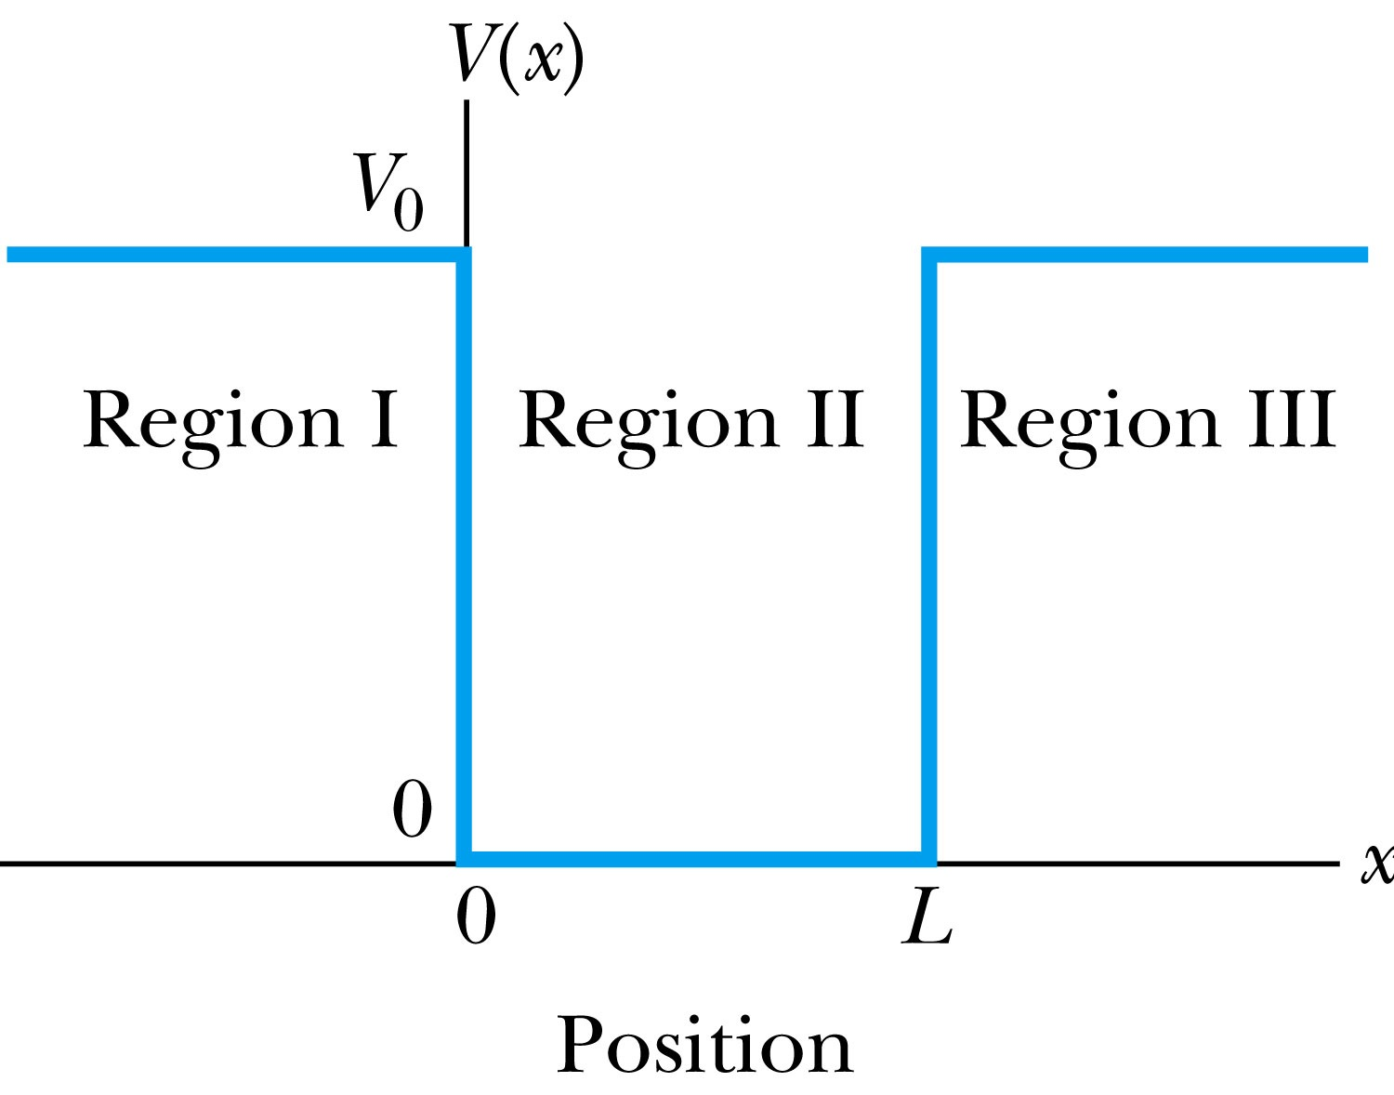
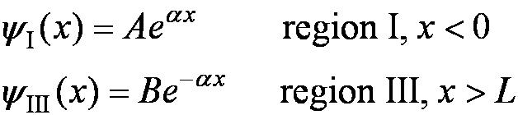
6.4: Finite Square-Well Potential
The finite square-well potential is
The Schrödinger equation outside the finite well in regions I and III is
or using
yields . The solution to this differential has exponentials of the form e^{αx} and e^{-αx}. In the region x > L, we reject the positive exponential and in the region x < L, we reject the negative exponential.Then the other one decays into the classically forbidden region

Slide 2
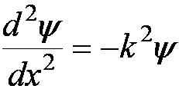

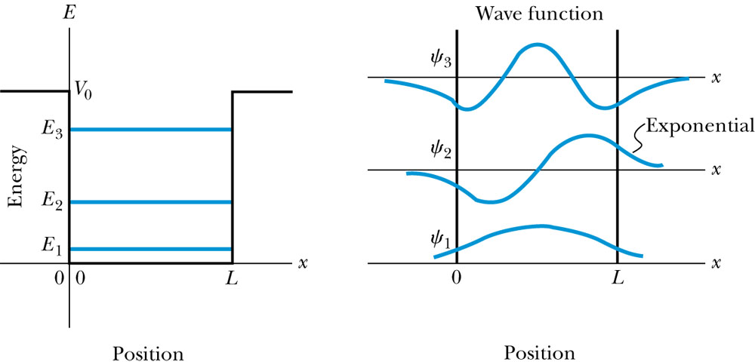
Finite Square-Well Solution
Inside the square well, where the potential V is zero, the wave equation becomes where
Instead of a sinusoidal solution we have
The boundary conditions require that
and the wave function must be smooth where the regions meet.
Note that the
wave function is
nonzero outside
of the box.
Larger wavelength
Smaller momentum and energy
We will skip the tedious procedure of fulfilling the above boundary conditions, but discuss the results

Slide 3
Clicker - Questions
13) Compare the results of the finite and infinite square well potential?
The wavelengths are longer for the finite square well.
The wavelengths are shorter for the finite square well.
The wavelengths are the same.

Slide 4
Clicker - Questions
13) Compare the finite and infinite square well potentials and chose the correct statement.
There is a finite number of bound energy states for the finite potential.
There is an infinite number of bound energy states for the finite potential.
There are bound states which fulfill the condition E>V_{o}.

Slide 5
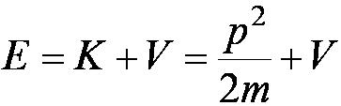
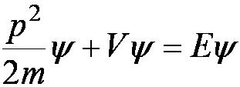
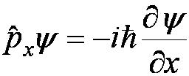
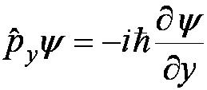
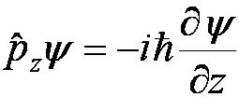

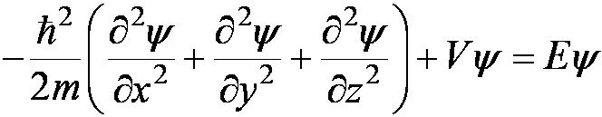
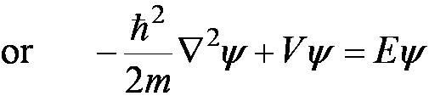

6.5: Three-Dimensional Infinite-Potential Well
The wave function must be a function of all three spatial coordinates. We begin with the conservation of energy
Multiply this by the wave function to get
Now consider momentum as an operator acting on the wave function. In this case, the operator must act twice on each dimension. Given:
The three dimensional Schrödinger wave equation is
$$△=$$
Laplace operator
Time independent Schroedinger equation

Slide 6
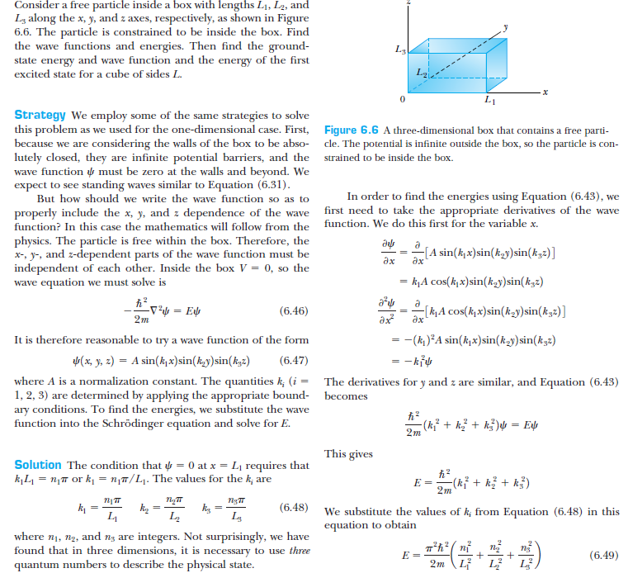
Particle in3-D box
Use 3 quantum numbers n

Slide 7
Degeneracy
Analysis of the Schrödinger wave equation in three dimensions introduces three quantum numbers that quantize the energy.
A quantum state is degenerate when there is more than one wave function for a given energy.
Degeneracy results from particular properties of the potential energy function that describes the system. A perturbation of the potential energy can remove the degeneracy (to be shown later).

Slide 8
Problem6.26
For a cubical box L1=L2=L3=L
Find the energies of the second, third, fourth, and fifth levels for the three dimensional cubical box. Which energy levels are degenerate?
A given state is degenerate when there is more than one wave function for a given energy
ground state wavefunction E1 is not degenerate

Slide 9
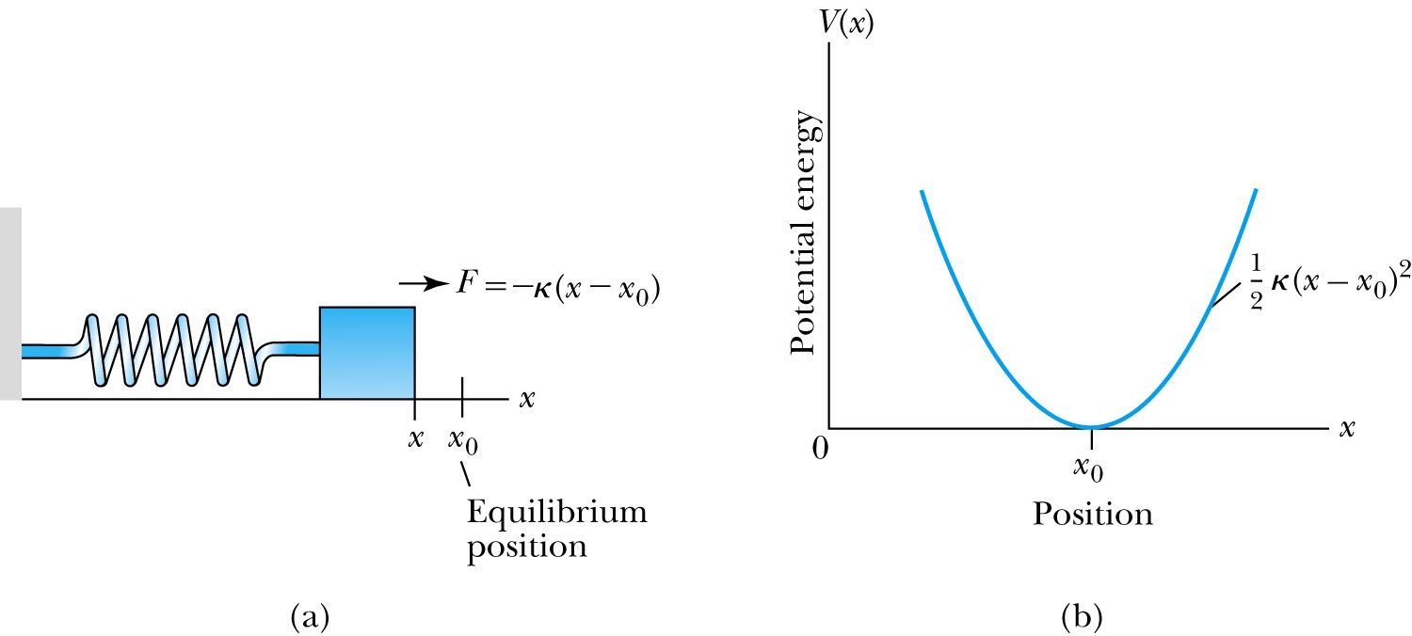
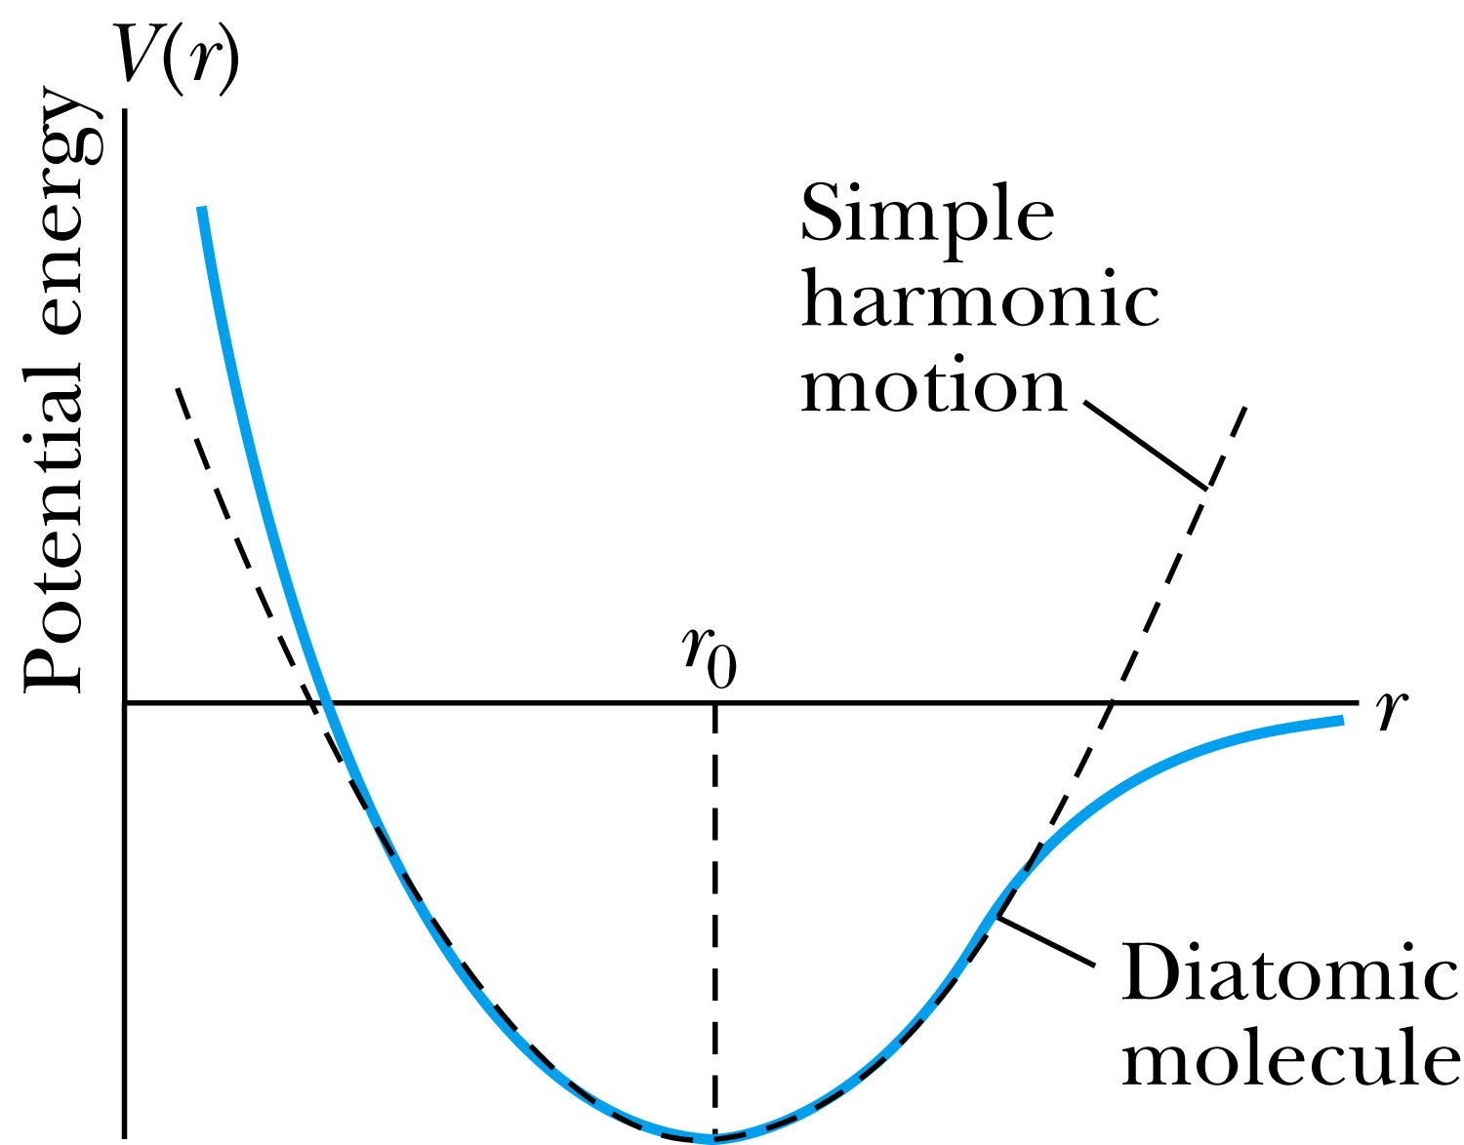


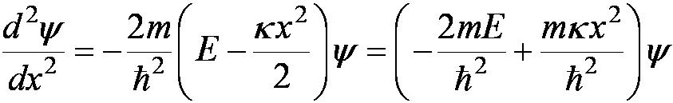
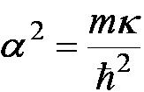
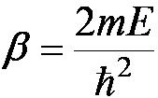
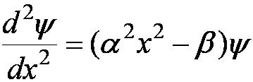
6.6: Simple Harmonic Oscillator
Simple harmonic oscillators describe many physical situations: springs, diatomic molecules and atomic lattices.
Consider the Taylor expansion of a potential function:
Redefining the minimum potential and the zero potential, we have
=
Substituting this into the wave equation:
Let and which yields .

Slide 10
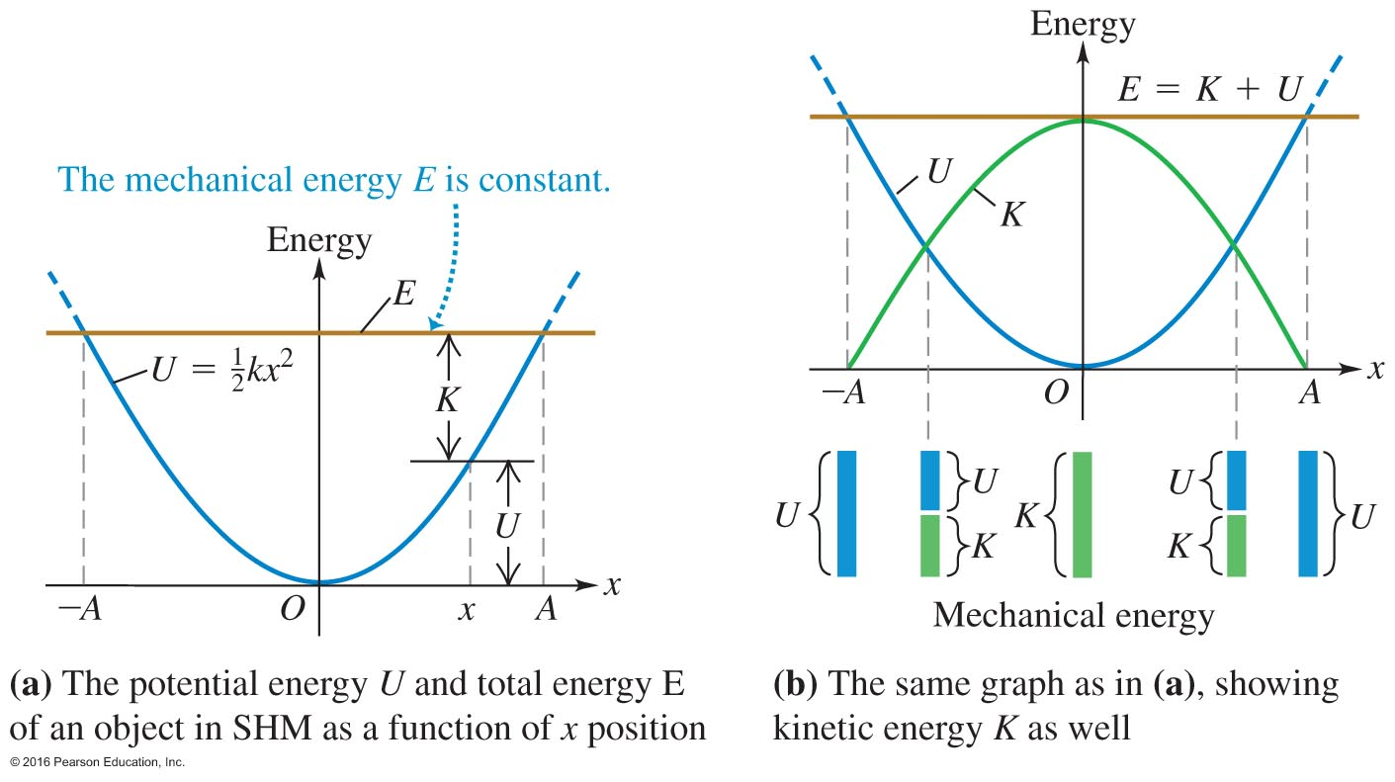
Notes:
Figure 11.18

Slide 11
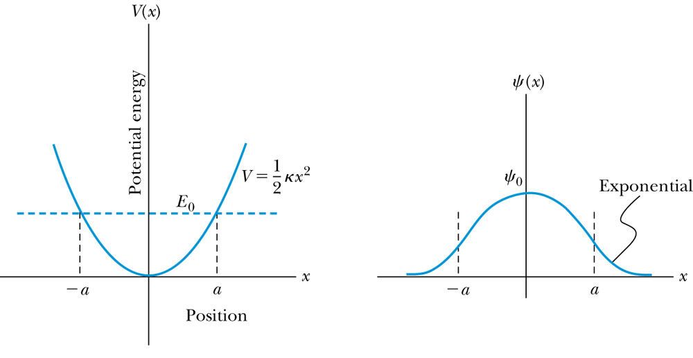

Parabolic Potential Well
If the lowest energy level is zero, this violates the uncertainty principle.
The wave function solutions are where H_{n}(x) are Hermite polynomials of order n.
In contrast to the particle in a box, where the oscillatory wave function is a sinusoidal curve, in this case the oscillatory behavior is due to the polynomial, which dominates at small x. The exponential tail is provided by the Gaussian function, which dominates at large x.

Slide 12
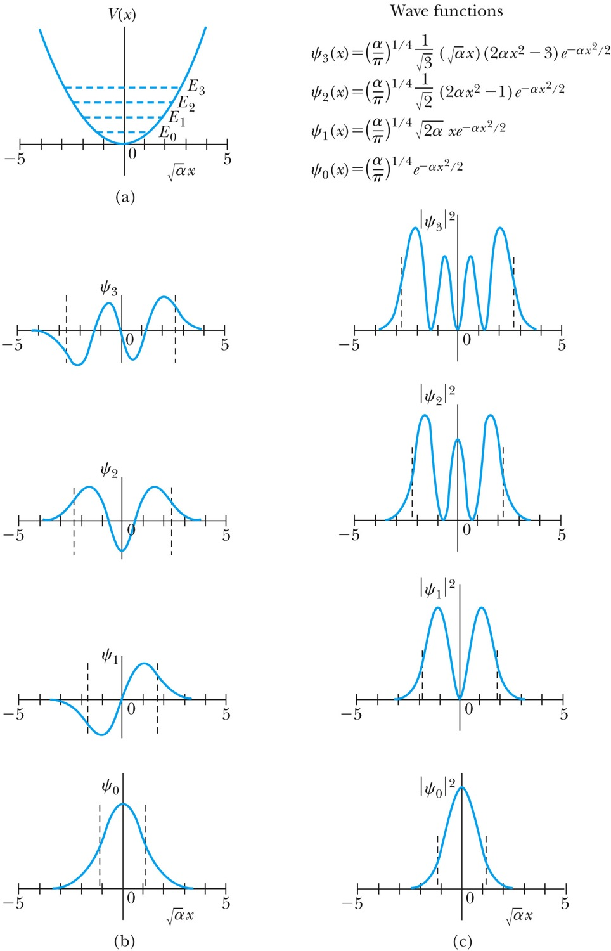
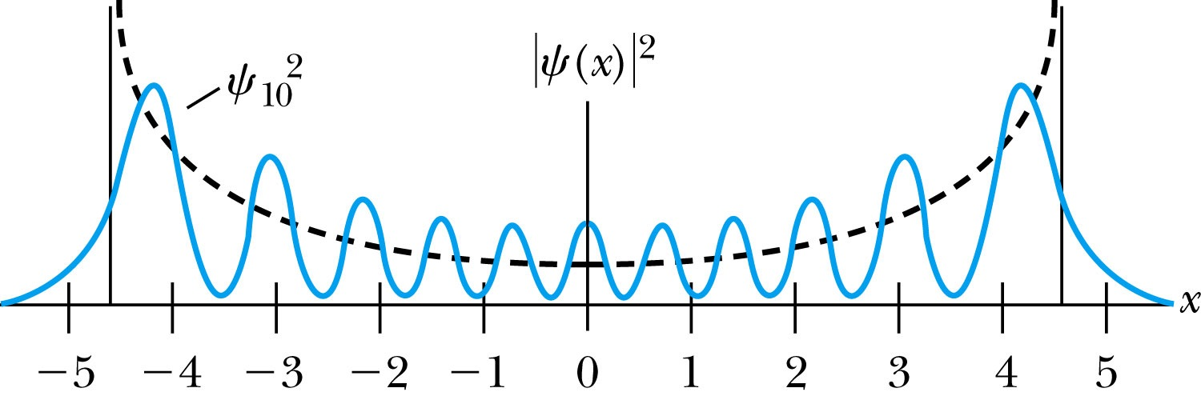
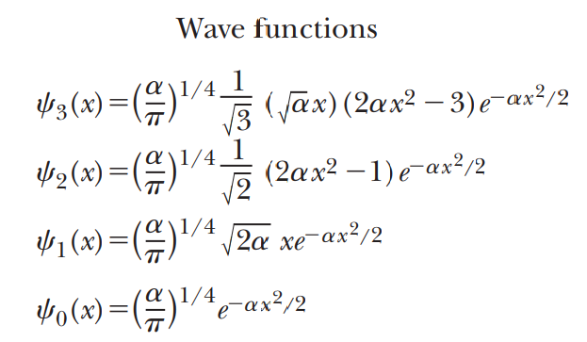

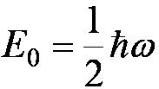
Analysis of the Parabolic Potential Well
The energy levels are given by
The zero point energy is called the Heisenberg limit:
Classically, the probability of finding the mass is greatest at the ends of motion and smallest at the center (that is, proportional to the amount of time the mass spends at each position).
Contrary to the classical one, the largest probability for this lowest energy state is for the particle to be at the center.
Hermite polynomial functions are shown above

Slide 13
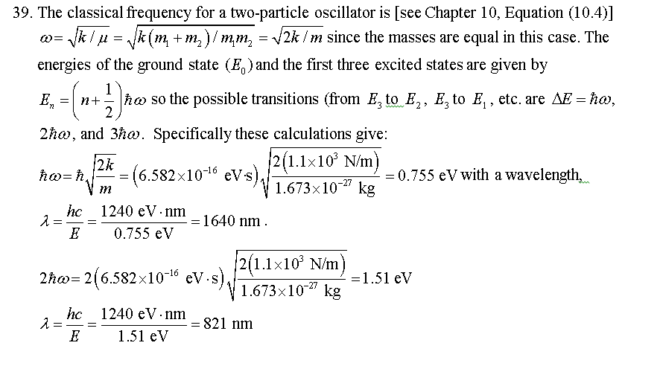
A hydrogen molecule can be approximated as a simple harmonic oscillator with force constant k=1.1x10^3 N/m. Find (a) the energy levels and (b) the possible wavelengths of photons emitted when the H2 molecule decays from the second excited state eventually to the ground state.

Slide 14
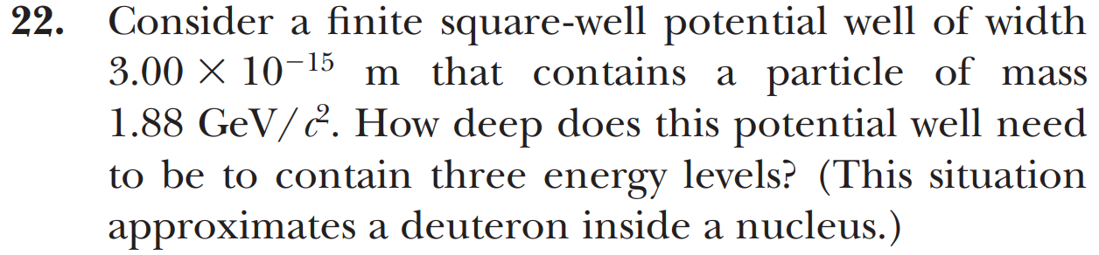
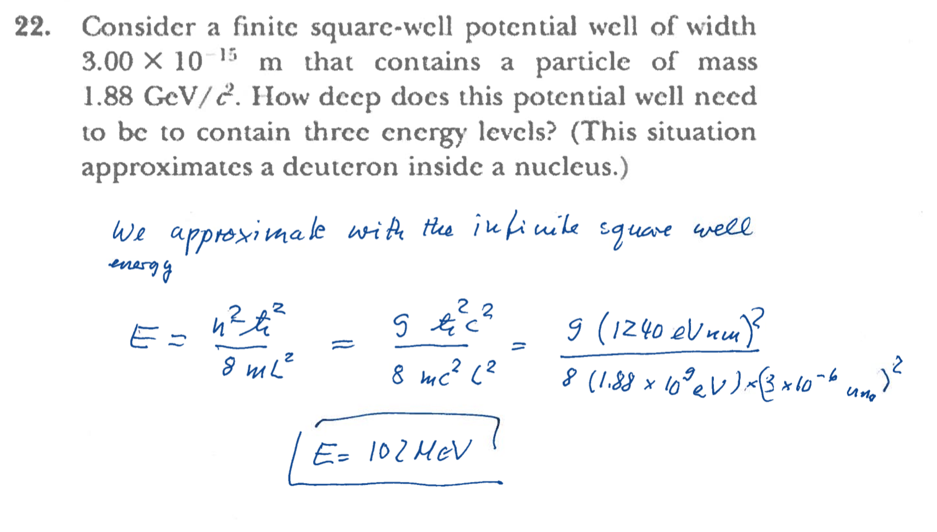
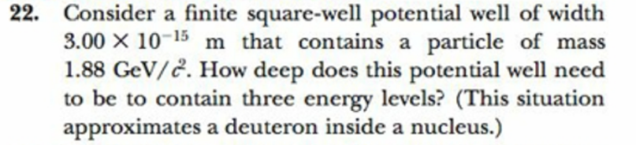
Deuteron in a nucleus
h
h

Slide 15
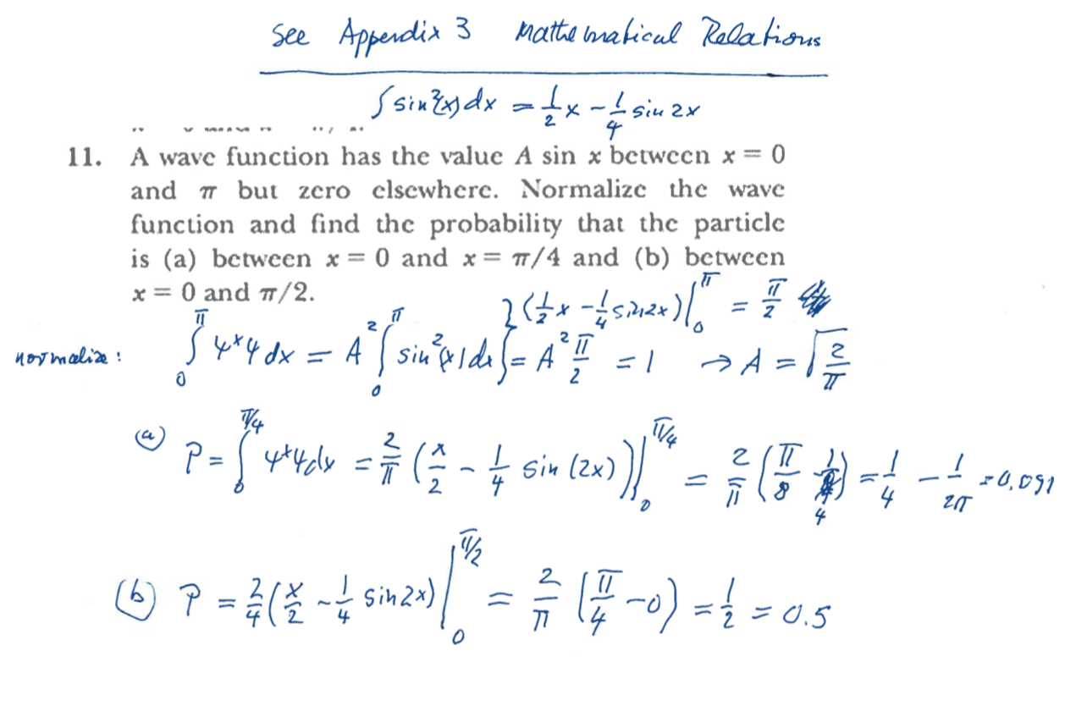
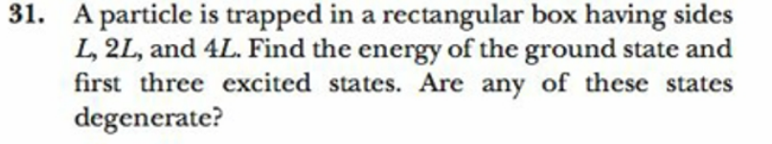

3A

Slide 16
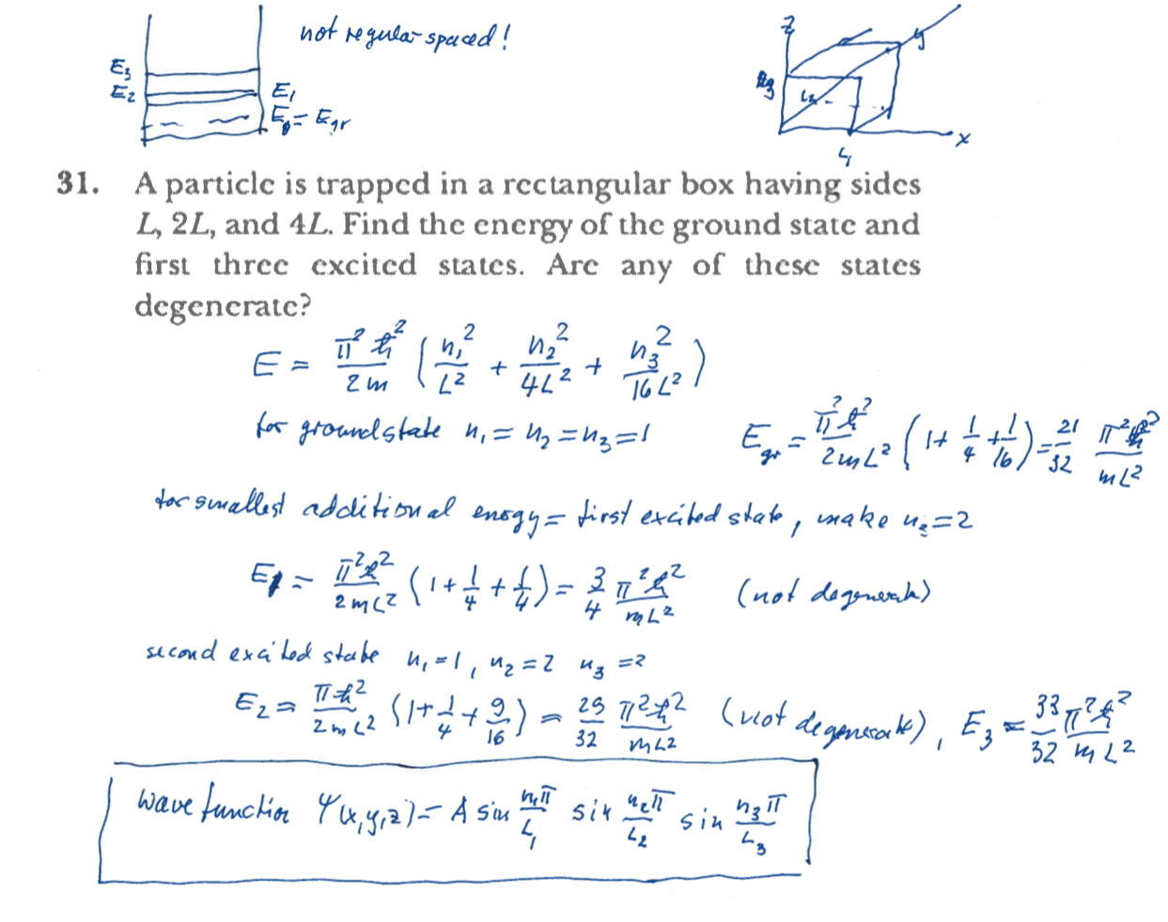
Rectangular box
n₁=1, n₂=1, n₃ =3
n₁=1, n₂=2, n₃ =1

Slide 17
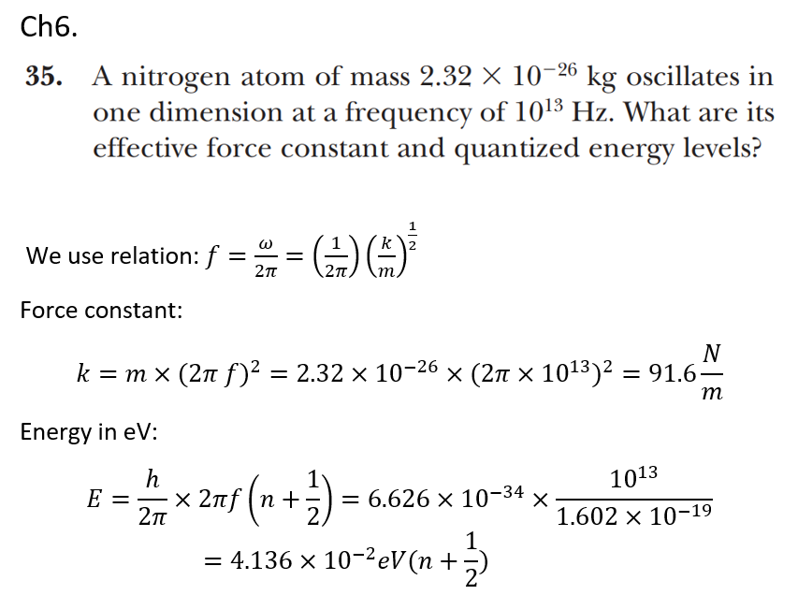

Slide 18
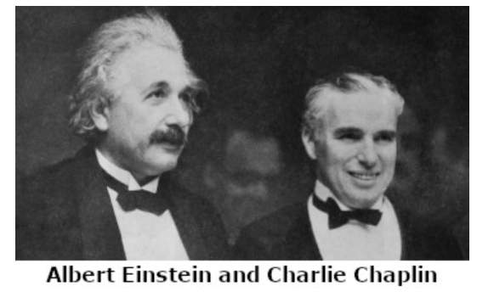
Einstein: What I most admire about your art, is your universality. You don’t say a word, yet the world understands you!
Chaplin: True. But your glory is even greater! The whole world admires you, even though they don’t understand a word of what you say.

Slide 19
CHAPTER 7
The Hydrogen Atom
7.1 Application of the Schrödinger Equation to the Hydrogen Atom
7.2 Solution of the Schrödinger Equation for Hydrogen
7.3 Quantum Numbers
7.4 Magnetic Effects on Atomic Spectra – The Normal Zeeman Effect
This spherical system has very high symmetry causing very high degeneracy of the wavefunctions

Slide 20
Lecture a
Labelling of corresponding video

Slide 21
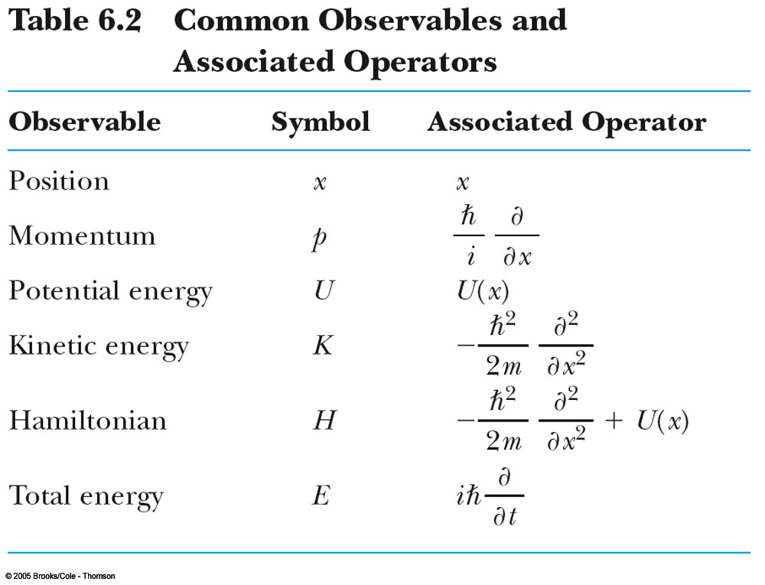

Slide 22
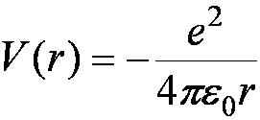
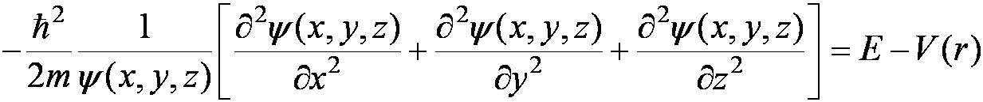
7.1: Application of the Schrödinger Equation to the Hydrogen Atom
The approximation of the potential energy of the electron-proton system is electrostatic:
Rewrite the three-dimensional time-independent Schrödinger Equation.
For Hydrogen-like atoms (He⁺ or Li⁺⁺)
Replace e² with Ze² (Z is the atomic number)
Use appropriate reduced mass μ
Uranium is a chemical element with the symbol U and atomic number Z=92

Slide 23
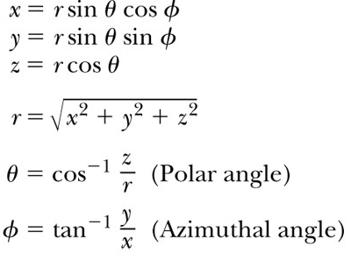
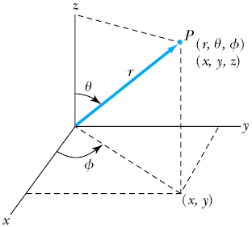
Application of the Schrödinger Equation
The potential (central force) V(r) depends on the distance r between the proton and electron.
Transform to spherical polar coordinates because of the radial symmetry.
Insert the Coulomb potential into the transformed Schrödinger equation.

Slide 24


Application of the Schrödinger Equation
The wave function ψ is a function of r, θ, .
Equation is separable.
Solution may be a product of three functions.
We can separate Equation 7.3 into three separate differential equations, each depending on one coordinate: r, θ, or .
Equation 7.3
Divide and conquer !!

Slide 25
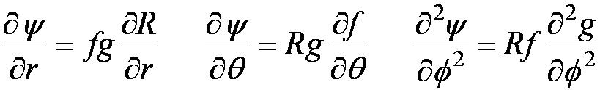
7.2: Solution of the Schrödinger Equation for Hydrogen
Substitute Eq (7.4) into Eq (7.3) and separate the resulting equation into three equations: R(r), f(θ), and g( ).
Separation of Variables
The derivatives from Eq (7.4)
Substitute them into Eq (7.3)
Multiply both sides of Eq (7.6) by r² sin² θ / Rfg

Slide 26
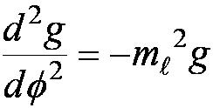

Solution of the Schrödinger Equation
Only r and θ appear on the left side and only appears on the right side of Eq (7.7)
The left side of the equation cannot change as changes.
The right side cannot change with either r or θ.
Each side needs to be equal to a constant for the equation to be true.
Set the constant −m_{ℓ}² equal to the right side of Eq (7.7)
It is convenient to choose a solution to be .
-------- azimuthal equation
Eq (7.8)

Slide 27
Properties of Valid Wave Functions
Boundary conditions
In order to avoid infinite probabilities, the wave function must be finite everywhere.
In order to avoid multiple values of the probability, the wave function must be single valued.
For finite potentials, the wave function and its derivative must be continuous. This is required because the second-order derivative term in the wave equation must be single valued. (There are exceptions to this rule when V is infinite.)
In order to normalize the wave functions, they must approach zero as x approaches infinity.
Solutions that do not satisfy these properties do not generally correspond to physically realizable circumstances.
Not normalizable

Slide 28



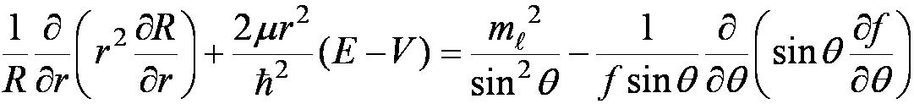
Solution of the Schrödinger Equation
satisfies Eq (7.8) for any value of m_{ℓ}.
The solution be single valued in order to have a valid solution for any , which is
m_{ℓ} to be zero or an integer (positive or negative) for this to be true.
If Eq (7.8) were positive, the solution would not be realized.
Set the left side of Eq (7.7) equal to −m_{ℓ}² and rearrange it.
Everything depends on r on the left side and θ on the right side of the equation.

