Slide 1
CHAPTER 6
Quantum Mechanics II
6.1 The Schrödinger Wave Equation
6.2 Expectation Values
6.3 Infinite Square-Well Potential
6.4 Finite Square-Well Potential
6.5 Three-Dimensional Infinite-Potential Well
6.6 Simple Harmonic Oscillator
Heisenberg presented Matrix formulation of QM with the same results

Slide 2
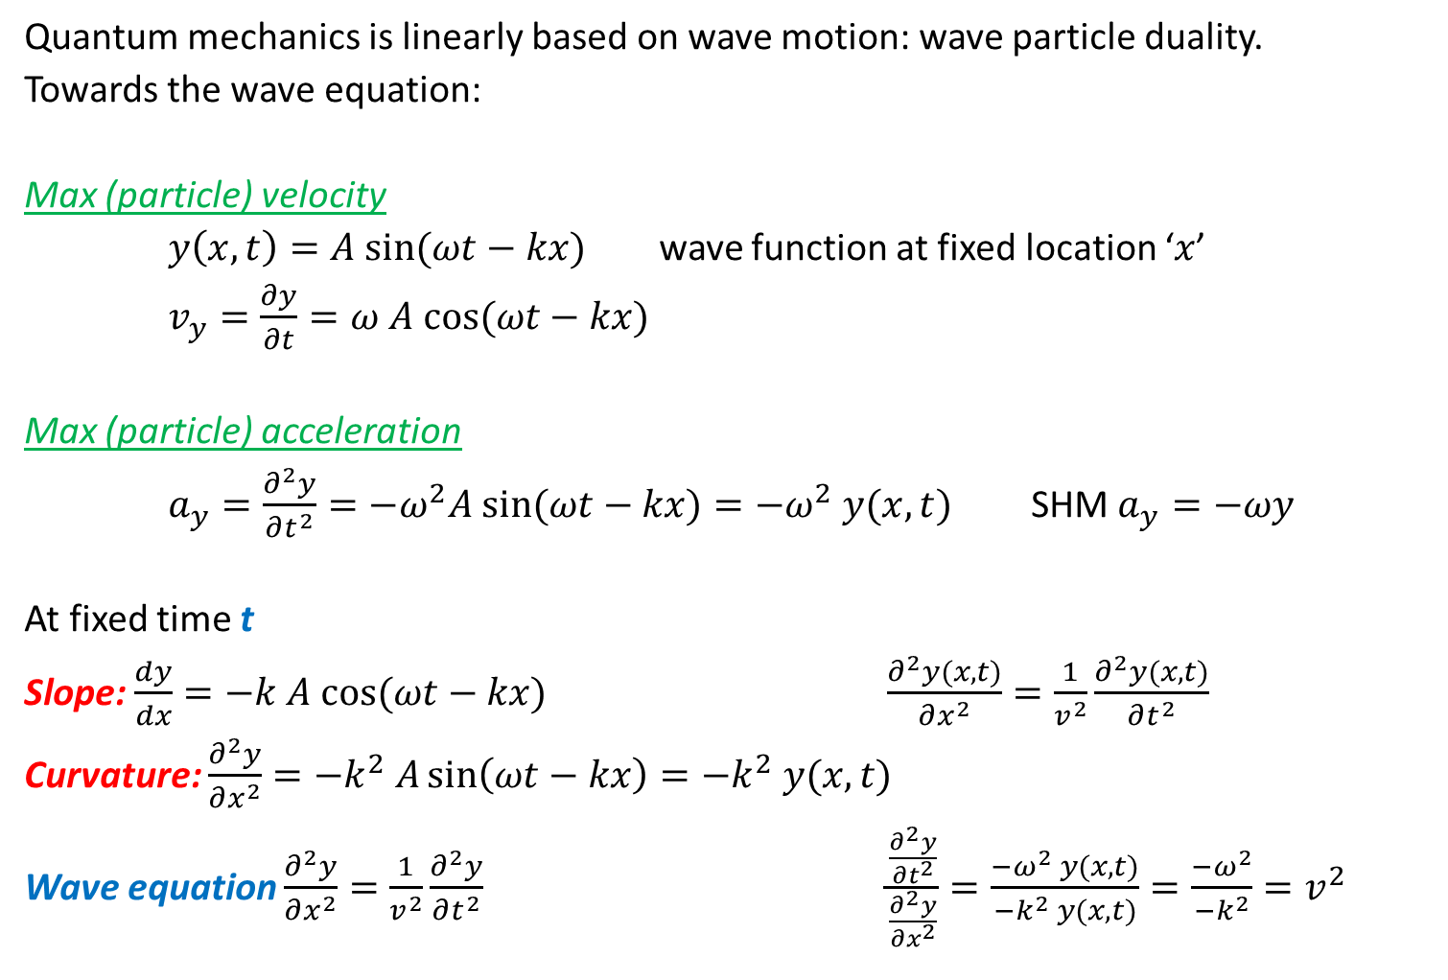
Wave motion

Slide 3
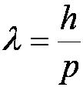

5.2: De Broglie Waves = matter waves
Prince Louis V. de Broglie suggested that mass particles should have wave properties similar to electromagnetic radiation.
Thus the wavelength of a matter wave is called the de Broglie wavelength:
Since for a photon, E = pc and E = hf, the energy can be written as

Slide 4
The Copenhagen Interpretation
Bohr’s interpretation of the wave function consisted of 3 principles:
    The uncertainty principle of Heisenberg
    The complementarity principle of Bohr
    The statistical interpretation of Born, based on probabilities determined by the wave function
Together these three concepts form a logical interpretation of the physical meaning of quantum theory. According to the Copenhagen interpretation, physics depends on the outcomes of measurement.

Slide 5
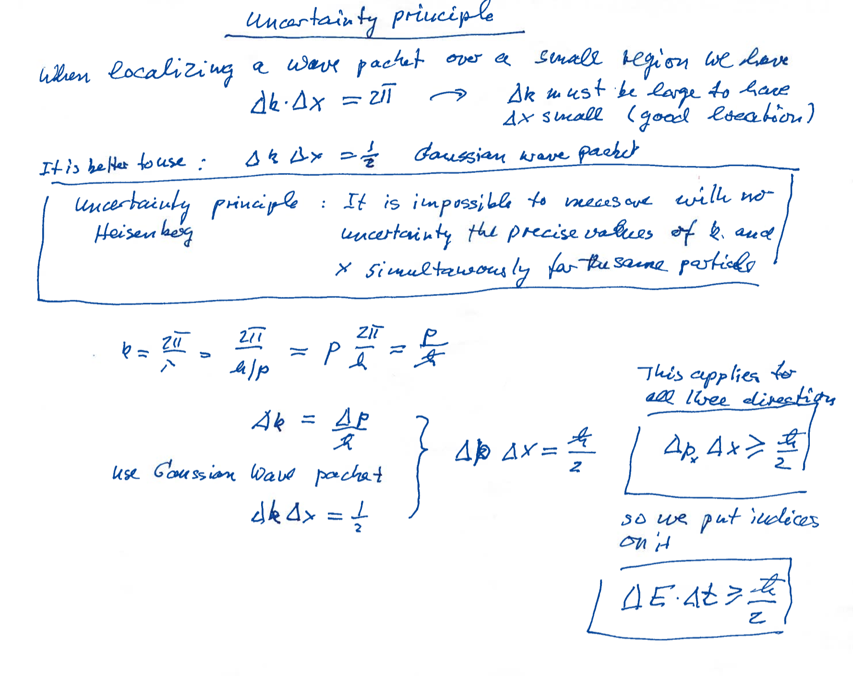

Slide 6
Wave particle duality solution
The solution to the wave particle duality of an event is given by the following principle.
Bohr’s principle of complementarity: It is not possible to describe physical observables simultaneously in terms of both particles and waves.
Physical observables are those quantities such as position, velocity, momentum, and energy that can be experimentally measured. In any given instance we must use either the particle description or the wave description.

Slide 7


5.7: Probability, Wave Functions, and the Copenhagen Interpretation
The wave function determines the likelihood (or probability) of finding a particle at a particular position in space at a given time.
The total probability of finding the electron is 1. Forcing this condition on the wave function is called normalization.

Slide 8
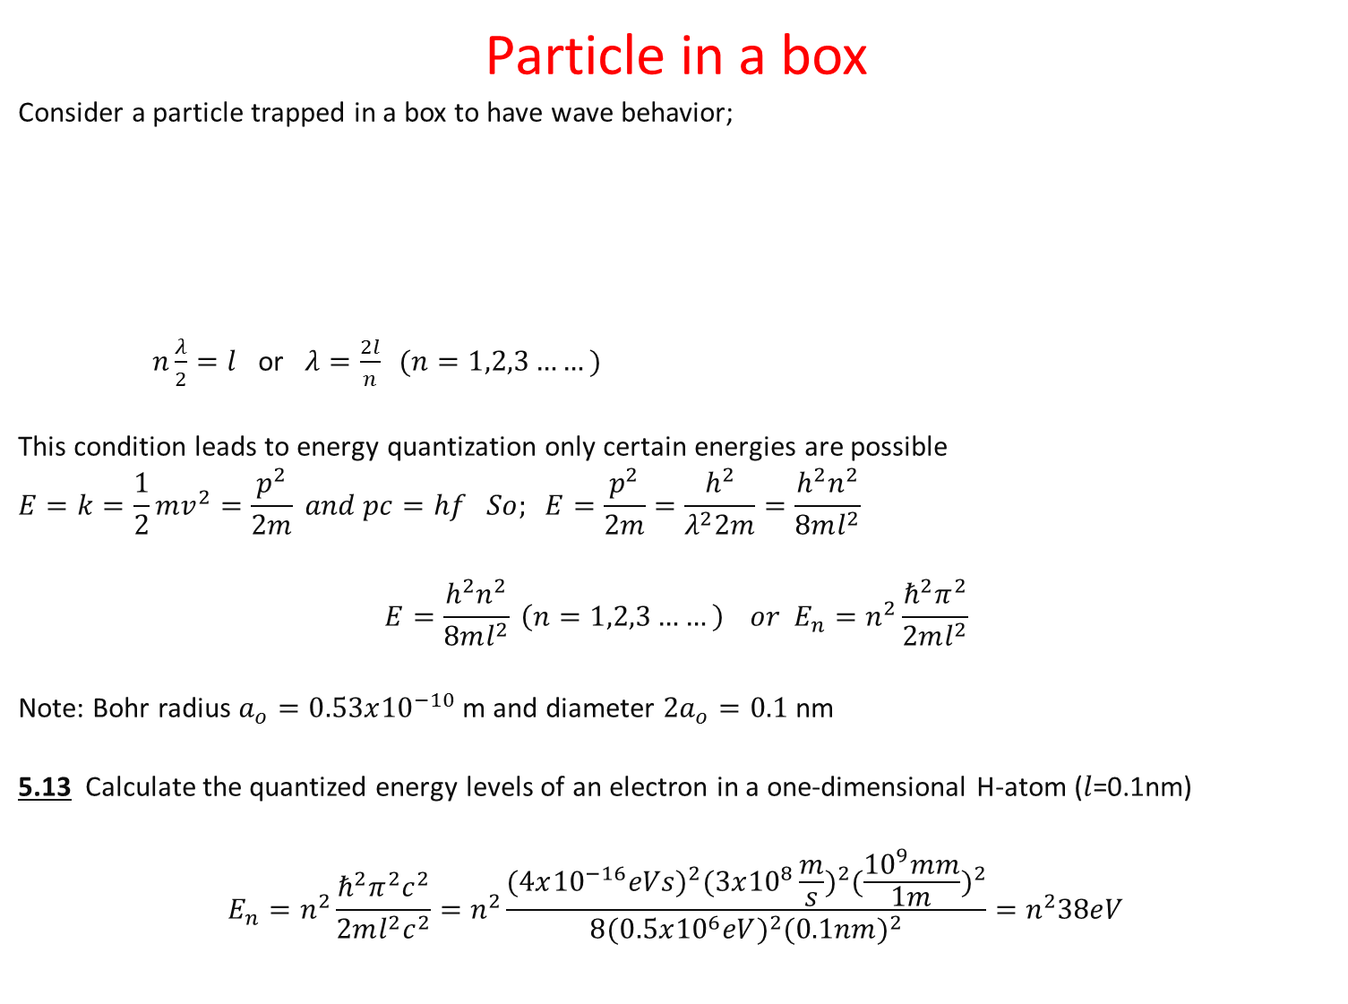


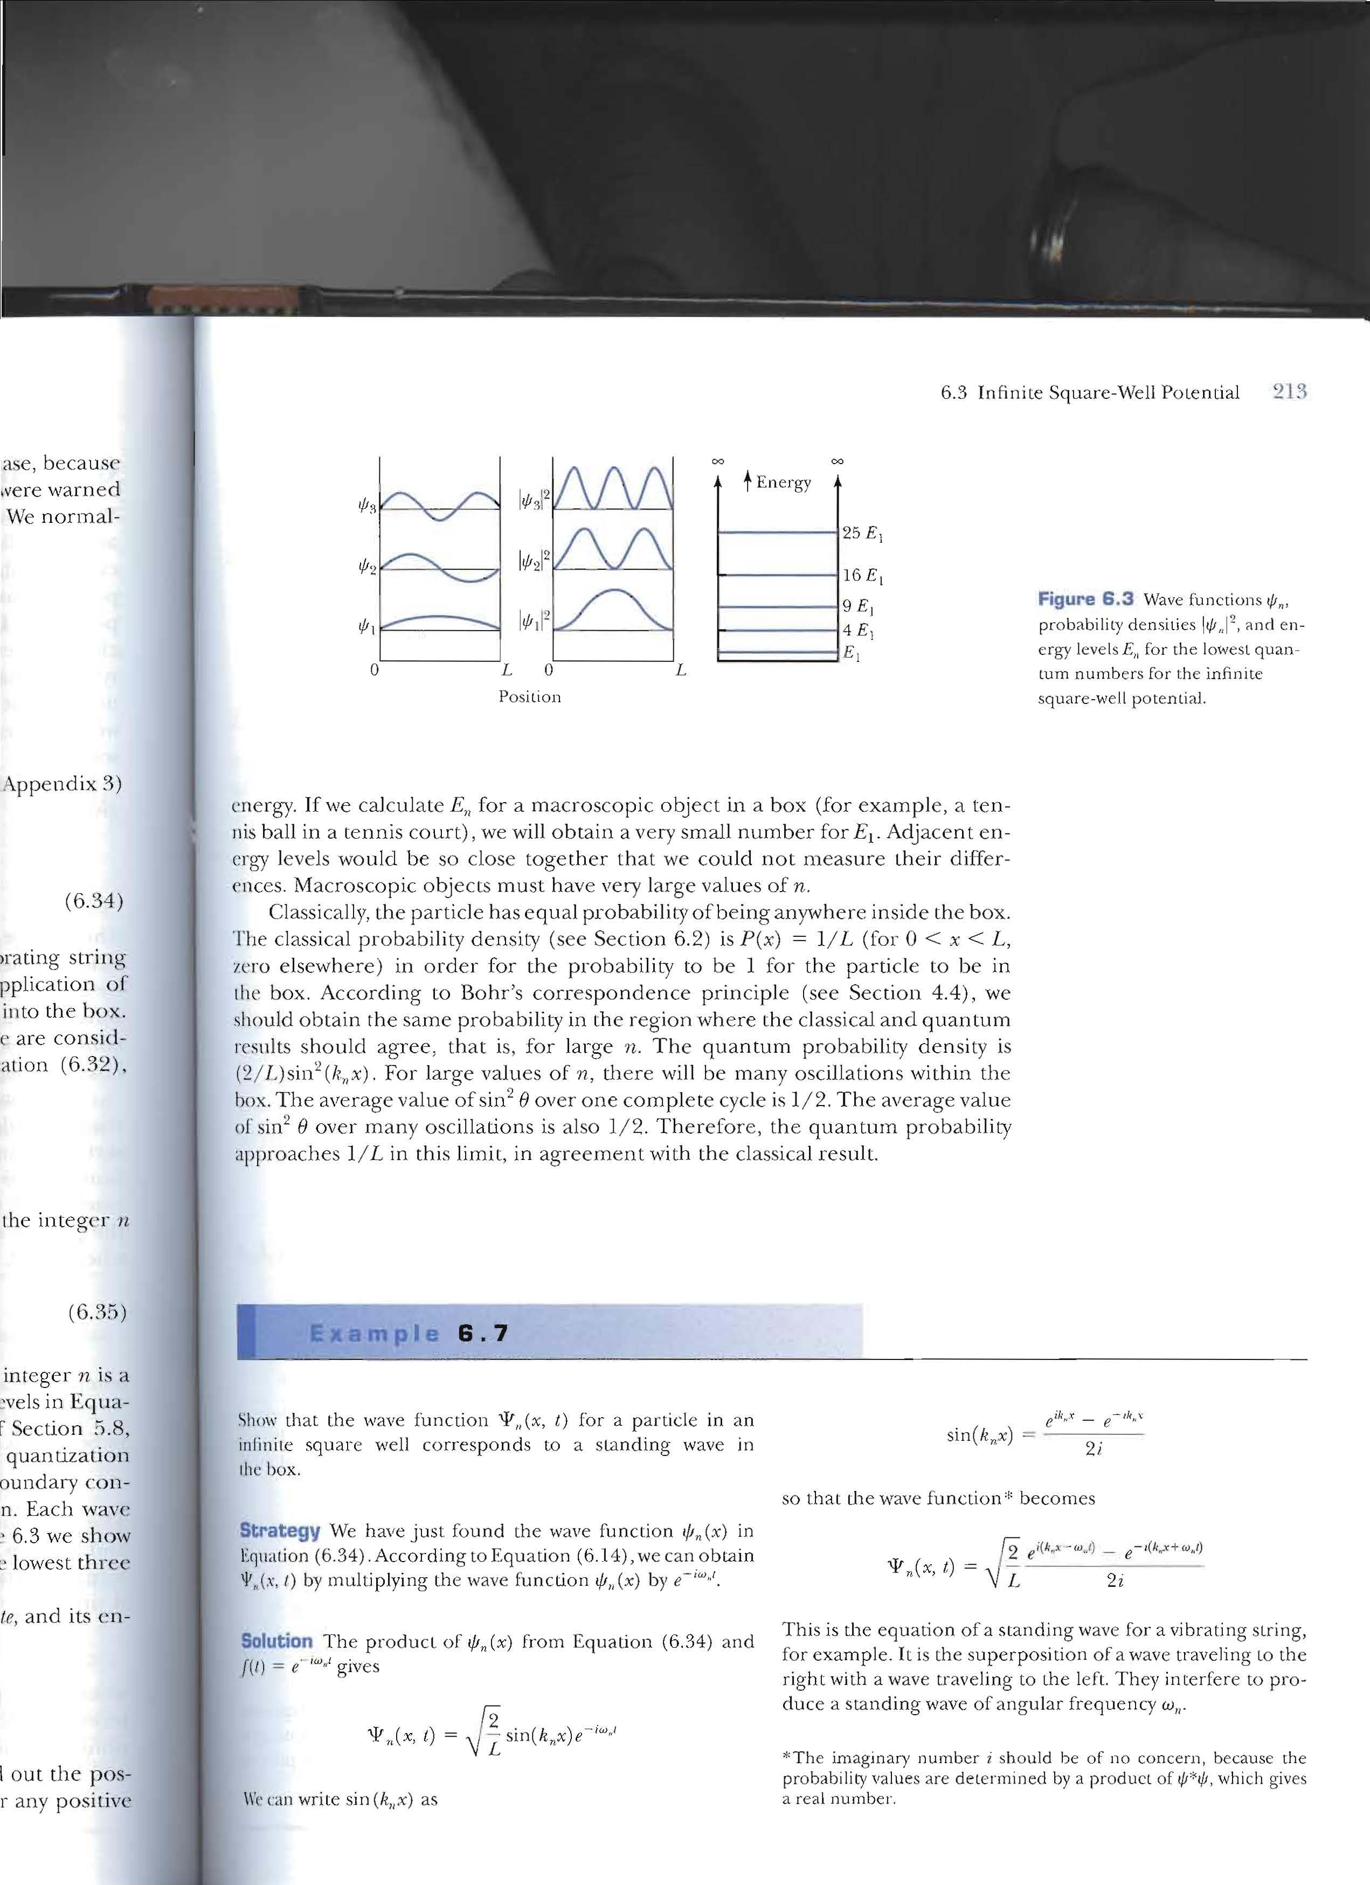
(Infinite Square Well)
An integer number of half wavelengths must fit into the box. At the wall’s the probability must be zero which means also the wave function must be zero.

Slide 9
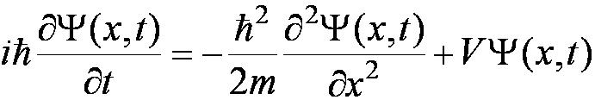
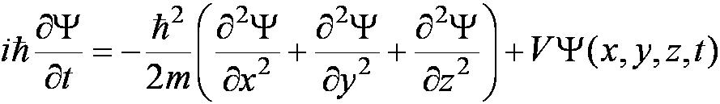

6.1: The Schrödinger Wave Equation
The Schrödinger wave equation in its time-dependent form for a particle of energy E moving in a potential V in one dimension is
The extension into three dimensions is
where is an imaginary number
Cannot be derived from first principles. Only plausibility arguments will be given.

Slide 10
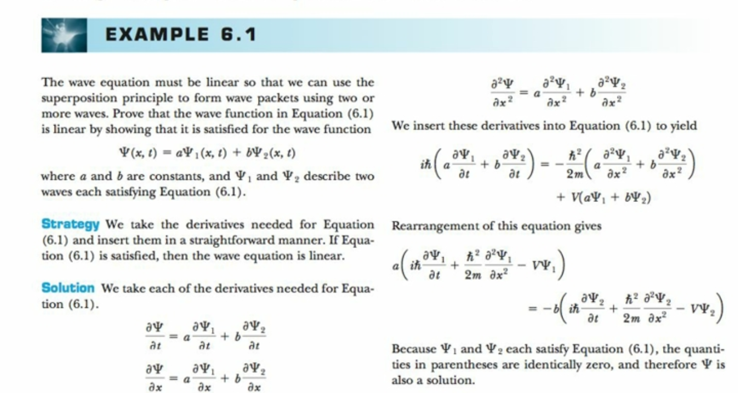
The wave function is linear
Use equation 6.6 and not 6.1

Slide 11
General Solution of the Schrödinger Wave Equation
The general form of the solution of the Schrödinger wave equation is given by:
which also describes a wave moving in the x direction. In general the amplitude may also be complex. This is called the wave function of the particle.
The wave function is also not restricted to being real. Notice that the sin term has an imaginary number. Only the physically measurable quantities must be real. These include the probability, momentum and energy.

Slide 12
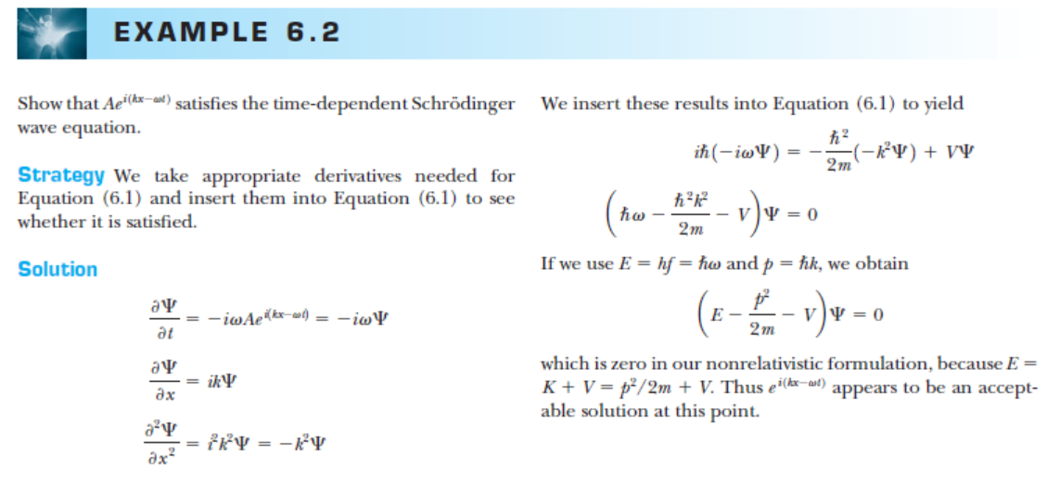
d/dx​[f(g(x))]=f′(g(x))g′(x)
Beware: Appears to be an acceptable solution at this point

Slide 13
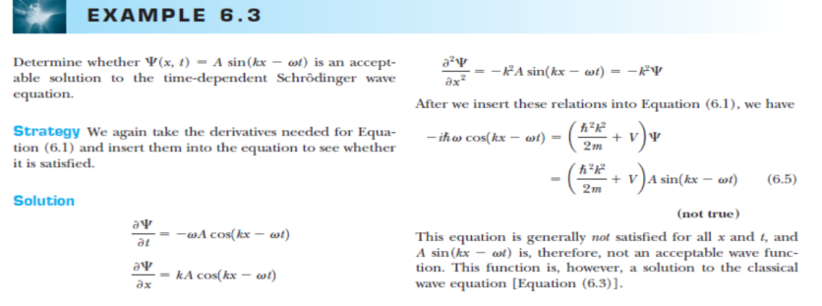
Use equation 6.6 and not 6.1

Slide 14
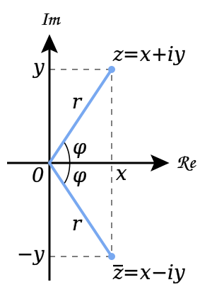
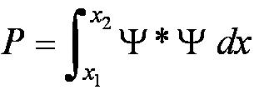
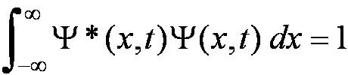
Normalization and Probability
The probability P(x) dx of a particle being between x and X + dx was given in the equation
here denotes the complex conjugate of
The probability of the particle being between x₁ and x₂ is given by
The wave function must also be normalized so that the probability of the particle being somewhere on the x axis is 1.

Slide 15
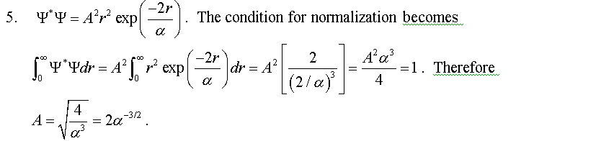
Normalize the wave function below (useful integrals are in Appendix 3 A)and at Wolframalpha.com

Slide 16
Problem6.10
A wave function Ψ is A(e^{ix} + e^{-ix}) in the region -π<x< π and zero elsewhere. Normalize the wave function and find the probability that the particle is (a) between x=0 and x=π/4 and (b) between x=0 and x=π/8.

Slide 17
Properties of Valid Wave Functions
Boundary conditions
In order to avoid infinite probabilities, the wave function must be finite everywhere.
In order to avoid multiple values of the probability, the wave function must be single valued.
For finite potentials, the wave function and its derivative must be continuous. This is required because the second-order derivative term in the wave equation must be single valued. (There are exceptions to this rule when V is infinite.)
In order to normalize the wave functions, they must approach zero as x approaches infinity.
Solutions that do not satisfy these properties do not generally correspond to physically realizable circumstances.
Not normalizable

Slide 18
Clicker - Questions
15) Consider to normalize the wave function e^{i(kx-ωt)}?
a) It can not be normalized
b) It can be normalized
c) It can be normalized by a constant factor
d) It can not be normalized because it is a complex function

Slide 19

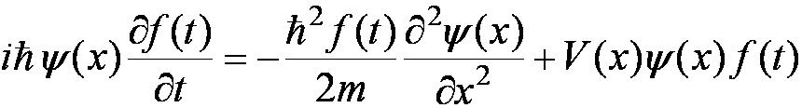
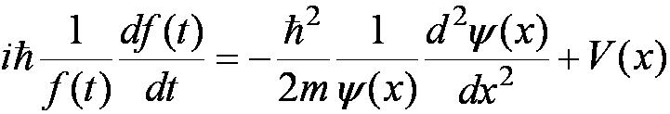
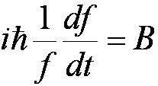
Time-Independent Schrödinger Wave Equation
The potential in many cases will not depend explicitly on time.
The dependence on time and position can then be separated in the Schrödinger wave equation. Let ,
which yields:
Now divide by the wave function:
The left side of this last equation depends only on time, and the right side depends only on spatial coordinates. Hence each side must be equal to a constant. The time dependent side is
See Example 6.5

Slide 20
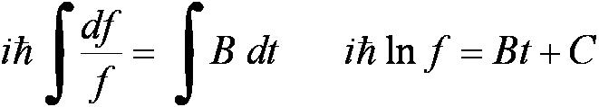
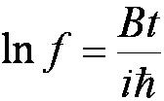

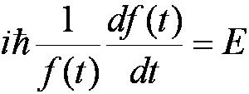
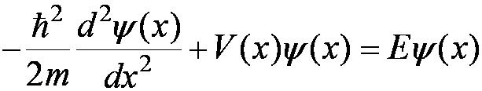
Time-Independent Schrödinger Wave Equation (con’t)
here B = E for a free
particle wave function :
We integrate both sides and find:
where C is an integration constant that we may choose to be 0. Therefore
This determines f to be where
This is known as the time-independent Schrödinger wave equation, and it is a fundamental equation in quantum mechanics.
comparison with the free particle wavefunction gives the separation constant E

Slide 21

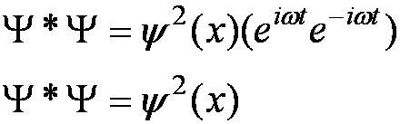
Stationary State
Recalling the separation of variables:
and with f(t) = the wave function can be written as:
The probability density becomes:
The probability distributions are constant in time. This is a standing wave phenomena that is called the stationary state.

Slide 22
Comparison of Classical and Quantum Mechanics
Newton’s second law and Schrödinger’s wave equation are both differential equations.
Newton’s second law can be derived from the Schrödinger wave equation, so the latter is the more fundamental.
Classical mechanics only appears to be more precise because it deals with macroscopic phenomena. The underlying uncertainties in macroscopic measurements are just too small to be significant.
Ray optics is characteristic of particle-like behavior and is a good approximation in aclassical description as long as the as the wavelength of the radiation is smaller than then the obstacles(apertures etc) it passes.
The only correct theory is quantum mechanics.

Slide 23
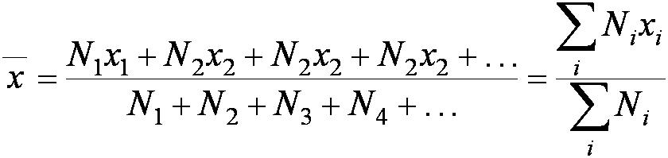
6.2: Expectation Values
The expectation value is the expected result of the average of many measurements of a given quantity. The expectation value of x is denoted by <x>
Any measurable quantity for which we can calculate the expectation value is called a physical observable. The expectation values of physical observables (for example, position, linear momentum, angular momentum, and energy) must be real, because the experimental results of measurements are real.
The average value of x is

Slide 24
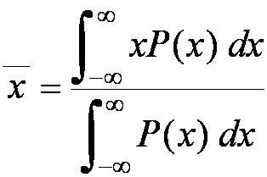
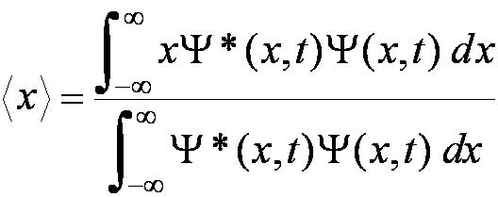
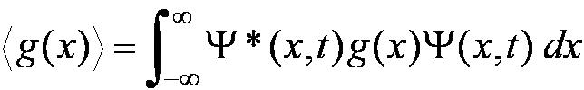
Continuous Expectation Values
We can change from discrete to continuous variables by using the probability P(x,t) of observing the particle at a particular x.
Using the wave function, the expectation value is of position:
The expectation value of any function g(x) for a normalized wave function:

Slide 25
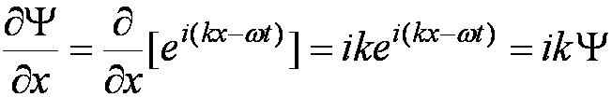
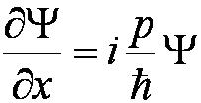
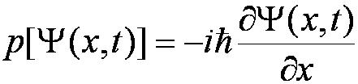
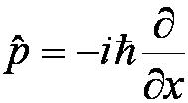
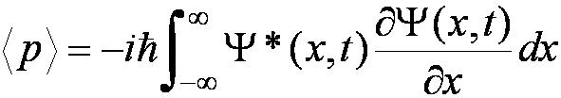
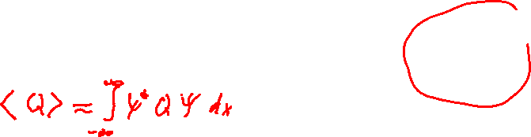
Momentum Operator
An operator transforms one function into another
To find the expectation value of p, we first need to represent p in terms of x and t. Consider the derivative of the wave function of a free particle with respect to x:
With k = p / ħ we have
This yields
This suggests we define the momentum operator as .
The expectation value of the momentum is

Slide 26
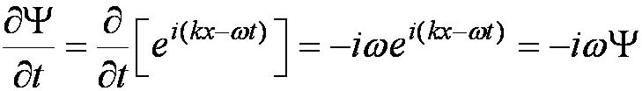
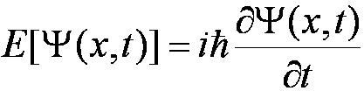
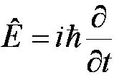
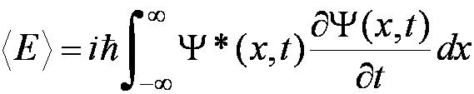

Position and Energy Operators
The position x is its own operator as seen above.
The time derivative of the free-particle wave function is
Substituting ω = E / ħ yields
The energy operator is
The expectation value of the energy is

Slide 27
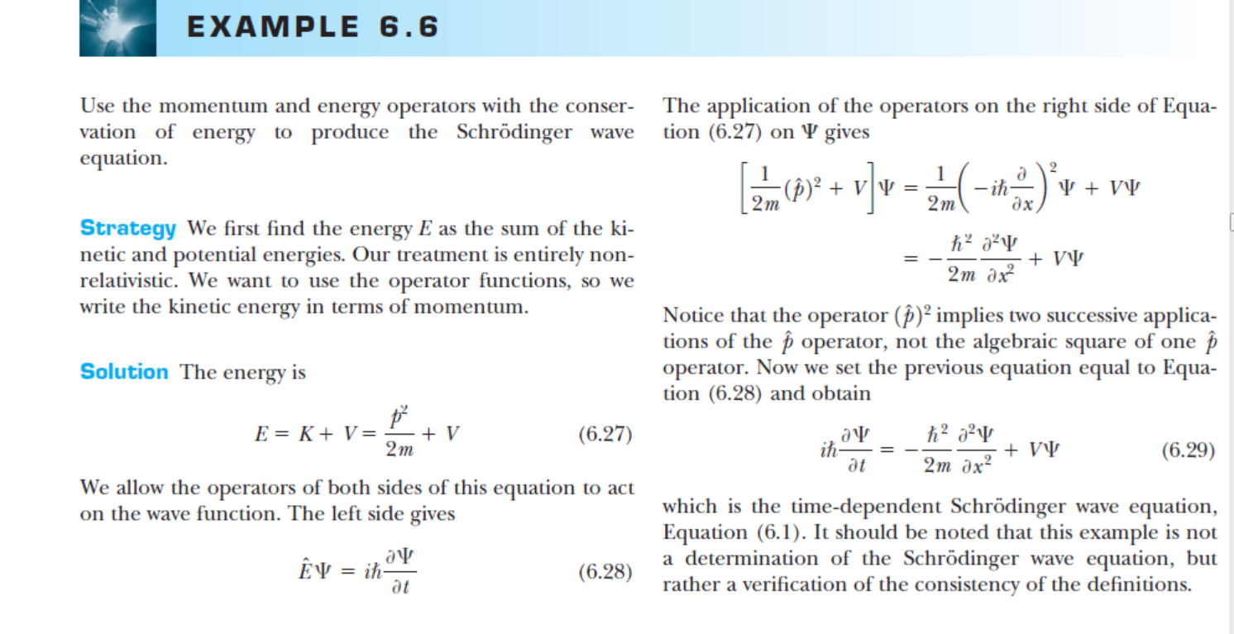

Slide 28

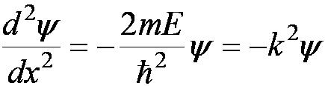


6.3: Infinite Square-Well Potential
The simplest such system is that of a particle trapped in a box with infinitely hard walls that the particle cannot penetrate. This potential is called an infinite square well and is given by
Clearly the wave function must be zero where the potential is infinite.
Where the potential is zero inside the box, the Schrödinger wave
equation becomes where .
The general solution is .

Slide 29
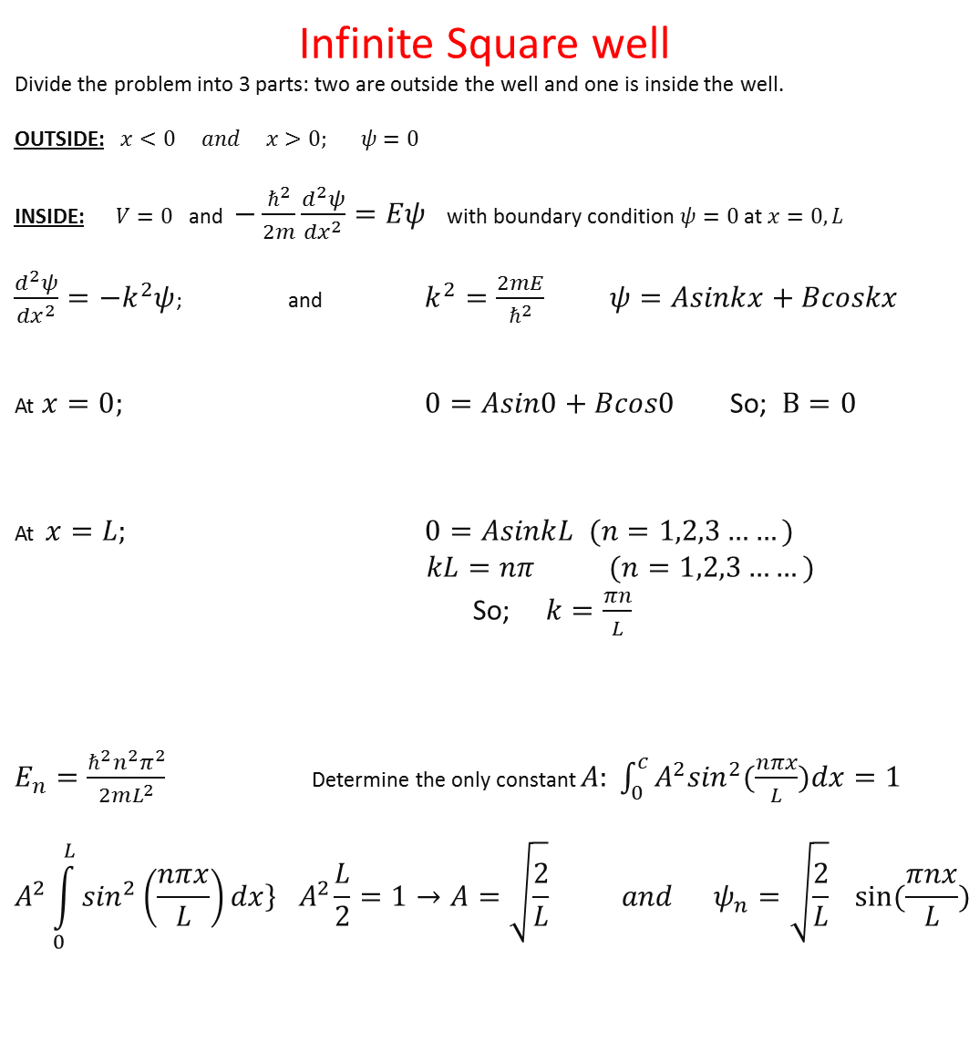
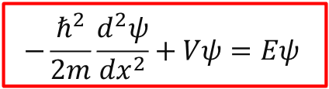
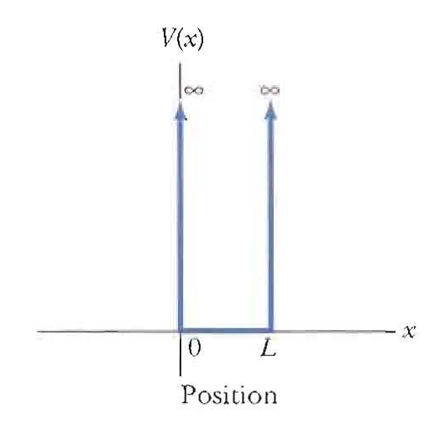
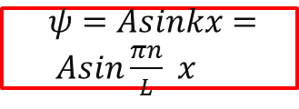

=
=1

Slide 30
An integer number of half wavelengths must fit into the box. At the wall’s the probability must be zero which means also the wave function must be zero.

Slide 31
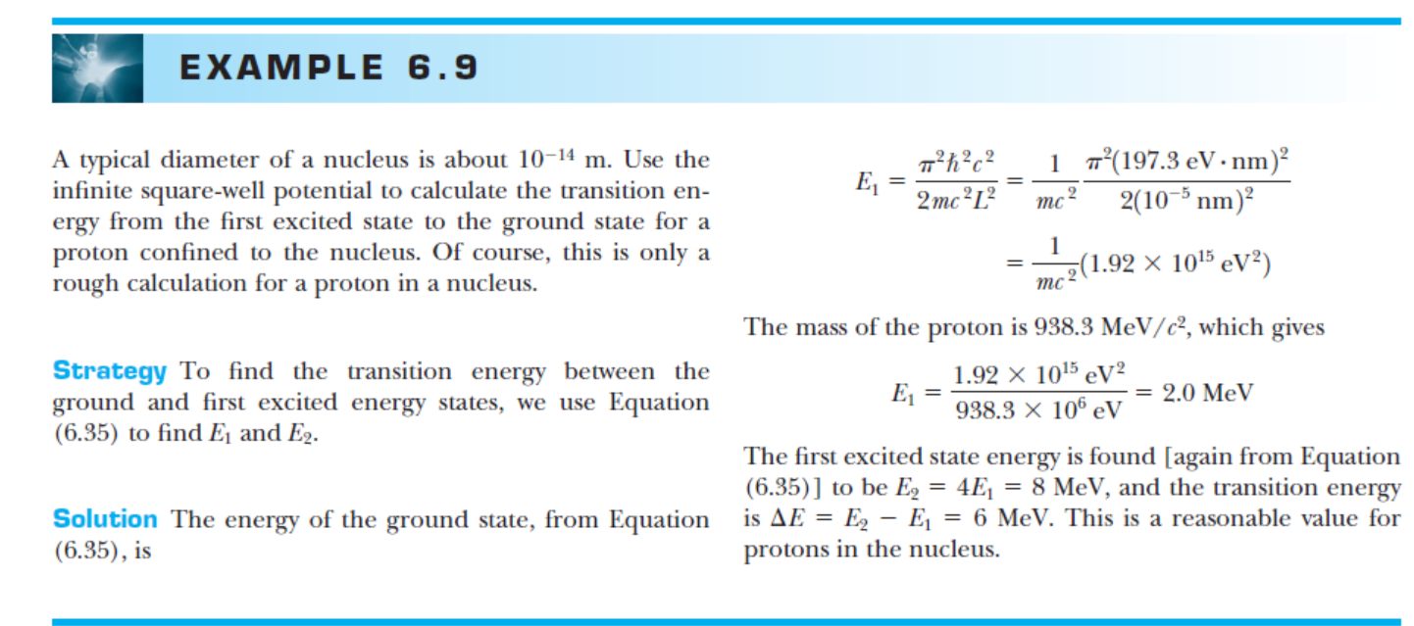

Slide 32
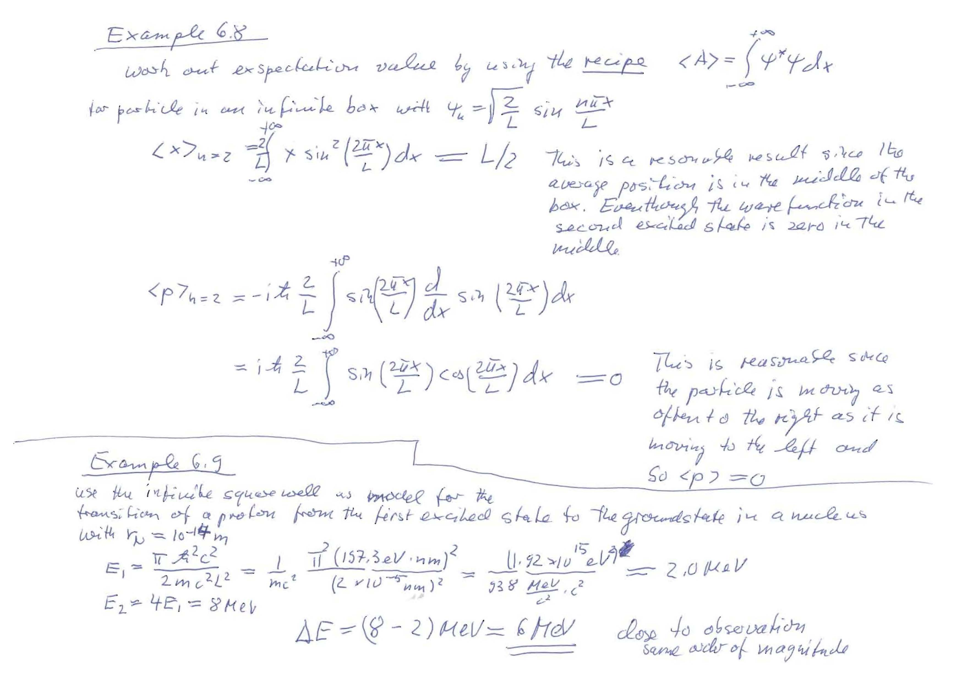

Slide 33
Problem6.14
A particle in an infinite square-well potential has ground-state energy 4.3eV. (a) Calculate and sketch the energies of the next three levels, and (b) sketch the wave functions on top of the energy levels.

Slide 34
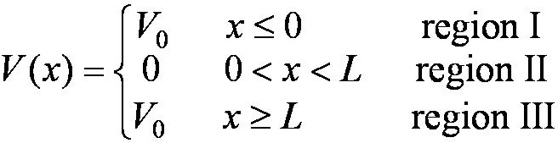
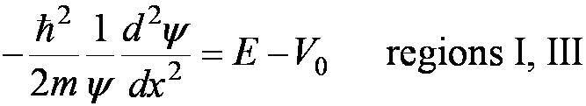

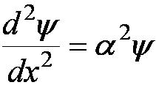
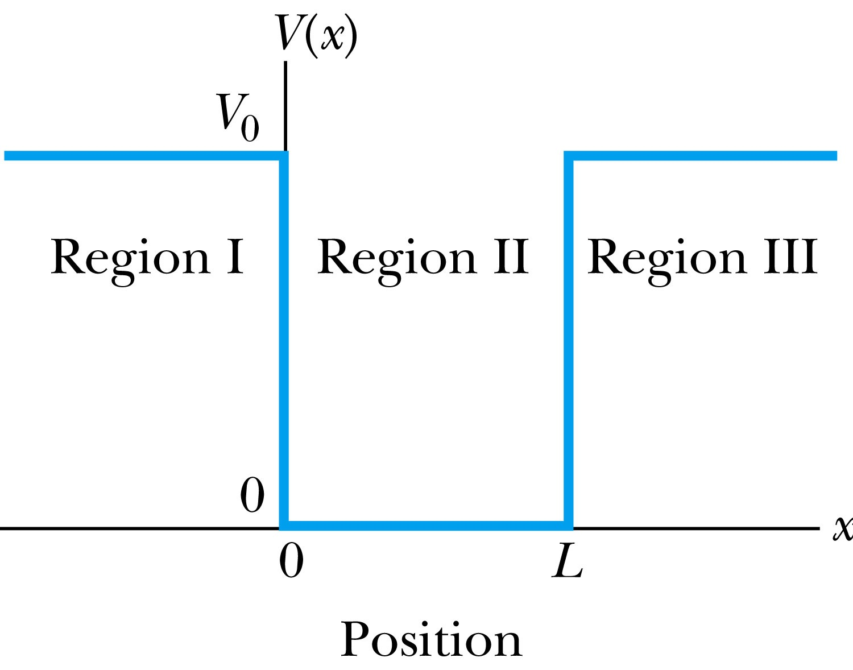
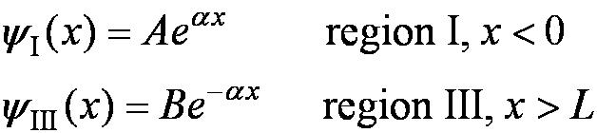
6.4: Finite Square-Well Potential
The finite square-well potential is
The Schrödinger equation outside the finite well in regions I and III is
or using
yields . The solution to this differential has exponentials of the form e^{αx} and e^{-αx}. In the region x > L, we reject the positive exponential and in the region x < L, we reject the negative exponential.Then the other one decays into the classically forbidden region

Slide 35
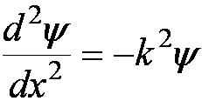


Finite Square-Well Solution
Inside the square well, where the potential V is zero, the wave equation becomes where
Instead of a sinusoidal solution we have
The boundary conditions require that
and the wave function must be smooth where the regions meet.
Note that the
wave function is
nonzero outside
of the box.
Larger wavelength
Smaller momentum and energy
We will skip the tedious procdure of fulfilling the above boundary conditions, but discuss the results

Slide 36
Clicker - Questions
13) Compare the results of the finite and infinite square well potential?
The wavelengths are longer for the finite square well.
The wavelengths are shorter for the finite square well.
The wavelengths are the same.

Slide 37
Clicker - Questions
13) Compare the finite and infinite square well potentials and chose the correct statement.
There is a finite number of bound energy states for the finite potential.
There is an infinite number of bound energy states for the finite potential.
There are bound states which fulfill the condition E>V_{o}.

Slide 38








6.5: Three-Dimensional Infinite-Potential Well
The wave function must be a function of all three spatial coordinates. We begin with the conservation of energy
Multiply this by the wave function to get
Now consider momentum as an operator acting on the wave function. In this case, the operator must act twice on each dimension. Given:
The three dimensional Schrödinger wave equation is
Laplace operator
Time independent Schroedinger equation

Slide 39

Particle in3-D box
Use 3 quantum numbers n

Slide 40
For a cubical box L1=L2=L3=L
Problem6.26
Find the energies of the second, third, fourth, and fifth levels for the three dimensional cubical box. Which energy levels are degenerate?
A given state is degenerate when there is more than one wave function for a given energy
ground state wavefunction E1 is not degenerate

Slide 41
Degeneracy
Analysis of the Schrödinger wave equation in three dimensions introduces three quantum numbers that quantize the energy.
A quantum state is degenerate when there is more than one wave function for a given energy.
Degeneracy results from particular properties of the potential energy function that describes the system. A perturbation of the potential energy can remove the degeneracy (to be shown later).

Slide 42







6.6: Simple Harmonic Oscillator
Simple harmonic oscillators describe many physical situations: springs, diatomic molecules and atomic lattices.
Consider the Taylor expansion of a potential function:
Redefining the minimum potential and the zero potential, we have
Substituting this into the wave equation:
Let and which yields .

Slide 43

Notes:
Figure 11.18

Slide 44


Parabolic Potential Well
If the lowest energy level is zero, this violates the uncertainty principle.
The wave function solutions are where H_{n}(x) are Hermite polynomials of order n.
In contrast to the particle in a box, where the oscillatory wave function is a sinusoidal curve, in this case the oscillatory behavior is due to the polynomial, which dominates at small x. The exponential tail is provided by the Gaussian function, which dominates at large x.

Slide 45




Analysis of the Parabolic Potential Well
The energy levels are given by
The zero point energy is called the Heisenberg limit:
Classically, the probability of finding the mass is greatest at the ends of motion and smallest at the center (that is, proportional to the amount of time the mass spends at each position).
Contrary to the classical one, the largest probability for this lowest energy state is for the particle to be at the center.
Hermite polynomial functions are shown above

Slide 46

A hydrogen molecule can be approximated a simple harmonic oscillator with force constant k=1.1x10^3 N/m

Slide 47


3A

Slide 48


Deuteron in a nucleus

Slide 49

Rectangular box

Slide 50



