Slide 1
CHAPTER 8
Atomic Physics
8.1 Atomic Structure and the Periodic Table
8.2 Total Angular Momentum
Atomic physics describes multi-electron atoms not only hydrogen-like one-electron atoms

Slide 2
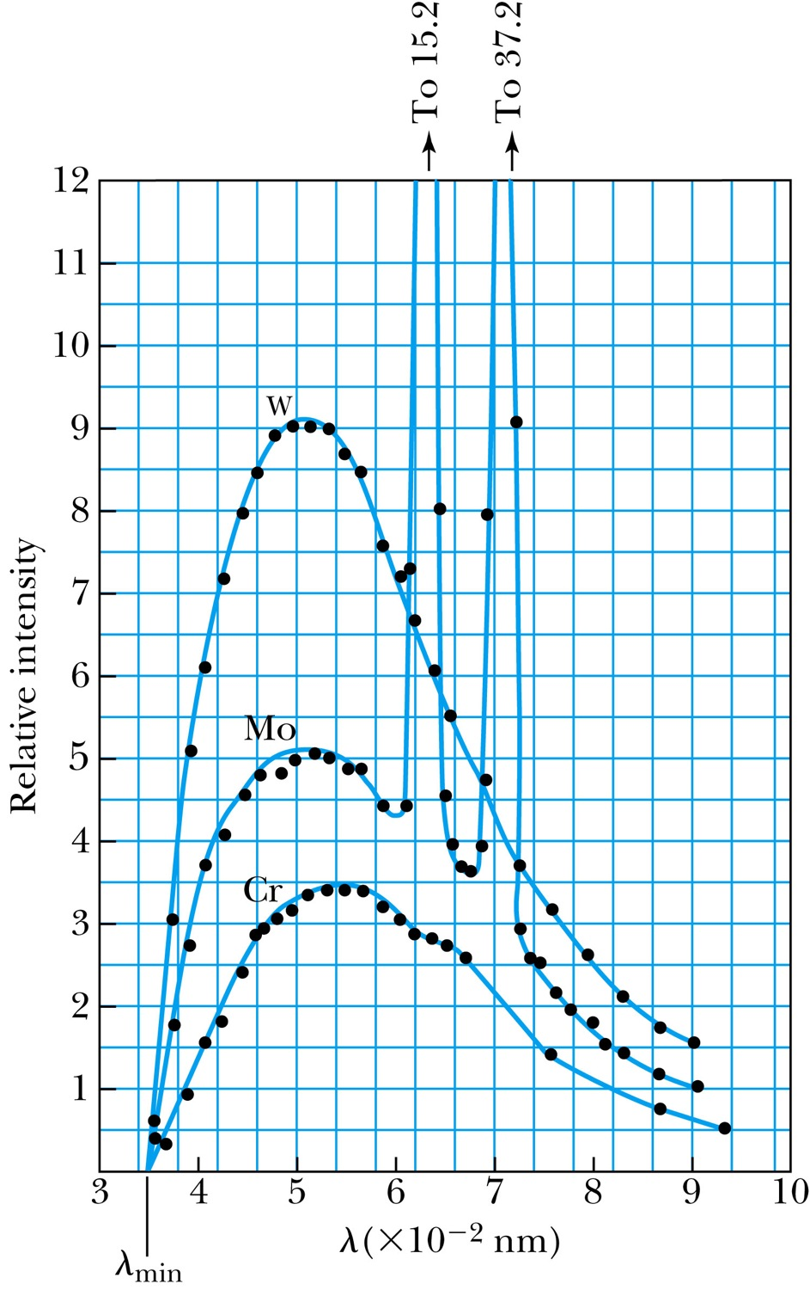
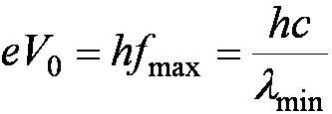
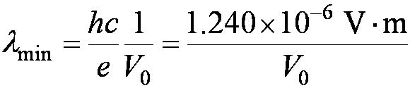
Inverse Photoelectric Effect (slide from Chapter3).
Conservation of energy requires that the electron kinetic energy equal the maximum photon energy where we neglect the work function because it is normally so small compared to the potential energy of the electron. This yields the Duane-Hunt limit which was first found experimentally. The photon wavelength depends only on the accelerating voltage and is the same for all targets.

Slide 3
4.6: Characteristic X-Ray Spectra and Atomic Number
Shells have letter names:
K shell for n = 1
L shell for n = 2
The atom is most stable in its ground state.
When it occurs in a heavy atom, the radiation emitted is an x ray.
It has the energy E (x ray) = E_{u} − E_{ℓ}.
For this to happen an inner shell vacancy has to be produced(for instance by a high energy electron collision) in Roentgen’s discovery of X-rays
An electron from higher shells will fill the inner-shell vacancy at lower energy.

Slide 4
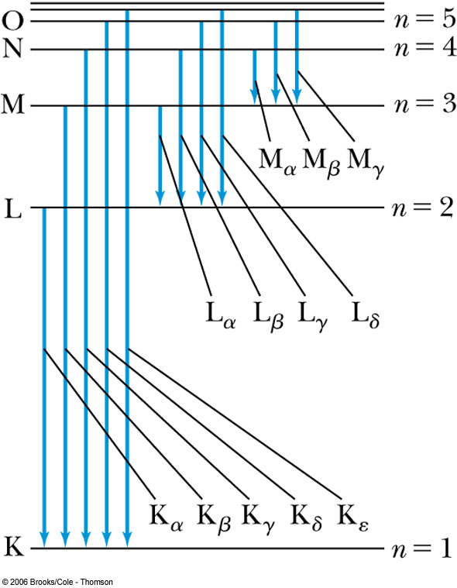
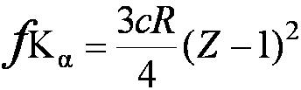
Atomic Number
L shell to K shell K_{α} x ray
M shell to K shell K_{β} x ray
Atomic number Z = number of protons in the nucleus
Moseley found a relationship between the frequencies of the characteristic x ray and Z.
This holds for the K_{α} x ray

Slide 5
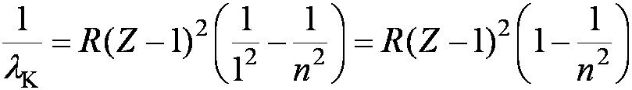
Moseley’s Empirical Results
The x ray is produced from n = 2 to n = 1 transition.
In general, the K series of x ray wavelengths are
Moseley’s research clarified the importance of the electron shells for all the elements, not just for hydrogen.

Slide 6
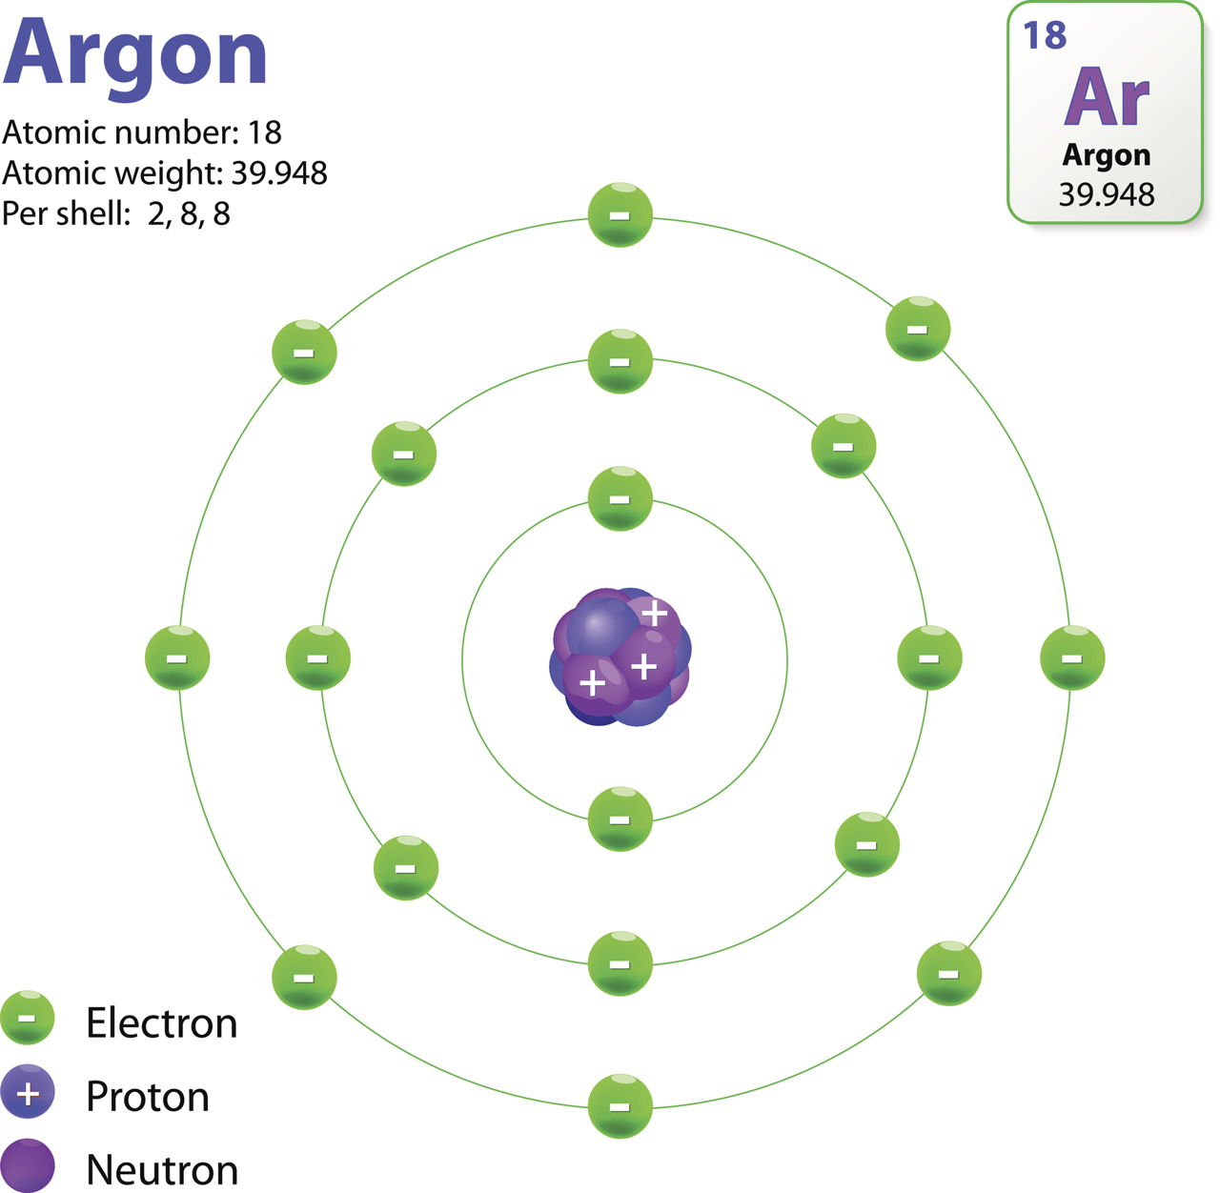
Atomic structure parameters

Slide 7
8.1: Atomic Structure and the Periodic Table
What would happen if there are more than one electron?
a nucleus with charge +2e attracting two electrons
the two electrons repelling one another
Can not solve problems exactly with the Schrödinger equation because of the complex potential interactions
Can understand experimental results without computing the wave functions of many-electron atoms by applying the boundary conditions and selection rules

Slide 8
Pauli Exclusion Principle
To understand atomic spectroscopic data for optical frequencies, Wolfgang Pauli proposed an exclusion principle:
No two electrons in an atom may have the same set of quantum numbers (n, ℓ, m_{ℓ}, m_{s}).
It applies to all particles of half-integer spin, which are called fermions, and particles in the nucleus are fermions.
The periodic table can be understood by two rules:
The electrons in an atom tend to occupy the lowest energy levels available to them.
Only one electron can be in a state with a given (complete) set of
quantum numbers (Pauli exclusion principle).

Slide 9
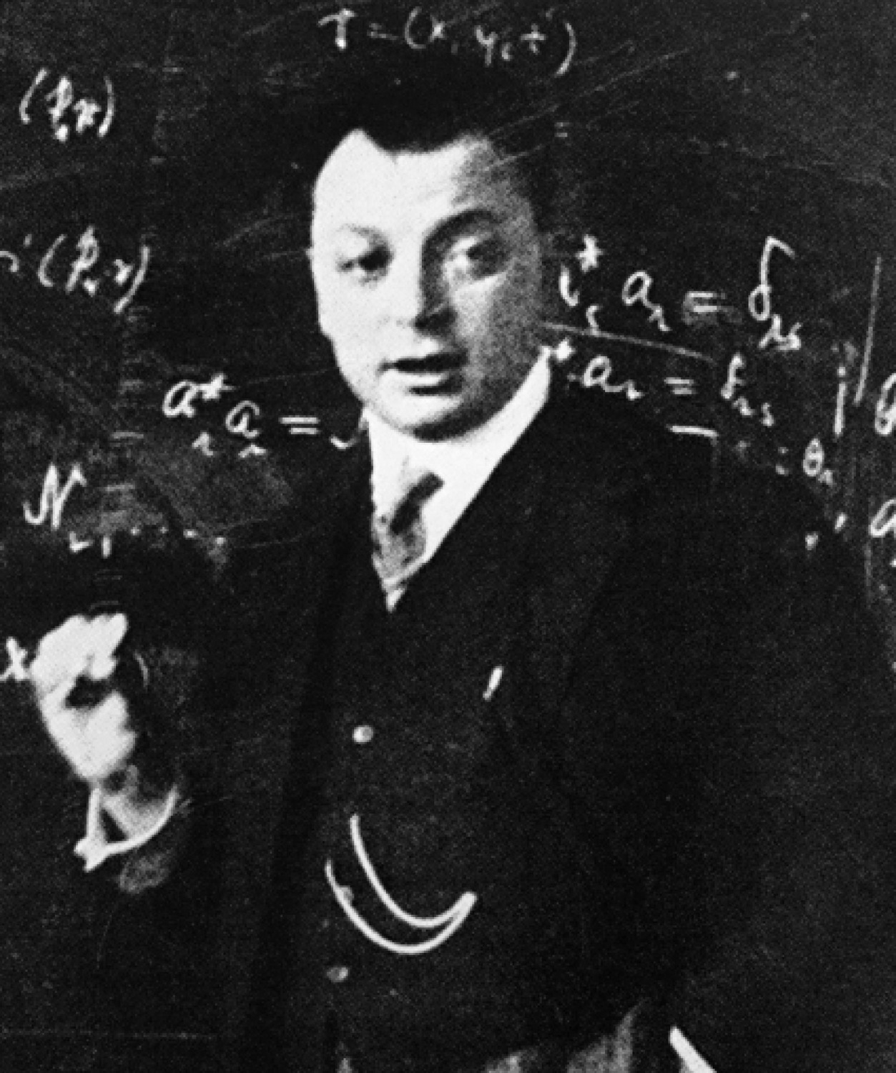
Wolfgang Pauli (1900–1958) was born in Austria, studied at Munich under Arnold Sommerfeld, and spent brief periods at Göttingen (with Max Born), Copenhagen (with Niels Bohr), and Hamburg before accepting an appointment at Zurich in 1925 where he remained, except for brief periods at American universities including Princeton University during World War II. Pauli was a brilliant theoretical physicist who formulated the Pauli exclusion principle named after him, proposed a quantum spin number for the electron, and recognized the existence of the neutrino to explain nuclear beta decay. He received the Nobel Prize in 1945 for discovering the exclusion principle.
p273
Notes:
Wolfgang Pauli (1900–1958) was born in Austria, studied at Munich under Arnold Sommerfeld, and spent brief periods at Göttingen (with Max Born), Copenhagen (with Niels Bohr), and Hamburg before accepting an appointment at Zurich in 1925 where he remained, except for brief periods at American universities including Princeton University during World War II. Pauli was a brilliant theoretical physicist who formulated the exclusion principle named after him, proposed a quantum spin number for the electron, and recognized the existence of the neutrino to explain nuclear beta decay. He received the Nobel Prize in 1945 for discovering the exclusion principle.

Slide 10
7.3: Quantum Numbers
The three quantum numbers:
  n Principal quantum number
  ℓ Orbital angular momentum quantum number
  m_{ℓ} Magnetic quantum number
The boundary conditions:
  n = 1, 2, 3, 4, . . . Integer
  ℓ = 0, 1, 2, 3, . . . , n − 1 Integer
  m_{ℓ} = −ℓ, −ℓ + 1, . . . , 0, 1, . . . , ℓ − 1, ℓ Integer
The restrictions for quantum numbers:
  n > 0
  ℓ < n
  |m_{ℓ}| ≤ ℓ

Slide 11
Atomic Structure
Hydrogen: (n, ℓ, m_{ℓ}, m_{s}) = (1, 0, 0, ±½) in ground state
In the absence of a magnetic field, the state m_{s} = ½ is degenerate with the m_{s} = −½ state.
Helium: (1, 0, 0, ½) for the first electron
(1, 0, 0, −½) for the second electron
Electrons have antialigned (m_{s} = +½ and m_{s} = −½) spins as being paired Supports Pauli exclusion principle
The principle quantum number also has letter codes.
  n = 1 2 3 4...
  Letter = K L M N…
n = shells (eg: K shell, L shell, etc.)
nℓ = subshells (eg: 1s, 2p, 3d)
Electrons for H and He atoms are in the K shell.
H: 1s¹ or 1s
He: 1s²
Pauli added a fourth quantum number ms

Slide 12
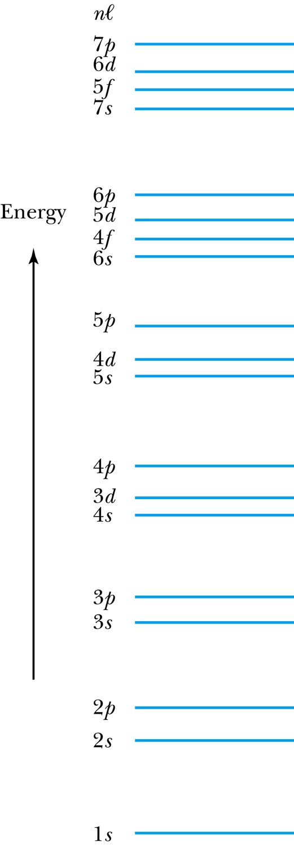
Atomic Structure
How many electrons may be in each subshell?
Recall: ℓ = 0 1 2 3 4 5 …
letter = s p d f g h …
ℓ = 0, (s state) can have two electrons
ℓ = 1, (p state) can have six electrons, and so on
 | Total
For each m_{ℓ}: two values of m_{s} | 2
For each ℓ: (2ℓ + 1) values of m_{ℓ} | 2(2ℓ + 1)
The lower ℓ values have more elliptical orbits than the higher ℓ values.
Electrons with higher ℓ values are more shielded from the nuclear charge
Electrons lie higher in energy than those with lower ℓ values
the shielding is so pronounced that the 4s fills
before 3d even though it has a larger n

Slide 13
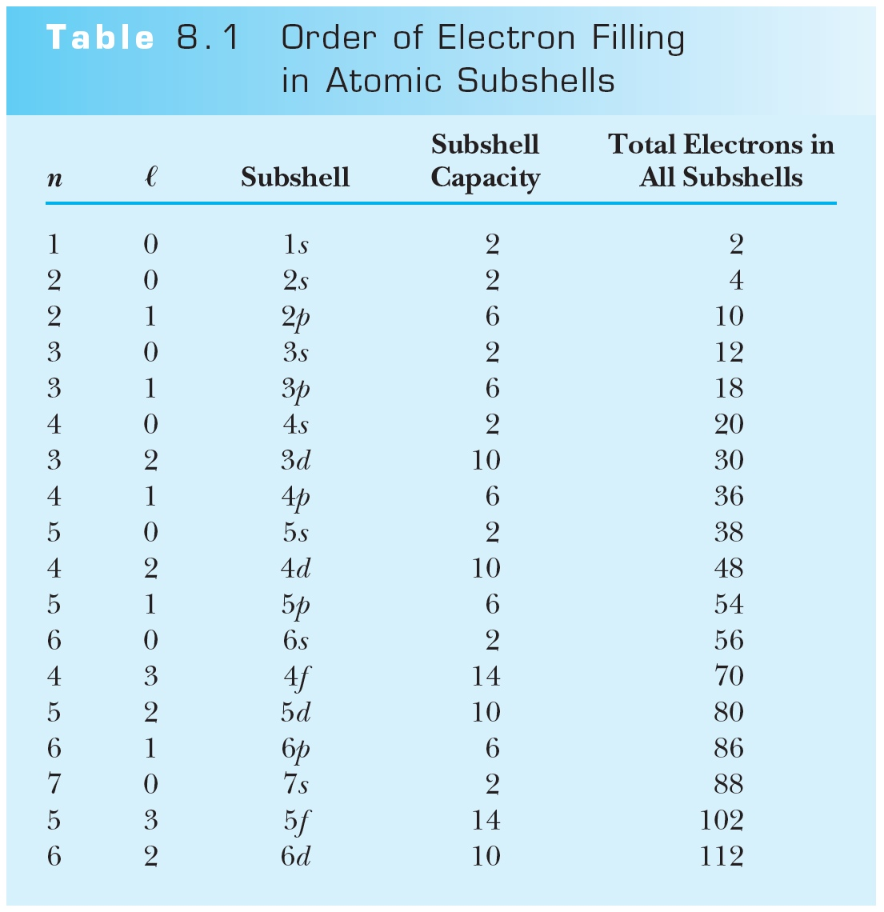
Order of Electron Filling in Atomic Subshells
Due to shielding 4s shell fills before 3d

Slide 14
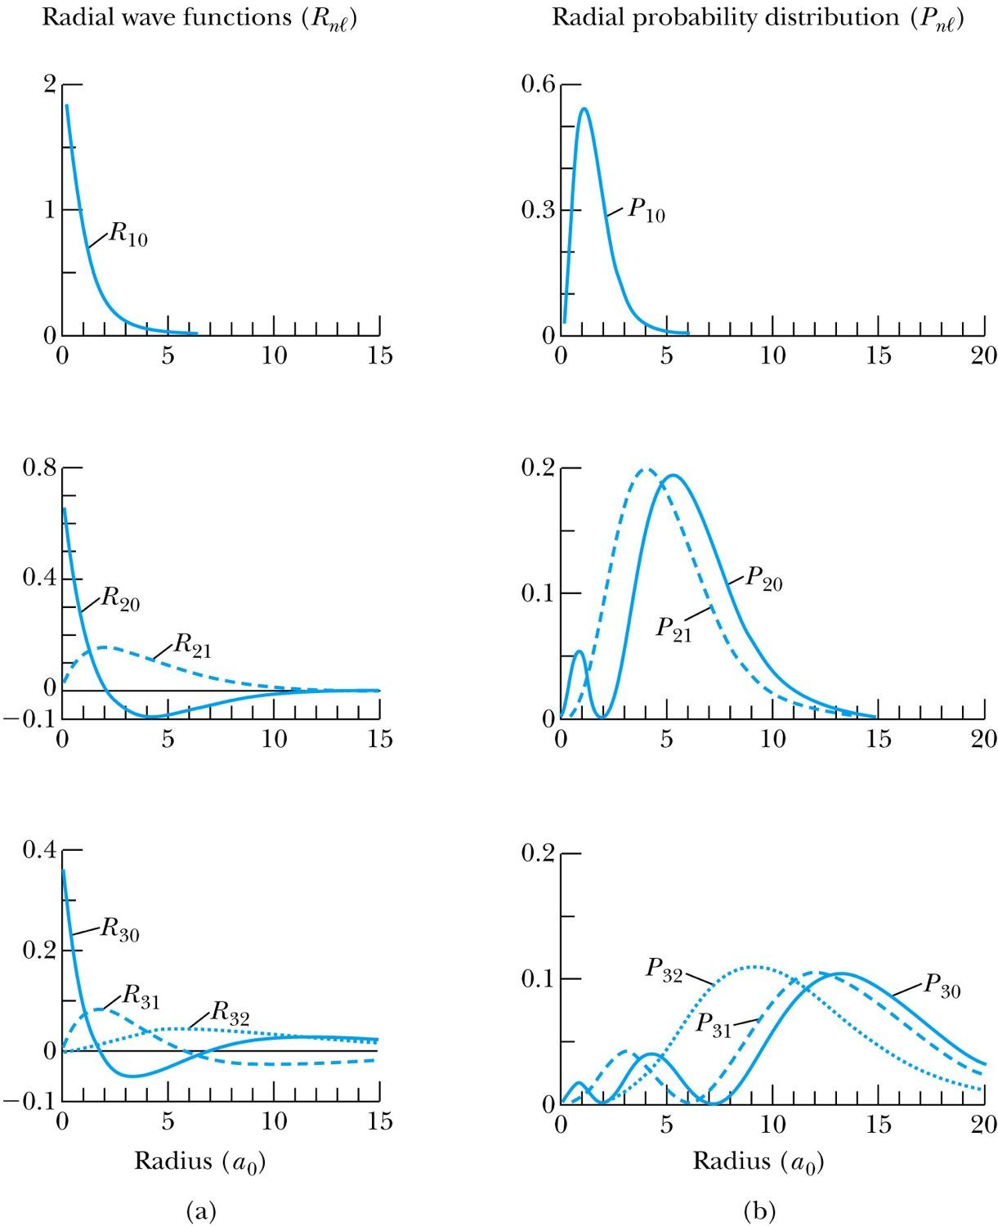
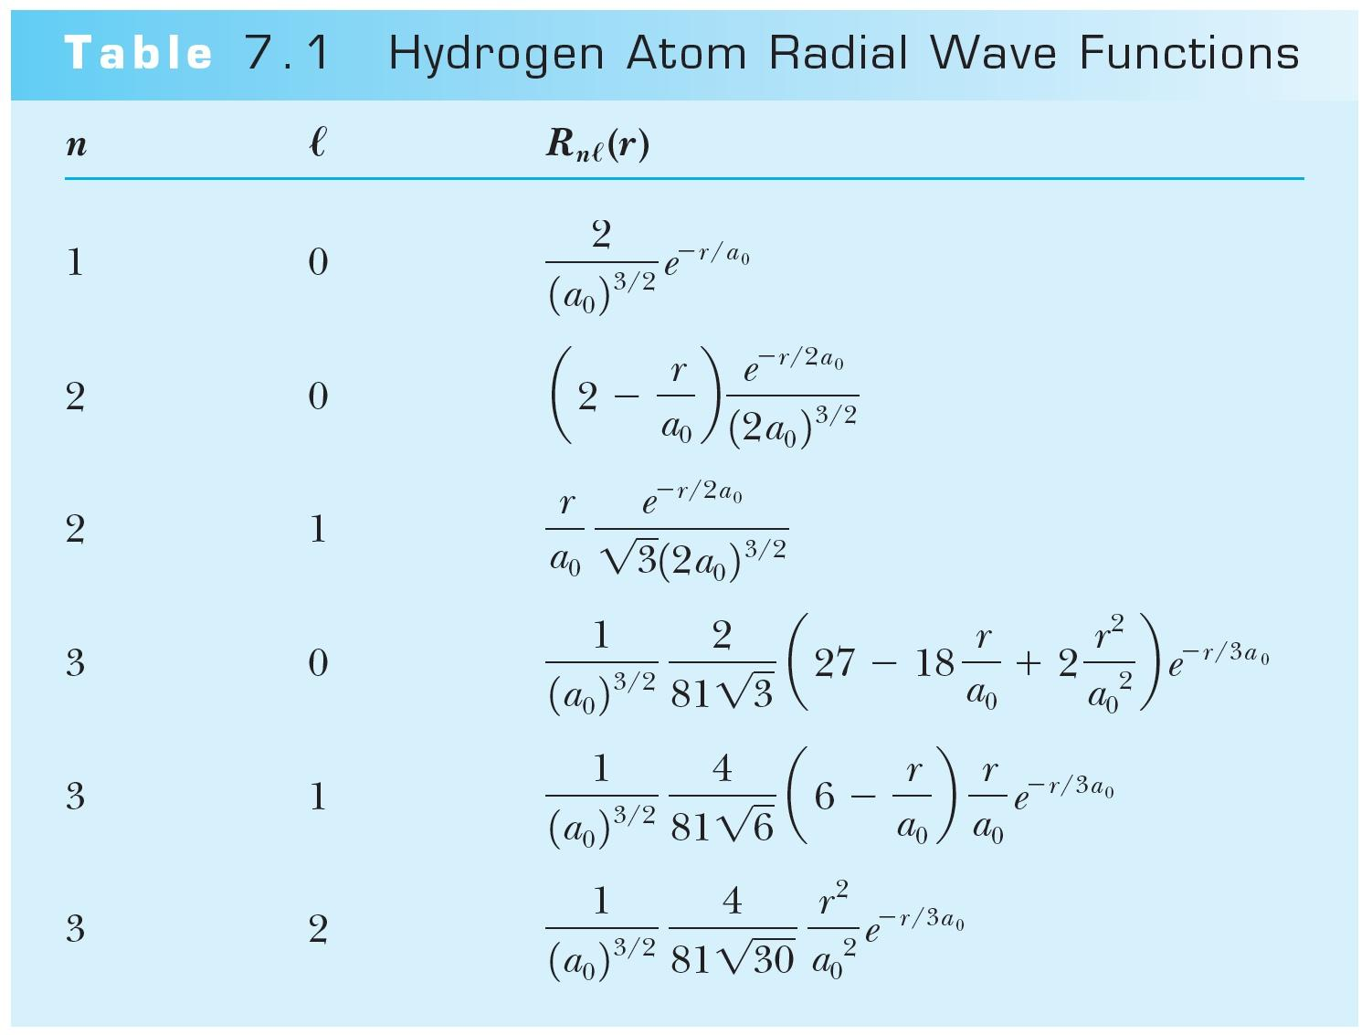
Radial Probability Distribution Functions
R(r) and P(r) for the lowest-lying states of the hydrogen atom
n=1
n=2
n=3
Horizontal axis in units of the Bohr radius
Shielding: high I electrons shield more than low l electrons and see a smaller nuclear charge Z

Slide 15
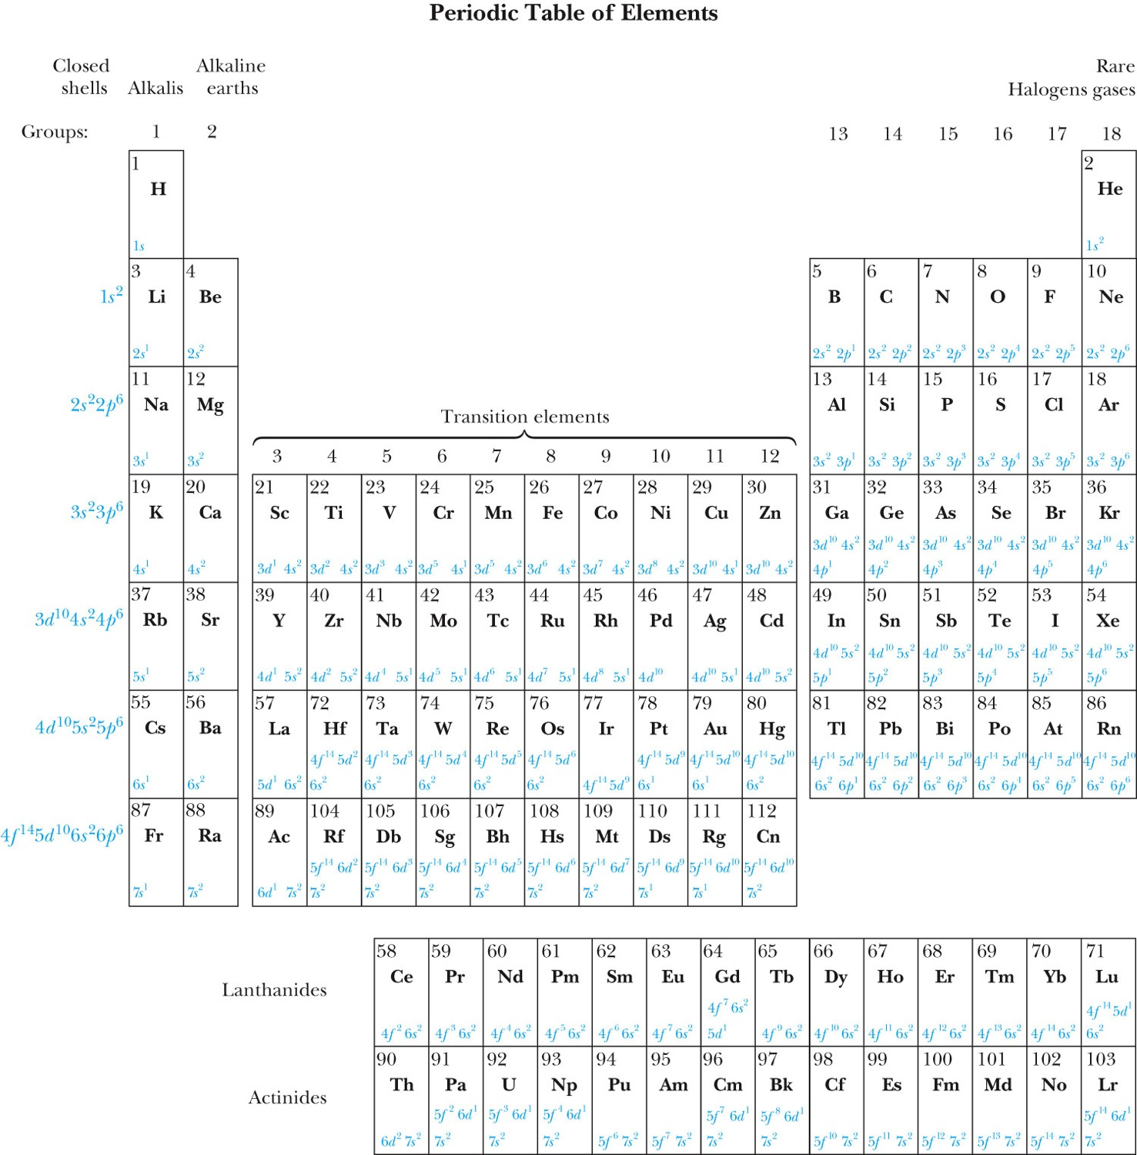
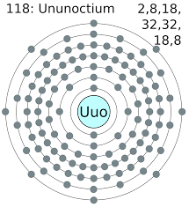
The Periodic Table
Horizontal groupings are according to separate subshells
Vertical columns are Groups : similar chemical and physical properties

Slide 16
Groups and Periods in the Periodic Table
Groups:
Vertical columns
Same number of electrons in an ℓ orbit
Can form similar chemical bonds
Periods:
Horizontal rows
Correspond to filling of the subshells
Filling of inner: d-levels for the transition elements, f-levels for Lanthanides an Actinides

Slide 17
Problem8.8
Use figure 8.2 to list all the (a) inert gases, (b) alkalis, (c) halogens, and (d) alkaline earths.

Slide 18
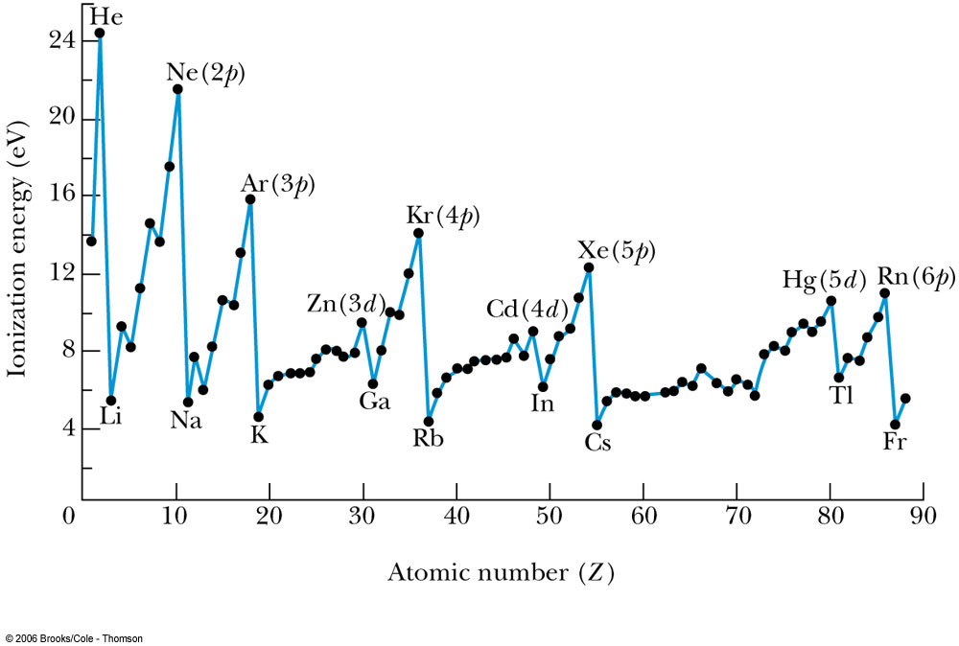
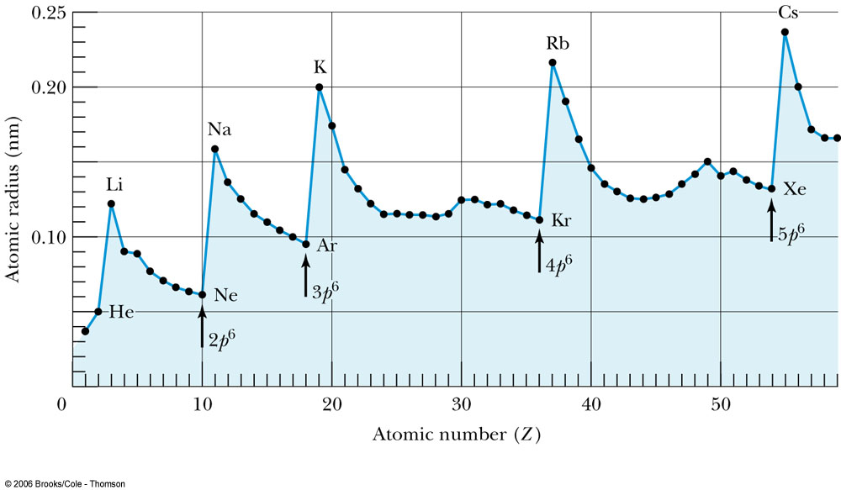
Ionization Energies of Elements and Atomic Radii
Some properties of elements are compared by the ionization energies of elements and atomic radii:

Slide 19
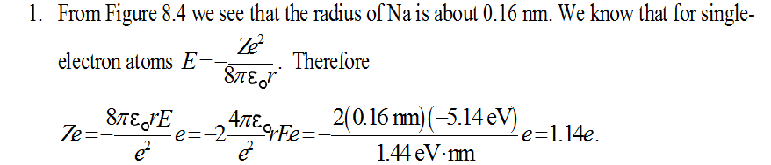
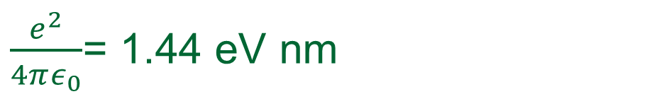
Problem 8.7
The 3s state of Na has an energy of -5.14eV. Determine the effective nuclear charge.

Slide 20
The Periodic Table
Inert Gases:
Last group of the periodic table
Closed p subshell except helium
Zero net spin and large ionization energy
Their atoms interact weakly with each other
Alkalis:
Single s electron outside an inner core
Easily form positive ions with a charge +1e
Lowest ionization energies
Electrical conductivity is relatively good
Alkaline Earths:
Two s electrons in outer subshell
Largest atomic radii
High electrical conductivity

Slide 21
The Periodic Table
Halogens:
Need one more electron to fill outermost subshell
Form strong ionic bonds with the alkalis
More stable configurations occur as the p subshell is filled
Transition Metals:
Three rows of elements in which the 3d, 4d, and 5d are being filled
Properties primarily determined by the s electrons, rather than by the d subshell being filled
Have d-shell electrons with unpaired spins
As the d subshell is filled, the magnetic moments, and the tendency for neighboring atoms to align spins are reduced

Slide 22
The Periodic Table
Lanthanides (rare earths):
Have the outside 6s² subshell completed
As occurs in the 3d subshell, the electrons in the 4f subshell have unpaired electrons that align themselves
The large orbital angular momentum contributes to the large ferromagnetic effects
Actinides:
Inner subshells are being filled while the 7s² subshell is complete
Difficult to obtain chemical data because they are all radioactive
Have longer half-lives

Slide 23
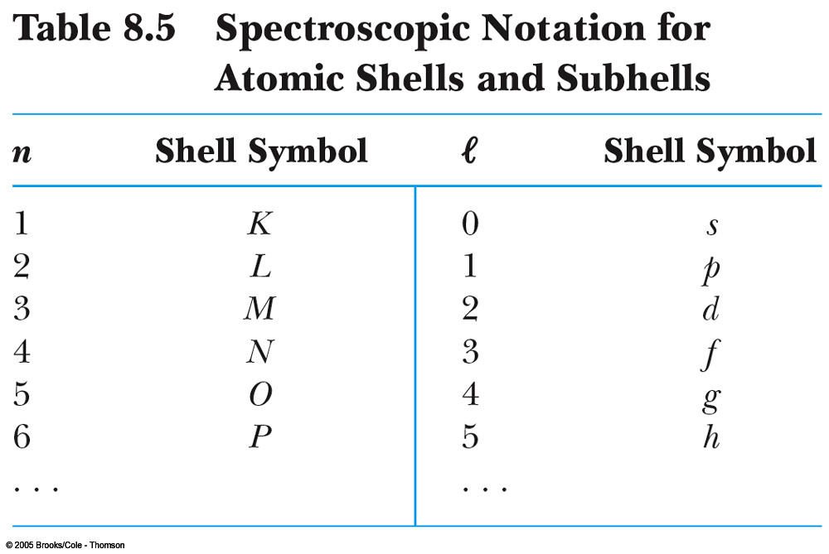
ss

Slide 24
Problem 8.2
What electron configuration would you expect (nl) for the first excited state of neon and xenon?

Slide 25
Clicker - Questions
Indicate which statement is not true in the ordering of the periodic table ?
a) The electrons tend to occupy the lowest energy levels available to them
b) No two electrons in an atom can have the same set of quantum numbers (n , l , m_{e} , m_{s})
c) Electrons with higher l values go earlier into unfilled shells than those with lower l values, because they are less shielded from the nuclear charge.
d) Electrons with higher l values go later into unfilled shell than those with lower l values, because they are more shielded from the nuclear charge.
Notes:
C is correct answer a tricky question=not

Slide 26
Clicker - Questions
Consider the periodic table and select the statement which is true.
a) The electron configuration for each element is specified by n , l , and the projection of L namely m_{l} , and the projection of S namely m_{s}
b) The electron configuration for each element is specified by the principal quantum number n , and the angular quantum number l (s, p, d or f)
c) The electron configuration for each element is specified by n , l , and the spin quantum number s
d) The electron configuration for each element is specified by the principal quantum number n , and the angular quantum number l (s, p, d , f…….) and the number of electrons relevant for this element in each shell.

Slide 27
Clicker - Questions
2) Why the Alkali metals have the lowest ionization energies?
a) they have a single electron outside an inert noble gas core.
b) they have one valence electron which is strongly bound.
c) they have an electron missing in the outer shell.
d) They have the smallest atomic radii.

Slide 28
Problem 8.10
What are the electronic configurations for the ground states of the elements Ag, Hf, and Sb?

Slide 29
Problem 8.11
What atoms have the configuration (a) 1s²2s²2p⁵, (b) 1s²2s²2p⁶3s² , (c) 3s²3p⁶ ? Explain.

Slide 30
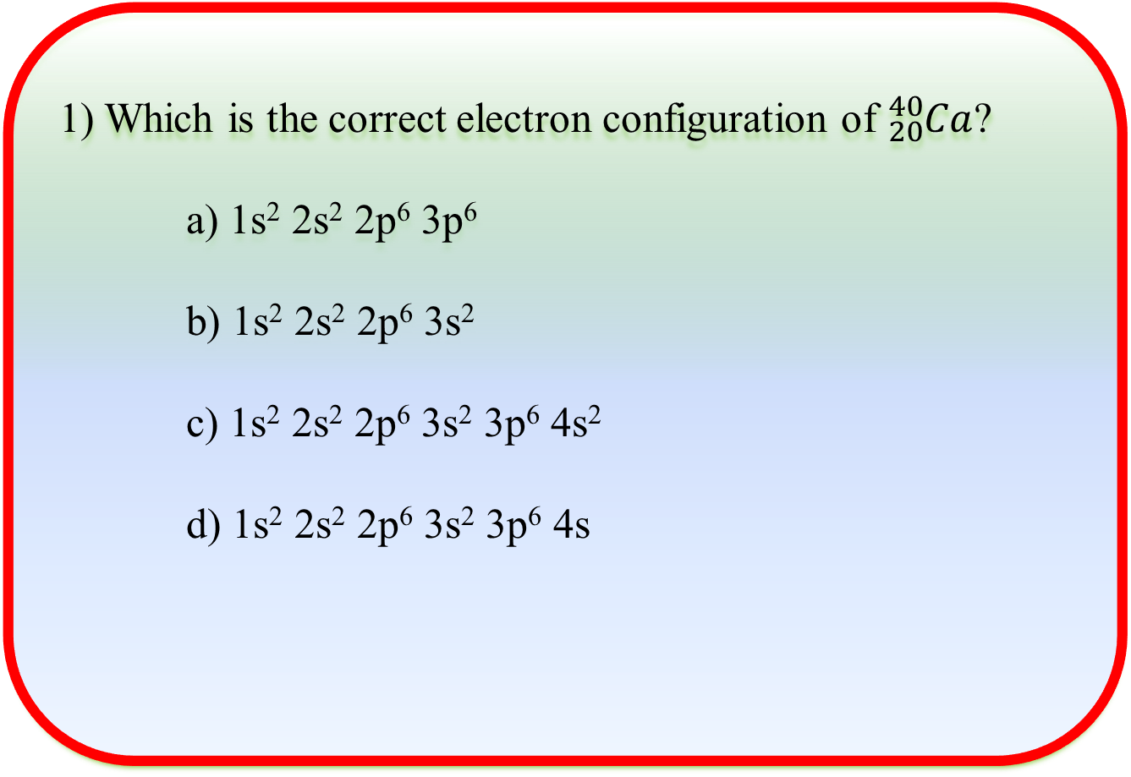
Clicker - Questions

Slide 31
Clicker - Questions
Which of the following is NOT a general selection rule for the filling of electron shells?
a)For a particular n, the subshells fill in the order s, p, d, f, ...
b)Shielding affects the ordering of energy levels as described by n and l.
c)The orbital and spin angular momentum in each shell and subshell are restricted by Hund's rules.
d)Electrons usually completely fill a subshell before starting another shell.
e)For the s shell there are 2 electrons, for the p shell 6, for the d shell 10, and for the f shell 16.

Slide 32




8.2: Total Angular Momentum
Orbital angular momentum
Spin angular momentum
Total angular momentum
L, L_{z}, S, S_{z,}J and J_{z} are quantized

Slide 33
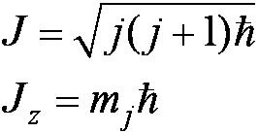
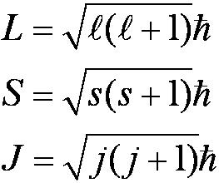

Total Angular Momentum for single electron Atoms outside an inert core
If j and m_{j} are quantum numbers for the single electron (hydrogen atom)
Quantization of the magnitudes
The total angular momentum quantum number for the single electron can only have the values

Slide 34
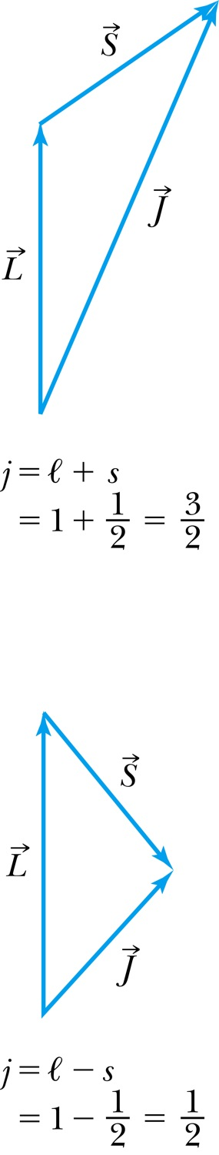
The Total Angular Momentum Diagram
Figure 8.5 When forming the total angular momentum from the orbital and spin angular momenta, the addition must be done vectorially, .

Slide 35






Spin-Orbit Coupling
An effect of the spins of the electron and the orbital angular momentum interaction is called spin-orbit coupling.
is the magnetic field due to the proton
where cos α is the angle between
The dipole potential energy
The spin magnetic moment ∝ .
.

Slide 36
Clicker - Questions
Which of the following statements is true about the spin-orbit coupling effects on the transitions of an atom such as sodium? Assume sodium is modeled by a single electron atom.
a)The difference in the energy of a split state does not depend on the electron's angular momentum, but instead the angular momentum of the nucleus.
b)The differences in energy level transitions are significant enough to change the order of filling of the subshells.
c)Electrons with a state of l = 0 never have split energy levels.
d)For single electron atoms (or atoms with one electron outside a filled shell) each nl state is made a doublet

Slide 37
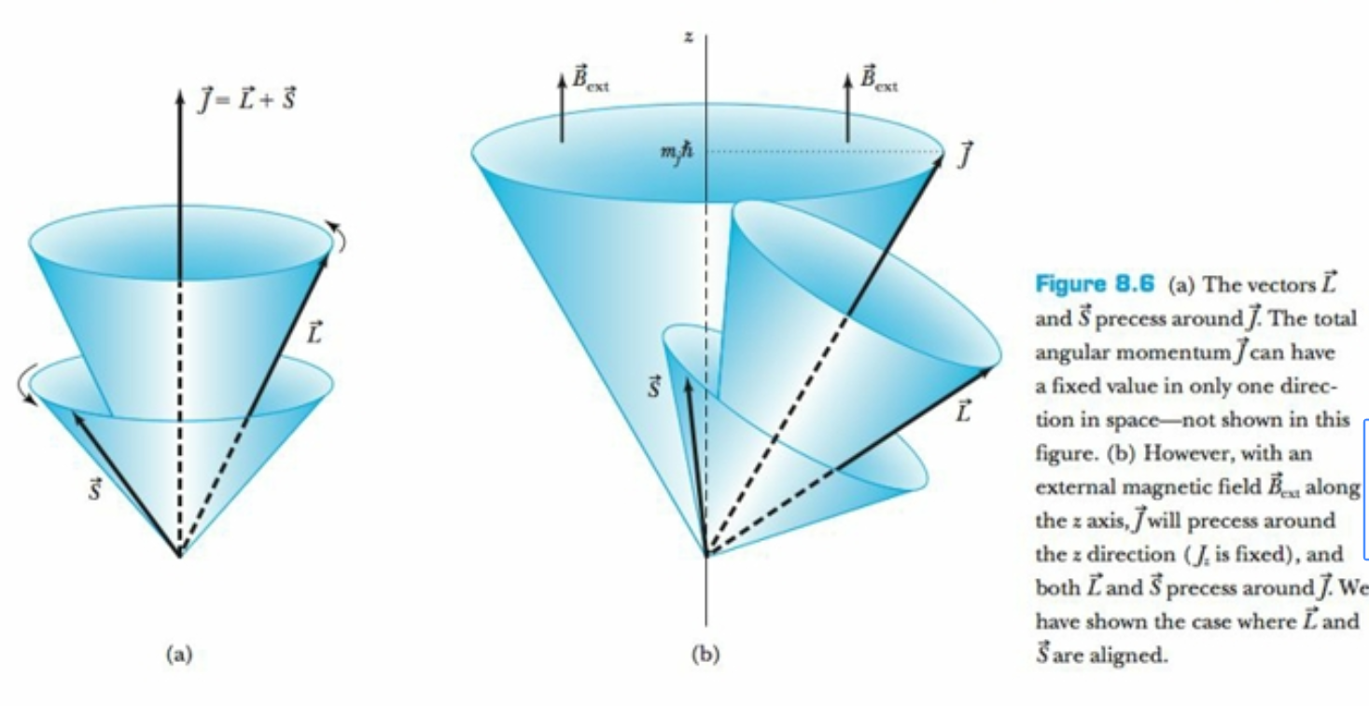
Spin-orbit coupling

Slide 38
Clicker - Questions
The energy levels of a single-electron atom (or the approximation for one electron outside of a filled shell) can be split due to a relationship between the spin and the orbital angular momentum. Choose the statement that best explains why this occurs.
a) The electron is affected by the magnetic field of the proton, which in the rest frame of the electron is seen as orbiting the electron.
b)There is a state with lesser energy when the spin magnetic moment of the electron and internal magnetic field of the atom are aligned.
c)Only in an external magnetic field do the energy levels split due to spin-orbit coupling.
d)Only in an external electric field do the energy levels split due to spin-orbit coupling.
e)The total angular momentum component in the z-direction is not quantized and can take on any value as a sum of orbital and spin angular momentum.

Slide 39
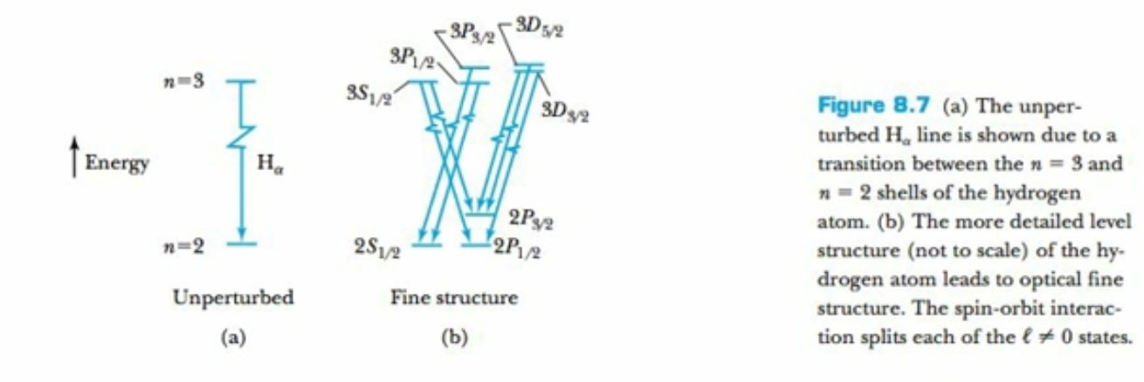
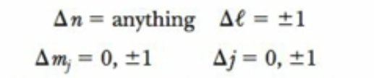
Doublet splitting of the Balmer line
Selection rules for single electron atom transitions

Slide 40
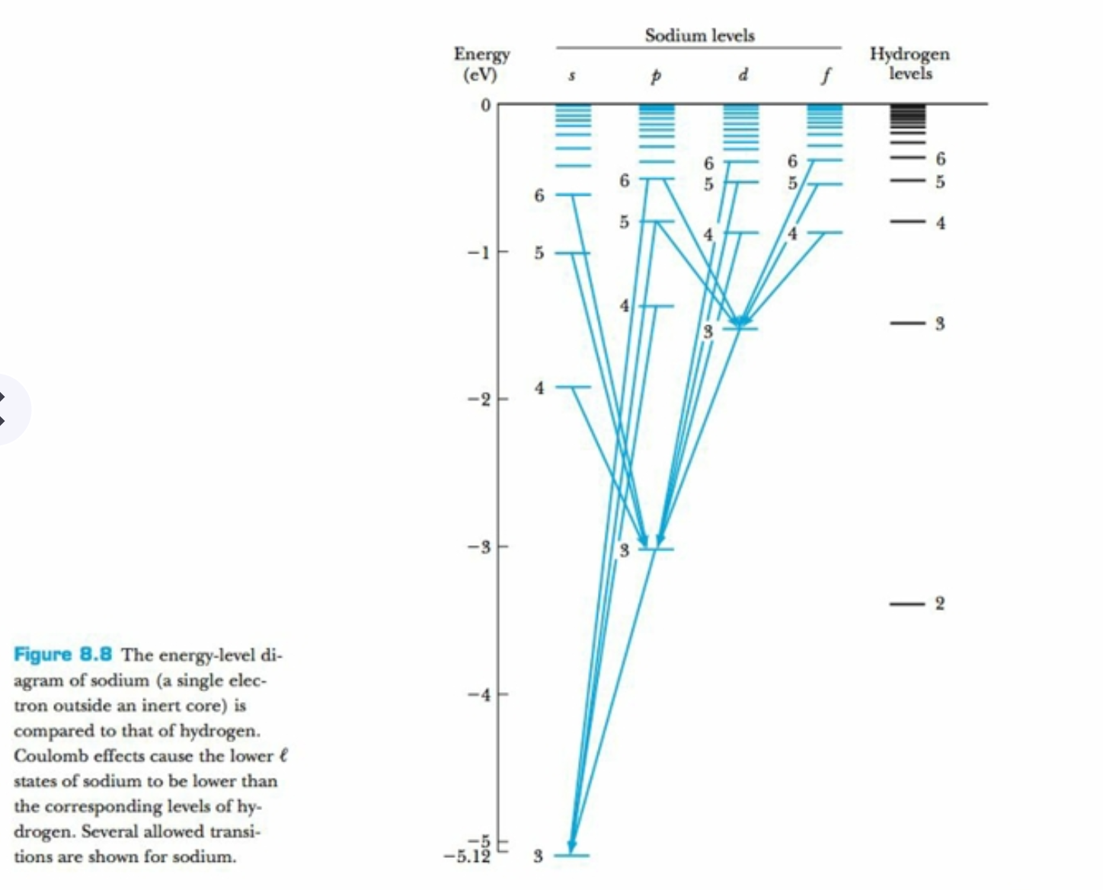
Comparison between sodium and hydrogen spectrum

Slide 41

Many-Electron Atoms
Consider 2- electron atoms: helium and the alkali atoms
Hund’s rules:
The total spin angular momentum S should be maximized to the extent possible without violating the Pauli exclusion principle.
Insofar as rule 1 is not violated, L should also be maximized.
For atoms having subshells less than half full, J should be minimized.
For labeled two-electron atom
There are LS coupling and jj coupling to combine four angular momenta J.
In jj coupling L+S=J for each electron

Slide 42
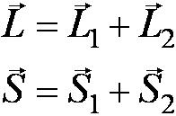
LS Coupling Many-Electron Atoms
This is used for most atoms when the magnetic field is weak.
If two electrons are single subshell, S = 0 or 1 depending on whether the spins are antiparallel or parallel.
For given L, there are 2S + 1 values of J
For L > S, J goes from L − S to L + S
For L < S, there are fewer than 2S + 1 possible J values
The value of 2S + 1 is the multiplicity of the state

Slide 43
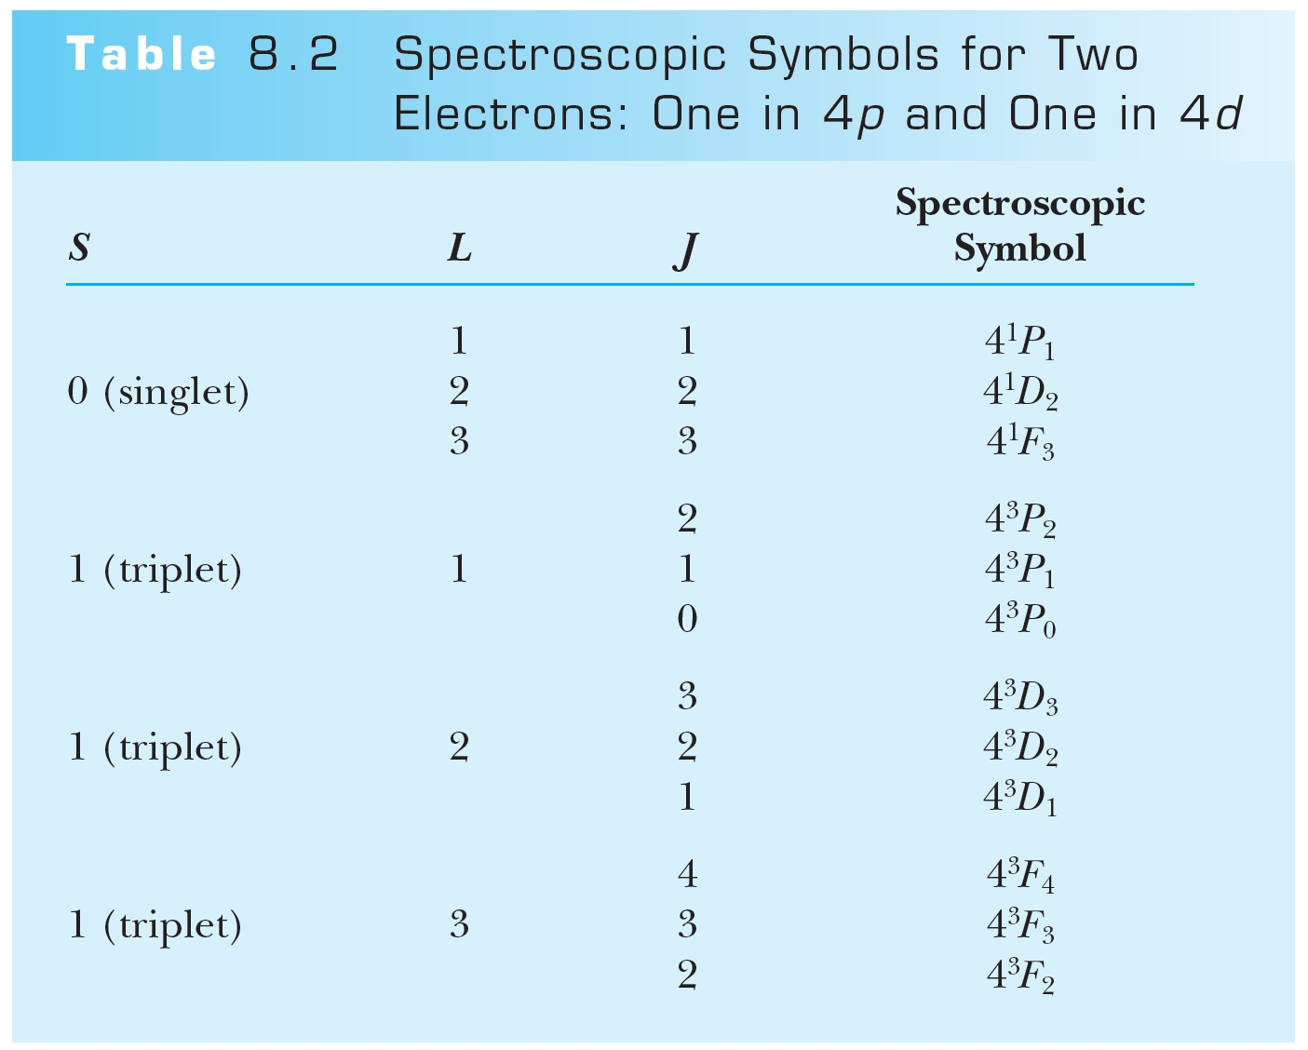
Table 8-2 p287

Slide 44
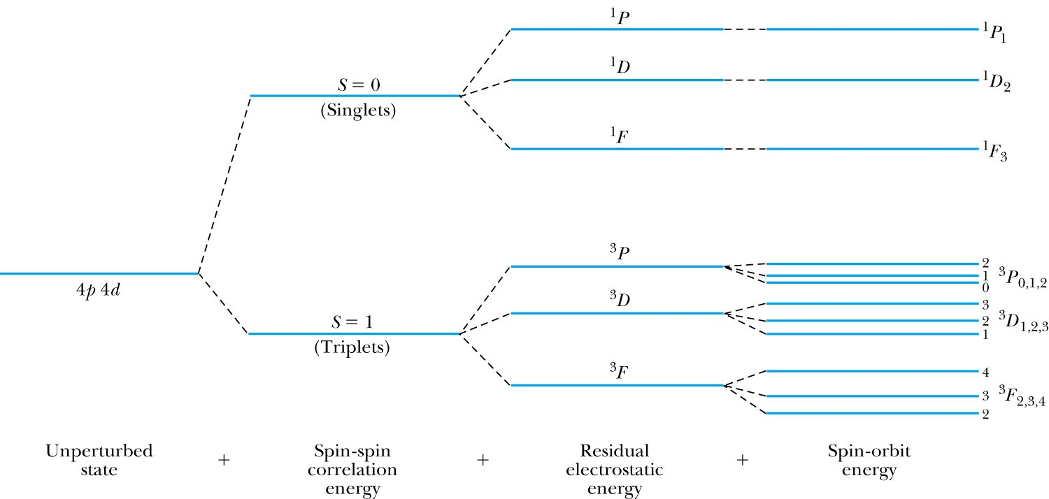
LS Coupling
The notation for a single-electron atom becomes
n^{2S+1} L_{J}
The letters and numbers are called spectroscopic symbols.
There are singlet states (S = 0) and triplet states (S = 1) for two electrons.

Slide 45
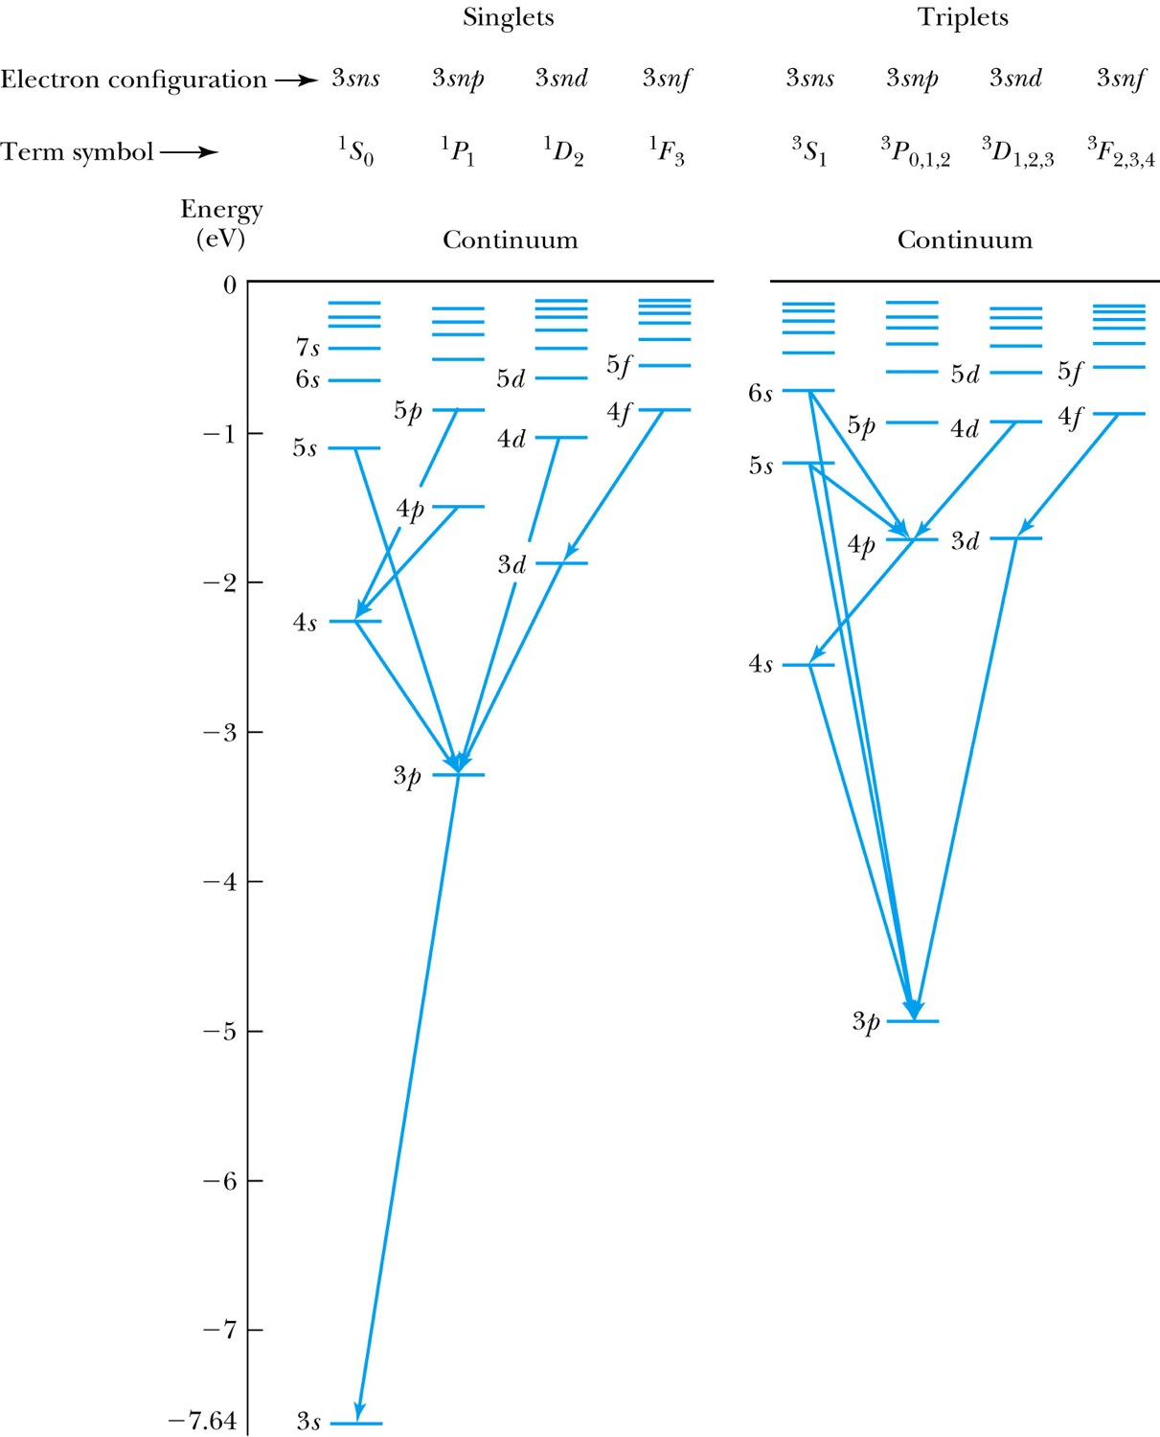
LS Coupling for the magnesium atom
There are separated energy levels according to whether they are S = 0 or 1
Allowed transitions must have ΔS = 0
No allowed (forbidden) transitions are possible between singlet and triplet states with much lower probability
1s²2s²2p⁶3s²
3p state is metastable

Slide 46
LS Coupling
The allowed transitions for the LS coupling scheme are
  ΔL = ±1 ΔS = 0
  ΔJ = 0, ±1 (J = 0 → J = 0 is forbidden)
A magnesium atom excited to the 3s3p triplet state has no lower triplet state to which it can decay.
It is called metastable, because it lives for such a long time on the atomic scale.
3s3p - lifetime of 2050 seconds, which corresponds to approximately ½ hour used in research with ultra-precise atomic clocks

Slide 47
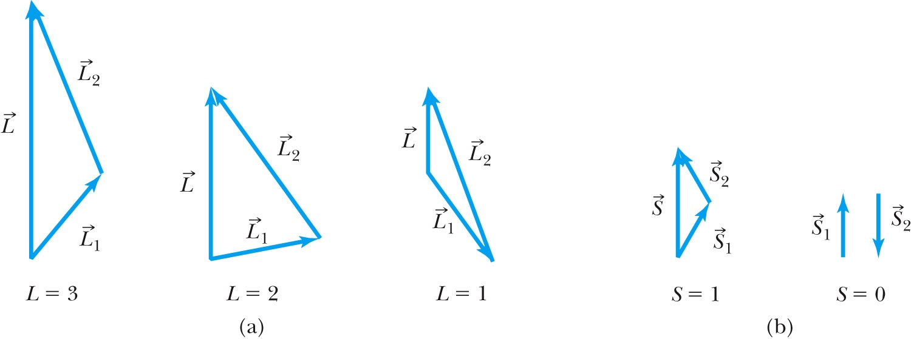
jj coupling
In heavier atoms the situation is different. In atoms with bigger nuclear
charges, spin–orbit interactions are frequently as large as or larger than spin–spin interactions or orbit–orbit interactions.
In this situation, each orbital angular momentum ℓ_{i} tends to combine
with the corresponding individual spin angular momentum s_{i}, originating an individual total angular momentum j_{i}.
These then couple up to form the total angular momentum J
In jj coupling L+S=J for each electron
Figure 8.11 (a) Two electrons having orbital angular momentum quantum numbers of 1 and 2 combine to form L values of 1, 2, 3. (b) Two electrons having spin angular quantum numbers of 1/2 and 1/2 form S values of 0 and 1.
Figure 8-11 p290
Notes:
Figure 8.11 (a) Two electrons having orbital angular momentum quantum numbers of 1 and 2 combine to form L values of 1, 2, 3. (b) Two electrons having spin angular quantum numbers of 1/2 and 1/2 form S values of 0 and 1.

Slide 48
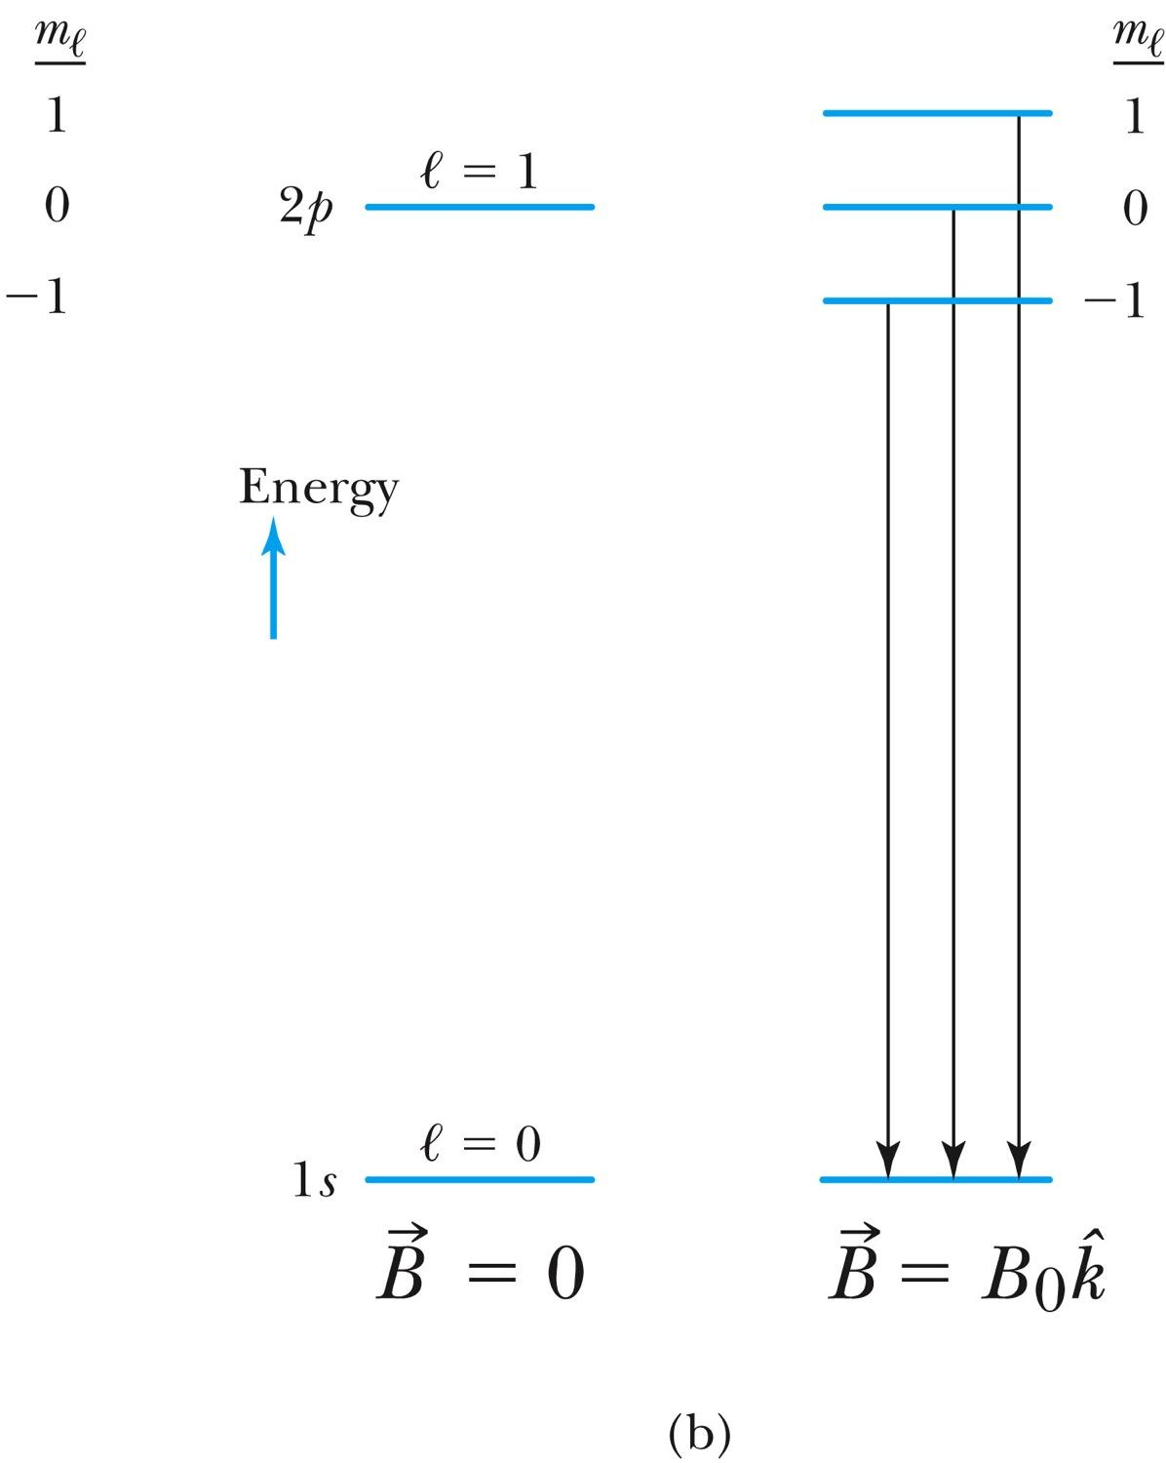
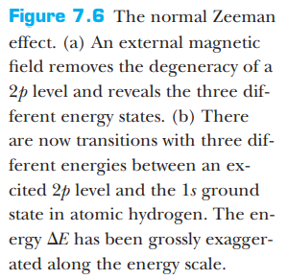
The Normal Zeeman Effect: line splitting in a magnetic field
A transition from 2p to 1s
From lecture10b

Slide 49
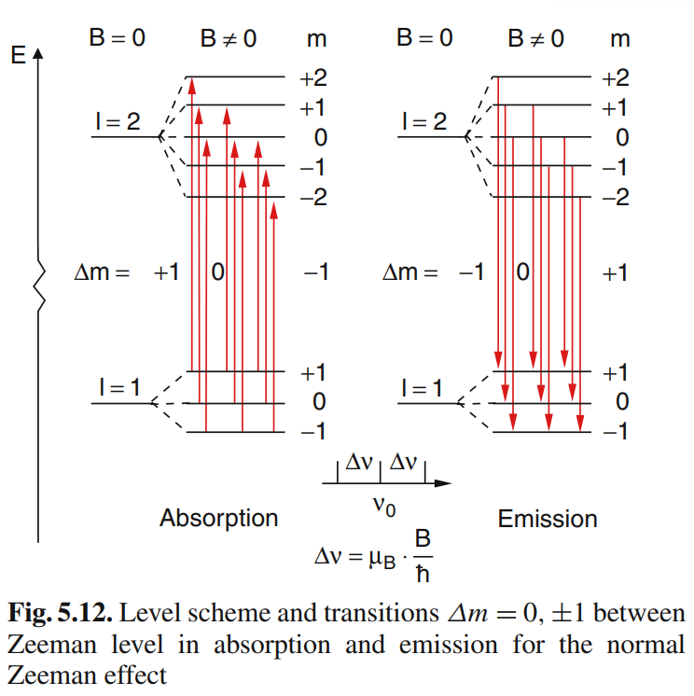
From lecture10b
3 spectral lines are detected
for normal Zeeman effect
Level scheme and transitions beween excited states l = 2 l =1
W. Demtroeder. Atoms, Molecules and Photons: An Introduction to Atomic, Molecular and Quantum Physics, 2006.

Slide 50







8.3: Anomalous Zeeman Effect
More than three closely spaced optical lines were observed.
The interaction that splits the energy levels in an external magnetic field is caused by interaction.
The magnetic moment depends on
The 2J + 1 degeneracy for a given total angular momentum state J is removed by the effect of the .
If the is small compared to internal magnetic field, then and precess about while precesses slowly about .
Orbital contribution
and
Spin magnetic moment

Slide 51
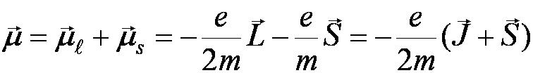
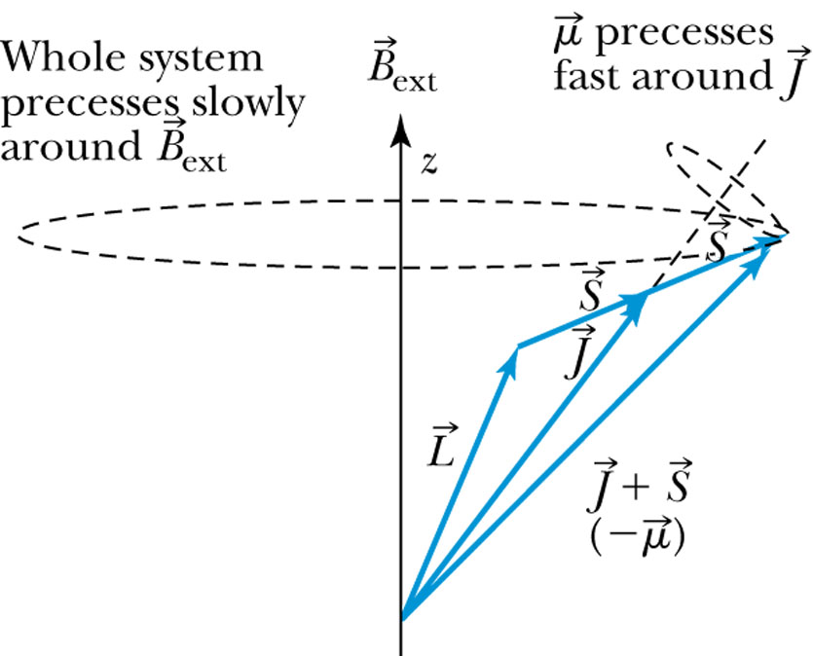
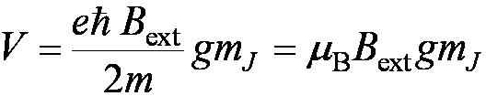
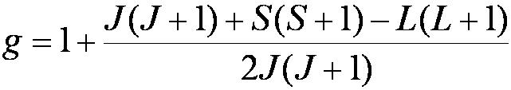

Anomalous Zeeman Effect
The total magnetic moment is
The magnetic total angular momentum numbers m_{J} from −J to J in integral steps.
splits each state J into 2J + 1 equally spaced levels separated ΔE = V.
For photon transitions between energy levels
Δm_{J} = ±1, 0 but is forbidden when ΔJ = 0.
μ_{B} is the Bohr magneton and
it is called the Landé g factor

Slide 52
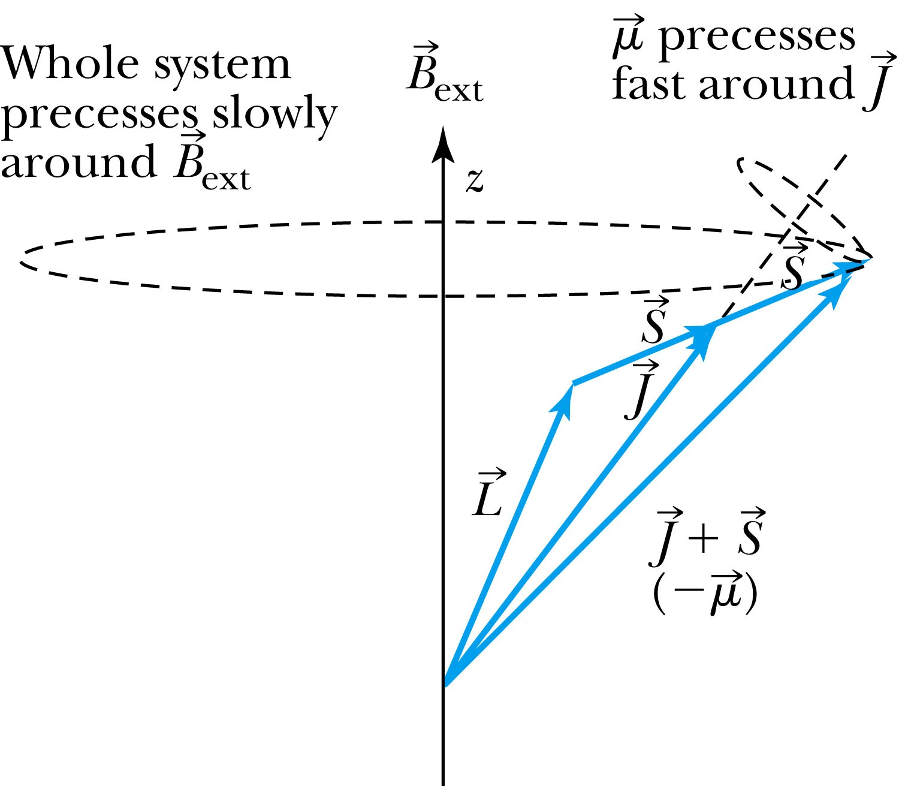
Figure 8-14 p293
Notes:
Figure 8.14 Relationships between S, L, J, and m are indicated. The vector Bext is in the z direction. The magnetic moment μ precesses fast around J as J precesses more slowly around the weak Bext.

Slide 53
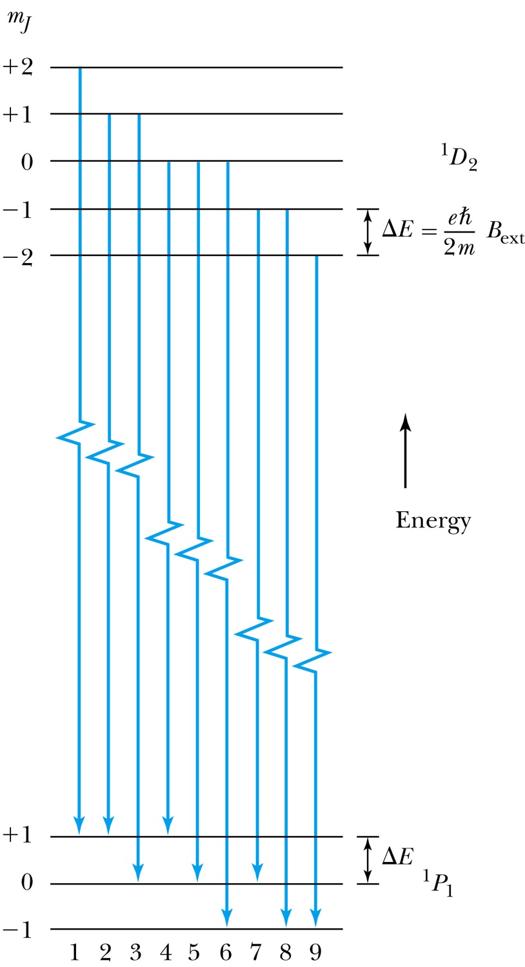
Figure 8-15 p293
Notes:
Figure 8.15 Examples of transitions for the normal Zeeman effect. The nine possible transitions are labeled, but there are only three distinctly different energies because the split energy levels are equally spaced (∆E) for both the ¹D₂ and ¹P₁ states.

Slide 54
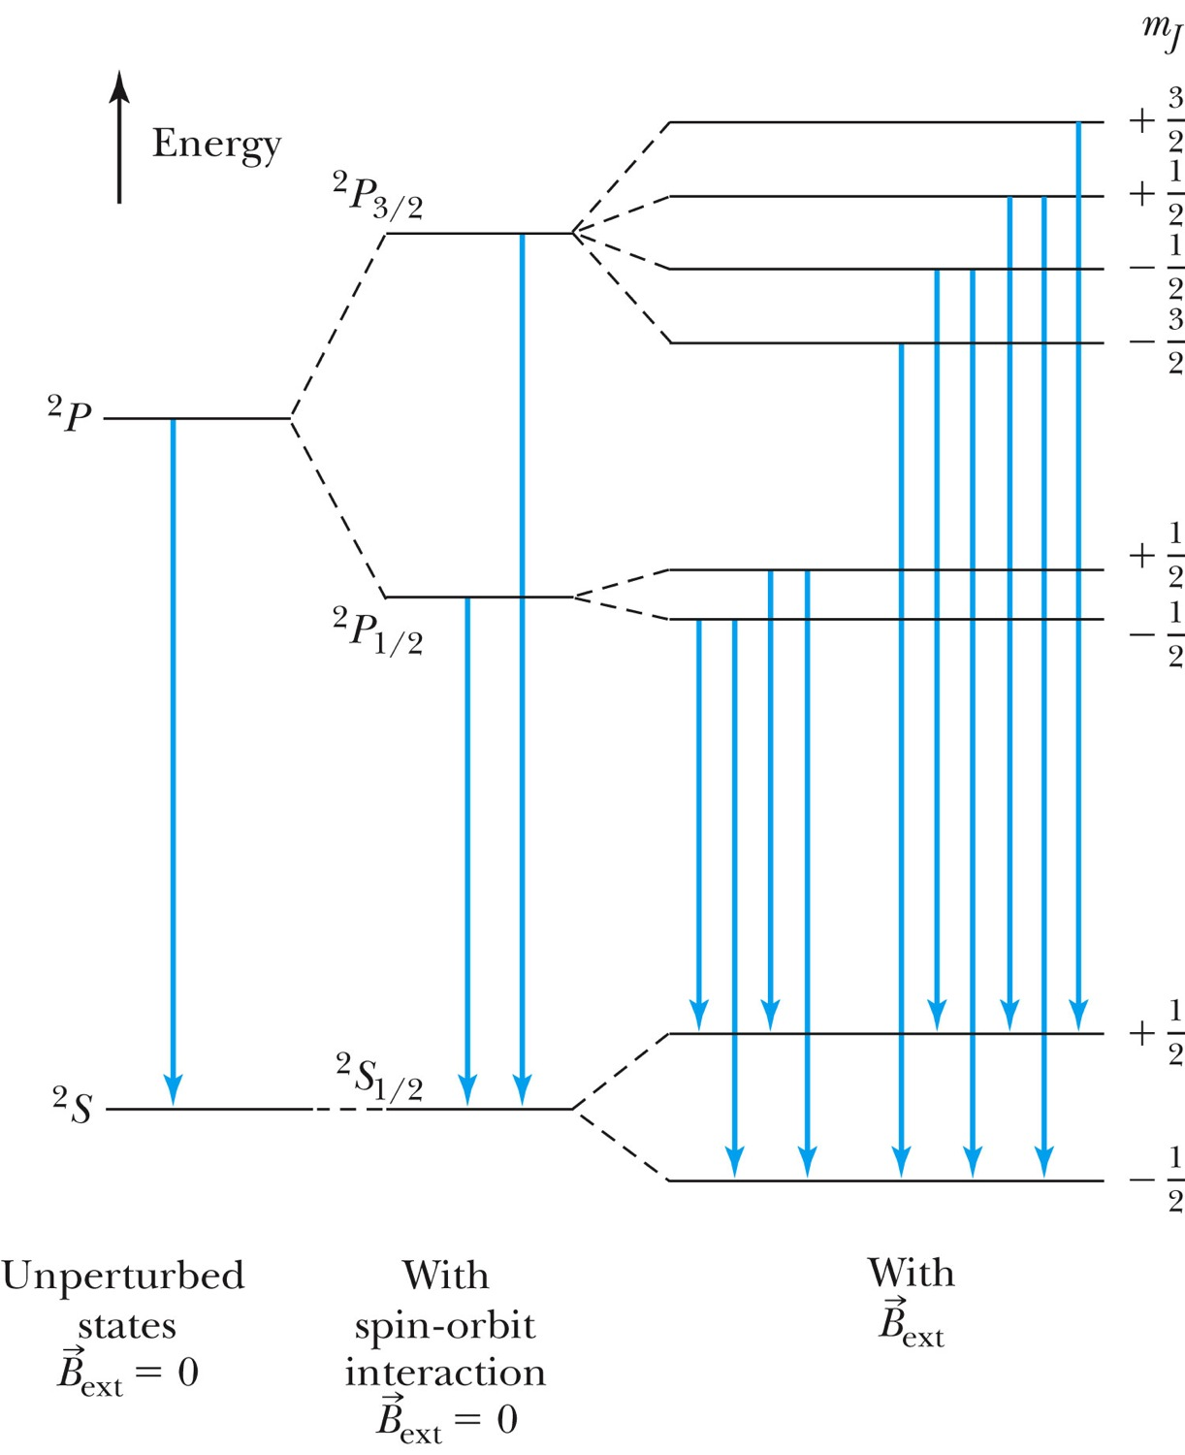
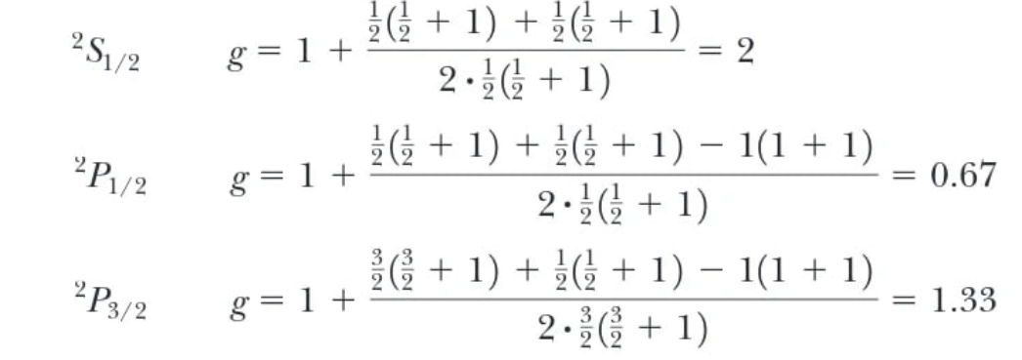
Lande g-factors
Figure 8-16 p294
Notes:
Figure 8.16 Schematic diagram of anomalous Zeeman effect for sodium (energy levels not to scale). With B_{ext} = 0 for the unperturbed states, there is only one transition. With the spin-orbit interaction splitting the 2P state into two states, there are two possible transitions when B_{ext} = 0. Finally, B_{ext} splits J into 2J + 1 components, each with a different m_{J}. The energy splitting ∆E for each major state is different because ΔE = gmJ (eh2m)B_{ext} and the Landé g factor for g[∆E(²S_{1/2})] > g[∆E(²P_{3/2})] > g[∆E(²P_{1/2})]. All allowed transitions are shown.

Slide 55
Many-Electron Atoms
:
Hund’s rules:
The total spin angular momentum S should be maximized to the extent possible without violating the Pauli exclusion principle. This is occasionally called the "bus seat rule" since it is analogous to the behaviour of bus passengers who tend to occupy all double seats singly before double occupation occurs.)
Insofar as rule 1 is not violated, L should also be maximized. This rule deals with reducing the repulsion between electrons. It can be understood from the classical picture that if all electrons are orbiting in the same direction (higher orbital angular momentum) they meet less often than if some of them orbit in opposite directions. In the latter case the repulsive force increases, which separates electrons. This adds potential energy to them, so their energy level is higher.
For atoms having subshells less than half full, J should be minimized. This rule considers the energy shifts due to spin–orbit coupling. In the case where the spin–orbit coupling is weak compared to the residual electrostatic interaction, L and S are still good quantum numbers and the splitting is given by minimizing J
For labeled two-electron atom
There are LS coupling and jj coupling to combine four angular momenta J.
In jj coupling L+S=J for each electron

Slide 56
Hund’s rules
Select all of the following which are possible sets of quantum numbers (n, ℓ, mℓ, ms) for the 2 electrons in the unfilled shell of the ground state of a carbon atom.
a. (2, −1, 1, 1/2), (2, −1, 0, 1/2)
b. (2, 1, −1, −1/2), (2, 1, 0, 1/2)
c. (2, 1, −1, 1/2), (2, 1, 0, 1/2)
d. (2, 1, 1, 1/2), (2, 1, 0, 1/2)
See EXAMPLE 8.9
Notes:
C is correct

Slide 57
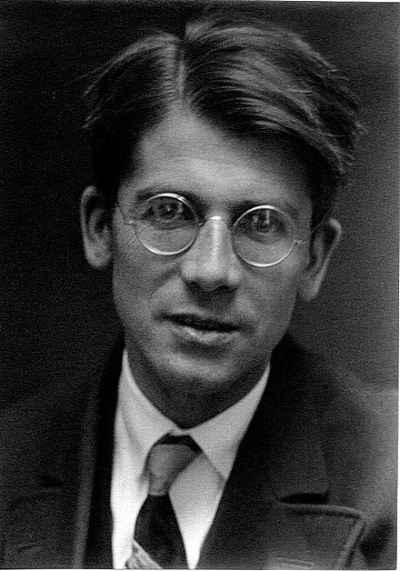
Born 4 February 1896
Karlsruhe
Died 31 March 1997 (aged 101)
Göttingen
Nationality German
Awards Max Planck Medal (1943)
Otto Hahn Prize for Chemistry and Physics (1974)
Scientific career
Fields Physics
Doctoral advisor Max Born
Doctoral students Harry Lehmann
Carl Friedrich von Weizsäcker
Jürgen Schnakenberg
Edward Teller

Slide 58
What are S, L, and J for the following states?
 | S | L | J
¹S₀ | 0 | 0 | 0
²P_{1/2} | 1/2 | 1 | 1/2
²G_{7/2} | 1/2 | 4 | 7/2
⁵F₁ | 2 | 3 | 1

Slide 59
Select all of the following which are possible sets of quantum numbers (n, ℓ, m_{ℓ}, m_{s}) for the 2 electrons in the unfilled shell of the ground state of a zirconium atom.
correct (4, 2, -2, 1/2), (4, 2, -1, 1/2)
(4, -2, 2, -1/2), (4, -2, 1, -1/2)
correct (4, 2, 2, -1/2), (4, 2, 1, -1/2)
(4, 2, 2, 1/2), (4, 2, 1, 1/2)
[Kr] 4d² 5s²

Slide 60
Apply the periodic table
What is the number of electrons in zirconium?
40 electrons
Zirconium has 40 electrons and 40 protons, so this picture has 40 electrons separated into the different levels.

Slide 61
Hund’s rules
Select all of the following which are possible sets of quantum numbers (n, ℓ, m_{ℓ}, m_{s}) for the 1 electron in the unfilled shell of the ground state of an aluminum atom.
  Al
correct (3, 1,1, -1/2)
Not correct(3, 1, -1, -1/2),
Not correct (3, 1, 1, 1/2)
correct (3, 1, -1, 1/2

Slide 62
Hund’s rules
Select all of the following which are possible sets of quantum numbers (n, ℓ, mℓ, ms) for the 3 electrons in the unfilled shell of the ground state of a vanadium atom.
(2, 2, 2, 1/2), (2, 2, 1, 1/2), (2, 2, 0, 1/2)
(3, -2, 2, -1/2), (3, -2, 1, -1/2), (3, -2, 0, -1/2)
correct (3, 2, 2, -1/2), (3, 2, 1, -1/2), (3, 2, 0, -1/2)
correct (3, 2, -2, 1/2), (3, 2, -1, 1/2), (3, 2, 0, 1/2)

Slide 63
Hund’s rules
Select all of the following which are possible quantum numbers (n, ℓ, mℓ, ms) for the electron in the unfilled shell of the ground state of a scandium atom.
correct (3, 2, -2, 1/2)
(3, -2, 2, -1/2)
(3, -2, 2, 1/2)
(3, 2, -2, -1/2)

Slide 64
Hund’s rules
Select all of the following which are possible sets of quantum numbers (n, ℓ, mℓ, ms) for the 3 electrons in the unfilled shell of the ground state of a phosphorus atom.
(2, 1, 1, 1/2), (2, 1, 0, 1/2), (2, 1, -1, 1/2)
correct (3, 1, -1, 1/2), (3, 1, 0, 1/2), (3, 1, 1, 1/2)
correct (3, 1, 1, -1/2), (3, 1, 0, -1/2), (3, 1, -1, -1/2)
(3, -1, 1, -1/2), (3, -1, 0, -1/2), (3, -1, -1, -1/2)

Slide 65
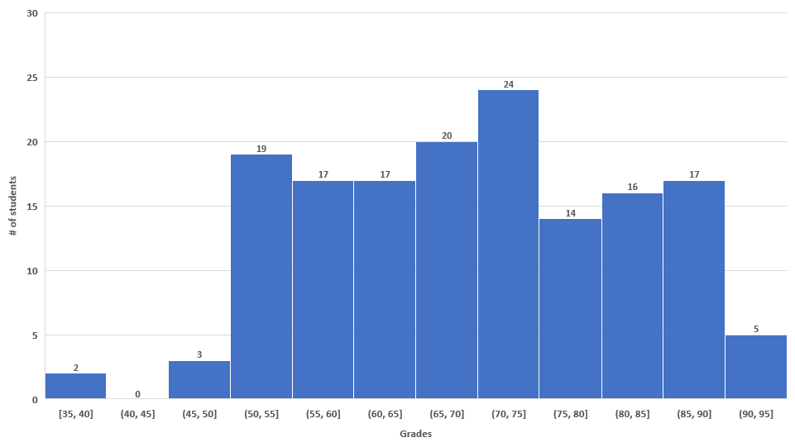
PHYS222-Fall2022
Exam III
N = 154
AVG: 72
A = 80 - 100
B = 65 - 79
C = 50 - 64
D = 45 - 49
F < 45

