Slide 1
Final Exam Review

Slide 2
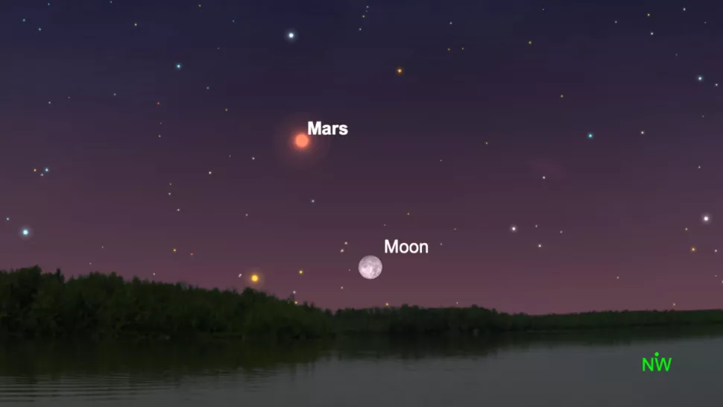
Lunar occultation of Mars
The Moon will pass in front of Mars, creating a lunar occultation visible from parts of the Americas, Europe and Northern Africa.
Lunar occultations are only ever visible from a small fraction of the Earth's surface. Since the Moon is much closer to the Earth than other celestial objects,
this occasion, the occultation will be visible from College Station. It will begin with theOn disappearance of Mars behind the Moon at 21:01 CSTin the eastern sky at an altitude of 47.1 degrees. Its reappearance will be visible at 21:15 CSTat an altitude of 50.1 degrees.
An illustration of the night sky on Dec. 07 showing the full Cold Moon occulting Mars

Slide 3
Topics and What to Study
Exam time and date: Friday, Dec. 9th from 7:30am to 9:30am on Canvas
Exam will be made up of 30 multiple choice questions
Not all questions worth the same amount of points
Majority of content will come from most recent chapters
Remaining content will come from rest of the semester
Review previous final exam posted on SIBOR
Use study guide given on SIBOR

Slide 4

1. A large Michelson interferometer consisting of orthogonal optical cavities, where each cavity has a length of 10 km is used to detect gravitational waves. The maximum amplitude of strain (or fractional change in length) measured by the detectors was 10⁻²¹. What was the maximum change in length (in m) of the optical cavity due to the gravitational wave? (For comparison, the radius of a proton is about 10⁻¹⁵ m.)
10km
ΔL = 10⁻²¹ _{(Not to scale)}
$\frac{∆L}{L}={10}^{−21}$= A
10km
$$∆L=A∗L$$
$∆L={10}^{−21}∗{10}^{4}$(m)
$$∆L={10}^{−17}(m)$$

Slide 5
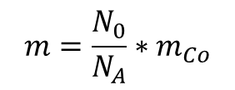

2. A radioactive sample of ⁶⁰Co (t_{1/2} = 5.271y) has a β⁻ activity of 2 x 10⁷ Bq. How many grams of ⁶⁰Co are present?
$$λ=\frac{ln⁡(2)}{t_{1/2}}$$
$$K=λ∗N_{0}$$
$$K=\frac{ln⁡(2)}{t_{1/2}}∗N_{0}$$
$$m=\frac{N_{0}}{N_{A}}∗m_{Co}$$
$$N_{0}=\frac{t_{1/2}}{\ln\left(2\right)}∗K$$
$t_{1/2}$= 5.271 y = 1.662E8 s
$K$= 2E7 Bq = 2E7 particle/s
$$N_{0}=\text{4.796}\text{E}\text{15}$$
$N_{A}$= 6.023E23 atoms/mole
$m=\frac{N_{0}}{N_{A}}∗$ $m_{Co}$
$m=\text{4.77}\text{8}\text{E}\text{−7}$ g

Slide 6
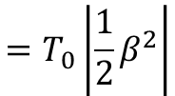
3. An airplane flies at 300 m/s with an altitude of 10⁴ m and circles the world. It flies for a total of 45 hours. Calculate the gravitational red shift of a clock on the airplane assuming the airplane speed remains 300 m/s. Assume the circumference of the earth is 4E7 (m), the acceleration due to gravity is 9.8 m/s², and the speed of light c=3E8 m/s.
$$Gravitation redshift: \frac{∆T}{T}=\frac{g∗H}{c^{2}}$$
General form:
$$\frac{Δf}{f}=\frac{ΔT}{T}=\frac{GM}{c^{2}}\left(\frac{1}{r_{2}}−\frac{1}{r_{1}}\right)$$
$$\frac{∆T}{T}=\frac{g∗H}{c^{2}}=1.09E−12$$
H = 10⁴ m
$$∆T=T∗1.09E−12$$
T = 45 hr = 1.62E5 s
$∆T=$ 177E-9 s
Approximation by Power Series
$$\sqrt{1−β^{2}}≈1−\frac{1}{2}β^{2}$$
Special Relativity Time Dilation:
$$T_{p}=\frac{T_{0}}{γ}$$
$$ΔT=\left|T_{0}−T_{p}\right|$$
D = 4E7m
$$v=\frac{D}{T}$$
$$=\left|T_{0}−T_{0}\left(\sqrt{1−β^{2}}\right)\right|$$
V=300 m/s
$$=T_{0}\left|1−\left(1−\frac{1}{2}β^{2}\right)\right|$$
T₀$=\frac{D}{V}$= 1.33E5 s
$$β=\frac{3E2}{3E8}=1E−6$$
T₀$=$ 1.33E5 s
$$=T_{0}\left|\frac{1}{2}β^{2}\right|$$
$ΔT=$ 6.65E-8 s = 66.5 ns

Slide 7
4. A gravitational wave signal was the result of two black holes, orbiting around a common center of mass, which spiraled inward and merged to form a single black hole. The mass of the first black hole was 40 solar masses, and the second was 30 solar masses. The final black hole mass after the merger was 60 solar masses. The entire detected signal lasted about 20 seconds. What was the average power (in W) radiated away as gravitational waves during this time? (Take one solar mass to be 2E30 kg.)
M₁ = 40
M₂ = 30
M_{f} = 60
T = 20s
ΔM = (M₁ + M₂) – M_{f} = 10
E = mc² = (ΔM)c²
= (10*2E30 kg)*(3E8 m/s²)²
E = 1.8E48 J
P = $\frac{E}{T}=9$E46W

