Slide 1
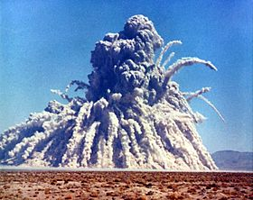
CHAPTER 12
The Atomic Nucleus
12.1 Discovery of the Neutron
12.2 Nuclear Properties
12.3 The Deuteron
12.4 Nuclear Forces
12.5 Nuclear Stability
12.6 Radioactive Decay
12.7 Alpha, Beta, and Gamma Decay
12.8 Radioactive Nuclides
13.4 Fission

Slide 2
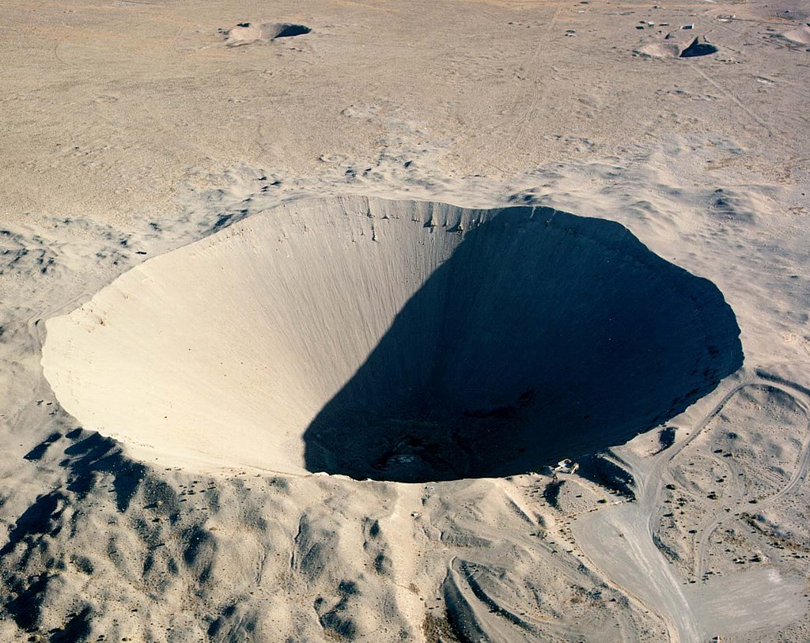
Sedan crater 1972 test Nevada National Security Site NNSS

Slide 3
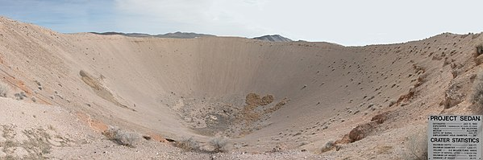
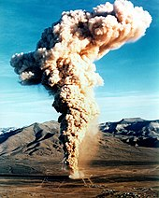
Radioactive materials were accidentally released from the 1970 Baneberry shot in Area 8.

Slide 4
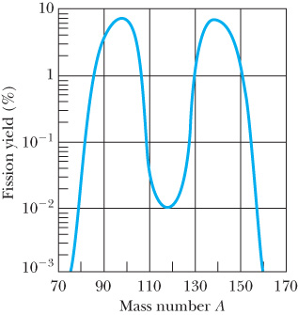
13.4: Fission
In fission a nucleus separates into two fission fragments. As we will show, one fragment is typically somewhat larger than the other.
Fission occurs for heavy nuclei because of the increased Coulomb forces between the protons.
We can understand fission by using the semi-empirical mass formula based on the liquid drop model. For a spherical nucleus of mass number A ~ 240, the attractive short-range nuclear forces offset the Coulomb repulsive term. As a nucleus becomes non-spherical, the surface energy is increased, and the effect of the short-range nuclear interactions is reduced.
Nucleons on the surface are not surrounded by other nucleons, and the unsaturated nuclear force reduces the overall nuclear attraction. For a certain deformation, a critical energy is reached, and the fission barrier is overcome.
Spontaneous fission can occur for nuclei with

Slide 5
Induced Fission
Fission may also be induced by a nuclear reaction. A neutron absorbed by a heavy nucleus forms a highly excited compound nucleus that may quickly fission.
An induced fission example is
The fission products have a ratio of N/Z much too high to be stable for their A value.
There are many possibilities for the Z and A of the fission products.
Symmetric fission (products with equal Z) is possible, but the most probable fission is asymmetric (one mass larger than the other).

Slide 6
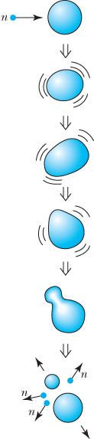
Thermal Neutron Fission
Fission fragments are highly unstable because they are so neutron rich.
Prompt neutrons are emitted simultaneously with the fissioning process. Even after prompt neutrons are released, the fission fragments undergo beta decay, releasing more energy.
Most of the ~200 MeV released in fission goes to the kinetic energy of the fission products, but the neutrons, beta particles, neutrinos, and gamma rays typically carry away 30–40 MeV of the kinetic energy.

Slide 7
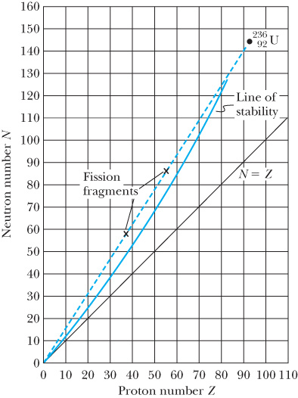
Chain Reactions (1 of 2)
Because several neutrons are produced in fission, these neutrons may subsequently produce other fissions. This is the basis of the self-sustaining chain reaction.
If at least one neutron, on the average, results in another fission, the chain reaction becomes critical.
A sufficient amount of mass is required for a neutron to be absorbed, called the critical mass.
If less than one neutron, on the average, produces another fission, the reaction is subcritical.
If more than one neutron, on the average, produces another fission, the reaction is supercritical.
  An atomic bomb is an extreme example of a supercritical fission chain reaction.

Slide 8
Chain Reactions (2 of 2)
A critical-mass fission reaction can be controlled by absorbing neutrons. A self-sustaining controlled fission process requires that not all the neutrons are prompt. Some of the neutrons are delayed by several seconds and are emitted by daughter nuclides. These delayed neutrons allow the control of the nuclear reactor.
Control rods regulate the absorption of neutrons to sustain a controlled reaction.

Slide 9
13.5: Fission Reactors
Table 13.1 Energy Content of Fuels
Material | Amount | Energy (J)
Coal | 1 kg | 3 × 10⁷
Oil | 1 barrel (0.16 m³) | 6 × 10⁹
Natural gas | 1ft³ (0.028 m³) | 10⁶
Wood | 1 kg | 10⁷
Gasoline | 1 gallon (0.0038 m³) | 10⁸
Uranium (fission) | 1 kg | 10¹⁴
Several components are important for a controlled nuclear reactor:
  Fissionable fuel
  Moderator to slow down neutrons
  Control rods for safety and to control criticality of reactor
  Reflector to surround moderator and fuel in order to contain neutrons and thereby improve efficiency
  Reactor vessel and radiation shield
  Energy transfer systems if commercial power is desired
  Two main effects can “poison” reactors: (1) neutrons may be absorbed without producing fission [for example, by neutron radiative capture], and (2) neutrons may escape from the fuel zone.
Table 13.2 Daily Fuel Requirements for 1000-MWe Power Plant
Material | Amount
Coal | 8 × 10⁶ kg | (1 trainload/day)
Oil | 40,000 barrels (6400 m³) | (1 tanker/week)
Natural gas | 2.5 × 10⁸ ft³ (7 × 10⁶ m³)
Uranium | 3 kg
MWe =megawatt ( e indicates electrical power)

Slide 10

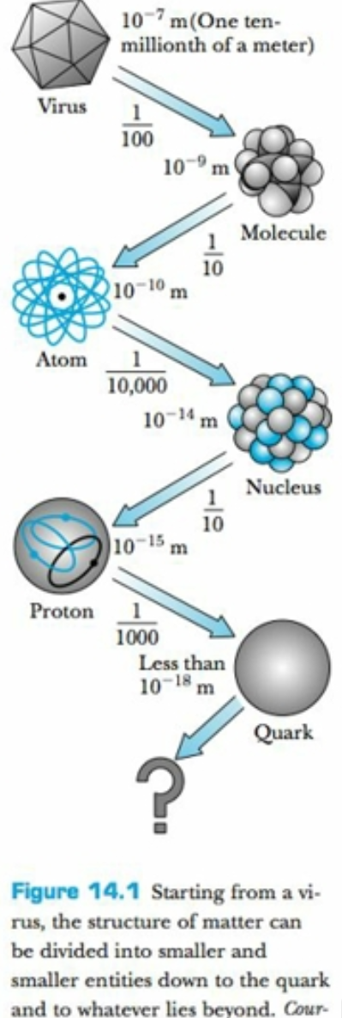
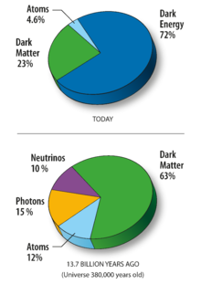
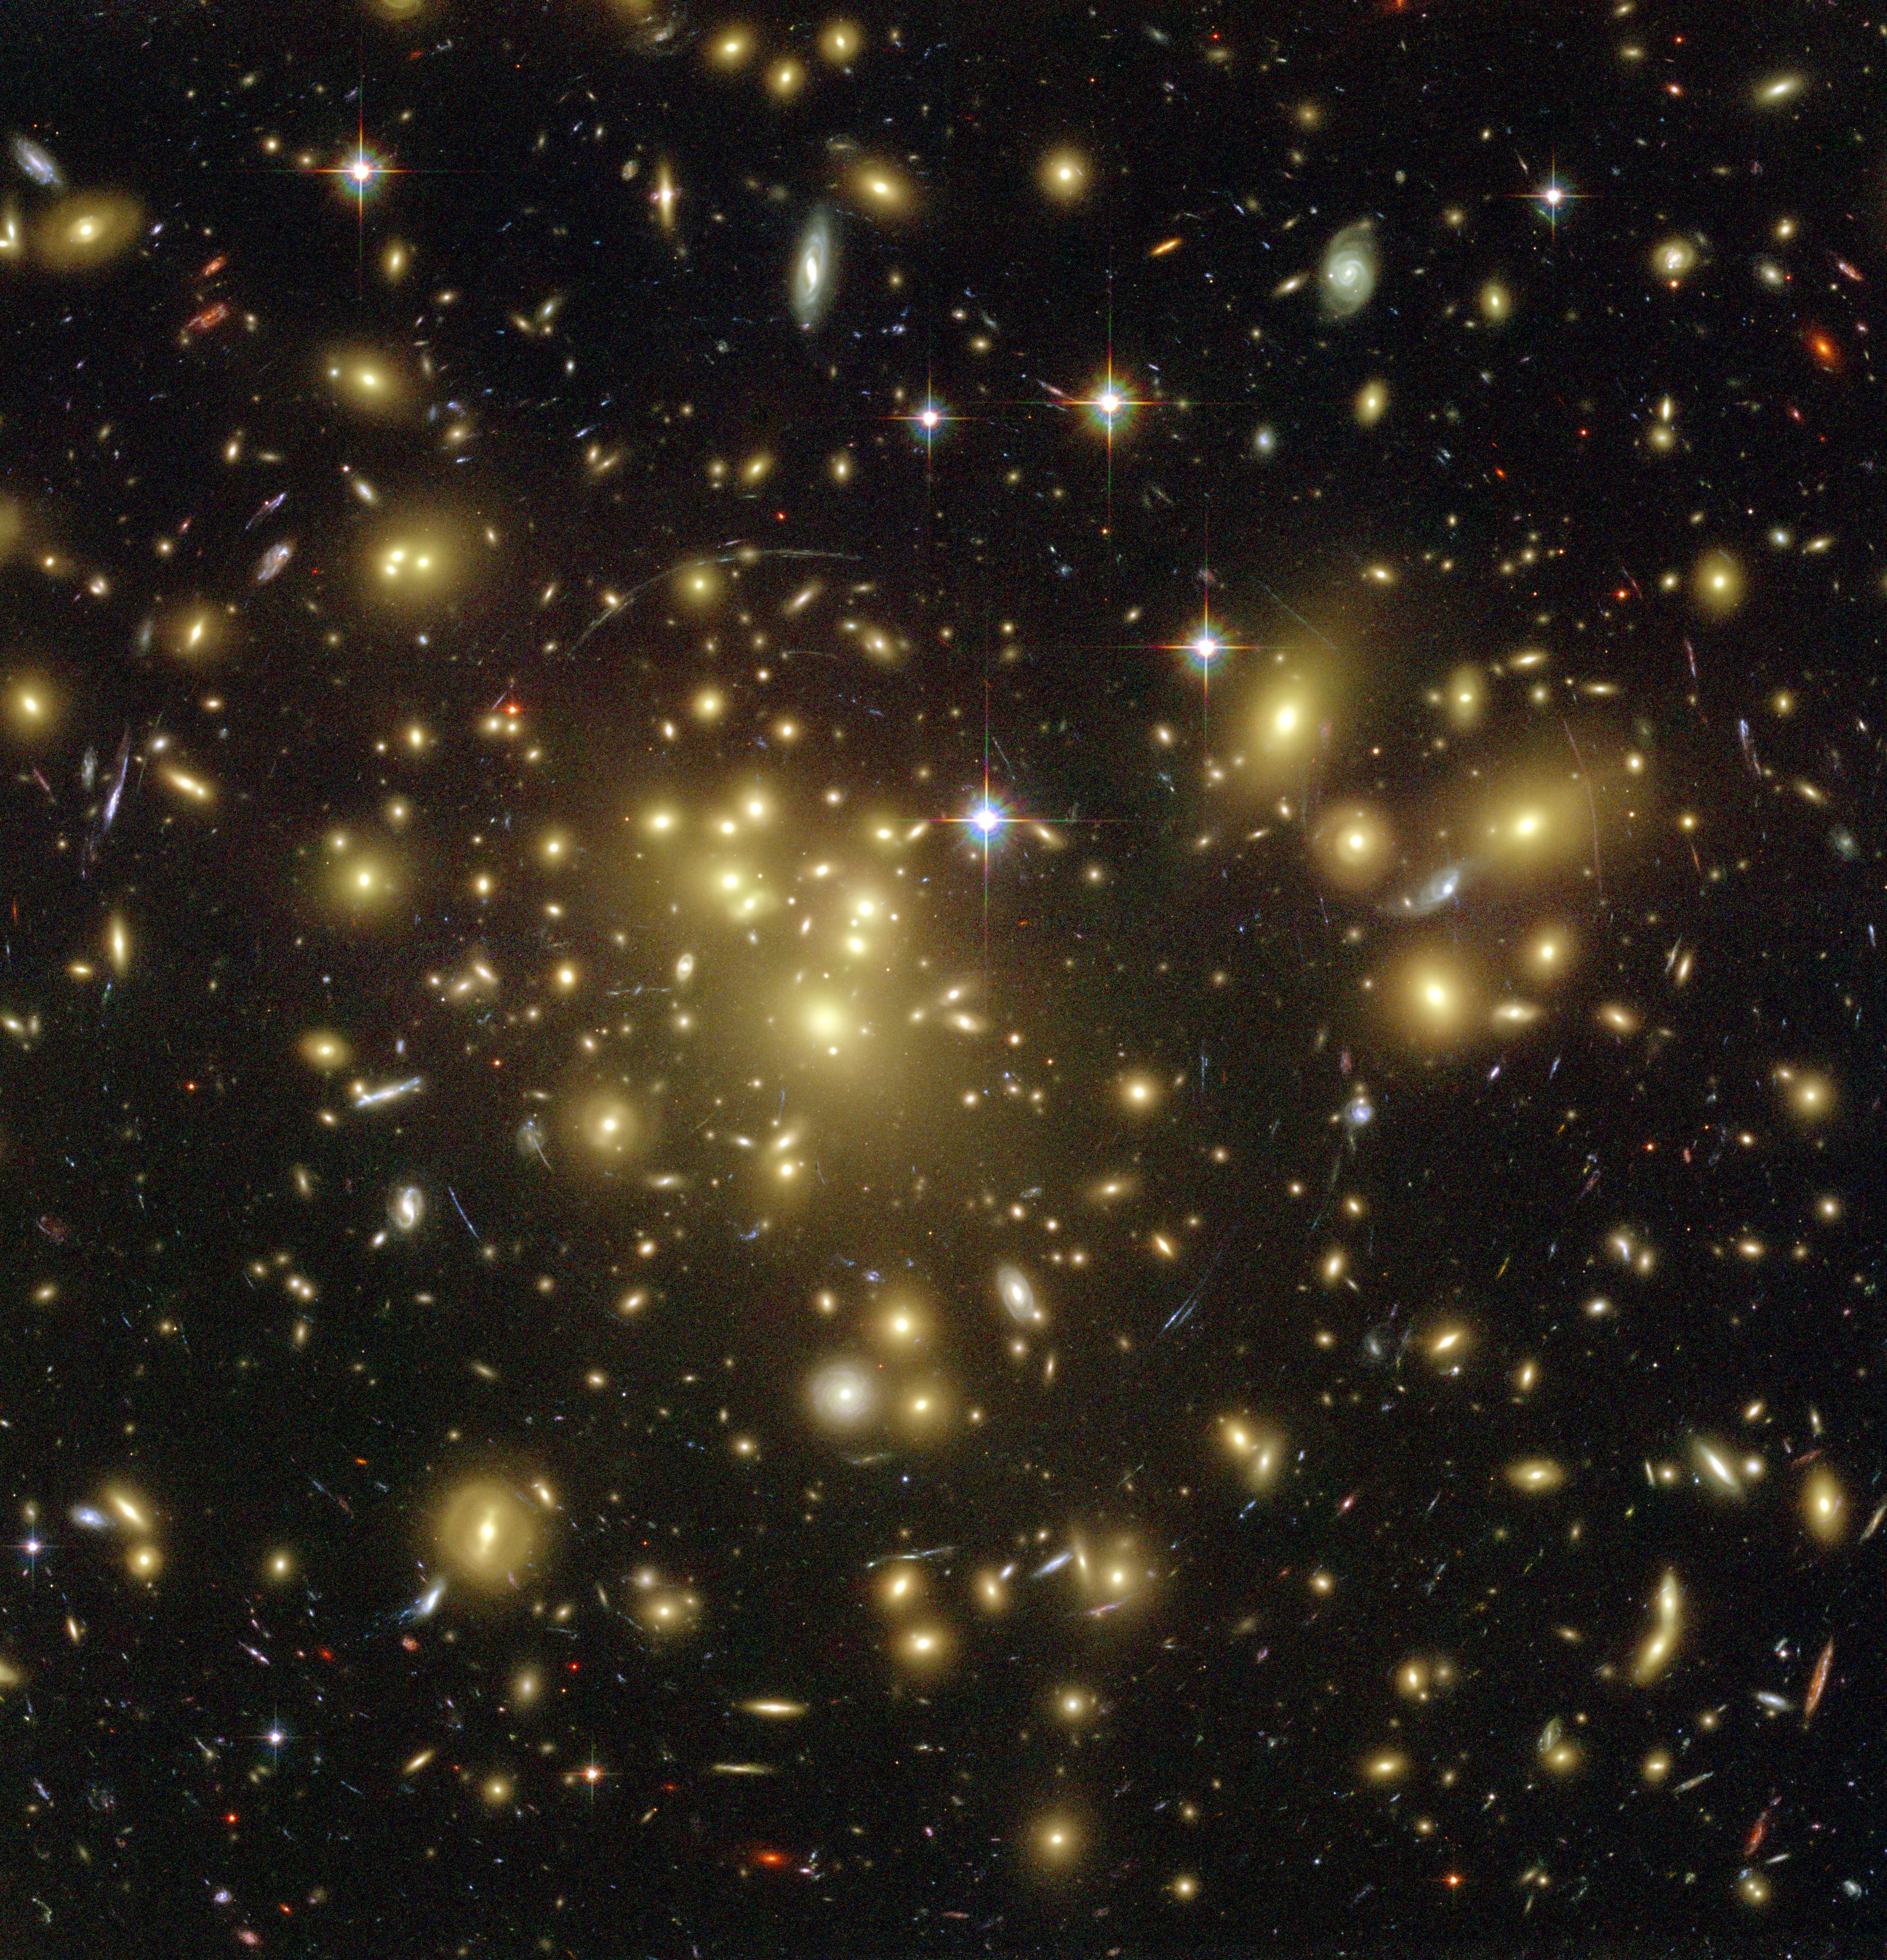
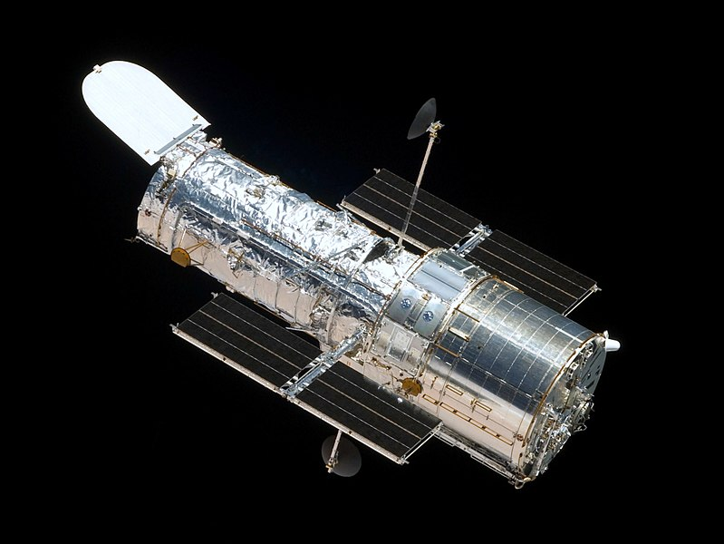
Structure of matter
Structure of matter
Dark matter and dark energy are the yin and yang of the cosmos. Dark matter produces an attractive force (gravity), while dark energy produces a repulsive force (antigravity). ... Astronomers know dark matter exists because visible matter doesn't have enough gravitational muster to hold galaxies together.

Slide 11
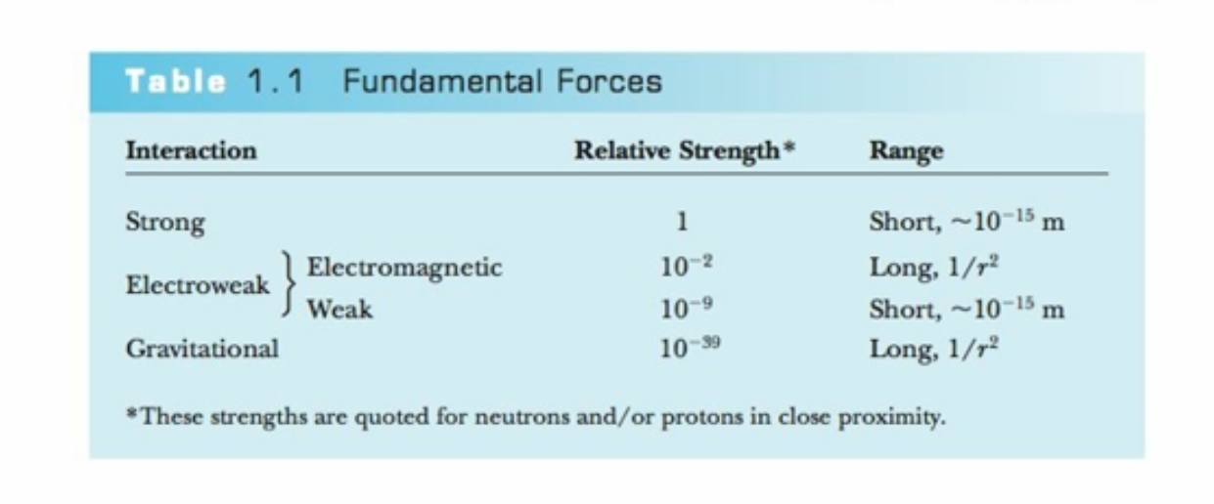
Hierarchy of forces

Slide 12
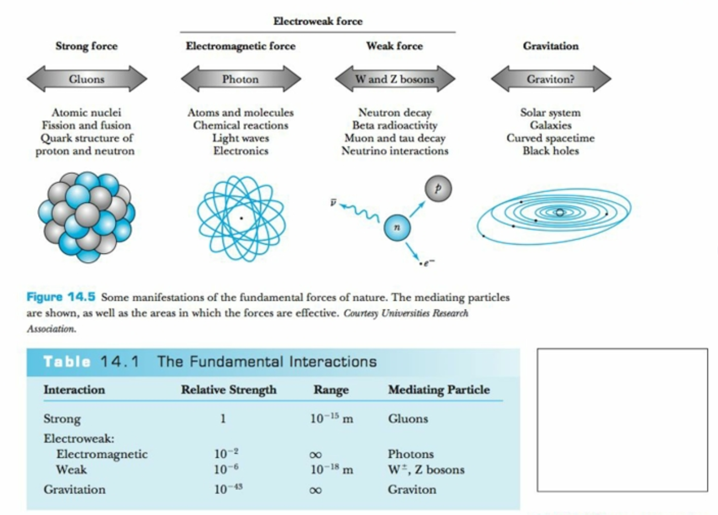
Sta
Standard Model tries to unify the forces into one force

Slide 13
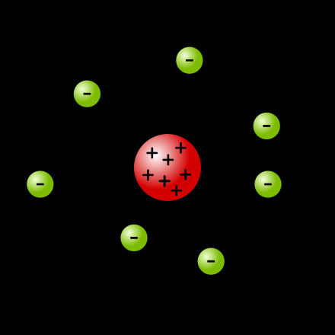
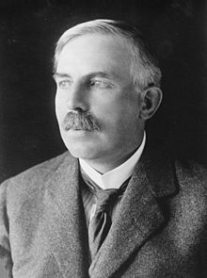
Ernest Rutherford “Father of the Nucleus”

Slide 14
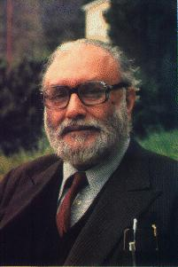
Story so far: Unification
Faraday Glashow,Weinberg,Salam Georgi,Glashow Green,Schwarz Witten
1831 1967 1974 1984 1995
Electricity }
}
} Electromagnetic force }
} }
Magnetism} } Electro-weak force }
} }
Weak nuclear force} } Grand unified force }
} } 5 Different }
Strong nuclear force} } D=10 String } M-theory
} Theories }
Gravitational force}
?
+branes in D=11

Slide 15
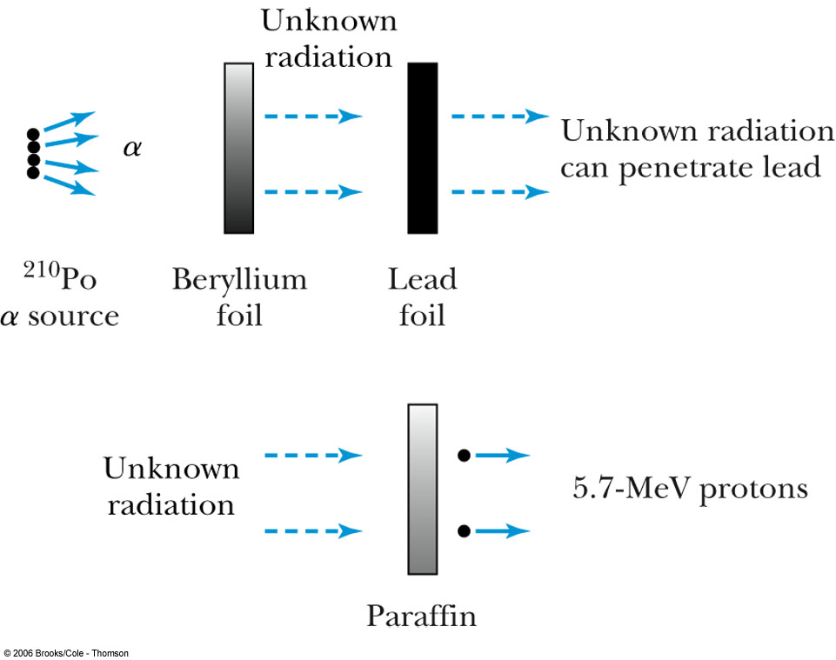
Discovery of the Neutron
Nuclear magnetic moment:
The magnetic moment of an electron is over 1000 times larger than that of a proton.
The measured nuclear magnetic moments are on the same order of magnitude as the proton’s, so an electron is not a part of the nucleus.
In 1930 the German physicists
Bothe and Becker used a
radioactive polonium source
that emitted α particles. When
these α particles bombarded
beryllium, the radiation
penetrated several centimeters
of lead.
The neutrons collide elastically with the protons of the paraffin thereby producing the5.7 MeV protons
Notes:
1. Split this slide: make the bullet with diagram a new slide.

Slide 16
Discovery of the Neutron
Photons are called gamma rays when they originate from the nucleus. They have energies on the order of MeV (as compared to X-ray photons due to electron transitions in atoms with energies on the order of KeV.)
Curie and Joliot performed several measurements to study penetrating high-energy gamma rays and the unknown radiation in particular on paraffin ( which contains H )
In 1932 Chadwick proposed that the new radiation produced by α + Be consisted of neutrons. His experimental data estimated the neutron’s mass as somewhere between 1.005 u and 1.008 u, not far from the modern value of 1.0087 u.
Notes:
1. Rewrote bullet 1 as above.

Slide 17
12.2: Nuclear Properties
The nuclear charge is +e times the number (Z) of protons.
Hydrogen’s isotopes:
  Deuterium: Heavy hydrogen; has a neutron as well as a proton in its nucleus
  Tritium: Has two neutrons and one proton
The nuclei of the deuterium and tritium atoms are called deuterons and tritons.
Atoms with the same Z, but different mass number A, are called isotopes.

Slide 18

Nuclear Properties
The symbol of an atomic nucleus is .
where Z = atomic number (number of protons)
N = neutron number (number of neutrons)
A = mass number (Z + N)
X = chemical element symbol
Each nuclear species with a given Z and A is called a nuclide.
Z characterizes a chemical element.
The dependence of the chemical properties on N is negligible.
Nuclides with the same neutron number are called isotones and the same value of A are called isobars.
Notes:
1. Fixed spacing between last 2 bullets.

Slide 19
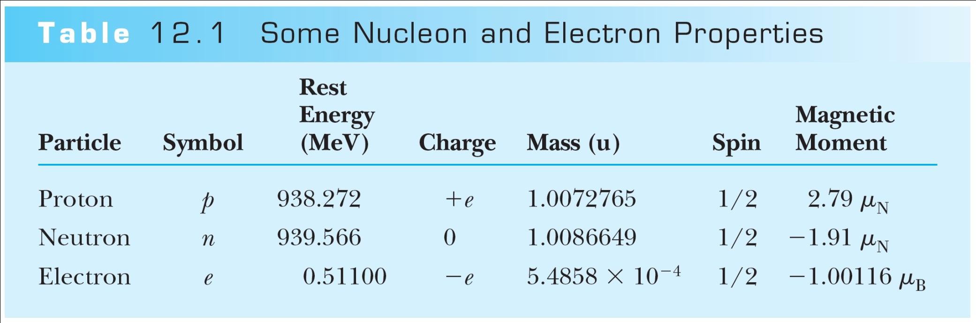
Nuclear Properties
Atomic masses are denoted by the symbol u.
1 u = 1.66054 × 10⁻²⁷ kg = 931.49 MeV/c²
Both neutrons and protons, collectively called nucleons, are constructed of other particles called quarks.

Slide 20
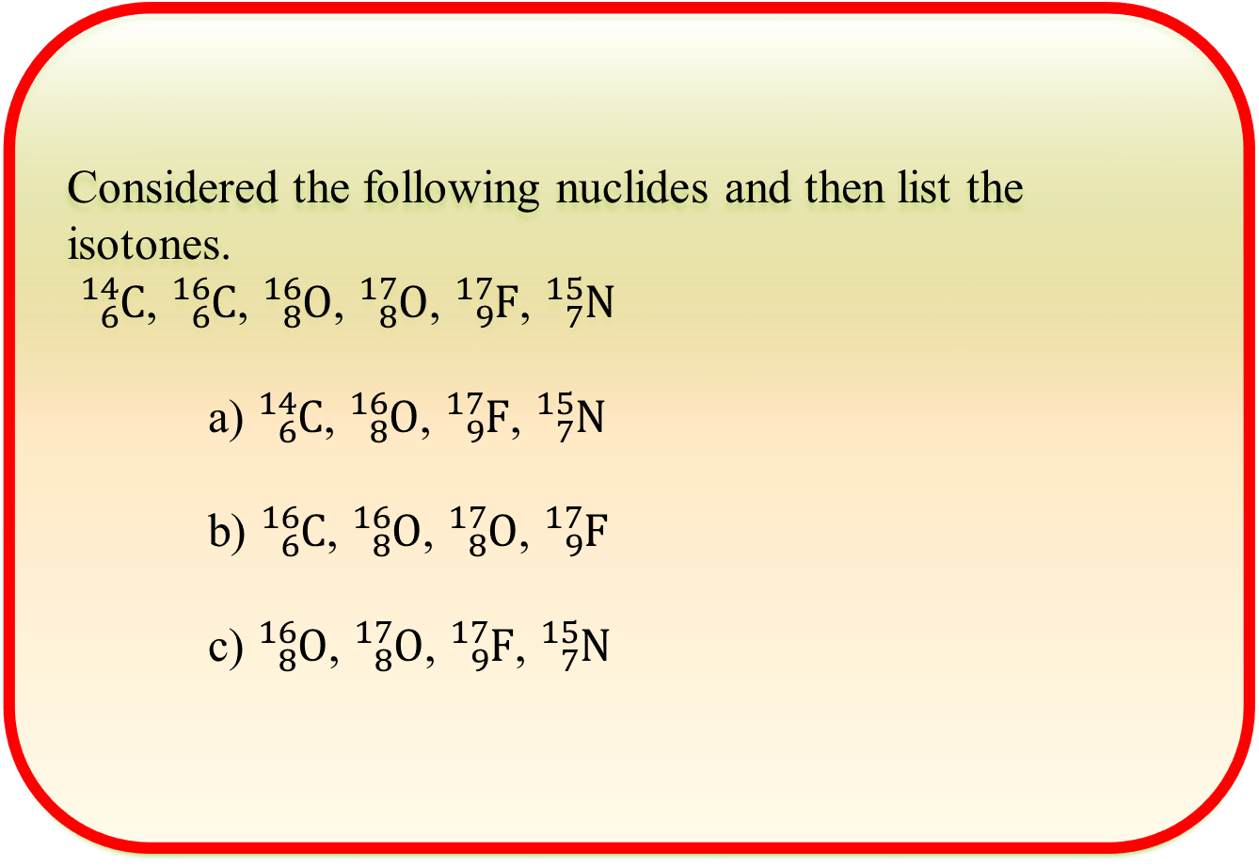
Clicker - Questions

Slide 21
From chapter12 quiz
The nuclear force can be all of the following EXCEPT:
a. short-range
b. saturable
c. spin dependent
d. charge dependent

Slide 22
Sizes and Shapes of Nuclei
Rutherford concluded that the range of the nuclear force must be less than about 10⁻¹⁴ m.
Assume that nuclei are spheres of radius R.
Particles (electrons, protons, neutrons, and alphas) scatter when projected close to the nucleus.
It is not obvious whether the maximum interaction distance refers to the nuclear size (matter radius), or whether the nuclear force extends beyond the nuclear matter (force radius).
The nuclear force is often called the strong force.
Nuclear force radius ≈ mass radius ≈ charge radius

Slide 23
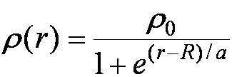
Sizes and Shapes of Nuclei
The nuclear radius may be approximated to be R = r₀A^{1/3}
where r₀ ≈ 1.2 × 10⁻¹⁵ m.
We use the femtometer with 1 fm = 10⁻¹⁵ m, or the fermi.
The lightest nuclei by the Fermi distribution for the nuclear charge density ρ(r) is

Slide 24
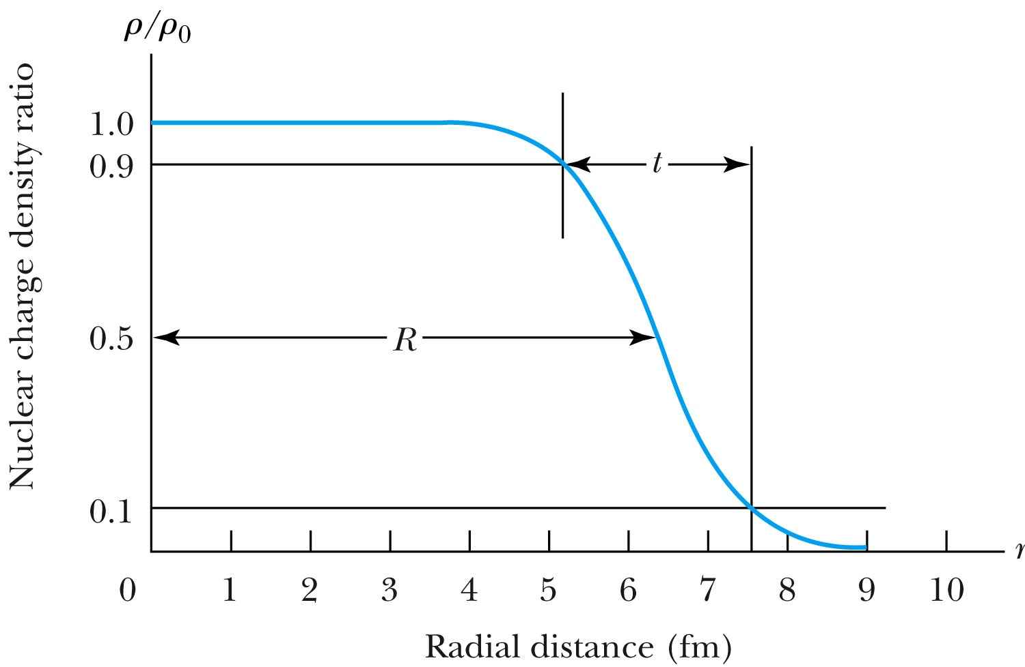
Sizes and Shapes of Nuclei
The shape of the Fermi distribution

Slide 25
Nuclear Density and Intrinsic Spin
Nuclear Density: If we approximate the nuclear shape as a sphere, then we have: the nuclear mass density (mass/volume) can be determined from (Au/V) to be
2.3 x 10¹⁷ kg/m³.
Intrinsic Spin: The neutron and proton are fermions with spin quantum numbers s = ½. The spin quantum numbers are those previously learned for the electron (see Chapter 7).
The density for any typical nucleus, in terms of mass number, is thus constant, not dependent on A or r, theoretically:
What is the ratio of the density of the nucleus to that of water? Water density 1g/cm^3
convert 2.3 x 10¹⁷ kg/m³ to g/ cm³
The nucleus is 10¹⁴ times denser than water
Notes:
Add this slide.

Slide 26
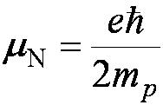
Intrinsic Magnetic Moment
The proton’s intrinsic magnetic moment points in the same direction as its intrinsic spin angular momentum.
Nuclear magnetic moments are measured in units of the nuclear magneton μ_{N}.
The divisor in calculating μ_{N} is the proton mass m_{p}, which makes the nuclear magneton some 1836 times smaller than the Bohr magneton.
The proton magnetic moment is μ_{p} = 2.79μ_{N}.
The magnetic moment of the electron is μ_{e} = −1.00116μ_{B}.
The neutron magnetic moment is μ_{n} = −1.91μ_{N}.
The nonzero neutron magnetic moment implies that the neutron has negative and positive internal charge components at different radii.
Complex internal charge distribution.

Slide 27
Nuclear Magnetic Resonance (NMR)
A widely used medical application using the nuclear magnetic moment's response to large applied magnetic fields.
Although NMR can be applied to other nuclei that have intrinsic spin, proton NMR is used more than any other kind.
Notes:
Add tjhis slide

Slide 28
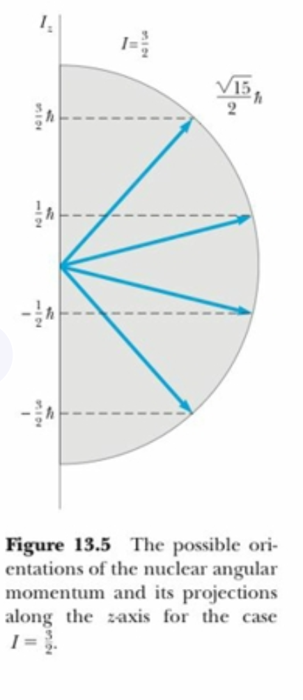
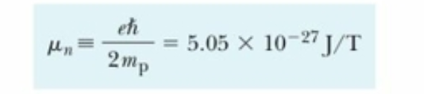
Nuclear magnetic moment for a nucleus with I= 3/2

Slide 29
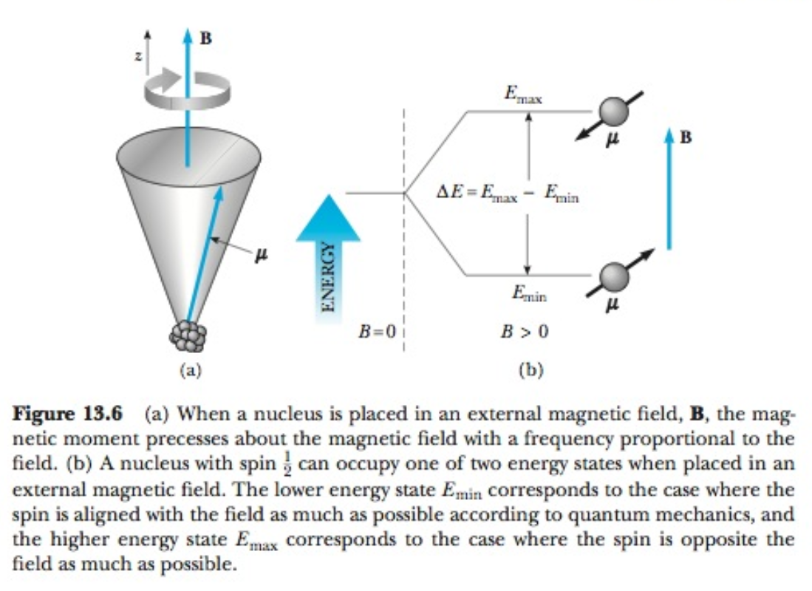
Nuclear magnetic resonance and imaging

Slide 30
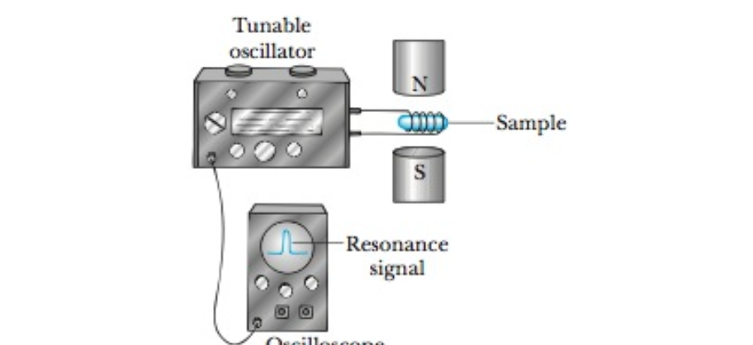
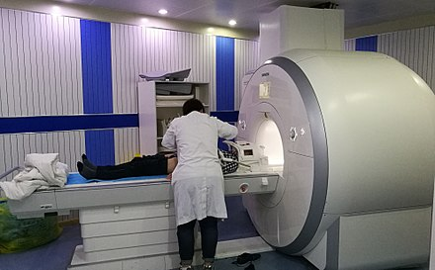
NMR apparatus

Slide 31
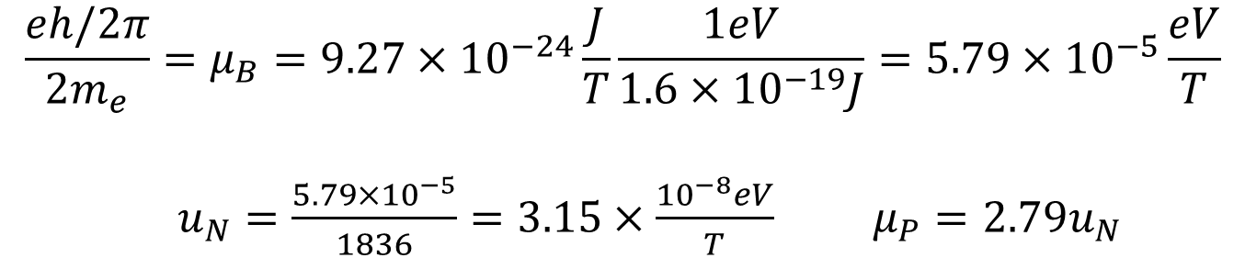
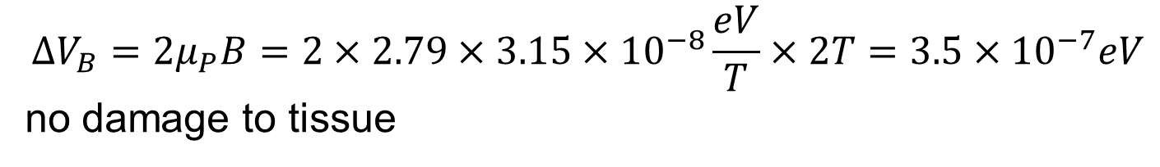
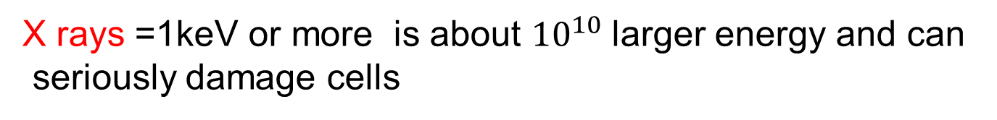
Compare NMR with X-rays
Appendix 7
NMR at magnetic field of 2T
Find the energy difference between the two nuclear spin orientations

Slide 32
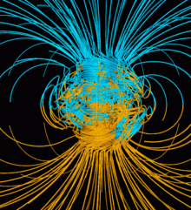
Compare the magnetic fields of NMR and earth
Earth's magnetic field, also known as the geomagnetic field, is the magnetic field that extends from the Earth's interior out into space, where it meets the solar wind, a stream of charged particles emanating from the Sun. Its magnitude at the Earth's surface ranges from 25 to 65 micro teslas (0.25 to 0.65 gauss).
Earth's magnetic field - Wikipedia

Slide 33


12.3: The Deuteron
See Particle masses for calculations
The determination of how the neutron and proton are bound together in a deuteron.
The deuteron mass = 2.013553 u
The mass of a deuteron atom = 2.014102 u
The difference = 0.000549 u; the mass of an electron
The deuteron nucleus is bound by a mass-energy B_{d}
The mass of a deuteron is
Add an electron mass to each side of Eq. (12.6)
1 u = 1.66054 × 10⁻²⁷ kg = 931.49 MeV/c²
(electron binding energy=13.6 eV can be neglected)

Slide 34

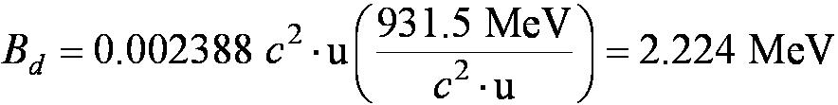
The Deuteron
m_{d} + m_{e} is the atomic deuterium mass M(²H) and m_{p} + m_{e} is the atomic hydrogen mass. Thus Eq.(12.7) becomes
Because the electron masses cancel in almost all nuclear-mass difference calculations, we use atomic masses rather than nuclear masses.
Convert this to energy using u = 931.5 MeV / c²
Even for heavier nuclei we neglect the electron binding energies (13.6 eV) because the nuclear binding energy (2.2 MeV) is almost one million times greater.
Use upper case M for atomic,lower case m for nuclear masses
See Appendix 8 Atomic mass tables

Slide 35



The Deuteron
The binding energy of any nucleus = the energy required to separate the nucleus into free neutrons and protons.
Experimental Determination of Nuclear Binding Energies
Check the 2.22-MeV binding energy by using a nuclear reaction. We scatter gamma rays from deuteron gas and look for the breakup of a deuteron into a neutron and a proton:
This nuclear reaction is called photo disintegration or a photo nuclear reaction.
The mass-energy relation is
where hf is the incident photon energy.
K_{n} and K_{p} are the neutron and proton kinetic energies.

Slide 36
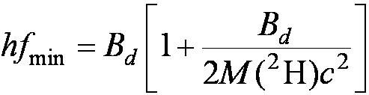

The Deuteron
The minimum energy required for the photodisintegration:
Momentum must be conserved in the reaction (K_{n}, K_{p} ≠ 0)
Experiment shows that a photon of energy less than 2.22 MeV cannot dissociate a deuteron
Deuteron Spin and Magnetic Moment
Deuteron’s nuclear spin quantum number is 1. This indicates the neutron and proton spins are aligned parallel to each other.
The nuclear magnetic moment of a deuteron is 0.86μ_{N} ≈ the sum of the free proton and neutron 2.79μ_{N} − 1.91μ_{N} = 0.88μ_{N} .(supporting parallel spins)

Slide 37
From chapter12 quiz
The mass of the deuteron
a. is exactly the sum of the neutron and proton mass.
b. is slightly less than the sum of the neutron and proton mass.
c. is exactly 2.000000 u.
d. is exactly the sum of a neutron, proton, and electron mass.

Slide 38
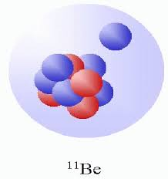
Halo –nucleus ( a nuclear hydrogen atom)
A. Takamine, M. Wada, K. Okada, T. Sonoda, P. Schury, T. Nakamura, Y. Kanai, T. Kubo, I. Katayama, S. Ohtani, H. Wollnik, and H. A. Schuessler
Hyperfine Structure Constant of the Neutron Halo Nucleus 11Be+
Phys. Rev. Lett. 112, 162502 (2014).
The short range strong nuclear force causes the halo neutron to be 7 fm outside the nucleus
half life 13.8 s

Slide 39
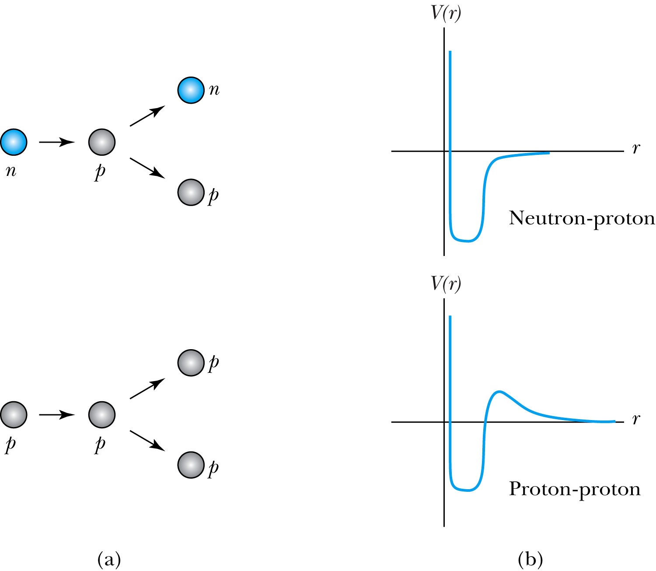
12.4: Nuclear Forces
The angular distribution of neutron classically scattered by protons.
Neutron + proton (np) and proton + proton (pp) elastic
The nuclear potential

Slide 40
Nuclear Forces
The internucleon potential has a “hard core” that prevents the nucleons from approaching each other closer than about 0.4 fm.
The proton has charge radius up to 1 fm.
Two nucleons within about 2 fm of each other feel an attractive force.
The nuclear force (short range):
It falls to zero so abruptly with interparticle separation. stable
The interior nucleons are completely surrounded by other nucleons with which they interact.
The only difference between the np and pp potentials is the Coulomb potential shown for r ≥ 3 fm for the pp force.

Slide 41
Nuclear Forces
The nuclear force is known to be spin dependent.
The neutron and proton spins are aligned for the bound state of the deuteron, but there is no bound state with the spins antialigned.
The nn system is more difficult to study because free neutrons are not stable from analyses of experiments.
The nuclear potential between two nucleons seems independent of their charge (charge independence of nuclear forces).
The term nucleon refers to either neutrons or protons because the neutron and proton can be considered different charge states of the same particle.

Slide 42
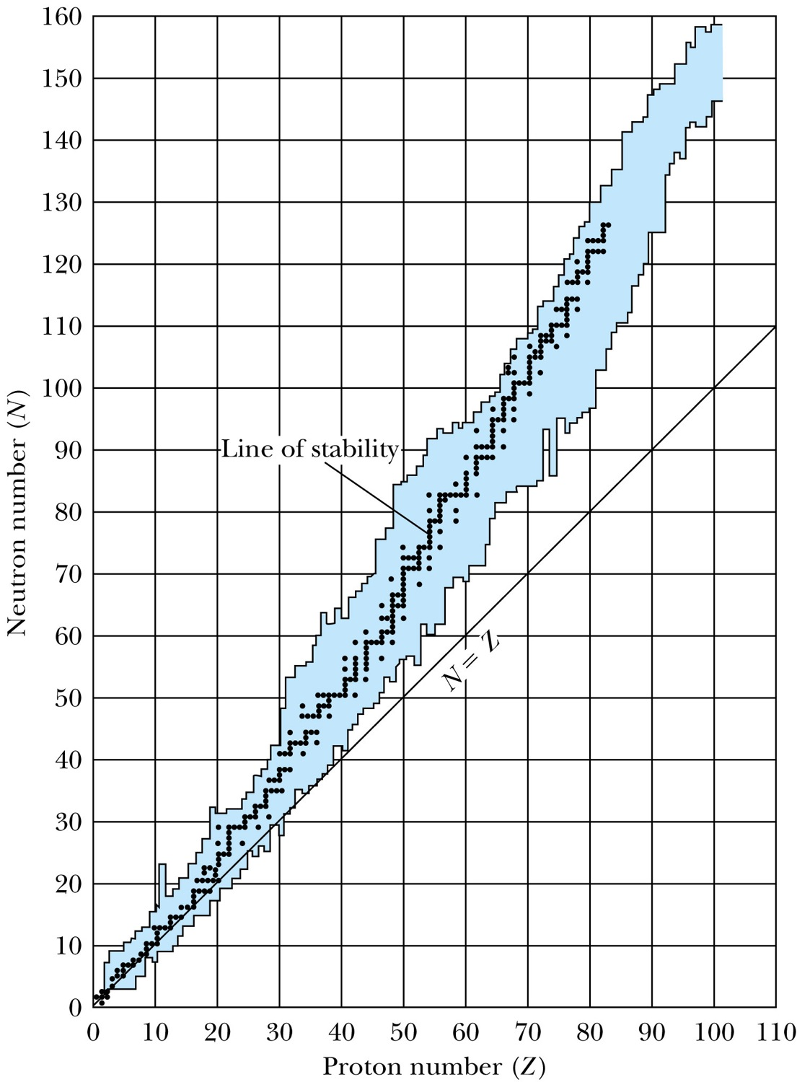

12.5: Nuclear Stability
The binding energy of a nucleus against dissociation into any other possible combination of nucleons. Ex. nuclei R and S.
Proton (or neutron) separation energy:
  The energy required to remove one proton (or neutron) from a nuclide.
All stable and unstable nuclei that are long-lived enough to be observed.
Nature does not allow Z> N with the exception of a few low Z unstable nucleons

Slide 43
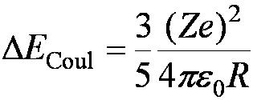
Nuclear Stability
The line representing the stable nuclides is the line of stability.
It appears that for A ≤ 40, nature prefers the number of protons and neutrons in the nucleus to be about the same Z ≈ N.
However, for A ≥ 40, there is a decided preference for N > Z because the nuclear force is independent of whether the particles are nn, np, or pp.
As the number of protons increases, the Coulomb force between all the protons becomes stronger until it eventually affects the binding significantly.
The work required to bring the charge inside the sphere from infinity is

Slide 44
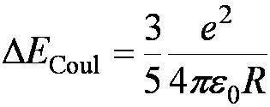
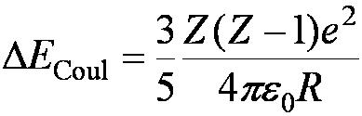

Nuclear Stability
For a single proton,
The total Coulomb repulsion energy in a nucleus is
For heavy nuclei, the nucleus will have a preference for fewer protons than neutrons because of the large Coulomb repulsion energy.
Most stable nuclides have both even Z and even N (even-even nuclides).
Only four stable nuclides have odd Z and odd N (odd-odd nuclides).
Work to assemble the proton itself must not be included
Nature prefers nuclei with even numbers of protons and even neutrons

Slide 45
From chapter12 quiz
Which of the following statements best describes the line of stability?
a. It has N = Z when A = 240.
b. It has Z > N at A = 240
c. N always tends to be greater than Z.
d. N tends to be greater than Z, especially for masses greater than calcium.

Slide 46
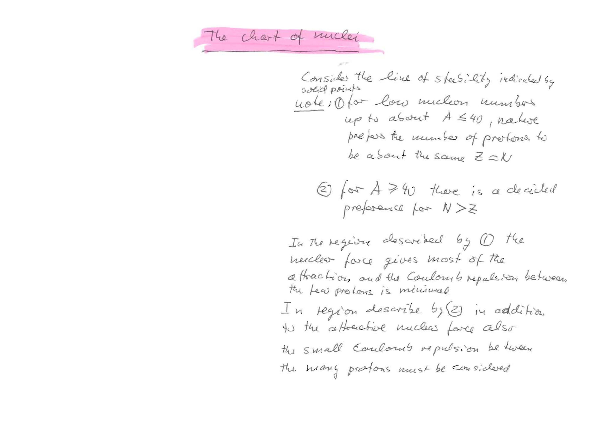
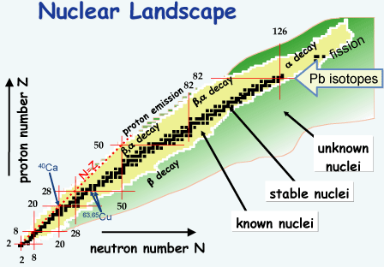
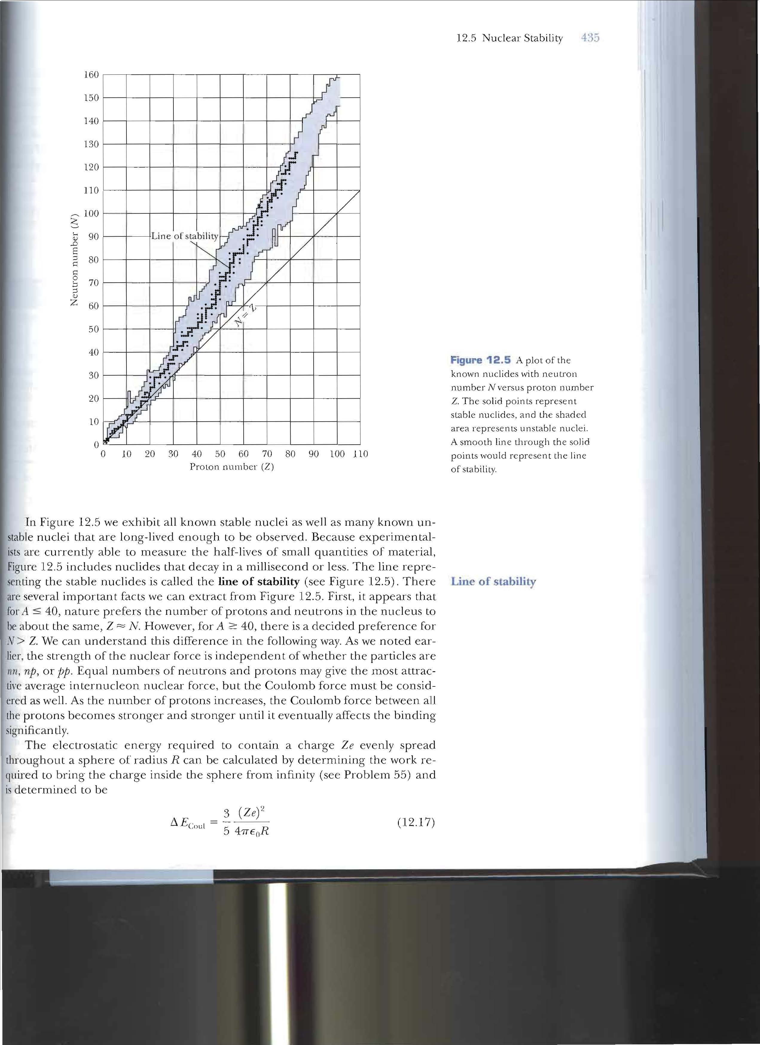
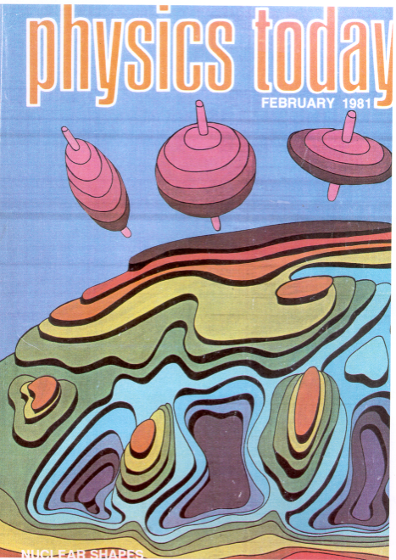
Magic numbers(high stability nuclei) show shell structure Goeppert-Mayer,Jensen(1963 Nobel price)
N or Z=2,8,20,28,50,82,126

Slide 47
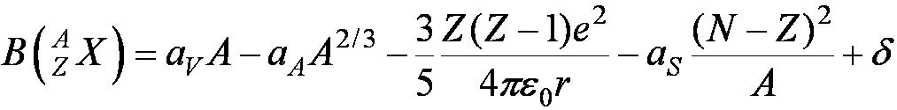
The Liquid Drop Model
Treats the nucleus as a collection of interacting particles in a liquid drop.
The total binding energy, the semi-empirical mass formula is
The volume term (a_{v}) indicates that the binding energy is approximately the sum of all the interactions between the nucleons.
The second term is called the surface effect because the nucleons on the nuclear surface are not completely surrounded by other nucleons.
The third term is the Coulomb energy in Eq. (12.17) and Eq. (12.18)
Surface area nuclear radius R = r₀A^{1/3}

Slide 48
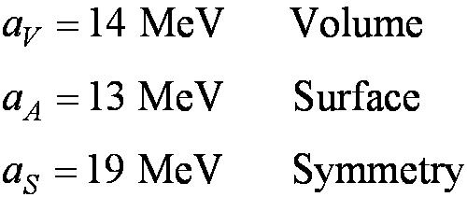
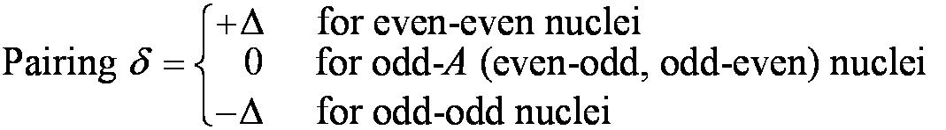

The Liquid Drop Model
The fourth term is due to the symmetry energy. In the absence of Coulomb forces, the nucleus prefers to have N ≈ Z and has a quantum-mechanical origin, depending on the exclusion principle.
The last term is due to the pairing energy and reflects the fact that the nucleus is more stable for even-even nuclides. Use values given by Fermi to determine this term.
where Δ = 33 MeV·A^{−3/4}
No nuclide heavier than has been found in nature. If they ever existed, they must have decayed so quickly that quantities sufficient to measure no longer exist.

Slide 49
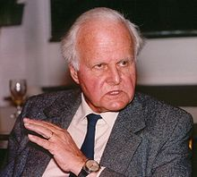
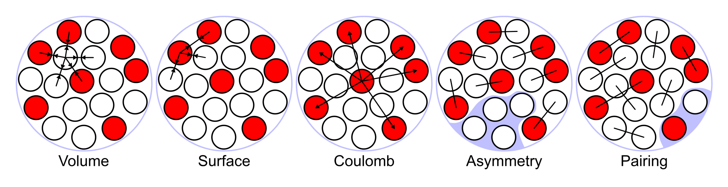
The liquid drop model was first proposed by George Gamow and further developed by Niels Bohr and John Archibald Wheeler. It treats the nucleus as a drop of incompressible fluid of very high density, held together by the nuclear force (a residual effect of the strong force), there is a similarity to the structure of a spherical liquid drop. While a crude model, the liquid drop model accounts for the spherical shape of most nuclei and makes a rough prediction of binding energy.
The corresponding mass formula is defined purely in terms of the numbers of protons and neutrons it contains. The original Weizsäcker formula defines five terms:
Volume energy, when an assembly of nucleons of the same size is packed together into the smallest volume, each interior nucleon has a certain number of other nucleons in contact with it. So, this nuclear energy is proportional to the volume.
Surface energy corrects for the previous assumption made that every nucleon interacts with the same number of other nucleons. This term is negative and proportional to the surface area, and is therefore roughly equivalent to liquid surface tension.
Coulomb energy, the potential energy from each pair of protons. As this is a repulsive force, the binding energy is reduced.
Asymmetry energy (also called Pauli Energy), which accounts for the Pauli exclusion principle. Unequal numbers of neutrons and protons imply filling higher energy levels for one type of particle, while leaving lower energy levels vacant for the other type.
Pairing energy, which accounts for the tendency of proton pairs and neutron pairs to occur. An even number of particles is more stable than an odd number due to spin coupling
The liquid drop model was first proposed by George Gamow and further developed by Niels Bohr and John Archibald Wheeler. It treats the nucleus as a drop of incompressible fluid of very high density, held together by the nuclear force (a residual effect of the strong force), there is a similarity to the structure of a spherical liquid drop. While a crude model, the liquid drop model accounts for the spherical shape of most nuclei and makes a rough prediction of binding energy.
The corresponding mass formula is defined purely in terms of the numbers of protons and neutrons it contains. The original Weizsäcker formula defines five terms:
Volume energy, when an assembly of nucleons of the same size is packed together into the smallest volume, each interior nucleon has a certain number of other nucleons in contact with it. So, this nuclear energy is proportional to the volume.
Surface energy corrects for the previous assumption made that every nucleon interacts with the same number of other nucleons. This term is negative and proportional to the surface area, and is therefore roughly equivalent to liquid surface tension.
Coulomb energy, the potential energy from each pair of protons. As this is a repulsive force, the binding energy is reduced.
Asymmetry energy (also called Pauli Energy), which accounts for the Pauli exclusion principle. Unequal numbers of neutrons and protons imply filling higher energy levels for one type of particle, while leaving lower energy levels vacant for the other type.
Pairing energy, which accounts for the tendency of proton pairs and neutron pairs to occur. An even number of particles is more stable than an odd number due to spin coupling
The liquid drop model was first proposed by George Gamow and further developed by Niels Bohr and John Archibald Wheeler. It treats the nucleus as a drop of incompressible fluid of very high density, held together by the nuclear force (a residual effect of the strong force), there is a similarity to the structure of a spherical liquid drop. While a crude model, the liquid drop model accounts for the spherical shape of most nuclei and makes a rough prediction of binding energy.
The corresponding mass formula is defined purely in terms of the numbers of protons and neutrons it contains. The original Weizsäcker formula defines five terms:
Volume energy, when an assembly of nucleons of the same size is packed together into the smallest volume, each interior nucleon has a certain number of other nucleons in contact with it. So, this nuclear energy is proportional to the volume.
Surface energy corrects for the previous assumption made that every nucleon interacts with the same number of other nucleons. This term is negative and proportional to the surface area, and is therefore roughly equivalent to liquid surface tension.
Coulomb energy, the potential energy from each pair of protons. As this is a repulsive force, the binding energy is reduced.
Asymmetry energy (also called Pauli Energy), which accounts for the Pauli exclusion principle. Unequal numbers of neutrons and protons imply filling higher energy levels for one type of particle, while leaving lower energy levels vacant for the other type.
Pairing energy, which accounts for the tendency of proton pairs and neutron pairs to occur. An even number of particles is more stable than an odd number due to spin coupling.
The liquid drop model
Carl Friedrich Freiherr von Weizsäcker,28 June 1912 – 28 April 2007) was a German physicist and philosopher.

Slide 50
From chapter12 quiz
The "liquid drop model" of the nucleus allowed von Weizsaecker to propose his equation for a semi-empirical mass formula. This formula includes all of the following EXCEPT:
a. A correction for nuclear surface interactions being different than interior saturated interactions.
b. A term providing for the repulsion of protons in the nucleus.
c. A term proportional to the total number of nucleons.
d. A term for the energy associated with the fact that most stable nuclei prefer to have N approximately equal to Z.
e. A term incorporating the instability of protons within the nucleus.

Slide 51
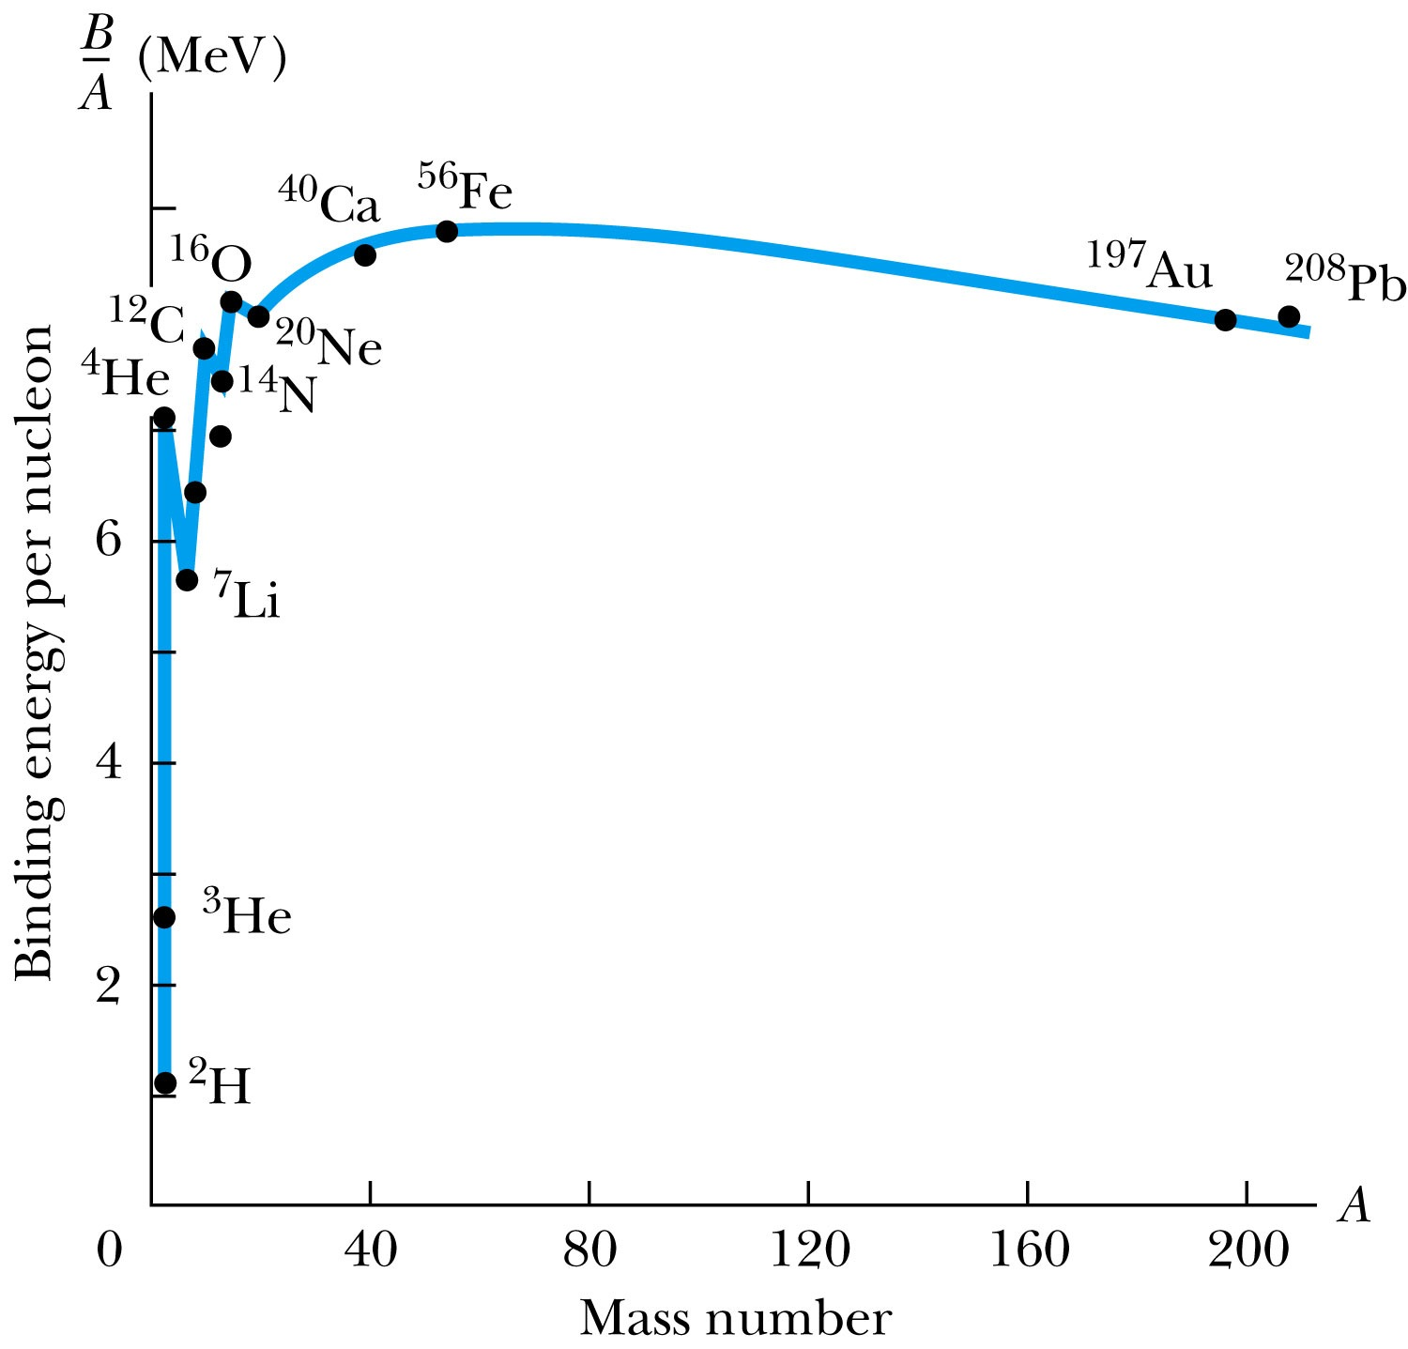
Binding Energy Per Nucleon
Use this to compare the relative
stability of different nuclides
It peaks near A = 56
The curve increases rapidly,
demonstrating the saturation
effect of nuclear force
Sharp peaks for the even-even
nuclides ⁴He, ¹²C, and ¹⁶O
tightly bound

Slide 52
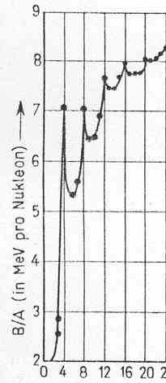

Shortcomings of the Liquid Drop Model
It does not explain the high stability of nuclei with magic number.
➡️The concept of pairing cannot be explained with this model.
(10,10)
(N,Z)
(6,6)
(2,2)
(8,8)
(4,4)

Slide 53


Slide 55
Nuclear Models
Current research focuses on the constituent quarks and physicists have relied on a multitude of models to explain nuclear force behavior.
Independent-particle models:
The nucleons move nearly independently in a common nuclear potential. The shell model has been the most successful of these.
Strong-interaction models:
The nucleons are strongly coupled together. The liquid drop model has been successful in explaining nuclear masses as well as nuclear fission.

Slide 56


Nuclear Shell Model
The nuclear potential felt by the neutron and the proton
Neutrons are more strongly bound due to the absence of the repulsive Coulomb force
The difference of the shape between the proton and the neutron potentials are due to the Coulomb interaction on the proton.
Nuclei have a Fermi energy level which is the highest energy level filled in the nucleus.
In the ground state of a nucleus, all the energy levels below the Fermi level are filled.
Notes:
Add “potential” as indicated.

Slide 57


Nuclear Models
Energy-level diagrams for ¹²C and ¹⁶O.
Both are stable because they are even-even.
Case 1: If we add one proton to ¹²C to make
unstable
Case 2: If we add one neutron to ¹²C to make ¹³C:
stable

Slide 58
Nuclear Shell Model
Even when we add another neutron to produce ¹⁴C, we find it is barely unstable.
Indicating neutron energy levels to be lower in energy than the corresponding proton ones.
In this mass region, nature prefers the number of neutrons and protons to be N ≈ Z, but it doesn’t want N < Z.
This helps explain why ¹³C is stable, but not ¹³N

Slide 59

Nuclear shell model with well defined orbital states
(each nucleon moves in the average field of all other nucleons)

Slide 60


The Nobel Prize in Physics 1963.
Nuclear Shell Model
Magic numbers(high stability nuclei) show shell structure Goeppert-Mayer,Jensen(1963 Nobel price)
N or Z=2,8,20,28,50,82,126
Maria Goeppert Mayer
J. Hans D. Jensen

Slide 62

Radioactivity is characteristic of elements with large atomic numbers
. Elements with at least one stable isotope are shown in light blue. Green shows elements of which the most stable isotope has a half-life measured in millions of years. Yellow and orange are progressively less stable, with half-lives in thousands or hundreds of years, down toward one day. Red and purple show highly and extremely radioactive elements where the most stable isotopes exhibit half-lives measured on the order of one day and much less.

Slide 63

12.6: Radioactive Decay
The discoverers of radioactivity were Wilhelm Röntgen, Henri Becquerel, Marie Curie and her husband Pierre.
Marie Curie and her husband Pierre discovered polonium and radium in 1898.
  The simplest decay form is that of a gamma ray, which represents the nucleus changing from an excited state to lower energy state.
  Other modes of decay include emission of α particles, β particles, protons, neutrons, and fission.
The disintegrations or decays per unit time (activity):
where dN / dt is negative because total number N decreases with time.
Notes:
Add first bullet.

Slide 64


Radioactive Decay
SI unit of activity is the becquerel: 1 Bq = 1 decay / s
Recent use is the Curie (Ci) 3.7 × 10¹⁰ decays / s
If N(t) is the number of radioactive nuclei in a sample at time t, and λ (decay constant) is the probability per unit time that any given nucleus will decay:
If we let N(t = 0) ≡ N₀
----- radioactive decay law

Slide 65




Radioactive Decay
The activity R is
where R₀ is the initial activity at t = 0
It is common to refer to the half-life t_{1/2} or the mean lifetime τ rather than its decay constant.
The half-life is
The mean lifetime is

Slide 66

Radioactive Decay
The number of radioactive nuclei as a function of time
Euler’s number e=2.71828..
The exponential function changes by equal amounts in equal times

Slide 67


Slide 68
12.7: Alpha, Beta, and Gamma Decay
When a nucleus decays, all the conservation laws must be
observed:
Mass-energy
Linear momentum
Angular momentum
Electric charge
Conservation of nucleons
  The total number of nucleons (A, the mass number) must be conserved in a low-energy nuclear reaction or decay.

Slide 69



Alpha, Beta, and Gamma Decay
Let the radioactive nucleus be called the parent and have the mass
Two or more products can be produced in the decay.
Let the lighter one be M_{y} and the mass of the heavier one (daughter) be M_{D}.
The conservation of energy is
where Q is the energy released (disintegration energy) and equal to the total kinetic energy of the reaction products(note:Q(disintegration) is the negative of B(binding)
If B > 0, a nuclide is bound and stable;
If Q > 0, a nuclide is unbound, unstable, and may decay
If Q < 0, decay emitting nucleons do not occur
Binding enery refers to stable, whereas disintegration energy to unstable nuclei

Slide 70







Alpha Decay a collection of nucleons inside a nucleus decays
The nucleus ⁴He has a binding energy of 28.3 MeV.
If the last two protons and two neutrons in a nucleus are bound by less than 28.3 MeV, then the emission of an alpha particle (alpha decay) is possible.
If Q > 0, alpha decay is possible
EX.
The appropriate masses are
Q= 6 MeV and alpha decay is possible
Q=( 230.004u -226.025 -4.003u )c^2(931.5 MeV/c^2 u)= 6 MeV

Slide 71



Beta Decay
Unstable nuclei may move closer to the line of stability by undergoing beta decay.
The decay of a free neutron is
The beta decay of ¹⁴C (unstable) to form ¹⁴N, a stable nucleus, can be written as
Figure 12.13
The electron energy spectrum from the beta decay

Slide 72

Beta Decay
β⁻ decay in an atomic nucleus (the accompanying antineutrino is omitted). The inset shows beta decay of a free neutron.
There was a problem in neutron decay, the spin ½ neutron cannot decay to two spin ½ particles, a proton and an electron. ¹⁴C has spin 0, ¹⁴N has spin 1, and the electron has spin ½.
we cannot combine spin ½ & 1 to obtain a spin 0.
Wolfgang Pauli suggested a neutrino that must be produced in beta decay. It has spin quantum number ½, charge 0, and carries away the additional energy missing in Fig. (12.13).
Can neutrinos penetrade the earth?They come straight through the earth at nearly the speed of light, all the time, day and night, in enormous numbers. About 100 trillion neutrinos pass through our bodies every second.

Slide 73
Beta Decay
An occasional electron is detected with the kinetic energy K_{max} required to conserve energy, but in most cases the electron’s kinetic energy is less than K_{max}.
the neutrino has little or no mass, and its energy may be all kinetic
Neutrinos have no charge and do not interact electromagnetically.
They are not affected by the strong force of the nucleus.
They are the weak interaction.
The electromagnetic and weak forces are the electroweak force.

Slide 74

Radioactive decay modes conservation of nucleons

Slide 75



Gamma Decay
If the decay proceeds to an excited state of energy E_{x} rather than to the ground state, then Q for the transition to the excited state can be determined with respect to the transition to the ground state. The disintegration energy Q to the ground state Q₀.
Q for a transition to the excited state E_{x} is

Slide 76



Gamma Decay
The excitation energies tend to be much larger, many keV or even MeV.
The possibilities for the nucleus to rid itself of this extra energy is to emit a photon (gamma ray).
The gamma-ray energy hf is given by the difference of the higher energy state E> and lower one E<.
The decay of an excited state of ^{A}X* (where * is an excited state) to its ground state is
A transition between two nuclear excited states E> and E< is

Slide 77

12.8: Radioactive Nuclides
The unstable nuclei found in nature exhibit natural radioactivity.
Big Bang was 13.7 billion years ago
3.154^+7 s/y

Slide 78

Radioactive Nuclides
The radioactive nuclides made in the laboratory exhibit artificial radioactivity.
Heavy radioactive nuclides can change their mass number only by alpha decay (^{A}X → ^{A−4}D) but can change their charge number Z by either alpha or beta decay.
There are only four paths that the heavy naturally occurring radioactive nuclides may take as they decay.
Mass numbers expressed by either:
  4n
  4n + 1
  4n + 2
  4n + 3

Slide 79

Radioactive Nuclides
The sequence of one of the radioactive series ²³²Th
²¹²Bi can decay by either alpha or beta decay (branching).

Slide 80

Radon gas in the form of ²²²Rn is a health hazard
Curie (Ci) 3.7 × 10¹⁰ decays / s
Radon is a naturally occurring radioactive gas.
It’s produced when uranium, thorium, and radium break down in soil, rock, and water. It’s then released into the air. Radon is odorless, tasteless, and invisible.
Northern end of Lake Travis
The average indoor radon reading in Travis County, TX is predicted to be less than 2 picocuries per liter (pCi/L), so the county has been assigned EPA Radon Zone 3.

Slide 81

Radium-226 Decay Chain

Slide 83

Time Dating Using Lead Isotopes
A plot of the abundance ratio of ²⁰⁶Pb / ²⁰⁴Pb versus ²⁰⁷Pb / ²⁰⁴Pb can be a sensitive indicator of the age of lead ores. Such techniques have been used to show that meteorites, believed to be left over from the formation of the solar system, are 4.55 billion years old.
The growth curve for lead ores from various deposits:
The age of the specimens can be obtained from the abundance ratio of ²⁰⁶Pb/^{204Pb} versus ²⁰⁷Pb/²⁰⁴Pb.
Notes:
Eliminate the diagram on this slide. Replace with Figure 12.18 and add new sentences indicated.

Slide 84


Radioactive Carbon Dating
Radioactive ¹⁴C is produced in our atmosphere by the bombardment of ¹⁴N by neutrons produced by cosmic rays.
When living organisms die, their intake of ¹⁴C ceases, and the ratio of ¹⁴C / ¹²C (= R) decreases as ¹⁴C decays. The period just before 9000 years ago had a higher ¹⁴C / ¹²C ratio by factor of about 1.5 than it does today.
Because the half-life of ¹⁴C is 5730 years, it is convenient to use the ¹⁴C / ¹²C ratio to determine the age of objects over a range up to 45,000 years ago.

Slide 85

Calculate the binding energies of the most loosely bound neutron in the following nuclei

Slide 86

What is the energy released when three alpha parti-
cles combine to form 12C?

Slide 87



Slide 88



Slide 89
From chapter12 quiz
Which of the following reasons explains why the neutrino must exist?
A. The neutrino is a product of gamma ray decay.
B. The neutrino is necessary to allow for the correct spin angular momentum conservation in a nuclear disintegration.
C. The neutrino is necessary to carry away a charge in a nuclear disintegration.
D. The neutrino is the force carrier that holds together quarks within protons and neutrons.
E. The neutrino decays into electrons and protons in an unstable nucleus.

Slide 90


Slide 91

If the age of the Earth is 4.5 billion years, what should the ratio of N^206 (Pb)/(N ^238 (U)) in a uranium-bearing rock as old as the Earth?

Slide 92


Slide 93


Slide 94


