Slide 1
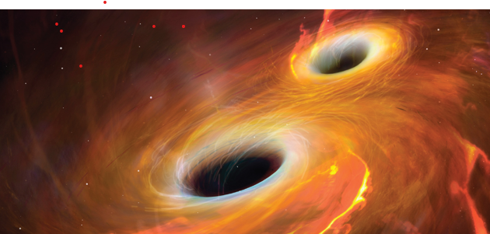
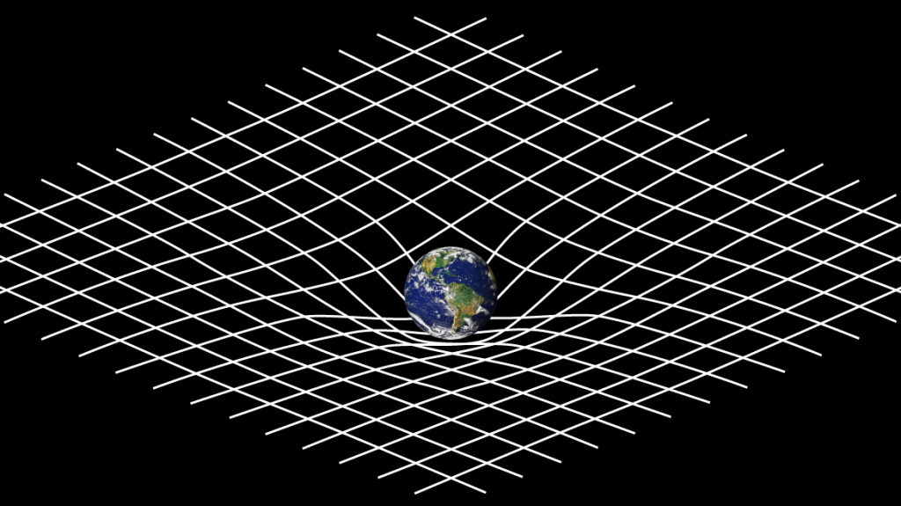
Chapter 15
Modern Astrophysics and General Relativity
Chapter 15
Chapter 15

Slide 2
Subsections of Chapter 15
15.1 Stellar Evolution
15.2 Galaxies and the Discovery of Dark Matter
15.3 Tenets of General Relativity
15.4 Tests of General Relativity
15.5 Black Holes
15.6 Gravitational Waves
Exoplanets ( Special Topic : Are other earths out there? )
Science progresses best when observations force us to alter our preconceptions. - Vera Rubin
Time and space and gravitation have no separate existence from matter.
Albert Einstein

Slide 3
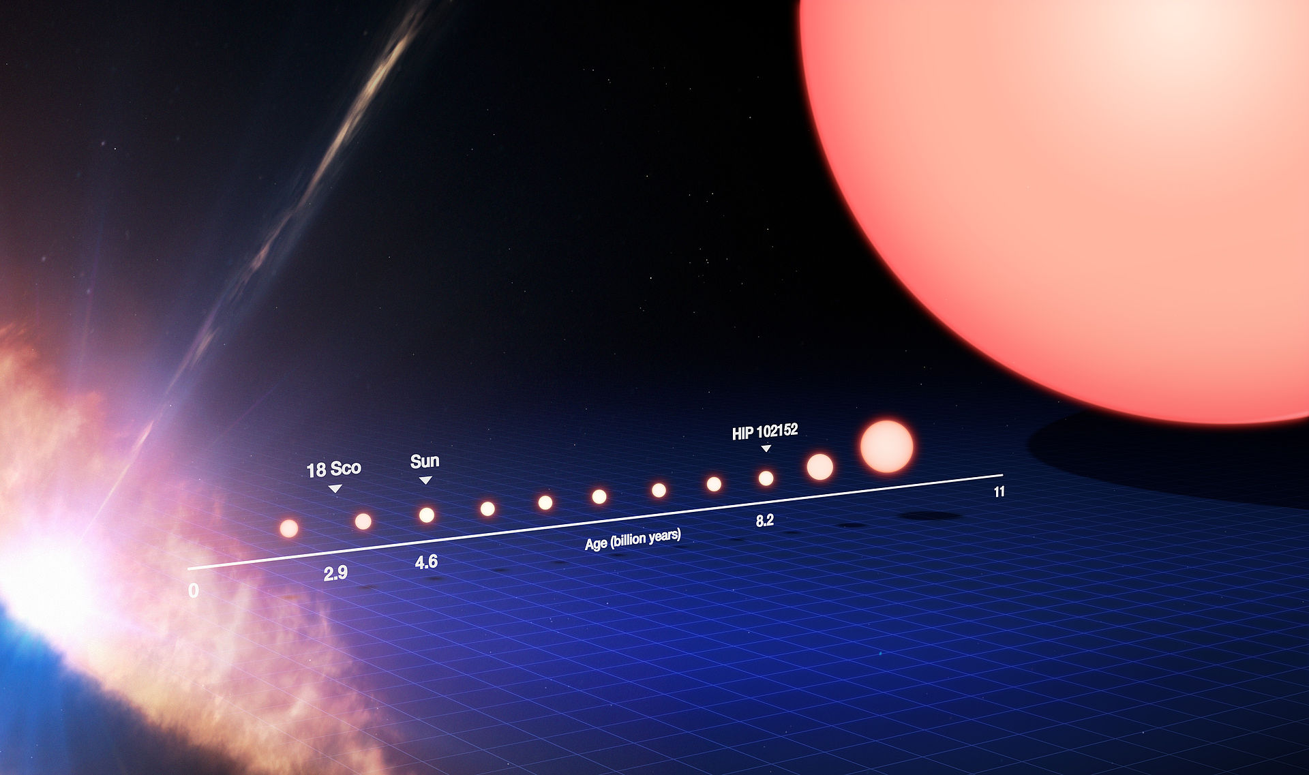
15.1 Stellar Evolution
As the universe cooled, gravitational forces attracted the matter into gaseous clouds, which formed the basis of stars. (a)
This process continued as the interior temperature and density of these clouds increased (b).
Nuclear fusion began when the temperature reached 10⁷ K (c).
Initially, fusion created helium from the hydrogen nuclei. Then further processes created carbon and heavier elements up to iron (d).
red giant

Slide 4
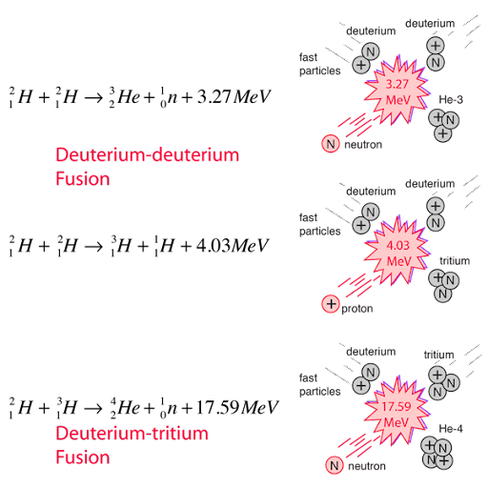
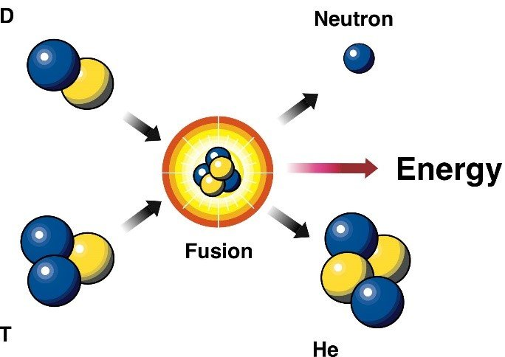
Fusion reactions

Slide 5
The Ultimate Fate of Stars
The final stages of a star occur when the hydrogen fuel is exhausted and helium fuses. Heavier elements are then created until the process reaches the iron region.
At this point the elements in the star have the highest binding energy per nucleon and the fusion reactions end.
For N nucleons each of mass m, the potential energy of a sphere of mass Nm and radius R is
The gravitational pressure is

Slide 6
Neutron Stars
Matter is kept from total collapse by the outward electron pressure due to the Pauli exclusion principle. For massive stars, the gravity will force the electrons to interact with the protons:
This result is called a neutron star from the abundance of neutrons. Similarly, the neutrons have an outward pressure:
Balancing these pressures yields the volume of a neutron star:

Slide 7
Novae and Supernovae
Novae and supernovae are stars that brighten and then fade.
Type I supernovae have no hydrogen spectral lines and type II do.
Type Ia supernovae are the brightest and are thought to be collapsing white dwarf stars.
Cataclysmic explosions (violently destructive) in supernovae provide the temperature and pressure to produce heavier elements such as uranium.
The Crab supernova occurred in 1054 and was recorded by the Chinese and Japanese. It was bright enough to see during the daytime.
Other supernovae occurred in 1572, 1604 and 1987.

Slide 8
Supernova Explosion
SN 1987A Supernova
As most of the heavier elements fused into iron, the iron nuclei became so hot that they spewed out helium nuclei. The temperature and density were large enough to radiate neutrinos.
after before
The gravitational force was strong enough to form a neutron star.
The implosion rebounded from the repulsive strong nuclear force in the core and created a dense shockwave. The shockwave radiated neutrinos out from the star.
These neutrinos were detected in Japan and the U.S. three hours before the light reached the Earth.
The neutrino observations were consistent with the supernova predictions.

Slide 9
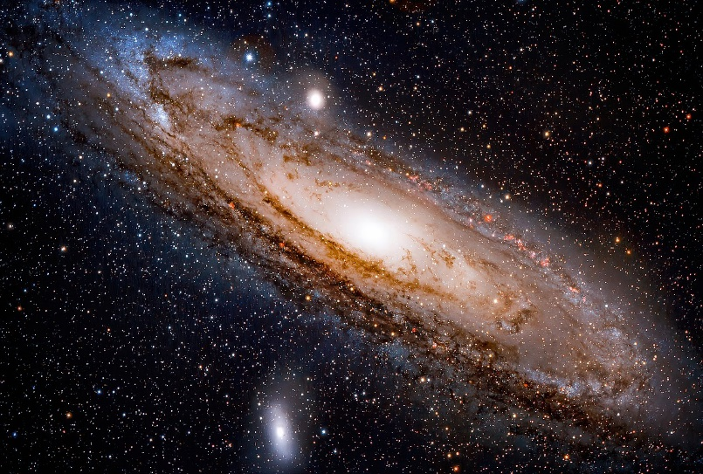
15.2: Galaxies
Collections of stars, gas, and dust are called galaxies.
The number of galaxies is extremely large, at least 100 billion.
Our own galaxy is the Milky Way, and it is believed to be composed of about 200 billion stars.
Andromeda is the closest galaxy within a million light-years.

Slide 10
Galaxies
As the gas and stars in a spiral galaxy orbit, the spectral lines can be seen to be redshifted when material is moving away from us and blueshifted when moving toward us.

Slide 11
15.3: Tenets of General Relativity
General relativity is the extension of special relativity. It includes the effects of accelerating objects and their mass on spacetime.
As a result, the theory is an explanation of gravity.
It is based on two concepts: (1) the principle of equivalence, which is an extension of Einstein’s first postulate of special relativity and (2) the curvature of spacetime due to gravity.
Einstein’s first postulate :The laws of physics are the same in all inertial frames. Now he extends to non inertial=accelerating frames

Slide 12
Principle of Equivalence
The principle of equivalence is an experiment in noninertial reference frames.
Consider an astronaut sitting in a confined space on a rocket placed on Earth. The astronaut is strapped into a chair that is mounted on a weighing scale that indicates a mass M. The astronaut drops a safety manual that falls to the floor (a).
Now contrast this situation with the rocket accelerating through space. The gravitational force of the Earth is now negligible. If the acceleration has exactly the same magnitude g on Earth, then the weighing scale indicates the same mass M that it did on Earth, and the safety manual still falls with the same acceleration as measured by the astronaut (b).
The question is: How can the astronaut tell whether the rocket is on earth or in space?
Principle of equivalence: There is no experiment that can be done in a small confined space that can detect the difference between a uniform gravitational field and an equivalent uniform acceleration.

Slide 13
Inertial Mass and Gravitational Mass
Recall from Newton’s 2nd law that an object accelerates in reaction to a force according to its inertial mass:
Inertial mass measures how strongly an object resists a change in its motion.
Gravitational mass measures how strongly it attracts other objects.
For the same force, we get a ratio of masses:
According to the principle of equivalence, the inertial and gravitational masses are equal.

Slide 14
Light Deflection
Consider accelerating through a region of space where the gravitational force is negligible. A small hole allows a beam of starlight to enter the spacecraft. Since the velocity of light is finite, there is a nonzero amount of time for the light to shine across the opposite wall of the spaceship.
During this time, the rocket has accelerated upward. From the point of view of a passenger in the rocket, the light path appears to curve downward.
The principle of equivalence implies that the light pulse is attracted by the gravitational field and curves downward.
This prediction seems surprising, however the unification of mass and energy from the special theory of relativity hints that the gravitational force of the Earth could act on the effective mass of the light pulse.

Slide 15
Spacetime Curvature
Light bending for the Earth observer seems to violate the premise that the velocity of light is constant from special relativity. Light traveling at a constant velocity implies that it travels in a straight line.
Einstein thought of gravity not as a force but as a curvature of spacetime. Spacetime would be ﬂat in empty space, but spacetime becomes highly changeable near matter.
Spacetime is curved by massive bodies. Imagine a small mass rolling in on the spacetime curvature toward a massive body.

Slide 16
The Unification of Mass and Spacetime
The ﬂow of time is determined by the magnitude of the gravitational ﬁeld nearby. In other words, the mass changes the geometry of the spacetime.
Einstein’s famous field equations sum up this relationship as:
* mass-energy tells spacetime how to curve
* Spacetime curvature tells matter how to move
The result is that light travels a longer path in strong gravitational ﬁelds because the spacetime geometry has changed and expanded.

Slide 17
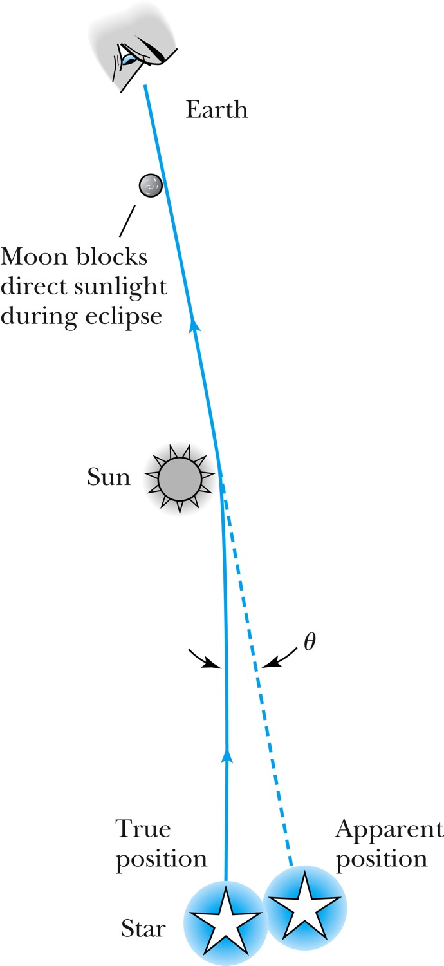
15.3: Tests of General Relativity
Bending of Light
During a solar eclipse of the sun by the moon, most of the sun’s light is blocked on Earth, which afforded the opportunity to view starlight passing close to the sun in 1919. The starlight was bent as it passed near the sun which caused the star to appear displaced.
Einstein’s general theory predicted a deflection of 1.75 seconds of arc, and the two measurements found 1.98 ± 0.16 and 1.61 ± 0.40 seconds.
Since the eclipse of 1919, many experiments, using both starlight and radio waves from quasars, have confirmed Einstein’s predictions about the bending of light with increasingly good accuracy.

Slide 18
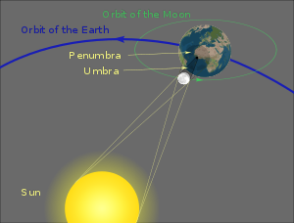
solar eclipse of the sun by the moon

Slide 19
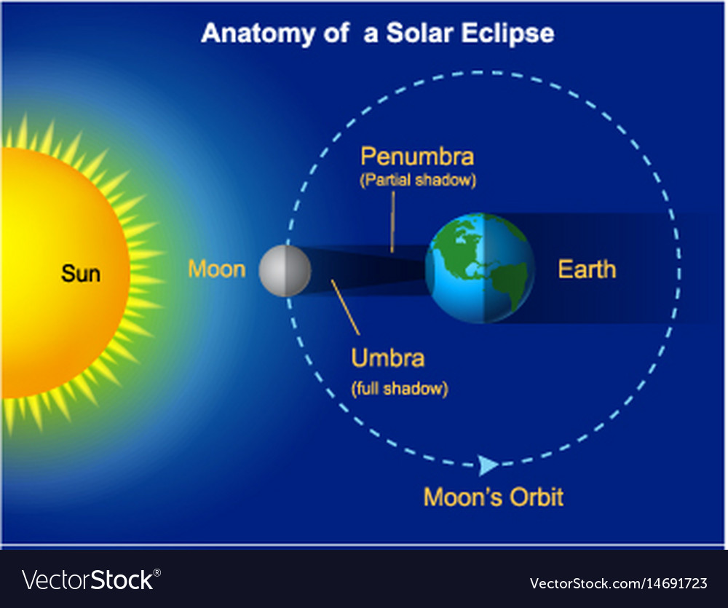
Shadow of moon on earth

Slide 20
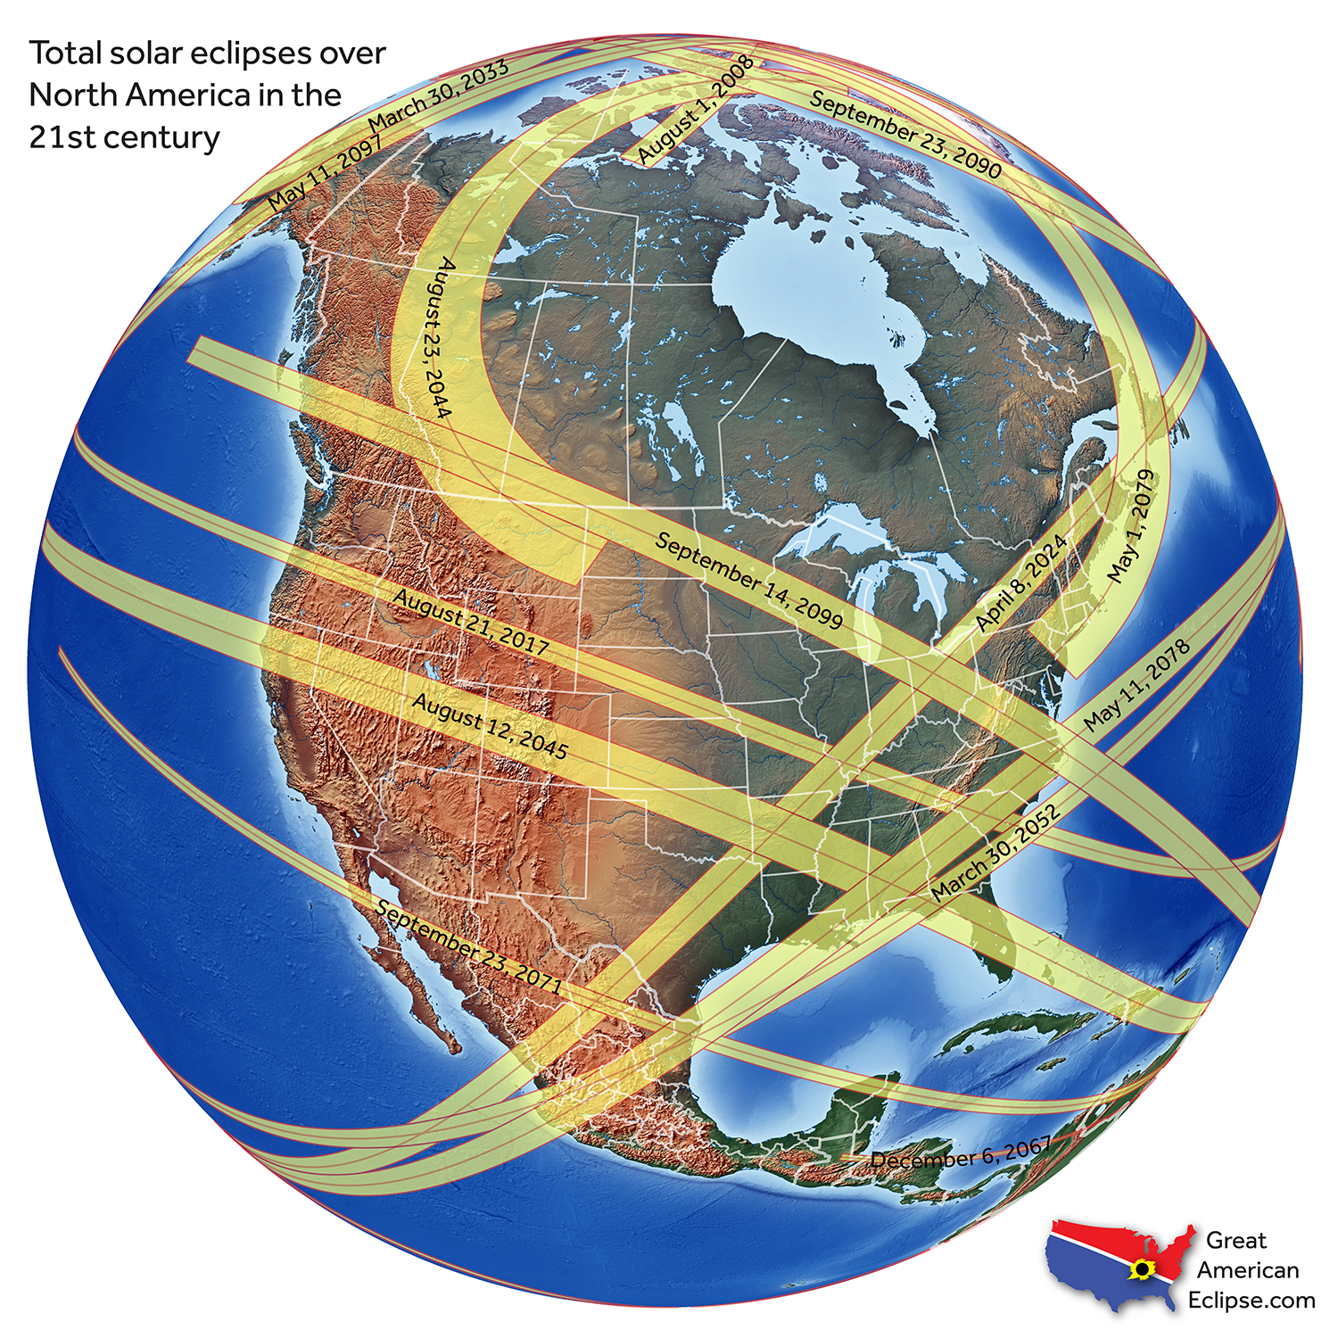

Slide 21
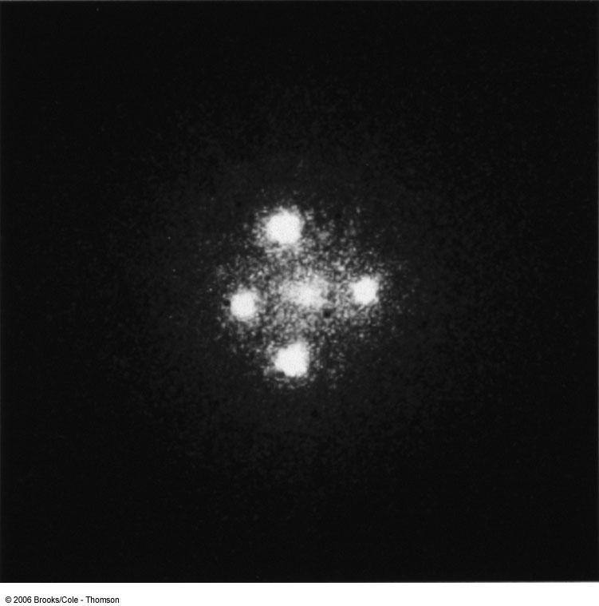
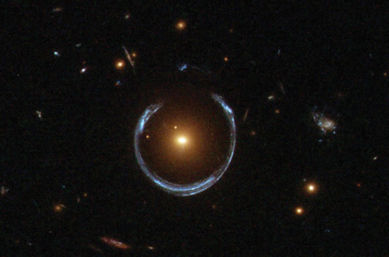
Gravitational Lensing
When light from a distant object like a quasar passes by a nearby galaxy on its way to us on Earth, the light can be bent multiple times as it passes in different directions around the galaxy.

Slide 22
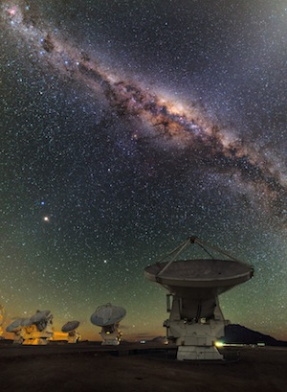
What is a Galaxy ?
But only in the past few decades have we come to understand that the Milky Way is one of the 100 billion galaxies in the universe, and that its disk stretches some 100,000 light-years across.
The Milky Way is a large barred spiral galaxy. All the stars we see in the night sky are in our own Milky Way Galaxy. Our galaxy is called the Milky Way because it appears as a milky band of light in the sky when you see it in a really dark area.

Slide 23
Quasar and Pulsar (stellar objects)
A quasar is an extremely luminous active galactic nucleus, in which a supermassive black hole with mass ranging from millions to billions of times the mass of the Sun is surrounded by a gaseous accretion disk

Slide 24
A frequency comb laser in space launched from near the polar circle
Future compact and reliable dual frequency comb systems in space can be game changers for precision spectroscopy, spectrometer calibration, sub-micrometer ranging, calibration of lidar lasers, and microwave generation in next-generation satellite missions. Based on the results of this flight, a long-term in-orbit verification of such devices is envisioned in the near future.
On its 10 minute journey carried by a sounding rocket the scientific payload has reached an altitude of 238 km and experienced 6 minutes of microgravity. The payload with the comb sustained vibrations up to 9 g rms, shocks of up to 21 g and constant accelerations up to 12 g. Under these conditions, the fully automated comb system has successfully performed its mission – and compared the Iodine optical reference with a standard radio frequency atomic clock.

Slide 25
Gravitational Redshift
The second test of general relativity is the predicted frequency change of light near a massive object.
Imagine a light pulse being emitted from the surface of the Earth to travel vertically upward. The gravitational attraction of the Earth cannot slow down light, but it can do work on the light pulse to lower its energy. This is similar to a rock being thrown straight up. As it goes up, its gravitational potential energy increases while its kinetic energy decreases. A similar thing happens to a light pulse.
A light pulse’s energy depends on its frequency f through Planck’s constant, E = hf. As the light pulse travels up vertically, it loses kinetic energy and its frequency decreases. Its wavelength increases, so the wavelengths of visible light are shifted toward the red end of the visible spectrum.
This phenomenon is called gravitational redshift.

Slide 26
Gravitational Redshift Experiments
An experiment conducted in a tall tower measured the “blueshift” change in frequency of a light pulse sent down the tower. The energy gained when traveling downward a distance H is mgH. If f is the energy frequency of light at the top and f’ is the frequency at the bottom, energy conservation gives
The effective mass of light is m = E / c² = h f / c².
This yields the ratio of frequency shift to the frequency:
Or in general:
If the distance is large then g is not constant and the shift depends on G, the mass of the earth M(or other body) and the distance r from the center of gravity
Using gamma rays, the frequency ratio was observed to be:

Slide 27
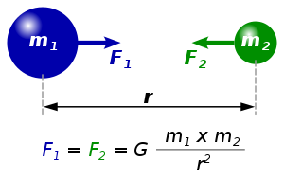
Cavendish torsion pendulum
Diagram of torsion balance used in the Cavendish experiment performed by Henry Cavendish in 1798, to measure G, with the help of a pulley, large balls hung from a frame were rotated into position next to the small balls

Slide 28
15.18
This time difference T is for clocks flying in east and west directions around the earth(one clock on each airplane, the other on earth at Washington DC )
Delta T= (1.09x10^-12 )(45h) (3600s/ 1h) =177 ns
Repeat Example15-1 with a more accurate expression
The gravitational redshift shift is larger than the time dilation shift for the westward flight

Slide 29
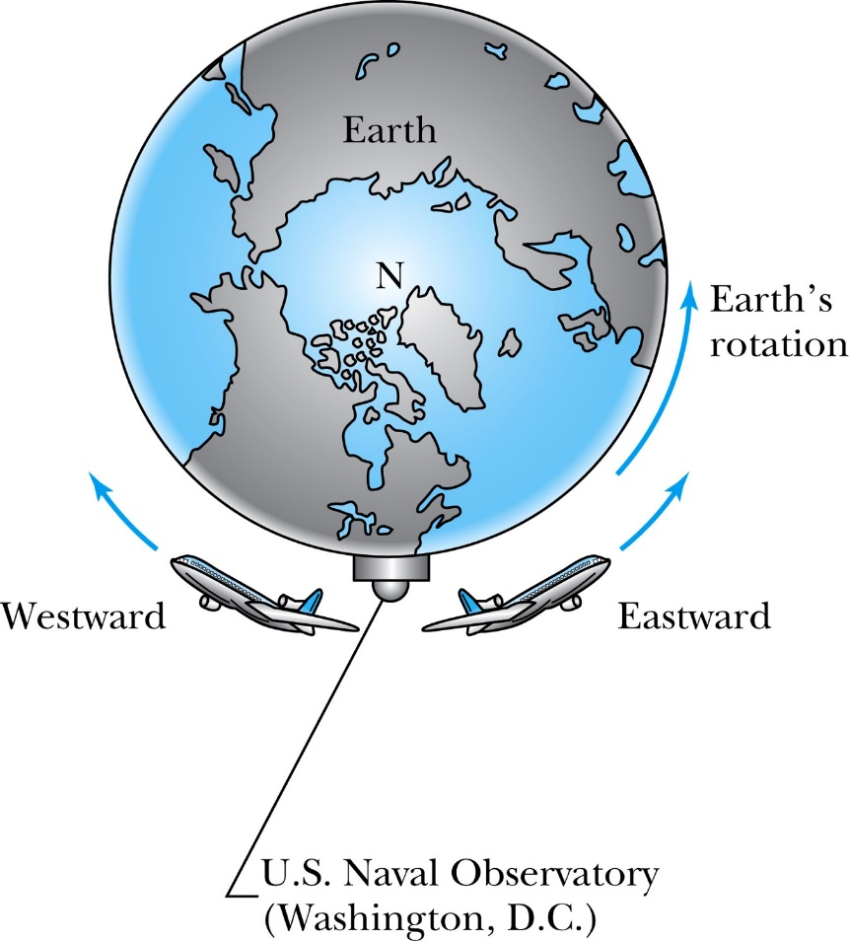
Atomic Clock Measurement
Figure 2.20: Two airplanes took off (at different times) from Washington, D.C., where the U.S. Naval Observatory is located. The airplanes traveled east and west around Earth as it rotated. Atomic clocks on the airplanes were compared with similar clocks kept at the observatory to show that the moving clocks in the airplanes ran differently.

Slide 30
Flight time
(41.2 h)
(48.6 h)
The time is changing in the moving frame, but the calculations must also take into account corrections due to general relativity (Einstein). Analysis shows that the special theory of relativity is verified within the experimental uncertainties.

Slide 31
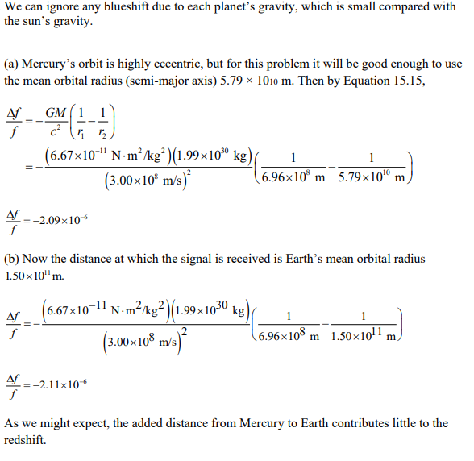
15.10
Find the relative frequency shift for light emitted from the sun, if the light is received at
a.the planet Mercury
b. The earth
Mass of sun

Slide 32
Gravitational Time Dilation
A very accurate experiment was done by comparing the frequency of an atomic clock flown on a Scout D rocket to an altitude of 10,000 km with the frequency of a similar clock on the ground. The measurement agreed with Einstein’s general relativity theory to within 0.02%.
Since the frequency of the clock decreases near the Earth, a clock in a gravitational field runs more slowly according to the gravitational time dilation.

Slide 33
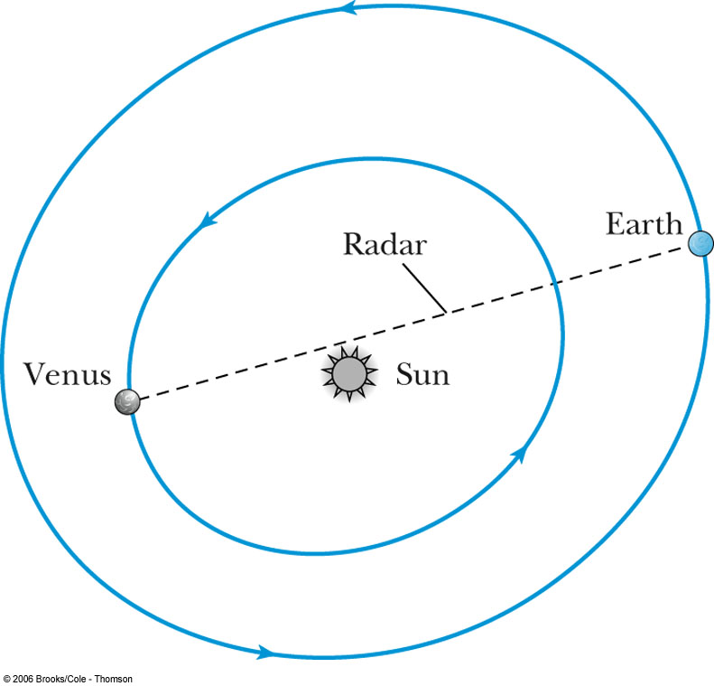
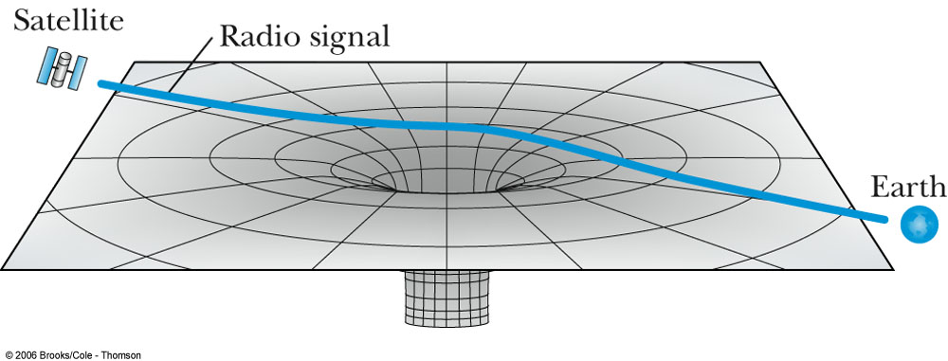
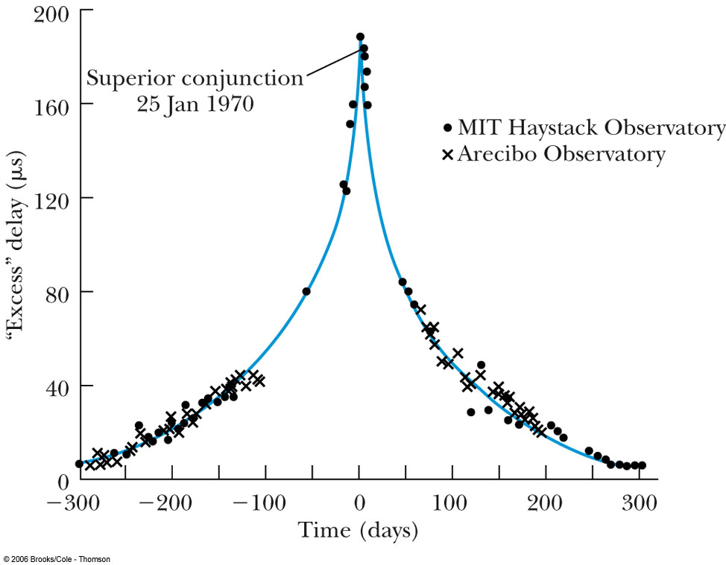
Light Retardation
As light passes by a massive object, the path taken by the light is longer because of the spacetime curvature.
The longer path causes a time delay for a light pulse traveling close to the sun.
This effect was measured by sending a radar wave to Venus, where it was reflected back to Earth. The position of Venus had to be in the “superior conjunction” position on the other side of the sun from the Earth. The signal passed near the sun and experienced a time delay of about 200 microseconds. This was in excellent agreement with the general theory.

Slide 34
Perihelion Shift of Mercury
The orbits of the planets are ellipses, and the point closest to the sun in a planetary orbit is called the perihelion. It has been known for hundreds of years that Mercury’s orbit processes about the sun. Accounting for the perturbations of the other planets left 43 seconds of arc per century that was previously unexplained by classical physics.
The curvature of spacetime explained by general relativity accounted for the 43 seconds of arc shift in the orbit of Mercury.

Slide 36
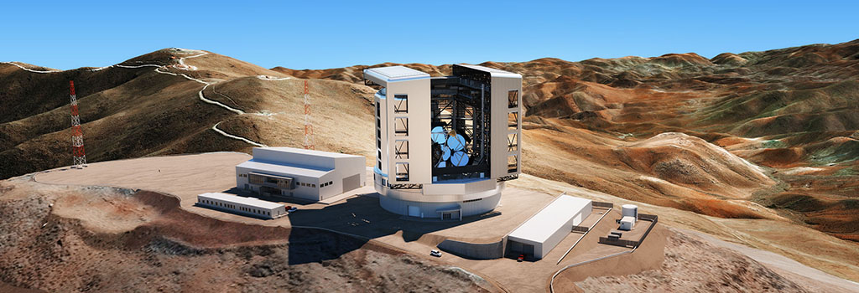
Size of the observable universe today=14billion light years 1ly=3.2x10^7 s x 3x10^8 m/s=9.46 x 10^15 m
Ground based telescopes
The Giant Magellan Telescope (GMT) is a ground-based extremely large telescope under construction. It will consist of seven 8.4 m (27.6 ft) diameter primary segments,^{[1]} that will observe optical and near infrared (320–25000 nm^{[2]}) light, with the resolving power of a 24.5 m (80.4 ft) primary mirror and collecting area equivalent to a 22.0 m (72.2 ft) one,^{[3]} which is about 368 square meters.^{[4]} The telescope is expected to have a resolving power 10 times greater than the Hubble Space Telescope. The GMT in Chile is slated for completion in the late 2020s. It will become one of the largest optical observatory in the world,

Slide 37
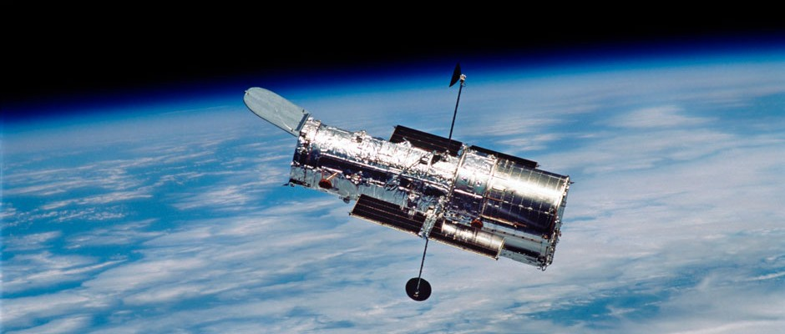
Present Space based telescopes
The Hubble Space Telescope orbits 547 kilometres (340 miles) above Earth and travels 8km (5 miles) every second.

Slide 38
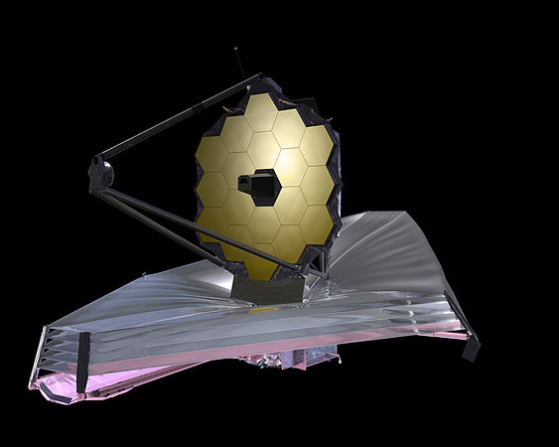
The space based telescope James Webb Space Telescope
The primary mirror of the JWST is composed of 18 hexagonal mirror segments which combine to create a 6.5 metres (21 ft) diameter mirror.The JWST will observe (0.6 to 28.3 μm), to observe high redshift objects that are too old and too distant for Hubble to observe
The James Webb Space Telescope is an international 21st century space observatory scheduled to be launched on December 25, 2021

Slide 39
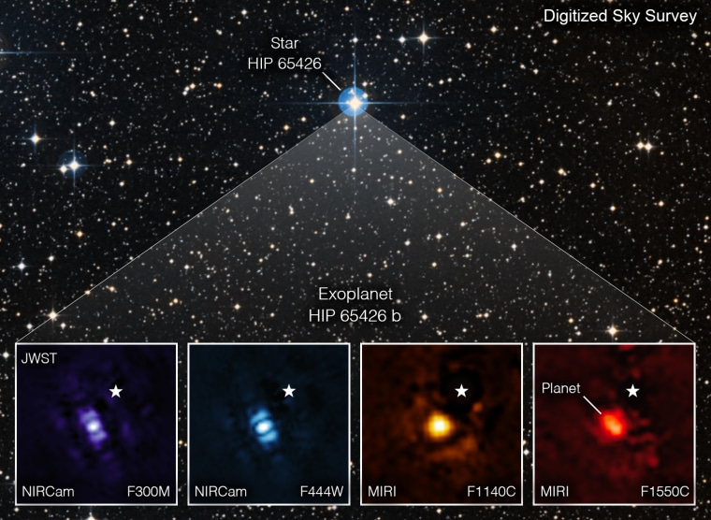
Picture of an exoplanet
The telescope's infrared "eyes" can see through dust and gas, making them able to pick up objects and features beyond the range of human sight.
The exoplanet HIP 65426 b in different bands of infrared light, as seen from the James Webb Space Telescope.NASA

Slide 40
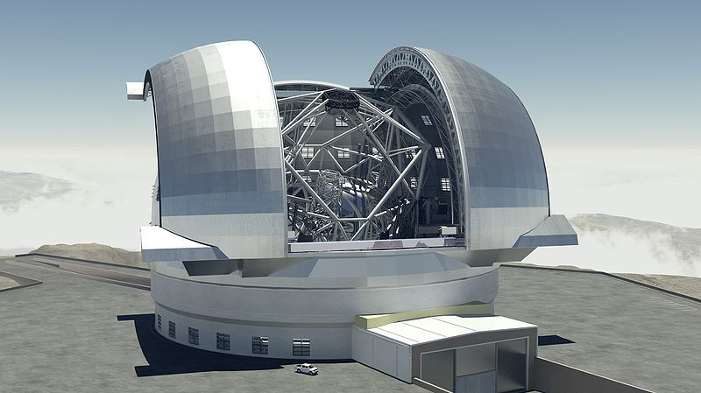
Extremely Large Telescope ELT
(ELT) is an astronomical observatory currently under construction. When completed, it is planned to be the world's largest optical/near-infrared extremely large telescope. Part of the European Southern Observatory (ESO) agency, it is located on top of Cerro Armazones in the Atacama Desert of northern Chile.
Completion with first light observed is being planned for 2027

Slide 41
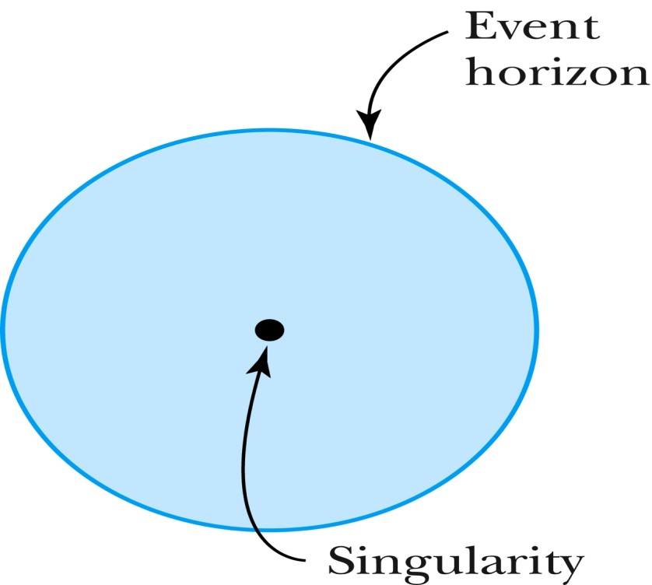
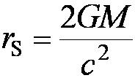
15.4: Black Holes
While a star is burning, the heat produced by the thermonuclear reactions pushes out the star’s matter and balances the force of gravity. When the star’s fuel is depleted, no heat is left to counteract the force of gravity, which becomes dominant. The star’s mass collapses into an incredibly dense ball that could warp spacetime enough to not allow light to escape. The point at the center is called a singularity.
A collapsing star greater than 3 solar masses will distort spacetime in this way to create a black hole.
Karl Schwarzschild determined the radius of a black hole now known as the Schwarzschild radius.

Slide 43
15.12,13
What is the Schwarzschild radius of
the moon?
Jupiter?

Slide 44
Black Hole Detection
Since light can’t escape, they must be detected indirectly:
Severe redshifting of light.
Hawking radiation results from particle-antiparticle pairs created near the event horizon. One member slips into the singularity as the other escapes. Antiparticles that escape radiate as they combine with matter. Energy expended to pair production at the event horizon decreases the total mass-energy of the black hole.
Hawking calculated the blackbody temperature of the black hole to be:
The power radiated is:
This result is used to detect a black hole by its Hawking radiation.
Mass falling into a black hole would create a rotating accretion disk. Internal friction would create heat and emit x rays.

Slide 45
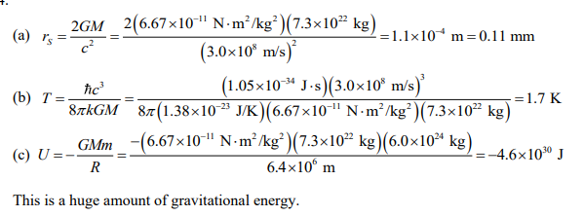
15.20
For a black hole with the mass of our moon find
The Schwarzschild radius
The effective temperature
The potential emery associated with the black hole being just above the earths surface

Slide 46
Evidence and Discovery of Black Holes
Matter from a companion star is attracted by gravity
Cygnus X-1 is an x ray emitter and part of a binary system in the Cygnus constellation. It is roughly 9 solar masses.
The galactic center of M87 is thought to be at least 3 billion solar masses.
NGC 4261 is thought to be a billion solar masses.
2020 Nobel price for the discovery of black holes
Roger Penrose University of Oxford, UK
“for the discovery that black hole formation is a robust prediction of the general theory of relativity”
and the other half jointly to
Reinhard Genzel Max Planck Institute for Extraterrestrial Physics, Garching, Germany and University of California, Berkeley, USA
and
Andrea Ghez University of California, Los Angeles, USA
“for the discovery of a supermassive compact object at the centre of our galaxy”

Slide 47
Active Galactic Nuclei (AGN) and Quasars
Active galactic nuclei is a category of exotic objects that includes: luminous quasars, Seyfert galaxies, and blazars.
Many believe the core of an AGN contains a supermassive black hole surrounded by an accretion disk. As matter spirals in the black hole, electromagnetic radiation and plasma jets spew outward from the poles.
Blazars are AGN with jets spewing relativistic energies toward the Earth.

Slide 48
Gamma Ray Astrophysics
Gamma-ray bursts (GRBs) are short flashes of electromagnetic radiation that are observed about once a day at unpredictable times from random directions.
GRBs are absorbed in the atmosphere so they are observed by satellites.
They last from a few milliseconds to several minutes.
They were recently discovered to come from supernovae in distant galaxies.
An interesting property of GRBs is the afterglow of lower energy photons including x rays, light and radio waves that last for weeks.
The optical spectra of the GRBs is nearly identical to the jet of a supernova. Astronomers in 1997 were able to prove the bursts came from far away. The directional measurements proved that GRBs came from random directions as well.

Slide 49
Nobel prize for Gravitational Waves
The Nobel Prize in Physics 2017 was divided, one half awarded to Rainer Weiss, the other half jointly to Barry C. Barish and Kip S. Thorne "for decisive contributions to the LIGO detector and the observation of gravitational waves"

Slide 50
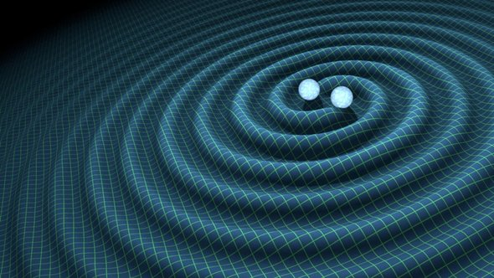
15.3: Gravitational Waves
When a charge accelerates, the electric field surrounding the charge redistributes itself. This change in the electric field produces an electromagnetic wave, which is easily detected. In much the same way, an accelerated mass should also produce gravitational waves.
Gravitational waves carry energy and momentum, travel at the speed of light, and are characterized by frequency and wavelength.
As gravitational waves pass through spacetime, they cause small ripples. The stretching and shrinking is on the order of 1 part in 10²¹ even due to a strong gravitational wave source.
Due to their small magnitude, gravitational waves are difficult to detect. Large astronomical events create measurable spacetime waves such as the collapse of a neutron star, a black hole or the Big Bang.
This effect has been likened to noticing a single grain of sand added to all the beaches of Long Island, New York.
blob:https://www.newyorker.com/117ea397-715a-4022-8dc1-1db0c17623e7

Slide 51
Gravitational Wave Experiments (1 of 2)
Taylor and Hulse discovered a binary system of two neutron stars that lose energy due to gravitational waves that agrees with the predictions of general relativity.
LIGO is a large Michelson interferometer device that uses four test masses on two arms of the interferometer. The device is meant to detect changes in length of the arms due to a passing wave.
NASA and the European Space Agency (ESA) were jointly developing a space-based probe called the Laser Interferometer Space Antenna (LISA), which was to measure fluctuations in its triangular shape.

Slide 52
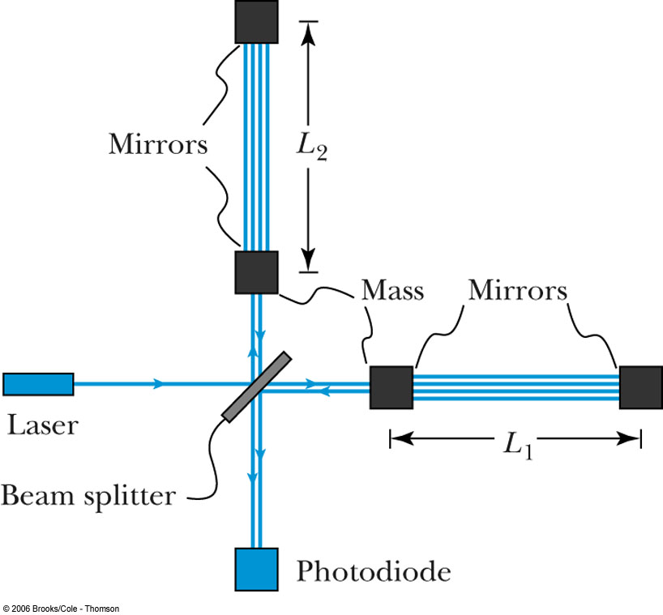
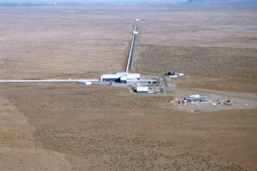
Gravitational Wave Experiments
Taylor and Hulse discovered a binary system of two neutron stars that lose energy due to gravitational waves that agrees with the predictions of general relativity.
LIGO is a large Michelson interferometer device that uses four test masses on two arms of the interferometer. The device is meant to detect changes in length of the arms due to a passing wave.
NASA and the European Space Agency (ESA) were jointly developing a space-based probe called the Laser Interferometer Space Antenna (LISA) which was to measure fluctuations in its triangular shape.

Slide 53
Gravitational Wave Experiments (2 of 2)
The merger of the two neutron stars was also detected electromagnetically (as a short-period GRB) by the Fermi Gamma-ray Space Telescope less than 2 seconds after the gravitational wave detection
Figure shows (Top panel) A schematic of the merger of two black holes. (Middle panel) The model of the gravitational wave signal detected from the merger. (Bottom panel) The separation distance (brown line) and the relative velocity of the black holes (green line) during the merger. B. P. Abbott et al, Physical Review Letters, 116, 061102 (2016).

Slide 54
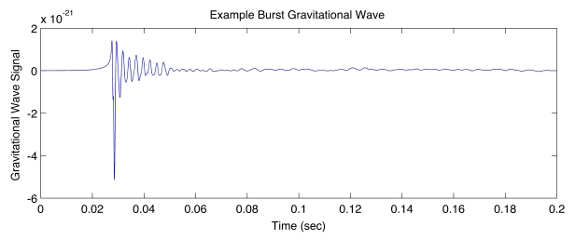

Slide 55
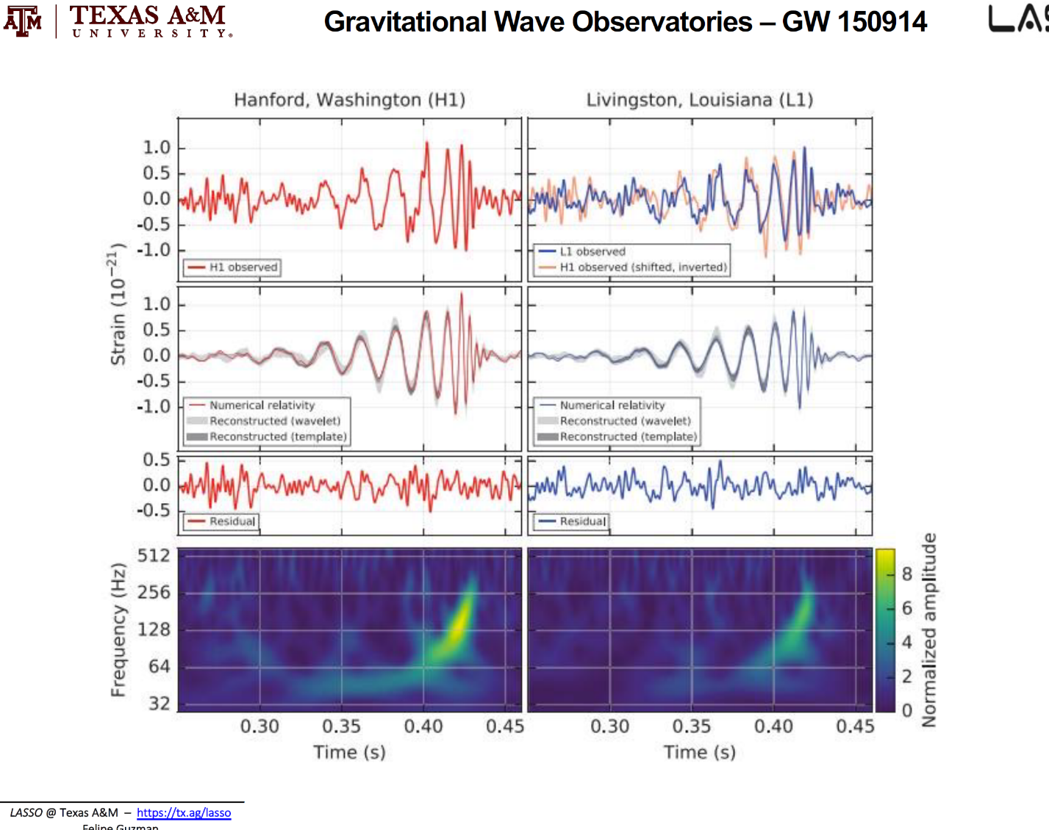
Gravitational wave summary

Slide 56
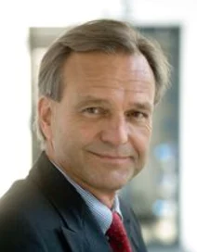
LIGO is a large Michelson interferometer device that uses four test masses on two arms of the interferometer
My drawing of LIGO before it was build
LIGO's Impact on Science and Technology
Gravitational wave detectors like LIGO will answer some outstanding questions related to gravitation and astrophysics, such as:
How does matter behave under extreme densities and pressures?
How abundant are stellar-mass black holes?
Is general relativity the correct theory of gravity?
What is the central engine driving gamma ray bursts?
What happens when a massive star collapses?
1990-1993 Danzmann, Project Leader Gravitational Waves, Max-Planck-Institut für Quantenoptik, Garching
2021 Dark matter search with LIGO in Hannover Germany

Slide 57
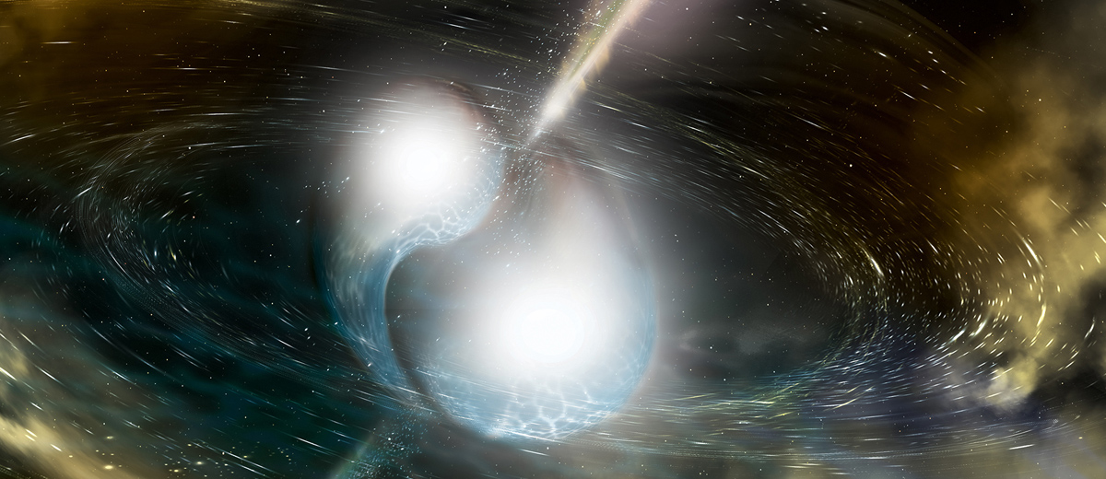
emit
GRAVITATIONAL WAVES DETECTED FROM COLLIDING NEUTRON STARS
Emit both gravitational waves and light (EM-radiation)
When two neutron stars orbit each other closely, they spiral inward as time passes due to gravitational radiation. When the two neutron stars meet, their merger leads to the formation of either a more massive neutron star, or a black hole
On 17 August 2017, the LIGO/Virgo collaboration detected a pulse of gravitational waves, named GW170817, associated with the merger of two neutron stars in NGC 4993, an elliptical galaxy in the constellation Hydra

Slide 58
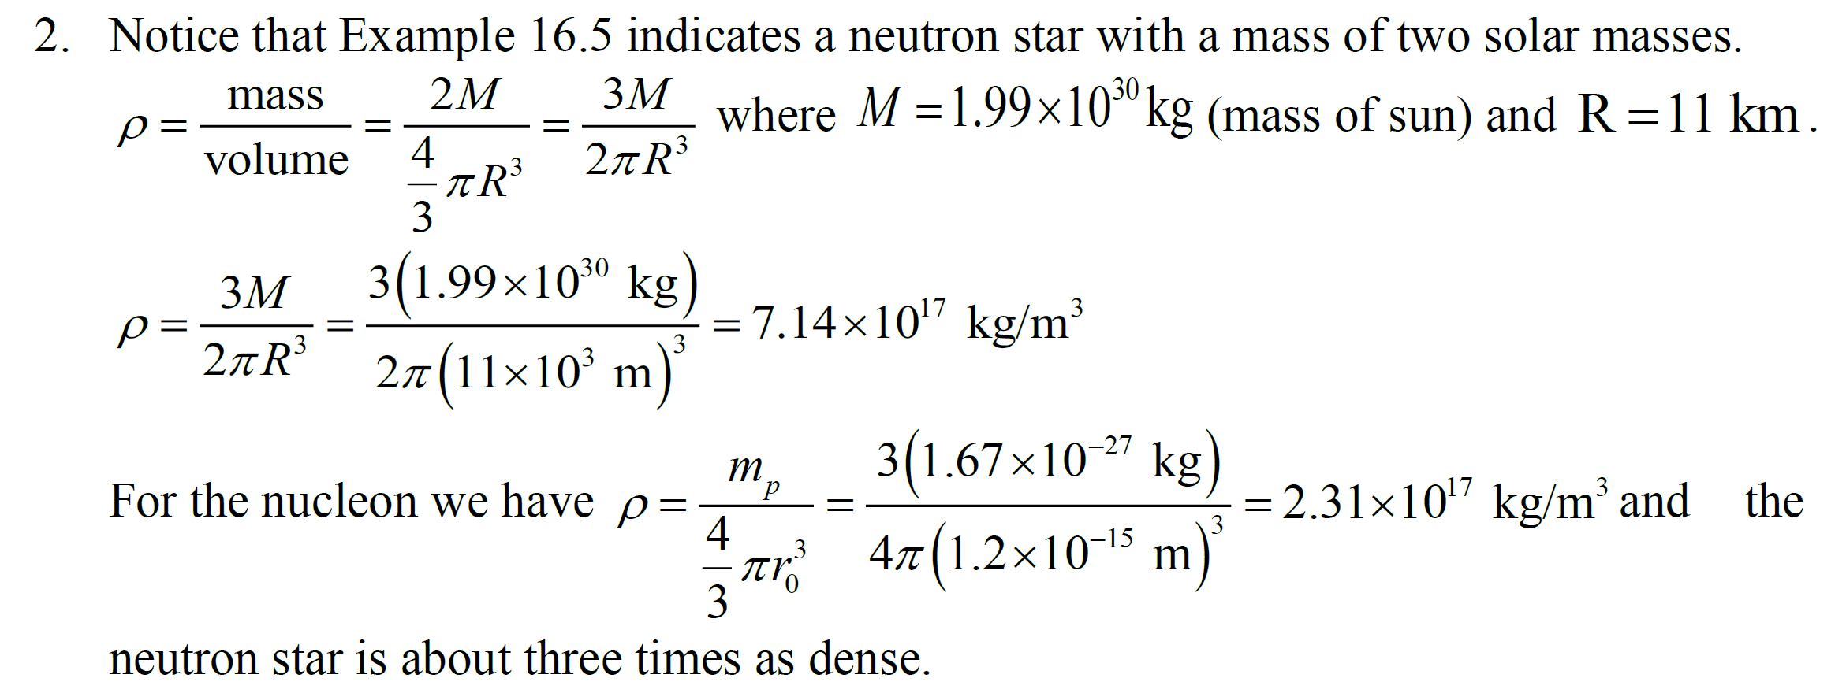
Calculate the density of a neutron star and ccompare with the density of a nucleon

Slide 59
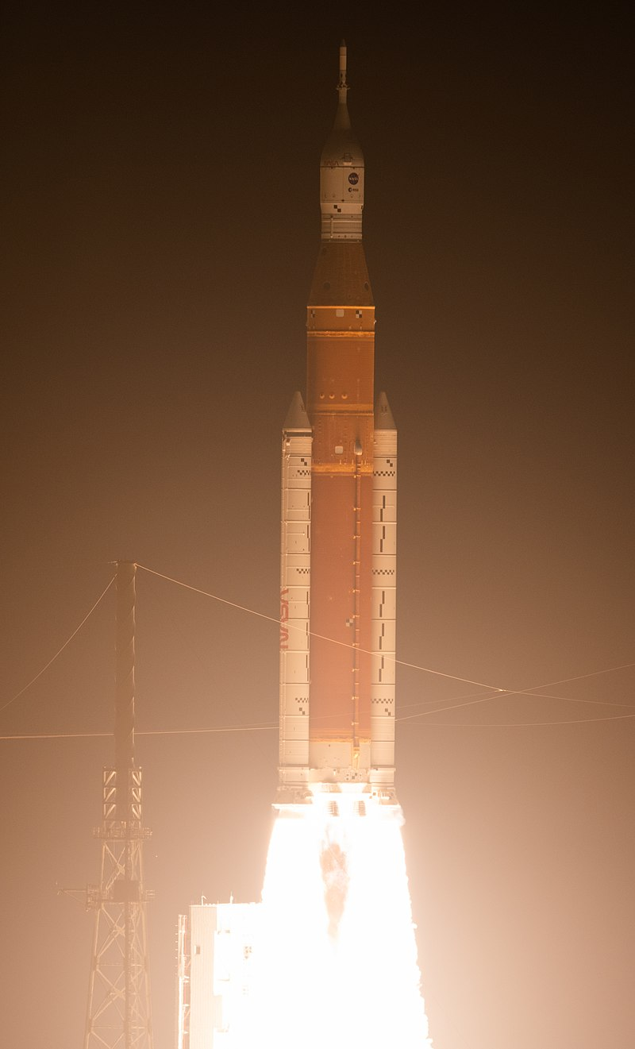
Once in orbit, the ICPS fired its engine to perform a trans-lunar injection (TLI) burn, which placed the Orion spacecraft and ten CubeSats on a trajectory to the Moon. Orion then separated from the ICPS and continued its coast into lunar space. Following Orion separation, the ICPS Stage Adapter deployed ten CubeSats for conducting scientific research and performing technology demonstrations
ICPS is a modified Delta IV Cryogenic Second Stage for NASA's Artemis program

Slide 60
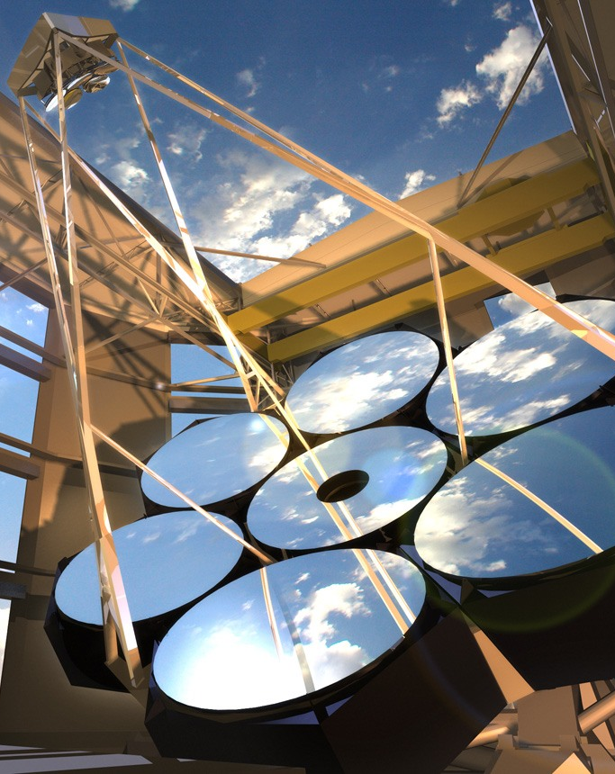
Frequency Comb Lasers for Astrophysics
Hans Schuessler
Texas A&M University
Department of Physics and Astronomy

Slide 61
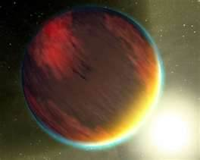
Detecting Extrasolar Planets
Great effort is made to discover earth-like planets in distant solar systems
Various techniques to detect Exoplanets via:
the additional redshift caused by the star’s motion around a common center of gravity
the induced change in position of its star
the dimming of the star’s brightness during the transition of a planet
the induced change of a another planet’s orbit
Habitable Earth-like exoplanets?
Notes:
Topic with much publicity: extrasolar planets
1st method: frequency measurement
Our business!
Habitable Earth-like exoplanets?

Slide 62
How many exoplanets are there?
To date, more than 4,000 exoplanets have been discovered and are considered "confirmed." However, there are thousands of other "candidate" exoplanet detections that require further observations in order to say for sure whether or not the exoplanet is real.
Remarkably, the first exoplanets were just discovered about two decades ago. We live in an extraordinary time where in the span of a single generation, the centuries-old question "Are there planets orbiting other stars?" has been answered with a resounding "Yes!"
Since the first exoplanets were discovered in the early 1990s, the number of known exoplanets has doubled approximately every 27 months.

Slide 63
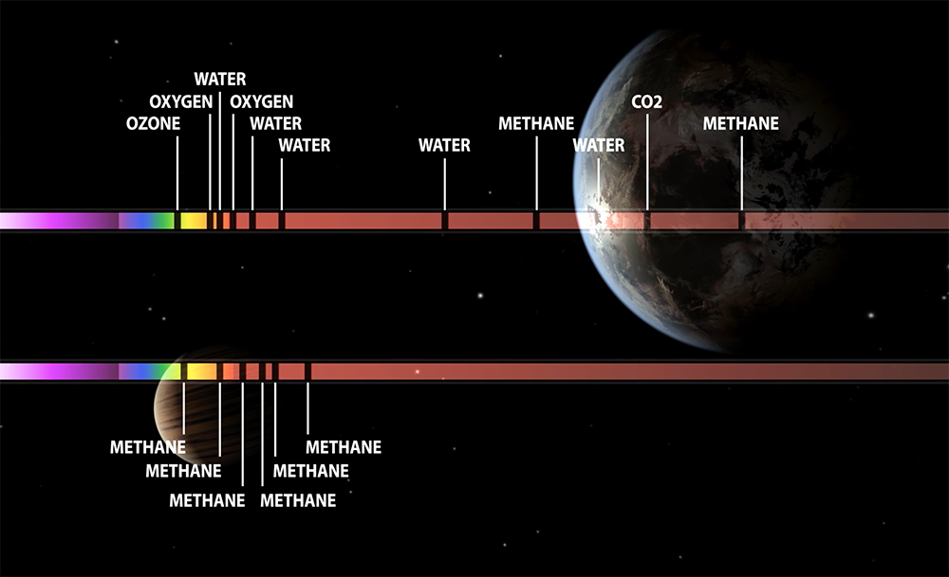
When we find life, how will we know? When we analyze light shot by a star through the atmosphere of a distant planet—a technique known as spectroscopy. The slices missing from the light spectrum tell us which chemicals or gases are present in the alien atmosphere.
Even without listening in on their conversations, the aliens’ reasonably advanced technology would be known to us by its pollution.

Slide 64
StoRy of GoldiLocks & the 3 bears
Once upon a time, there was a little girl named Goldilocks. She went for a walk in the forest. Pretty soon, she came upon a house. She knocked, and when no one answered, she walked right in…
At the table in the kitchen, there were three bowls of porridge.
“This porridge is too hot!”
“This porridge is too cold!”
“This porridge is just right!”
She also tried out each of the three chairs and three beds.
Too big, Too small, Too hard, Too soft, and Just Right

Slide 65
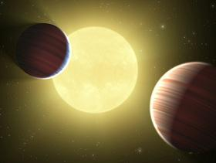
Transit lightcurves are being measured world wide
The Astrophysical Journal Volume 750 Number 1 Marta L. Bryan, Khalid Alsubai, et al. 2012 ApJ 750 84 doi:10.1088/0004-637X/750/1/84
QATAR-2: A K DWARF ORBITED BY A TRANSITING HOT JUPITER AND A MORE MASSIVE COMPANION IN AN OUTER ORBIT

Slide 66
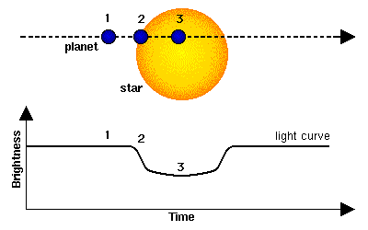
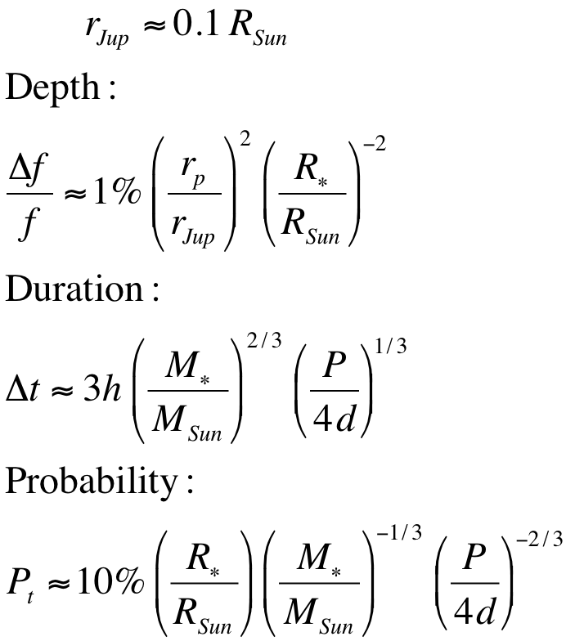
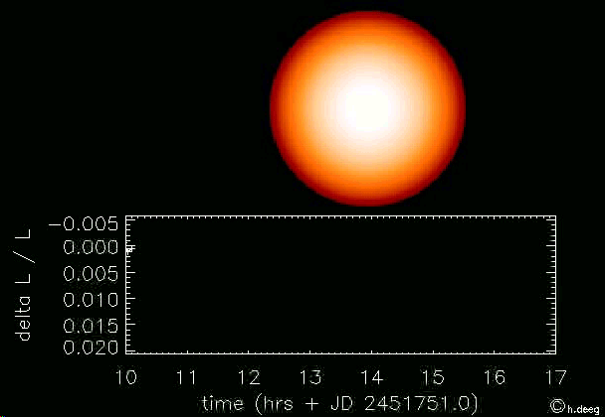
Transit Lightcurves
from Khalid Alsubai

Slide 67
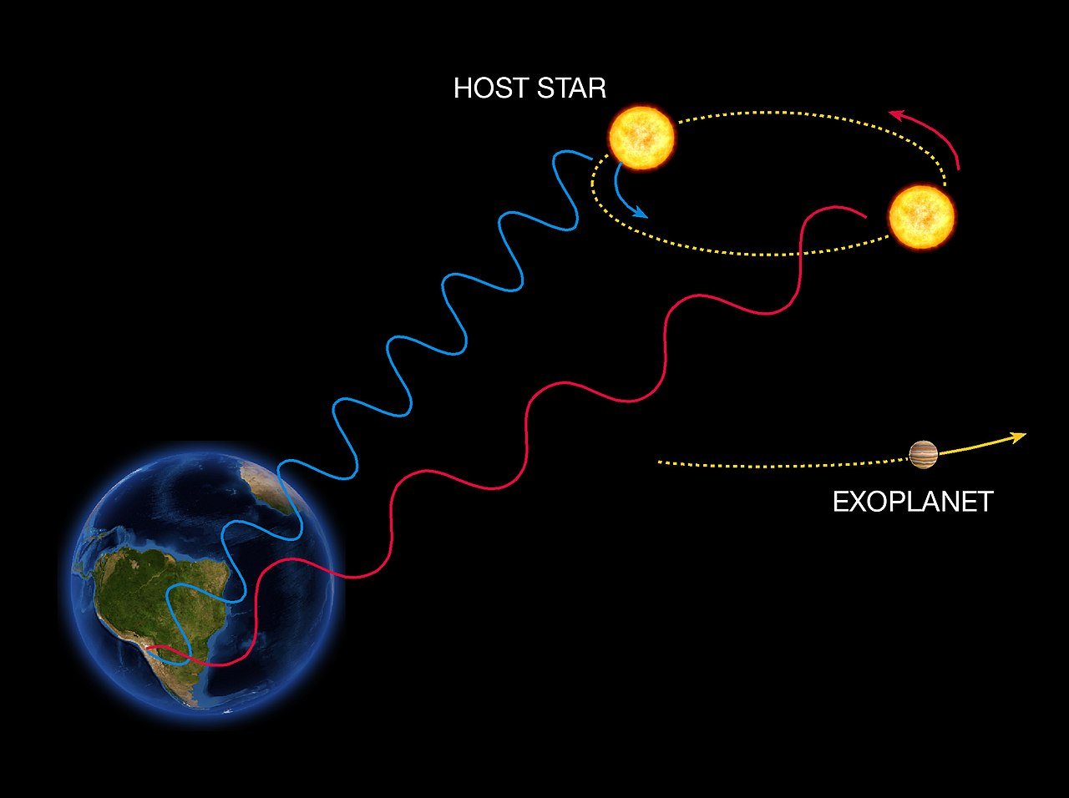
Measuring the radial velocity of celestial objects
Doppler spectroscopy detects periodic shifts in radial velocity by recording variations in the color of light from the host star. When a star moves towards the Earth, its spectrum is blueshifted, while it is redshifted when it moves away from us. By analyzing these spectral shifts, astronomers can deduce the gravitational influence of extrasolar planets.^{[1]}

Slide 68
Understanding Astronomers…
…or: which frequency is measured in m/s?
Most astronomical spectral data are Doppler shifted lines due to relative motion between the celestial object and the Earth!
Quantity of interest: radial velocity measured in m/s
e.g. 1MHz @1550nm corresponds to 1.55m/s
1.55 m/s= 1MHz x 1550 nm
Notes:
First: peculiarity of astronomers language
Other example: F-Number vs. NA

Slide 69
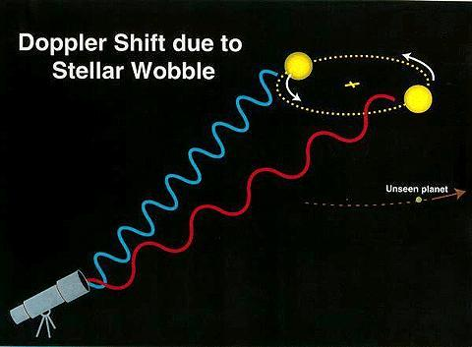
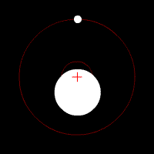
RV search for exo - Planets
A planet orbiting a star will induce a wobbling motion of the star around their common center of gravity. The period of the modulation is given by the planet’s orbital period P, and the modulation depth is dependent on the mass ratio of star and planet Mp/M
Radial Velocity
Variations induced
by exo-planets
~860 discovered
in 12 years
with RV technique
Notes:
A planet orbiting a star will induce a wobbling motion of the star around their common center of gravity. The period of the modulation is given by the planet’s orbital period P, and the modulation depth is dependent on the mass ratio of star and planet Mp/M

Slide 70
Dark energy with GMT
( 2027)
From Lucas Macri

Slide 71
Direct detection of expansion
400 nights of GMT time over 20 years
acceleration
From “Cosmic Dynamics in the Era of Extremely Large Telescopes”
deceleration
5x10⁹ yr
8x10⁹ yr
1x10¹⁰ yr
1.1x10¹⁰ yr
1.2x10¹⁰ yr
1.37x10¹⁰ yr
CMB
Z=1000

Slide 72
Conclusions
No variations of the Fundamental Constants have been seen so far, but excitement and suspense prevail in novel approaches(cold molecule spectroscopy with ion traps) or when reaching the next decimal in atomic spectroscopy measurements.
2 groups lead the search for exoplanets:
At the MPQ in Garching. Hänsch group (T. Wilken, Holzwarth, T. Udem, Nature 485,611(2012))
At NIST in Boulder. Diddams group (G. G. Yeas, et al, Optics Express 20,6631(2012)
The Giant Magellan Telescope (GMT) is planned to be finished in the late 2027.
The ESO Extremely Large Telescope is scheduled to be finished in 2027.
The GMT will hopefully be ahead and at the time should have an Astro-Comb ready to stay ahead of the competition.
At TAMU we have the frequency comb lasers available, but work needs to be done to do the mode filtering and adaptation to an astronomical spectrograph.

Slide 74
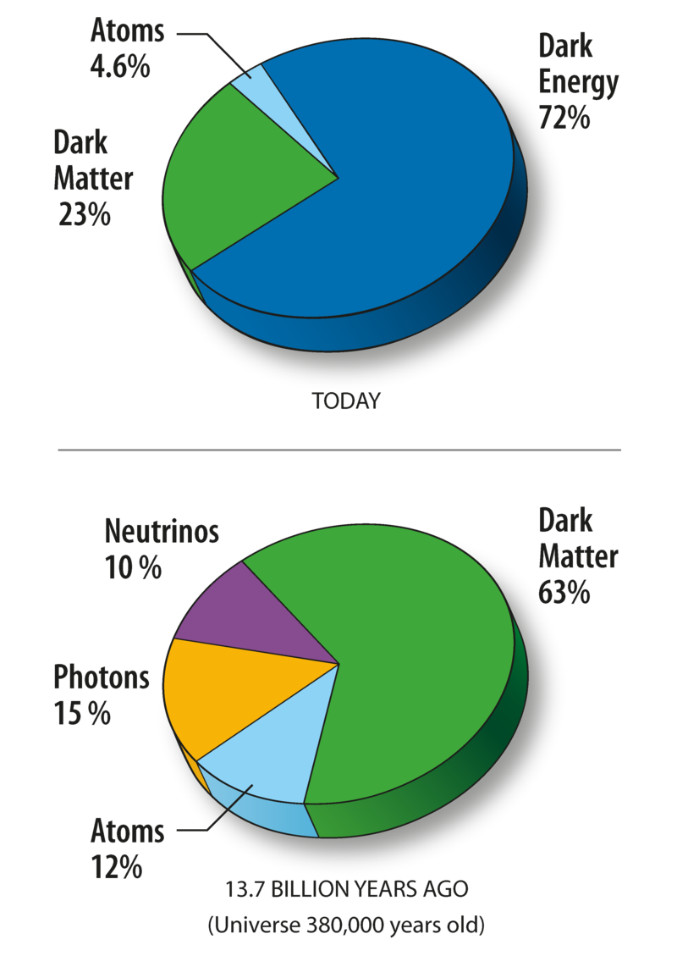
Cosmological Observations
Galaxies and the Discovery of Dark Matter
By fitting a theoretical model of the composition of the universe to the combined set of cosmological observations, scientists have come up with the composition that we described above, ~72% dark energy, ~23% dark matter, ~5% normal matter. What is dark energy and dark matter is at pressnt not known

Slide 75
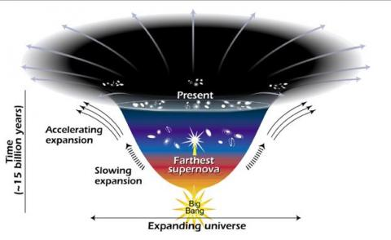
Dark Energy
One explanation for dark energy is that it is a property of space. Albert Einstein was the first person to realize that empty space is not nothing. Space has amazing properties, many of which are just beginning to be understood. The first property that Einstein discovered is that it is possible for more space to come into existence. Then one version of Einstein's gravity theory, the version that contains a cosmological constant, makes a second prediction: "empty space" can possess its own energy. Because this energy is a property of space itself, it would not be diluted as space expands. As more space comes into existence, more of this energy-of-space would appear. As a result, this form of energy would cause the universe to expand faster and faster. Unfortunately, no one understands why the cosmological constant should even be there, much less why it would have exactly the right value to cause the observed acceleration of the universe.
Universe Dark Energy-1 Expanding Universe
This diagram reveals changes in the rate of expansion since the universe's birth 15 billion years ago. The more shallow the curve, the faster the rate of expansion. The curve changes noticeably about 7.5 billion years ago, when objects in the universe began flying apart as a faster rate. Astronomers theorize that the faster expansion rate is due to a mysterious, dark force that is pulling galaxies apart.
Credit: NASA/STSci/Ann Feild

Slide 79
Physics 222 Summary
Selfie of the SIBOR
We touched horizons in special and general relativity, atomic physics, nuclear physics, astrophysics, gravitational wave detection
Around the globe
TRIUMF
私の研究室は太陽が沈まない On my laboratories, the sun never sets.
Sur mes laboratoires, le soleil ne se couche jamais.
In meinem Labor geht die Sonne nicht unter.
على مختبرات بلدي، لا تغيب عنها الشمس
RIKEN
College Station,
Texas
Doha,
Qatar
Notes:
Watashi no kenkyushitsu wa taiyo ga shizumanai
There is legitimate concern over what physics will eventually come out of this. The hope, of course, is for a competitive and model-independent value of r_neutron to compare to medium-energy reaction cross-sections. It is reasonably that although there is unlikely to be a truly model-independent determination of r_n, the anomaly would provide valuable information to discriminate between different explicit models. E.g., the anomaly would determine accurately parameters in a standard two-configuration model for 11Be, and in that model there would be a determination r_n. This could in principle eventually be compared with modern 'ab-initio' calculations, and Takamine et al's measurement might well encourage such calculations.

