Slide 1
COLLEGE PHYSICS 201 (sections 31-35)
Instructor: Hans Schuessler
Substituting: Alexandre Kolomenski
https://sibor.physics.tamu.edu/courses/physics-201-college-physics/

Slide 2
PHYS 201 College Physics Fall 2023 TR 5:30
Course Description: Fundamentals of classical mechanics, heat and sound.
Prerequisites: High school algebra and trigonometry or the equivalent.
Learning Outcomes: Upon completion of PHYS 201 a student will understand the basic laws and concepts of physics in the following areas and will be able to apply them in problems relating to physical situations: mechanics, mechanical waves, and thermodynamics.
Instructor: Hans Schuessler email: h-schuessler@tamu.edu
Office Hours: TBD
Grad. Assistant: Carlos Rodriguez email: carlos.rodriguez@tamu.edu
Text: College Physics 11th ed by Young and Adams with Modified Mastering Physics
The mid-term exams are in person 7:00 to 9:00 pm, on the following Thursdays:
September 14 (Chs 1-5), October 12 (Chs 6-8), November 2 (Chs 9-11), and November 30 (Chs 12-16)
Access Mastering Physics for homework and Webassign for lab
There are prelecture videos and tutorial problems assigned in Mastering Physics (for grade) in addition to the problems from the textbook that are listed on the syllabus.
Grading: 4 exams 60%; Final (comprehensive) 20%; Lab 5%; Recitation 5%; Homework (Mastering Phys) 5%; in-class quizzes 5%.
Scale: 90-100 A, 80-89 B, 60-79 C, 45-59 D, <45 F. Grades may be curved upward. Follow university policy on making up missed work.
You must achieve 70% or better in the laboratory in order to pass the course.
If your grade on the Final Exam is higher than your lowest grade on one of the four exams during the semester, that lowest grade will be replaced by its average with the Final in computing the course grade. The quiz grade will come from 25 quizzes; if more quizzes than this are given during the semester the lowest grades beyond the best 25 will be dropped.
August 25 is last day for no record drop. Nov. 15 is the last day to Q-drop.
Final Exam is on Tuesday, December 12, 3:30 – 5:30 pm
https://sibor.physics.tamu.edu/courses/physics-201-college-physics/

Slide 3
What is physics about?
Science that studies the most general laws of nature.
Quantifies relations (dependences) between different quantities.
Needs units to express all these quantities and relations.
Uses models as approximations for real processes.
Physics is the basis for many engineering disciplines.

Slide 4
What is physics about? (cont.)
Observations
Experiments
Measurements
Instruments (rulers, clocks, etc.)
Units
Language of physics

Slide 7
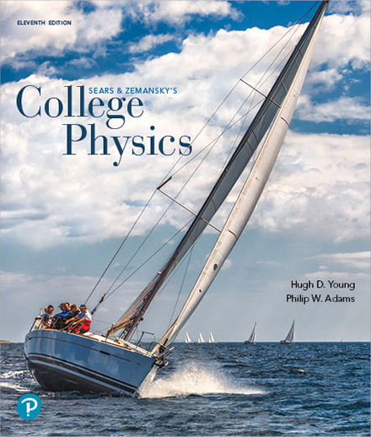
Chapter 0: Mathematics Review
You are encouraged to review this chapter.
All topics are important for this course.
In particular: scientific notation and powers of 10.
135,000=1.35x10⁵
0. 000135 =1.35x10⁻⁴
one digit to the left of the decimal point, multiplied by the appropriate power of 10.
3 significant
digits

Slide 8
Rules for significant figures
When numbers are multiplied or divided, the number of significant figures in the final answer equals the smallest number of significant figures in any of the original factors.
(2) When adding/subtracting, the answer should have the same number of decimal places as the limiting term. The limiting term is the number with the least decimal places.
Indication of significant figures (digits) using scientific notation: decimal number with one digit to the left of the decimal point, multiplied by the appropriate power of 10.

Slide 9
1.5 Precision and Significant Figures
How precise can you measure a physical quantity?
For example, using a meter stick to measure lengths, you may get
0.7880 m or 0.3575 m. These quantities have 4 significant figures.
In the sense of significant figures, 0.788 m ≠ 0.7880 m.
● Multiplication and Division
2.4 × 2.30 = 5.5 (≠ 5.52 or 5.520)
● Addition and Subtraction
2.4 + 2.320 = 4.7 (≠ 4.720)
1.24×10⁶ + 3.23×10⁵ = 1.24×10⁶ + 0.323×10⁶ = 1.56×10⁶
1.24×10⁶ + 3.23×10⁴ = 1.24×10⁶ + 0.0323×10⁶ = 1.27×10⁶
1.24×10⁶ + 3.23×10³ = 1.24×10⁶ + 0.00323×10⁶ = 1.24×10⁶
Courtesy of Wenhao Wu

Slide 10
Chapter 0 Math Review
Please review the following subjects
0.1 Exponents
0.2 Scientific Notation and Powers of 10
0.3 Algebra
Solving Quadratic Equations
Quadratic Formula
Solving Two Equations with Two Unknown Variables
0.4 Direct, Inverse, and Inverse-Square Relationships
Graph of Proportionality Relationship
0.5 Data-Driven Problems
Linearizing the Data
Find slope and Intercept
0.6 Logarithmic and Exponential Functions
0.7 Areas and Volumes
0.8 Plane Geometry and Trigonometry
Courtesy of Wenhao Wu

Slide 11
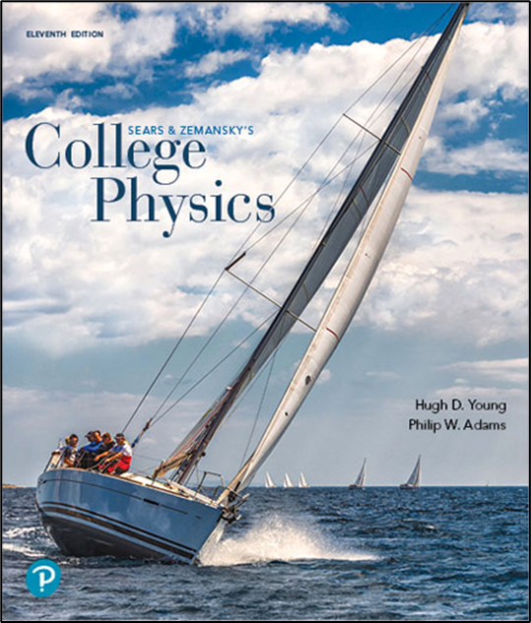
Chapter 1: Models, Measurement, and Vectors
Note: Explore your textbook!
Unit Conversion Factors (back of the cover),
App. A: The International System of Units
App. B: The Greek Alphabet
App. C: Periodic Table
App. D: Unit Conversion Factors
App. E: Fundamental Physical Constants
Fundamental Physical Constants (end)

Slide 12
Goals for Chapter 1
To know standards and units and be able to do unit conversions.
To express measurements and calculated information with the correct number of significant figures.
To be able to add and subtract vectors both graphically and analytically.
To be able to break down vectors into x- and y- components.

Slide 13
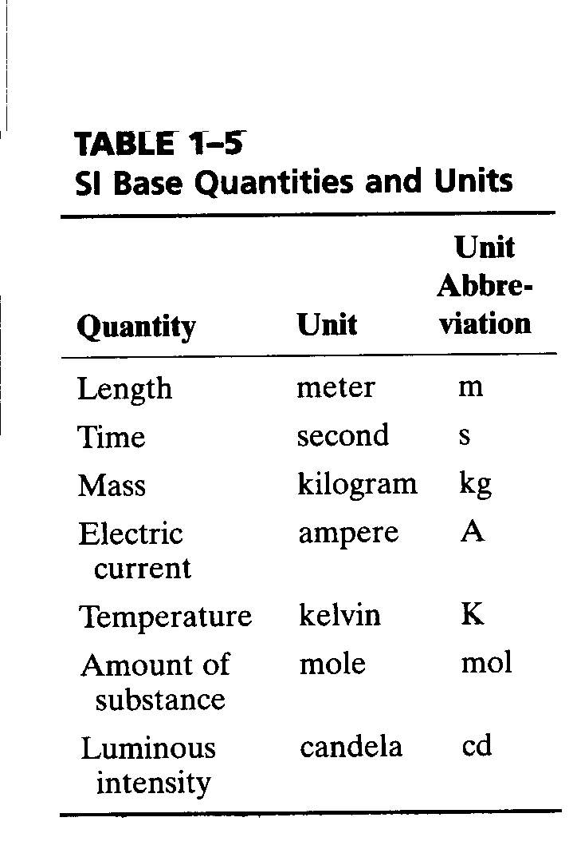
SI Base Quantities and Units

Slide 14
Objects of different dimension
Scale
Astronomic
Macro
Micro
Size difference within scale

Slide 15
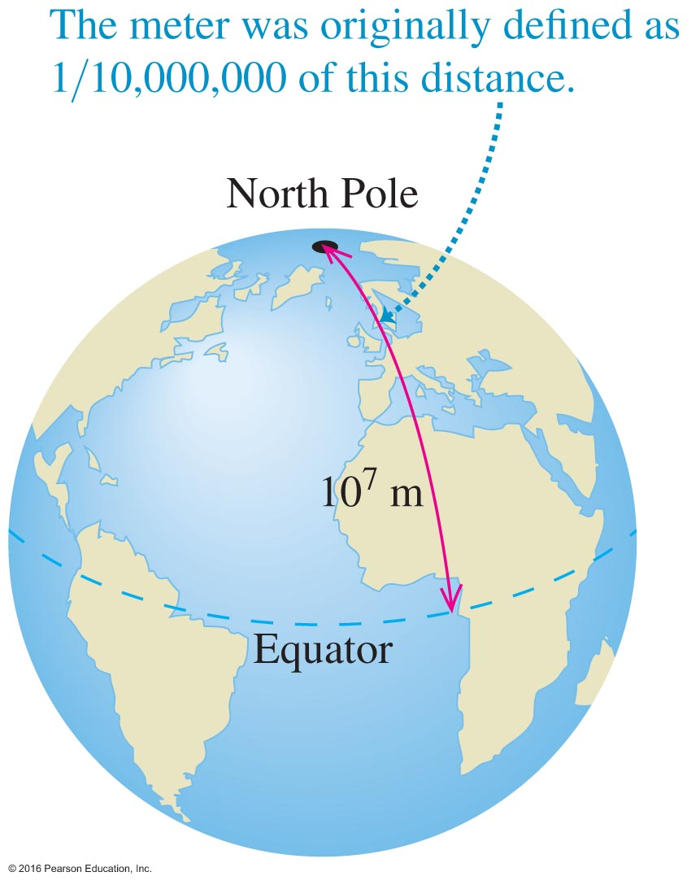
The Meter – The Original Definition of 1791

Slide 16
The Meter – More Recently
Now tied to Kr discharge and counting a certain number of wavelengths.
Exceptionally accurate, in fact redefining c, speed of light.
New definition is the distance that light can travel in a vacuum in 1/299,792,458 seconds.
So accurate that it loses only 1 second in 30 million years.

Slide 17
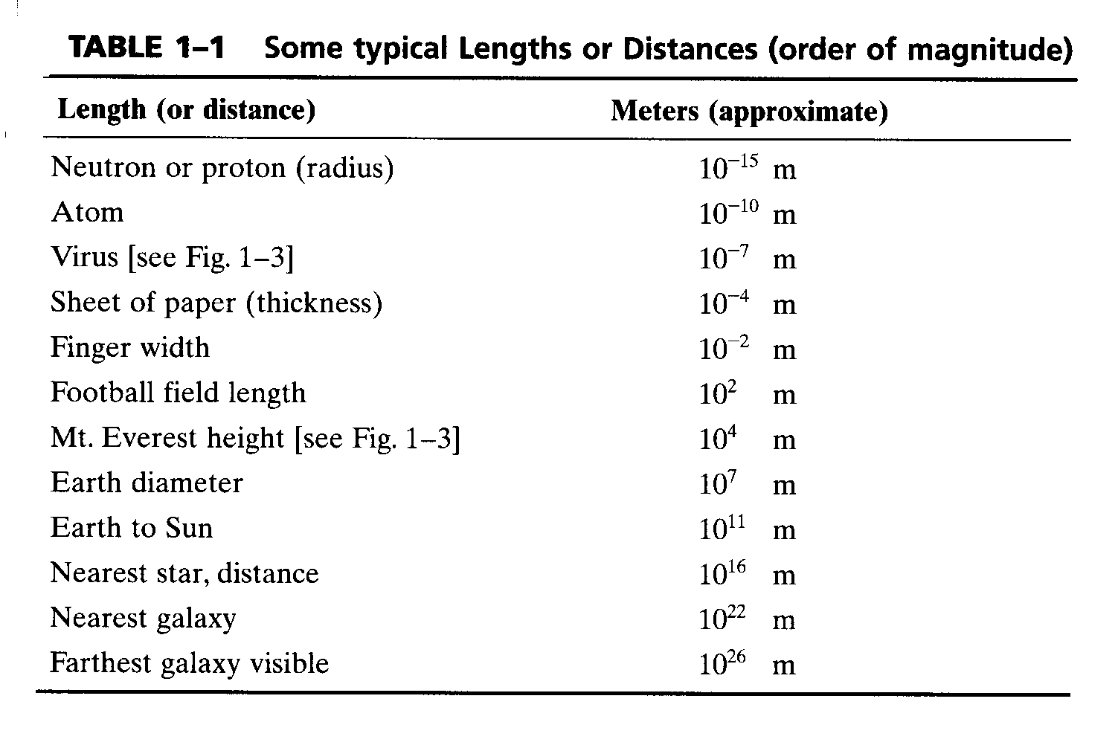
Length
1m ≈ 10⁻⁷ of the distance from the equator to the pole (old definition)
1m = length of the path traveled by light in vacuum during the time interval of 1/299,792,458 of a second

Slide 18
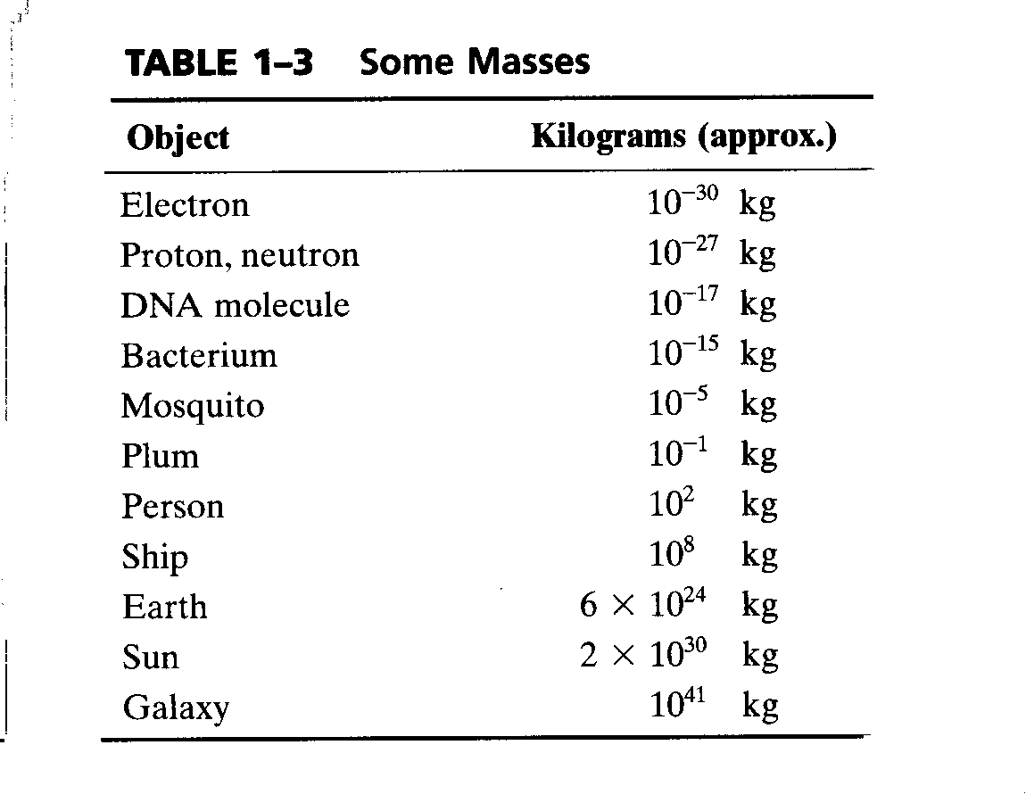
Mass
1kg = mass of the platinum-iridium cylinder in Paris
1u = 1.6605× 10⁻²⁷kg ( unified atomic mass unit)

Slide 19
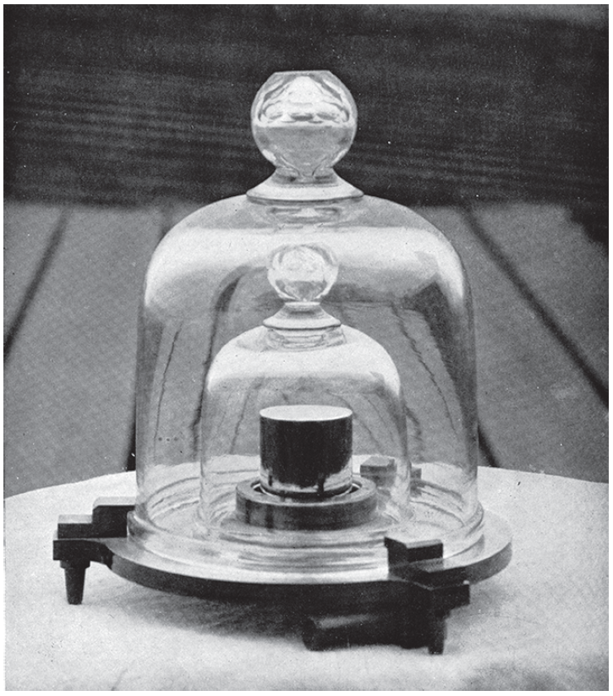
The Reference Kilogram - Figure 1.3

Slide 20
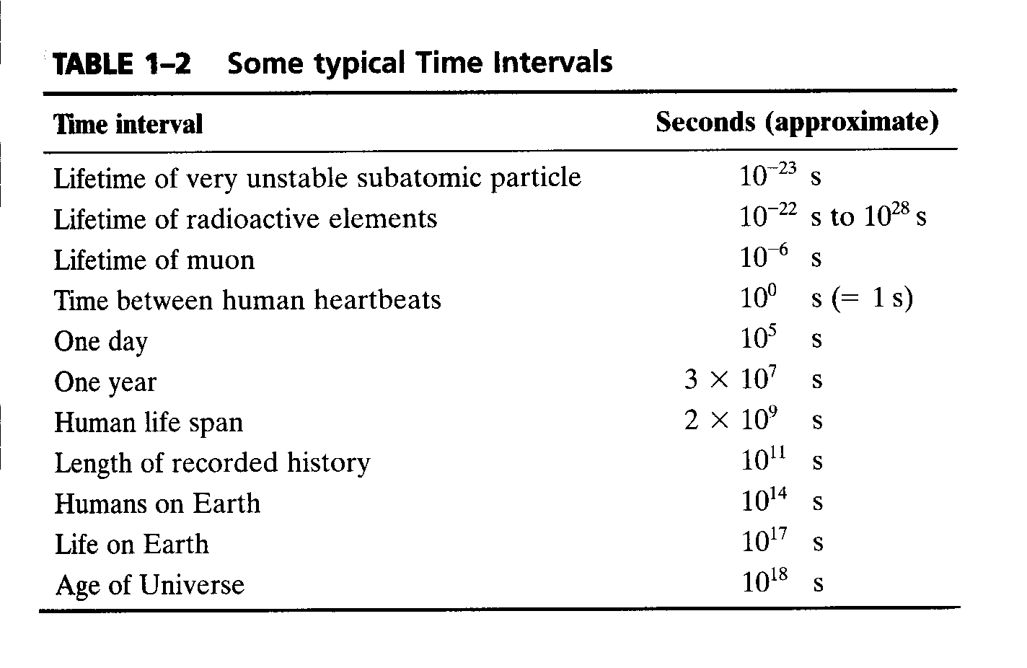
Time
1s = 1/24*60*60 day=1/86400 day (def. till 1967)
1s = time required for 9,192,631,720 periods of radiation of the Cs-atom

Slide 21
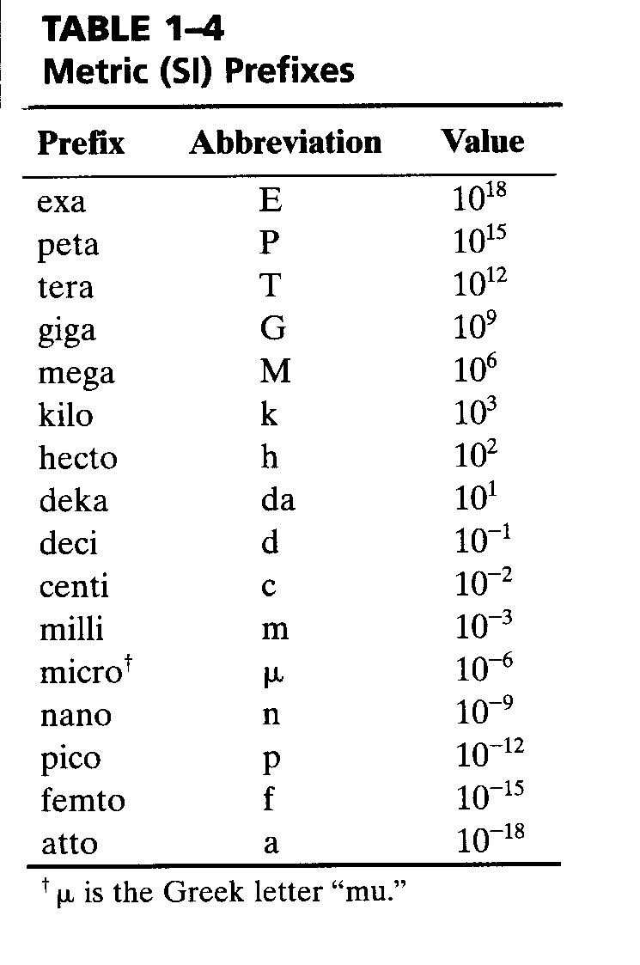
Metric(SI) Prefixes

Slide 22
10 to the negative fifteenth power | femto-

Slide 24
Conversion of units
We would like to find how many meters in 20 miles, how do we do this?
We go to the pages in the end of the textbook, Appendix D “Unit conversion Factors” and use the formula
1 mile=1.609 km
now we know 1km=1000 m then
20 mi=20x1.609x1000 m=32180 m

Slide 25
Conversion of units (2nd example)
We would like to know, what will be
18 km/h in m/s?
18 km/h=18x1000m/(60x60s)=5 m/s

Slide 26
Conversion of units
We would like to find how many meters in 20 miles, how do we do this?
We go to the pages in the end of the textbook, Appendix D “Unit conversion Factors” and use the formula
1 mile=1.609 km
now we know 1km=1000 m then
20 mi=20x1.609x1000 m=32180 m

Slide 27
Unit Conversion
Alpha Centauri is the closest "star." It is 4.3 light-years away. How many kilometers away is the star from earth?
Write down: What do you know? What are we trying to get to?
4.3 light-years = time it takes for light to travel distance
Distance = time × speed
Now do it…
What's the speed (rate)?
Speed of light

Slide 28
Physical quantities and units
1. All physical quantities always
have some units!
2. From relationships between these
quantities one can derive new units.

Slide 29
Units SI and derivative units
Displacement, distance: 1 meter 1m
Velocity, speed: 1 meter/second 1m/s
Acceleration: 1 meter/second² 1m/s²

Slide 30
Dimensional analysis
You have three equations with distance x, speed V, time t and acceleration a, which of them can be correct?

Slide 31
Vectors and vector addition

Slide 32
Vector: magnitude and direction

Slide 33
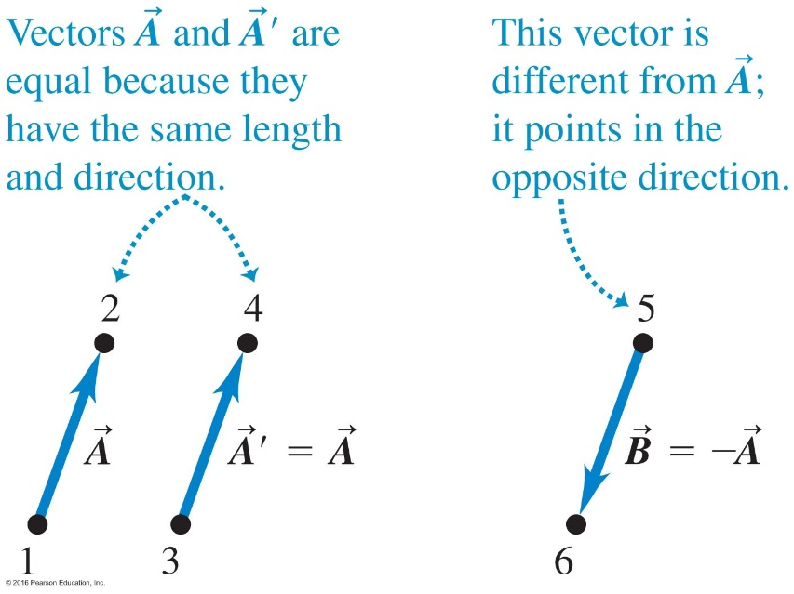
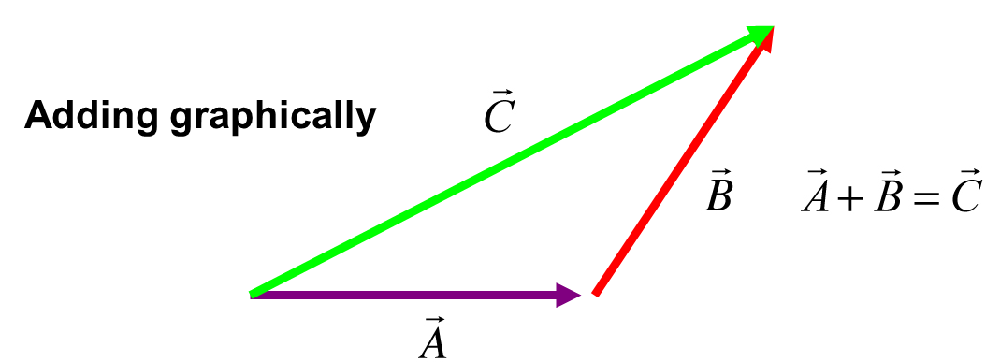
Vector Addition (1 of 2)
In the "world of vectors" 1+1 does not necessarily equals 2.
Graphically?

Slide 34
Vector Addition (2 of 2)
In the "world of vectors" 1+1 does not necessarily equal 2.
Graphically?

Slide 35
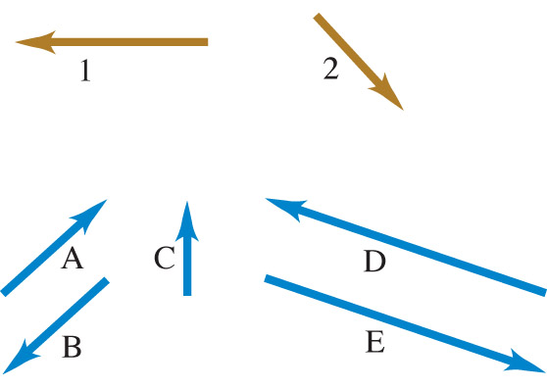
Which of the vectors A–E represents the vector sum of vectors 1 and 2?
Clicker question
Notes:
Answer: a)

Slide 36
Vectors: example of subtraction

Slide 37
Simple Multiplication
Multiplication of a vector by a scalar
Let’s say Mr.X travelled 1 km east. What if Mr.X had gone 4 times as far in the same direction?
Just stretch it out: multiply the magnitude and preserve the direction
Negatives:
Multiplying by a negative number turns the vector around

Slide 38
Reference frame or system of coordinates
Almost any problem in mechanics starts
with selection of the reference system.
To determine the location of an object
we provide its position in respect to
some other object or point that we select
as an origin.

Slide 39
Reference frame and unit vectors
+z

Slide 41
Position vector (radius-vector)
The tale of this vector is always in
the origin of the reference frame.
Describes position of a point on a plane
(in 2D, 2 numbers: {x,y}),
or in space (in 3D, 3 numbers, {x,y,z}).
Displacement- change of the position, this is a vector!

Slide 42
Trigonometry

Slide 43
Vectors by Components
How do you do it?
First RESOLVE the vector by its components! Turn one vector into two
Careful when using the sin and cos: don’t mix them up!

Slide 44
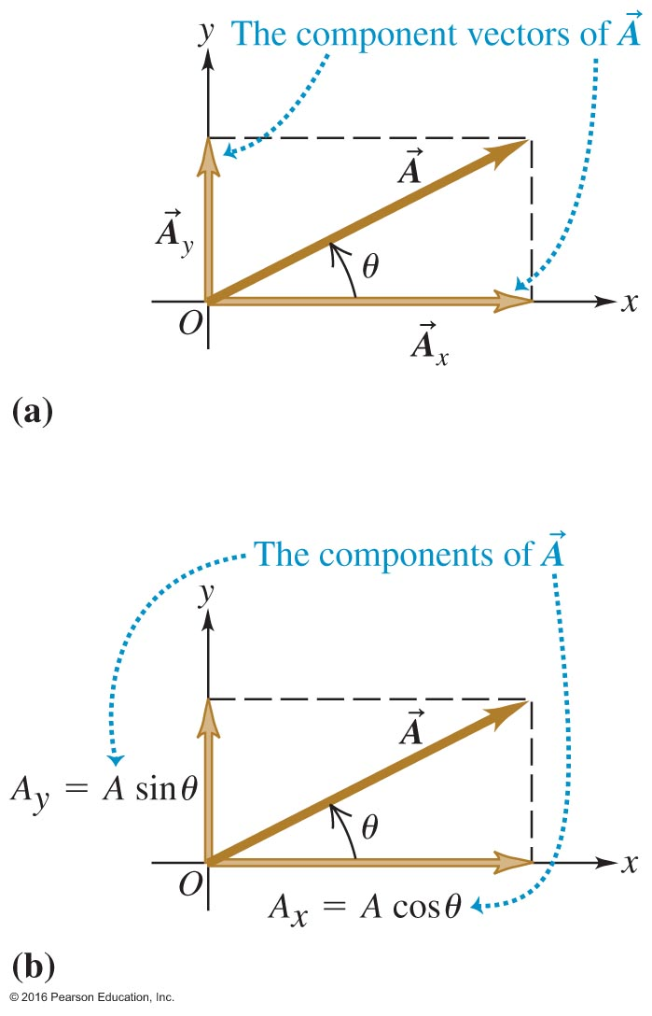
Or, Decompose the Vectors into Components, Then Solve
sin
Angle is measured counterclockwise!

Slide 45
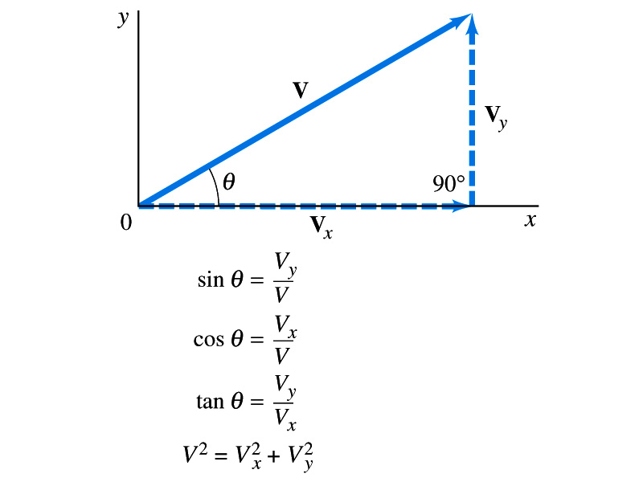
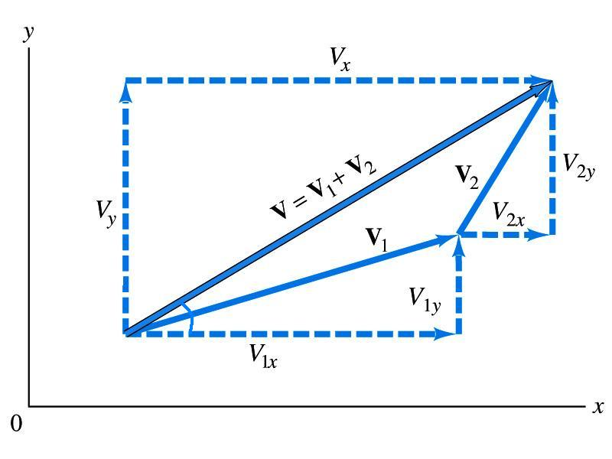
Vector addition (by components)
Components are projections along the axis
Find components by trigonometry

Slide 46
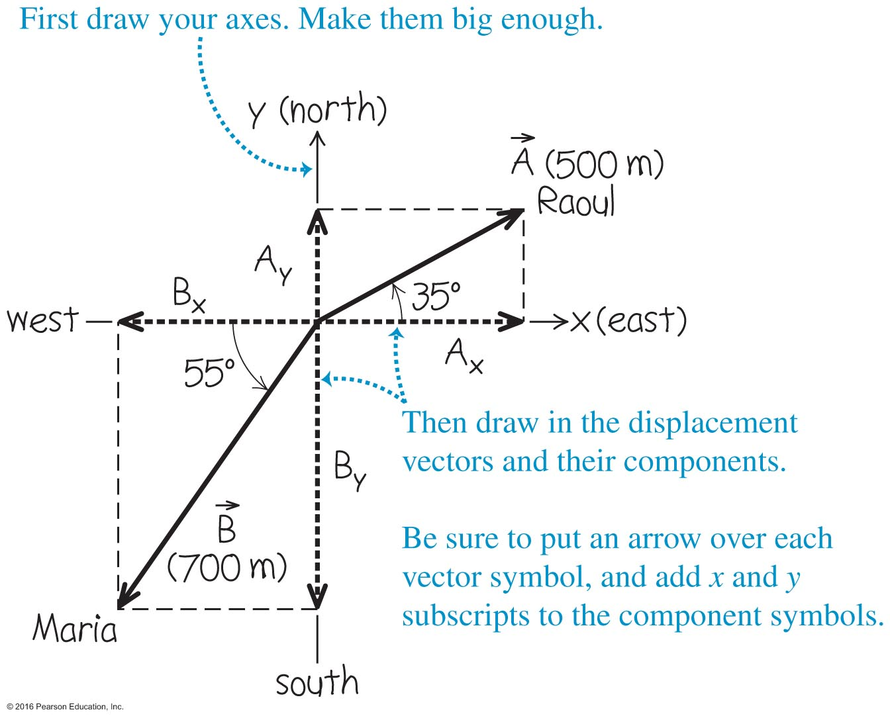
Example 1.6 on P. 17-18
Aunt’s house at origin
How far did Raoul walk?
on the east leg of the trip
A_{x} = A cos(35°) = 500 cos(35°)
= 410 m
on the north leg of the trip
A_{y} = A sin(35°) = 500 sin(35°)
= 287 m
How far did Maria walk?
(c) on the west leg of the trip
B_{x} = B cos(180°+55°) = 700 cos(235°)
= - 402 m
Or, B_{x} = - B cos(55°) = - 700 cos(55°)
= - 402 m
(d) on the south leg of the trip
B_{y} = B sin(180°+55°) = 700 sin(235°)
= - 573 m
Or, B_{y} = - B sin(55°) = - 700 sin(55°)
= - 573 m
Courtesy of Wenhao WU

Slide 47
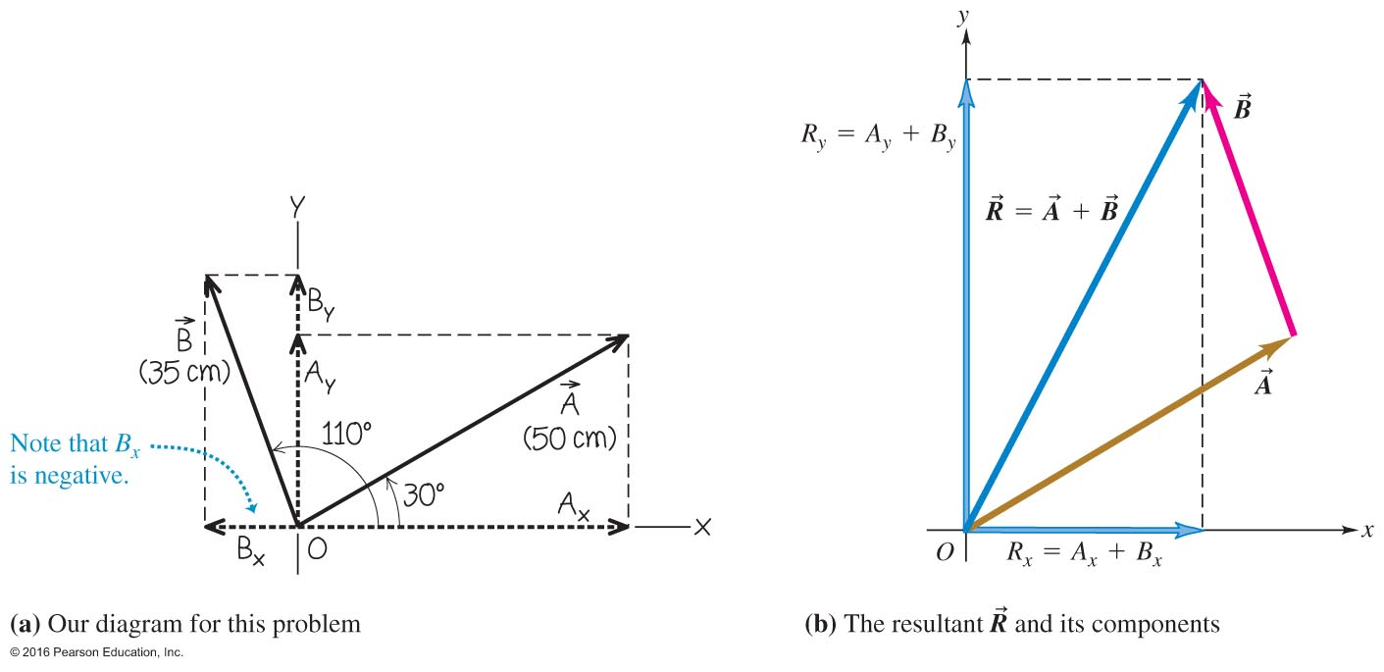
Using Components to Add Vectors
Example 1.7: Vector
has a magnitude of 50 centimeters and
direction of 30º, and vector
has a magnitude of 35 centimeters
and direction 110º (both angles measured c c w from
What is the resultant vector

Slide 48
(similar to1-43)
flying 115 miles more
v
or φ=19 deg. south of east

Slide 49
Examples: vector or scalar?
1. Displacement
2. Velocity
3. Acceleration
4. Force
1. Distance
2. Speed
3. Time
4. Mass

Slide 50
A radio-controlled model car moves 3 m in one direction and then 5 m in another direction. The car's resultant displacement could have a magnitude as small as
Clicker question
–2 m.
0 m.
2 m.
3 m.
8 m.
Notes:
Answer: c) 2 m.

Slide 51
Summary of simple operations on vectors
1. Sum and subtract
2. Multiply by a number
You can do this by components!
For components it works just as
with numbers, but signs should
be taken into account!
However, multiplication of vectors is different!

Slide 52
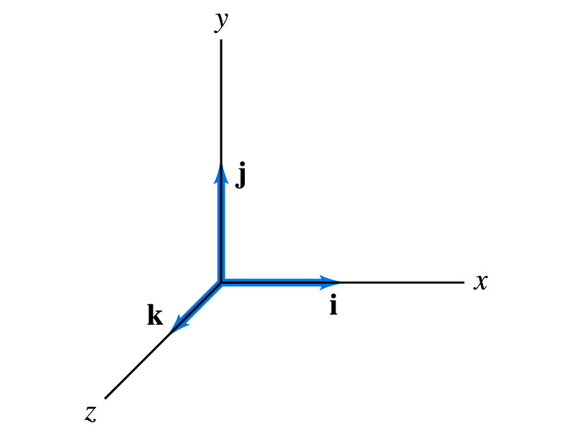
Vector Multiplication
Scalar (dot) product
Vector product

Slide 53
Thank you for your attention!

