Slide 1
Chapter 2:Motion along a straight line
Translational Motion and Rotational Motion
Today
Later

Slide 2
Goals for Chapter 2
Become comfortable with displacement, velocity, and acceleration in one dimension.
Explore motions at constant acceleration.
Be able to graph and interpret graphs as they describe motion.
Be able to reason proportionally.
Examine the special case of freely falling bodies.
Consider relative motion.

Slide 3
Describing Motion …
Coordinates
→ Position (displacement)
→ Velocity
→ Acceleration
a) Motion with zero acceleration
b) Motion with non-zero acceleration

Slide 4
Kinematics in One Dimension: Displacement

Slide 5
Average velocity
Average velocity = total displacement covered divided
by total elapsed time
Unit: m/s
meter per second

Slide 6
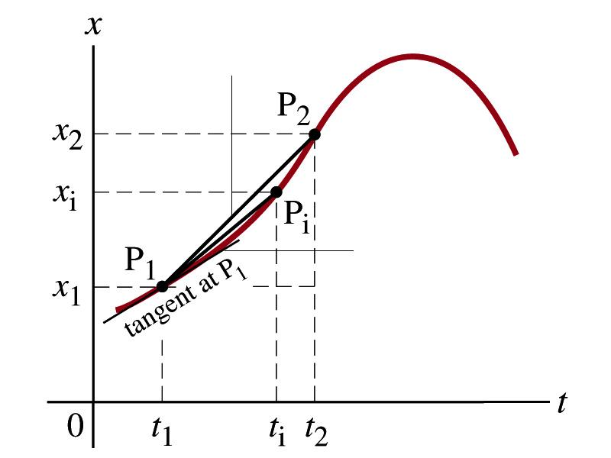
Graphic representation: average and instantaneous velocities
Average velocity
(slope of line P₁P₂)
Slope is average velocity during Δt=t₂-t₁
Slope of the tangent line is instantaneous velocity at t₁

Slide 7
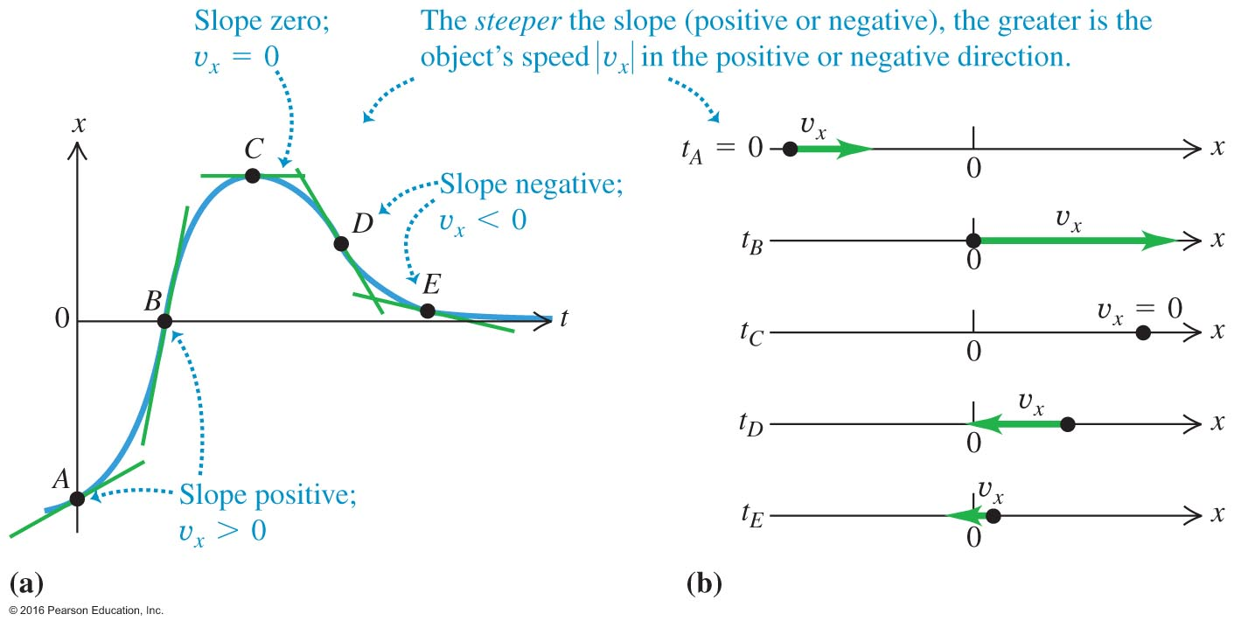
Understanding the direction and the magnitude of the instantaneous velocity graphically

Slide 8
Average speed and velocity
Average velocity = total displacement covered
divided by total elapsed time,
Speed is just the magnitude of velocity!
The “how fast” without accounting for the direction.
Average speed = total distance covered per total elapsed time,
Instantaneous velocity, velocity at a given instant

Slide 9
Average Velocity (example)
x (meters)
6
4
2
0
-2
1
2
3
4
t (seconds)
What is the average velocity over the first 4 seconds ?
A) -2 m/s
B) 4 m/s
C) 1 m/s
D) not enough
information to
decide.

Slide 10
Instantaneous Velocity
x (meters)
6
4
2
-2
1
2
3
4
t (seconds)
What is the instantaneous velocity at the fourth second ?
A) 4 m/s
B) 0 m/s
C) 1 m/s
D) not enough
information to
decide.

Slide 11
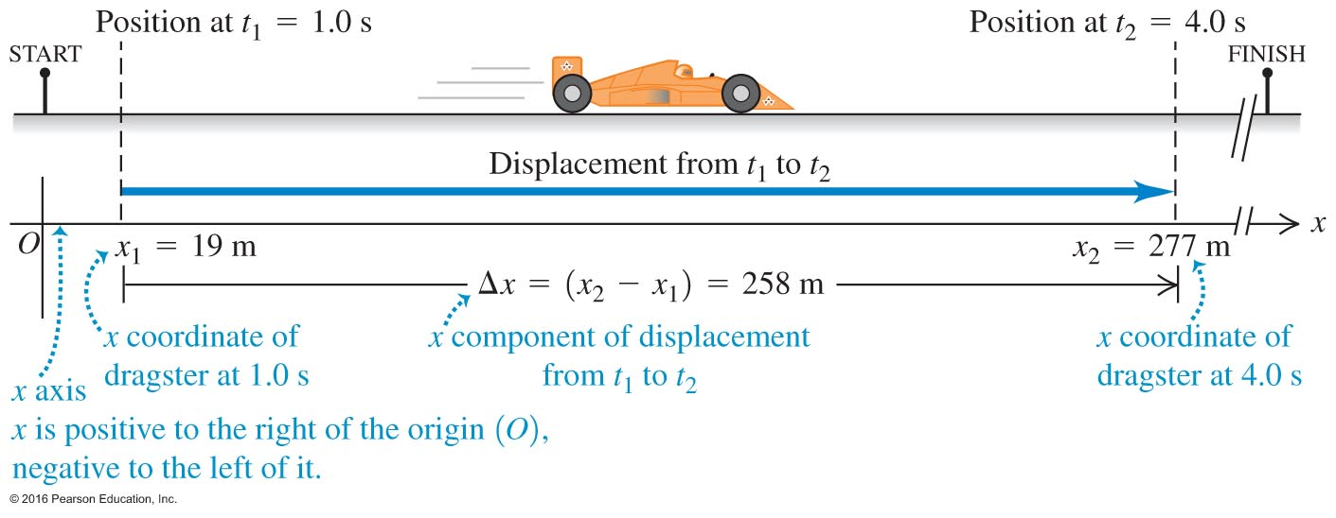
Average Velocity - Figure 2.1

Slide 12
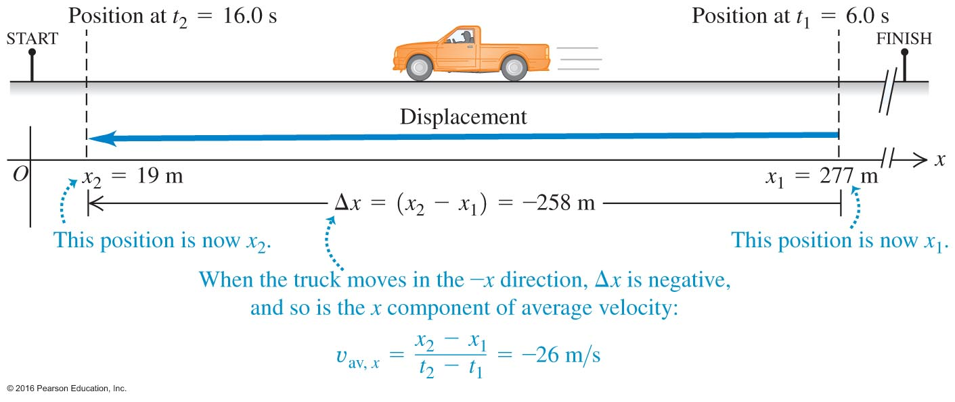
Displacement and Average Velocity
Courtesy of Wenhao Wu

Slide 13
Acceleration
We say that things which have changing velocity are “accelerating”
Acceleration is the “Rate of change of velocity”
You hit the accelerator in your car to speed up
(Ok…It’s true you also hit it to stay at constant velocity, but that’s because friction is slowing you down…we’ll get to that later…)

Slide 14
Average acceleration
Average acceleration = total change of the velocity divided
by total elapsed time
Unit of acceleration:
(m/s)/s=m/s²
Meters per second squared

Slide 15
Average Velocity
For constant acceleration
$$v=v_{0}+at$$
v
The area under the graph v(t)
is the total distance travelled
v
v_{av}
v₀
t
Δt

Slide 16
Kinematics in one dimension
Motion with constant acceleration.
From the formula for average acceleration
We find
On the other hand
Then we can find

Slide 17
Recap
So for constant acceleration we find:
x
v
t
t
a
t

Slide 18
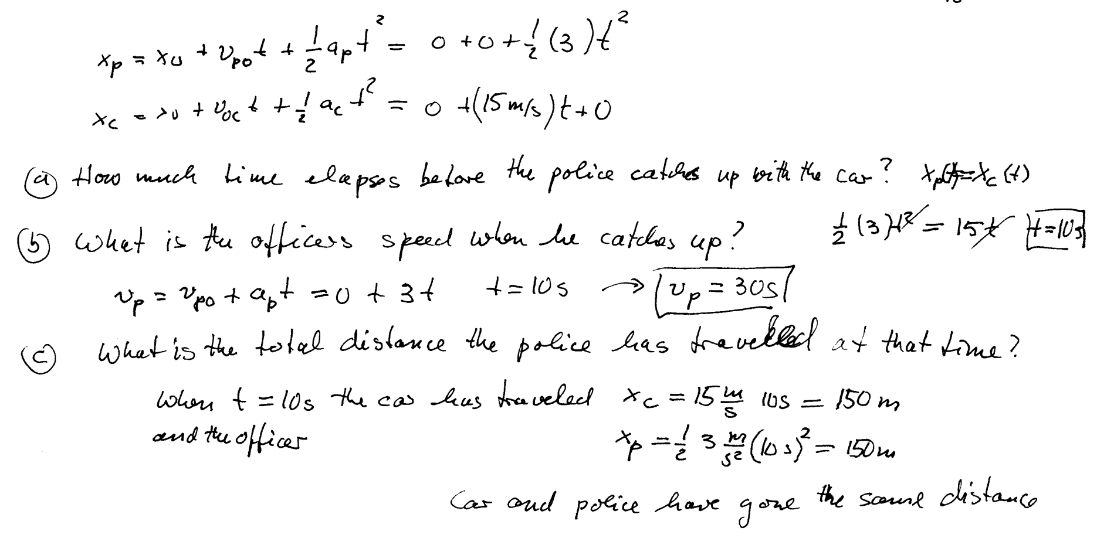
Example of graphic solution: Catching a speeder
m/s

Slide 19
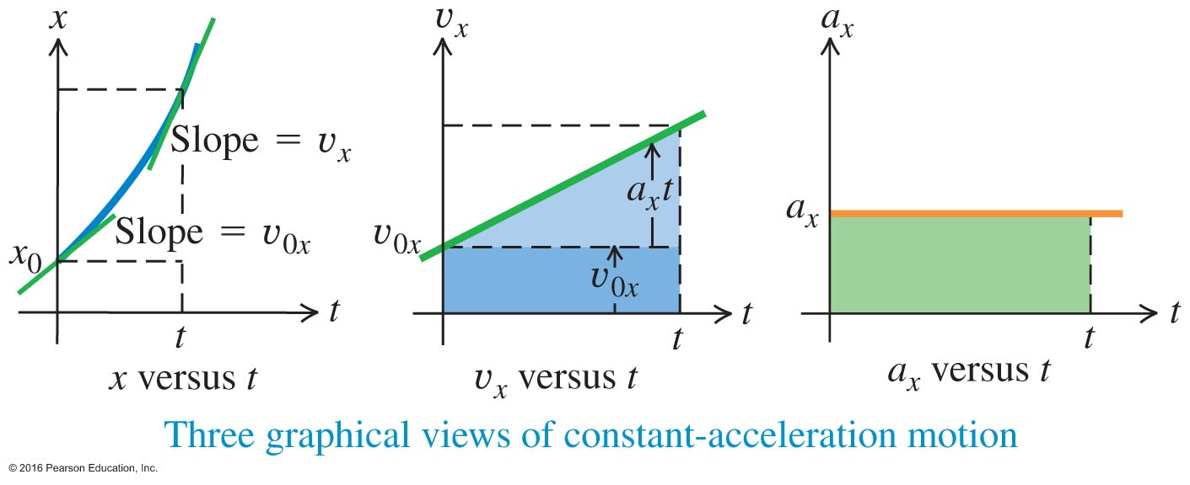
Question: How can we predict the position of the particle at any time t?
● Since the average velocity is defined by $v_{av,x}=\frac{x\left(t\right) − x(0)}{t − 0}=\frac{x\left(t\right) − x_{0}}{t}$,
we have $x\left(t\right)=x_{0}+v_{av,x}t$.
● But, what is $v_{av,x}$?
Since $v_{x}\left(t\right)$ is linear in time t, $v_{x}\left(t\right)= v_{0x}+ a_{x}t$ ,
we have $v_{av,x}=\frac{1}{2}[v_{x}\left(t\right) + v_{0x}]$ .
Therefore,
$x\left(t\right)=x_{0}+\frac{1}{2}[v_{x}\left(t\right) + v_{0x}]t$
$=x_{0}+\frac{1}{2}[\left(v_{0x}+ a_{x}t\right) + v_{0x}]t$ ,
or, $x\left(t\right)=x_{0}+v_{0x}t+\frac{1}{2}a_{x}t^{2}$ ……(2.10)
● This is the second of the three kinematic equations.
Courtesy of Wenhao Wu

Slide 20
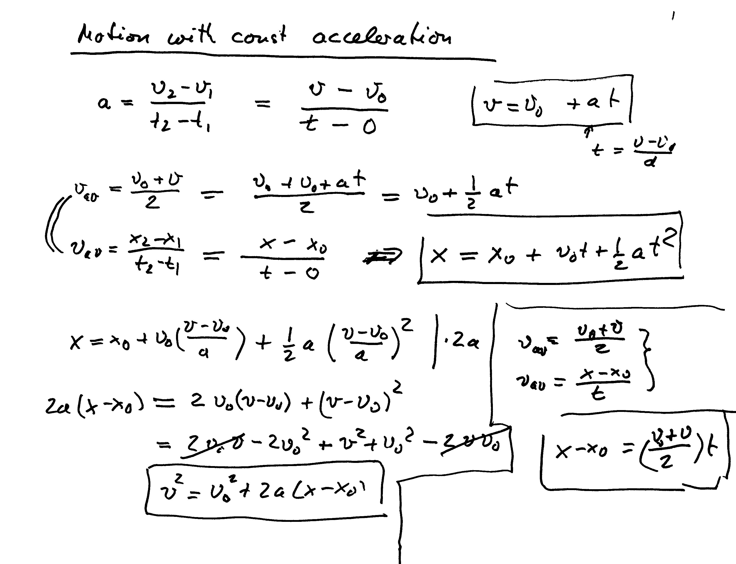
(main equations!)

Slide 21
Kinematics equations for constant acceleration
note: the mass m is not in these equations

Slide 22
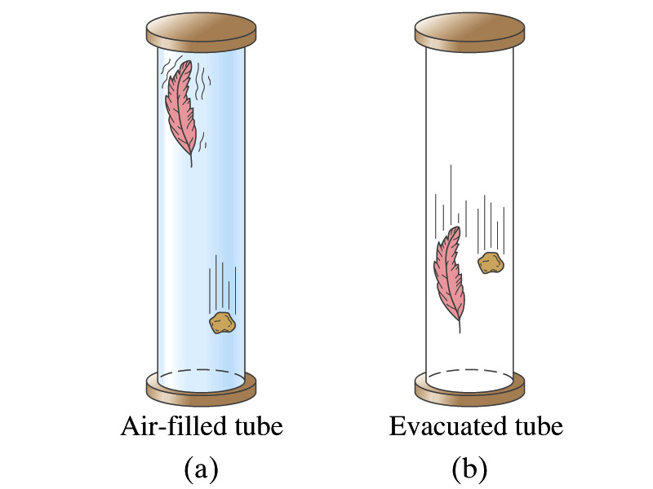
Particular case of motion with constant acceleration: Falling objects. All objects fall with the same constant acceleration!!

Slide 23
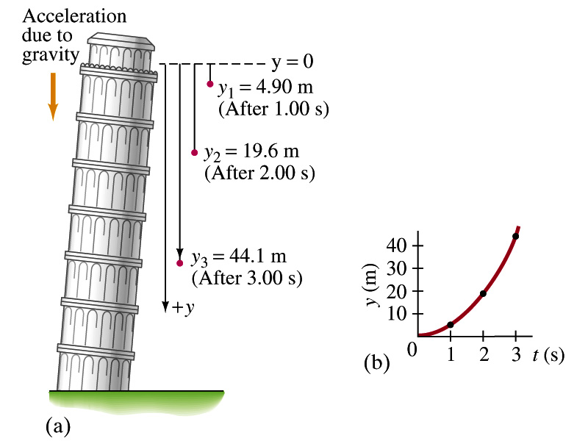
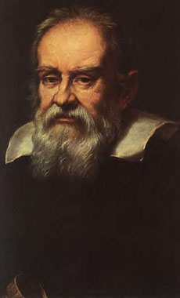
Kinematics for a=9.80m/s² (acceleration of gravity)
Between 1589 and 1592.
Experiments on the motion of objects falling from leaning tower of Pisa
under the action of the force of gravity
$a_{y}=g= 9.8 m/s^{2}$ if the y-axis
points down
$v_{y}\left(t\right)= v_{0y}+gt$ …………....(2.6)
y$\left(t\right)=y_{0}+v_{0y}t+\frac{1}{2}gt^{2}$ ……(2.10)
$v_{y}^{2}=v_{0y}^{2}+2g\left(y−y_{0}\right)$ ….….(2.11)
$v_{av,y}=\frac{1}{2}$[$v_{y}\left(t\right) + v_{0y}$]….….…(2.7)

Slide 24
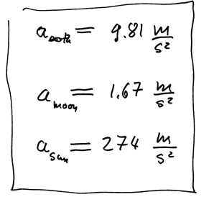
Acceleration of gravity on different planets, =9.81m/s²

Slide 25
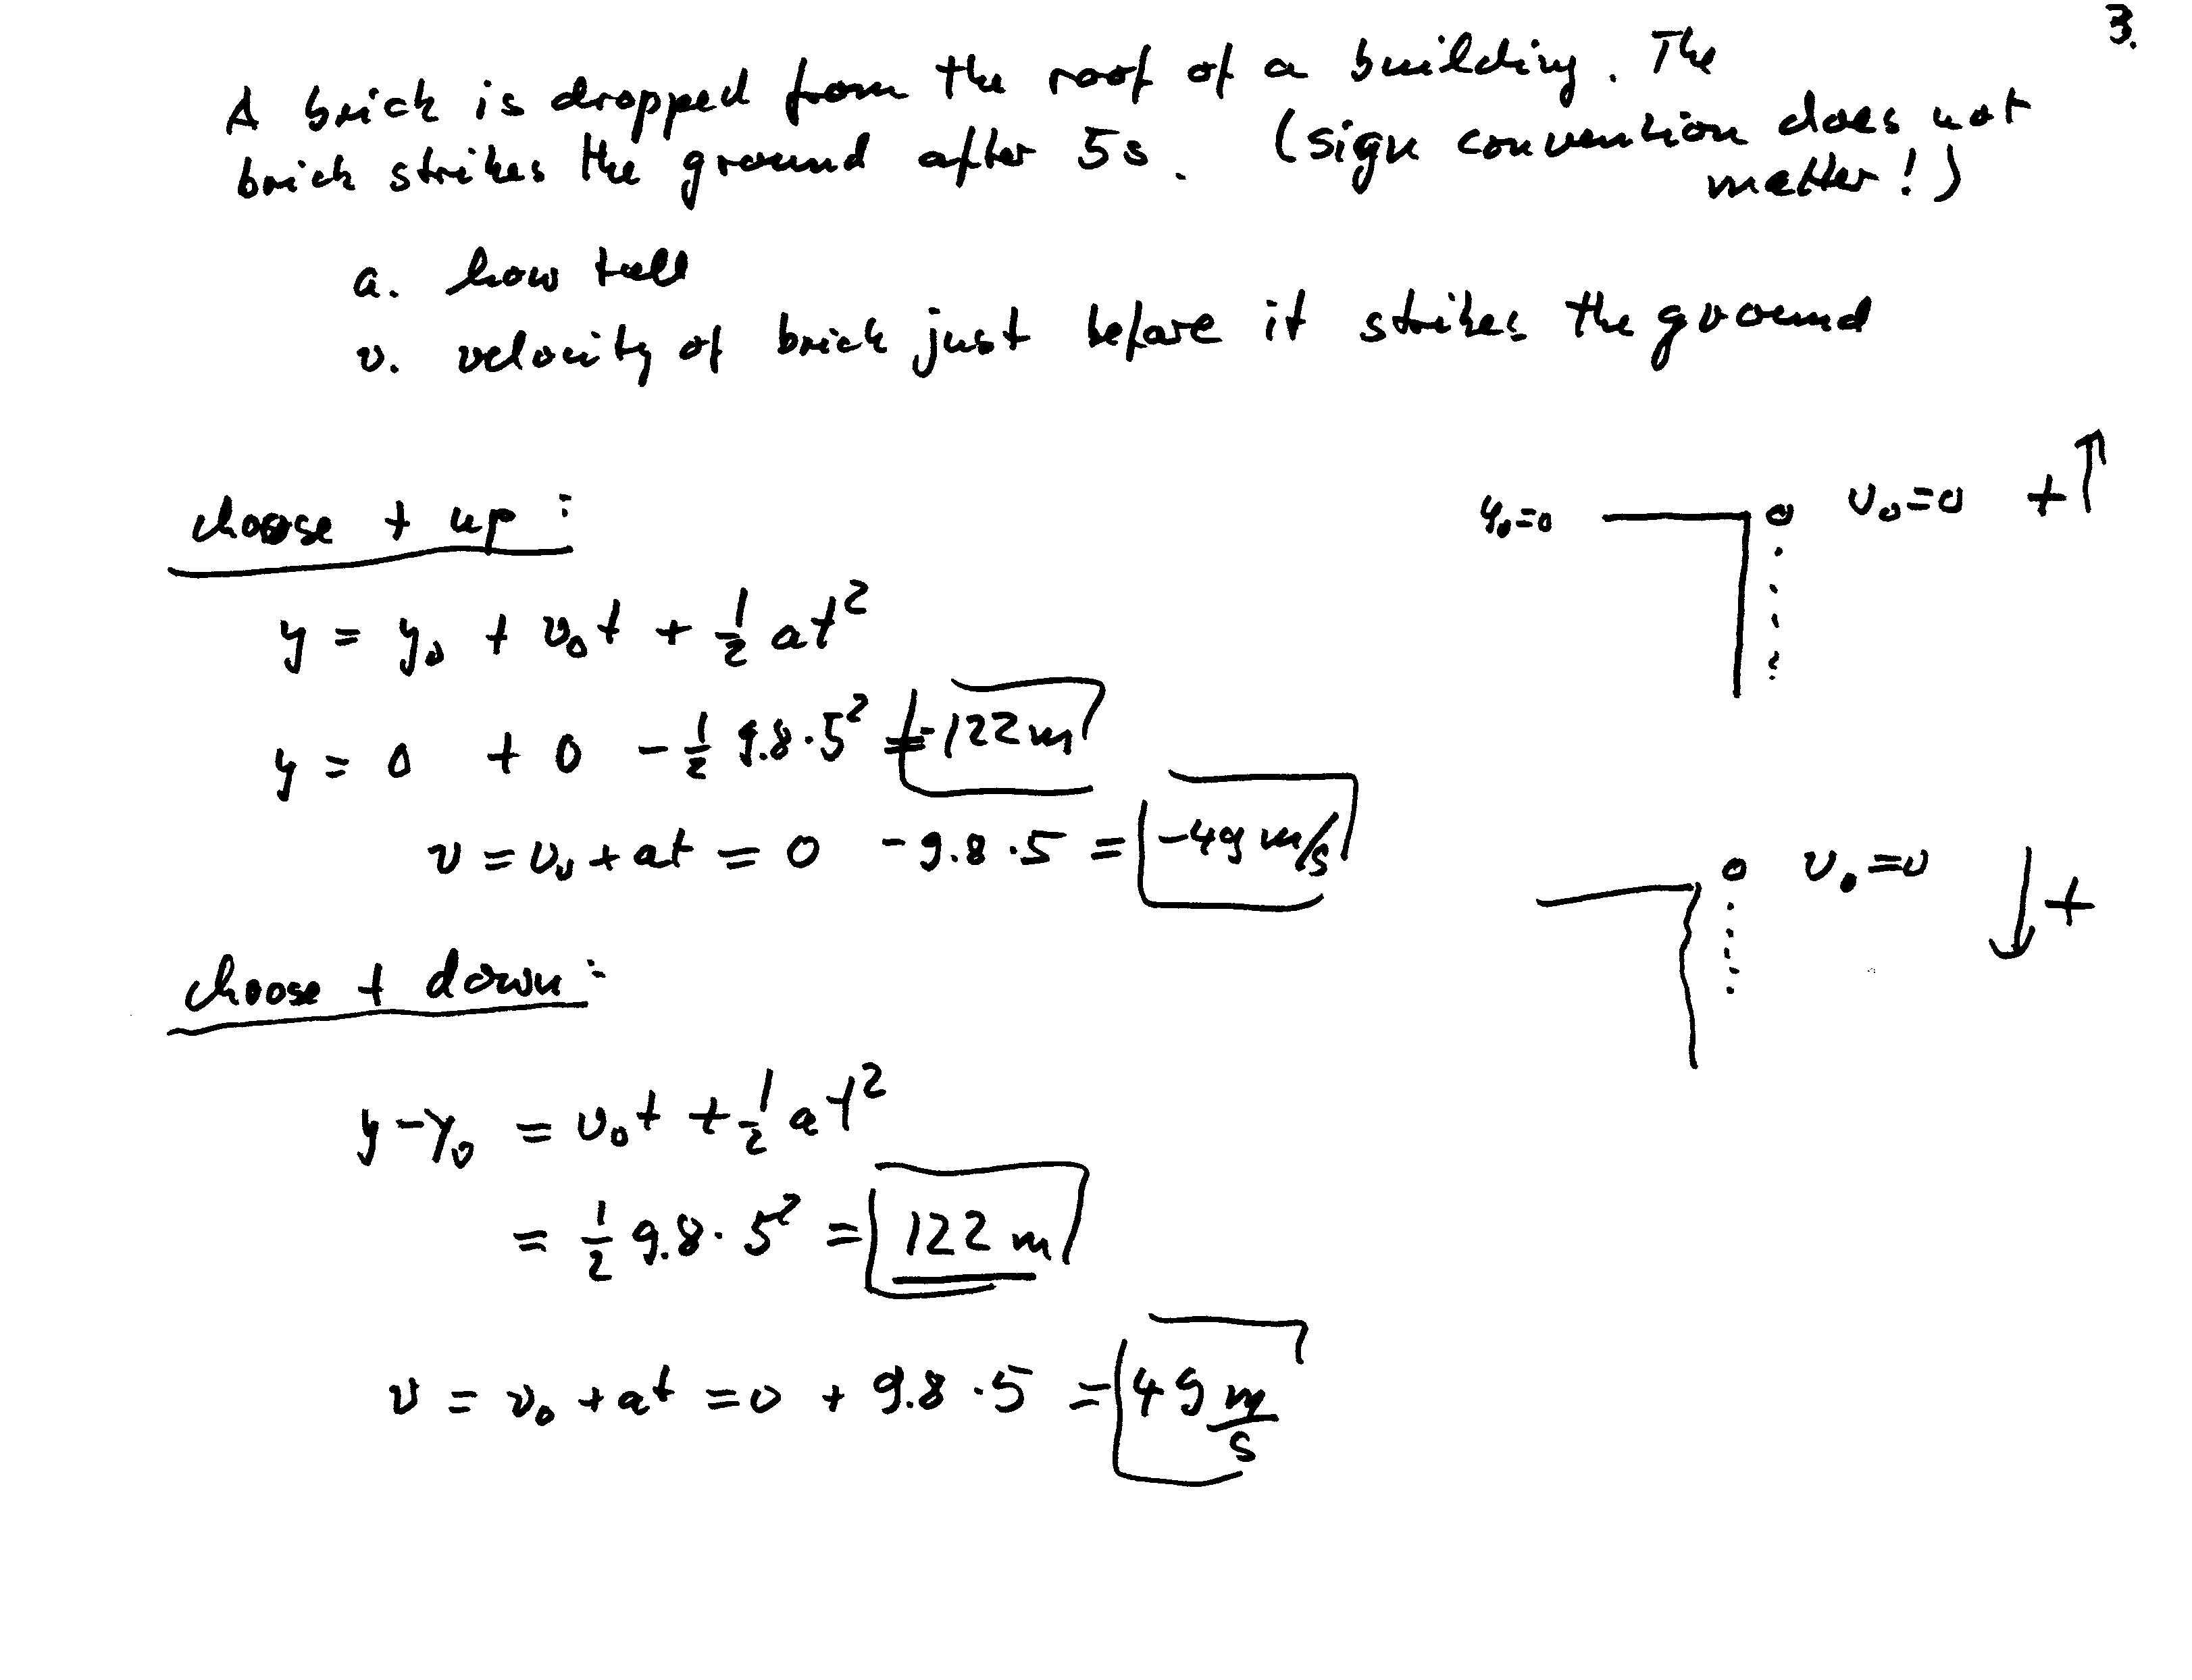
Important to have the
correct interpretation
of the results!
The optimal selection
of the reference frame helps.

Slide 26
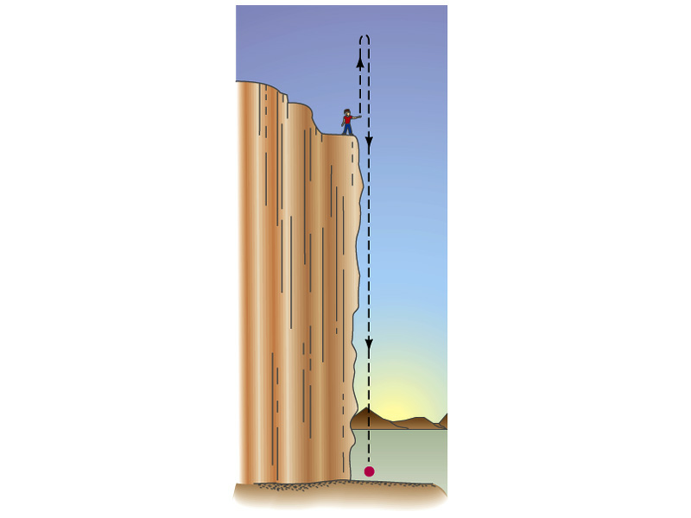
Problem: Vertical motion
Stone is thrown vertically upward

Slide 27
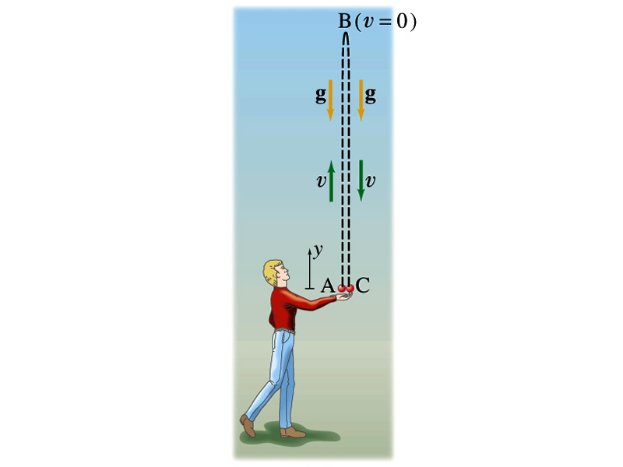
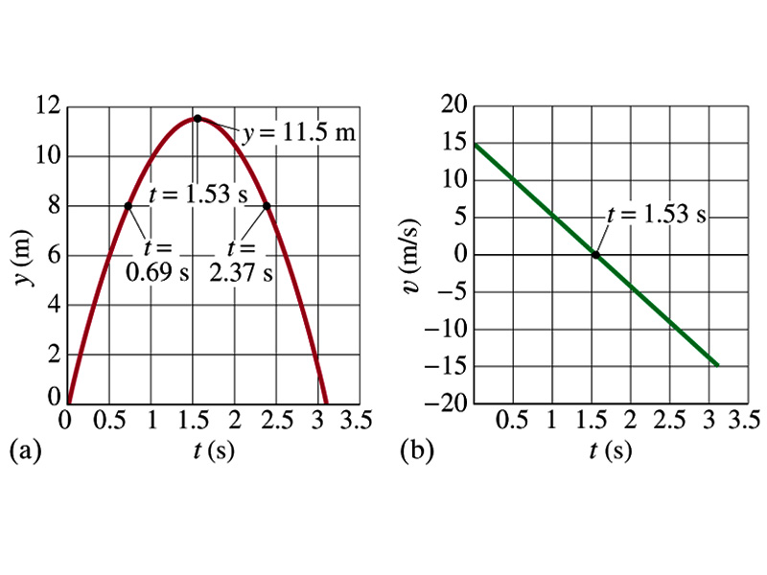
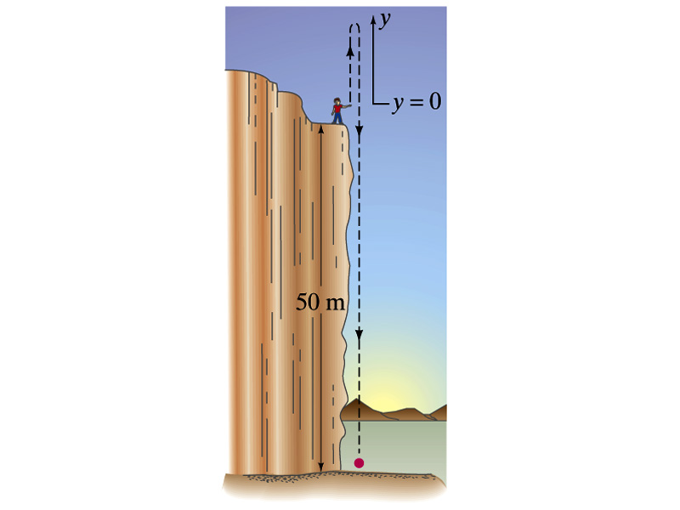
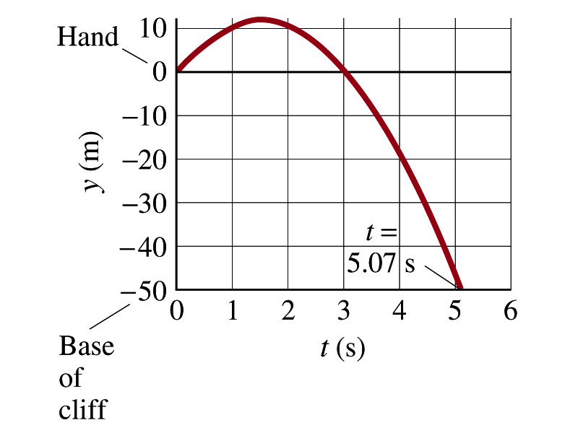
1-D motions in the gravitational field

Slide 28
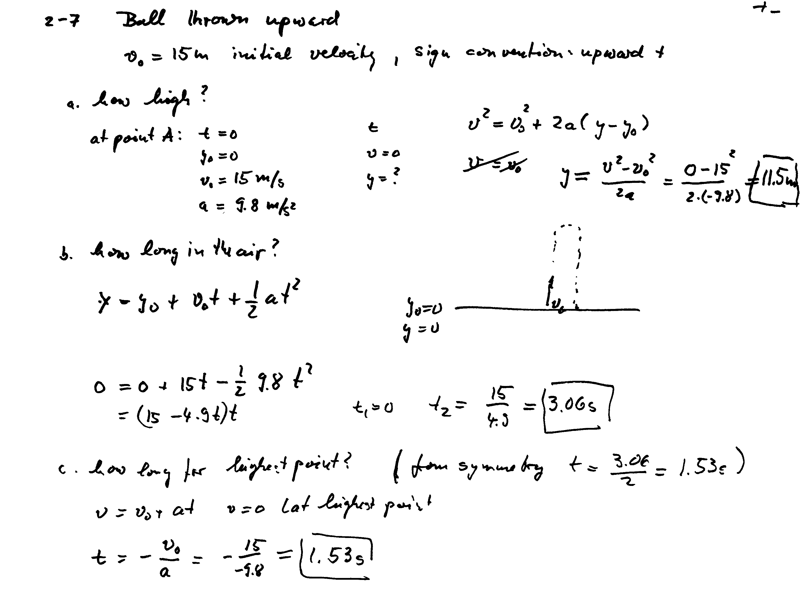
height of the cliff h=50m
(from point A to C)
(from point A to B)

Slide 29
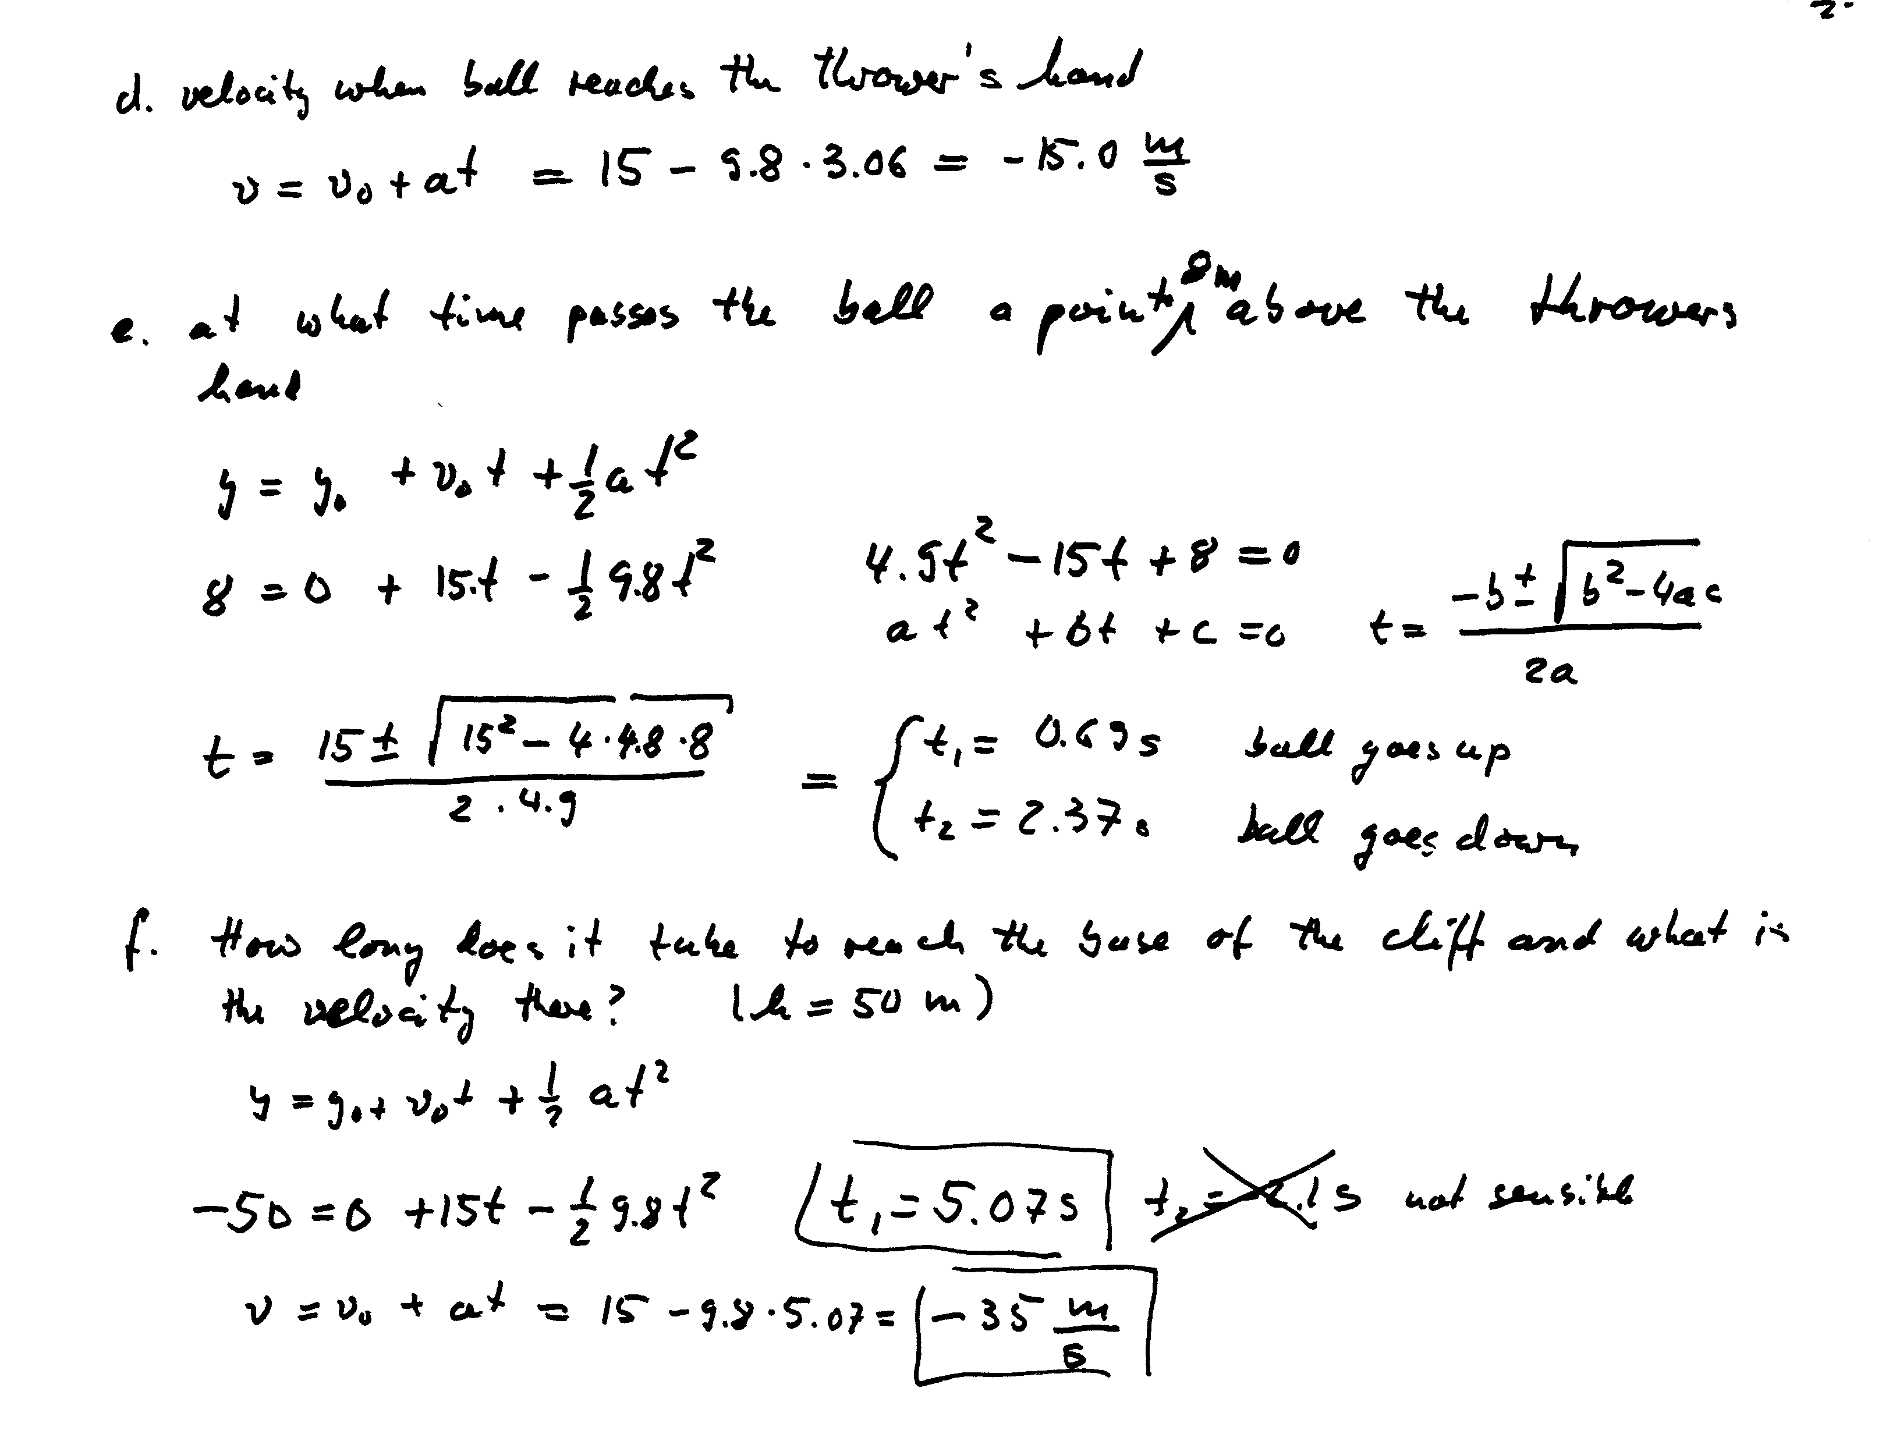
(point C)
9
t1 = (15 + (15^2 + 4*4.9*50)^0.5)/(2*4.95) = 5.0727 = 5.07 s

Slide 30
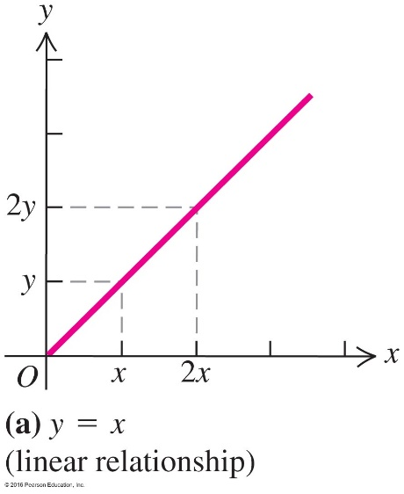
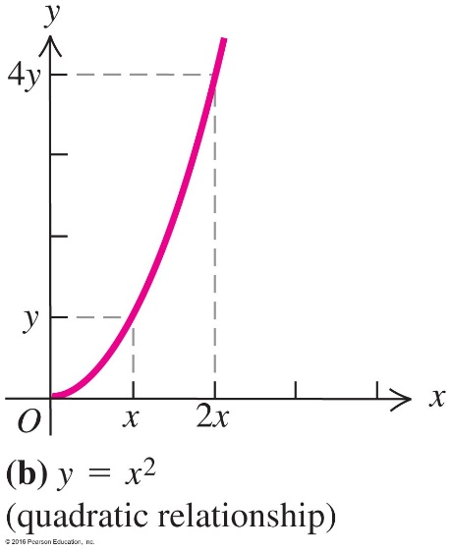
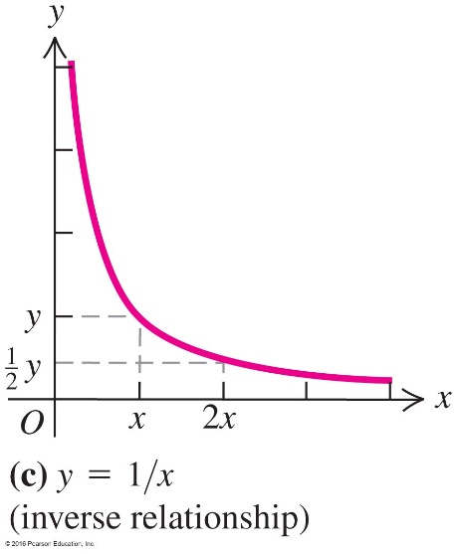
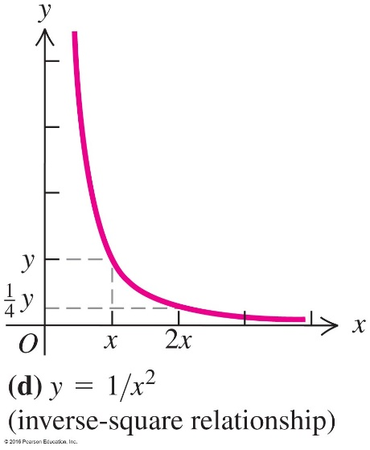
2.5: Proportional Reasoning
Thinking about your numbers
For example: there are linear, quadratic, inverse, inverse-square proportions between two variables x and y.

Slide 31
When you brake on dry pavement, your maximum acceleration is about three times greater than when you brake on wet pavement. For a given initial speed, how does your stopping distance x_{dry} on dry pavement compare with your stopping distance x_{wet} on wet pavement?
Clicker problem
a) x_{dry} = 1/3x_{wet}
b) x_{dry} = 3x_{wet}
c) x_{dry} = 1/9x_{wet}
d) x_{dry} = 9x_{wet}
Notes:
Answer: a) x_{dry} = 1/3x_{wet}

