Slide 1
Chapter 3 Motion in a Plane
(Motion in Two-Dimensions)
● calculate position, velocity, and acceleration vectors in 2D
● apply the kinematic equations to understand 2D projectile motion
● apply the kinematic equations to solve for unknown quantities for
an object moving with constant acceleration in 2D
● study the relative velocity of an object for observers in different
frames of reference in 2D
Courtesy of Wenhao Wu

Slide 2
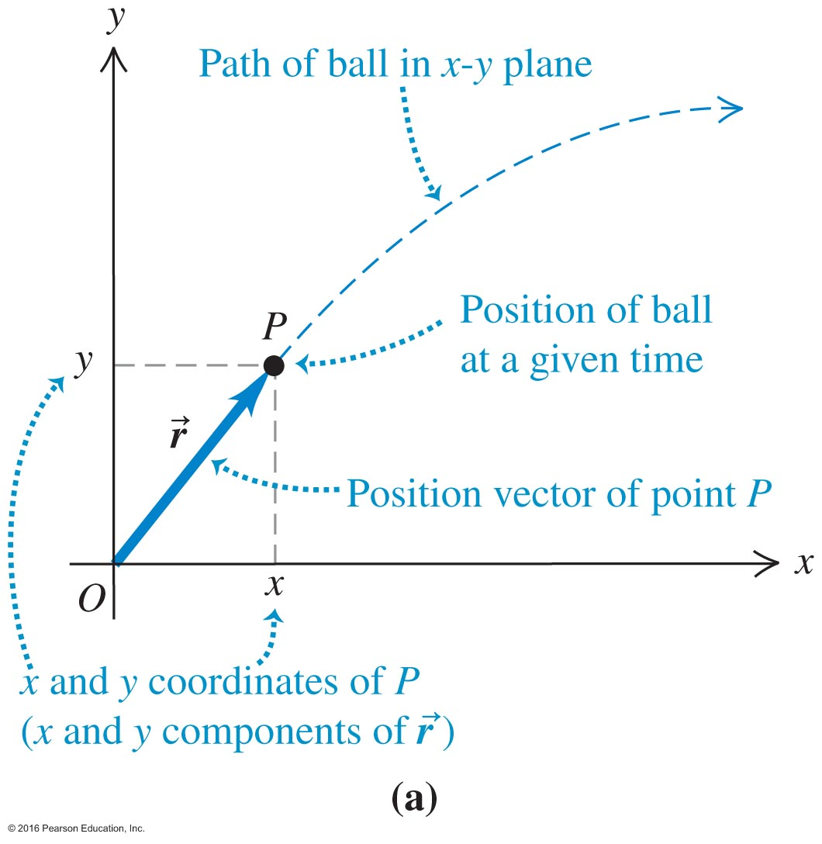
Velocity in a Plane (1 of 2)
Vectors in terms of Cartesian x- and y- coordinates may now also be expressed in terms of magnitude and angle.
distance of point P from the origin is the
magnitude of vector

Slide 3
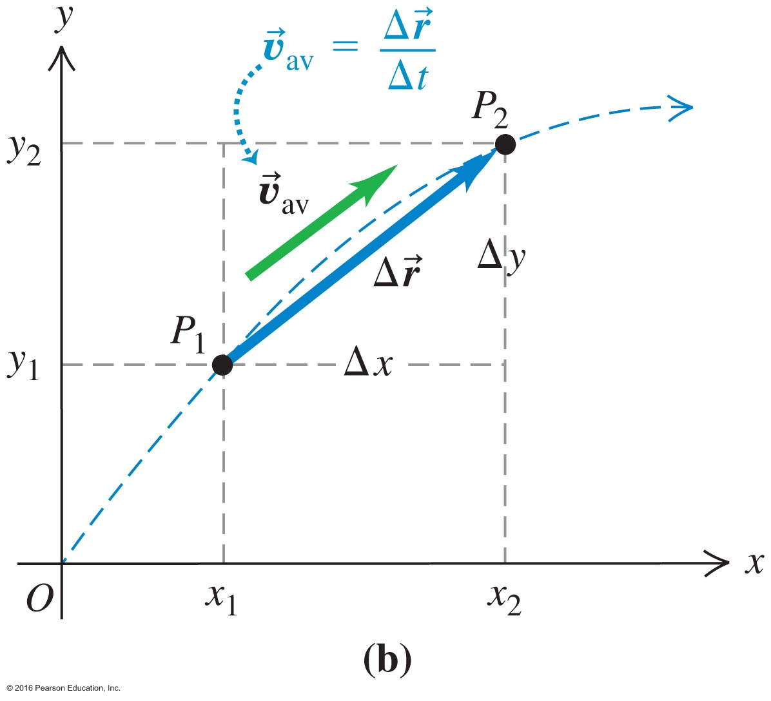
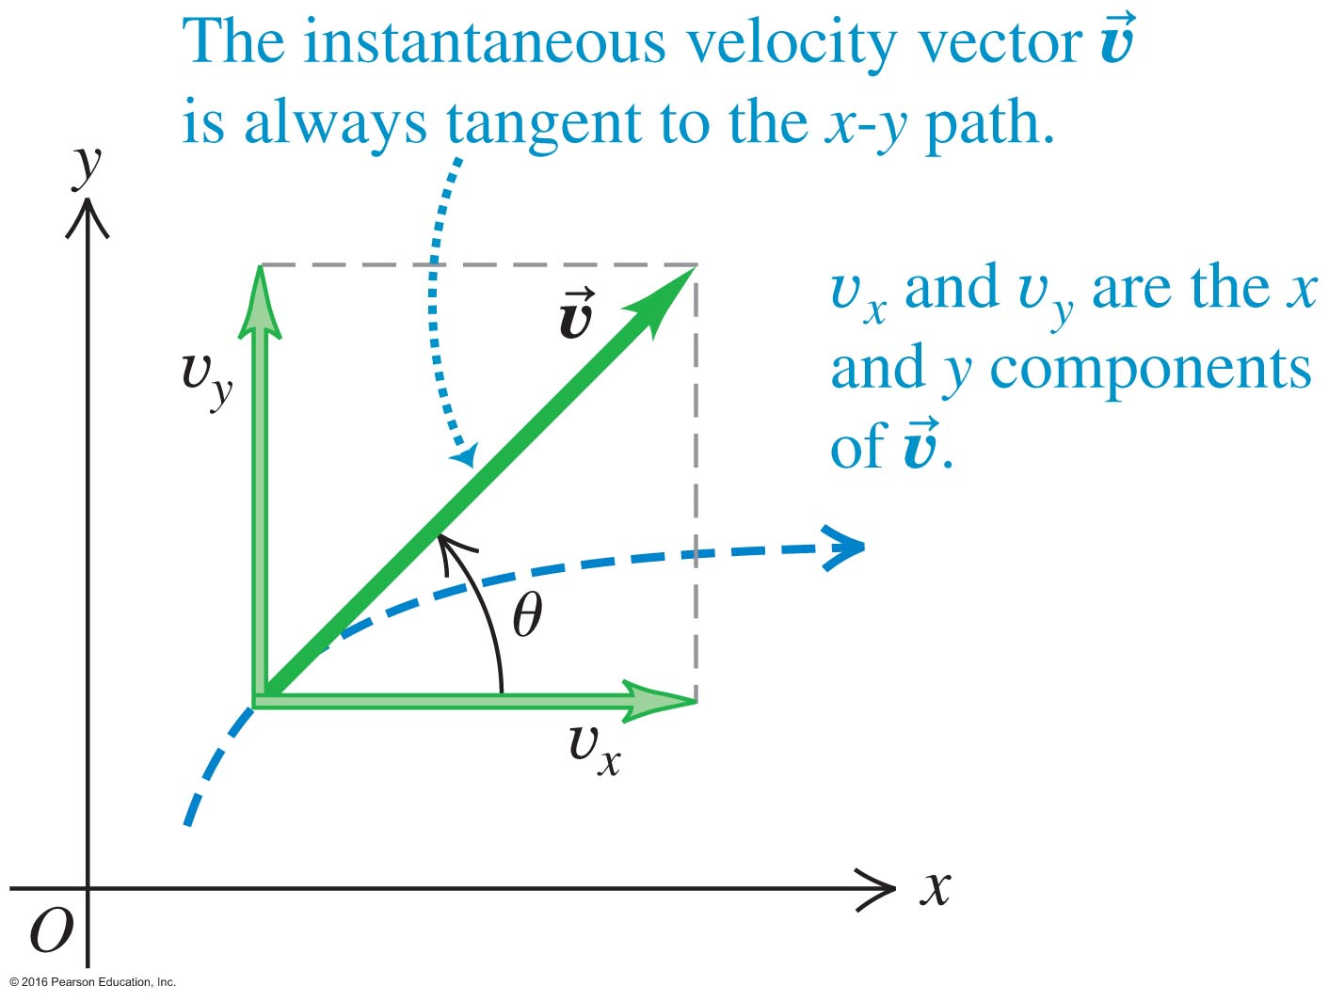
Velocity in a Plane (2 of 2)
From the graphs, we see both average and instantaneous velocity vectors.

Slide 4
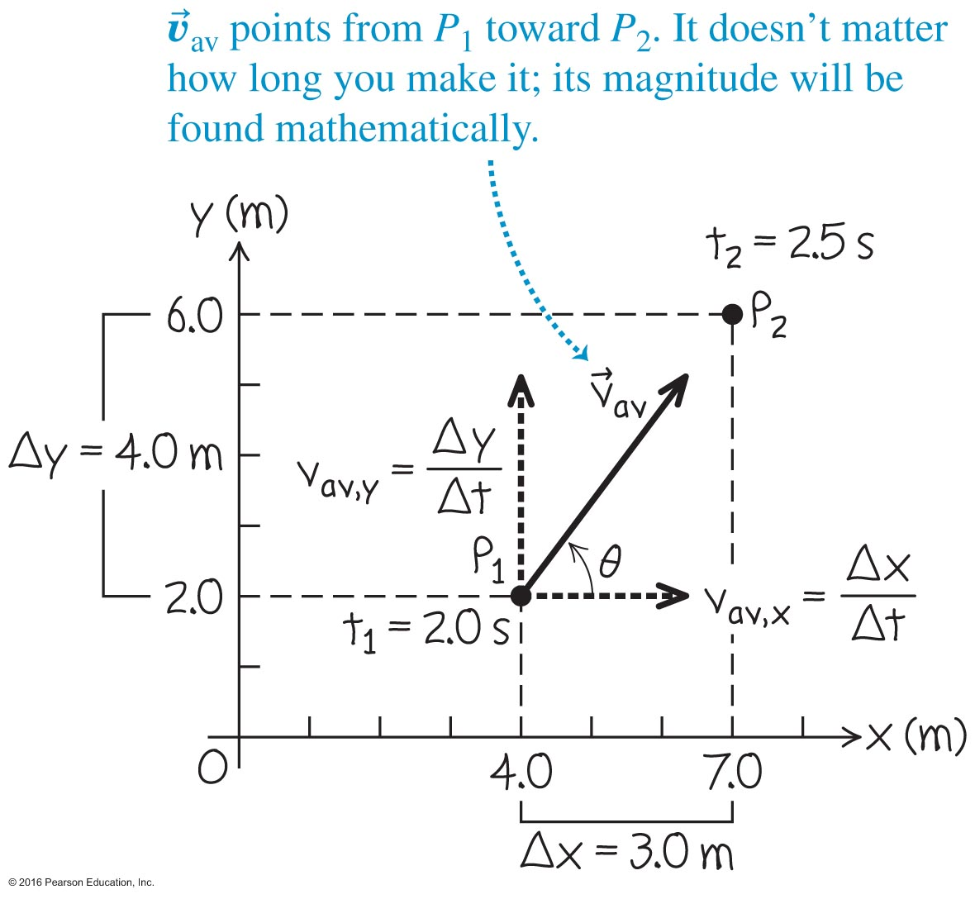
The Motion of a Model Car – Example 3.1
See the worked example on page 67.

Slide 5
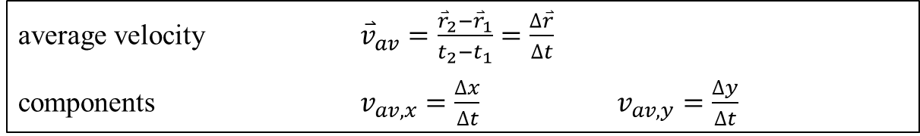
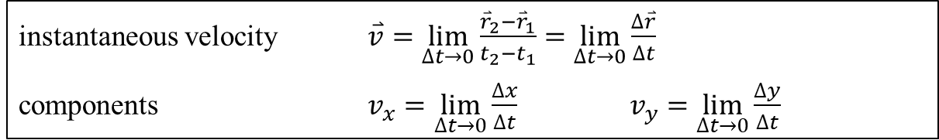
Velocity in a Plane
Courtesy of Wenhao Wu

Slide 6
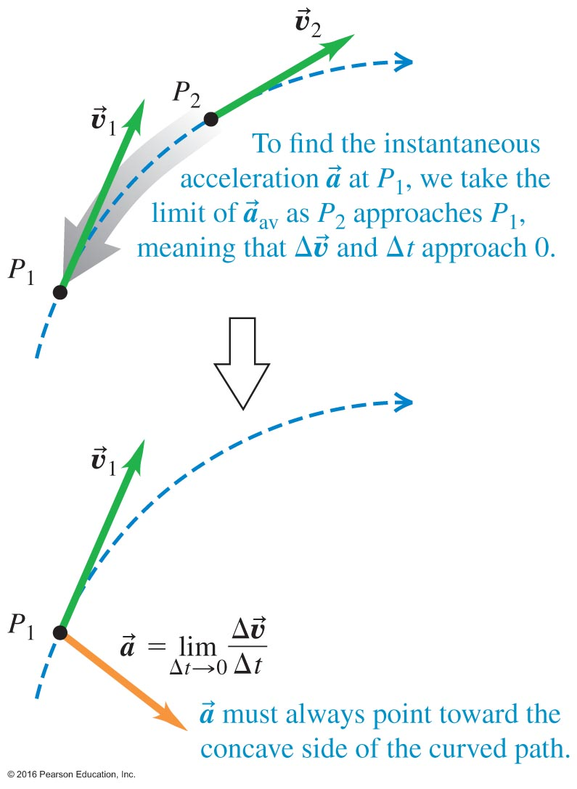
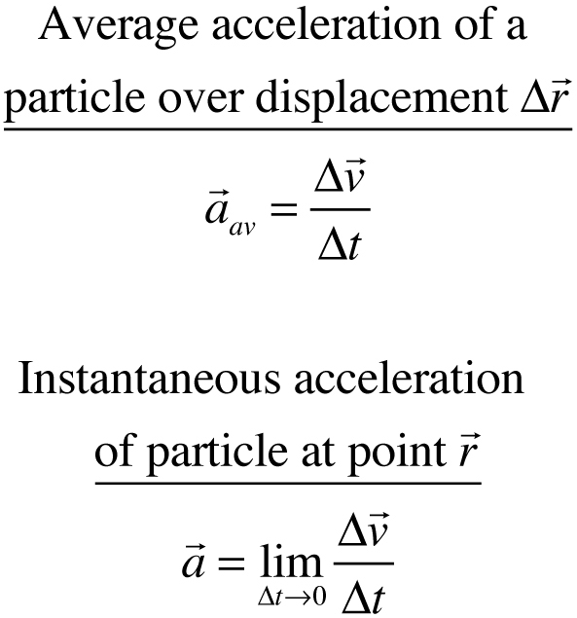
Accelerations in a Plane
Acceleration must now be considered during change in magnitude AND/OR change in direction.

Slide 7
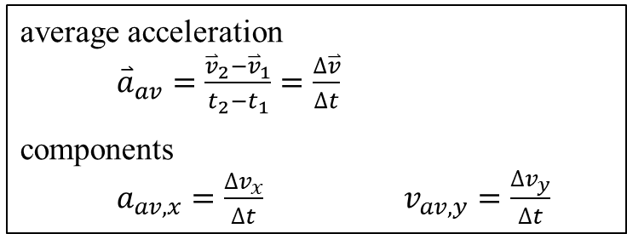


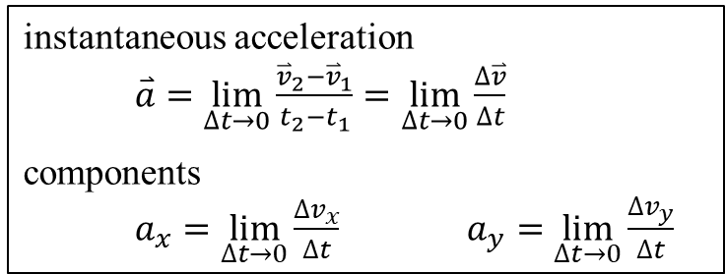

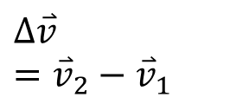

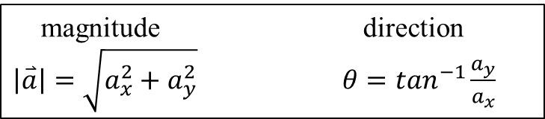
3.2 Acceleration in a Plane
y
P₁
P₂
O
x
Courtesy of Wenhao Wu

Slide 8
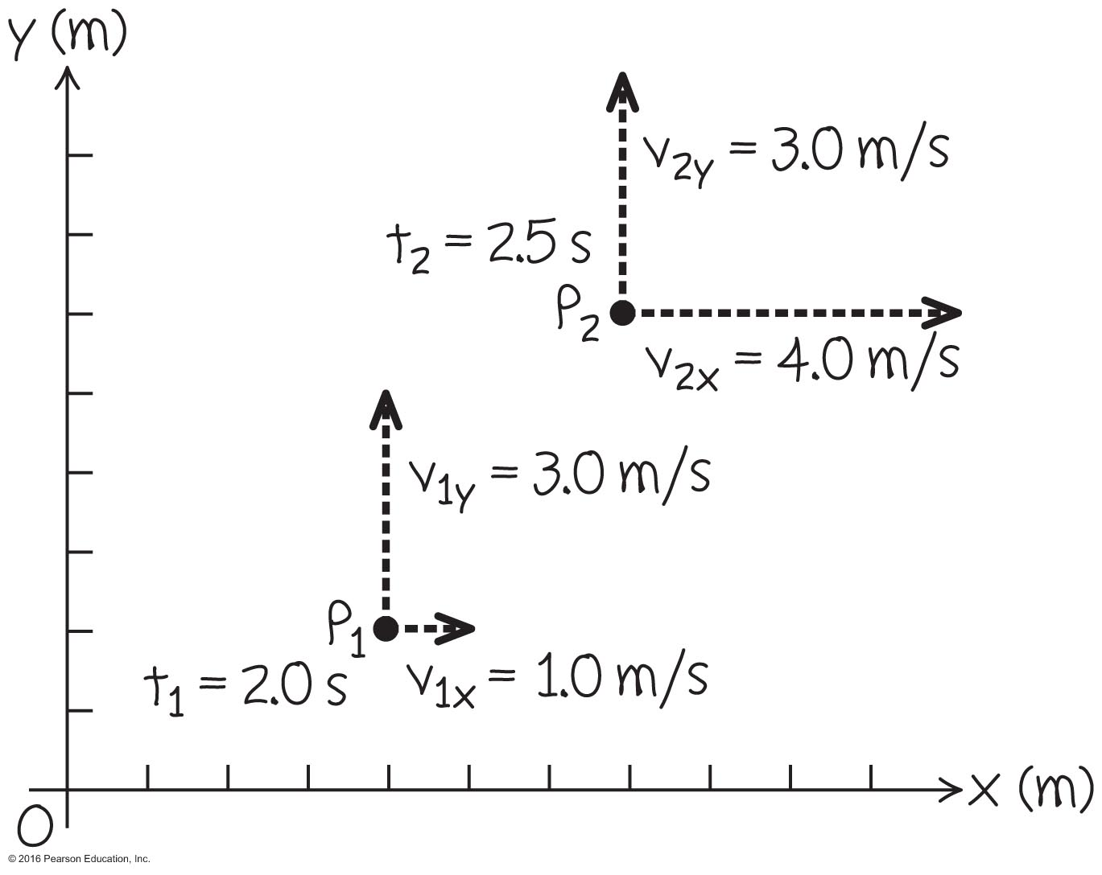
The Model Car Revisited – Example 3.2
See the worked example on page 69.

Slide 9
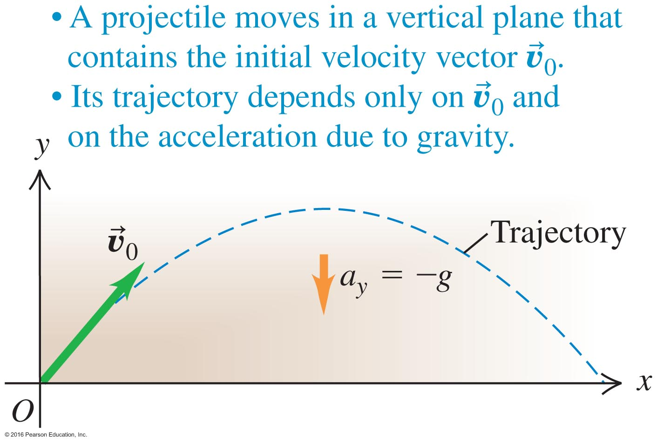
Projectile Motion
Determined by the initial velocity, gravity, and air resistance.
Footballs, baseballs … any projectile will follow this parabolic trajectory in the x-y plane.

Slide 10
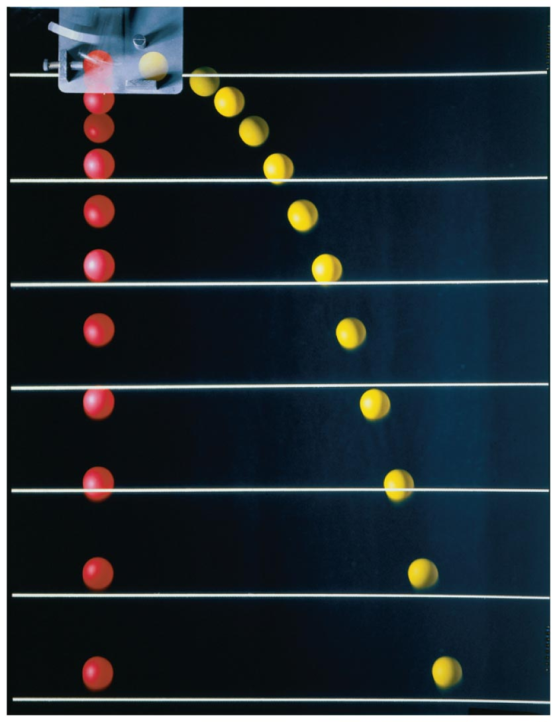
The Independence of x- and y-Motion – Figure 3.9
Notice how the vertical motion under free fall spaces out exactly as the vertical motion under projectile motion.
We can treat the
x- and y- coordinates separately!

Slide 11

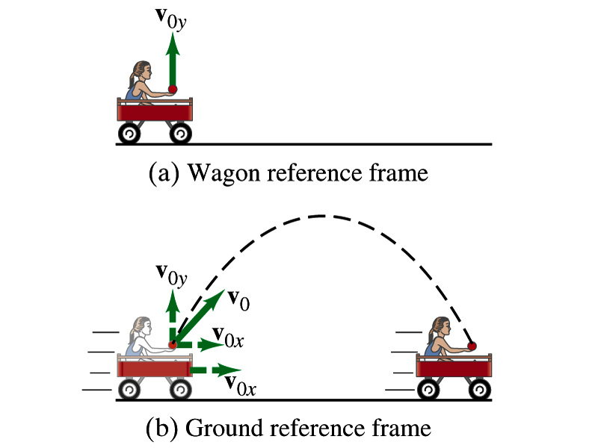
Where does the apple land?

Slide 12
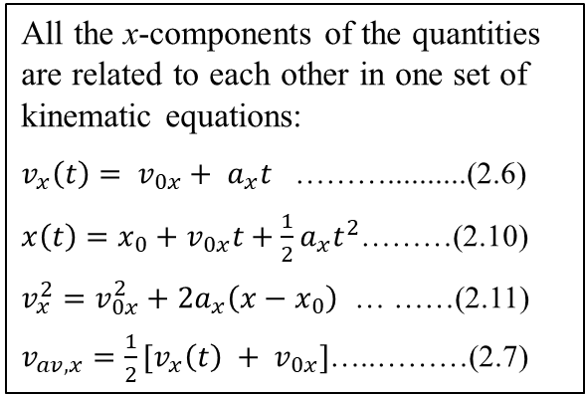
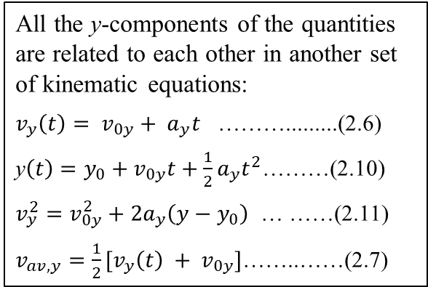
Motion in a Plane (2D) with Constant Acceleration
A General Rule: Two sets of quantities are treated separately/independently.
Important initial steps for solving 2D motion with constant acceleration:
● Set up a convenient x-y coordinate system.
● Identify the x and y components of initial position, initial velocity, and acceleration.
● Apply the rule set above and NEVER mix x-component and y-component quantities in the same kinematic equation.
Courtesy of Wenhao Wu

Slide 13
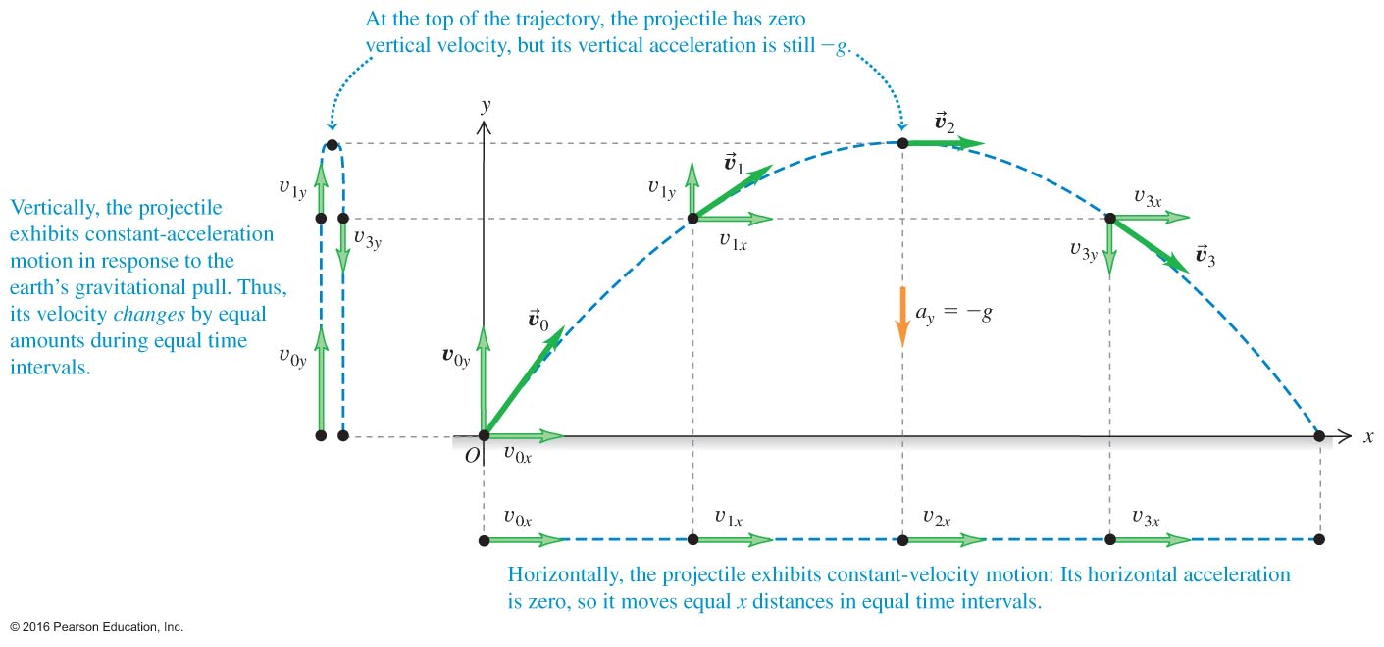
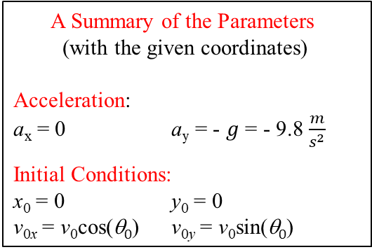
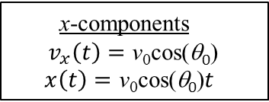
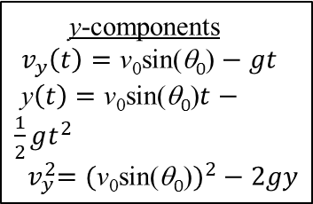
Projectile Motion: The motion in a vertical plane of a point particle, given an initial velocity, under the influence of a constant gravitation acceleration, with other factors such as air friction and wind, etc., all neglected.
3.3 Projectile Motion
v_{y} = 0 at the maximum height
constant a_{y}
θ₀
constant v_{x} since a_{x} = 0
Other Examples
● airplane dropping a package
● motorcycle running off a cliff
● rock sliding off the edge of a roof
etc.
Courtesy of Wenhao Wu

Slide 14
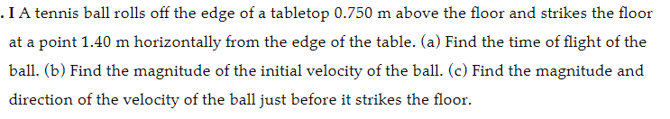
Problem 3.3 12

Slide 15
3.2 Acceleration in a Plane
y
P₁
P₂
O
x
Courtesy of Wenhao Wu

Slide 16

Problem 3.2 7

Slide 17
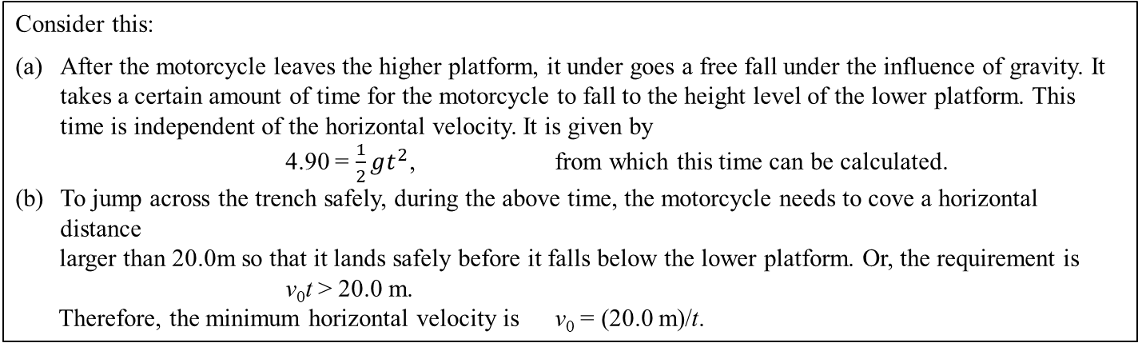
v₀
More Examples in 2D Motion:
Minimum speed required for a stunt performance
4.90 m
A stunt performer on a motorcycle attempts to jump across a trench as shown in the diagram. What is the minimum speed that is required to perform this safely?
20.0 m
Courtesy of Wenhao Wu

Slide 18
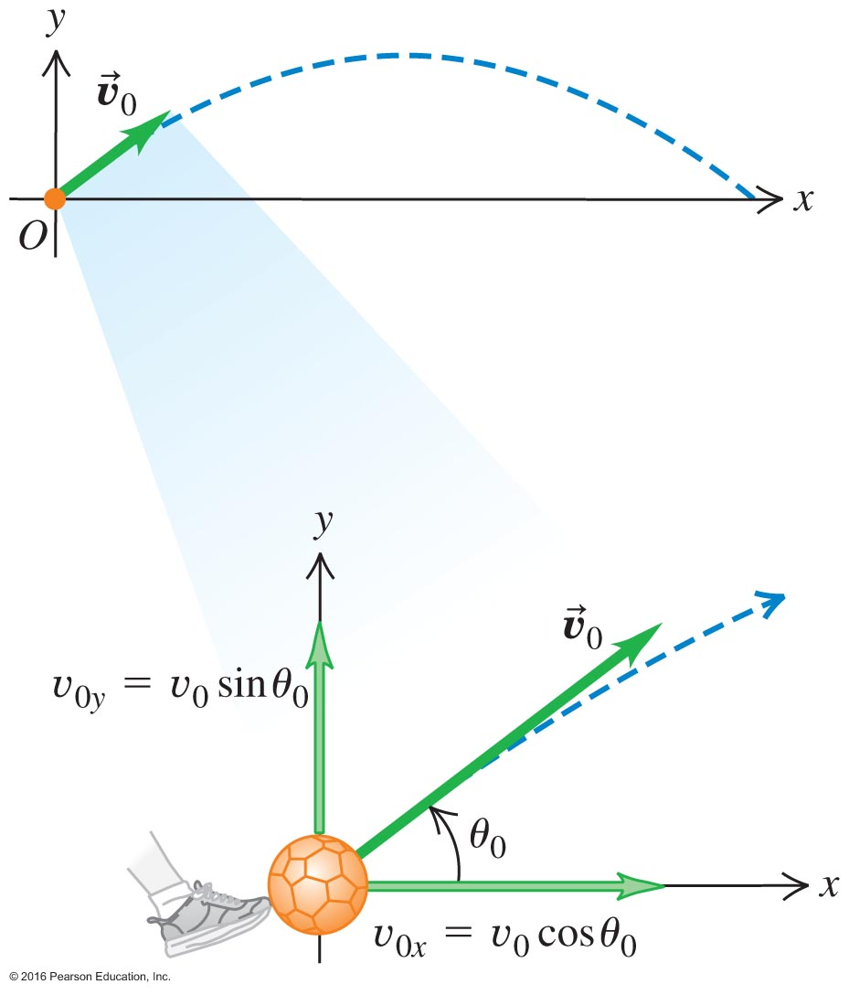
Determination of Key Items
Don't forget: Initial velocity is a 2D vector.

Slide 19
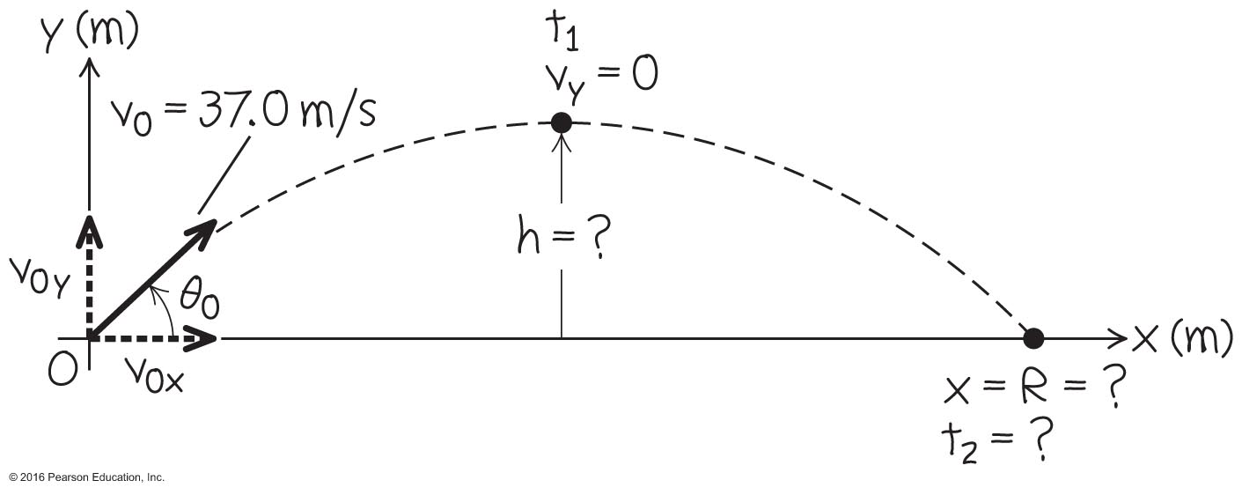
A Home-Run Hit – Example 3.4
See the fully worked example on pages 75–76.
Details examined for the flight of a baseball hit from home plate toward a fence hundreds of feet away.

Slide 20
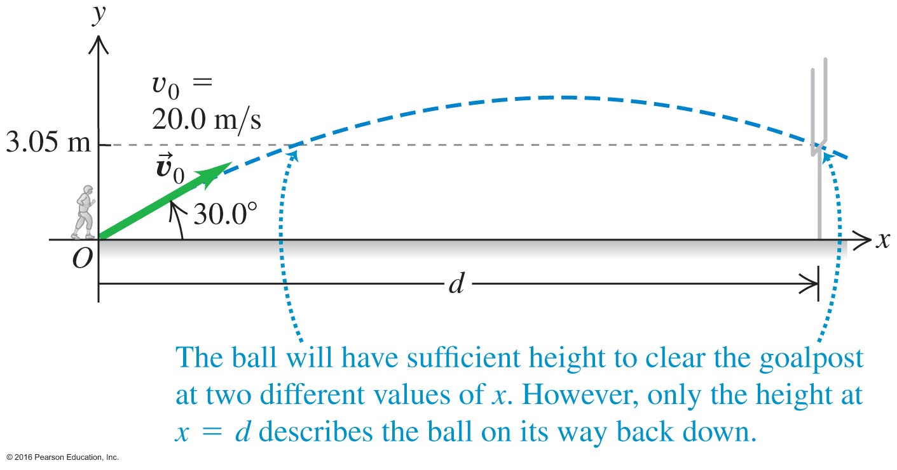
Vertical/Horizontal Displacement –
Example 3.6
After a given horizontal displacement, a projectile will have a vertical position.
Sports provide a large number of excellent examples.
For a field goal, see worked example on page 76.
v=?
The quadratic equation has 2 solutions

Slide 21

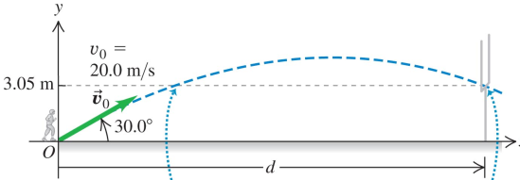
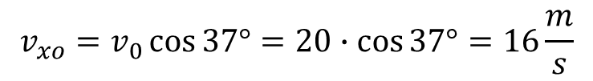
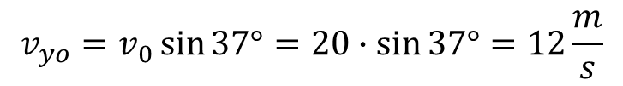
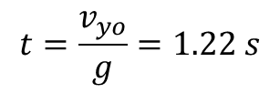

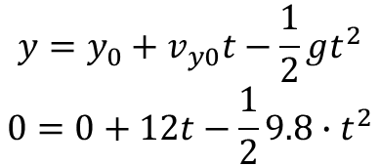

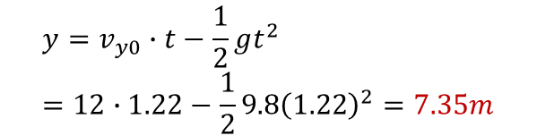



Kicked football
What is the max height?
37º
Time it takes to reach the ground?
Time to reach highest point
What is the range?

Slide 22
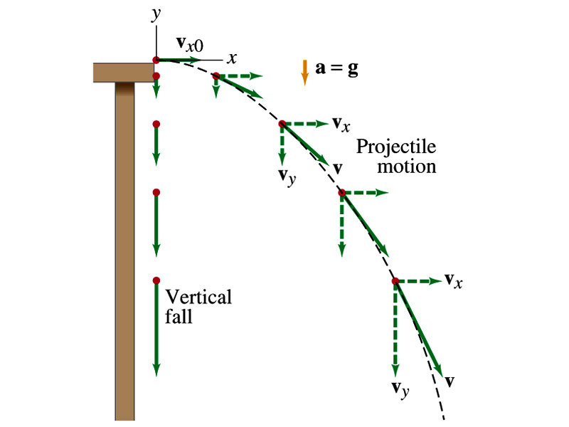
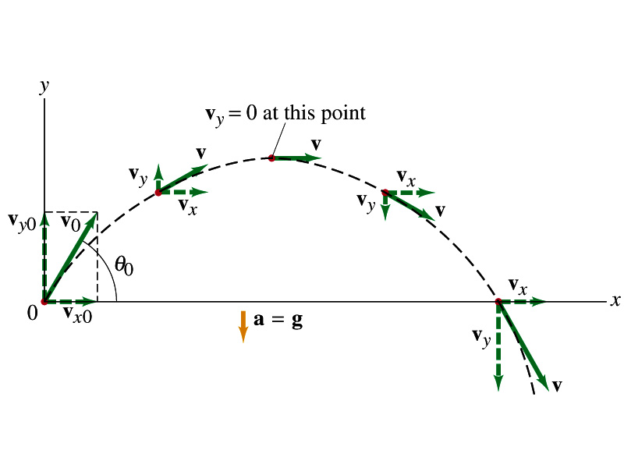
Projectile Motion

Slide 23
You throw a ball horizontally off a roof. Assuming the ball behaves as an ideal projectile, the time until it lands is determined only by
Clicker question
its initial speed and the horizontal distance to the point where it lands.
the height of the roof and its initial speed.
the height of the roof.
Notes:
Answer: c) the height of the roof.

Slide 24
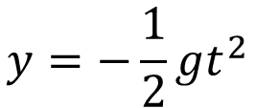
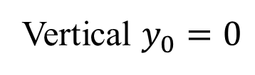
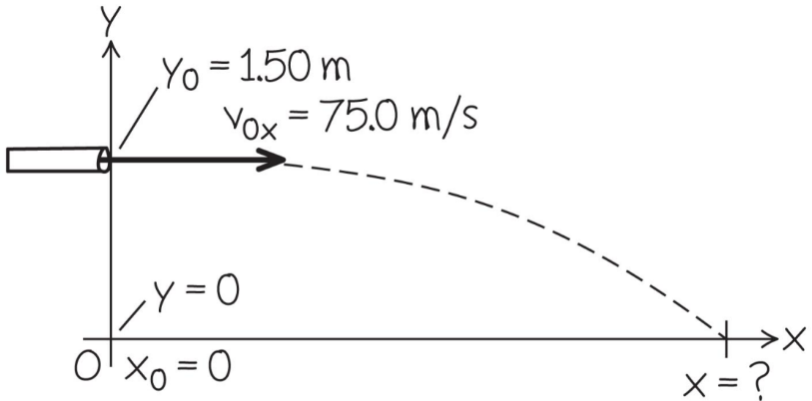
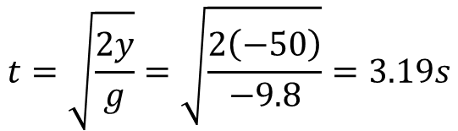

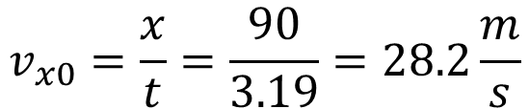
Driving off a cliff
0
?
50m
Time for vertical motion
90m

Slide 25
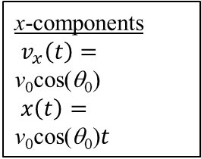
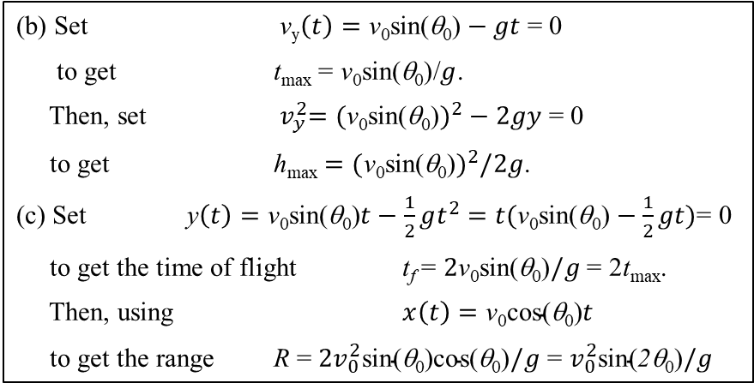
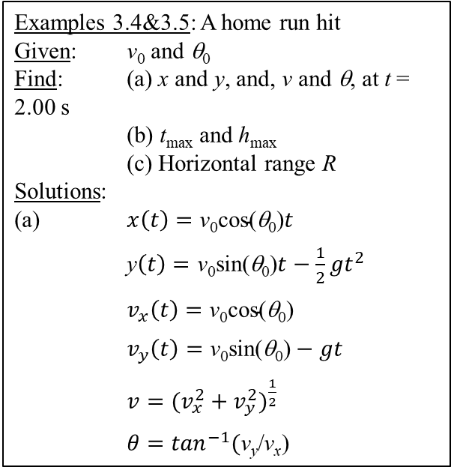
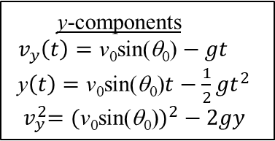
3.3 Projectile Motion
v_{y} = 0 at the maximum height
x-components
$v_{x}\left(t\right)=\text{v}\text{0}\text{cos}\text{(}\text{q}\text{0}\text{)}$
$x\left(t\right)=\text{v}\text{0}\text{cos}\text{(}\text{q}\text{0}\text{)}t$
y-components
$v_{y}\left(t\right)=\text{v}\text{0}\text{sin}\text{(}\text{q}\text{0}\text{)}−gt$
y$\left(t\right)=\text{v}\text{0}\text{sin}\text{(}\text{q}\text{0}\text{)}t−\frac{1}{2}gt^{2}$
${ v}_{y}^{2}=(\text{v}\text{0}\text{sin}\text{(}\text{q}\text{0}\text{)})^{2}−2gy$
constant a_{y}
θ₀
constant v_{x} since a_{x} = 0
Examples 3.4&3.5: A home run hit
Given: v₀ and θ₀
Find: (a) x and y, and, v and θ, at t = 2.00 s
(b) t_{max} and h_{max}
(c) Horizontal range R
Solutions:
(a) $x\left(t\right)=\text{v}\text{0}\text{cos}\text{(}\text{q}\text{0}\text{)}t$
y$\left(t\right)=\text{v}\text{0}\text{sin}\text{(}\text{q}\text{0}\text{)}t−\frac{1}{2}gt^{2}$
$v_{x}\left(t\right)=\text{v}\text{0}\text{cos}\text{(}\text{q}\text{0}\text{)}$
$v_{y}\left(t\right)=\text{v}\text{0}\text{sin}\text{(}\text{q}\text{0}\text{)}−gt$
$v=({v_{x}^{2}+v_{y}^{2})}^{\frac{1}{2}}$
$θ=\tan^{−1}\text{(}\text{v}\text{y}\text{/}\text{v}\text{x}$)
(b) Set $\text{v}\text{y}\left(t\right)=\text{v}\text{0}\text{sin}\text{(}\text{q}\text{0}\text{)}−gt$ = 0
to get t_{max} = $\text{v}\text{0}\text{sin}\text{(}\text{q}\text{0}\text{)}$/$g$.
Then, set ${ v}_{y}^{2}=(\text{v}\text{0}\text{sin}\text{(}\text{q}\text{0}\text{)})^{2}−2gy$ = 0
to get h_{max} $=(\text{v}\text{0}\text{sin}\text{(}\text{q}\text{0}\text{)})^{2}/2g$.
(c) Set y$\left(t\right)=\text{v}\text{0}\text{sin}\text{(}\text{q}\text{0}\text{)}t−\frac{1}{2}gt^{2}$ $=t(\text{v}\text{0}\text{sin}\text{(}\text{q}\text{0}\text{)}−\frac{1}{2}gt)$= 0
to get the time of flight t_{f} = $2\text{v}\text{0}\text{sin}\text{(}\text{q}\text{0}\text{)}/g$ = 2t_{max}.
Then, using $x\left(t\right)=\text{v}\text{0}\text{cos}\text{(}\text{q}\text{0}\text{)}t$
to get the range R = ${2v}_{0}^{2}\text{sin}\text{(}\text{q}\text{0}\text{)}\text{cos}\text{(}\text{q}\text{0}\text{)}/g$ = $v_{0}^{2}\text{sin}\text{(}\text{2}\text{q}\text{0}\text{)}/g$
Courtesy of Wenhao Wu

Slide 26
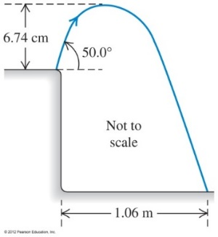












Grasshopper problem
What is the initial speed??
What is the height of the cliff??
Note:
a)
y-component of initial speed of grasshopper
initial speed
b) Use horizontal motion to find the time in air. The grasshopper travels in constant motion horizontally
Time in air
Find the vertical displacement at t=1.1s.This is now accelerated motion
Height of cliff

Slide 27
You and a friend throw two rocks off a bridge. Your friend throws hers with an initial direction 30º below the horizontal. You throw yours with the same initial speed but in a direction 30º above the horizontal. When the two rocks hit the water
Clicker question
your friend's is moving faster.
yours is moving faster.
they are moving at the same speed.
Notes:
Answer: c) they are moving at the same speed.

Slide 28
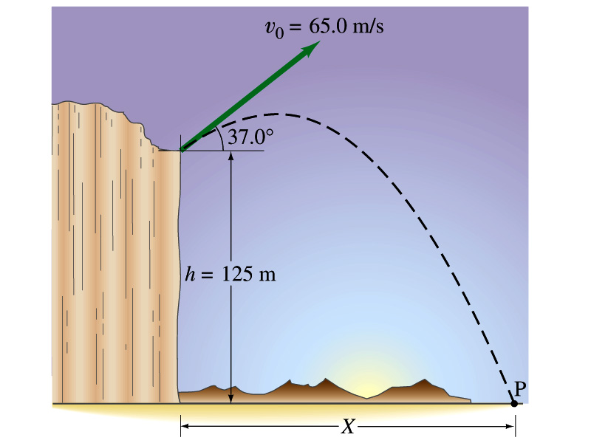
Projectile launched from a cliff

Slide 29
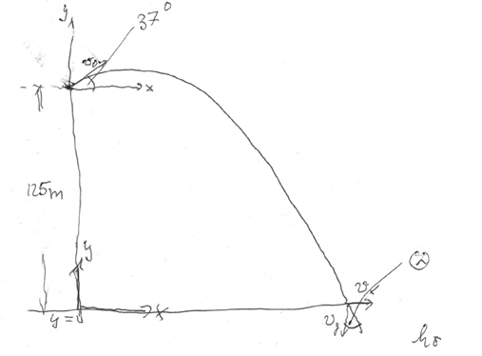
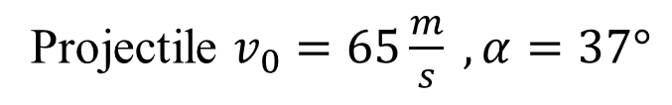
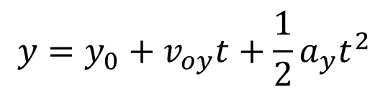
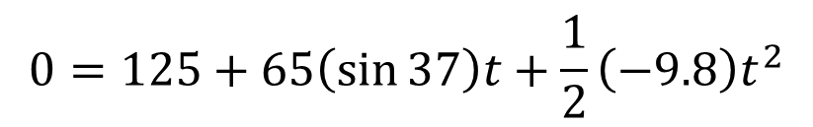









Workout problem:
Vertical motion
Not a sensible root
What is |velocity| at the bottom of the cliff?

Slide 30


Example 3.7 (and demo) Shooting a falling pear, on page 77

Slide 31






x,y motions are independent
The monkey jumps from the tree at the moment when the tranquilizer arrow leaves the barrel:
Is there a hit?
Condition:
For a hit, the x and y coordinates must be the same for a particular time
There is a hit

Slide 32

Where is the monkey??

Slide 33

Helicopter drops parcel

Slide 34







Parcel delivered by helicopter
v_{heli}, v_{car} go in the same direction: difference
ground
Vertical motion:
Time to hit the ground
t=3.99s
Horizontal motion:
Release distance is 55.4m behind the car
x=55.4m
The parcel is always below the helicopter
Reference from: helicopter
Positive is down

Slide 35
You throw a ball horizontally off a roof. Assuming the ball behaves as an ideal projectile, the time until it lands is determined only by
a. its initial speed and the horizontal distance to the point where it lands.
b. the height of the roof and its initial speed.
c. the height of the roof.

Slide 36
You and a friend throw two rocks off a bridge. Your friend throws hers with an initial direction 30° below the horizontal. You throw yours with the same initial speed but in a direction 30° above the horizontal. When the two rocks hit the water
a. your friend's is moving faster.
b. yours is moving faster.
c. they are moving at the same speed.

Slide 37



Center-seeking Acceleration

Slide 38


3.4 Uniform Circular Motion
An object moving along a circular path with a constant speed v (magnitude of velocity)
Courtesy of Wenhao Wu

Slide 39

y
B
C
A
O
x
Courtesy of Wenhao Wu

Slide 40

Circular Motion as a Special Application – Figure 3.20
Two dimensional motion in a plane takes on unique features when it is confined to a circle.
The acceleration is centripetal ("center seeking").
The velocity vector retains the same magnitude, it changes direction.

Slide 41

It Is Possible to Solve for the Velocity – Figure 3.21
The problem may be treated by extracting a small portion
of the motion such that the
arc may be approximated
as a straight line.
Acceleration in a uniform circular motion has magnitude:

Slide 42

An Example You Can Go Try Right Now – Example 3.8
Refer to the worked example on page 80

Slide 43






Circular motion
Radial acceleration:

Slide 44

Notes:
Unnumbered Figure 1 Page 82

Slide 45

James Webb Space telescope
After traveling nearly one million miles, the James Webb Space Telescope arrived at its new home on Monday January 24 2022. The spacecraft’s arrival checks off another tricky step as scientists on Earth prepare to spend at least a decade using the observatory to study distant light from the beginning of time.
Launch date: December 24, 2021

Slide 46

Notes:
Figure 3.22

Slide 47



A Problem to Try on Your Next Vacation –Example 3.9
Uniform circular motion
applied to a daring carnival
ride. [1 period = time for
one revolution]

Slide 48

Pilot Blacks-Out
Stuka=
German war plane
(History Channel)
R = 350 m
R
6g
a(rad)= 5.5g =53.9 m/s^2 1mph = 0.4470 m/s
Loss of consciousness for an acceleration of 5.5 g

Slide 49





The pilot takes a vertical loop
6g! do not exceed
Has a velocity of 700 km/hr
What radius should the plane fly and not exceed 6g?

Slide 50


3.5 Relative Velocity in a Plane (in Two-Dimension)
Courtesy of Wenhao Wu

Slide 51

crossing a stream

Slide 52



Boat crossing a river
S = shore
Remember for addition of two vectors, you find the x and y components of each vector, add them quadratically, and take the square root to get the magnitude of the resultant vector

Slide 53

Relative Velocity: A Matter of Perspective – Figure 3.26
Velocities can carry multiple values depending on the position and motion of the object and the observer.

Slide 54





Example: The current in a river flows due south with a speed of 3.00 m/s. The river is 24.0 m wide. A boat travels due east from point A on one bank to point B on the other bank that is exactly opposite of point A. The speed of the boat relative to the water is 6.00 m/s. How long does it take the boat to travel from A to B?
Question to ask: How can the boat travel east with the current flowing south at a speed of 3.00 m/s?
y
A
B
x
O
24.0 m
Courtesy of Wenhao Wu

Slide 55

An Airplane in a Crosswind – Example 3.10
A solved application of relative motion.
This is just velocity vector addition.

Slide 56

Notes:
Figure 3.28

Slide 57
Questions 3.3 Projectile Motion
A projectile is launched at some angle to the horizontal with some initial speed vi; air resistance is negligible.
Is the projectile a freely falling body?
What is its acceleration in the vertical direction?
What is its acceleration in the horizontal direction?
A student throws a heavy red ball horizontally from a balcony of a tall building with an initial speed v0. At the same time, a second student drops a lighter blue ball from the same balcony. Neglecting air resistance, which statement is true?
The blue ball reaches the ground first.
The red ball reaches the ground first.
Both balls hit the ground with the same speed.
As a projectile moves in its path, is there any point along the path where the velocity and acceleration vectors are
perpendicular to each other?
Parallel to each other?

Slide 58

Questions 3.3 Projectile Motion
A passenger sitting in the rear of a bus claims that she was injured as the driver slammed on the brakes, causing a suitcase to come flying toward her from the front of the bus. If you were the judge in this case, what disposition would you make? Explain.
As an apple tree is transported by a truck moving to the right with a constant velocity, one of its apples shakes loose and falls toward the bed of the truck. Of the curves shown
which best describes the path followed by the apple as seen by a stationary observer on the ground, who observes the truck moving from his left to his right?
Which best describes the path as seen by an observer sitting in the truck?

