Slide 1
Chapter 4 Newton’s Laws of Motion
● To understand the concept of force – individual forces, the net
force, and the components of a force.
● To study and apply Newton's first law.
● To study and apply Newton's second law.
● To study and apply Newton's third law & identify action-reaction
force pairs.
● To draw a free-body diagram representing the forces acting on
an object.
● To differentiate between mass and weight.
Courtesy of Wenhao Wu

Slide 2
Dynamics, a New Frontier
Stated previously, the onset of physics separates into two distinct parts:
statics
dynamics
So, if something is going to be dynamic, what causes it to be so?
A force is the cause. It could be either:
pushing
pulling

Slide 3
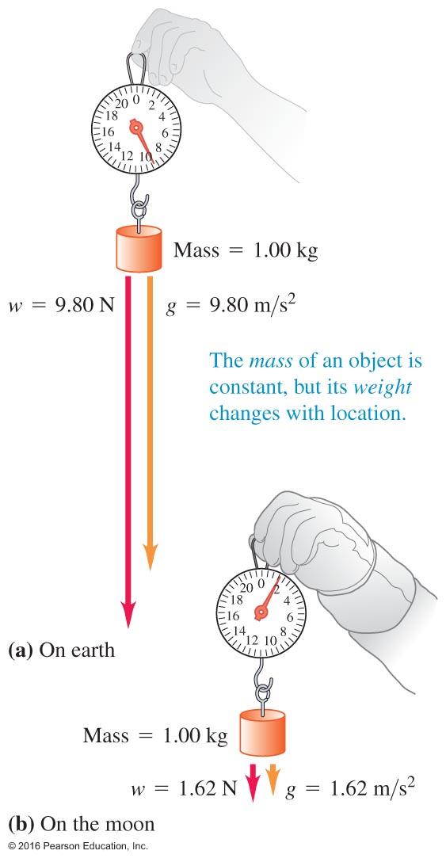
4.4 Mass and Weight
y
Mass is a measure of "how much material do I have?"
Weight is a force: "how hard do I pull on a scale?”
Weight of an object with mass m must have a magnitude w equal to the mass times the magnitude of acceleration due to gravity:
Why???
Consider an object of mass m falling under the influence of gravity only. In terms of the magnitude: $F=ma$ and $a=g$.
Therefore
$$w=F=mg$$
Courtesy of Wenhao Wu

Slide 4
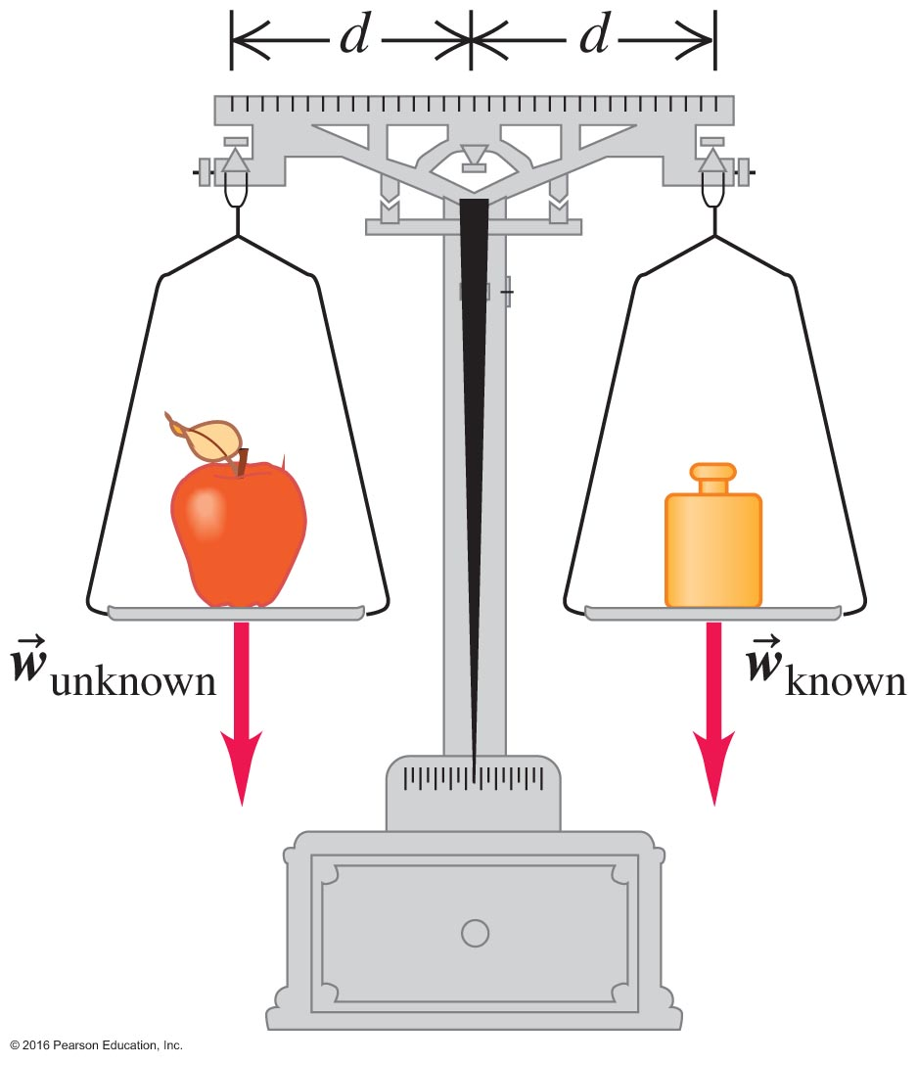
Measurement of Mass
Since gravity is constant, we can compare forces to measure unknown masses.

Slide 5
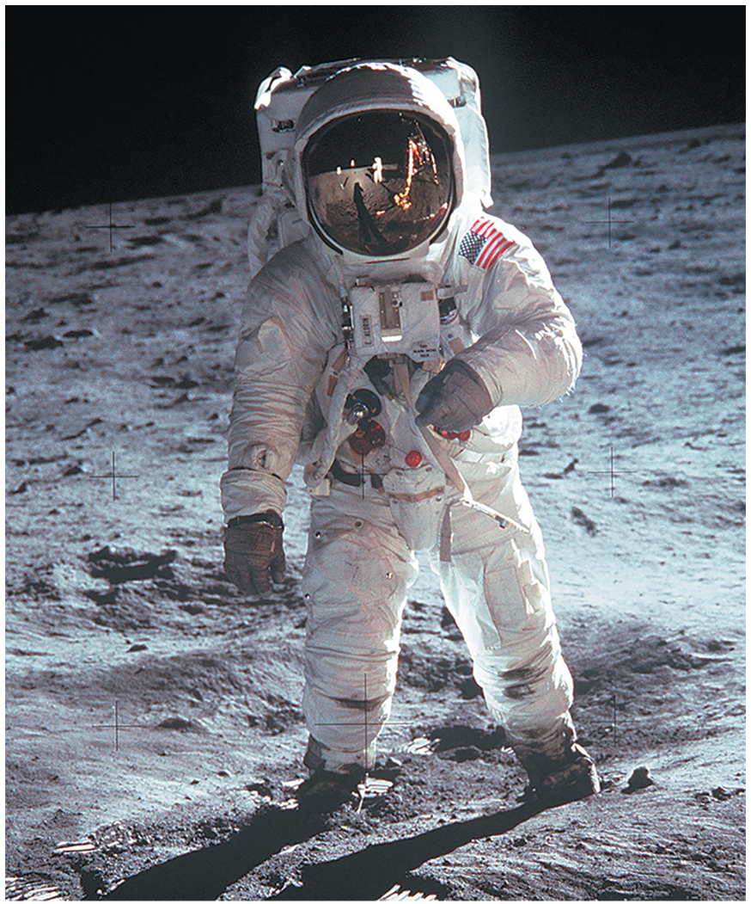
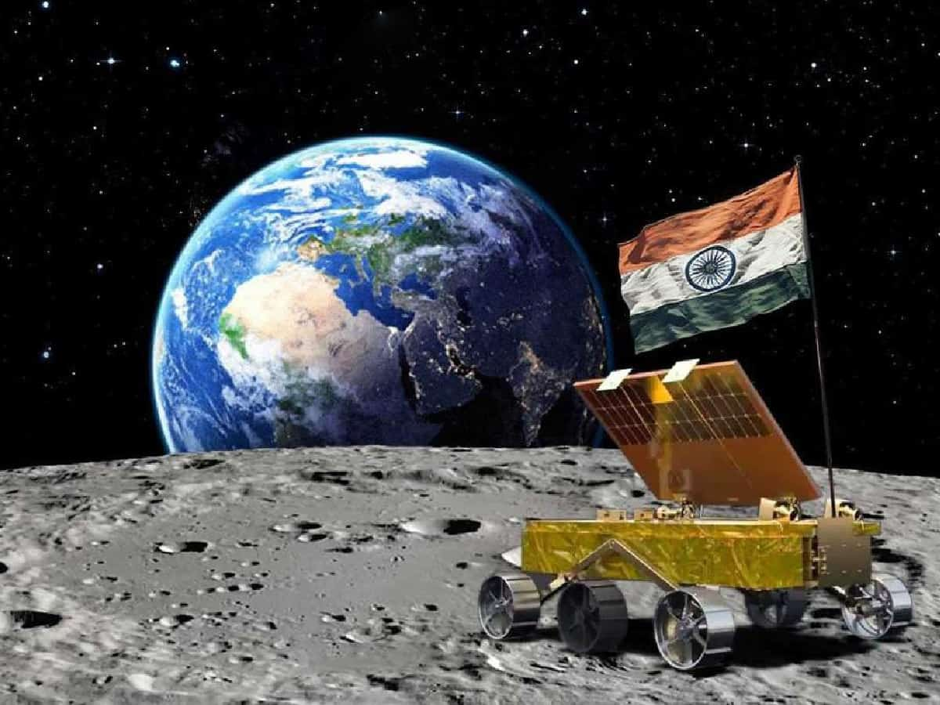
Astronauts on the moon

Slide 6
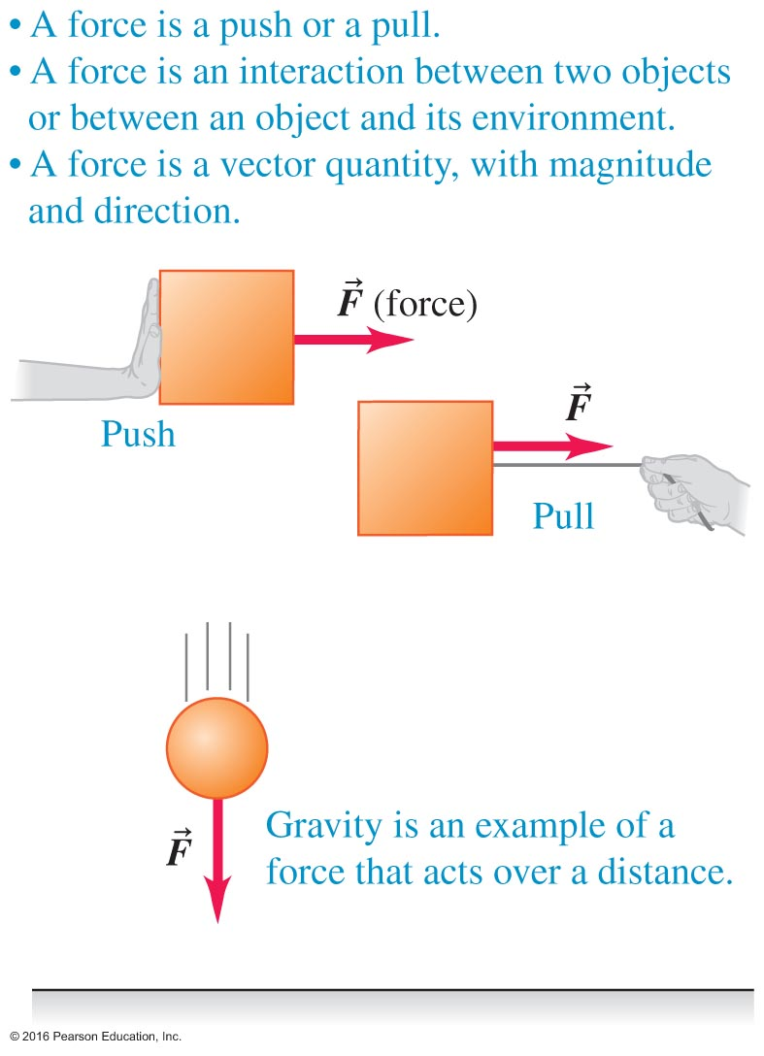
Types of Force Illustrated One – Figure 4.1

Slide 7
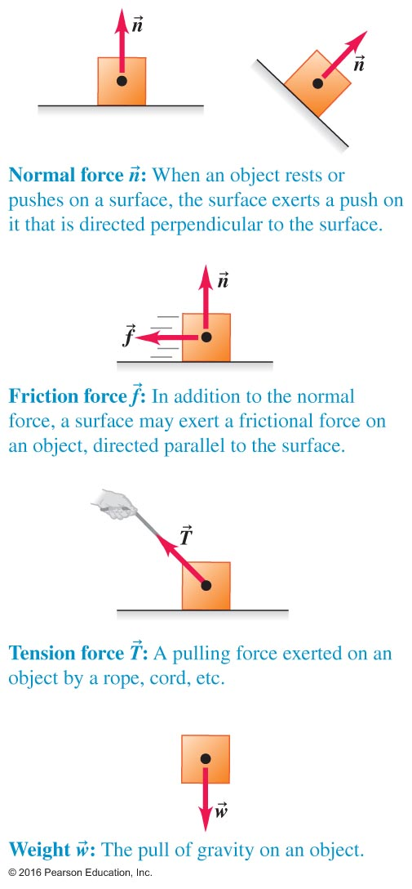
Types of Force Two – Figure 4.2
Single or net
Contact force
Normal force
Frictional force
Tension
Weight

Slide 8
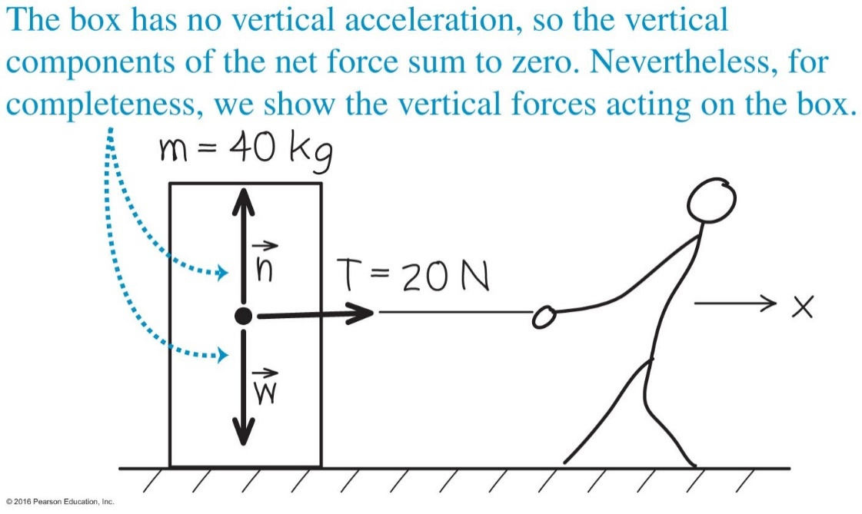
Forces and Free Body Diagrams One – Example 4.1
Observe the worked example on page 103.
The vertical forces are in equilibrium so there is no vertical motion.
But there is a net force along the horizontal direction, and thus acceleration.

Slide 9
Forces and Free Body Diagrams – Example 4.2 ketchup-slide
Like the previous example, we account for the forces and draw a free body diagram.
Again, in this case, the net horizontal force is unbalanced.
In this case, the net horizontal force opposes the motion and the bottle slows down (decelerates) until it stops.
$$v_{x}^{2}−v_{0x}^{2}=2a_{x}\left(x−x_{0}\right)$$
$$0−{\left(2.8\frac{m}{s}\right)}^{2}=2a_{x}\left(1.0 m −0\right)$$
$$a_{x}=−3.9\frac{m}{s^{2}}$$
$$ΣF_{x}=−f=ma_{x}$$
$$−\vec{f}=\left(0.20 kg\right)\left(−3.9\frac{m}{s^{2}}\right)=−0.78\frac{m}{s^{2}}=−0.78 N$$
Newton
1 N = (1 kg ) ( 1 m/s^2 )

Slide 10
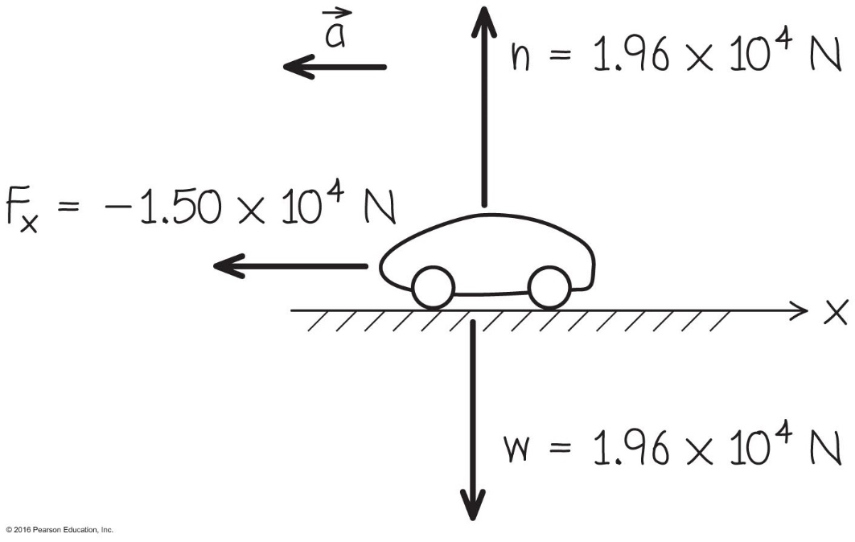
We Can Solve for Dynamic Information – Example 4.4
Knowing force and mass, we can sketch a free body diagram and label it with our information.
We can solve for acceleration.

Slide 11
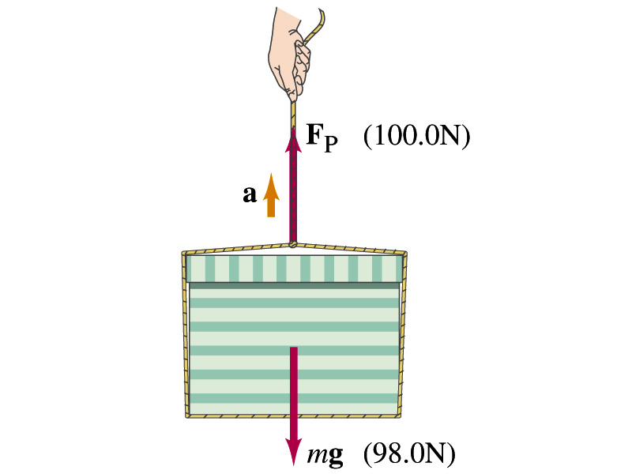
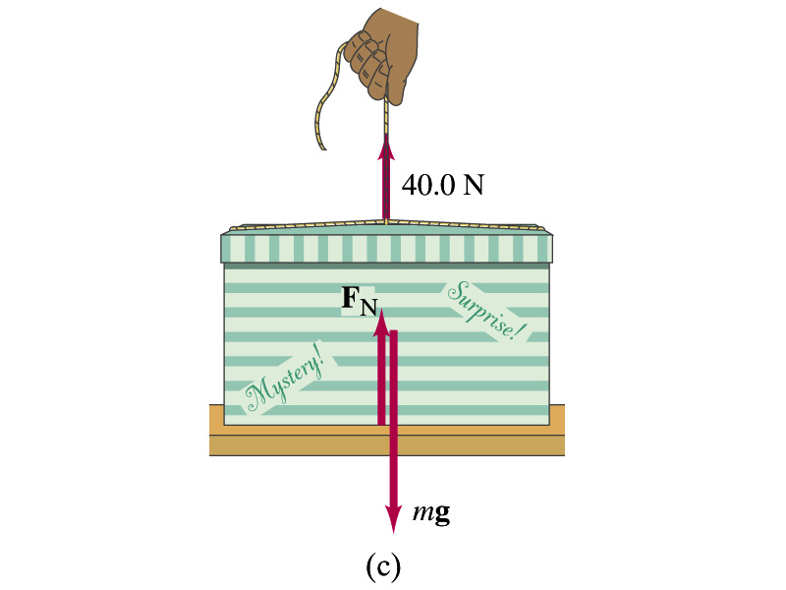
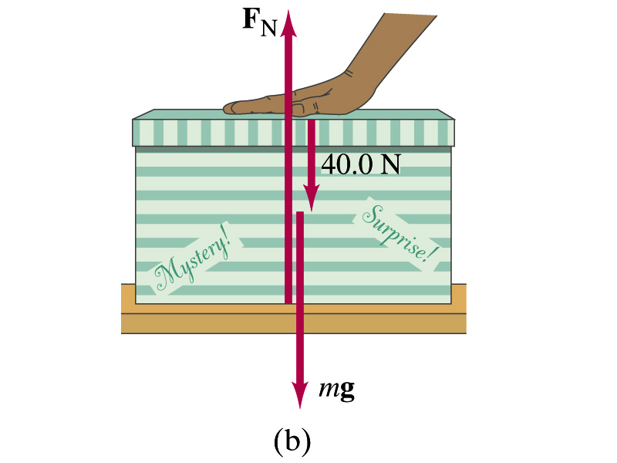
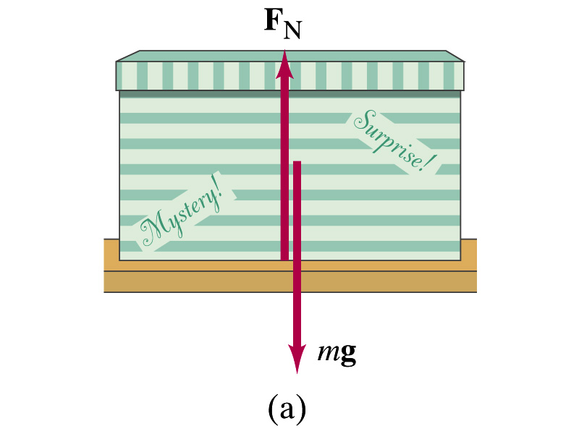
Weight, normal force and a box

Slide 12
Normal force = $F_{N}$ and mystery box
$\sum{F}=mg$ and (mass) $m=10 kg$
a) $\sum{F}=F_{N}−mg=ma$ and $a=0$
$F_{N}−mg=0$ So, $F_{N}=mg$ (normal force)
b) $F_{N}−mg−40N=0$; $F_{N}=98N+40N=138N$
c) $F_{N}−mg+40N=0$; $F_{N}=98N−40N=58N$
d) $F_{y}=F_{P}−mg=100N−98N=2N={ma}_{y}$
$a_{y}=\frac{F_{y}}{m}=\frac{2N}{10kg}=0.2\frac{m}{s^{2}}$

Slide 13
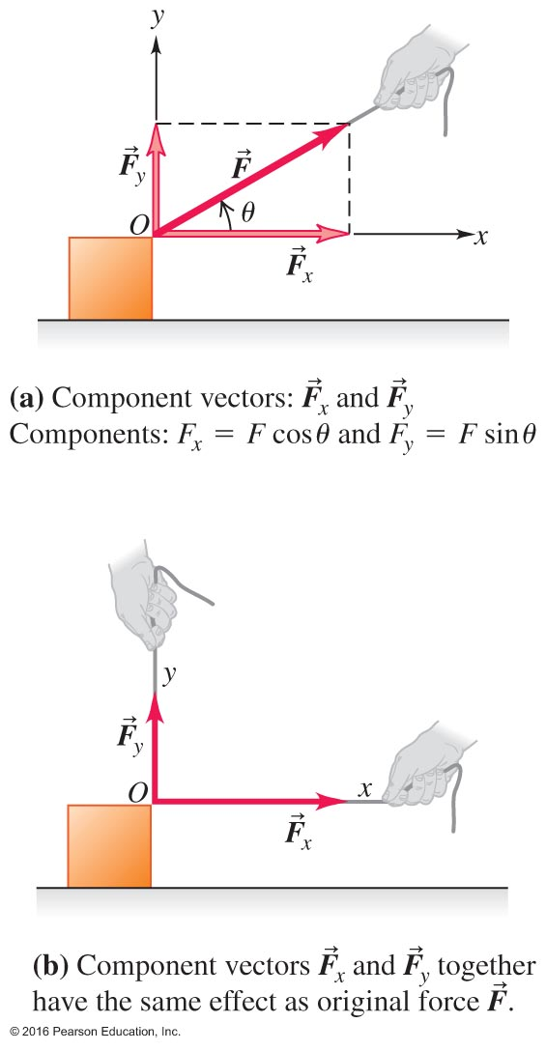
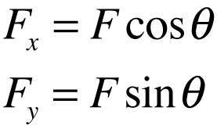
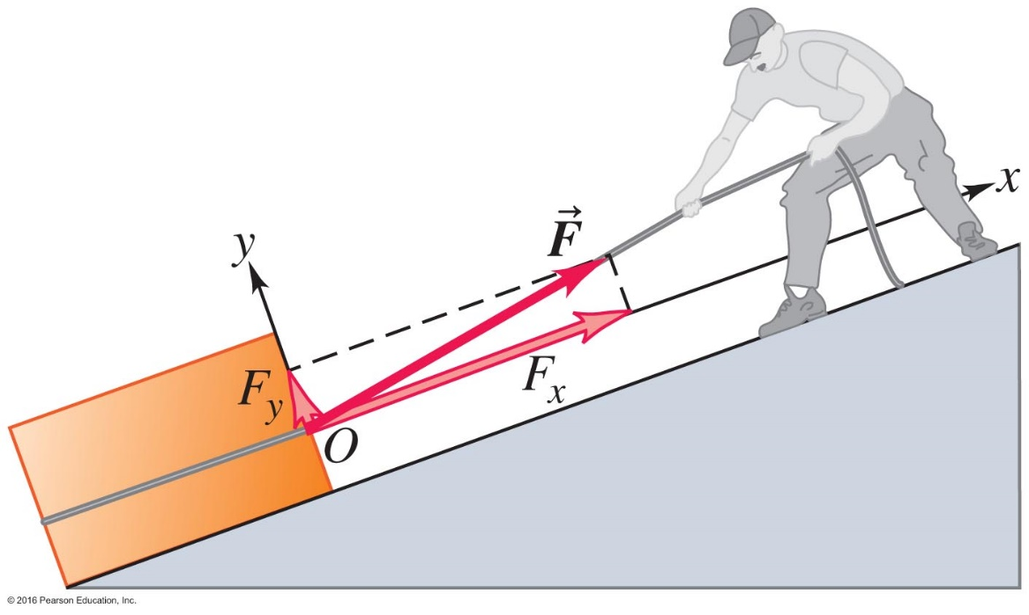
A Force May Be Resolved Into Components
The x- and y-coordinate axes don't have to be vertical and horizontal.

Slide 14
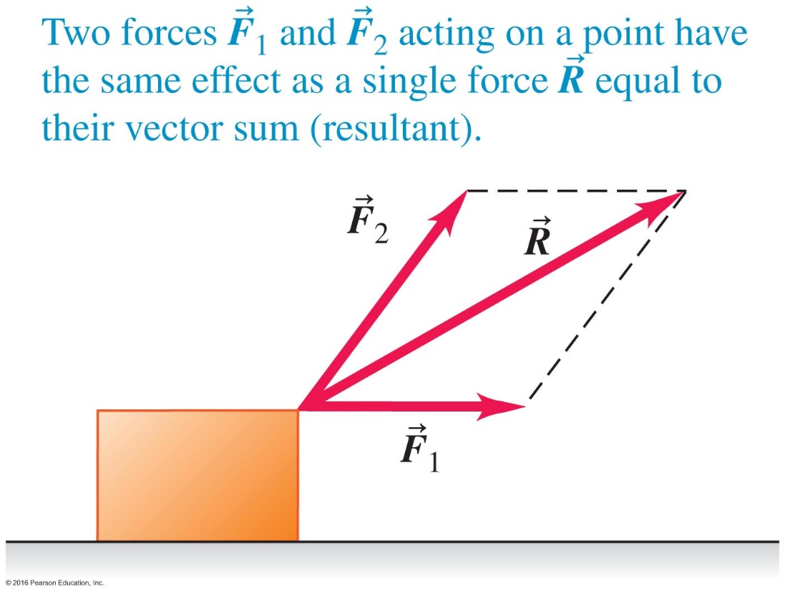
Superposition of Forces: Resultant and Components of Force Vectors
An example of superposition of forces:
In general, the resultant, or vector sum of forces, is:
y
x
$θ=\tan^{−1}\frac{R_{y}}{R_{x}}$ direction

Slide 15
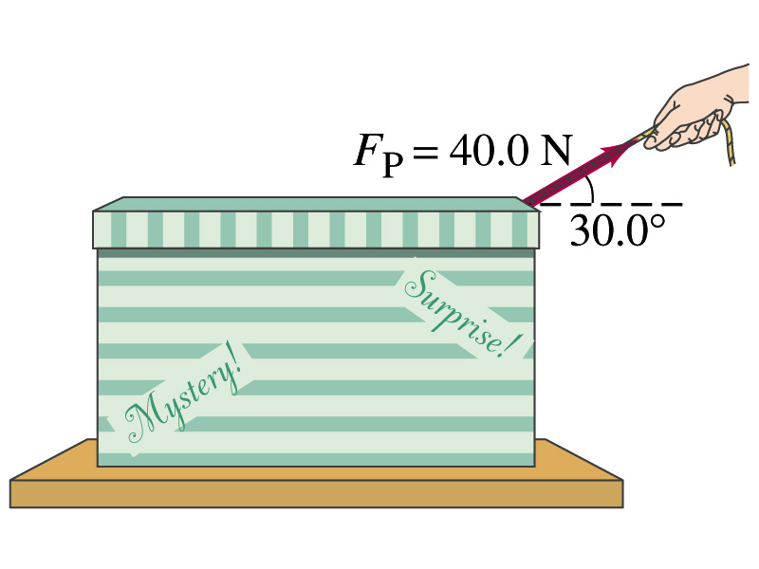
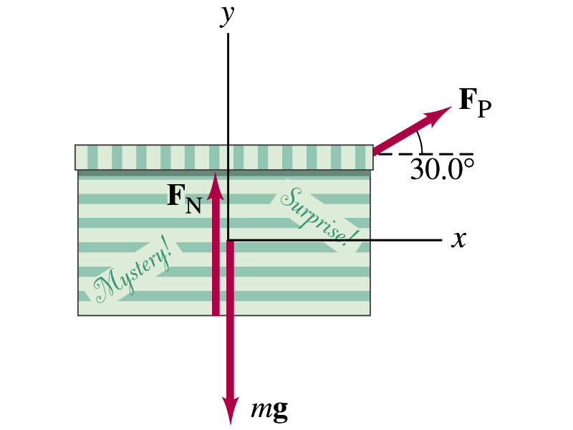
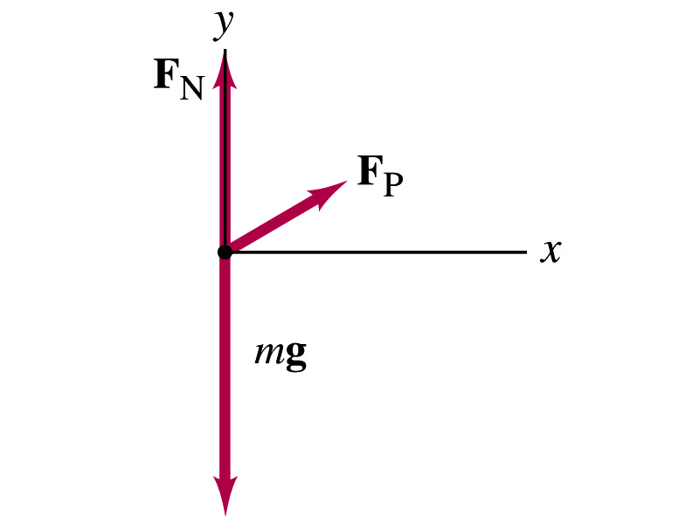
Pulling a box
Note: F_{N} is less than mg

Slide 16
Pulling the box
$\sum{F}=ma$ and $m=10 kg$
$$F_{px}=40∗cos30=34.6N$$
$$F_{py}=40∗sin30=20.0N$$
Horizontal
$F_{px}=ma_{x}$ → $a_{x}=\frac{F_{px}}{m}=\frac{34.6}{10}=3.46\frac{m}{s^{2}}$
Vertical
${\sum{F}}_{y}=ma_{y}$
→ $a_{y}=0$ box does not accelerate vertically
and $F_{N}−mg+F_{py}=ma_{y}$
$F_{N}−98N+20N=0=78N$
box accelerates horizontally

Slide 17
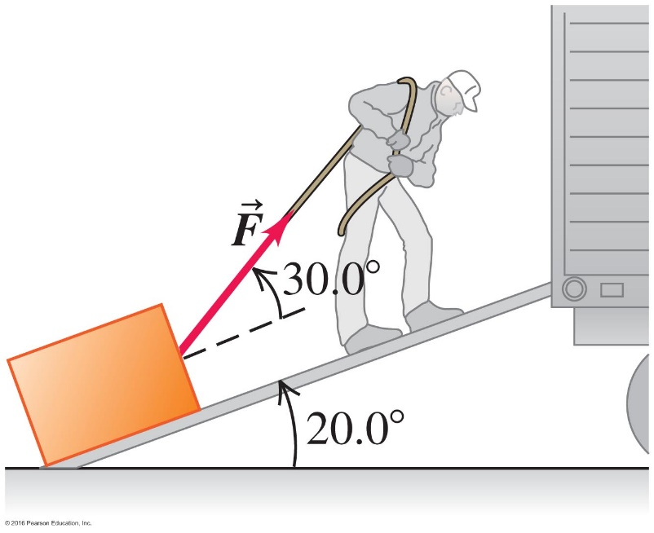
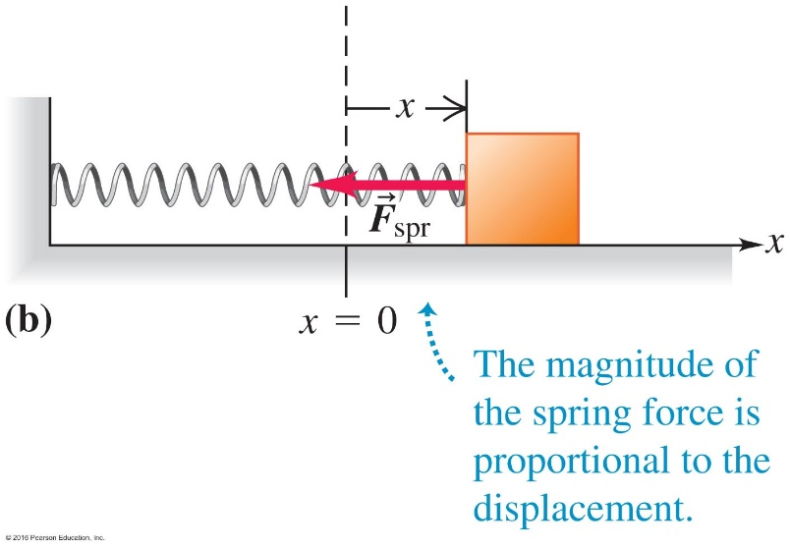
4.1 Force: a vector quantity describing the interaction between two objects
Type of Forces (that we will deal with in this course)
Contact forces
● Normal Force $\overset{⃑}{n}$ ● Friction Force ${\overset{⃑}{f}}_{k}$
normal to the tangent to the
contacting surface contacting surface
● Tension Force $\overset{⃑}{T}$ ● Spring Force ${\overset{⃑}{F}}_{spr}$
(in a rope) opposite to the
along the rope deformation
Action-at-a-Distance Forces (non-contacting)
● Gravitational Force ${\overset{⃑}{F}}_{G}$
(along the line connecting the two centers of mass)
$$\overset{⃑}{n}$$
$$\overset{⃑}{T}$$
$${\overset{⃑}{f}}_{k}$$
$${\overset{⃑}{F}}_{G}$$
Courtesy of Wenhao Wu

Slide 18
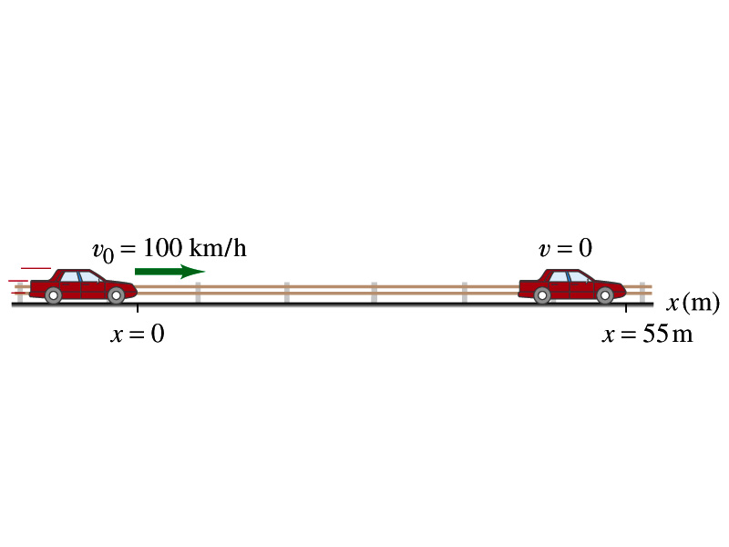
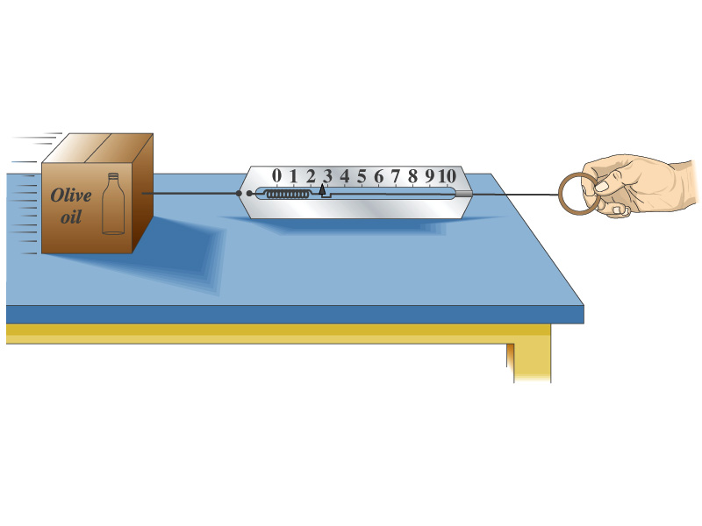
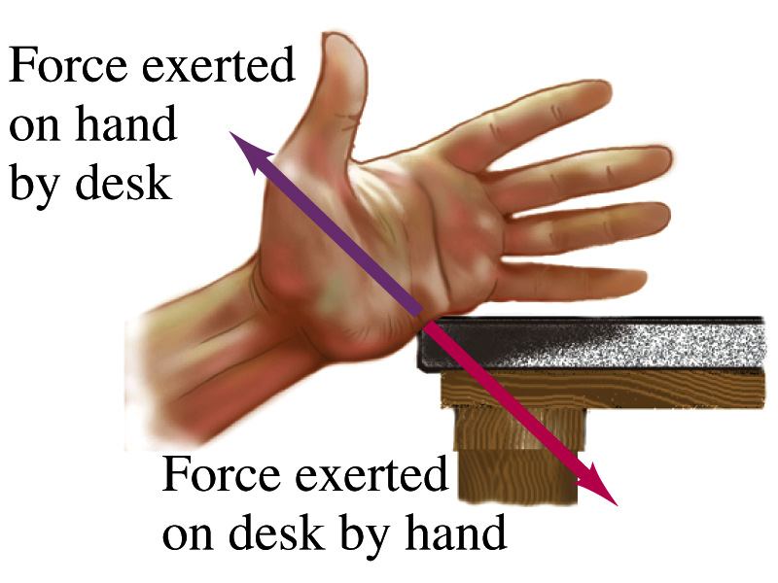
Dynamics, Newton’s Laws
First Law: Every body stays in its state of motion( rest or uniform speed) unless acted on by a non zero net force.
Second Law: The acceleration is directly proportional to the net force and inversely proportional to the mass:
Third Law: Action is equal to reaction.

Slide 19
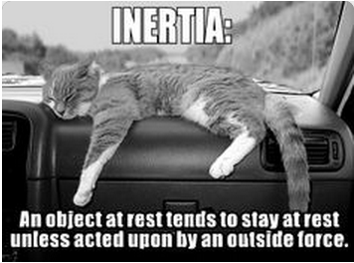
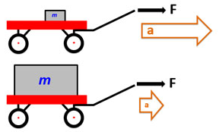
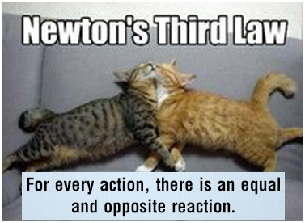
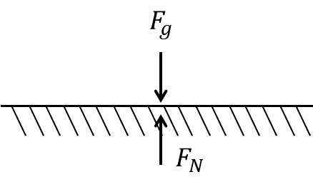
Newton’s laws and concept of mass
Famous equation:
$E=mc^{2}$ (Einstein) $F =m a$ (Newton)
$\left[N\right]=\left[kg\right]\left[\frac{m}{s^{2}}\right]$
1N=1kg*1m/s² (mkgs-systems)
Force=1dyn (cmgs-systems)
$$1N=\frac{1kg∗{10}^{3}g∗1m∗{10}^{2}cm}{1kg∗s^{2}∗1m}={10}^{5}g\frac{cm}{s^{2}}={10}^{5}dyn$$
Newton’s Laws
1st law: Without a force the state of motion is the same
2nd law: $F∝a$, and $a=\frac{\sum{F}}{m}$
3rd law: Action = Reaction

Slide 20
Newton's First Law – Figure 4.7
"Every object continues either at rest or at a constant speed in a straight line….”
What this common statement of the first law often leaves out is the final phrase “…unless it is forced to change its motion by forces acting on it.”
In one word, we say "inertia.”

Slide 21
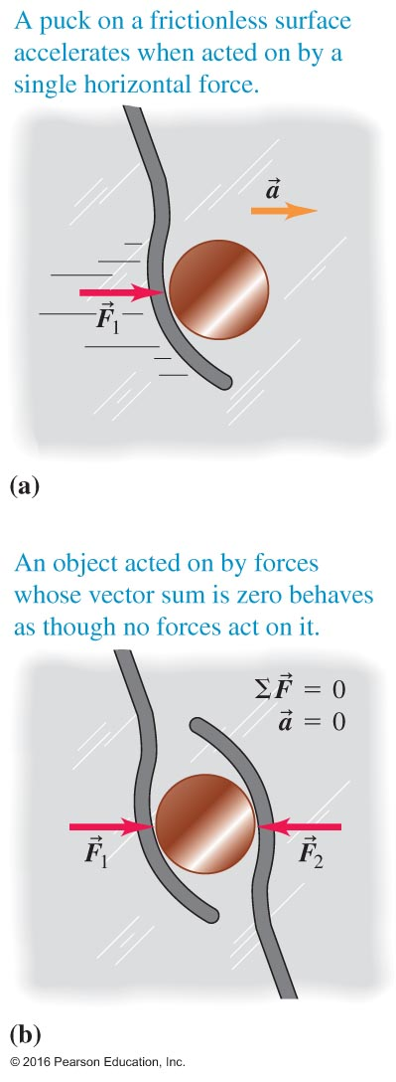
We Determine Effect with the Net Force – Figure 4.8
The top puck responds to a non-zero net force (resultant force) and accelerates.
The bottom puck responds to two forces whose vector sum is zero:
The bottom puck is in equilibrium, and does NOT accelerate.

Slide 22
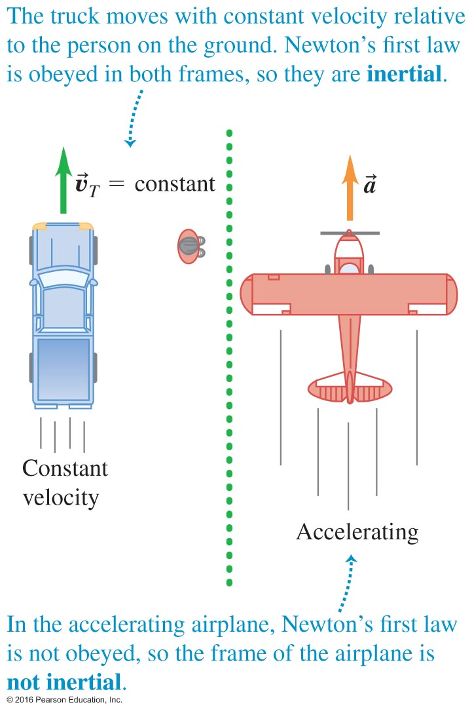
Forces are Inertial and Non-inertial – Figure 4.9
The label depends on the position of the object and its observer.
A frame of reference in which Newton's first law is valid is called an inertial frame of reference ( no acceleration ).

Slide 23
4.2 Newton’s First Law (Law of Inertia)
An object at rest stays at rest and an object in motion stays in motion with the same
speed and in the same direction unless acted upon by an unbalanced force.
If $\sum{\overset{⃑}{F}}$ = 0 or $\sum{F_{x}=0}$
$\sum{F_{y}=0}$
then $\overset{⃑}{a}$= 0 or $a_{x}=0$ $v_{x}=constant$
$a_{y}=0$ $v_{y}=constant$.
Inertia: a tendency to maintain the state of motion.
Mass: a quantitative measure of inertia.
Equilibrium
In mechanics, equilibrium means
$\overset{⃑}{a}$= 0 or $a_{x}=0$ $v_{x}=constant$
$a_{y}=0$ $v_{y}=constant$.
Courtesy of Wenhao Wu

Slide 24
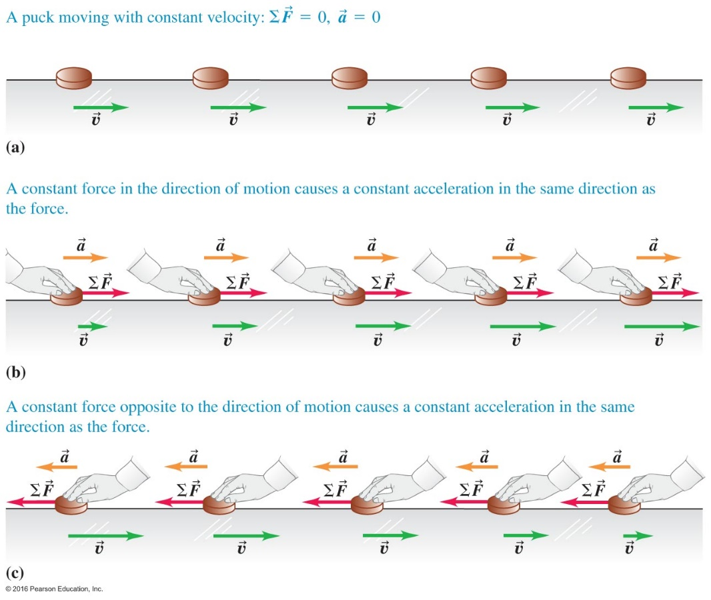
Mass and Newton's Second Law I –Figure 4.11
Object's acceleration is in same direction as the net force acting on it.
We can examine the effects of changes to each component.

Slide 25
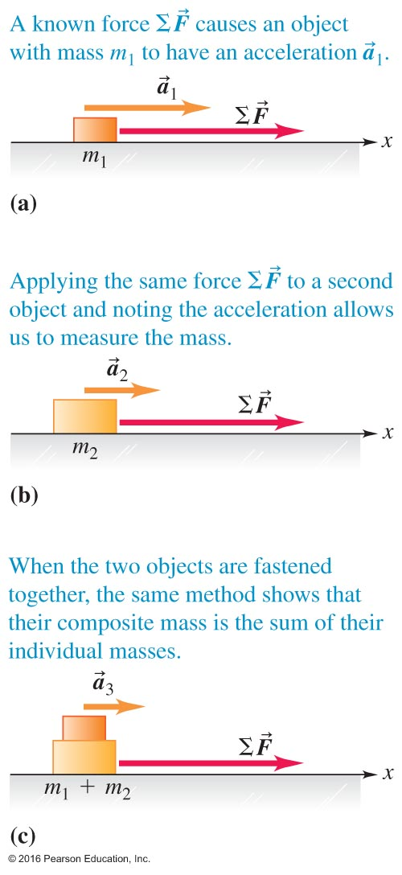
Mass and Newton’s Second Law Two – Figure 4.12
Let's examine some situations with more than one mass.
In each case we have Newton's second law of motion:
Force in N, mass in kilogram,
and acceleration in

Slide 26
4.3 Newton’s Second Law
The vector sum of all the forces acting on an object equals the object’s mass times its acceleration:
$\sum{\overset{⃑}{F}=m\overset{⃑}{a}}$
● The net force $\sum{\overset{⃑}{F}}$ and the acceleration $\overset{⃑}{a}$ have the same direction.
● The magnitude of the acceleration is proportional to the magnitude of the net force.
● One may also express Newton’s Second Law in this format:
$\overset{⃑}{a}=\frac{1}{m}\sum{\overset{⃑}{F}}$.
Therefore, in terms of magnitude:
● The magnitude of the acceleration is proportional to the magnitude of the net force.
● The magnitude of the acceleration is inversely proportional to the mass.
● Units: Force is measured in Newton or N: 1 N = (1 kg)(1 m/s²)
Courtesy of Wenhao Wu

Slide 27
The Component Form: $\sum{\overset{⃑}{F}=m\overset{⃑}{a}}$ $→$ $\sum{F_{x}=ma_{x}}$ and $\sum{F_{y}=ma_{y}}$
Example: An object of mass 5.0 kg is acted upon by two forces, F_{A} and F_{B}. F_{A} is directed toward east and has a magnitude 3.0 N. F_{B} is directed toward north and has a magnitude 4.0 N.
Draw diagram that describes this situation.
Set up a coordinate system.
Calculate the components, the magnitude, and the direction of the net force.
Calculate the components and the magnitude of the acceleration.
y
$${\overset{⃑}{F}}_{B}$$
$$\overset{⃑}{F}$$
$$θ$$
O
$${\overset{⃑}{F}}_{A}$$
x
Sketch a diagram that describes this situation.
Set up a coordinate system.
$F_{x}=F_{Ax}=$ 3.0 N $F_{y}=F_{By}=$ 4.0 N
$F={({3.0}^{2}+{4.0}^{2})}^{1/2} =5.0$ N $θ=\tan^{−1}\left(\frac{4.0}{3.0}\right)=53°$
$a_{x}=\frac{F_{x}}{m}=\frac{3.0}{5.0}=0.60$ m/s² $a_{y}=\frac{F_{y}}{m}=\frac{4.0}{5.0}=0.80$ m/s²
a $={({0.60}^{2}+{0.80}^{2})}^{1/2} =1.0$ m/s² or a = F/m = 1.0 m/s²

Slide 28
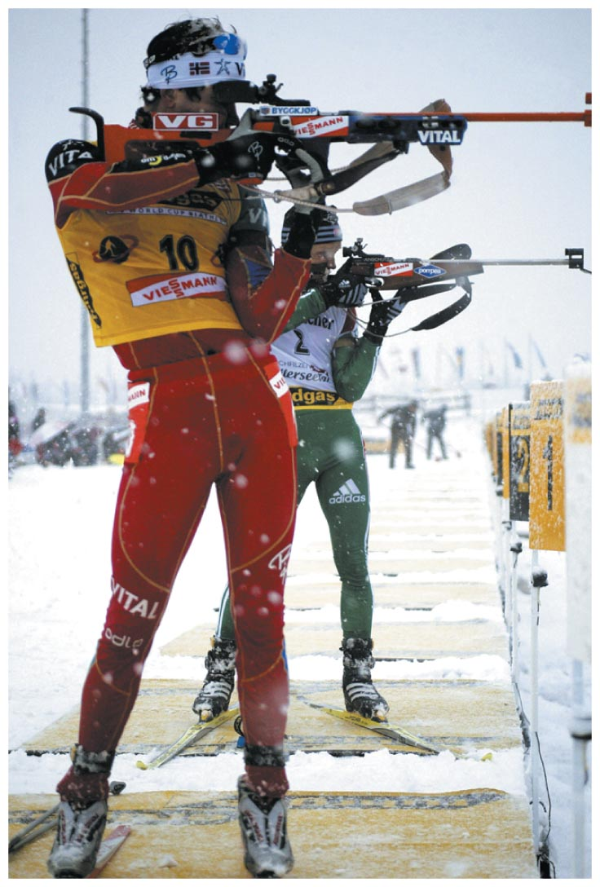
Newton's Third Law Action – Reaction Pair
"For every action, there is an equal and opposite reaction."
Rifle recoil is a wonderful example.
When shooting, press it hard against your shoulder !

Slide 29
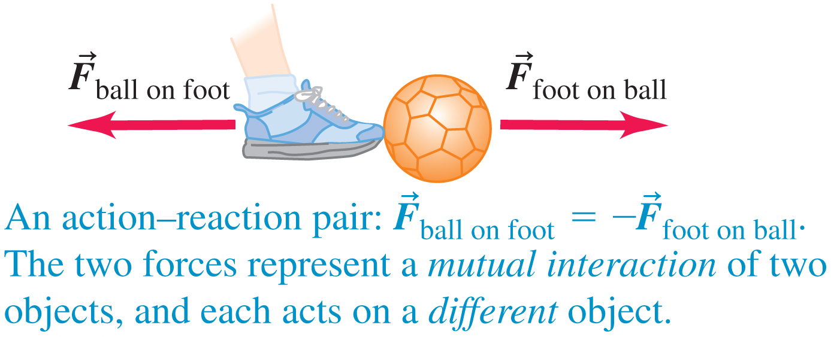
Chapter Summary Figure 5

Slide 30
You use a cord and pulley to raise boxes up to a loft, moving each box at a constant speed. You raise the first box slowly. If you raise the second box more quickly, what is true about the force exerted by the cord on the box while the box is moving upward?
Clicker question
The cord exerts more force on the faster-moving box.
The cord exerts the same force on both boxes.
The cord exerts less force on the faster-moving box.
The cord exerts less force on the slower-moving box.
b) The cord exerts the same force on both boxes
Notes:
Answer: b) The cord exerts the same force on both boxes.

Slide 31
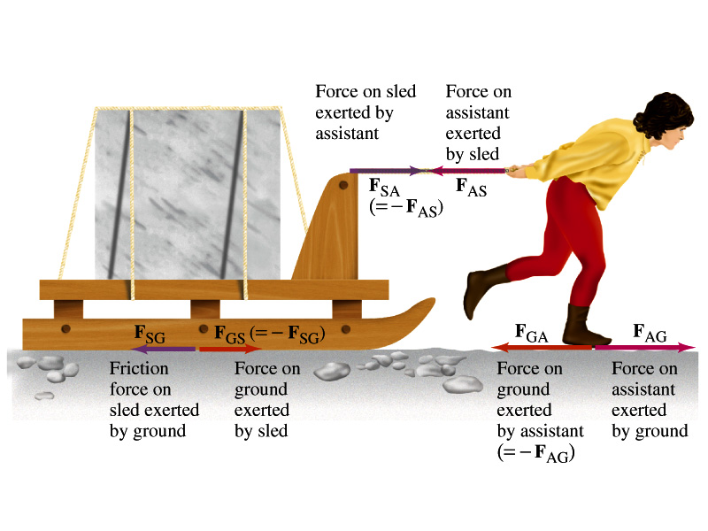
pulling a sled, Michelangelo’s assistant
The two forces in an action-reaction pair always act on different objects
For forward motion: F_{AG}> F_{AS} F_{SA} > F_{SG}

Slide 32
w$eight=mg$
When drawing force diagrams consider only forces acting on the same object
For forward motion:
$$F_{SA}>F_{SG}$$
$$F_{AG}>F_{AS}$$

Slide 33
Use Free Body Diagrams In Any Situation – Figure 4.24
Find the object of the focus of your study, and collect all forces acting upon it.

Slide 34
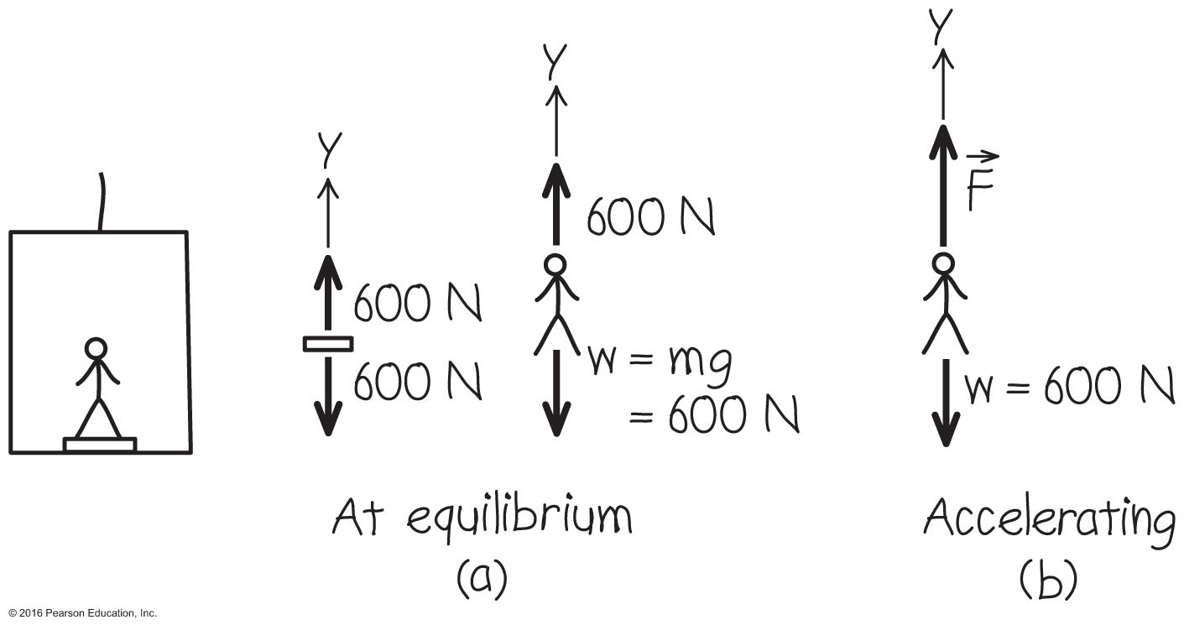
Forces Transmit Themselves as Tension – Example 4.9
We can solve for several outcomes using the elevator as our example.
Follow the worked problem on page 114.

Slide 35
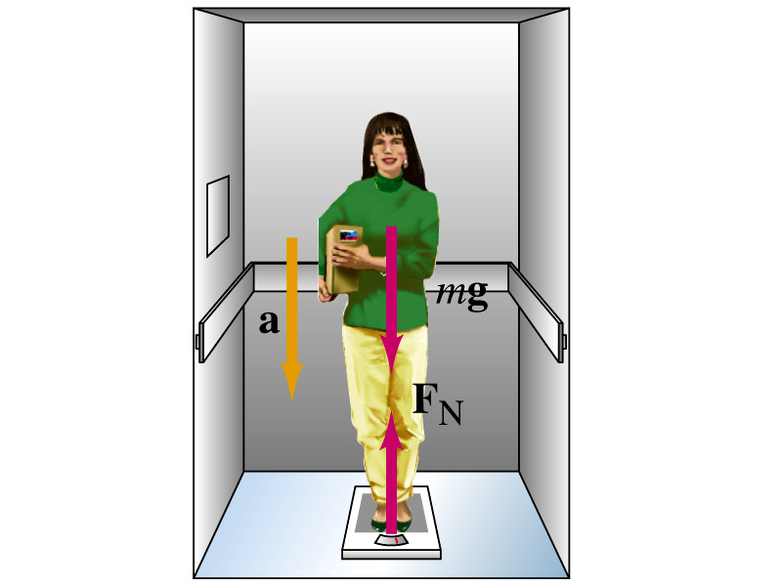
Unwanted weight loss(descending)

Slide 36
Weight loss in a descending elevator
$\sum{F}=ma$ and $m=65 kg$ with $a=0.2∗g$ (elevator)
${ F}_{N}$=normal force indicated by scale
$F_{N}−mg=m(−a)$ → $F_{N}=mg−0.2∗g∗m=m0.8g=509.6N$ (apparent weight)
$F_{N}=mg=65 kg∗9.8\frac{m}{s^{2}}=637 N$ (real weight)
$m=\frac{0.8∗637}{9.8}=52 kg$ (apparent mass)

Slide 37
Stepping on a scale in an elevator and push “up”. Your normal weight is 625N.
Your weight going up
Tension in the string
a) Work out your mass
$$m=\frac{W}{g}=63.8 kg$$
Elevator goes up
$$a=+2.5\frac{m}{s^{2}}$$
What does the scale read? $\sum{F_{y}}=ma_{y}=N−W=ma$
Scale reading;
$N=ma+W=63.8∗2.5+63.8∗9.8=784N$
Apparent mass $=\frac{784}{9.8}=80 kg$
b) What is the tension in a string holding a 3.85kg package?
$\sum{F_{y}}=ma_{y}=T−W$
$T=ma+W=3.85∗2.5+3.85∗9.8=47.4N$

Slide 38
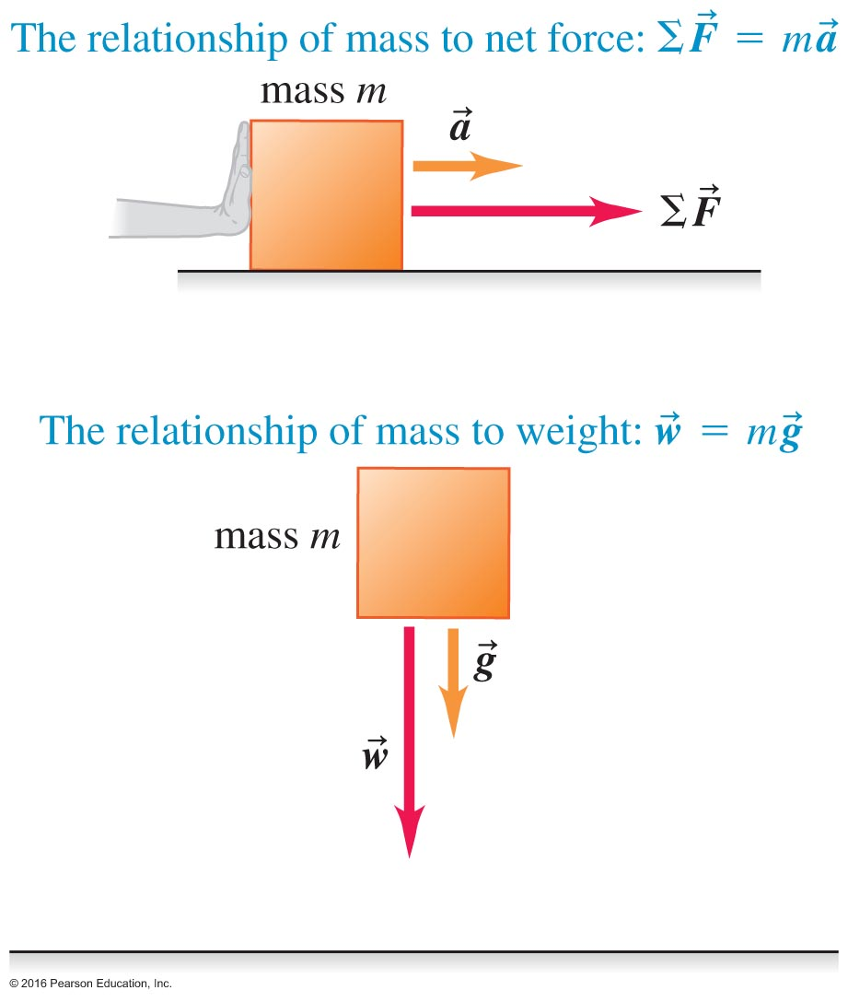
$${\overset{⃑}{F}}_{B on A}$$
B
$${\overset{⃑}{F}}_{A on B}$$
A
4.5 Newton’s Third Law
“For every action, there is an equal
and opposite reaction.”
${\overset{⃑}{F}}_{A on B}=−{ \overset{⃑}{F}}_{B on A}$
$${\overset{⃑}{F}}_{B on A}$$
A
B
$${\overset{⃑}{F}}_{A on B}$$

Slide 39
Newton’s Second Law:
in vector form $\sum{\overset{⃑}{F}=m\overset{⃑}{a}}$
in component form $\sum{F_{x}=ma_{x} }$ $\sum{F_{y}={ma}_{y}}$
Example 1: A box of known mass m is resting on a level table surface. Find all the forces acting on this box and their action-reaction counterparts.
Strategy for Solving Newton’s Law Problems
● Isolate the bodies in a system.
● Analyze all the forces acting on each body and draw one
free-body diagram for each body.
● Based on the free-body diagram, set up a most convenient
x-y coordinate system.
● Break each force into components with these coordinates.
● For each body, sum up all the x-components of the forces
to an equation: $\sum{F_{x}=ma_{x}}$.
● For each body, sum up all the y-components of the forces
to an equation: $\sum{F_{y}=ma_{y}}$.
● Use these equations to solve for unknown quantities.
n
y
m
W
Two forces act on the box:
weight (known) W = – mg
normal force n
Sum up the y – component forces:
n + (– mg) = 0.
Therefore, n = mg.
Courtesy of Wenhao Wu

Slide 40
Example: Two boxes of masses m₁ and m₂ are pushed together by a horizontal force F to accelerate to the right on a level frictionless table surface as shown. Calculate the acceleration and the normal force between the boxes.
m₁
m₂
F
n₁
n₂
m₁
m₂
y
n
n
F
x
m₁g
m₂g
x-axis: F – n = m₁a
y-axis: n₁ – m₁g = 0
x-axis: n = m₂a
y-axis: n₂ – m₂g = 0
F – m₂a = m₁a
F = m₁a + m₂a = (m₁ + m₂)a
a = F/(m₁ + m₂)
n = m₂a = [m₂/(m₁ + m₂)]F
Since m₂/(m₁ + m₂) < 1 n < F
n₁ = m₁g
n₂ = m₂g
Courtesy of Wenhao Wu

Slide 41
Example: Box of mass m on a frictionless incline
Given: m and θ
Find: n and a
Solutions:
Weight: W = mg W_{x} = mgsinθ W_{y} = – mgcosθ
x-axis: mgsinθ = ma a = gsinθ
y-axis: n – mgcosθ = 0 n = mgcosθ
y
n
x
θ
θ
mg
Another Question: Near the bottom of the incline, the box is given an initial velocity of a known magnitude v₀ pointing up the incline. What distance will it slide before it turns around and slides downward?
Solution: The acceleration is given above a = gsinθ
Use the kinematic equation $v_{2}^{2}−v_{1}^{2}=2a(x_{2}−x_{1})$
$(x_{2}−x_{1})=$ $−v_{1}^{2}$/$2a$ = $−v_{0}^{2}$/2gsinθ
The distance that it will slide up the incline is $v_{0}^{2}$/2gsinθ.
Courtesy of Wenhao Wu

Slide 42
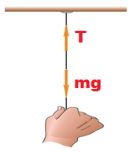
A gymnast climbs a rope
In which case does the rope break first? Need to see when rope tension is largest.
Consider the following cases;
a) He climbs with a constant rate
$\sum{F}=ma$ and $a=0 \text{So}\text{, }T=mg$
b) He just hangs on the rope
$\sum{F}=T−mg=0$; So, $T=mg$
c) He climbs up with constant acceleration
$\sum{F}=T−mg=ma$; So, $T=m(g+a)$
d) He slides downward with constant acceleration
$\sum{F}=T−mg=−ma$; So, $T=m(g−a)$
+a
-a

Slide 43
Clicker question
In which case does the rope break first
a) He climbs with a constant rate
b)He just hangs in the rope
c)He accelerates upward with constant a
d) He decelerates downward with the same
constant a

Slide 44
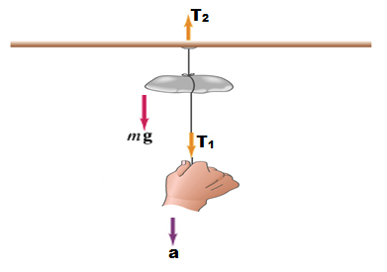
Where does the thread break?
Similar to Multiple Choice 8
If the lower string is pulled slowly, the upper string eventually breaks, because it supports both the applied force and the hanging weight. However, if the lower string is suddenly jerked, it is the one which breaks. The traditional explanation is that the inertia of the mass keeps it from moving and hence from stretching the upper string.
Where does the tread break?
$\sum{F}=ma$
1) $T_{2}−T_{1}−mg=m(−a)$ → $T_{1}=T_{2}−mg+ma$
$a>g$ and $T_{1}>T_{2}$
Threads break below
2) $T_{2}=T_{1}+mg−ma$
$a<g$ and $T_{2}>T_{1}$
Threads break above

Slide 45
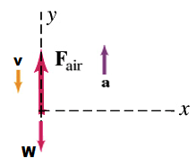
42
A parachutist relies on air. Let upward direction be positive and F_{air} =620N is the force of air resistance.
$\sum{F}=ma$
What is the weight of the parachutist?
$W=mg=55kg∗9.8\frac{m}{s^{2}}=539N$
What is the net force on the parachutist?
$\sum{F_{y}}=F_{air}−W=620N−539N=81N$
What is the acceleration of the parachutist?
$a_{y}=\frac{\sum{F_{y}}}{m_{1}+m_{2}}=\frac{81N}{55kg}=1.5\frac{m}{s^{2}}$ (upward)

Slide 46
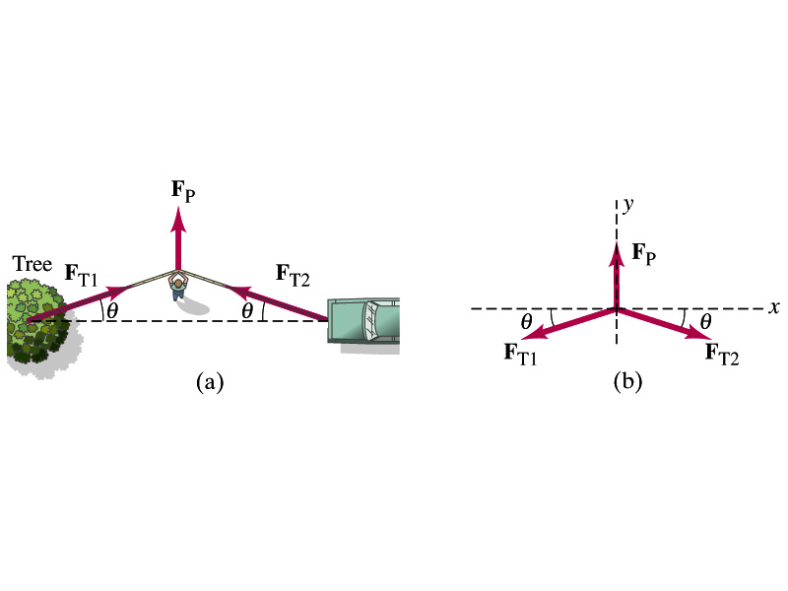
Getting the car out of the sand

Slide 47
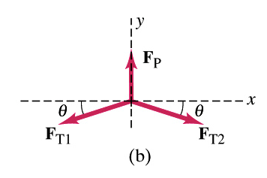
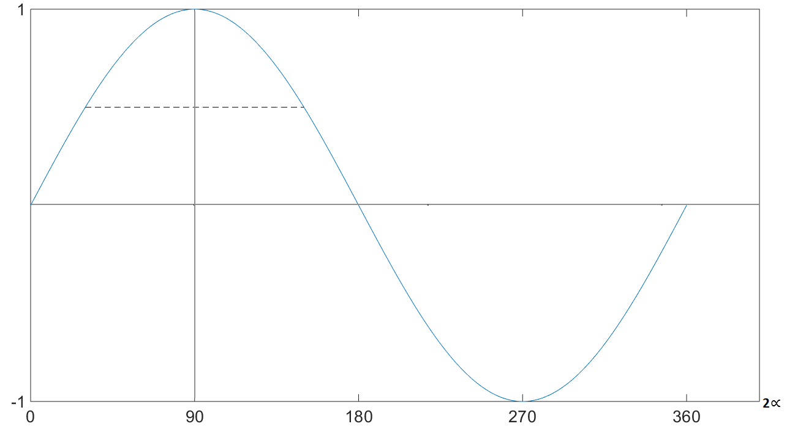
Getting the car out of the sand. All you need is a rope and Newton’s second law;
$\sum{F}=ma$ and $\sum{F_{x}=−F_{T1}\cos{θ}}+F_{T2}\cos{θ}$ and $F_{T1}=F_{T2}$
$\sum{F_{y}=F_{P}−2F_{T}\sin{θ}}=ma=0$ (At the break or loose point)
$F_{T}=\frac{F_{P}}{2\sin{θ}}$ and $F_{P}=300N, θ=5^{o}$
$F_{T}=\frac{300}{2sin5}=1700N$ (almost 6 times large)

Slide 48
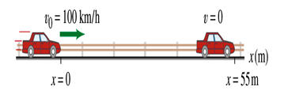
Force to stop a car
What force is required to bring a 1500kg car to rest to rest from a speed of 100 km/h within 55m?
Conversion of units; $100\frac{km}{h}∗\frac{{10}^{3}m}{1km}∗\frac{1h}{{3.6x10}^{3}s}=28\frac{m}{s}$
$\overset{⃑}{F}=m\overset{⃑}{a}$ and $v^{2}=v_{o}^{2}+2a(x−x_{o})$
So, $a=\frac{v^{2}−v_{o}^{2}}{2(x−x_{o})}=\frac{0−{28}^{2}}{2∗55}=−7.1\frac{m}{s^{2}}$
$\overset{⃑}{F}=1500\left(−7.1\right)={−1.1x10}^{4}N$

Slide 49
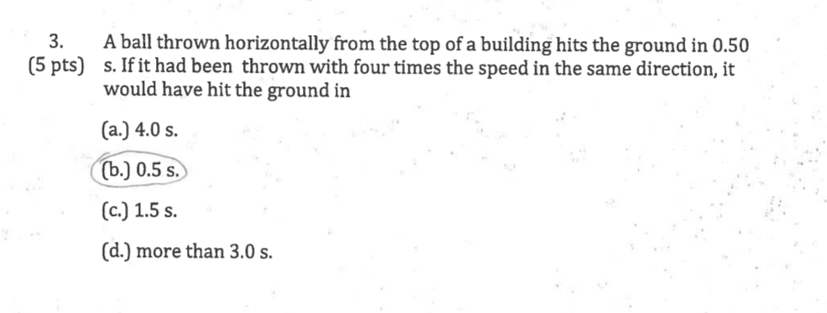
problems with solution

Slide 51
Example (Sections 5.1: Equilibrium of a Particle)
A box of known mass m is hung at rest by three
ropes as shown. Rope A is vertical. Rope B is
horizontal. Rope C forms an angle of θ = 60º with
the horizontal.
Find: the magnitude of tension T_{C} in Rope C
the magnitude of tension T_{B}in Rope B
Solutions:
y-axis: T_{C}sinθ – mg = 0 T_{C} = mg/sinθ
x-axis: T_{C}cosθ – T_{B} = 0 T_{B} = mgcosθ/sinθ
y
C
T_{C}
B
T_{B}
$$θ$$
x
T_{A}
A
m

