Slide 1
Chapter 5 Applications of Newton’s Laws
● To draw free-body diagrams and analyzing forces on individual objects.
● To solve for unknown quantities using Newton's 2nd law.
● To understand kinetic and static friction forces acting on an object.
● To use Hooke's law to relate the restoring force of a spring to the amount of
stretching or compression of a spring.
Courtesy of Wenhao Wu

Slide 2


The Conditions for a Particle to be in Equilibrium
Applications of Newton’s first law
When an object is at rest or moving with constant velocity in an inertial frame of reference (i.e. it is in equilibrium), the vector sum of all forces acting on it must be zero.
Necessary conditions for an object to settle into equilibrium:
Or in component form:
Note: a=0 means that an object in equilibrium may be at rest or moving with a constant velocity.

Slide 3
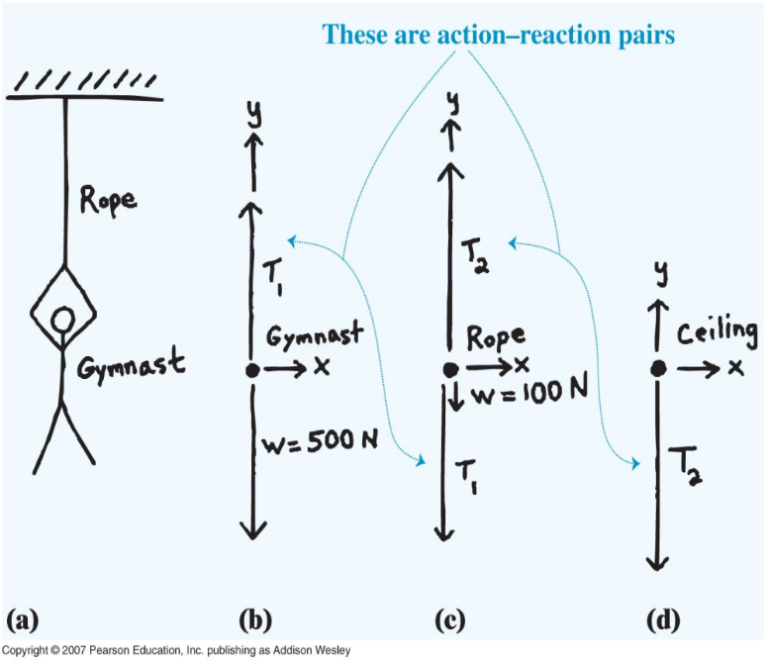
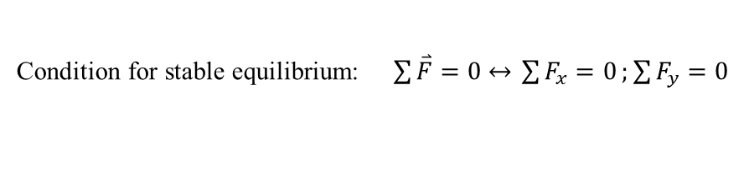
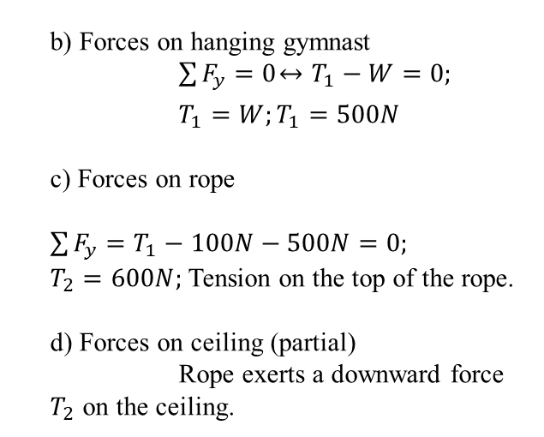
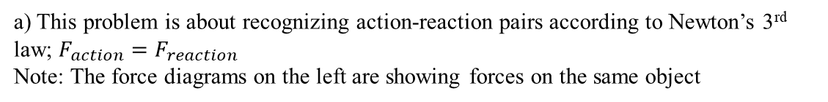
Equilibrium of a “particle”
One-dimensional equilibrium
A gymnast has just begun climbing up a rope hanging from a gymnasium ceiling. She stops, suspended from the lower end of the rope by her hands. Her weight is 500 N, and the weight of the rope is 100 N. Analyze the forces on the gymnast and on the rope.
Condition for stable equilibrium: $\sum{\overset{⃑}{F}}=0 \overset{↔}{ } \sum{F_{x}=0};\sum{F_{y}=0}$
a) This problem is about recognizing action-reaction pairs according to Newton’s 3rd law; $F_{action}=F_{reaction}$
Note: The force diagrams on the left are showing forces on the same object
b) Forces on hanging gymnast
$\sum{F_{y}=0}\overset{↔}{ } T_{1}−W=0;$
$T_{1}=W;T_{1}=500N$
c) Forces on rope
$\sum{F_{y}=T_{1}−100N−500N=0;}$
$T_{2}=600N;$ Tension on the top of the rope.
d) Forces on ceiling (partial)
Rope exerts a downward force $T_{2}$ on the ceiling.
2

Slide 4
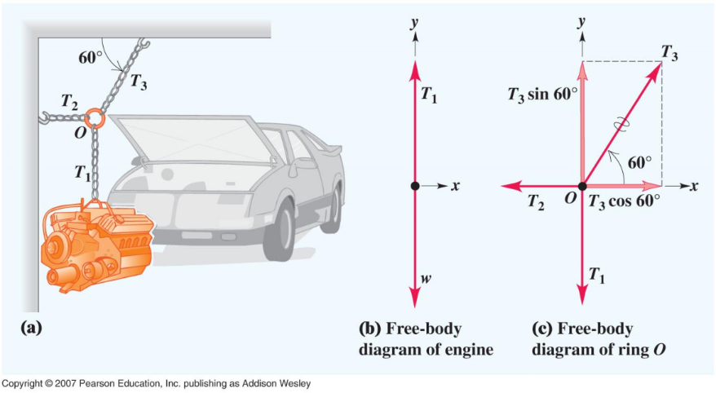
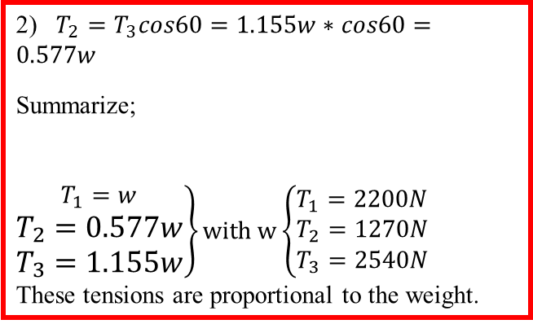
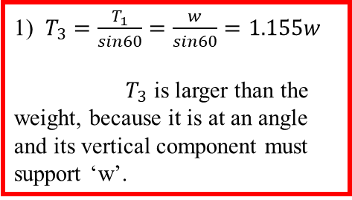
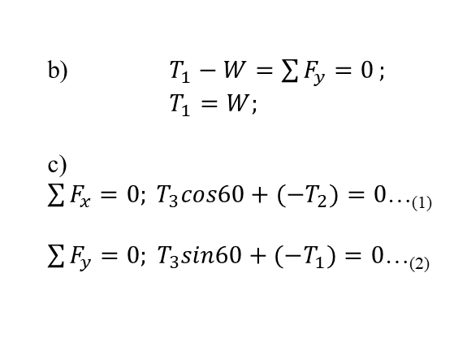
5.1 Equilibrium of a Particle
Two Dimensional Equilibrium – Example 5.2 A cherry-picker
A car engine with weight w=2200N hangs from a chain that is linked at point O to two other chains, one fastened to the ceiling and the other to the wall. Find the tension in each of the three chains, assuming that w is given and the weights of the chains themselves are negligible.
b) $T_{1}−W=\sum{F_{y}=0};$
$T_{1}=W;$
c) $\sum{F_{x}=0; T_{3}cos60+(−T_{2})=0}$…₍₁₎
$\sum{F_{y}=0; T_{3}sin60+(−T_{1})=0}$…₍₂₎
1) $T_{3}=\frac{T_{1}}{sin60}=\frac{w}{sin60}=1.155w$
$T_{3}$ is larger than the weight, because it is at an angle and its vertical component must support ‘w’.
2) $T_{2}=T_{3}cos60=1.155w∗cos60=0.577w$
Summarize;
$\left.\begin{aligned}T_{1}=w \\ T_{2}=0.577w \\ T_{3}=1.155w\end{aligned}\right\}with \text{w}\left\{\begin{aligned}T_{1}=2200N \\ T_{2}=1270N \\ T_{3}=2540N\end{aligned}\right.$
These tensions are proportional to the weight.

Slide 5
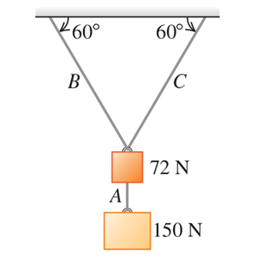

Problem 5. 1 4

Slide 6
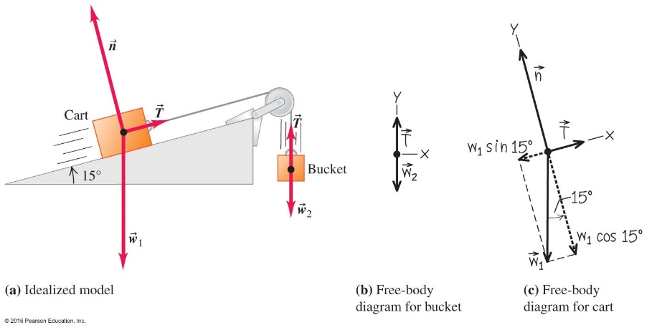
An Example Involving Two Systems –Example 5.4
See the worked example on page 126.
This example brings nearly every topic we have covered so far in the course.
This is an equilibrium problem because system moves with
constant speed!!
Note: x-axis for the cart does not have to align with the horizontal direction and is different from the bucket.

Slide 7
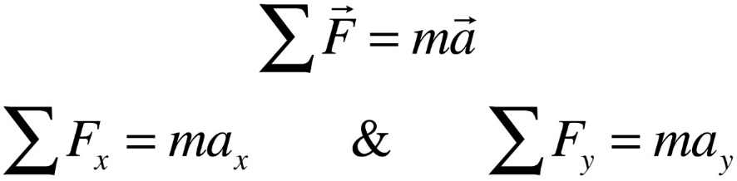
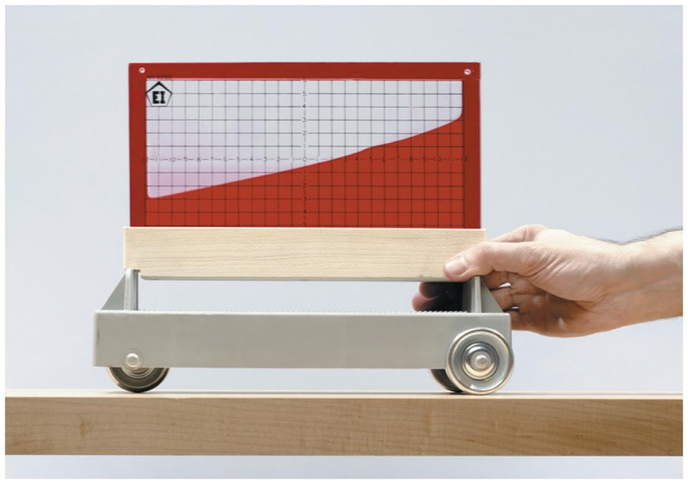
Let's Examine Applications of Newton's Second Law. → Non-equilibrium or Dynamic Problems
Although this container is on a level surface, the liquid surface is on a slant because the apparatus is being accelerated to the left.
Can you tell that th container is accelerated to the left ?

Slide 8
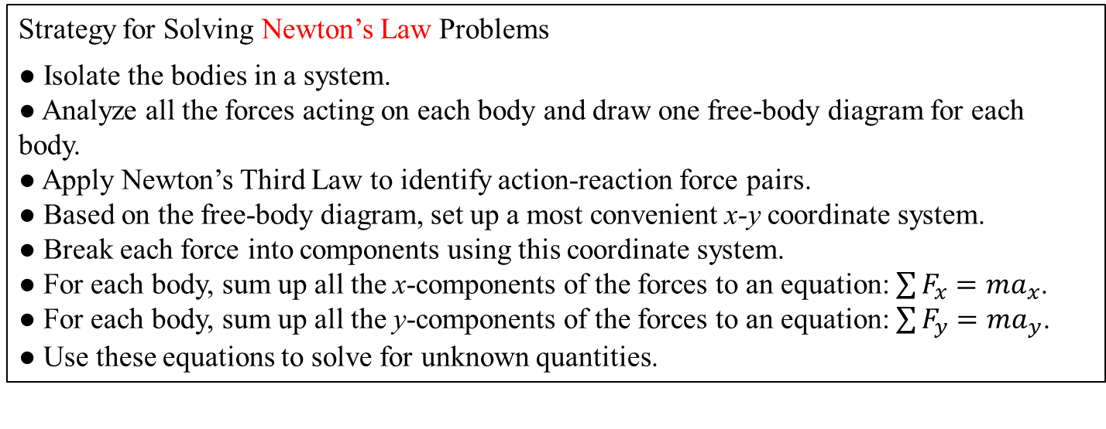
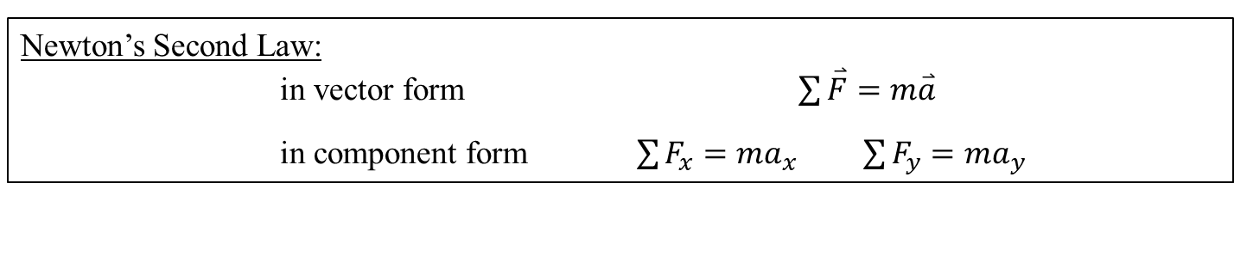
5.2 Applications of Newton’s Second Law
A Review of Problem-Solving Strategy
Newton’s Second Law:
in vector form $\sum{\overset{⃑}{F}=m\overset{⃑}{a}}$
in component form $\sum{F_{x}=ma_{x} }$ $\sum{F_{y}={ma}_{y}}$
Strategy for Solving Newton’s Law Problems
● Isolate the bodies in a system.
● Analyze all the forces acting on each body and draw one free-body diagram for each body.
● Apply Newton’s Third Law to identify action-reaction force pairs.
● Based on the free-body diagram, set up a most convenient x-y coordinate system.
● Break each force into components using this coordinate system.
● For each body, sum up all the x-components of the forces to an equation: $\sum{F_{x}=ma_{x}}$.
● For each body, sum up all the y-components of the forces to an equation: $\sum{F_{y}=ma_{y}}$.
● Use these equations to solve for unknown quantities.
Courtesy of Wenhao Wu

Slide 9
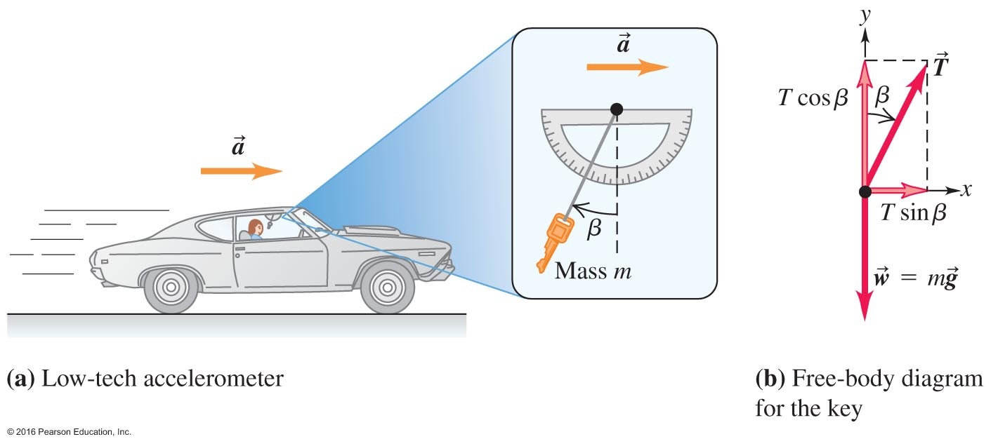
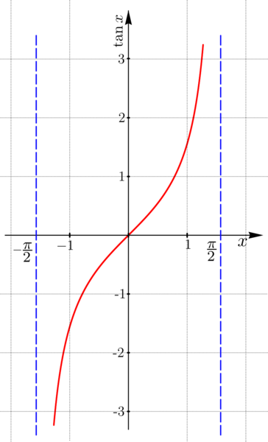
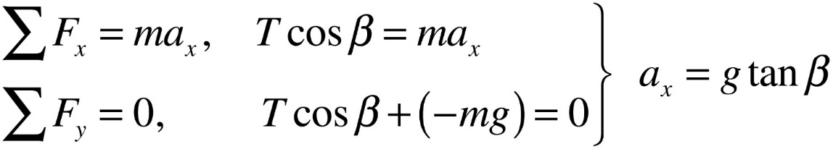
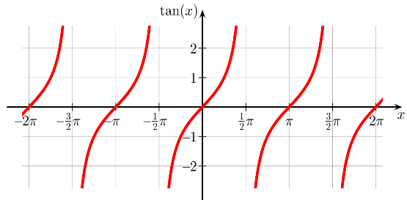
Application I – Example 5.5
This experiment works in your car, a bus, or even an amusement park ride!
sin

Slide 10
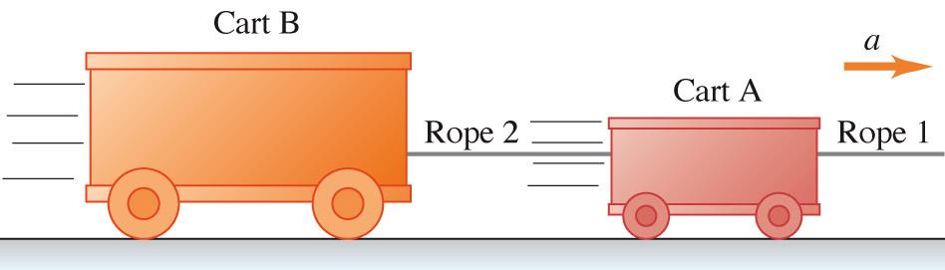
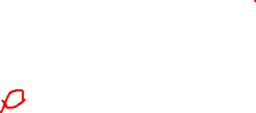
The carts in the figure are held together by ropes and are accelerating to the right. The ropes do not stretch and have negligible mass. Which of the following statements is true about the magnitudes of the tension forces exerted by the ropes on the carts?
Clicker question
Rope 2 pulls harder on cart B than on cart A.
Rope 1 pulls harder on cart A than rope 2 pulls
on cart B.
Rope 2 pulls harder on cart B than rope 1 pulls on cart A.
Notes:
Answer: b) Rope 1 pulls harder on cart A than rope 2 pulls on cart B.

Slide 11
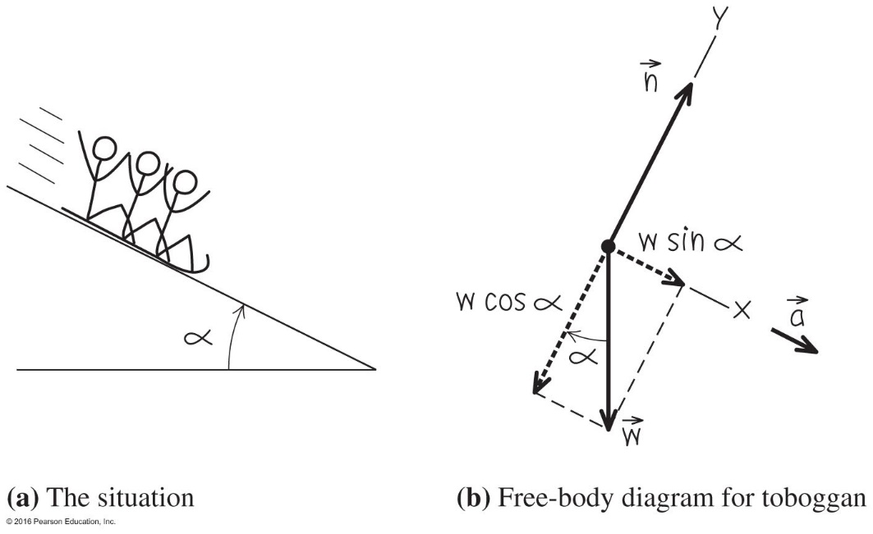
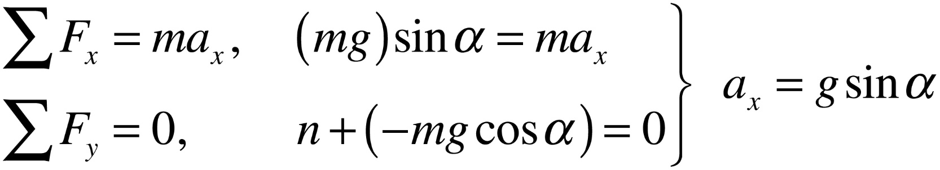
Application II – Example 5.6
Acceleration down a hill, no friction

Slide 12
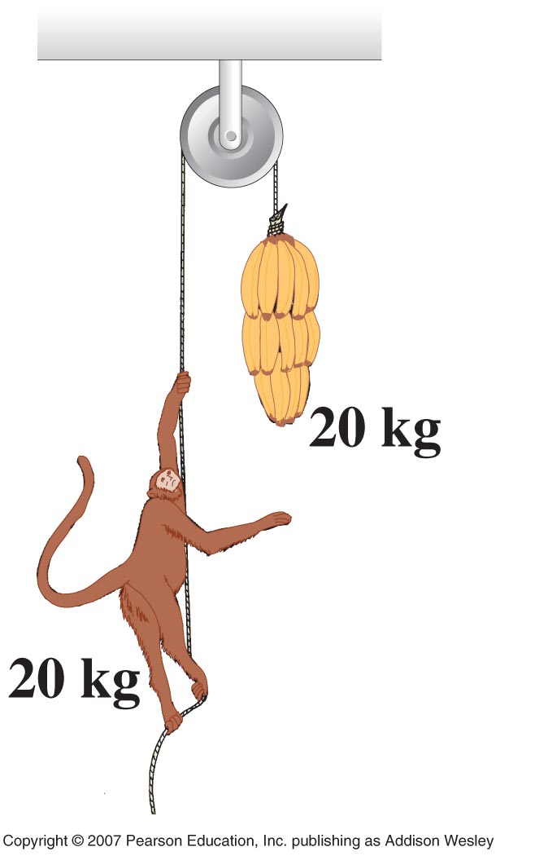
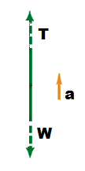
What happens to the monkey and the bananas as the monkey climbs up, or releases the rope and falls, and grabs the rope to stop the fall.
For the monkey to move up, T>mg. the bananas also move up.
The bananas and monkey move with the same acceleration and the distance between them remains constant.
Both the monkey and bananas are in free fall. They have the same initial velocity and as they fall the distance between them doesn’t change.
The bananas will slow down at the same rate as the monkey. If the monkey comes to a stop, so will the bananas.
Just as in the gymnast climbing the rope problem; $T−mg=ma→a=constant$
$T=m\left(g+a\right)→T>mg$

Slide 13
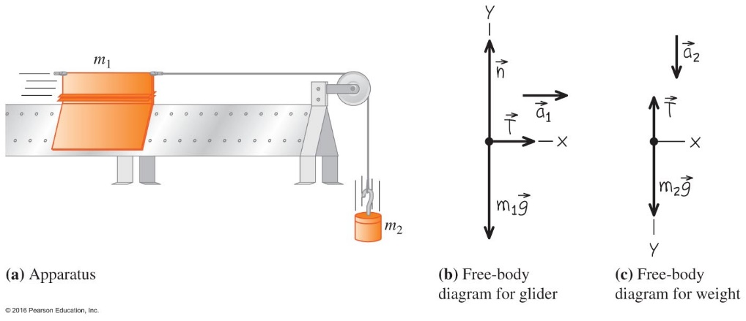
Application Three – Example 5.7 An air track
This problem involves two interactive systems in a common lab experiment.
a = ( m₂ g ) / ( m ₁ + m ₂ ) T = (m ₁ m ₂ ) g / (m ₁ + m ₂ )
What happens for m₁ =0 ?

Slide 14
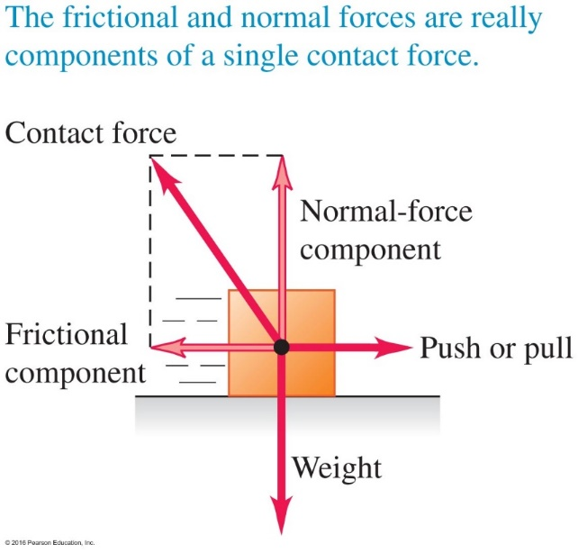

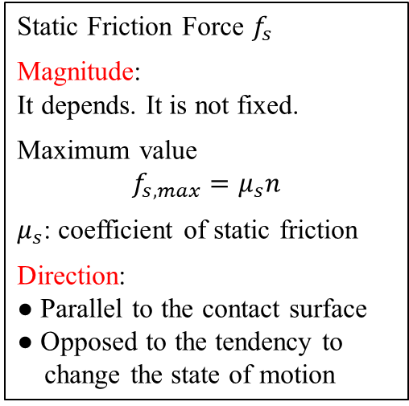

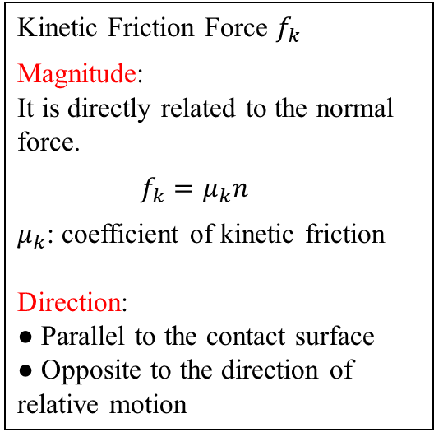


5.3 Contact Force and Friction
Friction force exits at the contact surfaces of two objects. There are two regions of friction:
● when an object is sliding with respect to another → kinetic-friction force
● when there is no relative motion → static-friction force
Kinetic Friction Force $f_{k}$
Magnitude:
It is directly related to the normal force.
$f_{k}=μ_{k}n$
$μ_{k}$: coefficient of kinetic friction
Direction:
● Parallel to the contact surface
● Opposite to the direction of relative motion
Static Friction Force $f_{s}$
Magnitude:
It depends. It is not fixed.
Maximum value
$$f_{s,max}=μ_{s}n$$
$μ_{s}$: coefficient of static friction
Direction:
● Parallel to the contact surface
● Opposed to the tendency to
change the state of motion
A box being pushed on a table surface
force $\overset{⃑}{n}$
force $\overset{⃑}{f}$
$\overset{⃑}{F}$
$\overset{⃑}{W}$
Courtesy of Wenhao Wu

Slide 15
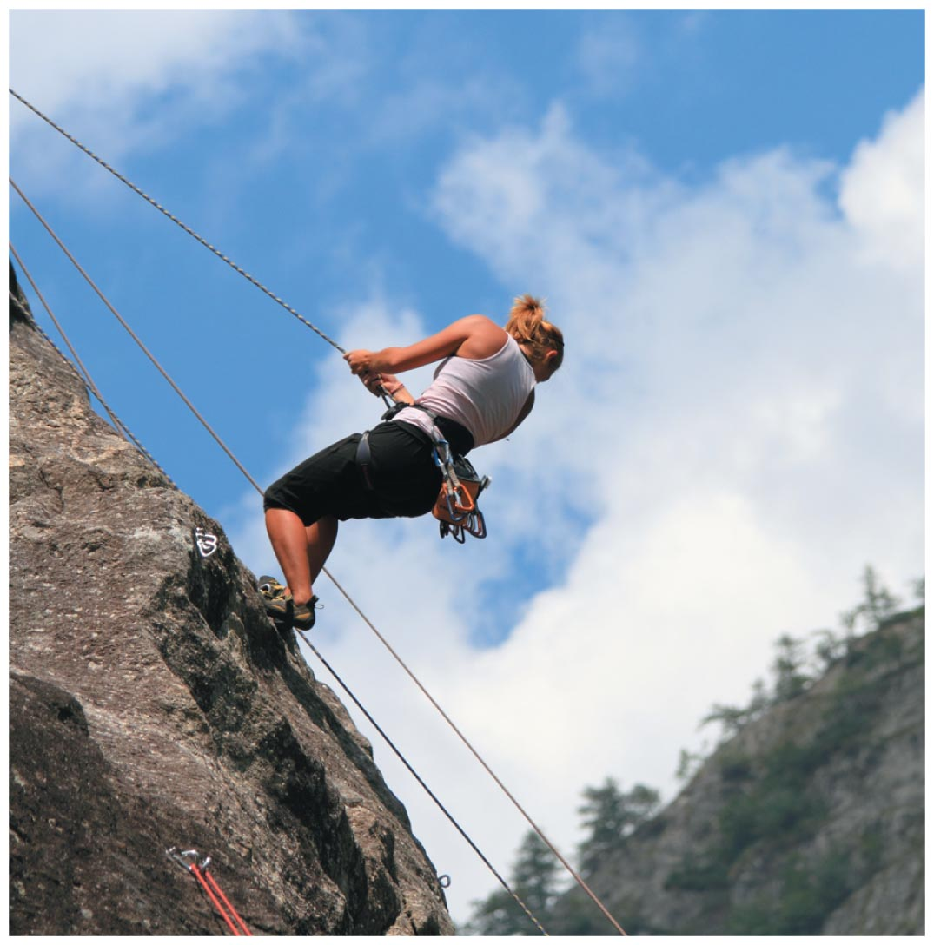
An angle of 90 degrees between the climber and the rock gives maximum friction. Why?
Notes:
Unnumbered Figure 1 Page 132

Slide 16
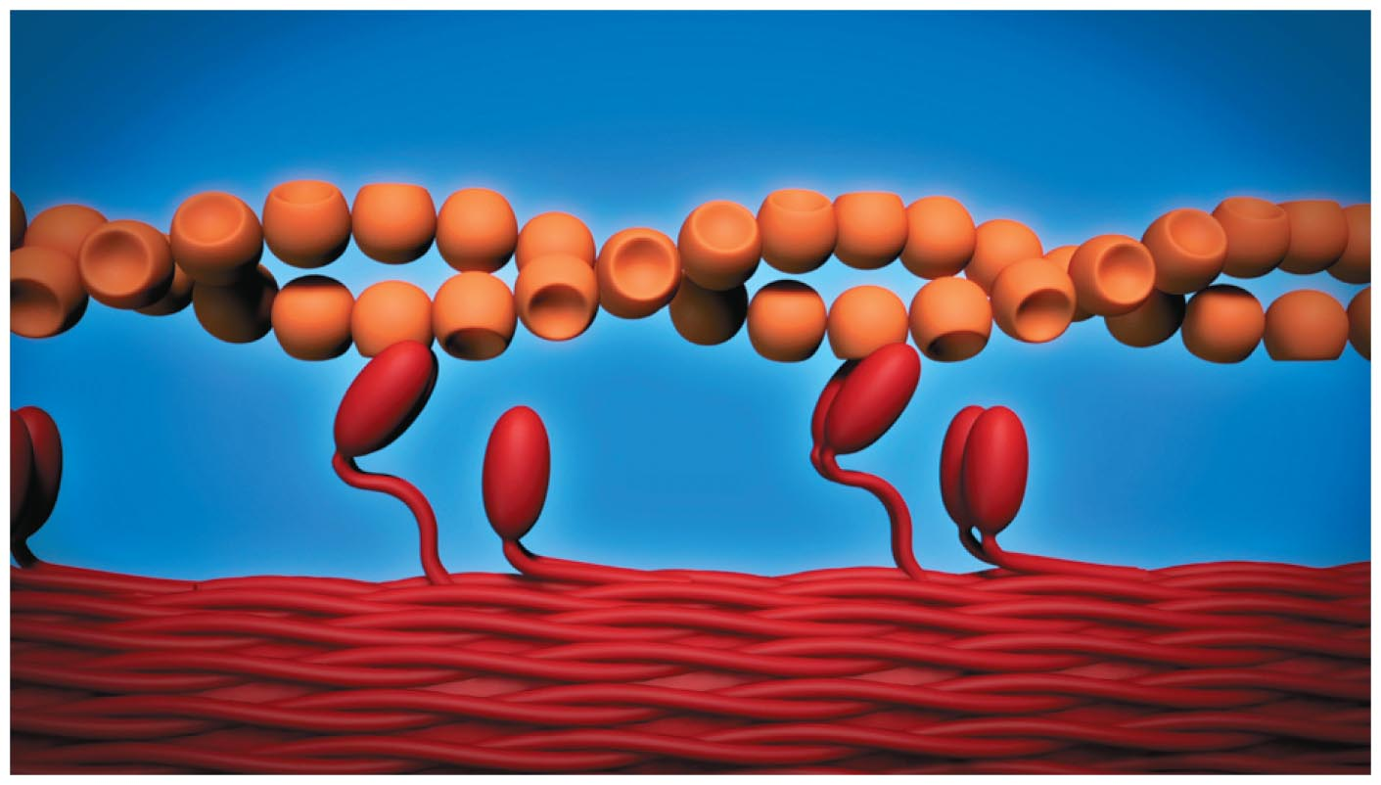
Notes:
Unnumbered Figure 1 Page 134

Slide 17
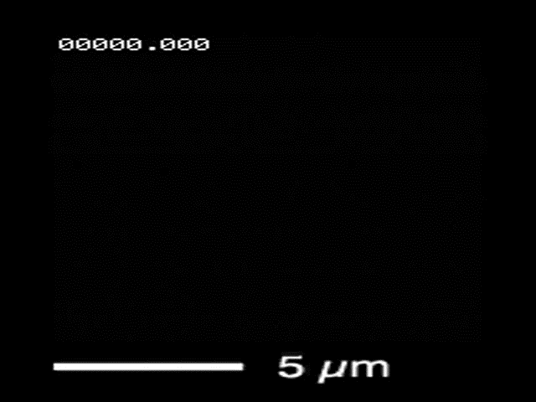
Cooperative Binding of Myosin to Tubulin

Slide 18
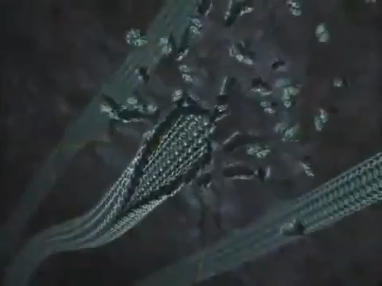
Molecular rail (tubulin) and motor (kinesin)

Slide 19

5.3 Contact Force and Friction
We need to re-examine
problems we formerly did
as "ideal."
We need to be able to find
frictional forces given the
mass of the object and the
nature of the surfaces in
contact with each other.
There are two regions of friction:
1) when an object is sliding with respect to a surface → kinetic-friction force
2) when there is no relative motion → static-friction force

Slide 20
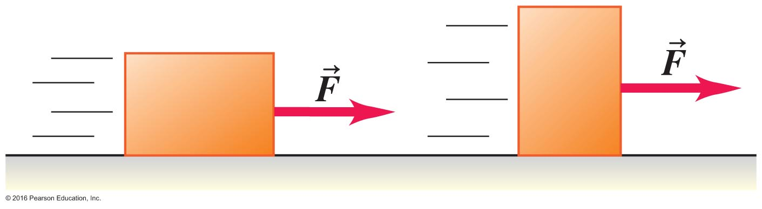
No Dependence on Surface Area
The normal force determines friction.

Slide 21
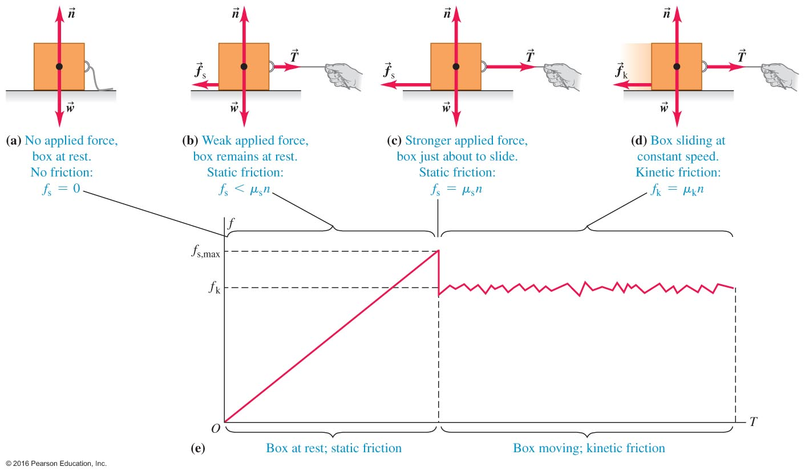
Friction Changes as Forces Change –
Figure 5.13
Forces from static friction increase as force increases while forces from kinetic friction are relatively constant.

Slide 22
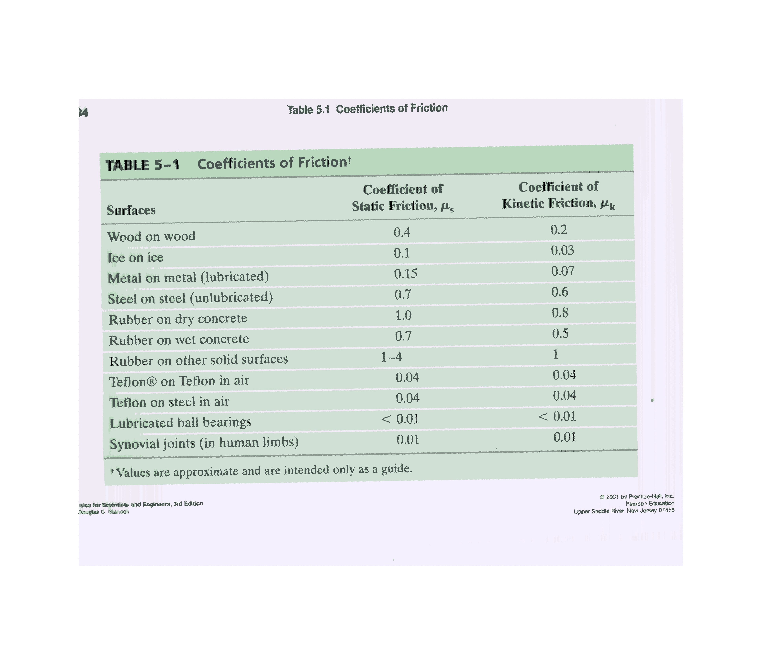
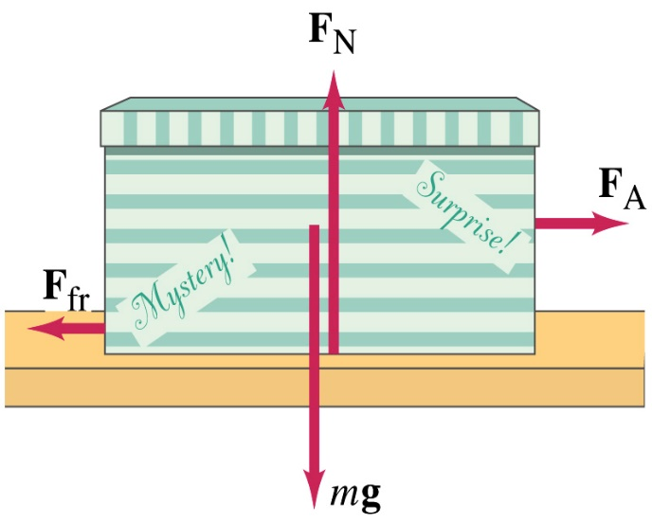
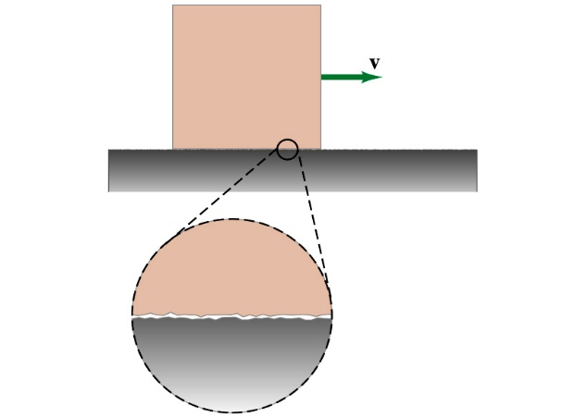
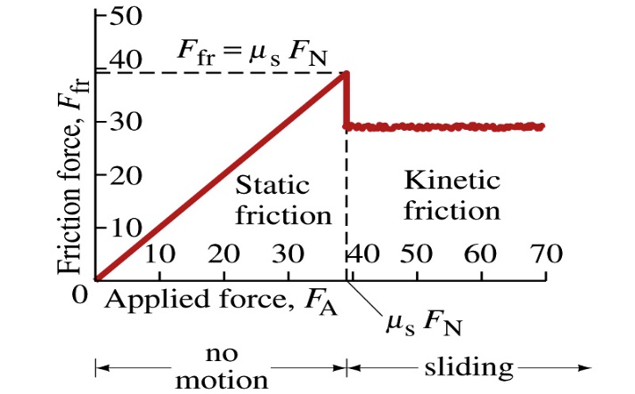
Applications of Newton’s laws

Slide 23

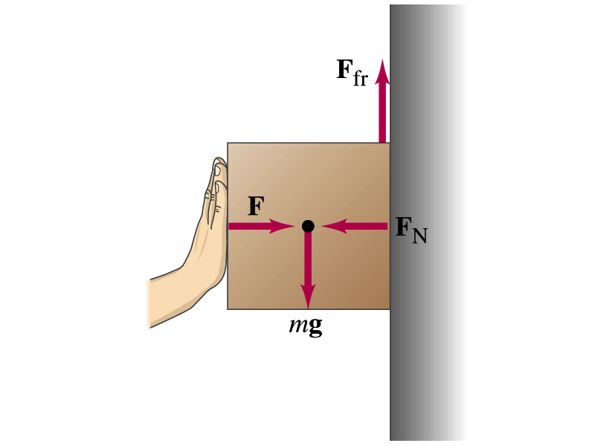
A box against a wall
With what force F one should press on the box that it will not
slide down and will be at rest?
When f_{s}=μ_{s}F_{N} > mg,
the box is at rest

Slide 24
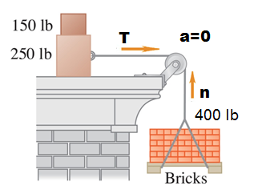
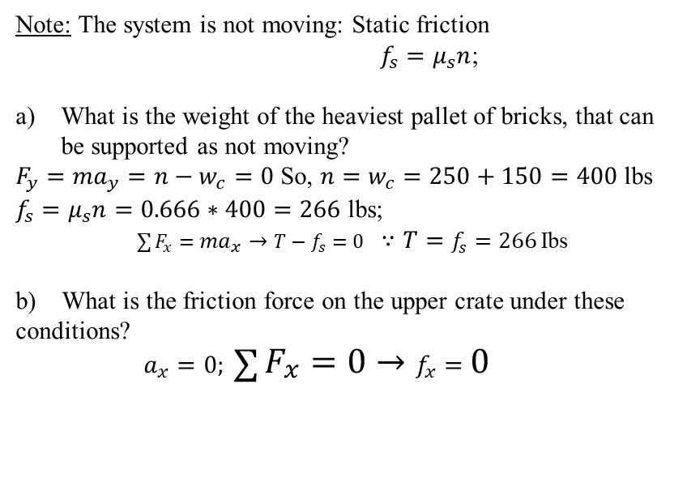
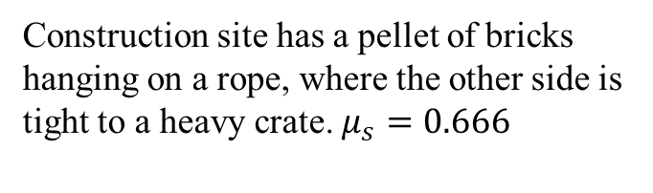
5.27
Construction site has a pellet of bricks
hanging on a rope, where the other side is
tight to a heavy crate. $μ_{s}=0.666$
a pallet
T
tied
Note: The system is not moving: Static friction
$f_{s}=μ_{s}n$;
What is the weight of the heaviest pallet of bricks, that can be supported as not moving?
$F_{y}={ma}_{y}=n−w_{c}=0$ So, $n=w_{c}=250+150=400$ lbs
$f_{s}=μ_{s}n=0.666∗400=266$ lbs;
$\sum{F_{x}={ma}_{x}→T−f_{s}=0}$ $∵T=f_{s}=266$ Ibs
b) What is the friction force on the upper crate under these conditions?
$a_{x}=0; \sum{F_{x}=0→f_{x}=0}$

Slide 25
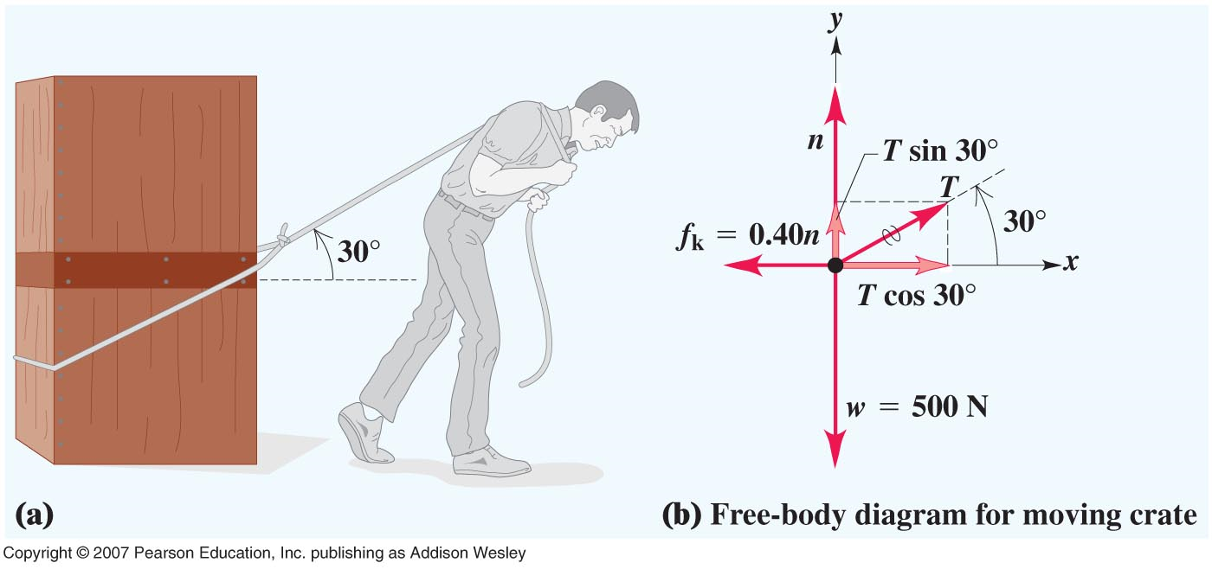
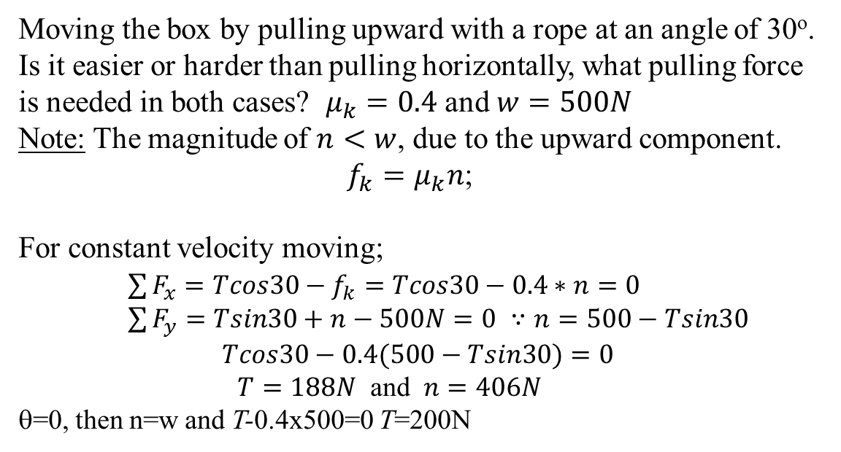
Example 5.10
Moving the box by pulling upward with a rope at an angle of 30º. Is it easier or harder than pulling horizontally, what pulling force is needed in both cases? $μ_{k}=0.4$ and $w=500N$
Note: The magnitude of $n<w$, due to the upward component.
$f_{k}=μ_{k}n$;
For constant velocity moving;
$\sum{F_{x}=Tcos30−f_{k}=Tcos30−0.4∗n=0}$
$\sum{F_{y}=Tsin30+n−500N=0}$ $∵n=500−Tsin30$
$$Tcos30−0.4(500−Tsin30)=0$$
$T=188N$ and $n=406N$
θ=0, then n=w and T-0.4x500=0 T=200N

Slide 26
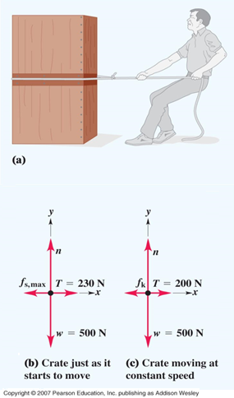
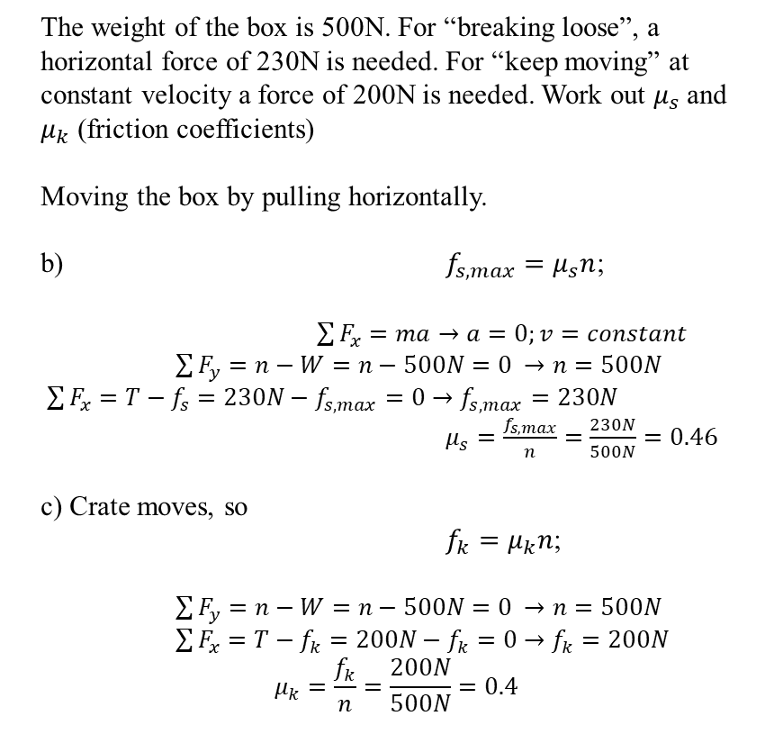
The weight of the box is 500N. For “breaking loose”, a horizontal force of 230N is needed. For “keep moving” at constant velocity a force of 200N is needed. Work out $μ_{s}$ and $μ_{k}$ (friction coefficients)
Moving the box by pulling horizontally.
b) $f_{s,max}=μ_{s}n$;
$\sum{F_{x}}=ma→a=0;v=constant$
$\sum{F_{y}=n−W=n−500N=0 →n=500N}$
$\sum{F_{x}=T−f_{s}=230N−f_{s,max}=0→f_{s,max}=230N}$
$μ_{s}=\frac{f_{s,max}}{n}=\frac{230N}{500N}=0.46$
c) Crate moves, so
$f_{k}=μ_{k}n$;
$\sum{F_{y}=n−W=n−500N=0 →n=500N}$
$\sum{F_{x}=T−f_{k}=200N−f_{k}=0→f_{k}=200N}$
$$μ_{k}=\frac{f_{k}}{n}=\frac{200N}{500N}=0.4$$

Slide 27
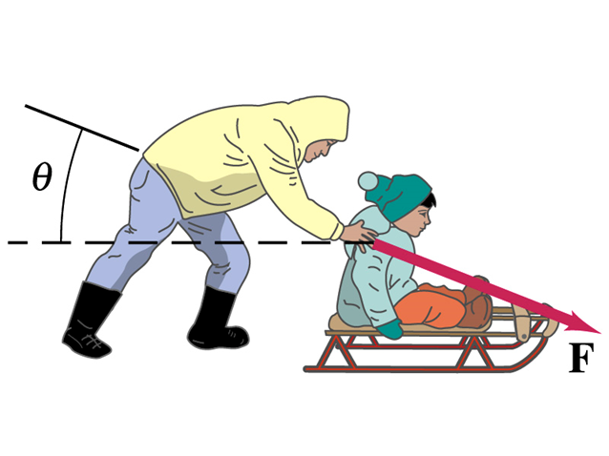
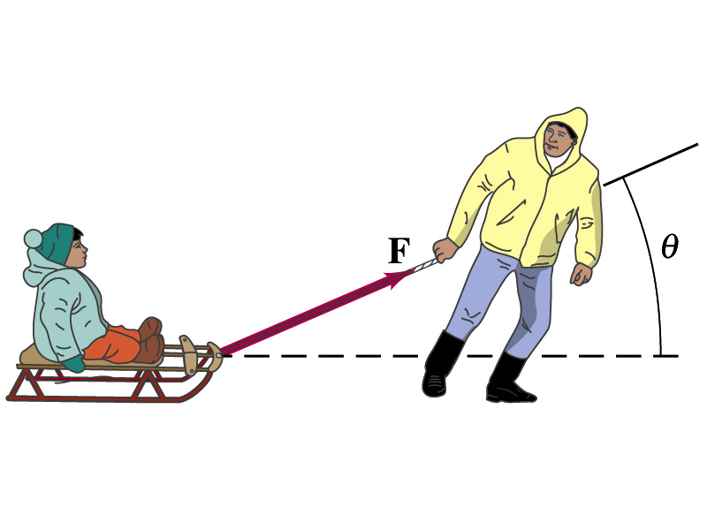
Clicker question
To push or to pull a sled, what is more efficient?
a) pushing
b) pulling
c) the same
d) depends on the magnitude
of the force

Slide 28
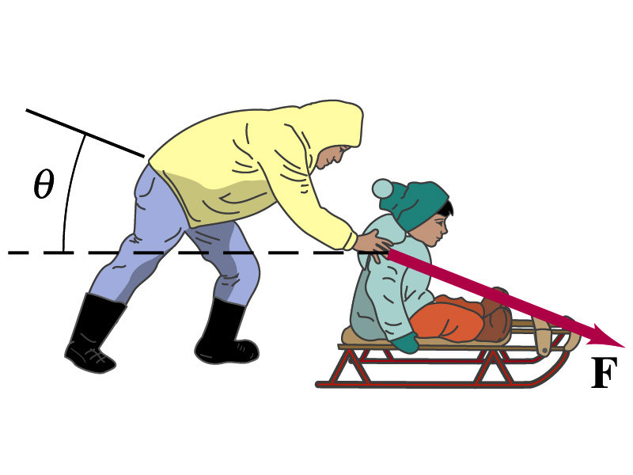
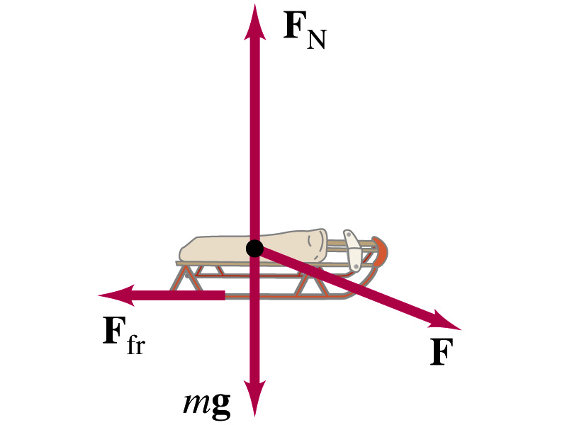

To push or to pull a sled?
Friction is less when you pull, since F_{N} is less

Slide 29





5-40:
Note: Nothing is moving. The coefficient of Static friction is;
$f_{s}=μ_{s}n$; $μ_{s}=0.8$
a) Make a free body diagram.
b) What is the normal force exerted by surface on the box?
$$\sum{F_{y}={ma}_{y}=0→n−Fsin30−W=0}$$
$n=W+Fsin30=125N+75∗sin30=163N$
c) What is the friction force on the box
$\sum{F_{x}={ma}_{x}→f−Fcos30=0}$
$$f=Fcos30=65N$$
d) What is the largest possible friction force?
$$f_{s}=μ_{s}n=0.8∗163=150N$$
e) Replace the push with a 75N pull, what is n?
$\sum{F_{y}={ma}_{y}→n+Fsin30−W=0}$
$$n=W−Fsin30=88N$$
f) What is the largest possible friction force for the75N pull?
$$f_{s}=μ_{s}n=0.8∗88=70N$$

Slide 30
Box on a horizontal table
An 80 N box is pulled at an horizontal table. Kinetic friction is 1/4 ,static friction is ½. What is the friction f on the box if the tension T on the rope is a. 0 N, b. 25 N, c.39 N,d.41 N, e.150 N ?

Slide 31




Dynamic motion problem:
Two boxes and a pulley
Two boxes and a pulley with friction $μ_{k}=0.2$
(a) What is the tension in the rope?
(b) What is the tension in the rope?
Y: ${ F}_{N}=m_{1}g=49N$and $F_{fr}=μ_{k}F_{N}=0.2∗49=9.8N$
$F_{T}−F_{fr}=m_{1}a→F_{T}=F_{fr}+m_{1}a$ (box I)
$m_{2}g−F_{T}=m_{2}a→F_{T}=m_{2}(g−a)$ (box II)
→ $m_{1}a$+ $m_{2}a$=$m_{2}g$-$F_{fr}$
$\left(a\right) a=\frac{m_{2}g−F_{fr}}{m_{1}+m_{2}}=1.4\frac{m}{s^{2}}$
(b) $F_{T}=m_{2}\left(g−a\right)=17N$

Slide 32

An Example Involving Two Systems –Example 5.4 Two boxes
This example brings
nearly every topic we
have covered so far in
the course.
This is an equilibrium
problem because
system moves with
constant speed!!
Note: x-axis for the cart does not have to align with the horizontal direction and is different from the bucket.

Slide 33



The skier with friction
What is acceleration?
μ_{K}=0.01
Winning (acceleration) does not depend on mass!

Slide 34


Skier with friction
Initial step: select the right
reference frame: it’s up to us,
and is a matter of convenience!
a) What is acceleration? ($μ_{k}=0.1$ and $θ={30}^{o}$)
$\sum{F_{x}={ma}_{x}→F_{gx}=mgsin30} and{ F}_{gy}−mgcos30=0 ∵{ F}_{gy}=mgcos30$=${ F}_{N}$
$mgsin30−μ_{k}F_{N}={ma}_{x}→mgsin30−μ_{k}mgcos30={ma}_{x}$
$a_{x}=0.41g$ $∵g=9.8\frac{m}{s^{2}}$
→$a_{x}=4\frac{m}{s^{2}}$
b) Starting from rest, what is the velocity of the skier after 4 second?
${v_{x}=v}_{o}−a_{x}t=0+a_{x}t=4∗4=16\frac{m}{s}$

Slide 35

How Much Effort to Move the Crate?
Dynamics as in the last chapter with a new force.
See the worked solution on page 135.

Slide 36




5.59 A block friction $μ_{s}=0.25$, a knot and two weights $W\left(A\right)=60N;w=12N$
a) Find the friction force on the block at $a=0$, for both objects. The tension in the vertical wire is ‘w’. Applying $\sum{F=ma}$ to the knot and to the block.
$\left.\begin{aligned}\sum{F_{y}=ma_{y}↔T_{2}sin45=w} \\ \sum{F_{x}=ma_{x}↔T_{2}cos45=w}\end{aligned}\right\}\sin{45}=\cos{45}→T_{3}=w=12N$
b) Find the maximum weight for which the system remains at rest.
$f_{s,max}=μ_{s}mg=0.25∗60N=15N$ → $w=f_{s,max}=15N$

Slide 37

Forces Applied at an Angle
The previous example has one new step if the force is applied at an angle.

Slide 38


A Toboggan on a Steep Hill with Friction –
now at constant speed.

Slide 39

Distinguishing Static and Kinetic Friction Forces
f_{s} = T
before “breaking loose”

Slide 40




Example: Two boxes of masses m₁ and m₂ are pushed together by a horizontal force F to accelerate to the right on a leveled table surface as shown. The coefficient of kinetic friction between either of the boxes and the table surface is $μ$_{k}. Calculate the acceleration and the normal force between the boxes.
m₁
m₂
F
n₁
n₂
m₁
m₂
y
n
f_{k2}
n
f_{k1}
F
x
m₁g
m₂g
x-axis: F–n–f_{k1}= m₁a
f_{k1}= $μ$_{k}m₁g
y-axis: n₁ – m₁g = 0
x-axis: n – f_{k2} = m₂a
f_{k2}= $μ$_{k}m₂g
y-axis: n₂ – m₂g = 0
F – f_{k1} – f_{k2} = m₂a + m₁a = (m₁ + m₂)a
a = (F–f_{k1}–f_{k2})/(m₁+m₂)
= (F–$μ$_{k}m₁g–$μ$_{k}m₂g)/(m₁+m₂)
n = f_{k2} +m₂a = $μ$_{k}m₂g +m₂a
= [m₂/(m₁ + m₂)]F
n₁ = m₁g
n₂ = m₂g
Courtesy of Wenhao Wu

Slide 41


Additional Examples
A box having an initial velocity 10 m/s enters a region of a leveled rough surface and slides a distance of 20 m before it reaches a stop. Assume that the acceleration due to friction is a constant. Calculate the coefficient of kinetic friction.
Solution:
● Initial velocity v₁ = 10 m/s; Final velocity v₂ = 0.0 m/s
● What is the acceleration?
$v_{2}^{2}−v_{1}^{2}=2ad$ $a={(v}_{2}^{2}−v_{1}^{2})/2d=−v_{1}^{2}/2d=−2.5$ m/s²
● Free-body diagram and Newton’s Second Law
y-axis: n – mg = 0
x-axis: – f_{k} = ma
and f_{k} = μ_{k}n
μ_{k} = f_{k}/n = – ma/mg = – a/g = 2.5/9.8 = 0.26
y
f_{k}
n
$$\overset{⃑}{v}$$
x
mg

Slide 42


Example: Box of mass m is pushed up an incline by a force F parallel to the incline. The coefficient of kinetic friction between the box and the incline is $μ$_{k}.
y
n
F
x
f_{k}
Given: F, m, $μ$_{k}, and θ
Find: n and a
Solutions:
Weight and its components W = mg W_{x}= – mgsinθ W_{y} = – mgcosθ
x-axis: F − mgsinθ − f_{k} = ma f_{k} = $μ$_{k}n = $μ$_{k}mgcosθ
a = (F − mgsinθ − $μ$_{k}mg)/m
y-axis: n – mgcosθ = 0 n = mgcosθ
θ
θ
mg
What if some other quantities are given and you are asked to calculate some different quantities?
Consider Problem 9 on Term Exam 1 from 2015.

Slide 43

Forces in Fluids – Figure 5.19
This topic is fully developed in advanced courses.
Conceptually, as objects fall through "thicker" liquids, they experience a drag force.

Slide 44

An adult and a teenager go skydiving. The adult weighs twice as much as the teen, but they use identical parachutes that exert identical drag forces. After the parachutes have opened and the two people have reached terminal speed, how do their speeds compare?
Clicker question
They are equal.
At terminal velocity
mg- D v _{T} ² =0
They are equal.
Notes:
Answer: c)

Slide 45





5.4 Elastic Force
Spring, Spring Restoring Force, and Hooke’s Law
equilibrium at x = 0
Hooke’s Law on spring restoring force:
● In magnitude $F_{spr}=k∆L$
● Direction: Opposed to length change restoring force
● A general expression taking care of the direction
$F_{spr}=− kx$
● x is measured with respect to the equilibrium position
Example 5.14
A vertical spring balance scale stretches 1.00 cm when a 12.0 N weight is hung on it. If the 12.0 N weight is replaced by a 1.50 kg fish, by what amount is the spring stretched?
Answer:
Spring constant k = F/$∆L$ = (12.0 N)/(0.0100 m) = 1200 N/m
Stretching = F/k = mg/k = 0.0123 m = 1.23 cm
Direction of force with stretching
Direction of
force with
compression
(c)
Courtesy of Wenhao Wu

Slide 46


Elastic Forces
Springs or other elastic material will exert force when stretched or compressed.
The magnitude of the spring force F_{spring} is given by Hooke's Law:
Where k is spring constant [N/m] and ΔL [m] is distance the spring is stretched or compressed from its equilibrium length.

Slide 47

Stretch a Spring to Weigh Objects –
Example 5.14 Fishy business
The force settings on the spring are calibrated with mass standards at normal earth gravity.
The spring scales are often calibrated in force (N) and mass (kg).

Slide 48



Elastic forces
Hooke’s Law: $F_{spr}=−kx$,
where $k=spring force constant;dimension\left[\frac{N}{m}\right]$
Example 5-14:
The spring stretches 1 cm for a 12N weight. When the 12N weight is replaced with 1.5kg fish; what distance does the spring stretch ?
$k=−\frac{−12N}{1x{10}^{−2}m}=1200\frac{N}{m}$
$w_{fish}=mg=1.5kg∗9.8\frac{m}{s^{2}}=14.7N$
$\sum{F_{x}=0=−mg+F_{spr}}$→$mg−kx=14.7N−1200x=0$
So, $x=\frac{14.7}{1200}m=1.23 cm$

Slide 49


n
Example with massless and non-stretchable rope & massless and frictionless pulley.
Given: m and M.
Answer the questions for the following two cases.
T
mg
T
Mg
If the table top is frictionless.
Question 1: what is the condition under which M accelerates downward?
Question 2: If M accelerates downward, calculate the acceleration a and the tension in the rope T.
(b) Assume the coefficient of friction between m and the table top to be to be $μ$_{s} = $μ$_{k} = $μ$.
Question 1: what is the condition under which M accelerates downward?
Question 2: If M accelerates downward, calculate the acceleration a and the tension in the rope T.

Slide 50
Dynamic motion problem:
Two boxes and a pulley
Two boxes and a pulley with friction $μ_{k}=0.2$
(a) What is the tension in the rope?
(b) What is the tension in the rope?
Y: ${ F}_{N}=m_{1}g=49N$and $F_{fr}=μ_{k}F_{N}=0.2∗49=9.8N$
$F_{T}−F_{fr}=m_{1}a→F_{T}=F_{fr}+m_{1}a$ (box I)
$m_{2}g−F_{T}=m_{2}a→F_{T}=m_{2}(g−a)$ (box II)
→ $m_{1}a$+ $m_{2}a$=$m_{2}g$-$F_{fr}$
$\left(a\right) a=\frac{m_{2}g−F_{fr}}{m_{1}+m_{2}}=1.4\frac{m}{s^{2}}$
(b) $F_{T}=m_{2}\left(g−a\right)=17N$

Slide 51





Example with massless and non-stretchable rope & massless and frictionless pulley.
Given: m₁, m₂, and $θ$.
Answer the questions for the following two cases.
n
T
T
m₁
m₂
$$θ$$
$$θ$$
m₁g
m₂g
If the incline is frictionless.
Question 1: what is the condition under which m₂ accelerates downward?
Question 2: If m₂ accelerates downward, calculate the acceleration a and the tension in the rope T.
(b) Assume the coefficient of friction between m₁ and the incline to be $μ$_{s} = $μ$_{k} = $μ$.
Question 1: what is the condition under which m₂ accelerates downward?
Question 2: If m₂ accelerates downward, calculate the acceleration a and the tension in the rope T.

Slide 52

A box rests on a frozen pond (assume it to be frictionless and horizontal). If a fisherman applies a horizontal force with a magnitude 48N to the box and produces an acceleration of 3 m/s² , what is the box’s mass?
Solution: This problem is a an application of Newton’s second law, F = ma. Here we are given the force (48N) and the acceleration (3 m/s²). To find the mass we re-arrange the equation to solve for m.
$$\frac{F}{a}=\frac{48}{3}=16=m$$
m= 16 kg
A table with a weight equivalent to 800N is slid across a floor with friction. The pushing force has a magnitude of 100N. If the table moves with constant speed, the friction force must be…
Solution: Because we are told the speed is constant, this means that there is no acceleration (or more specifically, the acceleration is 0). This would indicate that the pushing force and friction force have canceled out completely, thus telling use that the friction force is equal in magnitude and opposite in direction to the pushing force. Thus, the friction force is 100N.
Two boxes connected by a rope are pulled across a horizontal floor. There is friction between the floor and the boxes. Which way would the force due to friction point in each of the box’s free-body diagrams?
Solution: Friction always points opposite the direction of motion.

Slide 53

Two figure skaters, one weighing 625N and the other 725N, push off against each other on frictionless ice. If the lighter skater travels at 1.74 m/s, how fast will the heavier one travel?
Solution: There are many ways to solve this problem, but the simplest way is to use conservation of energy & Newton’s 3rd law. If the skaters were initially at rest, and then moved by pushing off against each other (over a frictionless surface), their kinetic energies will be equal to each other. Knowing their masses (indirectly from their weight) and one of the skater’s velocity, we can then solve for the other skater’s velocity.
$$\frac{1}{2}\left(\frac{ω_{1}}{g}\right)v_{1}^{2}=\frac{1}{2}\left(\frac{ω_{2}}{g}\right)v_{2}^{2}$$
Canceling the common terms (such as the ½ and g), and then solving for v₂, we get:
$\sqrt{\frac{w_{1}v_{1}^{2}}{w_{2}}}=\sqrt{\frac{625{\left(1.74\right)}^{2}}{725}}=1.6=v_{2}$ ${ v}_{2}$=1.6 m/s

Slide 54
Thanks for your attention

Slide 57



A plane, a pulley and two boxes
Selection of frame of reference for each object – up to us!
What can be the mass of m2 for this system,
so that it doesn’t move?

Slide 58




Inclined plane with two boxes
Two boxes and a pulley with friction $μ_{s}=0.4$ and $θ={37}^{o}$
y-motion: $F_{N}−m_{1}gcosθ=m_{1}a_{y}=0→F_{N}=m_{1}gcosθ$
$$F_{fr}=μ_{s}F_{N}=0.4∗m_{1}gcos37$$
x-motion: ${m_{1}gsinθ−F}_{T}−F_{fr}=m_{1}a_{x}=0$ $∵a_{y}=0$ $F_{T}$=$m_{2}g$
Static case $→F_{T}={m_{1}gsinθ−F}_{fr}=m_{2}g$
${m_{1}gsinθ−μ_{s}m}_{1}gcosθ=m_{2}g$, divide by g
→ $m_{2}={m_{1}sinθ−μ_{s}m}_{1}cosθ=2.8kg$
${m_{1}gsinθ−F}_{T}+F_{fr}=m_{1}a_{x}=0$ $∵a_{x}=0$
Static case $→F_{T}={m_{1}gsinθ+μ_{s}m}_{1}gcosθ=m_{2}g$
$∵m_{2}=\frac{F_{T}}{g}=9.2kg$ $∵2.8kg{<m}_{2}<9.2kg$

Slide 59

A plane, a pulley and two boxes
  $μ_{k}=0.3,m_{2}=$10kg and $θ={37}^{o}$
  $m_{2}$ will fall and $m_{1}$ will rise

Slide 60

Two boxes and an Inclined plane with kinetic friction
  Given that $\sum{F=ma}$;
$F_{T}−m_{1}gsinθ−μ_{k}F_{N}=m_{1}a→ since{ m}_{2} also accelerates{ F}_{T}−m_{2}g=−m_{2}a$
$$F_{T}=m_{2}(g−a)$$
$m_{1}a=m_{2}(g−a)−m_{1}gsinθ−μ_{k}F_{N}$ $→F_{N}={m_{1}gcosθ}_{ }$
$$∵a=\frac{m_{2}g−m_{1}gsinθ−μ_{k}m_{1}gcosθ}{m_{1}+m_{2}}=0.079g=0.78\frac{m}{s^{2}}$$
m2>>m1 a->g

Slide 61
Two boxes and an Inclined plane with kinetic friction
  Given that $\sum{F=ma}$;
$F_{T}−m_{1}gsinθ−μ_{k}F_{N}=m_{1}a→ since{ m}_{2} also accelerates{ F}_{T}−m_{2}g=−m_{2}a$
$$F_{T}=m_{2}(g−a)$$
$m_{1}a=m_{2}(g−a)−m_{1}gsinθ−μ_{k}F_{N}$ $→F_{N}={m_{1}gcosθ}_{ }$
$$∵a=\frac{m_{2}g−m_{1}gsinθ−μ_{k}m_{1}gcosθ}{m_{1}+m_{2}}=0.079g=0.78\frac{m}{s^{2}}$$
m2>>m1 a->g

