Slide 1
Chapter 6 Circular Motion and Gravitation
● To understand the dynamics of circular motion.
● To study the application of circular motion as it applies to Newton's law of
gravitation.
● To examine the idea of weight and relate it to mass and Newton's law of
gravitation.
● To study the motion of objects in orbit (satellites) as a special application of
Newton's law of gravitation.
Courtesy of Wenhao Wu

Slide 2

In Section 3.4
We studied the kinematics of circular motion.
  Centripetal acceleration
  Changing velocity vector
  Uniform circular motion
We acquire new terminology.
  Radian
  Period (T)
  Frequency (f)
How many degrees are in one radian ? $θ=\frac{S}{r}$ → ratio of two lengths (dimensionless)
$$\frac{S}{r}=\frac{2πr}{r}=2π rad ≅360°$$
$1 rad≅\frac{360°}{2π}=\frac{360°}{6.28}=57°$ $∴$ Factors of unity $\frac{1 rad}{57°}$ or $\frac{57°}{1 rad}$
1 radian is the angle subtended at the center of a circle by an arc with length equal to the radius.

Slide 3
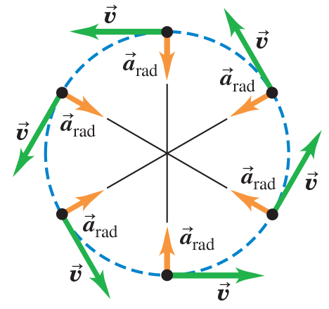
Velocity Changing from the Influence of a _{rad} – Figure 6.1
A review of the relationship between
The velocity changes direction, not magnitude.
The magnitude of the centripetal acceleration is:
In terms of the speed and period (time to make one complete revolution)

Slide 4

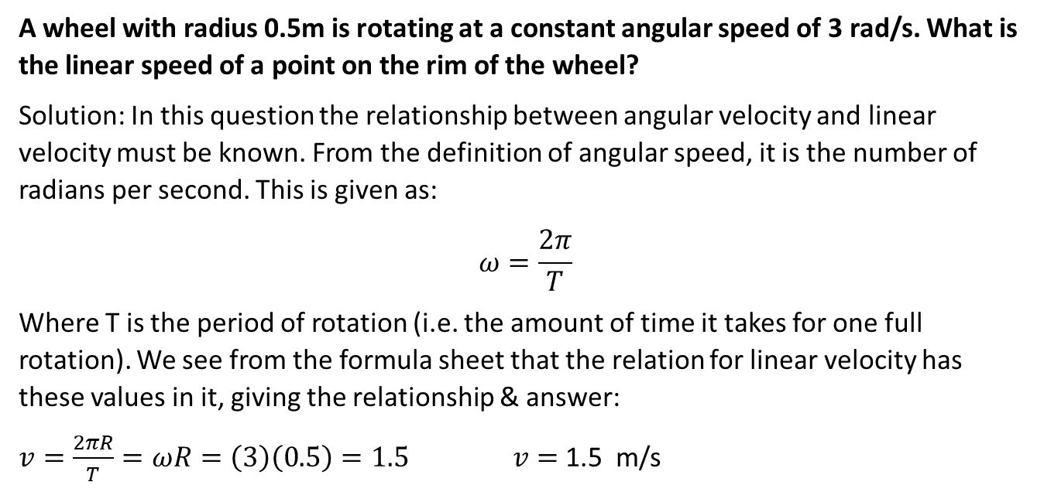

A wheel with radius 0.5m is rotating at a constant angular speed of 3 rad/s. What is the linear speed of a point on the rim of the wheel?
Solution: In this question the relationship between angular velocity and linear velocity must be known. From the definition of angular speed, it is the number of radians per second. This is given as:
$$ω=\frac{2π}{T}$$
Where T is the period of rotation (i.e. the amount of time it takes for one full rotation). We see from the formula sheet that the relation for linear velocity has these values in it, giving the relationship & answer:
$v=\frac{2πR}{T}=ωR=\left(3\right)\left(0.5\right)=1.5$ $v=$ 1.5 m/s
1 rad=360 ⁰ / $2π$ =57.3 ⁰
$1 rev/s= 2π$ rad/s

Slide 5

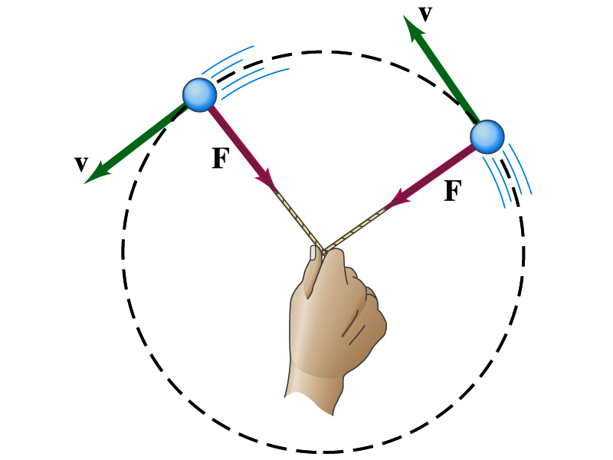
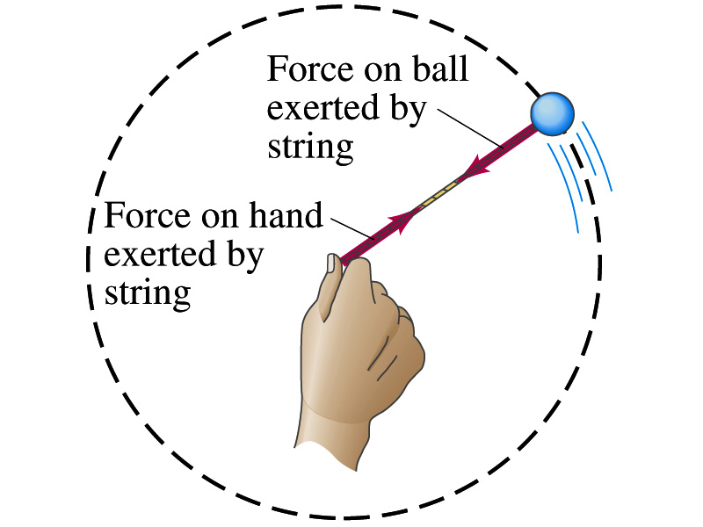
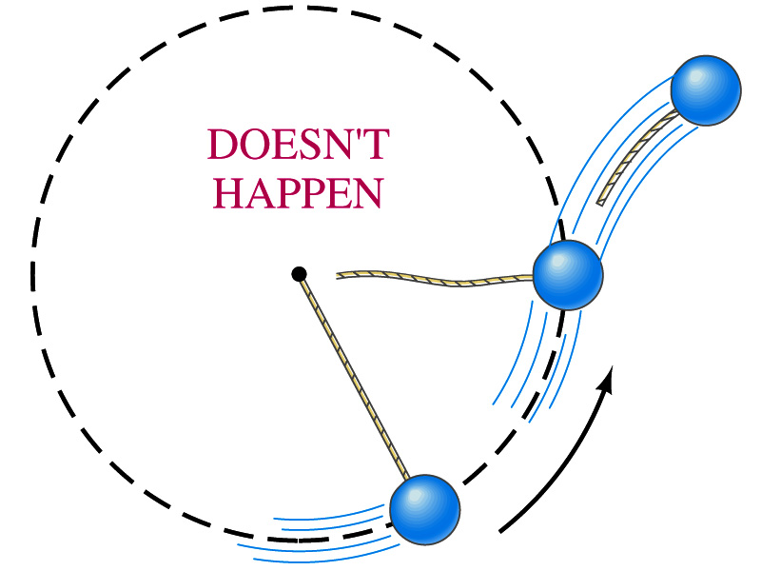
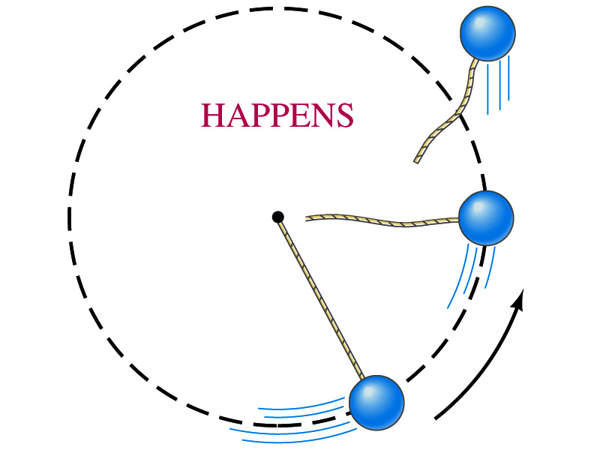
Circular motion and Gravitation

Slide 6
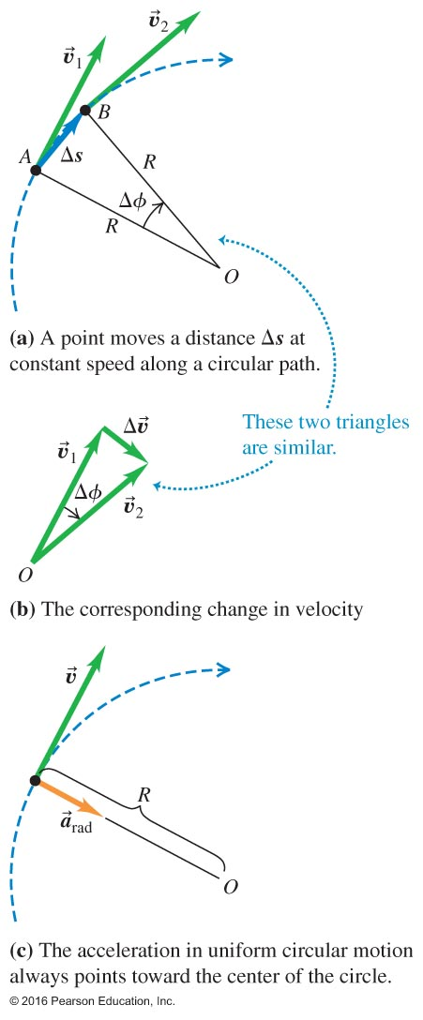
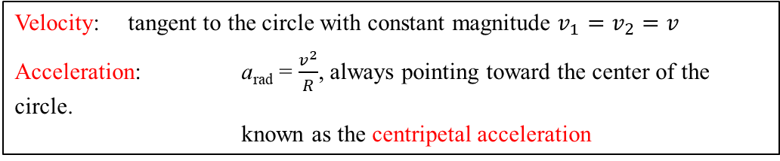
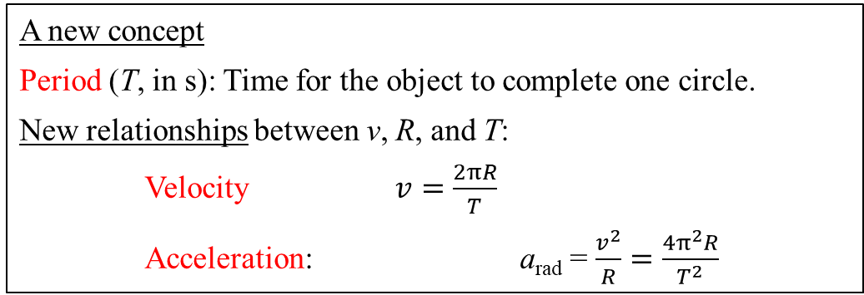
A Review of Uniform Circular Motion----Section 3.4
Velocity: tangent to the circle with constant magnitude $v_{1}=v_{2}=v$
Acceleration: a_{rad} = $\frac{v^{2}}{R}$, always pointing toward the center of the circle.
known as the centripetal acceleration
A new concept
Period (T, in s): Time for the object to complete one circle.
New relationships between v, R, and T:
Velocity $v=\frac{2πR}{T}$
Acceleration: a_{rad} = $\frac{v^{2}}{R}=\frac{4π^{2}R}{T^{2}}$
Another new concept
Frequency (f, in s⁻¹, or, Hz): revolutions per second.
Relationship between T and f: f = 1/T

Slide 7
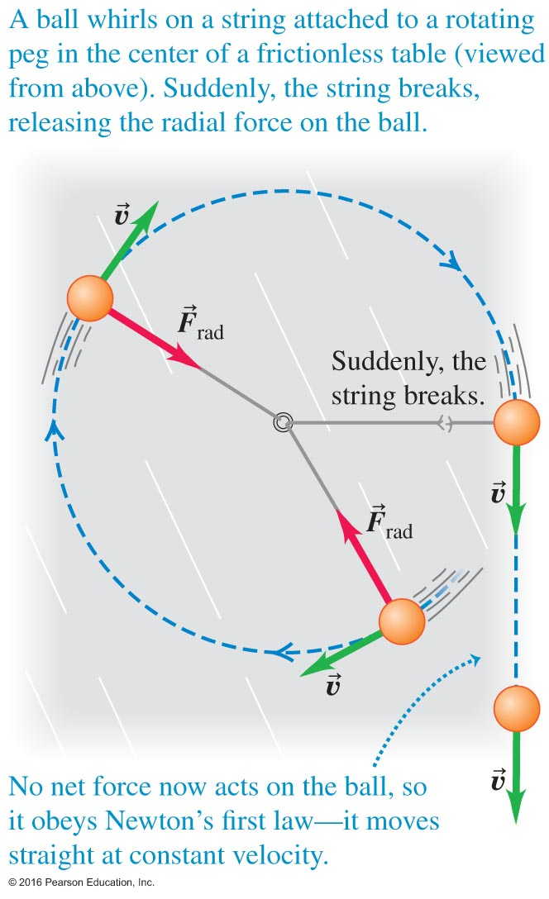
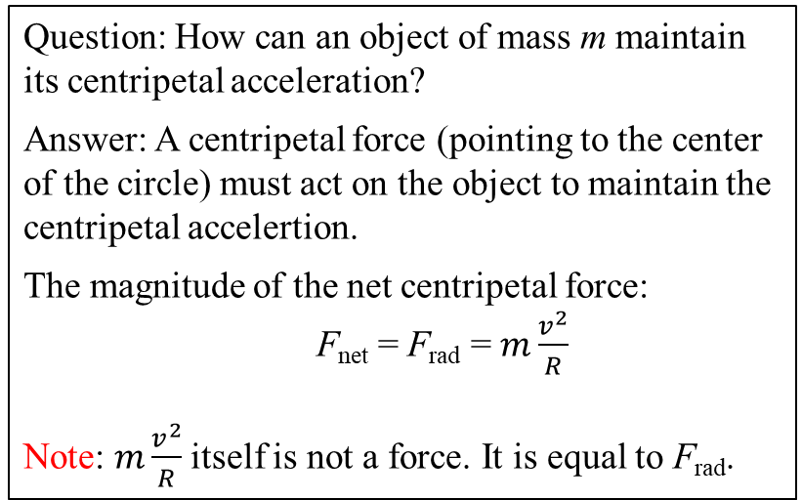
With a centripetal force provided by a string, the object moves along a circular orbit
6.1 Force in Circular Motion
Question: How can an object of mass m maintain its centripetal acceleration?
Answer: A centripetal force (pointing to the center of the circle) must act on the object to maintain the centripetal accelertion.
The magnitude of the net centripetal force:
F_{net} = F_{rad} = $m\frac{v^{2}}{R}$
Note: $m\frac{v^{2}}{R}$ itself is not a force. It is equal to F_{rad}.
In the absence of a centripetal force, the object moves at a constant velocity
Courtesy of Wenhao Wu

Slide 8
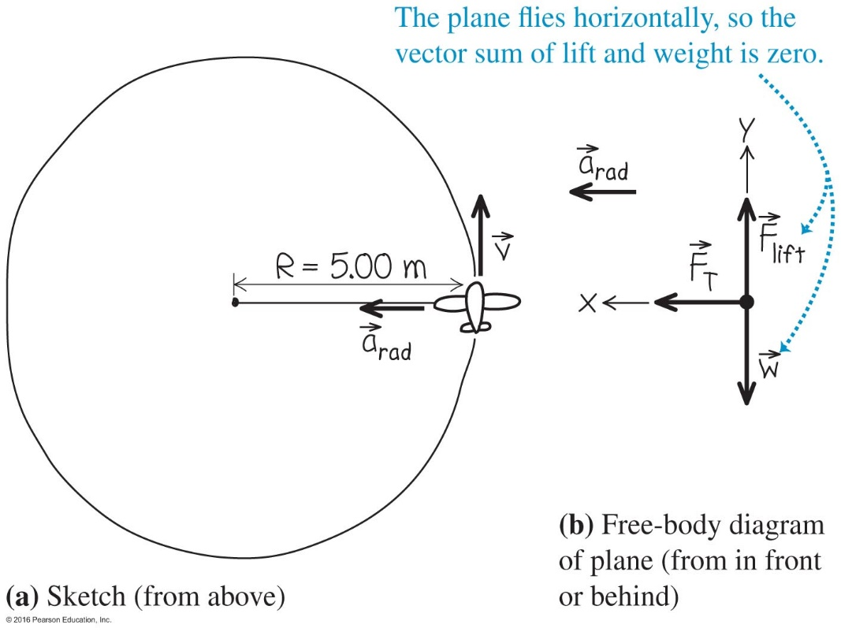
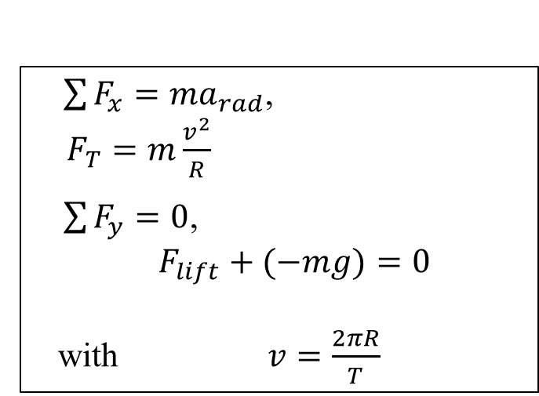
Example 6.1 Model Airplane on a String
Given: mass m = 0.500 kg
radius R = 5.00 m
period T = 4.00 s.
Find: Tension force in the string, F_{T}.
$\sum{F_{x}=ma_{rad}}$,
$F_{T}=m\frac{v^{2}}{R}$
$\sum{F_{y}=0}$,
$$F_{lift}+(−mg)=0$$
with $v=\frac{2πR}{T}$
with the horizontal x-axis
pointing toward the center
of the circle and the y-axis
pointing up vertically
Courtesy of Wenhao Wu

Slide 9
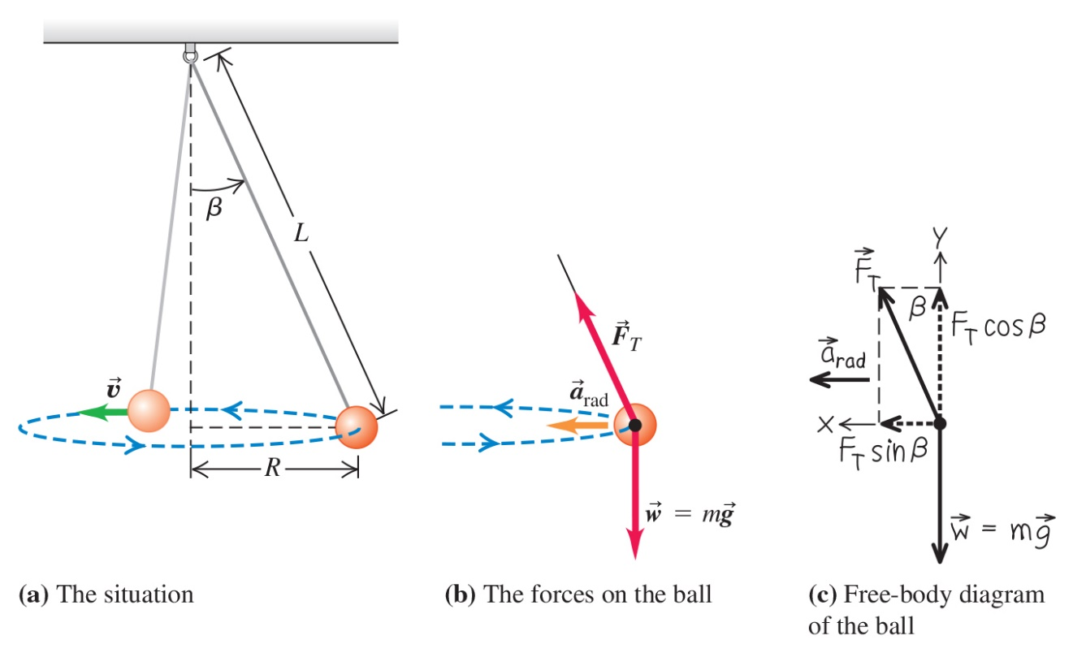
A Tether Ball Problem – Example 6.2
Refer to the worked example on page 156.

Slide 10
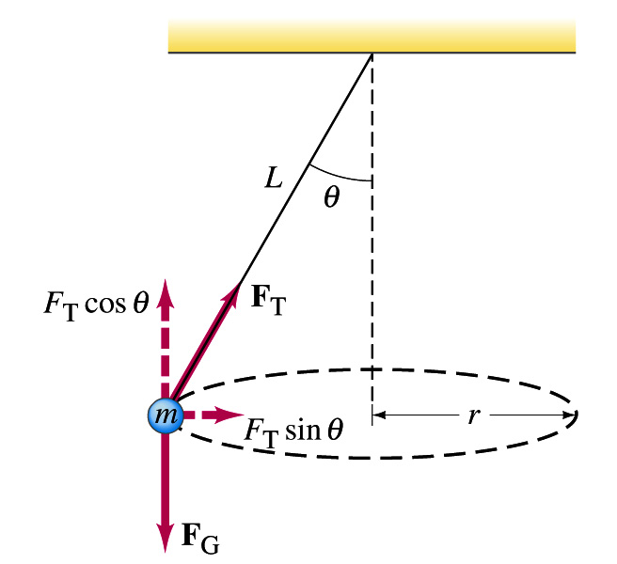
Conical Pendulum Tether Ball Problem – Example 6.2
Center-seeking Force: Tension
Circular Motion

Slide 11
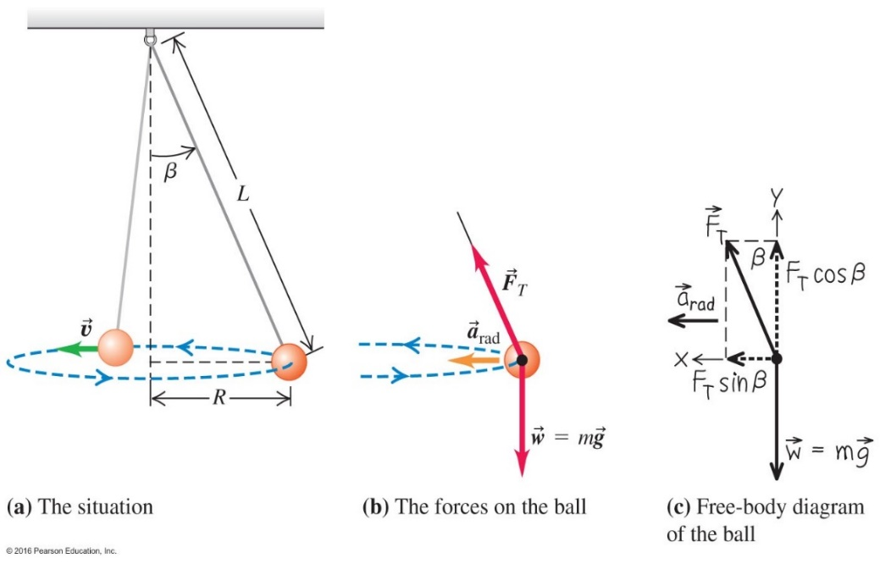

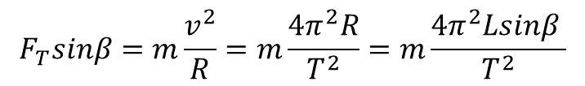
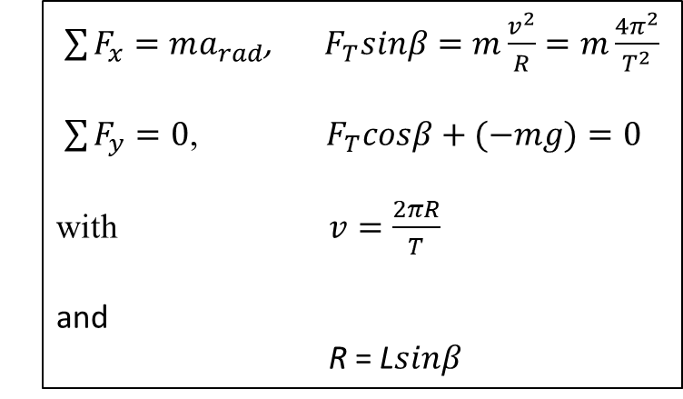

Example 6.2 A Tether Ball Problem
Given: mass m,
length of string L
period T
Find: Tension in the string, F_{T}.
Angle with vertical, β
$\sum{F_{x}=ma_{rad}}$, $F_{T}sinβ=m\frac{v^{2}}{R}=m\frac{4π^{2}}{T^{2}}$
$\sum{F_{y}=0}$, $F_{T}cosβ+(−mg)=0$
with $v=\frac{2πR}{T}$
and
R = L$sinβ$
$$F_{T}sinβ=m\frac{v^{2}}{R}=m\frac{4π^{2}R}{T^{2}}=m\frac{4π^{2}Lsinβ }{T^{2}}$$
$$F_{T}=m\frac{{4π}^{2}L }{T^{2}}$$
$$cosβ=\frac{gT^{2}}{{4π}^{2}L}$$
and

Slide 12
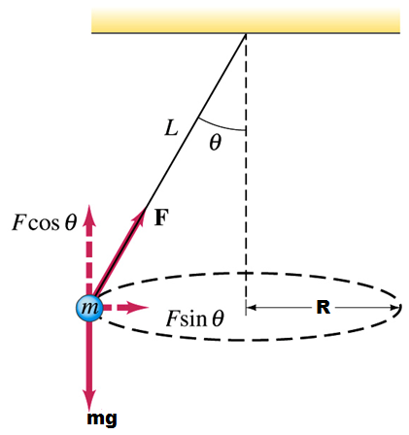
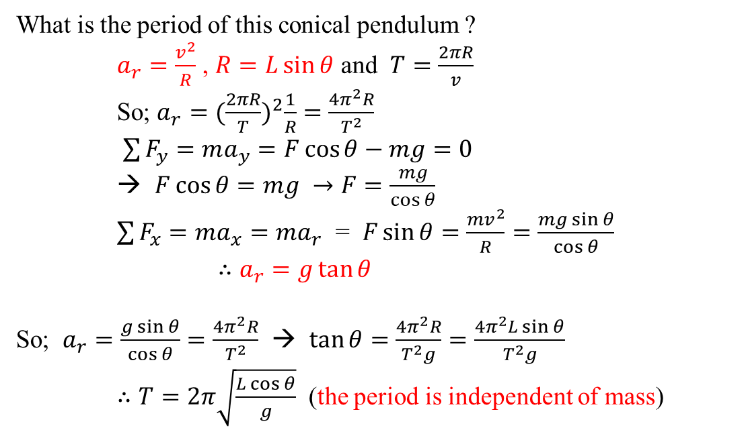
Conical Pendulum
  What is the period of this conical pendulum ?
  $a_{r}=\frac{v^{2}}{R}$ , $R=L\sin{θ}$ and $T=\frac{2πR}{v}$
  So; $a_{r}={(\frac{2πR}{T})}^{2}\frac{1}{R}=\frac{4π^{2}R}{T^{2}}$
$\sum{F_{y}=ma_{y}}=F\cos{θ}−mg=0$
→ $F\cos{θ}=mg →F=\frac{mg}{\cos{θ}}$
$\sum{F_{x}=ma_{x}=ma_{r}}$ = $F\sin{θ}=\frac{mv^{2}}{R}=\frac{mg\sin{θ}}{\cos{θ}}$
$∴a_{r}=g\tan{θ}$
So; $a_{r}=\frac{g\sin{θ}}{\cos{θ}}=\frac{4π^{2}R}{T^{2}}$ → $\tan{θ}=\frac{4π^{2}R}{T^{2}g}=\frac{4π^{2}L\sin{θ}}{T^{2}g}$
$∴T=2π\sqrt{\frac{L\cos{θ}}{g}}$ (the period is independent of mass)
All information is in the equations in red

Slide 13
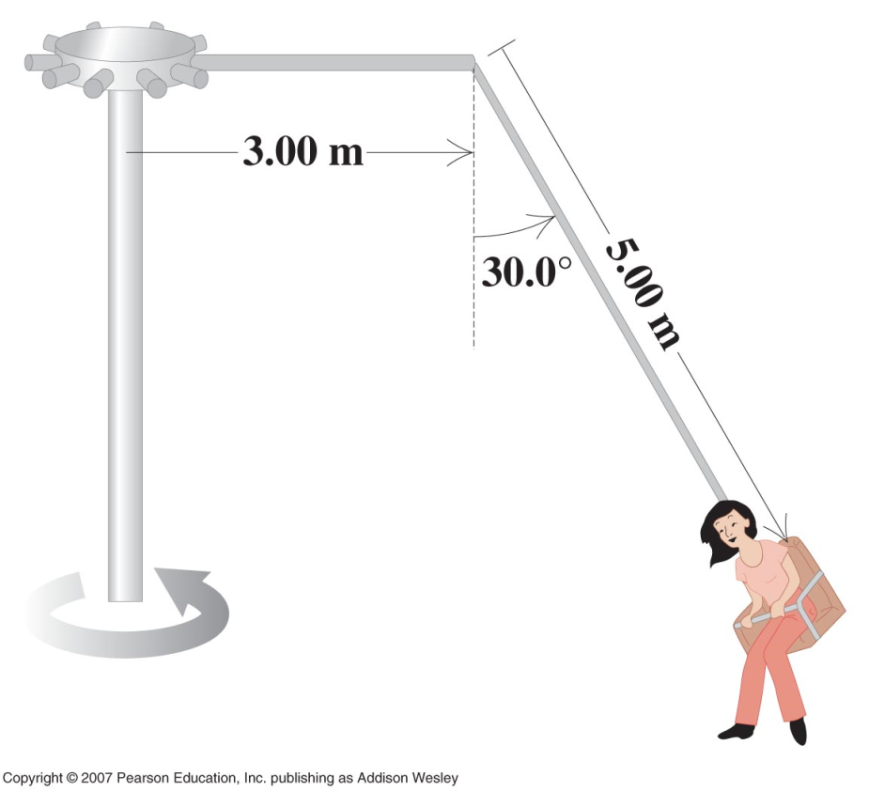
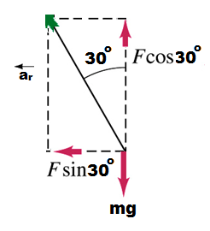
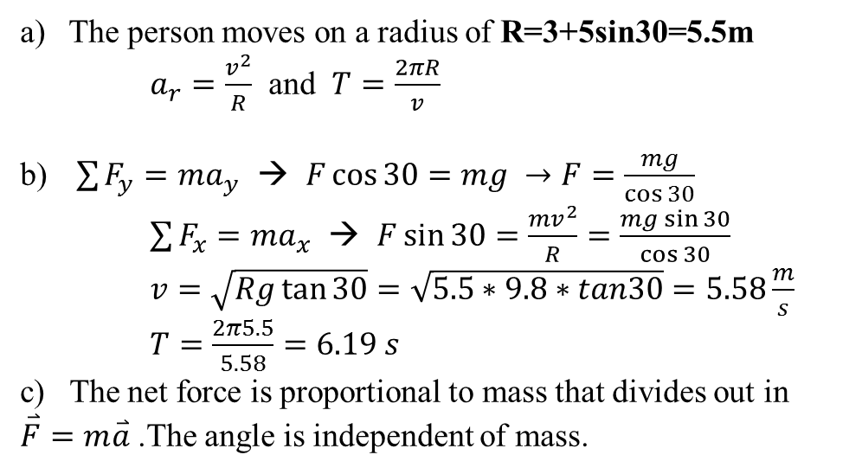
6.5
From a Brazos county fair
The “Giant Swing”:
Make a free body diagram of the seat including the person on it.
Find the time for one revolution for the indicated angle of 30º
Does the angle depend on the weight of the passenger?
The person moves on a radius of R=3+5sin30=5.5m
  $a_{r}=\frac{v^{2}}{R}$ and $T=\frac{2πR}{v}$
$\sum{F_{y}=ma_{y}}$ → $F\cos{30}=mg →F=\frac{mg}{\cos{30}}$
$\sum{F_{x}=ma_{x}}$ → $F\sin{30}=\frac{mv^{2}}{R}=\frac{mg\sin{30}}{\cos{30}}$
$v=\sqrt{Rg\tan{30}}=\sqrt{5.5∗9.8∗tan30}=5.58\frac{m}{s}$
$T=\frac{2π5.5}{5.58}=6.19 s$
c) The net force is proportional to mass that divides out in $\overset{⃑}{F}=m\overset{⃑}{a}$ .The angle is independent of mass.

Slide 14
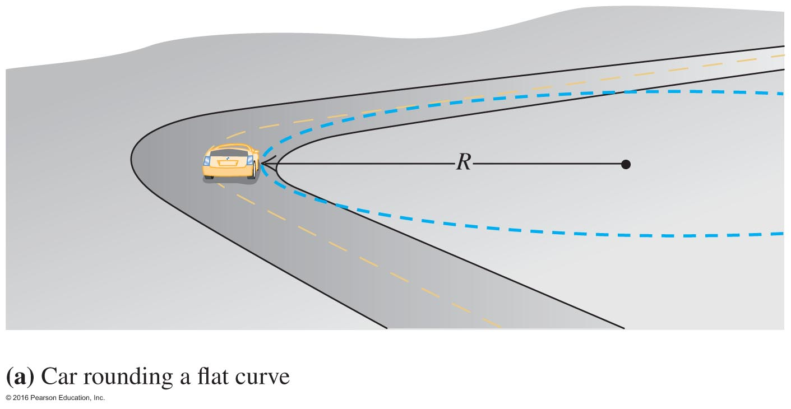
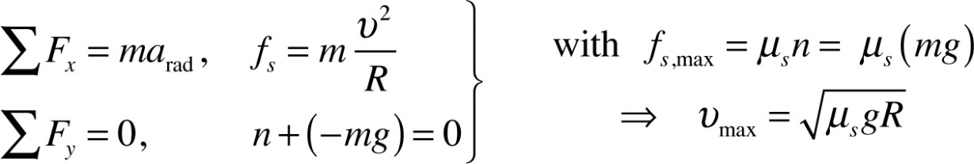





Example 6.3
Rounding a Flat Curve, page 157
$$y$$
$$\overset{⃑}{n}$$
Given: radius R = 250 m
μ_{s} = 0.90
Find: v_{max}
$${\overset{⃑}{f}}_{s}$$
$$x$$
$$mg$$
Solution:
The source of centripetal force is static friction force provided by the tires.
Equalize the maximum friction force to the force required by circular motion (m/R ) v_{max} ²

Slide 15
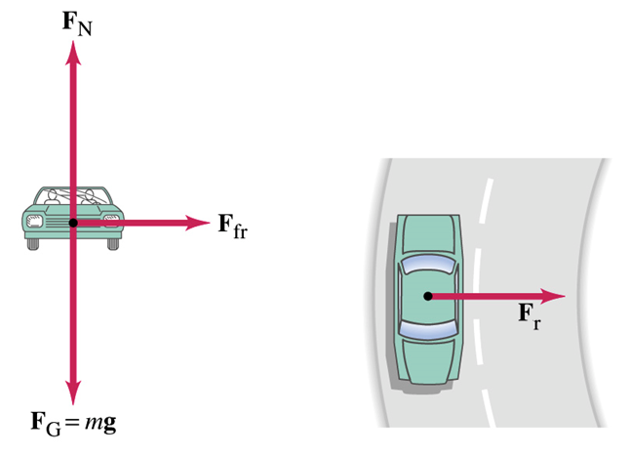
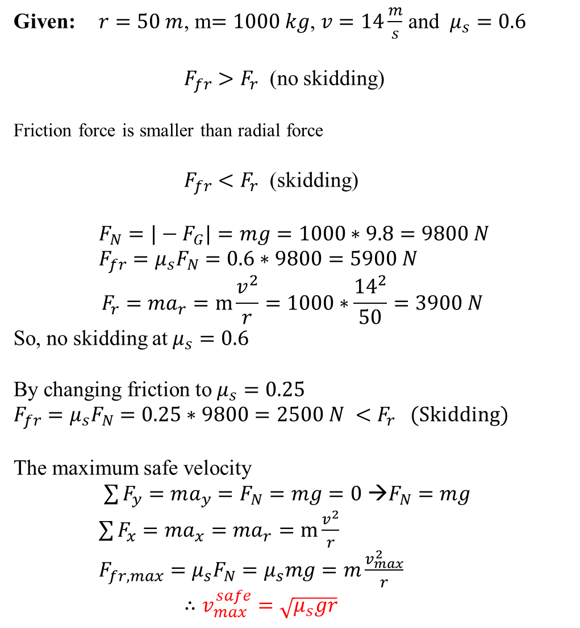
  Given: $r=50 m$, m$=1000 kg$, $v=14\frac{m}{s}$ and $μ_{s}=0.6$
  $F_{fr}>F_{r}$ (no skidding)
  Friction force is smaller than radial force
  $F_{fr}<F_{r}$ (skidding)
  $F_{N}=|−F_{G}|=mg=1000∗9.8=9800 N$
  $F_{fr}=μ_{s}F_{N}=0.6∗9800=5900 N$
  $${F_{r}=ma}_{r}=m\frac{v^{2}}{r}=1000∗\frac{{14}^{2}}{50}=3900 N$$
  So, no skidding at $μ_{s}=0.6$
  By changing friction to $μ_{s}=0.25$
  $F_{fr}=μ_{s}F_{N}=0.25∗9800=2500 N <F_{r}$ (Skidding)
  The maximum safe velocity
$\sum{F_{y}=ma_{y}}=F_{N}=mg=0$ →$F_{N}=mg$ $\sum{F_{x}=ma_{x}=ma_{r}}=m\frac{v^{2}}{r}$
$F_{fr,max}=μ_{s}F_{N}=μ_{s}mg=m\frac{v_{max}^{2}}{r}$
$∴v_{max}^{safe}=\sqrt{μ_{s}gr}$
Un-Banked Curve
Friction force is larger than radial force

Slide 16
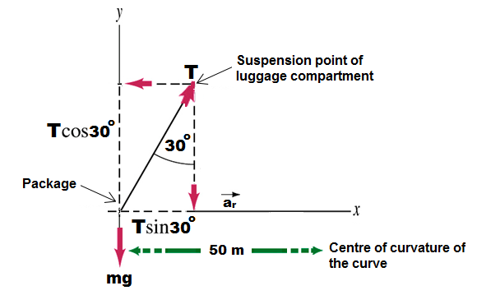
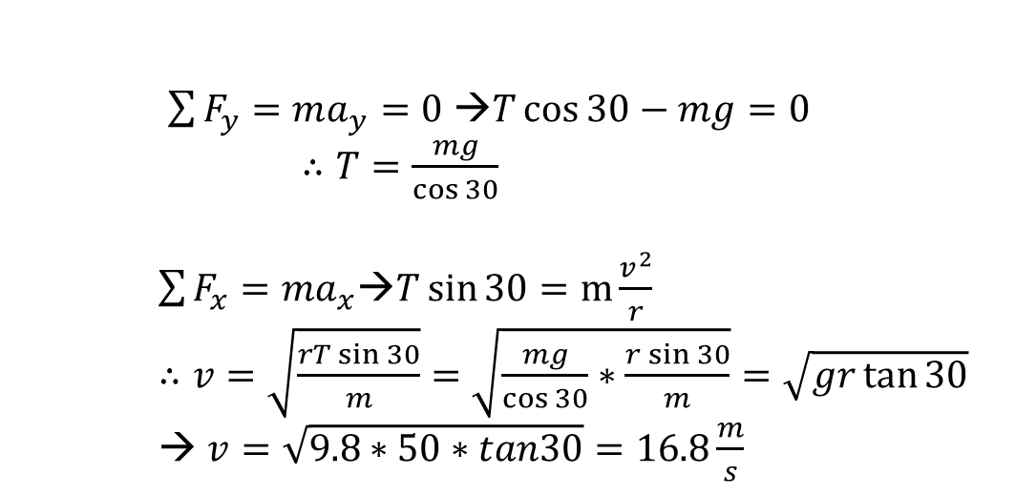
6-52 . As the bus rounds a flat curve at constant speed, a package suspended from the luggage rack on a string makes an angle with the vertical as shown.
What is the velocity of the bus?
What is the radial acceleration?
What is the radius of the curve?
$\sum{F_{y}=ma_{y}}=0$ →$T\cos{30}−mg=0$
$∴T=\frac{mg}{\cos{30}}$
$\sum{F_{x}=ma_{x}\text{→}T\sin{30}}=m\frac{v^{2}}{r}$
$∴v=\sqrt{\frac{rT\sin{30}}{m}}=\sqrt{\frac{mg}{\cos{30}}∗\frac{r\sin{30}}{m}}=\sqrt{gr\tan{30}}$
→ $v=\sqrt{9.8∗50∗tan30}=16.8\frac{m}{s}$

Slide 17
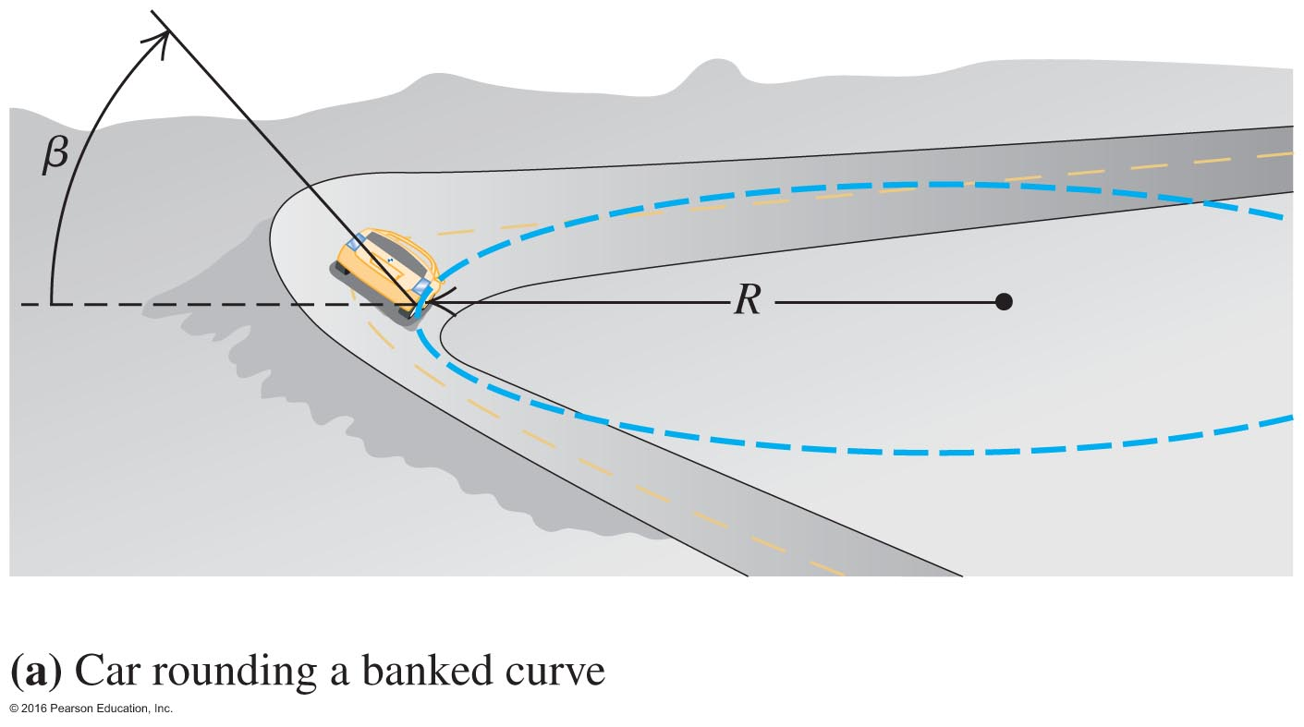



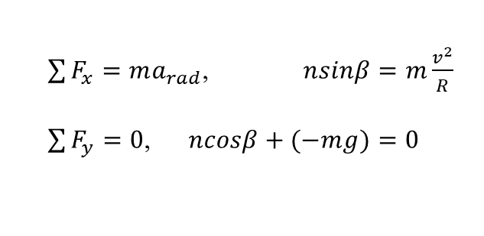

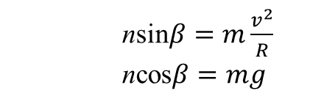




Example 6.4 Rounding a Banked Curve, page 158
$$y$$
No need to rely on friction. The horizontal component of the normal force is the source of the centripetal force.
Given: radius R = 250 m
Design: v_{max} = 25 m/s
Find: β
$$\overset{⃑}{n}$$
$$n_{y}$$
$$\text{b}$$
$$n_{x}$$
$$x$$
$$mg$$
$\sum{F_{x}=ma_{rad}}$, $nsinβ=m\frac{v^{2}}{R}$
$\sum{F_{y}=0}$, $ncosβ+(−mg)=0$
nsin$β=m\frac{v^{2}}{R}$
ncos$β=mg$
tan$β=\frac{v^{2}}{gR}$

Slide 18

Rounding a Banked Curve – Example 6.4
The centripetal force comes only from a component of normal force

Slide 19
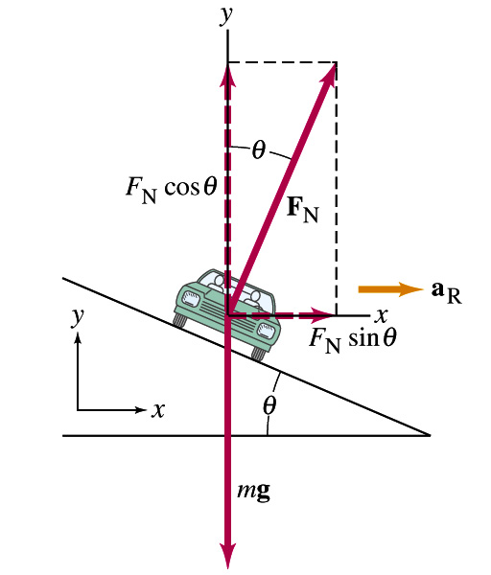
No Skidding on Banked Curve
F_{rad}

Slide 20
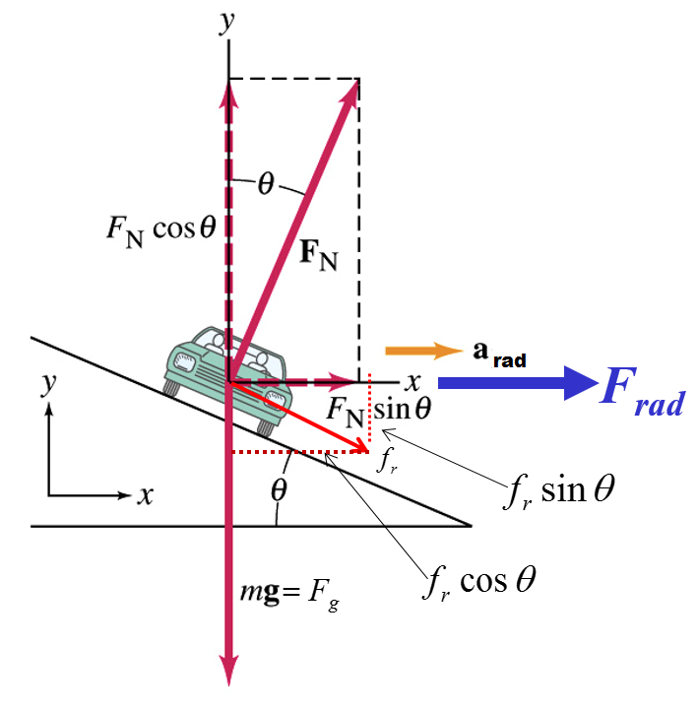
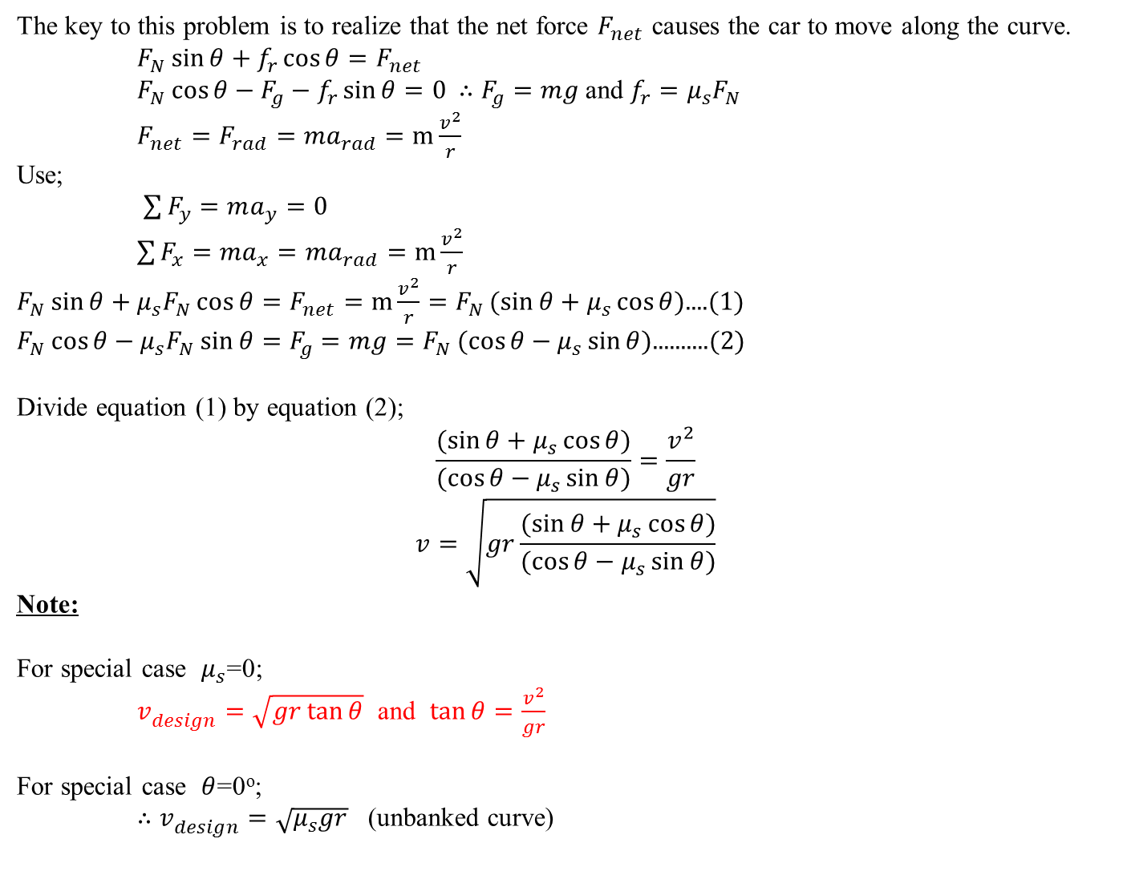
No Skidding on Banked Curve
  The key to this problem is to realize that the net force $F_{net}$ causes the car to move along the curve.
  $F_{N}\sin{θ}+f_{r}\cos{θ}=F_{net}$
  $F_{N}\cos{θ}−F_{g}−f_{r}\sin{θ}=0$ $∴F_{g}=mg$ and $f_{r}=μ_{s}F_{N}$
  $F_{net}={F_{rad}=ma}_{rad}=m\frac{v^{2}}{r}$
  Use;
  $\sum{F_{y}=ma_{y}}=0$
  $\sum{F_{x}=ma_{x}=ma_{rad}}=m\frac{v^{2}}{r}$
  $F_{N}\sin{θ}+μ_{s}F_{N}\cos{θ}=F_{net}=m\frac{v^{2}}{r}=F_{N}(sin{θ}+μ_{s}\cos{θ)}$....(1)
  $F_{N}\cos{θ}−μ_{s}F_{N}\sin{θ}=F_{g}=mg=F_{N}(cos{θ}−μ_{s}\sin{θ)}$..........(2)
Divide equation (1) by equation (2);
$$\frac{(sin{θ}+μ_{s}\cos{θ)}}{(cos{θ}−μ_{s}\sin{θ)}}=\frac{v_{ }^{2}}{gr}$$
$$v=\sqrt{gr\frac{(sin{θ}+μ_{s}\cos{θ)}}{(cos{θ}−μ_{s}\sin{θ)}}}$$
Note:
For special case $μ_{s}$=0;
$v_{design}^{ }=\sqrt{gr\tan{θ}}$ and $\tan{θ=\frac{v_{ }^{2}}{gr}}$
For special case $θ$=0º;
$∴v_{design}^{ }=\sqrt{μ_{s}gr}$ (unbanked curve)

Slide 21
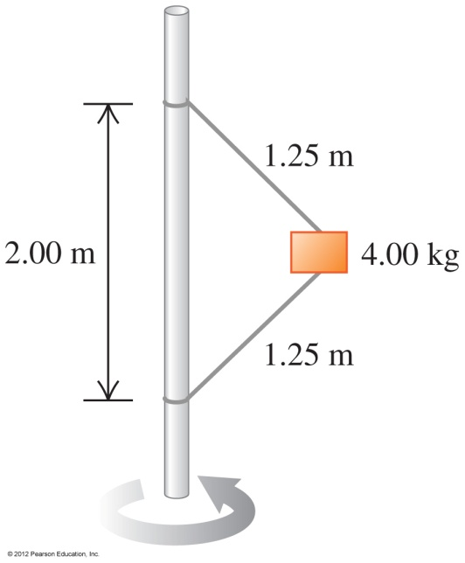
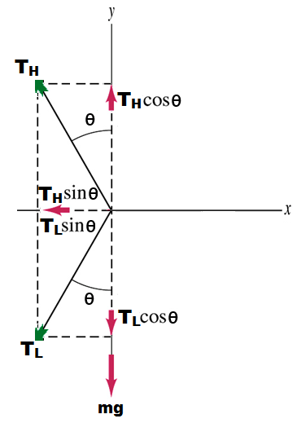
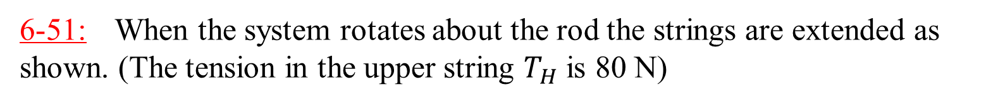
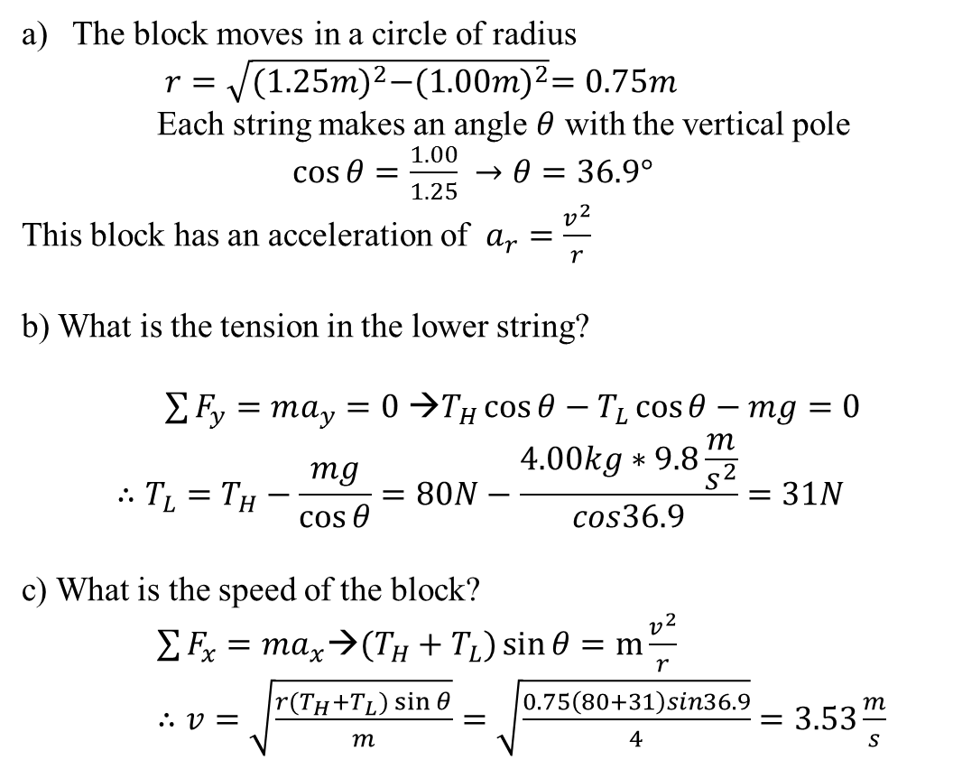
6-51: When the system rotates about the rod the strings are extended as shown. (The tension in the upper string $T_{H}$ is 80 N)
  The block moves in a circle of radius
  $r=\sqrt{{(1.25m)}^{2}−{(1.00m)}^{2}}=0.75m$
  Each string makes an angle $θ$ with the vertical pole
  $\cos{θ}=\frac{1.00}{1.25} →θ=36.9°$
  This block has an acceleration of $a_{r}=\frac{v_{ }^{2}}{r}$
  b) What is the tension in the lower string?
$\sum{F_{y}=ma_{y}}=0$ →$T_{H}\cos{θ}−T_{L}\cos{θ}−mg=0$
$$∴T_{L}=T_{H}−\frac{mg}{\cos{θ}}=80N−\frac{4.00kg∗9.8\frac{m}{s^{2}}}{cos36.9}=31N$$
c) What is the speed of the block?
$\sum{F_{x}=ma_{x}\text{→}(T_{H}+T_{L})\sin{θ}}=m\frac{v^{2}}{r}$
$∴v=\sqrt{\frac{r(T_{H}+T_{L})\sin{θ}}{m}}=\sqrt{\frac{0.75\left(80+31\right)sin36.9}{4}}=3.53\frac{m}{s}$

Slide 22
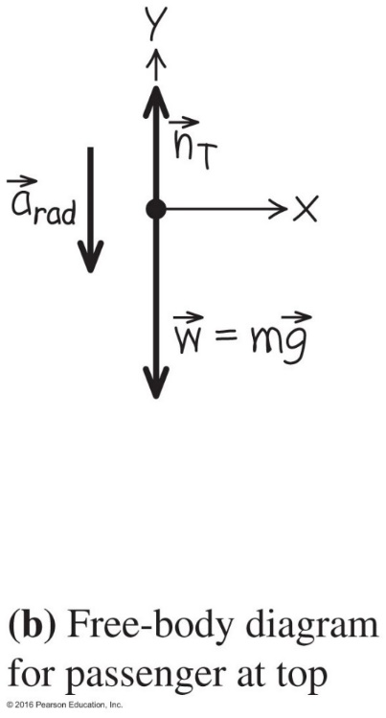
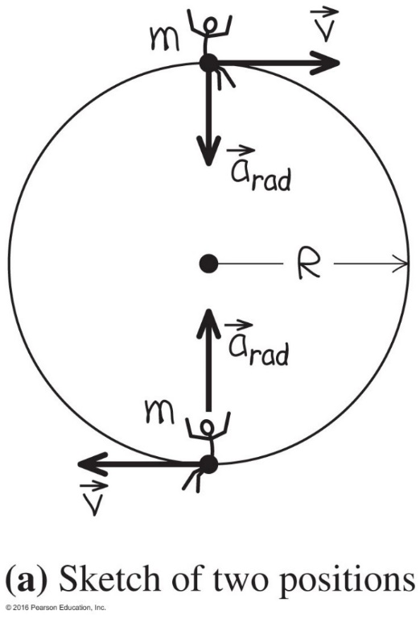
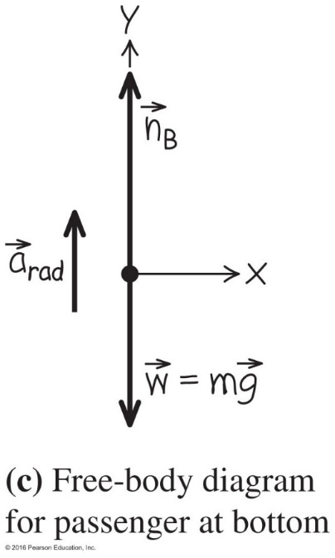
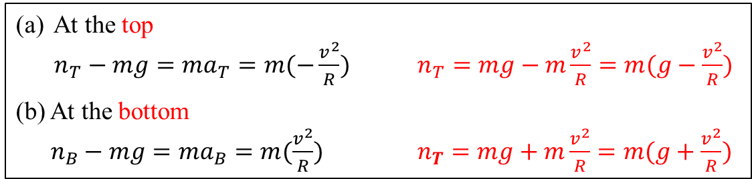
6.2 Motion in a Vertical Circle
at the top
Example 6.5 Dynamics of a Ferris wheel at a constant speed, page 158
Given: m = 60.0 kg
R = 8.00 m
T = 10.0 s (v = 2πR/T)
Find the normal force:
(a) at the top (n_{T})
(b) at the bottom (n_{B})
at the bottom
At the top
$n_{T}−mg=ma_{T}=m(−\frac{v^{2}}{R})$ $n_{T}=mg−m\frac{v^{2}}{R}=m(g−\frac{v^{2}}{R})$
(b) At the bottom
$n_{B}−mg=ma_{B}=m(\frac{v^{2}}{R})$ $n_{T}=mg+m\frac{v^{2}}{R}=m(g+\frac{v^{2}}{R})$
Courtesy of Wenhao Wu

Slide 23
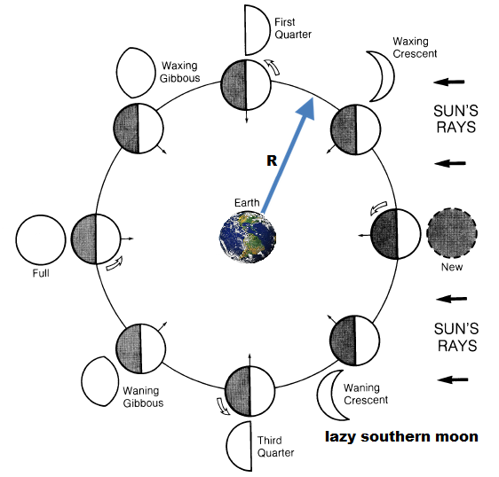
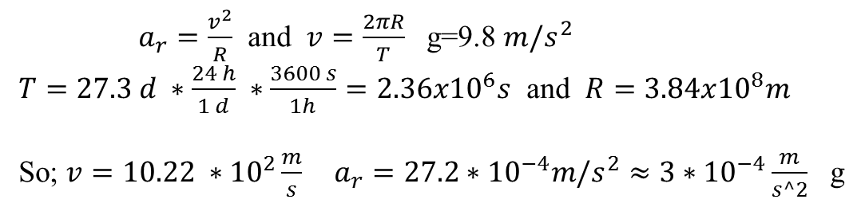
Work out the radial acceleration of the moon around the earth.
  $a_{r}=\frac{v^{2}}{R}$ and $v=\frac{2πR}{T}$ g=9.8 $m/s^{2}$
  $T=27.3 d ∗\frac{24 h}{1 d} ∗\frac{3600 s}{1h}=2.36x{10}^{6}s$ and $R=3.84x{10}^{8}m$
  So; $v=10.22 ∗{10}^{2}{\frac{m}{s} a}_{r}=27.2∗{10}^{−4}m/s^{2}≈{3∗10}^{−4}\frac{m}{s^2}$ g

Slide 24
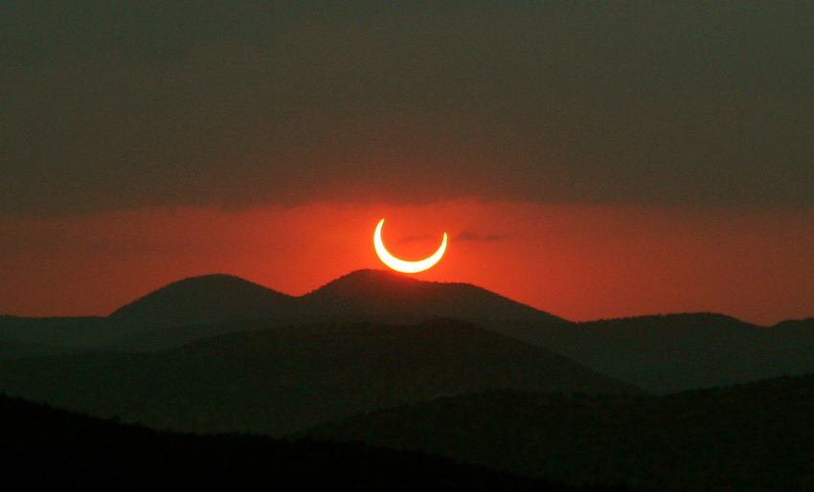

Slide 25
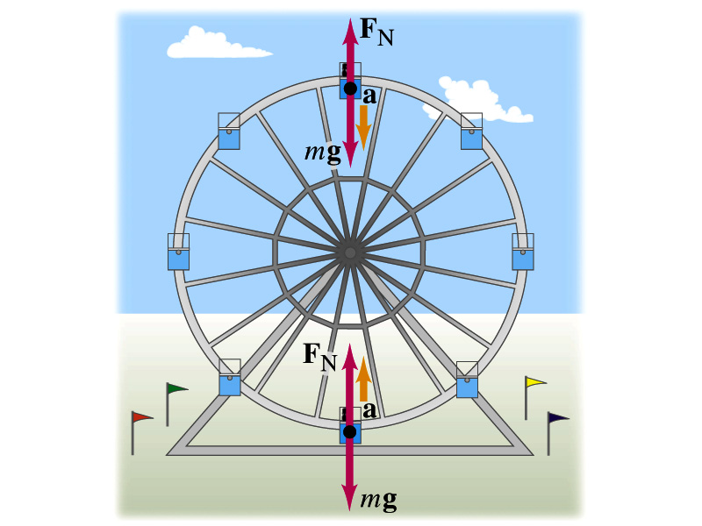
Ferris wheel

Slide 26



Ferris wheel
  Top:
  $a_{r}=\frac{v^{2}}{R}$ and $T=\frac{2πR}{v}$
$\sum{F_{y}=ma_{y}}=F_{N}−mg=−\frac{mv^{2}}{R}$
$$→F_{N}=m(g−\frac{v^{2}}{R})$$
The force which the seat applies to the passenger is smaller than his weight.
For, $\frac{v^{2}}{R}=g$ passenger is starting to fly off.
  Bottom:
  $F_{N}−mg=\frac{mv^{2}}{R}→F_{N}=m(g+\frac{v^{2}}{R})$
Passenger in Ferris wheel is pressed into the seat.

Slide 27

Model Airplane on a String – Example 6.1
How hard must you pull on the string to keep the airplane flying in a circle?
T=4s m=0.5 kg
v ² = (T R/ m ) ²

Slide 28

snowboarding
The net force F always down, but a=0 in A. a=positive in B, a=negative in C
C. Just like elevator accelerating down F-mg = m (-a ) F = m ( g-a )
Notes:
Figure 6.3

Slide 29

You're snowboarding down a slope. The free-body diagram in the figure represents the forces on you as you
Clicker question
go over the top of a mogul.
go through the bottom of a hollow
between moguls.
go along a horizontal stretch.
go along a horizontal stretch or over
the top of a mogul.
Notes:
Answer: a) go over the top of the moguls.

Slide 30


You whirl a ball of mass m in a fast vertical circle on a string of length R. At the bottom of the circle, the tension in the string is five times the ball's weight. The ball's speed at this point is given by
Clicker question
a) gR
b) 4gR
c) 6gR
d) 6 gR
F _{T} = 5mg = mg +(m/R) v²
Notes:
Answer: b)

Slide 31
You whirl a ball of mass m in a fast vertical circle on a string of length R. At the top of the circle, the tension in the string is five times the ball's weight. The ball's speed at this point is given by
Clicker question
a) gR
b) 4gR
c) 6gR
d) 6 gR
F _{T} = 5mg = -mg +(m/R) v²
Notes:
Answer: c)

Slide 32



6.3 Newton's Law of Gravitation
Properties of Gravitation Forces
● Always attractive.
● Directly proportional to both the masses involved.
● Inversely proportional to the square of the center-to-center distance between the two masses.
● Magnitude of force is given by:
● G is the gravitational constant:
Courtesy of Wenhao Wu

Slide 33

Gravitation
Newton’s Law of Gravitation

Slide 34
Clicker question
Compared to the earth, planet X has twice the mass and twice the radius. This means that compared to the earth’s surface gravity, the surface gravity on Planet X is
A. four times as much.
B. twice as much.
C. the same.
D. half as much.
E. one-quarter as much.
Notes:
Answer: D

Slide 35

Gravitational Forces (I)
M_{M}
M_{M} M_{E}
F_{G} = G
r ²
‘‘Attractive Force”
M_{E}

Slide 36

Gravitational attraction
Note: Two particles of different mass exert equally strong gravitational force on each other

Slide 37
Clicker question
The mass of the moon is 1/81 of the mass of the earth. Compared to the gravitational force that the earth exerts on the moon, the gravitational force that the moon exerts on the earth is
A. 81² = 6561 times greater.
B. 81 times greater.
C. equally strong.
D. 1/81 as great.
E. (1/81)² = 1/6561 as great.
Notes:
Answer: C

Slide 38


Why is the Aggie not falling off the earth?
Remember there is equally strong attraction between the earth and the Aggie and vice versa
Compare the acceleration of the Aggie to the acceleration of the Earth
$F=G\frac{m_{A}m_{E}}{r_{E}^{2}}=m_{A}g$
→$g=G\frac{m_{E}}{r_{E}^{2}}$
Forces are equal between the Aggie and the Earth
$F=G\frac{m_{A}m_{E}}{r_{E}^{2}}=m_{A}a_{A}=m_{E}a_{E}$ $a_{E}$=g
→$\frac{a_{A}}{a_{E}}=\frac{m_{E}}{m_{A}}≈{10}^{23}$ with $m_{E}=6x{10}^{24}kg$
$m_{A}=60 kg$ (Aggie’s mass) $a_{E}$=${10}^{−23}$g

Slide 39

Newton's Law of Gravitation – Figure 6.12
Always attractive.
Directly proportional to the masses involved.
Inversely proportional to the square of the separation between the masses.
Magnitude of force is given by:
G is gravitational constant:

Slide 40

Cavendish balance (1798)
Cavendish(1798) announced that he has weighted the earth

Slide 41


Cavendish Tension balance (1798)
Air current in the room is negligible to the gravitational attraction force
$F=G\frac{Mm}{r^{2}}=1.33x{10}^{−10}N$ (Torsion force)
and $M=0.5 kg;m=0.01 kg and r=0.05m$
When torsion and gravitational forces are in equilibrium;
$1.33x{10}^{−10}=G\frac{0.5∗0.01}{{0.05}^{2}}$
→$G=6.6x{10}^{−11}\frac{m^{2}N}{{kg}^{2}}$
Molecular motors (kinetics); $F=1.33x{10}^{−12}N$

Slide 42

This May Be Done in a Lab – Cavendish Experiment (1798)
The slight attraction of the masses causes a nearly imperceptible rotation of the string supporting the masses connected to the mirror. → use this to calculate G.
Use of the laser allows a point many meters away to move through measurable distances as the angle allows the initial and final positions to diverge.

Slide 43


6.4 Weight and Gravitation Acceleration near the surface of the Earth
The weight of an object near the surface of the earth is:
With this we find that the acceleration due to gravity near the earth's surface is:
Courtesy of Wenhao Wu

Slide 44

Even Within the Earth Itself, Gravity Varies – Figure 6.17
Distances from the center of rotation and different densities allow for interesting increase in F _{g}.

Slide 45

Average Density of the Earth
g = 9.80 m/s²
R_{E} = 6.37 x 10⁶ m
M_{E} = 5.96 x 10²⁴ kg
ρ_{E} = 5.50 x 10³ kg/m³
= 5.50 g/cm³ ~ 2 x ρ_{Rock}

Slide 46

Gravitational Force Falls off Quickly –
Figure 6.15
The gravitational force is proportional to 1/r², and thus the weight of an object decreases inversely with the square of the distance from the earth's center (not distance from the surface of the earth).

Slide 47


What is the magnitude of the gravitational force inside, on the surface, and outside the earth??
Earth mass $M_{E}=6x{10}^{24}kg$ and radius $R_{E}=6.37x{10}^{6}m$
$F=G\frac{M_{E}m}{{R_{E}}^{2}}=mg$
→$M_{E}=\frac{g{R_{E}}^{2}}{G}$
When radius is variable like $r$ with variable mass $m_{inside}$ of Earth.
Then;
$F=G\frac{m_{inside} m}{r^{2}}$ and $m_{inside}=\frac{M_{E} \frac{4}{3}π r^{3}}{\frac{4}{3}π R_{E}^{3}}=\frac{M_{E} r^{3}}{R_{E}^{3}}$
$∴F=G\frac{M_{E}m}{{R_{E}}^{3}}r$
At the center r=0 and F=?

Slide 48

Gravitation Applies Elsewhere – Figure 6.18
Example Mars
Mars calculate the weight on the surface
See the worked example on pages 166–167.
m=w/g=3.92 x 10⁴ N / 9.8 m/s
since G is the same everywhere
Earth weight of mars lander=39,200 N

Slide 49


6.5 Satellite Motion
What happens when the velocity increases?
When v is not large enough, you fall back onto the earth.
Eventually, F_{g} balances and you have an orbit.
When v is large enough, you achieve escape velocity.

Slide 50



Satellite Motion: What Happens When Velocity Rises?
Eventually, F_{g} balances and you have orbit.
When is large enough, you achieve escape velocity.
An orbit is not fundamentally different from familiar trajectories on earth. If you launch it slowly, it falls back. If you launch it fast enough, the earth curves away from it as it falls, and it goes into orbit.

Slide 51



Circular Satellite Orbit
If a satellite is in a circular orbit with speed v_{orbit}, the gravitational force provides the centripetal force needed to keep it moving in a circular path.
The orbital speed of a satellite
$$G\frac{mm_{E}}{r^{2}}=F_{g}=F_{rad}=m\frac{v^{2}}{r}$$
$$→ v_{orbit}=\sqrt{\frac{Gm_{E}}{r}}$$
The period of a satellite
$$v=\frac{2πr}{T}$$
$$T=\frac{2πr}{v}=2πr\sqrt{\frac{r}{Gm_{E}}}=\frac{2πr^{3/2}}{\sqrt{Gm_{E}}}$$
Courtesy of Wenhao Wu

Slide 52



Circular Satellite Orbit Velocity
If a satellite is in a perfect circular orbit with speed _{orbit}, the gravitational force provides the centripetal force needed to keep it moving in a circular path.

Slide 53

Circular orbit period
The larger r then slower the speed and the larger the period

Slide 54


Weather Satellite
Example 6.10:
Earth mass $M_{E}=5.98x{10}^{24}kg$ and radius $R_{E}=6380km$
$r=6380km+300km=6.68x{10}^{6}km$
a) What is the speed?
$\frac{mv^{2}}{r}=G\frac{M_{E}m}{r^{2}}$
→$v=\sqrt{G\frac{M_{E}}{r}}=7730\frac{m}{s}$
b) When is the period?
$T=\frac{2πr}{v}=\frac{2π(6.68x{10}^{6})}{7730}=5430 s$
c) What is the radial acceleration?
$a_{rad}=\frac{v^{2}}{r}=\frac{{(7730)}^{2}}{6.68x{10}^{6}}=8.95\frac{m}{s^{2}}$

Slide 55


Geo-synchronous Satellite (at the equator of Earth)
Not to scale
Height above the surface of Earth.
$h=r−r_{E}$
Earth mass $M_{E}=6x{10}^{24}kg$ and radius $r_{E}=6380km$
$\frac{m_{s}v^{2}}{r}=G\frac{M_{E}m_{s}}{r^{2}}$ → $v=\frac{2πr}{T}$ and $T=1 day=86400 sec$
$$\frac{m_{s}{(2πr)}^{2}}{rT^{2}}=G\frac{M_{E}m_{s}}{r^{2}} → r^{3}=\frac{GM_{E}T^{2}}{4π^{2}}=7.54x{10}^{22}m^{3}$$
$∴r=4.23x{10}^{7}m$
→ $h=r−r_{E}$=36000 km$≈6r_{E}$
b) What is the velocity?
→$v=\sqrt{G\frac{M_{E}}{r}}=3070\frac{m}{s}$

Slide 56

Calculations of Satellite Motion –
Example 6.10 (not Geo-synchronous)
Work on an example of a relay designed to stay in orbit permanently.
See the worked example on page 169.

Slide 57

Satellite motion
An artificial satellite is orbiting the earth (M earth = 5.97E+24 kg and radius = 38E+6 m) in a circular orbit. If the orbital speed of the satellite is 4000 m/s, what is the radius of the satellite’s orbit (measured from the center of the earth)?
Solution: Here we use combine two equations given to us. The first is the relationship between linear velocity and the radius & period of rotation of an object in circular motion:
$v=\frac{2πr}{T}$
The second equation is the period of orbit of a satellite:
$T=\frac{2πr^{3/2}}{\sqrt{GM_{e}}}$
If we arrange this second equation, we find that we can substitute in the linear velocity:
$\frac{T}{2πr}=\frac{r^{\frac{1}{2}}}{\sqrt{GM_{e}}}⇒\frac{1}{v}=\sqrt{\frac{r}{GM_{e}}}$
We are given G from the formula sheet (6.67E-11 N*m²*kg⁻²), and the values of M_{e} (5.97E+24 kg) and v (4000 m/s) in the problem. We can re-arrange the equation to solve for r, and we get:
$\frac{GM_{e}}{v^{2}}=\frac{\left(6.67×{10}^{−11}\right)\left(5.97×{10}^{24}\right)}{{\left(4000\right)}^{2}}≈2.5×{10}^{7}$r= $2.5×{10}^{7}$
m

Slide 58
If an Object is Massive, Even Photons Cannot Escape
A "black hole" is a collapsed sun of immense density such that a tiny radius contains all the former mass of a star.
The radius to prevent light from escaping is termed the "Schwarzschild Radius."
The edge of this radius has even entered pop culture in films. This radius for light is called the "event horizon."

Slide 59



Hawking @ HS ranch

Slide 60




Laser Interferometer Gravitational-Wave Observatory (LIGO)
operates two gravitational wave observatories in unison: the LIGO Livingston Observatory in Livingston, Louisiana, and the LIGO Hanford Observatory, on the DOE Hanford Site ,located near Richland, Washington. These sites are separated by 3,002 kilometers (1,865 miles)
Collison of two black holes 1.3 billion years ago, each black hole was about 30 times mass of the Sun, and 3 solar mass were converted to gravitational waves.

Slide 61

Sun properties
Sun mass $M_{S}=1.99x{10}^{30}kg$ and radius $R=6.96x{10}^{8}m$
Average density of Sun;
$ρ=\frac{M_{s}}{V}=\frac{M_{s}}{{\frac{4}{3}πR}^{3}}=\frac{1.99x{10}^{30}}{\frac{4}{3}π{(6.96x{10}^{8})}^{3}}=1.41\frac{g}{{cm}^{3}}$
40% denser than water
Temperature: 5800º K at surface and (1.5x10⁷)º K in the interior of Sun. (highly ionize plasma gas)
Steven Hawkins is associated with the department of Physics and Astronomy at TAMU

Slide 62
Clicker question
A Gravitational wave was created in a collision of two black holes 1.3 billion years ago, each black hole was about 30 times mass of the Sun, and 3 solar mass were converted to gravitational waves
In this process total energy was conserved
In this process the gravitational acceleration was g
In this process also light from the merger reached LIGO

Slide 63


${Critical radius for ligt emission R}_{s}=2G\frac{M_{s}}{c^{2}}$ (Schwarzschild radius)
For ${R>R}_{s}$ → light can be emitted
For ${R<R}_{s}$ → no light can be emitted (Black hole)
To what fraction of sun’s current radius would the sun have to be
compressed to become a black hole?
$$R_{s}=2G\frac{M_{s}}{c^{2}}=\frac{2x6.67x{10}^{−11}x1.99x{10}^{30}}{{(3x{10}^{8})}^{2}}=2.95 km$$
→ $\frac{R_{s}}{R_{ }}=\frac{2.95x{10}^{3}}{6.96x{10}^{8}}=4.2x{10}^{−6}$

Slide 64


Example: Problem 7, Exam II, Fall 2016
(a) A satellite of mass 80.0 kg is in a circular orbit around a spherical planet Q of radius 3.00×10⁶ m. The satellite has a speed 5000 m/s in an orbit of radius 8.00×10⁶ m. What is the mass of the planet Q?
(b) Imagine that you release a small rock from rest at a distance of 20.0 m above the surface of the planet. What is the speed of the rock just before it reaches the surface?
Given:
● About the satellite (m_{s} = 80.0 kg, r_{orbit} = 8.00×10⁶ m,
v = 5000 m/s)
● About the planet Q(R_{Q} = 3.00×10⁶ m)
Find: (a) The mass of the planet Q (m_{Q})
(b) Speed of a rock after falling h = 20.0 m.
(a) $G\frac{\text{m}\text{s}m_{Q}}{r_{orbit}^{2}}=F_{g}=F_{rad}=\text{m}\text{s}\frac{v^{2}}{\text{r}\text{orbit}}$
$$m_{Q}=\frac{{\text{r}\text{orbit}v}^{2}}{\text{G}}$$
(b) First, find the gravitational acceleration $g_{Q}$
near the surface of the planet Q.
$\text{m}\text{s}g_{Q}=G\frac{\text{m}\text{s}m_{Q}}{R_{Q}^{2}}$ $g_{Q}=G\frac{m_{Q}}{R_{Q}^{2}}$
Then, apply the kinematic equation
$$v_{2}^{2}=v_{1}^{2}+2g_{Q}h$$
to v₂ find with v₁ = 0.
R_{Q}
x
r_{orbit}
Courtesy of Wenhao Wu

Slide 66



Slide 67

Phys 201, FALL 2023
Exam 1
Avg: 56
N = 103
A: 85 – 100
B: 75 – 84
C: 55 – 74
D: 40 – 54
F: < 40

