Slide 1
Chapter 8 Momentum and Collision
● Understand momentum
● Understand the concept of conservation of momentum.
● Understand impulse.
● Understand center of mass (c.o.m.)
● Understand how forces affect the motion of the c.o.m.
Courtesy of Wenhao Wu

Slide 2
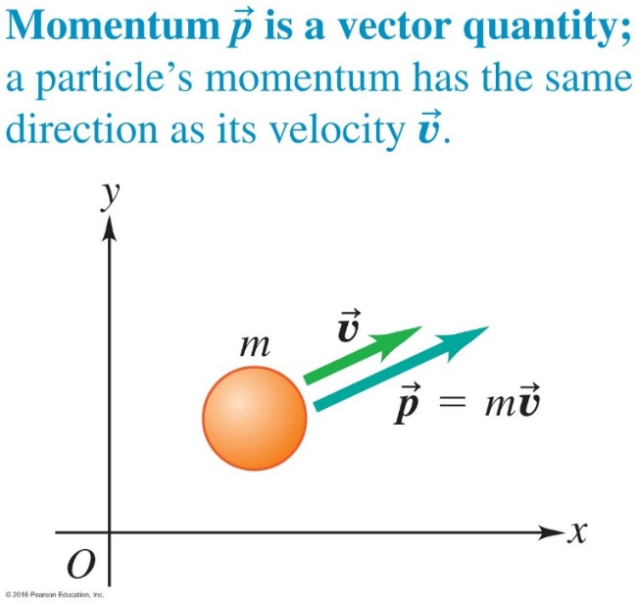
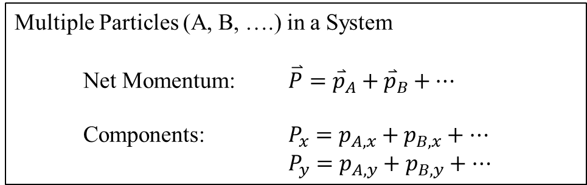
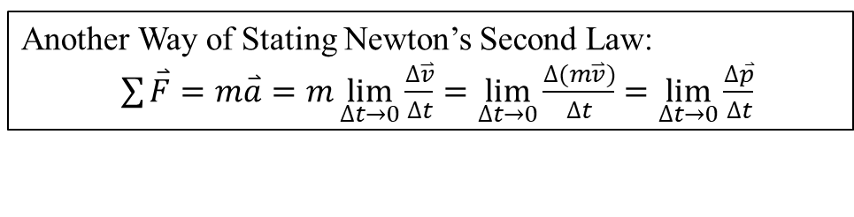
8.1 Momentum
Components of Momentum: $p_{x}=mv_{x}$; $p_{y}=mv_{y}$
Another Way of Stating Newton’s Second Law:
$\sum{\overset{⃑}{F}=m\overset{⃑}{a}=m\lim_{∆t→0}{\frac{∆\overset{⃑}{v}}{∆t}}}=\lim_{∆t→0}{\frac{∆(m\overset{⃑}{v})}{∆t}}=\lim_{∆t→0}{\frac{∆\overset{⃑}{p}}{∆t}}$
Multiple Particles (A, B, ….) in a System
Net Momentum: $\overset{⃑}{P}={\overset{⃑}{p}}_{A}+{\overset{⃑}{p}}_{B}+…$
Components: $P_{x}=p_{A,x}+p_{B,x}+…$
$P_{y}=p_{A,y}+p_{B,y}+…$
Unit = kg m/s

Slide 3
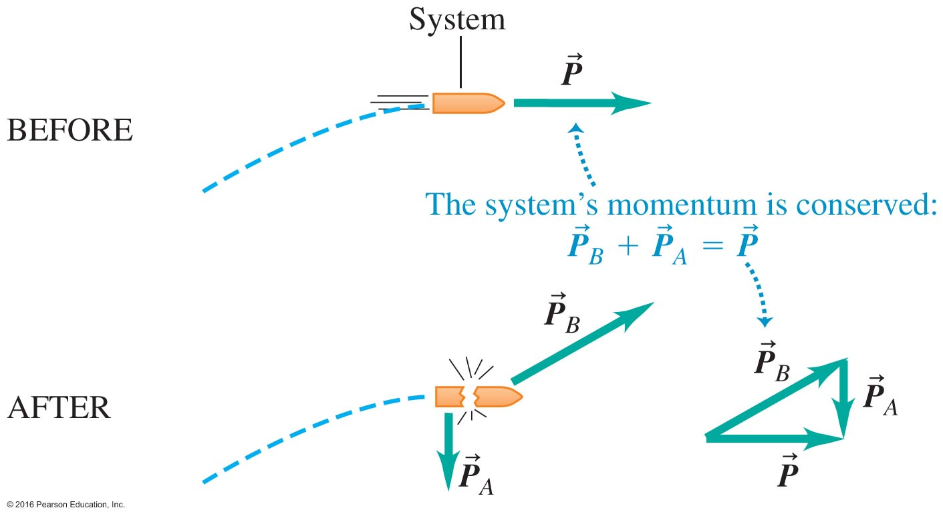
Exploding projectile after first stage burned out
Momentum is conserved
Notes:
Figure 8.8

Slide 4
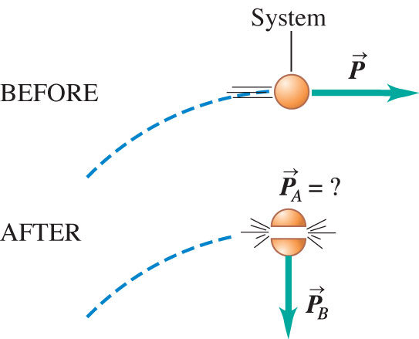
A space capsule follows a circular orbit around a planet. A shaped charge blows the capsule into two fragments. As shown in the figure, one fragment falls straight toward the planet's surface. How does the other fragment move right after the explosion?
Clicker question
It continues on the circular orbit of the original capsule.
It moves straight away from the planet.
It moves up and to the
right.
Notes:
Answer: c) It moves up and to the right.

Slide 5
Q-RT8.1
Clicker question
Rank the following objects in order of the magnitude of the momentum of the object, from largest to smallest.
K= p² /2m for the same magnitude of momentum p, the one with the smaller mass m has more kinetic energy K
Mass = 2.0 kg, kinetic energy = 2.0 J
Mass = 1.0 kg, kinetic energy = 2.0 J
Mass = 2.0 kg, kinetic energy = 4.0 J
Mass = 4.0 kg, kinetic energy = 4.0 J
K= p² /2m = ½ mv ²
a)ABCD b)DCBA c)DCAB d)ABDC
Notes:
Answer: DCAB

Slide 6
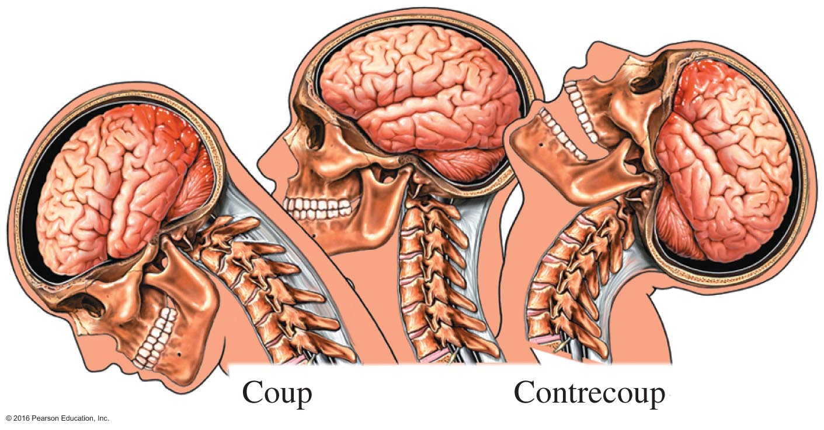
Momentum Can Cause Injury (Concussion)
This is a frame of reference problem just like a passenger in a car. When the brain and skull are moving at the same velocity, there is no problem. If the skull changes abruptly and the brain does not, there is a possibility of an injury.

Slide 7
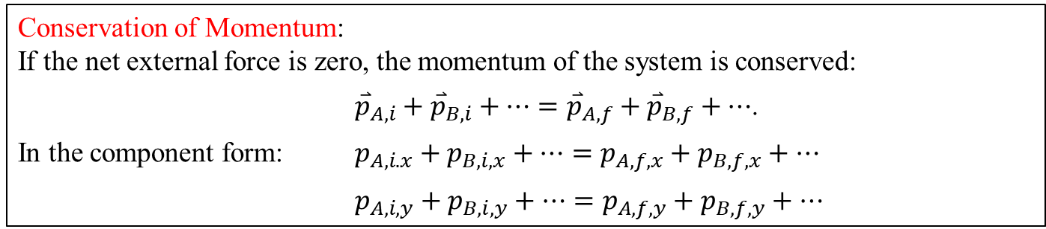
8.2 Conservation of Momentum
Consider a system consisting of a number of particles (A, B, … )
External Forces: Forces acting on objects in the system by objects outside the system.
Net External Force: the sum of the external forces.
Internal Forces: Forces acting on particles in the system by particles in the system.
Net Internal Force: the sum of the internal forces, which must be zero.
Conservation of Momentum:
If the net external force is zero, the momentum of the system is conserved:
${\overset{⃑}{p}}_{A,i}+{\overset{⃑}{p}}_{B,i}+…={\overset{⃑}{p}}_{A,f}+{\overset{⃑}{p}}_{B,f}+…$.
In the component form: $p_{A,i.x}+p_{B,i,x}+…=p_{A,f,x}+p_{B,f,x}+…$
$p_{A,i,y}+p_{B,i,y}+…=p_{A,f,y}+p_{B,f,y}+…$
Examples 8.3 and 8.4 on page 226
Example 8.5 on page 227
Courtesy of Wenhao Wu

Slide 8
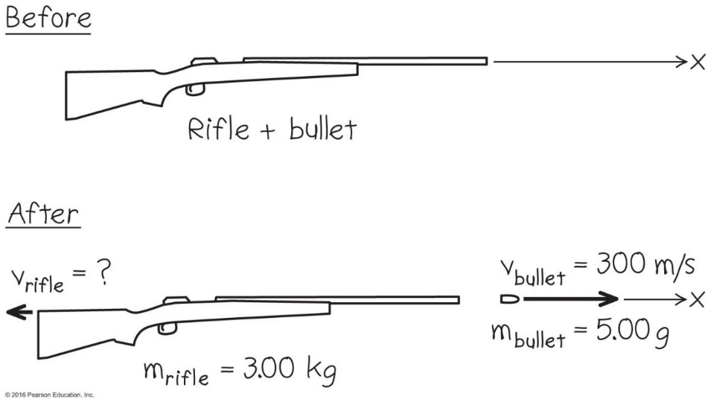
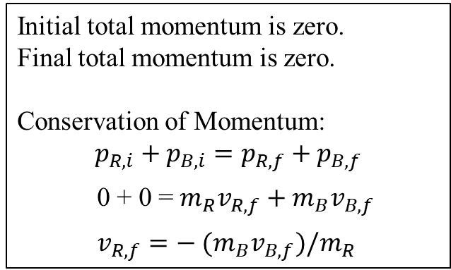
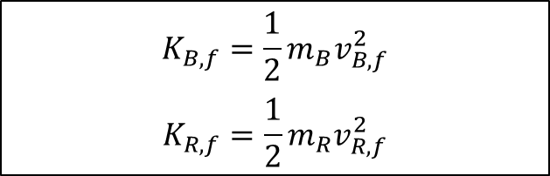
Rifle Recoil – Example 8.3 on page 228
Initial total momentum is zero.
Final total momentum is zero.
Conservation of Momentum:
$$p_{R,i}+p_{B,i}=p_{R,f}+p_{B,f}$$
0 + 0 = ${m_{R}v}_{R,f}+{m_{B}v}_{B,f}$
$v_{R,f}=− ({m_{B}v}_{B,f})/m_{R}$
$$K_{B,f}=\frac{1}{2}m_{B}v_{B,f}^{2}$$
$$K_{R,f}=\frac{1}{2}m_{R}v_{R,f}^{2}$$
Courtesy of Wenhao Wu

Slide 9
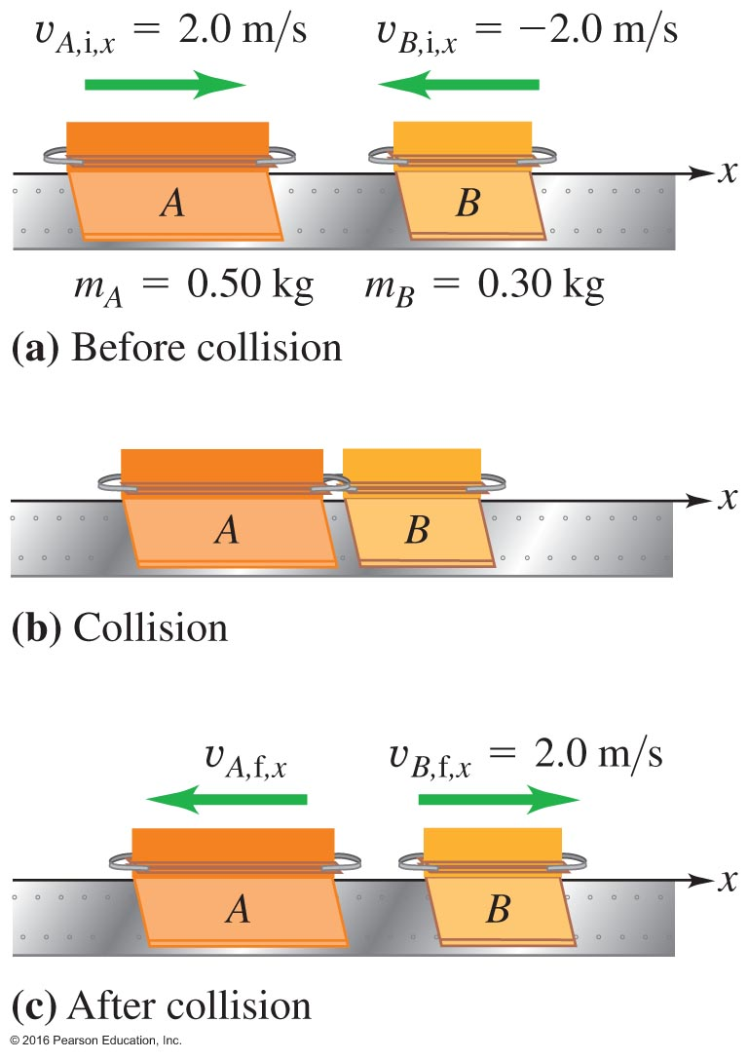
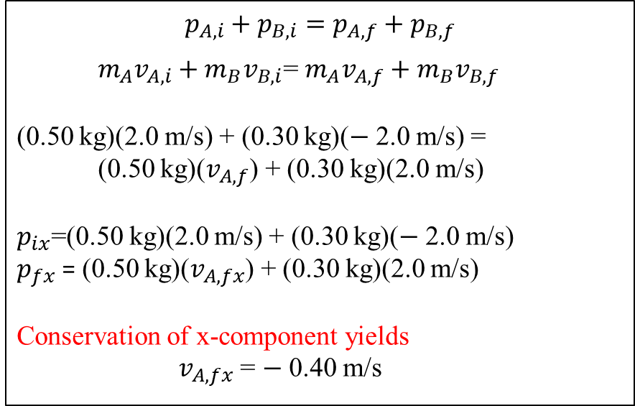
Head-on Collision – Example 8.4 on page 228
$$p_{A,i}+p_{B,i}=p_{A,f}+p_{B,f}$$
${m_{A}v}_{A,i}+{m_{B}v}_{B,i}$= ${m_{A}v}_{A,f}+{m_{B}v}_{B,f}$
(0.50 kg)(2.0 m/s) + (0.30 kg)($−$ 2.0 m/s) =
(0.50 kg)($v_{A,f}$) + (0.30 kg)(2.0 m/s)
$p_{ix}$=(0.50 kg)(2.0 m/s) + (0.30 kg)($−$ 2.0 m/s)
$p_{fx}$ = (0.50 kg)($v_{A,fx}$) + (0.30 kg)(2.0 m/s)
Conservation of x-component yields
$v_{A,fx}$ = $−$ 0.40 m/s

Slide 10
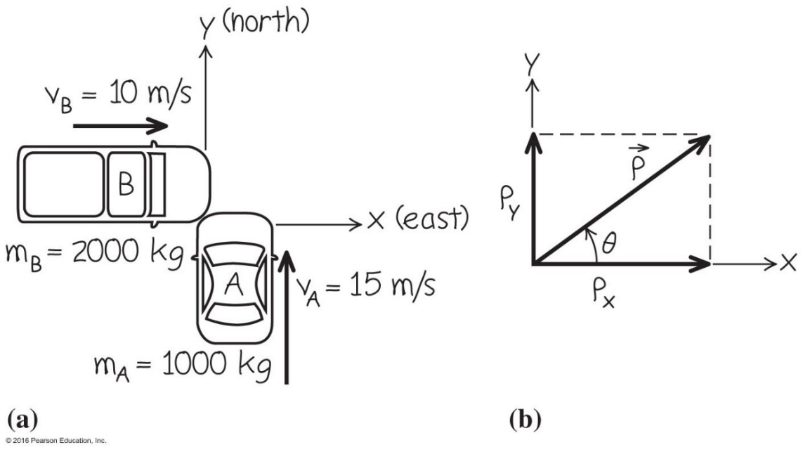
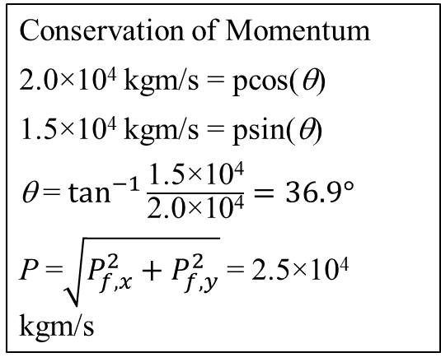
Collision In a Horizontal Plane
– Example 8.1 on page 225
The Initial State: Before Collision
P_{i,x} = p_{A,i,x}+p_{B,i,x} = 0 + (2000 kg)(10 m/s) = 2.0×10⁴ kgm/s
P_{i,y} = p_{A,i,y}+p_{B,i,y} = (1000 kg)(15 m/s) + 0 = 1.5×10⁴ kgm/s
The Final State: After Collision
P_{f,x} = pcos(θ)
P_{f,y} = psin(θ)
Conservation of Momentum
2.0×10⁴ kgm/s = pcos(θ)
1.5×10⁴ kgm/s = psin(θ)
θ = $\tan^{−1}{\frac{\text{1.5}\text{×}\text{104}}{\text{2.0}\text{×}\text{104}}}=36.9°$
P =$\sqrt{P_{f,x}^{2}+P_{f,y}^{2}}$= 2.5×10⁴ kgm/s

Slide 11
A accident analysis
8.27

Slide 12
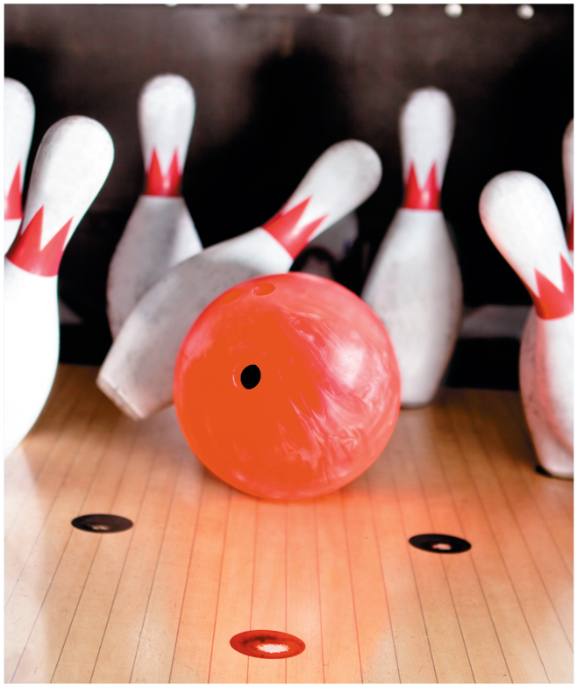
Scoring a "Strike" Is Many Momentum Transfers at Once
Before the strike momentum is in the ball
Afterwards in the ball and the pins

Slide 13
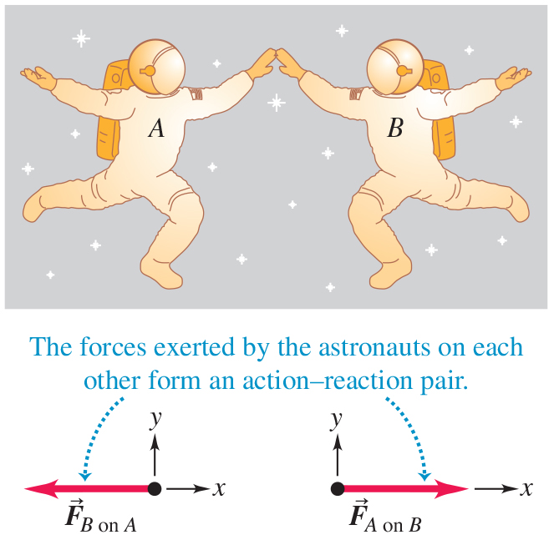
Momentum Is Conserved – Figure 8.3
Astronauts provide excellent examples of momentum transfer.
Internal forces on the astronauts are the same

Slide 14
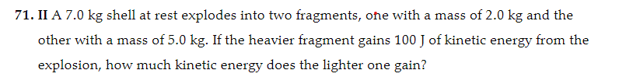
Explosion with2 fragments
8.71

Slide 15
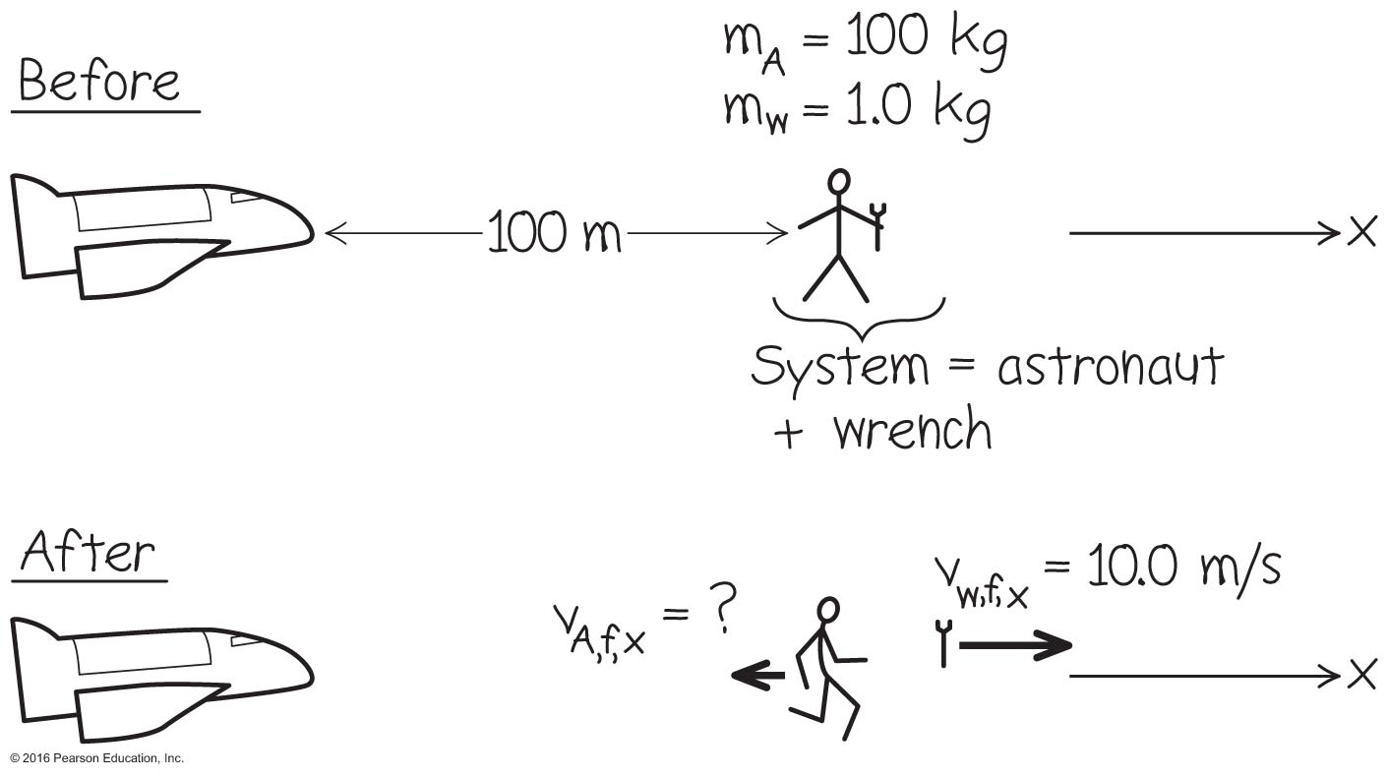
An Astronaut Rescue – Example 8.2
Refer to the worked example on page 227.

Slide 16
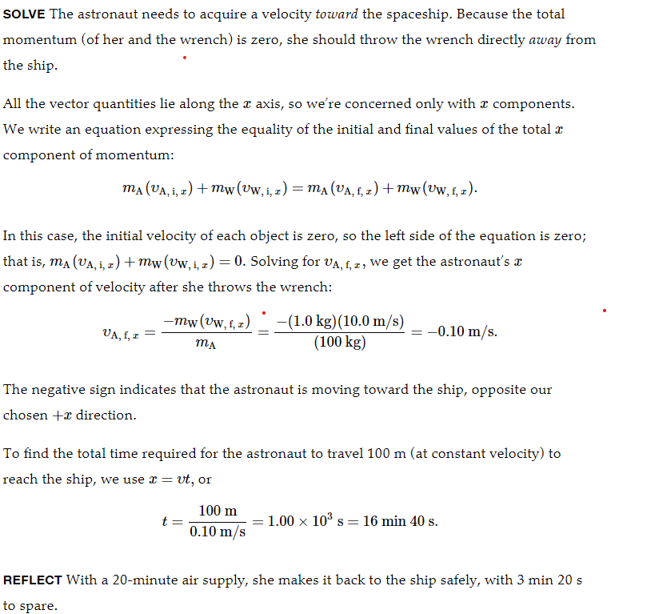
An Astronaut Rescue – Example 8.2

Slide 18
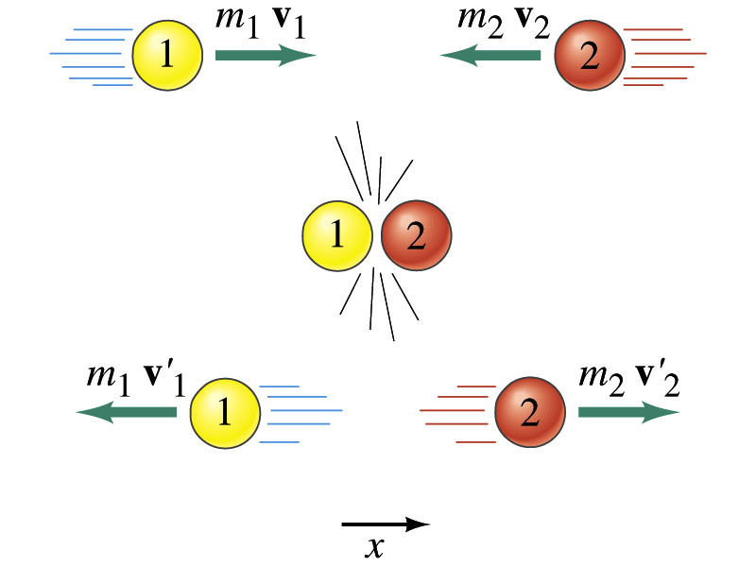
Elastic Collision

Slide 19

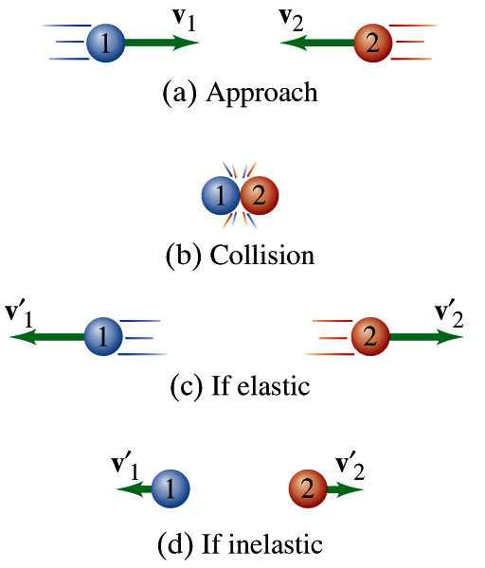
Energy Conservation
Loss of energy as thermal and
other forms of energy

Slide 20
Q8.7
Clicker question
Block A has mass 1.00 kg and block B has mass 3.00 kg. The blocks collide and stick together on a level, frictionless surface. After the collision, the kinetic energy (KE) of block A is
A. one-ninth the KE of block B.
B. one-third the KE of block B.
C. three times the KE of block B.
D. nine times the KE of block B.
E. the same as the KE of block B.
Notes:
Answer: B

Slide 21
Q8.3
Clicker question
A 3.00-kg rifle fires a 0.00500-kg bullet at a speed of 300 m/s. Which force is greater in magnitude: the force that the rifle exerts on the bullet or the force that the bullet exerts on the rifle?
A. The force that the rifle exerts on the bullet is greater.
B. The force that the bullet exerts on the rifle is greater.
C. Both forces have the same magnitude.
D. The answer depends on how the rifle is held.
E. The answer depends on how the rifle is held and on
the inner workings of the rifle.
Notes:
Answer: C

Slide 22
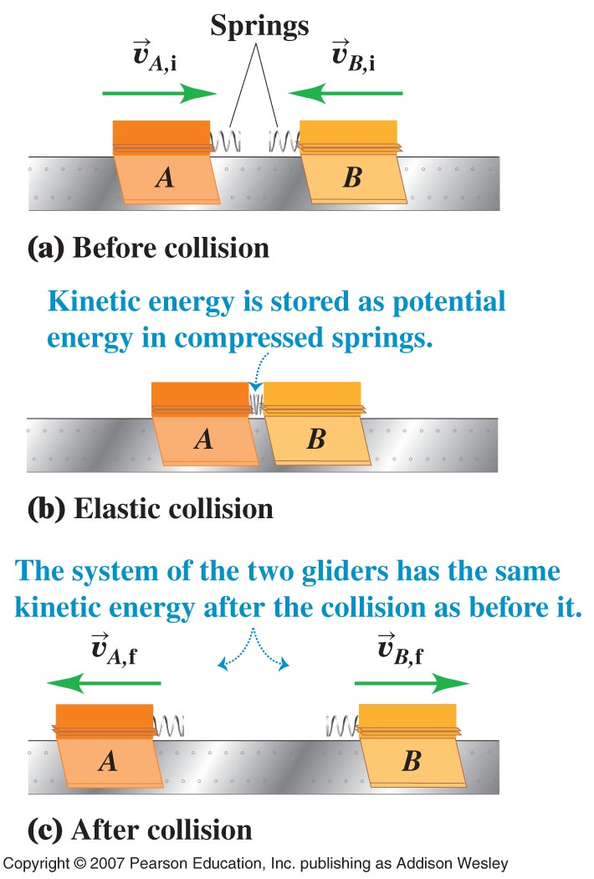
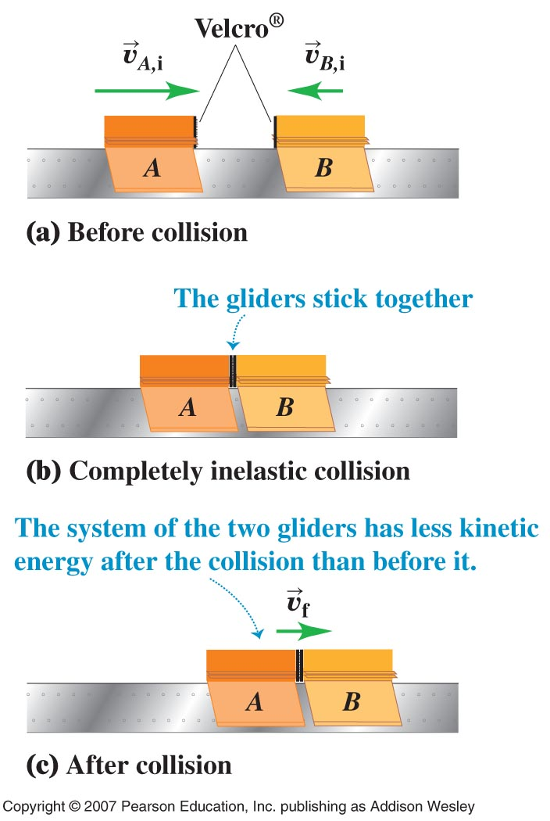
Elastic Collision
Inelastic Collision

Slide 23
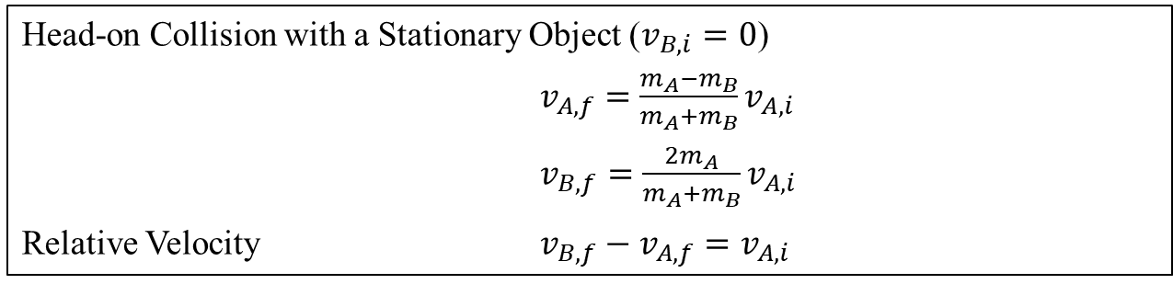
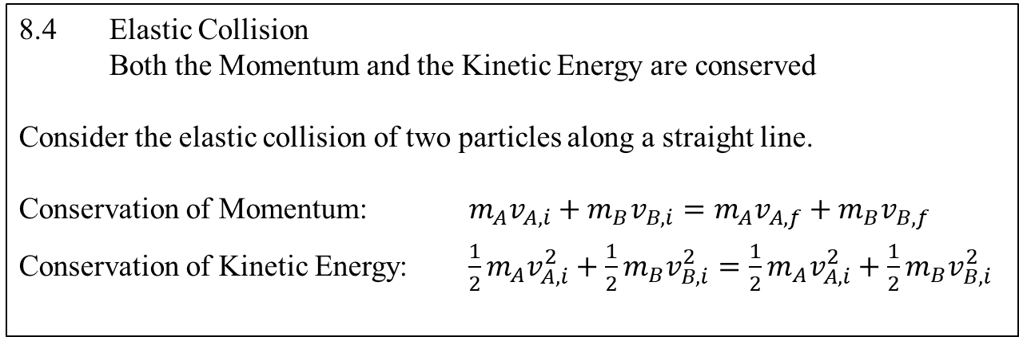
8.4 Elastic Collision
Both the Momentum and the Kinetic Energy are conserved
Consider the elastic collision of two particles along a straight line.
Conservation of Momentum: $m_{A}v_{A,i}+m_{B}v_{B,i}={m_{A}v}_{A,f}+m_{B}v_{B,f}$
Conservation of Kinetic Energy: $\frac{1}{2}m_{A}v_{A,i}^{2}+{\frac{1}{2}m}_{B}v_{B,i}^{2}={\frac{1}{2}m}_{A}v_{A,i}^{2}+{\frac{1}{2}m}_{B}v_{B,i}^{2}$
Head-on Collision with a Stationary Object ($v_{B,i}=0$)
$v_{A,f}=\frac{m_{A}−m_{B}}{m_{A}+m_{B}}v_{A,i}$
$v_{B,f}=\frac{{2m}_{A}}{m_{A}+m_{B}}v_{A,i}$
Relative Velocity $v_{B,f}−v_{A,f}=v_{A,i}$

Slide 24
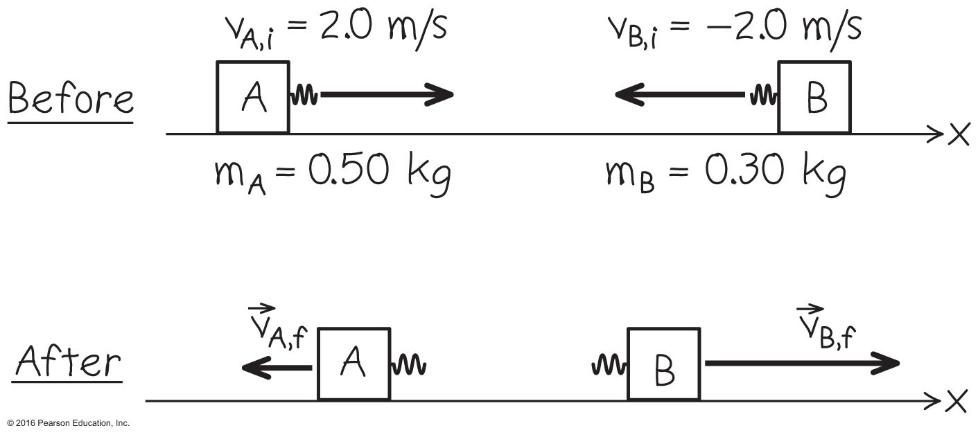
A Solved Air Track Problem – Example 8.9 (no friction)
See the example on page 236. An elastic collision
Special case : m _{A} v _{A} = m _{B} v _{B} K _{f} = K _{A} + K _{B} = U f in the after situation when initially compressed and at rest

Slide 25
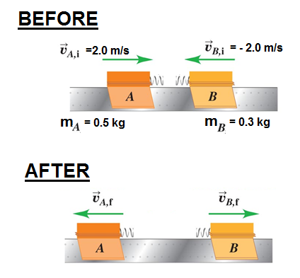
Elastic Collision on a air track

Slide 26
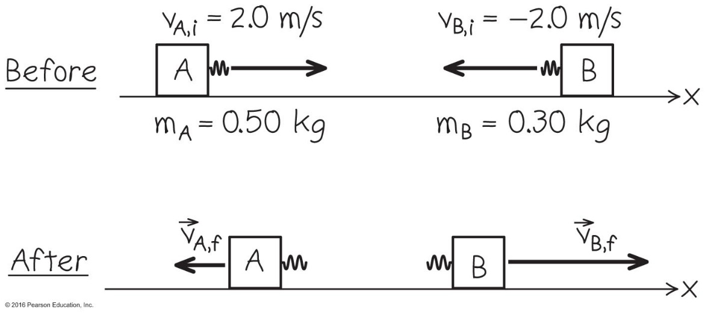
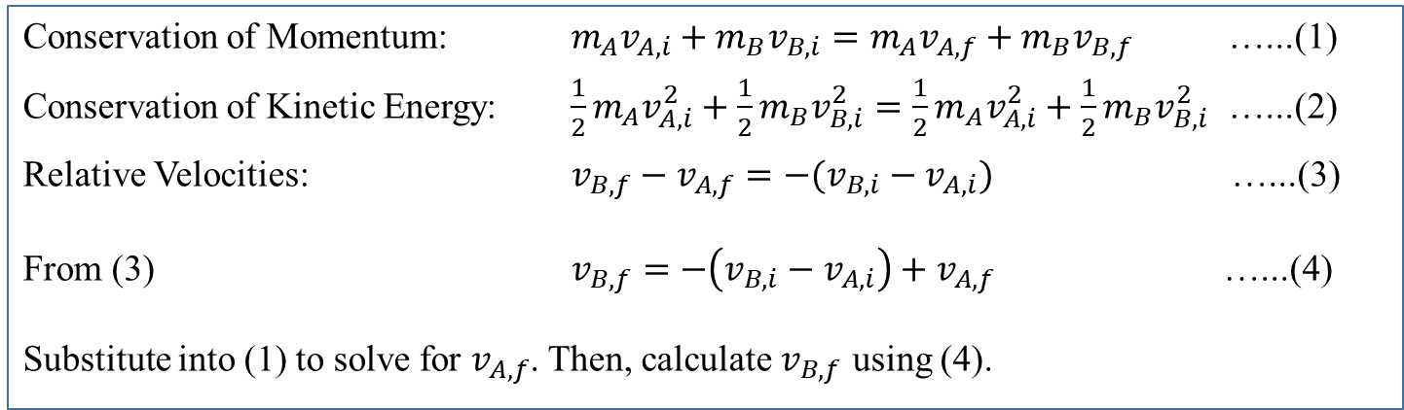
Elastic Collision on an Air Track
– Example 8.9 on page 234
Conservation of Momentum: $m_{A}v_{A,i}+m_{B}v_{B,i}={m_{A}v}_{A,f}+m_{B}v_{B,f}$ …...(1)
Conservation of Kinetic Energy: $\frac{1}{2}m_{A}v_{A,i}^{2}+{\frac{1}{2}m}_{B}v_{B,i}^{2}={\frac{1}{2}m}_{A}v_{A,i}^{2}+{\frac{1}{2}m}_{B}v_{B,i}^{2}$ …...(2)
Relative Velocities: $v_{B,f}−v_{A,f}=−(v_{B,i}−v_{A,i})$ …...(3)
From (3) $v_{B,f}=−\left(v_{B,i}−v_{A,i}\right)+v_{A,f}$ …...(4)
Substitute into (1) to solve for $v_{A,f}$. Then, calculate $v_{B,f}$ using (4).

Slide 27

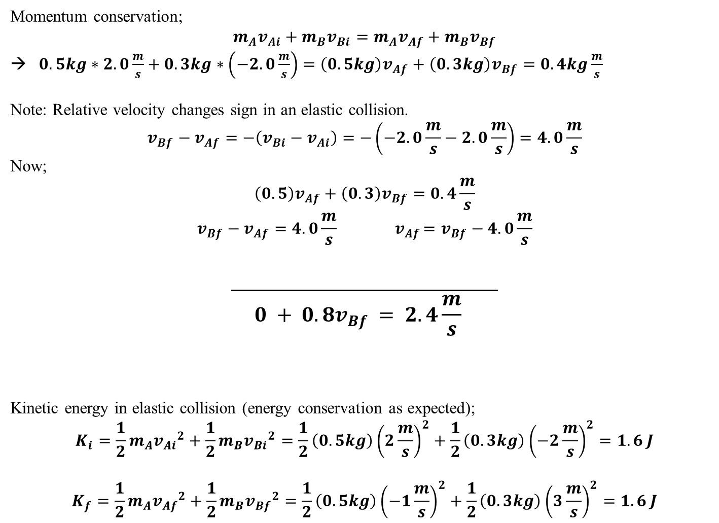
Elastic Collision on an air track
Momentum conservation;
$$m_{A}v_{Ai}+m_{B}v_{Bi}=m_{A}v_{Af}+m_{B}v_{Bf}$$
$0.5kg∗2.0\frac{m}{s}+0.3kg∗\left(−2.0\frac{m}{s}\right)=\left(0.5kg\right)v_{Af}+\left(0.3kg\right)v_{Bf}=0.4kg\frac{m}{s}$
Note: Relative velocity changes sign in an elastic collision.
$$v_{Bf}−v_{Af}=−\left(v_{Bi}−v_{Ai}\right)=−\left(−2.0\frac{m}{s}−2.0\frac{m}{s}\right)=4.0\frac{m}{s}$$
Now;
$$\left(0.5\right)v_{Af}+\left(0.3\right)v_{Bf}=0.4\frac{m}{s}$$
$$v_{Bf}−v_{Af}=4.0\frac{m}{s}{ v}_{Af}=v_{Bf}−4.0\frac{m}{s}$$
$$\overline{ 0 + 0.8v_{Bf} = 2.4\frac{m}{s} }$$
Kinetic energy in elastic collision (energy conservation as expected);
$$K_{i}=\frac{1}{2}m_{A}{v_{Ai}}^{2}+\frac{1}{2}m_{B}{v_{Bi}}^{2}=\frac{1}{2}\left(0.5kg\right){\left(2\frac{m}{s}\right)}^{2}+\frac{1}{2}\left(0.3kg\right){\left(−2\frac{m}{s}\right)}^{2}=1.6 J$$
$$K_{f}=\frac{1}{2}m_{A}{v_{Af}}^{2}+\frac{1}{2}m_{B}{v_{Bf}}^{2}=\frac{1}{2}\left(0.5kg\right){\left(−1\frac{m}{s}\right)}^{2}+\frac{1}{2}\left(0.3kg\right){\left(3\frac{m}{s}\right)}^{2}=1.6 J$$
$$v_{Bf}=\frac{2.4}{0.8}=3\frac{m}{s}$$
$$v_{Af}=−1\frac{m}{s}$$

Slide 28
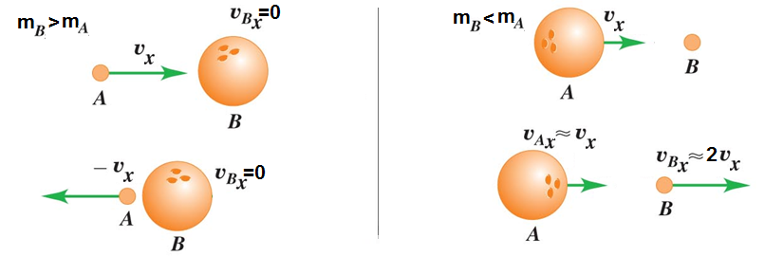
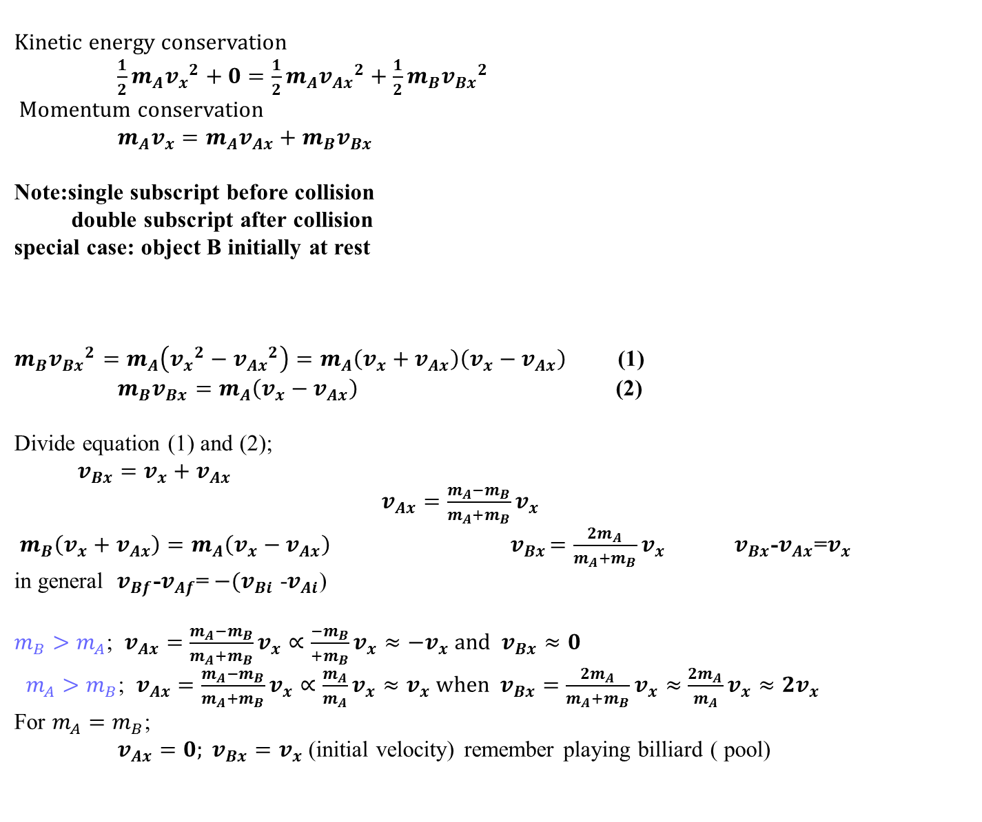
Elastic Collision between different mass balls
Kinetic energy conservation
$\frac{1}{2}m_{A}{v_{x}}^{2}+0=\frac{1}{2}m_{A}{v_{Ax}}^{2}+\frac{1}{2}m_{B}{v_{Bx}}^{2}$
Momentum conservation
$m_{A}v_{x}=m_{A}v_{Ax}+m_{B}v_{Bx}$
Note:single subscript before collision
double subscript after collision
special case: object B initially at rest
$m_{B}{v_{Bx}}^{2}=m_{A}\left({v_{x}}^{2}−{v_{Ax}}^{2}\right)=m_{A}\left(v_{x}+v_{Ax}\right)\left(v_{x}−v_{Ax}\right)$ (1)
$m_{B}v_{Bx}=m_{A}\left(v_{x}−v_{Ax}\right)$ (2)
Divide equation (1) and (2);
$v_{Bx}=v_{x}+v_{Ax}$ $v_{Ax}=\frac{m_{A}−m_{B}}{m_{A}+m_{B}}v_{x}$
$m_{B}\left(v_{x}+v_{Ax}\right)=m_{A}\left(v_{x}−v_{Ax}\right){ v}_{Bx}=\frac{{2m}_{A}}{m_{A}+m_{B}}v_{x}$ $v_{Bx}$-$v_{Ax}$=$v_{x }$ in general $v_{Bf}$-$v_{Af}$=${ −(v}_{Bi }$-$v_{Ai}$)
$m_{B}>m_{A}$; $v_{Ax}=\frac{m_{A}−m_{B}}{m_{A}+m_{B}}v_{x}∝\frac{−m_{B}}{+m_{B}}v_{x}≈−v_{x}$ and $v_{Bx}≈0$
$m_{A}>m_{B}$; $v_{Ax}=\frac{m_{A}−m_{B}}{m_{A}+m_{B}}v_{x}∝\frac{m_{A}}{m_{A}}v_{x}≈v_{x}$ when $v_{Bx}=\frac{{2m}_{A}}{m_{A}+m_{B}}v_{x}≈\frac{{2m}_{A}}{m_{A}}v_{x}≈{2v}_{x}$
For $m_{A}=m_{B}$;
$v_{Ax}=0; v_{Bx}=v_{x}$ (initial velocity) remember playing billiard ( pool)

Slide 29
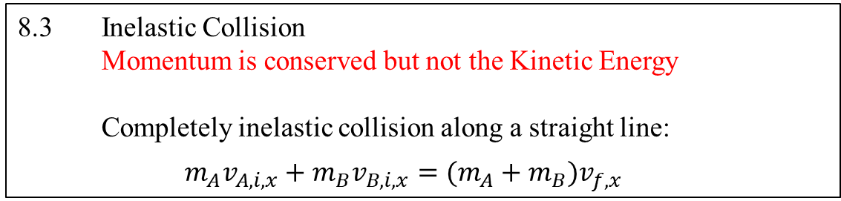
8.3 Inelastic Collision
Momentum is conserved but not the Kinetic Energy
Completely inelastic collision along a straight line:
$m_{A}v_{A,i,x}+m_{B}v_{B,i,x}=(m_{A}+m_{B})v_{f,x}$
Example 8.6 on page 230
Example 8.8 on page 232
Example 8.7 on page 231, and other variations
Courtesy of Wenhao Wu

Slide 30
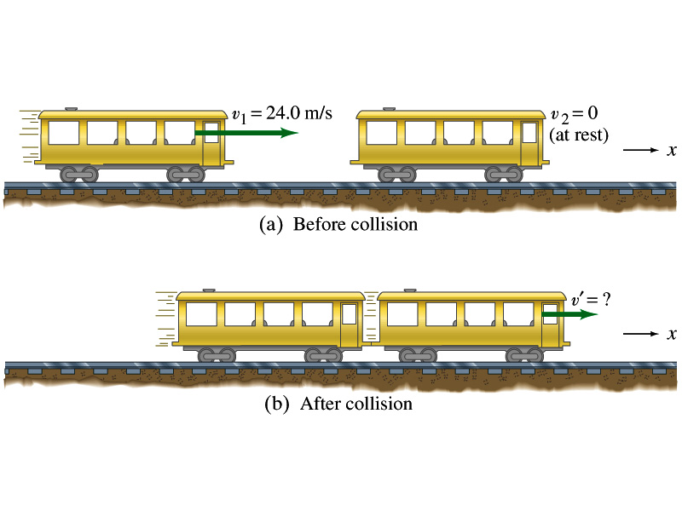
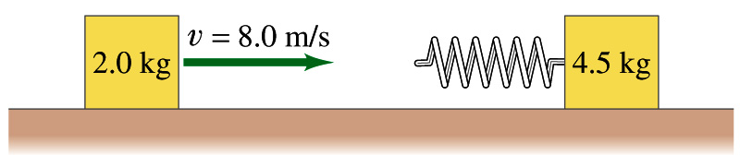
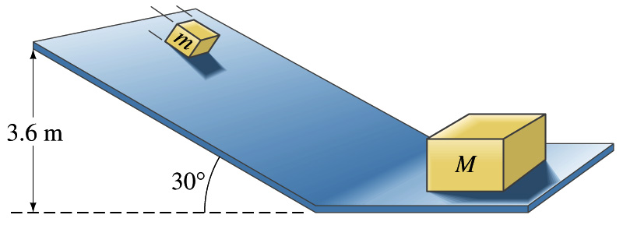
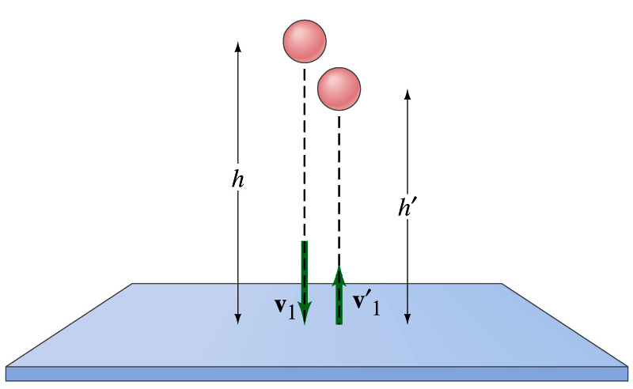
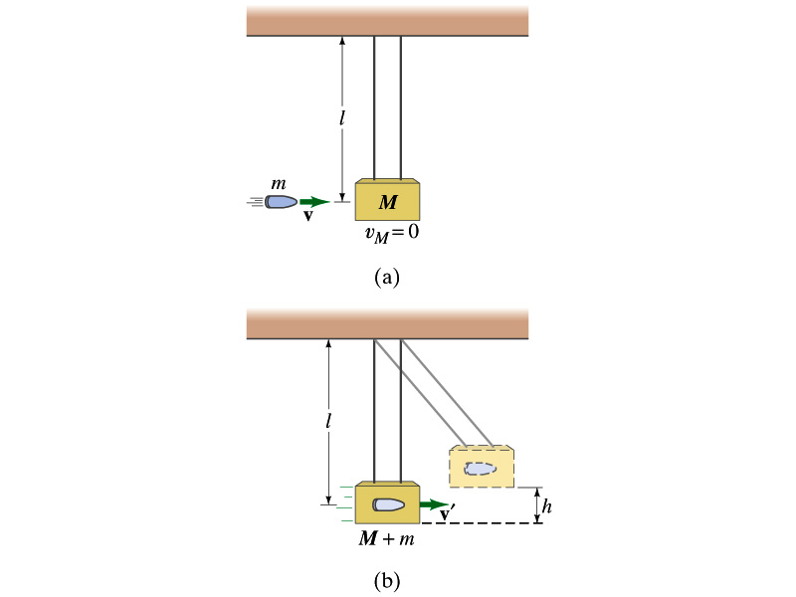
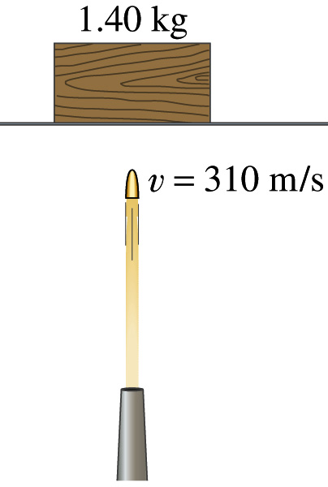
Examples of 1D Collisions Elastic and Inelastic
m
M
M
m

Slide 31
Example 2
Before collision
After collision
(totally inelastic collision)
m v₁ + m v₂ = m v₁’ + m v₂’
v₁’ = v₂’

Slide 32
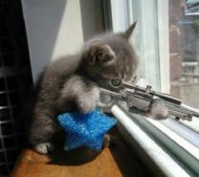
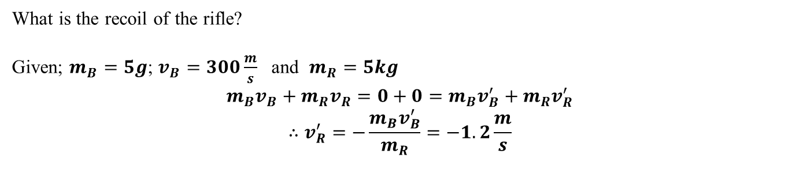
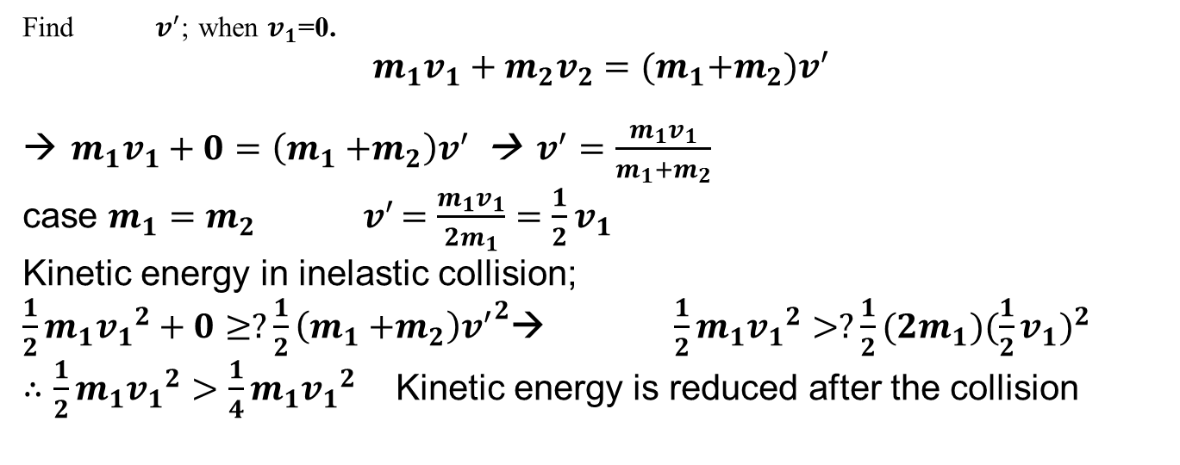
Railroad cars, locking up after the collision
Find${ v}^{′}$; when $v_{1}$=0.
$$m_{1}v_{1}+m_{2}v_{2}=(m_{1}{+m}_{2})v^{′}$$
$m_{1}v_{1}+0=\left(m_{1}{+m}_{2}\right)v^{′}$ → $v^{′}=\frac{m_{1}v_{1}}{m_{1}{+m}_{2}}$
case $m_{1}=m_{2}{ v}^{′}=\frac{m_{1}v_{1}}{2m_{1}}=\frac{1}{2}v_{1}$
Kinetic energy in inelastic collision;
$\frac{1}{2}m_{1}{v_{1}}^{2}+0≥?\frac{1}{2}\left(m_{1}{+m}_{2}\right){v^{′}}^{2}$→ $\frac{1}{2}m_{1}{v_{1}}^{2}>?\frac{1}{2}(2m_{1}){(\frac{1}{2}v_{1})}^{2}$
$∴\frac{1}{2}m_{1}{v_{1}}^{2}>\frac{1}{4}m_{1}{v_{1}}^{2}$ Kinetic energy is reduced after the collision
How to fire a rifle to reduce recoil
What is the recoil of the rifle?
Given; $m_{B}=5g$; $v_{B}=300\frac{m}{s}$ and $m_{R}=5kg$
$$m_{B}v_{B}+m_{R}v_{R}=0+0=m_{B}v_{B}^{′}+m_{R}v_{R}^{′}$$
$$∴v_{R}^{′}=−\frac{m_{B}v_{B}^{′}}{m_{R}}=−1.2\frac{m}{s}$$

Slide 33
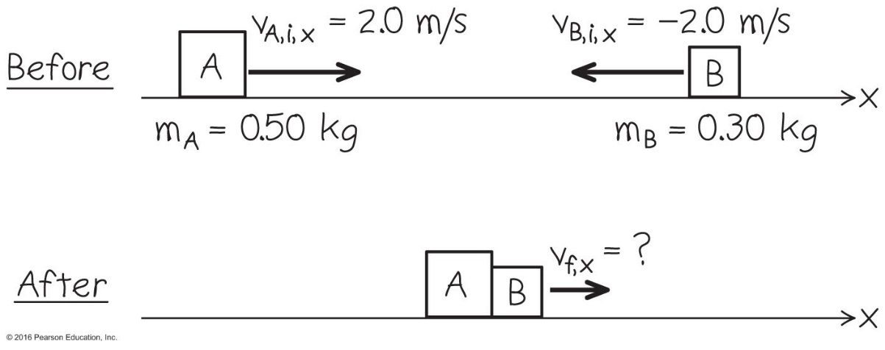
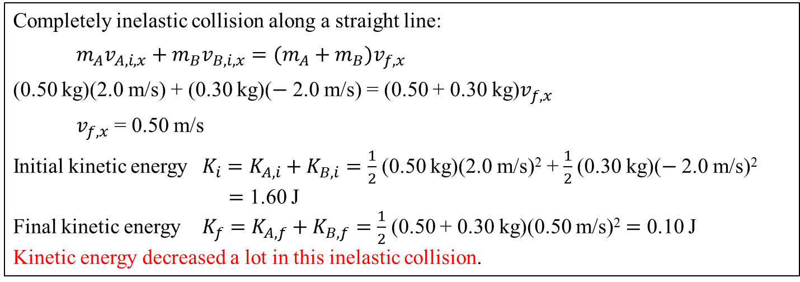
Inelastic Collision
on an Air Track
Example 8.6 on page 230
Completely inelastic collision along a straight line:
$m_{A}v_{A,i,x}+m_{B}v_{B,i,x}=(m_{A}+m_{B})v_{f,x}$
(0.50 kg)(2.0 m/s) + (0.30 kg)($−$ 2.0 m/s) = (0.50 + 0.30 kg)$v_{f,x}$
$v_{f,x}$ = 0.50 m/s
Initial kinetic energy $K_{i}=K_{A,i}+K_{B,i}=\frac{1}{2}$(0.50 kg)(2.0 m/s)² + $\frac{1}{2}$(0.30 kg)($−$2.0 m/s)²
$=$ 1.60 J
Final kinetic energy $K_{f}=K_{A,f}+K_{B,f}=\frac{1}{2}$(0.50 + 0.30 kg)(0.50 m/s)² $=$ 0.10 J
Kinetic energy decreased a lot in this inelastic collision.
Courtesy of Wenhao Wu

Slide 34
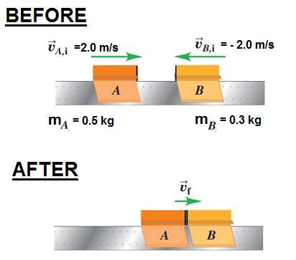
Inelastic Collision on an air track

Slide 35
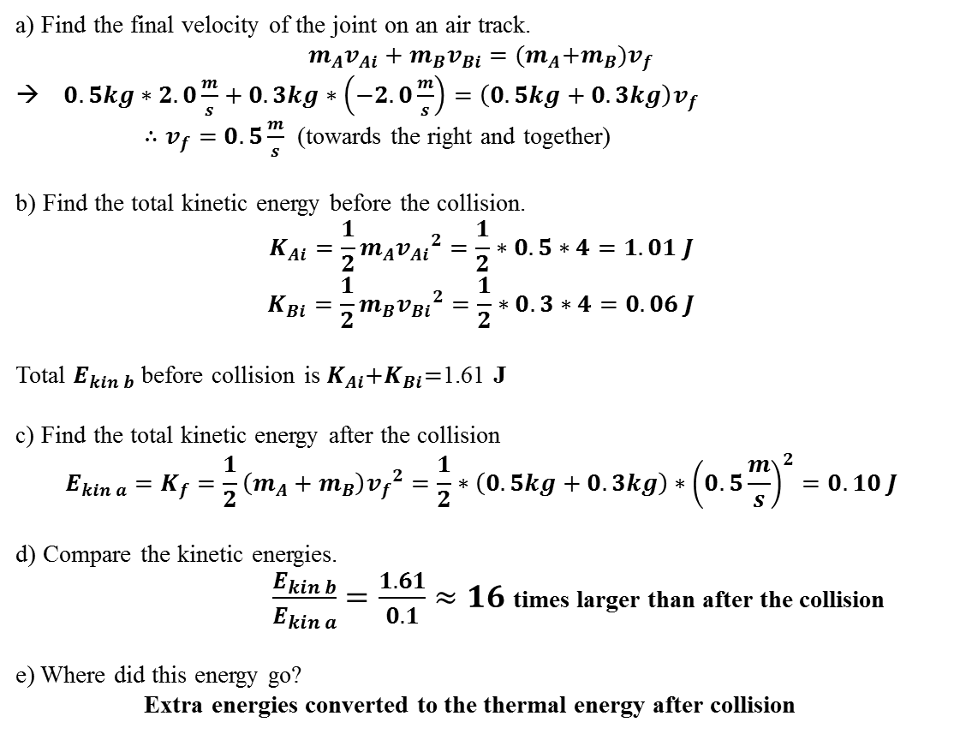
Inelastic Collision on an air track
a) Find the final velocity of the joint on an air track.
$$m_{A}v_{Ai}+m_{B}v_{Bi}={(m}_{A}+m_{B})v_{f}$$
$0.5kg∗2.0\frac{m}{s}+0.3kg∗\left(−2.0\frac{m}{s}\right)=\left(0.5kg+0.3kg\right)v_{f}$
$∴v_{f}=0.5\frac{m}{s}$ (towards the right and together)
b) Find the total kinetic energy before the collision.
$$K_{Ai}=\frac{1}{2}m_{A}{v_{Ai}}^{2}=\frac{1}{2}∗0.5∗4=1.01 J$$
$$K_{Bi}=\frac{1}{2}m_{B}{v_{Bi}}^{2}=\frac{1}{2}∗0.3∗4=0.06 J$$
Total $E_{kin b}$ before collision is $K_{Ai}{+K}_{Bi}=$1.61 J
c) Find the total kinetic energy after the collision
$$E_{kin a}=K_{f}=\frac{1}{2}\left(m_{A}+m_{B}\right){v_{f}}^{2}=\frac{1}{2}∗\left(0.5kg+0.3kg\right)∗{\left(0.5\frac{m}{s}\right)}^{2}=0.10 J$$
d) Compare the kinetic energies.
$\frac{E_{kin b}}{E_{kin a}}=\frac{1.61}{0.1}≈16$ times larger than after the collision
e) Where did this energy go?
Extra energies converted to the thermal energy after collision

Slide 36
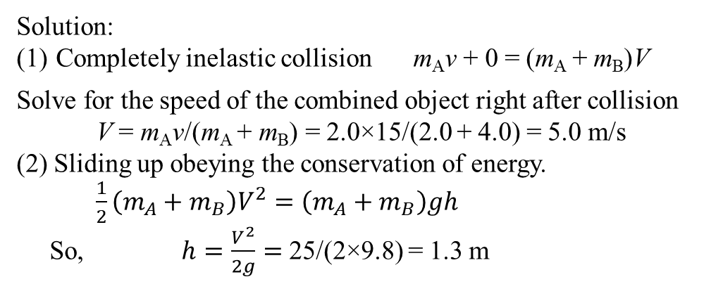
Box A of mass m_{A} = 2.0 kg is sliding at 15 m/s on a horizontal surface. It collides with and
sticks to Box B of mass m_{A} = 4.0 kg that is initially at rest on the horizontal surface. The
combined object then slides up an incline. There is no friction for any of the surfaces.
Find:
(a) the speed of the combined object right after the collision;
(b) the height above the horizontal surface the combined object reaches before sliding down.
Solution:
Completely inelastic collision m_{A}v + 0 = (m_{A} + m_{B})V
Solve for the speed of the combined object right after collision
V = m_{A}v/(m_{A} + m_{B}) = 2.0×15/(2.0 + 4.0) = 5.0 m/s
(2) Sliding up obeying the conservation of energy.
$\frac{1}{2}\left(m_{A}+m_{B}\right)V^{2}=$ $\left(m_{A}+m_{B}\right)gh$
So, $h=\frac{V^{2}}{2g}=$ 25/(2×9.8) = 1.3 m
15 m/s
A
B
Courtesy of Wenhao Wu

Slide 37
Q8.5
Clicker question
Two objects with different masses collide with and stick to each other. Compared to before the collision, the system of two objects after the collision has
A
B
A. the same amount of total momentum and the same total
kinetic energy.
B. the same amount of total momentum but less total kinetic
energy.
C. less total momentum but the same amount of total kinetic
energy.
D. less total momentum and less total kinetic energy.
E. Not enough information is given to decide.
Notes:
Answer: B

Slide 38
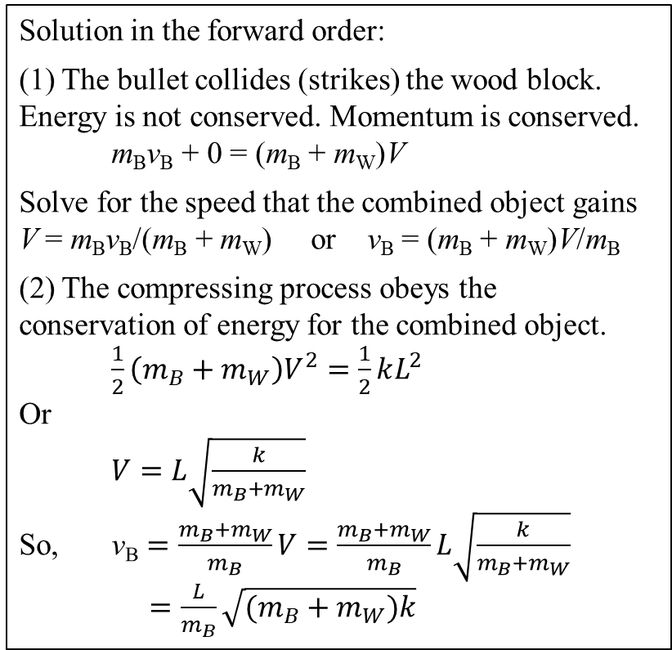
Bullet shot into a block of wood attached to a spring
Solution in the forward order:
(1) The bullet collides (strikes) the wood block. Energy is not conserved. Momentum is conserved.
m_{B}v_{B} + 0 = (m_{B} + m_{W})V
Solve for the speed that the combined object gains
V = m_{B}v_{B}/(m_{B} + m_{W}) or v_{B} = (m_{B} + m_{W})V/m_{B}
(2) The compressing process obeys the conservation of energy for the combined object.
$\frac{1}{2}\left(m_{B}+m_{W}\right)V^{2}=\frac{1}{2}kL^{2}$
Or
$V=L\sqrt{\frac{k}{m_{B}+m_{W}}}$
So, $\text{v}\text{B}=\frac{m_{B}+m_{W}}{m_{B}}V=\frac{m_{B}+m_{W}}{m_{B}}L\sqrt{\frac{k}{m_{B}+m_{W}}}$
$=\frac{L}{m_{B}}\sqrt{(m_{B}+m_{W})k}$
A bullet of unknown horizontal speed is shot into a block of wood attached to a spring which is initially at equilibrium. The bullet stuck in the wood block and together they compress the spring an amount L. Find the speed of the bullet before it strikes the wood block.
Given: m_{B}, m_{W}, L and spring constant k. Find: v_{B}
Comment: Solve this in either the forward or the backward order.
Courtesy of Wenhao Wu

Slide 39
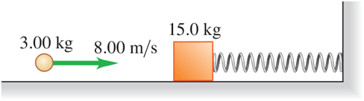
8.19
II Combining conservation laws. A 15.0 kg block is attached to a very light horizontal spring of force constant k = 500 N/m and is resting on a frictionless horizontal table. (See Figure 8.40.) Suddenly it is struck by a 3.00 kg stone traveling horizontally at to the right, whereupon the stone rebounds at horizontally to the left. Find the maximum distance that the block will compress the spring after the collision. (Hint: Break this problem into two parts—the collision and the behavior after the collision—and apply the appropriate conservation law to each part.)

Slide 40

Clicker question
Q8.8
Block A on the left has mass 1.00 kg. Block B on the right has mass 3.00 kg. The blocks are forced together, compressing the spring. Then the system is released from rest on a level, frictionless surface. After the blocks are released, how does p_{A} (the magnitude of momentum of block A) compare to p_{B} (the magnitude of momentum of block B)?
A. p_{A} = p_{B}/9
B. p_{A} = p_{B}/3
C. p_{A} = p_{B}
D. p_{A} = 3p_{B}
E. p_{A} = 9p_{B}
Notes:
Answer: C

Slide 41
Clicker question
Q8.9
Block A on the left has mass 1.00 kg. Block B on the right has mass 3.00 kg. The blocks are forced together, compressing the spring. Then the system is released from rest on a level, frictionless surface. After the blocks are released, how does K_{A} (the kinetic energy of block A) compare to K_{B} (the kinetic energy of block B)?
A. K_{A} = K_{B}/9
B. K_{A} = K_{B}/3
C. K_{A} = K_{B}
D. K_{A} = 3K_{B}
E. K_{A} = 9K_{B}
Notes:
Answer: D

Slide 42

I Three identical boxcars are coupled together and are moving at a constant speed of 20 m/s on a level track. They collide with another identical boxcar that is initially at rest and couple to it, so that the four cars roll on as a unit. Friction is small enough to be ignored. (a) What is the speed of the four cars? (b) What percentage of the kinetic energy of the boxcars is dissipated in the collision? What happened to this energy?

Slide 43
II A hungry 11.5 kg predator fish is coasting from west to east at when it suddenly swallows a 1.25 kg fish swimming from north to south at Find the magnitude and direction of the velocity of the large fish just after it snapped up this meal. Ignore any effects due to the drag of the water.

Slide 45


The Ballistic Pendulum
– Example 8.7 on page 233
A bullet of unknown horizontal speed is shot into a block of wood suspended from the ceiling. The bullet stuck in the wood block and together they swing up by an amount h. Find the speed of the bullet before it strikes the wood block.
Given: m_{B}, m_{W}, and h. Find: v
Comment: Solve this in either the forward or the backward order.
Solution in the forward order:
(1) The bullet collides (strikes) the wood block. Energy is not conserved, but momentum is conserved.
m_{B}v + 0 = (m_{B} + m_{W})V
Solve for the speed that the combined object gains
V = m_{B}v/(m_{B} + m_{W}) or v = (m_{B} + m_{W})V/m_{B}
(2) The swing-up process obeys the conservation of energy for the combined object.
$\frac{1}{2}\left(m_{B}+m_{W}\right)V^{2}=$ $\left(m_{B}+m_{W}\right)gh$
So, $v=\frac{m_{B}+m_{W}}{m_{B}}V=\frac{m_{B}+m_{W}}{m_{B}}\sqrt{2gh}$
y
o

Slide 46
Ballistic Pendulum
Express v and v’ in terms of
m, M, g, and h.
  (A) mv = (m+M) v’
  (B) K₁+U_{g1} = K₂+U_{g2}
(A) Momentum Conservation
2
1
(B) Energy Conservation

Slide 47
Ballistic Pendulum (cont.)
A bullet of mass m and velocity V_{o} plows into a block of wood with mass M which is part of a pendulum.
  How high, h, does the block of wood go?
  Is the collision elastic or inelastic?
Two parts: 1-collision (momentum is conserved)
2-from low point (after collision) to high point: conservation of energy
1st part:
2nd part:

Slide 48


Ballistic Pendulum numerical example
Obtain $v_{x}$ from the height of the ballistic pendulum swing?
(Unknowns are $v_{x}$ and $V_{x}$ ) (Given $m=0.005kg$ and $M=2kg$ )
Momentum conservation. ($v_{w}=0$)
$$mv_{x}+Mv_{w}=(m+M)V_{x}$$
$$∴v_{x}=\frac{m+M}{m}V_{x}$$
Conservation of energy.
$\frac{1}{2}\left(M+m\right){V_{x}}^{2}=\left(m+M\right)gh$
→$V_{x}=\sqrt{2gh}=0.767\frac{m}{s}$
$$∴v_{x}=\frac{m+M}{m}\sqrt{2gh}=307\frac{m}{s}$$
Energy of bullet;
$$K_{bullet}=\frac{1}{2}m{v_{x}}^{2}=236J$$
Energy of bullet and block;
$$K_{bullet}=\frac{1}{2}\left(m+M\right){V_{x}}^{2}=0.6J$$

Slide 49

Collision In a Horizontal Plane –
Example 8.5
Refer to the worked example on page 227.

Slide 50


A bullet is fired into a wooden block, which slides to a certain distance and then comes to rest due to friction. What is the velocity of the bullet $v_{x}$ ?
(Given $μ=0.2$, $m=0.005kg$, $h=0.23m$ and $M=1.2kg$ ) $V_{x}$=velocity of (M+m) right after the collision
Momentum conservation. ($v_{w}=0$)
$$mv_{x}+Mv_{w}=(m+M)V_{x}$$
$∴v_{x}=\frac{m+M}{m}V_{x}$ and $F_{N}=μ\left(m+M\right)g$
Conservation of energy.
$\frac{1}{2}\left(M+m\right){V_{x}}^{2}=F_{N}h=μ\left(m+M\right)gh$
→$V_{x}=\sqrt{2μgh}$
$$∴v_{x}=\frac{m+M}{m}\sqrt{2μgh}=229\frac{m}{s}$$

Slide 51


Example 8.8 Accident analysis
Conservation of momentum
(Given $m_{A}=1000kg$, $m_{B}=2000kg$, $v_{Ax}=0$ and $v_{Bx}=10\frac{m}{s}$)
$$P_{x}=P_{Ax}+P_{Bx}=m_{A}v_{Ax}+m_{B}v_{Bx}=2x{10}^{4}kg\frac{m}{s}$$
$$P_{y}=P_{Ay}+P_{By}=m_{A}v_{Ay}+m_{B}v_{By}=1000∗15+0=1.5x{10}^{4}kg\frac{m}{s}$$
→$P=\sqrt{{(P_{x})}^{2}+{(P_{y})}^{2}}=2.5x{10}^{4}kg\frac{m}{s}$
→ $\tan{θ}=\frac{P_{y}}{P_{x}}=\frac{1.5}{2.0}=0.75$ and $θ={37}^{o}$
$∴P=\left(m_{A}+m_{B}\right)V→V=\frac{P}{m_{A}+m_{B}}=8.3\frac{m}{s}$ (Velocity of wreckage)

Slide 52

Different Masses – Example 8.8
Incoming and outgoing velocities are very mass dependent.
.

Slide 53



Slide 54



Throwing a package overboard
(Given: $m_{package}=5.4kg$, $v_{package}=10\frac{m}{s}$, $m_{child}=26kg$ and $m_{boat}=55kg$ )
$$0=\left(m_{boat}+m_{child}\right)v_{boat}+m_{package}v_{package}=\left(55+26\right)∗v_{boat}+5.4∗10$$
$$∴v_{boat}=0.667\frac{m}{s}$$
Find speed and rebound height
Find the speed of the blocks after collision. (assume elastic collision). How far up does the smaller block go (rebound height)? (Given $θ={30}^{o}$, $m=2.2kg$, $h=3.6m$ and $M=7kg$ )
Energy and Momentum conservation ($∴v_{2}=0\frac{m}{s}$)
$\frac{1}{2}m{v_{1}}^{2}=mgh$ → $v_{1}=\sqrt{2gh}=\sqrt{2∗9.8∗3.6}=8.4\frac{m}{s}$ (speed of small block before collision)
$$mv_{1}+Mv_{2}=mv_{1}^{′}+Mv_{2}^{′}→2.2∗8.4+7∗0=2.2∗v_{1}^{′}+7∗v_{2}^{′}$$
$$v_{1}+v_{2}=−\left(v_{1}^{′}−v_{2}^{′}\right)→8.4−0=v_{2}^{′}−v_{1}^{′}$$
$∴v_{2}^{′}=4.02\frac{m}{s}$ and $v_{1}^{′}=−4.38\frac{m}{s}$
Rebound height
$∴{v_{1}^{′}}^{2}=2gh^{′}→{(−4.38)}^{2}=2∗9.8∗h^{′}$
→ $h^{′}=0.79 m$ and $d=\frac{h^{′}}{\sin{θ}}=1.96m$

Slide 56


Impulsive Force
[Example] an impulsive force on
a baseball that is struck with a bat
has:
<F> ~ 5000 N & Δt ~ 0.01 s
Very large magnitude
Impulsive Force
Very short time
[Note] The “impulse’’ concept
is most useful for impulsive
forces.

Slide 57

A golf shot
A large force applied for a very short duration, such as a golf shot, is often described as the club giving the ball an impulse.

Slide 58

Q8.1
A ball (mass 0.40 kg) is initially moving to the left at 30 m/s. After hitting the wall, the ball is moving to the right at 20 m/s. What is the impulse of the net force on the ball during its collision with the wall?
A. 20 kg • m/s to the right
B. 20 kg • m/s to the left
C. 4.0 kg • m/s to the right
D. 4.0 kg • m/s to the left
E. none of the above
J_{x} = Δp_{x} = p_{f,x} – p_{i,x}
= mv_{f,x} – mv_{i,x}
= 0.40 (20)-0.40(-30)
=8+12=20 kg m/s
to the right
Notes:
Answer: A

Slide 59

Impulse-Momentum Theorem
|J |

Slide 60


8.5 Impulse
When a constant force $\overset{⃑}{F}$ acts on an object over a period of time $∆t$, the impulse of the force is
$\overset{⃑}{J}=\overset{⃑}{F}\left(t_{f}−t_{i}\right)=\overset{⃑}{F}∆t$
If the force is not a constant, then $\overset{⃑}{J}={\overset{⃑}{F}}_{avg}∆t$
Since ${\overset{⃑}{F}}_{avg}=m{\overset{⃑}{a}}_{avg}=m\frac{∆\overset{⃑}{v}}{∆t}=\frac{∆\overset{⃑}{p}}{∆t}$,
we have $\overset{⃑}{J}=∆\overset{⃑}{p}={\overset{⃑}{p}}_{f}−{\overset{⃑}{p}}_{i}$

Slide 61


Example 8.11 on page 237
Impulse and Duration of the Impact
Given: m = 0.40 kg
v_{i,x} = $−$ 30 m/s
v_{f,x} = 20 m/s
contact time Δt = 0.010 s
Find: Average force F_{avg}.
Solution:
Impulse is equal to change in momentum
J_{x} = Δp_{x} = p_{f,x} – p_{i,x}
= mv_{f,x} – mv_{i,x}
= 0.40($2$0) $−$ 0.40($−3$0)
= 20 kgm/s
Average force
F_{avg} = J_{x}/Δt = (20 kgm/s)/(0.010 s)
= 2000 N

Slide 62


Kicking a soccer ball
Find the impulse and the average force on the ball, assuming a collision time $∆t=0.01s=10ms$
a) Given; $v_{ix}=−20\frac{m}{s}$ and $v_{iy}=0\frac{m}{s}$
$v_{fx}=v_{fy}=v_{f}\cos{45}=30∗0.7=21\frac{m}{s}$
$$J_{x}=m\left(v_{fx}+v_{ix}\right)=0.4\left(21−\left(−20\right)\right)=16.4 kg\frac{m}{s}$$
$$J_{y}=m\left(v_{fy}+v_{iy}\right)=0.4\left(21−0\right)=8.4 kg\frac{m}{s}$$
b) The components of the average force on the ball
$$F_{av,x}=\frac{J_{x}}{∆t}=\frac{16.4}{{10}^{−2}}=1640N$$
$$F_{av,y}=\frac{J_{y}}{∆t}=\frac{8.4}{{10}^{−2}}=840N$$
→ $F_{av}=\sqrt{{1640}^{2}+{840}^{2}}=1.8x{10}^{3}N$
$$∴θ=\tan^{−1}{\frac{840}{1640}}={27}^{o}$$
red is for a 1D problem

Slide 63


Bend your legs while landing
Given; m=70kg and h=3m
What is the velocity just before landing?
$$K_{1}+U_{1}=K_{2}+U_{2}$$
$$K_{1}−K_{2}=U_{2}−U_{1}$$
→ $\frac{1}{2}m{v_{1}}^{2}−\frac{1}{2}m{v_{2}}^{2}=\frac{1}{2}m{v_{1}}^{2}−0=−mg\left(y−y_{o}\right)=mgh$ ($v_{1}$ is landing velocity)
$$∴v_{1}=\sqrt{2gh}=\sqrt{2∗9.8∗3}=7.7\frac{m}{s}$$
What is the impulse during landing?
$J=F∙∆t=∆P=P_{f}−P_{i}=−70kg∗7.7\frac{m}{s}=−540N.s$
What is the average force while landing?
Stiff- legged: Total displacement of body during landing is d=1cm
$∆t=\frac{d}{v_{1}}=\frac{{10}^{−2}}{7.7}=1.3x{10}^{−3}s$ and $F=\frac{J}{∆t}=\frac{540}{1.3x{10}^{−3}}=4.15x{10}^{5}N$
Soft (bent) -legged: Total displacement of body during landing is d=0.5m
$∆t=\frac{d}{v_{1}}=\frac{0.5}{7.7}=0.065 s$ and $F=\frac{J}{∆t}=\frac{540}{0.065}=8.32x{10}^{3}N$
The average force is about 50 times less for the bent landing.

Slide 64

Impulse and force
8.39

Slide 65

Notes:
Figure 8.22

Slide 66
Q8.2
Clicker question
You are testing a new car using crash test dummies. Consider two ways to slow the car from 90 km/h (56 mi/h) to a complete stop:
(i) You let the car slam into a wall, bringing it to a sudden stop.
(ii) You let the car plow into a giant tub of gelatin so that it comes
to a gradual halt.
In which case is there a greater impulse of the net force on the car?
A. In case (i).
B. In case (ii).
C. The impulse is the same in both cases.
D. The answer depends on how rigid the front of the car is.
E. The answer depends on how rigid the front of the car is
and on the mass of the car.
Notes:
Answer: C

Slide 67
When you catch a softball, you reduce the impact by letting your hand move backward during the catch. This works mainly because
Clicker question
you increase the time over which the ball slows.
you reduce the ball's speed relative to your glove.
you reduce the impulse delivered to your glove.
The term "impulse" is also used to refer to a fast-acting force or impact.
Notes:
Answer: a) you increase the time over which the ball slows.

Slide 68
Center of Mass (CM)
What is the “Center of Mass?”
More importantly “Why do we care?”
This is a special point in space where “it’s as if the object could be replaced by all the mass at that one little point”

Slide 69
How do you calculate CM?
Pick an origin
Look at each “piece of mass” and figure out how much mass it has and how far it is (vector displacement) from the origin. Take mass times position
Add them all up and divide out by the sum of the masses
The center of mass is a displacement vector “relative to some origin”

Slide 70

8.6 Center of Mass
● For a shape with a simple symmetry, we can easily understand where the center of the object is. This is also the center of mass for the shape.

Slide 71




Center of Mass Position
● General definition of the center of mass position:
Vector form ${\overset{⃑}{r}}_{cm}=\frac{{m_{A}\overset{⃑}{r}}_{A}+{m_{B}\overset{⃑}{r}}_{B}+{m_{C}\overset{⃑}{r}}_{C}+…}{m_{A}+m_{B}+m_{C}+…}$
Component form $x_{cm}=\frac{m_{A}x_{A}+m_{B}x_{B}+m_{C}x_{C}+…}{m_{A}+m_{B}+m_{C}+…}$
$y_{cm}=\frac{m_{A}y_{A}+m_{B}y_{B}+m_{C}y_{C}+…}{m_{A}+m_{B}+m_{C}+…}$
y
$${\overset{⃑}{r}}_{A}$$
$${\overset{⃑}{r}}_{C}$$
o
x
$${\overset{⃑}{r}}_{B}$$

Slide 72


Center of Mass Velocity
Vector form ${\overset{⃑}{v}}_{cm}=\frac{{m_{A}\overset{⃑}{v}}_{A}+{m_{B}\overset{⃑}{v}}_{B}+{m_{C}\overset{⃑}{v}}_{C}+…}{m_{A}+m_{B}+m_{C}+…}$
Component form $v_{cm}=\frac{m_{A}v_{A,x}+m_{B}v_{B,x}+m_{C}v_{C,x}+…}{m_{A}+m_{B}+m_{C}+…}$
$v_{cm}=\frac{m_{A}v_{A,y}+m_{B}v_{B,y}+m_{C}v_{C,y}+…}{m_{A}+m_{B}+m_{C}+…}$
Total Momentum of the System
$\overset{⃑}{P}={m_{A}\overset{⃑}{v}}_{A}+{m_{B}\overset{⃑}{v}}_{B}+{m_{C}\overset{⃑}{v}}_{C}+…$
$=(m_{A}+m_{B}+m_{C}+…)$ $\frac{{m_{A}\overset{⃑}{v}}_{A}+{m_{B}\overset{⃑}{v}}_{B}+{m_{C}\overset{⃑}{v}}_{C}+…}{m_{A}+m_{B}+m_{C}+…}$
$=M{\overset{⃑}{v}}_{cm}$
Courtesy of Wenhao Wu

Slide 73

Motion of center of mass

Slide 74




CM Position (2D)
m₃
y_{cm} = 0.50 m
X
m₁ + m₂
X
m₁
x_{cm} = 1.33 m
m₂ + m₃

Slide 75


Quarreling pets
Example 8.13
on page 242
$x_{cm}=\frac{m_{c}x_{c}+m_{d}x_{d}}{m_{c}+m_{d}}=\frac{2.0×1.0+3.0×2.0}{2.0+3.0}=1.6 m$
$v_{cm,x}=\frac{m_{c}v_{c}+m_{d}v_{d}}{m_{c}+m_{d}}=\frac{2.0×3.0+3.0×(−1.0)}{2.0+3.0}=0.6 m/s$
$P_{x}=Mv_{cm,x}=\left(m_{c}+m_{d}\right)v_{cm,x}=\left(2.0+3.0\right)×0.6=3.0 kgm/s$
or
$P_{x}=m_{c}v_{c}+m_{d}v_{d}=2.0×3.0+3.0×\left(−1.0\right)=3.0kgm/s$
Coutesy of Wenhao Wu

Slide 76

8.7 Motion of the Center of Mass
Center of Mass Acceleration ${\overset{⃑}{a}}_{cm}=\frac{{m_{A}\overset{⃑}{a}}_{A}+{m_{B}\overset{⃑}{a}}_{B}+{m_{C}\overset{⃑}{a}}_{C}+…}{m_{A}+m_{B}+m_{C}+…}$
${M\overset{⃑}{a}}_{cm}={m_{A}\overset{⃑}{a}}_{A}+{m_{B}\overset{⃑}{a}}_{B}+{m_{C}\overset{⃑}{a}}_{C}+…$
$={ (\overset{⃑}{F}}_{A,ext}+{\overset{⃑}{F}}_{A,int})+{ (\overset{⃑}{F}}_{B,ext}+{\overset{⃑}{F}}_{B,int})+{ (\overset{⃑}{F}}_{C,ext}+{\overset{⃑}{F}}_{C,int})+…$
$=\sum{{ \overset{⃑}{F}}_{ext}}+\sum{{ \overset{⃑}{F}}_{int}}=\sum{{ \overset{⃑}{F}}_{ext}}$
Newton’s Second Law applied to the center of mass motion:
$\sum{{ \overset{⃑}{F}}_{ext}}={M\overset{⃑}{a}}_{cm}$
Since $\overset{⃑}{P}=M{\overset{⃑}{v}}_{cm}$, if $\sum{{ \overset{⃑}{F}}_{ext}}=0$, then ${\overset{⃑}{a}}_{cm}=0$, or, $\overset{⃑}{P}=M{\overset{⃑}{v}}_{cm}=$ constant
Conservation of Momentum
Courtesy of Wenhao Wu

Slide 77

Center of mass
Center of Mass (c.m. or CM)
The overall motion of a mechanical system
can be described in terms of a special point called “center of mass” of the system:

Slide 78

The center of mass is marked with a white dot
If the sum of the external forces is zero, then the acceleration of the CM is zero
Notes:
Figure 8.26

Slide 79

Notes:
Chapter Summary 8.5

Slide 80

Total momentum in terms of mass
Motion of center of mass

Slide 81



Summary of chapter 8
Momentum $\vec{p}=m\vec{v}$ → $[kg\frac{m}{s}]$ or [N.s]
Impulse $Δp=FΔt$ =F ( $t_{f}$ -$t_{i} )$= $J$
Force-momentum relation $\frac{d}{dt}\vec{P}=m\frac{d\vec{v}}{dt}=m\vec{a}=\vec{F}$
Elastic Collision $K_{1i}+K_{2i}=K_{1f}+K_{2f}$
Inelastic Collision $K_{1i}+K_{2i}=K_{1f}+K_{2f}+Q$
Here; $Q$ is other forms of energy
Both elastic and inelastic collisions conserve momentum
Elastic Collision $\vec{P_{1}}+\vec{P_{2}}=\vec{P_{1}^{′}}+\vec{P_{2}^{′}}→m_{1}v_{1}+m_{2}v_{2}=m_{1}^{′}v_{1}^{′}+m_{2}^{′}v_{2}^{′}$
Inelastic Collision $\vec{P_{1}}+\vec{P_{2}}=\vec{P_{1}^{′}}+\vec{P_{2}^{′}}→m_{1}v_{1}+m_{2}v_{2}=m_{1}^{′}v_{1}^{′}+m_{2}^{′}v_{2}^{′}$
Kinetic energy is not conserved in an inelastic collisions

Slide 82

Galilean Cannon
When balls are stacked on top of each and dropped, the linear momentum of the bottom balls are transferred to the lightest ball on top, which will reach a maximum height many times from which it was dropped.

