Slide 1

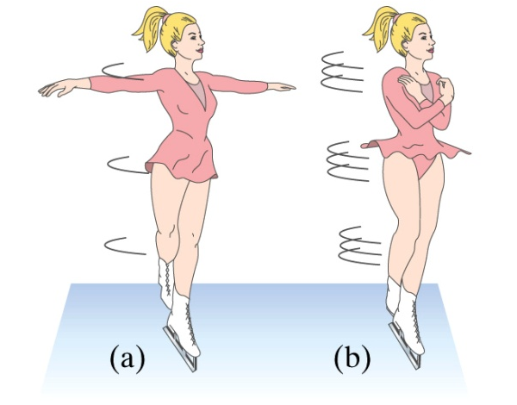
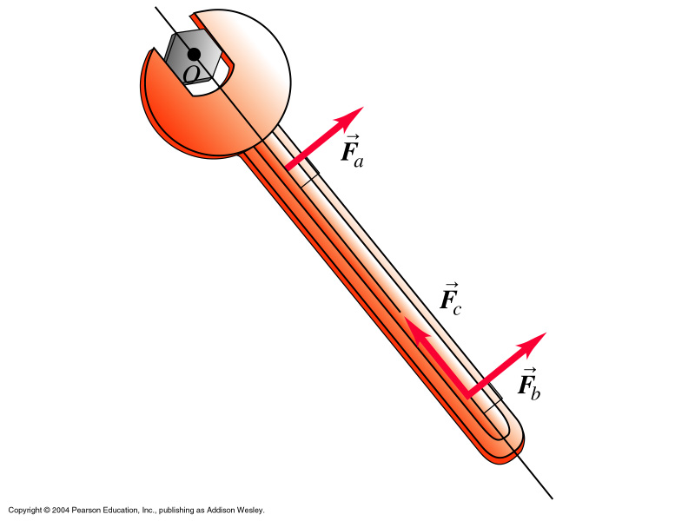
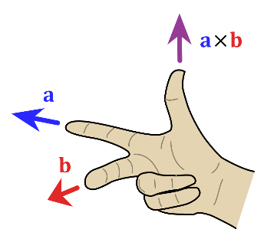

Chapter 10 Dynamics of Rotational Motion
(Conservation of angular momentum)
$$\left|a b\right|=\left|a\right| |b|sinθ$$

Slide 2
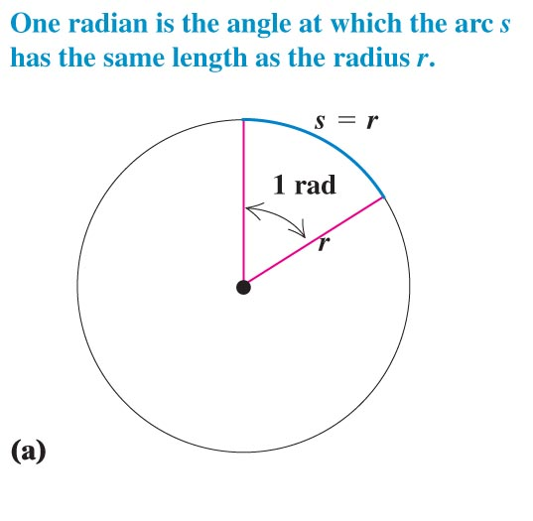
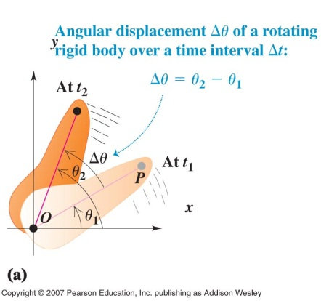
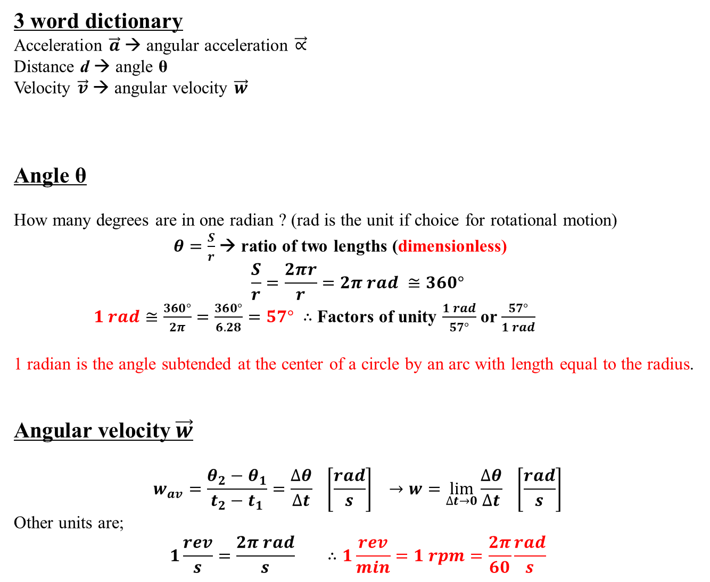
Concepts of rotational motion
3 word dictionary
Acceleration $\vec{a}$ → angular acceleration $\vec{∝}$
Distance d → angle θ
Velocity $\vec{v}$ → angular velocity $\vec{w}$
Angle θ
How many degrees are in one radian ? (rad is the unit if choice for rotational motion)
$θ=\frac{S}{r}$ → ratio of two lengths (dimensionless)
$$\frac{S}{r}=\frac{2πr}{r}=2π rad ≅360°$$
$1 rad≅\frac{360°}{2π}=\frac{360°}{6.28}=57°$ $∴$ Factors of unity $\frac{1 rad}{57°}$ or $\frac{57°}{1 rad}$
1 radian is the angle subtended at the center of a circle by an arc with length equal to the radius.
Angular velocity $\vec{w}$
$$w_{av}=\frac{θ_{2}−θ_{1}}{t_{2}−t_{1}}=\frac{∆θ}{∆t} \left[\frac{rad}{s}\right] →w=\lim_{∆t→0}{\frac{∆θ}{∆t} \left[\frac{rad}{s}\right]}$$
Other units are;
$$1\frac{rev}{s}=\frac{2π rad}{s} ∴1\frac{rev}{min}=1 rpm=\frac{2π}{60}\frac{rad}{s}$$
Euclidean geometry
325-265 BC
circumference /diameter=3.141593

Slide 3
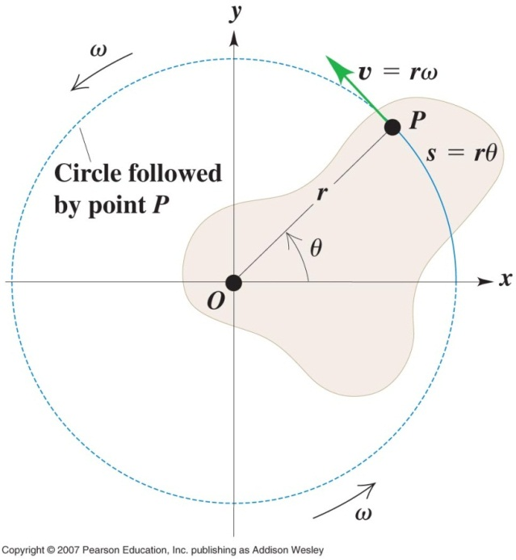
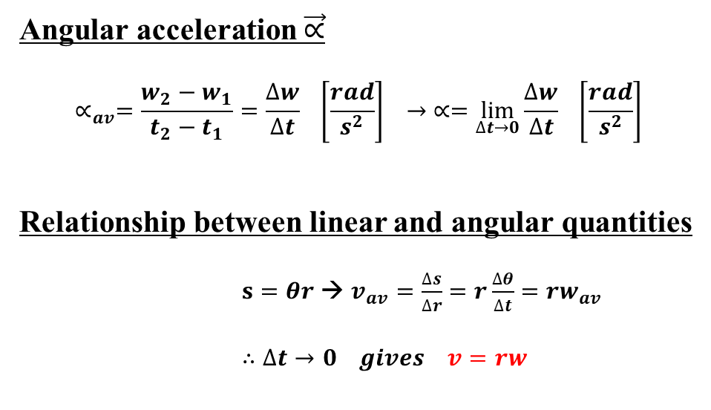
Angular acceleration $\vec{∝}$
$$∝_{av}=\frac{w_{2}−w_{1}}{t_{2}−t_{1}}=\frac{∆w}{∆t} \left[\frac{rad}{s^{2}}\right] → ∝=\lim_{∆t→0}{\frac{∆w}{∆t} \left[\frac{rad}{s^{2}}\right]}$$
Relationship between linear and angular quantities
$s=θr$ → $v_{av}=\frac{∆s}{∆r}=r\frac{∆θ}{∆t}=rw_{av}$
$∴∆t→0 gives v=rw$

Slide 4
Chapter 10 Dynamics of Rotational Motion
● To understand the concept of torque.
● To relate angular acceleration and torque.
● To work and power in rotational motion.
● To understand angular momentum.
● To understand the conservation of angular momentum.
● To study how torques add a new variable to equilibrium.
● To see the vector nature of angular quantities.
Ultimate goal is to derive a rotational version of Newtons second law

Slide 5
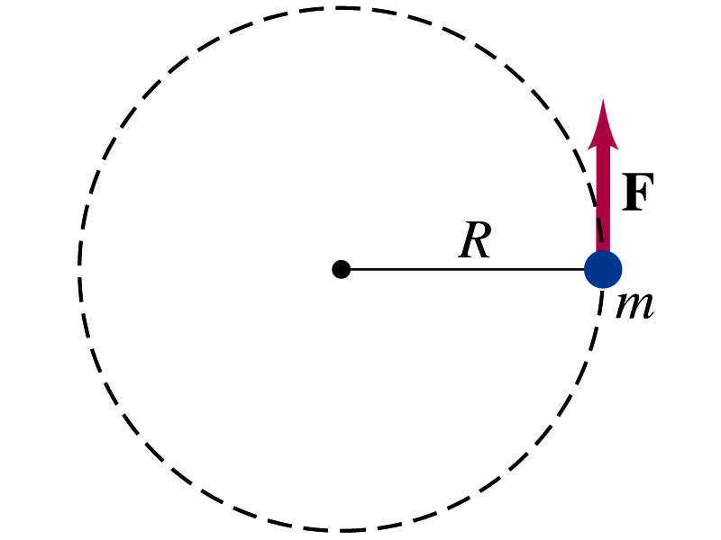
Rotational Dynamics: I
m₂
m₁
m₃

Slide 6
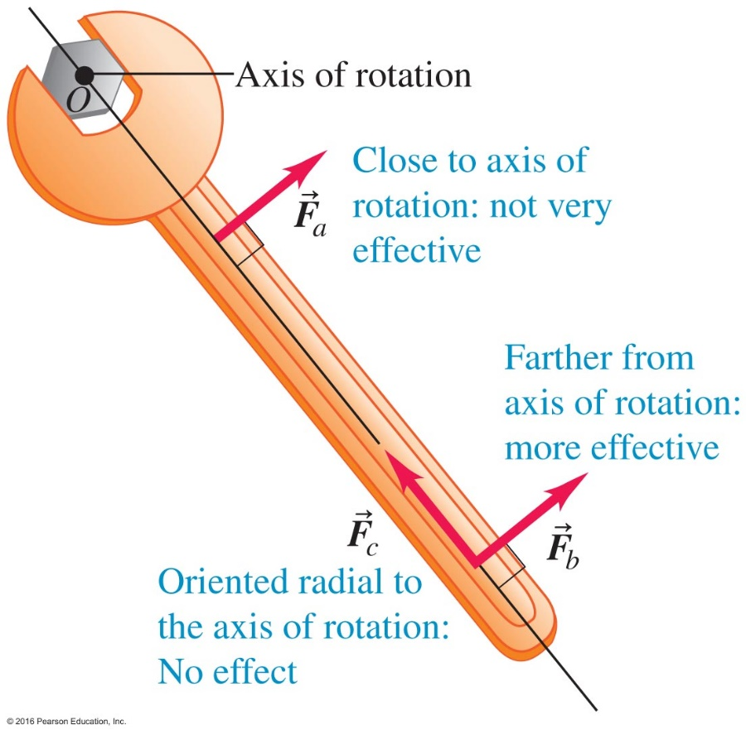

What is torque? When you apply a force to rotate an object about a pivot or an axis, the effectiveness of your action depends not only on the magnitude of the force you apply, but also on a quantity known as the moment arm.
What is the moment arm? It is the perpendicular distance from the pivot or the axis to the line of action of the applied force.
Torque = (Magnitude of Force) × (Moment Arm) $τ=Fl$ Units: N$∙$m

Slide 7
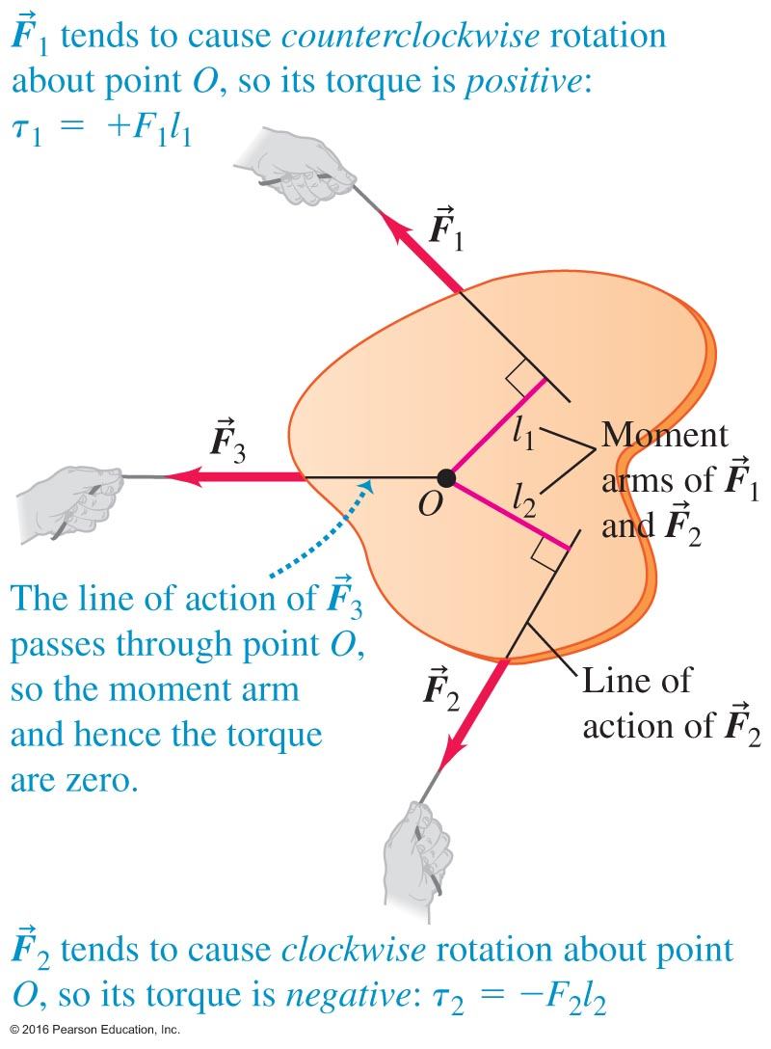
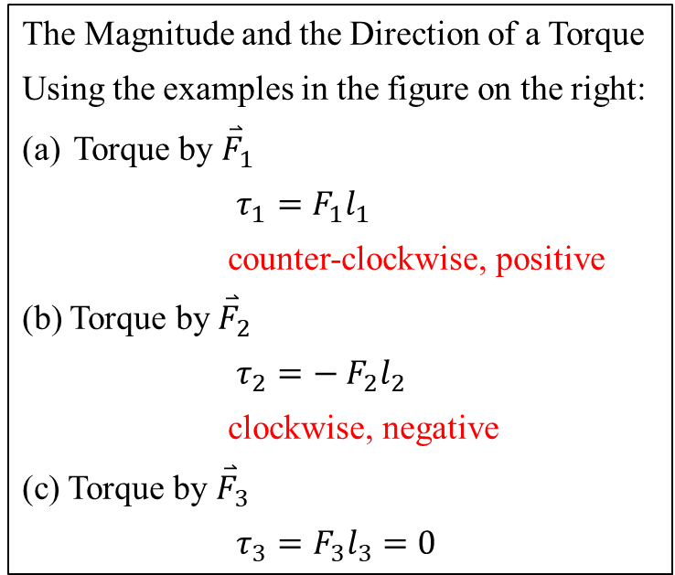
Torque is a Vector
The Magnitude and the Direction of a Torque
Using the examples in the figure on the right:
Torque by ${\overset{⃑}{F}}_{1}$
$τ_{1}=F_{1}l_{1}$
counter-clockwise, positive
(b) Torque by ${\overset{⃑}{F}}_{2}$
$τ_{2}=− F_{2}l_{2}$
clockwise, negative
(c) Torque by ${\overset{⃑}{F}}_{3}$
$τ_{3}=F_{3}l_{3}=0$

Slide 8
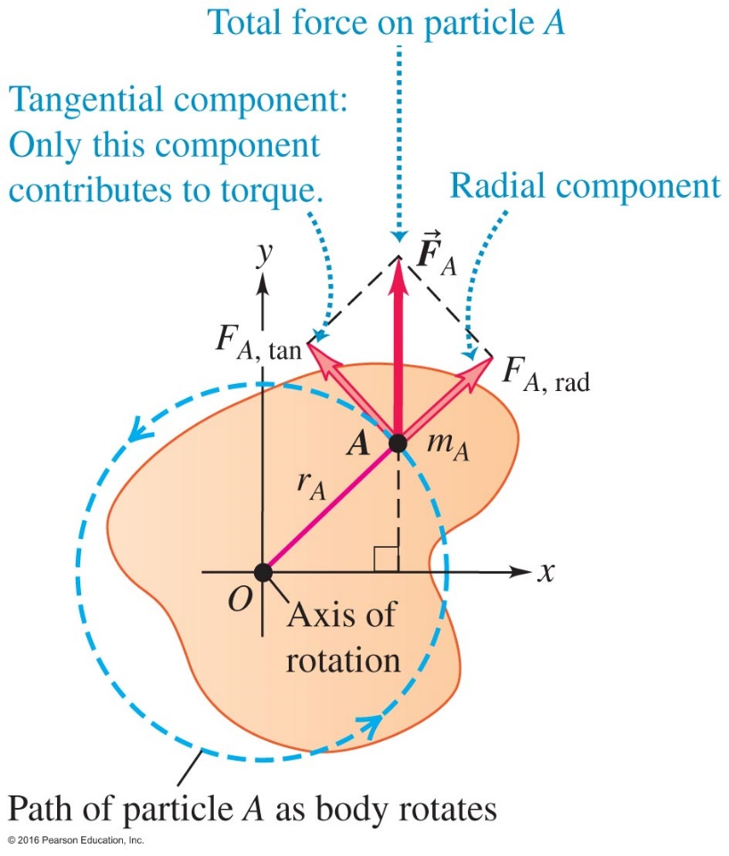
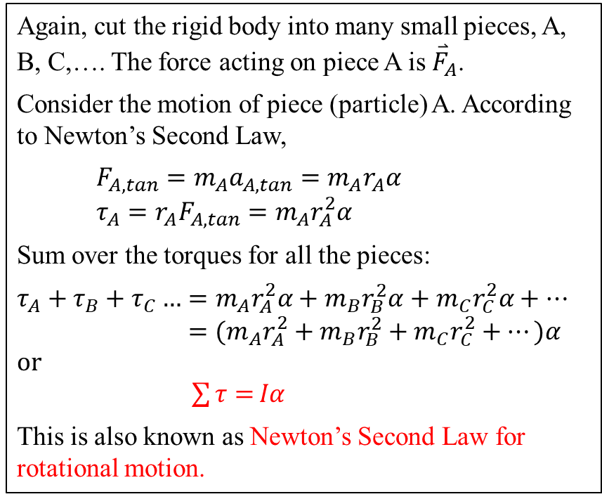
10.2 Torque and Angular Acceleration
Again, cut the rigid body into many small pieces, A, B, C,…. The force acting on piece A is ${\overset{⃑}{F}}_{A}$.
Consider the motion of piece (particle) A. According to Newton’s Second Law,
$F_{A,tan}=m_{A}a_{A,tan}=m_{A}r_{A}α$
${τ_{A}=r_{A}F}_{A,tan}=m_{A}r_{A}^{2}α$
Sum over the torques for all the pieces:
$τ_{A}+τ_{B}+τ_{C}…=m_{A}r_{A}^{2}α+m_{B}r_{B}^{2}α$ $+ m_{C}r_{C}^{2}α+…$
$={(m}_{A}r_{A}^{2}+m_{B}r_{B}^{2}+m_{C}r_{C}^{2}+…)α$
or
$\sum{τ=}Iα$
This is also known as Newton’s Second Law for rotational motion.

Slide 9
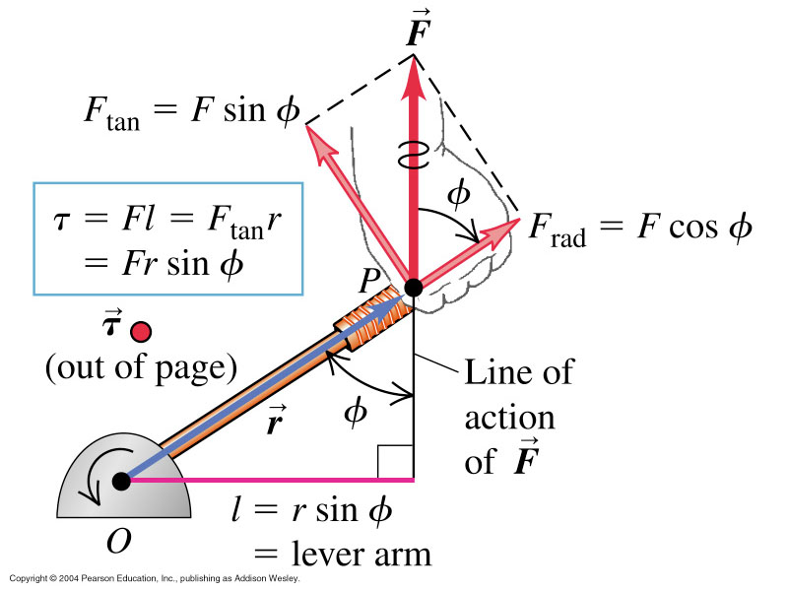
Torque
Note: F(rad)has no torque with respect to O

Slide 10
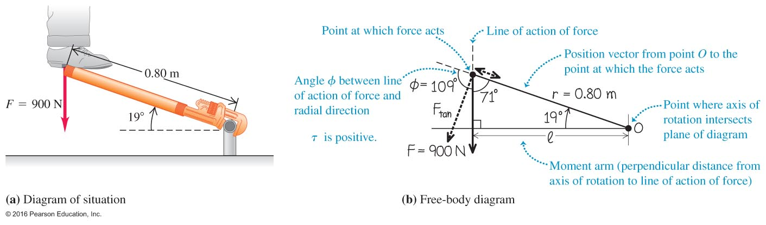
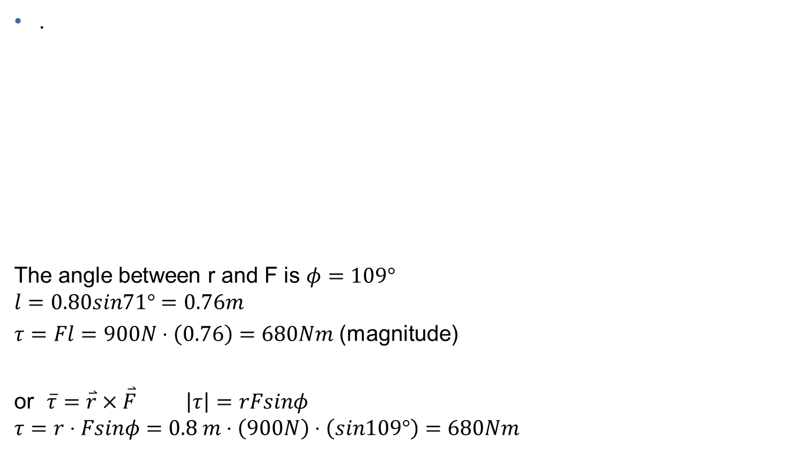
A Plumbing Problem to Solve – Example 10.1

Slide 11
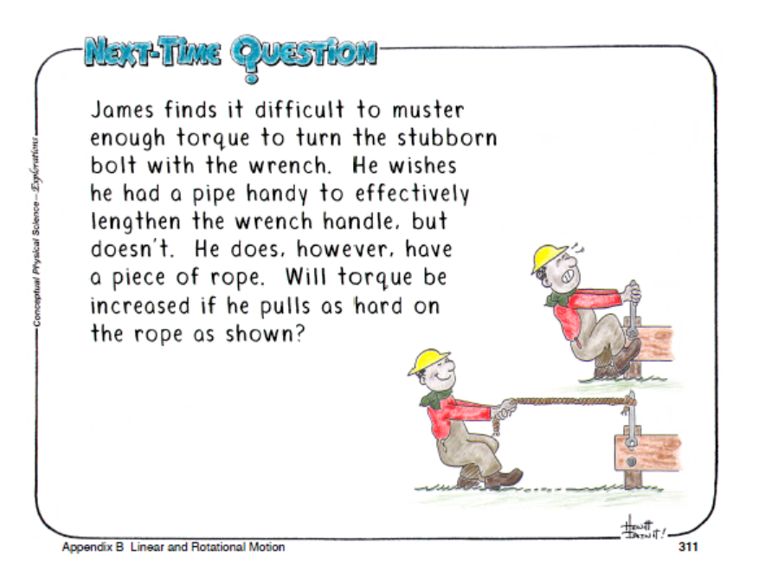
no
Notes:
no

Slide 12
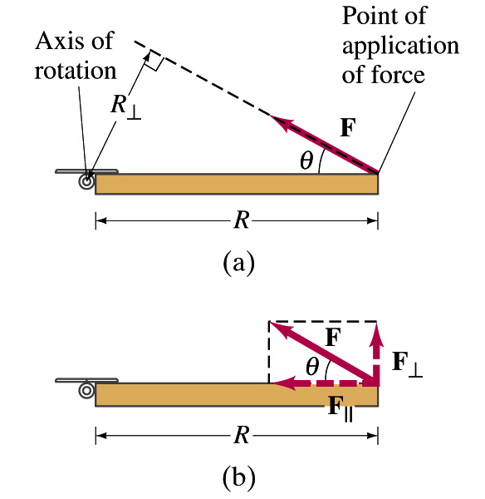
Note: τ = F R sinθ

Slide 13
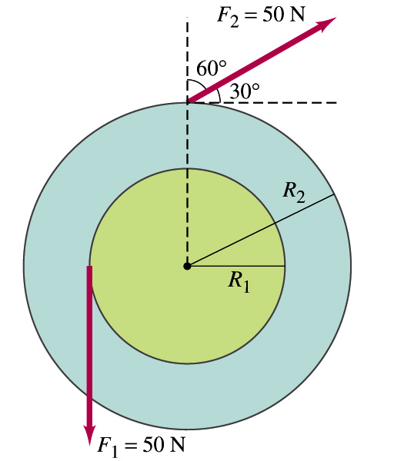
Note: sign of τ
R ₁ =0.300 m R ₂ =0.500 m

Slide 14
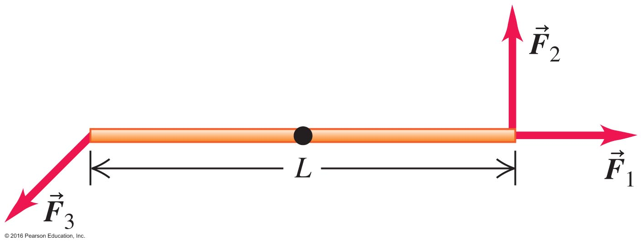

Clicker question
Torques on a Rod
The 3 forces have equal magnitude
A rod is pivoted at its center. Three forces of equal magnitude are applied as shown. Which of the following statements correctly describe the order in the magnitudes of the torques by these three forces with respect to the pivot?
a) $τ_{1}>τ_{2}>τ_{3}$
${b) τ}_{1}>τ_{3}>τ_{2}$
${c) τ}_{2}>τ_{3}>τ_{1}$
${c) τ}_{1}>τ_{3}>τ_{2}$
${c) τ}_{1}>τ_{3}>τ_{2}τ_{2}>τ_{3}>τ_{1}$
Notes:
Answer C

Slide 15
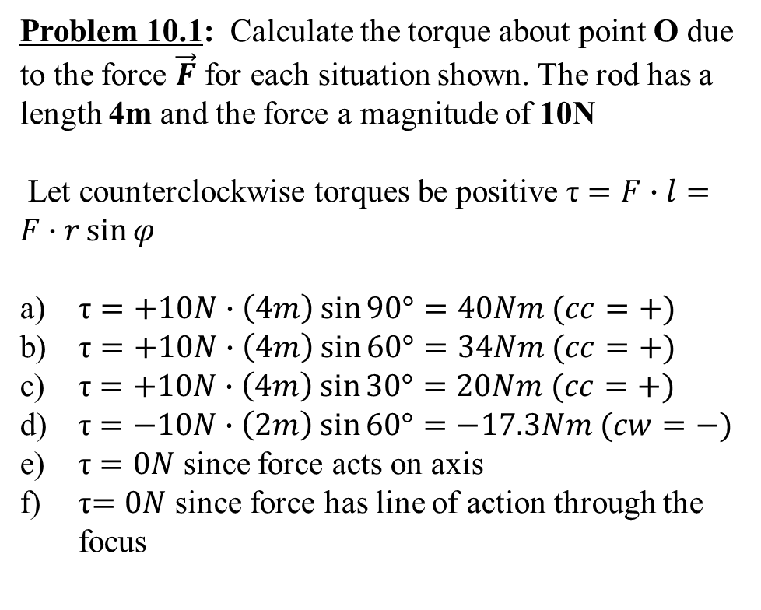
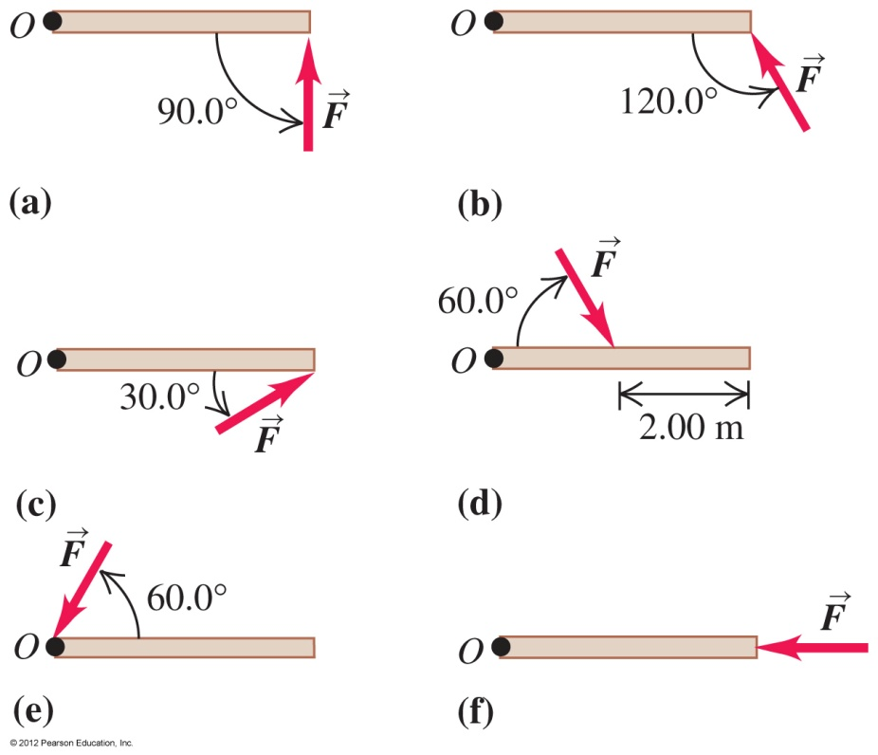

Slide 16
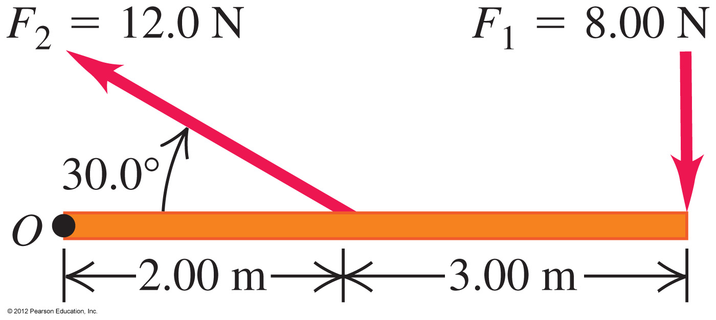
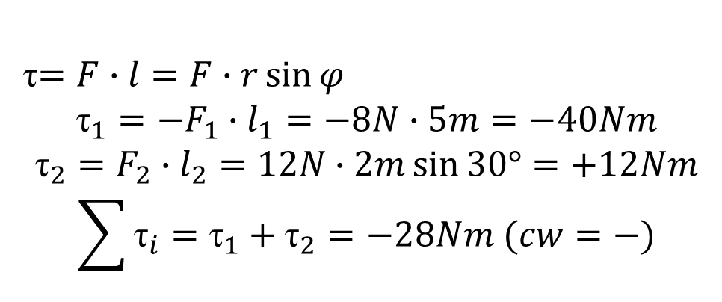

Slide 17
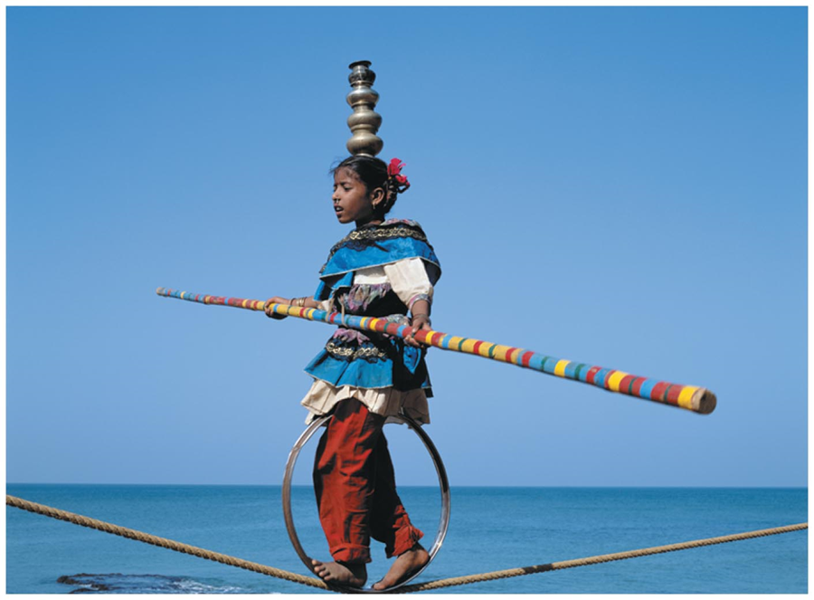
Why Do Acrobats Carry Long Bars?
In order not to fall the acrobat keeps the her center of gravity directly above the rope. She creates proper torques in this balancing act.

Slide 18
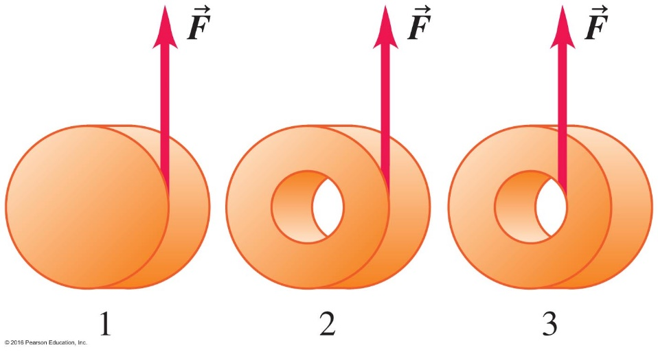

Clicker Question
Rotating Cylinders
Relationship of torque and angular acceleration
$Στ=Iα$ rotational analog of Newton’s law $ΣF=ma$
Which choice correctly ranks the magnitudes of the angular accelerations of the three cylinders?
A. $α_{3}>α_{2}>α_{1}$ B. $α_{1}>α_{2}>α_{3}$
C. $α_{2}>α_{1}>α_{3}$ D. $α_{1}=α_{2}=α_{3}$
page 289
Notes:
Answer B

Slide 19
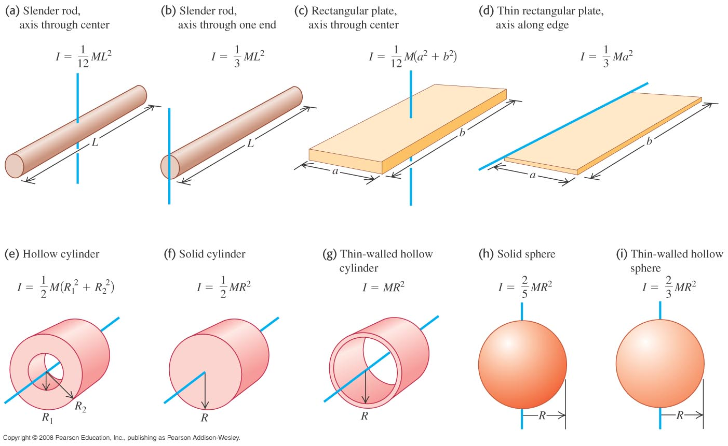
Finding the moment of inertia for common shapes

Slide 20
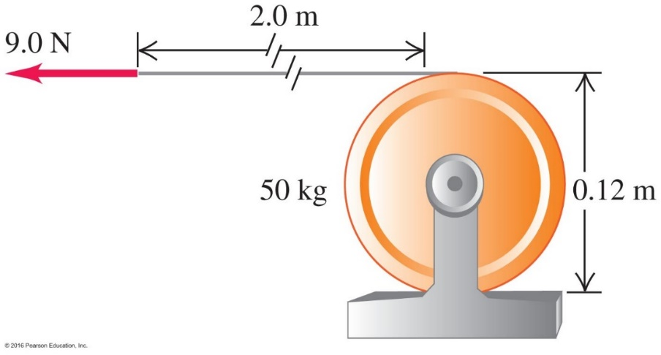

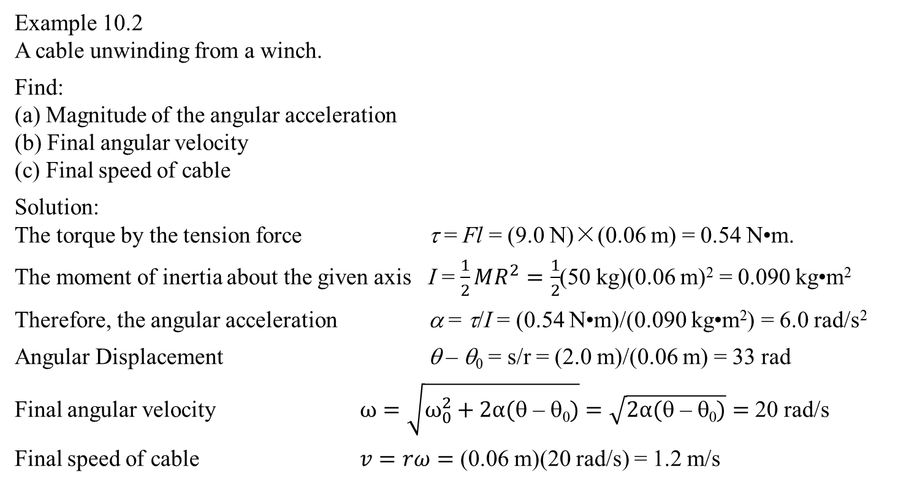
Re-visit an Earlier Problem
y
$$\overset{⃑}{F}$$
Example 10.2
A cable unwinding from a winch.
Find:
(a) Magnitude of the angular acceleration
(b) Final angular velocity
(c) Final speed of cable
Solution:
The torque by the tension force τ = Fl = (9.0 N)×(0.06 m) = 0.54 N•m.
The moment of inertia about the given axis I = $\frac{1}{2}MR^{2}=\frac{1}{2}$(50 kg)(0.06 m)² = 0.090 kg•m²
Therefore, the angular acceleration α = τ/I = (0.54 N•m)/(0.090 kg•m²) = 6.0 rad/s²
Angular Displacement θ – θ₀ = s/r = (2.0 m)/(0.06 m) = 33 rad
Final angular velocity $ω=\sqrt{ω_{0}^{2}+2α(\text{q}\text{ – }\text{q}\text{0})}=\sqrt{2α(\text{q}\text{ – }\text{q}\text{0})}=$ 20 rad/s
Final speed of cable $v=rω=$ (0.06 m)(20 rad/s) = 1.2 m/s
R
•
x

Slide 21
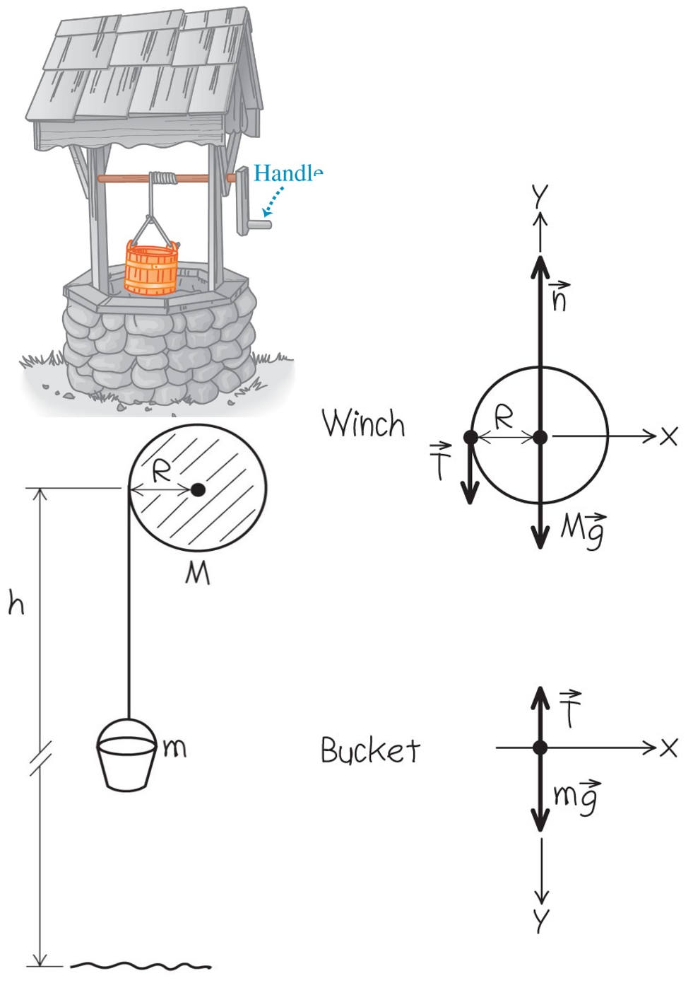
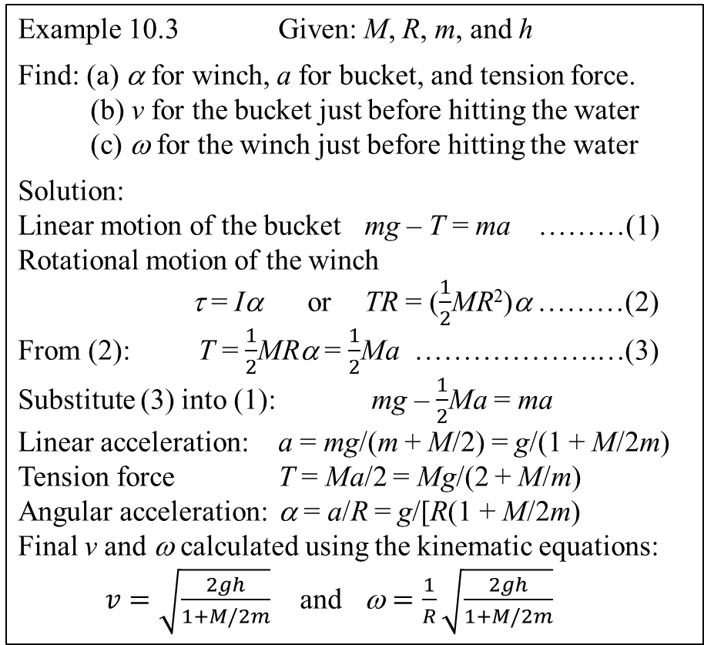
Re-visit Another Problem
Example 10.3 Given: M, R, m, and h
Find: (a) α for winch, a for bucket, and tension force.
(b) v for the bucket just before hitting the water
(c) ω for the winch just before hitting the water
Solution:
Linear motion of the bucket mg – T = ma ………(1)
Rotational motion of the winch
τ = Iα or TR = ($\frac{1}{2}$MR²)α ………(2)
From (2): T = $\frac{1}{2}$MRα = $\frac{1}{2}$Ma ……………….…(3)
Substitute (3) into (1): mg – $\frac{1}{2}$Ma = ma
Linear acceleration: a = mg/(m + M/2) = g/(1 + M/2m)
Tension force T = Ma/2 = Mg/(2 + M/m)
Angular acceleration: α = a/R = g/[R(1 + M/2m)
Final v and ω calculated using the kinematic equations:
$v=\sqrt{\frac{2gh}{1+M/2m}}$ and $\text{w}=\frac{1}{R}\sqrt{\frac{2gh}{1+M/2m}}$

Slide 22
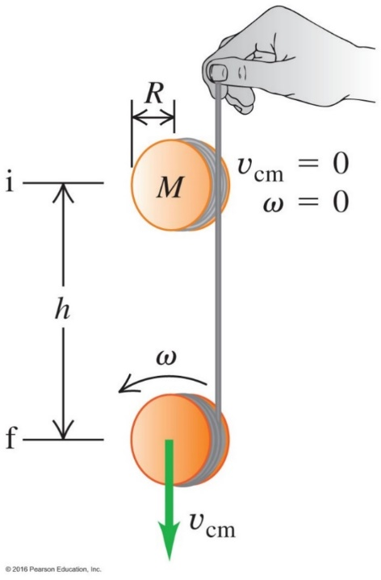
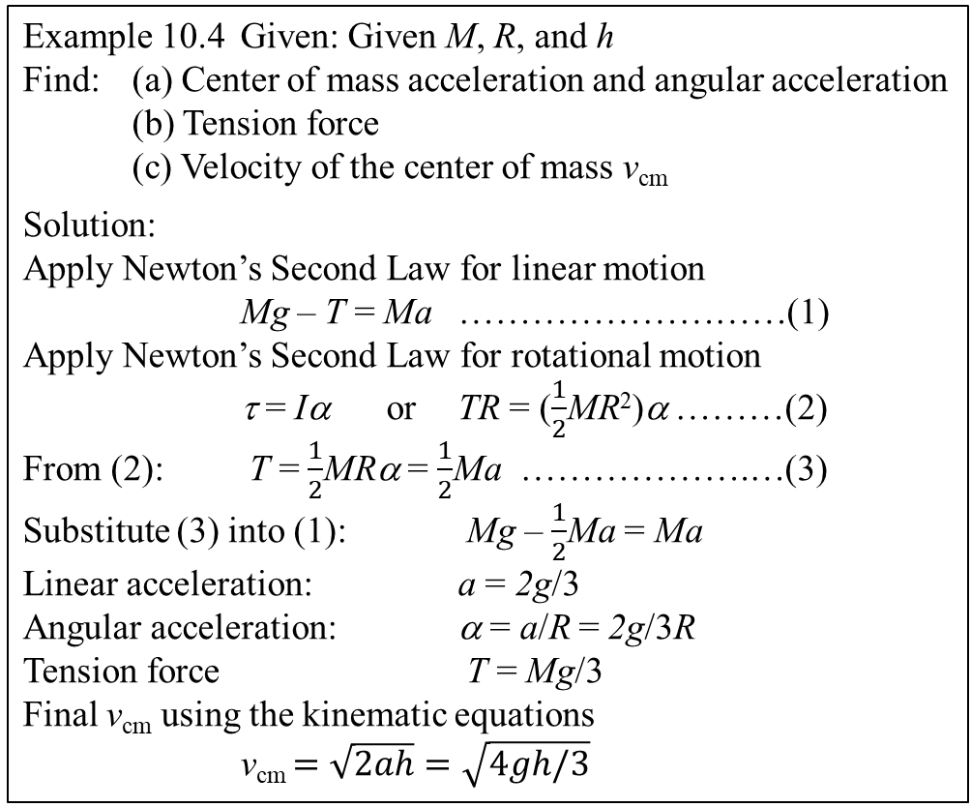
Re-visit One more Problem
Example 10.4 Given: Given M, R, and h
Find: (a) Center of mass acceleration and angular acceleration
(b) Tension force
(c) Velocity of the center of mass v_{cm}
Solution:
Apply Newton’s Second Law for linear motion
Mg – T = Ma ………………………(1)
Apply Newton’s Second Law for rotational motion
τ = Iα or TR = ($\frac{1}{2}$MR²)α ………(2)
From (2): T = $\frac{1}{2}$MRα = $\frac{1}{2}$Ma ……………….…(3)
Substitute (3) into (1): Mg – $\frac{1}{2}$Ma = Ma
Linear acceleration: a = 2g/3
Angular acceleration: α = a/R = 2g/3R
Tension force T = Mg/3
Final v_{cm} using the kinematic equations
v_{cm} $=\sqrt{2ah}=\sqrt{4gh/3}$
y
o
T
R
•
x
mg
y

Slide 23
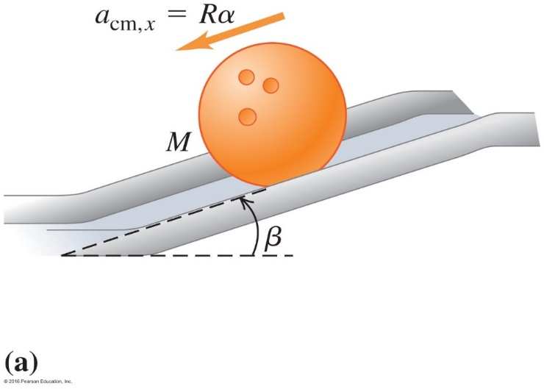
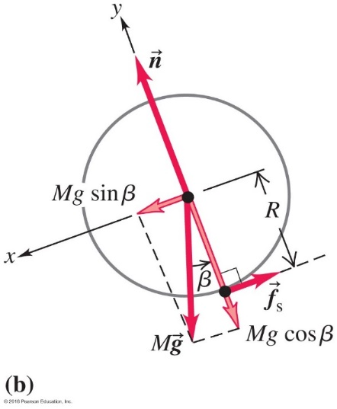
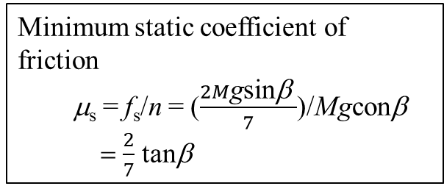
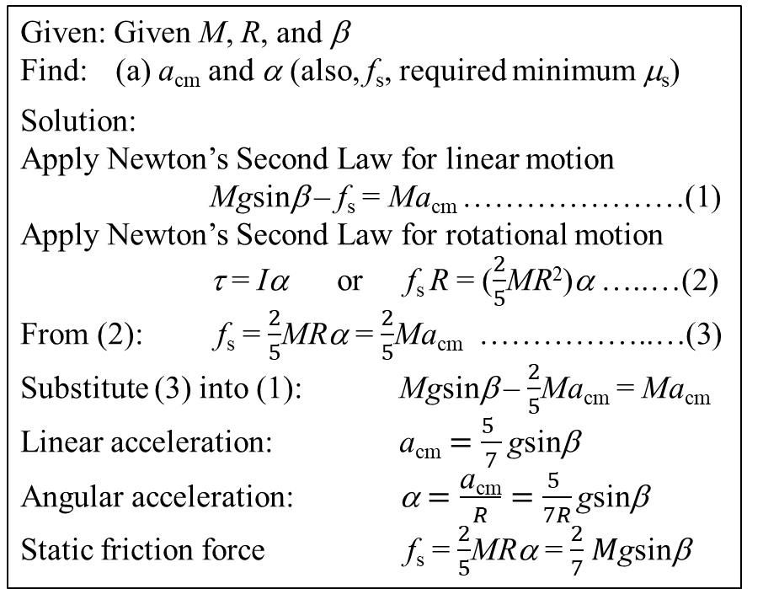
Example 10.5 on page 291: Rolling without slipping
What is the acceleration of a rolling bowling ball?
Given: Given M, R, and β
Find: (a) a_{cm} and α (also, f_{s}, required minimum μ_{s})
Solution:
Apply Newton’s Second Law for linear motion
Mgsinβ – f_{s} = Ma_{cm} …………………(1)
Apply Newton’s Second Law for rotational motion
τ = Iα or f_{s} R = ($\frac{2}{5}$MR²)α …..…(2)
From (2): f_{s} = $\frac{2}{5}$MRα = $\frac{2}{5}$Ma_{cm} ……………..…(3)
Substitute (3) into (1): Mgsinβ – $\frac{2}{5}$Ma_{cm} = Ma_{cm}
Linear acceleration: a_{cm} $=\frac{5 }{7}\text{g}\text{sin}\text{b}$
Angular acceleration: α $=\frac{\text{a}\text{cm}}{R}=$ $\frac{5 }{7R}\text{g}\text{sin}\text{b}$
Static friction force f_{s} = $\frac{2}{5}$MRα = $\frac{2}{7}$ $M\text{g}\text{sin}\text{b}$
Minimum static coefficient of friction
μ_{s} = f_{s}/n = ($\frac{2M\text{g}\text{sin}\text{b} }{7}$)/Mgconβ
= $\frac{2}{7}$ tanβ

Slide 24
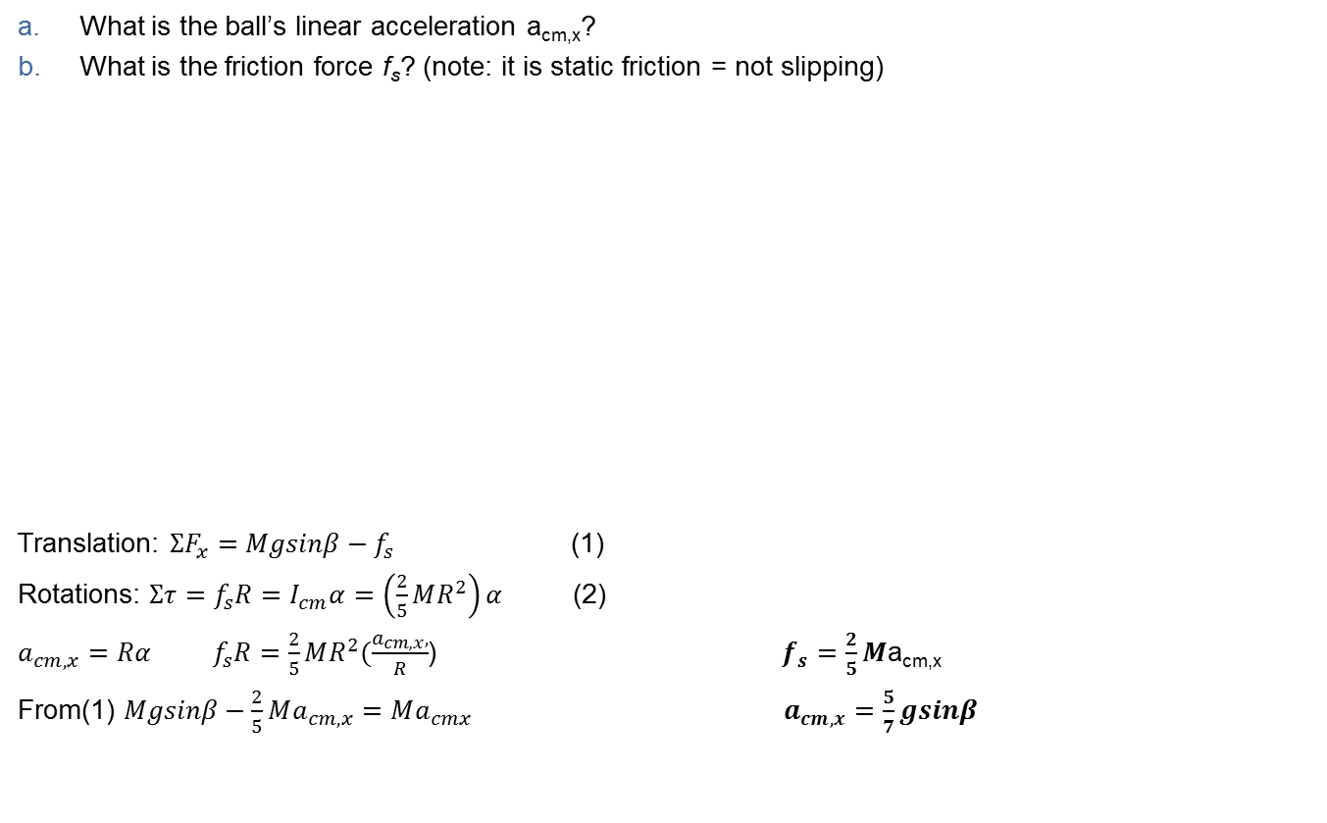
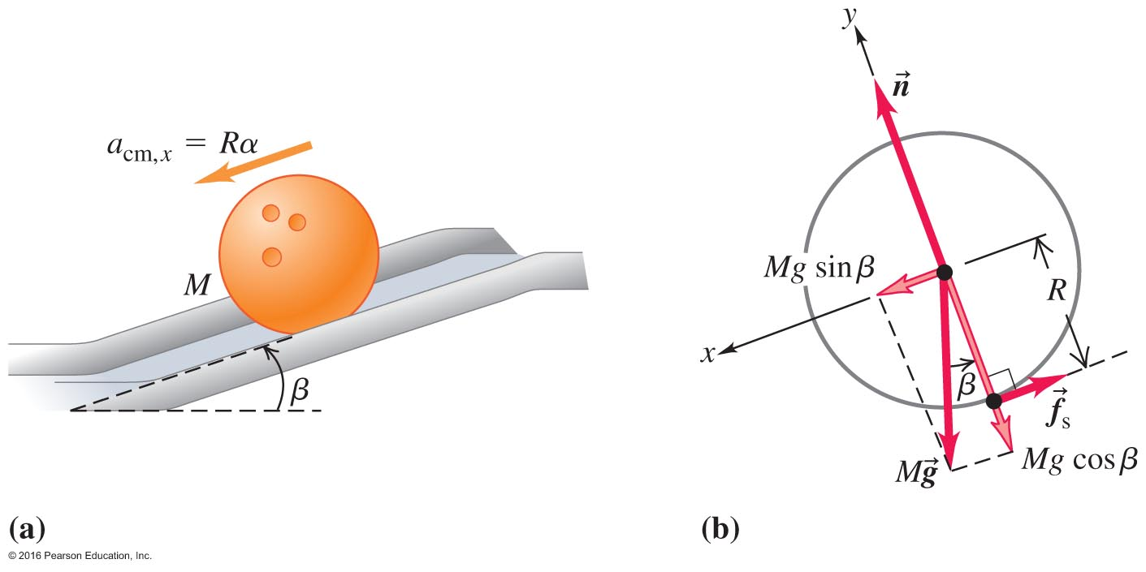
A Bowling Ball Rotates on a Moving Axis – Example 10.5

Slide 25
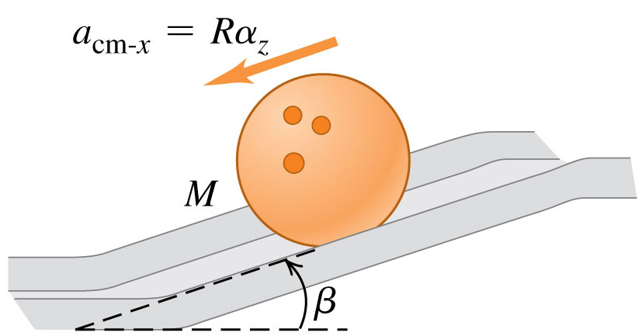
Clicker question
A solid bowling ball rolls down a ramp. Which of the following forces exerts a torque on the bowling ball about its center?
A. the weight of the ball
B. the normal force exerted by the ramp
C. the friction force exerted by the ramp
D. more than one of the above
E. depends on whether the ball rolls without slipping
Notes:
Answer: C

Slide 26
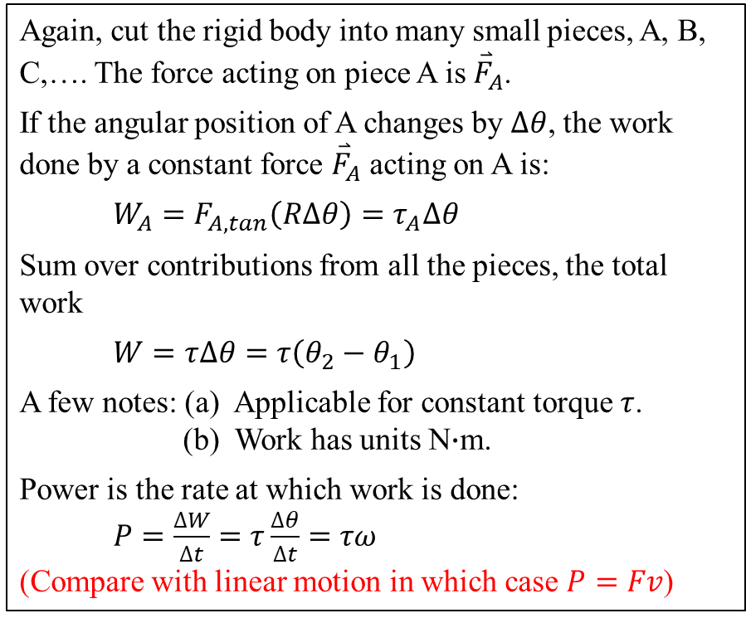
10.3 Work and Power in Rotational Motion
Again, cut the rigid body into many small pieces, A, B, C,…. The force acting on piece A is ${\overset{⃑}{F}}_{A}$.
If the angular position of A changes by $∆θ$, the work done by a constant force ${\overset{⃑}{F}}_{A}$ acting on A is:
$W_{A}=F_{A,tan}\left(R∆θ\right)=τ_{A}∆θ$
Sum over contributions from all the pieces, the total work
$W=τ∆θ=τ\left(θ_{2}−θ_{1}\right)$
A few notes: (a) Applicable for constant torque $τ$.
(b) Work has units N$∙$m.
Power is the rate at which work is done:
$P=\frac{∆W}{∆t}=τ\frac{∆θ}{∆t}=τω$
(Compare with linear motion in which case $P=Fv$)

Slide 27
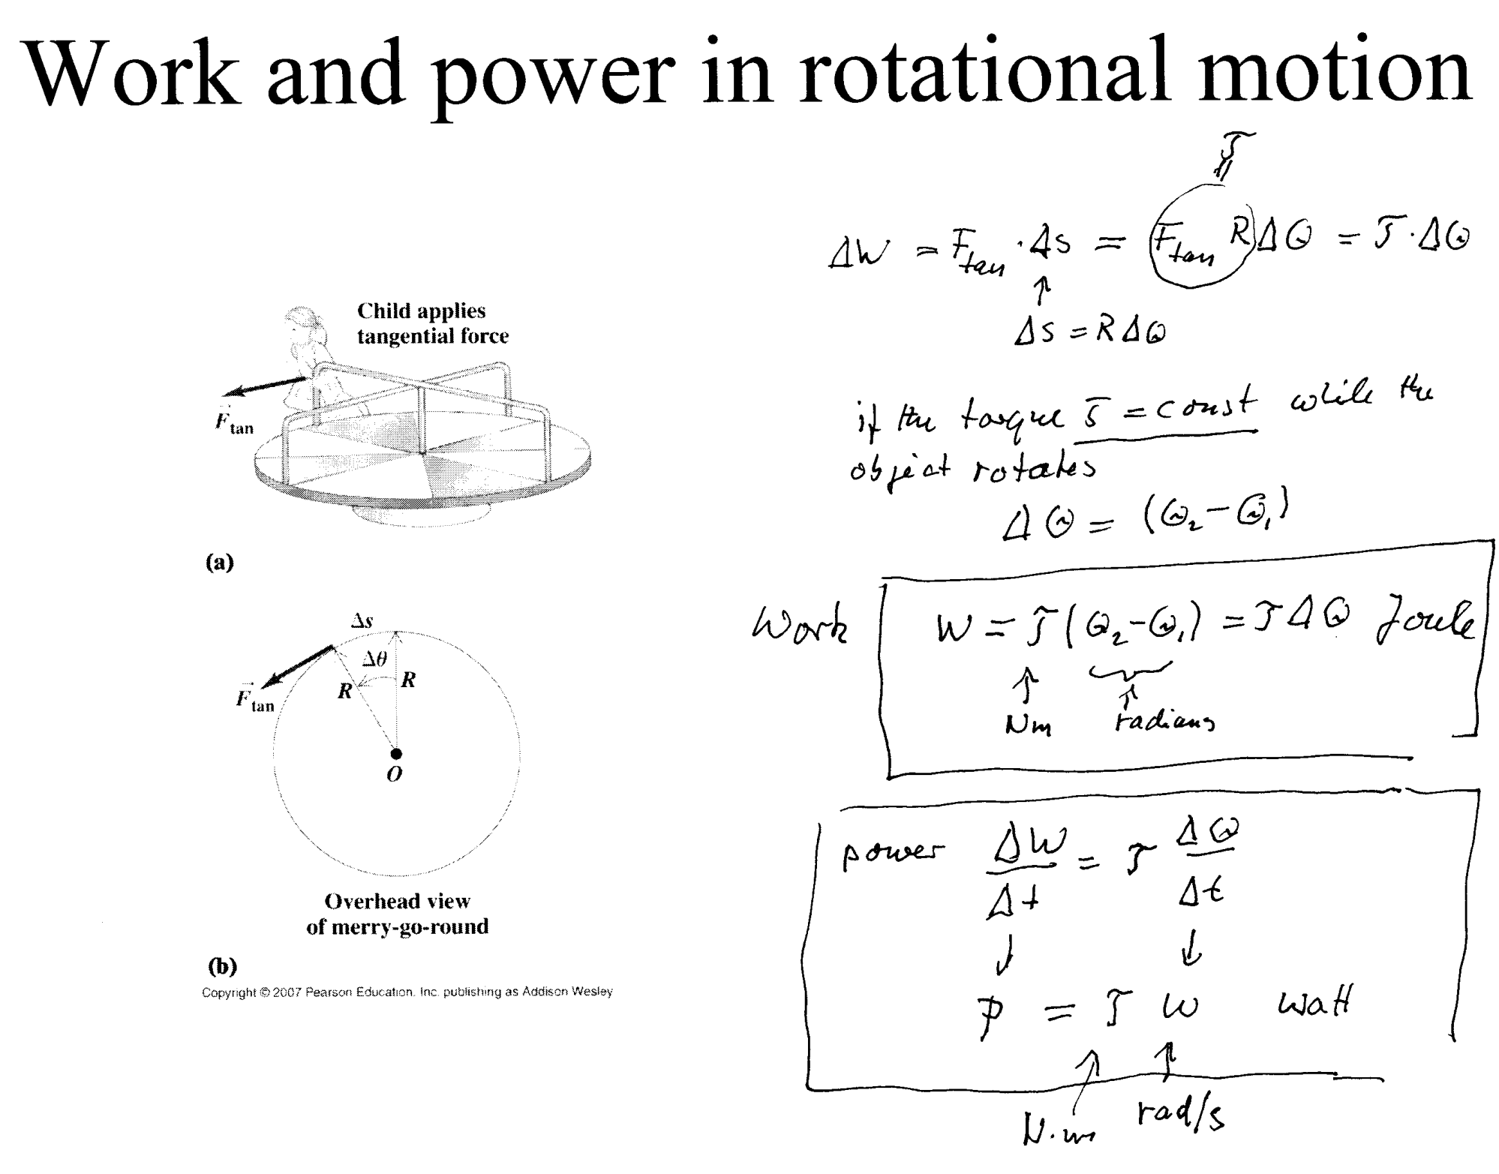
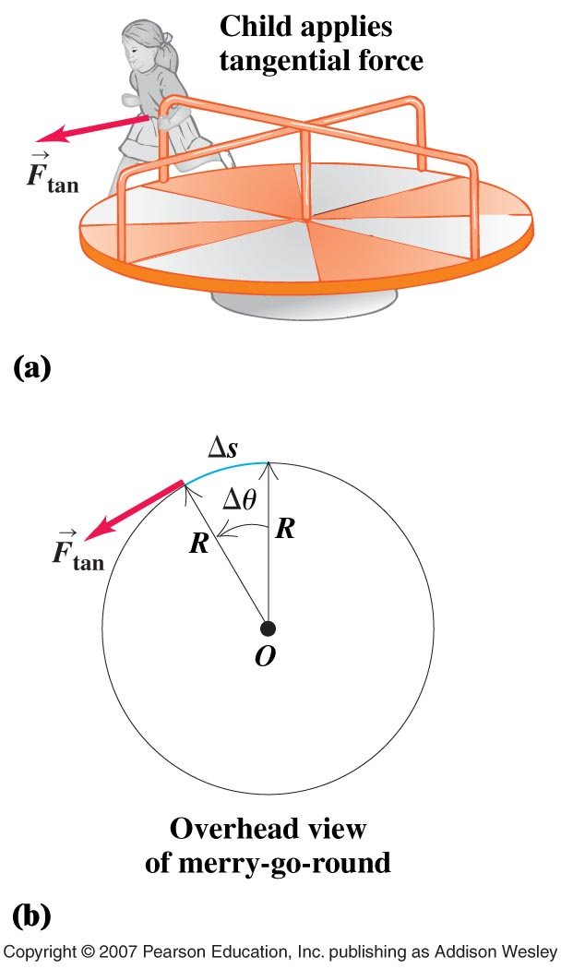
Work and power in rotational motion

Slide 28
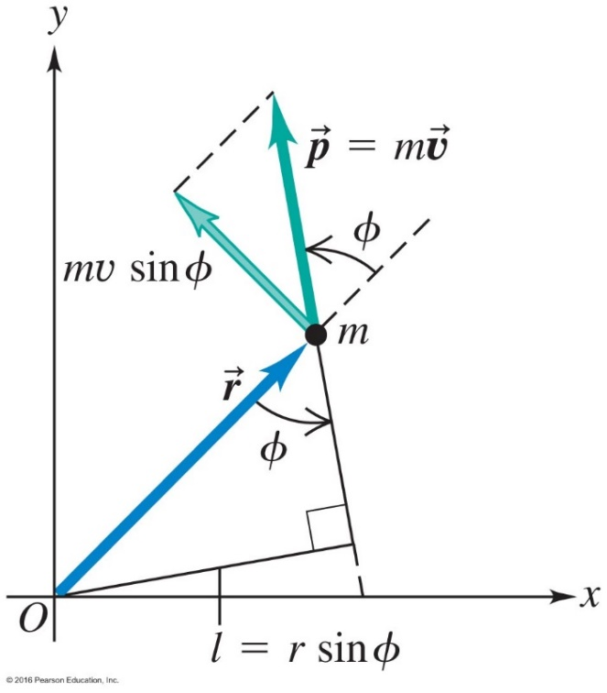
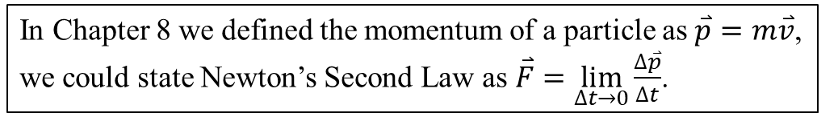
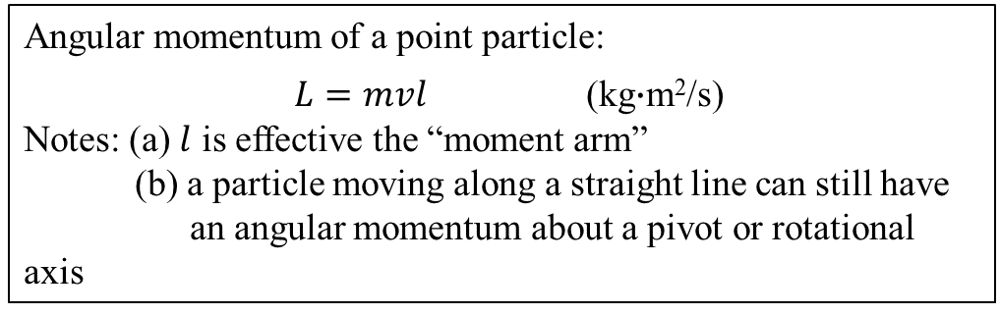
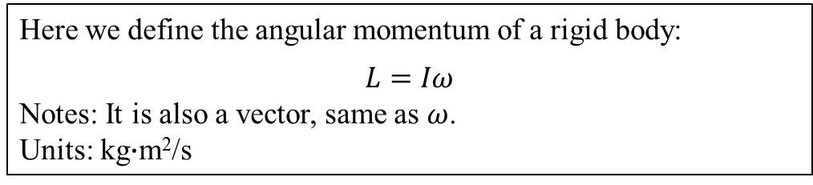
10.4 Angular Momentum
In Chapter 8 we defined the momentum of a particle as $\overset{⃑}{p}=m\overset{⃑}{v}$,
we could state Newton’s Second Law as $\overset{⃑}{F}=\lim_{∆t→0}\frac{∆\overset{⃑}{p}}{∆t}$.
Here we define the angular momentum of a rigid body:
$$L=Iω$$
Notes: It is also a vector, same as $ω$.
Units: kg$∙$m²/s
Angular momentum of a point particle:
$L=mvl$ (kg$∙$m²/s)
Notes: (a) $l$ is effective the “moment arm”
(b) a particle moving along a straight line can still have
an angular momentum about a pivot or rotational axis

Slide 29

Angular momentum

Slide 30


Example 10.7: A kinetic sculpture
Given: Two small metal sphere of masses m₁ = m₂ = 2.0 kg
Uniform metal rod of mass M = 3.0 kg and length s = 4.0 m
Angular velocity 3.0 rev/minutes about a vertical axis through the middle
Find: Angular momentum and Kinetic energy
Solution:
Angular momentum
Total moment of inertia I_{total} = I_{sphere 1} + I_{sphere 2} + I_{rod} = m₁(s/2)² + m₂(s/2)² + (1/12)Ms²
= 20 kg•m²
Angular momentum L = I$ω$ = (20 kg•m²)(3.0•2π/60 s⁻¹) = 6.2 kg•m² /s
(b) Kinetic energy K = (1/2)I$ω$² = 0.96 J

Slide 31

Calculate the angular momentum and kinetic energy of a solid uniform sphere with a radius of 0.12 m and a mass of 14.0 kg if it is rotating at 6.00 rad/s about an axis through its center
$I=\frac{2}{5}MR^{2}=\frac{2}{5}∗\left(14kg\right){\left(0.12m\right)}^{2}=0.0806 kgm^{2}$
$$L=Iw=0.0806 kgm^{2} ∗6.0 rad=0.484 kg\frac{m^{2}}{s}$$
$$K=\frac{1}{2}Iw^{2}=\frac{1}{2}Lw=\frac{1}{2}\left(0.484 kg\frac{m^{2}}{s}\right)∗6 rad=1.45 J$$

Slide 32


10.5 Conservation of Angular Momentum
The Relationship Between Torque and Angular Momentum
Since $\sum{τ}=Iα=I\lim_{∆t→0}\frac{∆ω}{∆t}=\lim_{∆t→0}\frac{I∆ω}{∆t}=\lim_{∆t→0}\frac{∆(Iω)}{∆t}=\lim_{∆t→0}\frac{∆L}{∆t}$
We can state Newton’s Second Law for rotational motion as
$\sum{τ}=\lim_{∆t→0}\frac{∆L}{∆t}$
Conservation of Angular Momentum
If $\sum{τ}=0$,
Then $L=$ constant

Slide 33

Angular Momentum Is Conserved – Figure 10.19
The first figure shows the figure skater with a large moment of inertia.
In the second figure, she has made the moment much smaller by bringing her arms in.
Since L is constant, ω must increase.

Slide 34




Conservation of angular momentum
L=r x p
|L|=(rp)sin90=(r)(mv)
v=r
5 kg
Conservation of L

Slide 35


Example 10.9:
Given: I_{body, i} = 3.0 kg•m² I_{body, f} = 2.2 kg•m²
m_{dumbbell} = 5.0 kg each
R_{dumbbell, i} = 1.0 m R_{dumbbell, f} = 0.20 m
$ω$_{i} = 1 rev in 2 s = 2π/2 rad/s = π rad/s
Find: (a) $ω$_{f} (b) compare K_{f} with K_{i}
Solution: (a) for $ω$_{f}
Total initial moment of inertia
I_{total,i} = I_{body, i} + 2I_{dumbbell,i} = (3.0 kg•m²) + 2[m_{dumbbell}(R_{dumbbell, i})²] = 13 kg•m²
Total final moment of inertia
I_{total,f} = I_{body, f} + 2I_{dumbbell,f} = (2.2 kg•m²) + 2[m_{dumbbell}(R_{dumbbell, f})²] = 2.6 kg•m²
Apply the conservation of angular momentum I_{total,i} $ω$_{i} = I_{total,f} $ω$_{f}
so that $ω$_{f} = I_{total,i} $ω$_{i}/I_{total,f} = 5.0π rad/s = 2.5 rev/s
(b) compare K_{f} with K_{i}
K_{i} = (1/2)I_{total,i} $ω$_{i} ² = 64 J K_{f} = (1/2)I_{total,f} $ω$_{f} ² = 320 J

Slide 36

Q10.12
A spinning figure skater pulls his arms in as he rotates on the ice. As he pulls his arms in, what happens to his angular momentum L and kinetic energy K?
A. L and K both increase.
B. L stays the same; K increases.
C. L increases; K stays the same.
D. L and K both stay the same.
E. None of the above.
Notes:
Answer: B

Slide 37


10.6 Equilibrium of a Rigid Body
The equilibrium of a point particle is determined by the conditions of
$\sum{F_{x}}=0$ and $\sum{F_{y}}=0.$
The Equilibrium of a Rigid Body
For the equilibrium of a rigid body, both its linear motion and rotational motion must be considered. Therefore, in addition to
$\sum{F_{x}}=0$ and $\sum{F_{y}}=0$,
We must add another condition regarding its rotational motion
$\sum{τ}=0$.
This third condition can be set up about any chosen axis.

Slide 38

Strategy for Solving Rigid Body Equilibrium Problems
General principle: The net force must be zero.
The net torque about any axis must be zero.
● Draw a diagram according to the physical situation.
● Analyze all the forces acting on each part of a rigid body.
● Sketch all the relevant forces acting on the rigid body.
● Based on the force analysis, set up a most convenient x-y coordinate system.
● Break each force into components using this coordinates.
● Sum up all the x-components of the forces to an equation: $\sum{F_{x}=0}$.
● Sum up all the y-components of the forces to an equation: $\sum{F_{y}=0}$.
● Based on the force analysis, set up a most convenient rotational axis.
● Calculate the torque by each force about this rotational axis.
● Sum up all the torques by the forces to an equation: $\sum{τ}=0$.
● Use the above three equations to solve for unknown quantities.

Slide 39




A New Equilibrium Condition – Figure 10.24
Now, in addition to , we also must add

Slide 40

Notes:
Answer D

Slide 41


Balancing on a Teeter-Totter – Figure 10.26
The heavier child must sit closer to balance the torque from the smaller child.
Your torque is $τ_{you}=+\left(90 kg\right)gx$
Your friend is $3.0 m−x$ from the pivot, and her torque is: $τ_{friend}=−\left(60 kg\right)×g\left(3.0 m−x\right).$
For equilibrium, $Στ=0$.
$τ_{you}+τ_{friend}=0$
$+\left(90 kg\right)gx−\left(60 kg\right)g\left(3.0 m−x\right)=0$
$x=1.2 m$

Slide 42


Walking the plank
In equilibrium board does not tilt

Slide 43

b)
Notes:
Answer B

Slide 44


A fishy wind chime

Slide 45


Example 10.12
Climbing a ladder (length is 5 m)
Find:
Normal and friction forces
at the base of the ladder
(b) Minimum μ_{s} at the base
(c) Magnitude and direction of
the contact force at the base
Solution: (a) $\sum{F_{x}=0}$ f_{s} – n₁ = 0
$\sum{F_{y}=0}$ n₂ – (800 N) – (180 N) = 0 n₂ = 980 N $\sum{τ}=0$ n₁(4.0 m) – (180 N)(1.5 m) – (800 N)(1.0 m) = 0
n₁ = 268 N
f_{s} = 268 N
(b) Minimum μ_{s} = (268 N)/(980 N) = 0.27
(c) $F_{B}=\sqrt{{(268 N)}^{2}+{(980 N)}^{2}}=1020 N θ=\tan^{−1}\left(\frac{980 N}{268 N}\right)=75°$

Slide 46


Balanced Forces During
Exercise
Refer to the worked example on page 308.

Slide 47

Atwood’s machine problem 10.58

Slide 48
Atwood’s machine problem 10.58

Slide 49

A simple Hinge problem 10.56

Slide 50



Hanging a farm gate

Slide 51



Carrying a box up the stairs
F

Slide 52

How a car’s clutch work
The clutch disk and the gear disk is pushed into each other by two forces that do not impart any torque, what is the final angular velocity when they come together?

Slide 53


Disk A and B are connected or disconnected by clutch C. Disk A is made from a lighter material
Problem 10. 66
. What is the original kinetic energy K_{i} of disk A?
$$I_{A}=\frac{1}{3}I_{B} →I_{B}=3I_{A}$$
Initially;
$L_{i}=w_{o}I_{A}$ and $K_{i}=\frac{1}{2}I_{A}w_{o}^{2}$
Final;
${I=I}_{A}+3I_{A}=4I_{A}$ (after coupling together)
Conservation of angular momentum;
$$L_{i}=w_{o}I_{A}=L_{f}=WI=W4I_{A} →W=\frac{w_{o}}{4}$$
Final Kinetic energy;
$$K_{f}=\frac{1}{2}IW^{2}=\frac{4}{2}I_{A}\frac{w_{o}^{2}}{4^{2}}=\frac{1}{4}K_{i}$$
$∴∆K=K_{f}−K_{i}=−\frac{3}{4}K_{i}=−2400 J$ (thermal energy developed during coupling)
So, original energy;
$$K_{i}=−\frac{3}{4}\left(−2400\right)=3200 J$$

Slide 54




ω₀ = 850 rev/min
If the grindstone comes to a complete stop after 7.5s, what was the coefficient of kinetic friction between the axe and the stone? (Assume negligible friction in the rest of the system)
0.52 m
F_{N} = 160 N
m = 50 kg

Slide 55



m = 0.010 kg
v = 500 m/s
R = 0.4 m
A bullet is shot into a solid disk of wood at rest as shown. It embeds itself in the disk, a distance of ½ R above the disk’s center. What will the resulting angular velocity of the disk?
0.2 m

Slide 56

Angular Quantities Are Vectors – Figure 10.29
The “right-hand rule” gives us a vector’s direction.

Slide 57

Vector nature of angular quantities

Slide 58

Gyroscopes Can Add Stability Figure 10.32
The gyroscopic motion adds stability to bicycles, footballs, bullets and more.

Slide 59

A Laboratory Gyroscope – Figure 10.33
Refer to the worked example on page 309.

Slide 60

Honda 600RR
Who races this bike?
Why can anybody race it, if he just
dares to go fast?
The oval track of a
World Speedway allows speeds
of 250 mph.

Slide 61


A non rotating and rotating gyroscope

Slide 62







Precesion Angular Velocity $Ω$
$$Ω is the rate\frac{Δφ}{Δt}at which the axis moves$$
$$\vec{L}=I \vec{ω}$$
$$Δ\vec{L}=\sum{\vec{τ} Δt}$$
$\sum{\vec{τ}}=\frac{Δ\vec{L}}{Δt}$ Analogous to $\sum{\vec{F}}=\frac{Δ\vec{P}}{Δt}$
$$Δφ=\frac{\left|Δ\vec{L}\right|}{\left|L\right|}$$
$Ω=\frac{Δφ}{Δt}=\frac{\frac{\left|Δ\vec{L}\right|}{\left|L\right|}}{Δt}=\frac{τ}{L}=\frac{Wr}{Iω}$ rad/s
$W$ is the weight of the flywheel, and $r$ is the distance from the pivot point of the center of mass of the flywheel.

Slide 63


Slide 64

Faster than Gravity
A small marble is placed on the tee at the very top of the raised end. A few inches below it is a plastic cup. The wooden board is held up by a wooden ruler. The ruler is quickly removed, allowing the board and the marble to fall due to the force of gravity. The center of percussion of the board is the point that has the acceleration of a free falling particle along the path that it follows, all points beyond the center of percussion descend with accelerations greater than they would have if they were particles moving freely on their respective paths. This is due to the board rotating about a hinged end. Thus, the cup falls at a faster rate than the marble, and the marble lands in the cup.

Slide 65

Vector Multiplication
Scalar product
Vector product
Magnitude C must be multiplied with a unit vector perpendicular to A and B

Slide 66


