Slide 1
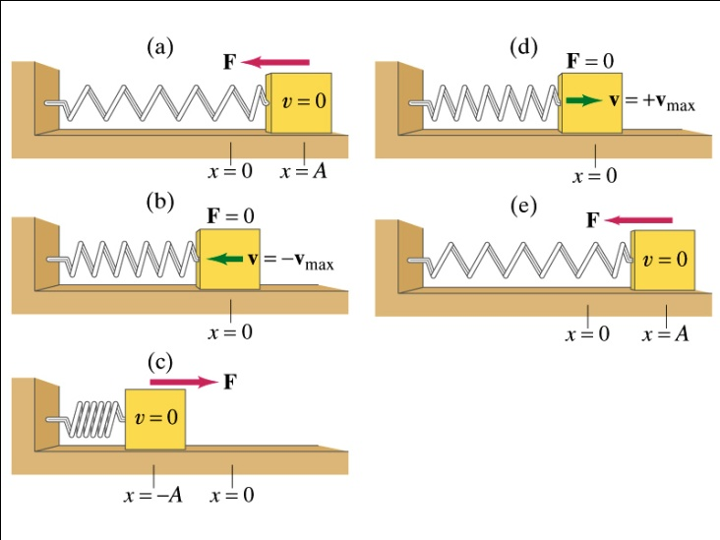
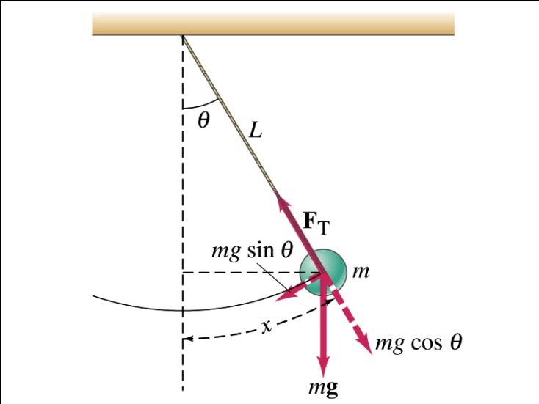
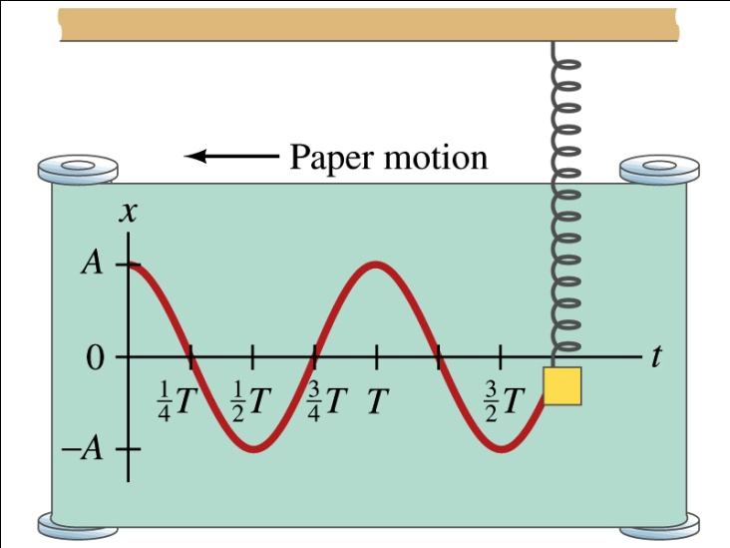
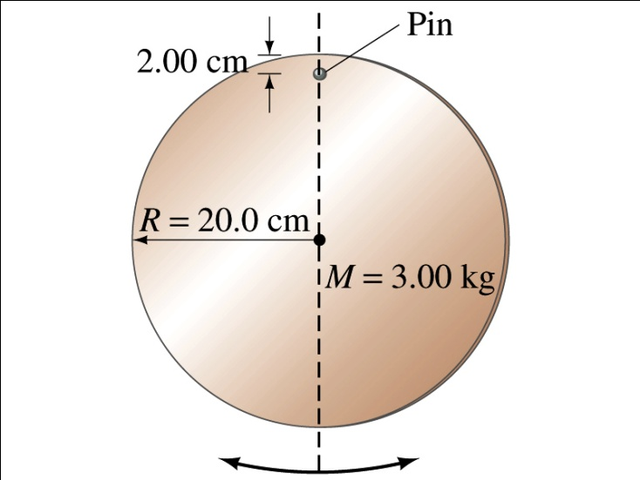
Chapter 11: Elasticity and Periodic Motion

Slide 2
Skiing with Harmonic motion in the German Alps

Slide 3
Chapter 11 Elasticity and Periodic Motion
● To understand stress, strain, and elastic deformation.
● To understand elasticity and plasticity.
● To understand simple harmonic motion (SHM).
● To solve equations of simple harmonic motion.
● To understand the pendulum as a an example of SHM.

Slide 4
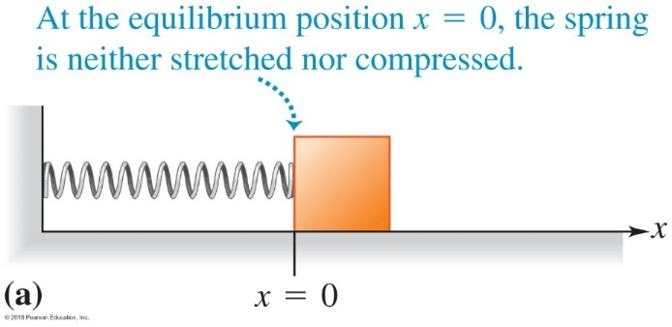
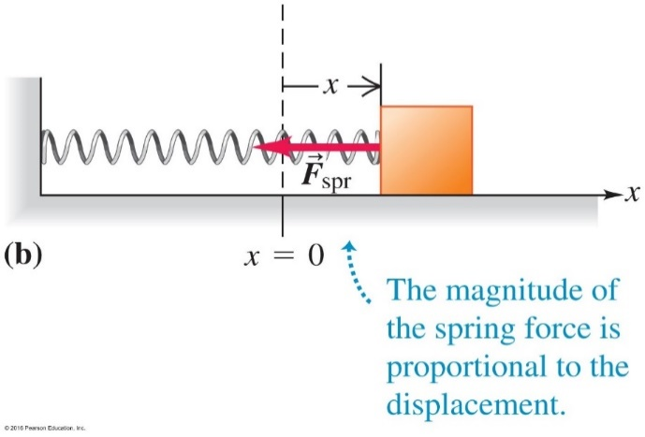
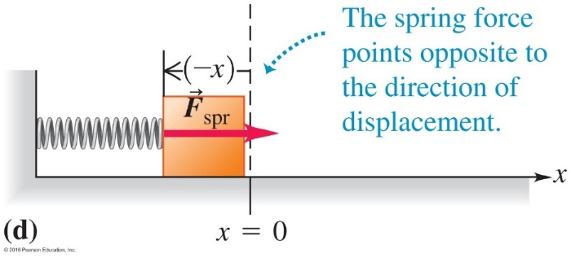
Hooke’s Law
5.4 Elastic Force
Spring, Spring Restoring Force, and Hooke’s Law
equilibrium at x = 0
Hooke’s Law on spring restoring force:
● In magnitude $F_{spr}=k∆L$
● Direction: Opposed to length change restoring force
● A general expression taking care of the direction
$F_{spr}=− kx$
● x is measured with respect to the equilibrium position
Example 5.14
A vertical spring balance scale stretches 1.00 cm when a 12.0 N weight is hung on it. If the 12.0 N weight is replaced by a 1.50 kg fish, by what amount is the spring stretched?
Answer:
Spring constant k = F/$∆L$ = (12.0 N)/(0.0100 m) = 1200 N/m
Stretching = F/k = mg/k = 0.0123 m = 1.23 cm
Direction of force with stretching
Direction of
force with
compression
(c)
We did this for springs in chapter 5, now for general objects

Slide 5
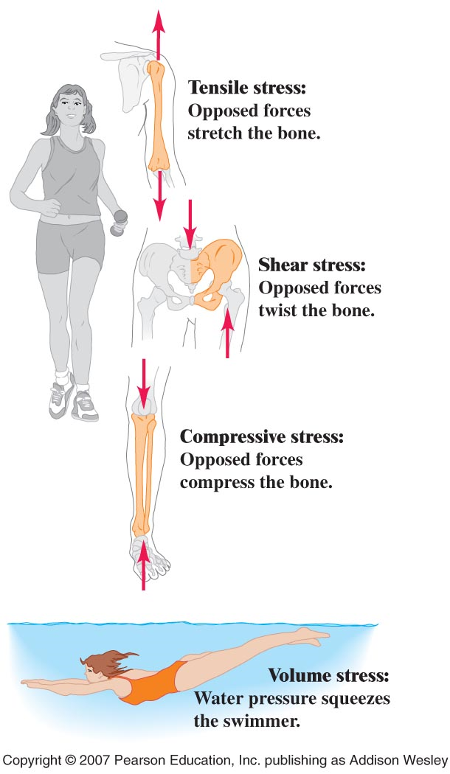
Stress and strain

Slide 6
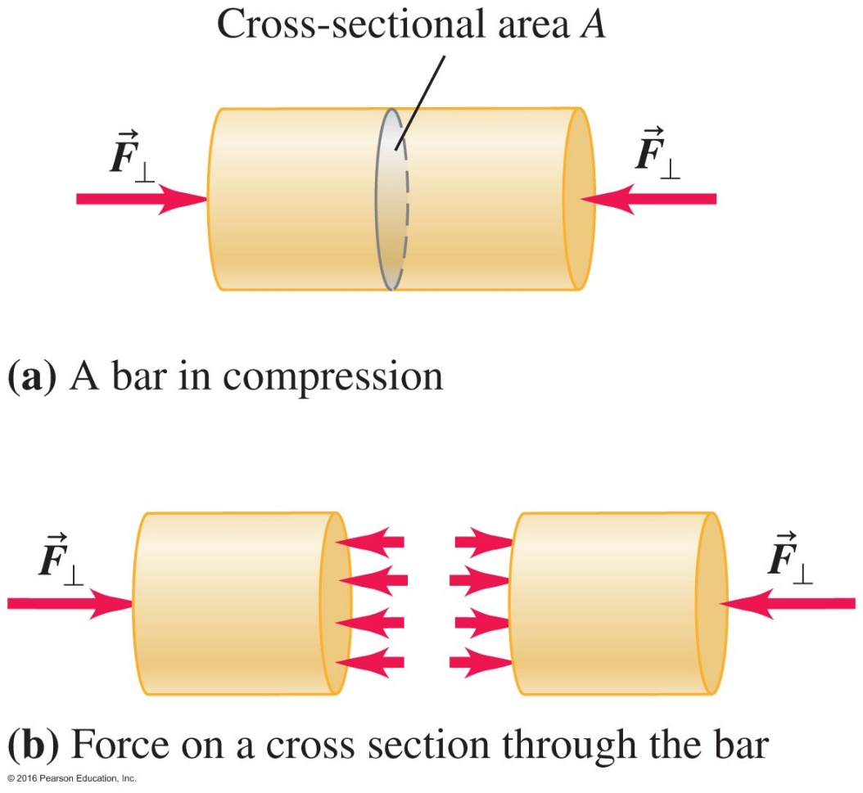
11.1 Stress, Strain, and Elastic Deformation

Slide 7
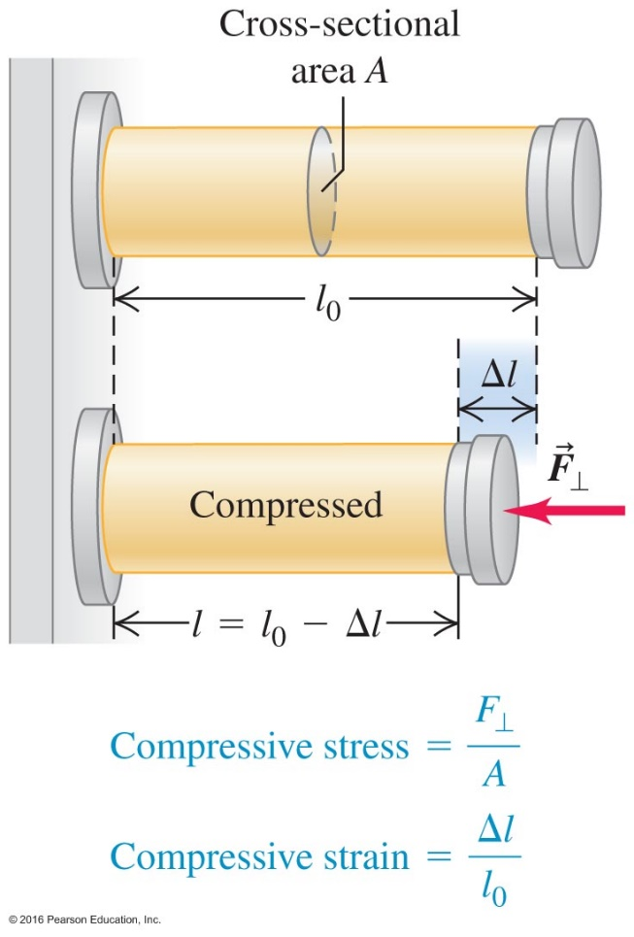
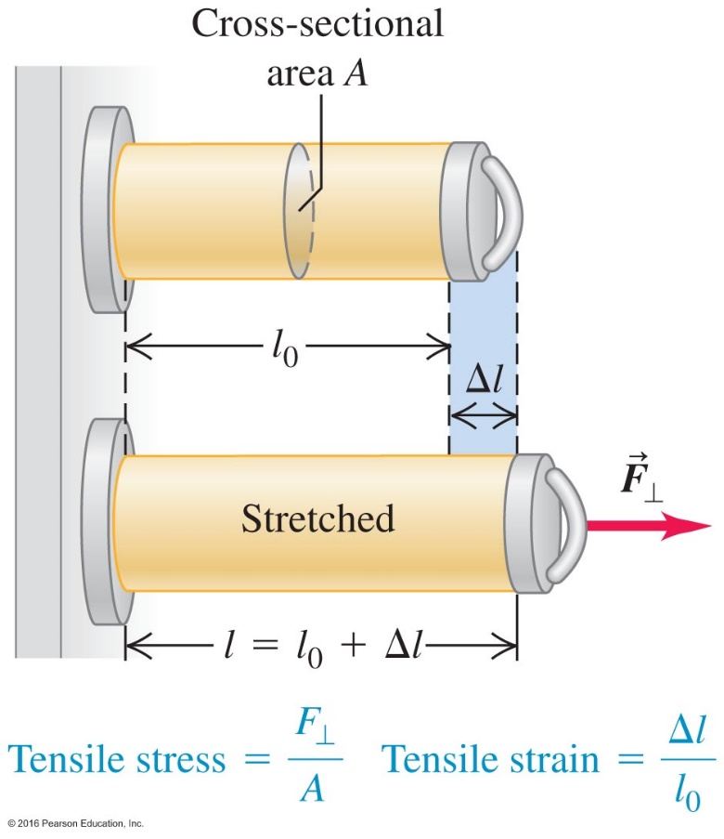
Tensile and Compressive Stress and Strain

Slide 8
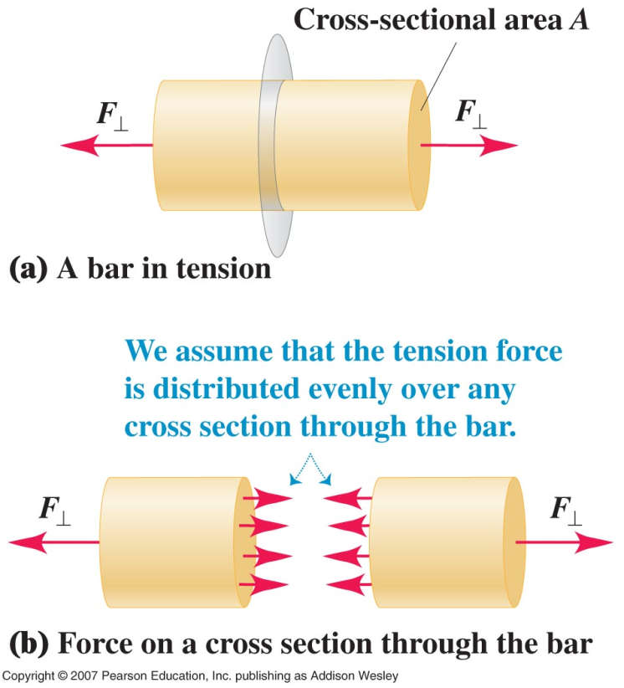
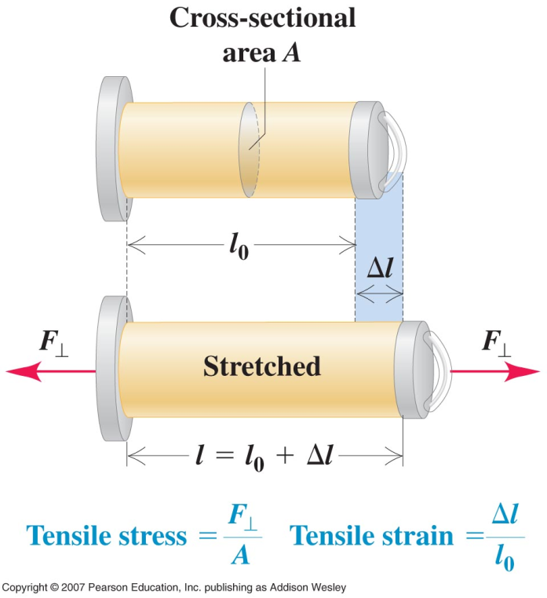
Compressive stress unit: pa=pascal=newton/m^2
Strain unit: dimensionless

Slide 9
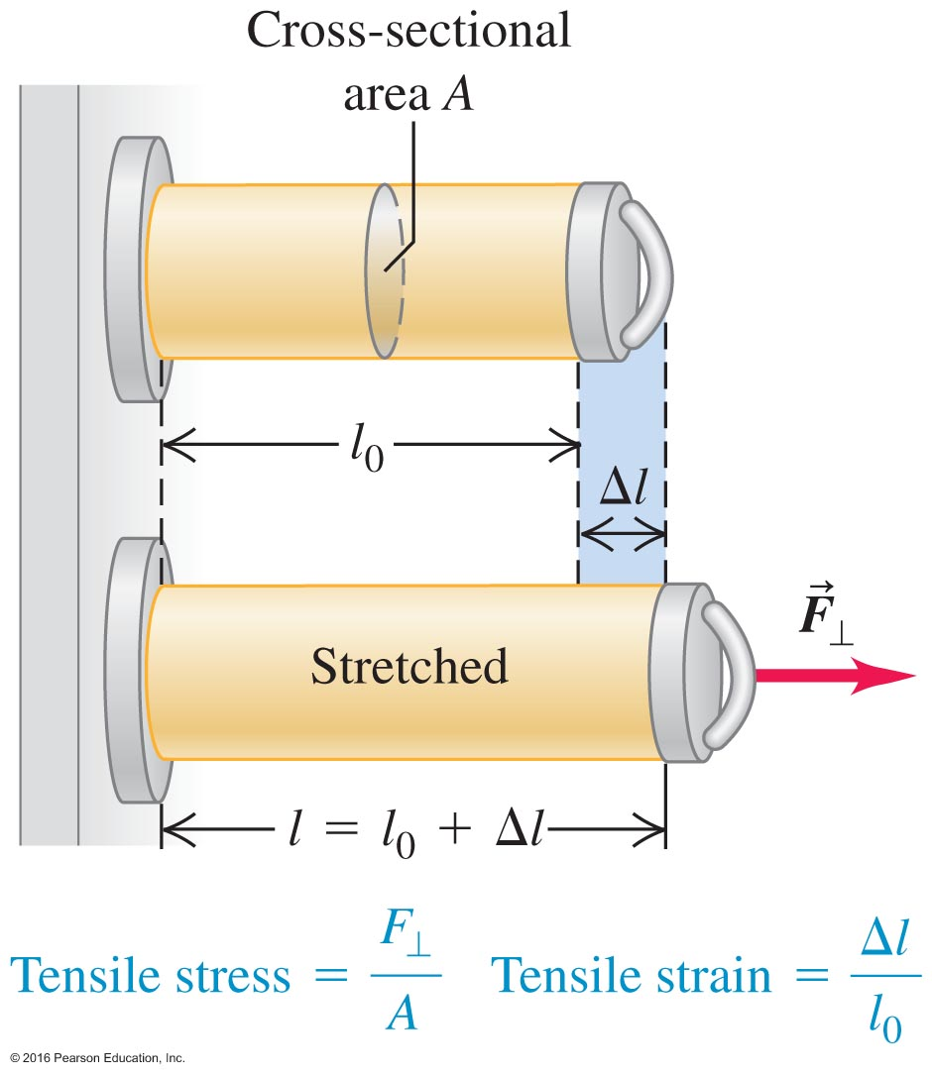
The Reaction to Stress Is Strain – Figure 11.4
If we return to the steel cable example, we could ask ourselves, "How much will the steel stretch under a load?"
Strain, then, is l/l₀, the unitless change in length divided by the original length.

Slide 10
Q11.5
Clicker question
Two rods are made of the same kind of steel and have the same diameter. A force of magnitude F is applied to each end of each rod. Compared to the rod of length L, the rod of length 2L has
F
length L
F
F
length 2L
F
A. more stress and more strain.
B. the same stress and more strain.
C. the same stress and less strain.
D. less stress and less strain.
E. the same stress and the same strain.
Notes:
Answer: E

Slide 11
Q11.6
Clicker question
Two rods are made of the same kind of steel. The longer rod has a greater diameter. A force of magnitude F is applied to each end of each rod. Compared to the rod of length L, the rod of length 2L has
F
length L
F
F
length 2L
F
A. more stress and more strain.
B. the same stress and more strain.
C. the same stress and less strain.
D. less stress and less strain.
E. the same stress and the same strain.
Notes:
Answer: D

Slide 12
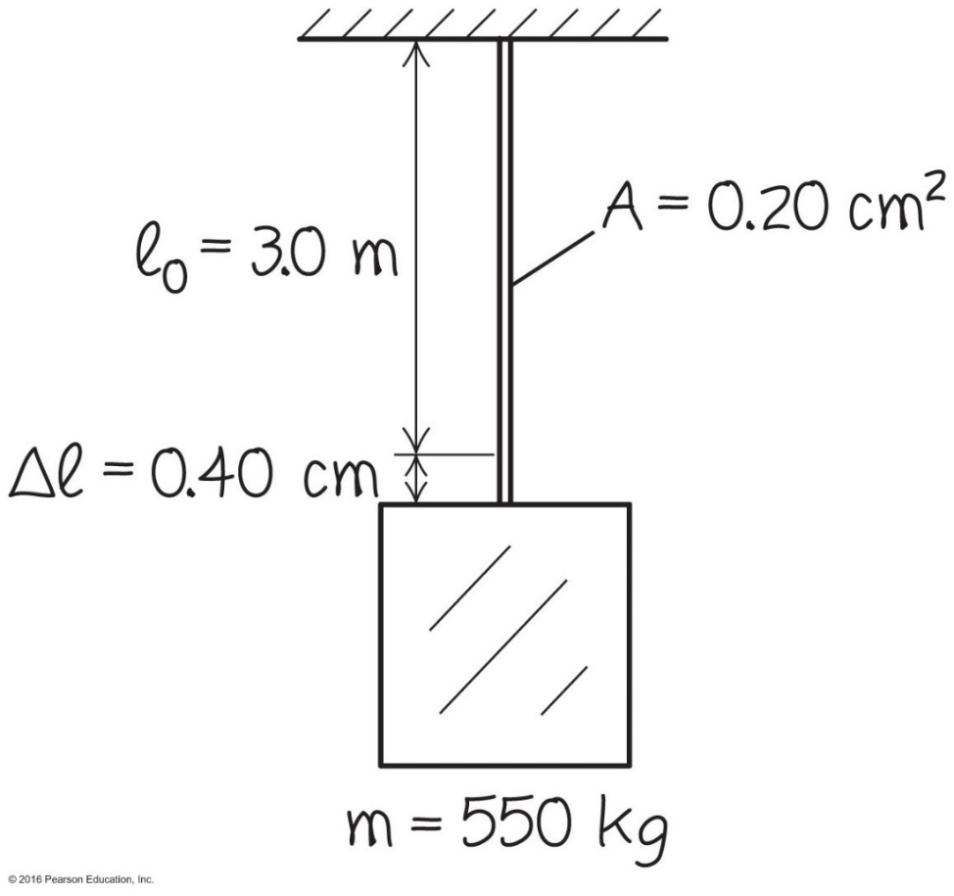
Example 11.1
A stretching elevator cable
Note: strain is dimensionless

Slide 13
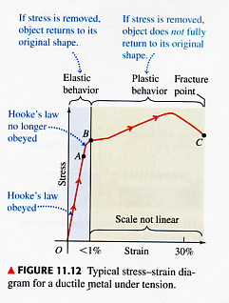
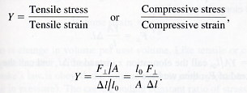
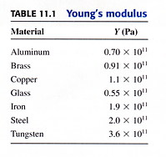
Elasticity and Plasticity
F _{x} =kx Hook’s law

Slide 14
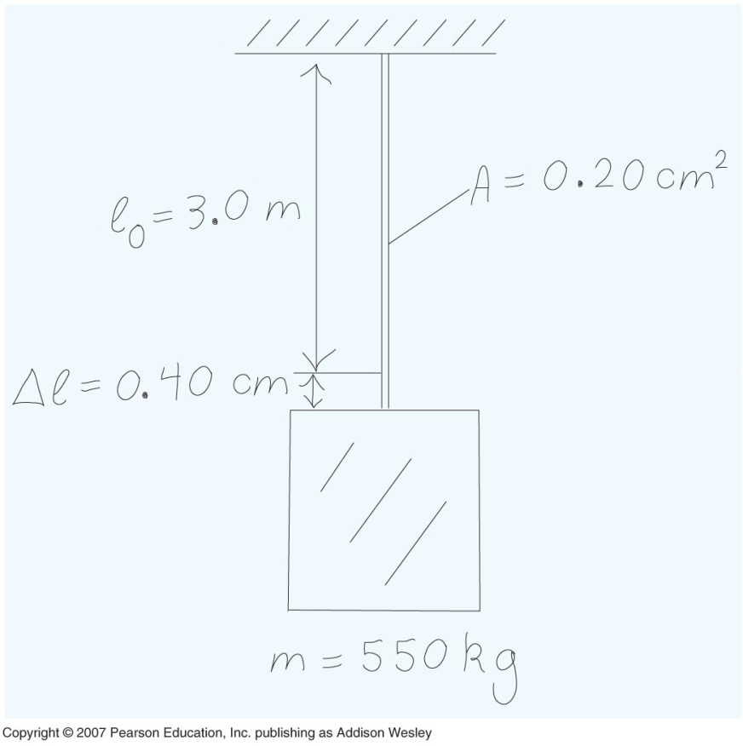
1 Pa = 1N/m ²

Slide 16
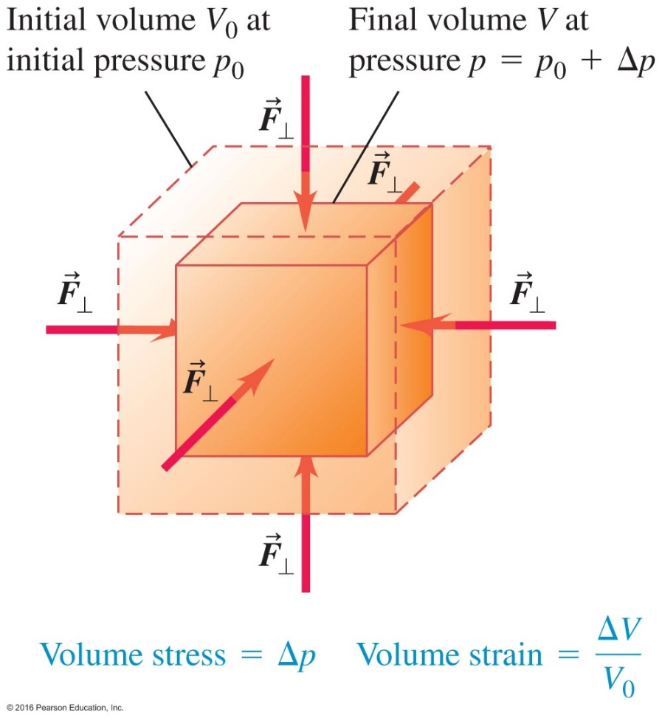
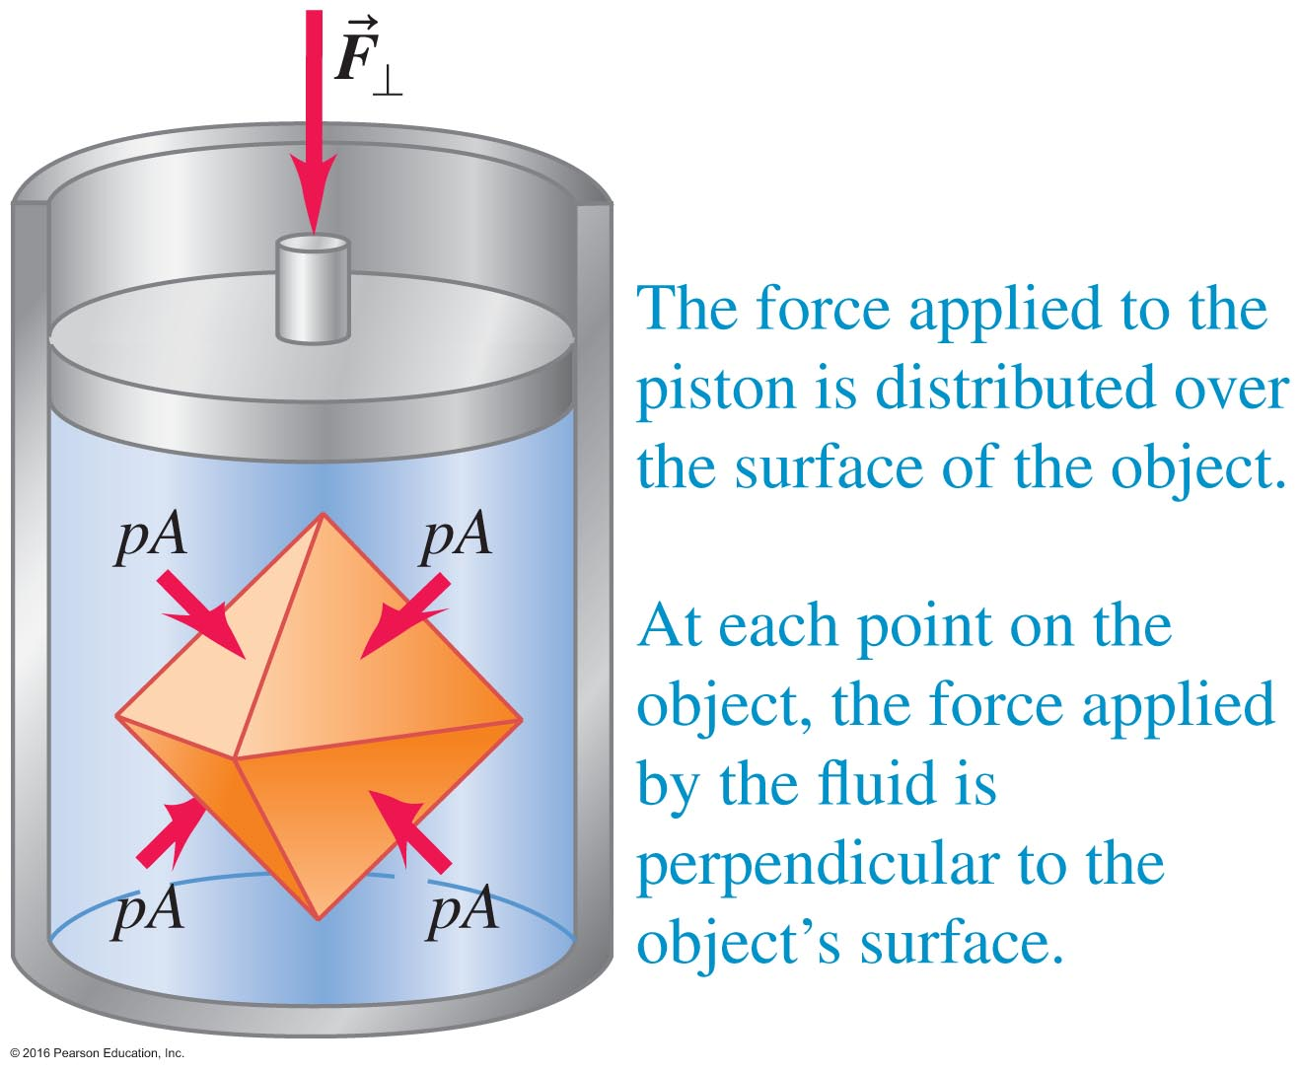
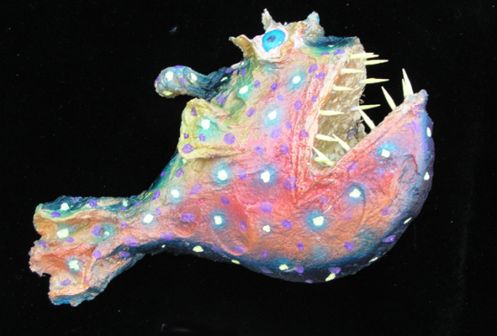
Volume Stress and Strain

Slide 17
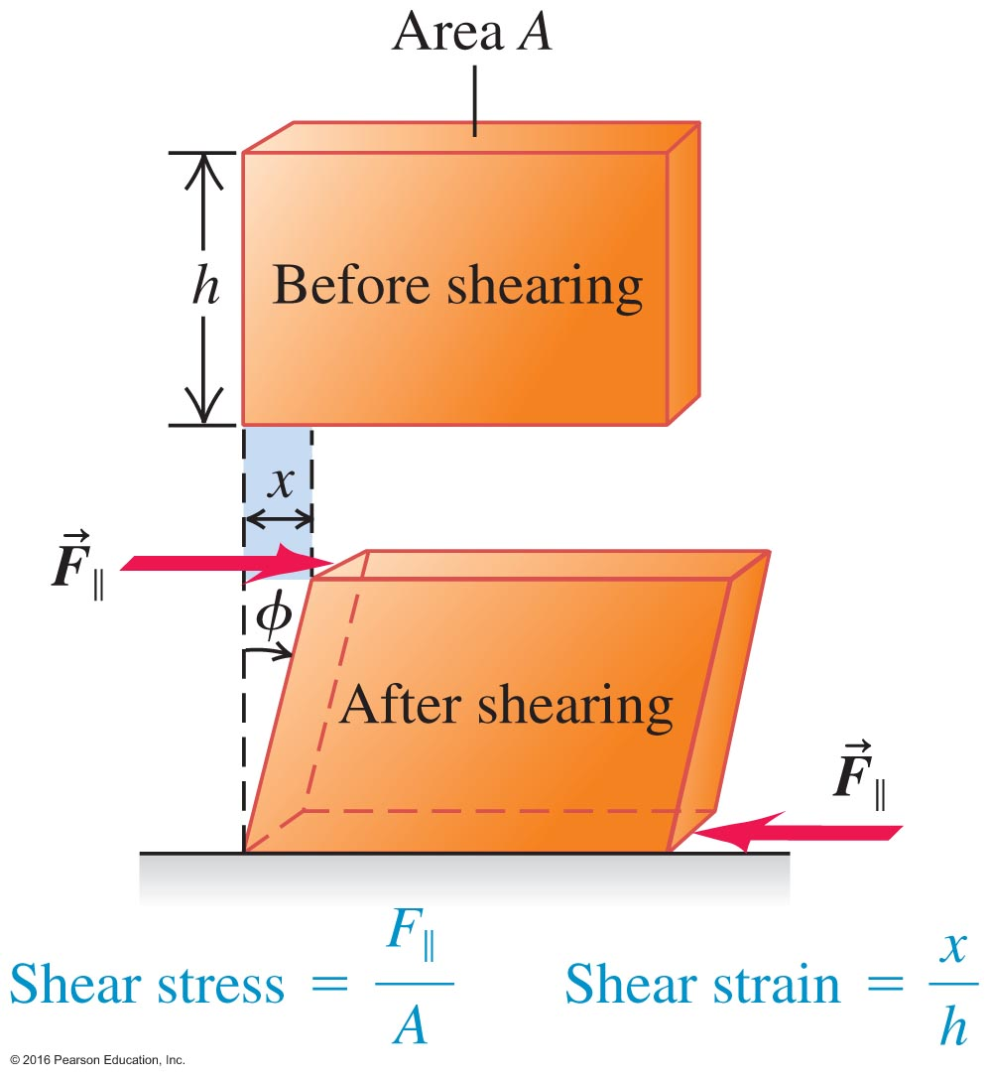
Shear Stress and Strain

Slide 18
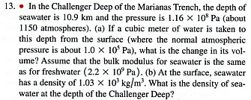

Slide 19
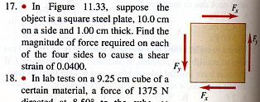
(Shear modulus for steel 0.84 ·10^11Pa)
N
or (Pa)
(No dimension)

Slide 20
Shear Stress and Strain

Slide 21
Simple harmonic motion SMH

Slide 22
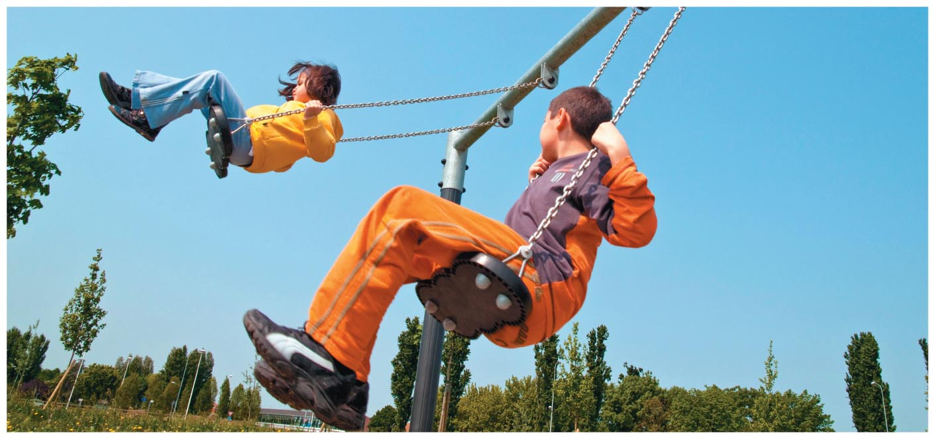
Notes:
Chapter 11 Opener

Slide 23
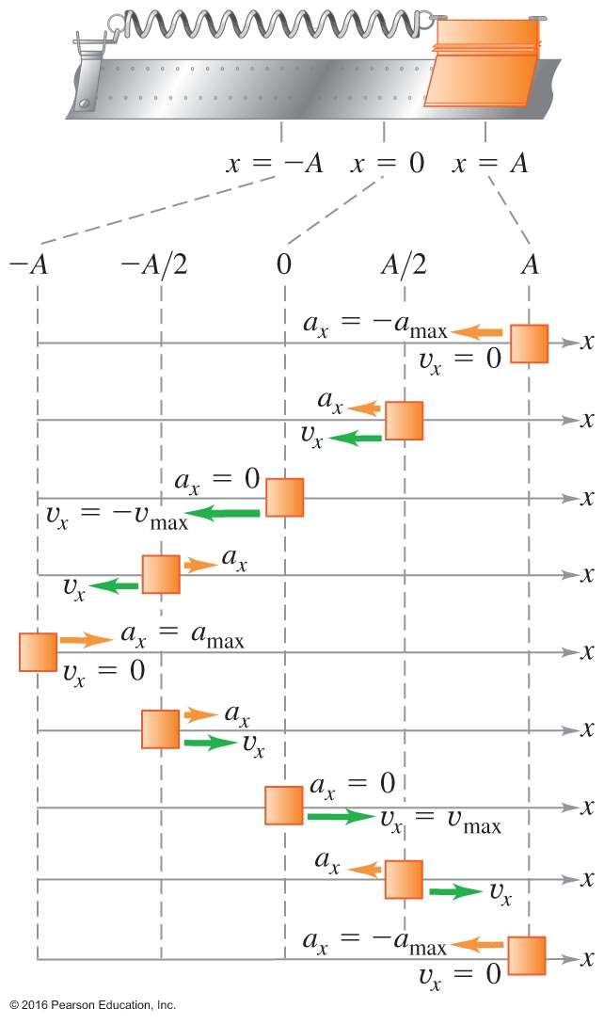
11.2 Periodic Motion

Slide 24
k= a m/ A =( 20 m/s ² ) 4 kg/0.5 m

Slide 25
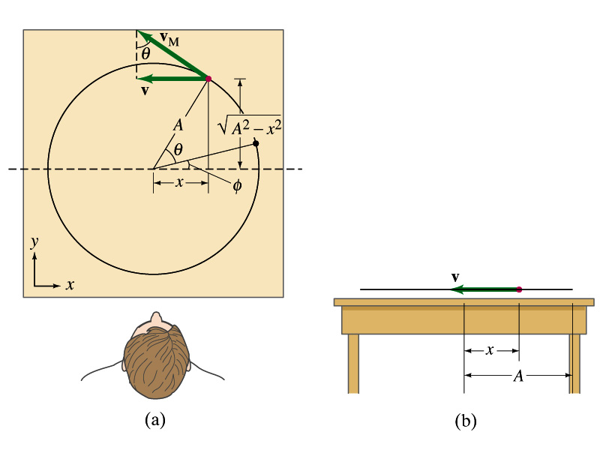
Circle of Reference
Simple harmonic motion is the projection of uniform circular motion on a diameter.
Consider a ball on a circular track on the table and looking at it from the side

Slide 26
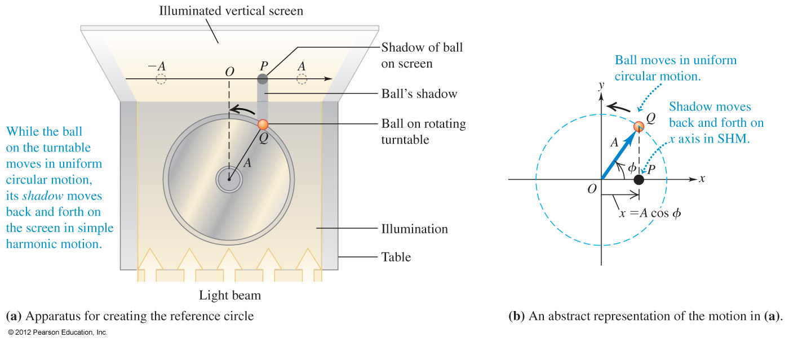
Circle of Reference

Slide 27
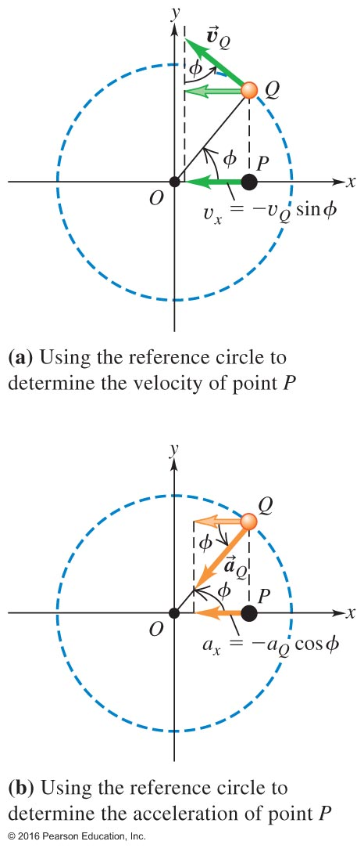
Circle of Reference: Consider a small object undergoing a uniform circular motion as shown in the sketch. The x-component of the position of the object obeys SHM exactly. Therefore, the expressions describing the x-component of its positon can be used to describe SHM.

Slide 28
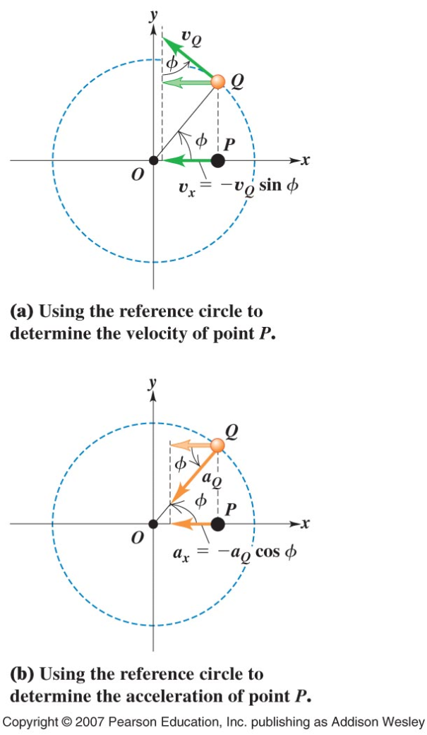
Use Hooke’s law

Slide 29
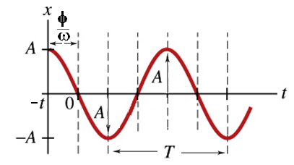
Simple harmonic motion

Slide 30
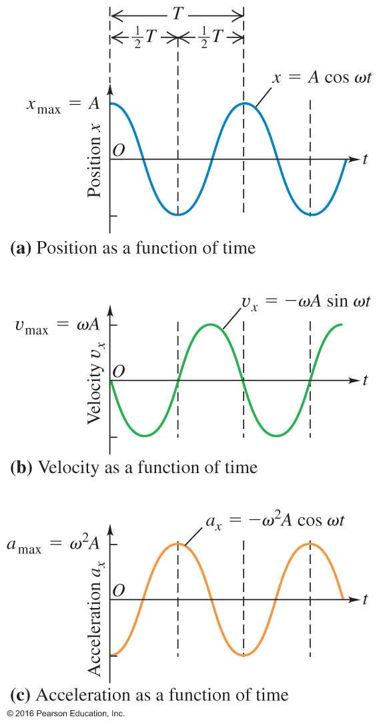
Position, Velocity, and Acceleration
Graphs from a particle undergoing simple harmonic motion.

Slide 31
x = A Cos(ωt +φ )
v = - ω A Sin(ωt +φ )
2π
ω = = 2π f
T
-a=- ω² A Cos(ωt +φ )

Slide 32
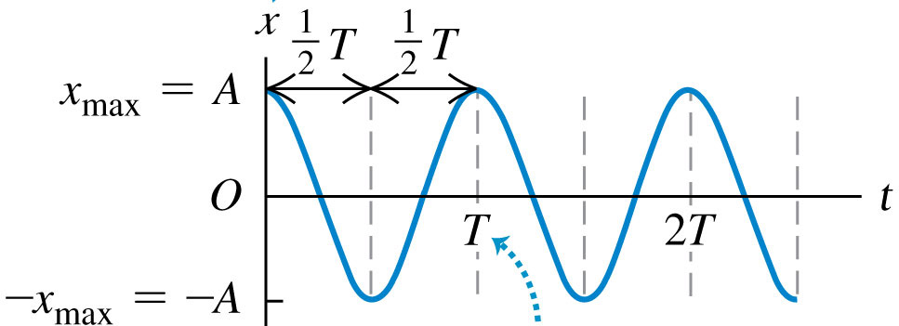
Q14.2
Clicker question
This is an x-t graph for an object in simple harmonic motion. At which of the following times does the object have the most negative velocity v_{x}?
A. t = T/4
B. t = T/2
C. t = 3T/4
D. t = T
E. Two of the above are tied for most negative velocity.
Notes:
Answer: A

Slide 33
Q14.3
Clicker question
This is an x-t graph for an object in simple harmonic motion. At which of the following times does the object have the most negative acceleration a_{x}?
A. t = T/4
B. t = T/2
C. t = 3T/4
D. t = T
E. Two of the above are tied for most negative acceleration.
Notes:
Answer: D

Slide 35
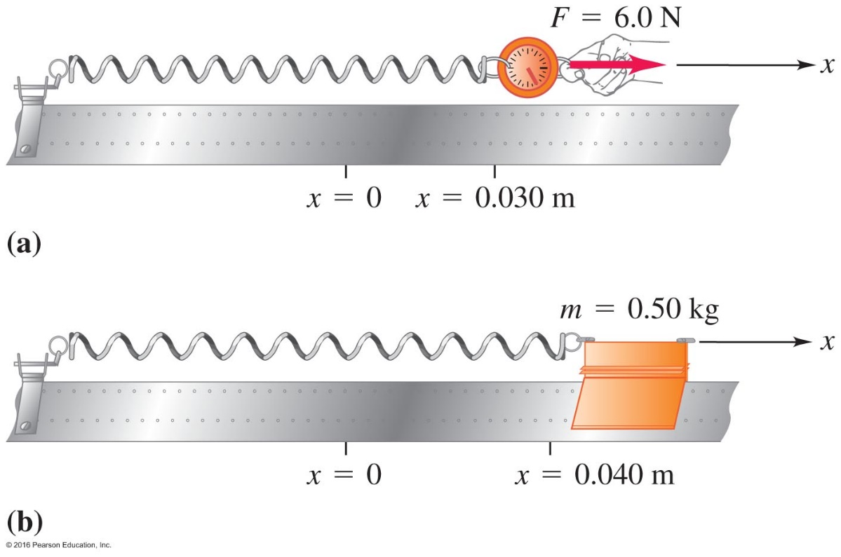
Example 11.5 on page 334, SHM on an air track
Given: m and A. Force constant k is give indirectly.
Find: (a) force constant k
(b) the maximum & minimum velocities
(c) the maximum & minimum accelerations
(d) v & a at half way to x = 0
(e) K, U, and E at half way to x = 0

Slide 36
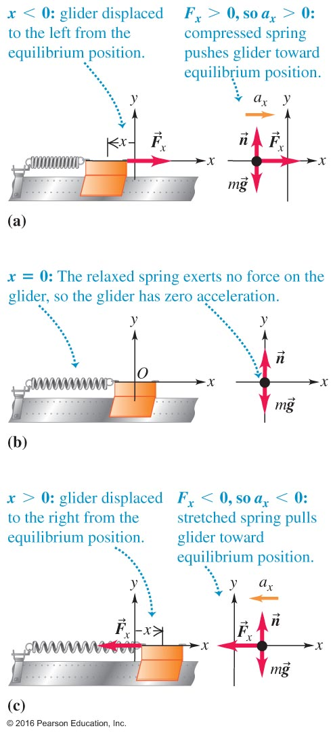
Elastic Situations Yield Simple Harmonic Motion
.

Slide 37
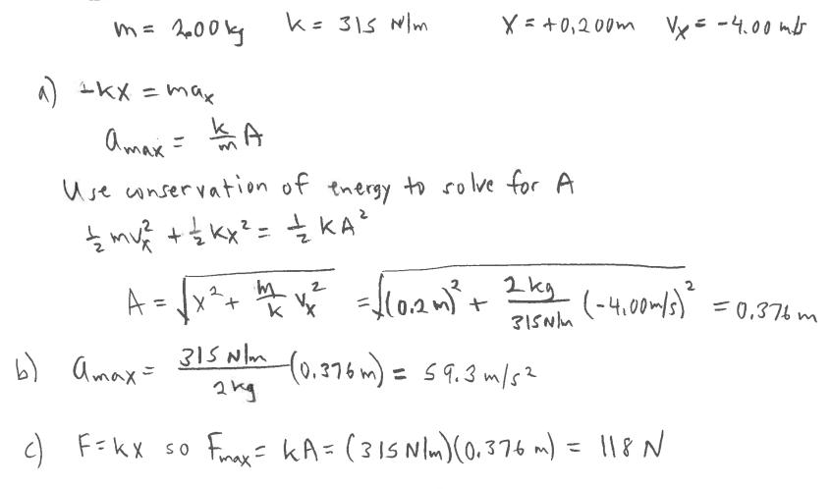
A block with mass m is attached to a spring with force constant k = 315 N/m. The spring is stretch in positive x direction by the amount shown, and the block has an initial velocity in the negative x direction.
Find the amplitude of the block.
Find the maximum acceleration of the block.
Find the maximum force the spring exerts on the block.
-4 m/s
k
m = 2 kg
0.2 m
X = 0

Slide 38
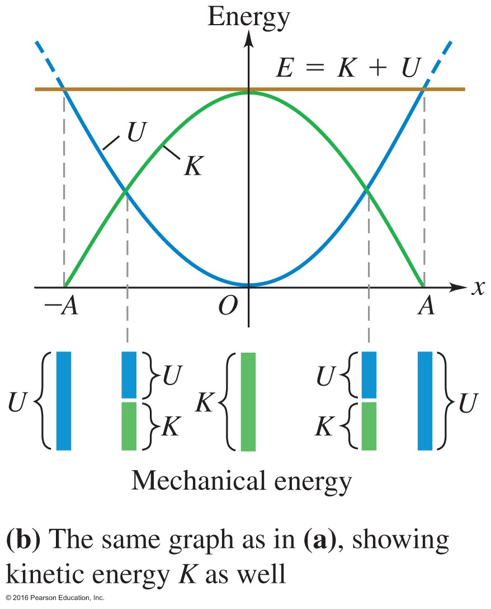
11.3 Energy in Simple Harmonic Motion

Slide 39
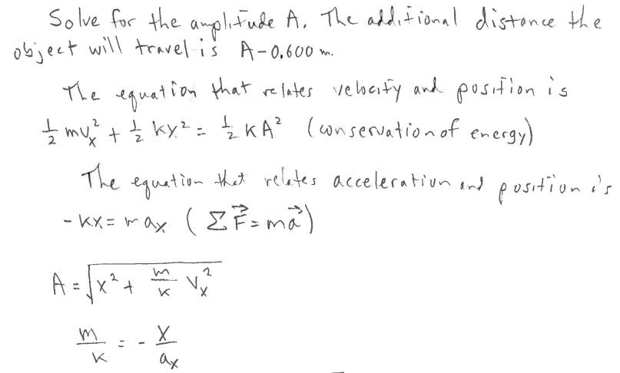
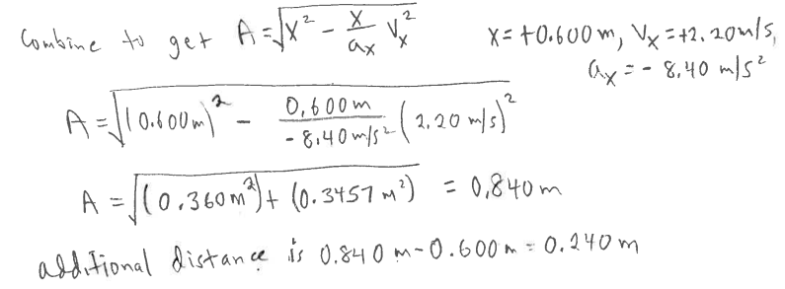
0.6 m
The object to the left is following Simple Harmonic Motion. It starts at the position shown with the velocity and acceleration as given. How much further from its current point will the object move before it stop momentarily and then starts to move back to the left?
v = +2.2 m/s
a = - 8.4 m/s²
X = 0

Slide 41
You construct a spring–glider system that oscillates with simple harmonic motion at a frequency f. If you replace the glider with one having one-fourth the mass, what is the system's new frequency?
Clicker question
a) f
b) 2f
c) 1/2f
d) 1/4f
Notes:
Answer: b) 2f

Slide 42
Pause and Consider Our Terminology –Figure 11.15
Oscillation
Restoring force
SHM
Hooke's Law
Amplitude (A) … in meters
Cycle
Period (T) … in seconds
Frequency (f) … in 1/s or Hz
Angular frequency ( ) … in rad/s

Slide 43
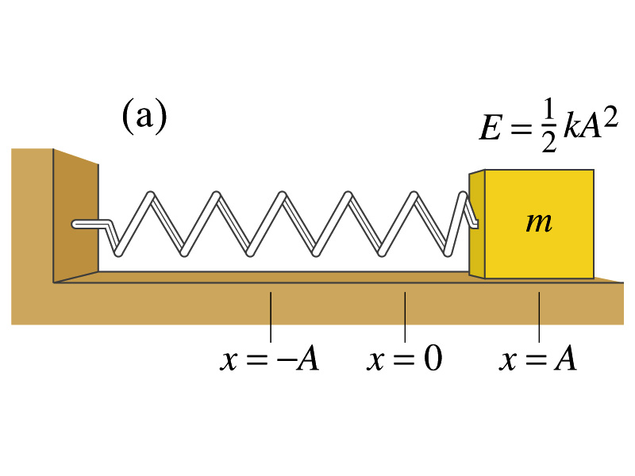
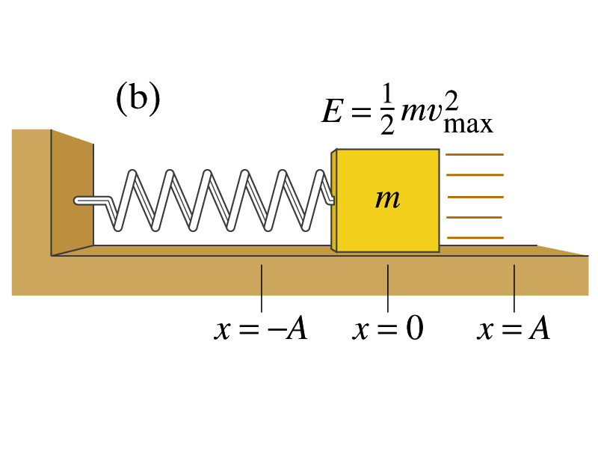
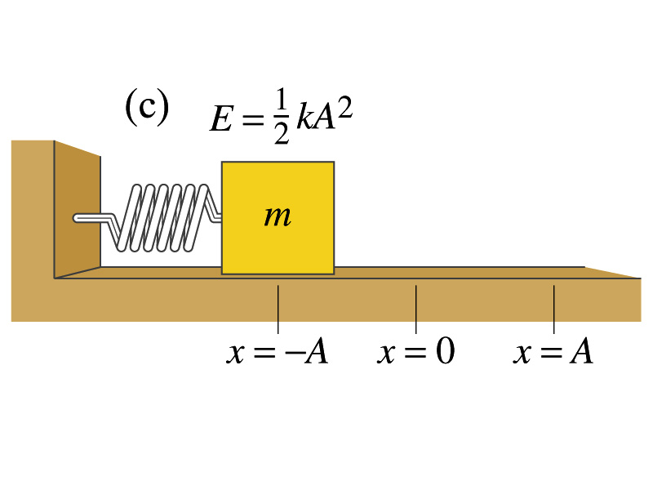
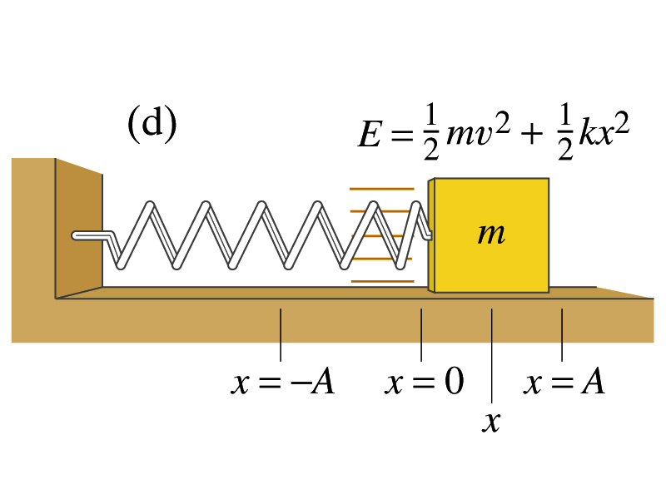
Energy in SHM

Slide 44
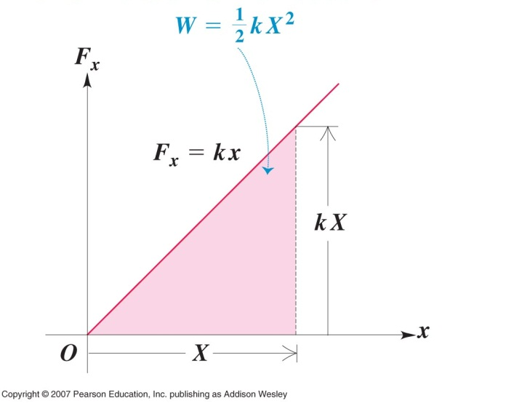
A force varying with distance is the basis of SHM

Slide 45
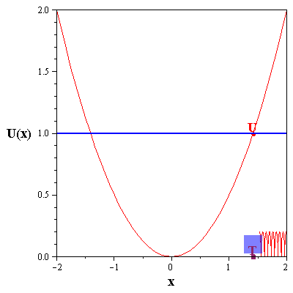
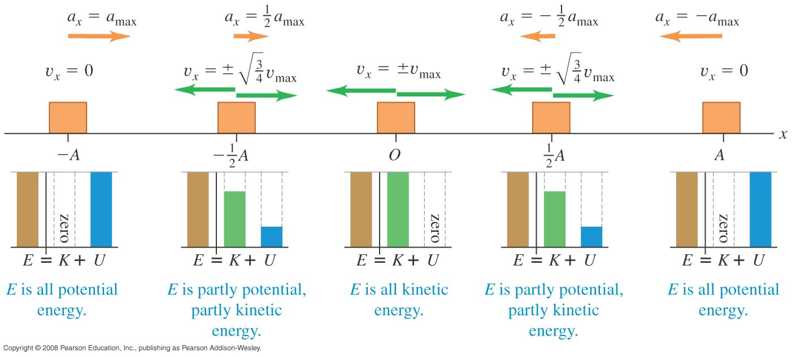
Energy in SHM Energy Changes as the Oscillator Moves –Figure 11.17
Energy is conserved during SHM and the forms (potential and kinetic) interconvert as the position of the object in motion changes.

Slide 46
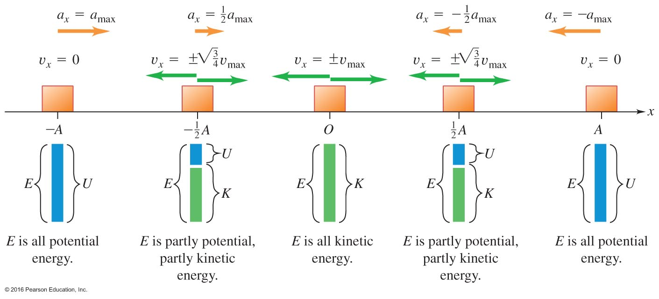
Energy Changes as the Oscillator Moves –Figure 11.17
Conserved in the absence of friction, energy converts between kinetic and potential.

Slide 47
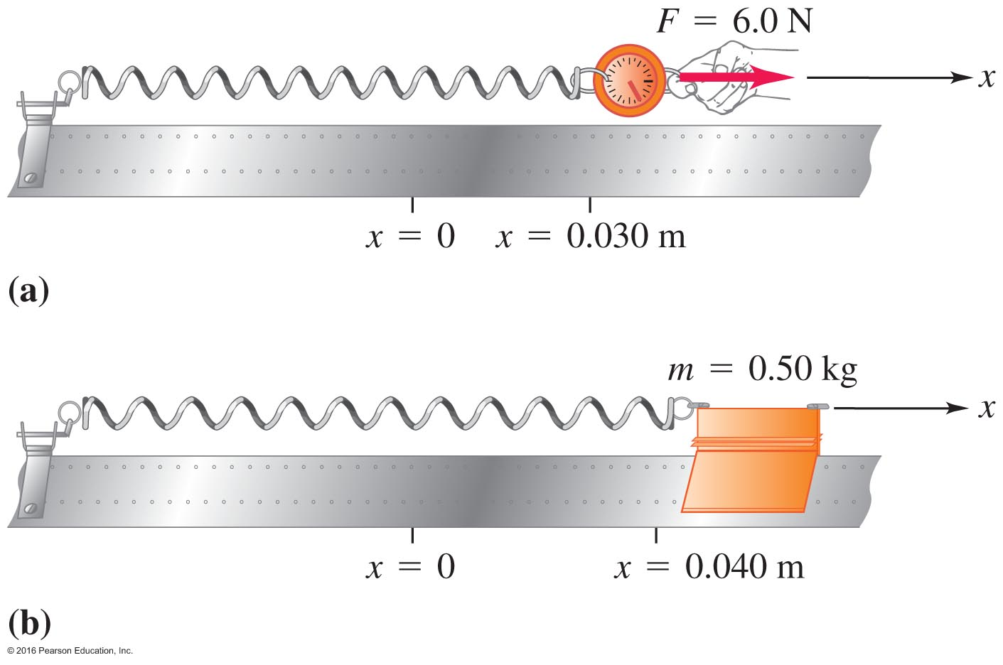
A Problem Using an Air Track – Example 11.5
Refer to the solved problem on page 334.

Slide 48
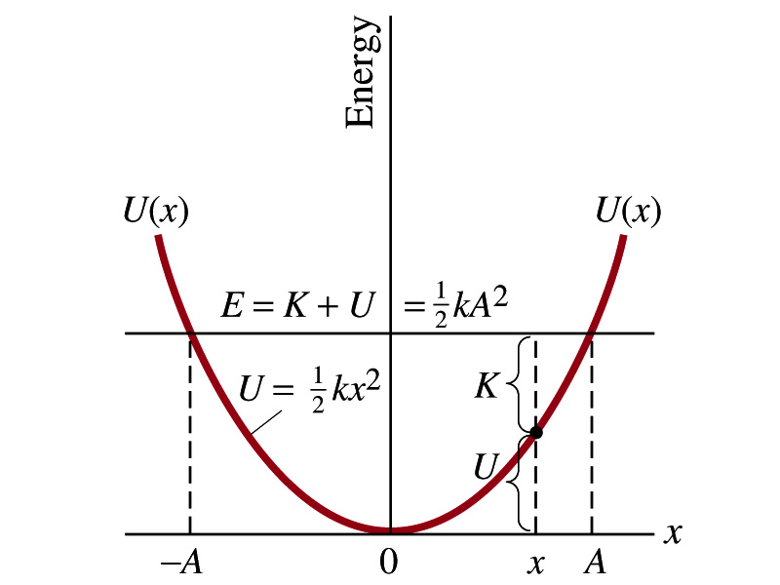
Energy conservation in SHM

Slide 49
Notes:
Figure 11.18

Slide 50
Q14.6
Clicker question
This is an x-t graph for an object connected to a spring and moving in simple harmonic motion. At which of the following times is the potential energy of the spring the greatest?
A. t = T/8
B. t = T/4
C. t = 3T/8
D. t = T/2
E. Two of the above are tied for greatest potential energy.
Notes:
Answer: D

Slide 51
Q14.7
Clicker question
This is an x-t graph for an object connected to a spring and moving in simple harmonic motion. At which of the following times is the kinetic energy of the object the greatest?
A. t = T/8
B. t = T/4
C. t = 3T/8
D. t = T/2
E. Two of the above are tied for greatest kinetic energy.
Notes:
Answer: B

Slide 54
11.5 The Simple Pendulum

Slide 56
A Pendulum Undergoes Harmonic Motion –
The pendulum is a good example of harmonic motion.
Oscillations depend on the length of the pendulum and the gravitational restoring, force BUT not the mass.
.

Slide 57
mg
F = -mg Sinθ ≈ -mg θ
x = L θ
F ≈ - x
L
mg
F = -kx
k =
L
θ = θ_{max} Cos(ωt +φ )
k
g
ω = =
m
L
Note: mass doesn’t enter
amplitude doesn’t enter

Slide 58
Clicker question
Foucault pendulum at TAMU
L=25 m
L=10 m
L=30 m
L=35 m
Notes:
L=25 m

Slide 59
You install two rope swings from a tree in your yard. The rope for swing A is 1/4 as long as the rope for swing B. Assuming they behave like ideal pendulums, how do their periods compare?
Clicker question
a) T_{A} = T_{B}
b) T_{A} = 1/2T_{B}
c) T_{A} = 2T_{B}
d) T_{A} = 2T_{B}
Notes:
Answer: c) T_{A} = 2T_{B}

Slide 60
What is the period of a pendulum on mars (g(mass)=3.71 m/s^2), if the period of this pendulum on earth is 1.6 sec.

Slide 61
SUMMARY
Periodic motion: motion that repeats itself in a defined cycle.
Simple harmonic motion: if the restoring force is proportional to the distance from equilibrium, the motion will be of the SHM type. The angular frequency and period do not depend on the amplitude of oscillation.
Energy in SHM:
Simple pendulum:

Slide 62
X versus t for SHM then simple variations on a theme
VERY IMPORTANT: frequency and period of oscillations DO NOT depend on the amplitude!!

Slide 63
Q14.9
Clicker question
A simple pendulum consists of a point mass suspended by a massless, unstrechable string. If the mass is doubled while the length of the string remains the same, the period of the pendulum
A. becomes four times greater.
B. becomes twice as great.
C. becomes smaller by a factor of
D. remains unchanged.
E. decreases.
Notes:
Answer: D

Slide 64
Notes:
b)Middle car gravitational and centrifugal accelerations act longest an the center of gravity which is the middle car

Slide 65
SI session on Sundays
Office hours:
Carlos Tuesday and Wednesday at1pm-2pm in MPHY 470
'Jonah Dean' via 202331 PHYS 201 all <cs-phys201-202331@lists.tamu.edu>
​cs-phys201-202331@lists.tamu.edu
​SI session at 6:00 - 7:15 In ILCB 224, see you there!

Slide 66
Notification
There will be no attendance quiz on Thursday
I have updated the lecture for chapter 11
Carlos updated study guide for exam3

Slide 67
Series & Parallel Spring
Two identical springs are linked together first in series and then in parallel. A mass is hung from each configuration and the effective spring constant is measured and compared to the spring constant of a single spring.
k (effective) is the same for 2 springs in series
k (effective) is different 2 springs in parallel
k is constant for single spring

