Slide 1

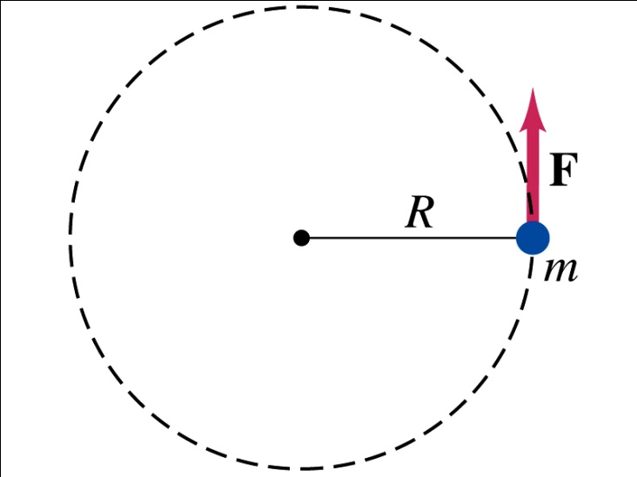
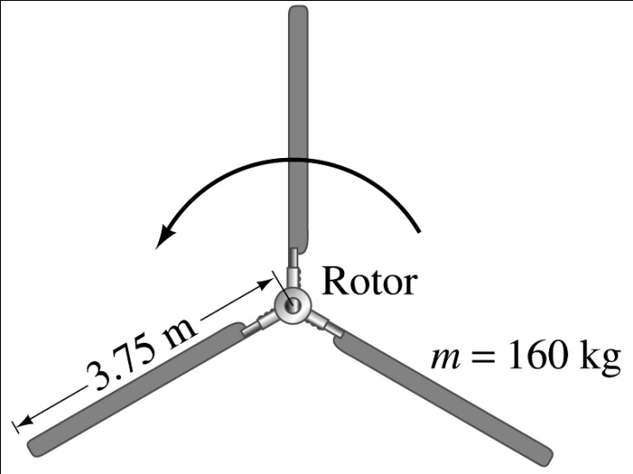
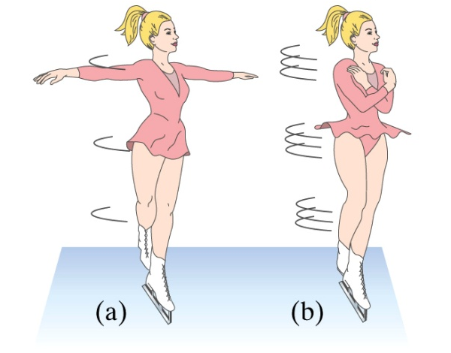
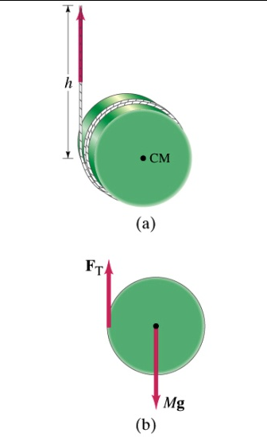
Chapter 9 Rotational Motion
Rigid body instead of a particle
Rotational motion about a fixed axis
Rolling motion (without slipping)

Slide 2
Chapter 9 Rotational Motion
● To study angular velocity and angular acceleration.
● To examine rotation with constant angular acceleration.
● To understand the relationship between linear and angular quantities.
● To determine the kinetic energy of rotation and the moment of inertia.
● To study rotation about a moving axis.
Courtesy of Wenhao Wu

Slide 3
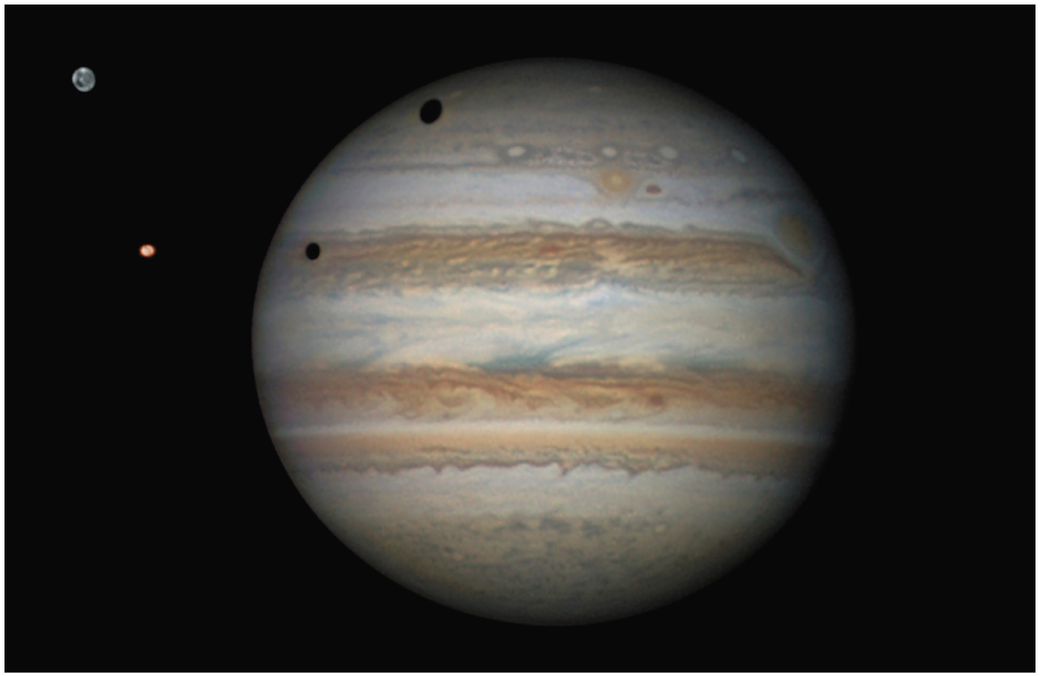
Chapter 9 Opener
Jupiter is the fastest rotating planet 1rotation takes about 10hours

Slide 4
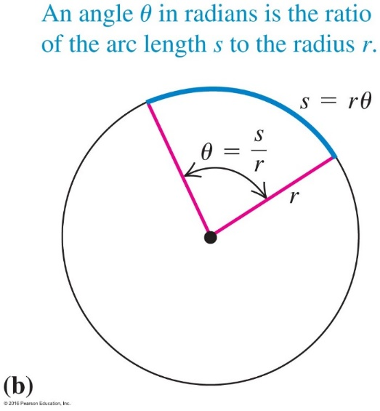
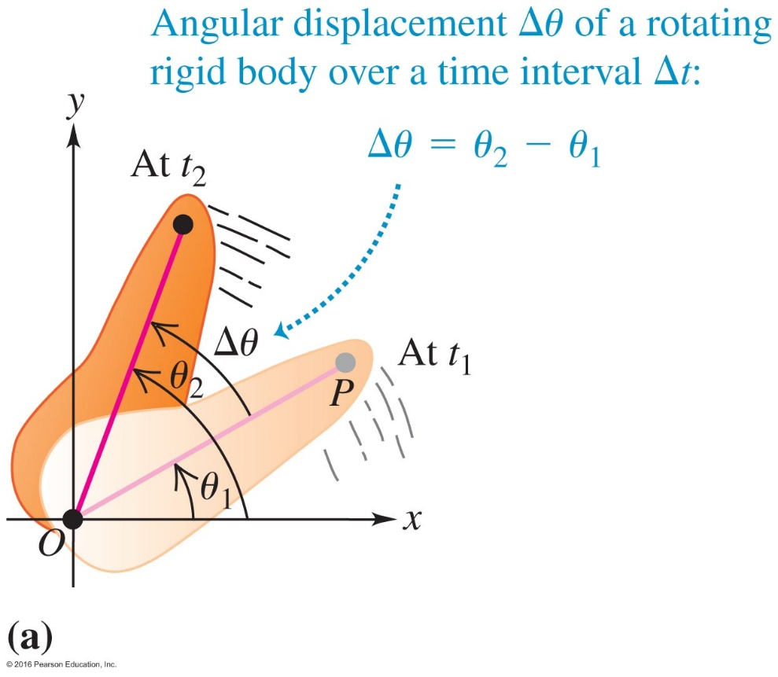
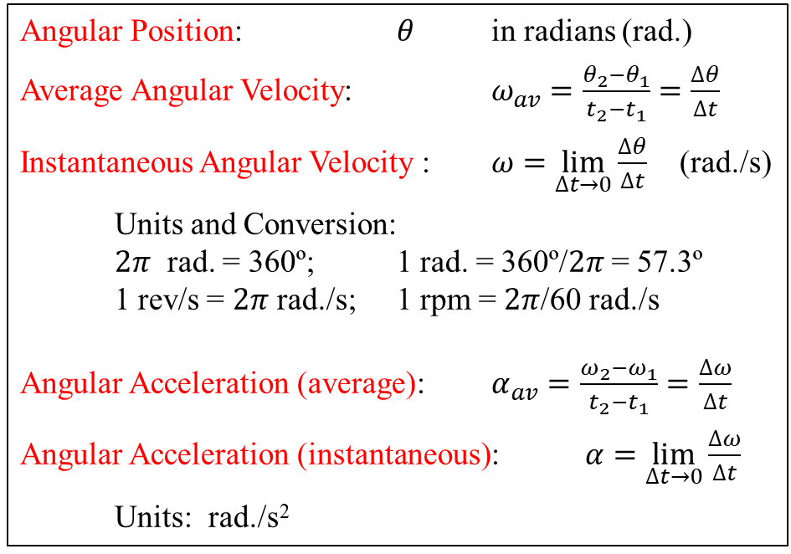
9.1 Angular Position, Angular Velocity,
and Angular Acceleration
Angular Position: $θ$ in radians (rad.)
Average Angular Velocity: $ω_{av}=\frac{θ_{2}−θ_{1}}{t_{2}−t_{1}}=\frac{∆θ}{∆t}$
Instantaneous Angular Velocity : $ω=\lim_{∆t→0}{\frac{∆θ}{∆t}}$ (rad./s)
Units and Conversion:
$2π$ rad. = 360º; 1 rad. = 360º/$2π$ = 57.3º
1 rev/s = $2π$ rad./s; 1 rpm = $2π$/60 rad./s
Angular Acceleration (average): $α_{av}=\frac{ω_{2}−ω_{1}}{t_{2}−t_{1}}=\frac{∆ω}{∆t}$
Angular Acceleration (instantaneous): $α=\lim_{∆t→0}{\frac{∆ω}{∆t}}$
Units: rad./s²
Angular
Displacement
Courtesy of Wenhao Wu

Slide 5
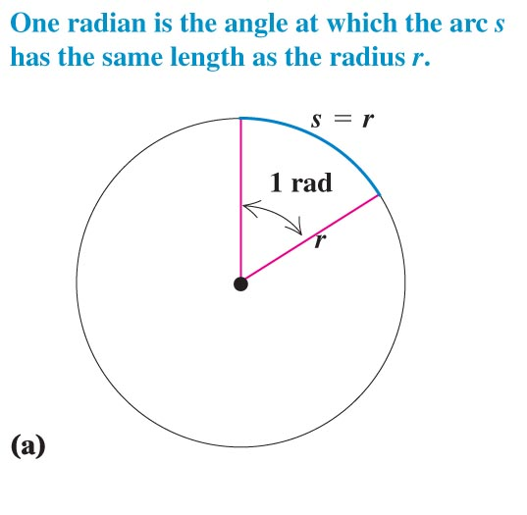
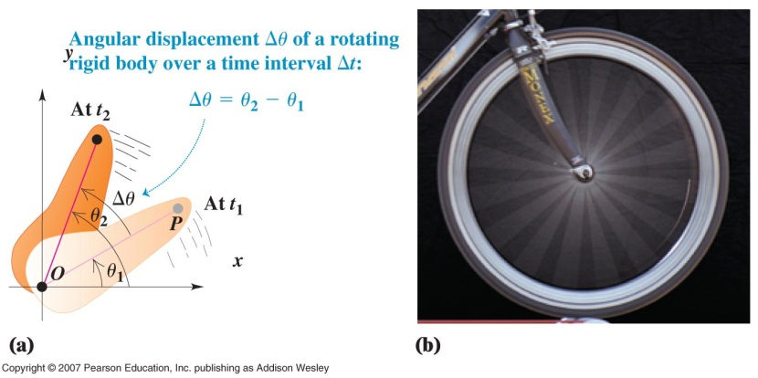
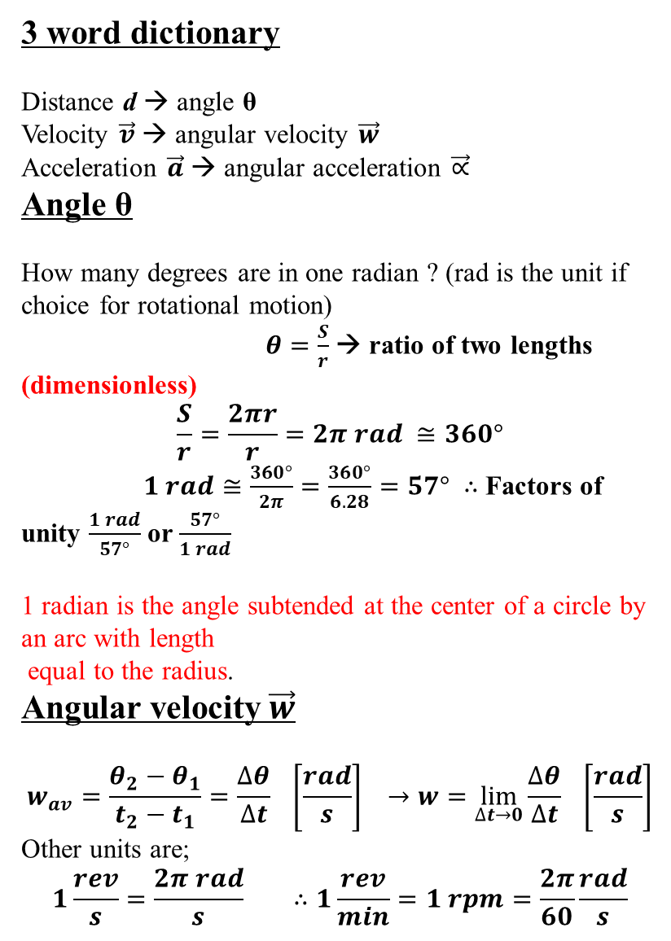
3 word dictionary
Distance d → angle θ
Velocity $\vec{v}$ → angular velocity $\vec{w}$
Acceleration $\vec{a}$ → angular acceleration $\vec{∝}$
Angle θ
How many degrees are in one radian ? (rad is the unit if choice for rotational motion)
$θ=\frac{S}{r}$ → ratio of two lengths (dimensionless)
$$\frac{S}{r}=\frac{2πr}{r}=2π rad ≅360°$$
$1 rad≅\frac{360°}{2π}=\frac{360°}{6.28}=57°$ $∴$ Factors of unity $\frac{1 rad}{57°}$ or $\frac{57°}{1 rad}$
1 radian is the angle subtended at the center of a circle by an arc with length
equal to the radius.
Angular velocity $\vec{w}$
$$w_{av}=\frac{θ_{2}−θ_{1}}{t_{2}−t_{1}}=\frac{∆θ}{∆t} \left[\frac{rad}{s}\right] →w=\lim_{∆t→0}{\frac{∆θ}{∆t} \left[\frac{rad}{s}\right]}$$
Other units are;
$$1\frac{rev}{s}=\frac{2π rad}{s} ∴1\frac{rev}{min}=1 rpm=\frac{2π}{60}\frac{rad}{s}$$
Concepts of rotational motion

Slide 6
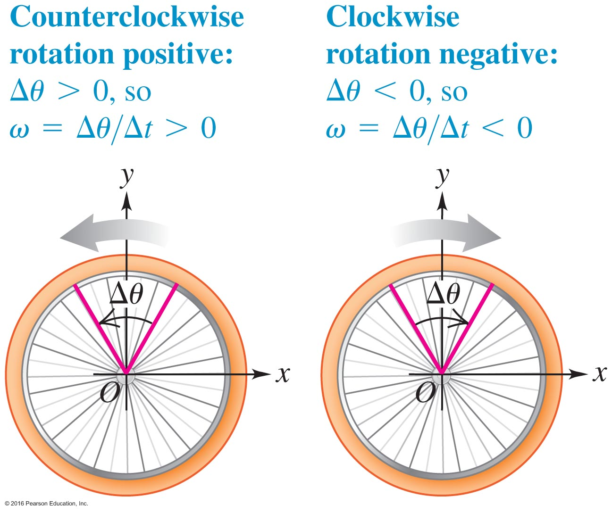
We Have a Sign Convention – Figure 9.7

Slide 7
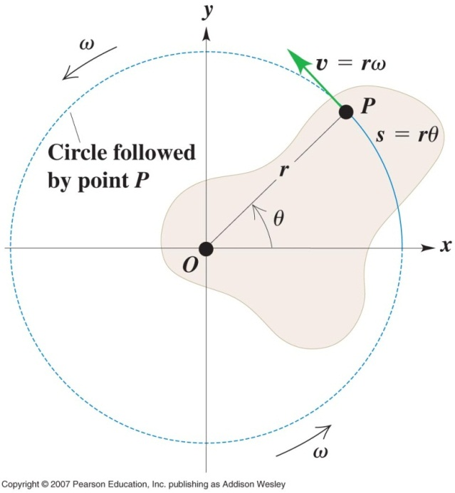
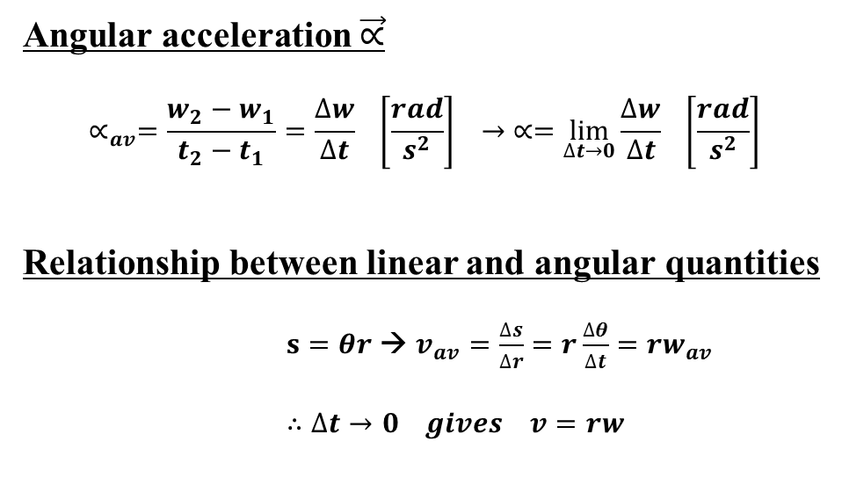
Angular acceleration $\vec{∝}$
$$∝_{av}=\frac{w_{2}−w_{1}}{t_{2}−t_{1}}=\frac{∆w}{∆t} \left[\frac{rad}{s^{2}}\right] → ∝=\lim_{∆t→0}{\frac{∆w}{∆t} \left[\frac{rad}{s^{2}}\right]}$$
Relationship between linear and angular quantities
$s=θr$ → $v_{av}=\frac{∆s}{∆r}=r\frac{∆θ}{∆t}=rw_{av}$
$∴∆t→0 gives v=rw$

Slide 8
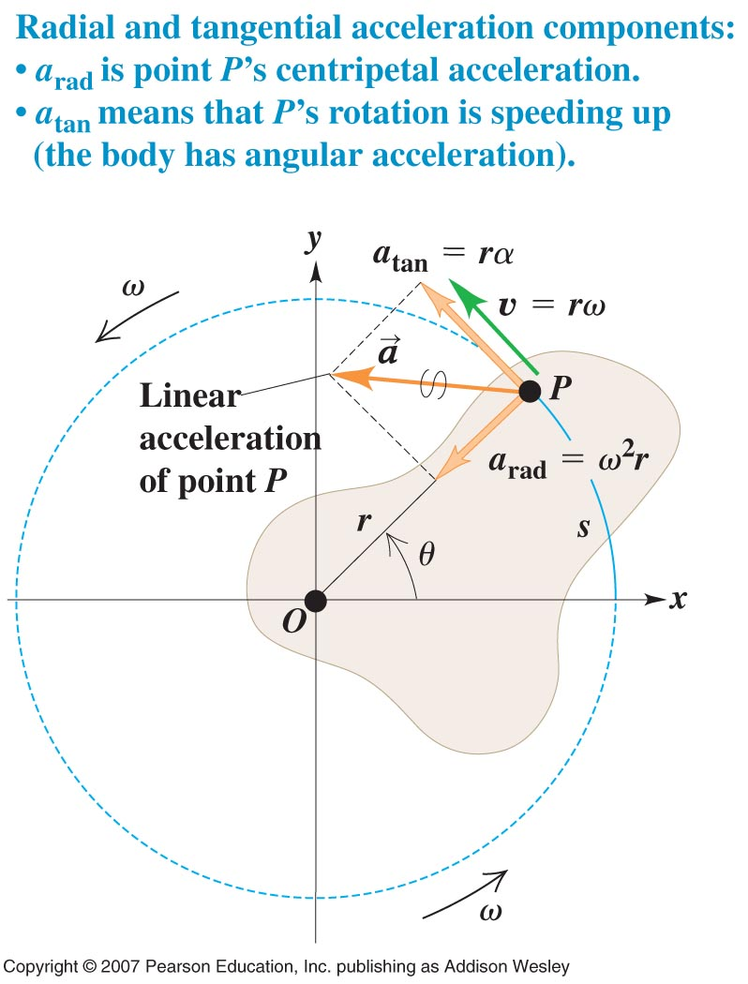
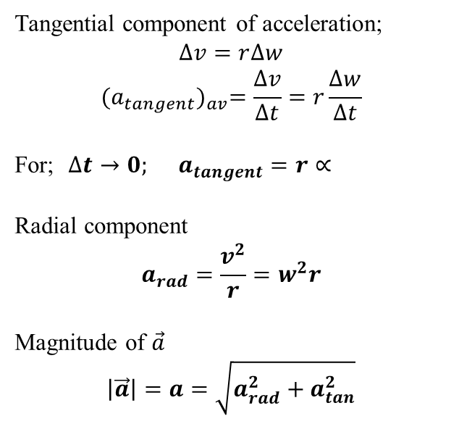
Tangential component of acceleration;
$$∆v=r∆w$$
$${(a_{tangent})}_{av}=\frac{∆v}{∆t}=r\frac{∆w}{∆t}$$
For; $∆t→0; a_{tangent}=r∝$
Radial component
$$a_{rad}=\frac{v^{2}}{r}=w^{2}r$$
Magnitude of $\vec{a}$
$$\left|\vec{a}\right|=a=\sqrt{a_{rad}^{2}+a_{tan}^{2}}$$

Slide 9
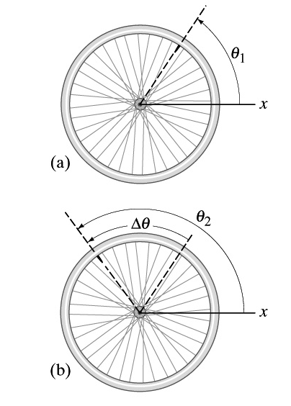
Angular Quantities
Kinematical variables to describe the rotational motion:
→Angular position, velocity and acceleration

Slide 10
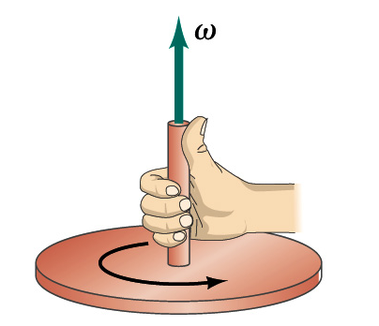
Angular Quantities: Vector
Kinematical variables to describe the rotational motion:
→Angular position, velocity and acceleration
→Vector natures
z
R.-H. Rule
y
x

Slide 11
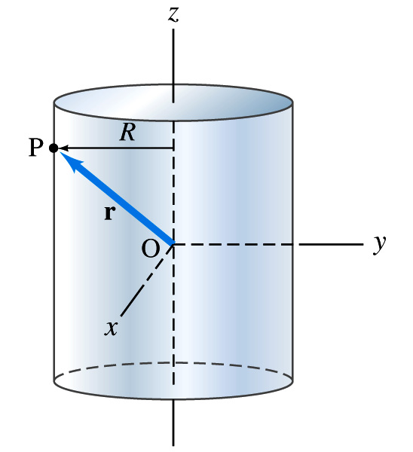
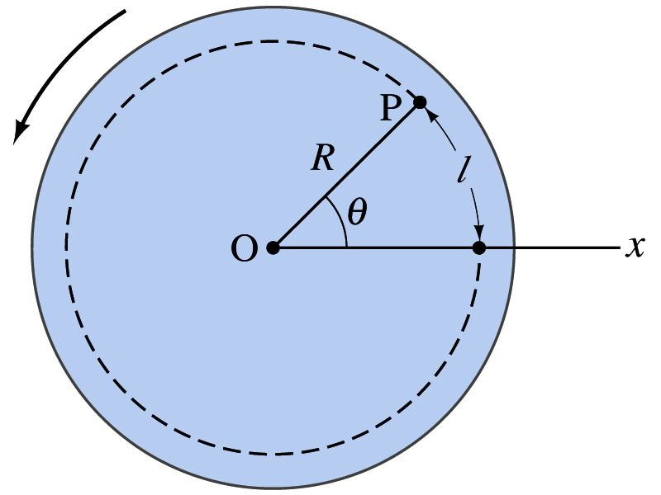
“R” from the Axis (O)
Solid Disk
Solid Cylinder

Slide 12
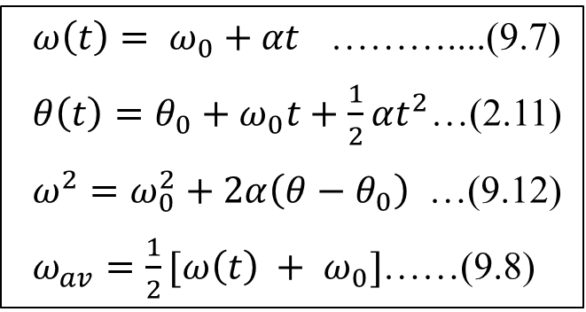
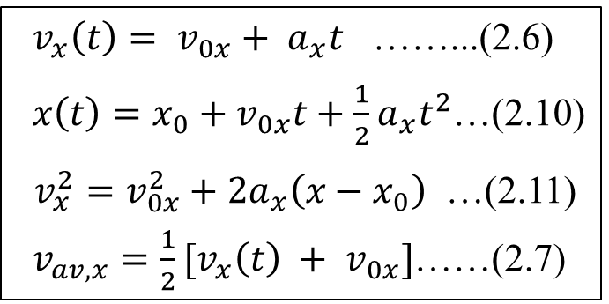
9.2 Rotation with Constant Angular Acceleration
Kinematic Equations for
Rotational Motion
compare
Kinematic Equations for
Linear Motion
$ω\left(t\right)= ω_{0}+αt$ ………....(9.7)
$θ\left(t\right)=θ_{0}+ω_{0}t+\frac{1}{2}αt^{2}$…(2.11)
$ω^{2}=ω_{0}^{2}+2α\left(θ−θ_{0}\right)$ …(9.12)
$ω_{av}=\frac{1}{2}[ω\left(t\right) + ω_{0}]$……(9.8)
$v_{x}\left(t\right)= v_{0x}+ a_{x}t$ ……...(2.6)
$x\left(t\right)=x_{0}+v_{0x}t+\frac{1}{2}a_{x}t^{2}$…(2.10)
$v_{x}^{2}=v_{0x}^{2}+2a_{x}\left(x−x_{0}\right)$ …(2.11)
$v_{av,x}=\frac{1}{2}[v_{x}\left(t\right) + v_{0x}]$……(2.7)
Courtesy of Wenhao Wu

Slide 13
Kinematical Equations for constant angular acceleration

Slide 14

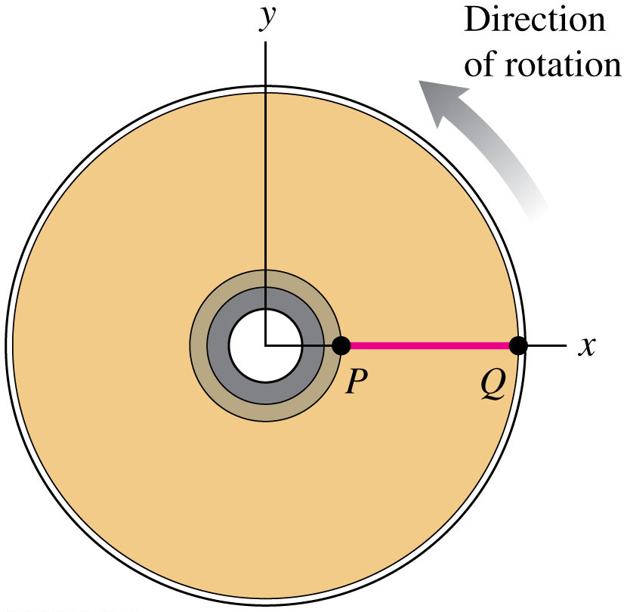
Q9.2
Clicker question
A DVD is initially at rest so that the line PQ on the disc’s surface is along the +x-axis. The disc begins to turn with a constant
= 5.0 rad/s². At t = 0.40 s, what is the angle between the line PQ and the +x-axis?
A. 0.40 rad
B. 0.80 rad
C. 1.0 rad
D. 1.6 rad
E. 2.0 rad
Notes:
Answer: A

Slide 15
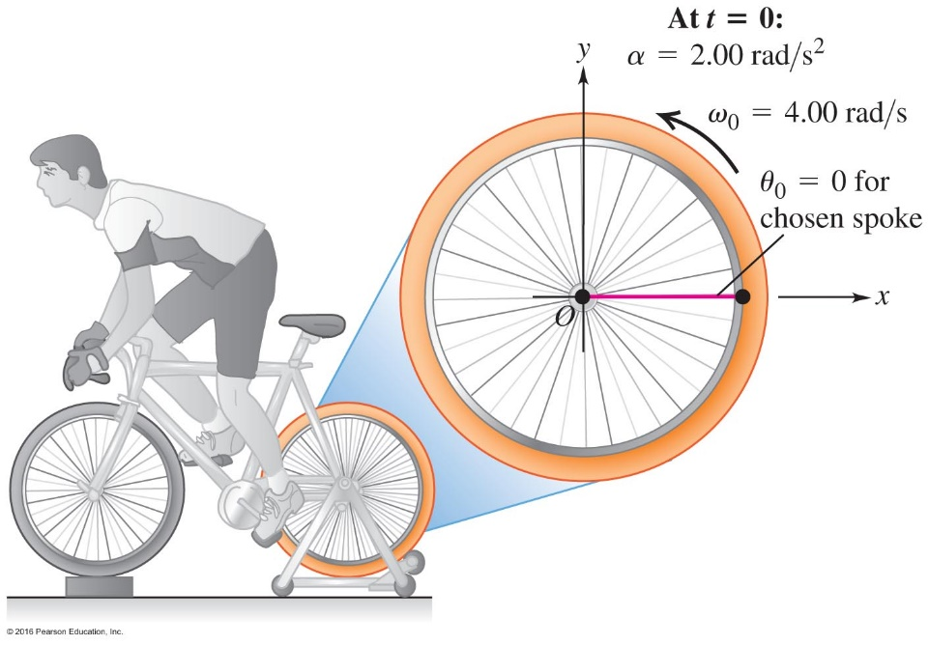
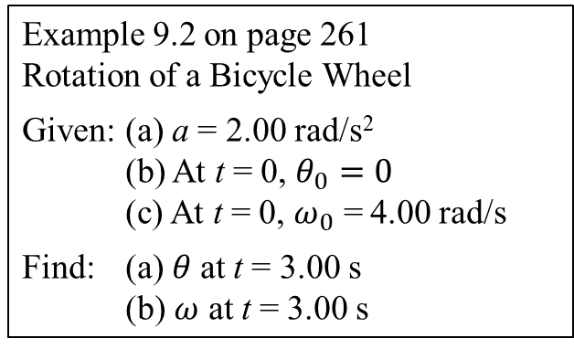
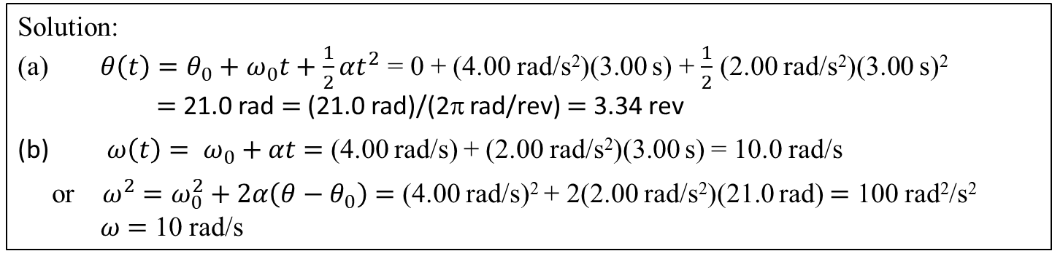
The rear wheel of the stationary bicycle is magnified for clarity
Example 9.2 on page 261
Rotation of a Bicycle Wheel
Given: (a) a = 2.00 rad/s²
(b) At t = 0, $θ_{0}=0$
(c) At t = 0, $ω_{0}$ = 4.00 rad/s
Find: (a) $θ$at t = 3.00 s
(b) $ω$ at t = 3.00 s
Solution:
(a) $θ\left(t\right)=θ_{0}+ω_{0}t+\frac{1}{2}αt^{2}$ = 0 + (4.00 rad/s²)(3.00 s) + $\frac{1}{2}$ (2.00 rad/s²)(3.00 s)²
$=$ 21.0 rad $=$ (21.0 rad)/(2π rad/rev) $=$ 3.34 rev
(b) $ω\left(t\right)= ω_{0}+αt$ $=$ (4.00 rad/s) + (2.00 rad/s²)(3.00 s) = 10.0 rad/s
or $ω^{2}=ω_{0}^{2}+2α\left(θ−θ_{0}\right)$ $=$ (4.00 rad/s)² + 2(2.00 rad/s²)(21.0 rad) $=$ 100 rad²/s²
$ω$ $=$ 10 rad/s

Slide 16

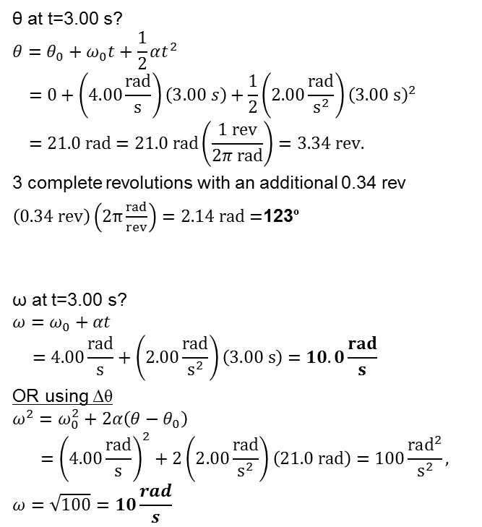
Rotation of a Bicycle Wheel – Figure 9.8
The rear wheel of the stationary bicycle is magnified for clarity
θ at t=3.00 s?
$$θ=θ_{0}+ω_{0}t+\frac{1}{2}αt^{2}$$
$$=0+\left(4.00\frac{rad}{s}\right)\left(3.00 s\right)+\frac{1}{2}\left(2.00\frac{rad}{s^{2}}\right){\left(3.00 s\right)}^{2}$$
$$=21.0 rad=21.0 rad\left(\frac{1 rev}{2π rad}\right)=3.34 rev.$$
3 complete revolutions with an additional 0.34 rev
$\left(0.34 rev\right)\left(2π\frac{rad}{rev}\right)=2.14 rad=$123º
ω at t=3.00 s?
$$ω=ω_{0}+αt$$
$$=4.00\frac{rad}{s}+\left(2.00\frac{rad}{s^{2}}\right)\left(3.00 s\right)=10.0\frac{rad}{s}$$
OR using Δθ
$$ω^{2}=ω_{0}^{2}+2α\left(θ−θ_{0}\right)$$
$$={\left(4.00\frac{rad}{s}\right)}^{2}+2\left(2.00\frac{rad}{s^{2}}\right)\left(21.0 rad\right)=100\frac{rad^{2}}{s^{2}},$$
$$ω=\sqrt{100}=10\frac{rad}{s}$$
See Example 9.2 in your text
Remember counterclockwise rotation is positive

Slide 17
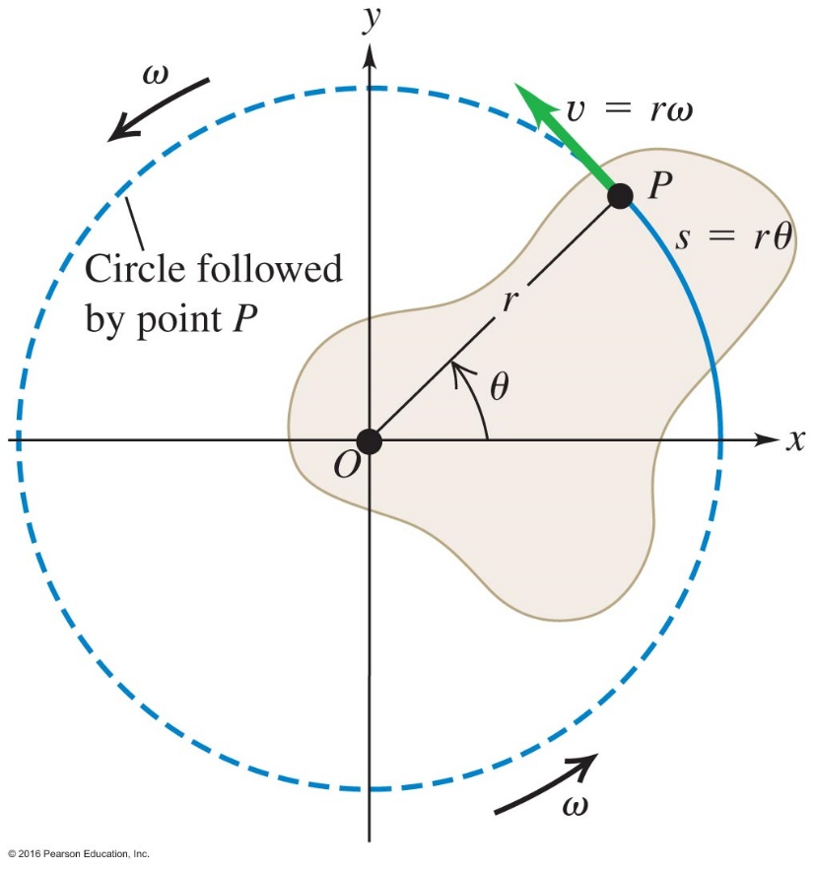
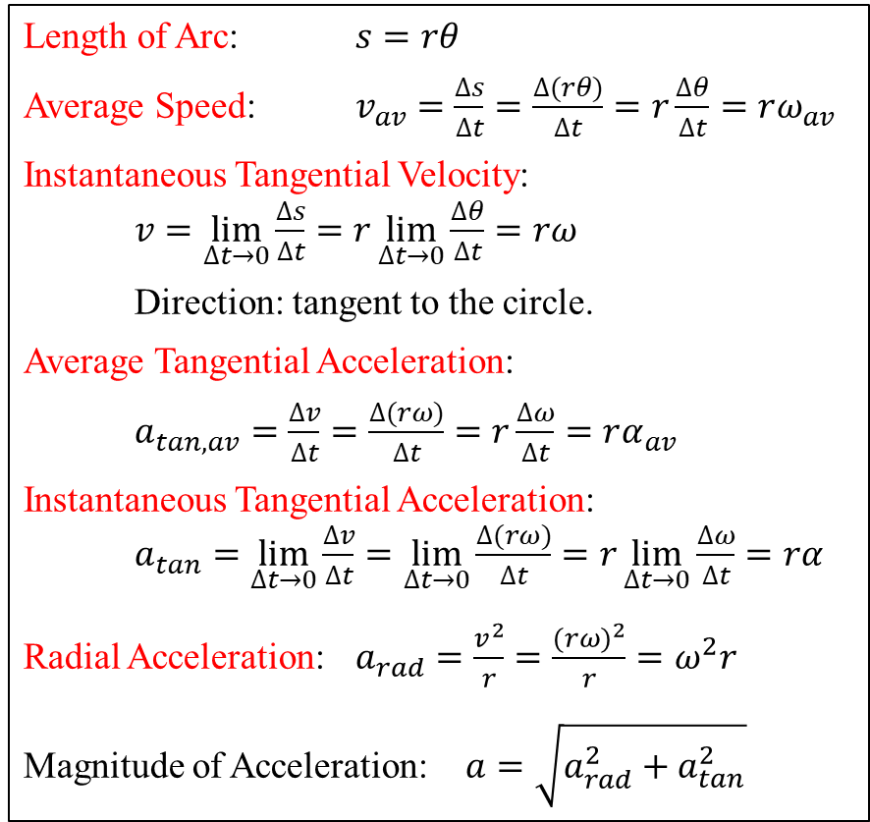

Length of Arc: $s=rθ$
Average Speed: $v_{av}=\frac{∆s}{∆t}=\frac{∆(rθ)}{∆t}=r\frac{∆θ}{∆t}=rω_{av}$
Instantaneous Tangential Velocity:
$v=\lim_{∆t→0}{\frac{∆s}{∆t}=r\lim_{∆t→0}{\frac{∆θ}{∆t}}=rω}$
Direction: tangent to the circle.
Average Tangential Acceleration:
$a_{tan,av}=\frac{∆v}{∆t}=\frac{∆(rω)}{∆t}=r\frac{∆ω}{∆t}=rα_{av}$
Instantaneous Tangential Acceleration:
$a_{tan}=\lim_{∆t→0}{\frac{∆v}{∆t}=\lim_{∆t→0}{\frac{∆(rω)}{∆t}}=r\lim_{∆t→0}{\frac{∆ω}{∆t}}=rα}$
Radial Acceleration: $a_{rad}=\frac{v^{2}}{r}=\frac{{(rω)}^{2}}{r}=ω^{2}r$
Magnitude of Acceleration: $a=\sqrt{a_{rad}^{2}+a_{tan}^{2}}$
9.3 Relationship Between Linear
and Angular Quantities
$$∆θ$$

Slide 18
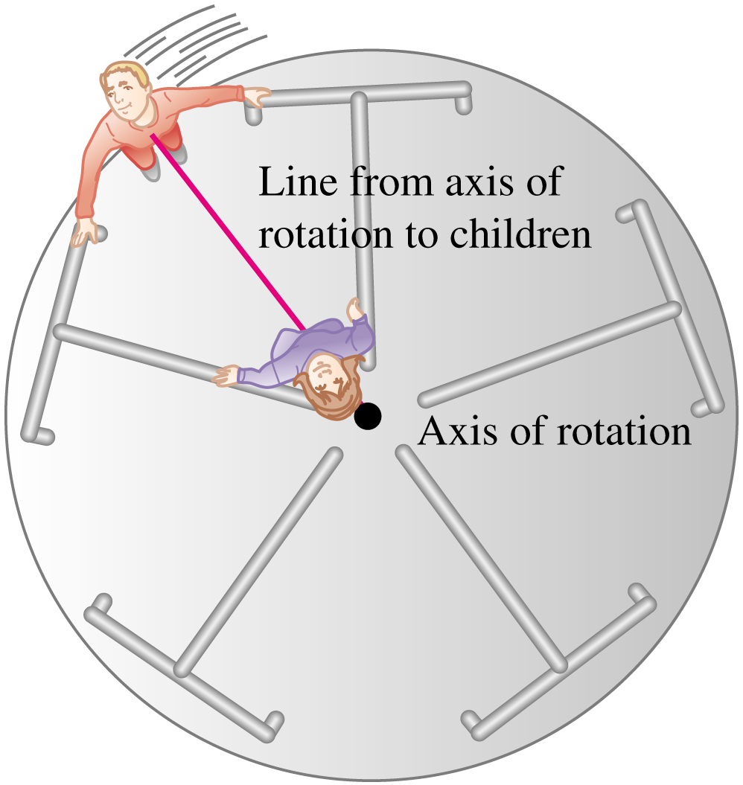
Figure 9.4
Merry-go-round
Compare the angular velocities

Slide 19
On a merry-go-round, you decide to put your toddler on an animal that will have a small angular velocity. Which animal do you pick?
Clicker question
Any animal; they all have the same angular velocity.
One close to the hub.
One close to the rim.
Notes:
Answer: a) Any animal; they all have the same angular velocity.

Slide 20
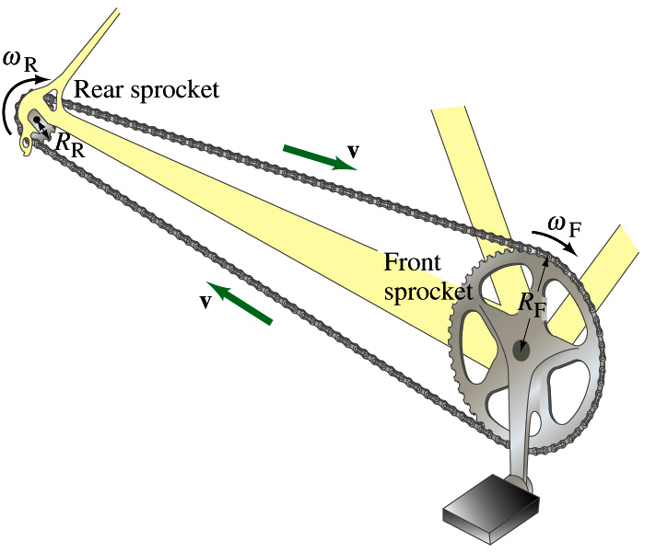
v_{tan}= same = r₁ω₁= r₂ω₂
Tooth spacing is the same
2πr₁
2πr₂
=
N₁
N₂
ω₂
N₁
=
ω₁
N₂

Slide 21
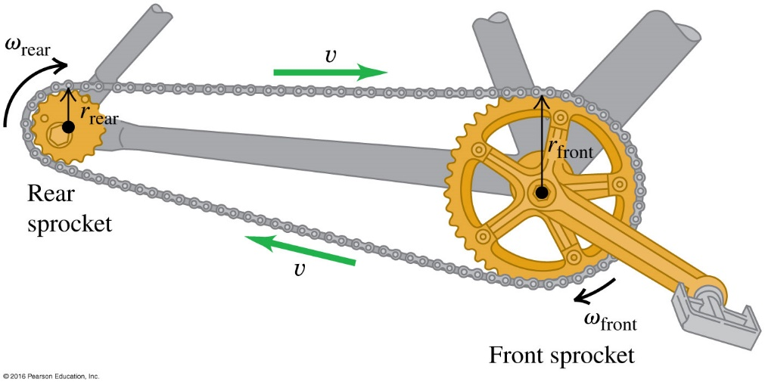
Q9.5
Clicker question
Compared to a gear tooth on the rear sprocket (on the left, of small radius) of a bicycle, a gear tooth on the front sprocket (on the right, of large radius) has
A. a faster linear speed and a faster angular speed.
B. the same linear speed and a faster angular speed.
C. a slower linear speed and the same angular speed.
D. the same linear speed and a slower angular speed.
E. none of the above.
Notes:
Answer: D

Slide 22
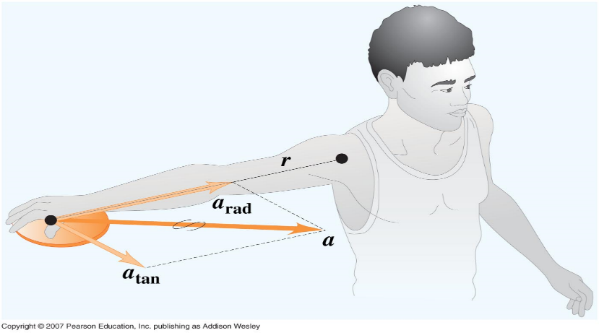
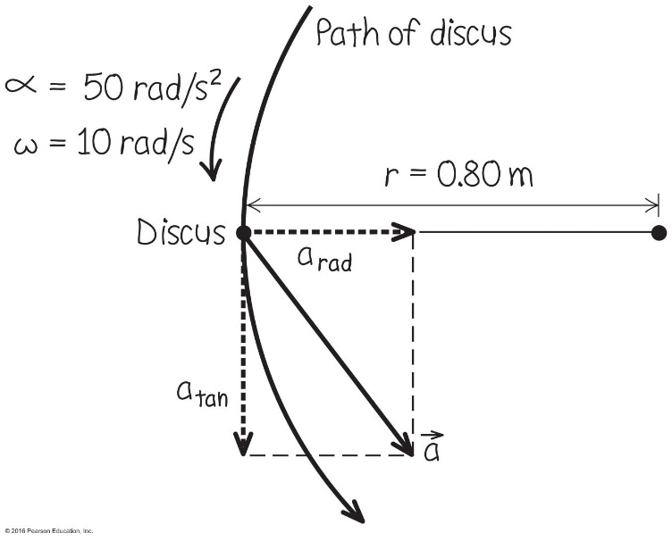
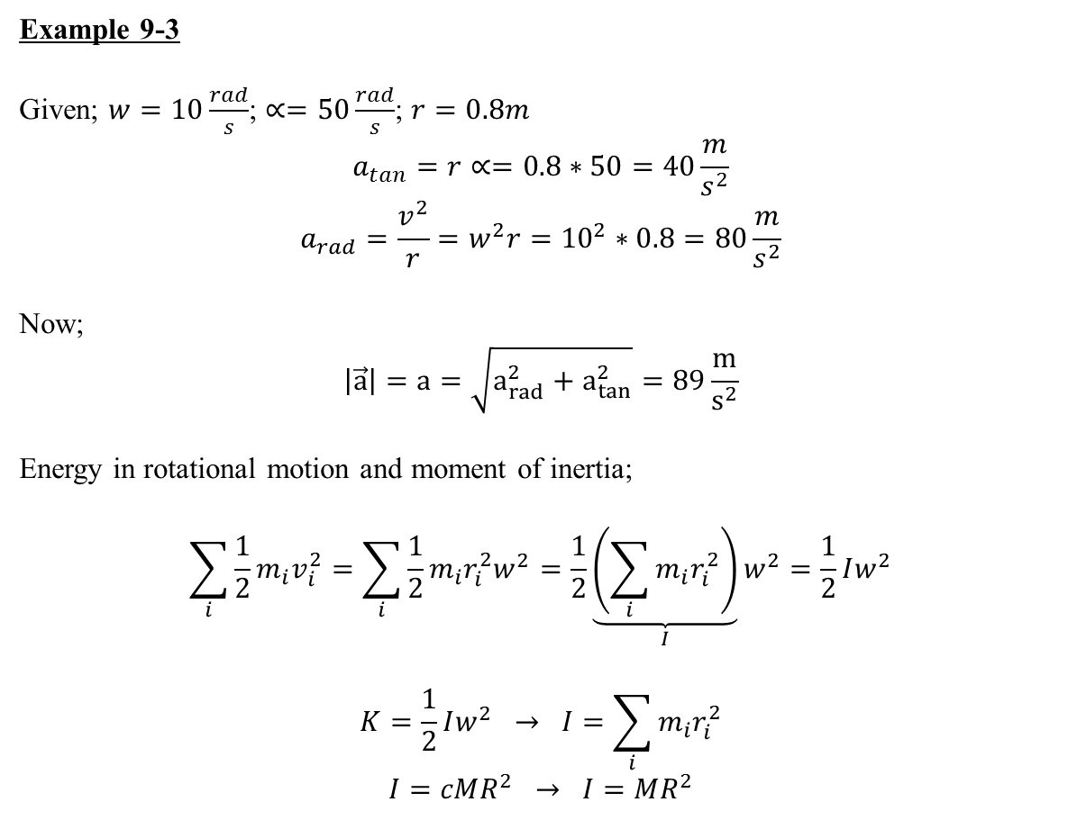
Example 9-3
Given; $w=10\frac{rad}{s}$; $∝=50\frac{rad}{s}$; $r=0.8m$
$$a_{tan}=r∝=0.8∗50=40\frac{m}{s^{2}}$$
$$a_{rad}=\frac{v^{2}}{r}=w^{2}r={10}^{2}∗0.8=80\frac{m}{s^{2}}$$
Now;
$$\left|\vec{a}\right|=a=\sqrt{a_{rad}^{2}+a_{tan}^{2}}=89\frac{m}{s^{2}}$$
Energy in rotational motion and moment of inertia;
$$\sum_{i}{\frac{1}{2}m_{i}v_{i}^{2}}=\sum_{i}{\frac{1}{2}m_{i}r_{i}^{2}w^{2}}=\frac{1}{2}\underset{I}{\underbrace{\left(\sum_{i}{m_{i}r_{i}^{2}}\right)}}w^{2}=\frac{1}{2}Iw^{2}$$
$$K=\frac{1}{2}Iw^{2} → I=\sum_{i}{m_{i}r_{i}^{2}}$$
$$I=cMR^{2} → I=MR^{2}$$

Slide 23

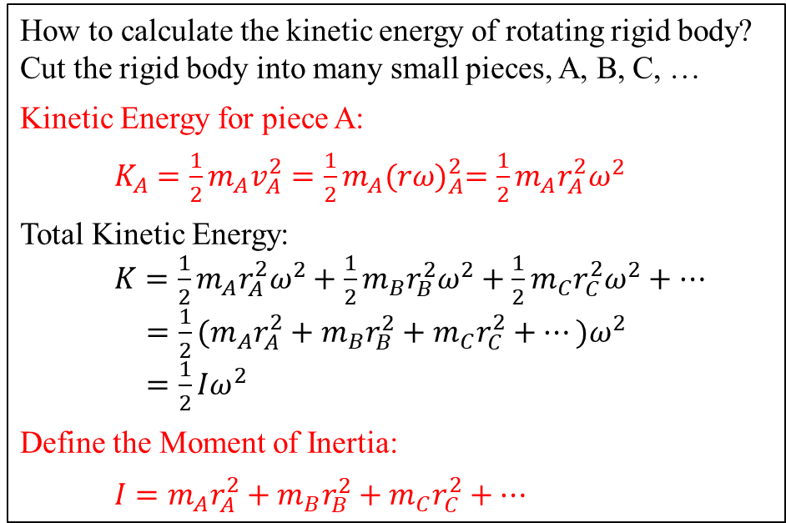
9.4 Kinetic Energy of Rotation and Moment of Inertia
How to calculate the kinetic energy of rotating rigid body?
Cut the rigid body into many small pieces, A, B, C, …
Kinetic Energy for piece A:
$K_{A}=\frac{1}{2}m_{A}v_{A}^{2}=\frac{1}{2}m_{A}{(rω)}_{A}^{2}=\frac{1}{2}m_{A}r_{A}^{2}ω^{2}$
Total Kinetic Energy:
$K=\frac{1}{2}m_{A}r_{A}^{2}ω^{2}+\frac{1}{2}m_{B}r_{B}^{2}ω^{2}+\frac{1}{2}m_{C}r_{C}^{2}ω^{2}+…$
$=\frac{1}{2}{(m}_{A}r_{A}^{2}+m_{B}r_{B}^{2}+m_{C}r_{C}^{2}+…)ω^{2}$
$=\frac{1}{2}Iω^{2}$
Define the Moment of Inertia:
$I={m_{A}r}_{A}^{2}+m_{B}r_{B}^{2}+m_{C}r_{C}^{2}+…$

Slide 24
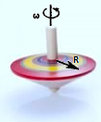
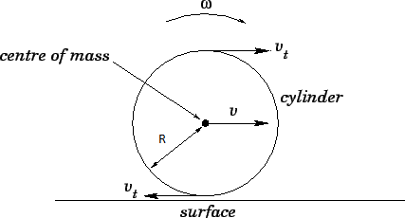
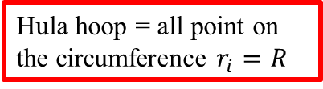
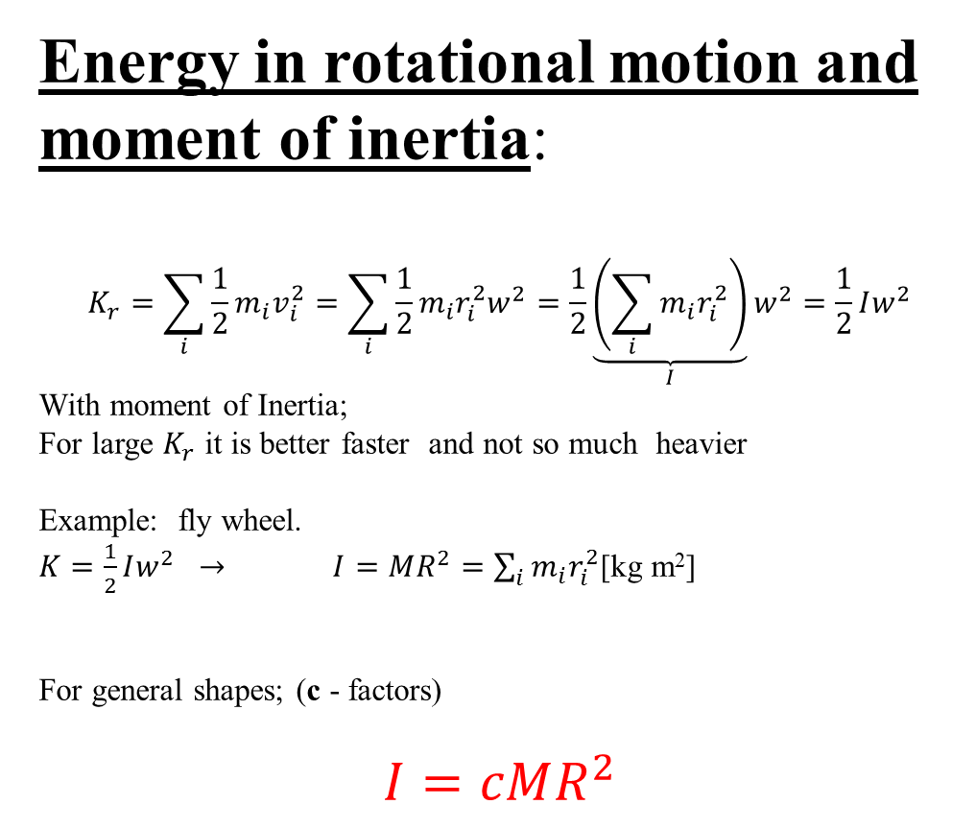
Energy in rotational motion and moment of inertia:
$$K_{r}=\sum_{i}{\frac{1}{2}m_{i}v_{i}^{2}}=\sum_{i}{\frac{1}{2}m_{i}r_{i}^{2}w^{2}}=\frac{1}{2}\underset{I}{\underbrace{\left(\sum_{i}{m_{i}r_{i}^{2}}\right)}}w^{2}=\frac{1}{2}Iw^{2}$$
With moment of Inertia;
For large $K_{r}$ it is better faster and not so much heavier
Example: fly wheel.
$K=\frac{1}{2}Iw^{2} → I=MR^{2}=\sum_{i}{m_{i}r_{i}^{2}}$[kg m²]
For general shapes; (c - factors)
$$I=cMR^{2}$$
Hula hoop = all point on the circumference $r_{i}=R$

Slide 25
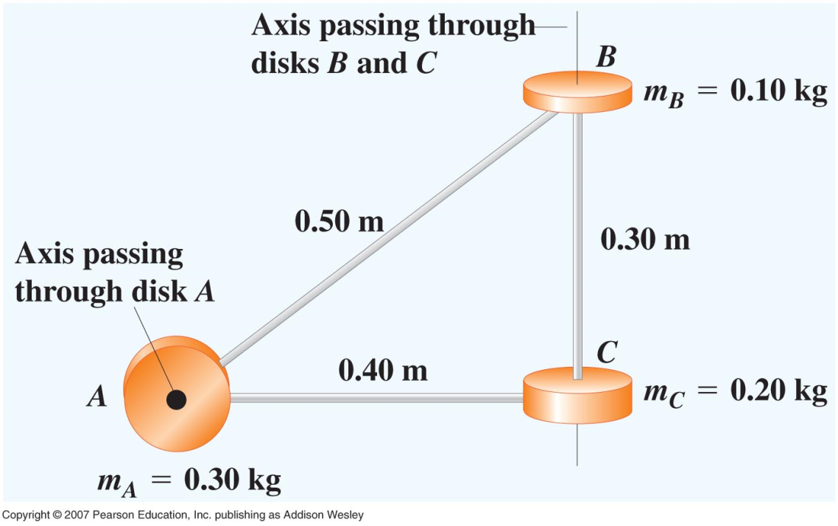
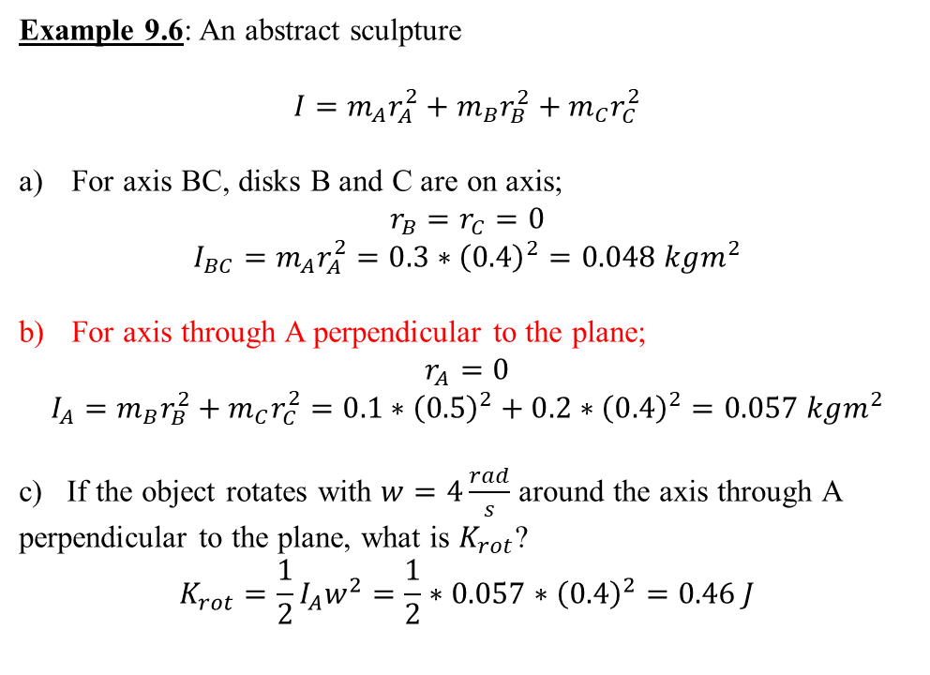
Example 9.6, an abstract sculpture, on page 269
Note: In rotational motion the moment of inertia depends on the axis of rotation. It is not like a mass a constant parameter of an object
Example 9.6: An abstract sculpture
$$I=m_{A}r_{A}^{2}+m_{B}r_{B}^{2}+m_{C}r_{C}^{2}$$
For axis BC, disks B and C are on axis;
$$r_{B}=r_{C}=0$$
$$I_{BC}=m_{A}r_{A}^{2}=0.3∗{\left(0.4\right)}^{2}=0.048 kgm^{2}$$
For axis through A perpendicular to the plane;
$$r_{A}=0$$
$$I_{A}=m_{B}r_{B}^{2}+m_{C}r_{C}^{2}=0.1∗{\left(0.5\right)}^{2}+0.2∗{\left(0.4\right)}^{2}=0.057 kgm^{2}$$
c) If the object rotates with $w=4\frac{rad}{s}$ around the axis through A perpendicular to the plane, what is $K_{rot}$?
$$K_{rot}={\frac{1}{2}I_{A}w}^{2}=\frac{1}{2}∗0.057∗{\left(0.4\right)}^{2}=0.46 J$$

Slide 26
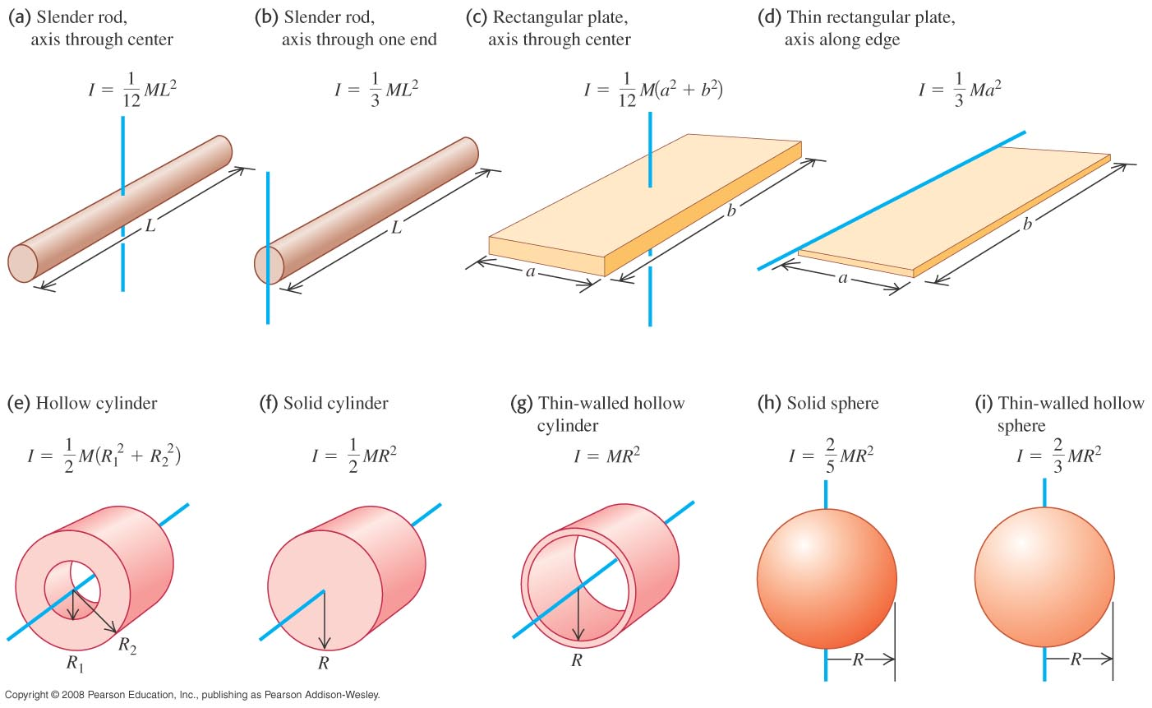
Table 9.2 Finding the moment of inertia for common shapes

Slide 27
Q9.6
Clicker question
You want to double the radius of a rotating solid sphere while keeping its kinetic energy constant. (The mass does not change.) To do this, the final angular velocity of the sphere must be
A. four times its initial value.
B. twice its initial value.
C. the same as its initial value.
D. half of its initial value.
E. one-quarter of its initial value.
Notes:
Answer: D

Slide 28
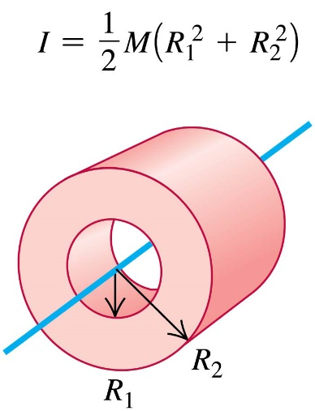
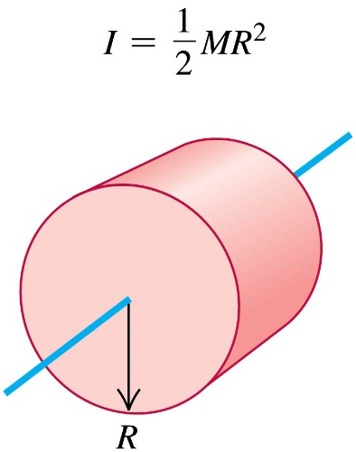
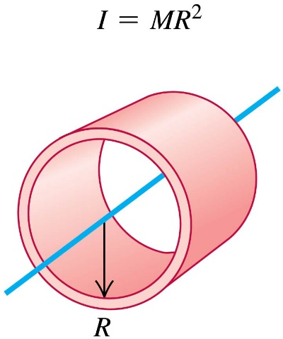
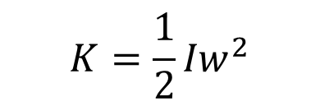
Q9.7
Clicker question
The three objects shown here all have the same mass and the same outer radius. Each object is rotating about its axis of symmetry (shown in blue). All three objects have the same rotational kinetic energy. Which object is rotating fastest?
A. Object A is rotating fastest.
B. Object B is rotating fastest.
C. Object C is rotating fastest.
D. Two of these are tied for fastest.
E. All three rotate at the same
speed.
A.
B.
C.
$$K={\frac{1}{2}Iw}^{2}$$
B
Notes:
Answer: B

Slide 29
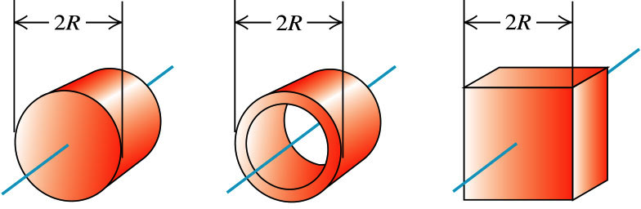
Q-RT9.1
Clicker question
Objects A, B, and C all have the same mass, all have the same outer dimension, and are all uniform.
A.
B.
C.
Rank these objects in order of their moment of inertia about an axis through its center (shown in blue), from largest to smallest.
BCA
Notes:
Answer: BCA

Slide 30
Q-RT9.2
Clicker question
Objects A, B, and C all have the same mass, all have the same outer dimension, and are all uniform. Each object is rotating about an axis through its center (shown in blue). All three objects have the same rotational kinetic energy.
A.
B.
C.
Rank these objects in order of their angular speed of rotation, from fastest to slowest.
ACB
Notes:
Answer: ACB

Slide 31
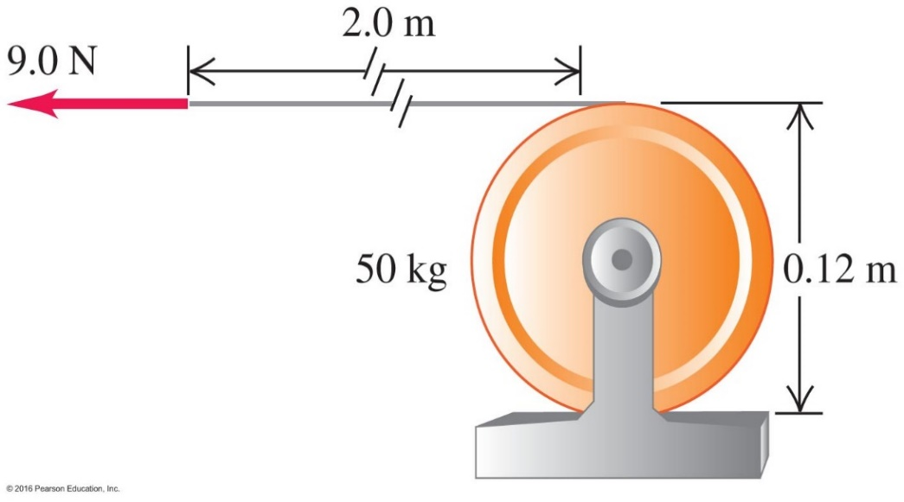
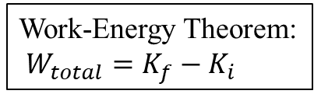

Work-Energy Theorem:
$W_{total}=K_{f}−K_{i}$
Example 9.7 on page 271
A cable unwinding from a winch.
Find: (a) Final angular velocity .
(b) Final speed of cable
Solution:
Work done W = Fd = (9.0 N)(2.0 m) = 18 J
Apply the work-energy theorem
W $=$ K_{f} – K_{i} = $\frac{1}{2}Iω_{f}^{2}−\frac{1}{2}Iω_{i}^{2}$ = $\frac{1}{2}Iω_{f}^{2}$
(18 J) $=$ $\frac{1}{2}\text{I}\text{A}ω_{f}^{2}$= $\frac{1}{2}[\frac{1}{2}$(50 kg)(0.060 m)²$]ω_{f}^{2}=$ (0.045 kg)$ω_{f}^{2}$
$ω$_{f} = 20 rad/s
Speed of cable $v=rω\text{f}$ = (0.06 m)(20 rad/s) = 1.2 m/s
Courtesy of Wenhao Wu

Slide 32

Q9.8
Clicker question
A thin, very light wire is wrapped around a drum that is free to rotate. The free end of the wire is attached to a ball of mass m. The drum has the same mass m. Its radius is R and its moment of inertia is I = (1/2)mR². As the ball falls, the drum spins.
At an instant that the ball has translational kinetic energy K, what is the rotational kinetic energy of the drum?
A. K B. 2K C. K/2 D. K/4
E. none of these
Notes:
Answer: C

Slide 33


Slide 34


Problem 9.31:
Each mass is at a distance $r=\frac{\sqrt{2∗{(0.4)}^{2}}}{2}=\frac{0.4}{\sqrt{2}}$ from the axis.
$I=\sum{mr^{2}}=4∗0.2∗{\left(\frac{0.4}{\sqrt{2}}\right)}^{2}=0.064 kgm^{2}$ (axis is through center)
Each mass is $r=0.2$m from the axis.
$I=4∗0.2∗{\left(0.2\right)}^{2}=0.032 kgm^{2} ( axis is$along the line AB)
Two masses are on the axis and two are $\frac{0.4}{\sqrt{2}}$ from the axis.
$$I=2∗0.2∗{\left(\frac{0.4}{\sqrt{2}}\right)}^{2}=0.032 kgm^{2}$$
(axis is alongCD)
The value of I depends on the location of the axis.

Slide 35


Problem 9.34:
$$I_{o}=m_{rim}R^{2}+\frac{8}{3}m_{spoke}R^{2}=0.193 kgm^{2}$$

Slide 36


Example 9.10 Race of rolling objects
Which object will win?
All moments of inertia in the previous table can be expressed as;
$I_{cm}=βMR^{2}=cMR^{2}$ (c - number)
Compare;
a) For a thin walled hollow cylinder $β=1$
For a solid cylinder $β=\frac{1}{2}$ etc.
Conservation of energy;
$$0+Mgh=\frac{1}{2}Mv^{2}+\frac{1}{2}Iw^{2}=\frac{1}{2}Mv^{2}+\frac{1}{2}βMR^{2}{(\frac{v}{R})}^{2}=\frac{1}{2}(1+β)Mv^{2}$$
$$v=\sqrt{\frac{2gh}{1+β}}$$
Small $β$ bodies wins over large $β$ bodies.

Slide 37

On a horizontal surface , what fraction of the total kinetic energy is rotational?
a) a uniform solid cylinder . b) a uniform sphere c)a thin walled hollow sphere d)a hollow cylinder with outer radius R an inner radius R/2
K=$\frac{1}{2}Mv^{2}+\frac{1}{2}Iw^{2}$
Small $β$ bodies win over large $β$ bodies

Slide 38

9.40 A light string is wrapped around the outer rim of a solid uniform cylinder of diameter 75 cm that can rotate about an axis through its center. A stone is tied to the free end of the string .When the string is released from rest the stone reaches a speed of 3.5m/sec after having fallen 2.5 m What is the mass of the cylinder??

Slide 39

Compute the magnitude of the tangential and radial acceleration
at the start
b after it turned through 60and120 degrees

Slide 40


Slide 41


Slide 42


Slide 43


Slide 44


You are preparing your unpowered soapbox vehicle for a soapbox derby down a local hill. You're choosing between solid-rim wheels and wheels that have transparent hollow rims. Which kind will help you win the race?
Clicker question
Either kind; it doesn't matter.
The solid-rim wheels.
The transparent hollow-rim wheels.
solid
hollow
Notes:
Answer: c) The hollow-rim wheels.

Slide 45



Conservation of energy in a well
Conservation of Energy: $U_{i}+K_{i}=U_{f}+K_{f}$
Example 9.8 on page 269
Given: M, R, m, and h
Find v and ω just before hitting the water
Solution:
As the bucket descends, it potential energy decreases and is converted to kinetic energy.
Apply the conservation of energy:
$mgh+0+0=0+\frac{1}{2}mv^{2}+\frac{1}{2}I{\text{w}}^{2}$
$=\frac{1}{2}mv^{2}+\frac{1}{2}(\frac{1}{2}MR^{2})(\frac{v}{R})^{2}=\frac{1}{2}(m+\frac{1}{2}M)v^{2}$
$v=\sqrt{\frac{2gh}{1+M/2m}}$ and $\text{w}=\frac{1}{R}\sqrt{\frac{2gh}{1+M/2m}}$
y
o
Note: free fall velocity for M<<<m; all energy goes to kinetic and not rotation

Slide 46



9.5 Rotation about a
Moving Axis
How to calculate the kinetic energy of a rigid body that is rotating and also having a linear motion?
$$K= K_{linear}+K_{rotational}=\frac{1}{2}Mv_{cm}^{2}+\frac{1}{2}I_{cm}ω^{2}$$
Example 9.9 on page 272
Given: Given M, R, and h
Find: Velocity of the center of mass v_{cm}
Solution:
U_{i} = Mgh, K_{i} = 0, U_{f} = 0
$K_{f}= K_{cm}+K_{rot}=\frac{1}{2}Mv_{cm}^{2}+\frac{1}{2}I_{cm}ω^{2}$
$=\frac{1}{2}Mv_{cm}^{2}+\frac{1}{2}(\frac{1}{2}MR^{2}){(\frac{v_{cm}}{R})}^{2}=\frac{3}{4}Mv_{cm}^{2}$
Apply the conservation of energy: $Mgh+0=0+\frac{3}{4}Mv_{cm}^{2}$
$$v_{cm}=\sqrt{4gh/3}$$
y
o
Courtesy of Wenhao Wu

Slide 47

Calculate the angular momentum and kinetic energy of a solid uniform sphere with a radius of 0.12 m and a mass of 14.0 kg if it is rotating at 6.00 rad/s about an axis through its center
$I=\frac{2}{5}MR^{2}=\frac{2}{5}∗\left(14kg\right){\left(0.12m\right)}^{2}=0.0806 kgm^{2}$
$$L=Iw=0.0806 kgm^{2} ∗6.0 rad=0.484 kg\frac{m^{2}}{s}$$
$$K=\frac{1}{2}Iw^{2}=\frac{1}{2}Lw=\frac{1}{2}\left(0.484 kg\frac{m^{2}}{s}\right)∗6 rad=1.45 J$$

Slide 48
Q-RT9.3
Clicker question
Two identical uniform solid spheres are attached by a solid uniform thin rod. The rod lies on a line connecting the centers of mass of the two spheres. Axes A, B, C, and D are in the same plane as the centers of mass of the spheres and of the rod.
For the combined object of two spheres plus rod, rank the object’s moments of inertia about the four axes, from largest to smallest.
A
B
C
CBAD
D
Notes:
Answer: CBAD

Slide 49


Relationship between Linear and Angular Quantities
a_{tan}
a_{rad}

Slide 50

Find the magnitude of the tangential component of acceleration (a_{tan}), the radial component of acceleration (a_{rad}), and the total acceleration (a) of a point on its rim..
At the start
After it has turned through 60º
After it has turned through 120º
r = 0.3 m
ω₀ = 0
α=0.6 rad/s²

Slide 51

Find the magnitude of the tangential component of acceleration (a_{tan}), the radial component of acceleration (a_{rad}), and the total acceleration (a) of a point on its rim..
At the start
After it has turned through 60º
After it has turned through 120º
r = 0.3 m
ω₀ = 0
α=0.6 rad/s²

Slide 52

Find the magnitude of the tangential component of acceleration (a_{tan}), the radial component of acceleration (a_{rad}), and the total acceleration (a) of a point on its rim..
At the start
After it has turned through 60º
After it has turned through 120º
r = 0.3 m
ω₀ = 0
α=0.6 rad/s²

Slide 53

m = 2.25 kg
85 cm
How fast is the wheel moving at the bottom of the slope (assume no slipping occurred)?
How much Kinetic Energy does the wheel have when it reaches the bottom?
11 m/s
75 m

Slide 54
m = 2.25 kg
85 cm
How fast is the wheel moving at the bottom of the slope (assume no slipping occurred)?
How much Kinetic Energy does the wheel have when it reaches the bottom?
11 m/s
75 m

Slide 55
Exam2 histogram

