Slide 1
Chapter 7 Work and Energy
● Overview energy.
● Study work as defined in physics.
● Relate work to kinetic energy.
● Consider work done by a variable force.
● Study potential energy.
● Understand energy conservation.
● Include time and the relationship of work to power.
Note: In previous chapters, we studied motion. We used Newton's three laws to understand the motion of an object and the forces acting on it.
Sometimes this can be complicated and difficult. That was the reason we limited our studies to problems with a constant acceleration.
Now, we introduce work and energy as the next step.
Courtesy of Wenhao Wu

Slide 2
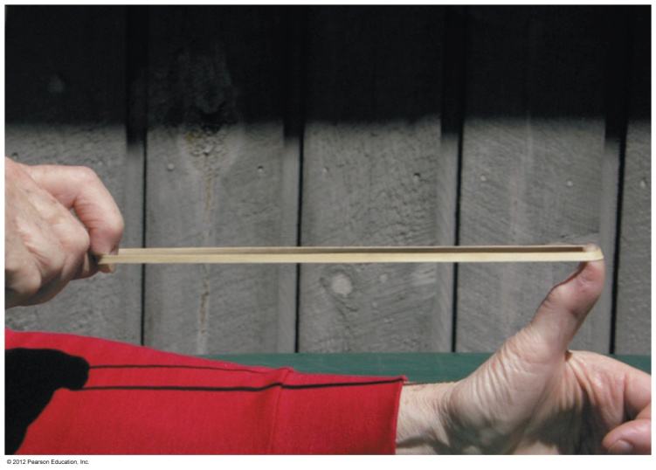
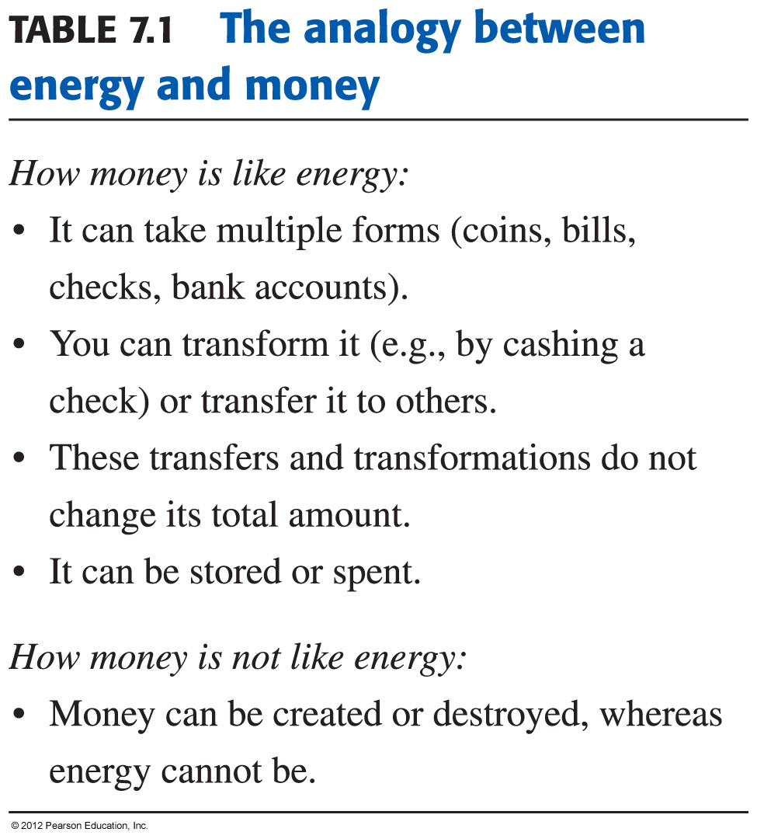
Forms of Mechanical Energy
Energy is conserved,

Slide 3
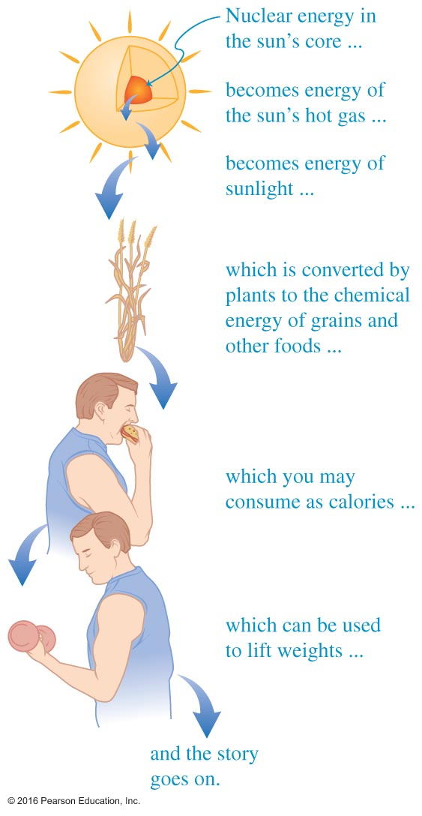
7.1 An Overview of Energy
Energy is the capability to do work.
● Energy is conserved, but can transfer from one form to another.
● Kinetic energy describes motion and relates to the mass of the
object and its speed squared
$$K=\frac{1}{2}mv^{2}$$
● Energy on earth originates from the sun.
● Energy on earth is stored thermally, chemically and physically.
● Chemical energy can be released by metabolism.
● Energy can be stored as potential energy in object height and
mass and also through elastic deformation.
Courtesy of Wenhao Wu

Slide 4
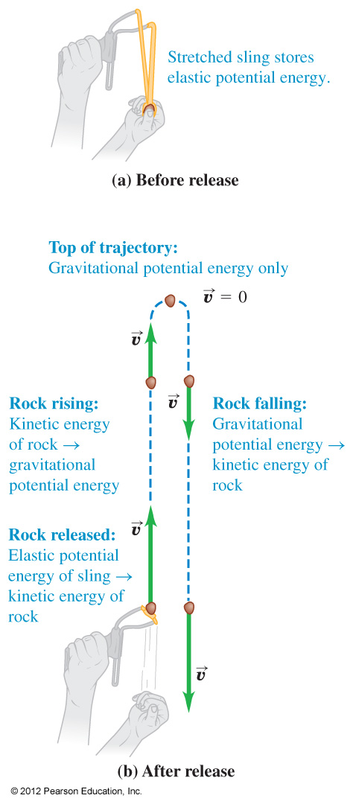
CONSERVATION OF ENERGY

Slide 5
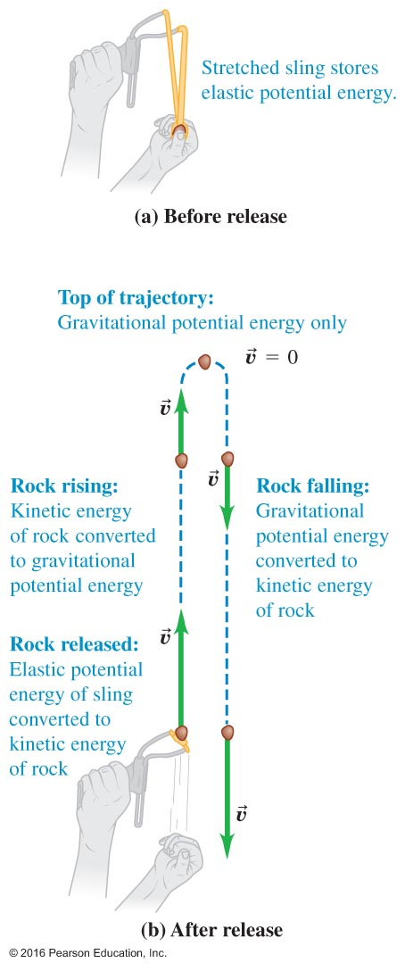
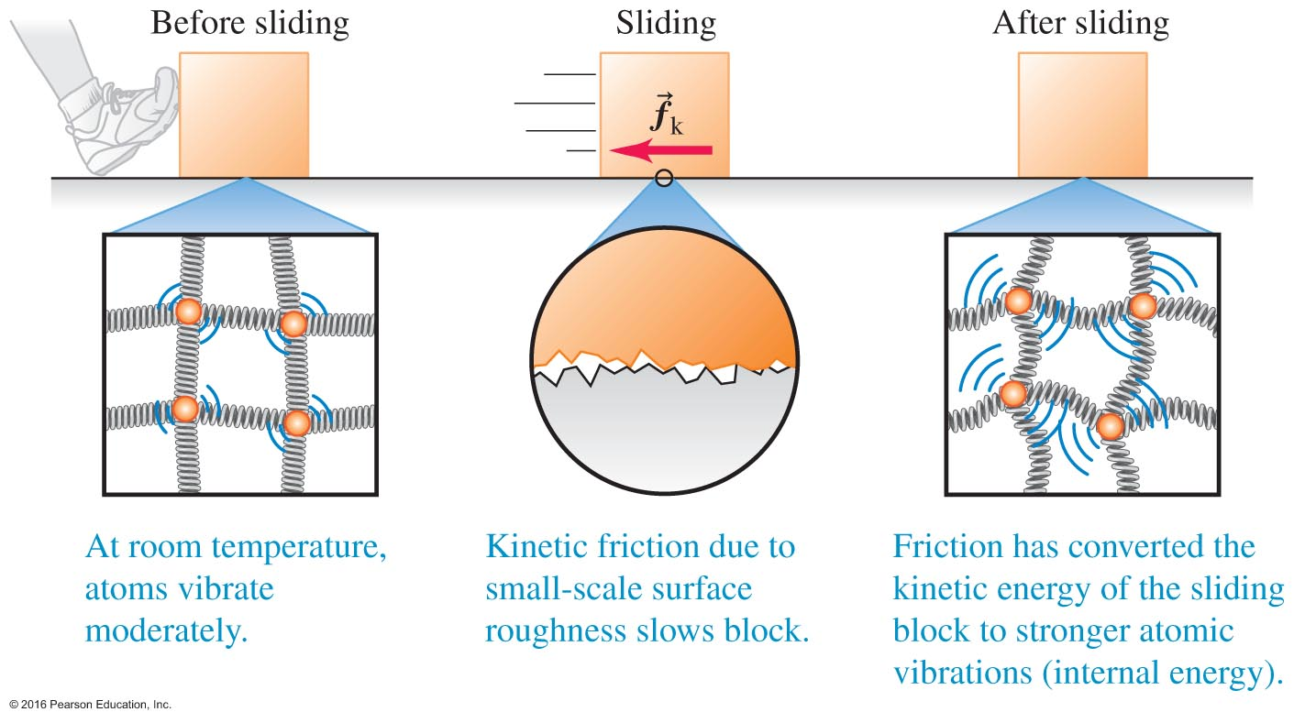
Other Examples of Energy Transfer
● Biological energy to elastic potential energy to kinetic energy to gravitational potential energy to kinetic energy
● Biological energy to kinetic energy to heat energy to kinetic energy

Slide 6
7.2 Work
How is "Work" Defined in Physics?
In a simple definition, work is the product of a constant force F and a parallel displacement s made under the influence of the force.
Work done: $W=Fs$
Work is a scalar quantity.
Courtesy of Wenhao Wu
Notes:
In a simple definition, work is the product of a constant force F and a parallel displacement s made under the influence of the force.

Slide 7
$$W=\overset{⃑}{F}∙\overset{⃑}{d}=\left|F\right|∙\left|d\right|\cos{∝}$$
[1 Joule]=[1 N][1 m]
Units of Work - Energy
Work = energy
$E=mc^{2}$(Einstein)
$E=\frac{1}{2}mv^{2}$(Kinetic energy)
Work – energy theorem
$$W_{net}=k_{2}−k_{1}=∆k$$
Force
$$1 Joule=\overbrace{kg\frac{m}{s^{2}}}m(\frac{{10}^{3}g}{1 kg}\frac{{10}^{2}cm}{1 m}\frac{{10}^{2}cm}{1 m})={10}^{7}\frac{g {cm}^{2}}{s^{2}}$$
Power → [Watt]=[Joule/second]
1Joule = 10^7 erg

Slide 8
More generally, work is the product of the component of the force in the direction of displacement and the magnitude s of the displacement.
Forces applied at angles must be resolved into components.
W is a scalar quantity that can be positive, zero, or negative.
If W > 0 (W < 0), energy is added to (taken from) the system.
Equivalent Representations: $W=F_{||}s=\left(F∗cos∅\right)s$
Notes:
More generally, work is the product of the component of the force in the direction of displacement and the magnitude s of the displacement.
Forces applied at angles must be resolved into components.
W is a scalar quantity that can be positive, zero, or negative.
If W > 0 (W < 0), energy is added to (taken from) the system.

Slide 9
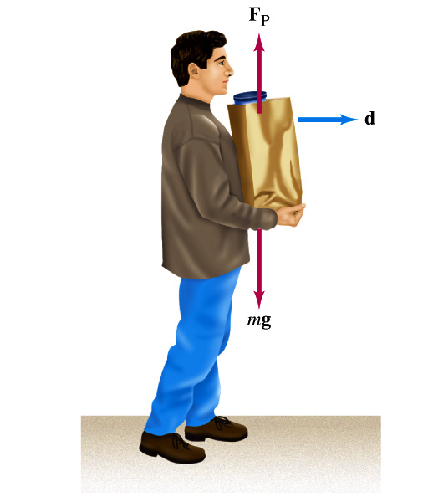
Clicker question Work Done by a Constant Force
Example: Work done on the bag by the person..
→ Special case: W = 0 J
a) W_{P} = F_{P} d cos ( 90º )
b) W_{g} = m g d cos ( 90º )
→ Nothing to do with the motion

Slide 10
Example 1A
A 50.0-kg crate is pulled 40.0 m by a
constant force exerted (F_{P} = 100 N and
θ = 37.0º) by a person. A friction force F_{f} =
50.0 N is exerted to the crate. Determine
the work done by each force acting on the
crate.

Slide 11
Example 1A (cont’d)
F.B.D.
W_{P} = F_{P} d cos ( 37º )
W_{f} = F_{f} d cos ( 180º )
W_{g} = m g d cos ( 90º )
W_{N} = F_{N} d cos ( 90º )
180º
d
90º

Slide 12
Example 1A (cont’d)
W_{P} = 3195 [J]
W_{f} = -2000 [J] (< 0)
W_{g} = 0 [J]
W_{N} = 0 [J]
180º

Slide 13
Example 1A (cont’d)
W_{net} = ΣW_{i}
= 1195 [J] (> 0)
The body’s speed increases.

Slide 14
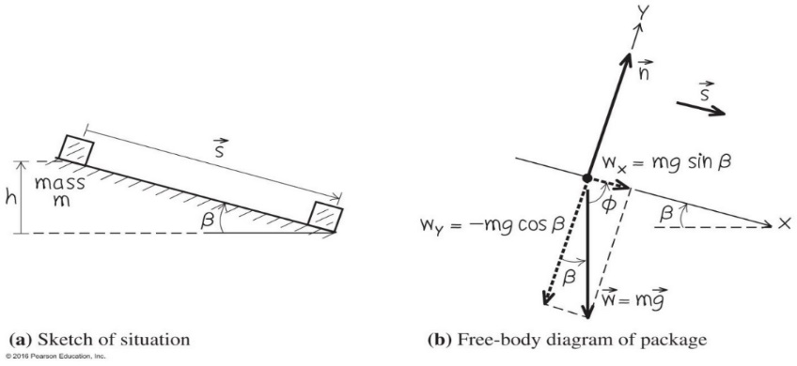
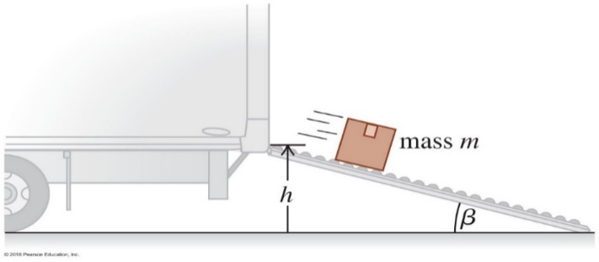
Example 7.2 on Page 187: Sliding on a Ramp
Package of mass m slides down a frictionless incline of height h and angle β.
Find: The total work done by all the relevant forces.
Work done by the gravity force (the weight):
Component of the weight parallel to displacement = mgsinβ.
Work done: (mgsinβ)s = mg[s(sinβ)] = mgh
Work done by the normal force = 0
since the component of the normal force parallel to displacement = 0
Total work done by all the relevant forces = mgh
Courtesy of Wenhao Wu

Slide 15
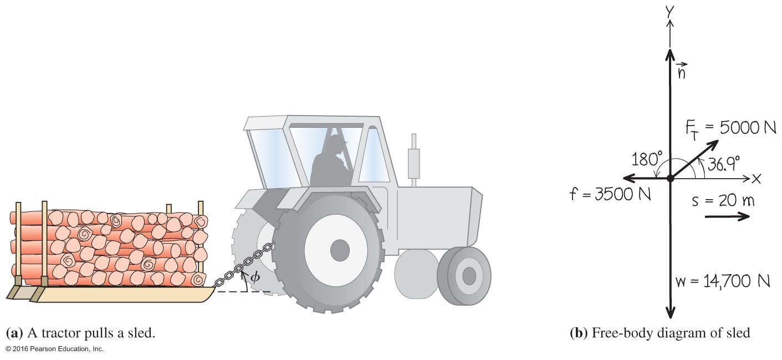
Work Done By Several Forces – Example 7.3
$$W_{total}=W_{T}{+W}_{w}{+W}_{n}{+W}_{f}$$
$W_{total}=$80.0 kJ + 0 + 0 -70.0 kJ = 10.0 kJ

Slide 16
7.3 Work and Kinetic Energy
What if the net amount of work done on an object is not zero?
The work-energy theorem:
The kinetic energy K of a particle with mass m moving with speed $v$ is $K=\frac{1}{2}mv^{2}.$ It is the energy related to the motion of the particle.
During any displacement of the particle, the net amount of work done by all the external
force on the particle is equal to the change in its kinetic energy.
Although the kinetic energy K is always positive, W_{total} may be positive, negative, or zero (energy added to, taken away, or left the same, respectively).
If W_{total} = 0, then the kinetic energy does not change and the speed of the particle remains constant.
Notes:
7.3 Work and Kinetic Energy
What if the net amount of work done on an object is not zero?
The work-energy theorem:
The kinetic energy K of a particle with mass m moving with speed $v$ is $K=\frac{1}{2}mv^{2}.$ It is the energy related to the motion of the particle.
During any displacement of the particle, the net amount of work done by all the external
force on the particle is equal to the change in its kinetic energy.
Although the kinetic energy K is always positive, W_{total} may be positive, negative, or zero (energy added to, taken away, or left the same, respectively).
If W_{total} = 0, then the kinetic energy does not change and the speed of the particle remains constant.

Slide 17
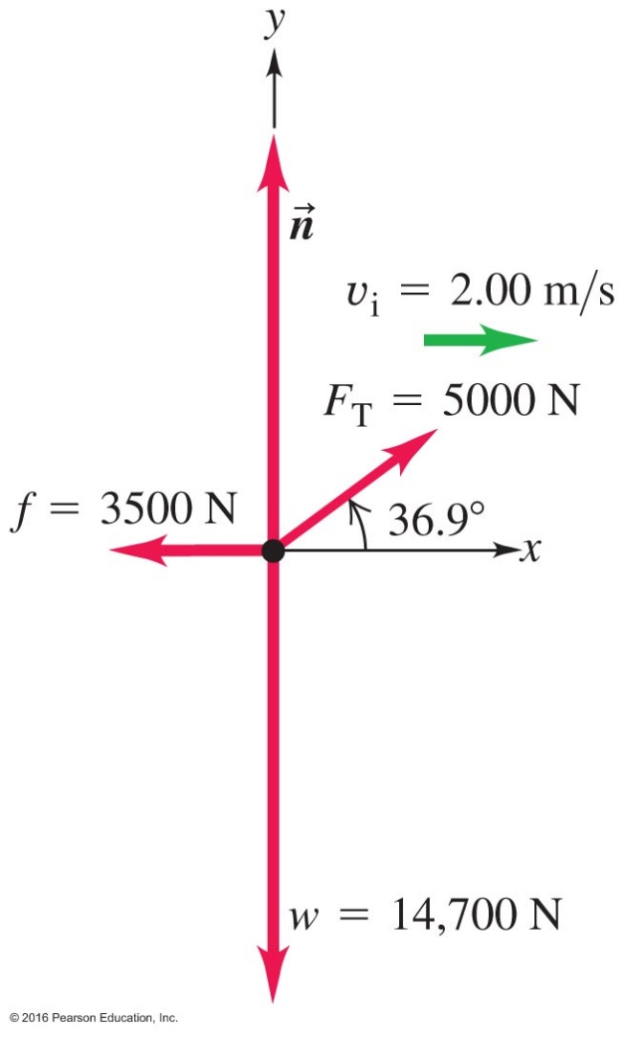
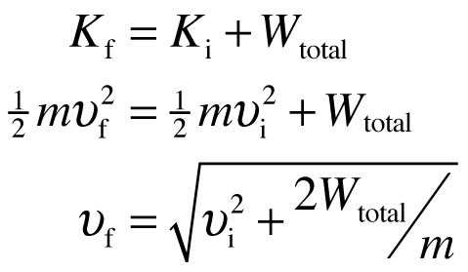
Work and Energy Related – Example 7.4
Using work and energy to calculate speed.
Returning to the tractor pulling a sled problem of Example 7.3:
If you know the initial speed, and the total work done, you can determine the final speed after displacement s.

Slide 18
Revisit Example 7.2 on Page 186: Sliding on a Ramp
Package of mass m, initially at rest, slides down a frictionless incline
of height h and angle β.
Find: Its speed the moment it reaches the bottom.
As we calculated earlier, the total work done by all the relevant forces is
=(mgsinβ)s =Wmg[s(sinβ)] = mgh.
Apply the Work-Energy Theorem:
$W=mgh= \frac{1}{2}mv_{f}^{2}−\frac{1}{2}mv_{i}^{2}$
$v_{f}=\sqrt{2gh}$

Slide 19
Work-Energy Theorem
W_{net} = F_{net} d = ( m a ) d
= m [ (v₂ ² – v₁ ² ) / 2d ] d
= (1/2) m v₂ ² – (1/2) m v₁ ²
= K₂ – K₁

Slide 20
Kinetic energy
Notes:
Chapter Summary 7.2

Slide 21
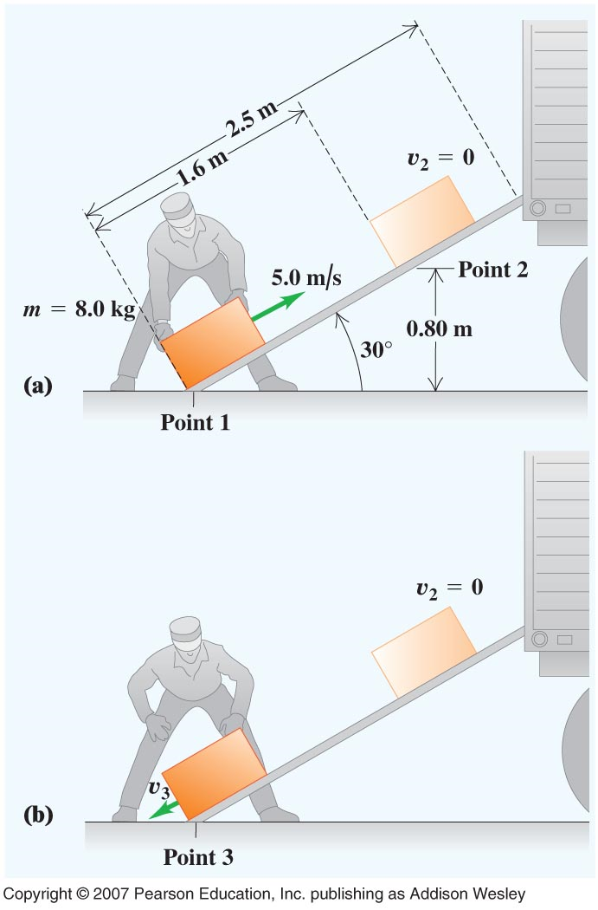
Example 7.14
Loading a crate (with friction it does not go all the way up)
$K_{1}=\frac{1}{2}mv^{2}=\frac{1}{2}8{(5)}^{2}=100 J;K_{2}=0; U_{1}=0; U_{2}=mgh=8\left(9.8\right)\left(0.8\right)=62.7 J$
$$W_{other}=−f_{s}=−f d=−f(1.6)$$
Here; $f$ is the unknown friction force
$K_{1}+U_{1}+W_{other}=K_{2}+U_{2}$
$100 J+0 −f\left(1.6\right)=0+62.7 J$ → $f=23 N$
b) $W_{other}=W_{f}=(−2)\left(1.6\right)\left(23.3\right)=$-74.6 J
$$K_{1}=100 J; U_{1}=U_{3}=0; K_{3}=\frac{1}{2}mv_{3}^{2}=\frac{1}{2}8v_{3}^{2}$$
$$100 J+0−74.6J=\frac{1}{2}8v_{3}^{2}+0$$
→ $v_{3}=2.5\frac{m}{s}$
The return velocity is smaller than the launch velocity due to friction

Slide 22
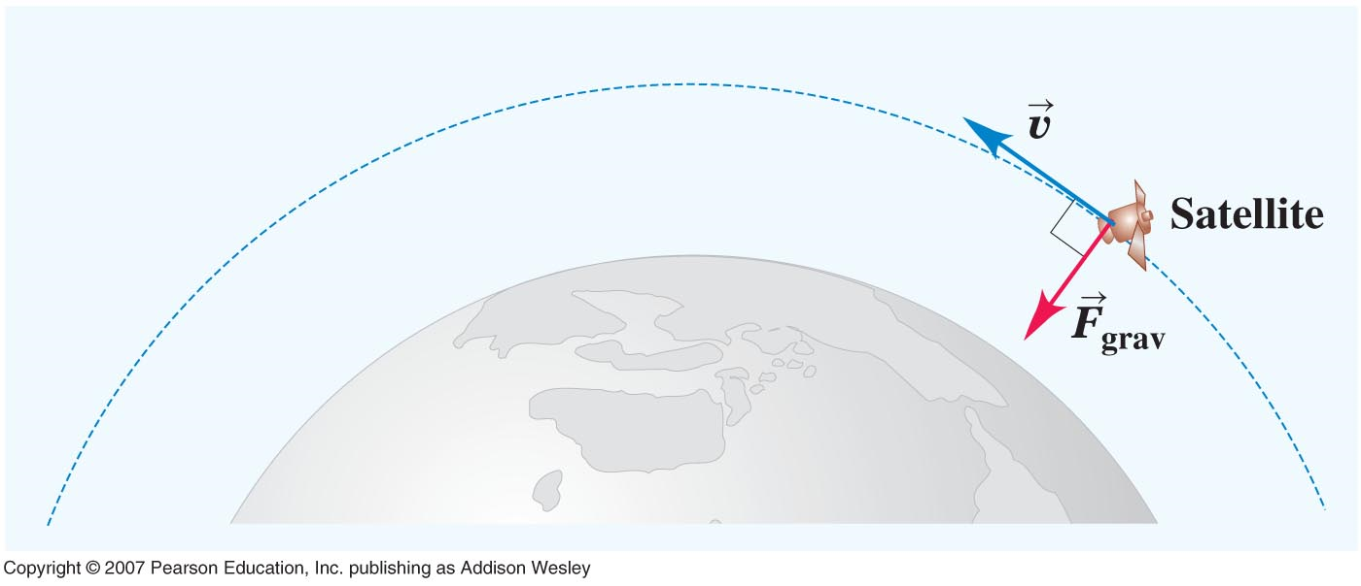
Satellite in a circular orbit
Does the Earth do work on the satellite?

Slide 23
What can you say about the work the sun does on the earth during the earth's orbit? (Assume the orbit is perfectly circular.)
Clicker question
The sun does net negative work on the earth.
The sun does net positive work on the earth.
The work done on the earth is positive for half the orbit and negative for the other half, summing to zero.
The sun does no work on the earth at any point in the orbit.
Notes:
Answer: d) The sun does no work on the earth at any point in the orbit.

Slide 24
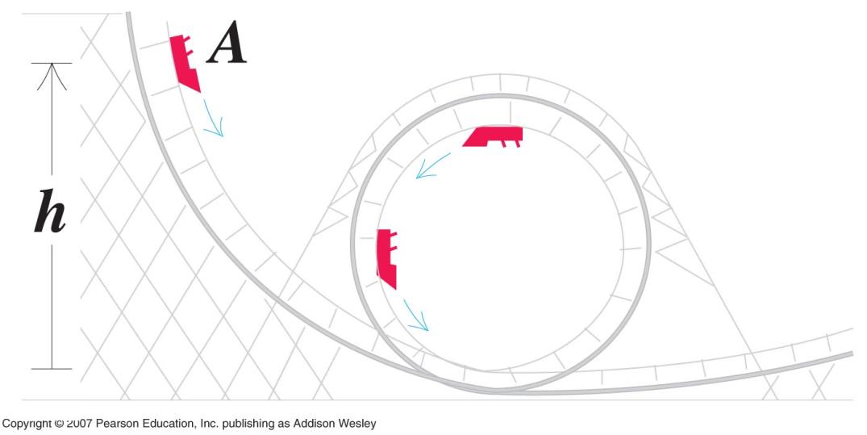
Problem81. Riding a loop-the-loop starting at rest from a point A, find the minimum height h, so that the car will not fall of the track at the top of the circular part of the loop, which has a radius of 20m.
At the top of the loop at point B
$F_{rad}=mg=m\frac{v^{2}}{R} →v=\sqrt{gR}=v_{B}$ → minimum velocity needed to stay on the track.
Calculate the height $h_{A}$ necessary to produce minimum speed $v_{B}$
$$U_{A}+K_{A}=U_{B}+K_{B}$$
$${mgh}_{A}+0={mgh}_{B}+\frac{1}{2}mv_{B}^{2}$$
$${gh}_{A}=g2R+\frac{1}{2}{(\sqrt{gR})}^{2}$$
$$h_{A}=\frac{5}{2}R$$
If h < 2.5R the car is moving too slow and falls off the track
If h > 2.5R than at point B more downward force than gravity is needed and this is provided by the normal force that the track exerts on the car.
B

Slide 25
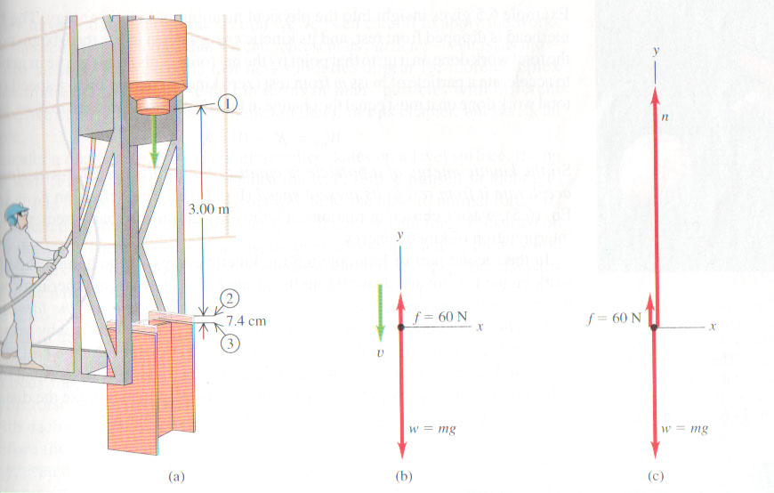
Forces on a hammerhead
Forces

Slide 26
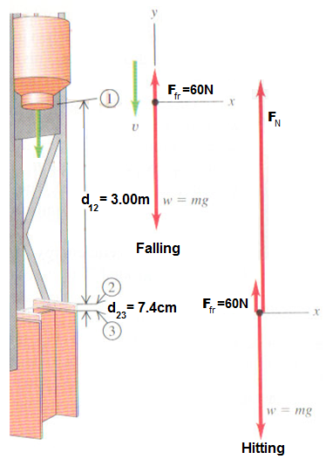
Forces on a hammerhead
$$W=F∙d$$
$$W=200kg∙9.8\frac{m}{s^{2}}=1960N$$
Weight $w−F_{fr}=1960−60=1900N$
$$K_{2}−K_{1}=\frac{1}{2}mv_{2}^{2}−0=W=\left(w−F_{fr}\right)∙d_{12}=1900∙3=5700N$$
→ $\frac{1}{2}mv_{2}^{2}=5700N$ (Falling) and $v_{2}=\sqrt{\frac{2∗5700}{200}}=7.55\frac{m}{s}$
$K_{3}−K_{2}=\left(w−F_{fr}−F_{N}\right)∙d_{23}$ (Hitting)
→$F_{N}=w−F_{fr}−\frac{K_{3}−K_{2}}{d_{23}}=1960−60−\frac{0−5700}{0.074}$
$$∴F_{N}=79000N$$
So, the normal force is 40 times larger than weight of the hammer.

Slide 27
Work Done on a Spring Scale – Example 7.6
Energy may be stored in compressed springs on a bathroom scale.
Refer to the worked example on page 194.

Slide 28
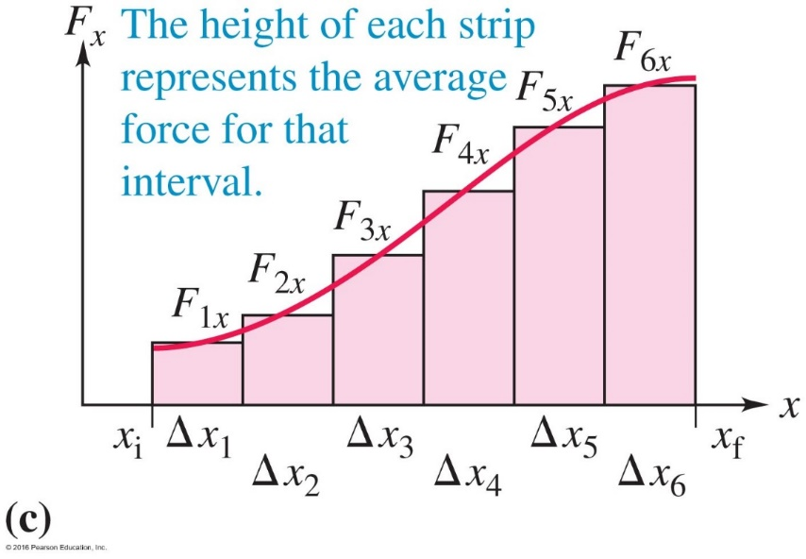
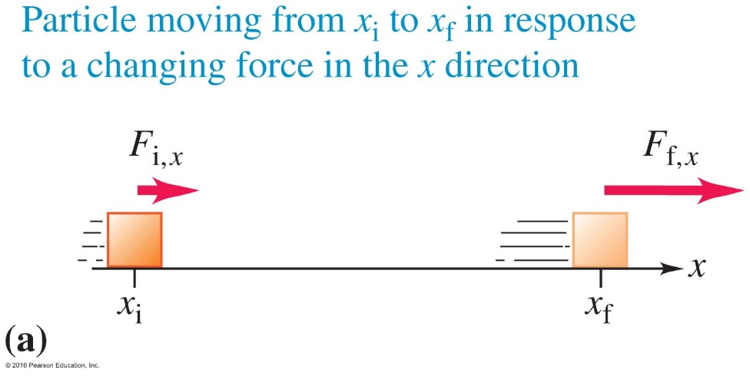
7.4 Work Done by a Varying Force
In reality, relevant forces are not always constant forces.
How do we calculate the work done by a varying force?

Slide 29
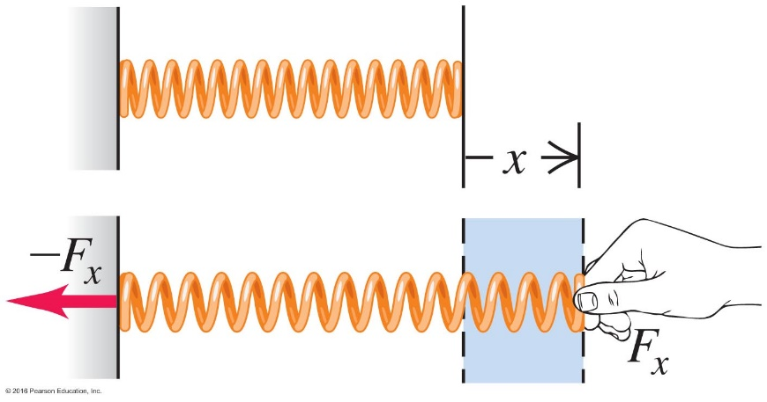
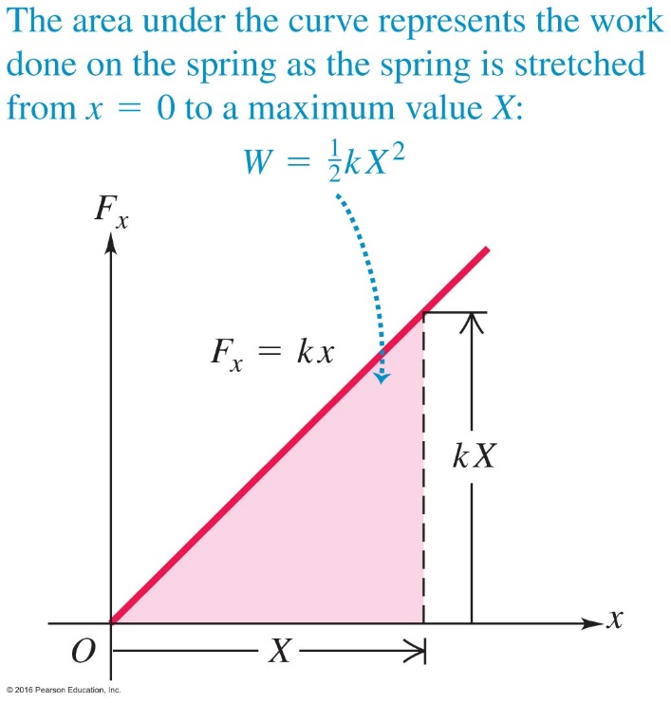
Work Done By a Varying Force
Hooke's law:
As seen, this is a prime example of a varying force. The work done by a stretching/compressing a spring is equal to the area of the shaded triangle, or

Slide 30
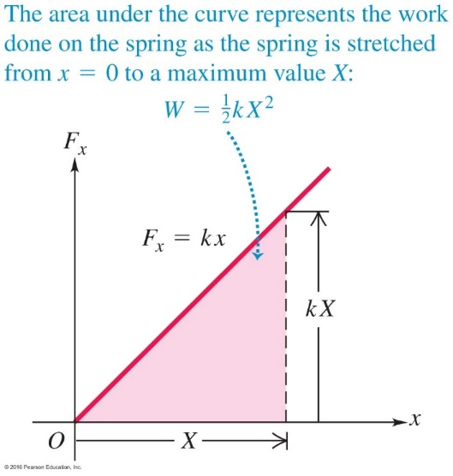
Example:
Work done on a spring by a Varying external force.
● The force needed to stretch or compress a spring
$F=kx$.
● The work done on the spring
$$W=\left(\frac{1}{2}\right)\left(x\right)\left(kx\right)=\frac{1}{2}kx^{2}$$
● The work done on the spring for stretching
it from x₁ to x₂ is
$$W=\frac{1}{2}kx_{2}^{2}−\frac{1}{2}kx_{1}^{2}$$
● The work done by the spring during this process
$$W_{spring}=\frac{1}{2}kx_{1}^{2}−\frac{1}{2}kx_{2}^{2}$$
O
x
$$W=\frac{1}{2}kx^{2}$$
$W=\frac{1}{2}kx_{2}^{2}−\frac{1}{2}kx_{1}^{2}$
x₁
x₂

Slide 31
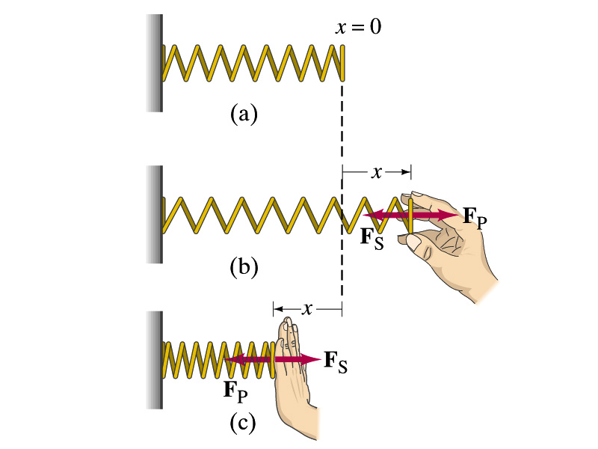
Spring Force (Hooke’s Law)
Spring Force
(Restoring Force):
The spring exerts its force in the
direction opposite
the displacement.
F_{S}
F_{P}
x > 0
Natural Length
x < 0
F_{S}(x) = - k x

Slide 32
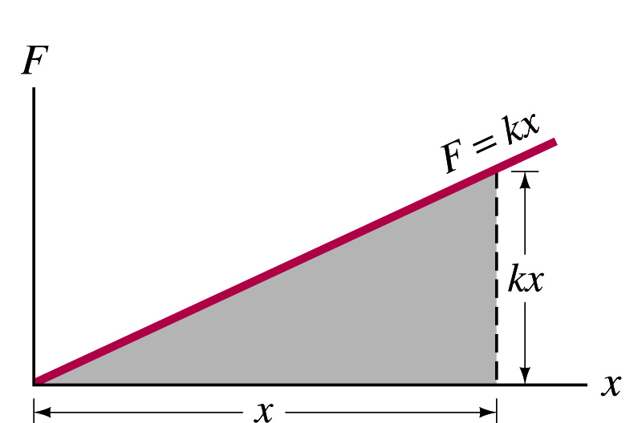
Work Done to Stretch a Spring
F_{S}
F_{P}
F_{S}(x) = - k x
Natural Length
Area ( triangle)
= baseline * height/ 2
W
k x · x/2=A

Slide 33
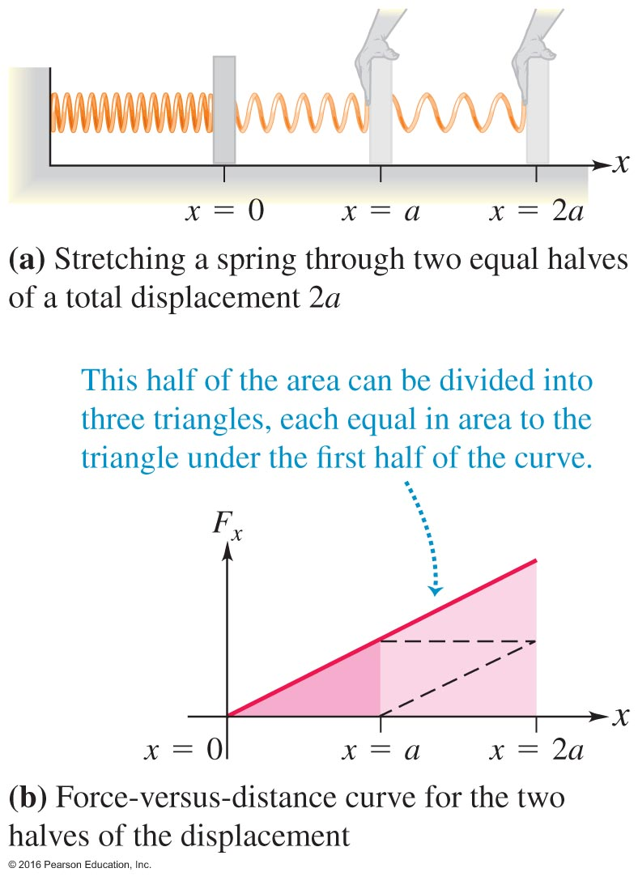
Notes:
Figure 7.21

Slide 34
Example 1A
A person pulls on the spring, stretching it
3.0 cm, which requires a maximum force
of 75 N. How much work does the person
do ? If, instead, the
person compresses
the spring 3.0 cm,
how much work
does the person do ?

Slide 35
Example 1A (cont’d)
(a) Find the spring constant k
k = F_{max} / x_{max}
= (75 N) / (0.030 m) = 2.5 x 10³ N/m
(b) Then, the work done by the person is
W_{P} = (1/2) k x_{max}² = 1.1 J

Slide 36
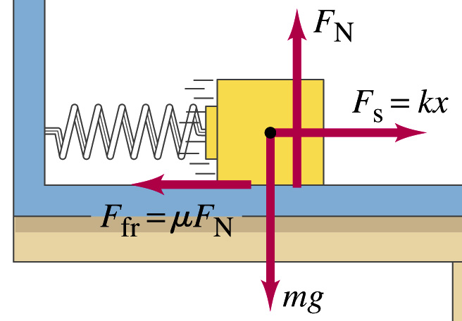
Example 2
A 1.50-kg block is pushed against a spring
(k = 250 N/m), compressing it 0.200 m, and
released. What will be the speed of the
block when it separates from the spring at
x = 0? Assume μ_{k} =
0.300.
F_{S} = - k x
(i) F.B.D. first !
(ii) x < 0

Slide 37
Example 2 (cont’d)
(a) The work done by the spring is
(b) W_{f} = - μ_{k} F_{N} (x₂ – x₁) = -4.41 (0 + 0.200)
(c) W_{net} = W_{S} + W_{f} = 5.00 - 4.41 x 0.200
(d) Work-Energy Theorem: W_{net} = K₂ – K₁
→ 4.12 = (1/2) m v² – 0
→ v = 2.34 m/s
W_{S} =1/2 k x² = ½ (250N/m) (0.2 m² )= +5.00 J

Slide 38
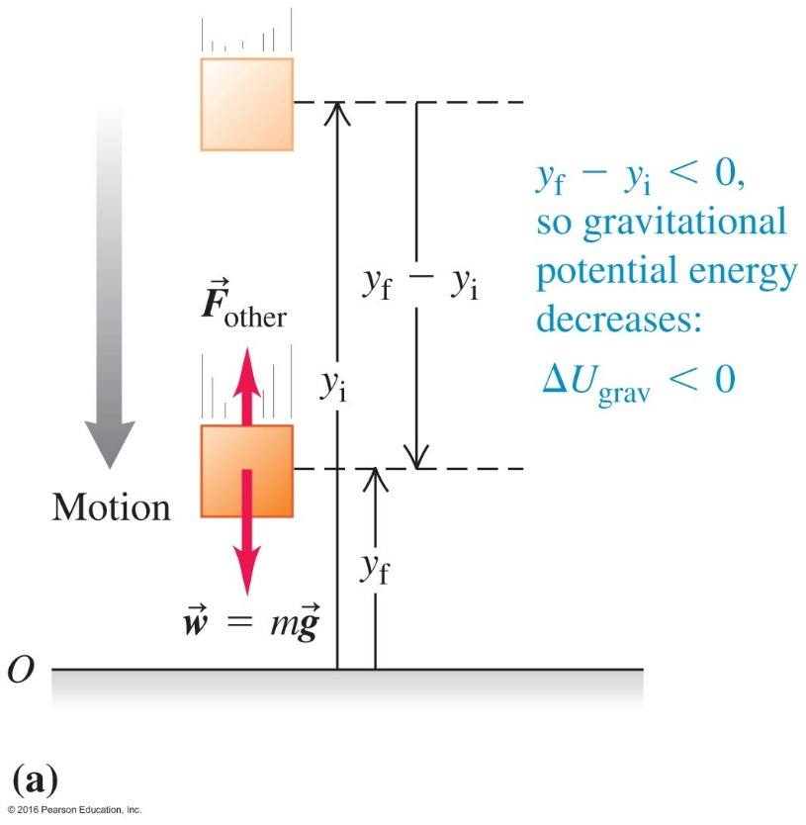
7.5 Potential Energy-------What is potential energy???
Using free-fall under the influence of gravity (weight) as an example.
How does the work-energy theorem describe this motion?
Work $=\left(mg\right)∗\left(y_{i}−y_{f}\right)=mgy_{i}−mgy_{f}$
Change in kinetic energy$=\frac{1}{2}mv_{f}^{2}−\frac{1}{2}mv_{i}^{2}$
The work-energy theorem:
$$mgy_{i}−mgy_{f}=\frac{1}{2}mv_{f}^{2}−\frac{1}{2}mv_{i}^{2}$$
y
$$w=mg$$
Describing this motion using the concept of potential energy.
Define gravitational potential energy: U_{grav} = mgy
In the presence of a force, there is energy associated with the position of a particle----potential energy.
$$w=mg$$
Unit = joule can be positive ,negative, or zero
Courtesy of Wenhao Wu

Slide 39
Examples of Force and Potential Energy
Force Type Work Done by the Force (i $→$ f ) Potential Energy
Gravity
$F_{g}=mg$ $W=mgy_{i}−mgy_{f}=U_{i}−U_{f}$ $U_{grav}=mgy$
Spring (elastic)
$F_{spring}=− kx$ $W=\frac{1}{2}kx_{i}^{2}−\frac{1}{2}kx_{f}^{2}=U_{i}−U_{f}$ $U_{el}=\frac{1}{2}kx^{2}$

Slide 40
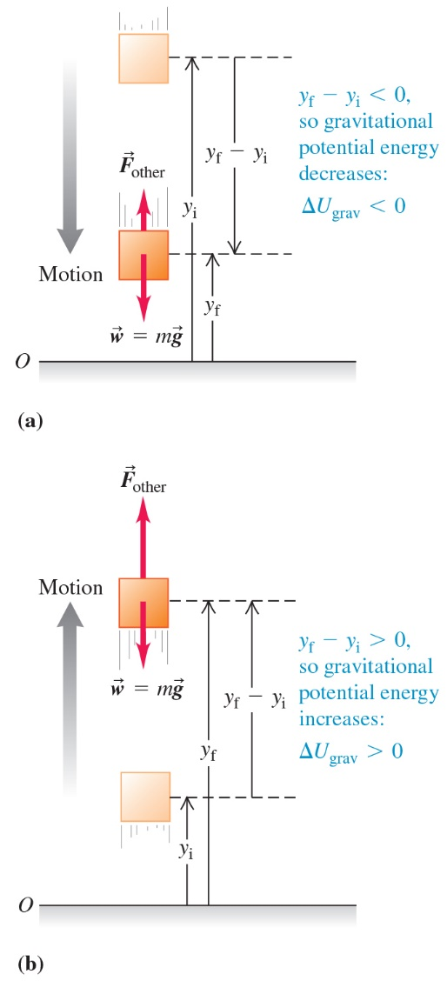
Potential Energy (1 of 2)
In cases of conservative forces (gravity or elastic forces), there can be "stored" energy due to the spatial arrangement of a system, or potential energy.
Gravitational potential energy (U _{grav}), near the surface of the earth can be written:

Slide 41
Potential Energy (2 of 2)
The change in the potential energy due to conservative forces is related to the work done by the net force:
If only conservative forces act, then by the work-energy theorem we can define the total mechanical energy:

Slide 42
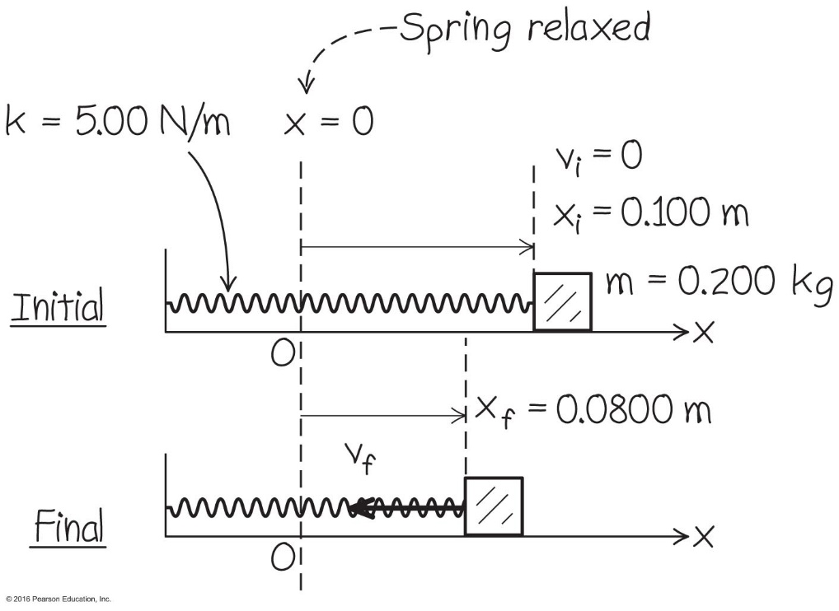
Potential Energy on an Air Track with Mass and Spring
Refer to Example 7.8.
Knowing the initial state of our system and thus the total mechanical energy, we use this to find the final state at any position.
Using conservation of total mechanical energy:

Slide 43
7.6 Conservation of Energy
For a conservative force, the work done is related to the change in the potential energy:
$W=U_{i}−U_{f}$.
Apply the work-energy theorem, we obtain:
$U_{i}−U_{f}=K_{f}−K_{i}$ or $U_{i}+K_{i}=U_{f}{+ K}_{f}.$
The expression in red is the conservation of energy, when the force is a conservative force.
The total mechanical energy E is the sum of the potential energy and kinetic energy:
$E=U+K$

Slide 44
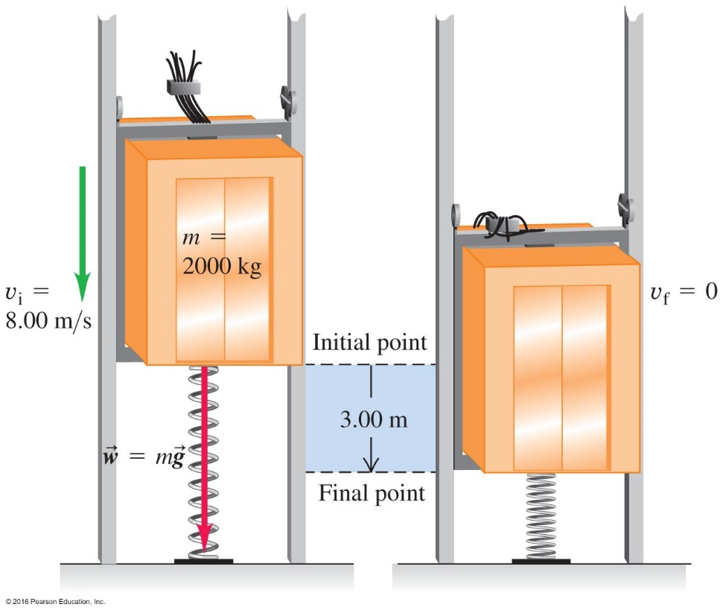
Conversion and Conservation – Example 7.11
As kinetic and potential energy are interconverted, dynamics of the system may be solved.
$K_{i}=\frac{1}{2}mv^{2}=64 000J{ U}_{i}=mgh=58 800 J U_{i}+K_{i}=U_{f}+K_{f}$
64 000 J+ 58 800 J = 0 + $\frac{1}{2}k{\left(−3 m\right)}^{2} k=2.73x{10}_{}^{2}$N/m

Slide 45
Clicker question
K increases as it slides down the ramp and remains constant along the horizontal surface.
K remains constant as it slides down the ramp and decreases along the horizontal surface.
K increases as it slides down the ramp and deceases along the horizontal surface
How about the potential energy with the same questions??
Notes:
Figure 7.28

Slide 46
Useful Expressions for Applications
With gravity force: $E=U_{grav}+K=mgy+\frac{1}{2}mv^{2}$
Conservation of energy: $mgy_{i}+\frac{1}{2}mv_{i}^{2}=mgy_{f}+\frac{1}{2}mv_{f}^{2}$
With spring force: $E=U_{el}+K =\frac{1}{2}kx^{2}+\frac{1}{2}mv^{2}$
Conservation of energy: $\frac{1}{2}kx_{i}^{2}+\frac{1}{2}mv_{i}^{2}=\frac{1}{2}kx_{f}^{2}+\frac{1}{2}mv_{f}^{2}$
With both g&s forces: $E={U_{grav}+U}_{el}+K =mgy+\frac{1}{2}ky^{2}+\frac{1}{2}mv^{2}$
Conservation of energy: $mgy_{i}+\frac{1}{2}ky_{i}^{2}+\frac{1}{2}mv_{i}^{2}=mgy_{f}+\frac{1}{2}ky_{f}^{2}+\frac{1}{2}mv_{f}^{2}$

Slide 47
7.7 Conservative and Nonconservative Forces
$$y$$
Nonconservative Forces
Friction Force
● Work done depends on the path.
● Cannot define a potential energy.
$$\overset{⃑}{n}$$
$${\overset{⃑}{f}}_{k}$$
$$i$$
$$f$$
$$x$$
$$mg$$
Conservative Forces
Work done by a conservative force depends on the initial and the final
positions only. It is independent of the details of the path along which the
object moves from the initial to the final positions.
When both conservative and nonconservative forces act on an object
$${(U}_{grav,i} +{ U}_{el,i}+\frac{1}{2}mv_{i}^{2})+W_{other}={(U}_{grav,f}+U_{el,f}+\frac{1}{2}mv_{f}^{2})$$

Slide 48
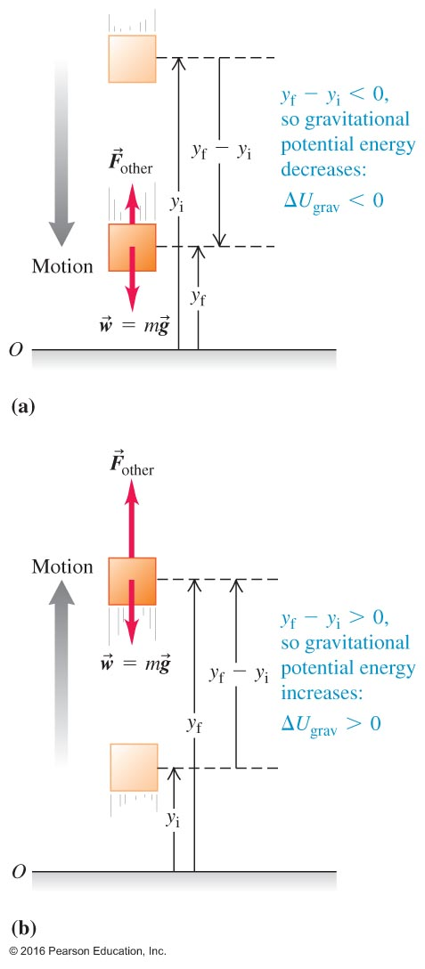
Gravitational potential energy
In cases of conservative forces (gravity or elastic forces), there can be "stored" energy due to the spatial arrangement of a system, or potential energy.
Gravitational potential energy (U_{grav}), near the surface of the earth can be written:

Slide 49
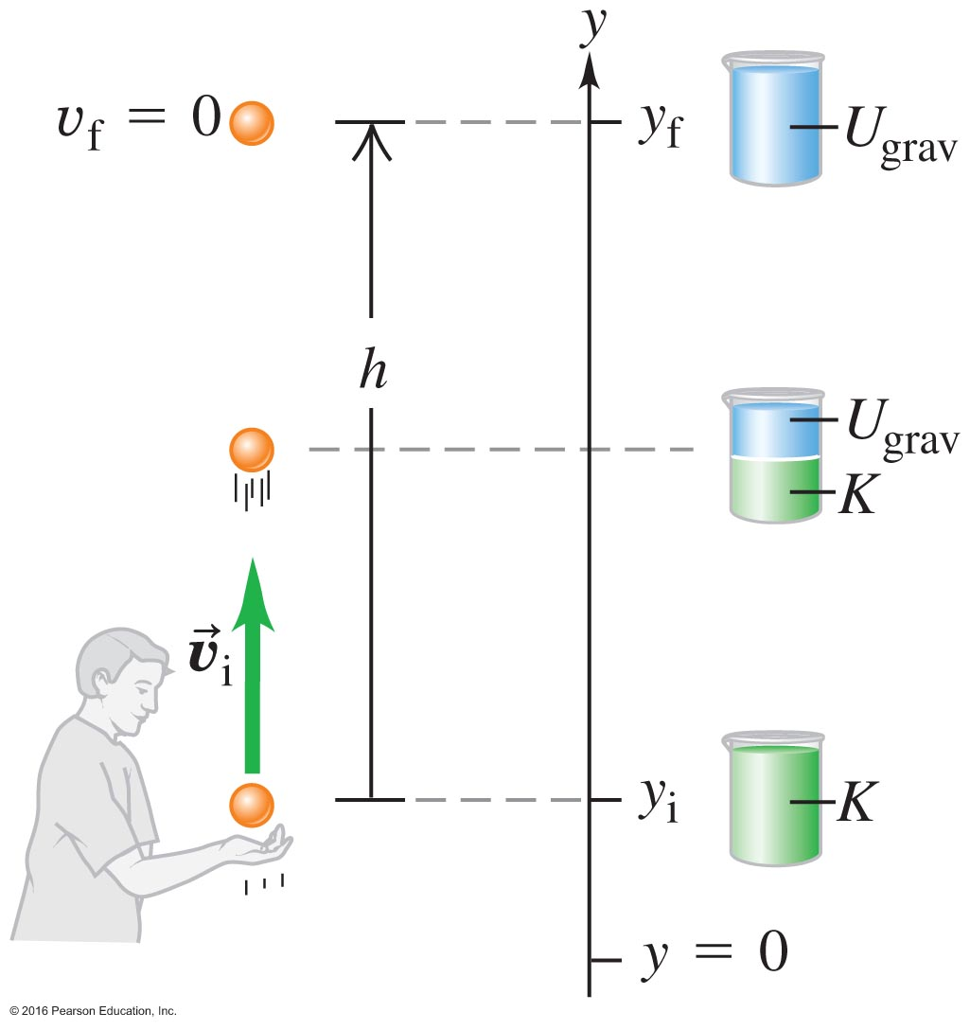
Notes:
Chapter Summary 7.5

Slide 50
Potential Energy
The change in the potential energy due to conservative forces is related to the work done by the net force:
If only conservative forces act, then by the work-energy theorem we can define the total mechanical energy:

Slide 51
Work Done by the Gravitational Force (III)
W_{g} < 0 if y₂ > y₁
W_{g} > 0 if y₂ < y₁
The work done by the gravitational
force depends only on the initial and
final positions..

Slide 52
Work Done by the Gravitational Force (IV)
W_{g(A→B→C→A)}
= W_{g(A→B)} +
W_{g(B→C)} +
W_{g(C→A)}
= mg(y₁ – y₂) +
0 +
mg(y₂- y₁)
= 0
C
B
dl
A

Slide 53
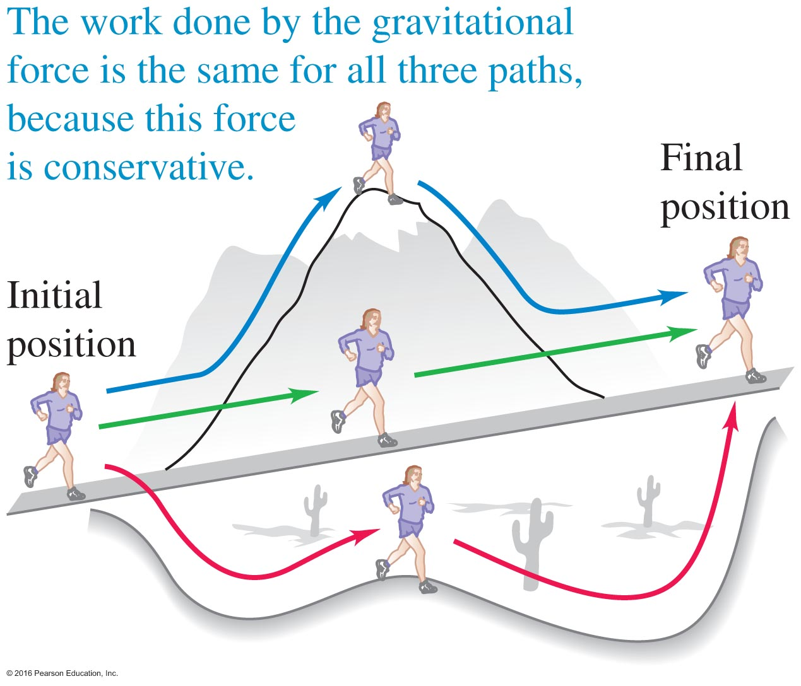
Conservative Forces II – Figure 7.34
The work done by a conservative force is independent of the path taken.
When the starting and ending points are the same, the total work is zero.

Slide 54
Conservative and Nonconservative Forces
In the previous section, we discussed that if we had only conservative forces acting, then we could used conservation of total mechanical energy.
If we have nonconservative forces which do work, we have to add this to the total energy:
W_{other} is the work done by nonconservative forces (e.g. friction).

Slide 55
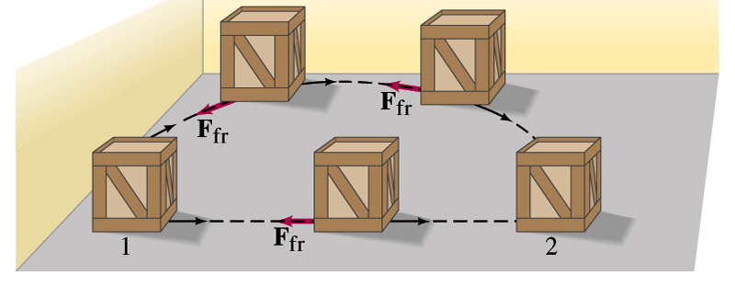
Work Done by F_{f} (I)
- μmg L
W(friction)=
L depends on the path.
L_{B}
Path B
Path A
L_{A}

Slide 56
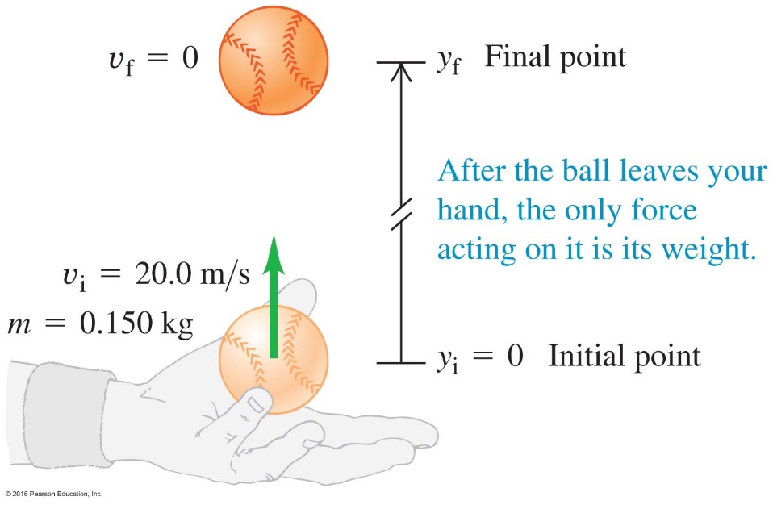
A Solved Baseball Problem – Example 7.7
When the ball, with initial speed _{i} is thrown straight upward, it slows down on the way up as the kinetic energy is converted to potential energy (mgy>0).
At the top, the kinetic energy is zero and potential energy is maximum.
On the way back down, the potential energy is converted back to kinetic energy, and the ball speeds up.
Conservation of total mechanical energy

Slide 57
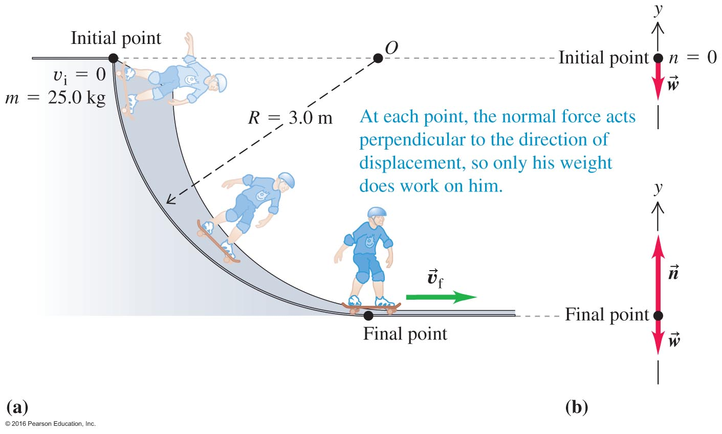
Notes:
Figure 7.31

Slide 58
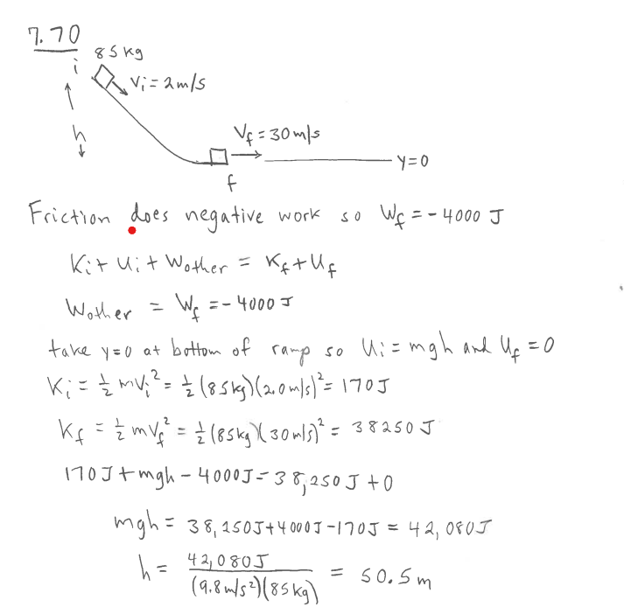
Ski jump ramp

Slide 59
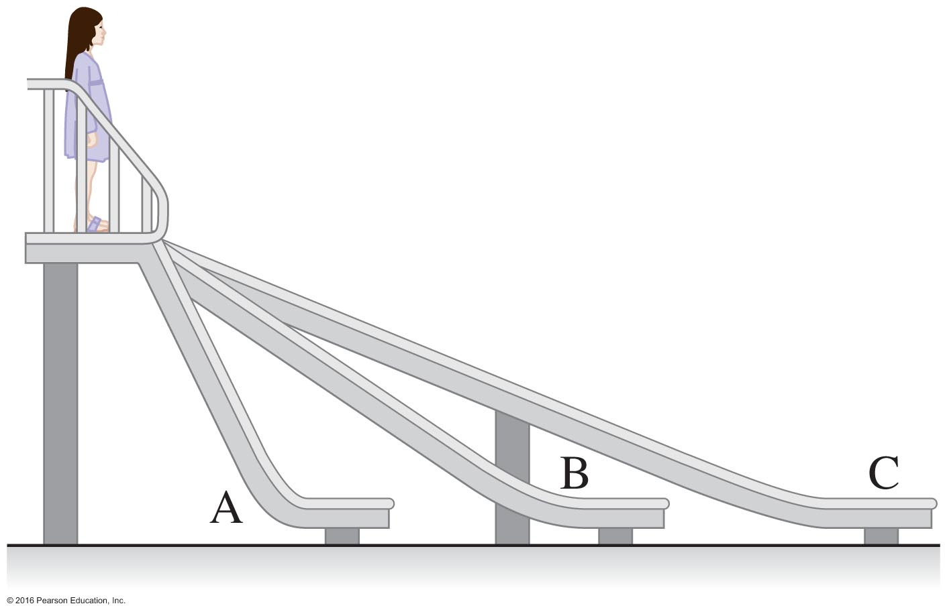
Clicker question
On which slide will the speed on the bottom be greatest ?
A
B
C
The speed will be the same
In each case the final energy of the child is the same K_{f} = U _{f} – U _{I} = mgy
Notes:
Figure 7.40

Slide 60
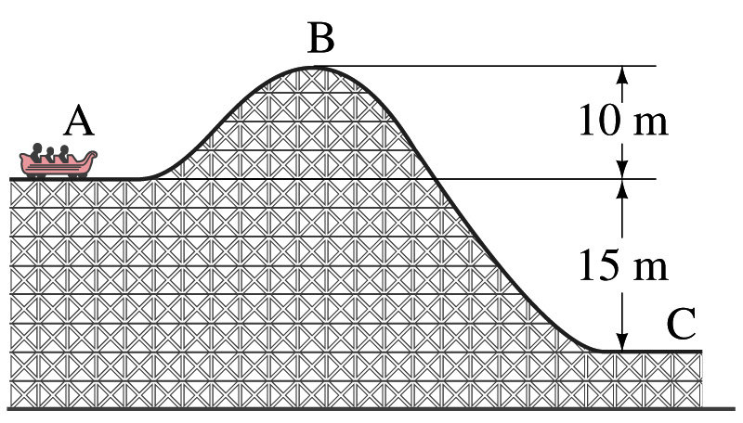
W_{g(A→C)} = U_{g}(y_{A}) – U_{g}(y_{C})
W_{g(A→B→C)} = W_{g(A→B)} + W_{g(B→C)}
= mg(y_{A}- y_{B}) + mg(y_{B} - y_{C})
= mg(y_{A} - y_{C})
y
B
A
B
dl
C
A

Slide 61
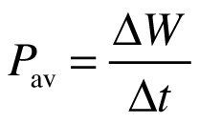
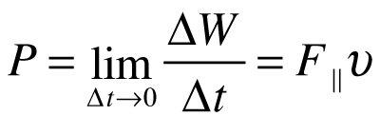
Power – How fast work is done
When a quantity of work ΔW is done during a time interval Δt, the average power P_{av} or work per unit time is:
Units of watt [W], or 1 watt = 1 joule per second [J/s]
The rate at which work is done is not always constant. When it varies, we define the instantaneous power P as:
Notes:
Power – How fast work is done
When a quantity of work ΔW is done during a time interval Δt, the average power P_{av} or work per unit time is:
Units of watt [W], or 1 watt = 1 joule per second [J/s]
The rate at which work is done is not always constant. When it varies, we define the instantaneous power P as:

Slide 62
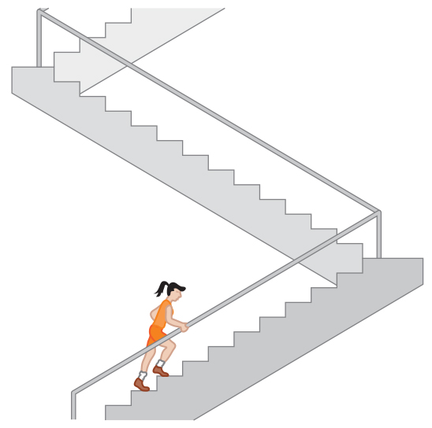
Power – Considers Work and Time to Do It (2 of 2)
Example 7.16: A marathon stair climb
If the runner is initially at rest and ends at rest, the work done by the runner is equal to the work done by gravity on the runner.
The average power output by the runner is then:

Slide 63
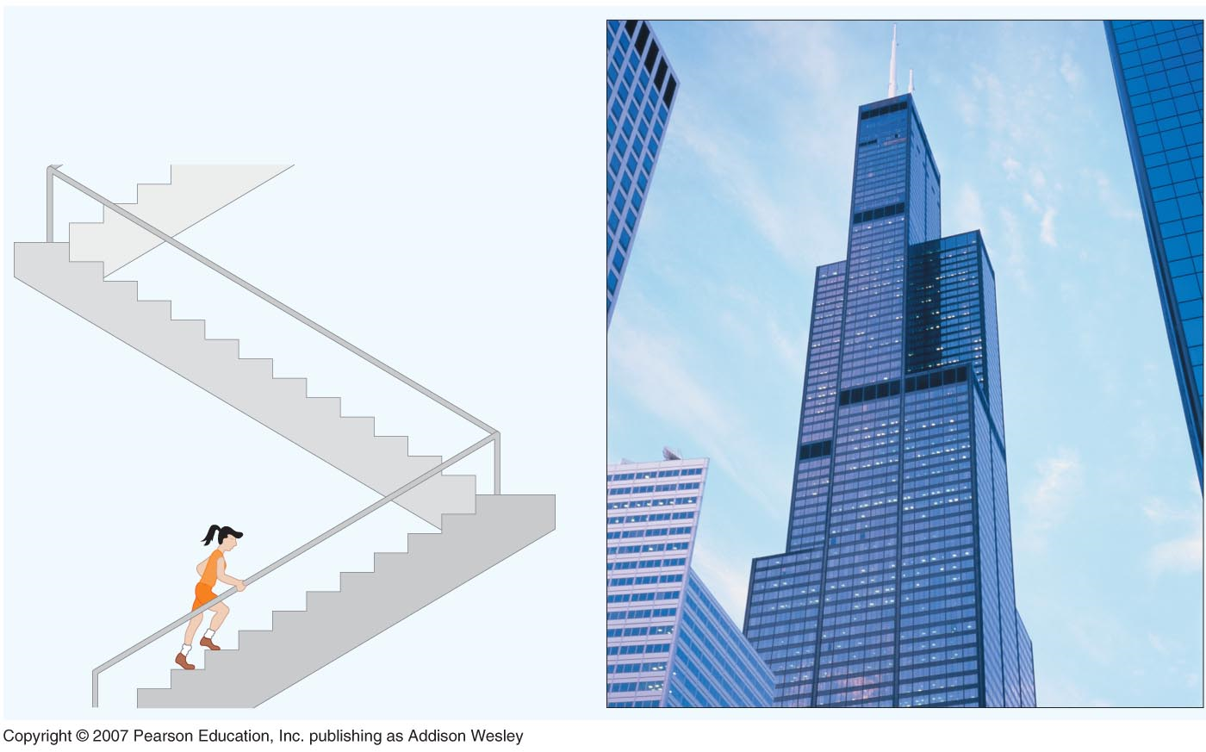
Climbing the Sears tower The Willis Tower (formerly the Sears Tower) is a 108-story, 1,450-foot (42. 41 m) skyscraper in Chicago.

Slide 64
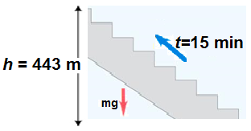
Power
Power = rate of energy production and consumption = $[\frac{J}{s}]$=watt
$$1 hp≅746 Watt$$
What do we pay to the electricity company for 100 watt bulb? (11 cents / 1 kwatt.h)
$$1 kwatt∙h={10}^{3}watt∙h\frac{3.6x{10}^{3}s}{1h}=3.6x{10}^{6}J∙\frac{1kcal}{{4.18x10}^{3}J}=860kcal$$
Is electricity cheap? 1 kWatt-hour costs 11 cents. The exercise bike shows 100watt. How long must you pedal to produce energy of 1 kWatt-hour?
$100 watt∙10 hour=0.1 kwatt∙10 hour=1 kwatt∙h$ → $11 cents$
So; need to pedal for 10 hours.
A power climb: P=? and m=50kg
$mg∙h=50\left(9.8\right)443=2.17x{10}^{5}J$ and $t=15 min \frac{60 s}{1 min}=900 s$
$$∴P=\frac{2.17x{10}^{5}}{900}=241 Watt$$

Slide 65
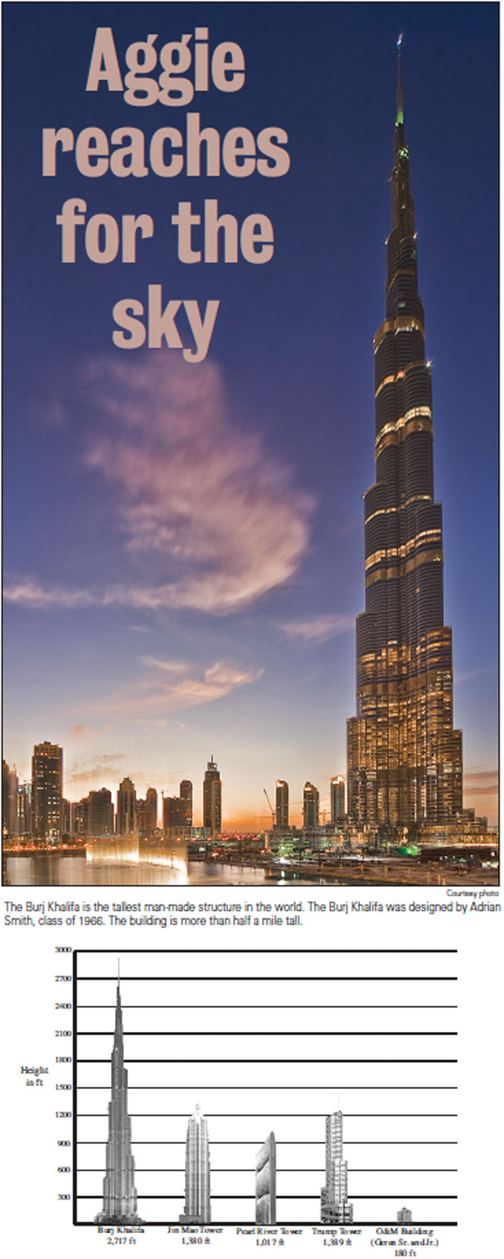
The Burj Khalifa is the largest
man made structure in the world
and was designed by Adrian
Smith class of 1966
thebatt.com Febuary 25th

Slide 66
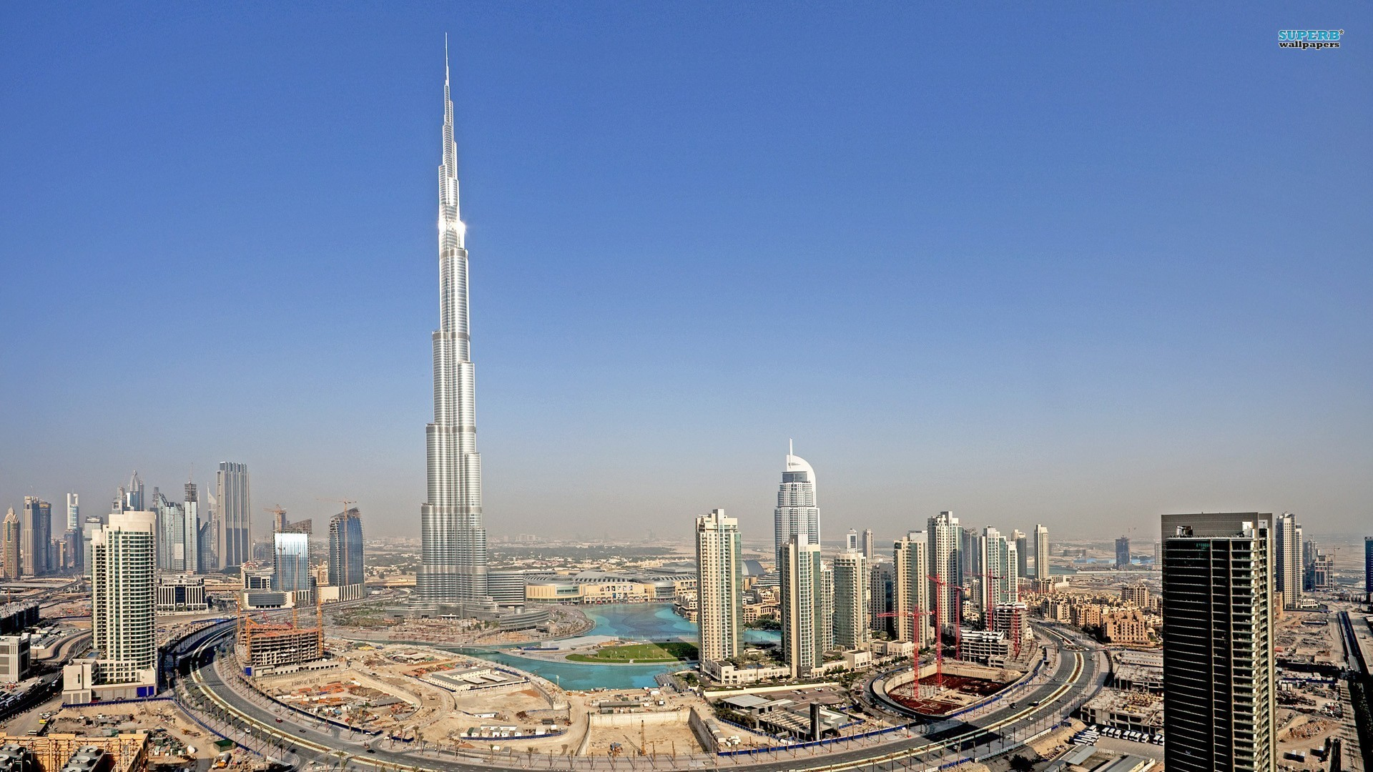
How many pillars of steel and concrete must be in the foundation? How long and wide it should be, so this building can be constructed on desert sand? What are the friction forces, which must be present, so it does not sink in the dessert sand?

Slide 67
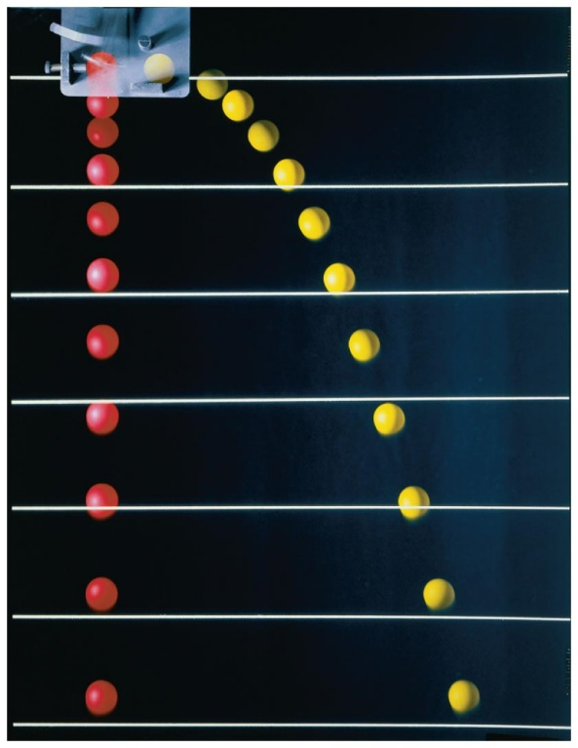
Comments on Force and Potential Energy
● Potential energy is defined for conservative forces only.
● What kind of forces are conservative forces? As an example, let’s
consider the free-fall motions of a particle of mass m under the
influence of gravity, with different horizontal initial velocities.
v_{ix} varies; v_{iy} = 0
v_{fx} = v_{ix}; v_{fy} = $\sqrt{2g(y_{i}−y_{f})}$ independent of the paths
Apply the work-energy theorem and remember that ${v^{2}=v}_{x}^{2}+v_{y}^{2}$:
$$W_{g}= \frac{1}{2}mv_{f}^{2}−\frac{1}{2}mv_{i}^{2}=mgh=mg\left(y_{i}−y_{f}\right)$$
Conclusion: The work done by the gravity force depends on the initial and the final positions only.
It is independent of the exact path.
● If the work done by a force depends only on the initial and the final positions and is
independent of the path of motion, this force is a conservative force.

Slide 68
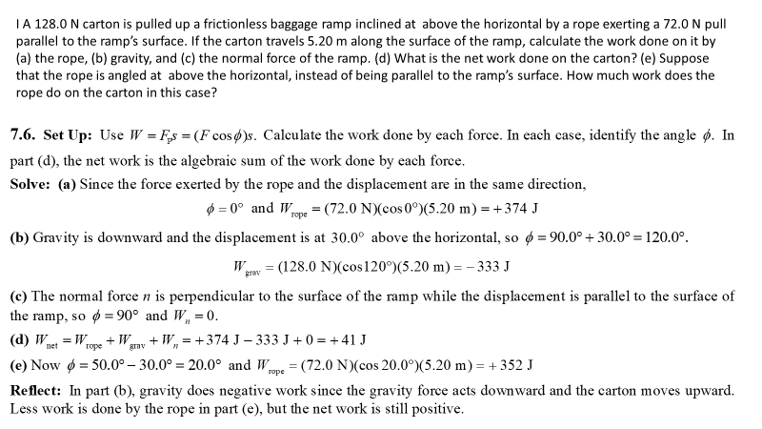
7.6

Slide 69
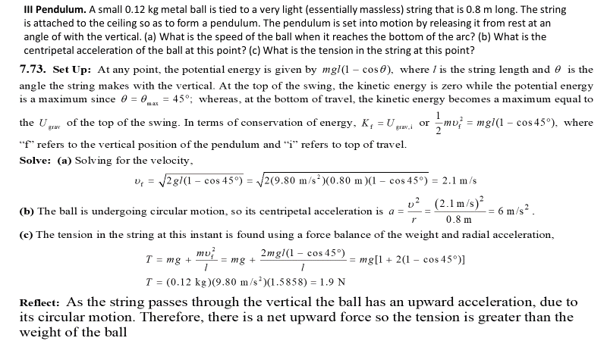
7. 73

Slide 70
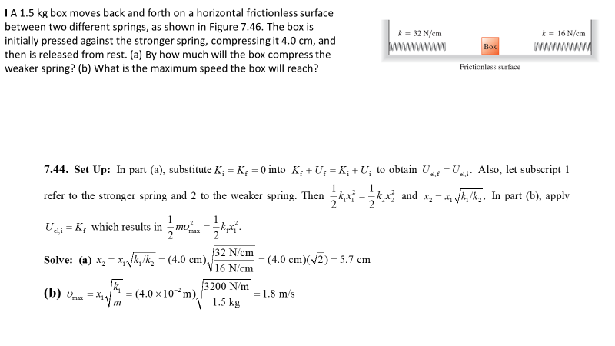
7. 44

Slide 71
7. 75

Slide 72
Mass pushed on horizontal spring

Slide 73
Roofer and toolbox

