Slide 1
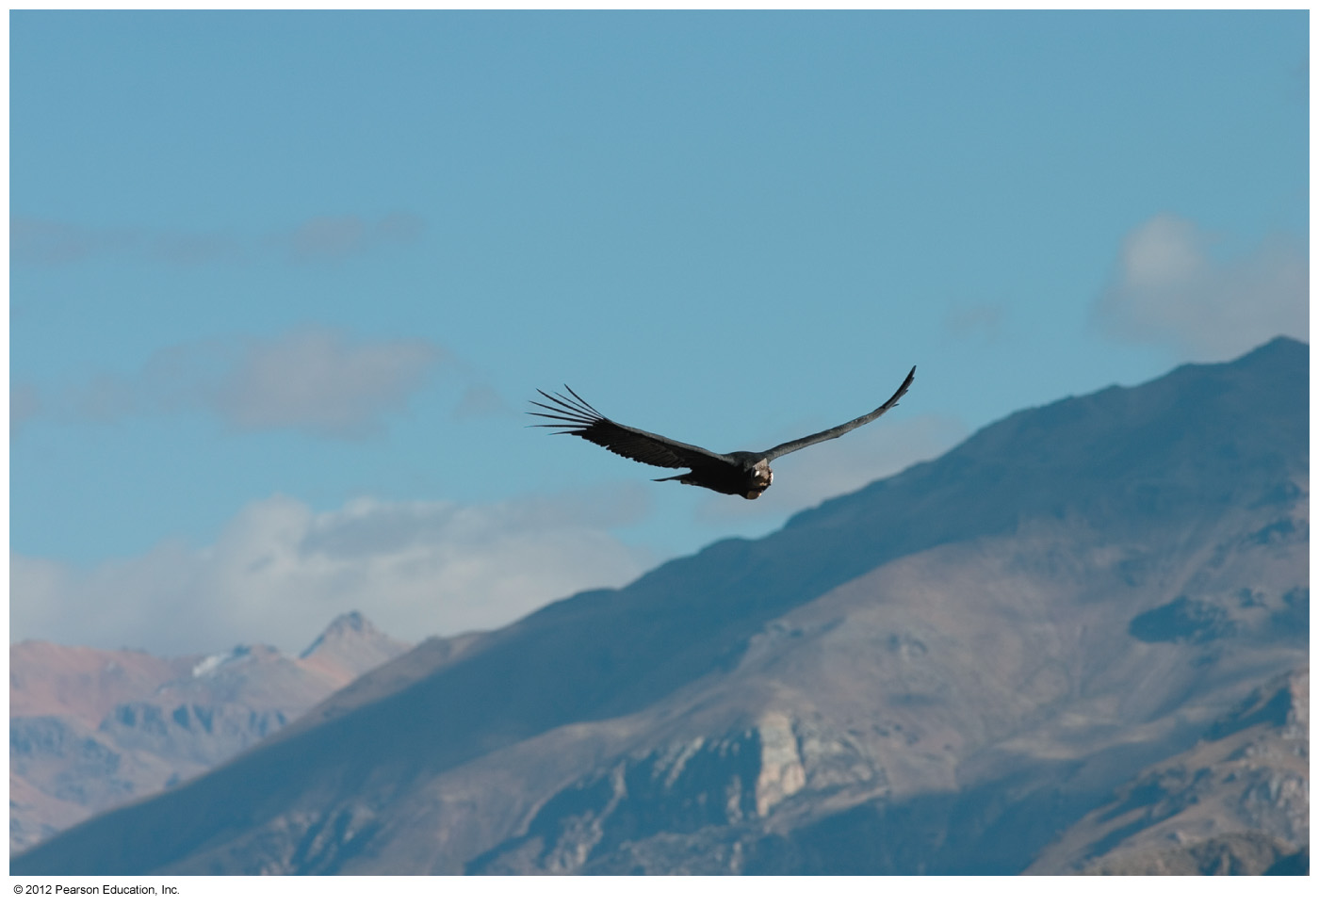
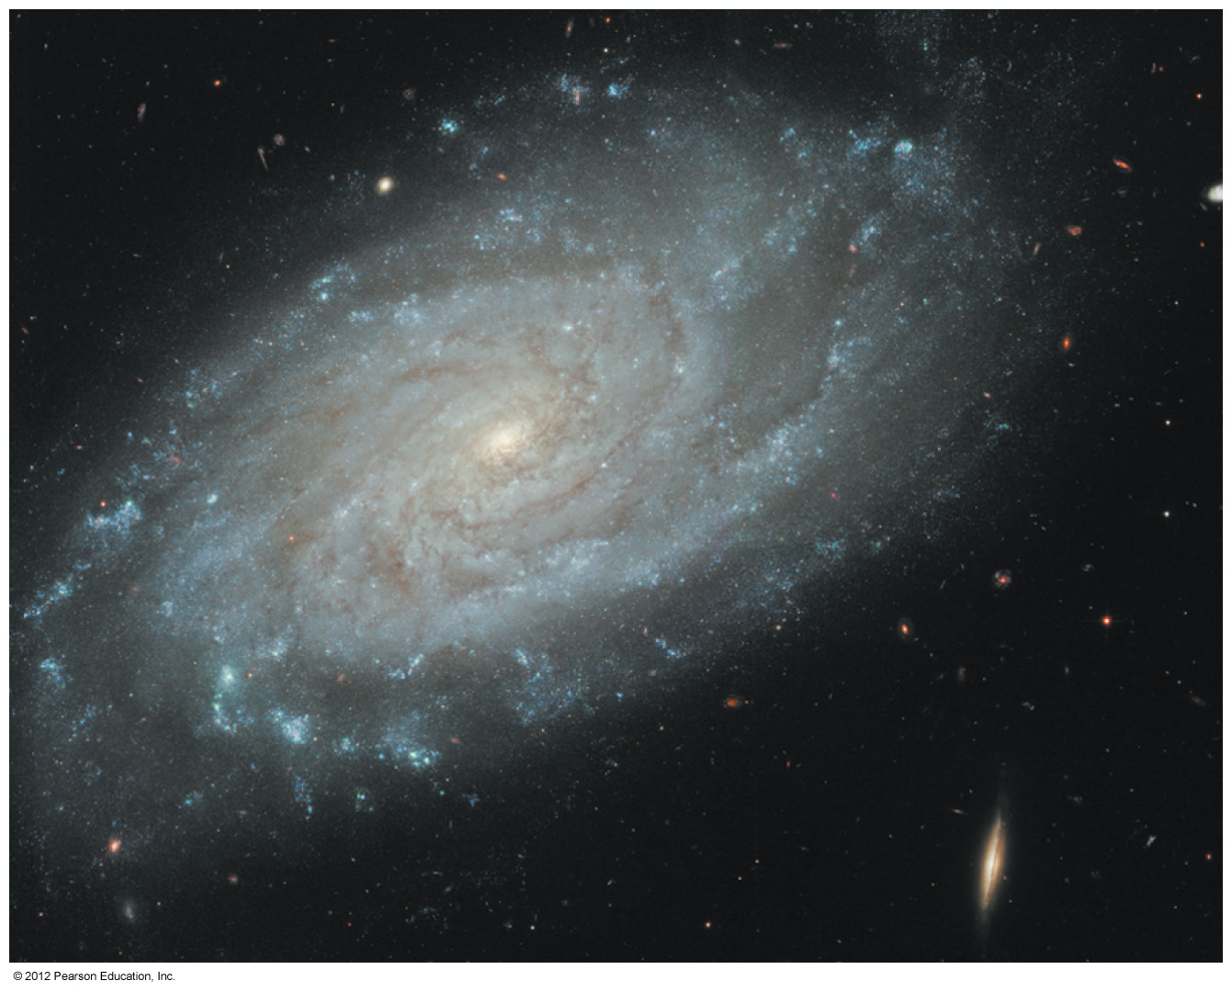
Chapter 15: Thermal Properties of Matter
10^11 stars in our Milky Way

Slide 2
Chapter 15 Thermal Properties of Matter
● To understand the mole and Avogadro's number.
● To understand equations of state.
● To study the kinetic theory of ideal gas.
● To understand heat capacity.
● To learn and apply the first law of thermodynamics.
● To study thermodynamic processes.
● To understand the properties of an ideal gas.

Slide 3
Goals
Relate the macroscopic properties to the microscopic properties
Gain an understanding of the thermal properties of matter
Consider various phases of matter: gas, liquid, and solid and conditions under which they occur

Slide 4
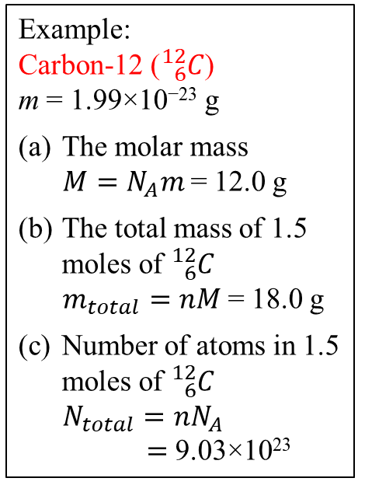
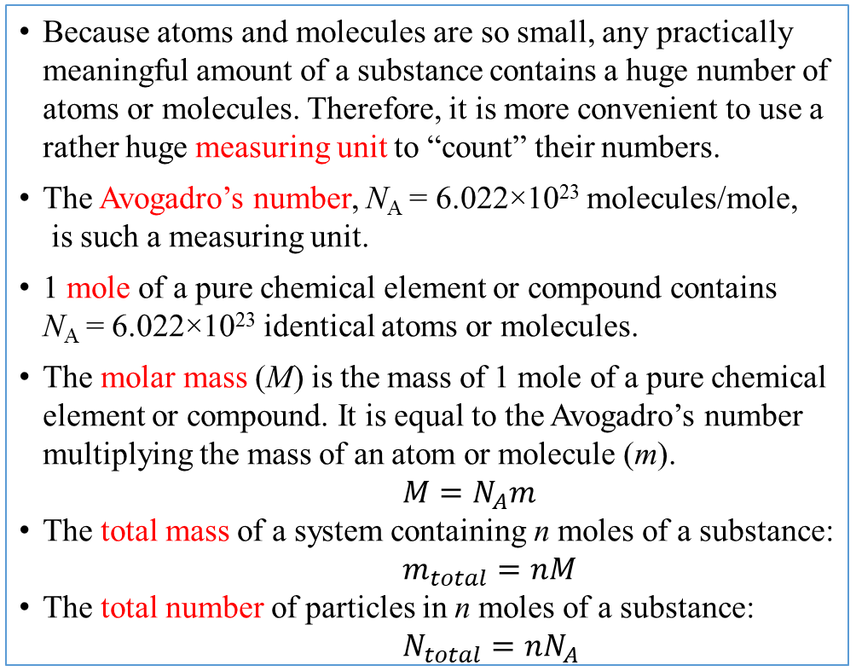
15.1 The Mole and Avogadro’s Number
Because atoms and molecules are so small, any practically meaningful amount of a substance contains a huge number of atoms or molecules. Therefore, it is more convenient to use a rather huge measuring unit to “count” their numbers.
The Avogadro’s number, N_{A} = 6.022×10²³ molecules/mole,
is such a measuring unit.
1 mole of a pure chemical element or compound contains N_{A} = 6.022×10²³ identical atoms or molecules.
    The molar mass (M) is the mass of 1 mole of a pure chemical element or compound. It is equal to the Avogadro’s number multiplying the mass of an atom or molecule (m).
    $M=N_{A}m$
The total mass of a system containing n moles of a substance:
    $m_{total}=nM$
The total number of particles in n moles of a substance:
    $N_{total}=nN_{A}$
Example:
Carbon-12 (${}_{6}^{12}C$)
m = 1.99×10⁻²³ g
The molar mass
    $M=N_{A}m$ = 12.0 g
The total mass of 1.5 moles of ${}_{6}^{12}C$
    $m_{total}=nM$ = 18.0 g
Number of atoms in 1.5 moles of ${}_{6}^{12}C$
$N_{total}=nN_{A}$
$=$ 9.03×10²³

Slide 5
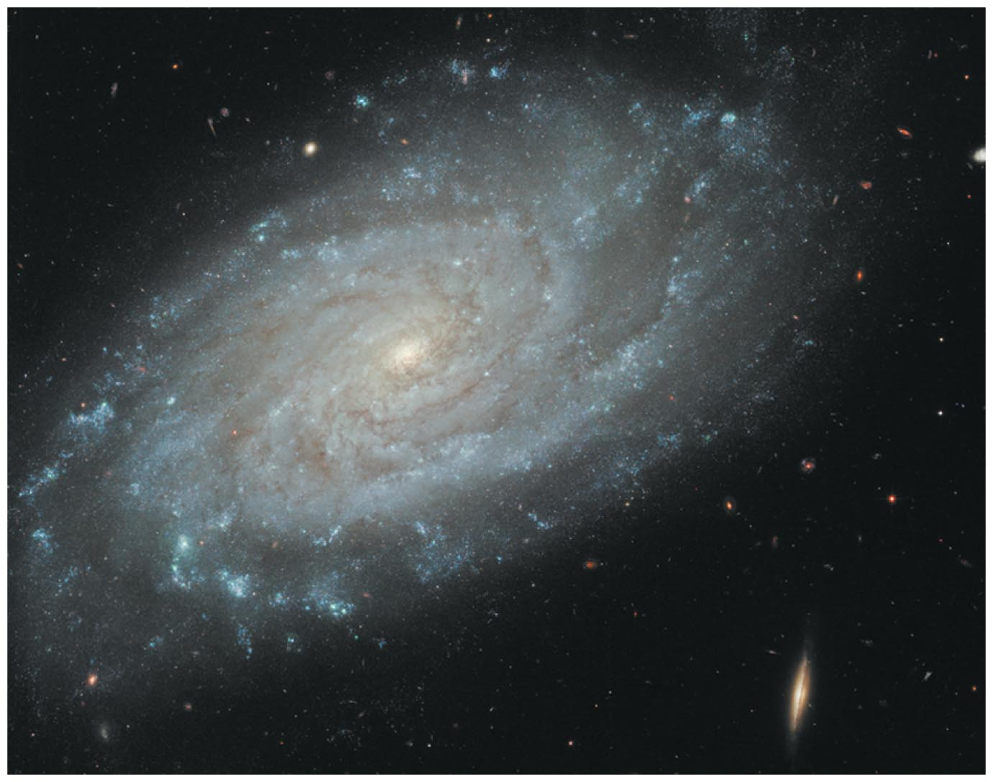

Avogadro's Number
A number to describe a set count of atoms, like "dozen" is a standard set for eggs.
Because atoms are so small, it must be a huge number: 6.022 10²³.
To put that number in perspective, count all the stars. That number
would be approximately 100 billion (1.0 10¹¹).
It would take a trillion (1.0 10¹²)
Milky Way galaxies to contain as many stars as there are particles in a mole. Again, because atoms are tiny.

Slide 6
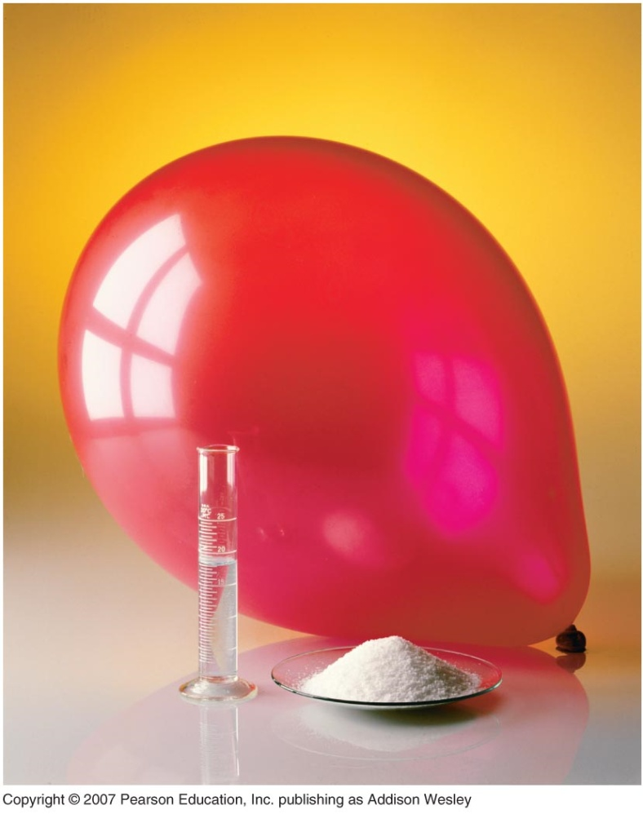
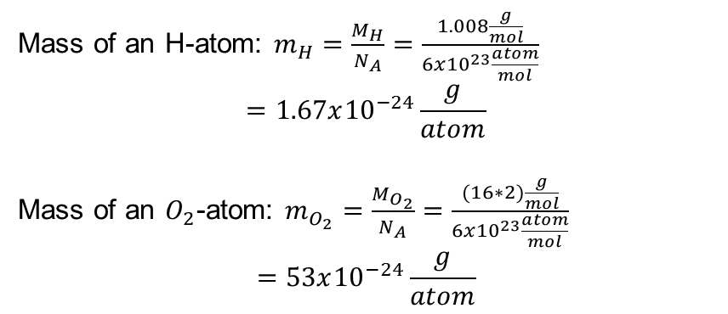
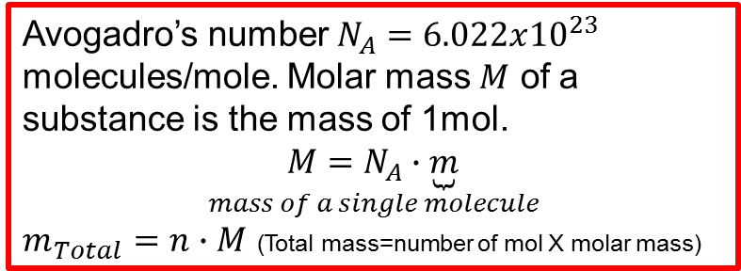
1 mole each of several familiar substances
Macroscopic parameters: pressure, volume, temperature, and mass.
Microscopic parameters: speeds, kinetic energies, momentum and masses of individual molecules.
Ideal gas can relate the macroscopic and microscopic parameters.
Phases of matters: gas, liquid, and solid.
Use the mole as the unit to describe the quantity of material (rather than mass).
1 mole (1 mol) is the amount of a substance that contains as many molecules or atoms as there are inside 0.012kg of carbon 12
Mass of an H-atom: $m_{H}=\frac{M_{H}}{N_{A}}=\frac{1.008\frac{g}{mol}}{6x{10}^{23}\frac{atom}{mol}}$
$$=1.67x{10}^{−24}\frac{g}{atom}$$
Mass of an $O_{2}$-atom: $m_{O_{2}}=\frac{M_{O_{2}}}{N_{A}}=\frac{(16∗2)\frac{g}{mol}}{6x{10}^{23}\frac{atom}{mol}}$
$$=53x{10}^{−24}\frac{g}{atom}$$
Avogadro’s number $N_{A}=6.022x{10}^{23}$ molecules/mole. Molar mass $M$ of a substance is the mass of 1mol.
$$\underset{mass of a single molecule}{M=N_{A}∙\underbrace{m}}$$
$m_{Total}=n∙M$ (Total mass=number of mol X molar mass)

Slide 7
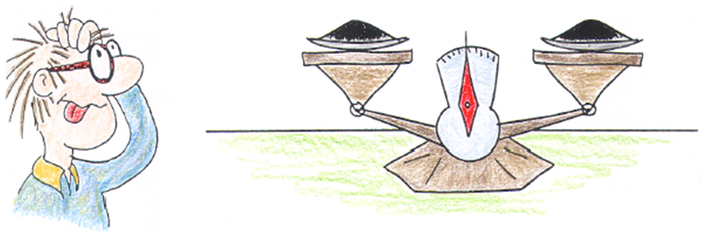
Clicker – Questions 1
Which has more atoms: a one gram sample of carbon-12, or a one gram sample of carbon-13?
carbon-12
carbon-13
Notes:
Carbon -12

Slide 8
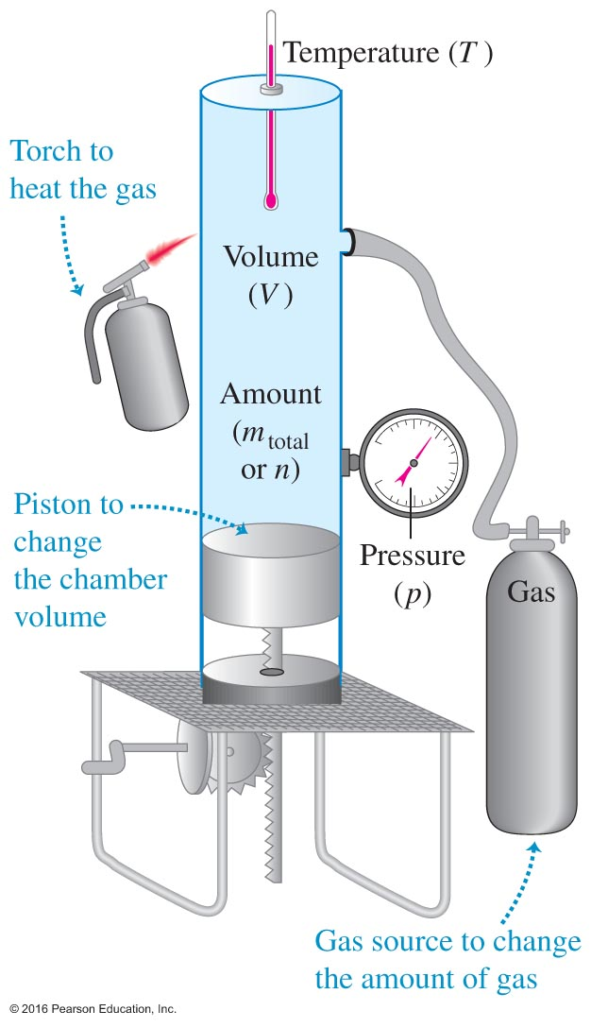
15.2 Equation of State
● Imagine that we can work on the device on the right.
● We may take different actions and expect some results:
If we heat it up, temperature (T) rises and the volume (V)
expands; if we compress it, pressure (p) increases; if we
add more gas (n) into the system, pressure (p) increases
and volume expands (V), etc.
● Question: how are these physical quantities (T, p, V, n, etc.)
related to each other for a given system?
● The equation of state: a mathematical equation relates these
physical quantities to each other. These physical quantities
are also known as state variables or state coordinates.

Slide 9
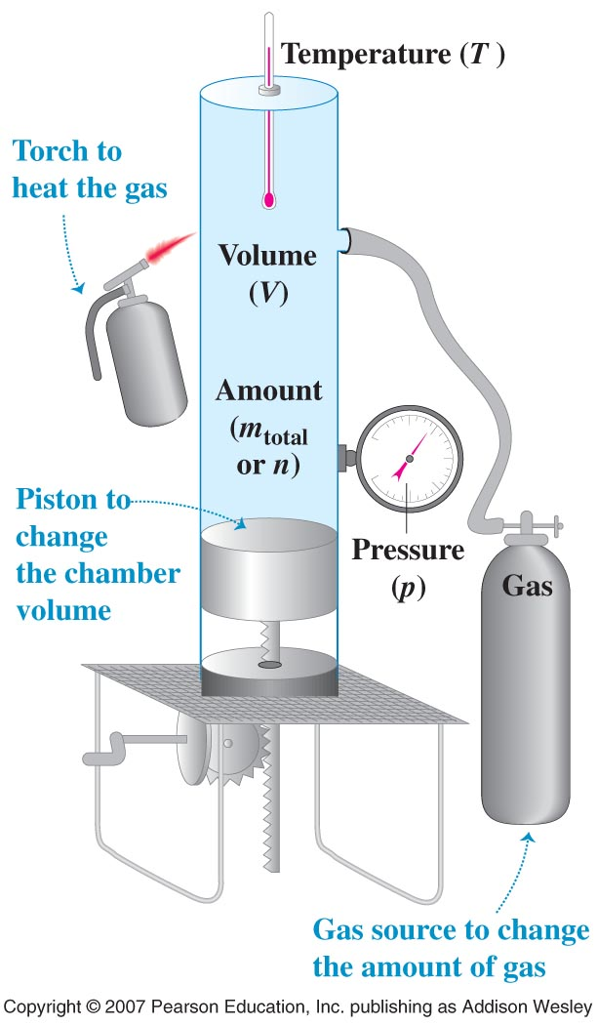
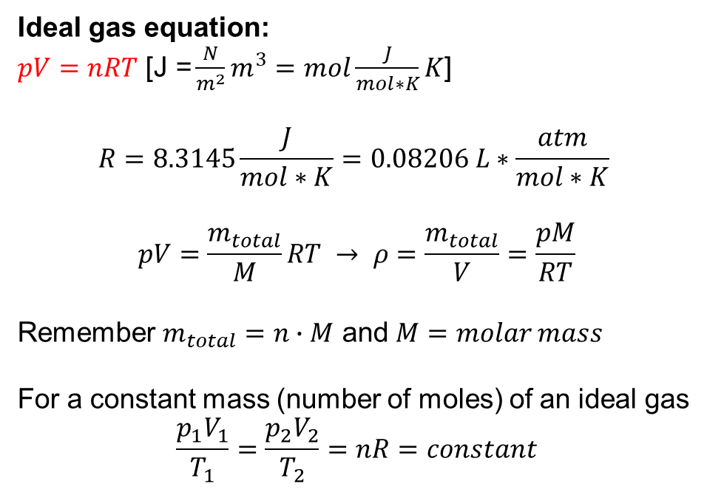
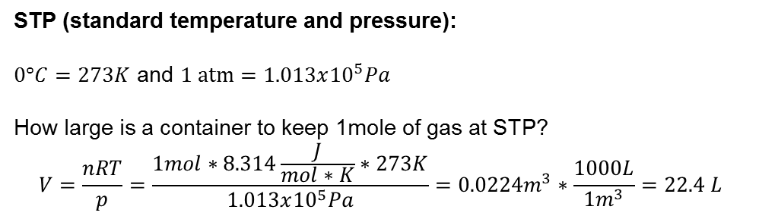
Equations of state with state variables
Ideal gas equation:
$pV=nRT$ [$\text{J}\text{ =}\frac{N}{m^{2}}m^{3}=mol\frac{J}{mol∗K}K$]
$$R=8.3145\frac{J}{mol∗K}=0.08206 L∗\frac{atm}{mol∗K}$$
$$pV=\frac{m_{total}}{M}RT → ρ=\frac{m_{total}}{V}=\frac{pM}{RT}$$
Remember $m_{total}=n∙M$ and $M=molar mass$
For a constant mass (number of moles) of an ideal gas
$$\frac{p_{1}V_{1}}{T_{1}}=\frac{p_{2}V_{2}}{T_{2}}=nR=constant$$
STP (standard temperature and pressure):
$0°C=273K$ and $1 atm=1.013x{10}^{5}Pa$
How large is a container to keep 1mole of gas at STP?
$$V=\frac{nRT}{p}=\frac{1mol∗8.314\frac{J}{mol∗K}∗273K}{1.013x{10}^{5}Pa}=0.0224m^{3}∗\frac{1000L}{1m^{3}}=22.4 L$$
V volumevvoe of 1mol = 224 l

Slide 10
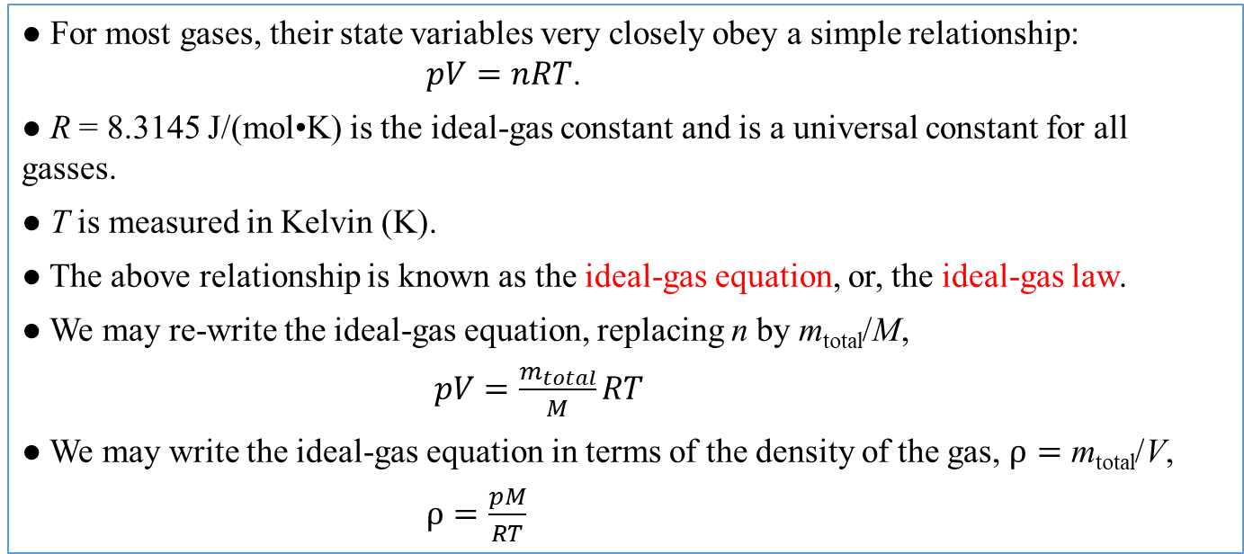
The Ideal-Gas Equation or Ideal-Gas Law
● For most gases, their state variables very closely obey a simple relationship:
$pV=nRT$.
● R = 8.3145 J/(mol•K) is the ideal-gas constant and is a universal constant for all gasses.
● T is measured in Kelvin (K).
● The above relationship is known as the ideal-gas equation, or, the ideal-gas law.
● We may re-write the ideal-gas equation, replacing n by m_{total}/M,
$pV=\frac{m_{total}}{M}RT$
● We may write the ideal-gas equation in terms of the density of the gas, $ρ=$ m_{total}/V,
$ρ=\frac{pM}{RT}$

Slide 11
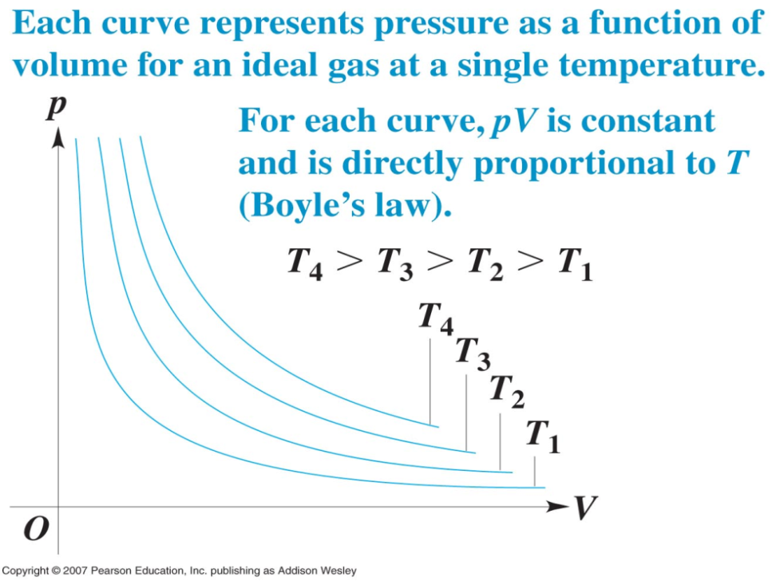
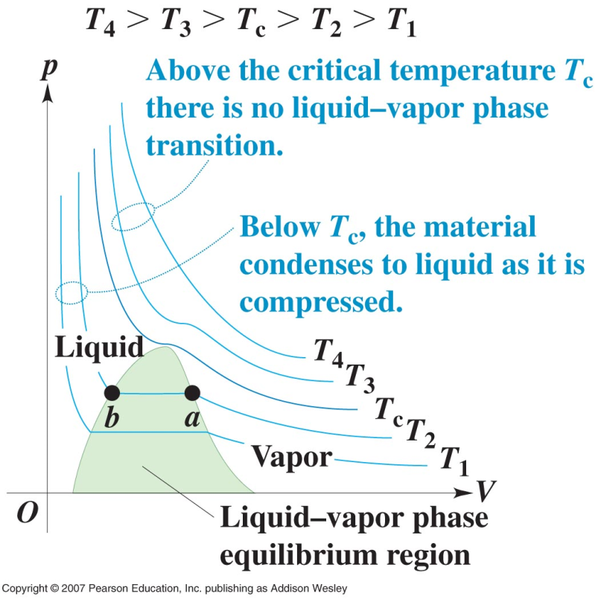
PV-diagrams
Isotherm = (same temperature)
curve representing pV-behavior at a specific temperature
Critical temperature = temperature above which material does not separate into two phases. It goes smoothly without a phase transition.
Not ideal gas
The area under a pV-curve represents the work done by the system during a change in volume equivalent to heat transfer and the change of the internal energy.
Critical
Pressure

Slide 12
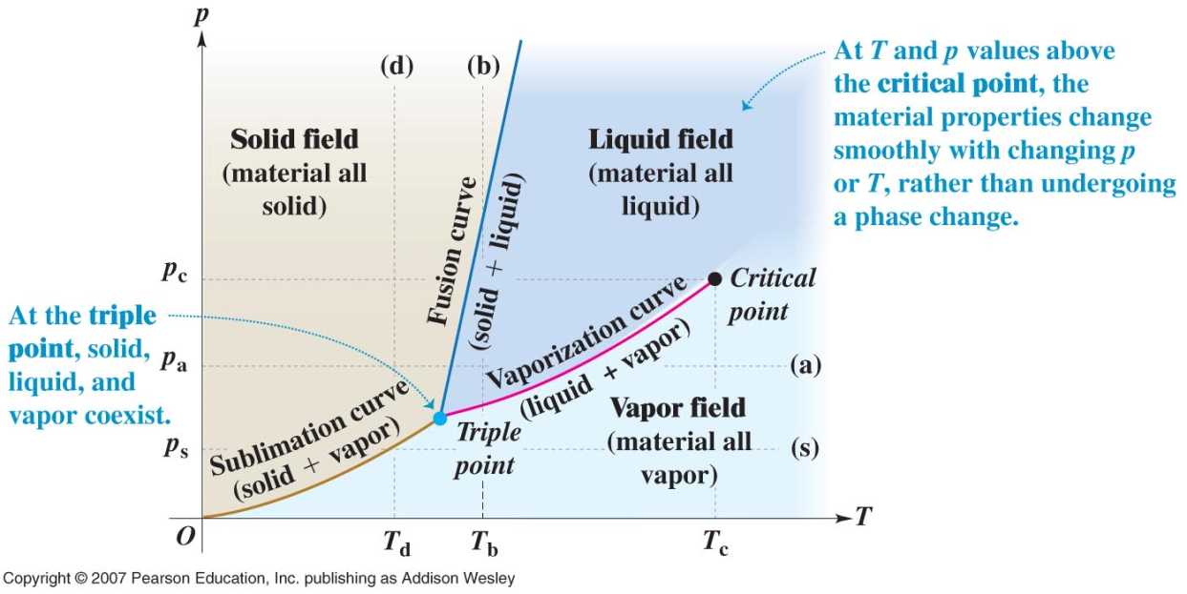
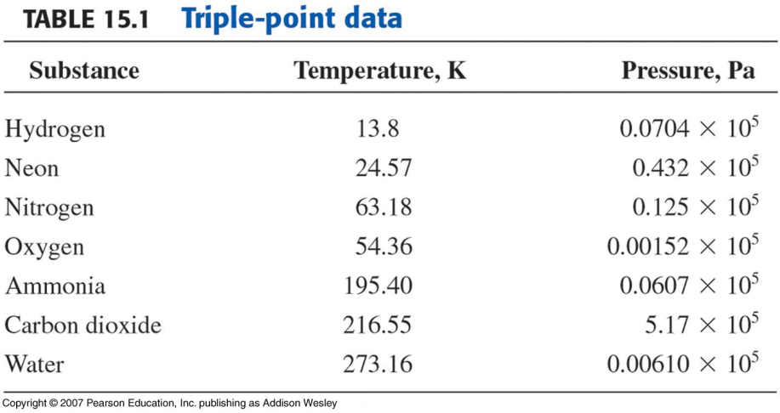
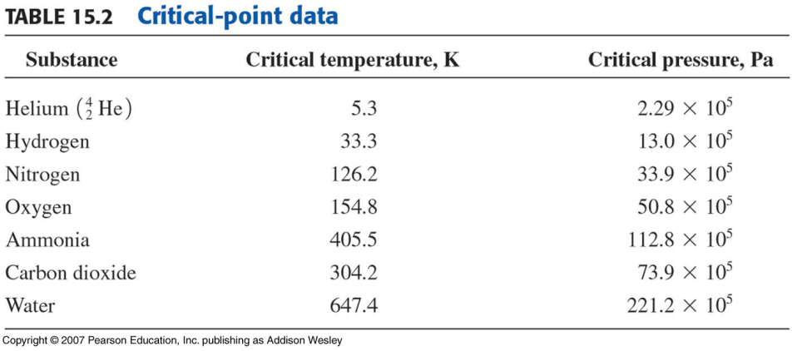
PT-phase diagram
A graph which indicates what phase occurs at a particular p and V
(Line a) → horizontal = constant pressure reducing T yields: vapor, liquid, and solid phases
(Line b) → vertical = constant temperature increasing p yields: vapor, liquid, and solid phases
(Line s) → horizontal = constant pressure sublimation or direct transfer of solid to liquid (no vapor phase). Example: dry ice ←→ carbon dioxide
Triple point = all three phases coexist at a unique pressure-temperature combination.
Critical point= distinction between liquid and gas disappears (properties change gradually)

Slide 13
15.3 Kinetic Theory of an Idea Gas
● The question: how are measurable macroscopic variables related to microscopic
properties of the atoms and molecules?
● The idea gas: We will treat atoms or molecules as point particles undergoing rapid
elastic collisions with each other and the walls of the container in the given volume.
The potential energies due to all the forces are ignored.
● The process is to apply Newton’s laws to establish the relationship between
microscopic and macroscopic quantities.
● The goals are to understand: the pressure of an ideal gas;
the ideal-gas equation;
the temperature of an ideal gas;
internal energy of an ideal gas;
the heat capacity of an ideal gas;
etc.

Slide 14
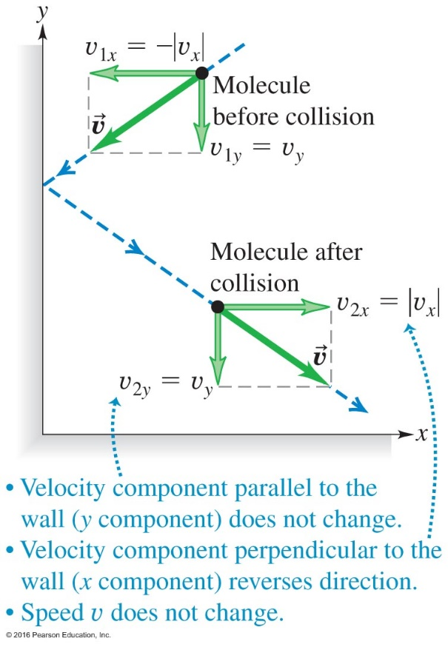
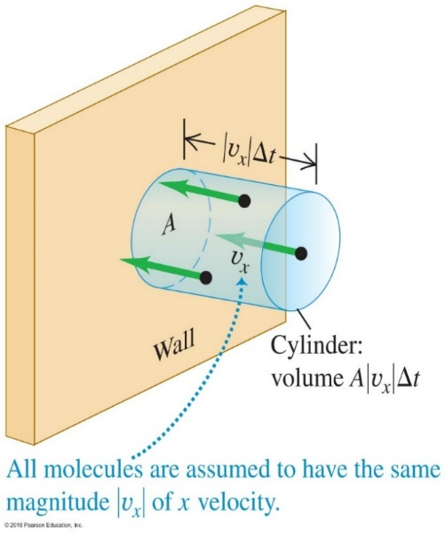
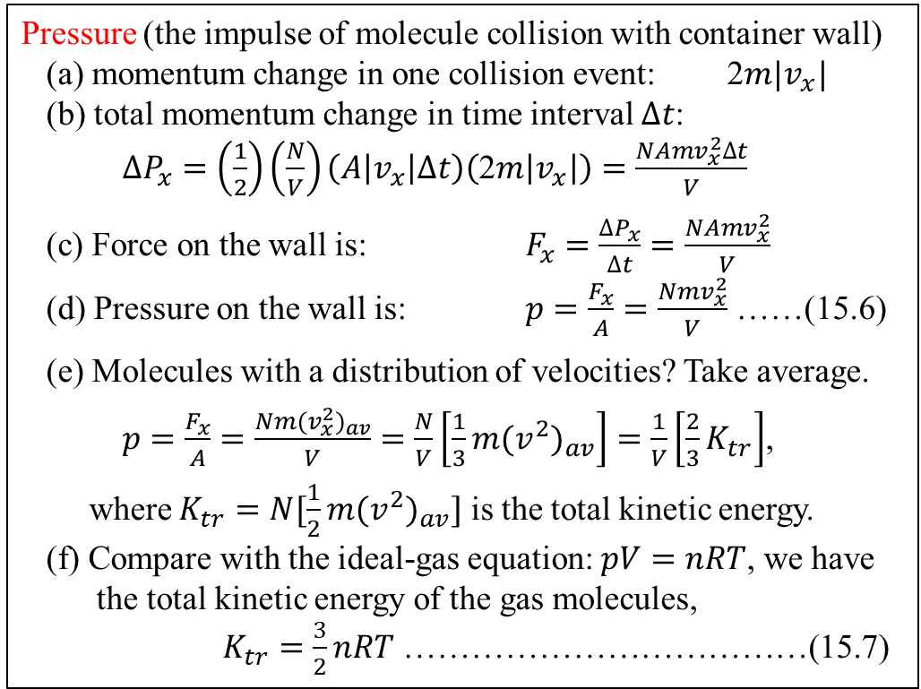
Kinetic Molecular Theory of an Ideal Gas
Pressure (the impulse of molecule collision with container wall)
(a) momentum change in one collision event: 2$m|v_{x}|$
(b) total momentum change in time interval $∆t$:
$∆P_{x}=\left(\frac{1}{2}\right)\left(\frac{N}{V}\right)\left(A\left|v_{x}\right|∆t\right)\left(\text{2}m\left|v_{x}\right|\right)=\frac{NAmv_{x}^{2}∆t}{V}$
(c) Force on the wall is: $F_{x}=\frac{∆P_{x}}{∆t}=\frac{NAmv_{x}^{2}}{V}$
(d) Pressure on the wall is: $p=\frac{F_{x}}{A}=\frac{Nmv_{x}^{2}}{V}$ ……(15.6)
(e) Molecules with a distribution of velocities? Take average.
$p=\frac{F_{x}}{A}=\frac{Nm{(v}_{x}^{2})_{av}}{V}=\frac{N}{V}\left[\frac{1}{3}m{(v}^{2})_{av}\right]=\frac{1}{V}\left[\frac{2}{3}K_{tr}\right]$,
where $K_{tr}=N[\frac{1}{2}m{(v}^{2})_{av}]$ is the total kinetic energy.
(f) Compare with the ideal-gas equation: $pV=nRT$, we have
the total kinetic energy of the gas molecules,
$K_{tr}=\frac{3}{2}nRT$ ………………………………(15.7)

Slide 15
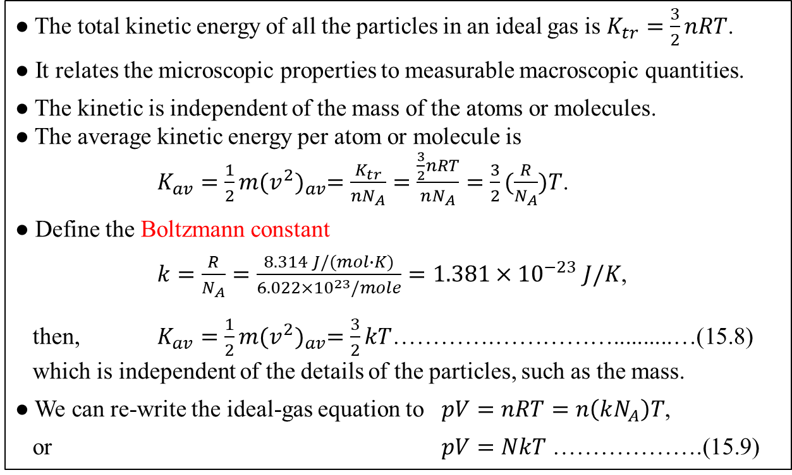
The Boltzmann Constant
● The total kinetic energy of all the particles in an ideal gas is $K_{tr}=\frac{3}{2}nRT$.
● It relates the microscopic properties to measurable macroscopic quantities.
● The kinetic is independent of the mass of the atoms or molecules.
● The average kinetic energy per atom or molecule is
$K_{av}=\frac{1}{2}m{(v^{2})}_{av}=\frac{K_{tr}}{nN_{A}}=\frac{\frac{3}{2}nRT}{nN_{A}}=\frac{3}{2}(\frac{R}{N_{A}})T$.
● Define the Boltzmann constant
$k=\frac{R}{N_{A}}=\frac{8.314 J/(mol∙K)}{6.022×{10}^{23}/mole}=1.381×{10}^{−23} J/K$,
then, $K_{av}=\frac{1}{2}m{(v^{2})}_{av}=\frac{3}{2}kT$………….……………..........…(15.8)
which is independent of the details of the particles, such as the mass.
● We can re-write the ideal-gas equation to $pV=nRT=n\left(kN_{A}\right)T$,
or $pV=NkT$ ……………….(15.9)
Gas constant R =8.3144598 J/ (mol K )

Slide 16
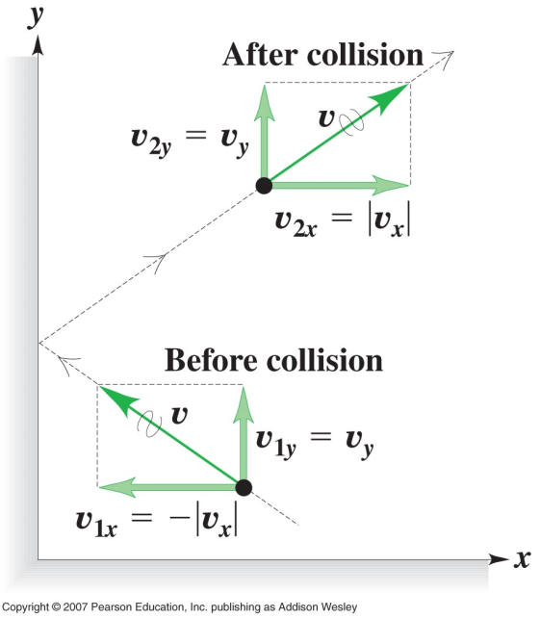
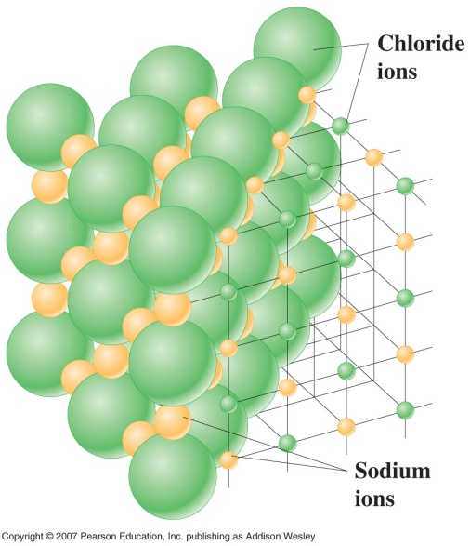
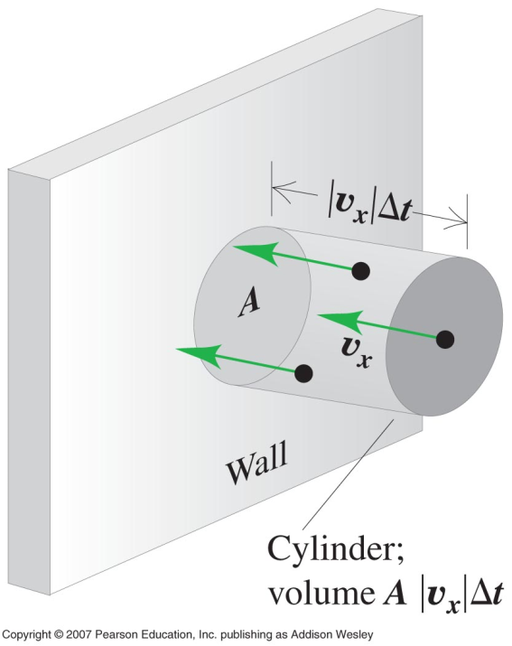
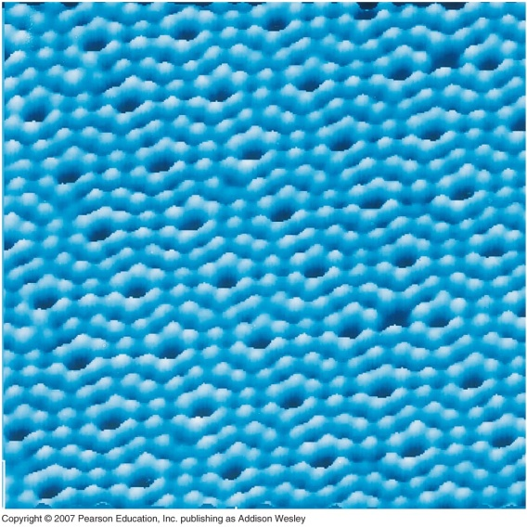
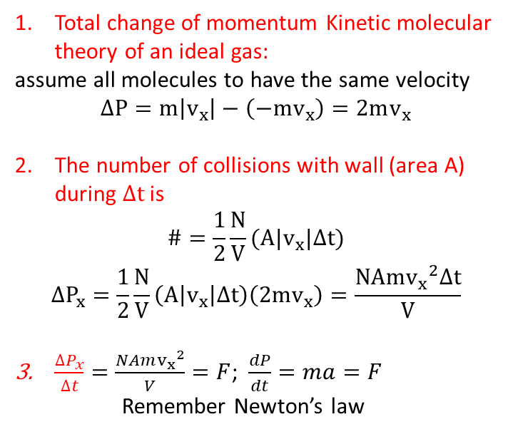
4 steps:
Find Δ p /collision
Find # of collisions
Find force/area
Find p and relate to ideal gas law
Molecular model of an ideal gas
Elastic collision of a molecule with the wall
Aim: derive pressure in the molecular picture
Atoms sizes ≈ 10⁻¹⁰ m
Largest molecule sizes ≈ 10⁻⁶ m
In gas molecules are in motion.
In solids molecules vibrate around centers.
In liquids molecules vibrate with more freedom in movement.
Note: Parallel
Velocity
Does not
Change!
NaCl
silicon
Total change of momentum Kinetic molecular theory of an ideal gas:
assume all molecules to have the same velocity
$$∆P=m\left|v_{x}\right|−\left(−mv_{x}\right)=2mv_{x}$$
The number of collisions with wall (area A) during $∆t$ is
$$\#=\frac{1}{2}\frac{N}{V}(A|v_{x}|∆t)$$
$$∆P_{x}=\frac{1}{2}\frac{N}{V}\left(A\left|v_{x}\right|∆t\right)\left(2mv_{x}\right)=\frac{NAm{v_{x}}^{2}∆t}{V}$$
$\frac{∆P_{x}}{∆t}=\frac{NAm{v_{x}}^{2}}{V}=F$; $\frac{dP}{dt}=ma=F$
Remember Newton’s law
Small ‘p’ → pressure
Large ‘P’ → momentum

Slide 17
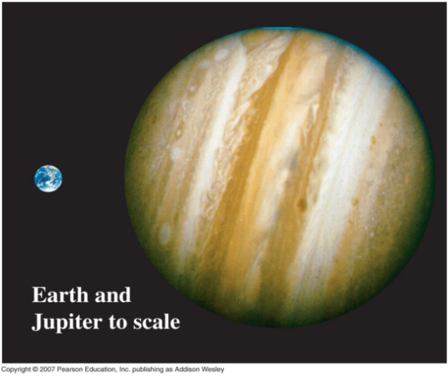
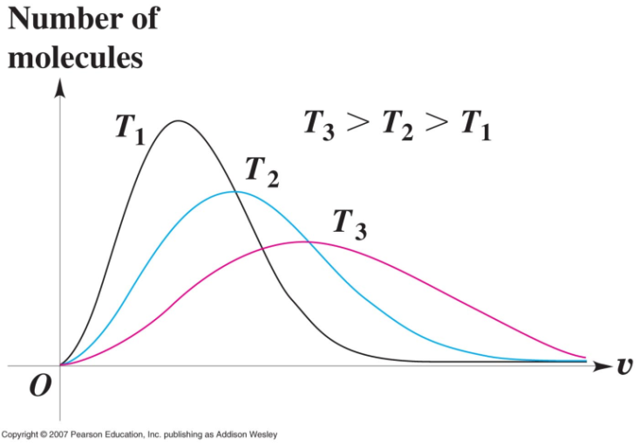
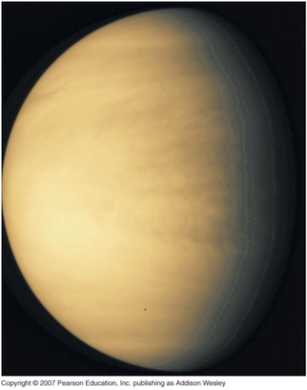

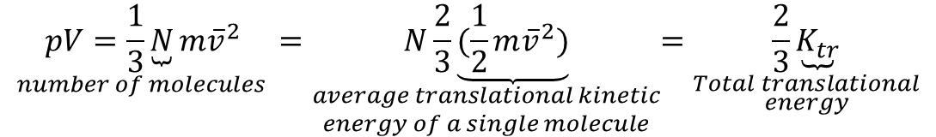

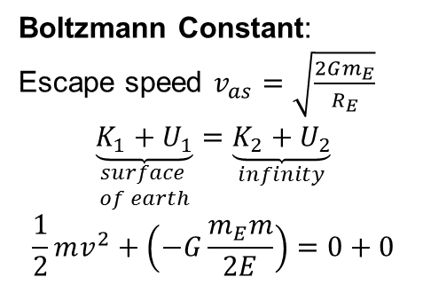
4 expression for pressure
$p=\frac{F}{A}=\frac{Nm{v_{x}}^{2}}{V}$ → $pV=Nm{v_{x}}^{2}$
Aim:The average translational kinetic energy
of a molecule depends only on T, not p or V
Express ${v_{x}}^{2}$ in terms of the average in $v^{2}$ of all molecule
${v_{av}}^{2}={v_{x_{av}}}^{2}+{v_{y_{av}}}^{2}+{v_{z_{av}}}^{2}=3{v_{x_{av}}}^{2}$ (no distinction between x, y, and z) →${{\overline{v}}_{x}}^{2}=\frac{1}{3}{\overline{v}}^{2}$
$$\underset{number of molecules }{pV=\frac{1}{3}\underbrace{N}m{\overline{v}}^{2}}=\underset{\begin{aligned}average translational kinetic \\ energy of a single molecule\end{aligned}}{N\frac{2}{3}\underbrace{(\frac{1}{2}m{\overline{v}}^{2})}}=\underset{\begin{aligned}Total translational \\ energy\end{aligned}}{\frac{2}{3}\underbrace{K_{tr}}}$$
Compare; $pV=nRT=\frac{2}{3}K_{tr} →K_{tr}=\frac{3}{2}nRT$
Venus is just like in “Goldie Locks” ,too hot and Mars is too cold but Jupiter is just right .
Note: H₂ exceeds the escape speed. Hydrogen as the lightest gas has an average speed at a given temperature than other heavier gases.
Boltzmann Constant:
Escape speed $v_{as}=\sqrt{\frac{2Gm_{E}}{R_{E}}}$
$$\underset{\begin{aligned}surface \\ of earth\end{aligned}}{\underbrace{K_{1}+U_{1}}}=\underset{infinity}{\underbrace{K_{2}+U_{2}}}$$
$$\frac{1}{2}mv^{2}+\left(−G\frac{m_{E}m}{2E}\right)=0+0$$
${\overline{K}}_{molecular}=\frac{K_{tr}}{N}=\frac{3}{2}\frac{nRT}{N}=\frac{3}{2}\frac{nRT}{nN_{A}}=\frac{3}{2}kT$ → $k=\frac{R}{N_{A}}=1.38x{10}^{−23}\frac{J}{molecule∙K}$

Slide 18
Clicker – Questions 2
You heat a sample of air to twice its original temperature in a constant volume container. The average translational kinetic energy of the molecules is;
Half the original value.
Unchanged.
Twice the original value.
Four time the original value.
Notes:
Probably C

Slide 19
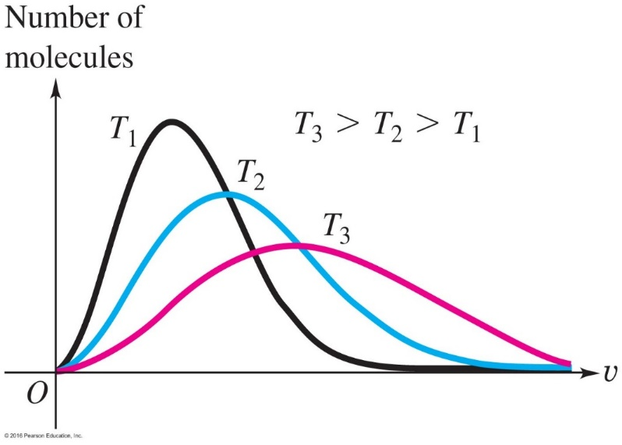
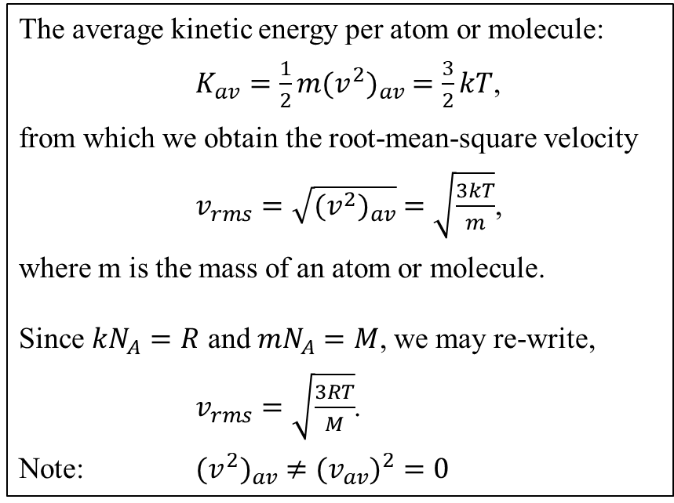
Molecular Speeds in an Ideal Gas
The average kinetic energy per atom or molecule:
$K_{av}=\frac{1}{2}m{(v^{2})}_{av} =\frac{3}{2}kT$,
from which we obtain the root-mean-square velocity
$v_{rms}=\sqrt{{(v^{2})}_{av}} =\sqrt{\frac{3kT}{m}}$,
where m is the mass of an atom or molecule.
Since $kN_{A}=R$ and ${mN}_{A}=M$, we may re-write,
$v_{rms}=\sqrt{\frac{3RT}{M}}$.
Note: ${(v^{2})}_{av} ≠{(v}_{av})^{2}=0$
Maxwell-Boltzmann Distribution
of Molecular Speed

Slide 20
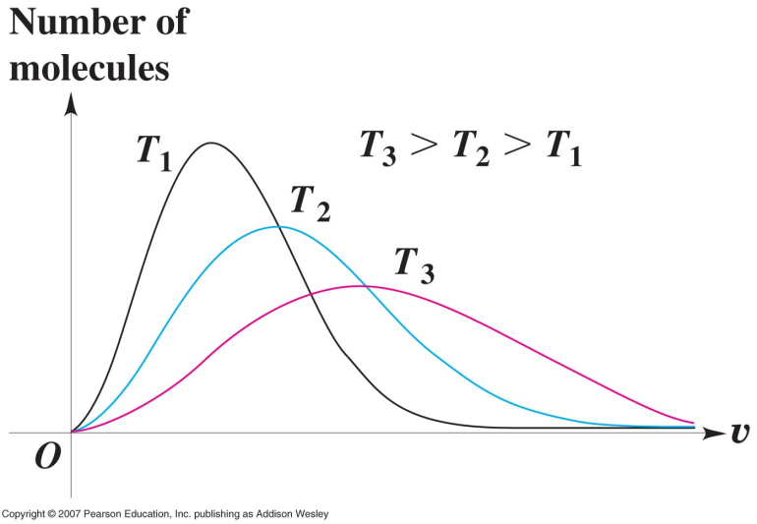
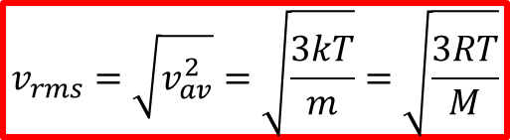


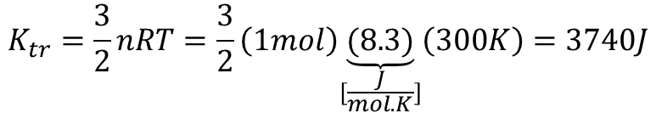
Example for Molecular speeds in an ideal gas
$$v_{rms}=\sqrt{v_{av}^{2}}=\sqrt{\frac{3kT}{m}}=\sqrt{\frac{3RT}{M}}$$
Consider O₂ as residual gas at 27ºC. Find $\underset{per molecule}{\underbrace{K_{av}}}$ and $\underset{per mole}{\underbrace{K_{tr}}}$→ 27ºC=300K
$$K_{av}=\frac{1}{2}mv_{av}^{2}=\frac{3}{2}kT=\frac{3}{2}\left(1.38x{10}^{−23}\right)\left(300K\right)=6.21x{10}^{−21}J$$
$$K_{tr}=\frac{3}{2}nRT=\frac{3}{2}\left(1mol\right)\underset{[\frac{J}{mol.K}]}{\underbrace{(8.3)}}\left(300K\right)=3740J$$
[$\frac{J}{mol.K}]$
k=$1.38x{10}^{−23}$

Slide 21
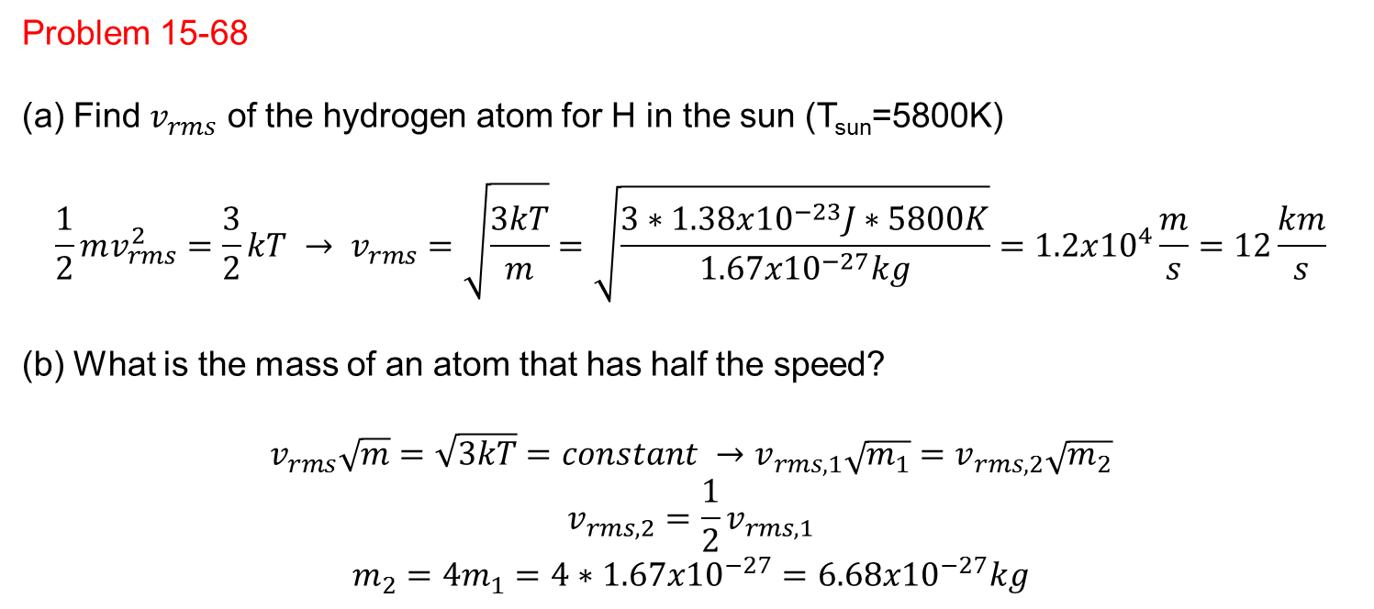
Problem 15-68
Find $v_{rms}$ of the hydrogen atom for H in the sun (T_{sun}=5800K)
$$\frac{1}{2}mv_{rms}^{2}=\frac{3}{2}kT → v_{rms}=\sqrt{\frac{3kT}{m}}=\sqrt{\frac{3∗1.38x{10}^{−23}J∗5800K}{1.67x{10}^{−27}kg}}=1.2x{10}^{4}\frac{m}{s}=12\frac{km}{s}$$
(b) What is the mass of an atom that has half the speed?
$$v_{rms}\sqrt{m}=\sqrt{3kT}=constant →v_{rms,1}\sqrt{m_{1}}=v_{rms,2}\sqrt{m_{2}}$$
$$v_{rms,2}=\frac{1}{2}v_{rms,1}$$
$$m_{2}=4m_{1}=4∗1.67x{10}^{−27}=6.68x{10}^{−27}kg$$

Slide 22
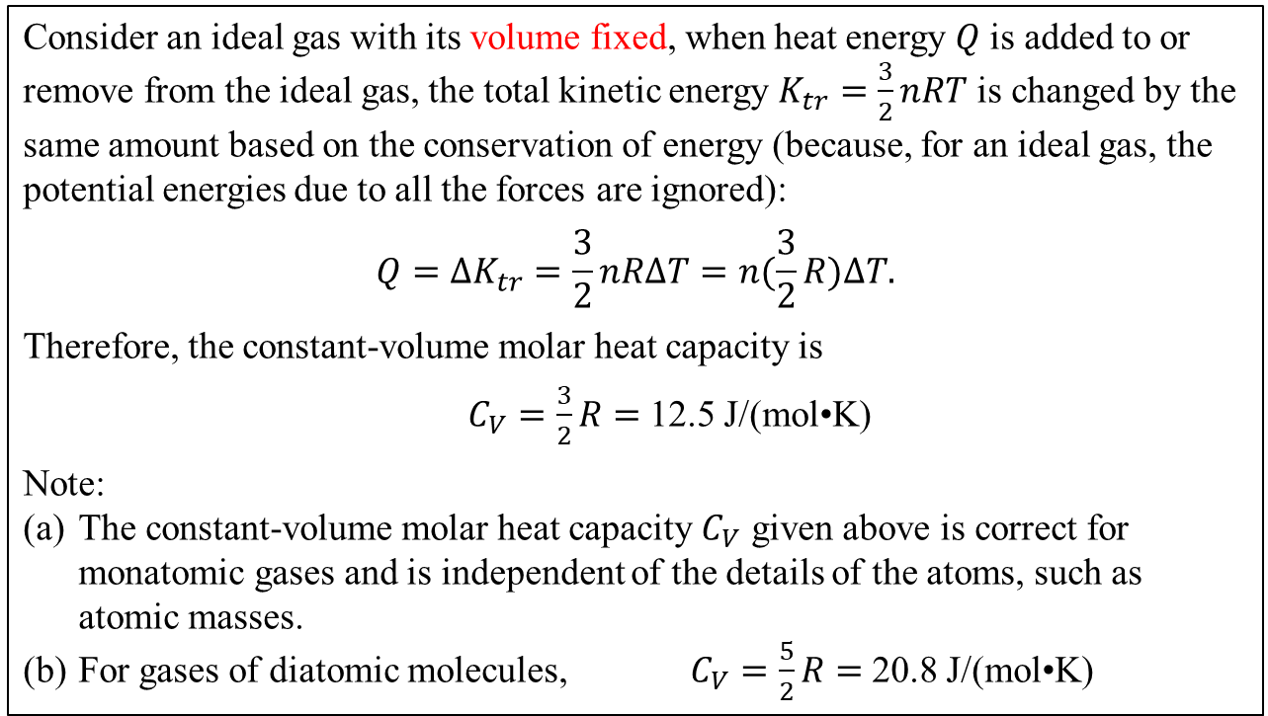
Constant-Volume Molar Heat Capacity of an Ideal Gas
Consider an ideal gas with its volume fixed, when heat energy $Q$ is added to or remove from the ideal gas, the total kinetic energy $K_{tr}=\frac{3}{2}nRT$ is changed by the same amount based on the conservation of energy (because, for an ideal gas, the potential energies due to all the forces are ignored):
$${Q=∆K}_{tr}=\frac{3}{2}nR∆T=n(\frac{3}{2}R)∆T.$$
Therefore, the constant-volume molar heat capacity is
$C_{V}=\frac{3}{2}R=$ 12.5 J/(mol•K)
Note:
The constant-volume molar heat capacity $C_{V}$ given above is correct for monatomic gases and is independent of the details of the atoms, such as atomic masses.
For gases of diatomic molecules, $C_{V}=\frac{5}{2}R=$ 20.8 J/(mol•K)

Slide 23
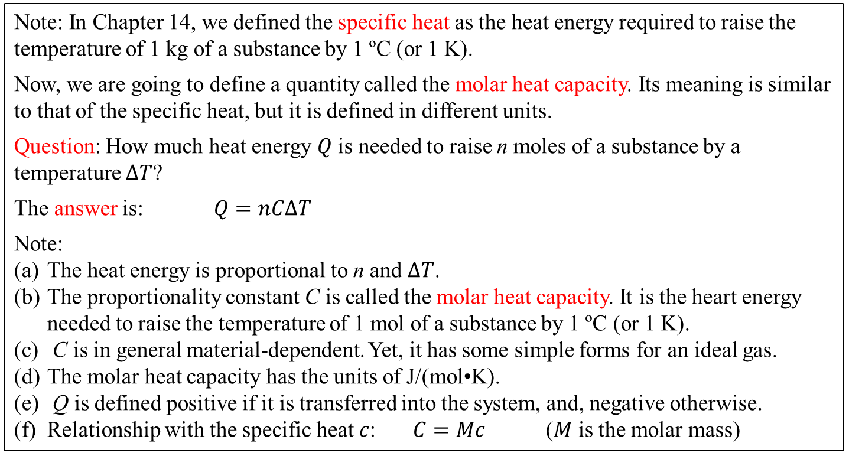
15.4 The Molar Heat Capacities
Note: In Chapter 14, we defined the specific heat as the heat energy required to raise the temperature of 1 kg of a substance by 1 ºC (or 1 K).
Now, we are going to define a quantity called the molar heat capacity. Its meaning is similar to that of the specific heat, but it is defined in different units.
Question: How much heat energy $Q$ is needed to raise n moles of a substance by a temperature $∆T$?
The answer is: $Q=nC∆T$
Note:
The heat energy is proportional to n and $∆T$.
The proportionality constant C is called the molar heat capacity. It is the heart energy needed to raise the temperature of 1 mol of a substance by 1 ºC (or 1 K).
C is in general material-dependent. Yet, it has some simple forms for an ideal gas.
The molar heat capacity has the units of J/(mol•K).
Q is defined positive if it is transferred into the system, and, negative otherwise.
Relationship with the specific heat $c$: $C=Mc$ ($M$ is the molar mass)

Slide 24
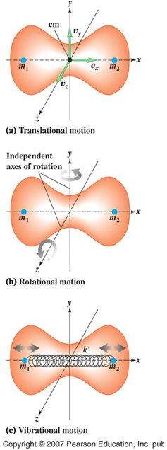
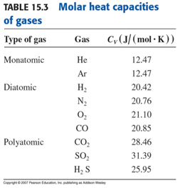
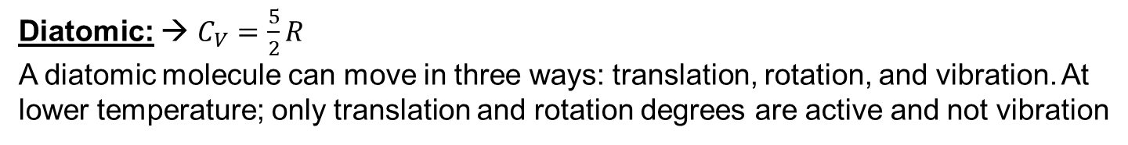
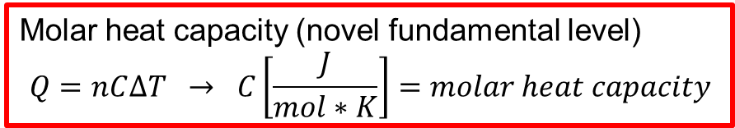
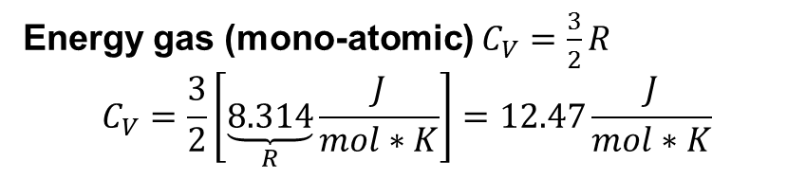
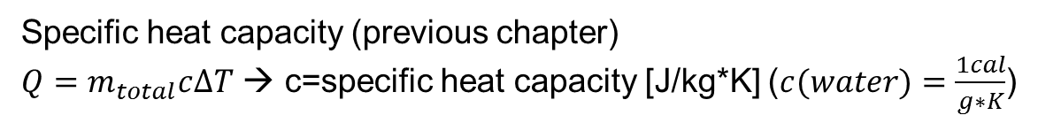
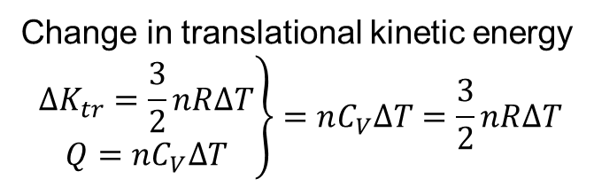

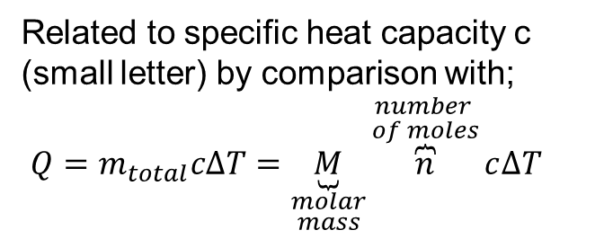
Heat capacities
Specific heat capacity (previous chapter)
$Q=m_{total}c∆T$ → c=specific heat capacity [J/kg*K] ($c(water)=\frac{1cal}{g∗K}$)
Molar heat capacity (novel fundamental level)
$$Q=nC∆T → C\left[\frac{J}{mol∗K}\right]=molar heat capacity$$
Related to specific heat capacity c (small letter) by comparison with;
$Q=m_{total}c∆T=\underset{\begin{aligned}molar \\ mass\end{aligned}}{\underbrace{M}}\overset{\begin{aligned}number \\ of moles\end{aligned}}{\overbrace{n}}c∆T$
Molar mass
Molar heat capacity
$$C=Mc$$
Specific heat capacity
Change in translational kinetic energy
$$\left.\begin{aligned}∆K_{tr}=\frac{3}{2}nR∆T \\ Q=nC_{V}∆T\end{aligned}\right\}=nC_{V}∆T=\frac{3}{2}nR∆T$$
Energy gas (mono-atomic) $C_{V}=\frac{3}{2}R$
$$C_{V}=\frac{3}{2}\left[\underset{R}{\underbrace{8.314}}\frac{J}{mol∗K}\right]=12.47\frac{J}{mol∗K}$$
Diatomic: → $C_{V}=\frac{5}{2}R$
A diatomic molecule can move in three ways: translation, rotation, and vibration. At lower temperature; only translation and rotation degrees are active and not vibration
Poly-atomic: more degrees of freedom

Slide 25
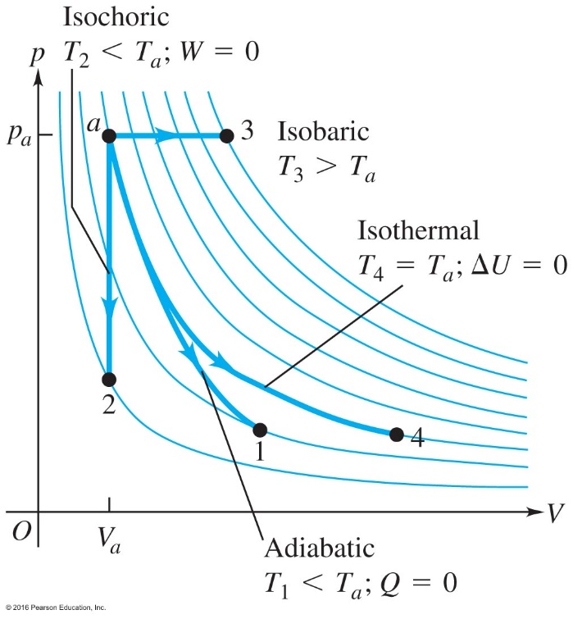



15.6 Thermodynamics Processes
$$∆U=Q−W$$
Adiabatic: no heat transfer in or out of the system
$Q=0$
$∆U=−W$
Isochoric: no volume change
    $V=$constant or $∆V=0$ or $W=0$
    $∆U=Q$
Isobaric: no pressure change.
$p=$ constant
$W=p\left(V_{2}−V_{1}\right)$
Isothermal: no temperature change.
$T=$constant or $∆U=0$
$Q=W$

Slide 26

15.30
When te temperature increases at constant volume the pressure increases

Slide 27

15.53

Slide 28


factors of unity
1 atm = 1.013x10^5 Pa
1 liter = 1000 cm ³ = 10 ⁻³ m ³

Slide 29






15.5 The First Law of Thermodynamics
It sets the relationship between the change in the internal energy $∆U$, work done by the system $W$, and heat transfer.
$$Q$$
$$W$$
$$∆U$$
$$∆U=Q−W$$
Note: (a) $Q$ is positive if added to the system; negative if removed from the system.
(b) W is positive if it is done by the system on the surrounding; negative otherwise.

Slide 30





Work done during volume change
Work: $W=F∆x=pA∆x=p∆V$
Work done at constant pressure: $W=p\left(V_{2}−V_{1}\right)$
When the pressure is not a constant:
$$W=p_{1}∆V+p_{2}∆V+p_{3}∆V+….$$
which is the area under the pV diagram
$$∆V$$

Slide 31


Work is the area under the pV diagram
Work done at constant temperature
$$W=nRTln\frac{V_{2}}{V_{1}}$$

Slide 32




Work is the area under the pV diagram.
It depends on the exact path that the system follows.

Slide 33



Example 15.10 on page 483
Given:
(1) from a to b, $Q_{ab}=$ 150 J of heat is added to the system
(2) From b to d, $Q_{bd}=$ 600 J of heat is added to the system
Find: (1) internal energy change from a to b
(2) internal energy change from a to b to d
(3) total heat added to system from a to c to d
Solution:
From a to b $W=0$ $∆U_{ab}=Q_{ab}−W=$ 150 J
From b to d, constant pressure,
$W_{bd}=p\left(V_{d}−V_{b}\right)=$ (8.0×10⁴)(5.0×10⁻³ $−$ 2.0×10⁻³) = 240 J
$∆U_{abd}=Q_{abd}−W_{abd}=$ (150 + 600) – (0 + 240) = 510 J
(3) $Q_{acd}=∆U_{acd}+W_{acd}=∆U_{abd}+W_{ac}$
$=$ 510 + (3.0×10⁴)(5.0×10⁻³-2.0×10⁻³) = 510 + 90 = 600 J
The First Law
$$∆U=Q−W$$

Slide 34


Energy, heat, and work in a thermodynamic system:
The first law of Thermodynamics

Slide 35






Work done during volume changes
s
Thermodynamics is the study of
Energy, ${ \atop \begin{aligned}heat \\ ↑ \\ Q added\end{aligned}}$and ${ \atop \begin{aligned}Work \\ ↑ \\ work done\end{aligned}}$
(sign convection)
Thermodynamic system = exchanges heat with environment
Work done during volume changes
When gas expands, it pushes on the boundary surfaces and does positive work.
$$W=F∆x=p\underset{∆V}{\underbrace{A∆x}}=p∆V$$
Assume p is constant;
$$W=p(V_{2}−V_{1})$$
But usually it is not constant;
$$W=p_{1}∆V_{1}+p_{2}∆V_{2}…….$$
The work W done is equal
to the area under the
pV curve

Slide 36


Isothermal (constant temperature) expansion
(Particular case)
$W=nRT\ln{\frac{V_{2}}{V_{1}}}$ (without proof)
Positive work
No Work
Consider a series of paths, in such a way that each can be plotted on a pV-diagram → they all require different work (areas under the path)
Work done depends not only on the initial and final points, but also on the path taken.

Slide 37


Work done in a cyclic process
15.39 note:
For a constant volume process: W=0
For a constant pressure process: W=p*ΔV
1 atm = 1.013x10⁵Pa, 1Liter=10⁻³m³
The work done is positive when the volume increases and negative when the volume decreases.
Find W for each process in the cycle;
1→2: $W=p∆V=2.5atm∗1.013x{10}^{5}\frac{Pa}{atm}\left(8L−2L\right)x{10}^{−3}\frac{m^{3}}{L}=1.5x{10}^{3}J$
2→3: $W=0$ since $∆V=0$
3→4: $W=p∆V=0.5atm∗1.013x{10}^{5}\frac{Pa}{atm}\left(2L−8L\right)x{10}^{−3}\frac{m^{3}}{L}=−3.0x{10}^{2}J$
4→1: $W=0$ since $∆V=0$
$$W_{cycle}=1.5x{10}^{3}J+0+\left(−3.0x{10}^{2}J\right)+0=1.2x{10}^{3}J$$
The area enclosed by the cycle (energy) is;
$$2atm∗6L≅12.0 L∙atm∗{10}^{−3}\frac{m^{3}}{L}∗1.013x{10}^{5}\frac{Pa}{atm}=1.2x{10}^{3}J$$

Slide 38



Heat transfer during volume changes
Slow controlled isothermal expansion
Rapid uncontrolled expansion
Free expansion=uncontrolled expansion
Experiments have shown that during free expansion,
there is no change in temperature. Heat also depends
on the path like work.
Q= heat of an object is not a useful concept, better talk about internal energy U
First law of thermodynamics
$$\begin{matrix}Q \\ \begin{aligned}↑ \\ Added \\ heat\end{aligned}\end{matrix}\begin{matrix}\begin{aligned}= \\ \end{aligned} \\ \\ \end{matrix}\begin{matrix}∆U \\ \begin{aligned}↑ \\ Change of \\ internal energy\end{aligned}\end{matrix}\begin{matrix}\begin{aligned}+ \\ \end{aligned} \\ \begin{aligned} \\ \\ \end{aligned}\end{matrix}\begin{matrix}W \\ \begin{aligned}↑ \\ Work done \\ against surroundings\end{aligned}\end{matrix}$$
Experiments show U=f(p,V,T)
$$\underset{independent of path}{U_{2}−U_{1}=\underbrace{∆U}=Q−W}$$

Slide 39


Example
One gram of water (1cm³) becomes 1671cm³ steam when boiled at constant pressure of 1atm. The heat of vaporization is $L_{V}=2.256x{10}^{6}\frac{J}{kg}$
Compute: (a) the work done by the water when it vaporizes
(b) the increase in internal energy
$W=p\left(V_{2}−V_{1}\right)=1.013x{10}^{5}Pa \left(1671x{10}^{−6}m^{3}−1x{10}^{−6}m^{3}\right)=169 J$
$Q=mL_{o}=1g∗2256\frac{J}{g}=2256 J$
First law of thermodynamics: $Q=∆U+W$
$$∆U=Q−W=\left(2256−169\right)J=2087 J$$
Why is $∆U$ > W ??
Not all heat goes into internal energy but some heat does work on the water molecules pulling them apart when water transforms into steam.

Slide 40




Thermodynamic processes
4 processes:
No heat transfer = Adiabatic
Constant volume = isochoric
Constant pressure = isobaric
Constant temperature = isothermal
Isothermal:→$∆T=0, ∆U=0$ W=Q
Adiabatic: → Q=0
$∆U=U_{2}−U_{1}=\begin{matrix} \\ \\ \begin{aligned} \\ Q \\ || \\ 0\end{aligned}\end{matrix}−W$= -W
Expanding system W>0, ΔU<0
Compressing system W<0, ΔU>0
Increasing internal energy is often happen with increasing temperature T
Example: combustion engine; isochoric → constant volume
$$U_{2}−U_{1}=∆U=Q−\begin{matrix} \\ \\ \begin{aligned} \\ W \\ || \\ 0\end{aligned}\end{matrix}$$
All the energy added as heat increases energy U
Example: heating a gas in a closed volume isobaric → constant pressure
All three quantities ΔU₁, W₁ , and Q change
$W=p(V_{2}−V_{1})$ $Q=nC_{p}∆T \text{Δ}\text{U}\text{ =}\text{Q}\text{−}\text{W}$
Constant pressure isobaric → constant pressure: none of the quantities ΔU₁, W₁ , and Q is zero.

Slide 41




Example 15.9 An isothermal expansion
Example 15.9
$$W=nRTln\frac{V_{2}}{V_{1}}=3mol∗8.3\frac{J}{mol.K}∗300K∗ln\frac{5L}{4L}=1700 J$$
Since, temperature is constant and we consider an ideal gas the change in internal energy is zero → all the heat entering goes into work
Example 15.10 A series of thermodynamical processes (due to its importance repeated )
Consider paths in a pV diagram: in path ab 150J of heat are added to the system , in bd. 600J of heat are added. Find
Internal energy change in ab ?
Internal energy change in abd ?
Total heat added in acd ?
No volume change → $W_{ab}=0, ∆U_{ab}=Q_{ab}=150 J$
bd at constant pressure
$$W_{bd}=p\left(V_{2}−V_{1}\right)=8x{10}^{4}Pa\left(5−2\right)x{10}^{−5}m^{3}=240 J$$
$$W_{total}=W_{ab}+W_{bd}=0+240=240 J$$
$$Q_{abd}=Q_{ab}+Q_{bd}=150+600=750 J$$
$${∆U}_{abd}=Q_{abd}−W_{abd}=750−240=510 J$$
Because ΔU is independent of the path ${∆U}_{acd}={∆U}_{abd}$
Total work for path acd :
$$W_{total}=W_{ac}+W_{cd}=p\left(V_{2}−V_{1}\right)+0=3x{10}^{4}Pa\left(5−2\right)x{10}^{−3}m^{3}=90 J$$

Slide 42


Problem on Heat Capacities
How much heat does it take to increase the temperature of 2.5moles of an ideal gas (monoatomic) from 25ºC to 55ºC, if the gas is at constant volume.
How much heat is needed if the gas is diatomic rather than monoatomic?
Sketch in a pV-diagram of these processes.
a) $Q=2.5mol\frac{3}{2}\left(8.315\frac{J}{mol.K}C\right)30K=935J$ R= $8.315\frac{J}{mol.K}C$
b) $Q=\frac{5/2}{3/2}∗935=1560 J$
c)
Isochoric = when the temperature increases at constant volume the pressure increases

Slide 43
Clicker – Questions 3
You compress a sample of air slowly to half its original volume, keeping its temperature constant. The internal energy of the gas.
Decreases to half its original value.
Remains unchanged.
Increases to twice its original value.
Notes:
Answer Remains unchanged

Slide 44



15.7 Properties of an Ideal Gas
$$∆U=Q−W$$
We learned in Section 15.4 that the constant-volume molar heat capacity for a monatomic ideal gas is
$C_{V}=\frac{3}{2}R=$ 12.5 J/(mol•K)
Question: What is the molar heat capacity for a monatomic ideal gas under a constant pressure? $[ p=constant$; $W=p\left(V_{2}−V_{1}\right)=p∆V ]$
$Q=∆U+W=nC_{V}∆T+p∆V$
Since $pV=nRT$, or $p∆V=nR∆T$
We have
$Q=nC_{V}∆T+p∆V=nC_{V}∆T+nR∆T=n\left(C_{V}+nR\right)∆T=nC_{p}∆T$.
The constant-pressure molar heat capacity is $C_{p}=C_{V}+R=\frac{5}{2}R$

Slide 45






Properties of an ideal gas:Heat capacities and the adiabatic process
Free expansion: When the partition is broken the gas expands freely into the vacuum region. Internal energy stays constant and temperature does not change
Molar heat capacity depends on condition under which heat is added.
$C_{V}$= heat is added to raise temperature $Q=∆U$ under constant volume, but letting pressure go up.
$C_{p}$= heat is added while gas expands $Q=∆U+W$ but keeping pressure constant.
Adiabatic: Q=0
$p_{1}V_{1}^{γ}=p_{2}V_{2}^{γ}=constant$→$γ=\frac{C_{p}}{C_{V}}$
Isothermal: ΔT=0
$p_{1}V_{1}=p_{2}V_{2}=nRT$
Walls of container
do not move
Note: $C_{p}=C_{V}+R$ where $R=8.314\frac{J}{mol.K}$

Slide 46

Molar heat capacity depends on condition under which heat is added.
$C_{V}$= heat is added to raise temperature $Q=∆U$ under constant volume, but letting pressure go up. W=0 no work, since volume is constant.
$C_{p}$= heat is added while gas expands $Q=∆U+W$ but keeping pressure constant. . W>0 work performed, since volume is expanding
$C_{p}=C_{V}+R$ where $R=8.314\frac{J}{mol.K}$
Careful with constant pressure equations W=p$∆V=nR$ $∆T$
$∆U=nC_{V}∆T,$if at constant pressure replace $C_{V}$=$C_{p}$-R=3/2R for a mono atomic gas

Slide 47

Clicker – Questions 4
The gas shown in figure is in a completely insulated rigid container. Weight is added to the frictionless piston, compressing the gas. As this is done,
The temperature of the gas stays the same because the container is insulated.
The temperature of the gas increases because heat is added to the gas.
The temperature of the gas increases because work is done on the gas.
The pressure of the gas stays the same because the temperature of the gas is constant.
Notes:
Answer C

Slide 48



Problem 15 - 75
Note: ab isochoric (constant volume)
bc isothermic (constant temperature)
ca isobaric (constant pressure)
For;
$\left.\begin{aligned}∆T=0→ ∆U=0 \\ Q=∆U+W\end{aligned}\right\}Q=W=nRTln\frac{V_{c}}{V_{b}}$ (isotherm)
$C_{V}=\frac{5}{2}R$ (diatomic gas)
$C_{p}=C_{V}+R=\frac{7}{2}R$ (R=8.315$\frac{J}{mol.K}$)
$$∆U=nC_{V}∆T$$
pV-diagram for 0.004mole of ideal H₂ gas temperature does not change during path bc.
What is the volume at c ?
$T_{b}=T_{c}$→ for states b and c
$$pV=nRT → p_{b}V_{b}=p_{c}V_{c}$$
$$V_{c}=V_{b}\left(\frac{p_{b}}{p_{c}}\right)=0.2∗\frac{2}{0.5}=0.8 L$$
Find temperature of the gas at points ab and c
$T_{a}=\frac{p_{a}V_{a}}{nR}=\frac{(0.5 atm)(1.013x{10}^{5}\frac{Pa}{atm})(0.2x{10}^{−3}m^{3})}{0.004mol∗8.315\frac{J}{mol.K}}=305K$ (Note: $p_{a}=\frac{N}{m^{2}}$)
$V_{a}=V_{b}$ → for states a and b → $\frac{T}{p}=\frac{V}{nR}=constant →\frac{T_{a}}{p_{a}}=\frac{T_{b}}{p_{b}}$
$$T_{b}=T_{c}=T_{a}\frac{p_{b}}{p_{a}}=305∗\frac{2}{0.5}=1220K$$
Continued on next slide

Slide 49


(c) How much heat went into or out of the gas during segments ab, ca and bc ?
ab: $Q=nC_{V}∆T=n\frac{3}{2}R∆T=\left(0.004mol\right)\frac{3}{2}∗8.315\frac{J}{mol.K}\left(1220−305\right)K=+76 J$
ca: $Q=nC_{p}∆T=n\frac{7}{2}R∆T=\left(0.004mol\right)\frac{7}{2}∗8.315\frac{J}{mol.K}\left(305−1220\right)K=−107 J$
bc: $Q=W=nRT=nRTln\frac{V_{c}}{V_{b}}=\left(0.004mol\right)∗8.315\frac{J}{mol.K}\left(1220K∗ln⁡(\frac{0.8 L}{0.2 L})\right)=+56 J$
(d) Find the change in the internal energy of this hydrogen during segments ab, ca and bc ?
ab: $∆U=nC_{V}∆T=n\frac{5}{2}R∆T=\left(0.004mol\right)\frac{5}{2}∗8.315\frac{J}{mol.K}\left(1220−305\right)K=+76 J$
ca: $∆U=p\left(V_{c}−V_{a}\right)+n\frac{7}{2}R∆T$
$$=0.5∗1.013∗{10}^{5}\left(0.8−0.2\right)∗{10}^{−3}+\left(0.004mol\right)\frac{7}{2}∗8.315\frac{J}{mol.K}\left(305−1220\right)K=−76 J$$
bc: $∆T=0 →∆U=0$
Note: the net energy change in a cycle is zero. $∆U_{total}=+76+0−76=0$
factors of unity
1 atm = 1.013x10⁵ Pa
1 m³ = 10³ L

Slide 50


Slide 51


Slide 52


Slide 53


Slide 54

Stirling Engine
The Stirling Engine is a piston that, when heated or cooled, increases or decreases the pressure/energy of the gas trapped inside. This causes the gas molecules to apply more pressure on the piston. This in turn increases the pressure on the opposite side of the piston, and the cycle repeats. As long as heat is allowed to flow (be it from a cold or hot source) the gas pressure variance will drive the piston.
To set up the demonstration, place the beaker of water on the hot plate and the stirling engine on the beaker. Turn the hot plate on to 300C. It will take approximately 21 minutes for the water to boil. If the stirling engine does not begin to spin on its own, give it a small spin.

Slide 55

Crookes Radiometer
The radiometer consists of black and white vanes inside a partial vacuum. When heated via a light bulb, the vanes begin to spin (Black vanes leading, or clockwise in the photo) due to thermal transpiration as well as gas pressure differential.

