Slide 1
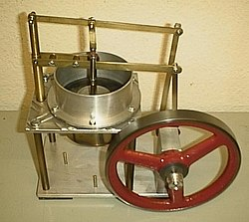
A model of a Stirling engine showing its simplicity. Unlike the steam engine or internal combustion engine, it has no valves or timing train. The heat source (not shown ) would be placed under the brass cylinder
Chapter 16 The Second Law of Thermodynamics
● To examine the directions of thermodynamic processes.
● To study heat engines.
● To understand internal combustion engines and refrigerators.
● To learn and apply the second law of thermodynamics
● To understand the Carnot engine: the most efficient heat engine.
● To learn the concept of entropy.
Stirling engine is a heat engine with cyclic compression and expansion producing mechanical work from heat energy

Slide 2

16.1 Directions of Thermodynamic Processes
T₁
T₂
● Heat flows spontaneously from a "hot" object to a "cold" object.
● A process can be
  Spontaneous
  Non-spontaneous
  Reversible
  Irreversible
  In equilibrium
● Overall, there can be an increase or decrease in order.
● Devices can interconvert order/disorder/energy.
T₁ > T₂
a drop of ink
free expansion of gas

Slide 3
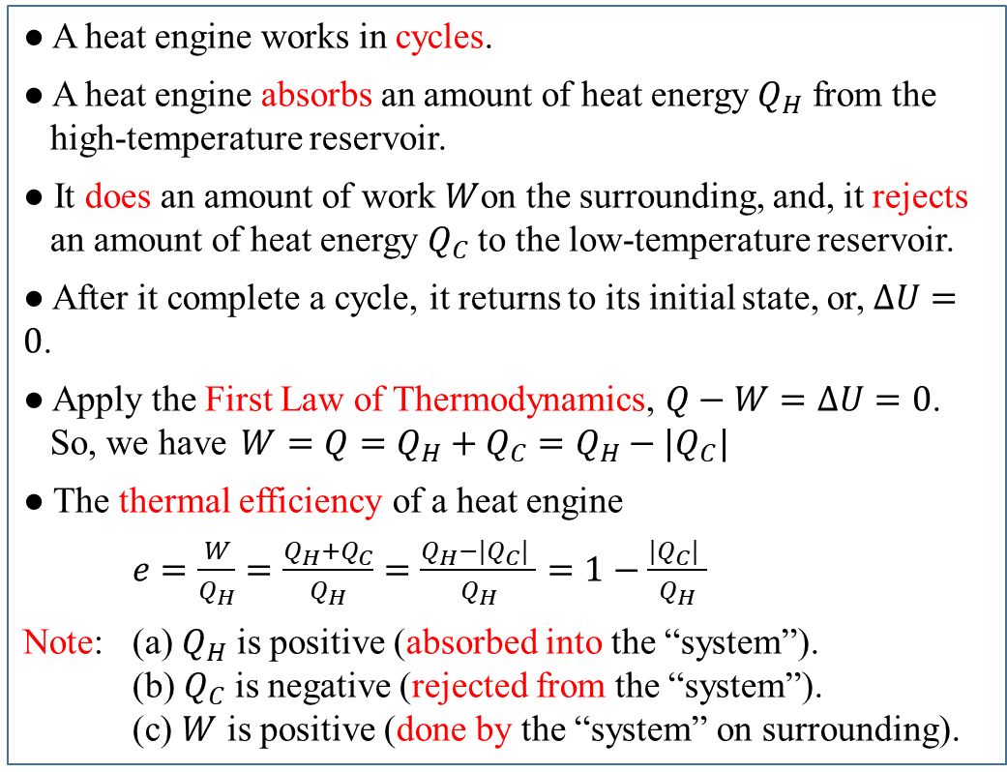
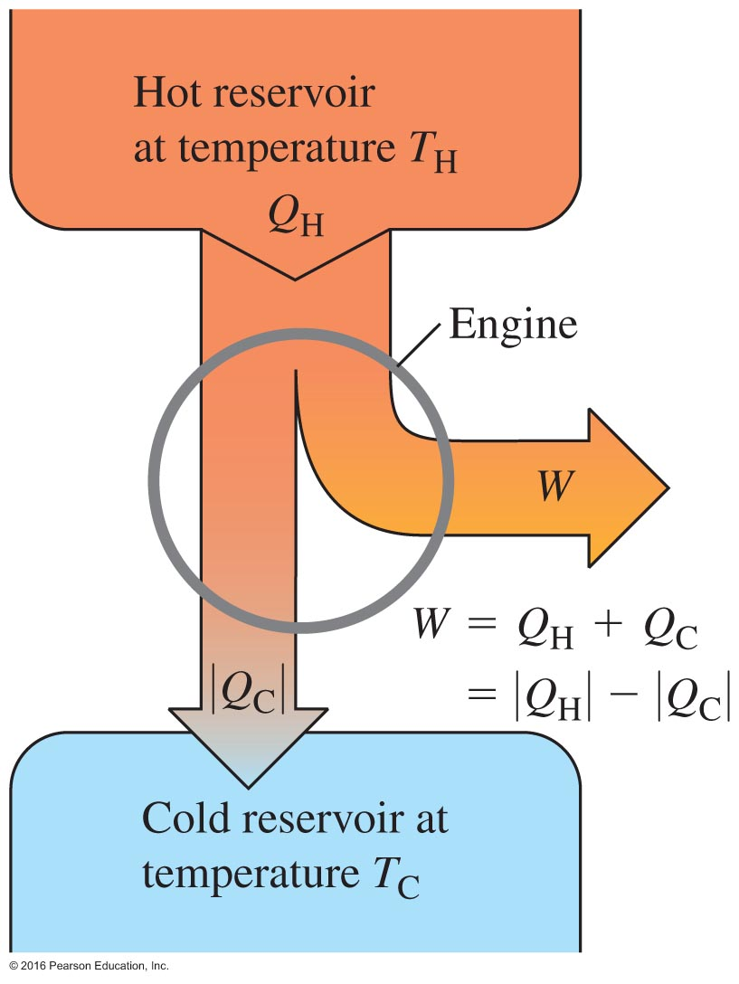
16.2 Heat Engine
Energy flow diagram

Slide 4
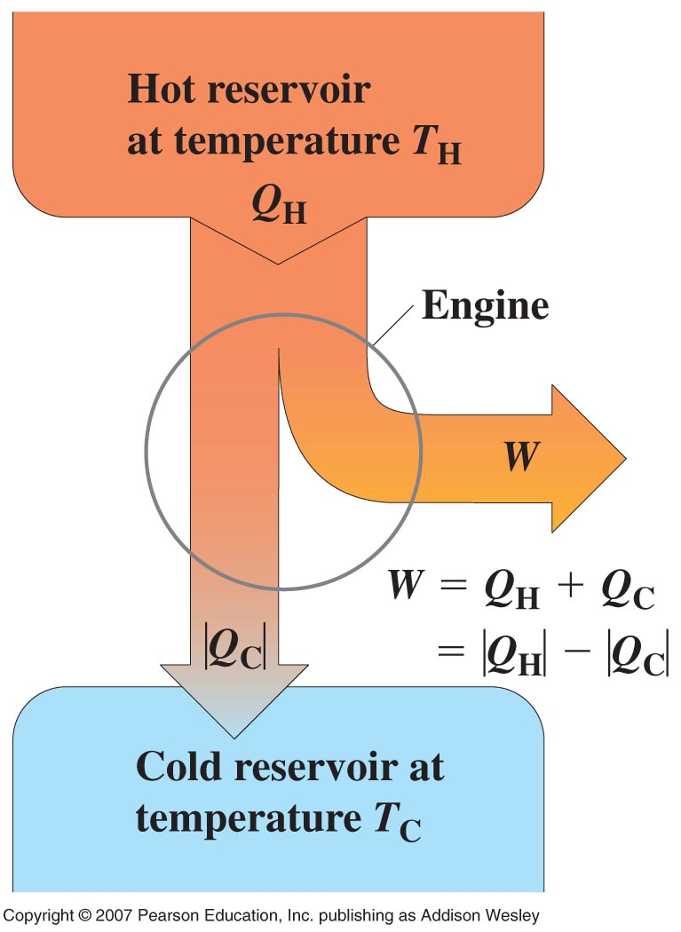
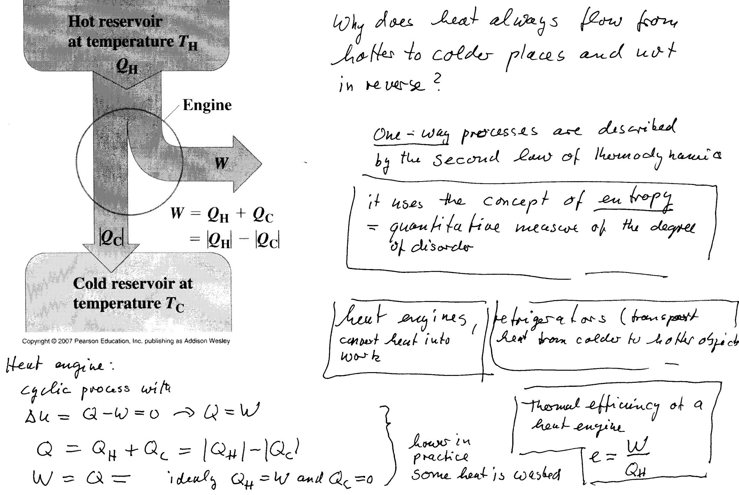
The second law of thermodynamics and heat engines
15.30

Slide 5
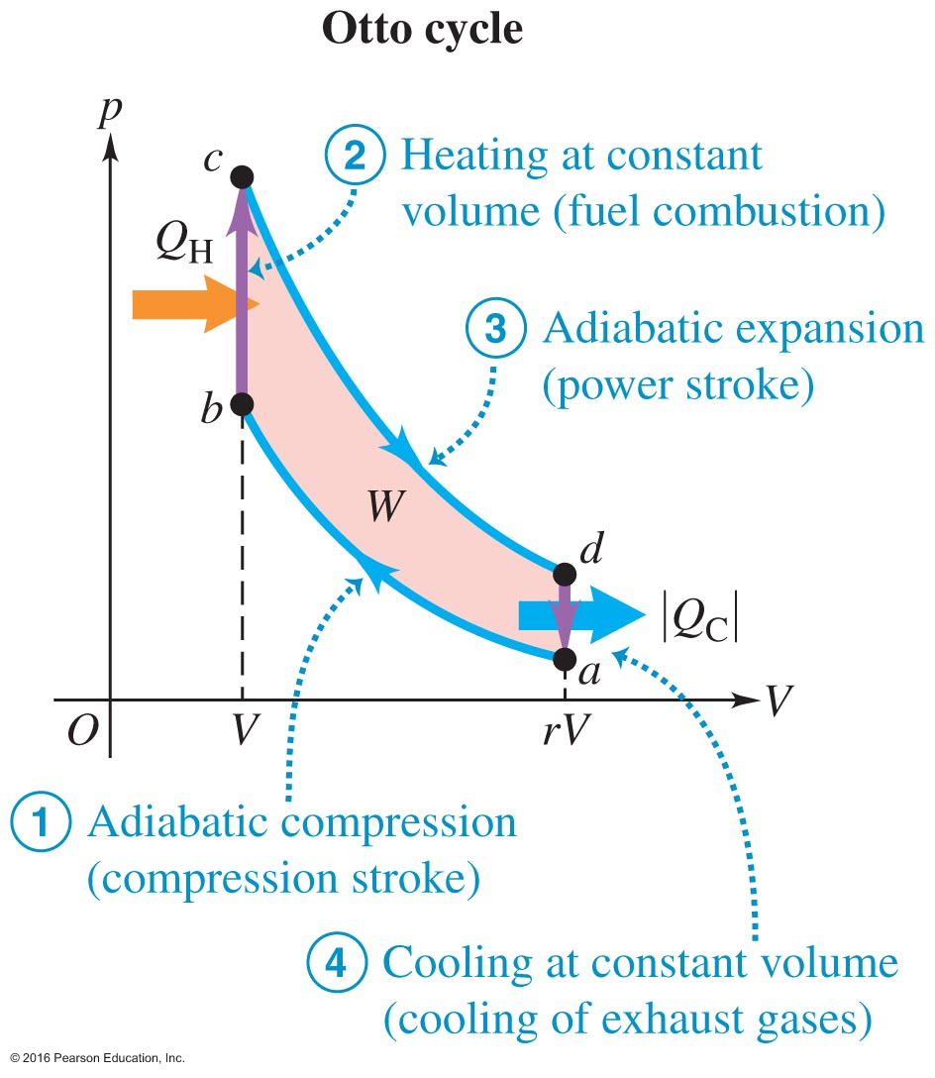
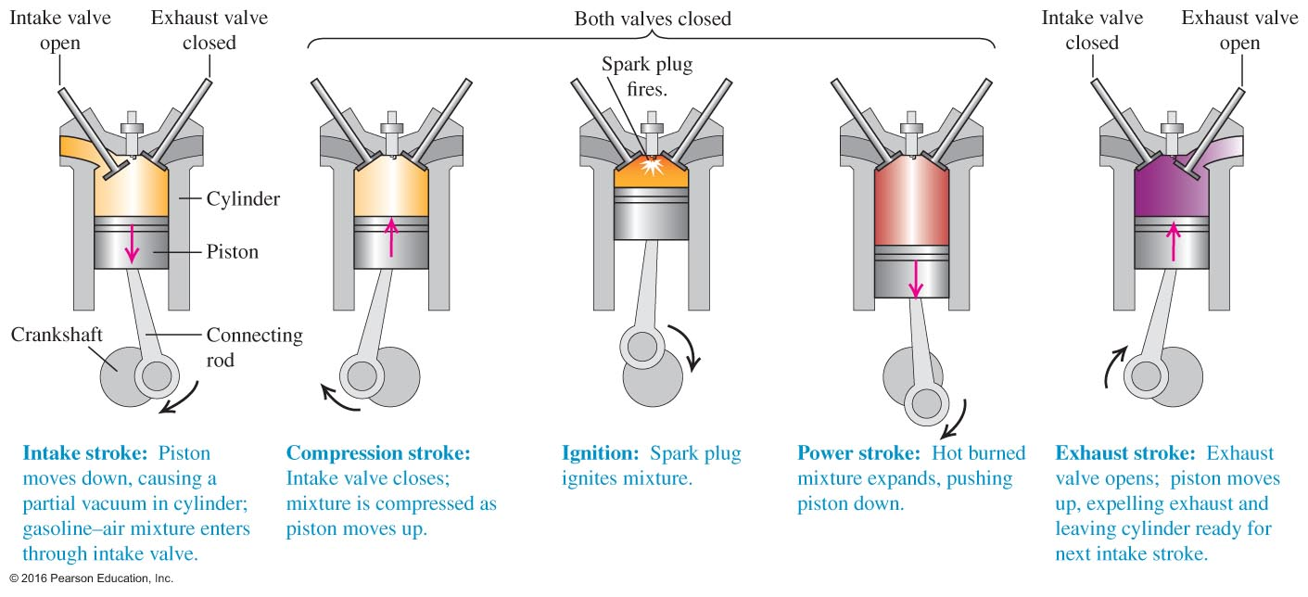
16.3 Internal Combustion Engine

Slide 6
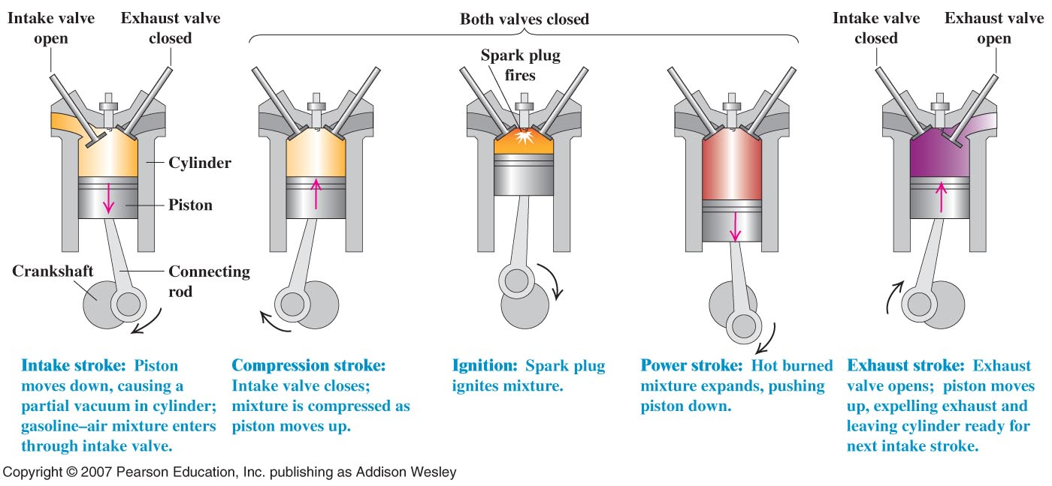
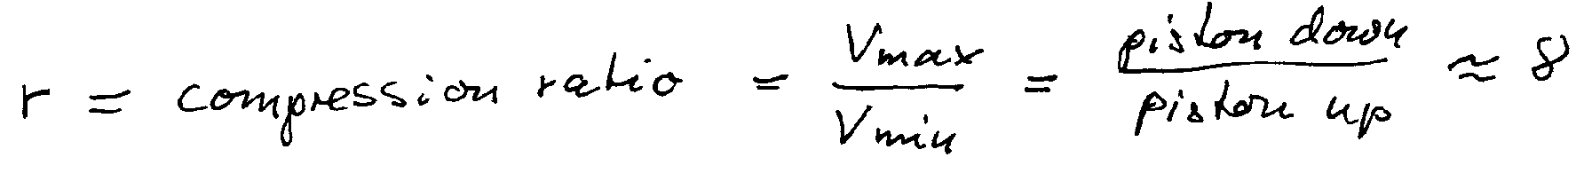
The ottocycle = gasoline engine
3 types of heat engines:
Gasoline or otto engine e = 56%
Diesel engine e= 68%
Carnot engine most efficient heat engine e= 90% for large temp difference

Slide 7
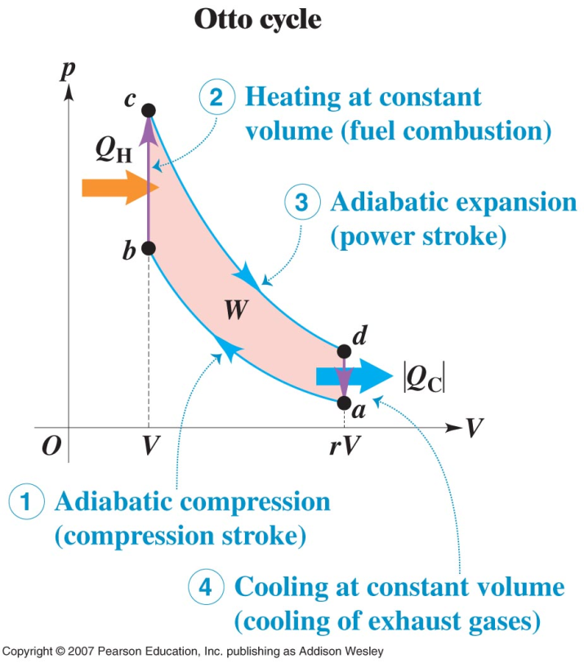
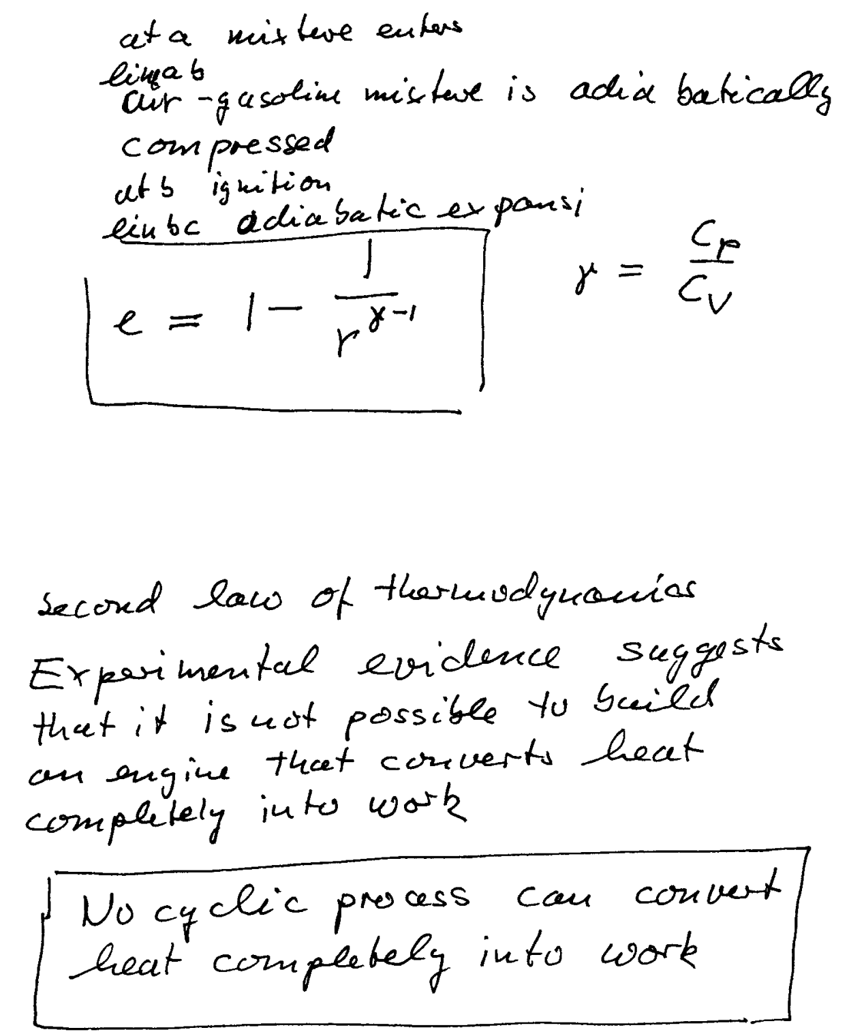
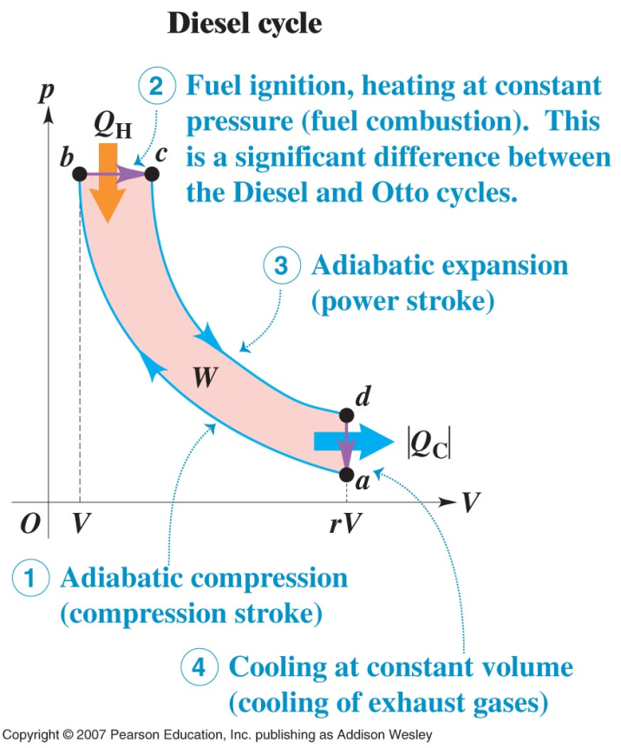
e=0.56 r=8 otto
e=0.70 r=20 Diesel
For Diesel there is no fuel in the compression stroke and r can be large

Slide 8
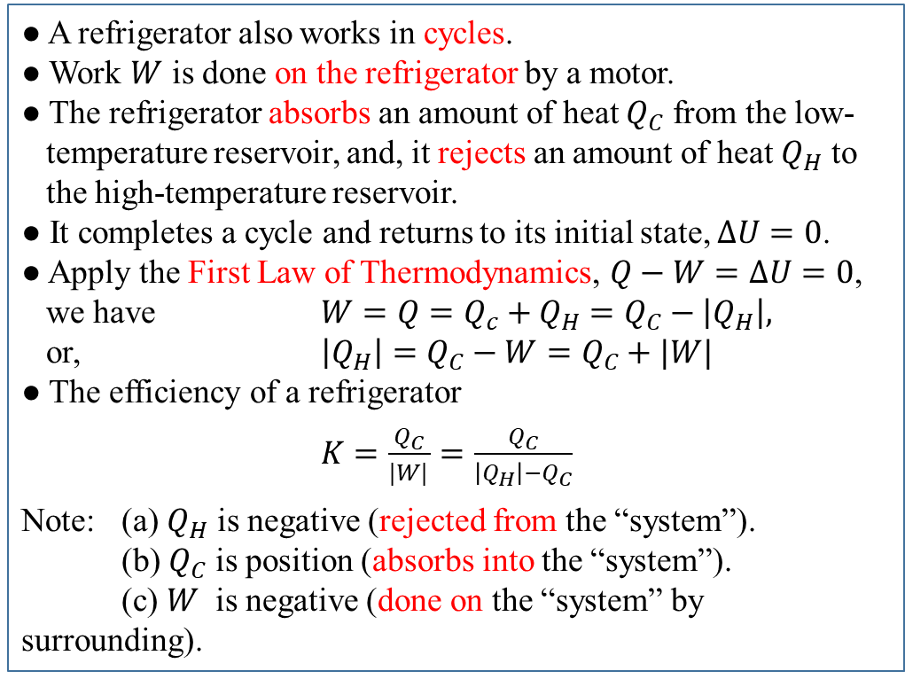
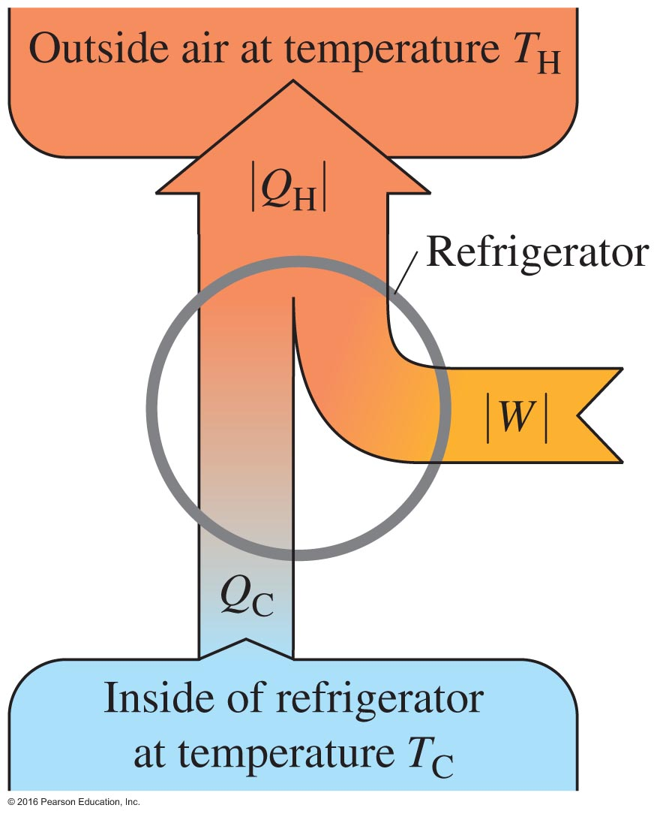
16.4 Refrigerators---Heat Engine Running “Backward”

Slide 9
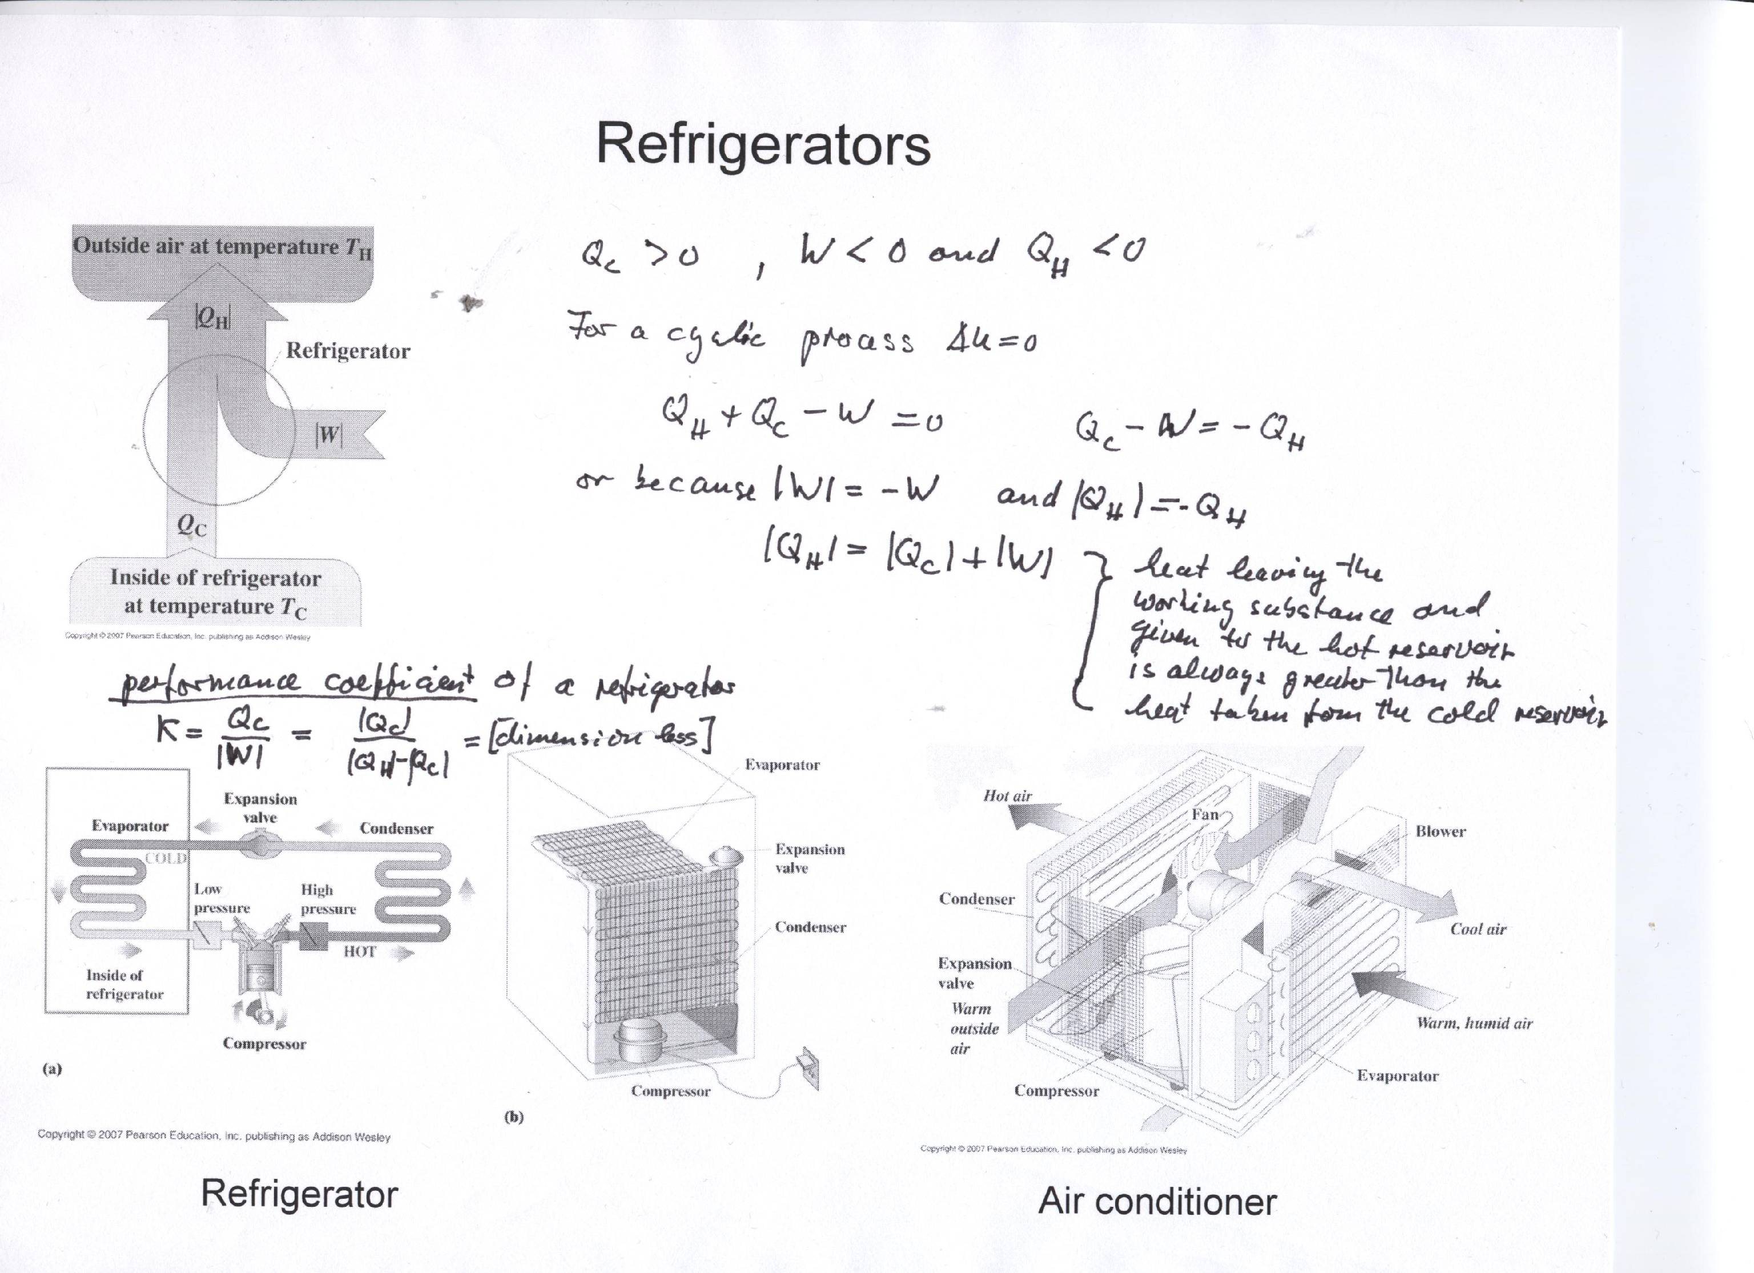
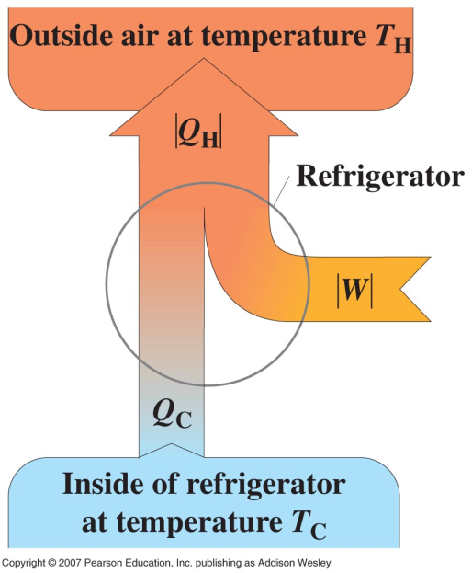
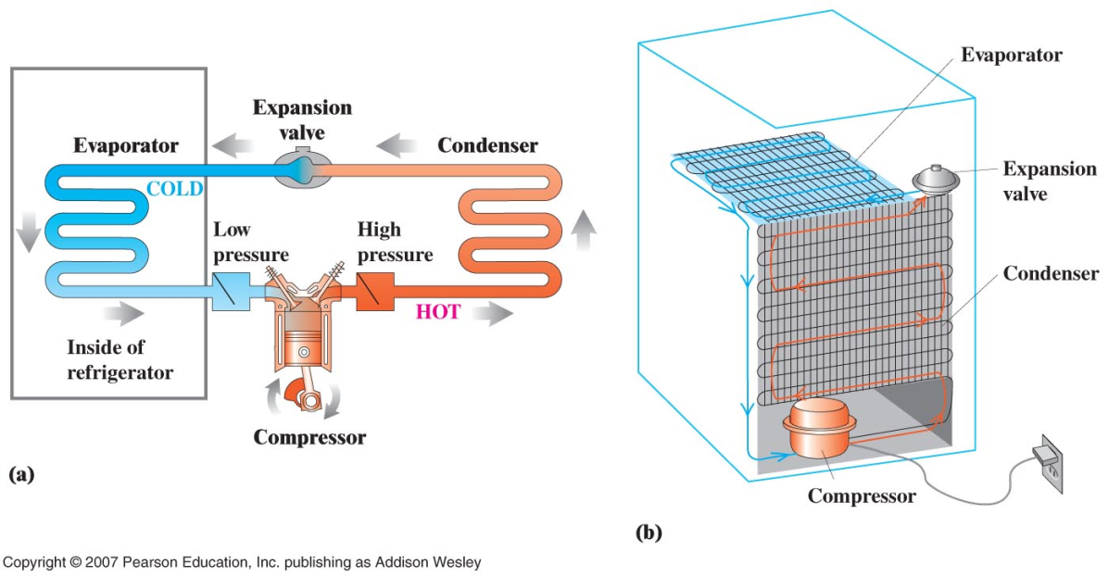
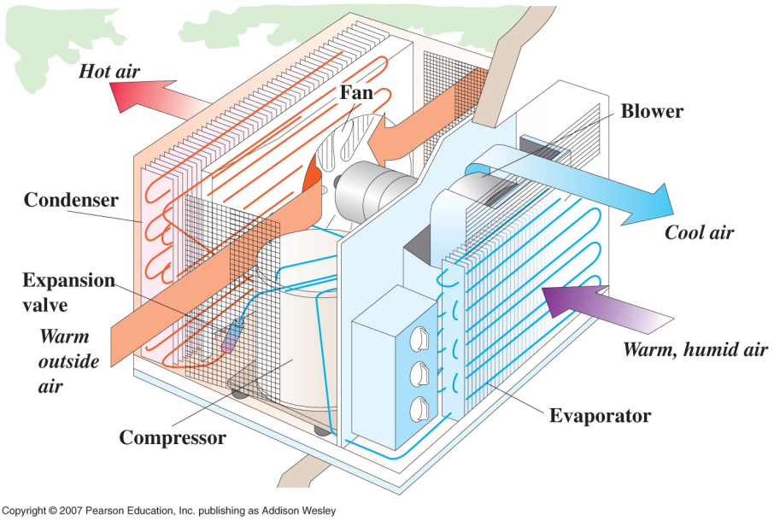
Refrigerators
Refrigerator
Air conditioner

Slide 10
16.5 The Second Law of Thermodynamics
Equivalent Statements of the Second Law of Thermodynamics
● The Engine Statement
It is impossible for any heat engine to undergo a cyclic process in which it
absorbs heat from a reservoir at a single temperature and converts the heat
completely into mechanical work.
● The Refrigerator Statement
It is impossible for any process to have as its sole result the transfer of
heat from a cooler to a hotter object.

Slide 11
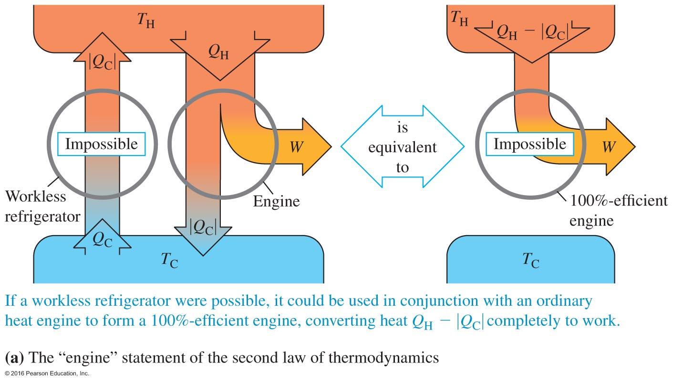
A “workless” refrigerator is impossible:
It would violate the “engine statement”

Slide 12
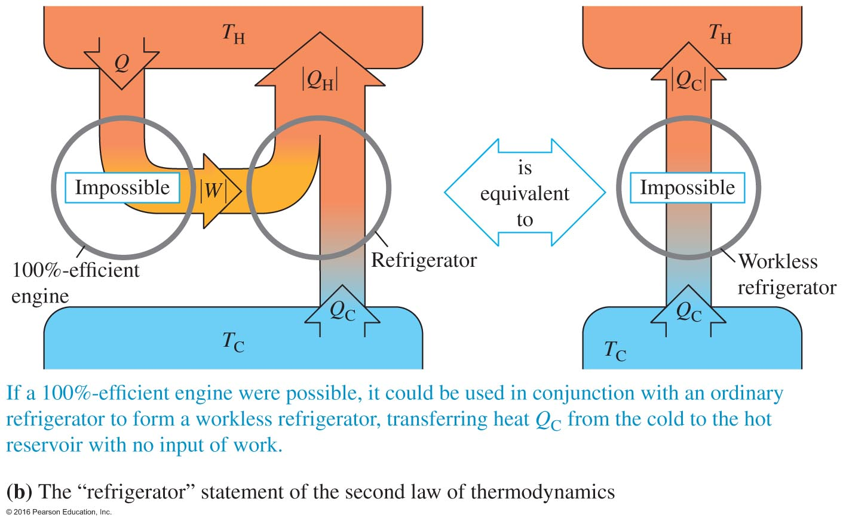
A “100% efficient” engine is impossible:
It would violate the “refrigerator statement”

Slide 13
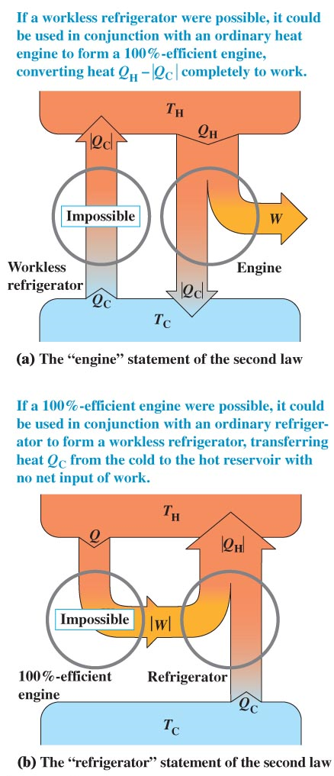
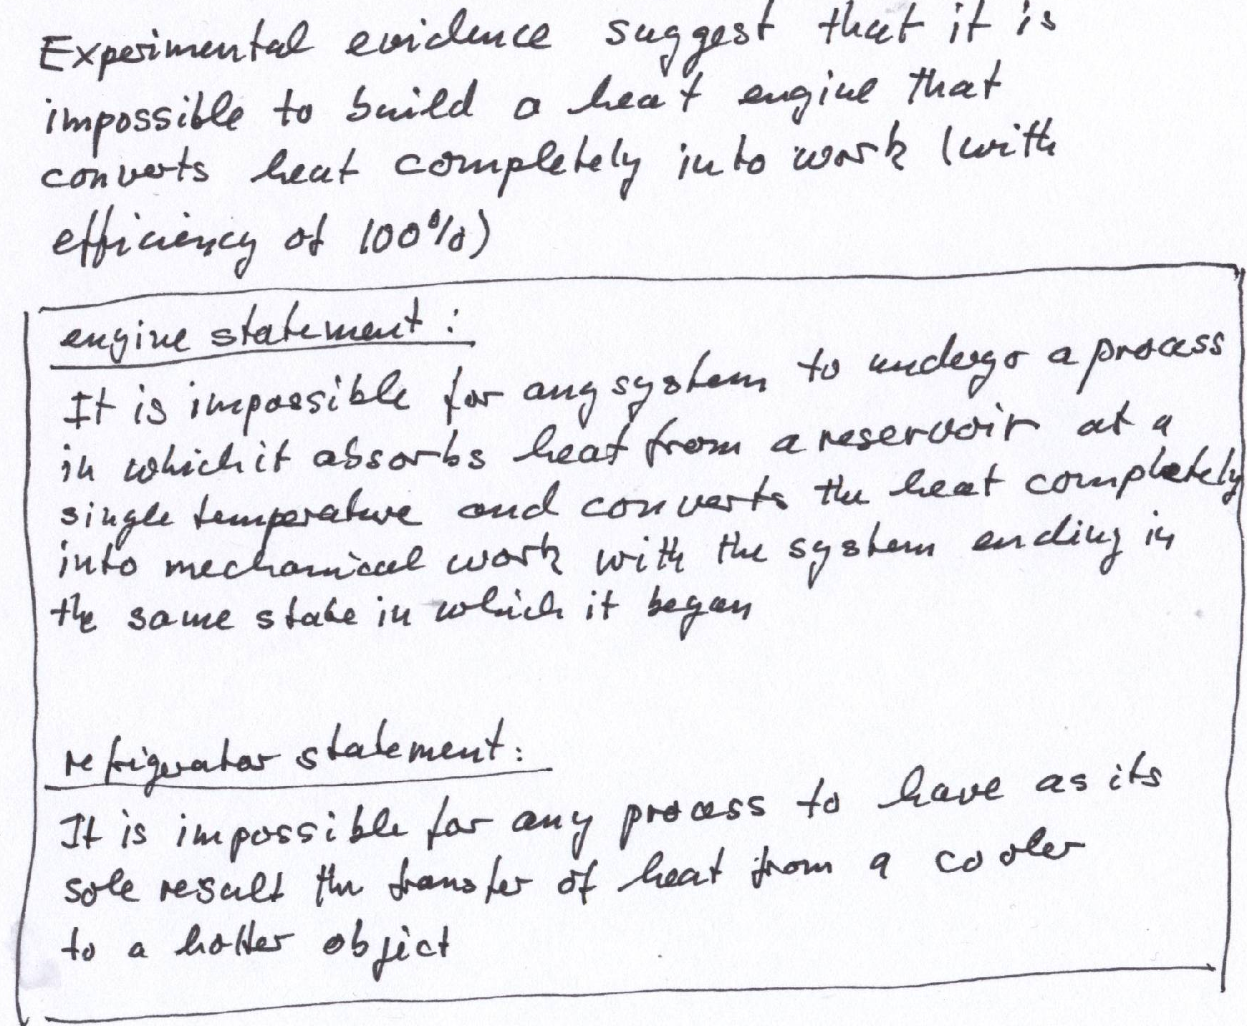
Second law of thermodynamics

Slide 14

The Essence of the Second Law of Thermodynamics
The one-way aspect of the processes occur in nature----irreversibility.
a drop of ink
free expansion of gas
T₁
T₂
T₁ > T₂

Slide 15
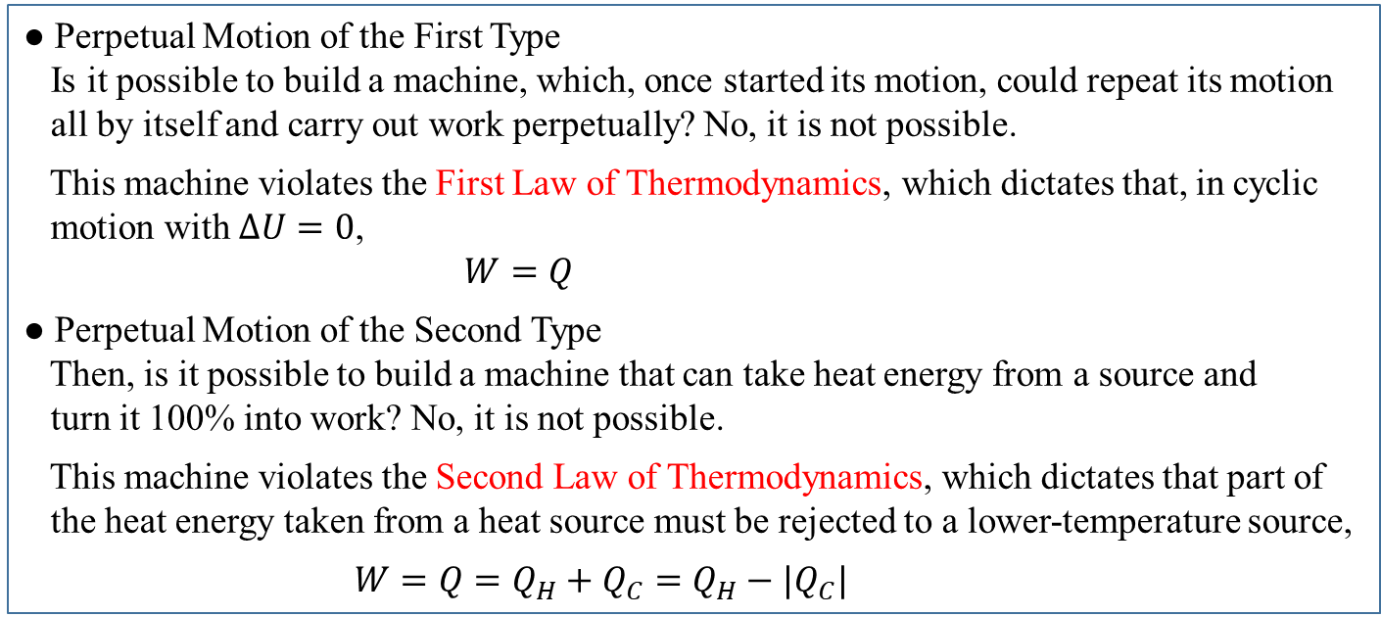
Machines of Perpetual Motion that Violate the Laws of Thermodynamics

Slide 16
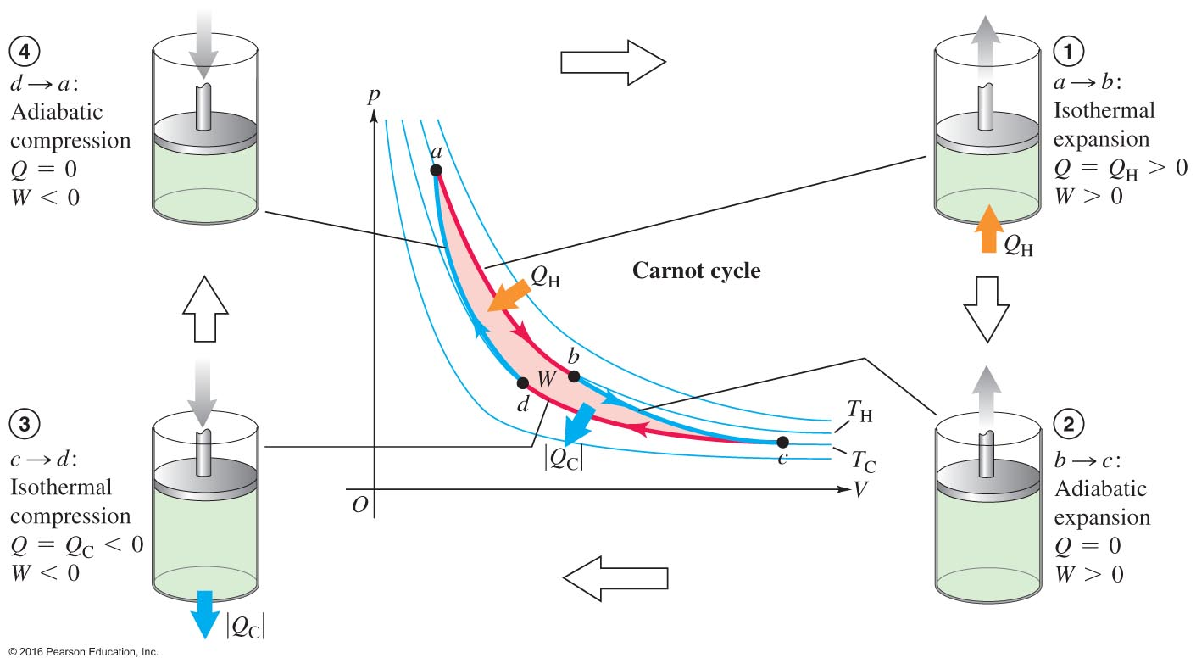
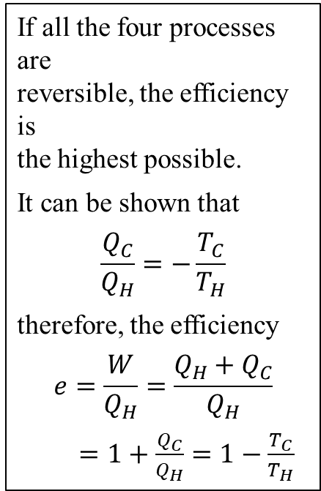
16.6 The Carnot Engine---The Most Efficient Engine
The Carnot Cycle is an ideal model of the heat engine.
Try to avoid irreversible processes

Slide 17
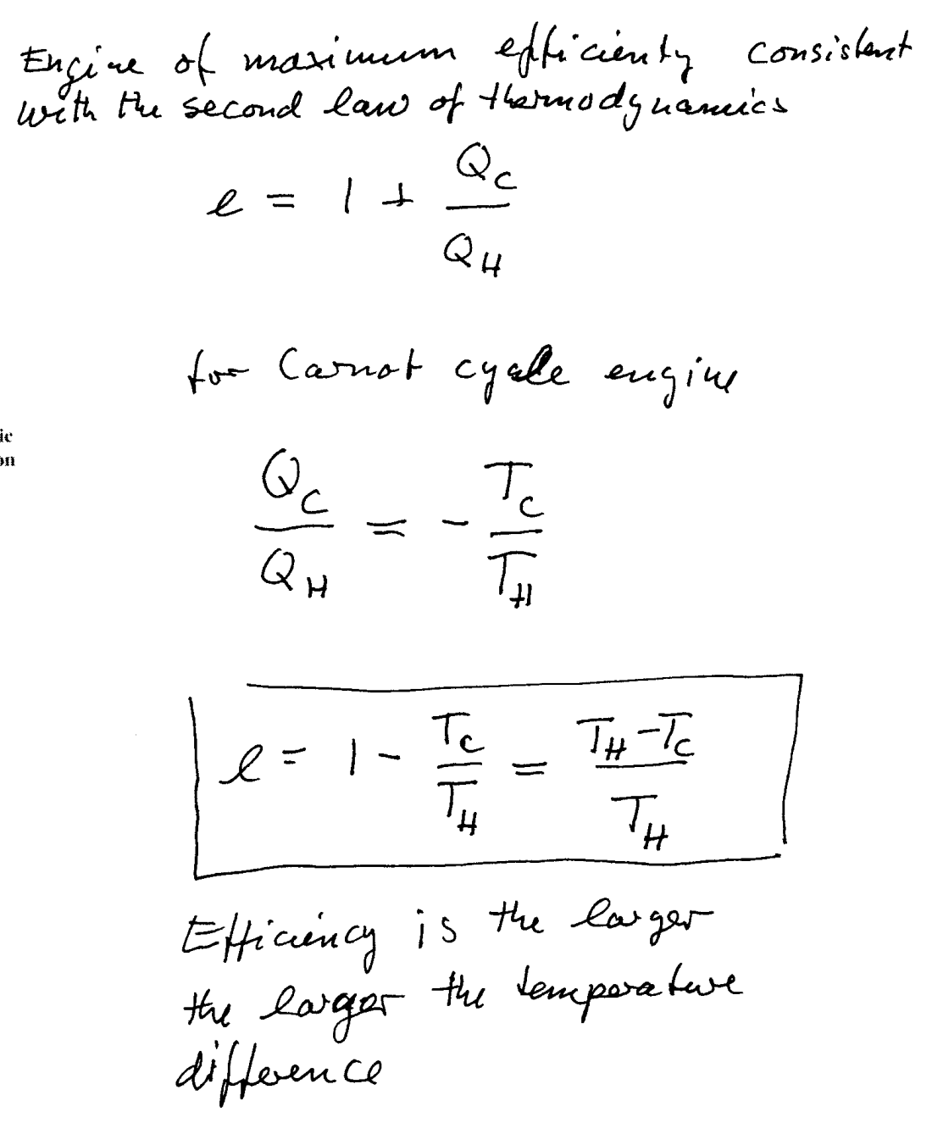

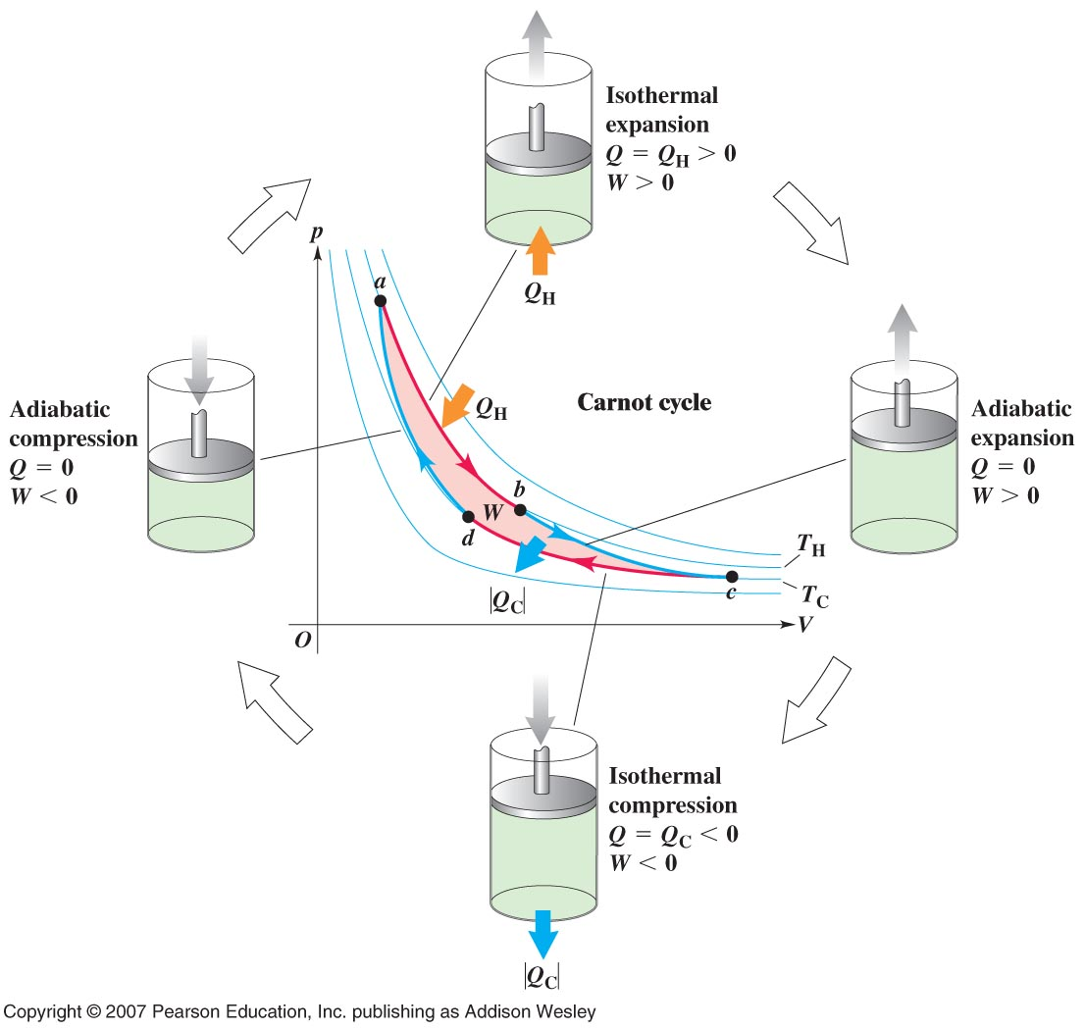
The gas expands isothermally at temperature T _{H} absorbing heat Q _{H}
It Expands adiabatically until its temperature drops to T _{C}
It is compressed isothermally at T _{C} rejecting heat Q _{C}
It is compressed adiabatically back to its initial state at temperature T _{H}

Slide 18
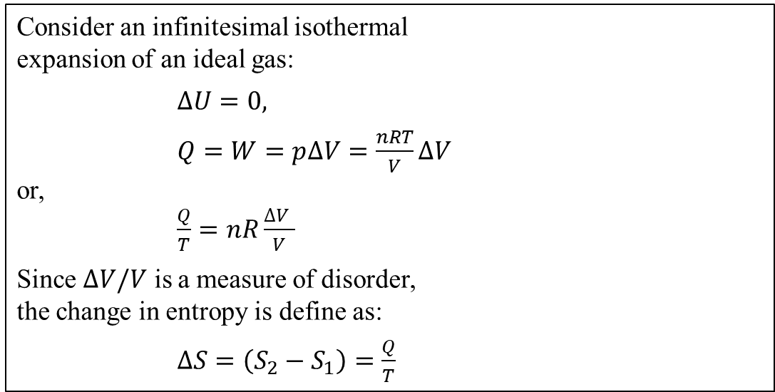

16.7 Entropy----Provides a quantitative measure of disorder
T₁
T₂
T₁ > T₂
a drop of ink
free expansion of gas
The Entropy Statement of the Second Law of Thermodynamics:
● It is impossible to have a process in which the total entropy decreases when all systems taking part in the process are included.
● It is impossible for the entropy of a closed system to decrease.
Entropy change in a reversible isothermal process with units: J/K

Slide 19
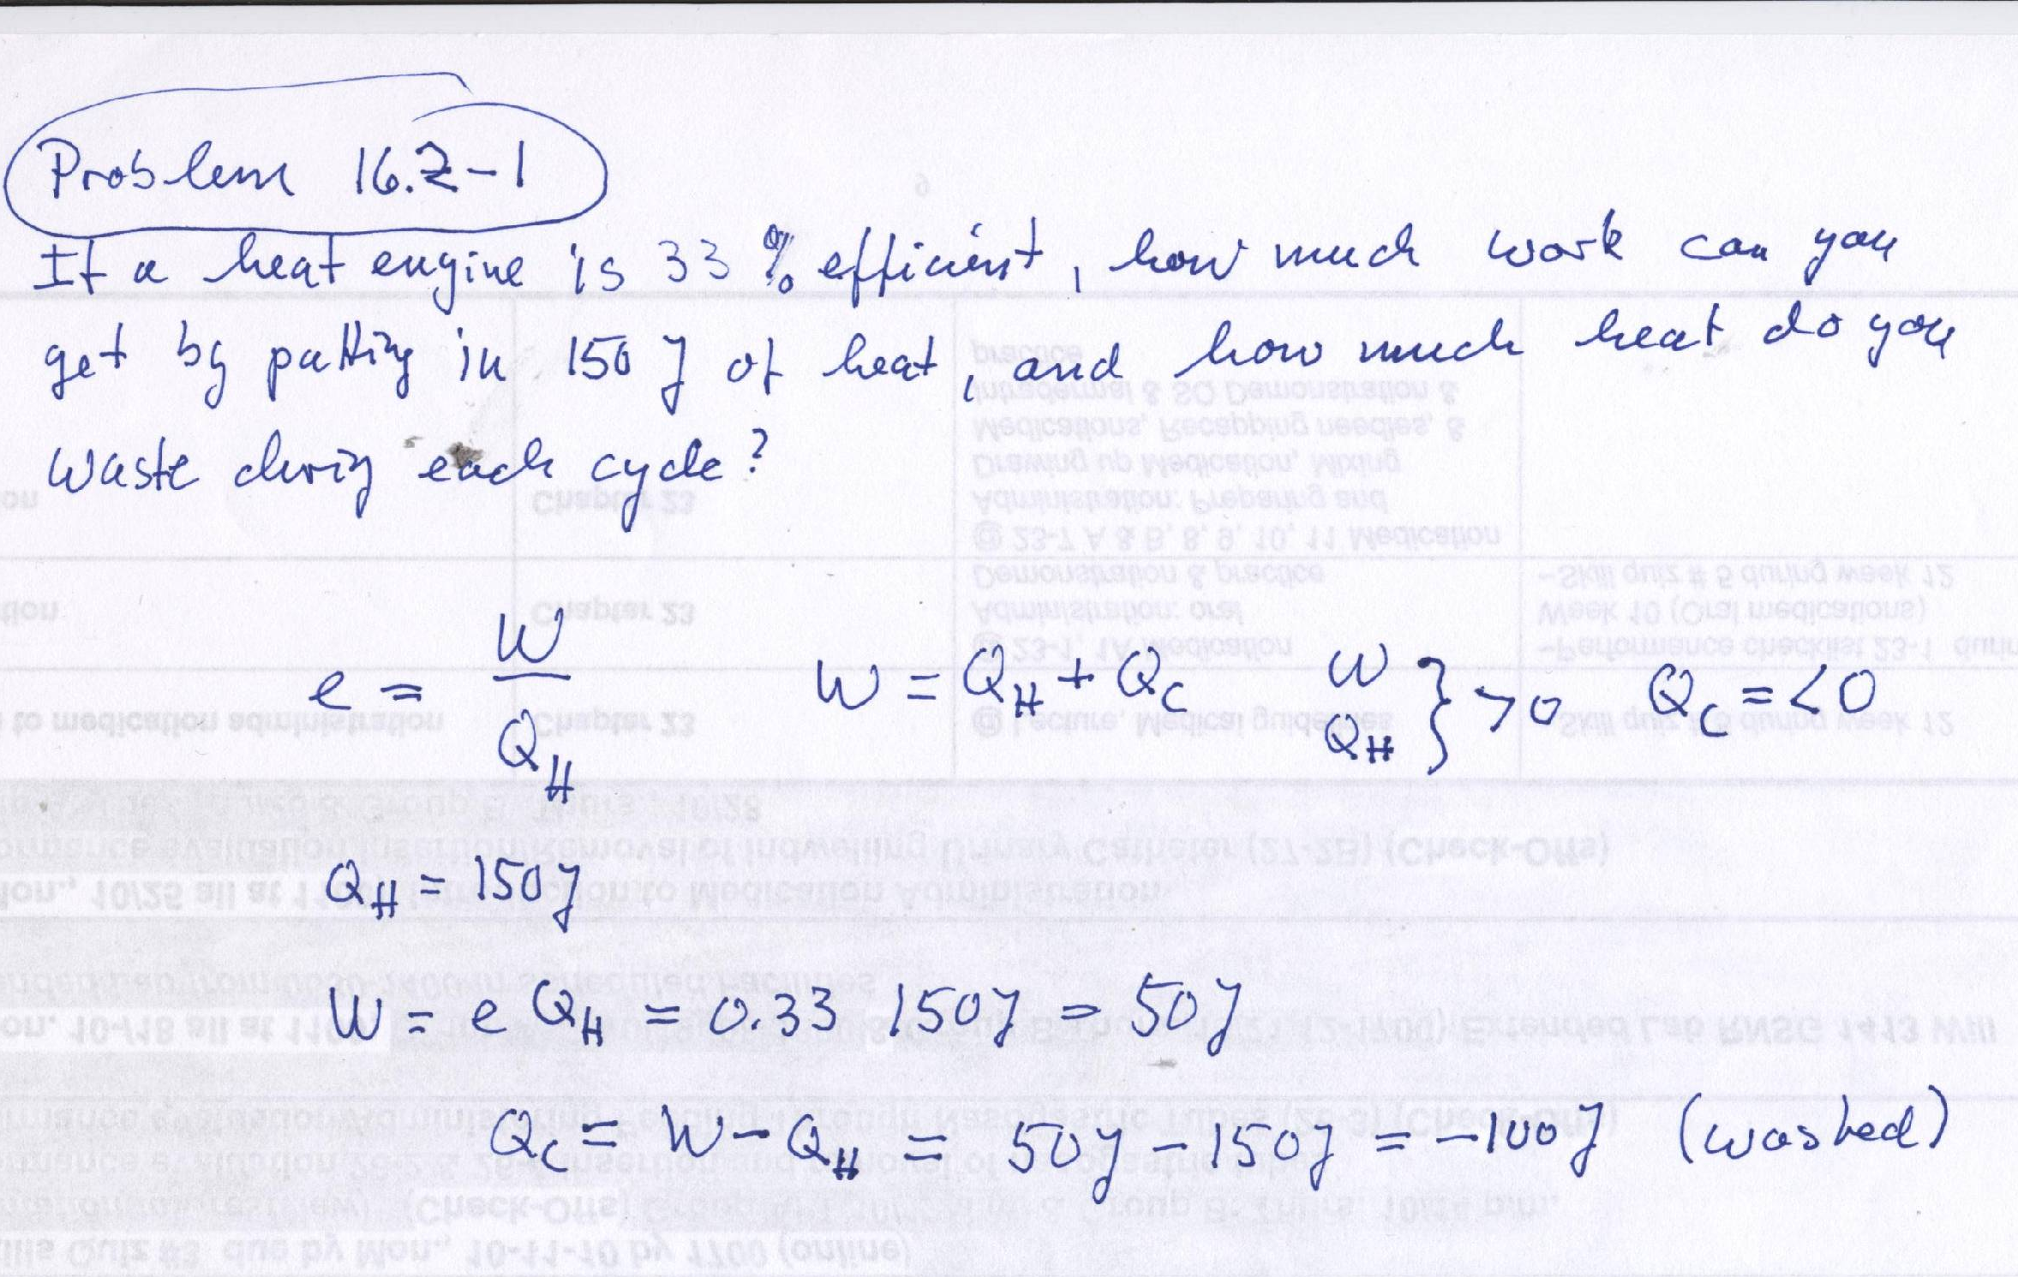

Slide 20
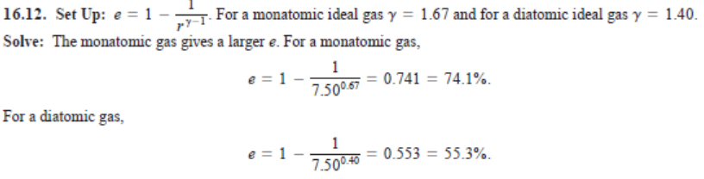
For an Otto engine with a compression ratio of 7.50, you have your choice of using an
Ideal monatomic or ideal diatomic gas. Which one would give greater efficiency?

Slide 21
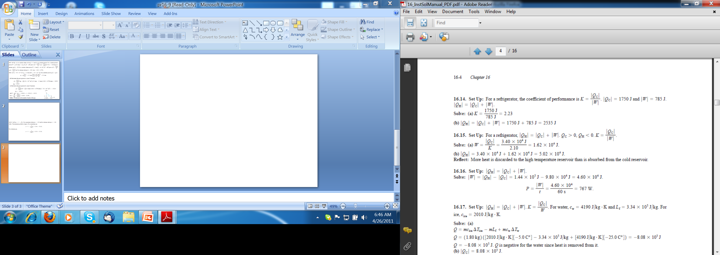
In one cycle a freezer uses 785 J of electrical energy in order to remove 1750 J of heat
From its freezer compartment at 10 F. a) what is the coefficient of performance
Of this freezer? b) how much heat does it expel into the room during this cycle?

Slide 22
A refrigerator has a coefficient of performance of 2.10. Each cycle, it absorbs
3.4 E4 J of heat from the cold reservoir. A) how much mechanical energy is required
Each cycle to operate the refrigerator? B) During each cycle, how much heat is
Discarded to the high-temp reservoir?

Slide 23
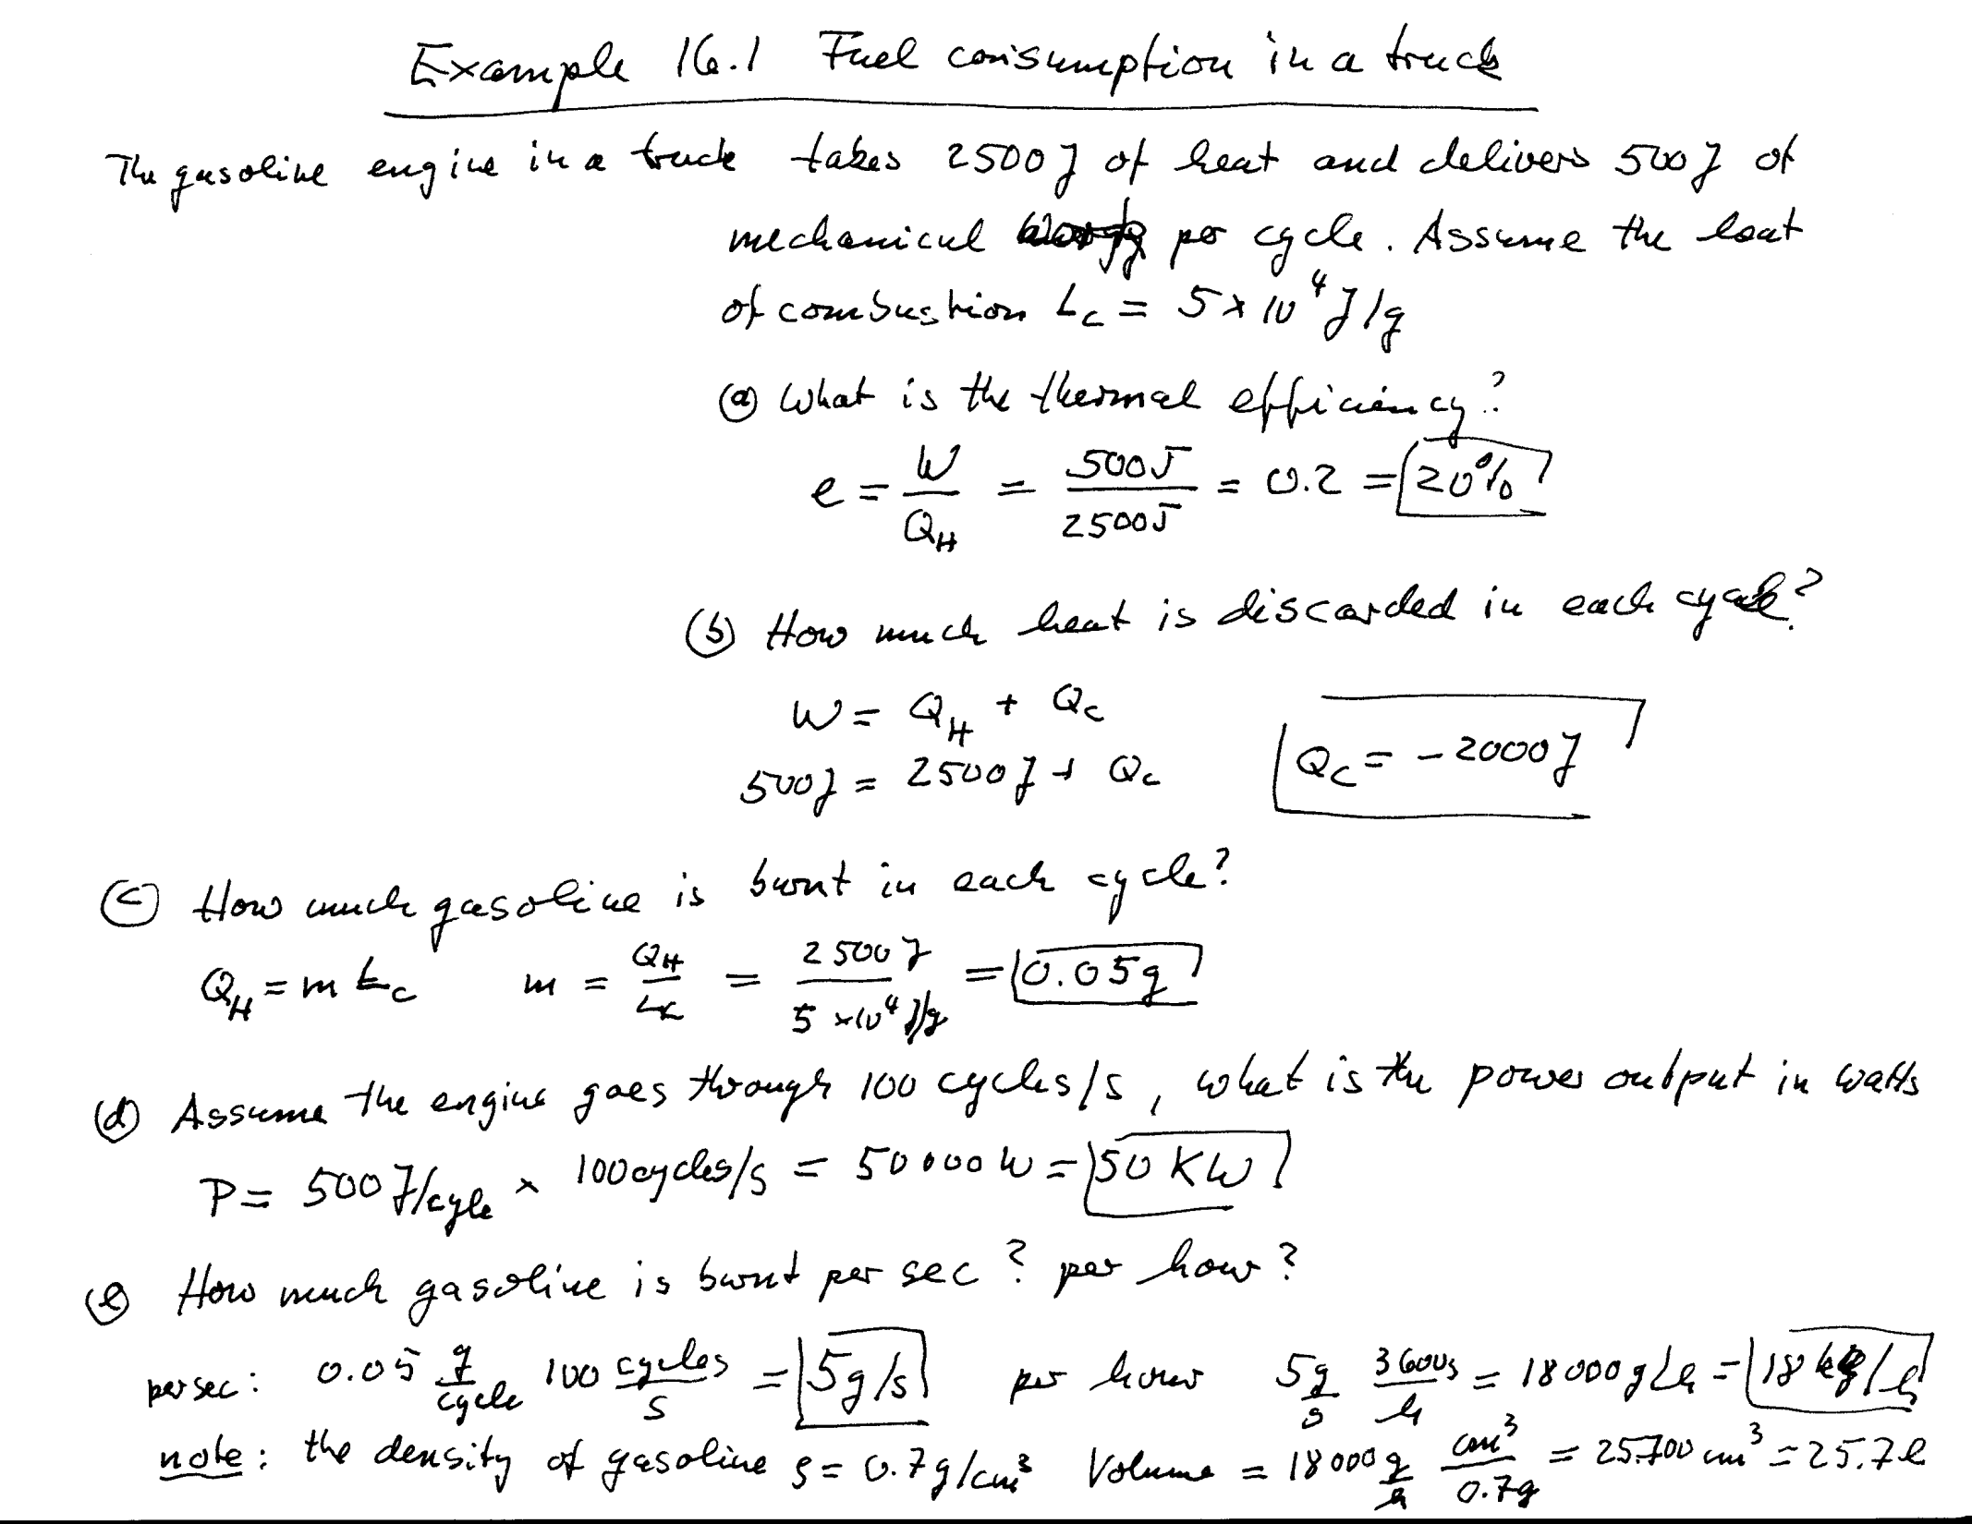
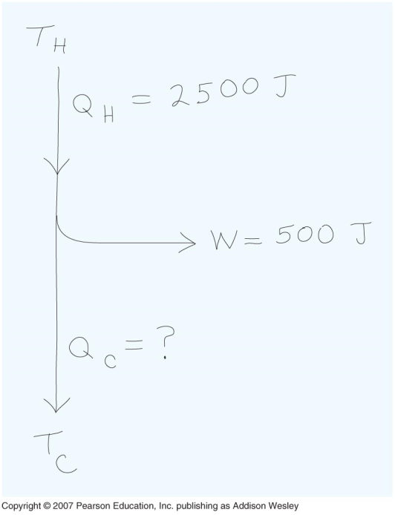

Slide 24
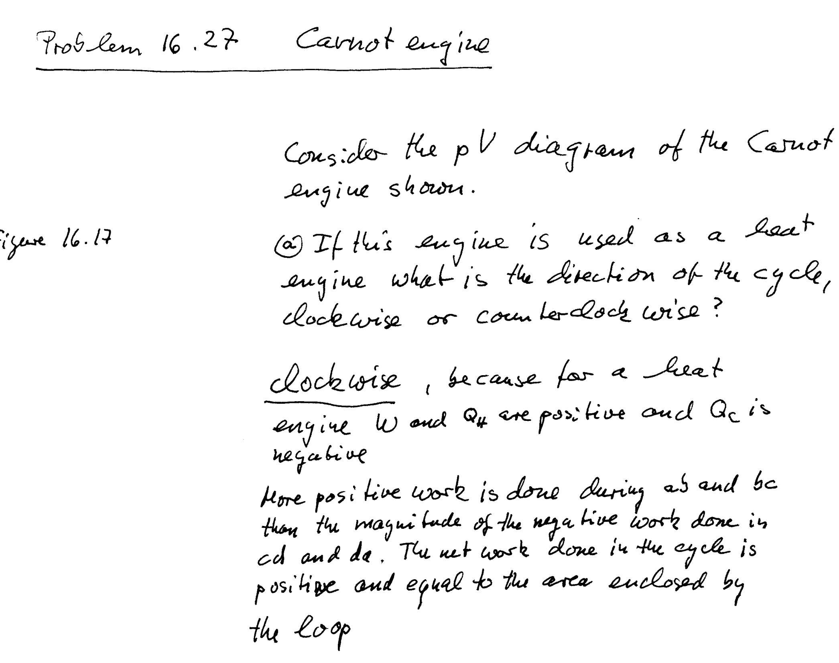
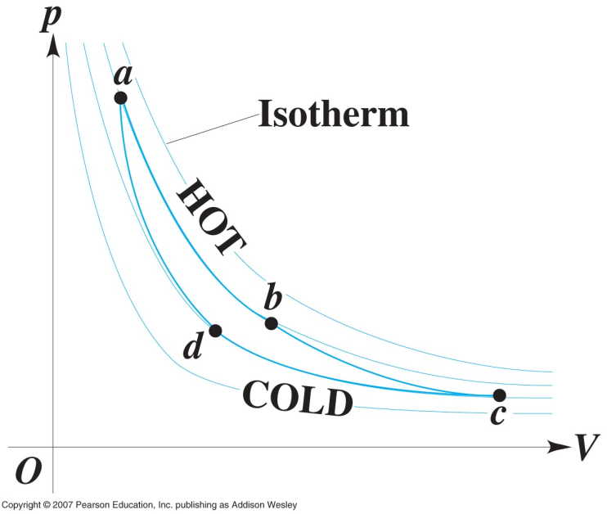

Slide 25
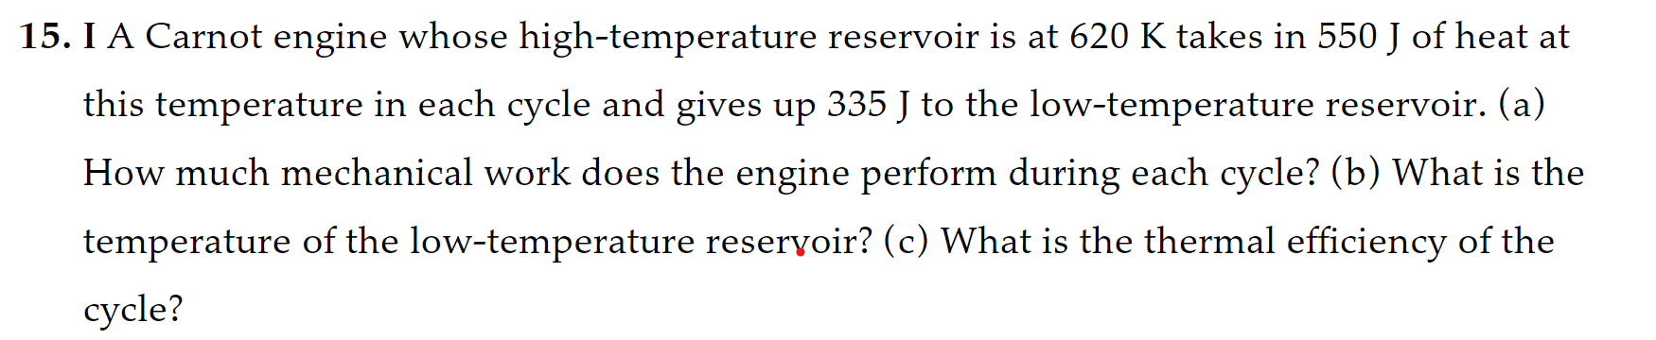

Slide 26
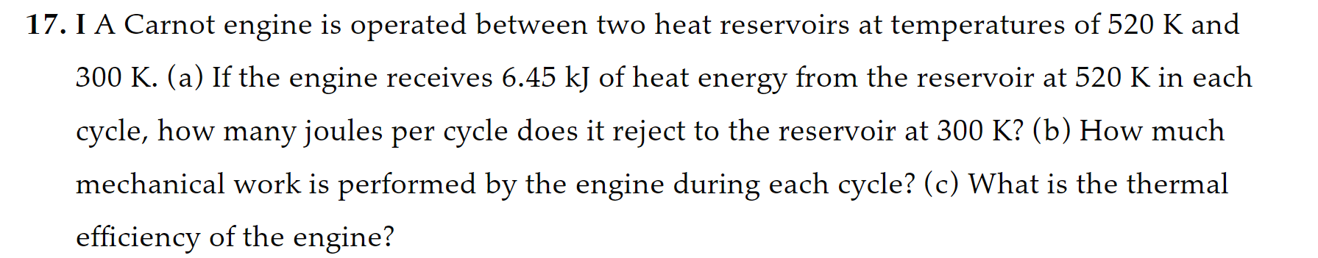

Slide 27
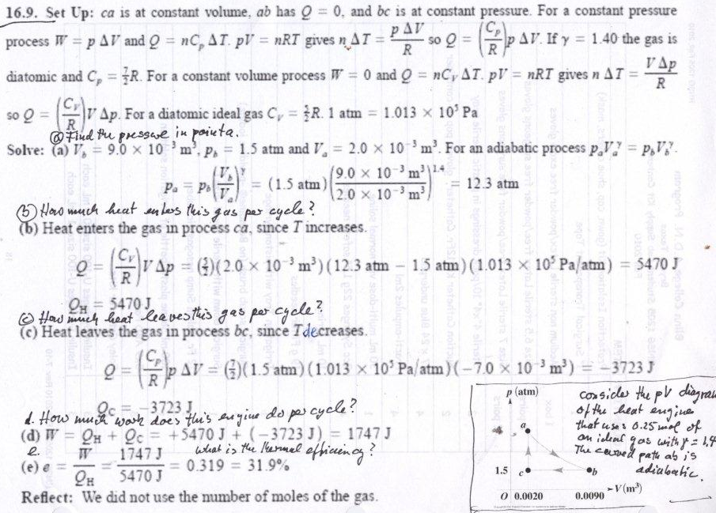
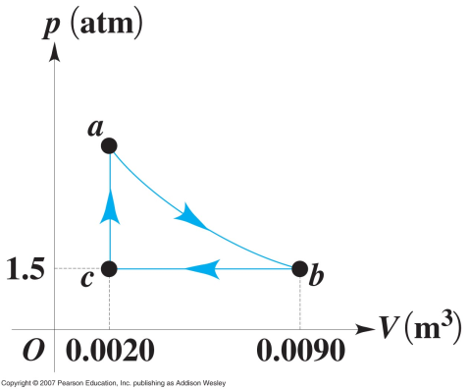

Slide 28
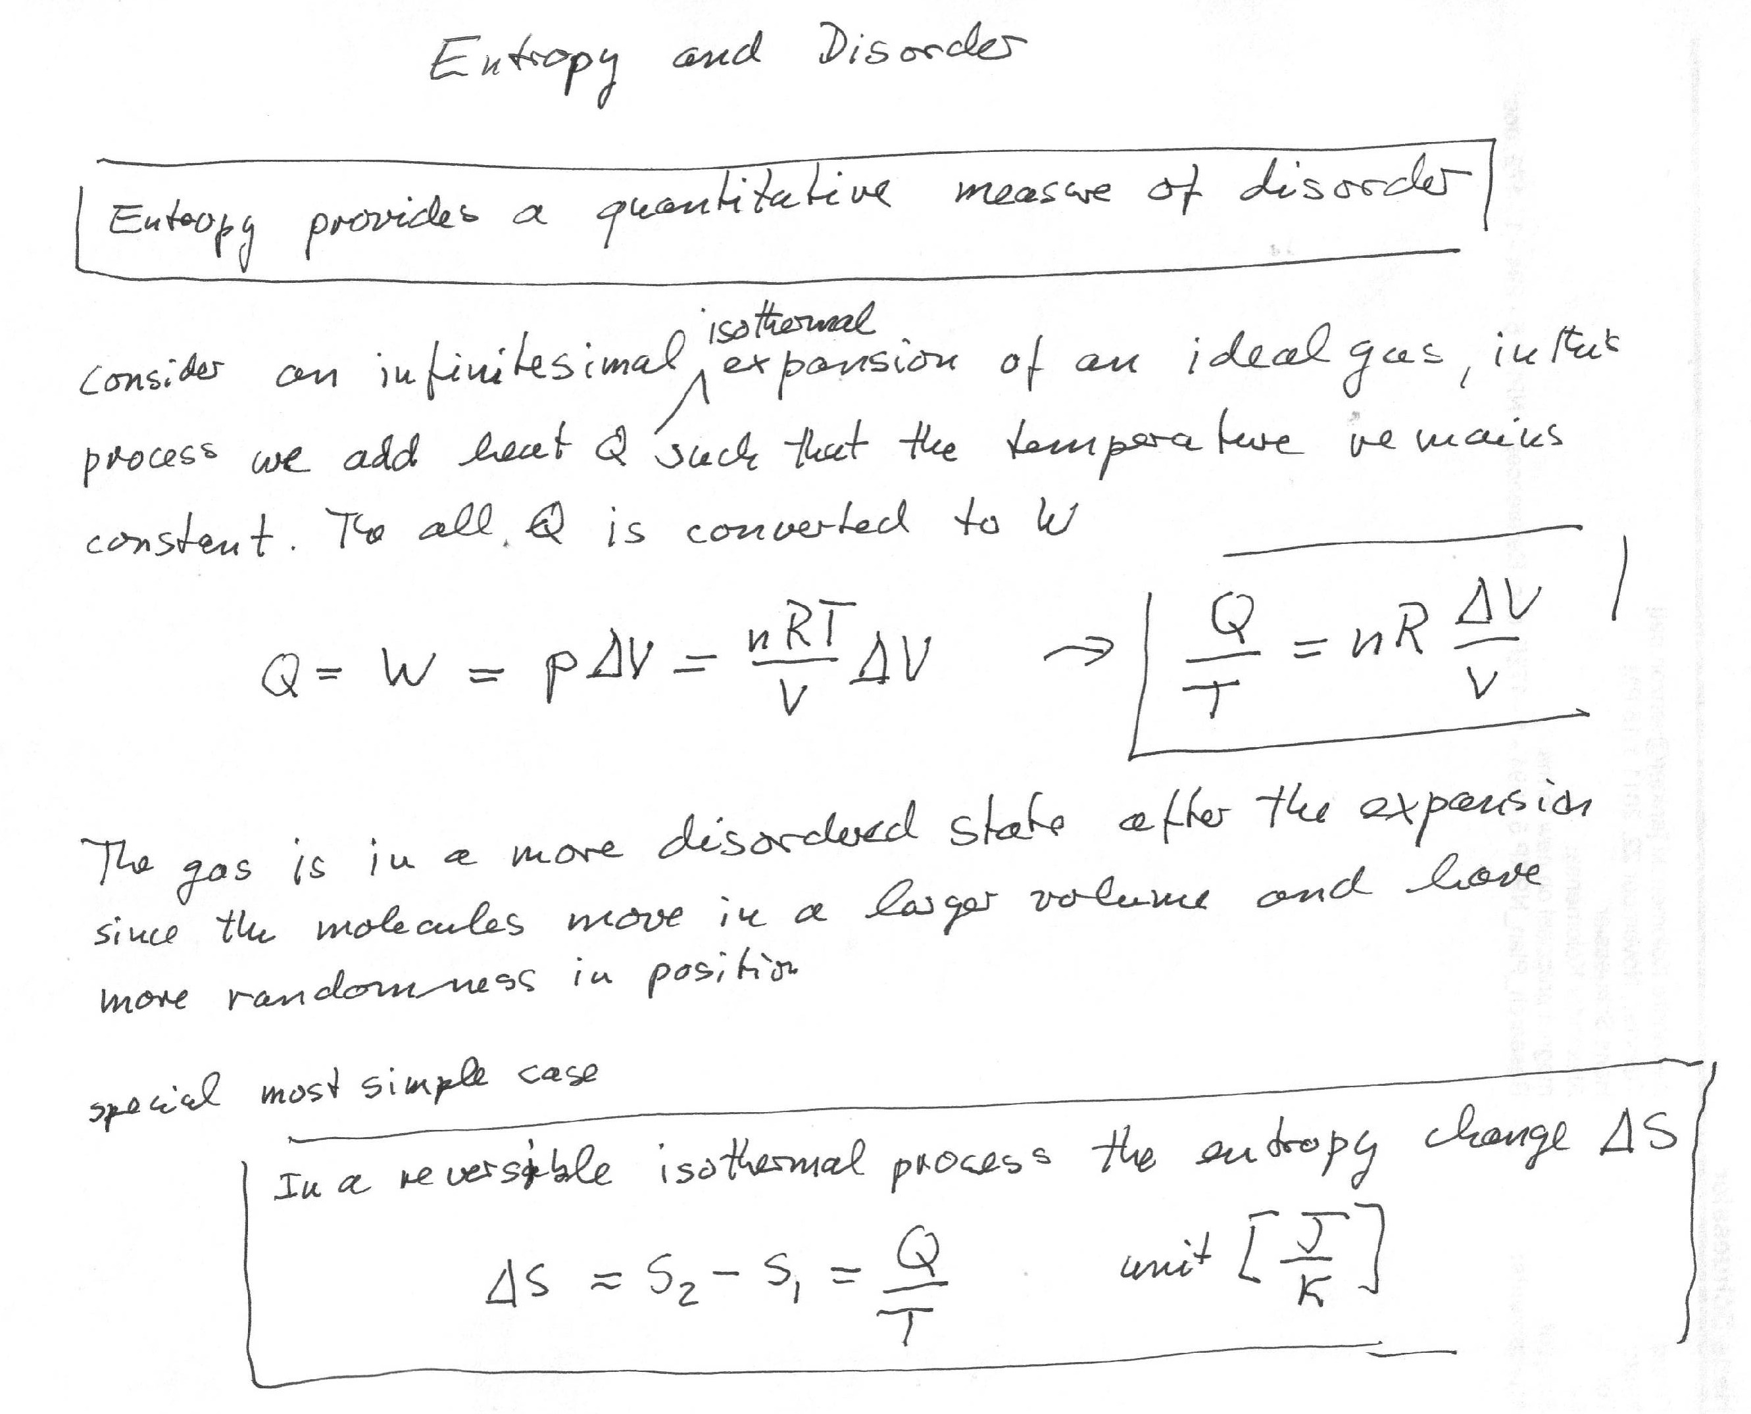

Slide 29
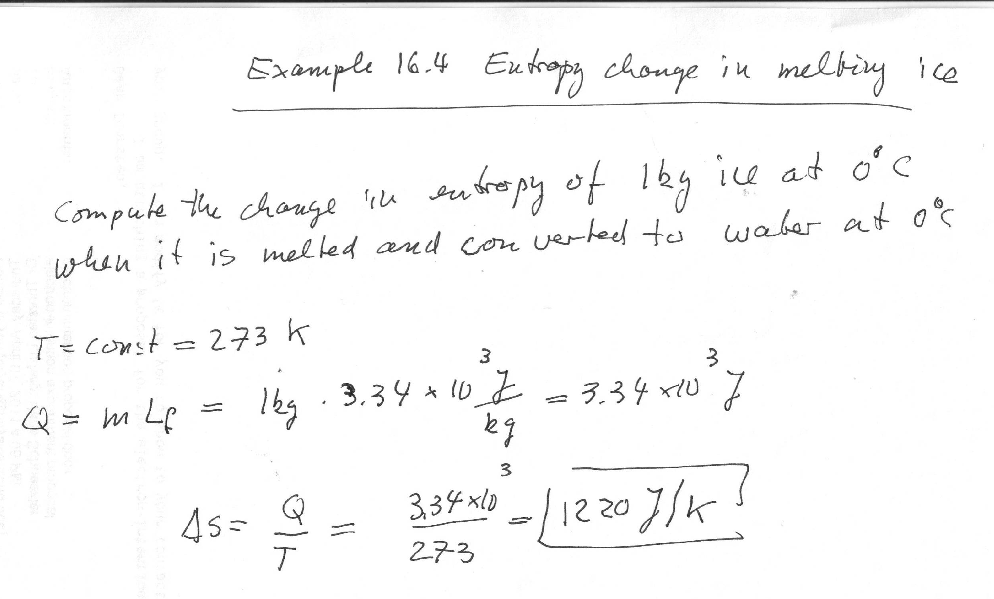
5
5

