Slide 1
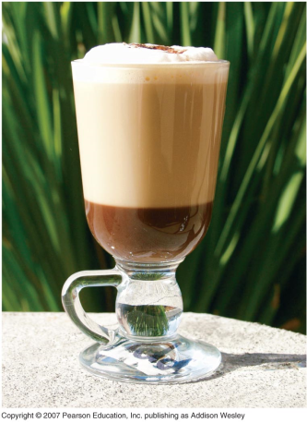

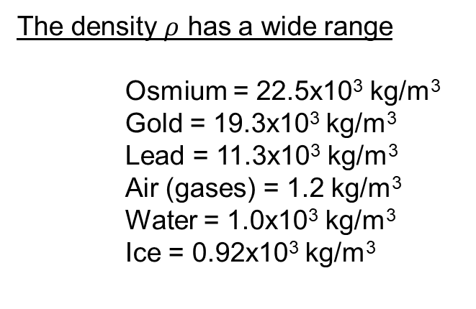
Chapter 13 Fluid Mechanics
Fluid statics = equilibrium situations
Density = $ρ$ = $\frac{m}{V}$ = $\frac{mass}{volume}$ [kg/m³]
The density $ρ$ has a wide range
Osmium = 22.5x10³ kg/m³
Gold = 19.3x10³ kg/m³
Lead = 11.3x10³ kg/m³
Air (gases) = 1.2 kg/m³
Water = 1.0x10³ kg/m³
Ice = 0.92x10³ kg/m³

Slide 2
Chapter 13 Fluid Mechanics
● 13.1 To understand density.
● 13.2 To understand pressure in a fluid.
● 13.3 To apply Archimedes principle of buoyancy.
Sections not covered:
● 13.4 To understand surface tension and capillary action.
● 13.5 To understand fluid flow
● 13.6 To Bernoulli’s equation.
● 13.7 The application of Bernoulli’s equation.
● 13.8 To understand turbulence and viscosity in real fluids.

Slide 3
Goals for Chapter 13
To study density and pressure in a fluid withPascal’s Law
To apply Archimedes principle of buoyancy.

Slide 4
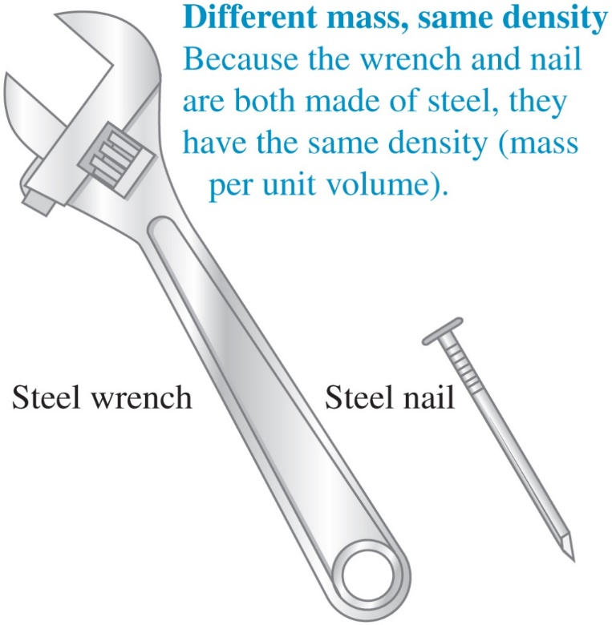
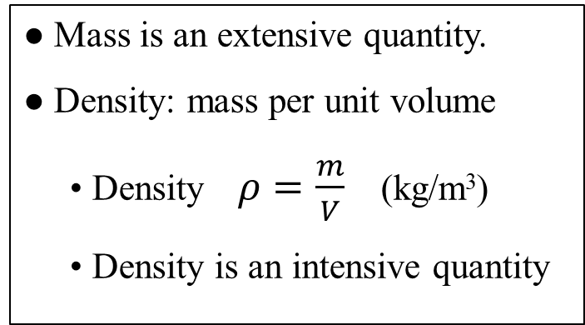
13.1 Density
● Mass is an extensive quantity.
● Density: mass per unit volume
  Density $ρ=\frac{m}{V}$ (kg/m³)
  Density is an intensive quantity

Slide 5
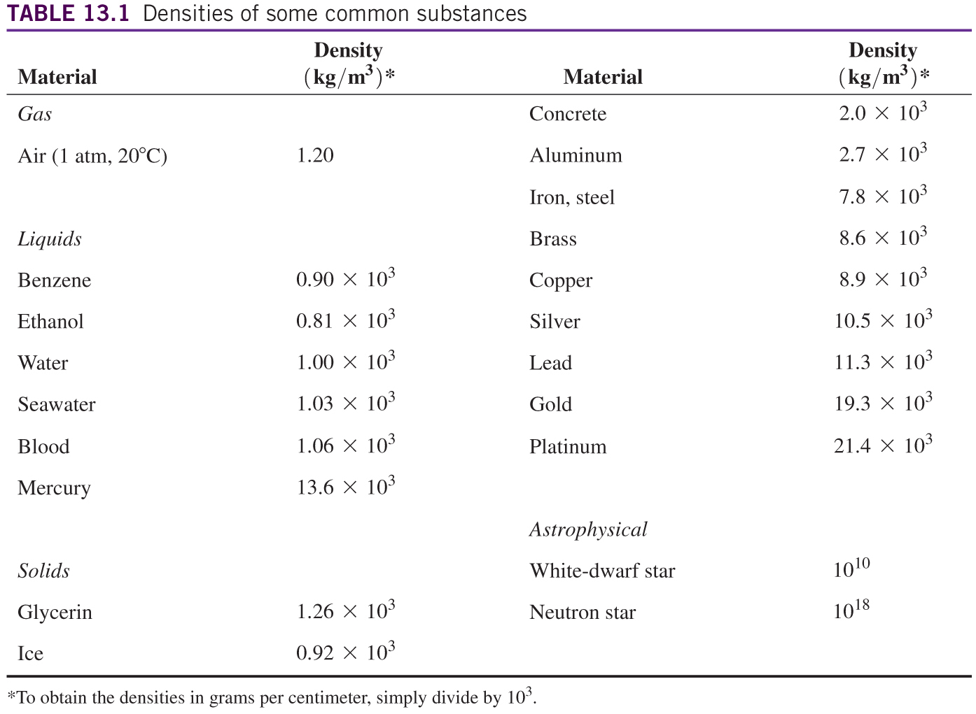

Slide 6
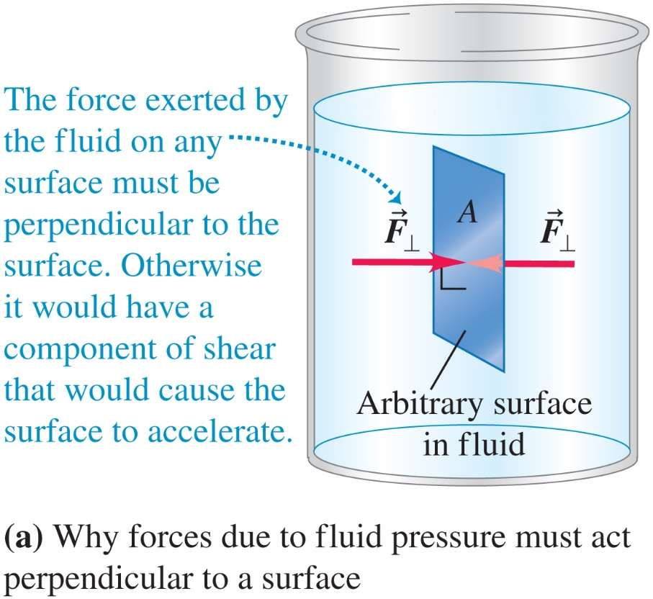
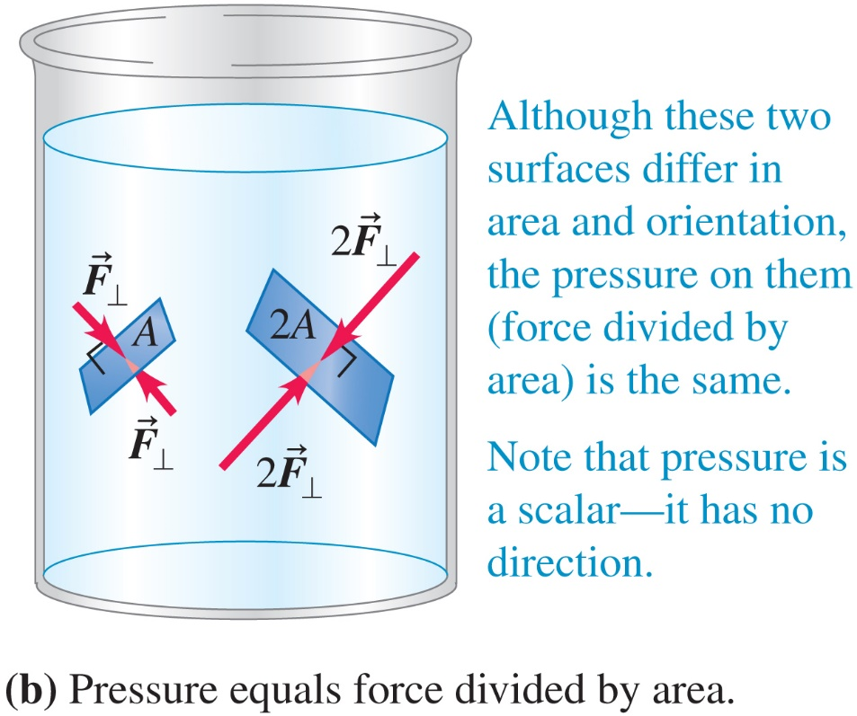
13.2 Pressure in a Fluid

Slide 7
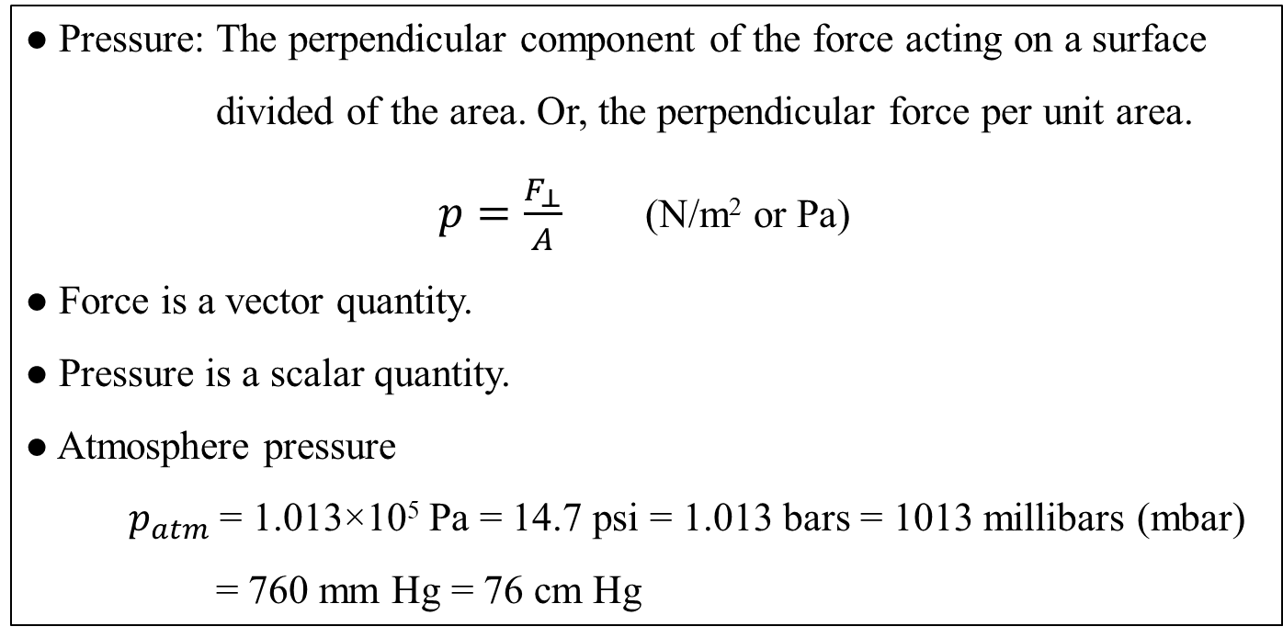
13.2 Pressure in a Fluid
● Pressure: The perpendicular component of the force acting on a surface
divided of the area. Or, the perpendicular force per unit area.
$p=\frac{F_{⊥}}{A}$ (N/m² or Pa)
● Force is a vector quantity.
● Pressure is a scalar quantity.
● Atmosphere pressure
$p_{atm}$= 1.013×10⁵ Pa = 14.7 psi = 1.013 bars = 1013 millibars (mbar)
= 760 mm Hg = 76 cm Hg

Slide 8
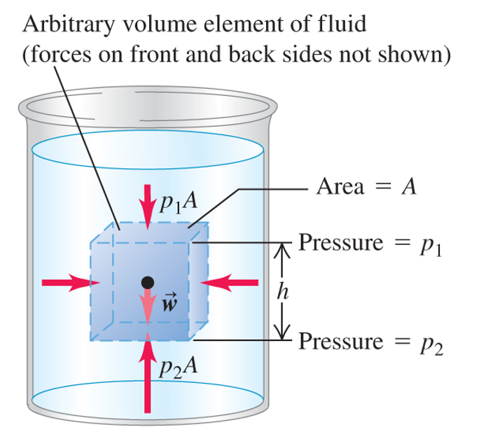
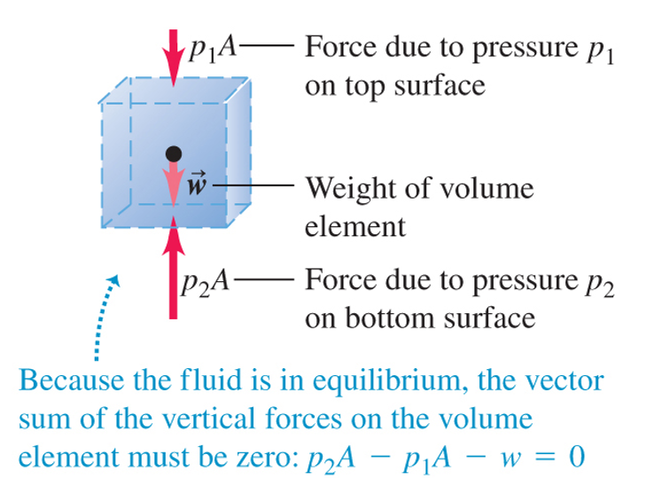
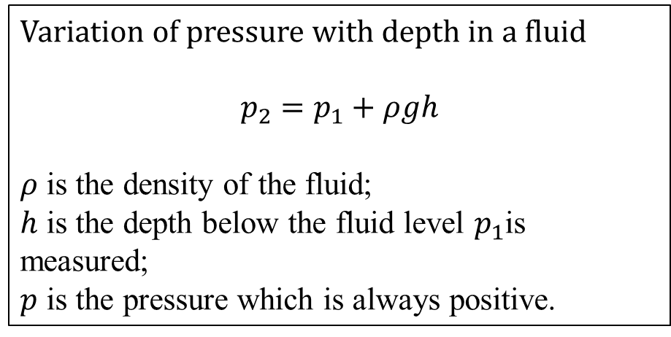
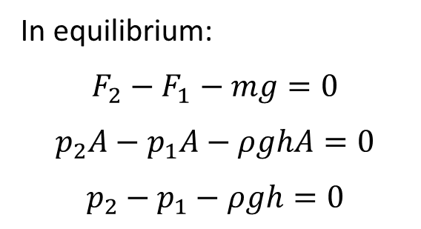
Question: How does the pressure vary in a fluid?
In equilibrium:
$$F_{2}−F_{1}−mg=0$$
$$p_{2}A−p_{1}A−ρghA=0$$
$$p_{2}−p_{1}−ρgh=0$$
Variation of pressure with depth in a fluid
$$p_{2}=p_{1}+ρgh$$
$ρ$ is the density of the fluid;
$h$ is the depth below the fluid level $p_{1}$is measured;
$p$ is the pressure which is always positive.

Slide 9
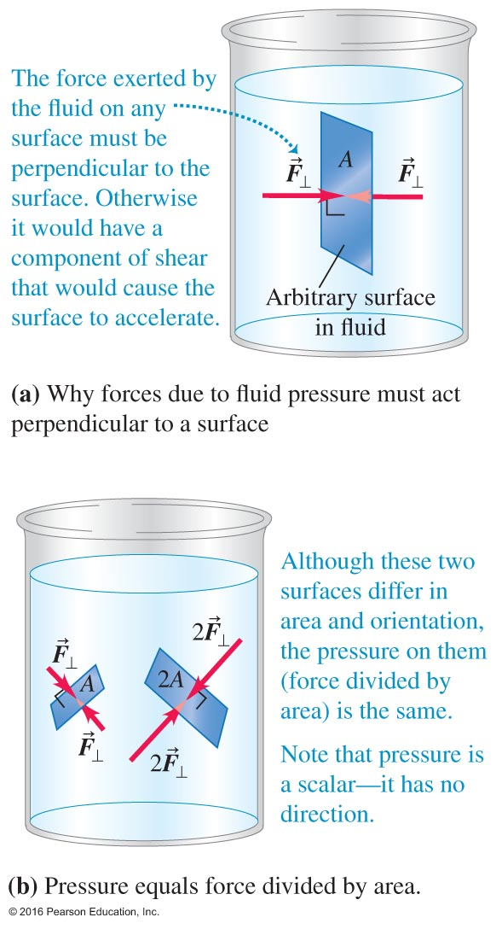
Pressure In a Fluid
P = F/A
The pressure is equal to force (in N) per unit area (in m²).
A new derived unit N/m² = 1 Pascal = 1 Pa
Atmospheric pressure is 1 atm = 760 mm Hg = 14.7lb/in² = 101325 Pa = 1.013 bars
1mm Hg=1 torr=133.3Pa

Slide 10
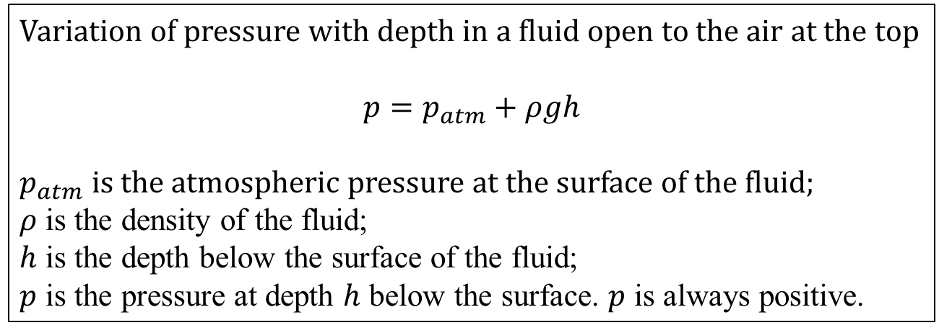
Pressure in a fluid open to air
Variation of pressure with depth in a fluid open to the air at the top
$$p=p_{atm}+ρgh$$
$p_{atm}$ is the atmospheric pressure at the surface of the fluid;
$ρ$ is the density of the fluid;
$h$ is the depth below the surface of the fluid;
$p$ is the pressure at depth $h$ below the surface. $p$ is always positive.

Slide 11
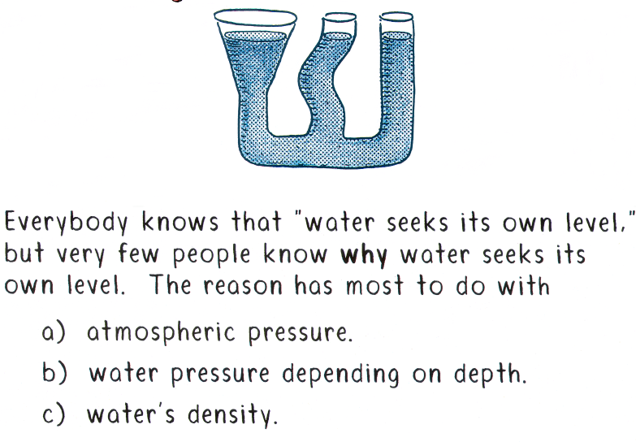
Clicker - Questions
b
Notes:
b)

Slide 12
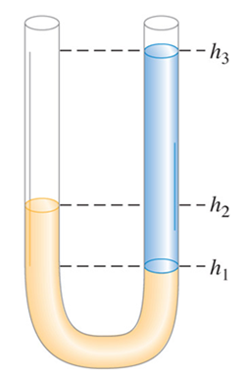
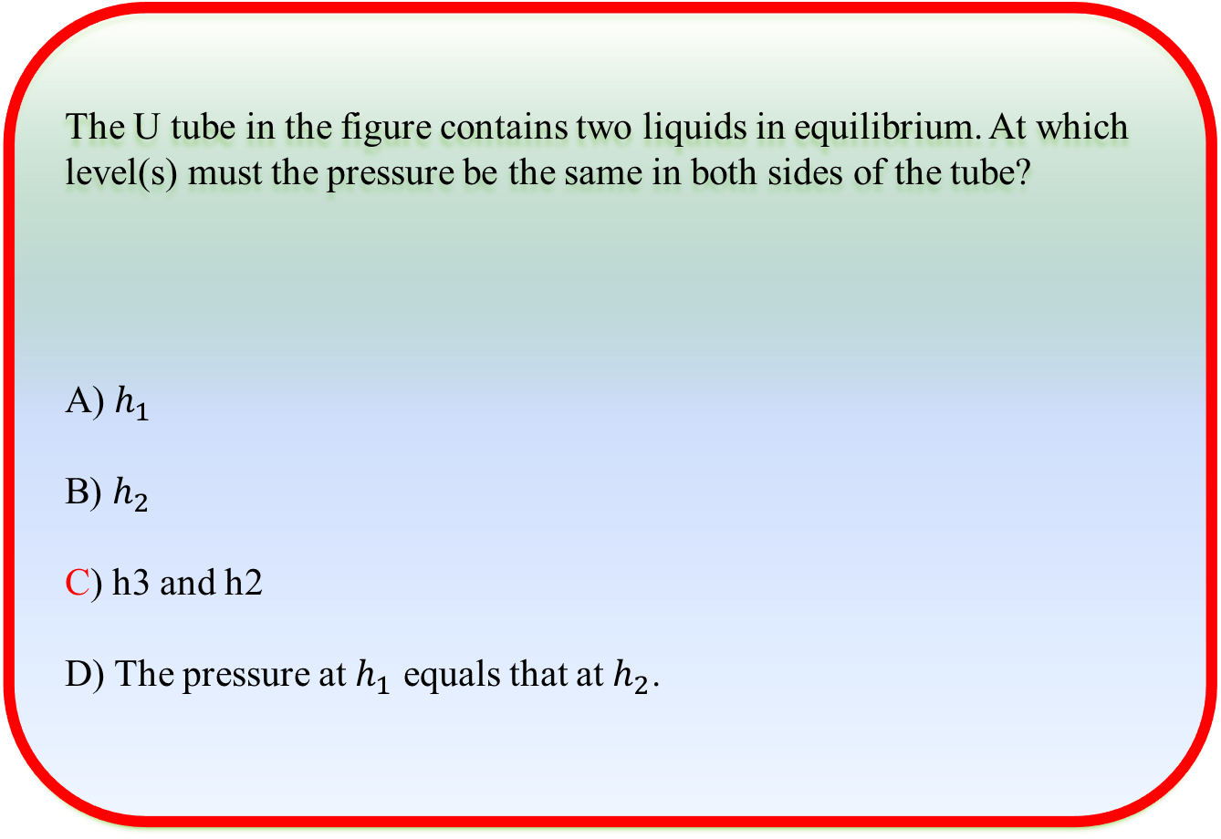
Clicker - Questions
The U tube in the figure contains two liquids in equilibrium. At which level(s) must the pressure be the same in both sides of the tube?
A) $h_{1}$
B) $h_{2}$
C) h3 and h2
D) The pressure at $h_{1}$ equals that at $h_{2}$.
Notes:
c), note:brown liquid is denser than blue liquid,h1 and h3

Slide 13
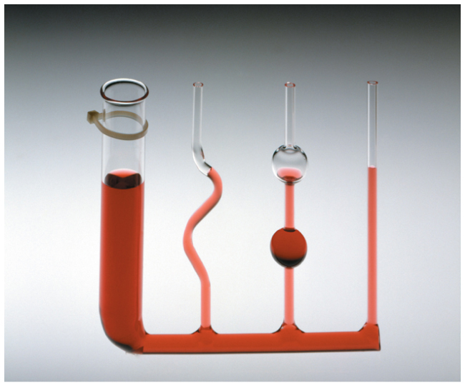
Pascal’s Law
Pressure applied to an enclosed fluid is transmitted undiminished to every portion of the fluid and the walls of the containing vessel. The pressure depends only on the depth; the shape of the container does not matter.

Slide 14
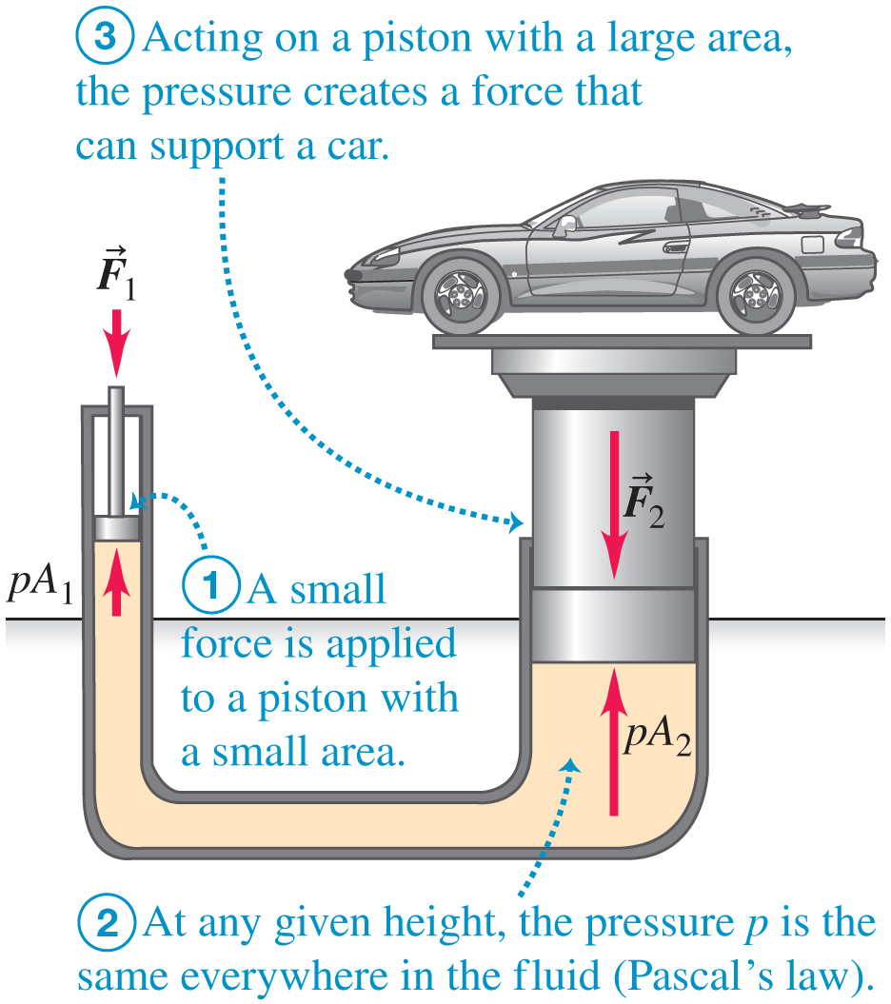
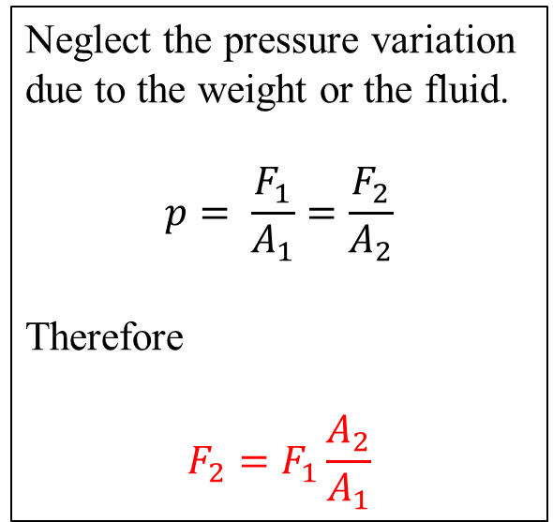
Hydraulic Lift
Neglect the pressure variation due to the weight or the fluid.
$$p= \frac{F_{1}}{A_{1}}=\frac{F_{2}}{A_{2}}$$
Therefore
$$F_{2}=F_{1}\frac{A_{2}}{A_{1}}$$

Slide 15
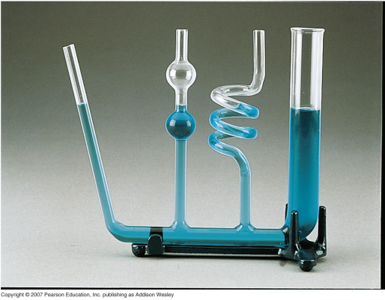
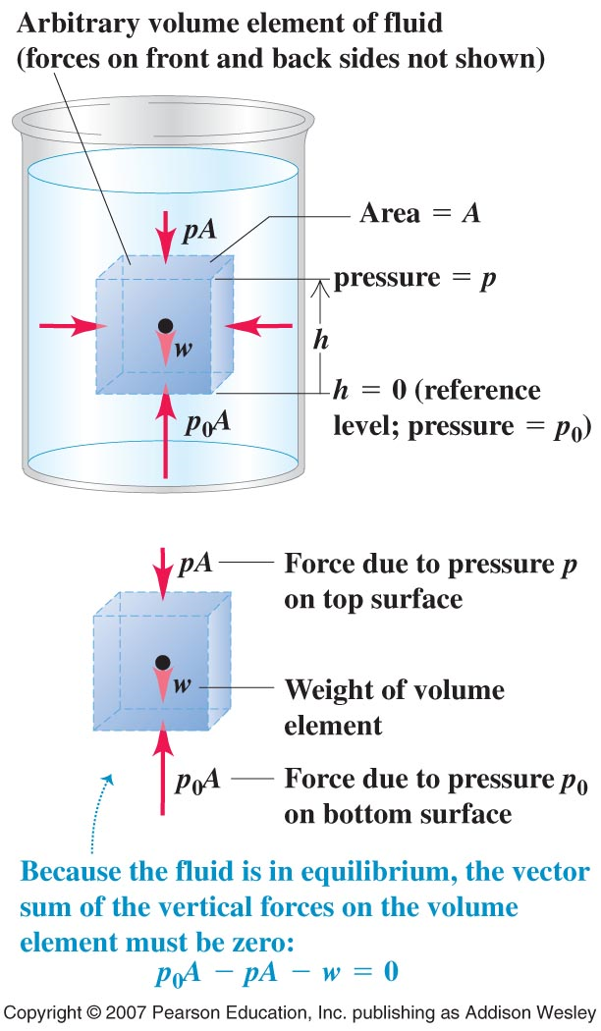
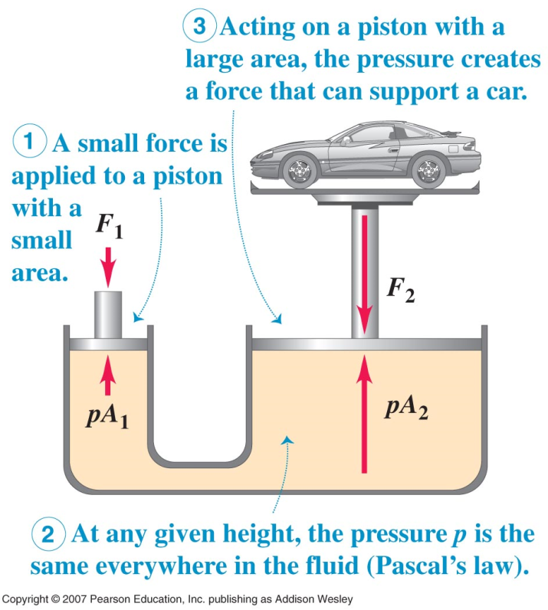
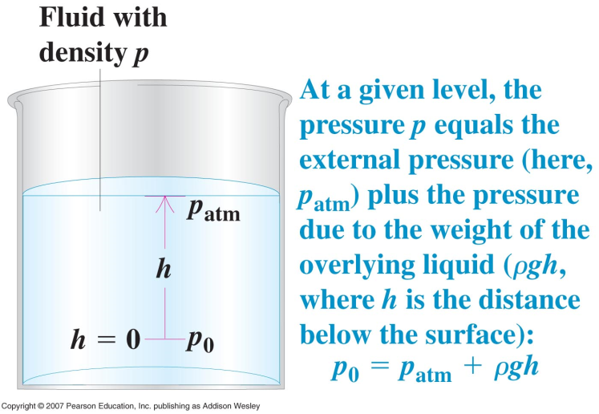
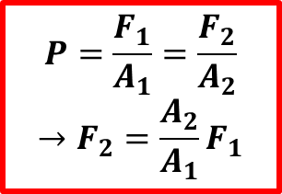
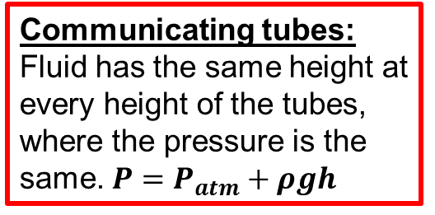
Pascal’s Law
Communicating tubes:
Fluid has the same height at every height of the tubes, where the pressure is the same. $P=P_{atm}+ρgh$
Pascal law:
Pressure applied to an enclosed fluid is transmitted undiminished to every portion of the fluid and to the walls of the containing vessel.
$$P=\frac{F_{1}}{A_{1}}=\frac{F_{2}}{A_{2}}$$
$$→F_{2}=\frac{A_{2}}{A_{1}}F_{1}$$

Slide 16
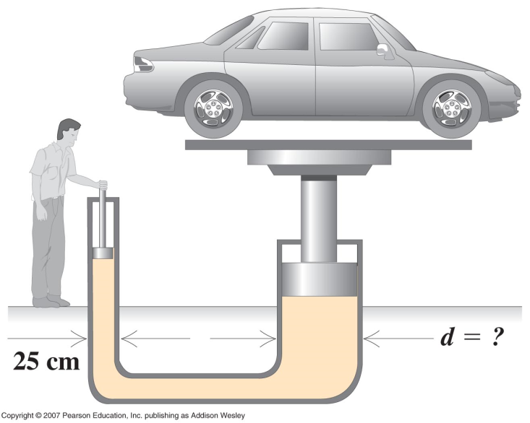
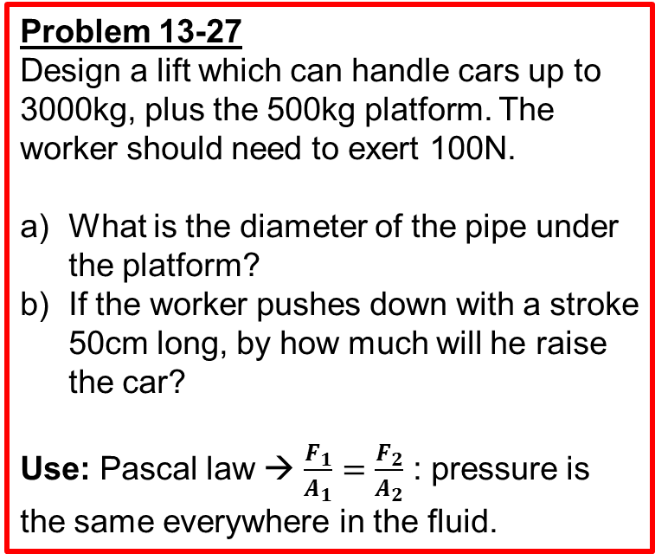
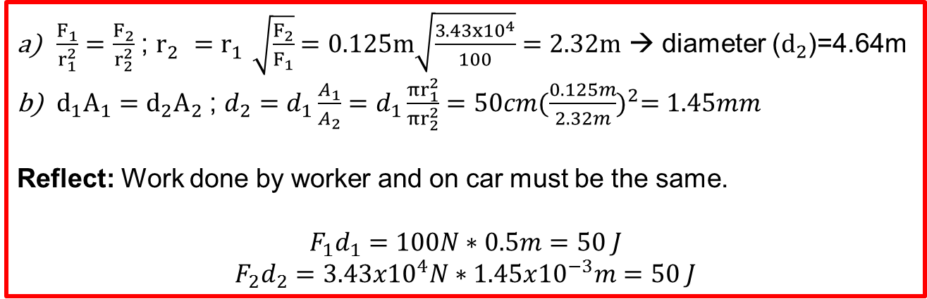
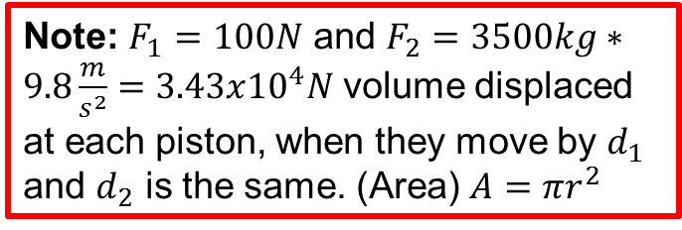
Hydraulic lift
Problem 13-27
Design a lift which can handle cars up to 3000kg, plus the 500kg platform. The worker should need to exert 100N.
What is the diameter of the pipe under the platform?
If the worker pushes down with a stroke 50cm long, by how much will he raise the car?
Use: Pascal law → $\frac{F_{1}}{A_{1}}=\frac{F_{2}}{A_{2}}$ : pressure is the same everywhere in the fluid.
Note: $F_{1}=100N$ and $F_{2}=3500kg∗9.8\frac{m}{s^{2}}=3.43x{10}^{4}N$ volume displaced at each piston, when they move by $d_{1}$ and $d_{2}$ is the same. (Area) $A=πr^{2}$
$\frac{F_{1}}{r_{1}^{2}}=\frac{F_{2}}{r_{2}^{2}}$ ; $r_{2}^{}=r_{1}^{}\sqrt{\frac{F_{2}}{F_{1}}}=0.125m\sqrt{\frac{3.43x{10}^{4}}{100}}=2.32m$ → diameter ($d_{2}$)=4.64m
$d_{1}A_{1}=d_{2}A_{2}$ ; $d_{2}=d_{1}\frac{A_{1}}{A_{2}}=d_{1}\frac{{πr}_{1}^{2}}{{πr}_{2}^{2}}=50cm{(\frac{0.125m}{2.32m})}^{2}=1.45mm$
Reflect: Work done by worker and on car must be the same.
$$F_{1}d_{1}=100N∗0.5m=50 J$$
$$F_{2}d_{2}=3.43x{10}^{4}N∗1.45x{10}^{−3}m=50 J$$

Slide 17
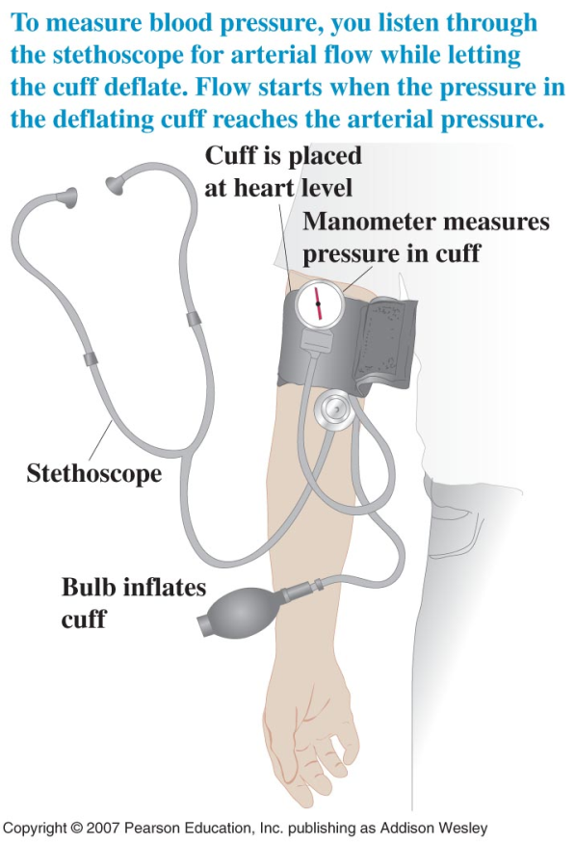
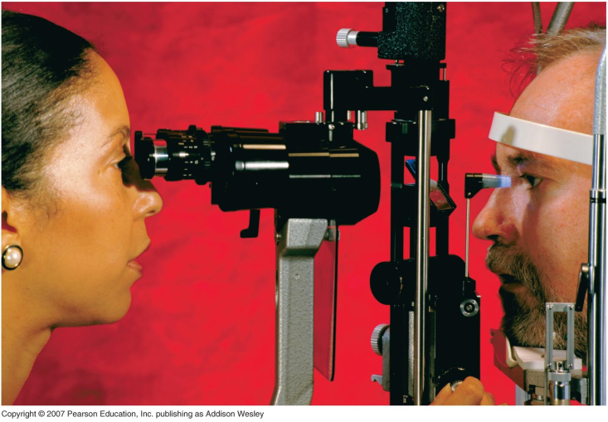
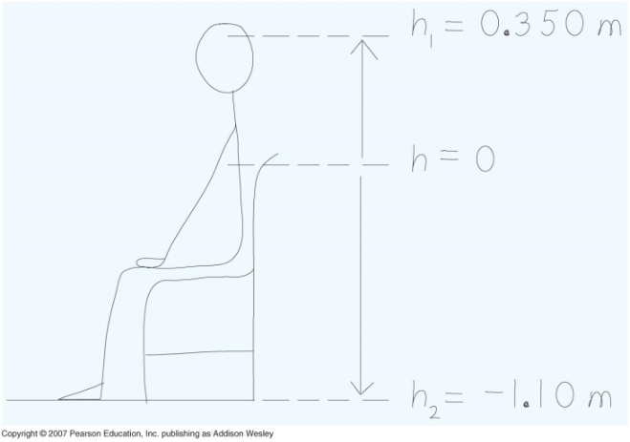
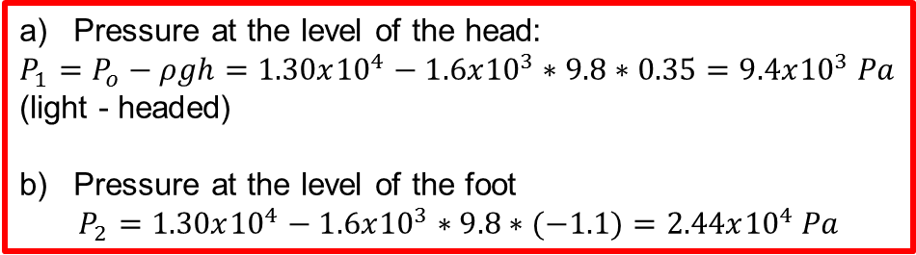
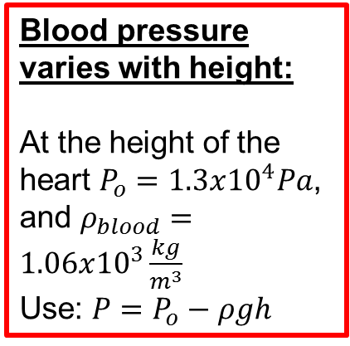
Medical instruments measure pressure
← Eye Heart →
A tonometer measures pressure within the eyeball to diagnose glaucoma.
Blood pressure varies with height:
At the height of the heart $P_{o}=1.3x{10}^{4}Pa$, and $ρ_{blood}=1.06x{10}^{3}\frac{kg}{m^{3}}$
Use: $P=P_{o}−ρgh$
Healthy blood pressure is 120/80mm Hg.
Pressure is measured at the height of the heart
Systolic pressure:
Blood starts to spread discontinuously through the compressed vessel.
Distolic pressure:
Blood flows continuously
Pressure at the level of the head:
$P_{1}=P_{o}−ρgh=1.30x{10}^{4}−1.6x{10}^{3}∗9.8∗0.35=9.4x{10}^{3} Pa$ (light - headed)
Pressure at the level of the foot
$$P_{2}=1.30x{10}^{4}−1.6x{10}^{3}∗9.8∗(−1.1)=2.44x{10}^{4} Pa$$

Slide 18
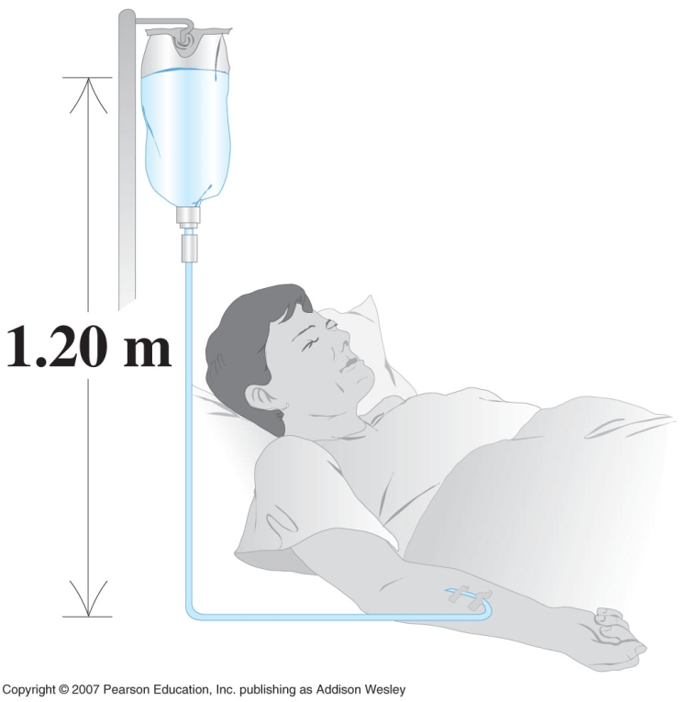
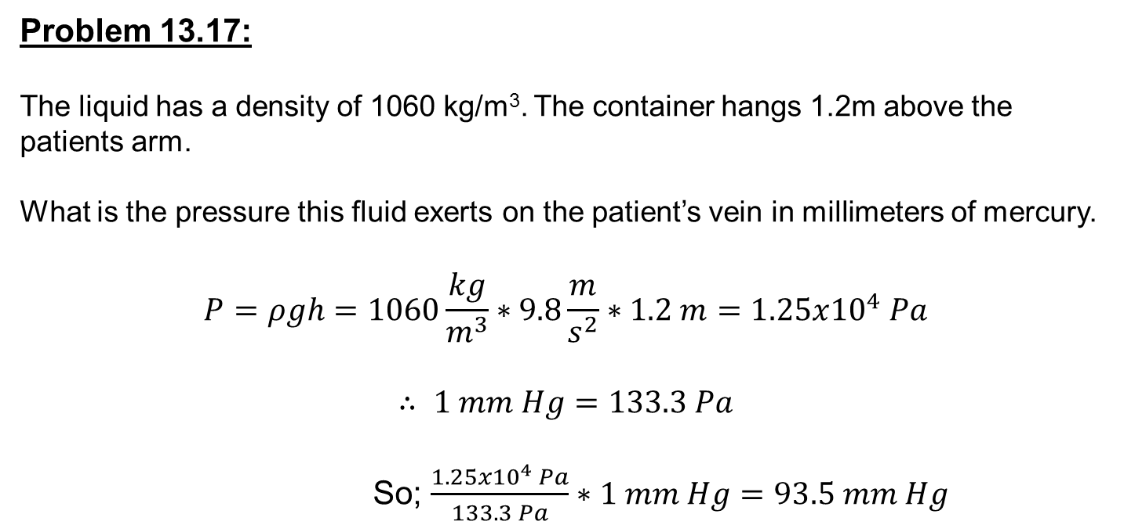
Intravenous feeding
Problem 13.17:
The liquid has a density of 1060 kg/m³. The container hangs 1.2m above the patients arm.
What is the pressure this fluid exerts on the patient’s vein in millimeters of mercury.
$$P=ρgh=1060\frac{kg}{m^{3}}∗9.8\frac{m}{s^{2}}∗1.2 m=1.25x{10}^{4} Pa$$
$$∴ 1 mm Hg=133.3 Pa$$
So; $\frac{1.25x{10}^{4} Pa}{133.3 Pa}∗1 mm Hg=93.5 mm Hg$

Slide 19
Problem 13.19
An electrical short cuts off all power to a submergible diving vessel when it is 30 m below the surface. the crew pushes out a hatch of area0.75m ² and weight 300 N on the bottom of the escape. If the pressure inside is1.0 atm, what downward force must the crew exert on the hatch to open it ?

Slide 20
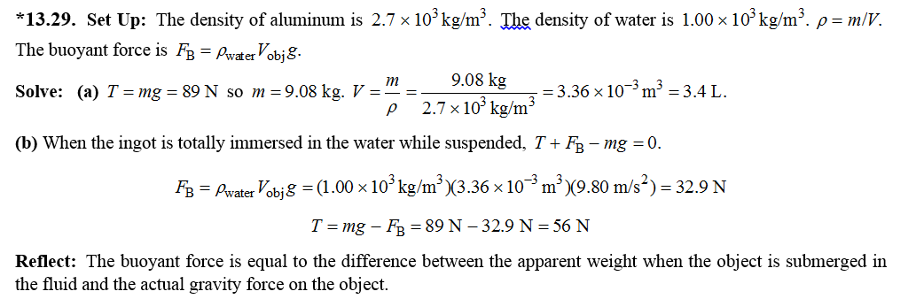
Archimedes buoyancy
A solid aluminum ingot weights 89 N in air. a) What is its volume? b)The ingot is suspended by a rope and totally submerged in water what is the tension(the apparent weight) in the rope??

Slide 21
13.3 Archimedes Principle: Buoyancy
● When an object is completely or partially immersed in a fluid,
the fluid exerts an upward force on the object equal to the weight
of the fluid that is displaced by the object.

Slide 22
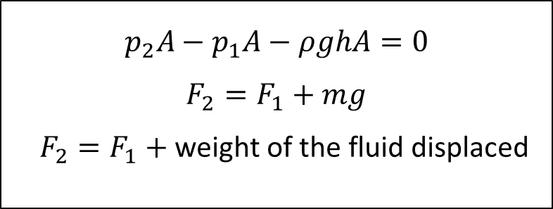
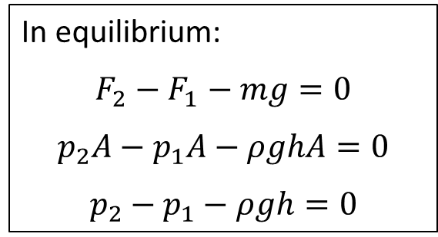
Question: How does the pressure vary in a fluid?
In equilibrium:
$$F_{2}−F_{1}−mg=0$$
$$p_{2}A−p_{1}A−ρghA=0$$
$$p_{2}−p_{1}−ρgh=0$$
$$p_{2}A−p_{1}A−ρghA=0$$
$$F_{2}=F_{1}+mg$$
$F_{2}=F_{1}+$ weight of the fluid displaced

Slide 23
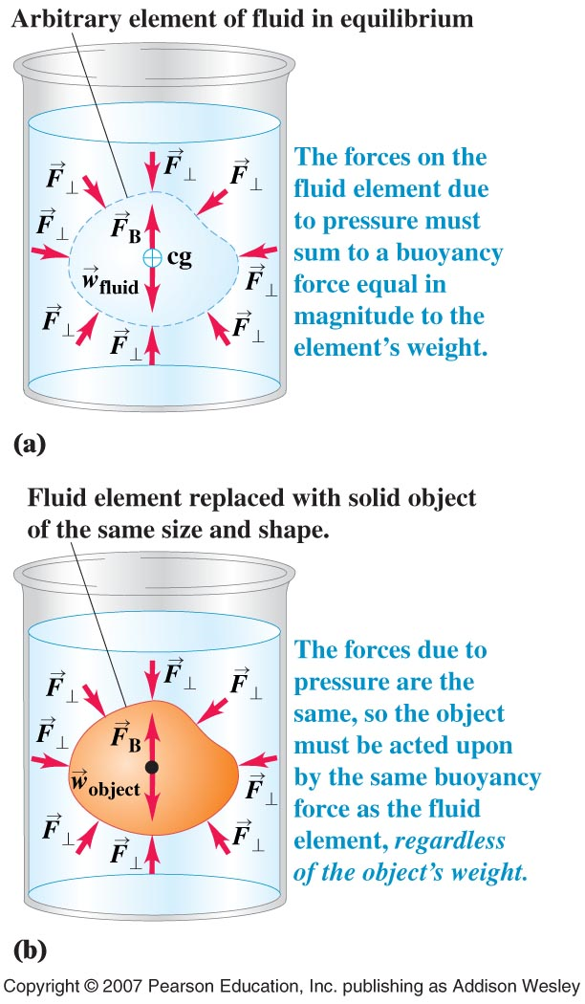
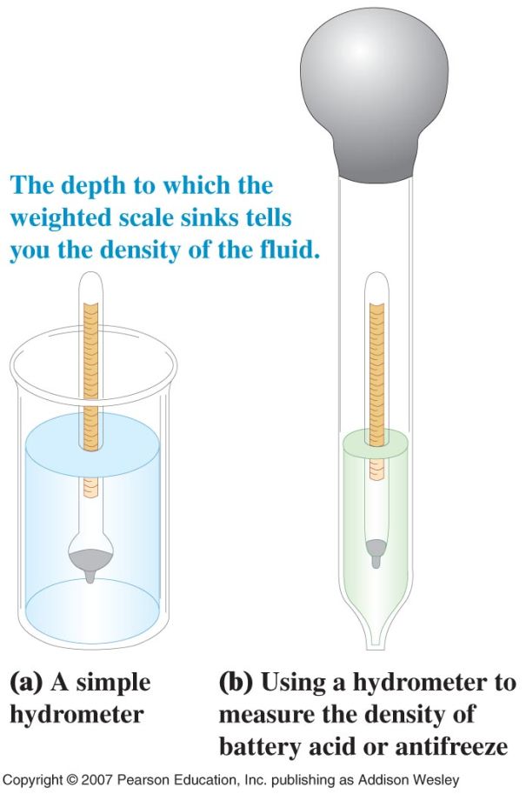
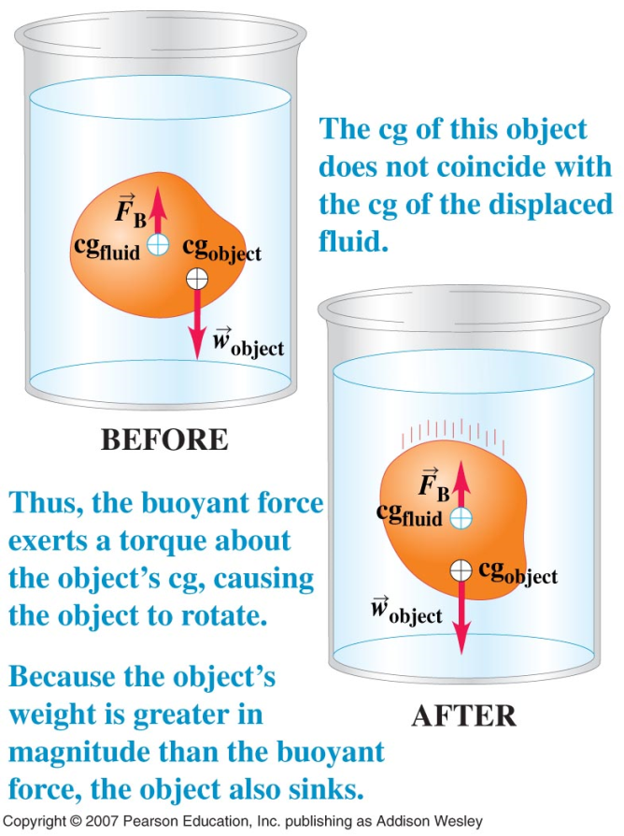
Archimedes’s Principle and Buoyancy
Note: hydrometer floats higher in denser fluids
Archimedes' principle:
When an object is immersed into a fluid, the fluid exerts an upward force on the object equal to the weight of the displaced fluid.
Note: The upward force is labeled the buoyant force

Slide 24
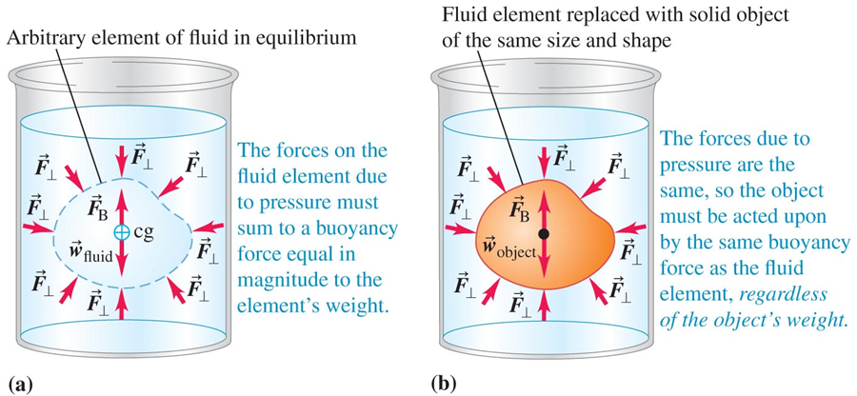
Archimedes’s Principle – Figure 13.15
An object submersed in a fluid experiences buoyant force equal to the mass of any fluid it displaces.
An object can experience buoyant force greater than its mass and float. Even if it sinks, it would weigh measurably less.
Refer to Example 13.7.

Slide 25
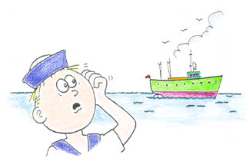
Clicker - Questions
Compare with an empty ship. Will a ship loaded with a cargo of Styrofoam float
a)lower in water? b) higher in water?
Notes:
b) lower

Slide 26
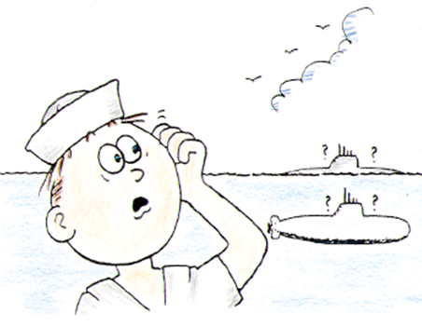
Clicker - Questions
Buoyant force is greater on a empty steel barge when it is;
A) Floating on the surface
B) Capsized and sitting on the bottom
C) Same either way.
Buoyant force is greater on a submarine when it is;
D) Floating
E) Submerged
D) Same either way.
Notes:
a) and e)

Slide 27
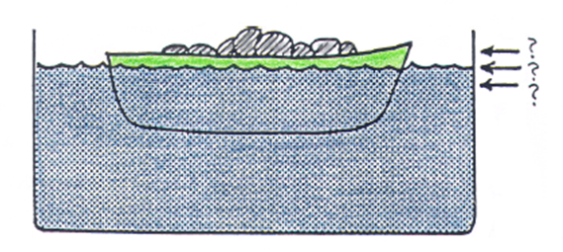
Clicker - Questions
Consider a boat loaded with scrap iron in a swimming pool. If the iron is thrown overboard into the pool, will the water level at the edge of the pool a) rise, b)fall or c) remain unchanged?
Notes:
b)fall

Slide 28
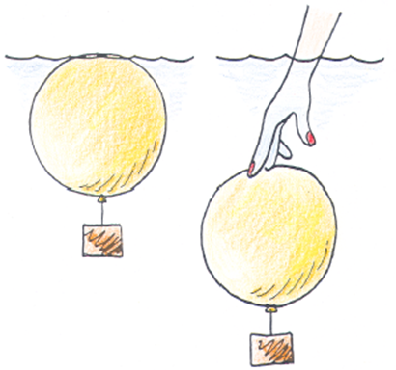
Clicker - Questions
Consider an air-filled balloon weighted so that it is on the verge of sinking – that is, its overall density just equals that of water.
Now if you push it beneath the surface. It will;
Sink
Return to the surface
Stay at the depth to which it is pushed.
Notes:
a)sink

Slide 29
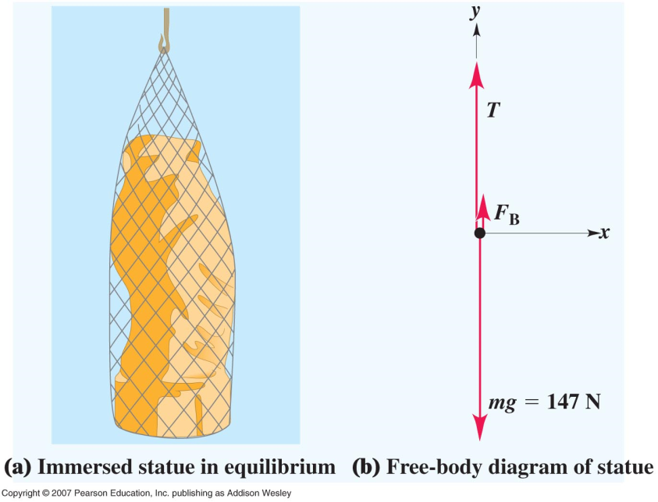
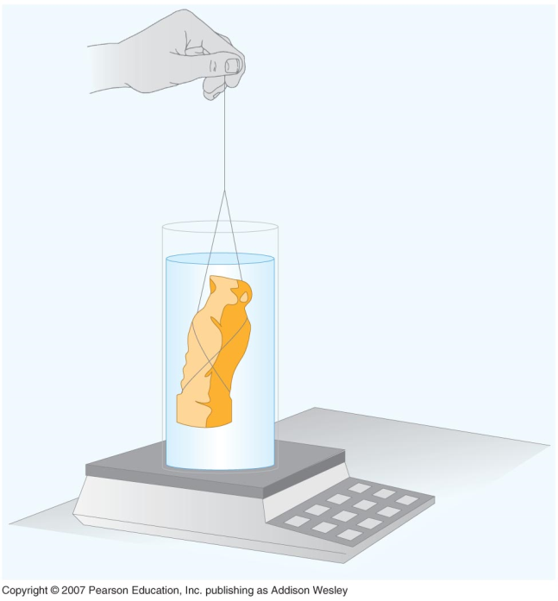

Example 13.7
Raising sunken treasure
Note: Weighing in water decreases the scale reading
A 15kg gold statue is raised from a sunken ship:
a) Find the tension in the hoisting cable while the statue is submerged
(Statue) $V=\frac{m}{ρ}=\frac{15 kg}{19.3x{10}^{3}\frac{kg}{m^{3}}}=7.77x{10}^{−4}m^{3}$
Weight of equal volume of water is the buoyant force.
$$F_{B}=ρ_{water}∗V_{water}∗g=1x{10}^{3}∗7.77x{10}^{−4}∗9.8=7.61 N$$
$T+F_{B}−W=0$ → $T+7.61−15∗9.8=0 ∴T=139 N$
b) Find the tension when the statue is out of the water
$$T=F_{g}=15 kg∗9.8=147 N$$

Slide 30

Archimedes buoyancy

Slide 31
!3.35 A hollow plastic sphere is held below the surface of a lake by a cord anchored to the bottom of a lake. The sphere has a volume of 0.650 m³ and the tension in the cord is is 900 N . a) calculate the buoyant force.
B) what is the mass of the sphere?
C) The cord breaks and the sphere rises to the surface. When the sphere comes to rest, what fraction of its volume will be submerged??
Archimedes buoyancy

Slide 32

Clicker - Questions
Notes:
b)more

Slide 33
Archimedes buoyancy
A U-tube open on both ends to air contains some mercury.
Water is poured into the left arm until the vertical height is 15cm.
a)What is the gauge pressure at the mercury-water interface?
b)Calculate the vertical distance h from the top of the mercury at the right arm of the tube to the top of the water at the left arm of the tube?

Slide 34
Archimedes buoyancy
A solid aluminum ingot weights 89 N in air. a) What is its volume? b)The ingot is suspended by a rope and totally submerged in water what is the tension(the apparent weight) in the rope??

Slide 35


Slide 36


Archimedes’ Principle
In this demonstration, first find the initial weight of the can/weight system that is being submerged in the beaker of water by using the scale. Once the system is fully submerged there will be a drop in the reading on the scale. This is due to the buoyancy force opposing the force of gravity. The displaced water can later be poured into the empty can to show that its weight is equivalent to the bourancy force.

Slide 37

Ball and Ring
Initially the ball is just shy of being able to fit into the ring. But if the ring is heated up, it will expand slightly allowing the ball to fit.

Slide 38

Geyser
In a flask, water is heated by using a hot plate. As the water heats up and begins to evaporate, because gas takes up a greater volume than a liquid, pressure begins to increase inside the flask. Due to the increase in pressure, the liquid water is able to rise in the tube and expel from the other end.

Slide 39

Density Bowling Balls
In this demonstration, two identical looking bowling balls which differ in their mass and density are submerged in a tank of water. The lighter bowling ball is hollow inside, thus its overall density is less than water. The heavier bowling ball is fully solid and has a larger density than water. These characteristics result in the hollow bowling ball floating while the solid bowling ball sinks.

Slide 40

Cartesian Diver
When the bottle is squeezed, the air that is in the diver is allowed to compress. This compression of air in the diver makes it more dense than the water around it, so it sinks. When the bottle is released the diver becomes less dense and allows it to rise.

