Slide 1
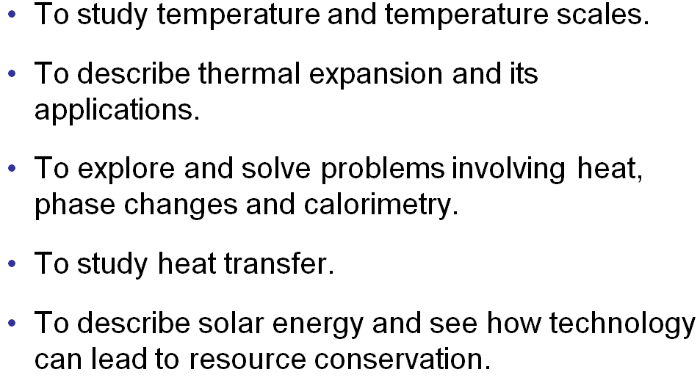
Chapter 14: Temperature and Heat
Goals:

Slide 2
Chapter 14 Temperature and Heat
● To understand temperature and temperature scales.
● To describe thermal expansion and its applications.
● To explore and solve problems involving heat, phase
changes and calorimetry.
● To understand heat transfer.

Slide 3
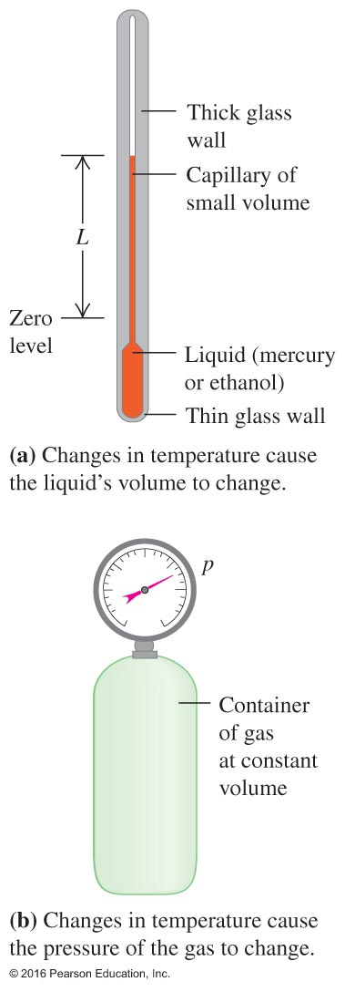
Temperature – Figure 14.1
14.1 Temperature and Thermal Equilibrium
Temperature is an attempt to measure the "hotness" or "coldness" on a scale you devise.
A device to do this is called a thermometer and is usually calibrated by the melting and freezing points of a substance. This is most often water with corrections for atmospheric pressure well known.
The thermometer is often a container filled with a substance that will expand or contract as heat flows in its surroundings.

Slide 4
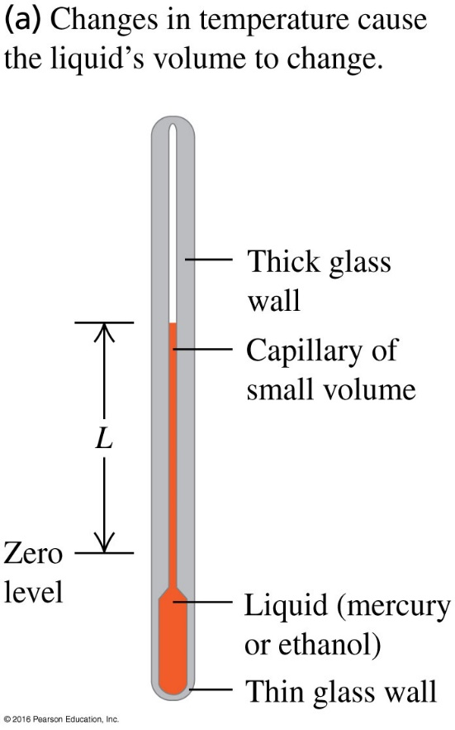
Q17.1
Clicker question 1
The illustration shows a thermometer that uses a column of liquid (usually mercury or ethanol) to measure air temperature. In thermal equilibrium, this thermometer measures the temperature of…
A. the column of liquid.
B. the glass that encloses the liquid.
C. the air outside the thermometer.
D. both A and B.
E. all of A, B, and C.
Notes:
Answer: E

Slide 5
What is thermal equilibrium?
● If two objects are placed in contact and one is “hotter” than the other, a net
amount of heat energy will flow from the hotter to the colder.
● This process cools down the hotter object and heats up the colder object.
● This process will continue until both objects reach the same temperature,
in a state called thermal equilibrium.
Here are a couple simple concepts:
● Thermal conductor: a medium through which heat energy can flow.
● Thermal insulator: a medium through which heat energy can not flow.

Slide 6
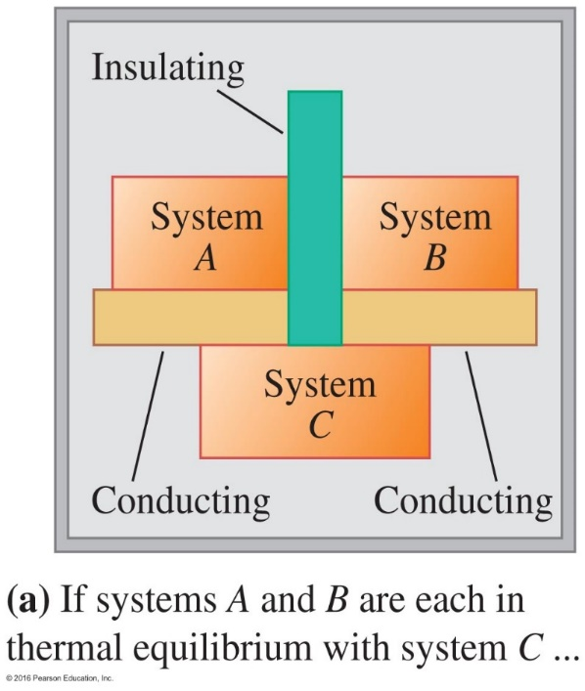
The Zeroth Law of Thermodynamics
If System A is in thermal equilibrium with System C (T_{A} = T_{C}),
and,
if System B is in thermal equilibrium with System C (T_{B} = T_{C}),
then,
System A is in thermal equilibrium with System B (T_{A} = T_{B}).

Slide 7
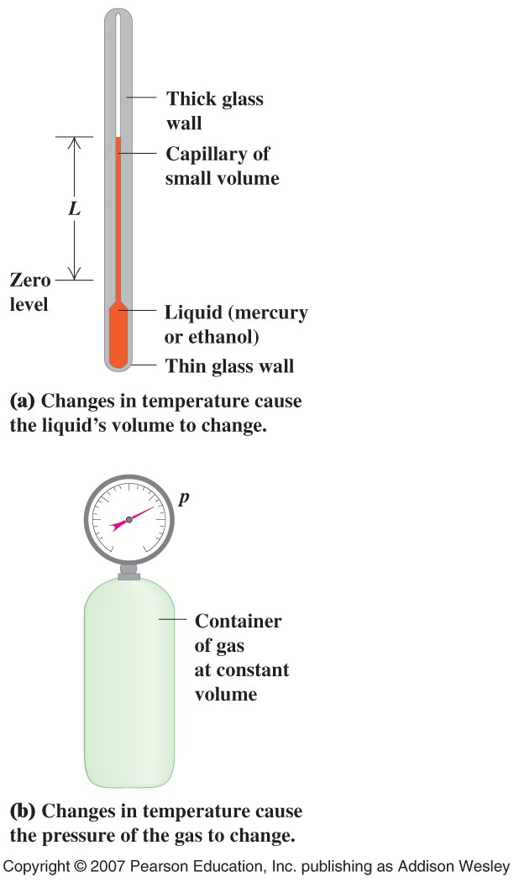
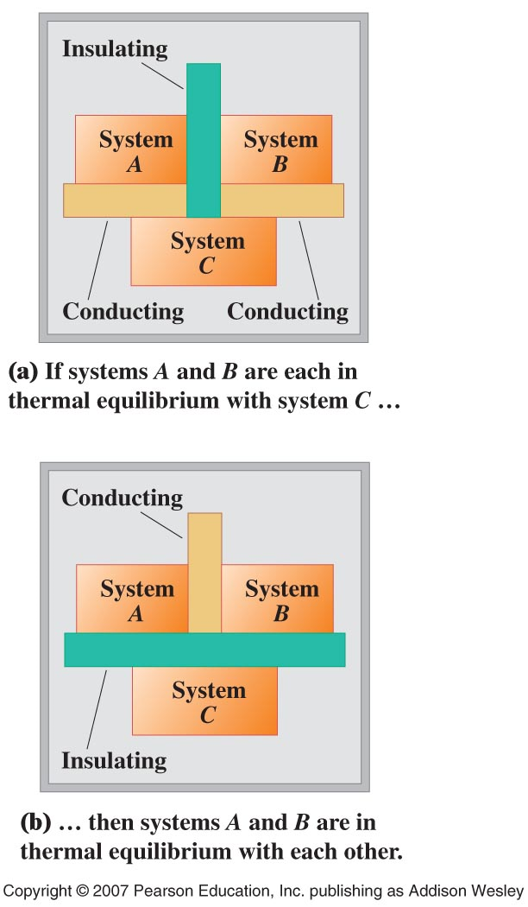
Thermometers and thermal equilibrium
Temperature and thermal equilibrium
“hot” and “cold” is quantified by thermometers.
Based on: thermal expansion (liquid or gas),change of resistance of a wire, thermoelectric effect.
The zeroth law of thermodynamics
Two systems that are each in thermal equilibrium with a third system are in thermal equilibrium with each other.
Two systems are in thermal equilibrium if they have the same temperature.

Slide 8
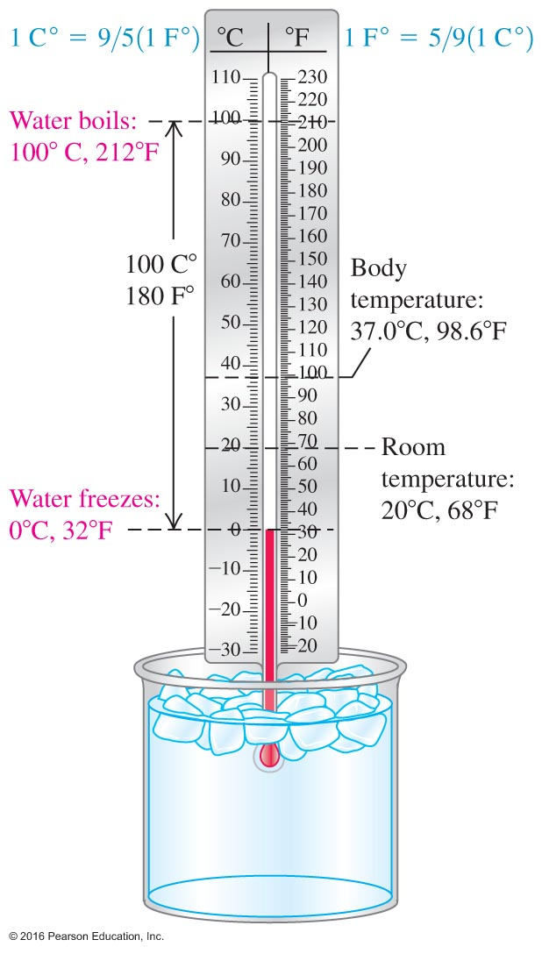
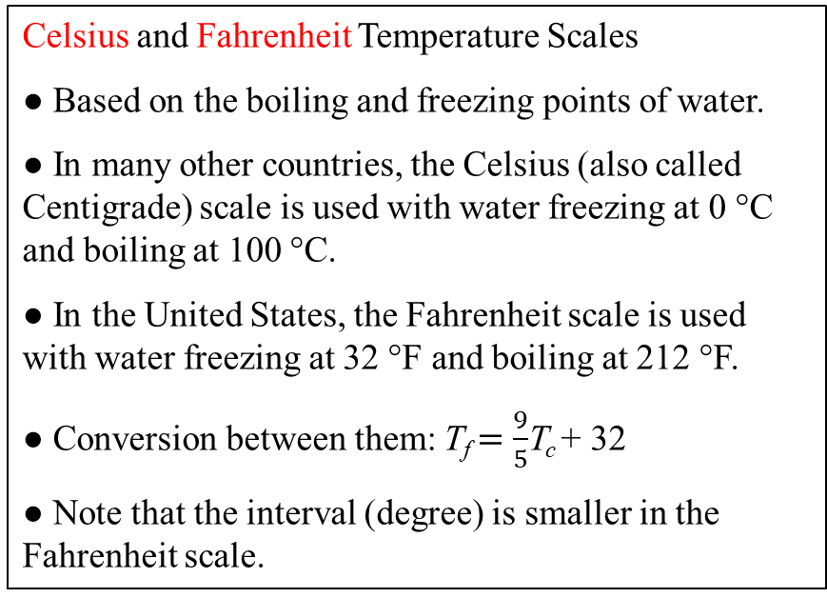
14.2 Temperature Scales
Celsius and Fahrenheit Temperature Scales
● Based on the boiling and freezing points of water.
● In many other countries, the Celsius (also called Centigrade) scale is used with water freezing at 0 °C and boiling at 100 °C.
● In the United States, the Fahrenheit scale is used with water freezing at 32 °F and boiling at 212 °F.
● Conversion between them: T_{f} $=\frac{9}{5}$T_{c} + 32
● Note that the interval (degree) is smaller in the Fahrenheit scale.
Courtesy of Wenhao Wu

Slide 9
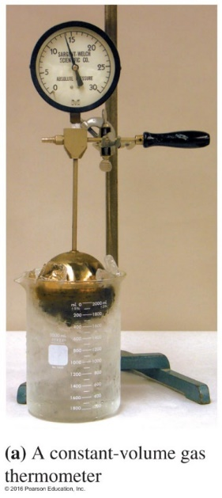
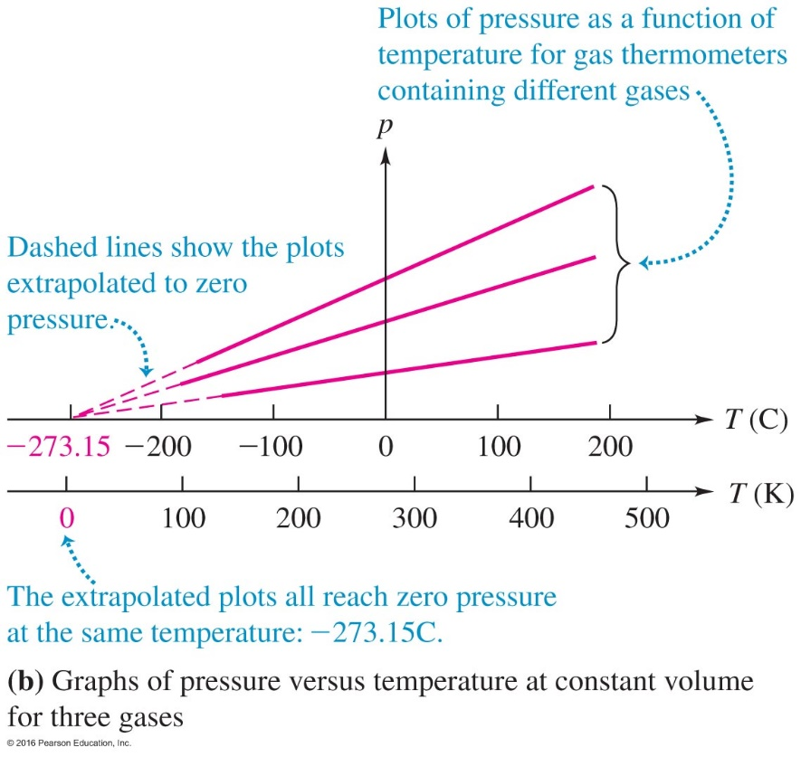
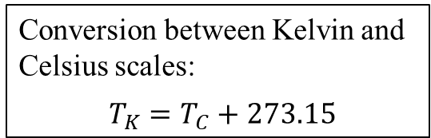
The Kelvin Scale, or, the Absolute Temperature Scales
● Some simple gases, especially helium, when placed in a constant–volume container, their pressures have a simple linear relationship with the temperature.
Conversion between Kelvin and Celsius scales:
$T_{K}=T_{C}+273.15$
Water Celsius Kelvin
Scale Scale
Freezing point 0 °C 273.15 K
Boiling point 100 °C 373.15 K
The Third Law of Thermodynamics: It is impossible by any procedure,
no matter how idealized, to reduce the temperature of any system to
zero temperature in a finite number of finite operations

Slide 10
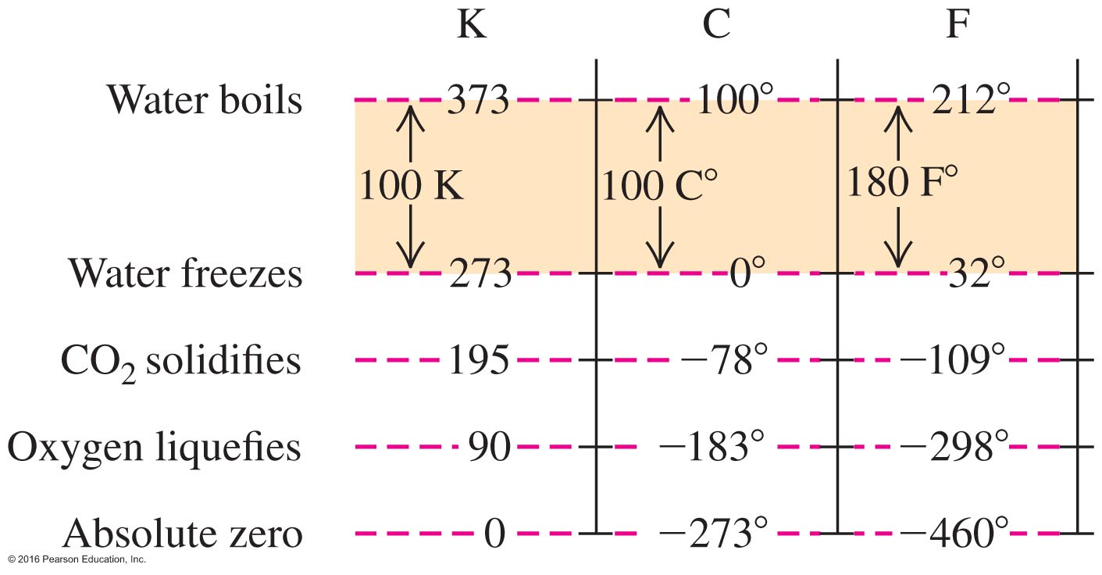
Temperature Conversions – Figure 14.5
Be comfortable converting between the different temperature scales.

Slide 11
Q-RT17.1
Clicker question 2
Rank the following temperatures from highest to lowest.
A. 20.0°F
B. 20.0°C
C. 20.0 K
D. –80.0°F
E. –80.0°C
a) ABCDE
b) BADEC
c) EDCBA
d) BADCE
Notes:
Answer: b) BADEC

Slide 12
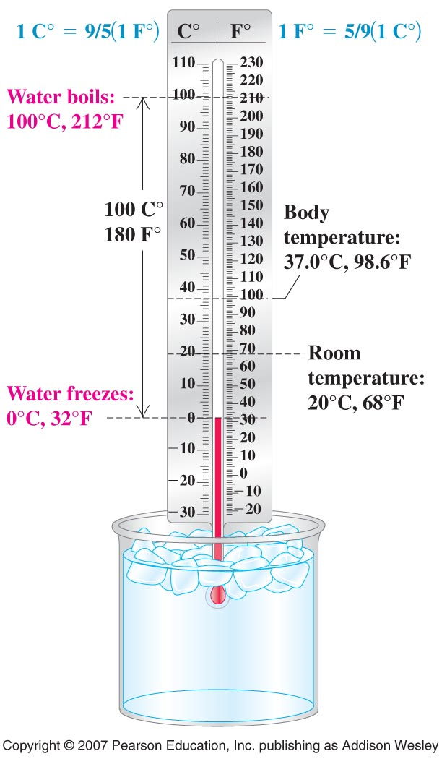
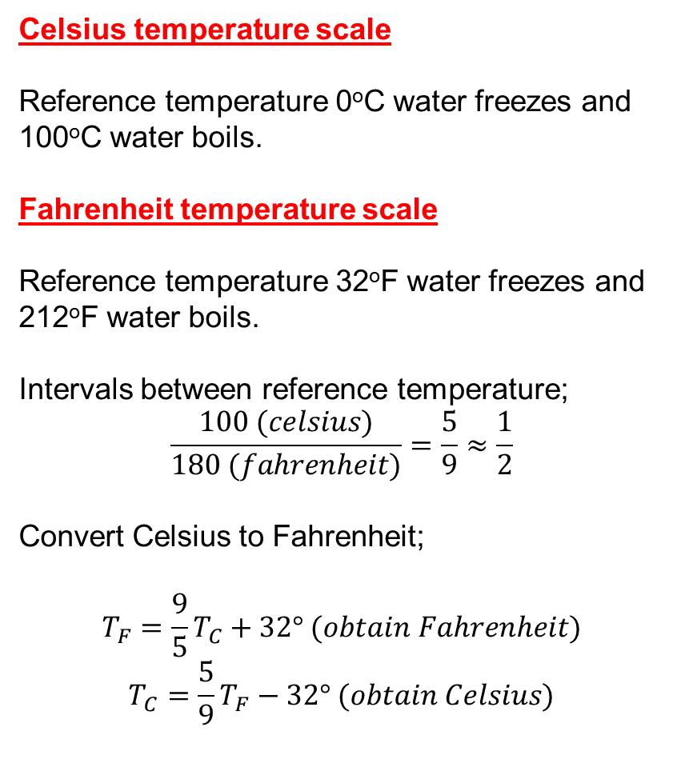
Celsius temperature scale
Reference temperature 0ºC water freezes and 100ºC water boils.
Fahrenheit temperature scale
Reference temperature 32ºF water freezes and 212ºF water boils.
Intervals between reference temperature;
$$\frac{100 (celsius)}{180 (fahrenheit)}=\frac{5}{9}≈\frac{1}{2}$$
Convert Celsius to Fahrenheit;
$$T_{F}=\frac{9}{5}T_{C}+32° (obtain Fahrenheit)$$
$$T_{C}=\frac{5}{9}T_{F}−32° (obtain Celsius)$$

Slide 13
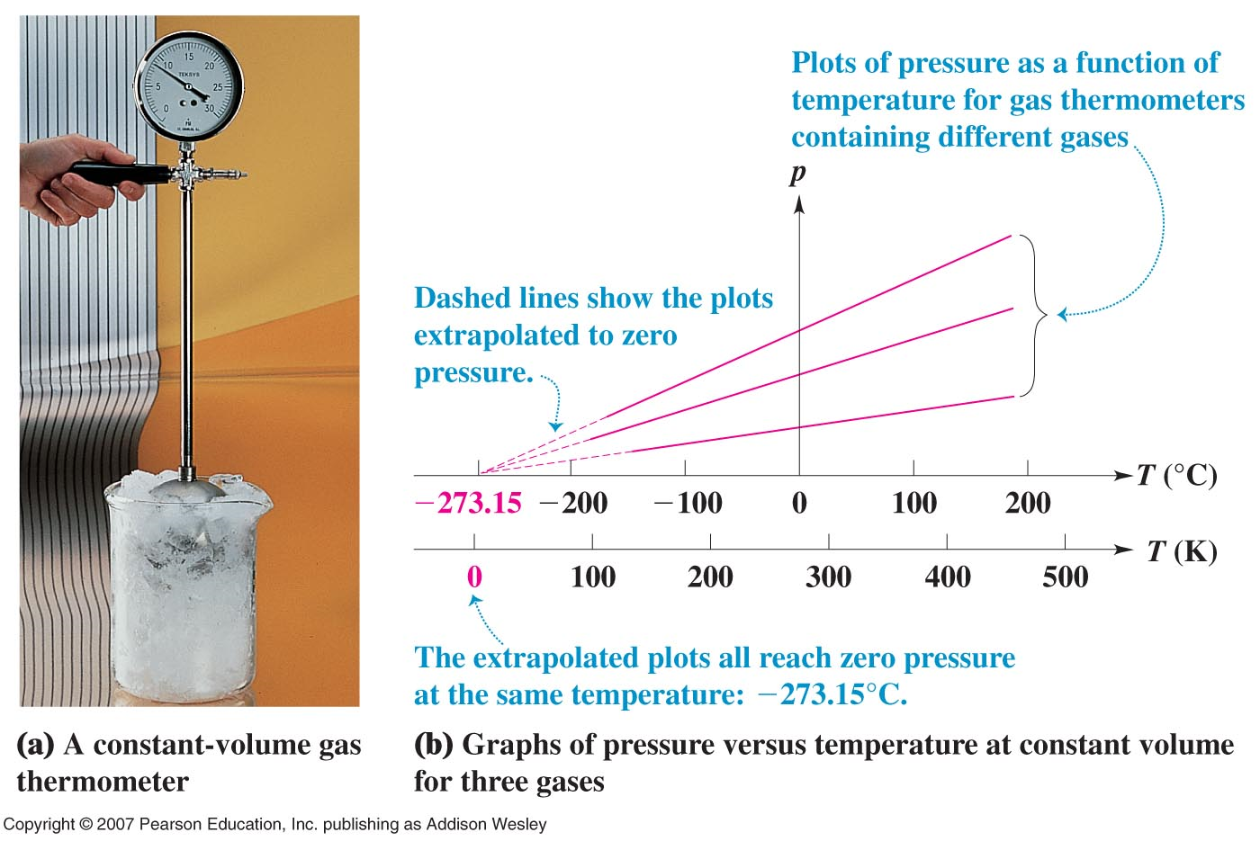
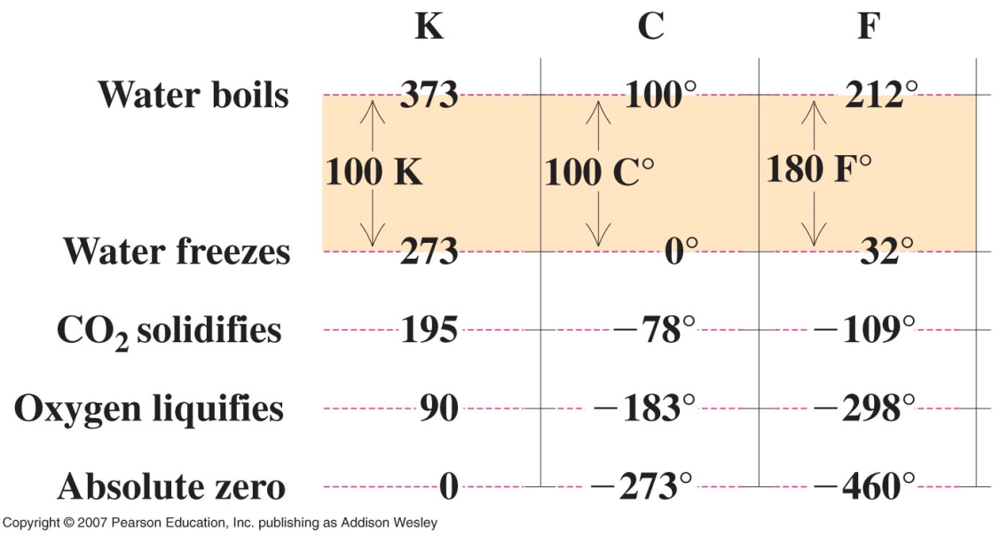

The Kelvin scale (scientific)
$$T_{K}=T_{C}+273.15°$$

Slide 14
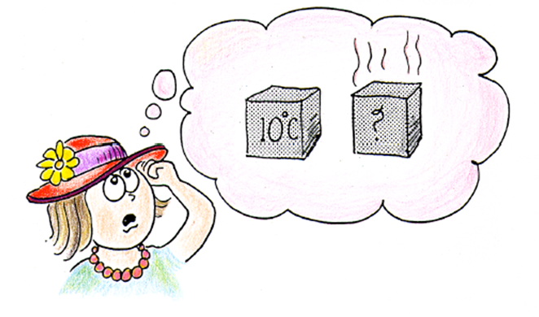

Example
A piece of iron has a temperature of 2ºC. A second identical piece of iron has twice the internal energy . What is the temperature of the second piece of iron?
$$2℃$$
a) 4ºC b) 277ºC c) 8ºC d) 275 K

Slide 15


iron
K
K

Slide 16
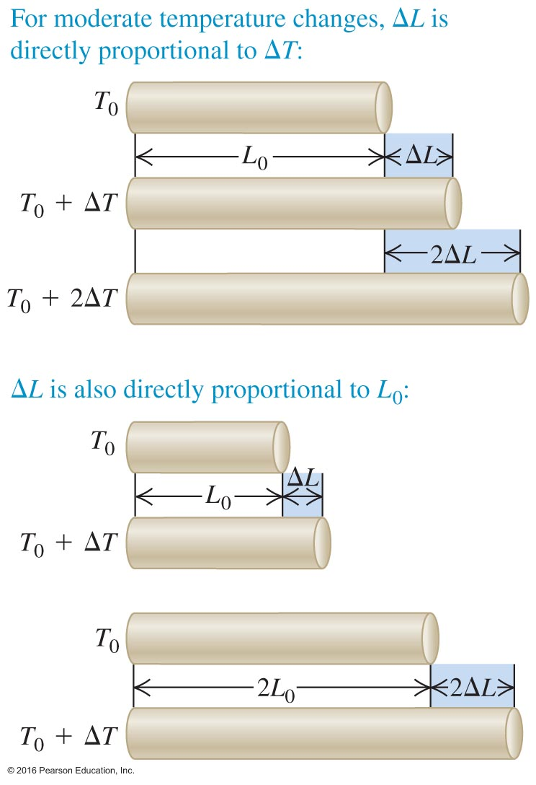
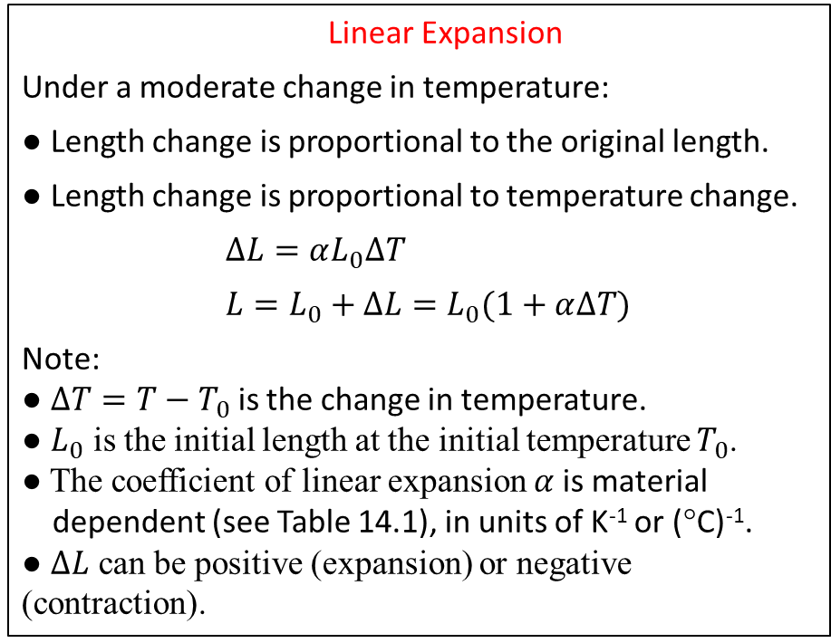
14.3 Thermal Expansion
Linear Expansion
Under a moderate change in temperature:
● Length change is proportional to the original length.
● Length change is proportional to temperature change.
$∆L=αL_{0}∆T$
$L=L_{0}+∆L=L_{0}(1+α∆T)$
Note:
● $∆T=T−T_{0}$ is the change in temperature.
● $L_{0}$ is the initial length at the initial temperature $T_{0}$.
● The coefficient of linear expansion $α$is material
dependent (see Table 14.1), in units of K⁻¹ or (°C)⁻¹.
● $∆L$ can be positive (expansion) or negative (contraction).

Slide 17
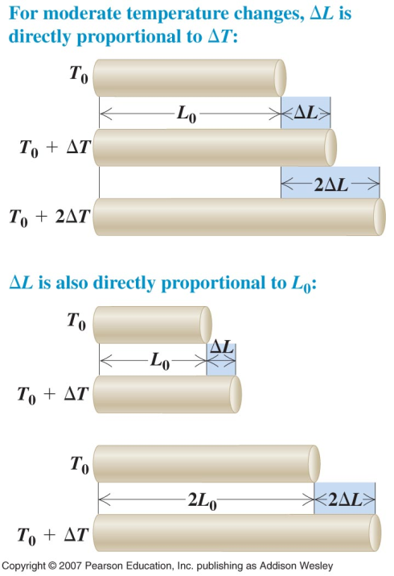
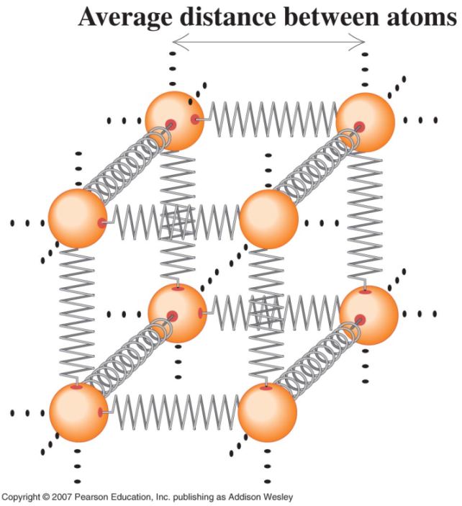
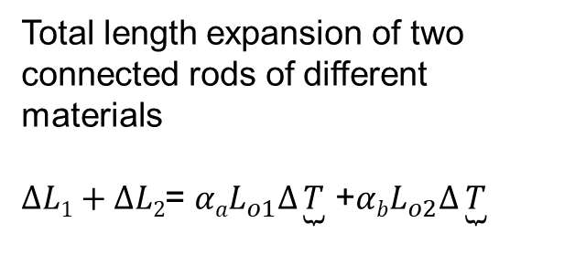
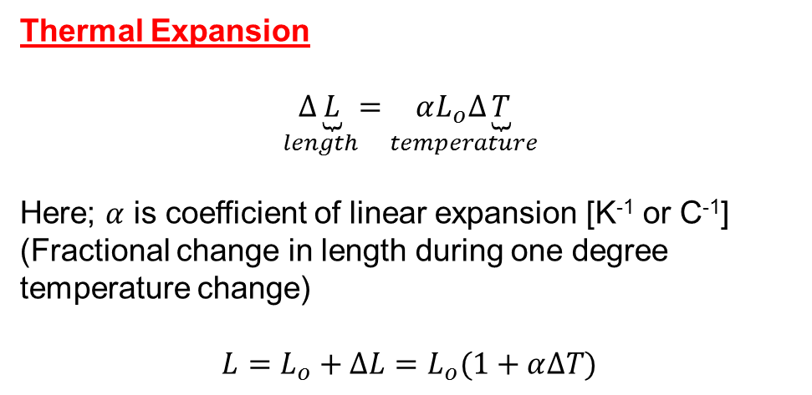
Thermal Expansion
$$\underset{length}{∆\underbrace{L}}=\underset{temperature}{αL_{o}∆\underbrace{T}}$$
Here; $α$ is coefficient of linear expansion [K⁻¹ or C⁻¹]
(Fractional change in length during one degree temperature change)
$$L=L_{o}+∆L=L_{o}(1+α∆T)$$
Total length expansion of two connected rods of different materials
$∆L1+∆L2$= $αaL_{o1}∆\underbrace{T}$ +$αbL_{o2}∆\underbrace{T}$

Slide 18
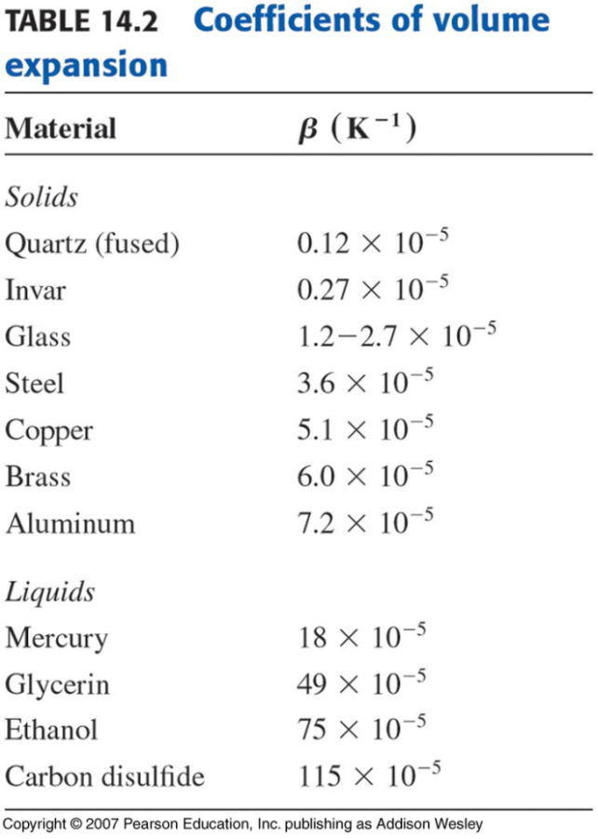
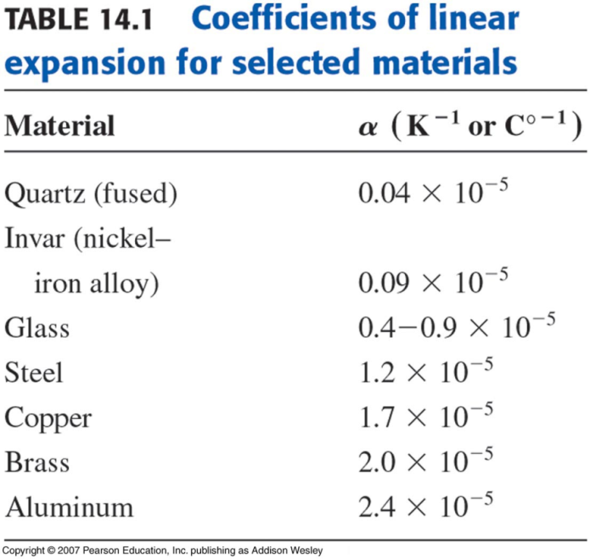
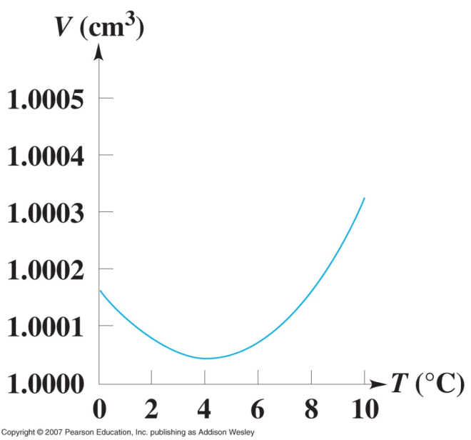
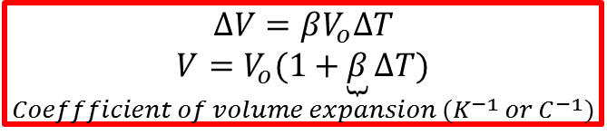
Volume Expansion
$$∆V=βV_{o}∆T$$
$$\underset{Coeffficient of volume expansion (K^{−1} or C^{−1})}{V=V_{o}(1+\underbrace{β}∆T)}$$
Thermal expansion of water
Note: water is densest at 4ºC

Slide 19
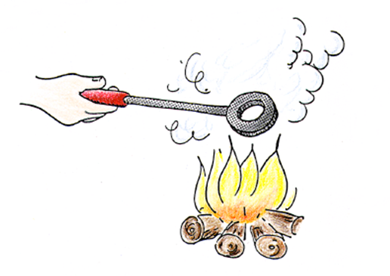
Example
When the temperature of a metal ring increases, does the hole become a)larger b)smaller c) remain the same size?

Slide 21
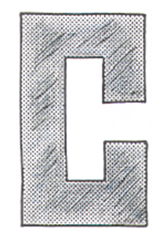
Example
When the temperature of the piece of metal is increased and the metal expands.
Will the gap between the ends become
a)narrower, b)wider, c) remain unchanged?

Slide 23
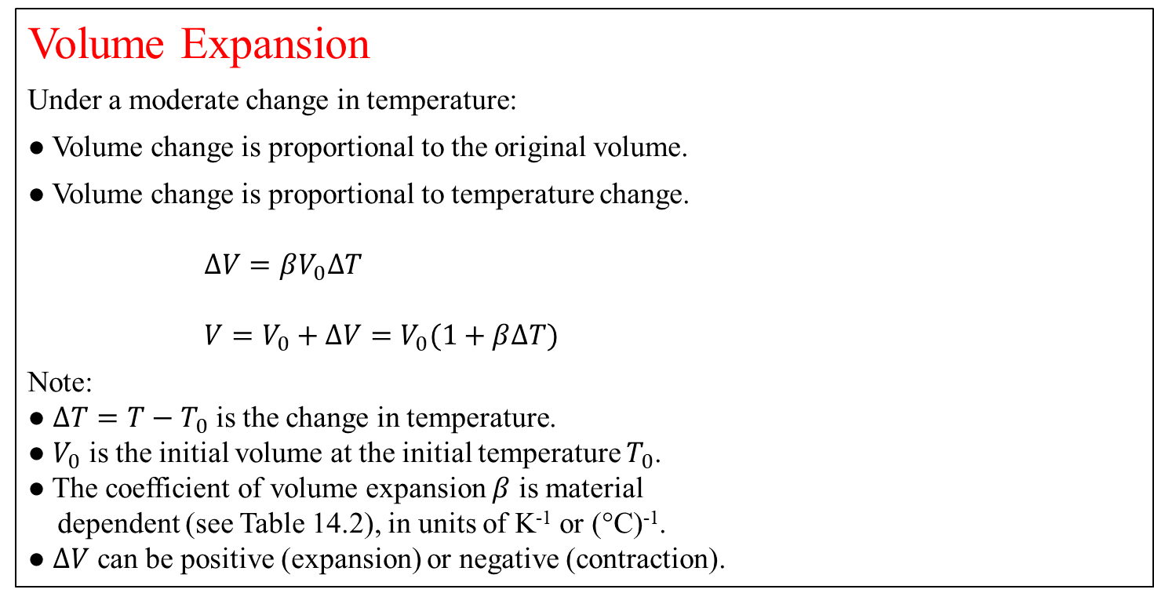
Volume Expansion
Under a moderate change in temperature:
● Volume change is proportional to the original volume.
● Volume change is proportional to temperature change.
$∆V=βV_{0}∆T$
$V=V_{0}+∆V=V_{0}(1+β∆T)$
Note:
● $∆T=T−T_{0}$ is the change in temperature.
● $V_{0}$ is the initial volume at the initial temperature $T_{0}$.
● The coefficient of volume expansion $β$ is material
dependent (see Table 14.2), in units of K⁻¹ or (°C)⁻¹.
● $∆V$ can be positive (expansion) or negative (contraction).

Slide 24
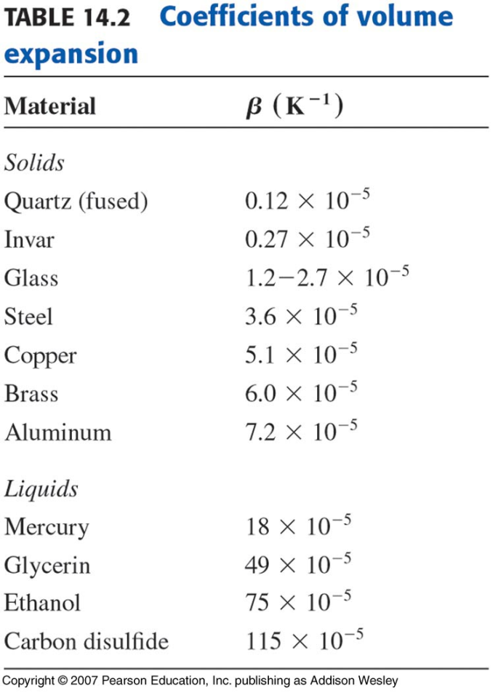
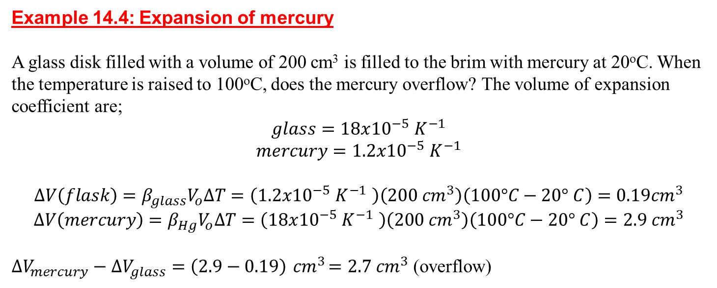
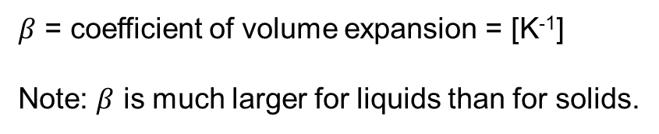
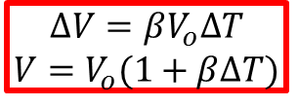
Volume expansion
$$∆V=βV_{o}∆T$$
$$V=V_{o}(1+β∆T)$$
$β$ = coefficient of volume expansion = [K⁻¹]
Note: $β$ is much larger for liquids than for solids.
Example 14.4: Expansion of mercury
A glass disk filled with a volume of 200 cm³ is filled to the brim with mercury at 20ºC. When the temperature is raised to 100ºC, does the mercury overflow? The volume of expansion coefficient are;
$$glass=18x{10}^{−5} K^{−1}$$
$$mercury=1.2x{10}^{−5} K^{−1}$$
$$∆V\left(flask\right)=β_{glass}V_{o}∆T=\left(1.2x{10}^{−5} K^{−1} \right)\left(200 {cm}^{3}\right)\left(100°C−20° C\right)=0.19{cm}^{3}$$
$$∆V\left(mercury\right)=β_{Hg}V_{o}∆T=\left(18x{10}^{−5} K^{−1} \right)\left(200 {cm}^{3}\right)\left(100°C−20° C\right)=2.9{ cm}^{3}$$
$∆V_{mercury}−∆V_{glass}=\left(2.9−0.19\right){ cm}^{3}=2.7{ cm}^{3}$ (overflow)

Slide 25
Q17.4
Clicker question 3
When the temperature of a certain solid, rectangular object increases by ∆T, the length of one side of the object increases by 0.010% = 1.0 10^{–4} of the original length. The increase in volume of the object due to this temperature increase is…
A. 0.010% = 1.0 10^{–4} of the original volume.
B. (0.010)³% = 0.0000010% = 1.0 10^{–8} of the original volume.
C. (1.0 10^{–4})³ = 0.00000000010% = 1.0 10^{–12} of the original
volume.
D. 0.030% = 3.0 10^{–4} of the original volume.
E. Not enough information is given to decide.
Notes:
Answer: D

Slide 26
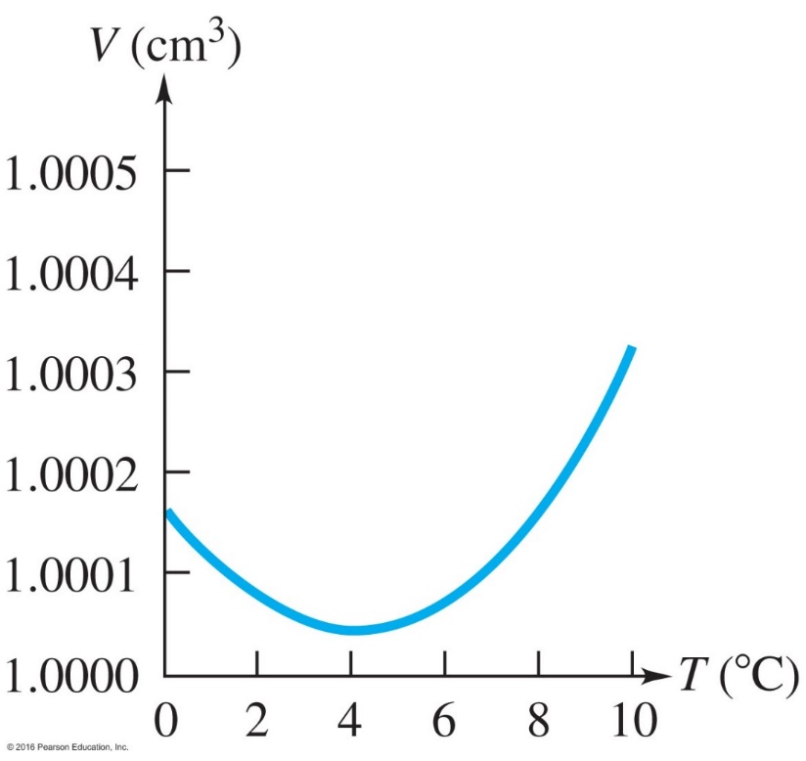
(The Anomalous) Expansion of Water
Water has the smallest volume (largest density) near 4 °C.

Slide 27
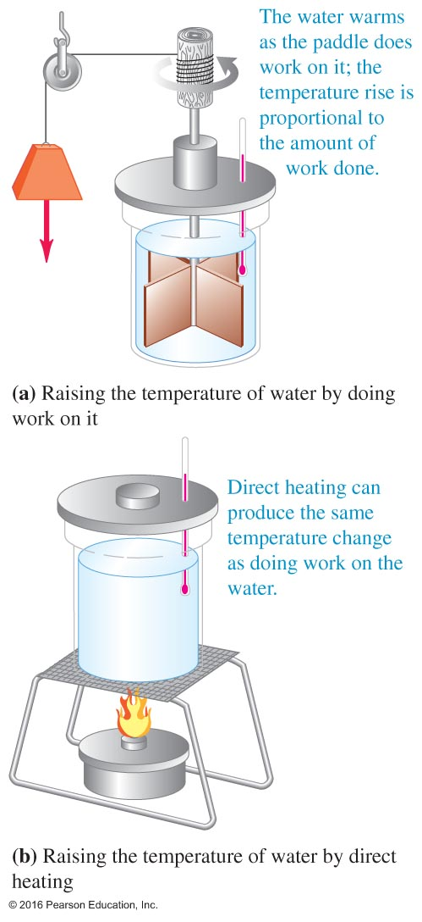
14.4 Heat Energy
The Mechanical Equivalent of Heat
● Done by James Joule in the 1800s.
● Potential energy stored in a raised mass was used to pull a cord wound on a rod mounted to a paddle in a water bath.
● The measured temperature change of the water proved the equivalence of mechanical energy and heat.
● The unit for potential energy, kinetic energy, and heat is the Joule in honor of his work.
Some Simple Numbers:
● On food labels, 1 calorie is 1 kilocalorie (kcal) in SI units.
● 1 cal is 4.184 J.
● The Big Mac contains about 3.5 million joules.
● The heat energy released by a 1000-W cooktop in 1000 s is
1 million joules.

Slide 28
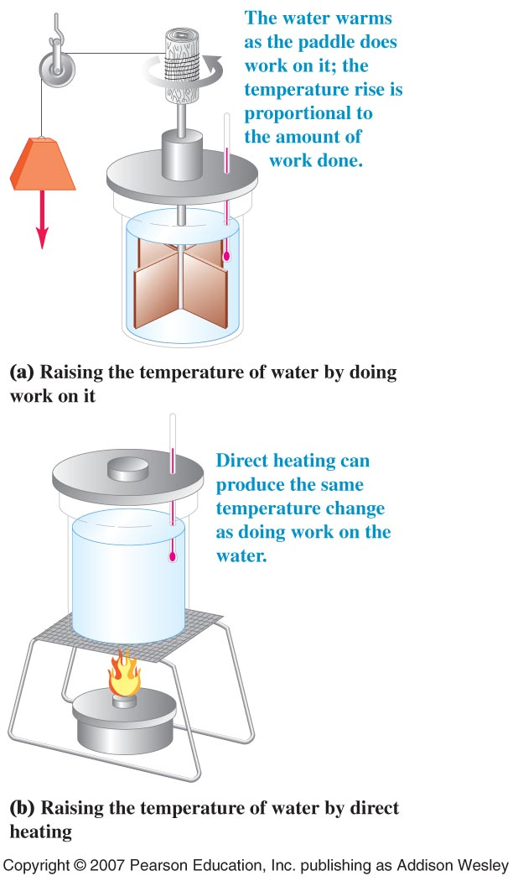
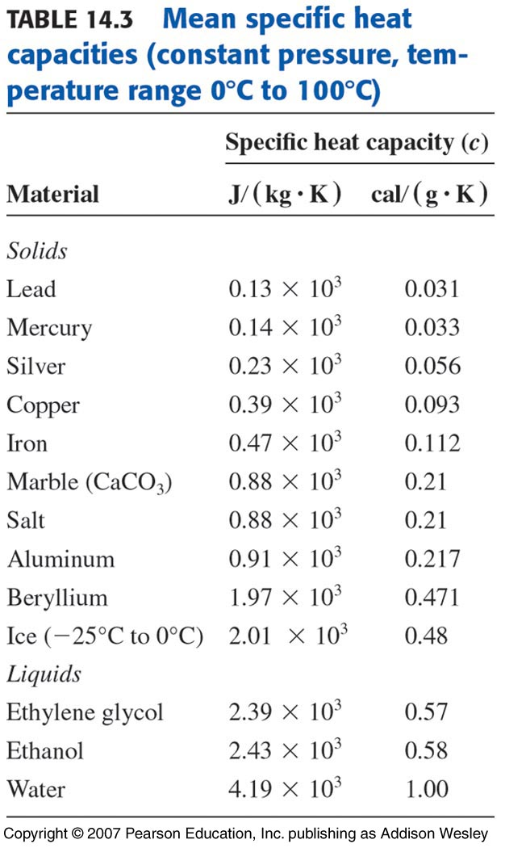
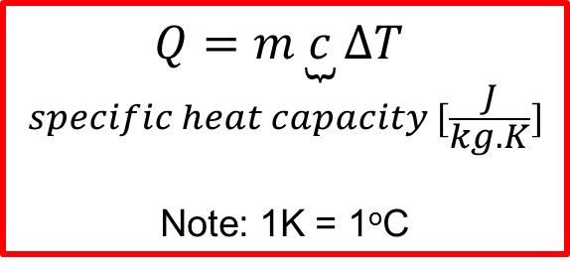
Quantity of Heat
Heat flow = energy in transit
1 cal = 4.186 J
1 kcal = 1000 cal = 4186 J
1 Btu = 778 ft.lb = 252 cal = 1055 J
Definition of Calorie
$$\underset{specific heat capacity [\frac{J}{kg.K}]}{Q=m\underbrace{c}∆T}$$
Note: 1K = 1ºC
1 cal is equal to the amount of heat required to raise the temperature of 1g of water from 14.5ºC to 15.5ºC

Slide 29
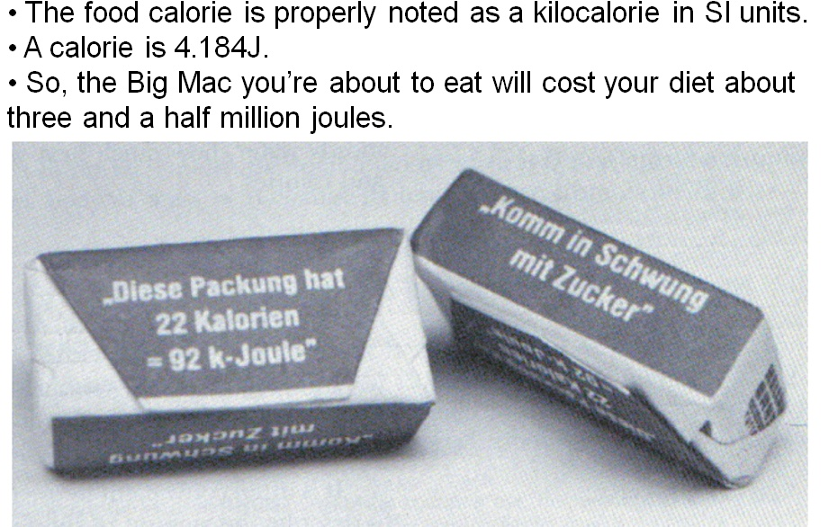
two

Slide 30
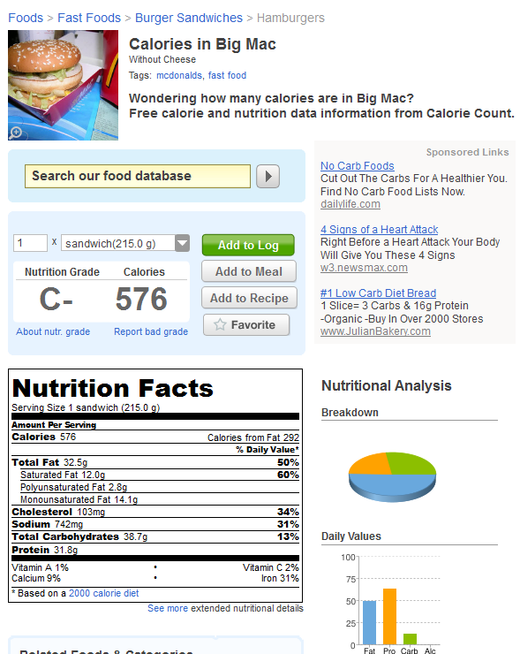
576 food calories =
Convert to joules

Slide 31
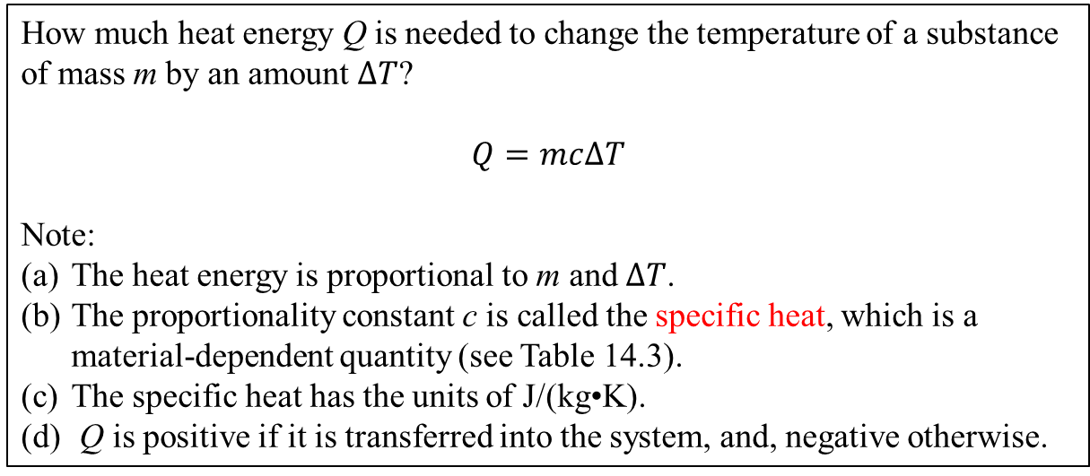
Specific Heat
How much heat energy Q is needed to change the temperature of a substance of mass m by an amount $∆T$?
$$Q=mc∆T$$
Note:
The heat energy is proportional to m and $∆T$.
The proportionality constant c is called the specific heat, which is a material-dependent quantity (see Table 14.3).
The specific heat has the units of J/(kg•K).
Q is positive if it is transferred into the system, and, negative otherwise.

Slide 32

Specific heat
The specific heat capacity of water is approximately;
$C_{water}=4190[\frac{J}{kg.K}]≈1[\frac{cal}{g.K}]≈1[\frac{Btu}{lb.F°}]$
Note: specific heat capacity is the amount of heat needed per unit mass and per unit temperature change.
$$Q=\underset{\begin{aligned}unit \\ mass\end{aligned}}{\underbrace{m}}c\underset{\begin{aligned}unit \\ temperature \\ change\end{aligned}}{∆\underbrace{t}}→ Q=1∗c∗1$$

Slide 33
Q17.5
Clicker question 4
You wish to increase the temperature of a 1.00-kg block of a certain solid substance from 20°C to 25°C. (The block remains solid as its temperature increases.) To calculate the amount of heat required to do this, you need to know…
A. the specific heat capacity of the substance.
B. the molar heat capacity of the substance.
C. the heat of fusion of the substance.
D. the thermal conductivity of the substance.
E. more than one of the above.
Notes:
Answer: A

Slide 34
Heat Capacity
Substances have an ability to "hold heat" that goes to the atomic level.
One of the best reasons to spray water on a fire is that it suffocates combustion. Another reason is that water has a huge heat capacity. Stated differently, it has immense thermal inertia. In plain terms, it's good at cooling things off because it's good at holding heat.
Taking a copper frying pan off the stove with your bare hands is an awful idea because metals have almost no heat capacity. In plain terms, metals give heat away as fast as they can.

Slide 35
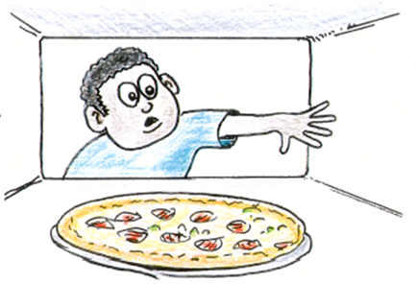
Clicker – Questions 5
You can reach with your bare hand inside a 300ºC pizza oven briefly without harm. But you cannot reach into a pot of boiling water at 100ºC without being burned. The explanation has to do with differences in…
Conductivities
Specific heat capacities.
Both of these.
Neither of these.

Slide 36
Clicker – Questions 6
You immerse a 1-kg block of iron in 1-kg of water in an insulated chamber, add 100J of heat, and allow the iron and water to equilibrate to the same temperature. Which has absorbed more heat, the iron or the water?
They absorb the same amount of heat.
The iron absorbs more heat.
The water absorbs more heat.
Water has 10 times the specific heat of iron Q= mc\delta T
Notes:
Water has 10 times the specific heat of iron Q= mc\delta T
n

Slide 37
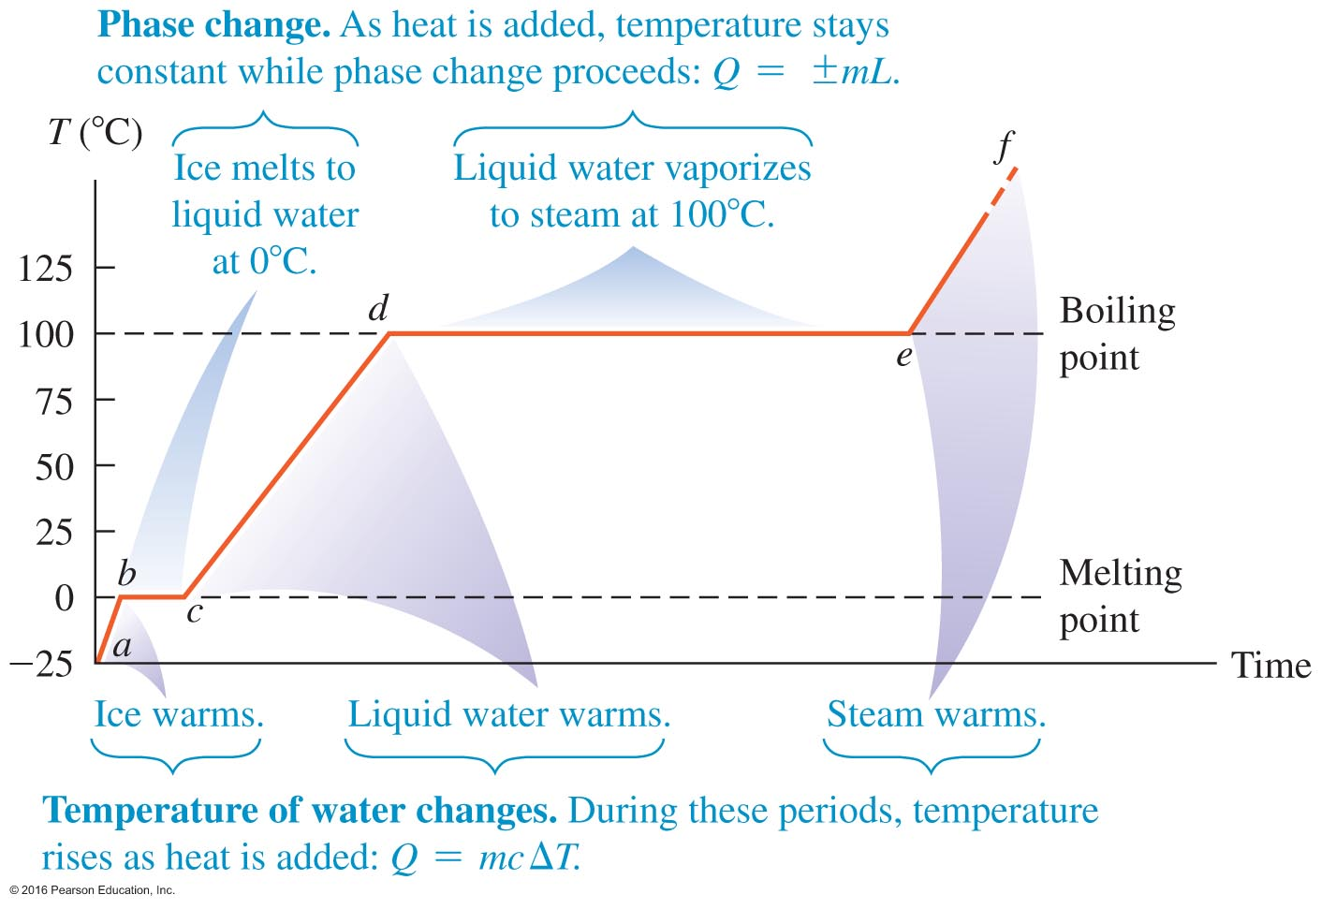
14.5 Phase Changes
Water
Ice
Vapor

Slide 38
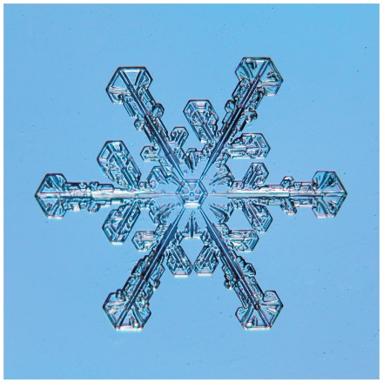
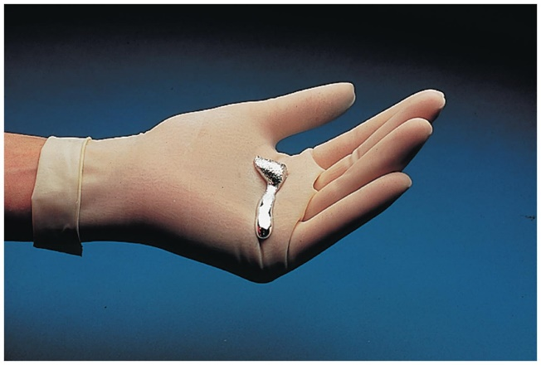
Phase Changes and the Snowflake
Which is worse to touch for a burn: 100ºC water or 100ºC steam? The steam, because it also contains the energy that it took to become a gas. In the case of water, this is 2.3 MILLION joules per kg of water.
The snowflake on the left needs to absorb the latent heat of fusion to become a liquid. The metal in the person's hand to the right just did that from the person's body temperature.
Put ice in water. You have a refreshing drink but also solid water and liquid water in equilibrium.

Slide 39
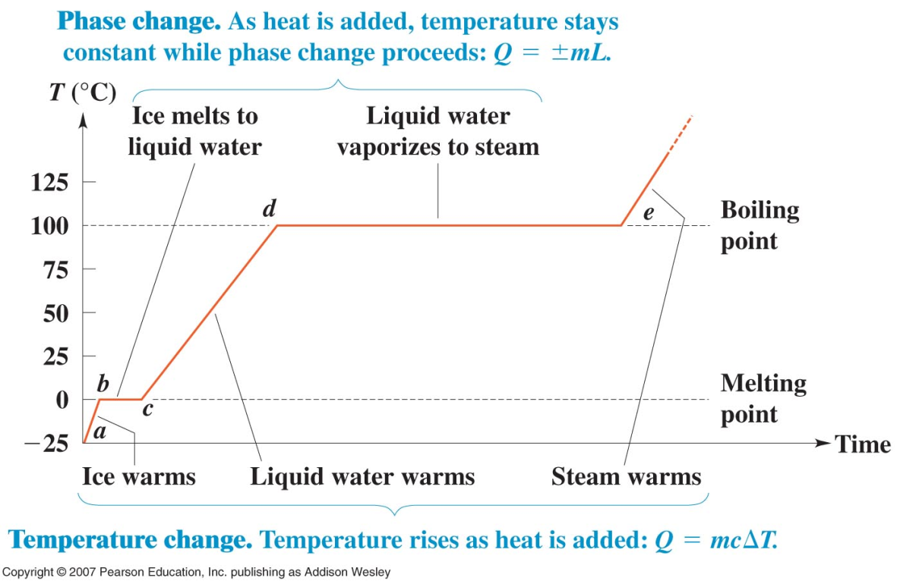
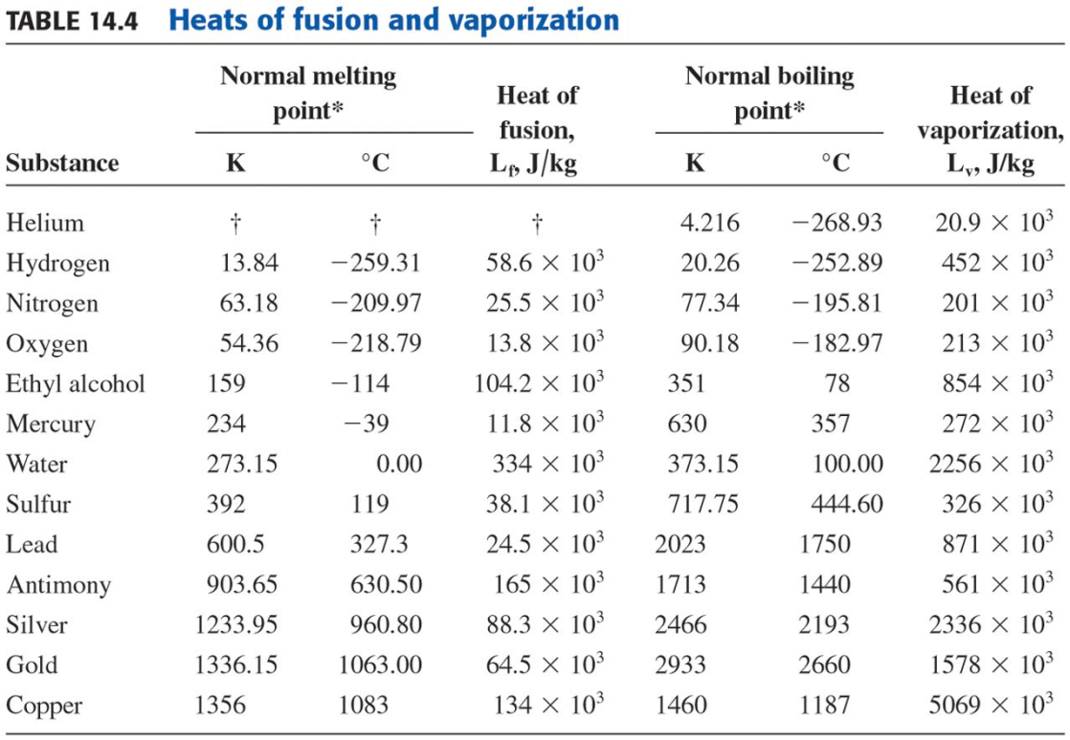

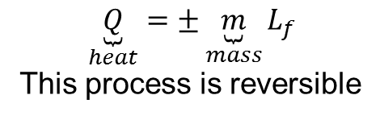

Phase changes
Example of H₂O
Solid phase = ice
Liquid phase = water
Gaseous phase = steam
Phase changes take place at a definite temperature and are accompanied by absorption or emission of heat.
1kg of ice at 0ºC becomes 1kg of water at 0ºC with supplying the heat of fusion.
Heat of fusion $L_{f}=3.34x{10}^{5}\frac{j}{kg}$
$$\underset{heat}{\underbrace{Q}}=±\underset{mass}{\underbrace{m}}L_{f}$$
This process is reversible
Heat of evaporation $L_{v}=2.26x{10}^{6}\frac{j}{kg}$
Note: Boiling and condensation depend on the atmospheric pressure. Water boils in Denver at 95ºC and at 100ºC in Aggieland.

Slide 40
Q17.6
Clicker question 7
A pitcher contains 0.50 kg of liquid water at 0°C and 0.50 kg of ice at 0°C. You let heat flow into the pitcher until there is 0.75 kg of liquid water and 0.25 kg of ice. During this process, the temperature of the ice-water mixture…
A. increases slightly.
B. decreases slightly.
C. first increases slightly, then decreases slightly.
D. remains the same.
E. The answer depends on the rate at which heat flows.
Notes:
Answer: D

Slide 41



Example: An ice water mixture comes to equilibrium
$$∆Q(water)=mc∆T=T_{f}−T_{i}$$
$∆Q(\text{i}\text{ce}\text{)}=mc∆T+mL_{F}$+ $mc∆T$
equilibrium : $∆Q\left(water\right)+∆Q(\text{i}\text{ce}\text{)}=$0

Slide 42
Clicker – Questions 8
Which requires more heat: Bringing a pan of liquid water from room temperature (20ºC) to the boiling point at 100ºC or converting all of the liquid water to steam at a constant 100ºC?
Heating the liquid water.
Converting the liquid water to steam.
They require the same amount of heat.

Slide 43

Phase Changes
Latent heat of infusion ice:
● The heat energy needs to be absorbed in order to change 1 kg of ice at 0 ºC and normal pressure to 1 kg of water at 0 ºC and normal pressure.
L_{f} = 3.34×10⁵ J/kg
● The same amount of heat energy is released in a reverse process.
Water
Ice
Vapor
Latent heat of vaporization of water:
● The heat energy needs to be absorbed in order to vaporize 1 kg of water at 100 ºC and normal pressure to 1 kg of vapor at 100 ºC and normal pressure.
L_{v} = 2.26×10⁶ J/kg
● The same amount of heat energy is released in a reverse process.
Heat Transfer
in Phase Change
$$Q=±mL$$

Slide 44


14.6 Calorimetry----”Measuring Heat”
Rule: For a “closed” system, the total heat energy is conserved, or $\sum{Q=0}$.
Example 14.9 on page 442---Chilling your soda
Given: m_{lemonade} = 0.25 kg, initially at T_{lemonade, i} = 20 ºC, and, ice initially at T_{ice, i} = $−$ 20 ºC.
Find: How much ice is to be mixed with the lemonade so that the combined mix has a T = 0 ºC with all the ice melted?
Solution: Assume that the ice needed is m_{ice}. This mixing can be separated into a few steps.
The heat that ice absorbs as it warms up from $−$ 20 ºC to 0 ºC:
Q₁ = m_{ice}c_{ice}[0 $−$ ($−$20 ºC)] = m_{ice}c_{ice}(20 ºC) (positive)
The heat that ice absorbs as it melts at 0 ºC :
      Q₂ = m_{ice}L_{f} (positive)
The heat that lemonade releases as it cools from 20 ºC to 0 ºC :
Q₃ = m_{lemonade}c_{water}[0 $−$ (20)] = $−$ m_{lemonade}c_{water}(20 ºC) (negative)
      Therefore, Q₁ + Q₂ + Q₃ = m_{ice}c_{ice}(20 ºC) + m_{ice}L_{f} + [$−$m_{lemonade}c_{water}(20 ºC)] = 0,
      or, m_{ice} = 0.056 kg

Slide 45


Example 14.11 on page 446
Conduction in two bars in series
Given: As shown in the sketch.
Find: (a) T at the joint
(b) Rate of heat flow.
Solution:
Assume that the joint has temperature T.
Heat flow in the steel bar: $H_{s}=k_{s}A\frac{T_{H}−T}{L_{s}}$.
Heat flow in the copper bar: $H_{c}=k_{c}A\frac{T−T_{c}}{L_{c}}$.
Therefore, $k_{s}A\frac{T_{H}−T}{L_{s}}=k_{c}A\frac{T−T_{c}}{L_{c}}$,
or, (50.2 W/m•K)$\frac{100 \text{º}\text{C} − T}{0.100 m}=\left(\text{385} \text{W}\text{/}\text{m}\text{•}\text{K}\right)\frac{T − 0 \text{º}\text{C}}{0.200 m}$.
Joint temperature T = 20.7 $\text{º}\text{C}$.
Heat flow $H_{s}=k_{s}A\frac{T_{H}−T}{L_{s}}=\text{(50.2 }\text{W}\text{/}\text{m}\text{•}\text{K}\text{)}{(0.0200 m)}^{2}\frac{100 \text{º}\text{C} −20.7 \text{º}\text{C}}{0.100 m}=$ 15.9 W

Slide 46


Example 14.12 on page 446
Conduction in two bars in parallel
Given: As shown in the sketch.
Find: Rate of total heat flow in the two bars.
Solution:
Heat flow in the steel bar: $H_{s}=k_{s}A\frac{T_{H}−T}{L_{s}}$.
Heat flow in the copper bar: $H_{c}=k_{c}A\frac{T−T_{c}}{L_{c}}$.
Therefore, total heat flow
${H=k}_{s}A_{s}\frac{T_{H}−T}{L_{s}}+k_{c}A_{c}\frac{T−T_{c}}{L_{c}}$,
$=\text{(50.2 }\text{W}\text{/}\text{m}\text{•}\text{K}\text{)}{(0.0200 m)}^{2}\frac{100 \text{º}\text{C} −0 \text{º}\text{C}}{0.100 m}+\left(\text{385} \text{W}\text{/}\text{m}\text{•}\text{K}\right){(0.0200 m)}^{2}\frac{100 \text{º}\text{C}− 0 \text{º}\text{C}}{0.200 m}$.
$=$ 77.0 W + 20.1 W
= 97.1 W

Slide 47


Heat of combustion
Gasoline $L_{c}=46,000\frac{J}{g}=46x{10}^{6}\frac{J}{kg}$
Energy value of food is measured in kilo-calories (Calories with capital C)
$$1 kcal=1000 cal=4186 J$$
Example: 1g of peanut butter “contains 6K calorie”. If completely burned by exercising; it would release;
$$6 K∗4186\frac{J}{K}=25,000 J$$
Note: Efficiency of energy conservation later, body is not totally efficient in “burning” food

Slide 48

The quantity of heat required depends on the material.
Water used about 4 times more than aluminum.
$$\underset{specific heat capacity}{∆Q=m\underbrace{c}∆T}$$
$$C_{water}=4190 J {kg}^{−1} {(C°)}^{−1}=4.19 J g^{−1} {(C°)}^{−1}=1 cal g^{−1} {(C°)}^{−1}$$

Slide 49

Example 14.6 Example person with fever
80kg person ran fever at 39ºC instead of normal 37ºC. Assume human body is mostly water, how much more heat is required?
$$∆Q=mc∆T=80∗4190∗2=6.7x{10}^{5}J\frac{1cal}{4.19J}=1.6x{10}^{5} cal=160 kcal=160 food value calories$$

Slide 50
14.7 Heat transfer
Conduction
Heat energy is transferred from one place to another via the
interactions between the electrons and lattices.
Convection
Heat energy is transferred from one place to another via the
flow of mass.
Radiation
Heat energy is transferred from one place to another via
electromagnetic radiation.

Slide 51




Heat Transfer
Conduction
Convection
Radiation
1. Conduction:
Objects are in contact and heat is transferred from the hotter to the colder object.
$$\underset{\begin{aligned}heat \\ current\end{aligned}}{\underbrace{H}}=\frac{∆Q}{∆t}$$
Experimentally, it is proportional to contact area and $∆T$ , and inversely to length “$L$”.
$$H=\frac{∆Q}{∆t}=\underset{\begin{aligned}thermal \\ conductivity\end{aligned}}{\underbrace{k}}\underset{area}{\underbrace{A}} \underset{\begin{aligned}\frac{temperature difference}{unit length} \\ =temperature gradient\end{aligned}}{\underbrace{(\frac{T_{H}−T_{C}}{L})}}$$
$$→ Watt=\frac{J}{s}=\frac{W.m^{2}.K}{m.K.m} unit of k=\left[\frac{W}{m.K}\right]$$
Note: Be consistent in units.
Standard units are W, m, K, kg etc.

Slide 52


Heat Conduction
$H=\frac{∆Q}{∆t}=kA\frac{T_{H}−T_{C}}{L}$.
Notes:
The temperature T can be given in either Kelvin or Celsius.
H = $∆$Q/$∆$t is the rate of heat transfer.
The thermal conductivity k is material-dependent (see Table 14.5).
A is the cross-section area of the object and L is the length.

Slide 53


A house has a layer of wood 3cm thick on the outside and a layer of Styrofoam insulation 2.2 cm thick on the inside wall surface. The wood has a thermal conductivity of k= 0.08 W/m K and Styrofoam has k=0.01W/m K. The interior surface is is at 19 $°C$and the exterior surface is at -10 $°C$
a) what is the temperature where wood and Styrofoam meet?
b) What is the rate of heat flow per square meter through that wall?

Slide 54



2. Convection
Transfer of heat by the motion of a mass of fluid from one region of space to another.
Examples:
Hot air and hot water home heating systems.
Cooling by radiator of a car
Heating of our body by blood flow
Convection in the atmosphere, glider pilots use thermal updrafts
Heat $Q$ is proportional to surface area and proportional to $\frac{5}{4}∆T$, complicated “wind-chill factors”
3. Radiation
Heat transfer by light in particular infra-red light
$H=AeσT^{4}$ Stefan-Boltzmann
$$σ=5.6705x{10}^{−8}\frac{W}{m^{2}K^{4}}$$
e = emissivity (dimensionless)
e = 1 blackbody
Emissivity varies zero to one
Emissivity of the earths
atmosphere varies with
cloud cover (on a clear sky e =1)

Slide 55

Clicker – Questions 9
Why is it significantly colder on a winter night under a clear sky than a cloudy sky?
The sun is not out
The lack of clouds makes it easier for heat to radiate out into space.
For the aesthetic.

Slide 56


3.Radiation
Stefan-Boltzmann law of heat radiation: $H=\frac{∆Q}{∆t}=AeσT^{4}$.
Notes: (a) The temperature T must be in the Kelvin scale.
(b)$σ=$5.6705×10⁻⁸ W/(m²•K⁴) is the Stefan-Boltzmann constant.
(c) A is the surface area of the object.
(d) e is the emissivity of the object, and is less than 1.
Example 14.14 on page 449---radiation from human body
Given: A, e, body temperature T_{b} = 30 ºC, surrounding temperature T_{s} = 20 ºC.
Find: Net rate of heat loss.
Solution:
Heat loss to surrounding: $H=AeσT_{b}^{4}$ with T_{b} = (273 + 30) K = 303 K
(b) Heat received from the surrounding:
$H=AeσT_{s}^{4}$ with T_{b} = (273 + 20) K = 293 K
(c) Net heat loss = $H=AeσT_{b}^{4}−AeσT_{s}^{4}=Aeσ\left({T_{b}^{4}−T}_{s}^{4}\right)=72$ W

Slide 57



3. Radiation
Radiation from the human body; T=30ºC=30+273=303K and surrounding T=20ºC=20+273=293K. (Assume emissivity $≈$1) Also the body area is $1.2 m^{2}$ 1.2
Loss
$$H=AeσT^{4}=\left(1.2 m^{2}\right)1\left(5.67x{10}^{−8}\frac{W}{m^{2}K^{4}}\right){\left(303\right)}^{4}=574 W$$
Gain
$$H=Aeσ(T^{4}−{T_{s}}^{4})=1.2\left(5.67x{10}^{−8}\right)({303}^{4}−{293}^{4})=72W$$

Slide 58

Clicker – Questions 10
Suppose in a restaurant your coffee is served about 5 or 10 minutes before you are ready for it. In order that it be as hot as possible when you drink it, should you pour in the room-temperature cream…
a) right away
b) when you are ready to drink the coffee
c) It does not matter
Notes:
a)

Slide 59



Example 14.9 Chilling your soda
A physics student wants to cool 0.25 kg of Diet Omni-Cola (mostly water) initially at 20°C by adding ice initially at -20°C. How much ice should she add so that the final temperature will be 0°C with all the ice melted? Assumer that the heat capacity of the paper container may be neglected.
$Q_{OCola}=m_{OCola}C_{OCola}{∆T}_{OCola}=\left(0.25 kg\right)\left(4190\frac{J}{kg∙K}\right)(0\text{°}C−20\text{°}\text{C}\text{)=}$ -21,000 J
$Q_{ice}=m_{ice}C_{ice}∆T_{ice}=\left(m_{ice}\right)\left(2.0×{10}^{3}\frac{J}{kg∙K}\right)(0\text{°}C−(−20\text{°}\text{C}\text{))= }m_{ice}\left(4.0×{10}^{4}\frac{J}{kg}\right)$
$$Q_{melt}=m_{ice}L_{f}=m_{ice}\left(3.34×{10}^{5}\frac{J}{kg}\right)$$
$$Q_{OCola}+Q_{ice}+Q_{melt}=0$$
$$−21,000 J+m_{ice}\left(4.0×{10}^{4}\frac{J}{kg}\right)+m_{ice}\left(3.34×{10}^{5}\frac{J}{kg}\right)=0$$
$m_{ice}=0.056 kg=$ 56 g

Slide 60

Clicker – Questions 11
You are a consultant for a cookware manufacturer who wishes to make a pan that will have two features:
Absorb thermal energy from a flame as quickly as possible.
Have a cooking surface that stays as hot as possible when heated
You should recommend a pan with the…
Outer and cooking surface black.
Outer and cooking surface shiny.
Outer surface shiny and cooking surface black.
Outer surface black and cooking surface shiny.
Notes:
d)

Slide 61

Problem 14.74: Hot air in a physics lecture
Student listening has a heat output of 100W. How much heat goes into the lecture hall from 90 students over a 50 min lecture?
Assume that all that heat goes to the 3200 m³ of air in the room and no air escapes. How much will the temperature raise during the 50 min lecture? ($c_{air}=1020\frac{J}{kg.K}$ and $ρ_{air}=1.2\frac{kg}{m^{3}}$)
If a class takes an exam, the heat output per student is 280W. What is the room temperature after the 50 min exam?
Mass of air = $m=ρ.V=1.2\frac{kg}{m^{3}}∗3200m^{3}=3840kg$ and $1W=1\frac{J}{s}$
$Q=mc∆T → ∆T=\frac{Q}{mc}$ and $Q=50∗60s∗90students∗100\frac{J}{s}=2.7x{10}^{7} J$
) $∆T=2.7x{10}^{7}\frac{J}{3840kg 1020\frac{J}{kg.K} }=6.89°C$
(c) $∆T=6.89°C\frac{280W}{100W}=19.3°C$

Slide 62


Slide 63

Jogging in the heat of the day
Assume a runner produces a rate of energy of 1.3 kW wit 80% into heat
How much heat is generated by jogging? (use 80% of power is converted by jogging)
$$P_{jog}=0.8∗1300=1.04x{10}^{3}\frac{J}{s}$$
(b) How much heat does the runner gain from 40ºC air of the environment?
$$H_{net}=Aeσ\left(T^{4}−T_{s}^{4}\right)=1.85∗1∗\left(5.67x{10}^{−8}\right)\left[{306}^{4}−{313}^{4}\right]=−87.1 W$$
The person gains 87.1 J/s by radiation.
(c) The total excess heat (1040+87) J/s=1130 J/s
(d) In 1min=60s the runner must dispose 60s*1130J/s=6.78x10⁴J. This heat goes into sweating = evaporation of water;
Mass of water $m=\frac{Q}{L_{v}}=\frac{6.78x{10}^{4}}{2.42x{10}^{5}}=28g$
(e) In a half hours or 30 minutes the runner looses 30minX0.028kg/min=0.84kg. The runner must drink 0.84kg(1L/1kg)=0.84L of water

Slide 64
Clicker – Questions 12
If you wish to save energy and you are going to leave your cool house for a half day or so on a very hot day but want it to be cool when you arrive home. How should you set your air conditioning thermostat? (You will be coming back home at night-time, but the outside temp will still be high)
Set it a few degrees warmer
Off altogether.
Let it remain at the cool room temperature you desire.

Slide 65

Gas Law Apparatus
This apparatus is a high-quality demonstrator of the relationship between pressure, volume and temperature of a gas. The pressure gauge shows how pressure affects volume and vice versa. A digital thermometer displays the temperature.

Slide 66

Pulse Glass
Inside the glass is an orange solution of ethyl alcohol which has a low boiling point. Putting your hand one one side of the glass will cause the solution to evaporate and for the pressure to increase. This increase of pressure will cause the alcohol to flow to the other side of the glass.

