Slide 1
Ray tracing in an optical system

Slide 9
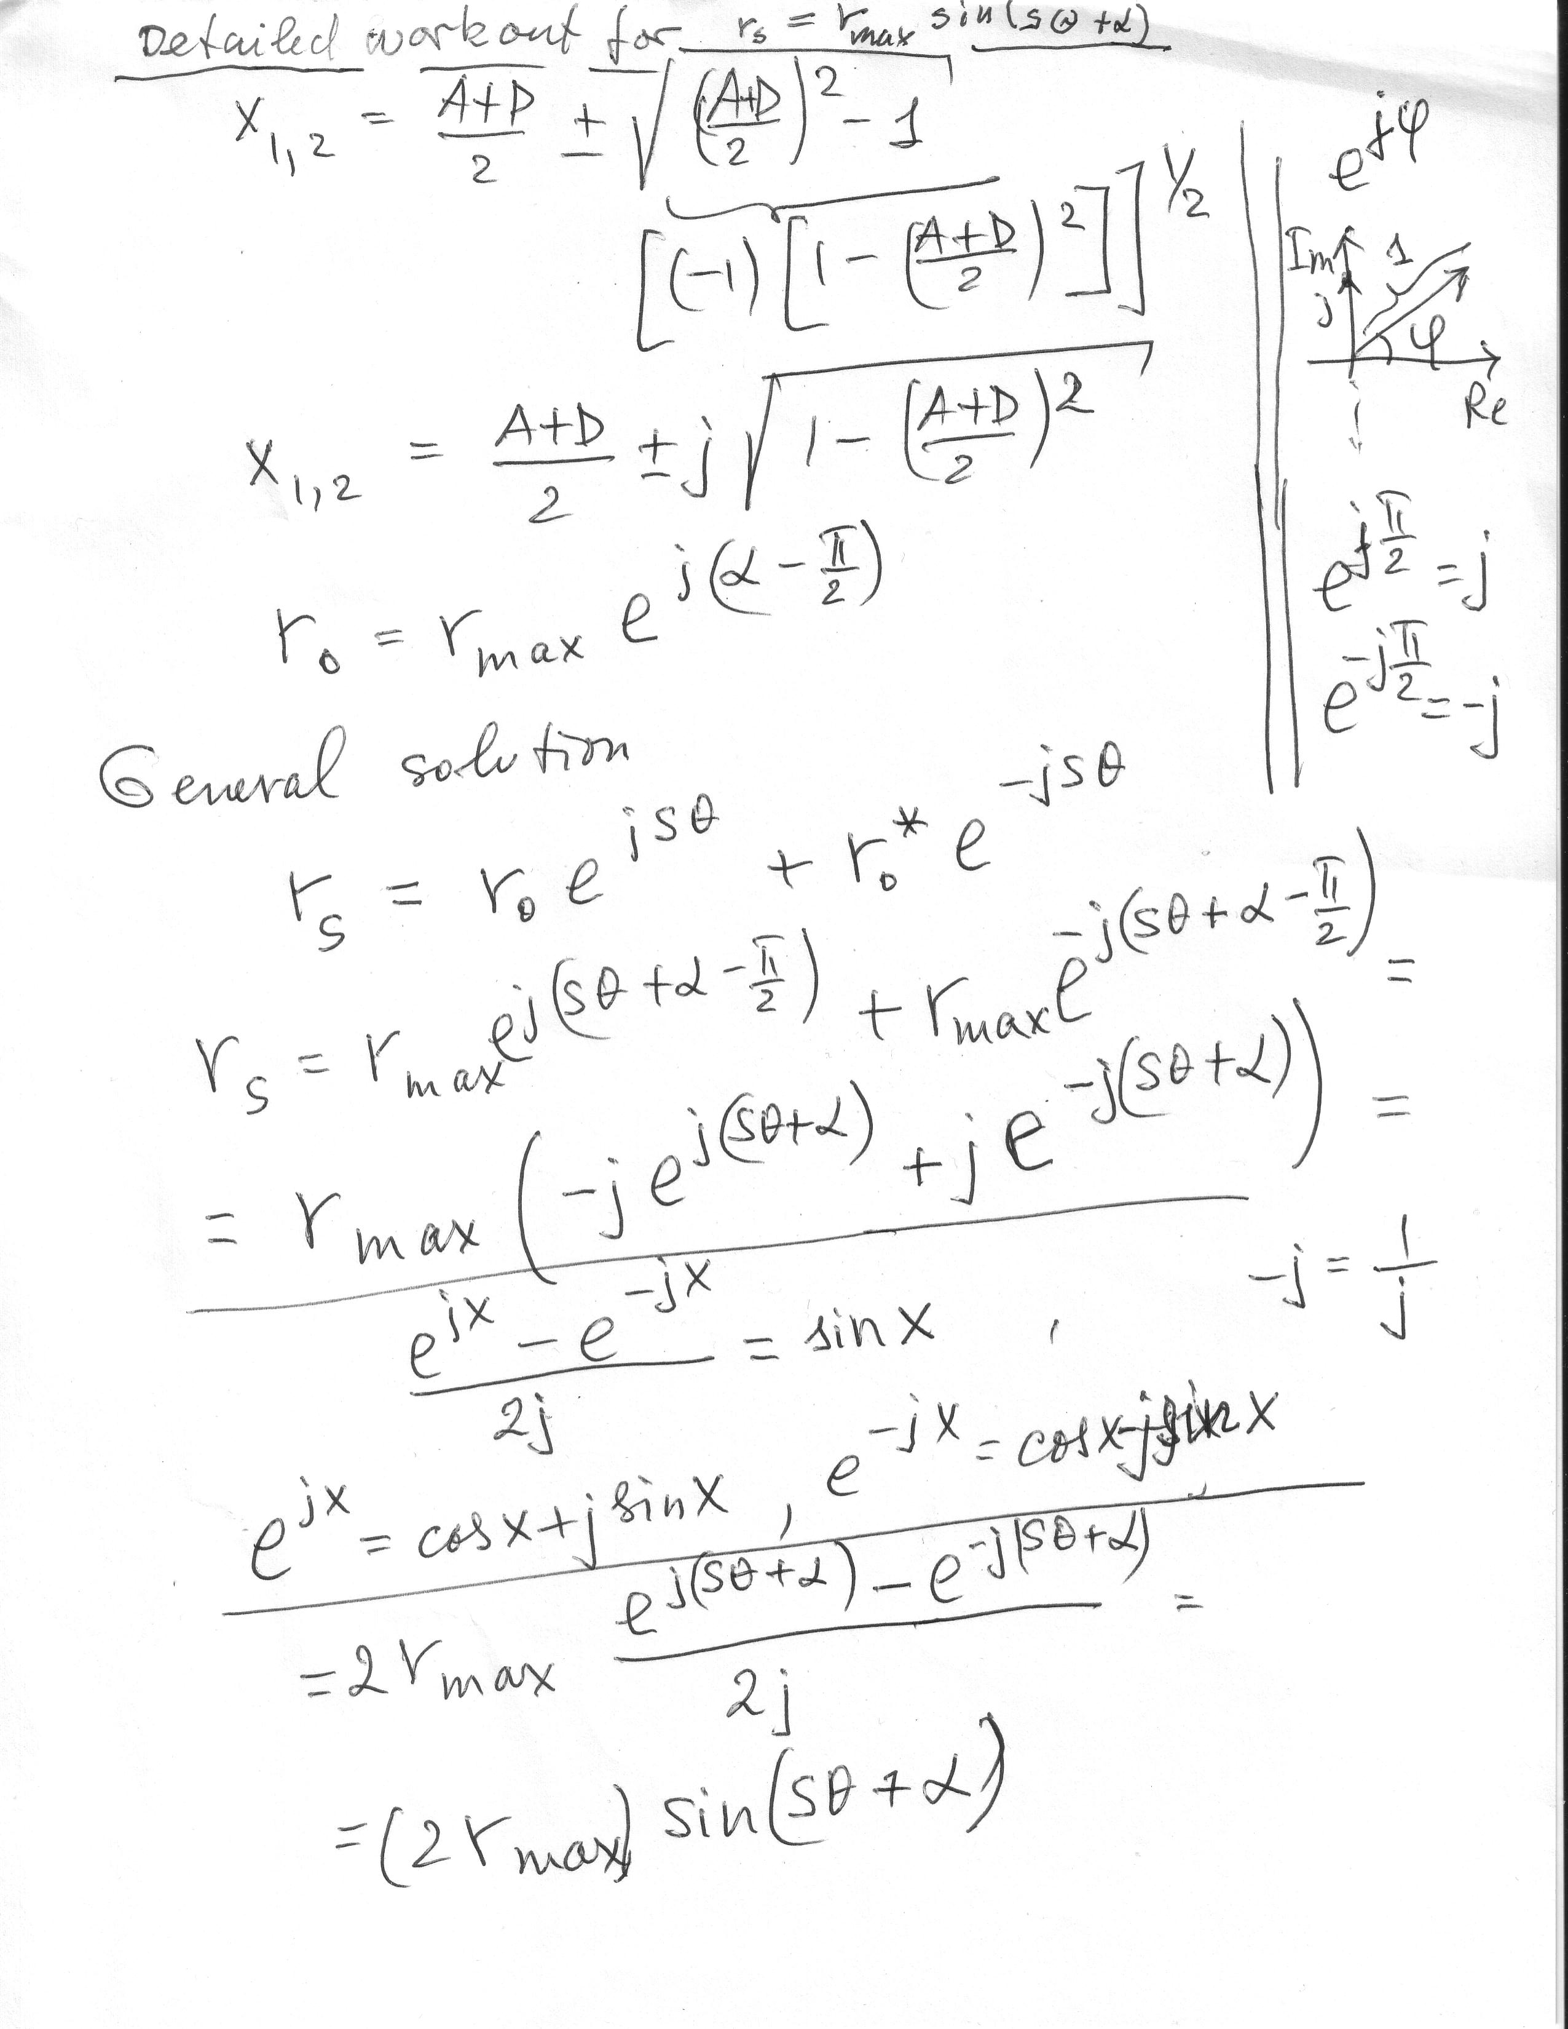
Verdeyen, formula (2.4.6).
I assumed for r0 the form r0=rmax exp[j(alfa-Pi/2)] and Verdeyen took as rmax the maximum of the expression
[r0 exp(jsTeta)+conjugate(r0) exp(-jsTeta)], which is equal to 2 Modulus[r0]. Thus my rmax 2 times less than his rmax, otherwise the formulas are the same.
In the context of the book his answer is correct!

