Slide 1
Shuttling and filtering multiple ion species in segmented linear trap

Slide 2
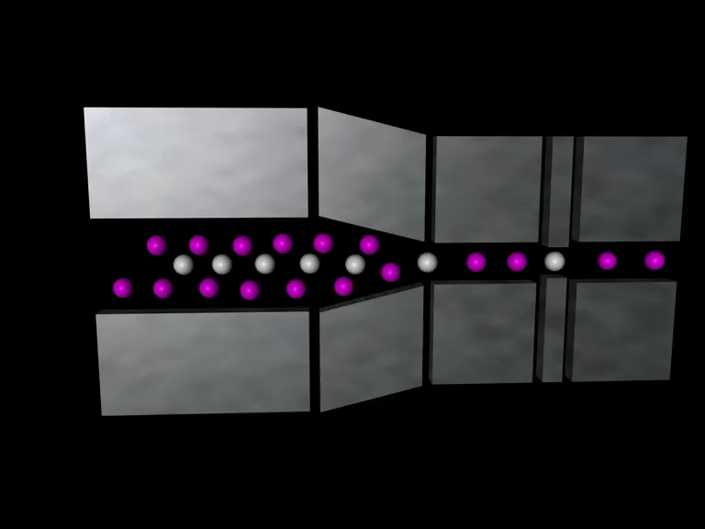
Mg⁺ and He⁺ ion shuttling
Video file by T. W. Hänsch courtesy T. Udem

Slide 3
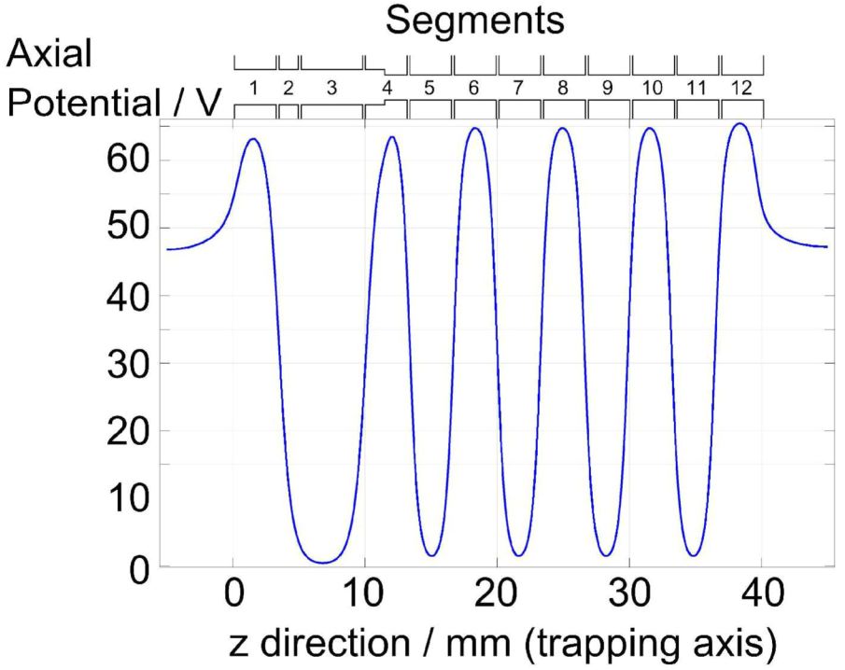
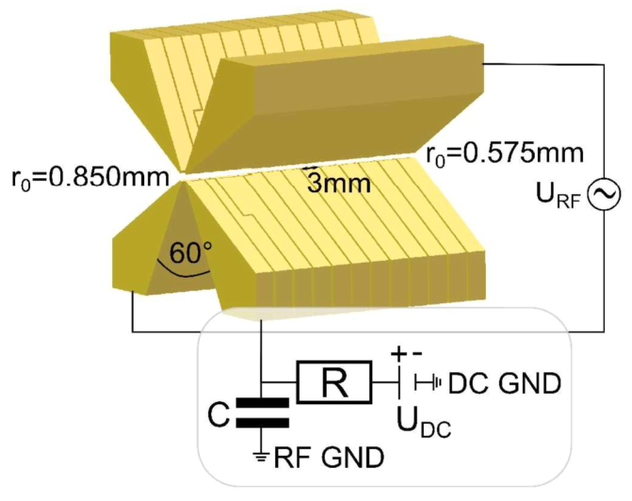
Segmented trap
Electron gun for He ionization
Helical resonator: Q =
Simulated axial potential for different DC voltages on neighboring electrodes
Electrode assembly with tank circuit sketch
Figures from J. Robin Master’s thesis [1]

Slide 4
Possible Schemes
RF Filtering
Shuffling with DC potentials
Mass filter
Dual frequency
Combination of techniques

Slide 5
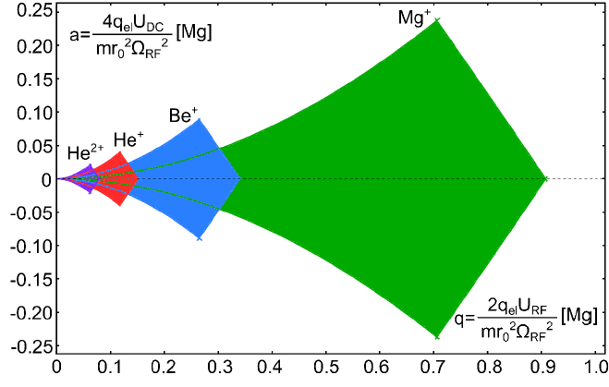
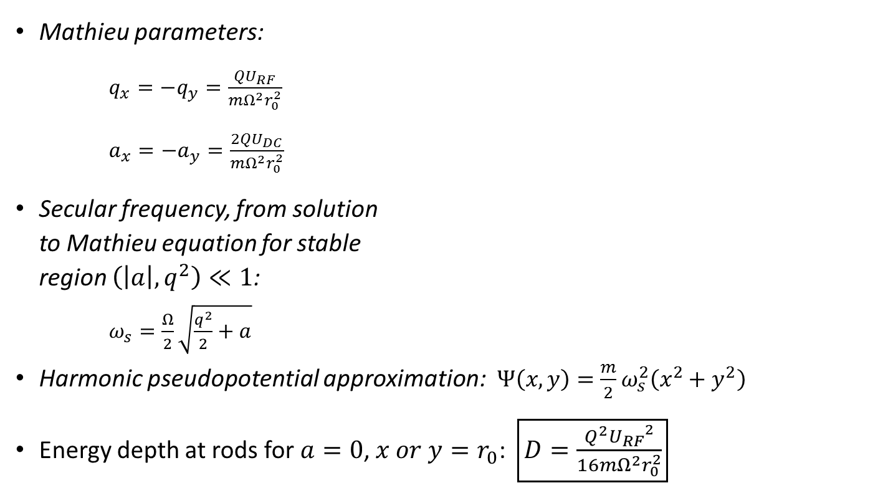
Well depth of linear quadrupole trap with 2 grounded electrodes
Mathieu parameters:
$q_{x}=−q_{y}=\frac{QU_{RF}}{mΩ^{2}r_{0}^{2}}$
$a_{x}=−a_{y}=\frac{2QU_{DC}}{mΩ^{2}r_{0}^{2}}$
Secular frequency, from solution
to Mathieu equation for stable
region $\left(\left|a\right|,q^{2}\right)≪1$:
$ω_{s}=\frac{Ω}{2}\sqrt{\frac{q^{2}}{2}+a}$
Harmonic pseudopotential approximation:$Ψ\left(x,y\right)=\frac{m}{2}ω_{s}^{2}\left(x^{2}+y^{2}\right)$
Energy depth at rods for $a=0$, $x or y=r_{0}$: $\boxed{D=\frac{Q^{2}{U_{RF}}^{2}}{16mΩ^{2}r_{0}^{2}}}$

Slide 6
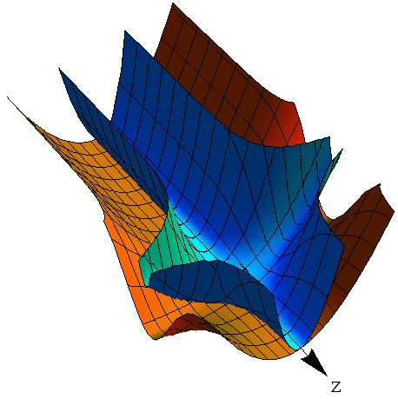

RF Filtering (1 of 3)
Lighter ions experience a deeper well, but also have higher q value:
  $\frac{q_{He^{+}}}{q_{Mg^{+}}}=\frac{D\left({{}_{ }^{4}{He}}^{+}\right)}{D({{}_{ }^{24}{Mg}}^{+})}=6$
Scheme framework:
  Lower trap depth on central segment
  “Tilt” axial potential by adjusting
  DC potential on boundary segments
  Ions “slide” into altered trapping region.
  Lighter ions remain trapped,
  but heavier ions are lost in shallower trap.
Pseudopotential
With filtering region
for He⁺
for Mg⁺

Slide 7
RF Filtering (2 of 3)
Is trap depth meaningful for crystalized ions?
  Observed: Sympathetically cooled ions (e.g. He⁺) occupy deeper positions in condensed ion crystal, but hotter ions of same species remain hot, outside condensed crystal due to higher RF heating [5].
  If heavier, directly-cooled ions (e.g. Mg⁺) are filtered prematurely sympathetic cooling mechanism would be lost.
  What are dynamics of ion crystal phase transitions? How does well depth effect melting of crystal/chaotic dissociation?

Slide 8
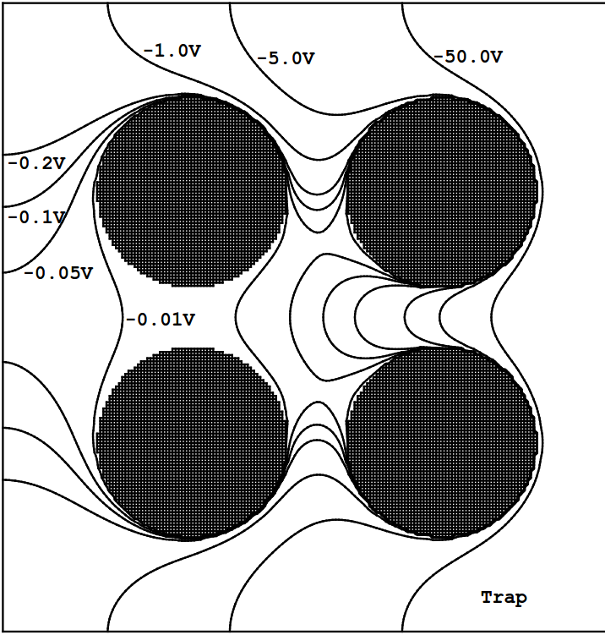
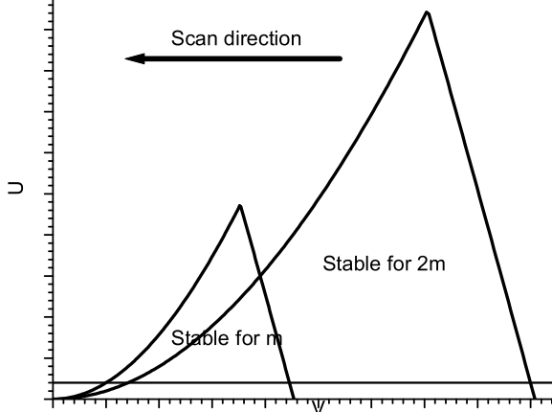
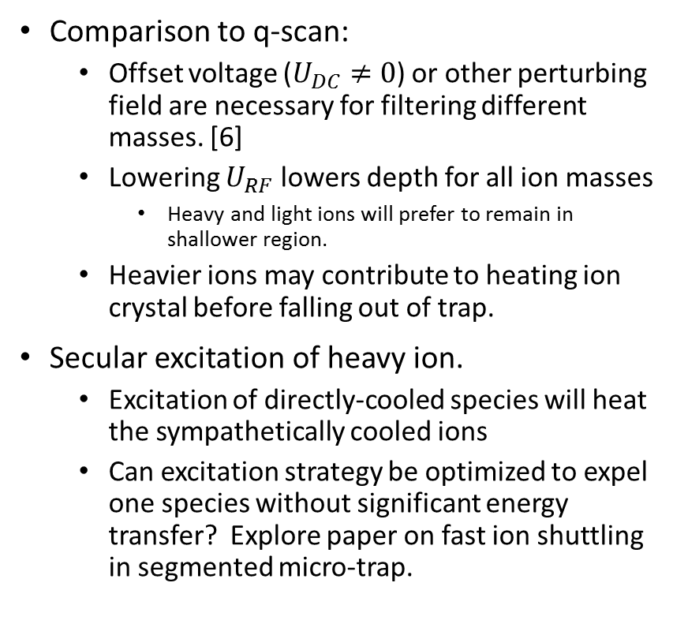
RF Filtering (3 of 3)
Comparison to q-scan:
  Offset voltage ($U_{DC}≠0$) or other perturbing field are necessary for filtering different masses. [6]
  Lowering $U_{RF}$ lowers depth for all ion masses
    Heavy and light ions will prefer to remain in shallower region.
  Heavier ions may contribute to heating ion crystal before falling out of trap.
Secular excitation of heavy ion.
  Excitation of directly-cooled species will heat the sympathetically cooled ions
  Can excitation strategy be optimized to expel one species without significant energy transfer? Explore paper on fast ion shuttling in segmented micro-trap.

Slide 9
DC Selection
Create long, somewhat uniform well with linear ion chain.
One side has high potential for pushing chain. Other end has very short “brim”, just high enough to contain ion chain.
Pushing potential is increased just enough to push last ion over brim into next region.
Separated ion(s) can now be targeted or shuttled to other segments.
Axial confinement by fringe effects of finite electrodes.

Slide 10
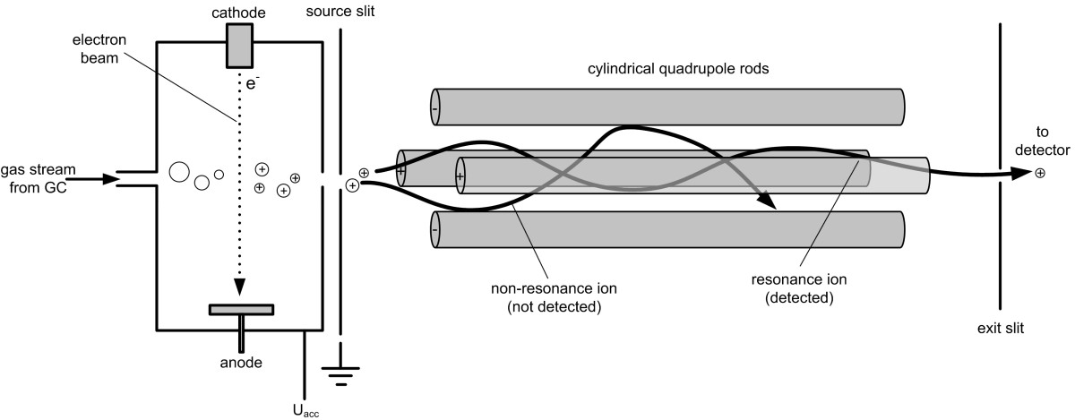
Mass Filter

Slide 11
References
[1] J. Robin, Mater’s thesis, Ludwig-Maximilians-Universität, Munich, Germany (2012).
[2] F. G. Major, V. N. Gheorghe and G. Werth, Charged particle traps (Springer, Berlin; New York, 2005).
[3] P. K. Ghosh, Ion traps. (Oxford University Press, New York, 1995).
[4] R. Blatt, P. Zoller, G. Holzmüller and I. Siemers, “Brownian motion of a parametric oscillator: A model for ion confinement in radio frequency traps,” Z. Physik D. 4 (2), 121-126 (1986).
[5] F. Zhu, Ph.D. thesis, Texas A&M University, College Station, Texas (2010).
[6] X. Zhao, Ph.D. thesis, Texas A&M University, College Station, Texas (2001).

Slide 12
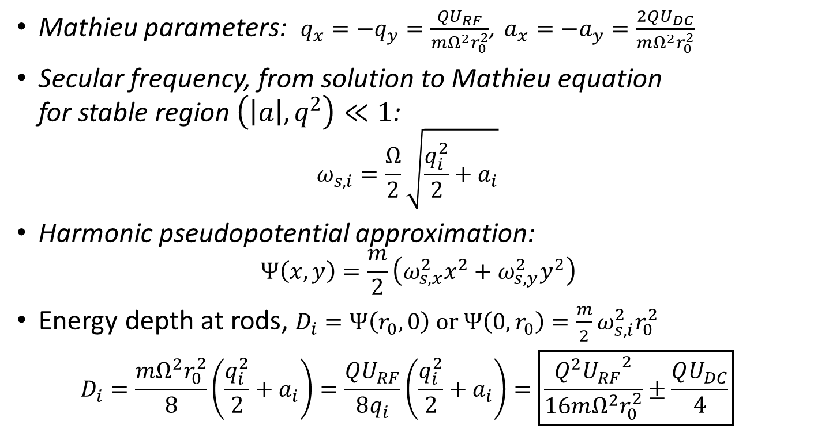
Well depth of linear quadrupole trap with 2 grounded electrodes
Mathieu parameters: $q_{x}=−q_{y}=\frac{QU_{RF}}{mΩ^{2}r_{0}^{2}}$, $a_{x}=−a_{y}=\frac{2QU_{DC}}{mΩ^{2}r_{0}^{2}}$
Secular frequency, from solution to Mathieu equation
for stable region $\left(\left|a\right|,q^{2}\right)≪1$:
$ω_{s,i}=\frac{Ω}{2}\sqrt{\frac{q_{i}^{2}}{2}+a_{i}}$
Harmonic pseudopotential approximation:
$Ψ\left(x,y\right)=\frac{m}{2}\left(ω_{s,x}^{2}x^{2}+ω_{s,y}^{2}y^{2}\right)$
Energy depth at rods, $D_{i}=Ψ\left(r_{0},0\right) or Ψ\left(0,r_{0}\right)=\frac{m}{2}ω_{s,i}^{2}r_{0}^{2}$
$D_{i}=\frac{mΩ^{2}r_{0}^{2}}{8}\left(\frac{q_{i}^{2}}{2}+a_{i}\right)=\frac{QU_{RF}}{8q_{i}}\left(\frac{q_{i}^{2}}{2}+a_{i}\right)=\boxed{\frac{Q^{2}{U_{RF}}^{2}}{16mΩ^{2}r_{0}^{2}}±\frac{QU_{DC}}{4}}$

Slide 13
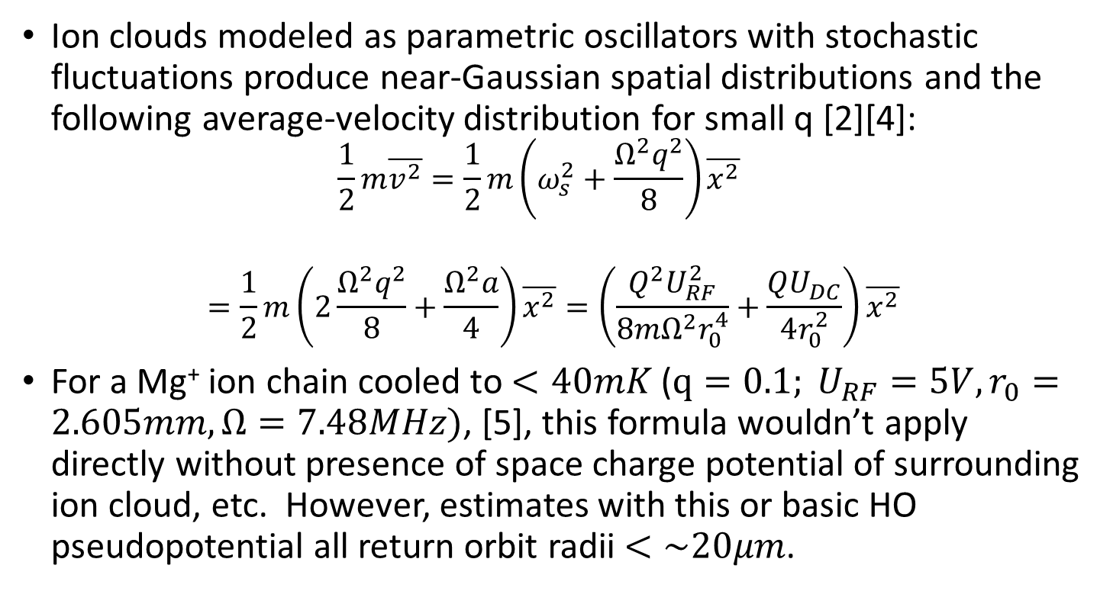
Ion velocities/temperature
Ion clouds modeled as parametric oscillators with stochastic fluctuations produce near-Gaussian spatial distributions and the following average-velocity distribution for small q [2][4]:
$\frac{1}{2}m\overline{v^{2}}=\frac{1}{2}m\left(ω_{s}^{2}+\frac{Ω^{2}q^{2}}{8}\right)\overline{x^{2}}$
$$=\frac{1}{2}m\left(2\frac{Ω^{2}q^{2}}{8}+\frac{Ω^{2}a}{4}\right)\overline{x^{2}}=\left(\frac{Q^{2}U_{RF}^{2}}{8mΩ^{2}r_{0}^{4}}+\frac{QU_{DC}}{4r_{0}^{2}}\right)\overline{x^{2}}$$
For a Mg⁺ ion chain cooled to $<40mK$ ($q=0.1; U_{RF}=5V,r_{0}=2.605mm, Ω=7.48MHz)$, [5], this formula wouldn’t apply directly without presence of space charge potential of surrounding ion cloud, etc. However, estimates with this or basic HO pseudopotential all return orbit radii $<\sim 20μm$.
Notes:
For a Mg⁺ ion chain at 50mK in a 4-rod symmetric trap ($U_{RF}=100V,r_{0}=2.605mm, Ω=7.48MHz)$, it would be $<1μm$.
Various references contain trajectories of ions in a trap, but I found none with an assigned temperature or other context, like cooled ions in a chain on the trap axis with given trapping parameters.

